Slide 1
LS2 introduced to TE-PPR Group

Slide 2
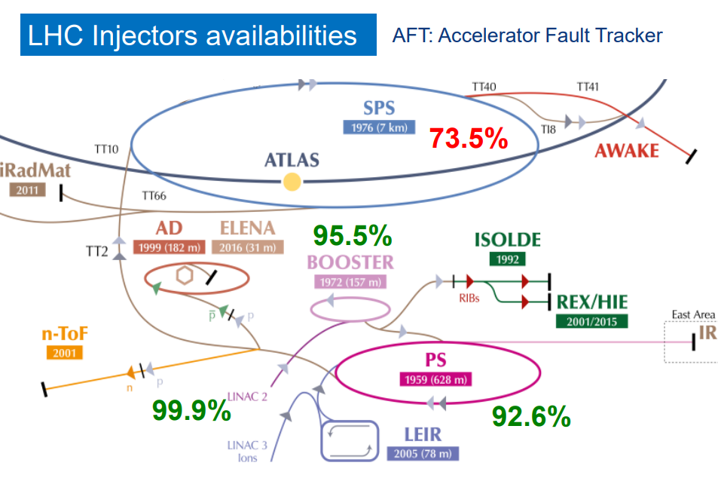

Slide 3
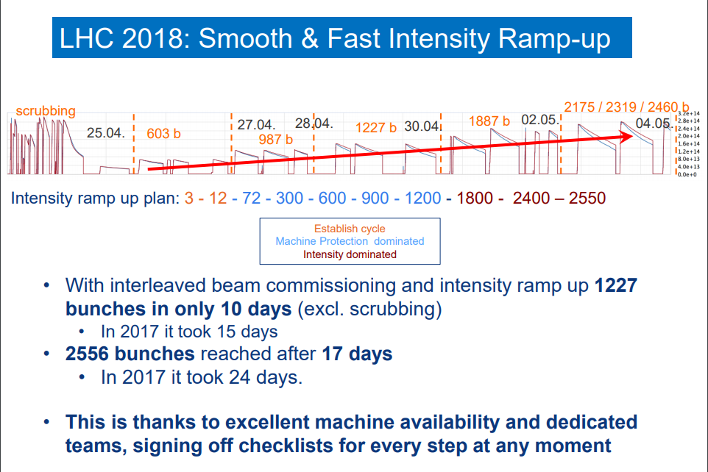

Slide 4
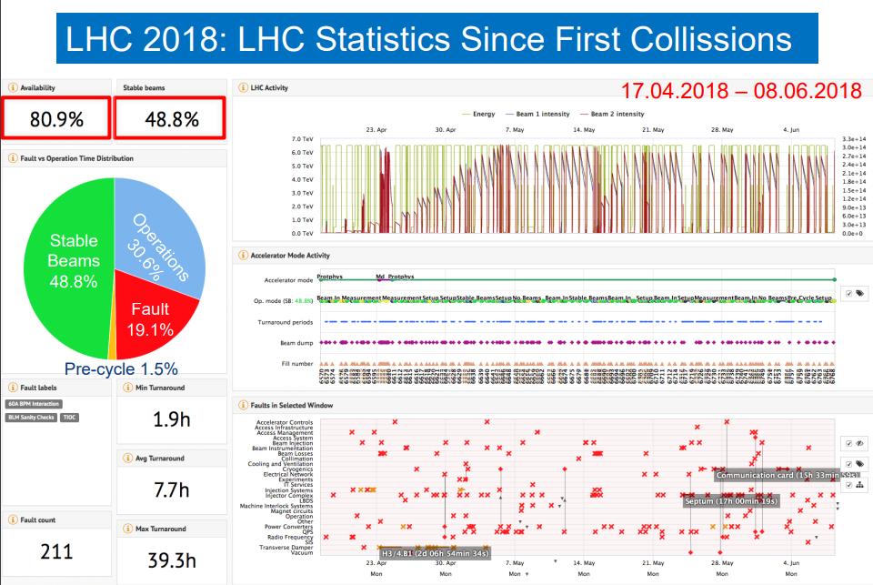

Slide 5
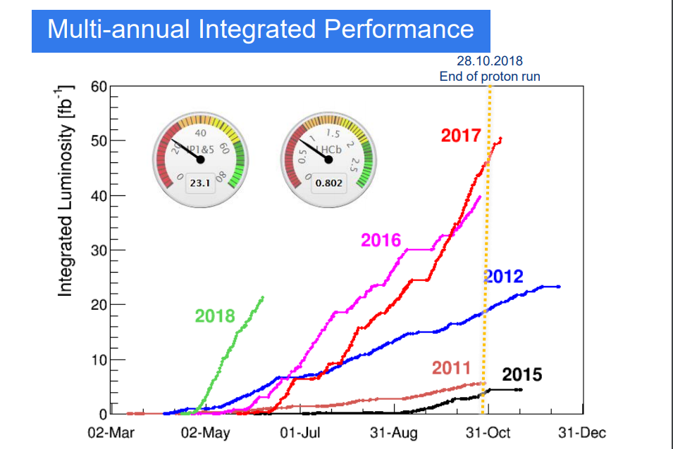

Slide 6
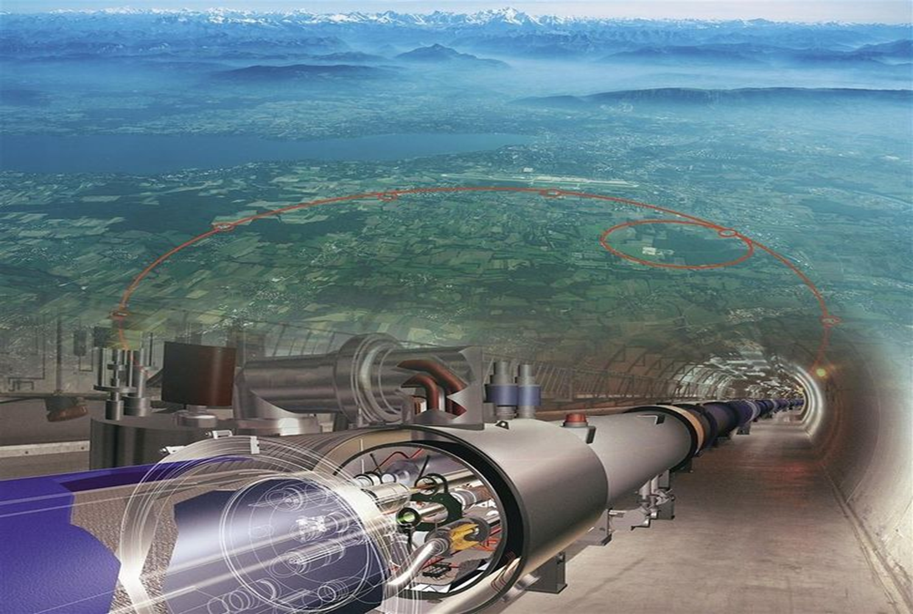

The Long Shutdown 2 (LS2)
Introduction
Perform major Maintenance and Consolidations
Increase intensity/brightness in the injectors to match HL-LHC requirements (LIU Project)
Increase injector reliability and lifetime to cover HL-LHC run (until ~2035) closely related to consolidation programs (in synergy with LIU Project)
Anticipate HL-LHC work
LS2

Slide 7

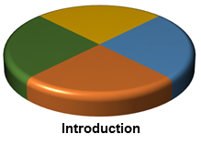
The LS2 Team
José Miguel JIMENEZ LS2 Coordinator
Jean-Philippe TOCK LS2 Office Manager
Katy FORAZ LS2 Planning Manager
Thomas OTTO Safety Support Officer for LHC
Ana Paula BERNARDES Safety Support Officer for Injectors
Jonathan MEIGNAN PLAN Quality Officer
Samy CHEMLI LS2 Committee Secretary
Anna LAMBERT Administrative Support Officer
Julie COUPARD Injectors & LIU Coordination
Marzia BERNARDINI LHC & HL-LHC Coordination
Beniamino Di GIROLAMO HL-LHC Link Person
Stefan ROESLER HSE Link Person

Slide 8
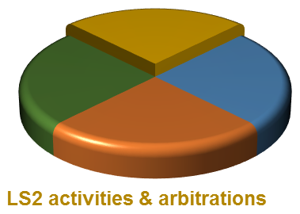
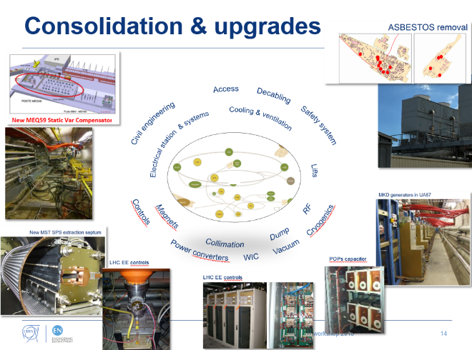
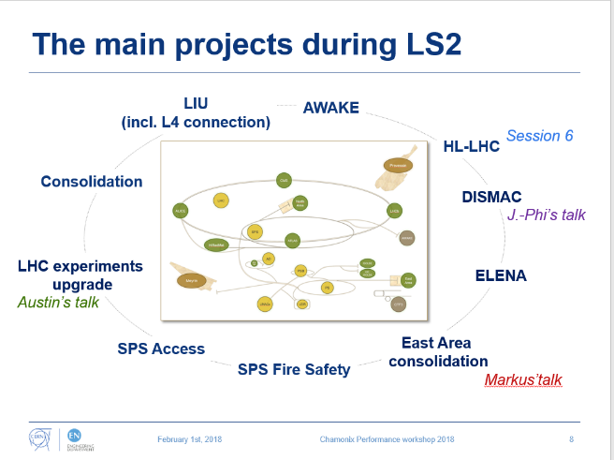
Overview of LS2 activities
Space Management
Storage (including radioactive)
Living quarters (Base de Chantier)
Logistics
Workshops

Slide 9
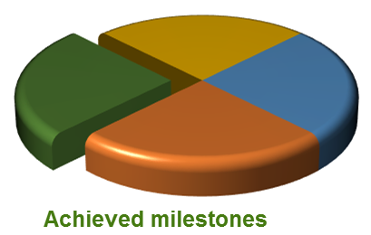
Successful (E)YETS since 2015
Coordination of co-activities
  All activities completed in due time and accelerators resumed operation as expected.
  Rescheduling to allow an earlier start-up of YETS
  2017-18 activities to allow CMS to work on its Detector.
  Efficiently managed the installation and commissioning of the Crab cavity module and related systems.

Slide 10

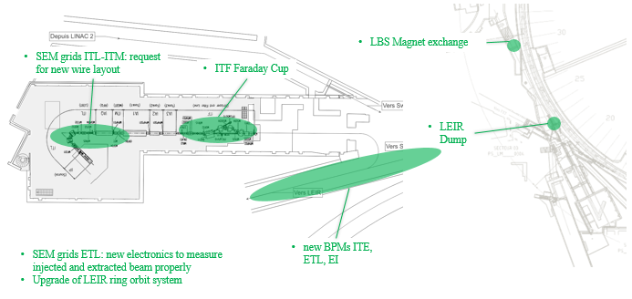
Activities anticipated from LS2
LIU-IONS activities (Linac3 and LEIR)
Completed before LS2
Scheduled for LS2

Slide 11
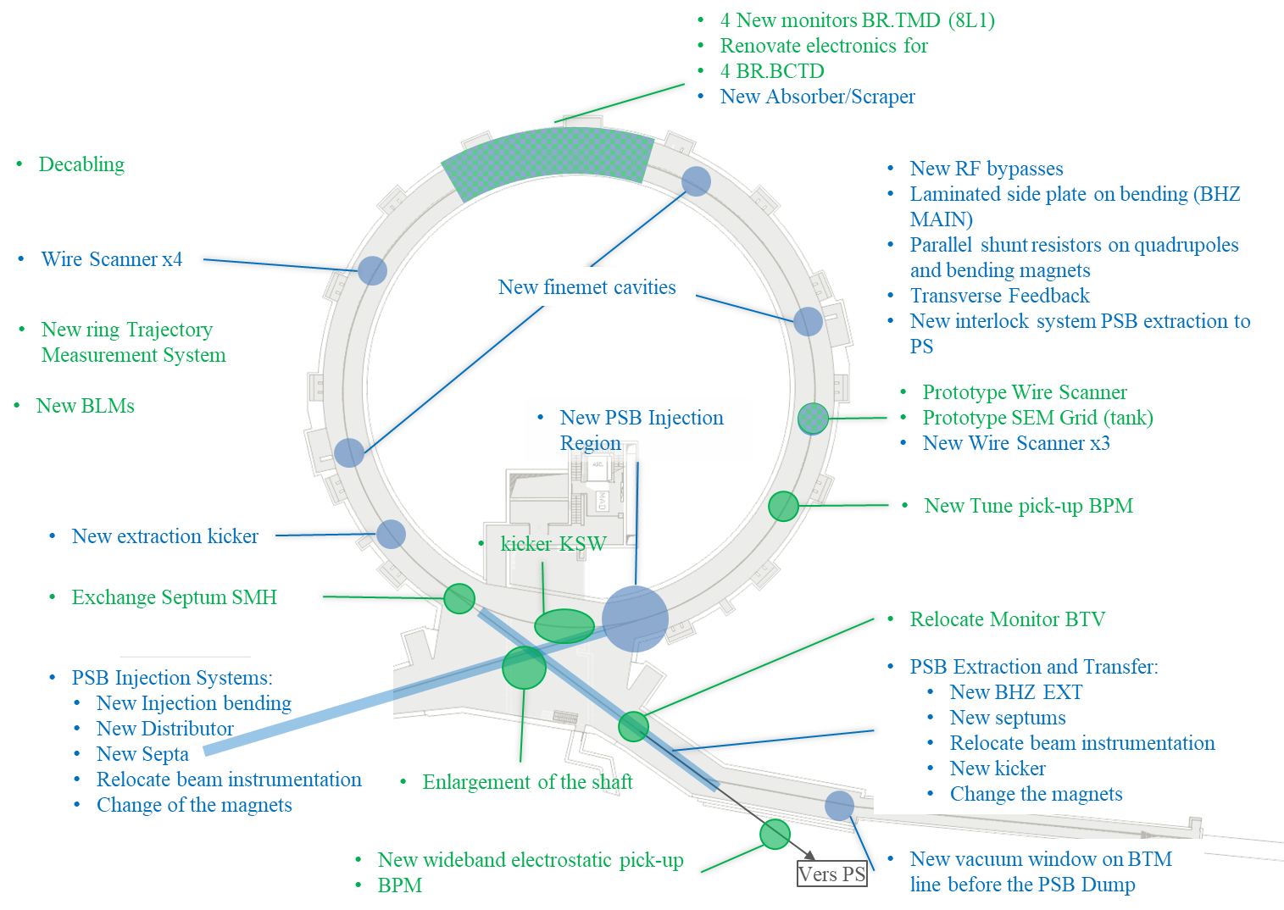
Activities anticipated from LS2
LIU-PSB activities
Completed before LS2
Scheduled for LS2

Slide 12
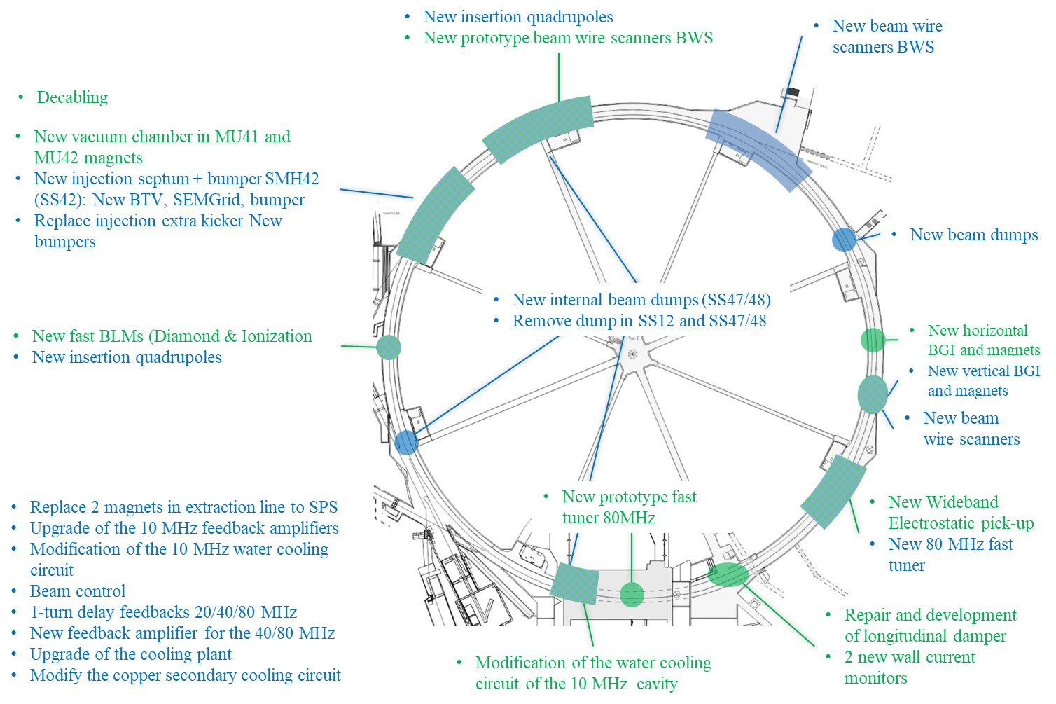
Activities anticipated from LS2
LIU-PS activities
Completed before LS2
Scheduled for LS2

Slide 13
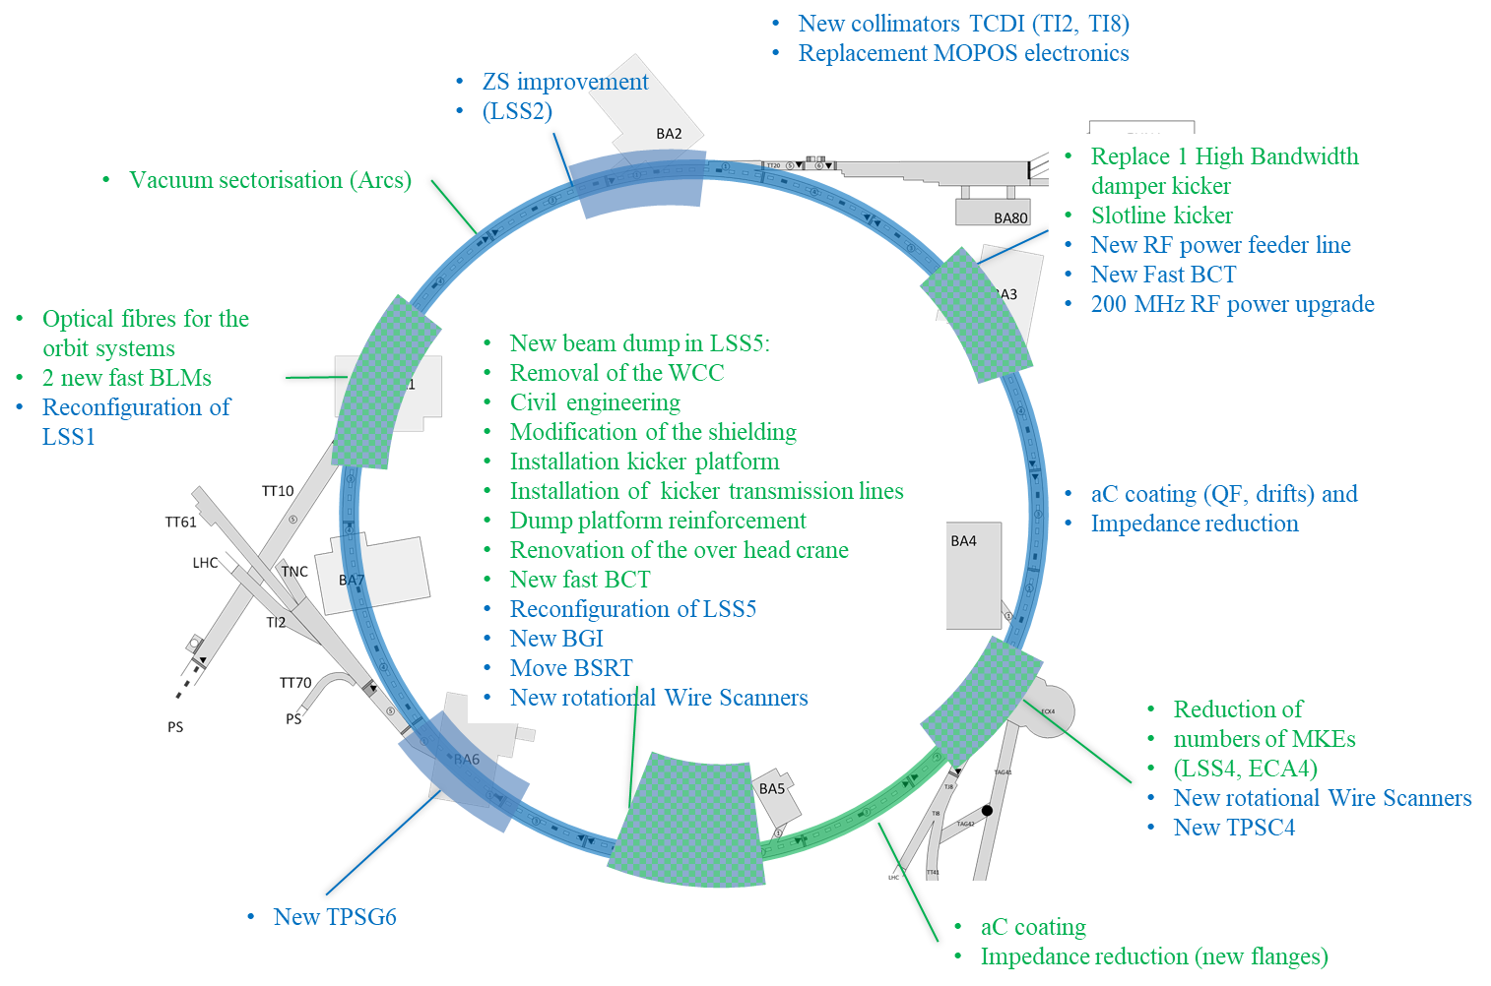
Activities anticipated from LS2
LIU-SPS activities
Completed before LS2
Scheduled for LS2

Slide 14
LS2 arbitrations in Injectors
Arbitrations decisions based on EL resources (I) Re-phased
SPS Fire Safety: delaying the installation of secondary and tertiary doors and of the dry risers in the arcs. Compensatory measures have been approved.
Irradiated cables: delaying the preventive replacement of irradiated cables SPS Point 2 and North Area. Compensatory measures have been approved for beam extraction in Point 2.
Declabing in Injectors: delay remaining decabling in Booster and PS.
Telecom radiating cable: delaying Priority 2 such as AD target, SPS Points 3&5, Awake and Priority 3 is SPS Points 4&6&7, TT60-61-70, TCC6. Compensatory measures will be taken after inspections for critical areas.
North Area: delaying all cabling except M&O activities.
SPS Electrical Network: delaying the consolidation of all the low-voltage network.

Slide 15
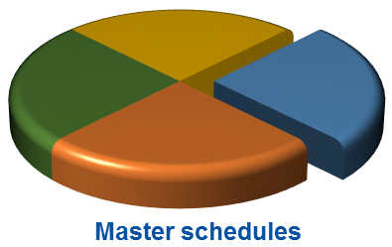
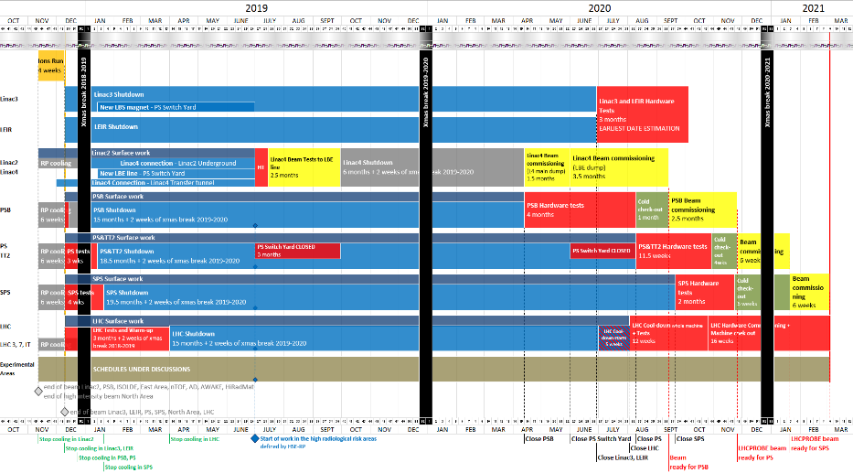
Injectors & LHC
6 months ahead !

Slide 16
LS2 arbitrations
Arbitrations decisions based on EL resources (II) Re-phased
LHC
  Telecom radiating cable: delaying the Priority 3 in LHC Points 3&7.
  Replacement of obsolete turbo pumps on Insulation Vacuum: delaying the replacement of the cabling on 7 Sectors.
  Compensatory measures have been found by recovering as spares the pumps from one Sector and as well with a successful extension of the maintenance contract by the pump supplier.
Surface buildings related to accelerators
  SM18 SC magnet test bench:
    Delaying the integration and cabling of the evolution of Clusters A, D, F.
    Compensatory measures will be studied for the preparation of the String 3 for
    HL-LHC.
    Delaying the electrical & cabling needed for the superconducting RF extension. Impact is being evaluated prior to formulate compensatory measures.
  SC Cable test bench (Blg 163 upgrade): delaying the integration and cabling of the upgrade of the infrastructure which includes the installation and commissioning of the FRESCA 2 test bench.
Impact on HL-LHC being evaluated

Slide 17
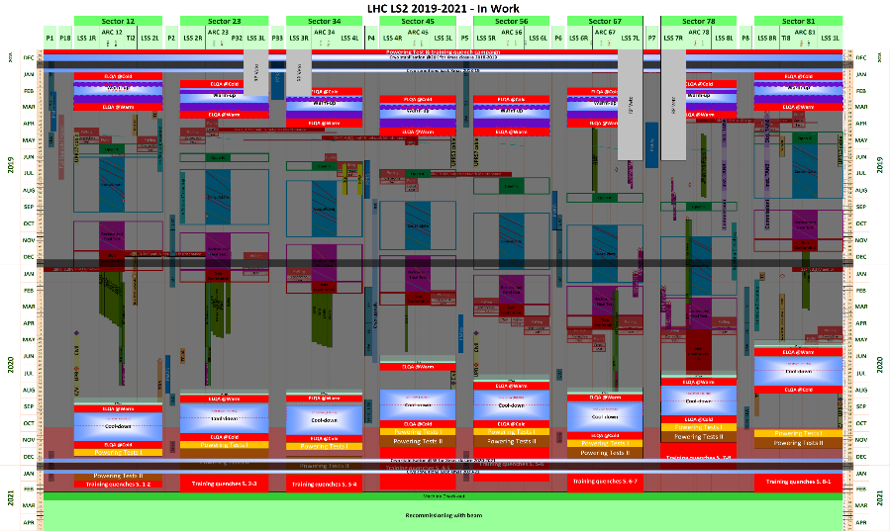
LHC & HL-LHC

Slide 18
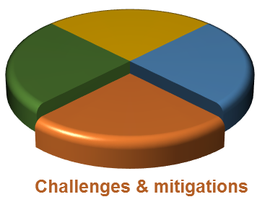
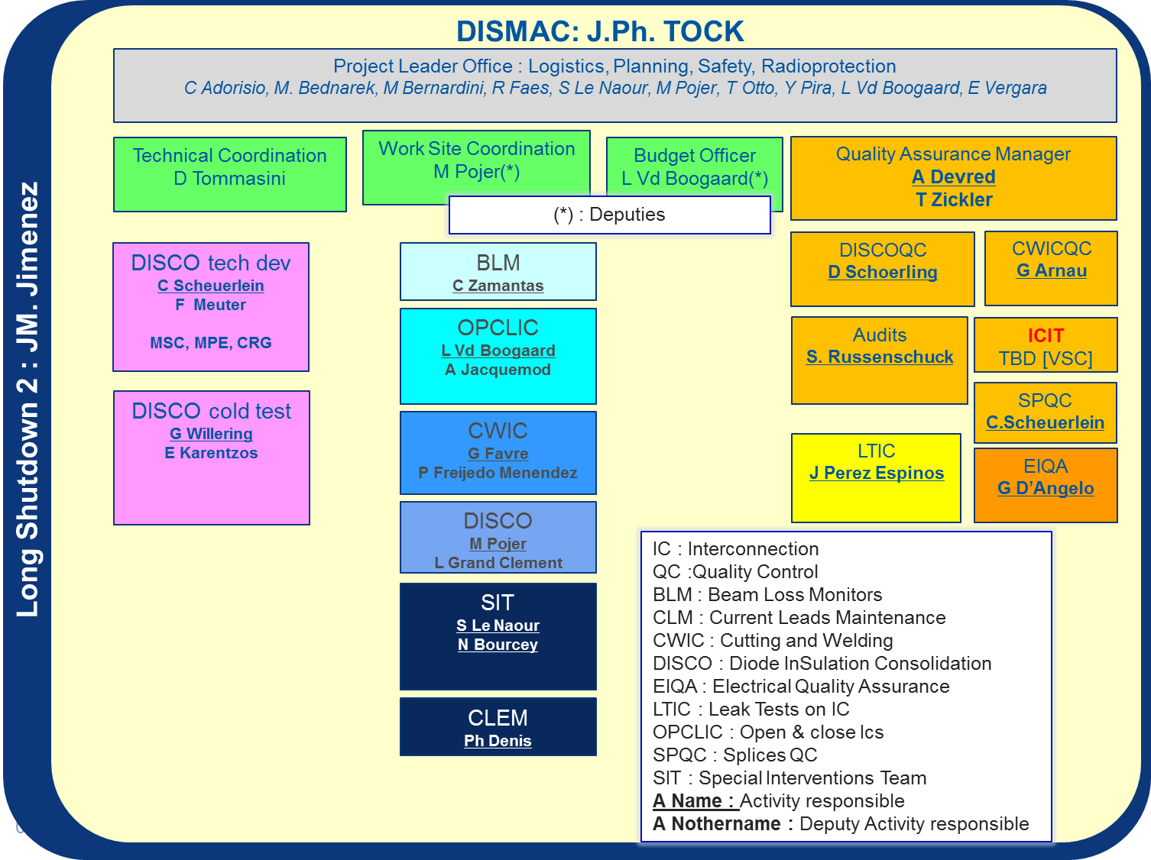
Impact on HL-LHC
Two activities added:
  Inner Triplet alignment: two-phase approach
    Restabilising the supporting configuration in IP1 & IP5 during LS2
    Study of a new supporting configuration, execution probably done post LS2
  DISMAC (Diode Insulation and Superconducting Magnets)
    Shortage of 11 FTE.y on HL-LHC activities
    2018(2.1), 2019 (5.5), 2020 (3.5)
    1.7 of Engineers / Physicists
    9.3 of Technician / Technical-Engineers
    Measures are being finalised by
    Management without financial impact on
    HL-LHC to limit the resource/competence
    impacts.

Slide 19
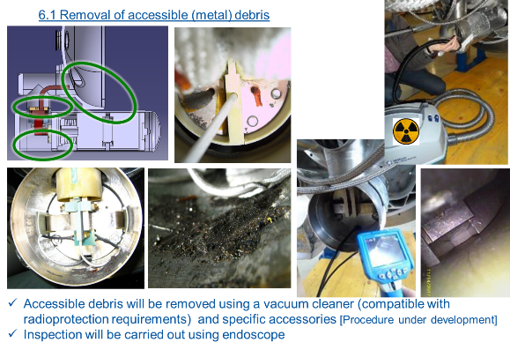
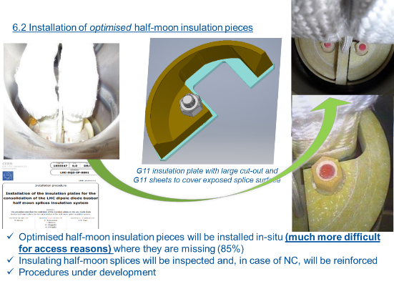
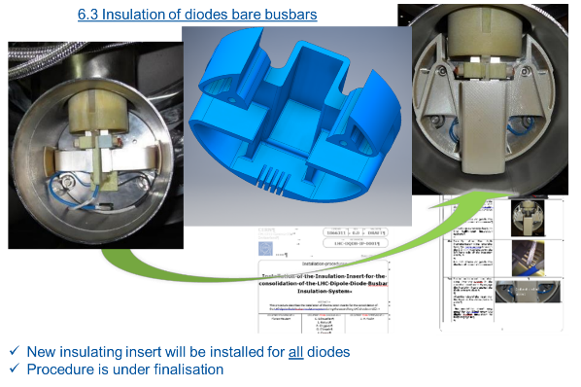
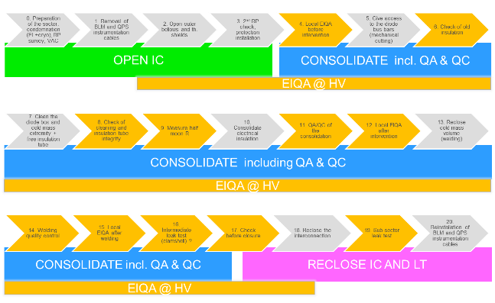
Challenges & Mitigations
Impact of DISMAC (TE-MSC) on HL-LHC

Slide 20

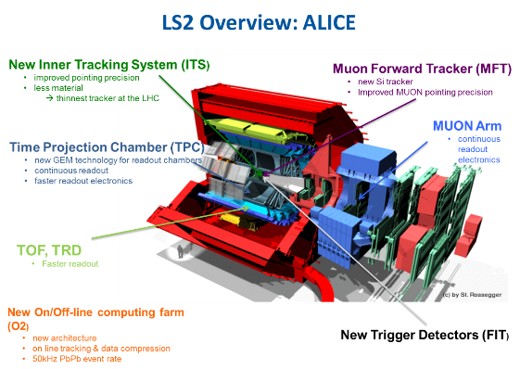
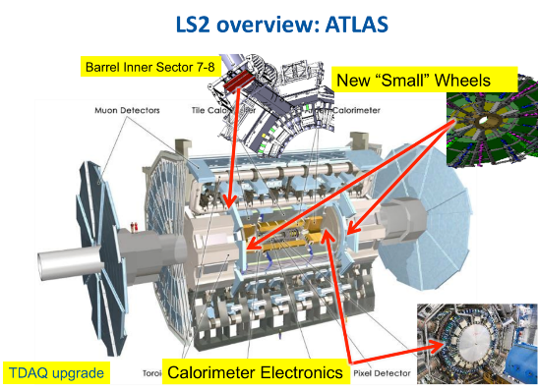
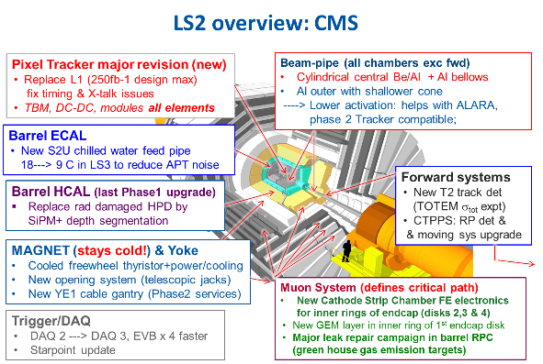
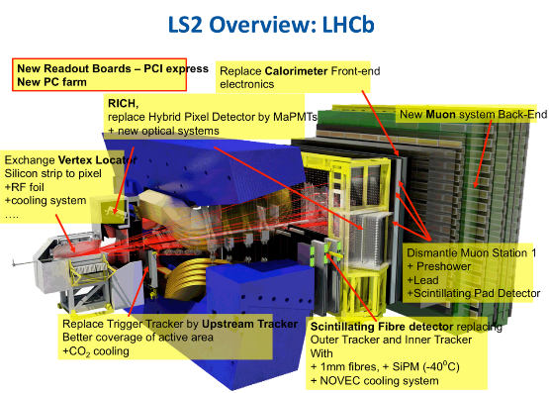
The LHC Experiments
Most of these activities need support from the A&T Sector

Slide 21
Risk Management
Engineering Change Requests to be issued by April 2018
Integration studies shall be completed by Summer 2018
Equipment readiness to be communicated for fine tuning of schedules by end of March 2018
Work package analysis to assess equipment and installation risks and feasibility by Q3-2018
ALARA committees to be scheduled already for Q2-2018
IMPACT tool to coordinate daily activities
Safety joint visits (VICs) and compensatory measures to be anticipated

Slide 22
“Running” the LS2…
Coordination and Logistics
  Individual system tests & overall Safety Coordination are being watched
  Space Management for Storage, “Base de Chantier” and Logistics: at prioritisation phase. March 2018
Milestones
  Arbitrations done, follow-up after QA checks with EN-EL
  LS2 consolidated Planning Baseline presented today
  (8 months ahead, final version in November)
    Priority given to ECR validation, Integration, Risk Mitigation and coactivity Risk Management

Slide 23
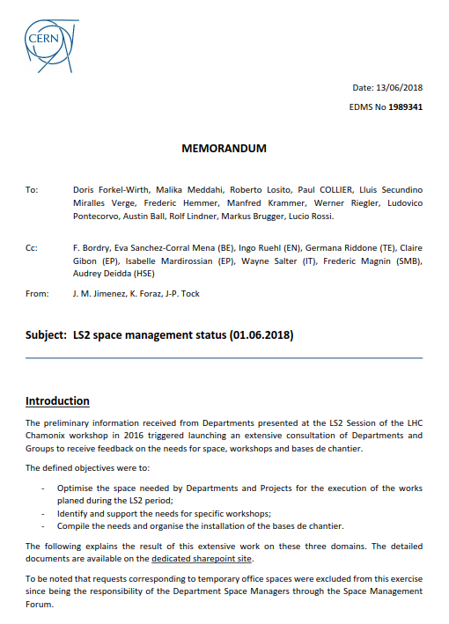
Memos addressed to Management

Slide 24
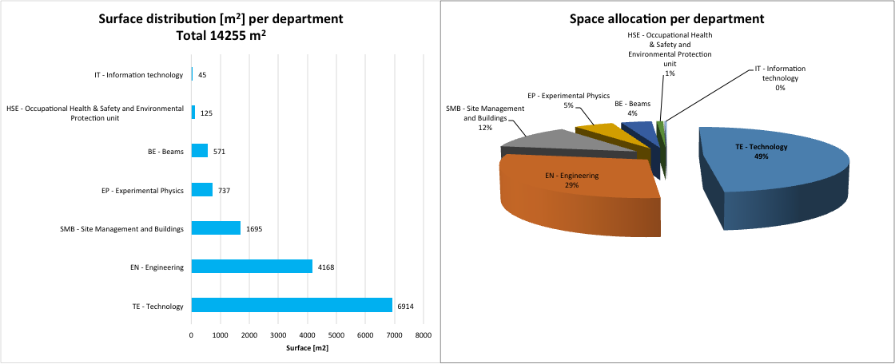
Storage: Surface distribution
80 %
Request evolution
82 requests on 22/08
189 requests on 26/09
238 requests on 19/10
244 requests on 26/01
239 requests on 25.04
220 requests on 01.06

Slide 25
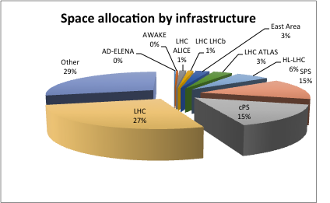
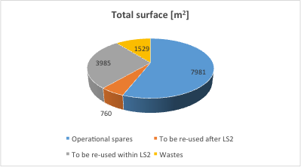
Storage: Infrastructures and type of storage
Type of storage
Other: e.g. Transport and handling equipment, storage from B954/955 to Flex

Slide 26
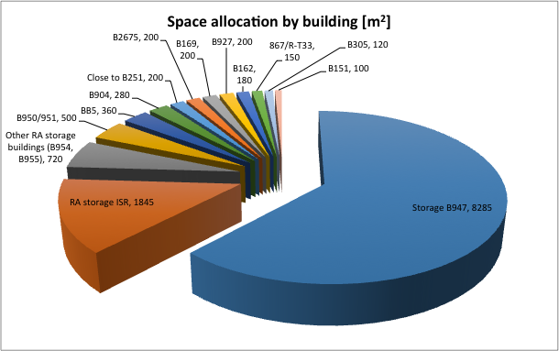
Storage: Main storage buildings
Sharing according to requirements
(e.g type of conditioning) and activation:
B947
ISR
Others

Slide 27
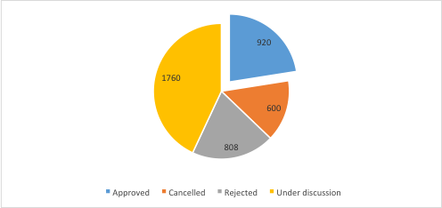
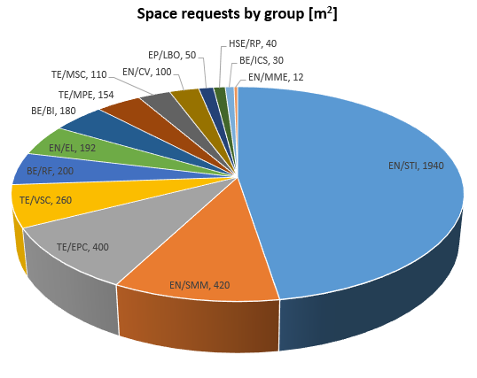
Workshops: Status of the requests
Total requested surface : 4088 m²

Slide 28
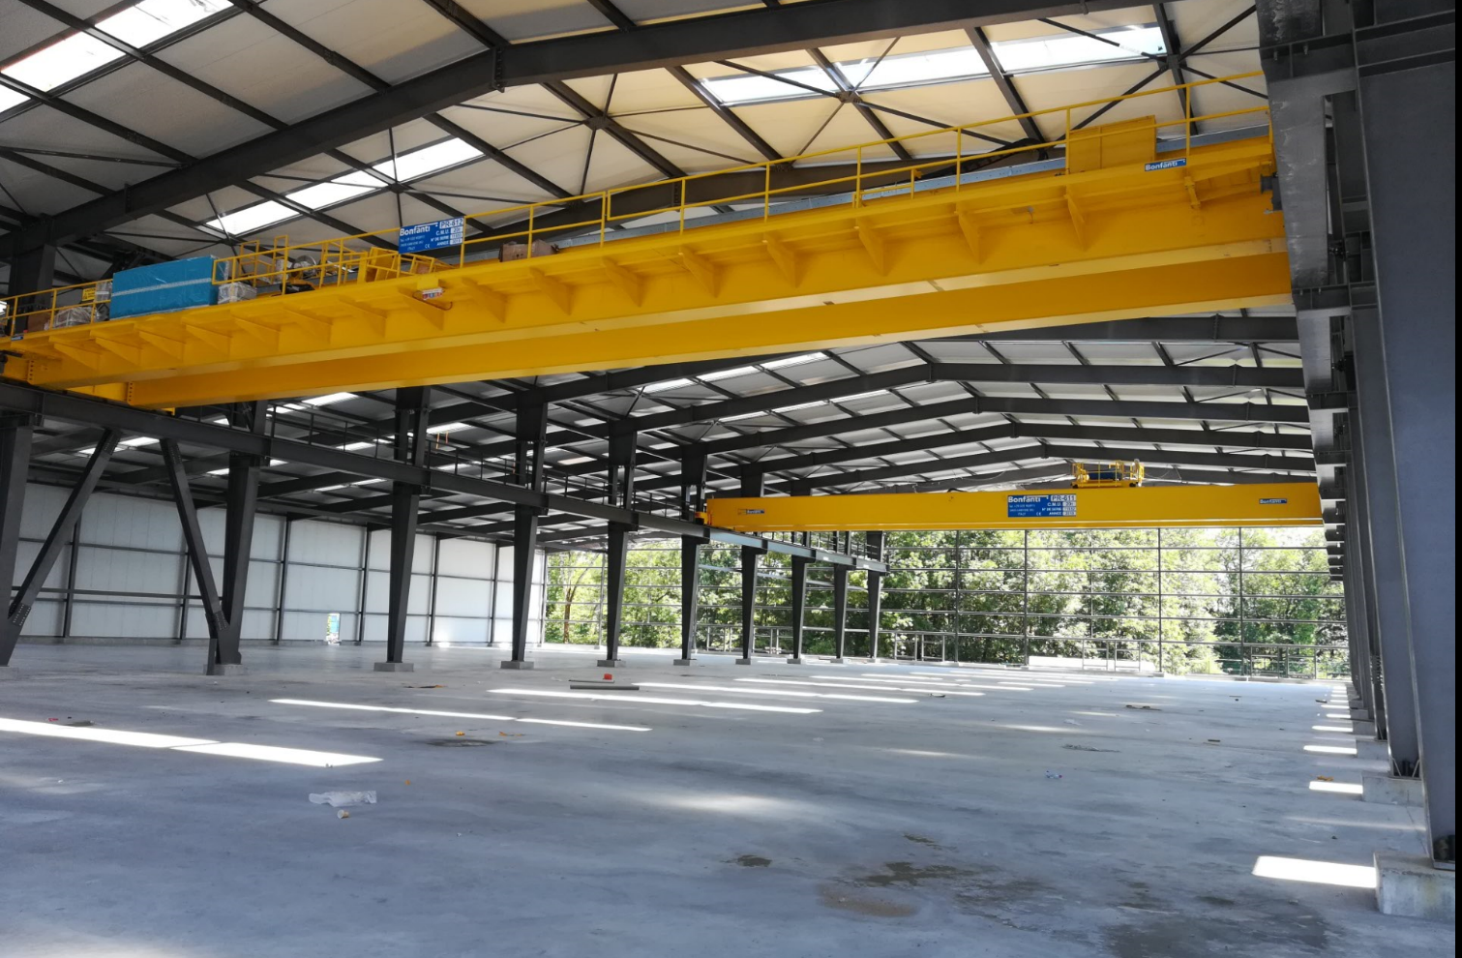
Flex Bld.947: Status of the work
Gantry cranes installed – 2 x 20 tons

Slide 29
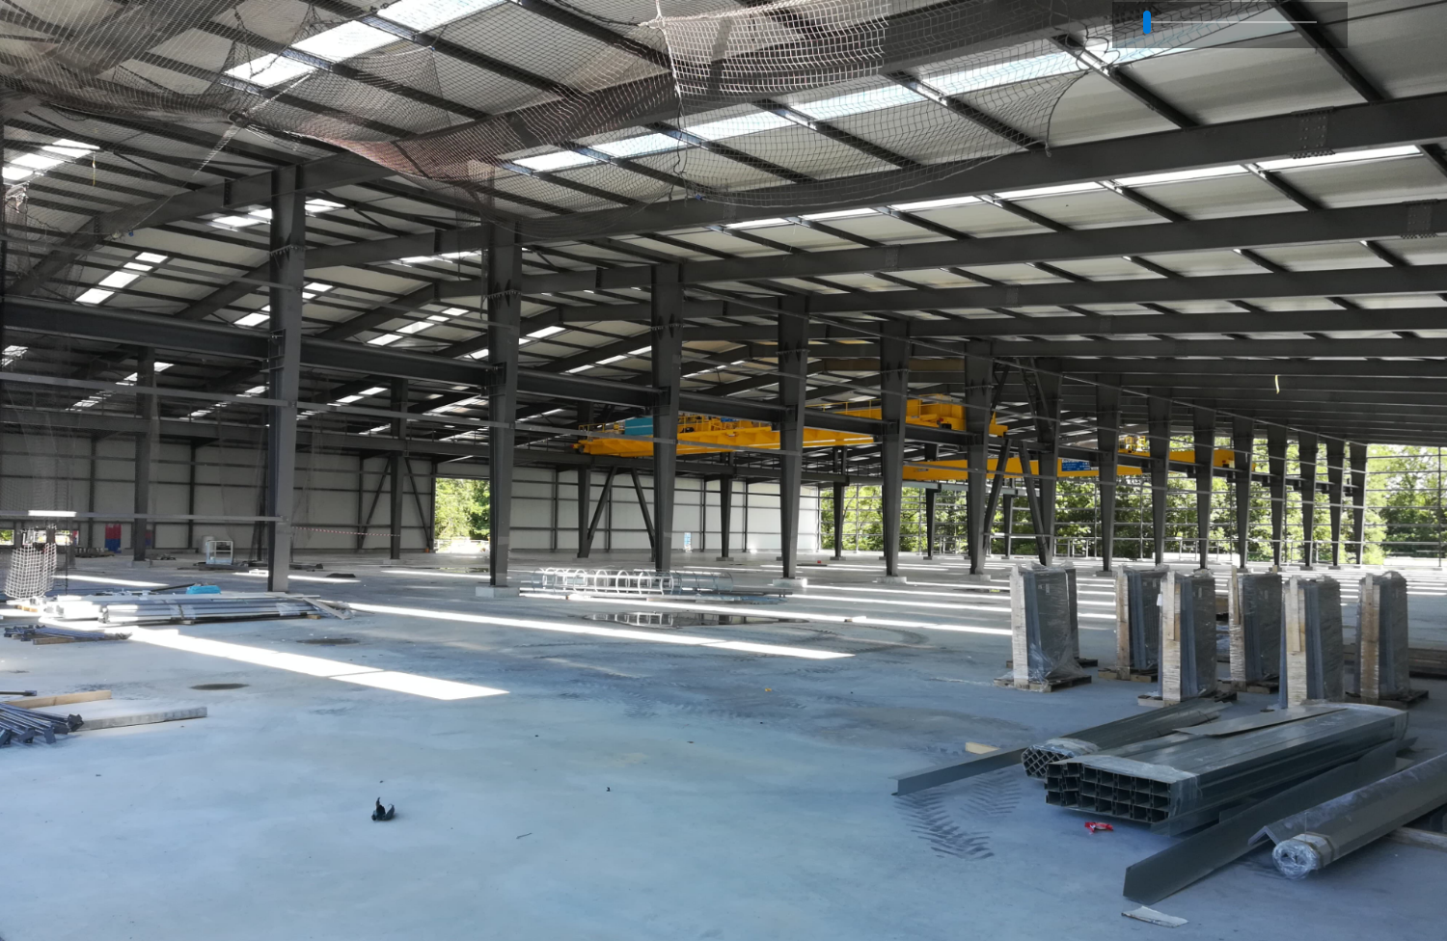
Flex Bld.947: Status of the work
Concrete pavement + metallic structure and envelope

Slide 30
Rules during LS2
No long term storage
No works (maintenance / workshops)
Packaging in compliance with the material to be transported (ADR)
No storage of metallic structures accepted inside as long as they can be stored outside
Each group* will be charged for the storage: 140 CHF/m²/year.
* To be noted that the following groups will not be charged for the space allocated in the Flex building :
  SMB: magnets from B.954,
  TE-VSC: beam screens from ISR2,
  TE-MSC: material from B.927,
  EN-HE: material from B.927

Slide 31
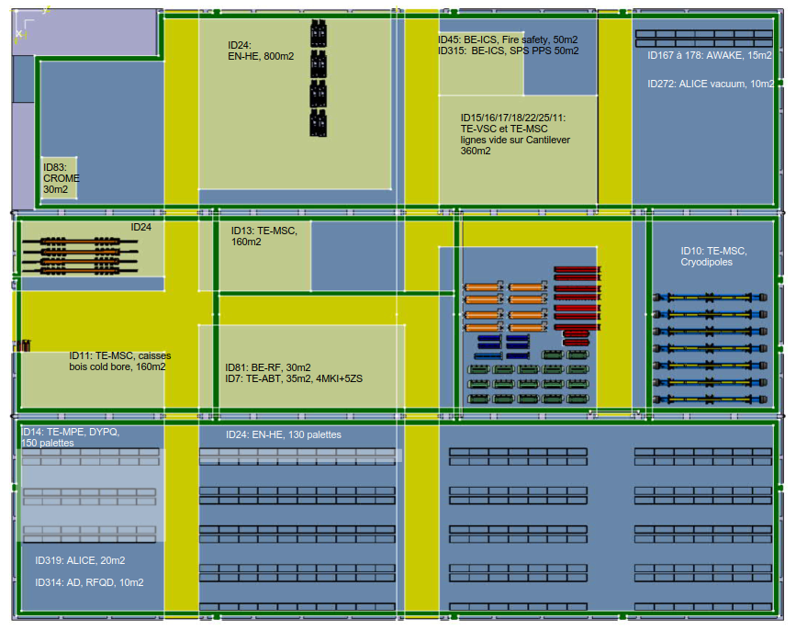
Flex Bld 947: Layout
These numbers are given as an indication.
The LS2C retains all rights regarding space optimization.
ID105/107/108: SMB, Aimants du 954 450m2 ID 121: TE-ABT, KFA20, 2m2
ID196 et 195: TE-ABT, septum, 50m2

Slide 32
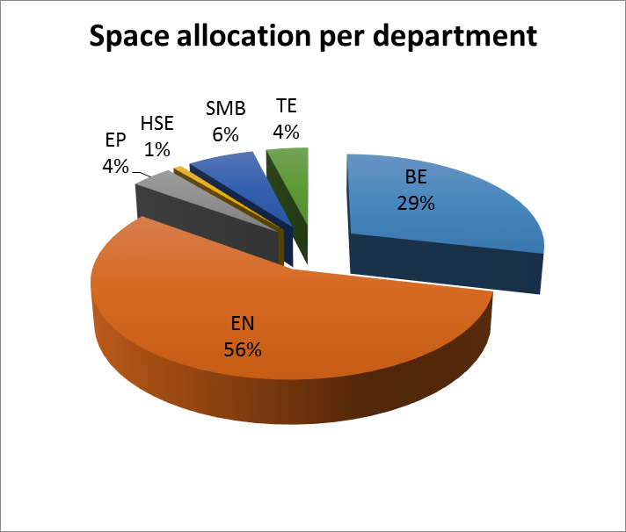
Bases de chantier: Status of the requests
No of requests
Approved + Under discussion 126
(surface [inside or outside] and underground)

Slide 33
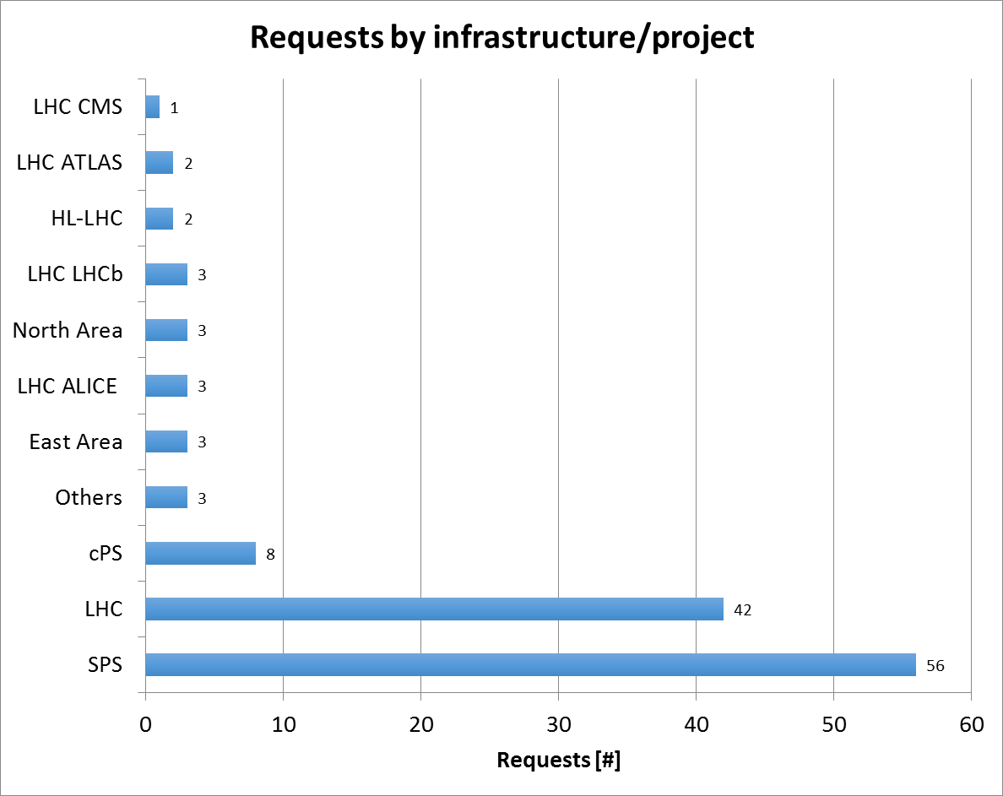
Bases de chantier: Facilities and location
Layout have been prepared in collaboration with EN-ACE, EN-HE and SMB. They provide
ID reference number and project description
Technical responsible
Space allocation
Infrastructures needed
start and end dates which shall be aligned with official planning prepared by the facility coordinators
http://ls1ls2.web.cern.ch/content/long-shutdown-2-project

Slide 34
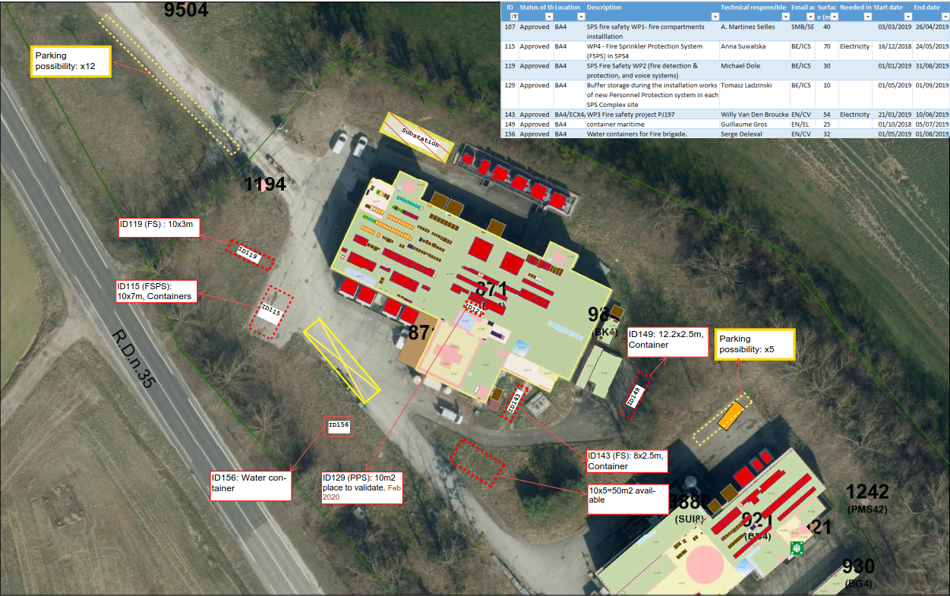
Bases de chantier: layout: typical example (BA4)
Scaled locations
Information on:
  free space to keep for EN-HE;
  parking options;
  additional place available.

Slide 35
Visits of accelerators during LS2
As of decision made with the Complex Manager
(F. Bordry), no visits will be allowed during LS2, with the exception of:
  VIP and Press visits;
  Professional visits:
      GSI-SH-1
      Step to follow: edms1281098 v.4.1
  Open days: 14-15 September 2019:
      LS2 Team will propose organising special visits for “CERNois”
Memo is being prepared and will be sent to ED Members before end of June 2018.

