Slide 1



QCD Results from the Tevatron
Kenichi Hatakeyama
畠山 賢一
Baylor University
Aspen Particle Physics Conference
Aspen Center of Physics
January 17 - 23, 2010

Slide 2
Outline
Fermilab Tevatron, CDF and D0 Detectors
Inclusive jets and dijets
Photons
W/Z+jets
Soft QCD and Exclusive Production
Summary & Remarks
Only a small fraction of extensive QCD results from the Tevatron can be covered in 20 minutes. More results can be found on:
http://www-cdf.fnal.gov/physics/new/qcd/QCD.html
http://www-d0.fnal.gov/Run2Physics/WWW/results/qcd.htm

Slide 3

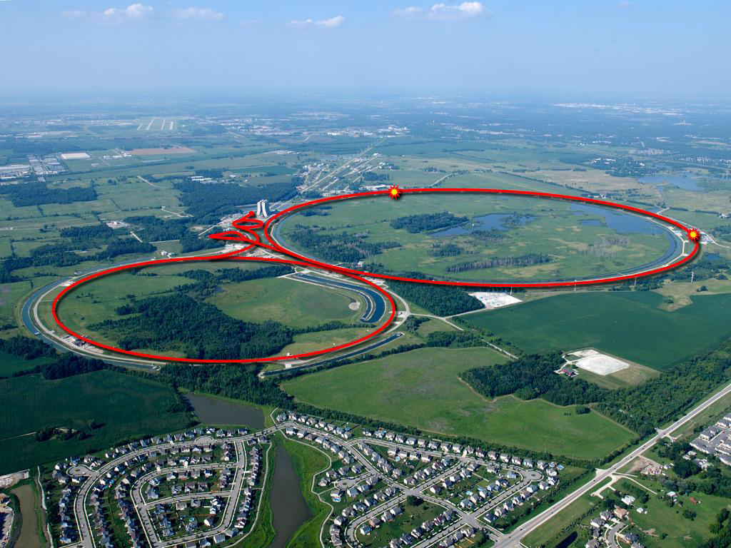
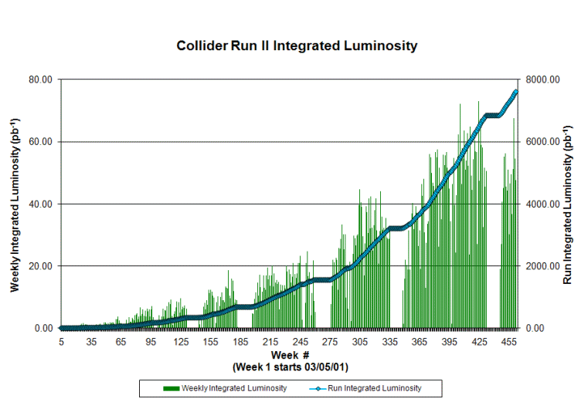
Fermilab Tevatron
World’s highest energy “proton-antiproton” collider
>7 fb-1 delivered
(Run I: 120 pb-1)
Tevatron
Main Injector
Most likely to run
until FY2011
Batavia, IL

Slide 4
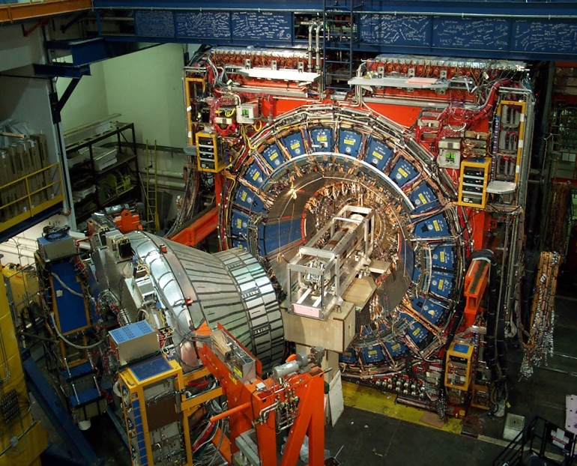
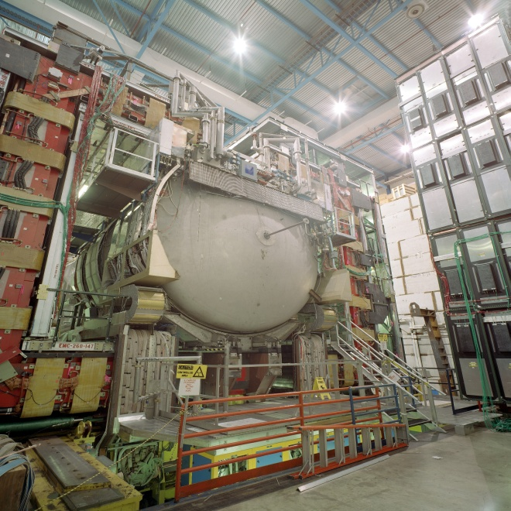
CDF and DØ
CDF & DØ running well and
recording physics quality data with high efficiency (85-90 %)
Both experiments have already
collected > 6 fb-1 on tape

Slide 5
Inclusive Jets & Dijets
α_{s}, PDFs,
Physics beyond the Standard Model

Slide 6
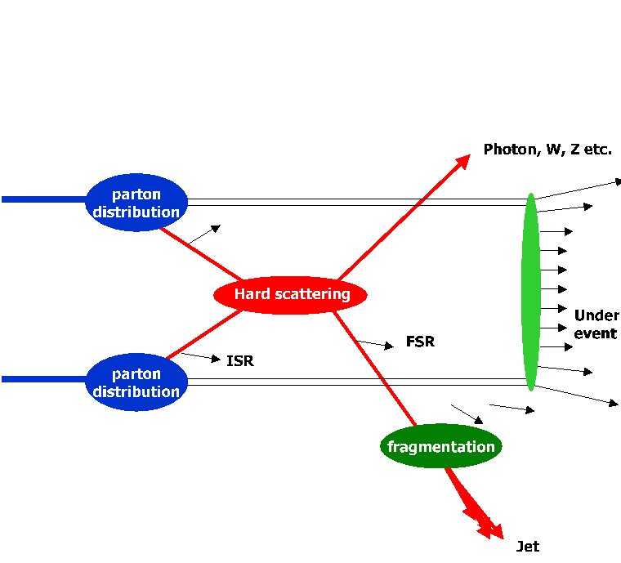
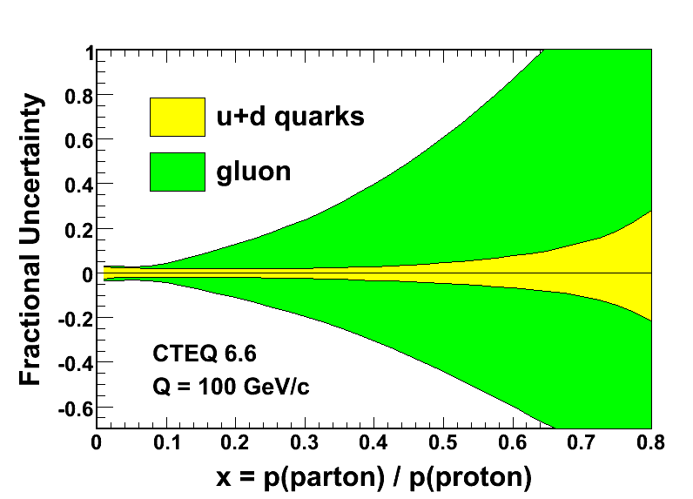
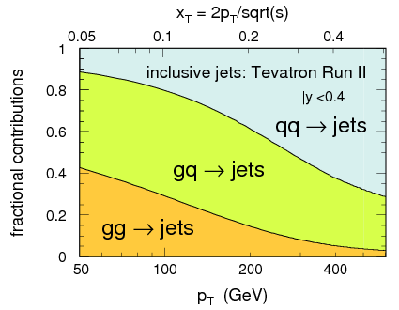
Jet Production at the Tevatron
jet
PDFs
underlying
event
Hard Scatter
Test pQCD at highest Q².
Unique sensitivity to new physics
  Compositeness, new massive particles, extra dimensions, …
Constrain PDFs (especially gluons at high-x)
Measure α_{s}
jet

Slide 7

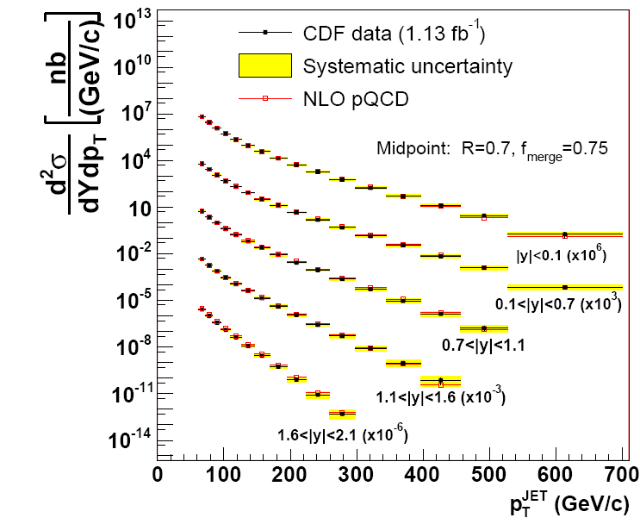
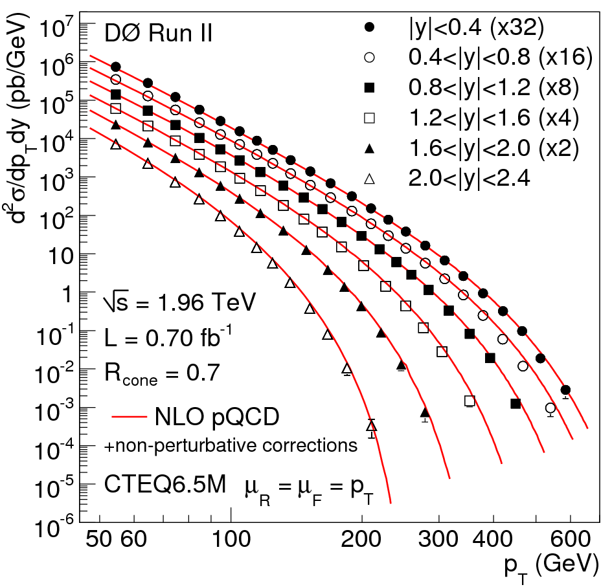
Inclusive Jet Cross Section
Phys. Rev. D 78, 052006 (2008)
p_{T} (GeV/c)
p_{T} (GeV/c)
Phys. Rev. Lett. 101, 062001 (2008)
Measurements span over 8 order of magnitude in dσ²/dp_{T}dy
Highest p_{T}^{jet} > 600 GeV/c

Slide 8
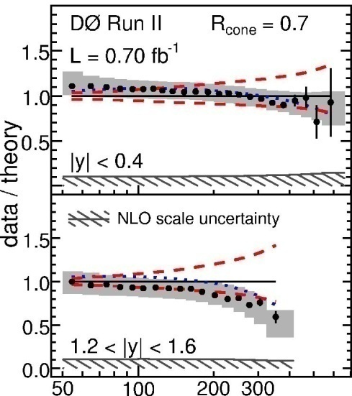
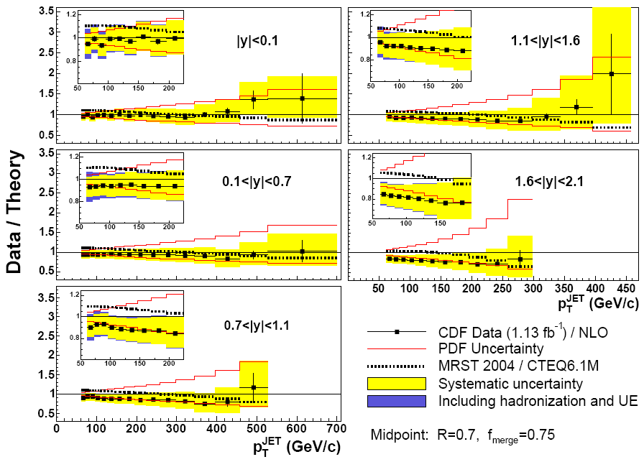
Inclusive Jet Cross Section
Both CDF and D0 measurements are in agreement with NLO predictions
  Both in favor of somewhat softer gluons at high-x
Experimental uncertainties:
smaller than PDF uncertainties
Discussions on the impact to PDF in a different talk
CTEQ6.5M PDFs
p_{T} (GeV)
see also, Inclusive jets with Kt, CDF, Phys. Rev. D 75, 092006.

Slide 9
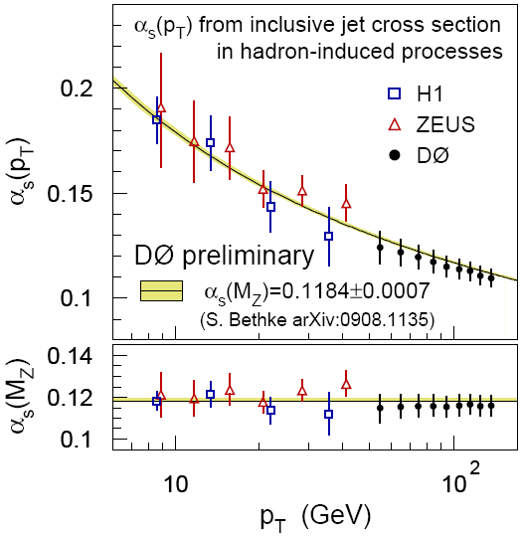
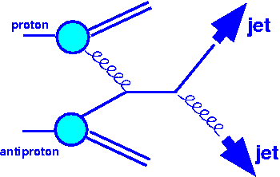
Strong Coupling Constant
From 22 (out of 110) inclusive jet cross section data points at 50 < p_{T} < 145 GeV/c
· NLO + 2-loop threshold corrections
· MSTW2008NNLO PDFs
· Extend HERA results to high p_{T}
3.5-4.2% precision
Phys. Rev. D 80, 111107
CDF results in Phys. Rev. Lett. 88, 042001

Slide 10
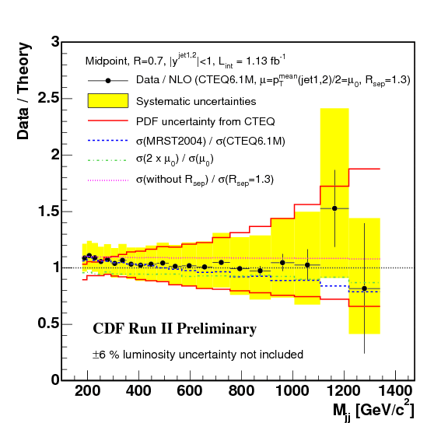
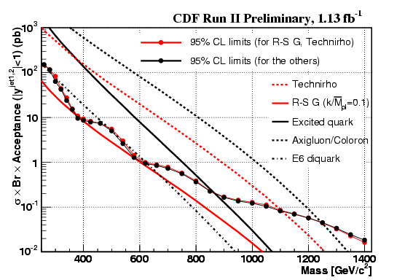
Dijet Mass Spectrum
Phys. Rev. D 79, 112002
Test pQCD predictions
Sensitive to new particles decaying into dijets: excited quarks, heavy gluons, techni-ρ, etc
Dijets with jets |y^{jet}|<1
Consistent with QCD - no resonance
Most stringent limits on many new
heavy particles
Limits:
σ B A(|y^{jet}|<1) (pb)
Mass reach up to ~ 1.2 TeV/c²

Slide 11
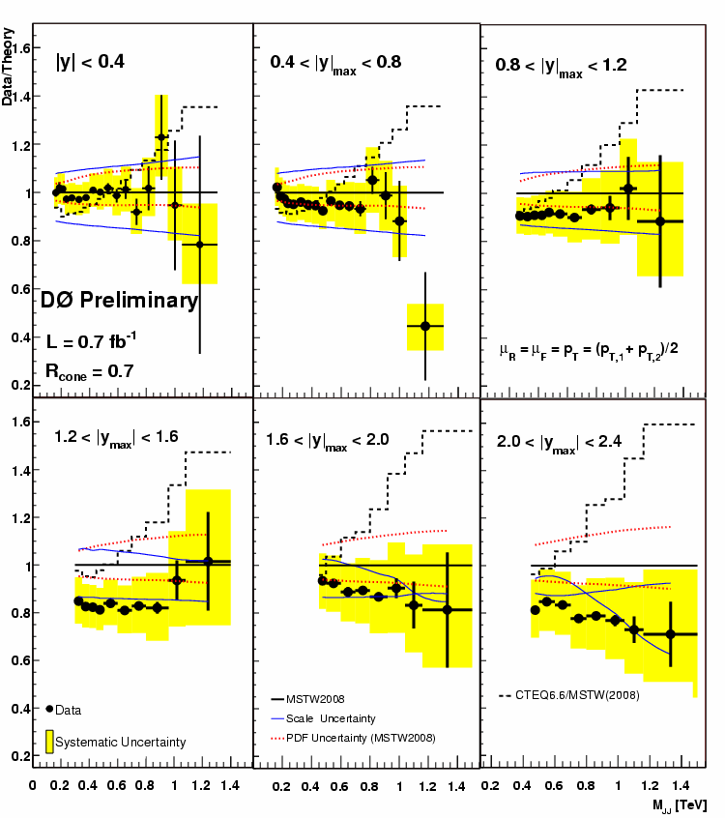
Dijet Mass Spectrum
D0 measurement goes to forward rapidity regions
six |y_{max}| regions (0<|y_{max}|<2.4)
PDF sensitivity at large |y_{max}|
Favor softer high-x gluons
No indications for resonances
Data / Theory
D0 Conf Note 5919
M_{jj} (TeV/c²)

Slide 12
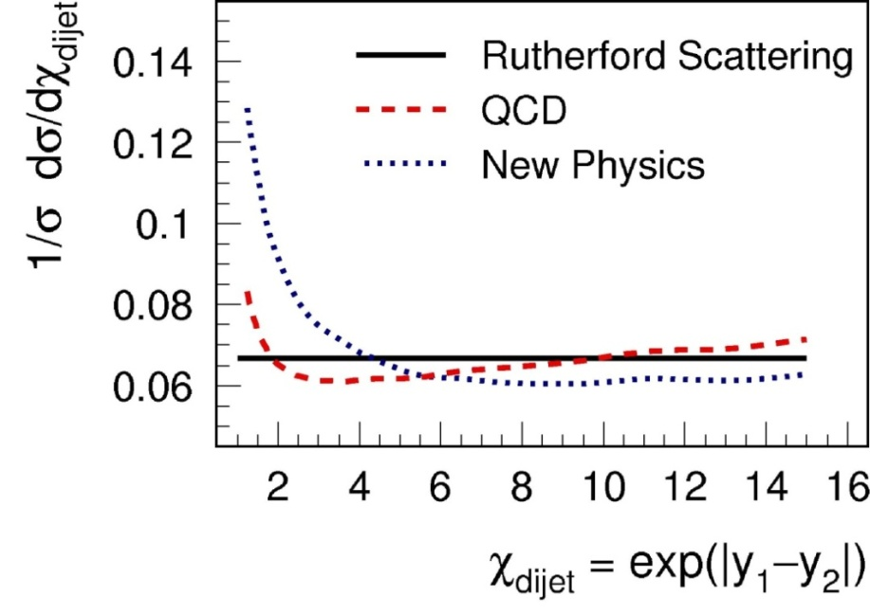
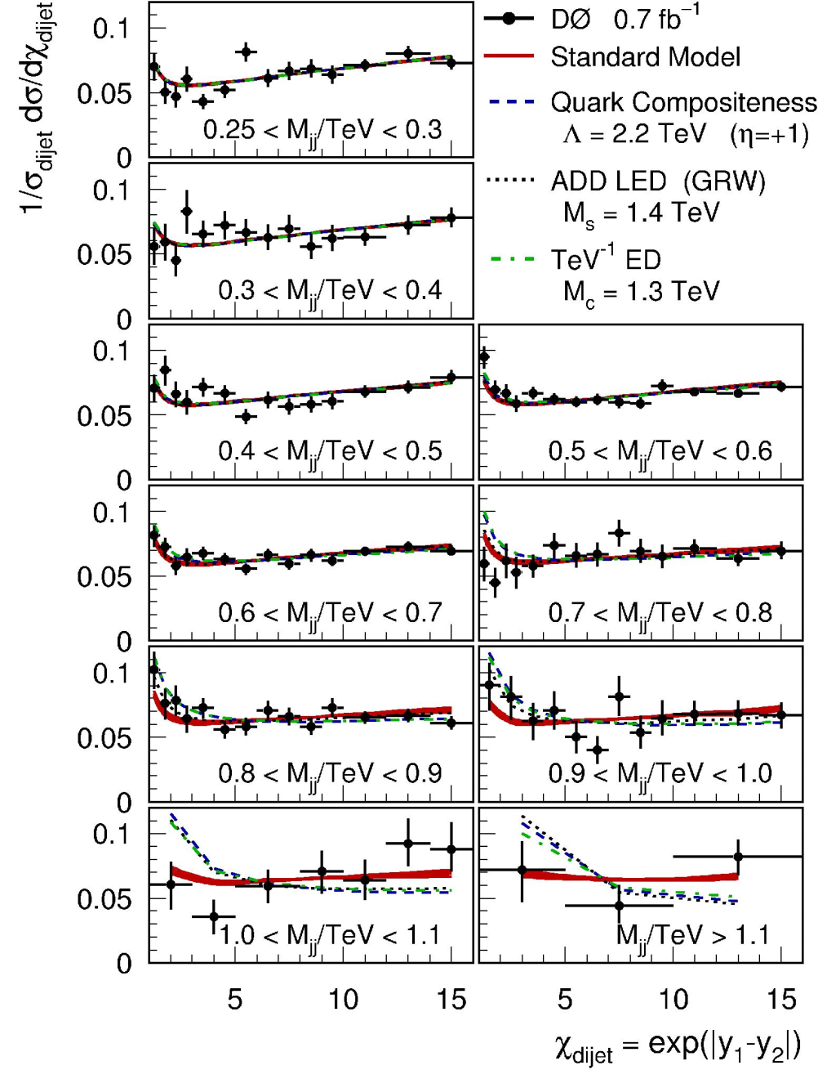
Dijet Angular Distribution
  quark compositeness
  extra dimensions
θ*
θ*
Consistent with NLO pQCD
Limits on Compositeness & LED
  Quark Compositeness Λ > 2.9TeV
  ADD LED (GRW) Ms > 1.6 TeV
  TeV-1 ED Mc > 1.6 TeV
Phys. Rev. Lett. 103, 191803.
Also CDF results in CDF public note 9609
Notes:
12

Slide 13
Photons
Photons: “direct” probes of hard scattering
Test perturbative QCD, PDFs

Slide 14
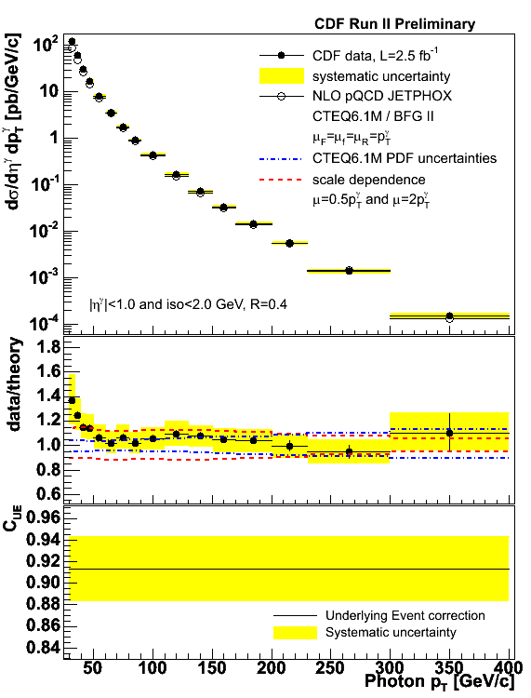
Inclusive Photon Cross Sections
Phys. Rev. D80, 11106 (2009)
Directly sensitive to hard scatter
Data/NLO pQCD: In agreement at high p_{T}, but enhancement at low p_{T}
D0 measurement shows similar trends (Phys. Lett. B 639, 151)
  Similar shape also in Run 1 analyses – need to be understood
Notes:
14

Slide 15

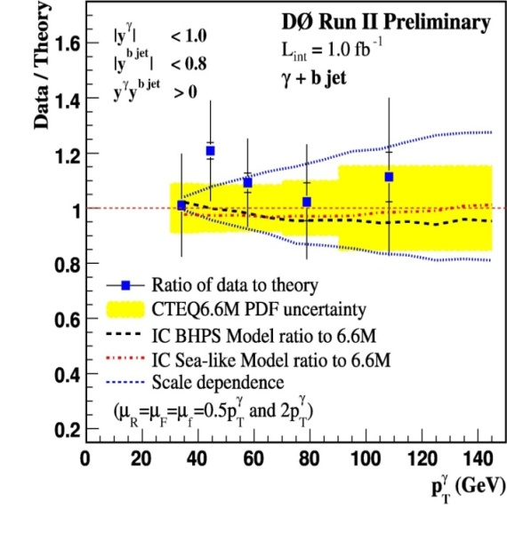
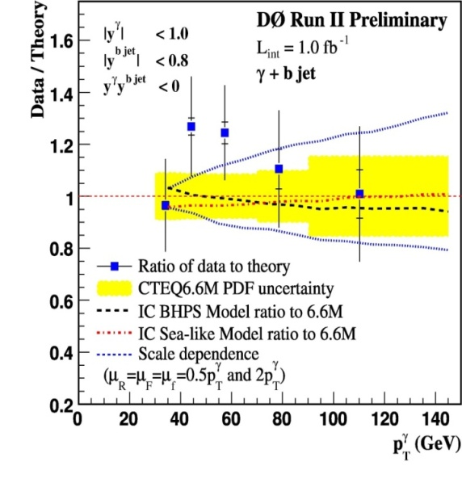
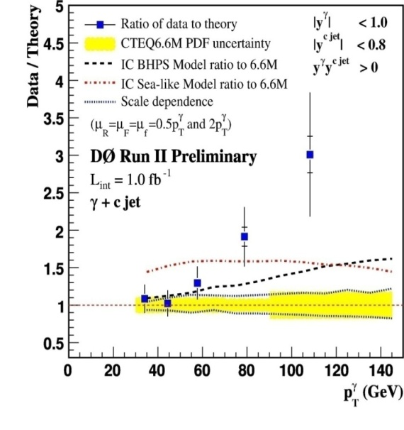
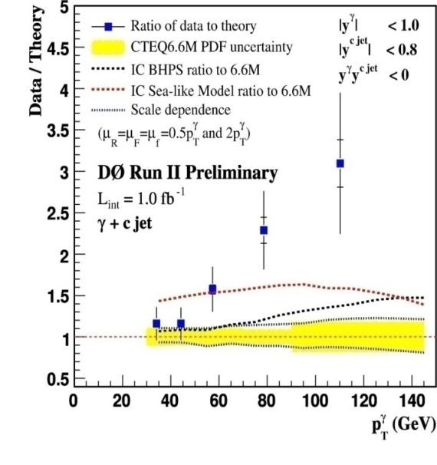
Photon + HF Jet Production
Phys. Rev. Lett. 102, 192002
Sensitive to HF-content of proton
Bkgd for many BSMs
Photon p_{T}: 30 – 150 GeV/c
Rapidities: |y^{γ}|<1.0, |y^{jet}|<0.8
Photon+b:
Agreement over full p_{T}^{γ} range
Photon+c:
Agree only at p_{T}^{γ}<50 GeV/c.
Disagreement increases with p_{T}^{γ}.
Using PDF including the intrinsic charm (IC) improves, but
p_{T}^{γ} (GeV/c)
data and theory still not compatible
Notes:
15

Slide 16
Vector Boson + Jets
Prerequisites for top, Higgs, SUSY, BSM
Test perturbative QCD calculations
& Monte Carlo Models

Slide 17
W/Z+Jets Production
W/Z+jets are critical for physics at the Tevatron and LHC: top, Higgs, SUSY, and other BSM
NLO pQCD calculations are available up to 2(3) jets
Many Monte Carlo tools are available
  LO + Parton shower Monte Carlo (Pythia, Herwig, )
  MC based on tree level matrix element + parton showers, matched to remove double counting: Alpgen, Sharpa, …
These calculations and tools need “validation” by experimental measurements

Slide 18
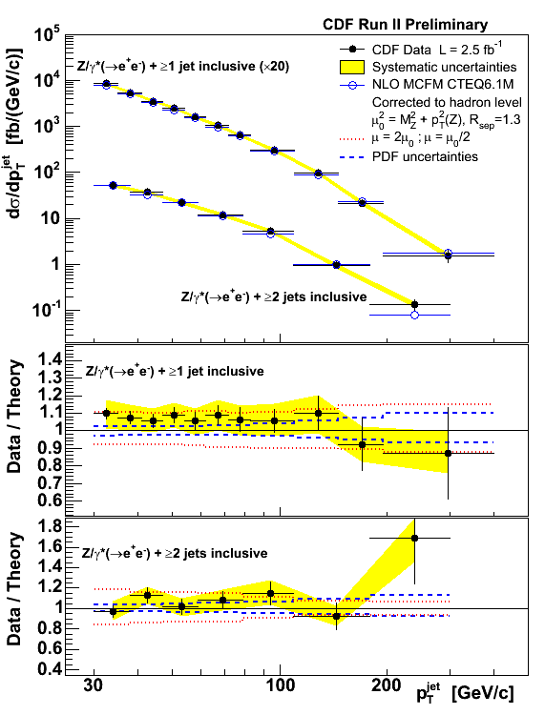
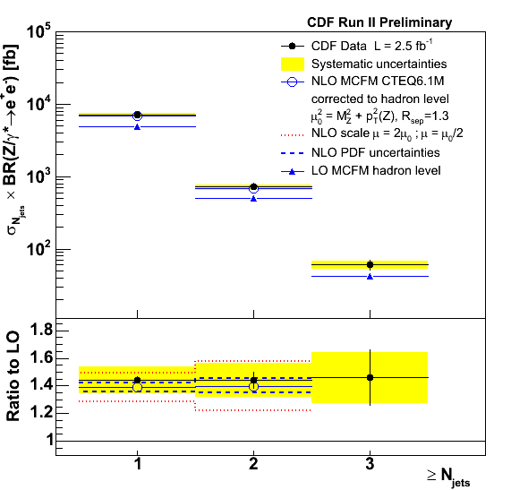
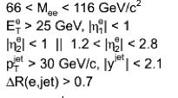
Z+Jets Production
Phys. Rev. Lett 100, 102001 & update
Data and NLO pQCD in agreement
Good control sample for SUSY search

Slide 19
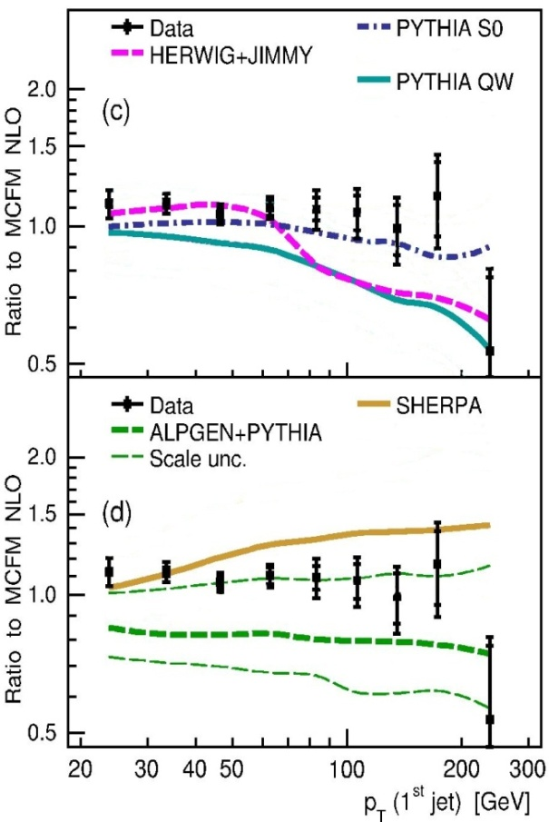
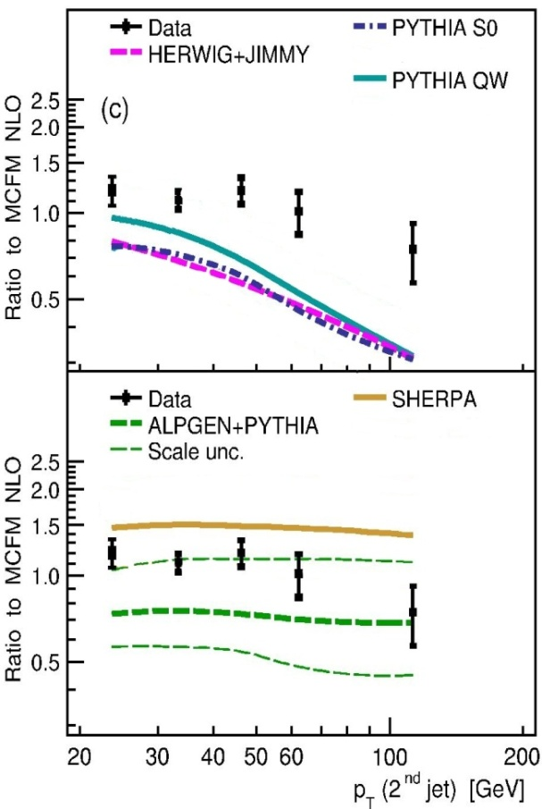
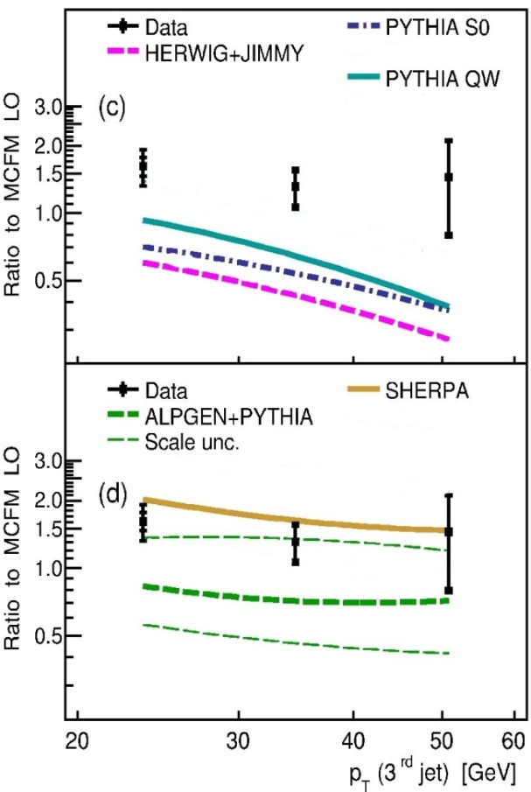
Z + (1, 2, 3) Jets
Testing Monte Carlo Models: favor Alpgen with low scale
Leading jet in Z + jet + X
Second jet in Z + 2jet + X
Third jet in Z + 3jet + X
Phys. Lett. B 669, 278, Phys. Lett. B 678, 45, Phys. Lett. B 682, 370.
See also W+jets, CDF, Phys. Rev. D 77, 011108(R).

Slide 20
Soft QCD and Exclusive Production
Prerequisites for High Pt Physics
Monte Carlo Tuning
Exclusive Higgs Production at the LHC

Slide 21
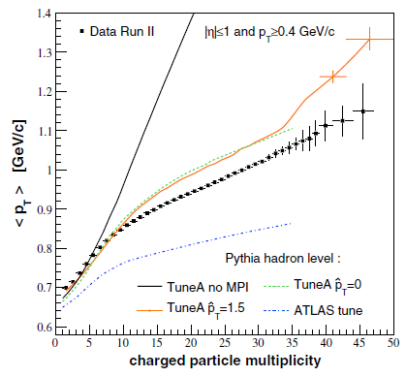
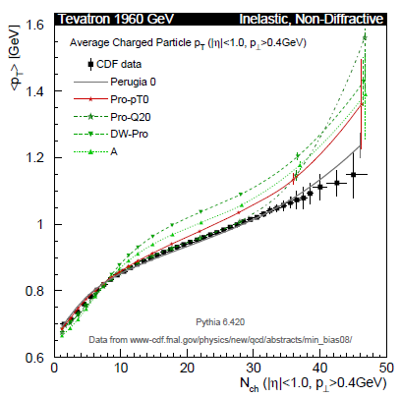
Particle Production in Non-Diffractive Inelastic Events
Particle production in “soft” collisions
Interesting soft QCD
Important for MC tunings
  Complement the underlying event study in hard-scattering events
  Actively used for recent MC tunes
Early physics from the LHC
Phys. Rev. D 79, 112005

Slide 22
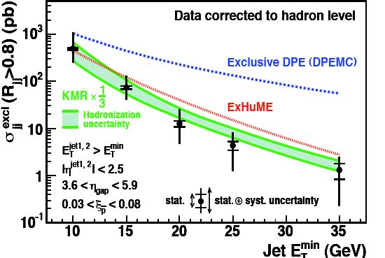
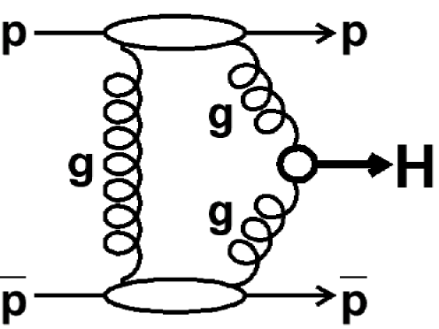
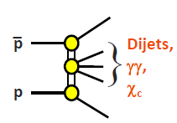
Exclusive Production
Phys. Rev. D 77, 052004
Attractive channel for Higgs physics at the LHC
At the Tevatron, the cross section too small
  Study similar channels to “calibrate” theory prediction
Reliable calculations from
Khoze, Martin, and Ryskin.
Eur. Phys. J C14,525(2000).

Slide 23
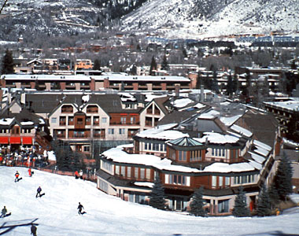
Summary & Remarks
Tremendous progress has been made to advance understanding of QCD at the Tevatron
Determination of α_{s} and PDFs from jet x-section measurements
Photon + c-jet measurement challenge theorists
Z/W+jet(s) measurements test pQCD, help
MC modeling and Higgs/BSM searches
Soft QCD interactions and Underlying event
measurements important for MC tuning
Tevatron exclusive production measurements
provide basis to LHC exclusive Higgs studies
Much more to come - Tevatron expects
~12 fb⁻¹ by 2011

Slide 24
Acknowledgement
Many thanks to:
S. Pronko, C. Mesropian, D. Bandurin, S. Lammers, D. Lincoln, A. Bhatti, J. Dittmann, …

Slide 25
Backup

Slide 26
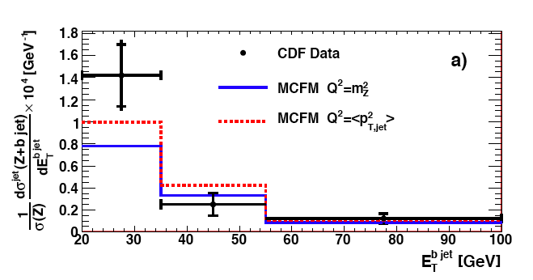
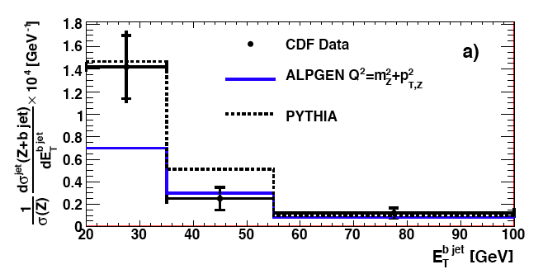
Z+b-jets Production
Phys. Rev. D79, 052008 (2009)
Probe the not well-known b-content of the proton
Backgrounds for SM Higgs Search (ZH→ννbb) and SUSY
Both electron and muon channels
Jets with Et > 20 GeV and |η| < 1.5
Data and theory in agreement but both
have sizable uncertainties (No complete NLO prediction for Z+bb)
Large variations between MC models
(important inputs for tuning)

Slide 27
Jet Production and Measuremnt
Calorimeter-level jets
HAD
Hadronic showers
EM showers
EM
Unfold measurements to
the hadron (particle) level
Hadron-level jets
Hadronization
Correct parton-level theory
for non-perturbative effects
(hadronization & underlying event)
Parton-level jets
Jets are collimated spray of particles
originating from parton fragmentation.
→ To be defined by an algorithm
Underlying event

Slide 28
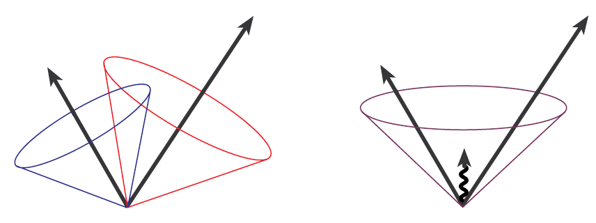
Jet “Definitions” – Jet Algorithms
Midpoint cone-based algorithm
Cluster objects based on their
proximity in y-φ space
Starting from seeds (calorimeter
towers/particles above threshold),
find stable cones
(kinematic centroid = geometric center).
Seeds necessary for speed, however source of infrared unsafety.
In recent QCD studies, we use “Midpoint” algorithm, i.e. look for stable cones from middle points between two adjacent cones
Stable cones sometime overlap
→ merge cones when p_{T} overlap > 75%
Infrared unsafety:
soft parton emission changes jet clustering
More advanced algorithm(s) available now, but negligible effects on this measurement.

Slide 29
Jet “Definitions” – Jet Algorithms
  k_{T} algorithm
  Cluster objects in order of increasing their
  relative transverse momentum (k_{T})
    until all objects become part of jets
  D parameter controls merging termination and
  characterizes size of resulting jets
  No issue of splitting/merging. Infrared and
  collinear safe to all orders of QCD.
  Every object assigned to a jet: concerns about vacuuming up too many particles.
  Successful at LEP & HERA, but relatively new at the hadron colliders
    More difficult environment (underlying event, multiple pp interactions…)

Slide 30
Inclusive Jet Cross Section
Phys. Rev. D 78, 052006 (2008)
p_{T} (GeV/c)
p_{T} (GeV/c)
Phys. Rev. Lett. 101, 062001 (2008)
Test pQCD over 8 order of magnitude in dσ²/dp_{T}dy
Highest p_{T}^{jet} > 600 GeV/c
Jet energy scale (JES) is dominant uncertainty: CDF (2-3%), D0 (1-2%)
Spectrum steeply falling: 1% JES error → 5—10% (10—25%) central (forward) x-section

Slide 31
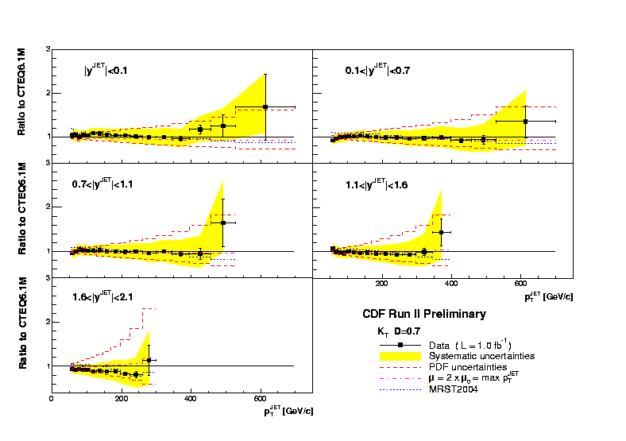
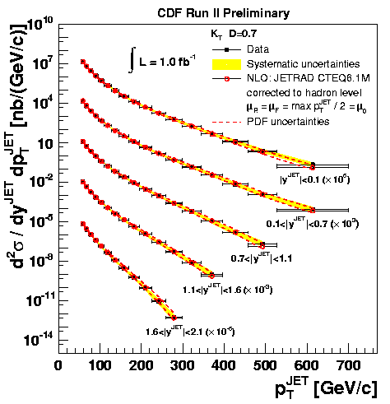
Inclusive Jets with Kt Algorithm
Data/theory comparison consistent between measurements with cone and Kt algorithms and with different D values (jet sizes)
Phys. Rev. D 75, 092006 (2007)

Slide 32
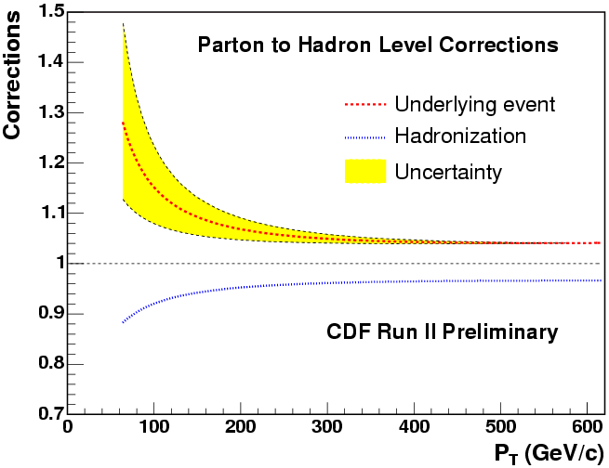
From Particle to Parton Level
use models to study effects
of non-perturbative processes
(PYTHIA, HERWIG)
hadronization correction
underlying event correction
CDF study for cone R=0.7
for central jet cross section
apply this correction to the pQCD calculation
to be used for future MSTW/CTEQ PDF results
first time consistent theoretical treatment of jet data in PDF fits
new in Run II !!!
32
Notes:
32

Slide 33
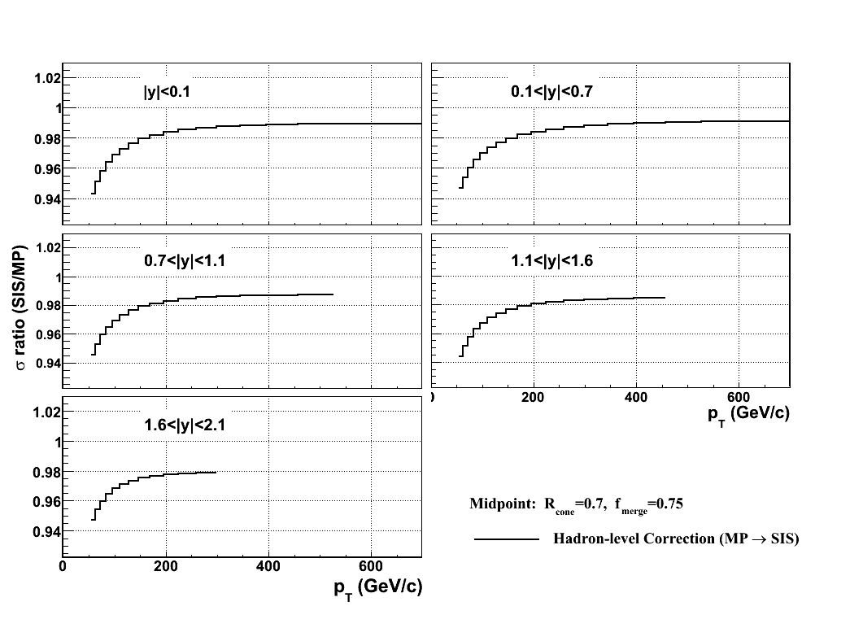
Midpoint vs SIScone: hadron level
Differences between the currently-used Midpoint algorithm and the newly developed SIScone algorithm in MC at the hadron-level.

Slide 34
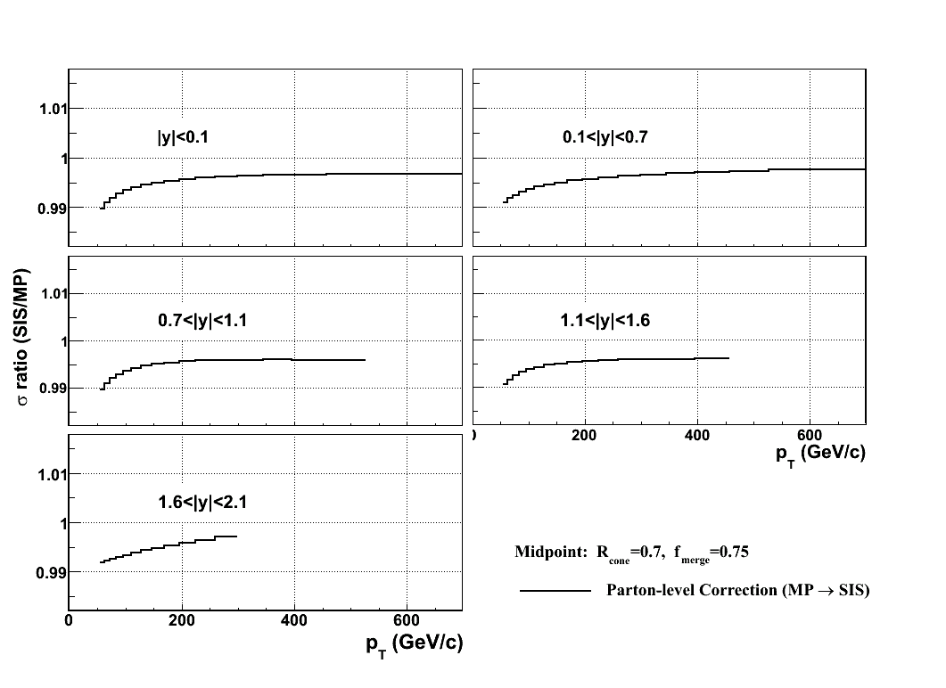
Midpoint vs SIScone: parton level
Differences between the currently-used Midpoint algorithm and the newly developed SIScone algorithm at the parton-level.
Differences < 1% → negligible effects on data-NLO comparisons

Slide 35
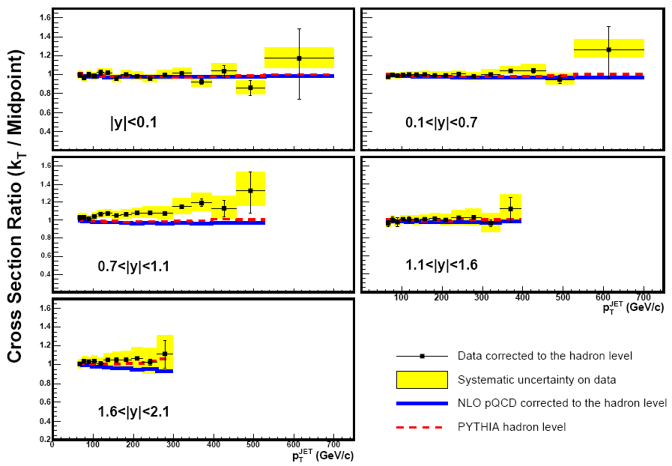
Inclusive Jets: Cone vs Kt Algorithms
Midpoint Cone Algorithm
kT Algorithm
35
Notes:
35

Slide 36
PDF with Recent Tevatron Jet Data
MSTW08: arXiv:0901.0002, Euro. Phys. J. C
CT09: Phys.Rev.D80:014019,2009.
W.r.t. MSTW 2008
W.r.t. CTEQ 6.6
Tevatron Run II data lead to softer high-x gluons (more consistent with DIS data) and help reducing uncertainties
MSTW08 does not include Tevatron Run 1 data any longer while CT09 (CTEQ TEA group) still does, which makes MSTW08 high-x even softer (consistent within uncertainty)

Slide 37
W+b-jets production
WH→lνbb search
Large bkgd for many analyses
SM Higgs (WH) production
Single top quark production
production
(See Bernd’s and Krisztian’s talks.)
Can we better understand this bkgd?
Both electron and muon channels
Jets with Et > 20 GeV and |η| < 1.5
arXiv: 0909.1505
Success of NLO QCD. Awaiting for differential measurements.

Slide 38
UE in Jet and Drell-Yan Production
jet, γ, Z
Leading jet / Z Direction
Transverse plane
Underlying Event:
everything except hard scatter
η-φ Plane
jet
DY production:
Transverse and toward regions (excluding lepton-pairs) sensitive to UE
Cleaner environment (Z/γ* carries no color)
Limited statistics
Jet production:
Transverse region sensitive to UE
High statistics jet sample
Studies in various dijet topologies

Slide 39
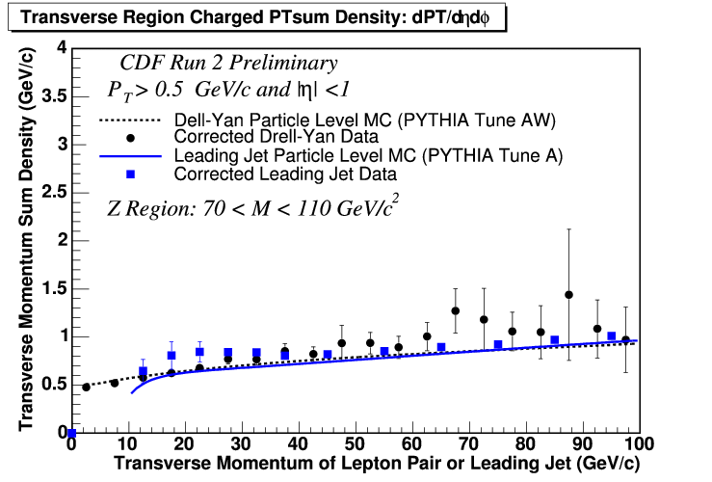
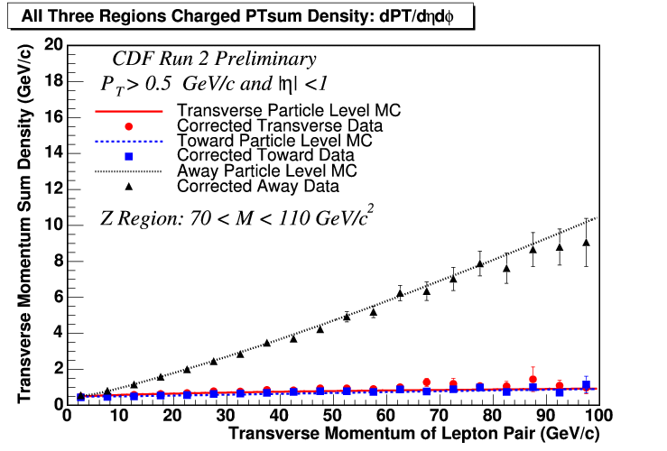
UE in DY and Jet Production
Comparisons of three regions
Away region p_{T} density goes up with lepton-pair p_{T}, while the transverse and toward region p_{T} densities are mostly flat with lepton-pair p_{T}
Comparisons between jet and DY
Similar trend in jet and DY events: UE universality?
Tuned Pythia describe data reasonably well.
There are many more plots for UE in jet and Drell-Yan production corrected
to hadron level: Very important for MC generator tuning/development

Slide 40
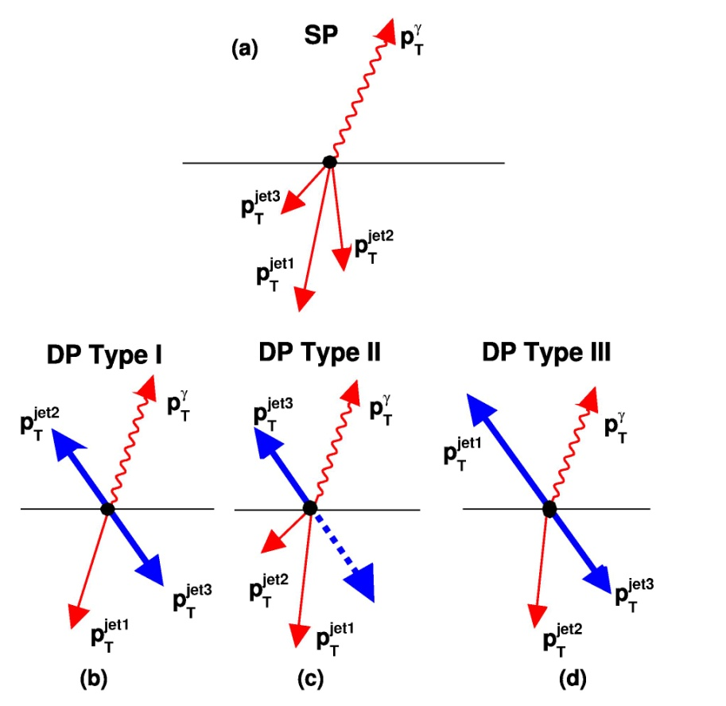
Double Parton using γ+3 Jets
σ_{DP} = σ_{γj} σ_{jj}/σ_{eff}
σ_{eff} : effective interaction region
(Large σ_{eff}: partons more uniformly distributed)
Main background
Study interactions of two parton pairs in single proton:
  Insight to parton spatial distributions in the proton
  Background to other process especially at high luminosities
signal
Notes:
40

Slide 41
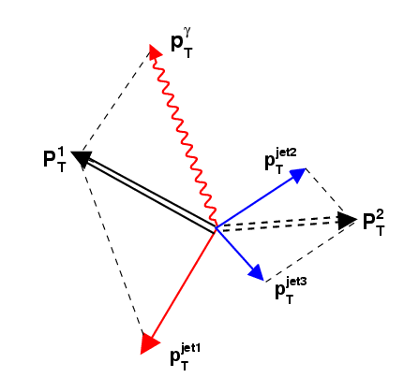
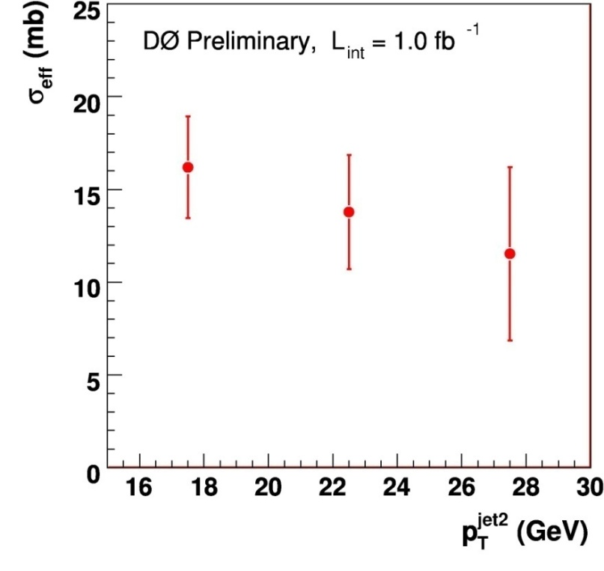
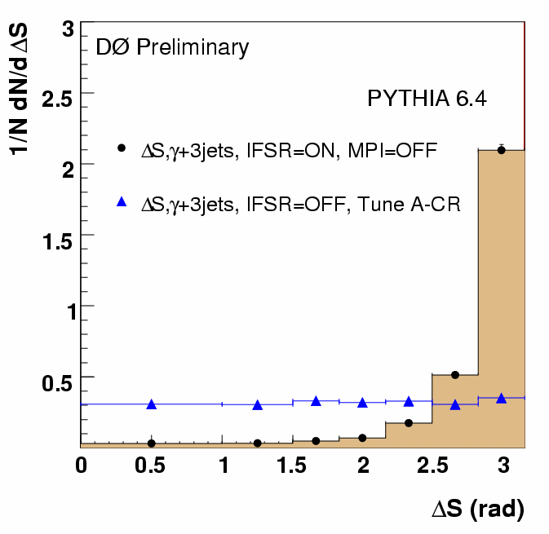
Double Parton Scattering
Calculated for the pair that gives
the minimum value of S:
D0 Note 5910
σ_{eff} = 15.1±1.9 mb
(consistent with previous CDF results.)

