Slide 1
RIRE ☺
Reliability Requirements and Initial Risk Estimation at the example of the quadrupole QPS
RASWG meeting - 28.06.2018
Miriam Blumenschein

Slide 2
RIRE - Principle
Adapted FMEA
Reliability Requirements
Reliability goals
The SPS must not cause damage of the dump block more often than 1 per 100 years
Initial Risk Estimation
Which system parts need to be studied further

Slide 4
Powering magnets and Interlock for 1 sector (out of 8)
BIS
SC equipment to be protected
Beam dump request
PC_DISCHARGE_REQUEST
PIC
DISCHARGE_REQUEST
Quench Protection
PC_FAST_ABORT
CIRCUIT_QUENCH
Quench Loop Controller DQQLC
RQF circuit
Power converter
Power converter
Quench Interlock Loop QIL
RQD circuit
open, read
open, read
Circuit quench loop
Energy Extraction System
open
open
open
open
Discharge loop
DQGPU-D
DQLPU_ B
DQLPU_ B
DQLPU_ B
Resistor
FPA Open/ Close
1/2 DQLPU_S
1/2 DQLPU_S
1/2 DQLPU_S
Quench Interlock Loop
Switch
Resistor
EE RQD
EE RQF
Switch
open
open
open
DQHDS
DQHDS
DQHDS
DQHDS
DQHDS
DQHDS
Current lead
Diode
Diode
Diode
Current lead
Beam 2
Odd point
MQF 1
MQD 2
MQF 47/51
Even point
Current lead
Quench heater
Quench heater
Quench heater
Current lead
Beam 1
MQD 1
MQF 2
MQD 47/51
Diode
Diode
Diode
Upgrade in LS2: DQLPU_B
Quadrupole MQ 1
MBA
MBB
MBC
Quadrupole MQ 2
Quadrupole MQ 47/51

Slide 5
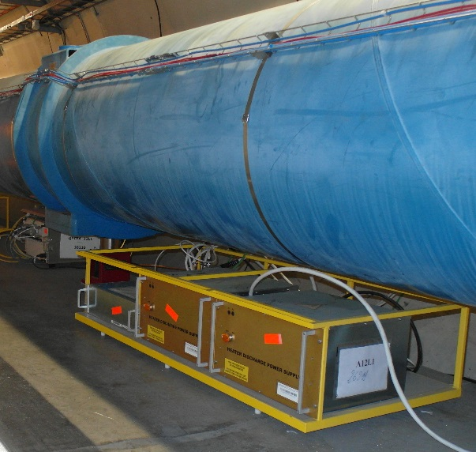
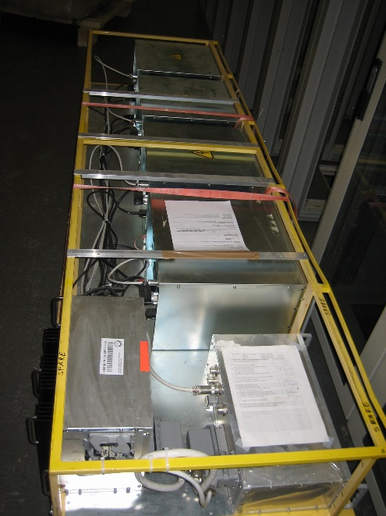
System structure: Quench Protection System Quadrupoles, one sector
  Quench Detection QD
    DYPQ Yellow Protection rack Quadrupole, n = 47/51 (one per Quadrupole)
    DYPB-S Yellow Protection rack type B (Dipole) S-variation, n = 54/ 55 (1 per 4 magnets)
    DYPG
  Energy extraction EE, n = 1
  Quench heater, n = 2 * 47/ 51
  Bypass diode, n = 47/ 51
DYPQ rack, under C dipoles
DYPB-S rack, under B dipoles
  System
    Rack

Slide 6
DYPQ input and output
DQHDS interlock
QPS_OK
DYPQ
Software link
WinCC supervision
Expert tool
MQF + MQD
Reset, simple commands
Reset, change configuration
Voltage tap int_B
Interlock IN
Interlock OUT
Voltage tap int_A
Voltage tap ext_A
Logging, PM
Voltage tap ext_B
Logging
UPS 1
DQHDS trigger
DYPB-S
UPS 2
MQF
MQD

Slide 7
DYPQ functions
DYPQ function
Symmetric quench ~0.5 s
Open QIL once Quench is asymmetric enough (~50ms)
Discharge DQHDS (by DYPB-S)
Set QPS_OK to false
Send logging data
Record post mortem
HDS SI: Do not interlock
Keep QIL opened locally
Keep DQHDS latched
Keep QPS_OK set to false
Send logging data
Record post mortem data
HDS SI: Do not interlock
Keep QIL opened locally
Keep DQHDS latched
Keep QPS_OK set to false
Send post mortem
HDS SI: Do not interlock
Keep QIL opened locally
Keep DQHDS latched
Keep QPS_OK set to false
Send logging data
HDS SI: Do not interlock
Keep QIL closed
Keep DQHDS charged
Keep QPS_OK set to true
Send logging data
HDS SI: Do not interlock
Post quench I
(trigger latched) ~5-10 min
Operator state ~ [h]
Asymmetric quench ~0.5 s
DYPQ sends
post mortem data ~ 15 min
Post mortem analysis by MP3
Open QIL locally
Discharge DQHDS
Set QPS_OK to false
Send logging data
Record post mortem
HDS SI: Do not interlock
Normal
operation of QPS
~4800 h/a
Post mortem data analysis finished
DQHDS off/ on manually
End normal op.
OK: Reset detection board/ power cycle
< 1 min
MP3 decision
acc signatures complete
Post quench II
(trigger unlatched)
~10 min
Commissioning without heaters
Capacitor bank charged (810 V)
Open, then close QIL locally
Charge DQHDS
Keep QPS_OK set to false
Reset post mortem buffer
HDS SI: Do not interlock
Revalidation OK
not OK
Keep QIL closed
Charge DQHDS
Keep QPS_OK set to false
Send logging data
HDS SI: Do not interlock
Keep QIL closed
Keep DQHDS charged
Set QPS_OK to true
Send configuration data
HDS SI: Do not interlock
Maintenance, repair, tests
Depends on tests
Commissioning with heaters
Depends on tests
Depends on tests

Slide 8
Schematic diagram, not true to scale
Δ Voltage quadrupole
t_{Energy extracted} = 50 s
Symmetric or asymmetric quench:
Starts when quench is detected
Ends when heaters are discharged
Post quench I:
10 s Post mortem recording
~ 5 min waiting to be able to send logging data
13 kA
RQD/ RQF current
t_{Heater effective} = t_{EE effective} 20 ms
t_{Evaluation} = 10 ms
t_{Heater discharged} = 400 ms
t_{Loop} _{Relay} = 10 ms
900 V
DQHDS voltage
t₀ = t_{Q detected}
100 mV
Normal operation
~4800 h/year
A/S Quench
~0.5 s
Post quench I
~5-10 min

Slide 9
2.1 DYPQ states and transitions
CCC function
MP3 function
Symmetric quench
Check automatically analysed post mortem data
Record results in table
Post quench I
(trigger latched)
Operator state
Asymmetric quench
DYPQ sends
post mortem data
Post mortem analysis by MP3
Check WinCC
Normal operation of QPS
Post mortem data analysis finished
DQHDS off/ on manually
End normal op.
OK: Reset detection board/ power cycle
MP3 decision
acc signatures complete
Post quench II
(trigger unlatched)
Commissioning without heaters
Capacitor bank charged (810 V)
Communicate results to CCC
not OK
Revalidation OK
Perform tests
Maintenance, repair, tests
Commissioning with heaters
Perform tests
Reset by CCC without MP3 agreement?
Perform tests

Slide 11
Next slide
  Quench protection system
    Quench Detection QD
      DYPQ Yellow Protection rack Quadrupole
      DYPB-S Yellow Protection rack type B (Dipole) S-variation
      DYPG
    Energy extraction EE, n = 1
    Quench heater, n = 2 * 47/ 51
    (Bypass diode, n = 47/ 51)
    Circuit quench interlock
  Quadrupole
  Beam operation (beam dump, injection)
FE
EE

Slide 12
Qualitative severity classification for end effects
Severity level |  | Consequence
5 | Catastrophic: Unsafe/ accident | Serious damage of the system and its environment. System inoperable. Immediate maintenance necessary
4 | Critical: Degraded unacceptable II | No damage or minor damage of the system and its environment. Immediate maintenance
3 | Major: Degraded unacceptable I | No damage Maintenance before the next machine cycle
2 | Moderate: Degraded acceptable | No damage Maintenance at the next technical stop
1 | Low: Availability | No damage, no impact on (beam) operation Maintenance at the next technical stop if time
Based on:
IEC 60812, table 2
MIL-HDBK-338B: table 7.8-3
Verband der Automobilindustrie (2000) VDA 3 Teil 1 Qualitätsmanagement in der Automobilindustrie – Zuverlässigkeitssicherung bei Automobilherstellern und Lieferanten – Zuverlässigkeitsmanagement. 3.Aufl, Frankfurt

Slide 13
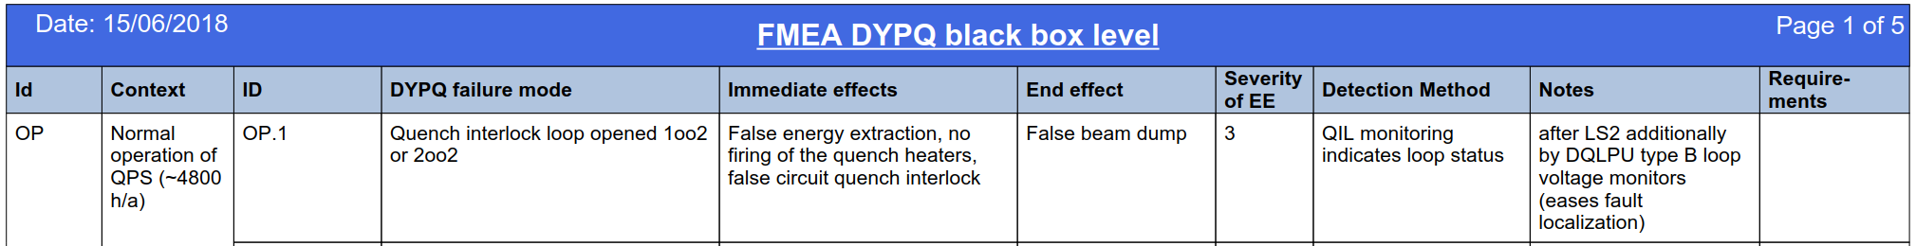
Excerpt of the FMEA report

Slide 14
DYPQ failure effects = failure modes of quadrupole and beam operation
  Quench protection system
    Quench Detection QD
      DYPQ Yellow Protection rack Quadrupole
  Quadrupole
    DYPQ_EE1: False heating, S3
    DYPQ_EE2: Quadrupole damaged, S5
  Beam operation (beam dump, injection)
    DYPQ_EE3: Injection delayed, S3
    DYPQ_EE4: False beam dump, S3
    DYPQ_EE5: Missed beam dump by DYPQ, beam dump by another protection system, S4
    DYPQ_EE6: Missed beam dump, S5

Slide 16
To be discussed !!!!
Consequences |  | Catastrophic | Critical | Major | Moderate | Low
 | Downtime | 3 month | 3 weeks | 3 days | 3 hours | 3 mins
Very frequent | 1/day
Frequent | 1/week
Probable | 1/month
Occasional | 1/year
Remote | 1/ 10 year |  |  | DYPQ_EE1, EE3, EE4,
Improbable | 1/100 years |  | DYPQ_EE5
Not credible | 1/1000 years | DYPQ_EE2 DYPQ_EE6
Frequency
  Quadrupole
    DYPQ_EE1: False heating, S3
    DYPQ_EE2: Quadrupole damaged, S5
  Beam operation (beam dump, injection)
    DYPQ_EE3: Injection delayed, S3
    DYPQ_EE4: False beam dump, S3
    DYPQ_EE5: Missed beam dump by DYPQ, beam dump by another protection system, S4
    DYPQ_EE6: Missed beam dump, S5

Slide 17
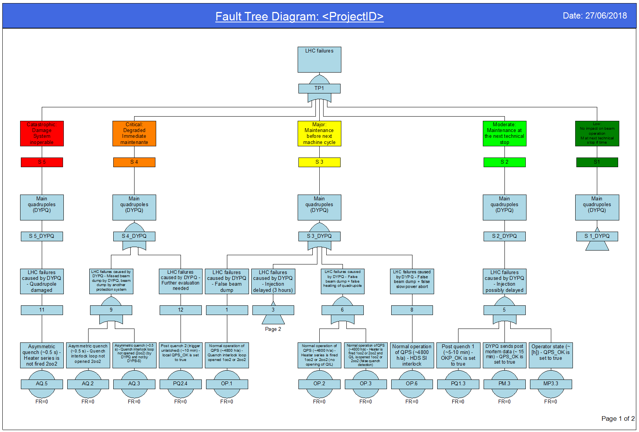

Slide 18
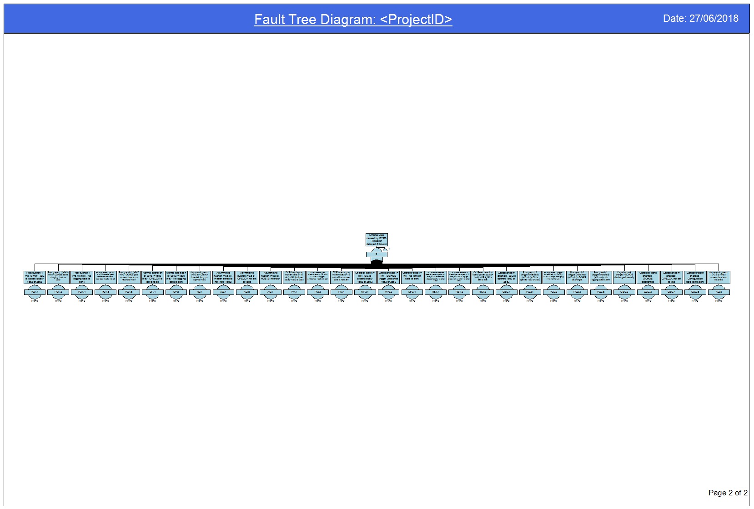

Slide 19
Risk estimation: what needs to be studied further?
FM which are in category 4, 5 or undetectable
Detailed study of the trigger link

Slide 20
Next steps: extend the fault tree sideward and downward
  Quench Detection QD
    DYPQ Yellow Protection rack Quadrupole, n = 47/51 (one per Quadrupole)
      DQLPU-B Local Protection Unit type B (iQPS) n = 1
        DQQDL Quench Detection Local, n = 4 (2 focusing, 2 defocusing)
        DQAMC Acquisition and Monitoring Controller, n = 1
        DQCSU Controller and Supervision Unit, n=1
      DQHDS Heaters Discharge power Supply, n = 2
      DQLIM, n = 1
    DYPB-S Yellow Protection rack type B (Dipole) S-variation, n = 54/ 55 (1 per 4 magnets)
      DQLPU-S Local Protection Unit type S (nQPS), n = 1
        DQQDS Quench Detector Symmetric, n = 4
        DQQBS Bus – bar Splice detector, n = 5
        DQQDE Quench Detector voltage to Earth, n = 3
        DQAMGS Acquisition and Monitoring crate controller G S, n = 1
      DQLPU-A Local Protection Unit type A (asymmetric quenches on dipoles)
      DQLIM Local protection Interface module (PS for DQLPU-A), n=1
      Power Pack for DQLPUS, n = 2
      DQHDS Heaters Discharge power Supply (Dipole), n = 4
    DYPG
      DQGPU-D Global Protection Unit type D, crate
        DQQDC Quench Detector Current leads, n = 4
        DQQDB Quench Detector main Busbar, n= 2
        DQAMG Acquisition and Monitoring crate controller, n = 1
  Energy extraction EE, n = 1
  Quench heater, n = 2 * 47/ 51
  Bypass diode, n = 47/ 51
DYPQ rack, under C dipoles
DYPB-S rack, under B dipoles
  System
    Rack
      Crate
        Board

Slide 21
Conclusions
RIRE provides a framework for the experience based derivation of quantitative reliability targets: system reliability requirements are derived from accelerator requirement
RIRE shows the risks posed by a system
RIRE prioritizes subsequent, more detailed analyses
RIRE works for systems with context dependant functions
System failures are visualised as Fault Tree model which can be extended sideward (more systems) and downwards (more details)

Slide 22
Thank you for your attention ☺

Slide 23
Environment variables
2.1 DYPQ states and transitions
Beam: false
RQD/ RQF energy: false
Beam: false
RQD/ RQF energy: false or true
Beam: false or true
RQD/ RQF energy: false or true
Symmetric quench in quadrupole
Transition
Initiator
Post quench I
(trigger latched)
Operator state
Asymmetric quench in quadrupole
Send post mortem data
Post mortem analysis by MP3
Normal operation of QPS
Post mortem data analysis finished
MP3 decision
DQHDS switched off/ on manually
Capacitor bank charged (810 V)
OK: Reset detection board/ power cycle
Post quench II
(trigger unlatched)
not OK
Revalidation OK
Maintenance, repair, tests
Commissioning without heaters
Commissioning with heaters

Slide 24
1. Block diagram: Details DYPQ rack
DQLPU_ B
1/2 DQLPU_S
DQHDS
DQHDS
Quench heater
DQHDS interlock
Interlock IN
Interlock OUT
Voltage tap ext_A
Voltage tap ext_B
QPS_OK
Information
Voltage tap int_A
Voltage tap int_B
UPS 1
UPS 2
DQLIM
DQAMC
Power Pack A
Power Pack B
DQQDL RQF+D A
DQQDL RQF+D B
DQLPR 1
UPS 1
3
Trigger supply coupling on motherboard
DQLPR 2
DQLPU-B
DQQDS A
DQQDS B
UPS 2
3
Trigger coupling on motherboard
Trigger coupling on motherboard
Burndy board
DQCSU
U(I)
Power supply
Supervision
DQCLT 1
DQCLT 2
DQHDS 1
DQHDS 2
Trigger line
DQHDS 1
U(U)
DQHDS
DYPB-S
Trigger line
DQHDS 2
Trigger line
DQHDS 1+2
MQF
MQD
DYPQ
QPS_OK

Slide 25
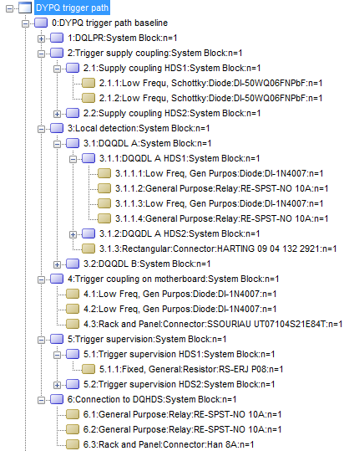
The baseline system failure rate estimated with 217Plus is 5700 FIT which corresponds to an MTTF of 0.0001754 Ghrs or 36.54 LHC operation years.

Slide 27
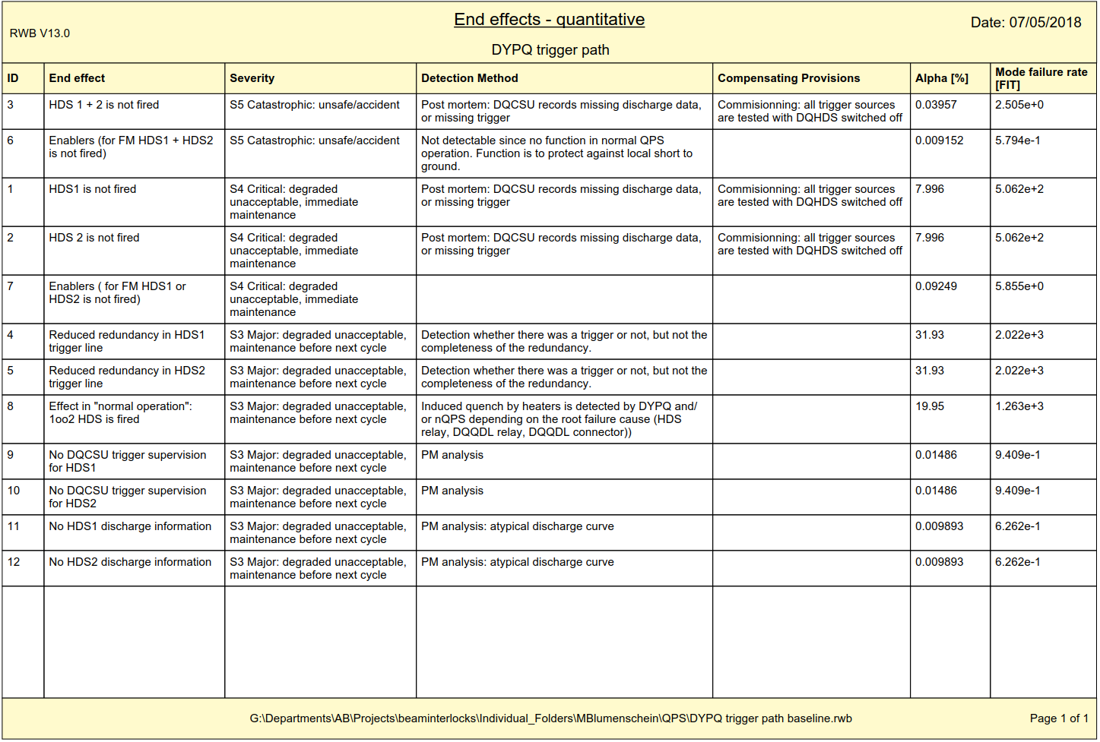

Slide 28
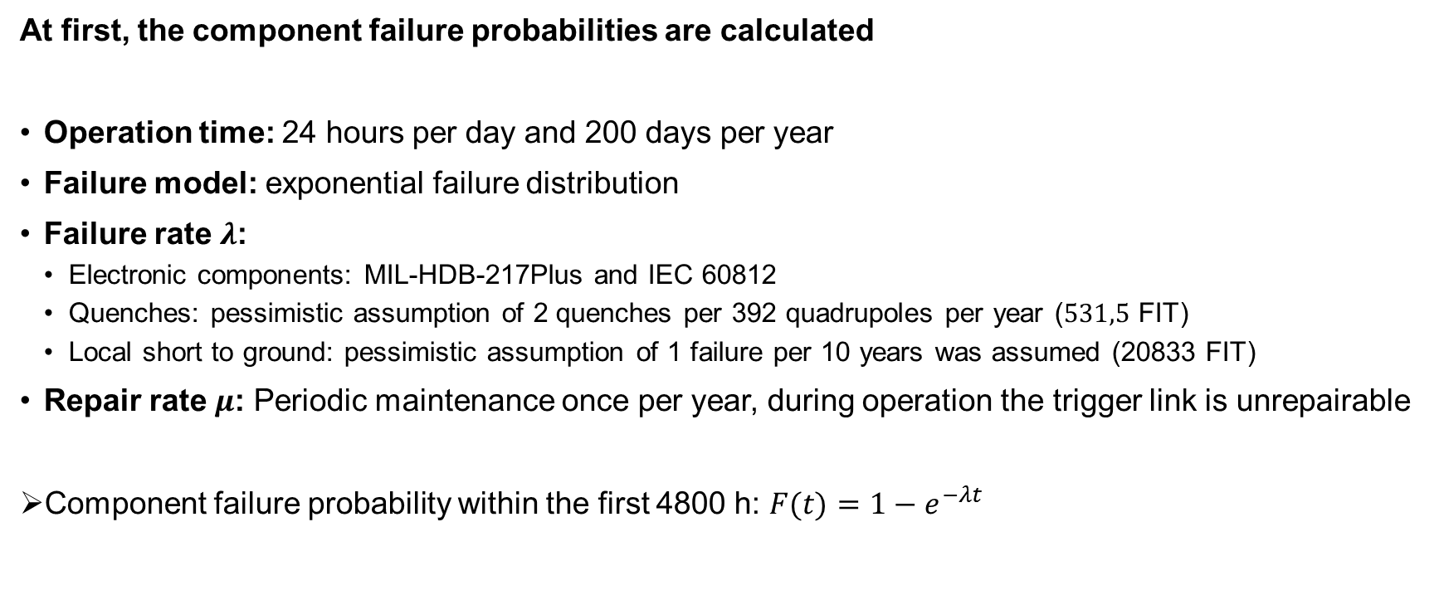
Component failure probabilities
At first, the component failure probabilities are calculated
Operation time: 24 hours per day and 200 days per year
Failure model: exponential failure distribution
Failure rate $λ$:
  Electronic components: MIL-HDB-217Plus and IEC 60812
  Quenches: pessimistic assumption of 2 quenches per 392 quadrupoles per year ($531,5$ FIT)
  Local short to ground: pessimistic assumption of 1 failure per 10 years was assumed (20833 FIT)
Repair rate $μ$: Periodic maintenance once per year, during operation the trigger link is unrepairable
Component failure probability within the first 4800 h: $F(t)$ $=1−e^{−λt}$

Slide 29
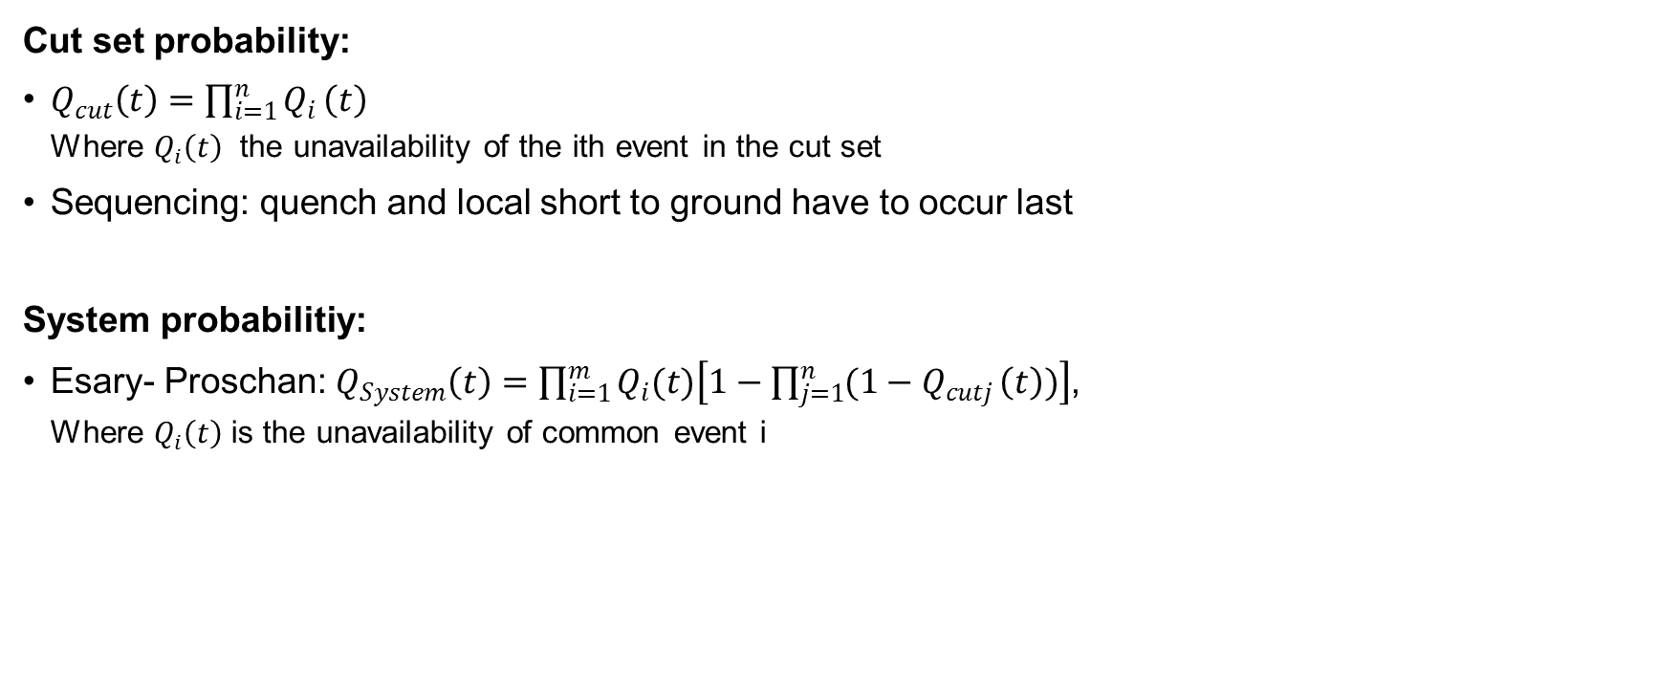
Cut set and system probabilities
Cut set probability:
$Q_{cut}\left(t\right)=\prod_{i=1}^{n}{Q_{i}}\left(t\right)$
  Where $Q_{i}\left(t\right)$ the unavailability of the ith event in the cut set
Sequencing: quench and local short to ground have to occur last
System probabilitiy:
Esary- Proschan: $Q_{System}\left(t\right)=\prod_{i=1}^{m}{Q_{i}(t)\left[1−\prod_{j=1}^{n}{{(1−Q}_{cutj}}\left(t\right))\right]}$,
  Where $Q_{i}\left(t\right)$is the unavailability of common event i

Slide 30

Cut set and system probabilities
The reliability function with periodic maintenance is:
$$R_{PM}\left(t\right)={R(T_{PM})}^{k}∗R({t−T}_{PM})$$
Calculated with Isograph

Slide 31
Results – top event
The probability that for one out of 392 quadrupoles no (0oo2) heater is fired within 100 years is 0.1 %.

Slide 32

Results – Cut set importance
Fussell-Vesely importance
$I_{cutj}^{FV}(t) =\frac{F_{j}(t)}{F_{System}(t)}$

