Slide 1
Update on K-modulation beta-beat measurements
Alexander Huschauer, Frank Tecker
with many thanks to the OP crew for the support!
Introduction
Measurement results
Comparison to MAD-X

Slide 2

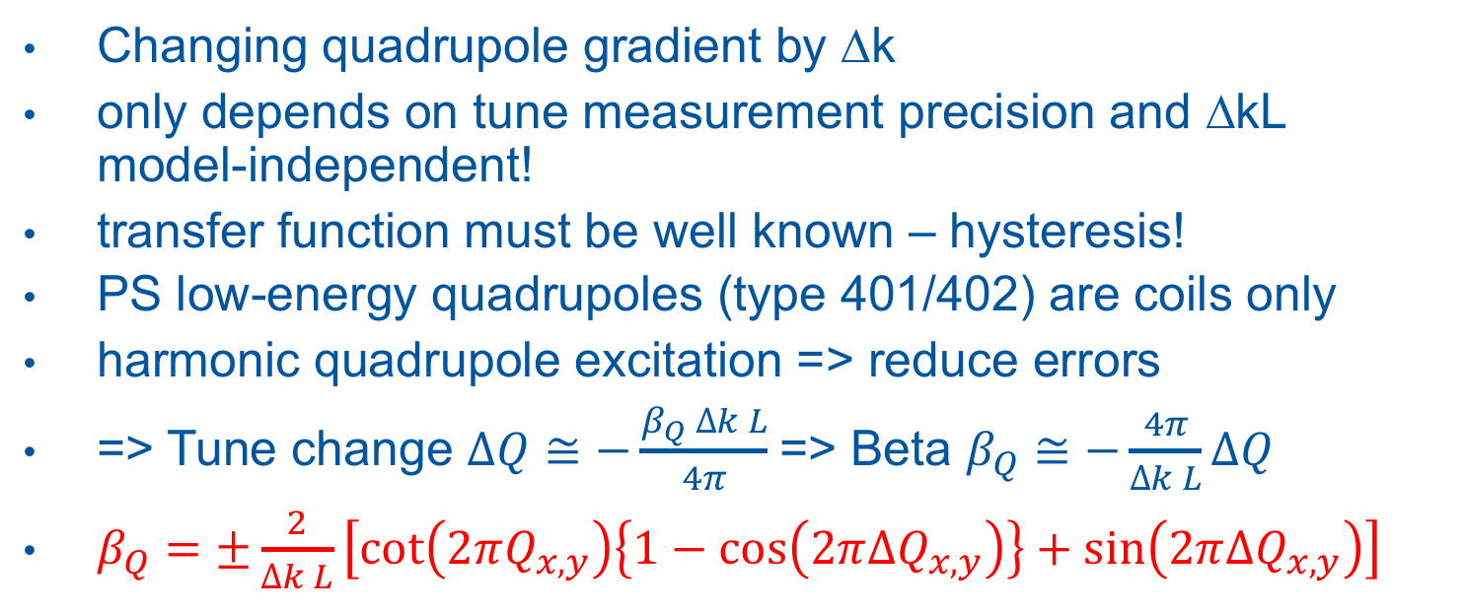
Introduction
Changing quadrupole gradient by ∆k
only depends on tune measurement precision and ∆kL
model-independent!
transfer function must be well known – hysteresis!
PS low-energy quadrupoles (type 401/402) are coils only
harmonic quadrupole excitation => reduce errors
=> Tune change $∆Q≅−\frac{β_{Q} ∆k L}{4π}$=> Beta $β_{Q}≅−\frac{4π}{∆k L}∆Q$
$β_{Q}=±\frac{2}{∆k L}\left[\cot\left(2πQ_{x,y}\right)\left\{1−\cos\left(2π{ΔQ}_{x,y}\right)\right\}+\sin\left(2π{ΔQ}_{x,y}\right)\right]$

Slide 3
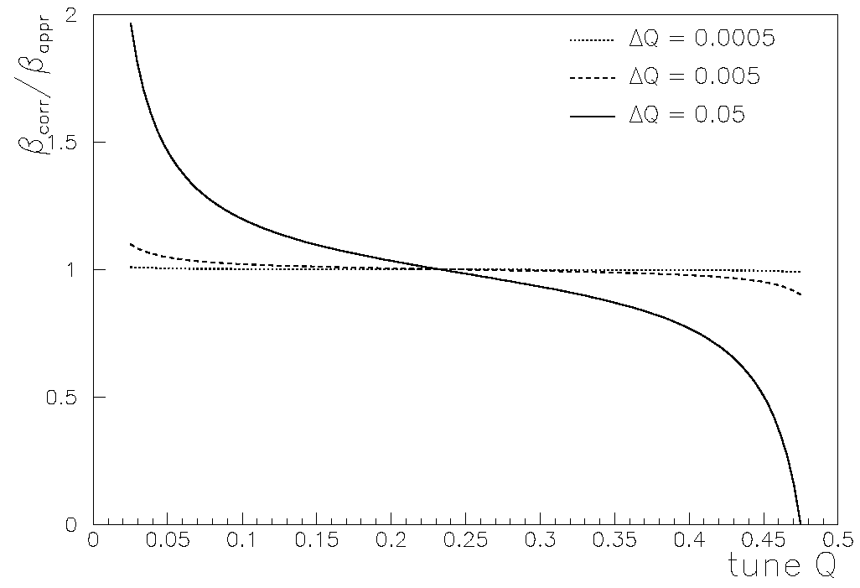
Approximation error
Difference depends on tune and excitation amplitude
Was in the range 0.2-2% for presented data from last year
F. Zimmermann

Slide 4
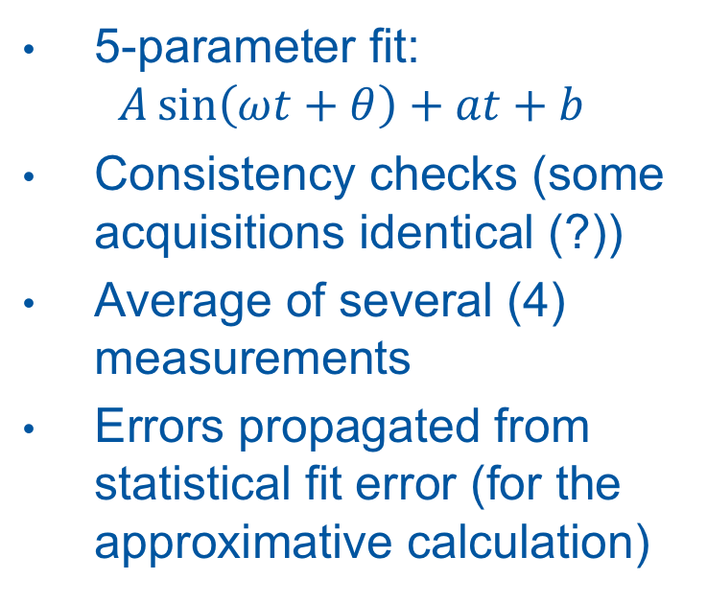
Analysis
Horizontal fit results
5-parameter fit:
$A\sin\left(ωt+θ\right)+at+b$
Consistency checks (some acquisitions identical (?))
Average of several (4) measurements
Errors propagated from statistical fit error (for the approximative calculation)
QF
QD

Slide 5
Beta-beating measured (6.19/6.22)

Slide 6
Beta-beating measured (6.19/6.22)
Some locations with large beating
Maybe off-centre in quad
=> orbit changes and sextupole feed-down also changes tune ?

Slide 7
Beta-beating measured HOR (6.19/6.22)
amplitude X: 0.07

Slide 8
Beta-beating measured VERT (6.19/6.22)
amplitude X: 0.08

Slide 9
Beta-beating measured H/V (6.19/6.22)
meanX=0.9992 meanY=1.0005
=> Magnet calibration errors small
amplitude X/Y: 0.07/0.08

Slide 10
Conclusion
analysis with approximation has 1-2% error
Residual beating of ~5% in both planes measured
Measured beating shows some outliers
orbit changes and sextupole feed-down also changes tune ?
Orbit measurement to be included
Interesting to measure:
at 6.21/6.24 / bare machine / low chroma

Slide 11
Spares

Slide 12
Beta-beating measured HOR (6.19/6.22)
amplitude X: 0.04

Slide 13
Beta-beating measured VERT (6.19/6.22)
amplitude X: 0.08

Slide 14
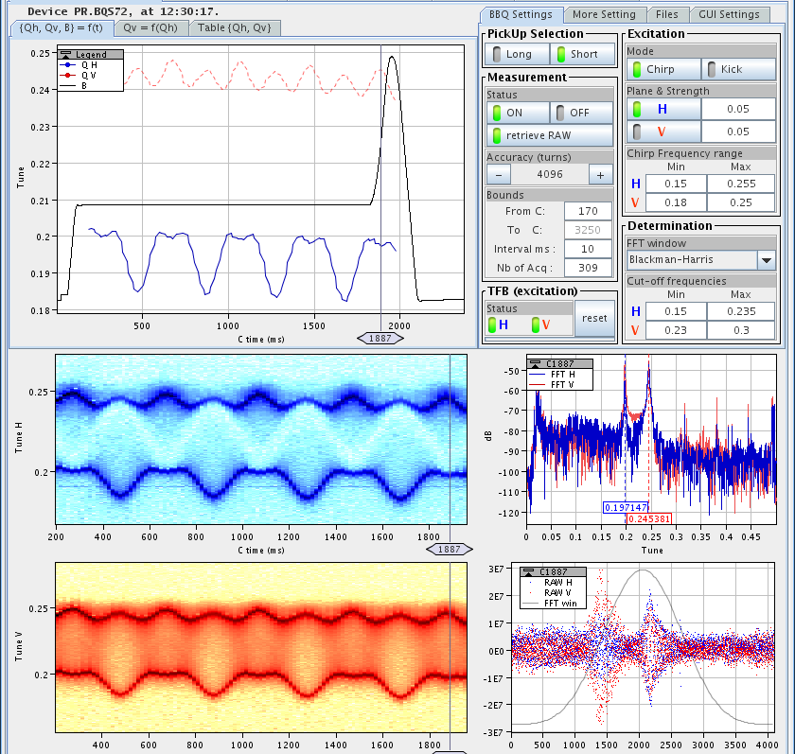
First try
expected sine tune variation
cropped sine due to strong coupling
skew quads used to decouple the planes
good sensitivity for decoupling

Slide 15
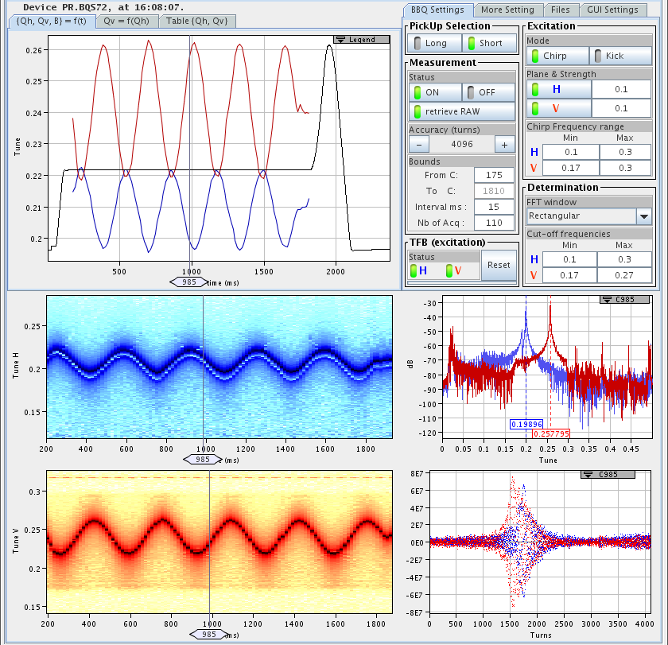
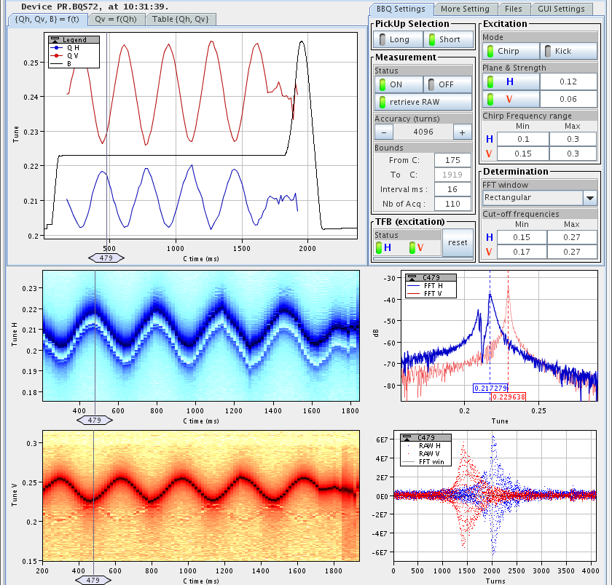
Uncoupled!
PR.QSKODD/EVEN 0.40 / -0.38 A
sinusoidal tune variation
excitation amplitude reduced
2 campaigns: QFN/QDN, QFW/QDW
Tunes H 6.21 / V 6.24

Slide 16
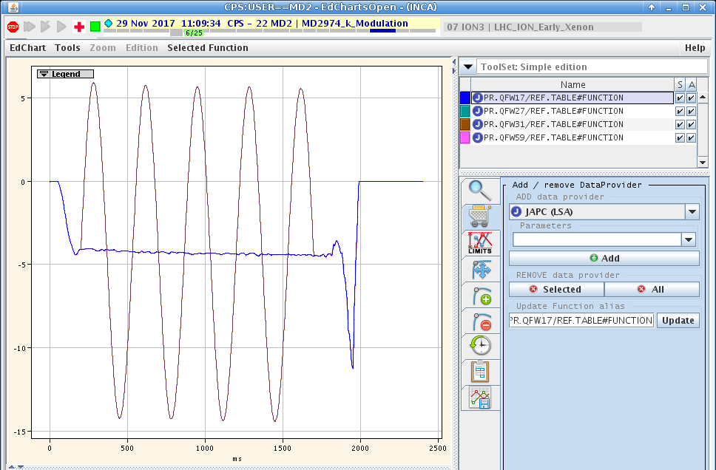
Quadrupole excitation
cycle with long injection flat bottom
tunes flattened
sine function added to individual quadrupoles

Slide 17
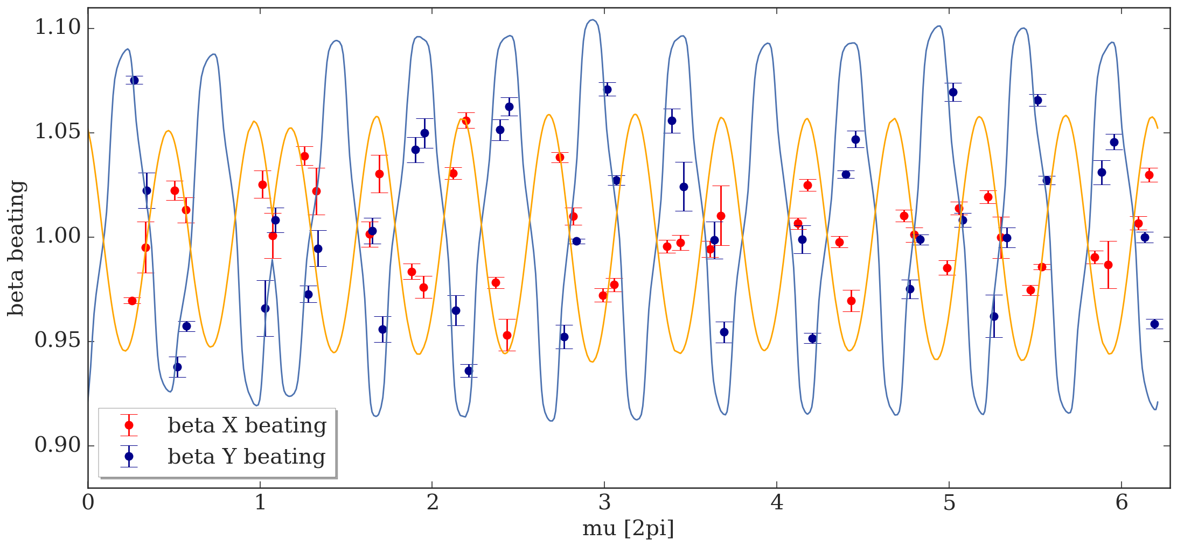
Beta-beating measured 2017 (vs. 6.21/6.24 nom.)

