Slide 1






Beam measurements of longitudinal impedance
H. Damerau, A. Lasheen, M. Migliorati
LIU - LHC Injectors Upgrade Project

Slide 2
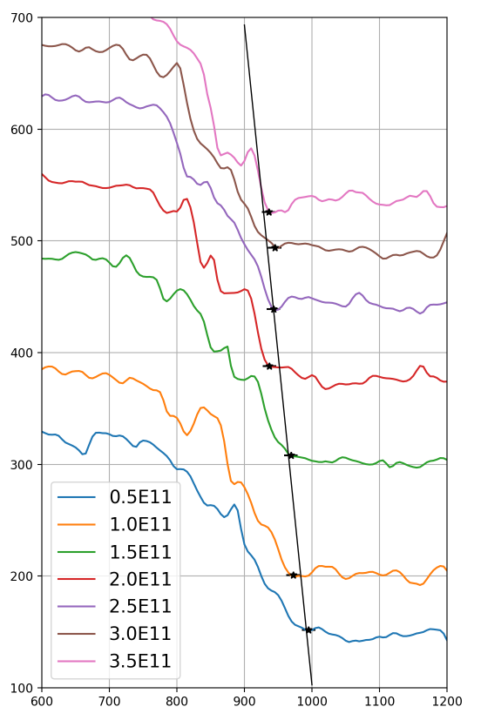
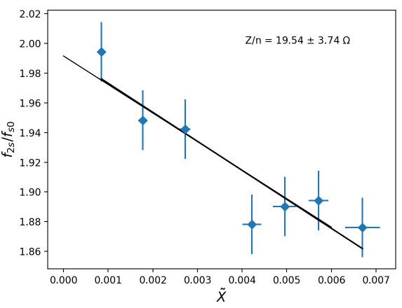
MD of 29/5/2018 on quadrupolar BTF
Quadrupolar BTF obtained by averaging 10 measurements directly with the network analyzer at each intensity.
Bunch length and intensity were also averaged during the 10 shots.
Signal phase (deg)
NB: V_{RF} = 84 kV
f (Hz)

Slide 3
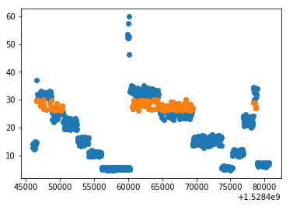
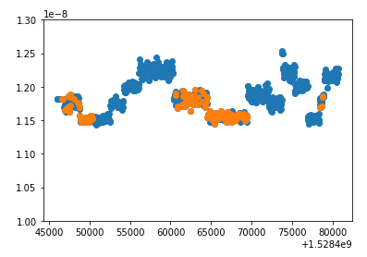
MD of 8/6/2018 on quadrupolar BTF
We tried an automatic acquisition of the data over a large time interval. This allowed to gather as much data as possible to improve the statistics.
For the data analysis, we divided the measurements into given intensity intervals.
Np (1e10)
total bunch length (s)
time
time

Slide 4
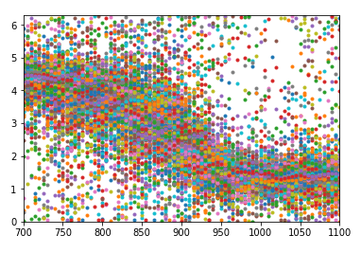
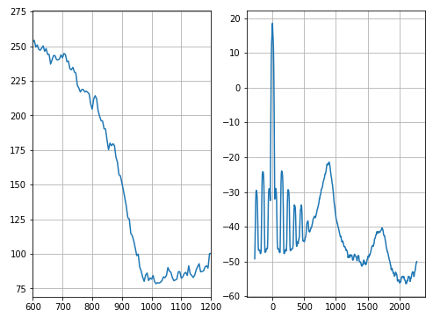
MD of 8/6/2018 on quadrupolar BTF
The BTF signal of a single acquisition is not very clean. The averaging of the data of the network analyzer was done in post-processing.
Signal phase (rad)
f (Hz)
f (Hz)
f (Hz)

Slide 5
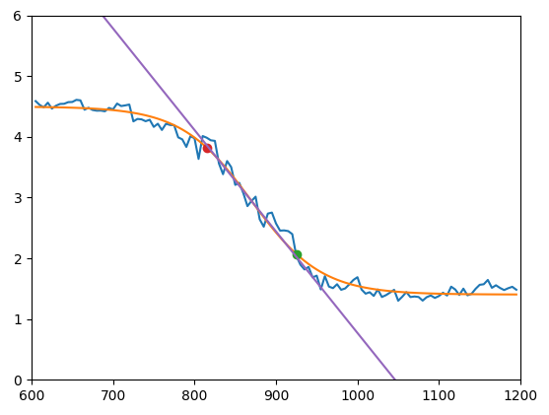
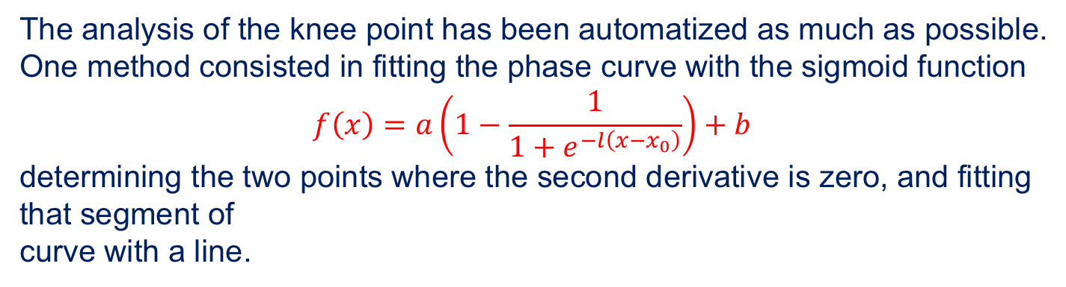
MD of 8/6/2018 on quadrupolar BTF
The analysis of the knee point has been automatized as much as possible.
One method consisted in fitting the phase curve with the sigmoid function
$$f\left(x\right)=a\left(1−\frac{1}{1+e^{−l\left(x−x_{0}\right)}}\right)+b$$
determining the two points where the second derivative is zero, and fitting that segment of
curve with a line.
Signal phase (rad)
f (Hz)

Slide 6
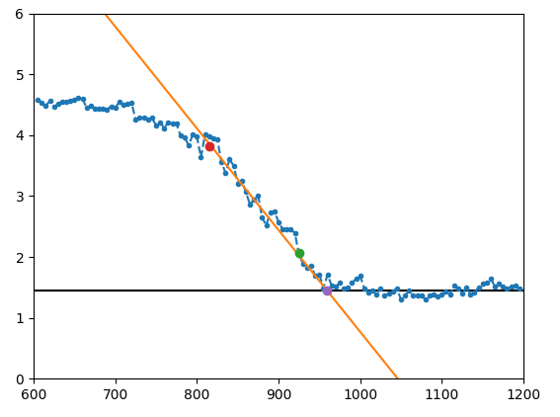
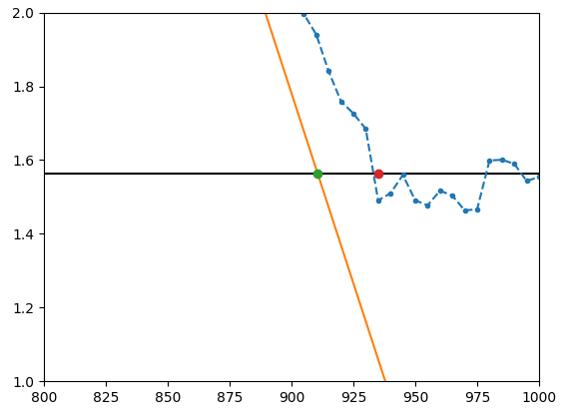
MD of 8/6/2018 on quadrupolar BTF
We then considered the interception of this line with the horizontal line obtained as average of the bottom flat plateau.
As a second criterion we considered as knee the last point below the horizontal line.
In some cases we had to remove manually some bad cases.
phase (rad)
phase (rad)
f (Hz)
f (Hz)

Slide 7
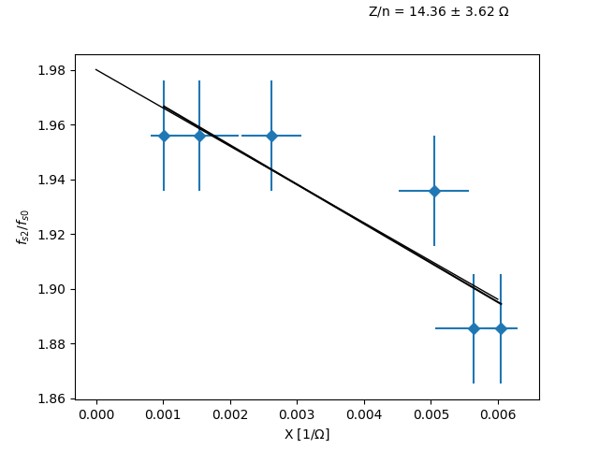
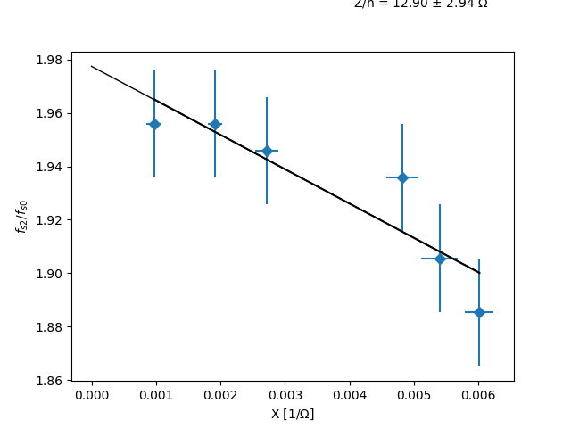
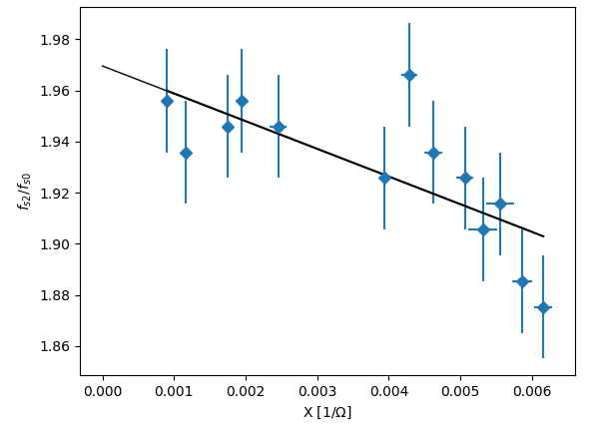
MD of 8/6/2018 on quadrupolar BTF
By changing the width of the intensity interval, we can average over more or less data.
Even if the interval of frequency shift is comparable with that of 29/5, in all cases the impedance Z/n is quite lower, between 10.8 Ω and 14.4 Ω . The problem is due to the ‘plateau’ at low intensities.
Very large interval
Large interval
Small interval

Slide 8
MD of 8/6/2018 on quadrupolar BTF
By changing the width of the intensity interval, we can average over more or less data.
Even if the interval of frequency shift is comparable with that of 29/5, in all cases the impedance Z/n is quite lower, between 10.8 Ω and 14.4 Ω . The problem is due to the ‘plateau’ at low intensities.
Very large interval
Large interval
Small interval

Slide 9
MD of 29/5/2018 on resistive impedance with 2 bunches
The measurements of the synchronous phase shift as a function of bunch intensity were performed by using two bunches, one with fixed intensity, and the other one with varying intensity.
The beam signal from the WCM was sent into a 14 bit 400 MS/s digitizer.
In this way it is possible to record the signal of the two bunches and measure directly the time distance between the two.
Also in this case we tried to automatize the acquisition.

Slide 10
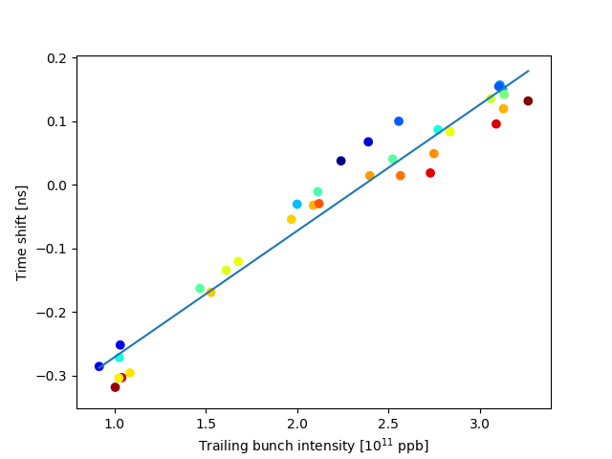
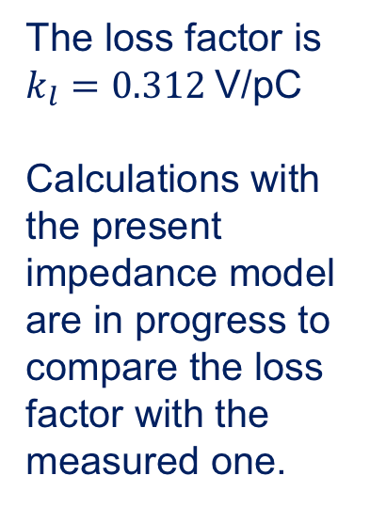
MD of 29/5/2018 on resistive impedance with 2 bunches
The loss factor is $k_{l}=0.312$V/pC
Calculations with the present impedance model are in progress to compare the loss factor with the measured one.

Slide 11
Conclusions
The procedures to perform in an automatic way the measurements and data analysis allow to have more data and better statistics.
For both kinds of measurements (quadrupolar BTF and synchrotron phase shift) we started to develop scripts for automatic acquisition and analysis.
The data analysis in particular still needs some improvements, and there are some points that necessitate further investigation.
Discussions are in progress.

