Slide 1
Updates on KFA45 post-pulse measurement
E.Senes, V.Forte, M.Fraser, F.Tecker,

Slide 2
Updates on KFA45 post-pulse measurement
4 modules
295 kV
Optimal fine start delay found from precedent beam-based measurements
Now stepping the kicker voltage in
15 kV steps, the RMS orbit can be computed

Slide 3
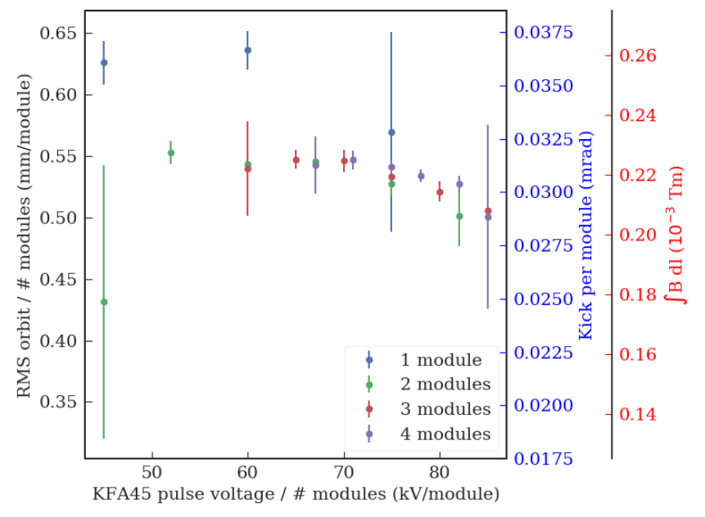
Post-pulse scaling ?
Post pulse scales linearly with the number of modules pulsing
From MADx the calculated conversion between kick and RMS orbit is
1.74 mm oscillation
=
0.1 mrad kick

