Slide 2
Transverse emittance growth studies:
…draft in progress…
LIU-PS Beam Dynamics Working Group Meeting
28 June 2018
S. Albright, W. Bartmann, H. Bartosik, A. Colomo, H. Damerau, V. Forte, M. Fraser,
G.P. Di Giovanni, A. Guerrero, G. Guidoboni, C. Hessler, A. Huschauer, T. Kramer, A. Lasheen,
A. Oeftiger, F. Roncarolo, E. Senes, P. Skowronski, J. Storey, F. Tecker, P. Zisopoulos

Slide 3
Talk overview
Motivation: preparation for LIU Beam Performance meeting next week
Quick review of systematics in PS emittance measurements
Quick review of PS emittance blow-up sources and studies
Large longitudinal emittance beams
Preparation for multi-turn SEM grid MD’s
Conclusions and next steps

Slide 4
Talk motivation
Requested to present at the next LIU Beam Performance meeting (Thursday 5th July) on the on-going transverse emittance blow-up from PSB-to-PS:
  To give a consistent picture of where we stand, concerning all the related activities including transfer line optics, emittance measurements and ring optics, etc.
  Where do we stand and where do we go next?
  Report, analyse and propose a path forward
A few general statements on the work so far…
  Re-matching the transfer line (on ring 3) has not reduced the measured emittance growth with RF on:
    We can measure and match dispersion accurately but we have no way to measure and quantify contribution to the blow-up from betatronic mismatch at injection
    No difference in beam size for 1.5 eVs emittance, even with matched dispersion
  Absolute emittance measurements are fraught with systematic errors
    The 5% LIU emittance growth budget is quickly swamped by systematics
  Fast electronics now installed on BSGH/V.52 in ITS1 and we are preparing the first MD:
    An important contribution to the project by BE-BI
    This is the next step in moving forward our understanding!

Slide 5
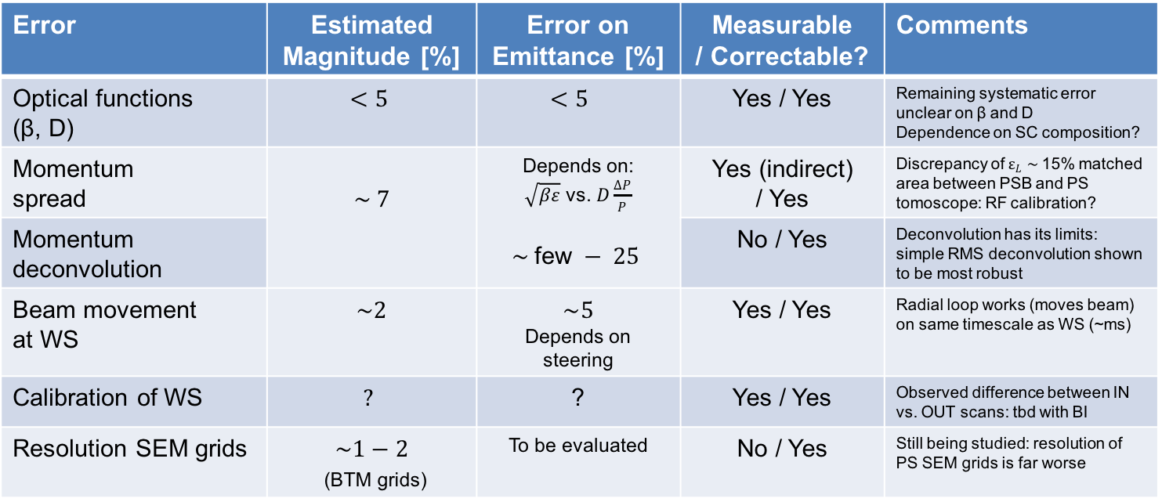
Emittance measurements: systematic errors
Summary of systematic error sources, each discussed in more detail:
Absolute accuracy of emittance measurement is hard to deduced
  Up to 25% systematic error on the accuracy would not be unreasonable to quote
Error | Estimated Magnitude [%] | Error on Emittance [%] | Measurable / Correctable? | Comments
Optical functions (β, D) | $<5$ | $$<5$$ | Yes / Yes | Remaining systematic error unclear on β and D Dependence on SC composition?
Momentum spread | $$\sim 7$$ | Depends on: $\sqrt{βε}$ vs. $D\frac{ΔP}{P}$ $$\sim \text{few} − 25$$ | Yes (indirect) / Yes | Discrepancy of $ε_{L} \sim$15% matched area between PSB and PS tomoscope: RF calibration?
Momentum deconvolution |  |  | No / Yes | Deconvolution has its limits: simple RMS deconvolution shown to be most robust
Beam movement at WS | $\sim 2$ | $$\sim 5$$ Depends on steering | Yes / Yes | Radial loop works (moves beam) on same timescale as WS (~ms)
Calibration of WS | $$?$$ | ? | Yes / Yes | Observed difference between IN vs. OUT scans: tbd with BI
Resolution SEM grids | $\sim 1−2$ (BTM grids) | To be evaluated | No / Yes | Still being studied: resolution of PS SEM grids is far worse

Slide 6
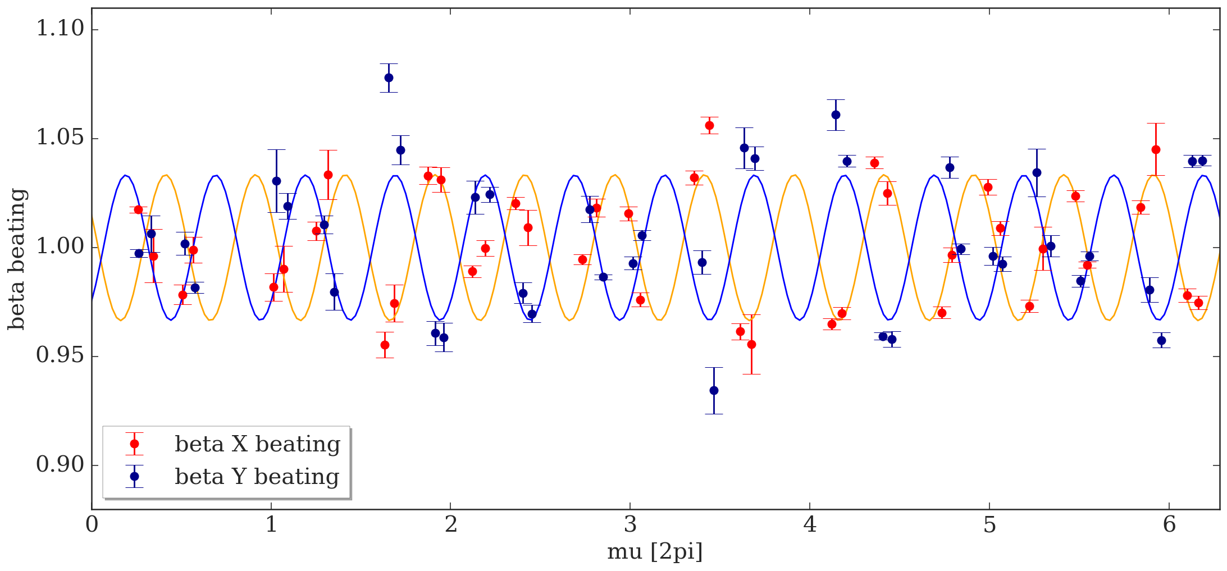
Optical functions (beta-beat)
Study by F. Tecker,
P. Skowronski &
P. Zisopoulos
Two techniques being pursued to improve knowledge of optics at profilers:
  K-modulation: model independent
    Systematics well controlled: PS low energy quads (coil only) with known I → k₁L
  BPM-phase advance response: model dependent, but fast
    Important technique to check perturbation to optics from the injection bump
    Latest measurements beating higher than 5% in first turns… to be checked
Comparison between techniques is yet to be done: an important next step
  Different tunes and machine configurations (w/o coupling, inc. non-linear elements)
    Beating within ±5% with an apparently low systematic error
    Dependence on super-cycle composition to be investigated:
      Do we need an automated tool to do optics measurements before emittance measurements?

Slide 7
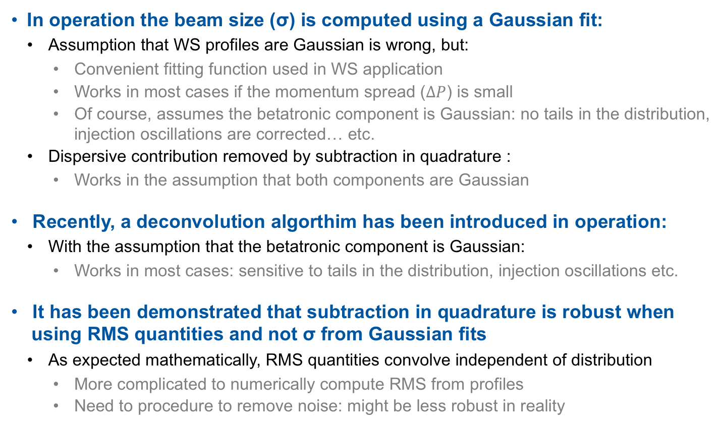
Momentum deconvolution (1)
Study by E. Senes
In operation the beam size (σ) is computed using a Gaussian fit:
  Assumption that WS profiles are Gaussian is wrong, but:
    Convenient fitting function used in WS application
    Works in most cases if the momentum spread ($ΔP$) is small
    Of course, assumes the betatronic component is Gaussian: no tails in the distribution, injection oscillations are corrected… etc.
  Dispersive contribution removed by subtraction in quadrature :
    Works in the assumption that both components are Gaussian
Recently, a deconvolution algorthim has been introduced in operation:
  With the assumption that the betatronic component is Gaussian:
    Works in most cases: sensitive to tails in the distribution, injection oscillations etc.
It has been demonstrated that subtraction in quadrature is robust when using RMS quantities and not σ from Gaussian fits
  As expected mathematically, RMS quantities convolve independent of distribution
    More complicated to numerically compute RMS from profiles
    Need to procedure to remove noise: might be less robust in reality

Slide 8
Momentum deconvolution (2)
Study by E. Senes
In a controlled environment (simulation!) testing subtraction in quadrature:
  No space-charge… tracking in pyOrbit (“RMS emittance”) agrees with analytical result
  Without steering errors the Gaussian fit approximation is good (“Profile emittance”)
  With steering errors (donut beams in betatronic component!) the RMS subtraction technique remains robust (“Profile emittance”) to the changing profile distribution
  Reconstructed emittance
  β = 16 m
  D = 2.5 m
  𝜀_{T} = 2.5 um
  𝜀_{L} = 0.5 eVs
  Injection steering error:
  blow-up driven by chromaticity with RF off

Slide 9
Momentum deconvolution (3)
Study by E. Senes
In a controlled environment (simulation!) testing deconvolution algorithms:
  Different particle distributions generated numerically and reconstructed using different algorithms:
Distributions | Quadrature (Gauss. fit) Emittance Error [%] | Quadrature (RMS) Emittance Error [%] | Deconvolution Alg. Emittance Error [%]
6D Gaussian ε_{T} = 2.5 um, ε_{L}= 0.5 eVs | + 0.6 | + 0.30 | + 0.25
Longitudinal
Gaussian (0.5 eVs)
Transverse
Gaussian (2.5 um)

Slide 10
Momentum deconvolution (3)
Study by E. Senes
In a controlled environment (simulation!) testing deconvolution algorithms:
  Different particle distributions generated numerically and reconstructed using different algorithms:
Distributions | Quadrature (Gauss. fit) Emittance Error [%] | Quadrature (RMS) Emittance Error [%] | Deconvolution Alg. Emittance Error [%]
6D Gaussian ε_{T} = 2.5 um, ε_{L}= 0.5 eVs | + 0.6 | + 0.30 | + 0.25
4D Gaussian + 2D Parabolic ε_{T} = 2.5 um, ε_{L}= 0.5eVs | + 4.4 | + 0.1 | + 2.7
Longitudinal
Parabolic (0.5 eVs)
Transverse
Gaussian (2.5 um)

Slide 11
Momentum deconvolution (3)
Study by E. Senes
In a controlled environment (simulation!) testing deconvolution algorithms:
  Different particle distributions generated numerically and reconstructed using different algorithms:
Distributions | Quadrature (Gauss. fit) Emittance Error [%] | Quadrature (RMS) Emittance Error [%] | Deconvolution Alg. Emittance Error [%]
6D Gaussian ε_{T} = 2.5 um, ε_{L}= 0.5 eVs | + 0.6 | + 0.30 | + 0.25
4D Gaussian + 2D Parabolic ε_{T} = 2.5 um, ε_{L}= 0.5eVs | + 4.4 | + 0.1 | + 2.7
4D Gaussian + 2D Parabolic ε_{T} = 2.5 um, ε_{L}= 1.4 eVs | + 14.9 | + 0.26 | + 7.5
Longitudinal
Parabolic (1.4 eVs)
Transverse
Gaussian (2.5 um)
Large longitudinal emittances exacerbate the problem:
  RMS subtraction in quadrature is the only technique robust to different distributions
  In theory… in practice it might be another story!

Slide 12
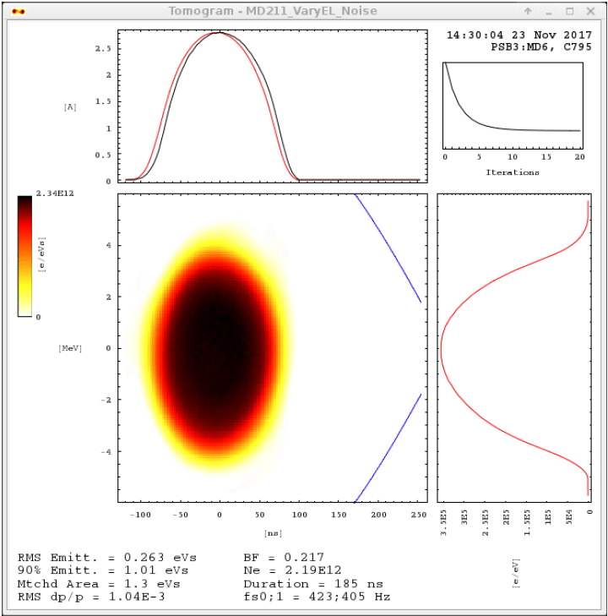
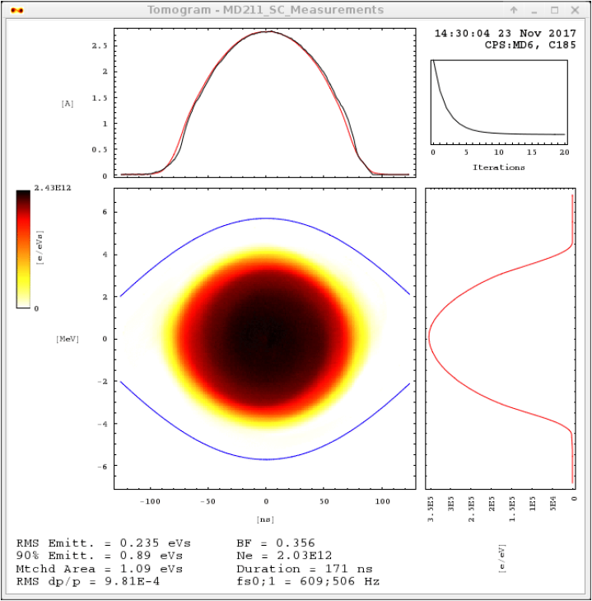

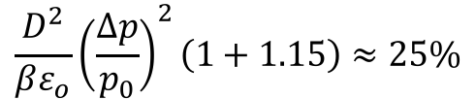
Momentum spread
Study by S. Albright and
A. Oeftiger
Matched area in PS is systematically lower by ≈ 15% than in PSB:
  Longitudinally matched, minimal transverse injection oscillations
  Underestimating the dispersive component will lead to an overestimation of the betatronic emittance in the PS
  For BCMS 1.5 eVs, assuming β = 16 m, D = 2.5 m, 𝜀₀ = 1 um and $\frac{∆p}{p_{0}}$ = 1.4e-3 with systematic error of $\sqrt{1.15}$ on $\frac{∆p}{p_{0}}$ , gives an emittance error:
RF voltage calibration of PSB and PS cavities needs to be checked
$$\frac{D^{2}}{βε_{o}}{\left(\frac{∆p}{p_{0}}\right)}^{2}\left(1+1.15\right)≈25\%$$

Slide 13
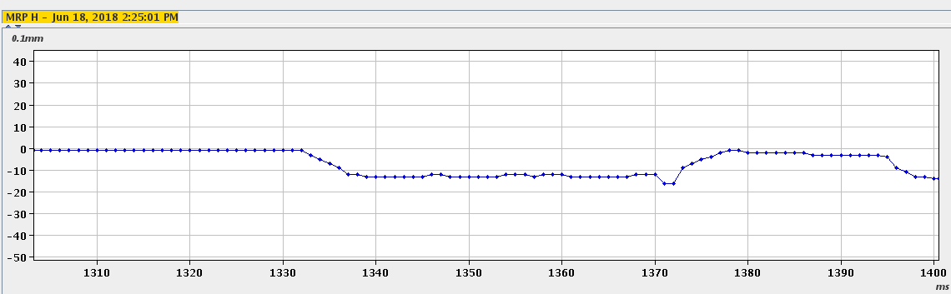
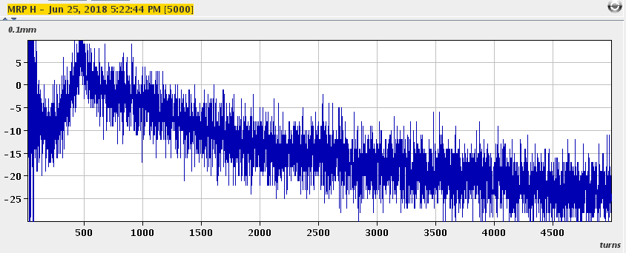

Beam movement at WS
Study by E. Senes and F. Tecker
Radial loop acts on a similar timescale to the motion of the WS (~ ms):
  Programming a radial trim and measuring the emittance:
  This is 2% of the wire speed (15 m/s) consistent with change in measured profile
  After deconvolution, the systematic error on the emittance in this case is 5%
After injection the non-closure of bump moves the beam, and the radial loop is working hard:
  Transverse beam velocity at 65H:
  Not negligible…
  A likely part of emittance discrepancy
Small linear ramp on MRP of 0.9 m/s at a dispersive location with D = 3 m gives a transverse speed of:
$\frac{∂}{∂t}\left(\frac{∆p}{p_{0}}\right)D=\frac{1}{α_{p}}\frac{∆R}{R}D≈$ 0.3 m/s

Slide 14
BGI as a single turn profiler
Study by J. Storey
Will it be possible to leak gas into the BGI during a dedicated MD?
  How much gas?
  Impact on ion operation?

Slide 15
Emittance: pause and review
If we want to achieve sub-5% accuracy on emittance measurements…
  We need to conclude on our optics parameters at our profilers ASAP:
    Beta-beat data to be checked and compared for relevant cycles
    Dependence on super-cycle, tune and coupling to be checked
    Correct optics function applied to emittance measurement
    Do we have to measure the optics before every emittance measurement?
  Orbit must be checked on TMS over the 1 - 2 ms of the WS or integration period of the BGI for every emittance measurements
  We need to move away from Gaussian fitting of profiles for proton beams:
    Gaussian distributions are not an intrinsic property of proton beams (electron beams, yes!)
    Let’s investigation the implementation of RMS beam size computation method, e.g., spline fit (arbitrary smoothing function, instead of Gaussian) to removing noise before computing RMS
  We need to calibrate the momentum spread in both PSB and PS to better than a few %
    Underestimating the dispersive component in the PS will lead to an overestimation of the betatronic emittance and therefore the apparent blow-up
We need a turn-by-turn profiler to understand and decouple effects happening after injection
  Is it possible with the BGI? SEM grid fast electronics a priority.

Slide 16
Emittance blow-up: potential sources
Summary of potential sources of blow-up, each discussed in more detail:
Total blow-up seen on OP BCMS beam is 30 - 40% in H
  Systematics on PSB and PS measurements to be considered too.
Source | Expected blow-up [%] | Measurable / Correctable? | Comment
Dispersion mismatch | 16 (in H) 2 (in V) | Yes / Yes | Dispersion re-matching has not helped: but we cannot rule out betatronic mismatch
Betatronic mismatch | 6 (in H and V) | No / Yes | No instrumentation yet available
Injection oscillations | 5 - 10 (TFB OFF) | Yes / Yes | For 1 - 2 mm amplitude oscillation and TFB OFF
Injection energy mismatch | Negligible after correction, up to ~ 5 (in H if uncorrected) | Yes / Yes | Slow drift (~few e-4) needs compensating, but can be done with ease
KFA10 / 20 | 2 – 3 | Yes / No | Depends on ring and PS injection energy [ref:1]
KFA45 FT ripple and post-pulse | 0 – 3 | Yes / No | Depends on ring and PS injection energy [ref:2]
Injection bump | Negligible | Yes / No | No blow-up observed (measurement)
Optics mismatch induced by space-charge | Negligible | Yes / Yes | PS closed solution with considering KV (rms) tune spread
Space-charge blow-up in TL | To be assessed | Yes / ? | To be checked (simulation)
Space-charge blow-up in PS | To be assessed | Yes / ? | To be checked (simulation)

Slide 17
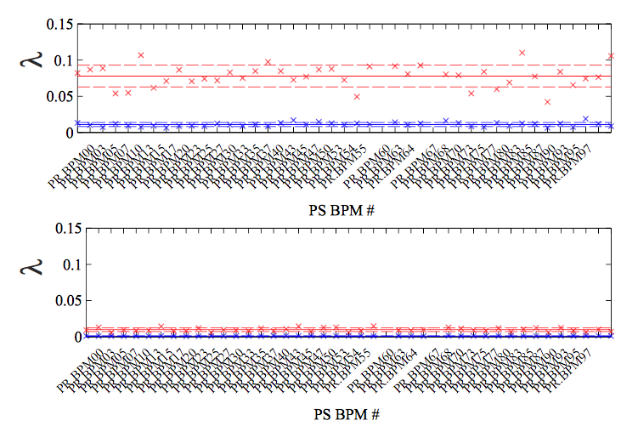
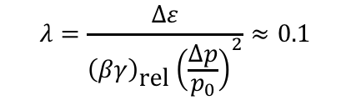
Dispersion mismatch (1)
Study by S. Albright,
V. Forte & A. Oeftiger
Turn-by-turn dispersion mismatch (beating) is easy to measure (beam position vs. frequency offset) in PS:
Operational optics
OP optics:
$$λ=\frac{∆ε}{{\left(βγ\right)}_{\text{rel}}{\left(\frac{∆p}{p_{0}}\right)}^{2}}≈0.1$$
Dispersion matched optics
H
V

Slide 18
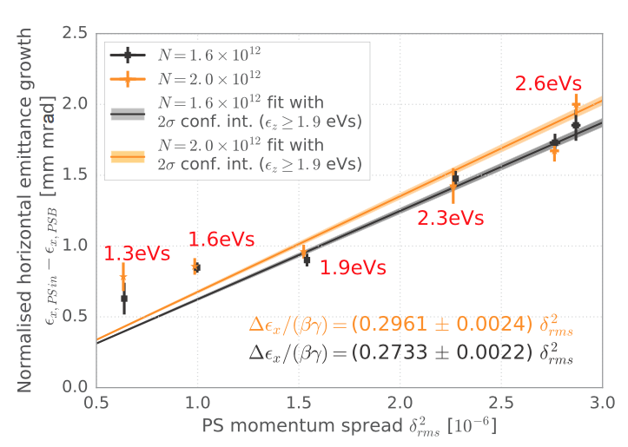
Dispersion mismatch (1)
Study by S. Albright,
V. Forte & A. Oeftiger
Turn-by-turn dispersion mismatch (beating) is easy to measure (beam position vs. frequency offset) in PS:
Direct measurements from measured emittance blow-up indicate a larger factor:
  Consistent with blow-up seen on OP beam
  What else is going on…?
    Systematic errors on momentum spread or deconvolution?
    Blow-up from another source?
    Space charge likely culprit at small ε_{L} where λ increases?
  To be repeated with BCMS, check with RMS deconvolution technique, V calibration
Operational optics
OP optics:
$$λ=\frac{∆ε}{{\left(βγ\right)}_{\text{rel}}{\left(\frac{∆p}{p_{0}}\right)}^{2}}≈0.1$$
Dispersion matched optics
H
V
$$λ≈0.3$$

Slide 19
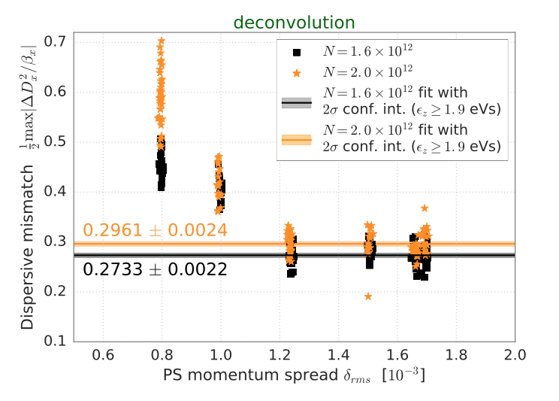
Dispersion mismatch (1)
Study by S. Albright,
V. Forte & A. Oeftiger
Turn-by-turn dispersion mismatch (beating) is easy to measure (beam position vs. frequency offset) in PS:
Direct measurements from measured emittance blow-up indicate a larger factor:
  Consistent with blow-up seen on OP beam
  What else is going on…?
    Systematic errors on momentum spread or deconvolution?
    Blow-up from another source?
    Space charge likely culprit at small ε_{L} where λ increases?
  To be repeated with BCMS, check with RMS deconvolution technique, V calibration
Operational optics
OP optics:
$$λ=\frac{∆ε}{{\left(βγ\right)}_{\text{rel}}{\left(\frac{∆p}{p_{0}}\right)}^{2}}≈0.1$$
Dispersion matched optics
H
V
$$λ≈0.3$$

Slide 20
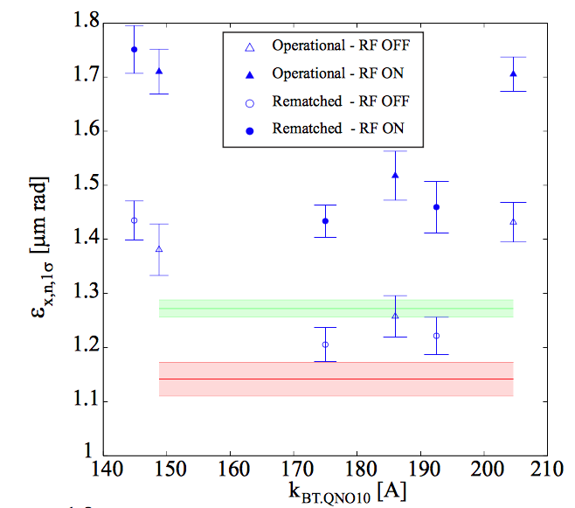
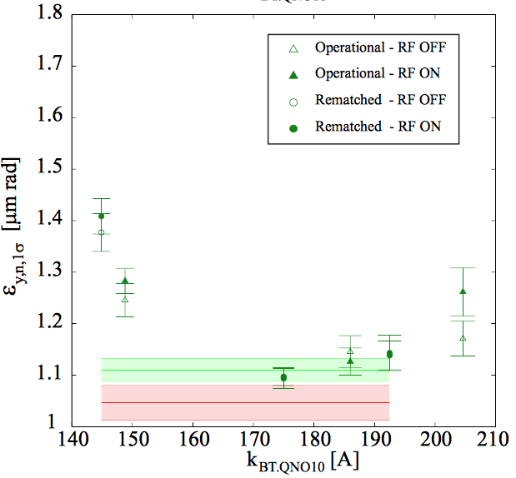
Dispersion mismatch (2)
Study by V. Forte
MD’s carried out last year to match optics in transfer line on BCMS OP:
  BTM line measurements with back-tracking give consistent starting Twiss parameters, to be confirmed:
    Starting dispersion was fitted from measurement instead of using model
    PSB optics (beta-beating) measurements will be crucial to understanding
RF ON/OFF effect still not fully understood:
  Energy matching, space-charge or radial beam movement during WS?
BTM SEM
BTM SEM
PSB WS
PSB WS

Slide 21
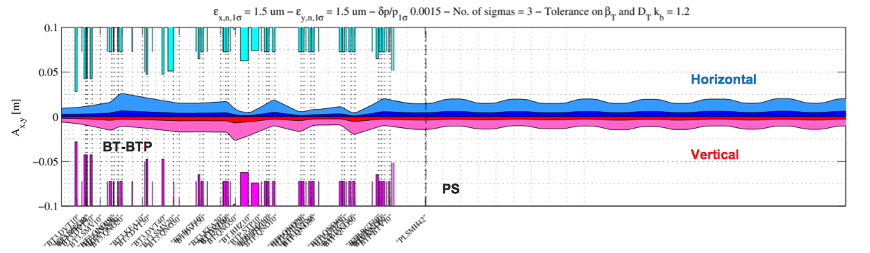
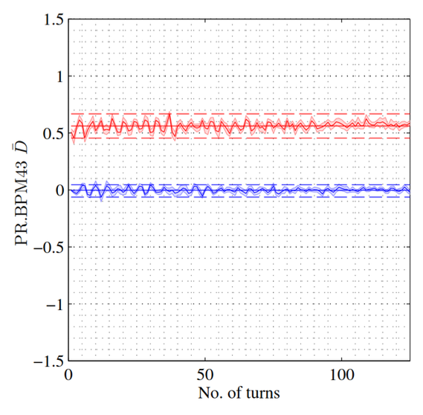
Dispersion mismatch (3)
Study by V. Forte
Dedicated transfer line MD’s carried out this year line:
  Different optics attempted, finally selected an optics compatible with PPM BT line OP, for ISOLDE and PSB MD’s
Optics implemented in YASP for steering into PS
Detailed analysis to be completed:
  TL quadrupole and steerer calibration errors being checked systematically in BT line
  SEM grids only used occasionally due to other MD pressure
  BT.QNO30 gradient scan showed similar sensitivity as BT.QNO10 last year
  Still, no way to verify/quantify betatronic mismatch:
    Need to be able to match empirically: turn-by-turn SEM grids
  Looking forward to injecting onto low chromaticity, no coupling (TFB ON) cycle
Dispersion mismatch very small!

Slide 22
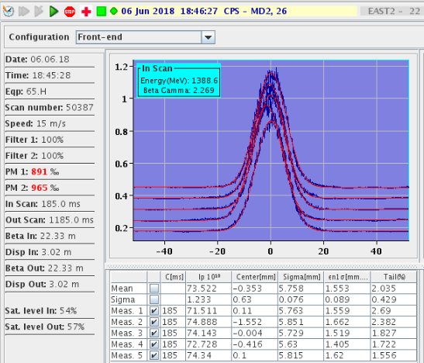
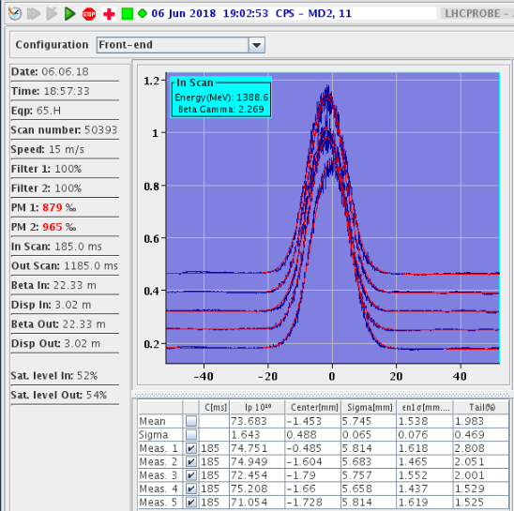
Dispersion mismatch (4)
Study by V. Forte
This year (6th June 2018) we transferred the 1.5 eVs beam with the dispersion matched optics and RF OFF:
  Horizontal beam size remained unchanged (PSB WS = 0.8 um vs. PS WS = 1.5 um) ?
  Vertical beam size was reduced by 8%
  Operational optics
  Rematched optics

Slide 23
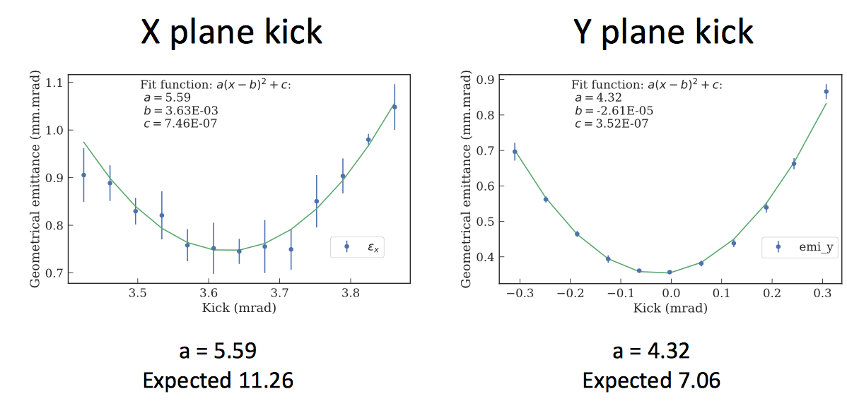
Injection oscillations (1)
Study by E. Senes & F. Tecker
Emittance blow-up studies at injection by steering errors
  H errors using KFA45 and V using DVT40/50
  Proved to be rather non-trivial: low brightness beam needed, away from resonances, coupling corrected and TFB off.
Emittance blow-up always smaller than predicted:
  Using Gaussian fits to profiles one would expect the opposite systematic effect
  Is blow-up dominated by another source or another systematic?
  To be repeated with RMS treatment of profiles: to be discussed best fitting algorithm

Slide 24
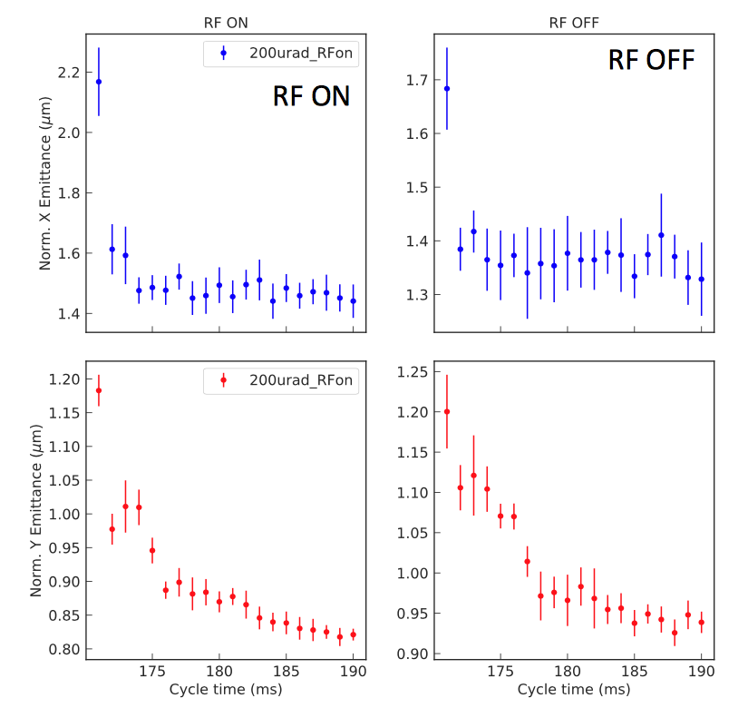
Injection oscillations (2)
Study by E. Senes & F. Tecker
Vertical injection error of 200 urad:
Emittance evolution after injection:
  Vertical steering error sees a slow, unexplained reduction of vertical emittance after injection, without losses
  Systematic difference RF ON/OFF
    Beam movement ?
    Space charge ?
  First point in H could be the injection bump non-closure moving the beam

Slide 25
Injection oscillations (2)
Study by E. Senes & F. Tecker
Vertical injection error of 200 urad:
Emittance evolution after injection:
  Vertical steering error sees a slow, unexplained reduction of vertical emittance after injection, without losses
  Systematic difference RF ON/OFF
    Beam movement ?
    Space charge ?
  First point in H could be the injection bump non-closure moving the beam
  Also seen on the horizontal BGI:
During injection bump collapse
Wirescan

Slide 26
Injection oscillations (2)
Study by E. Senes & F. Tecker
Vertical injection error of 200 urad:
Emittance evolution after injection:
  Vertical steering error sees a slow, unexplained reduction of vertical emittance after injection, without losses
  Systematic difference RF ON/OFF
    Beam movement ?
    Space charge ?
  First point in H could be the injection bump non-closure moving the beam
  Also seen on the horizontal BGI:
During injection bump collapse
Wirescan
Simulations with space-charge:
  pyOrbit simulations along with injection bump will complement this work nicely

Slide 27
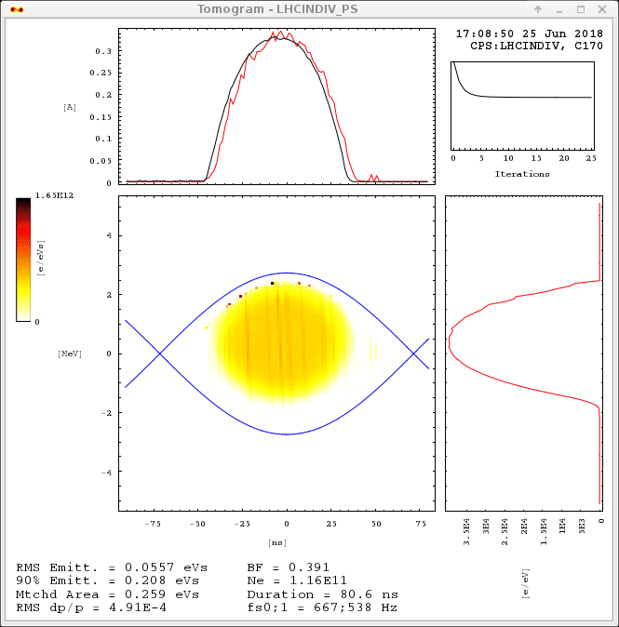
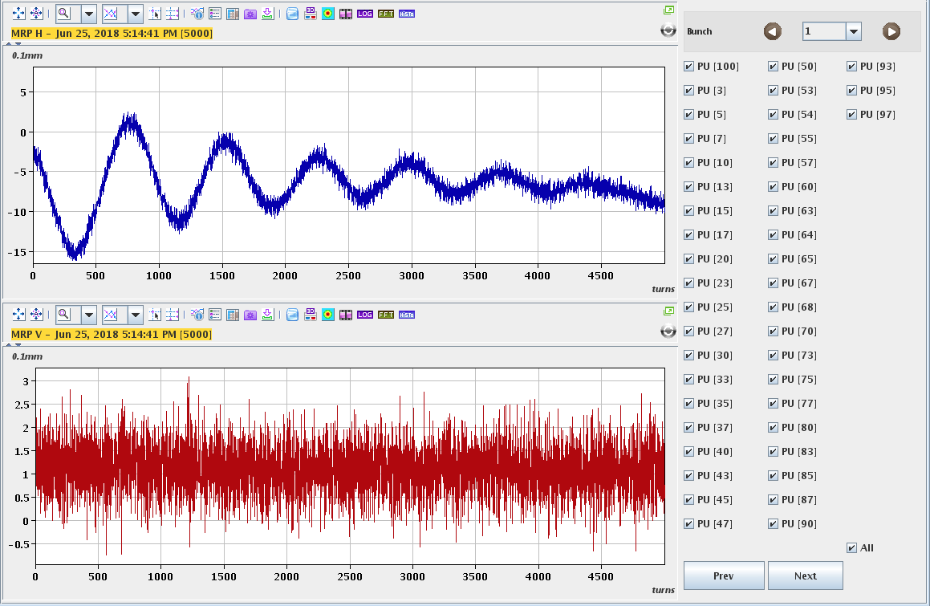

Energy matching error
The energy matching drifts in time, but is easily correctable
  This week the error was $\frac{∆p}{p_{0}}$ ~ 3e-4, giving an estimated blow-up of 5%
Suggestion to use the orbit system (TMS) to finalise the energy matching
  Far more sensitive than the using the bunch space from tomoscope
  Check this week on LHCINDIV:
  Check this week: loops delayed

Slide 28


Injection bump studies
Study by A. Huschauer, E. Senes & P. Zisopoulos
No emittance blow-up measured when firing second instance of bump:
The measured tune perturbation is reproduced in MADX when introducing the Eddy current sextupole terms:
  Impact on linear optics is small: maximum optics mismatch 5 – 6 %, with a change of one unit of chromaticity
  Maximum emittance growth from mismatch is expected to be 0.15 %
  pyOrbit simulations are being set-up nevertheless with space charge at injection
$$ε_{x,OFF}=ε_{x,ON}=1.26±0.03$$
$$ε_{y,OFF}=ε_{y,ON}=1.75±0.03$$

Slide 29
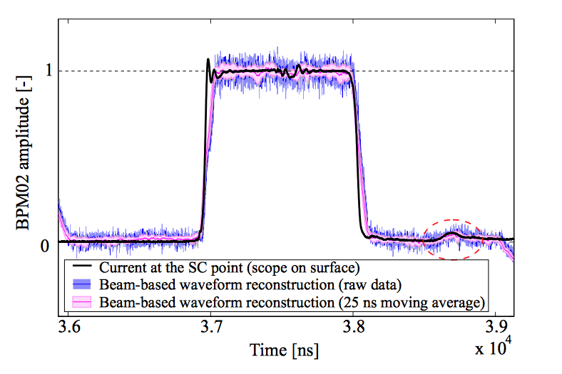
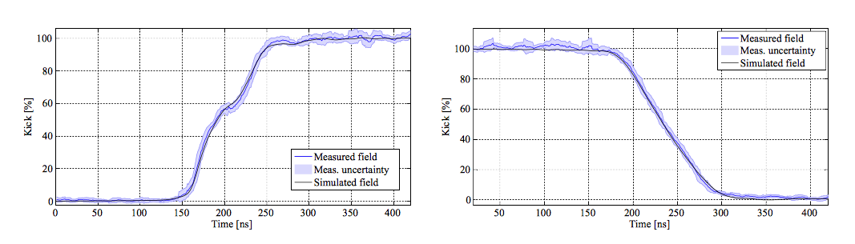
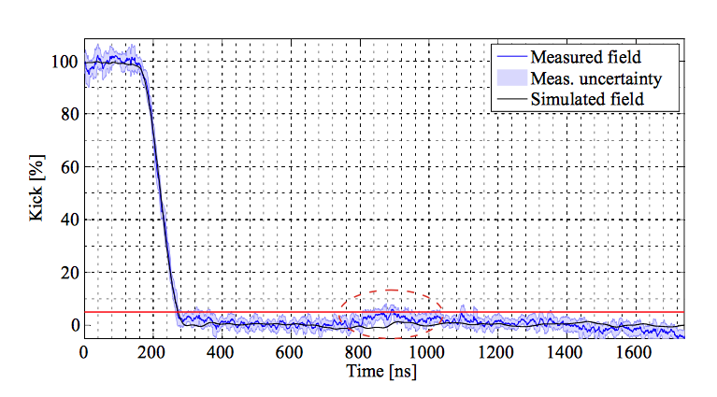
KFA45 post-pulse (1)
Study by V. Forte & A. Colomo
Good agreement between kicker PSpice (simulation) and measured waveforms (current and beam-based):
However, PSpice model does not reproduce the post-pulse:
  Depends on properties of the switches
  Work is on-going to understand the discrepancy
  Emittance growth estimates from
  post-pulse needs updating using measured waveform

Slide 30
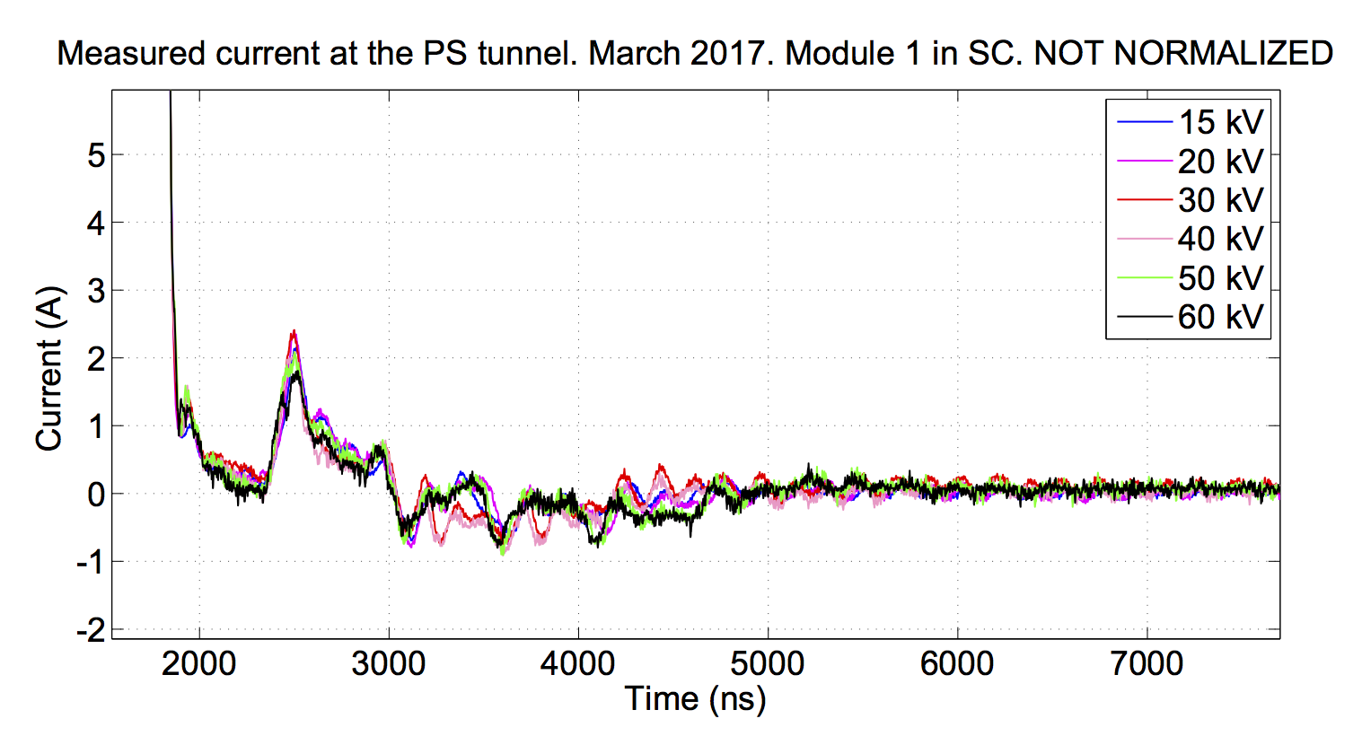
KFA45 post-pulse (2)
Study by A. Colomo, T. Kramer
& E. Senes
Post-pulse ripple does not scale with voltage of each kicker module:
  Impact reduced at higher voltage operation, 2 GeV (50 kV with 4 modules)

Slide 31
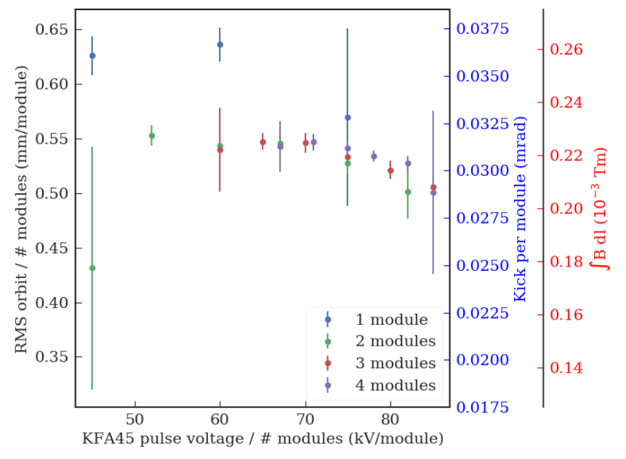
KFA45 post-pulse (2)
Study by A. Colomo, T. Kramer
& E. Senes
Post-pulse ripple does not scale with voltage of each kicker module:
  Impact reduced at higher voltage operation, 2 GeV (50 kV with 4 modules)
  Kick from post-pulse per module to be compared to 10 mTm (one module): 0.22/10 = 2%

Slide 32
KFA45 post-pulse (2)
Study by A. Colomo, T. Kramer
& E. Senes
Post-pulse ripple does not scale with voltage of each kicker module:
  Impact reduced at higher voltage operation, 2 GeV (50 kV with 4 modules)
  Kick from post-pulse per module to be compared to 10 mTm (one module): 0.22/10 = 2%
Detailed waveform measurements of post-pulse to be made imminently:
  Current and BB measurements to be made simultaneously
  Estimated emittance growth ~2% from post-pulse, to be checked
Further efforts are on-going to reduce post-pulse amplitude

Slide 33
On-going studies with QPU
Study by A. Oeftiger
…

Slide 34
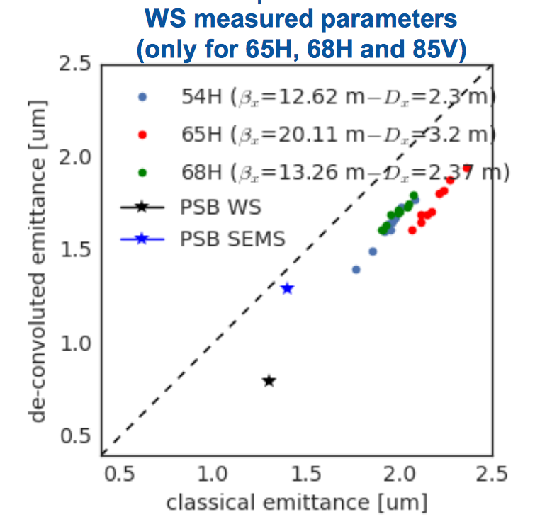
Transfer of 1.5 eVs BCMS beam
Study by V. Forte, G.P. Di Giovanni, & G. Guidoboni
Focus this year has been on establishing non-PPM optics, next steps
  Better understanding of systematics introduced with dispersive component
  Investigating the blow-up in the first ~100 turns: multi-turn SEM grids
Systematics from the dispersive contribution an issue in the PS, but also in the PSB

Slide 35
Transfer of 1.5 eVs BCMS beam
Study by V. Forte, G.P. Di Giovanni, & G. Guidoboni
Focus this year has been on establishing non-PPM optics, next steps:
  Better understanding of systematics introduced with dispersive component
  Investigating the blow-up in the first ~100 turns: multi-turn SEM grids
Systematics from the dispersive contribution an issue in the PS, but also in the PSB
Y. Dutheil and V. Forte (TE-ABT-BTP) have repeated analysis of dispersion free BTM quadrupole scan measurements
  No deconvolution: D-free
  A thick quadrupole approximation gives large measured emttances vs. thin lens:
    Thin lens ~ 1.2 um
    Thick lens measures closer to ~ 1.5 um
  Interesting topic: will pursue this analysis further
  Propose to invite Yann to present analysis either at LIU PSB or PS BD WG
Thick lens
PSB SEMs
Thin lens
PSB SEMs

Slide 36
Preparation for multi-turn SEM grid measurements
Successful reliability run of kickers to destroy the beam after ~100 turns
  No failure in 40,000 test shots without beam using KFA4, 13, 21 and 28
  7 missing kicker events: another redundant system was always there as back-up
SEM grids will be protected by procedure
  Procedure written and circulated
Interlock of ralentisseur now “maskable” via re-programming PLC
Fast electronics installed during ITS1 on SEM 52
Implementation of FESA class still to be completed
Tentatively we plan to take beam for 1 – 2 hours, dependent on Crab Cavity MD schedule first thing on Wednesday 11th July
  All actors invited to give their input on MD plan, to be discussed next week
  Cycle to be set-up and beam types to be agreed next week

Slide 37
Conclusion
Emittance measurement precision and accuracy:
  Relative precision of profile measurements (same cycle and beam) appear reliable
  Systematic errors hard to quantify: for different beams and in different machines error on absolute values are difficult to evaluate:
    Clues for likely sources of error identified
  On-going work to reduce contribution of systematics especially from deconvolution
    Decide on how to implement an RMS evaluation of beam size (aside from Gaussian fits) and check if this is the way forward
  Detailed procedure and check list will have to be organized for emittance measurements:
    Checks: optics, beam movement, voltage calibration
Injection MD’s are challenging and truly multi-disciplinary:
  Count on contributions from many groups in the LIU PS BD Working Group
  Learning how to control all variables and putting in place MD procedure
  We are still missing vital input to conclude on source of horizontal blow-up
  Simulations with space charge need to progress
Important next step to transferring larger longitudinal emittances will be to evaluate and quantify blow-up during first turns in PS

Slide 38
References
[1] V. Forte et al., New beam-based and direct magnetic waveform measurements of the BTx.KFA10(20) vertical recombination kickers and induced emittance blow-up simulations at 1.4 and 2 GeV, CERN-ACC-NOTE-2018-0032, 09 Apr 2018. - 30 p.
[2] V. Forte et al., Magnetic Waveform Measurements of the PS Injection Kicker KFA45 and Future Emittance Growth Estimates, CERN-ACC-NOTE-2018-0031, 09 Apr 2018. - 47 p.

