Slide 1
Part II: Interfaces
Daniel Schoerling
On behalf of the machine interface working group
CERN, 4th of July 2018

Slide 2
Mandate
End of April 2018 an interface working group was formed:
The WP11 technical interfaces working group meeting is the meeting where all aspects related to interfaces of WP11’s deliverables are discussed
If an issue concerning the WP11 interfaces is identified it will be escalated to the proper project bodies (HL-TCC, HL-PSM, MCF, HL-LHC integration meeting), groups, WP leaders or the project management
The aim of this meeting is to ensure the compatibility of technical interfaces of WP11 and their readiness for operation
After first successful operation of the deliverables of WP11 the work is considered completed
Subjects in the agenda are defined in close collaboration with the relevant WPs and the other meetings (HL-TCC, HL-PSM, MCF, MP3, HL-LHC integration meeting)
Prepare two HL-LHC Interface Specifications (IS): WP11 Point 7 11 T Dipole and WP11 Point2 Connection Cryostat Full Assembly
Establish two Engineering Change Requests (ECR): WP11 Point 7 11 T Dipole and WP11 Point2 Connection Cryostat Full Assembly
The outline, content and progress of the ECRs is discussed in the meeting
The meetings takes place bi-weekly (Tuesdays, 3:15-5:15 pm, odd weeks)

Slide 3
WP11 interfaces
Beam dynamics [WP2], M. Giovannozzi
Collimation scenarios [WP5], S. Redaelli
Mechanical 3D model, A. Bertarelli, L. Gentini, A. Ghezzo, Christophe Yves Mucher
Integration model, Maria Amparo Gonzalez de la Aleja Cabana
Cryogenics [WP9], R. van Weelderen
Vacuum [WP12], M. Sitko, V. Baglin, G. Riddone
Geometry and alignment [WP15], D. Missiaen, H. Mainaud-Durand
Powering and trim circuit [WP6B], H. Thiesen, S. Yammine, M. Martino
Trim current leads, A. Ballarino
Machine protection, D. Wollmann
QPS, R. Denz, D. Wollmann
Software, M. Zerlauth, D. Wollmann
MCF-ELQA and voltage withstand levels, F. Rodriguez Mateos
MP3-LHC magnet circuits, powering and performance panel, A. Verweij
Compliance to pressure equipment directive, A. Foussat
Integration, (de-)installation [WP15], P. Fessia, M. Modena, Maria Amparo Gonzalez de la Aleja Cabana
Cryo-assembly, D. Ramos
Cold mass assembly, H. Prin
Operation, M. Pojer
Interconnections, J.P. Tock, H. Prin, N Bourcey
HL-LHC Project Safety Officer (T. Otto)
HSE (Carlos Arregui Rementeria, Jose Gascon)
Cryo-magnet coordinator and Magnet Evaluation Board (MEB) (S. Le Naour)
Transport, C. Bertone
Energy deposition, A. Lechner
Beam-loss monitors, A. Lechner
DC electrical distribution, J.C. Guillaume
11 T electrical engineering, A. Foussat
Storage of signals: TIMBER

Slide 4
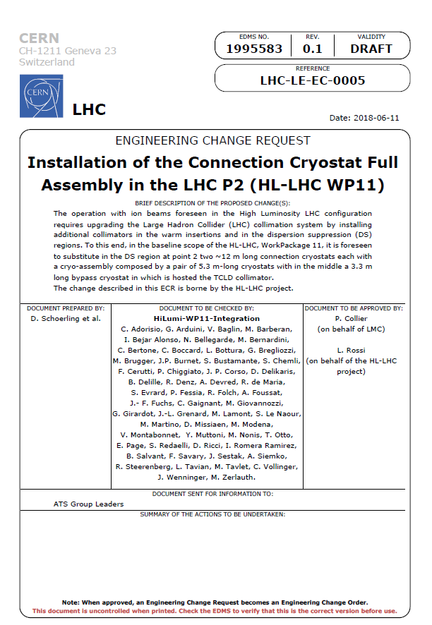
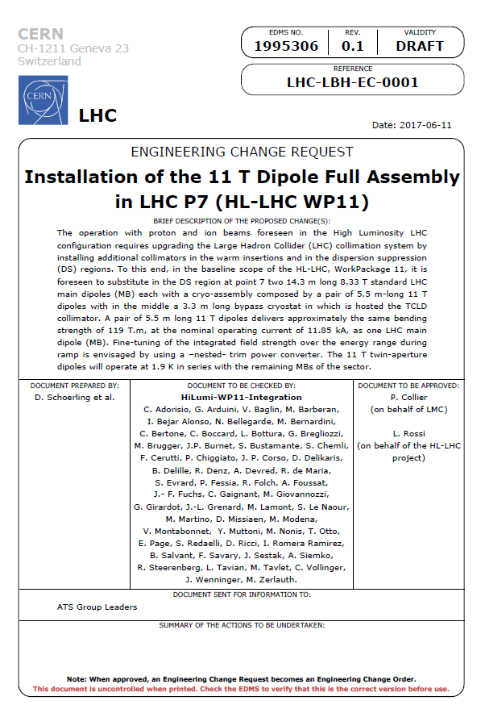
ECR was pre-approved by TCC (7th of June 2018)

Slide 5
Interface specification under preparation (P2 & P7)
External interfaces at P7 (interface specification under preparation: LHC-LBH-ES-0003):
Interface | Interface type | Specifications
Beam dynamics | Performance | Field quality and stability, integrated field, magnet position
Vacuum | Mechanical | Installation of beam pipe and beam screen inside magnet
Cryogenics | Performance and mechanical | Cooling, overpressure release valves
Geometry and alignment | Mechanical | Taylor-Hobson targets and alignement planes
Main dipole chain and trim circuit | Performance and electrical | Field stability, maximum correction of field integral, trim current leads
Powering and circuits | Performance and electrical
Quench detection system (QDS) | Performance and instrumentation | Characteristics of quench voltage, voltage tap position and feed-through
New Quench Protection System | Performance and electrical | Quench heater circuits
Powering Interlock System | Interlock
Protection of trim current leads | Instrumentation
Cabling | To be discussed if needed
Energy deposition in the 11 T dipoles | Performance
Instrumentation | Electrical
Interconnections | Mechanical and electrical | Under preparation by DISMAC SIT

Slide 6
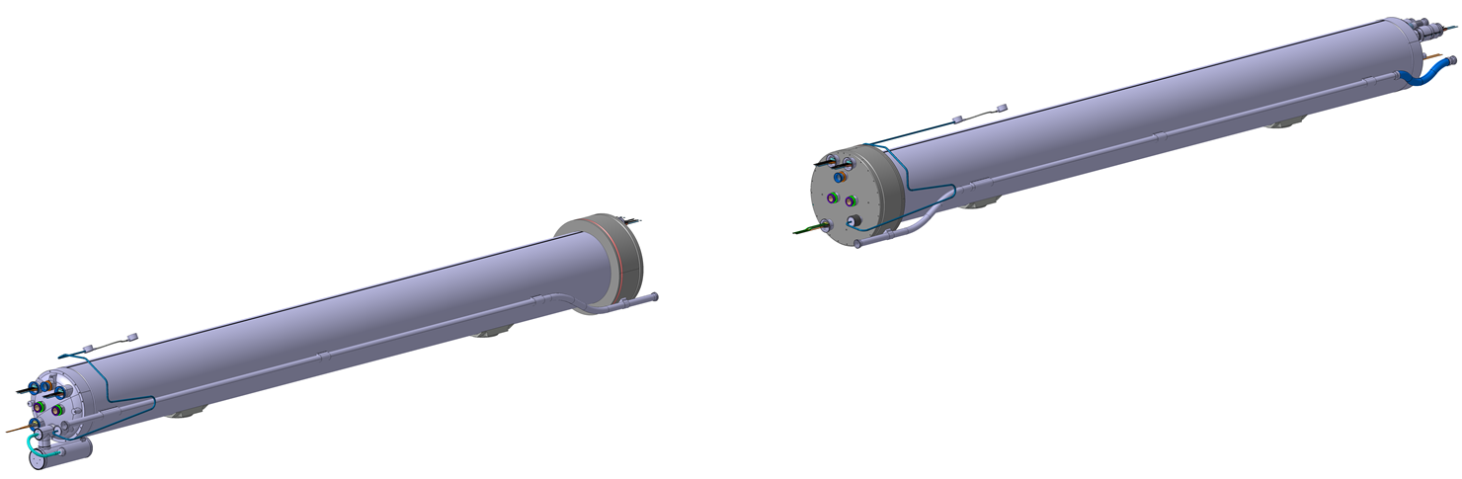
Physical interfaces: LMBHA&B 11 T cold mass
Instrumentation (V-Taps, cryo) & Quench Heaters Feed Thoughts
Main and spool busbars (M1,M2)
Heat Exchanger Tube
Heat Exchanger Tube
Courtesy H. Prin
Instrumentation (V-Taps, cryo) & Quench Heaters Feed Thoughts
Cold Bore Tubes
Main busbars (M3)
11T busbars (M4)
N-Line
TE-MSC-CMI Cryostat
TE-MSC-SCD Trim leads
TE-MPE Diode, ElQA, Protection
TE-EPC Powering
TE-CRG Cryogenics
TE-VSC Beam screens, CWT…
EN-SMM-ASG Geom meas., Fiducialisation
TE-MSC-TF Cold tests
TE-MSC-MM Magnetic meas.
Cold Mass Supports
Cold Bore Tubes
Diode
Trim busbars

Slide 7
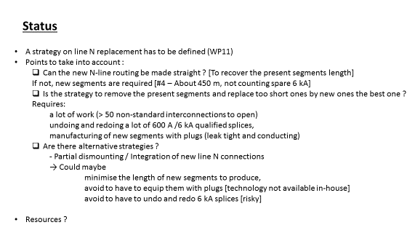
Physical interfaces: LMBHA&B 11 T cold mass
Interfaces to adjacent MBs are standard, interfaces to by-pass cryostat are WP11 internal
Interconnects in the tunnel will be installed by the special intervention team of DISMAC
The design, the procedures, components and validations will be prepared by TE/MSC
Trim current lead integration has been discussed in HL-MCF (https://indico.cern.ch/event/727539/): no issue
N-line is too short by 8 cm: Study within WP11 is on-going how to connect the N-line such that the existing N-line can be reused
Courtesy J.P. Tock

Slide 8
Open points: interfaces
The two open points are
  The N-line integration, as it is currently 8 cm too short (treated within WP11), not concerning the cold mass but the magnet integration
  The total thermal heat load (eddy currents + radiation heat load) on the cold mass and the extraction of this heat (treated within the interface working group) is under discussion and higher than previously expected. Following mitigation measures are discussed:
    Special yoke laminations
    Space between collars
    Holes in the pole
At this stage no other open points have been identified.

