Slide 1
QA for WP11
R. Principe on behalf of WP11 QA team
Production Readiness Review
CERN, July-4, 2016

Slide 2
Outline
QMS in WP11
  Documentation (QAP)
    Flow charts
    MIPs and follow up files
    Procedures (general, fabrication, control, annotated)
    Non conformities
  EDMS and MTF
  Contract S-197
Conclusion

Slide 3
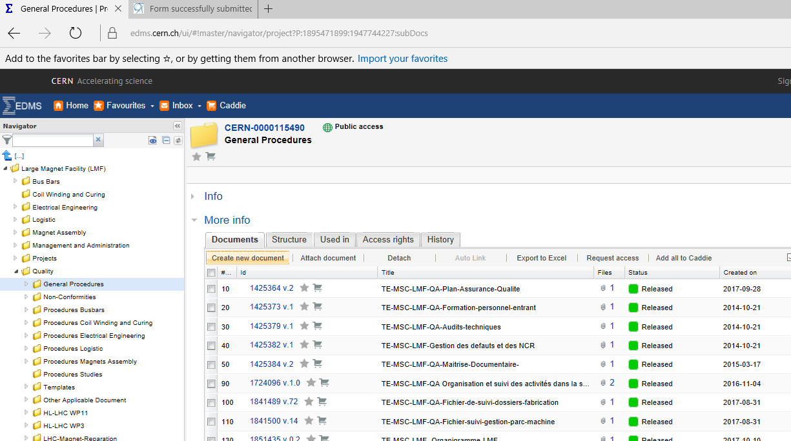
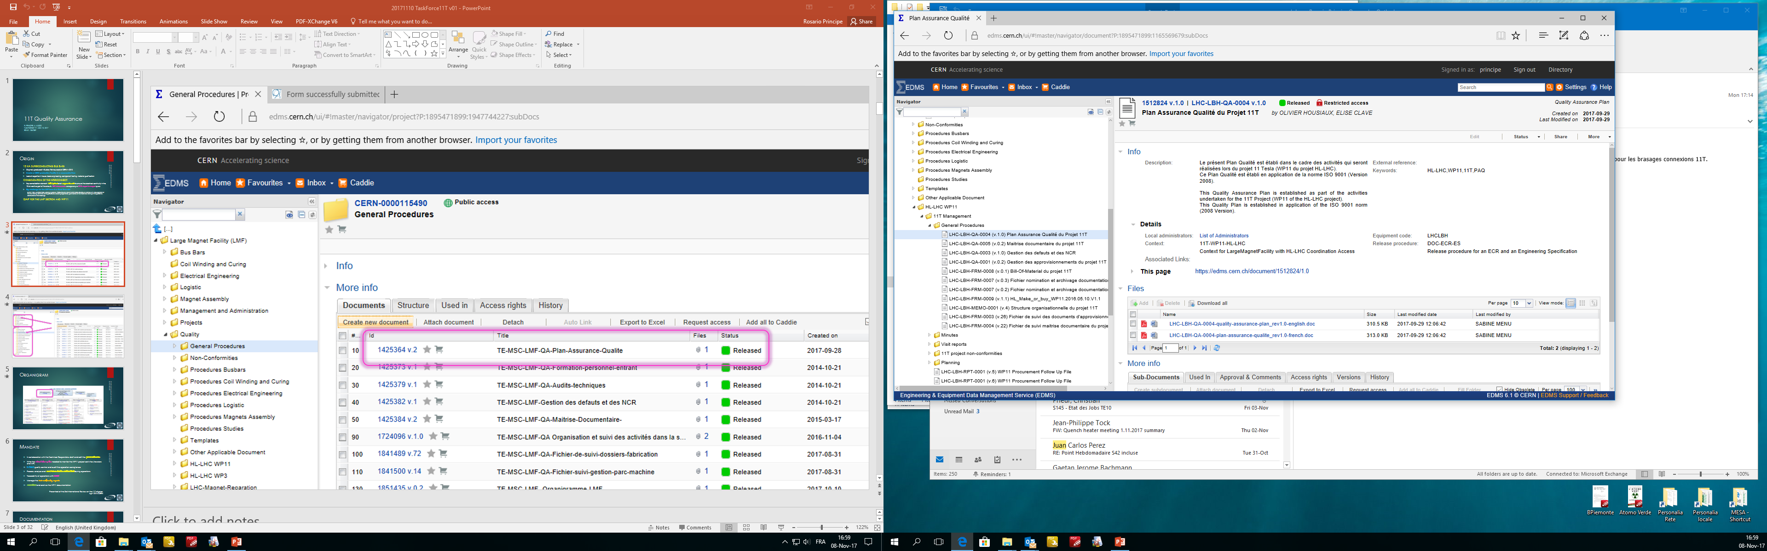
WP11 QMS
WP11 QAP available in EDMS at https://edms.cern.ch/document/1512824
First release May 2015
Conform with the HL-LHC QAP
Conform with QA in acc. sector https://quality.web.cern.ch/

Slide 4
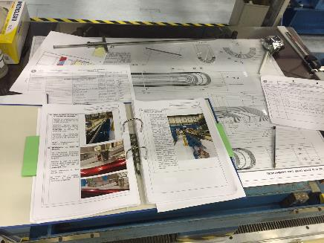
Documentation
Identify and describe any single production step
Manufacturing flowcharts
Manufacturing and Inspection Plans (MIPs)
Procedures and Work Instructions
Follow-up files
Control Procedures

Slide 5
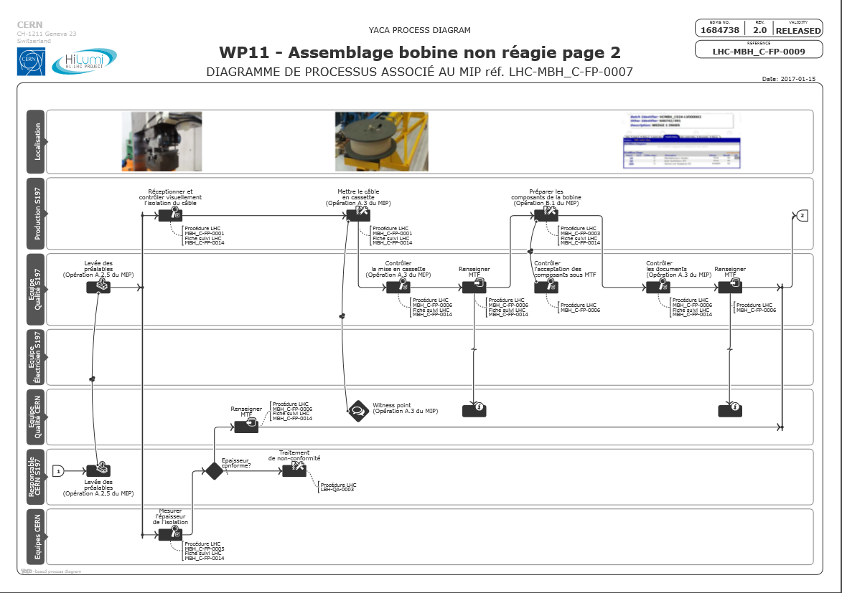
Manufacturing Flow Charts

Slide 6
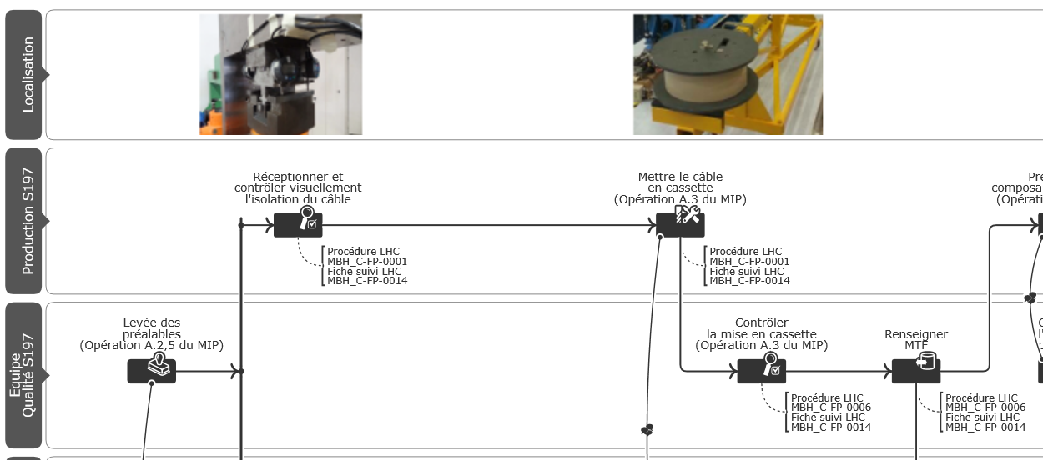
Identify each sigle production step

Slide 7
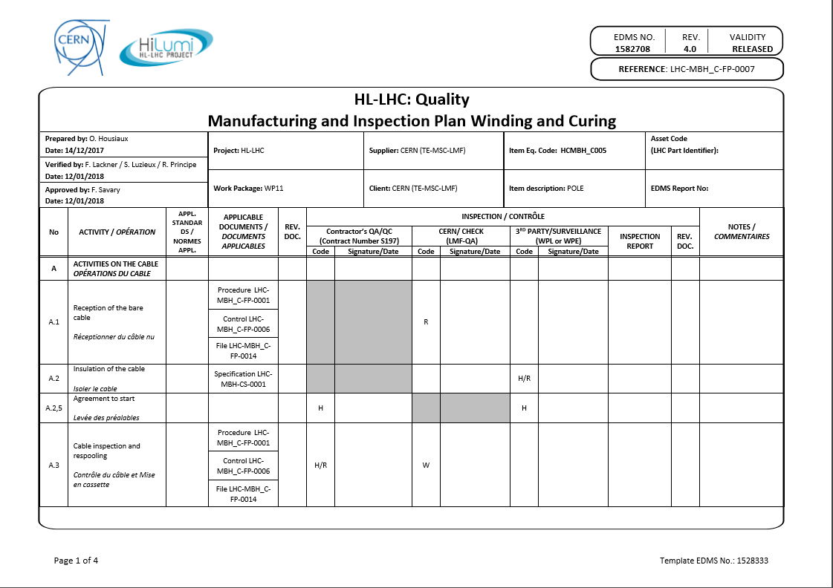
Manifacturing and Inspection Plan (MIP)
7

Slide 8
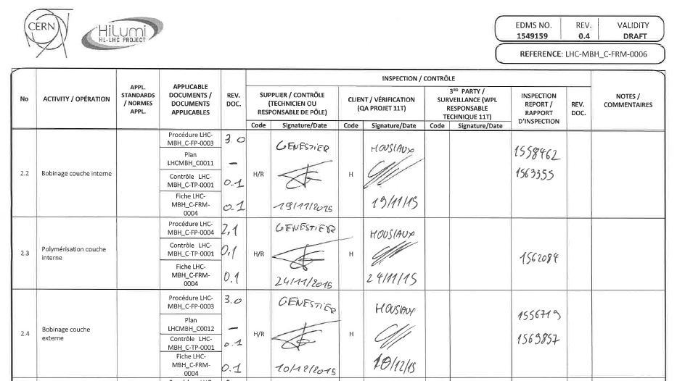
The MIP life

Slide 9
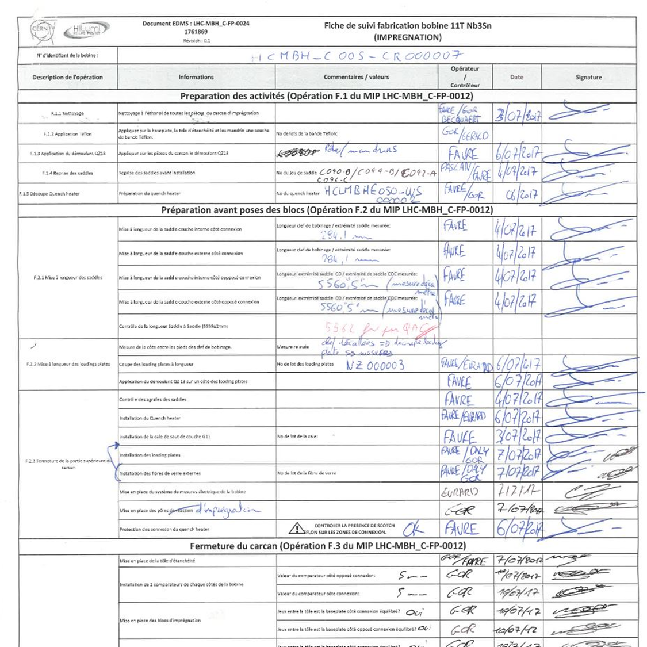
Follow up files

Slide 10
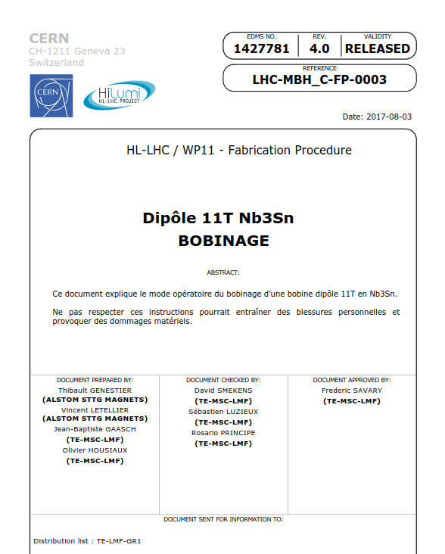
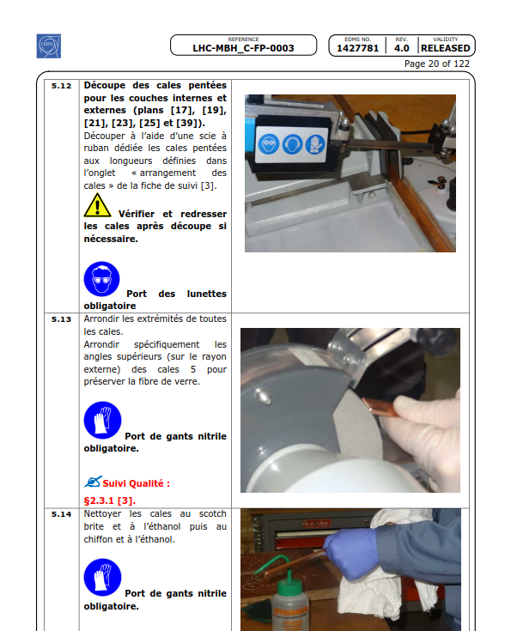
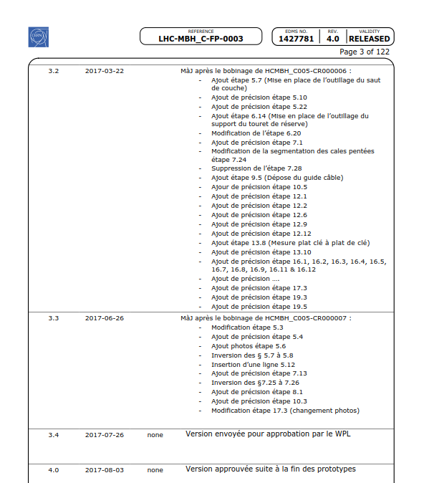
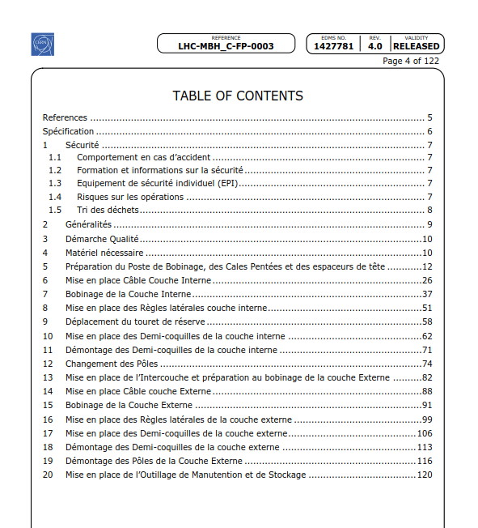
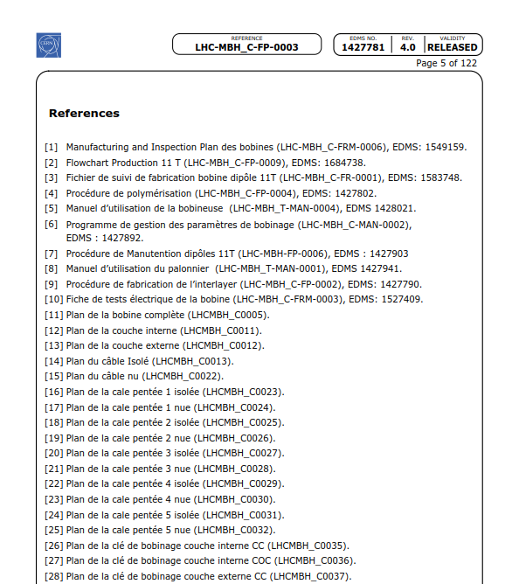
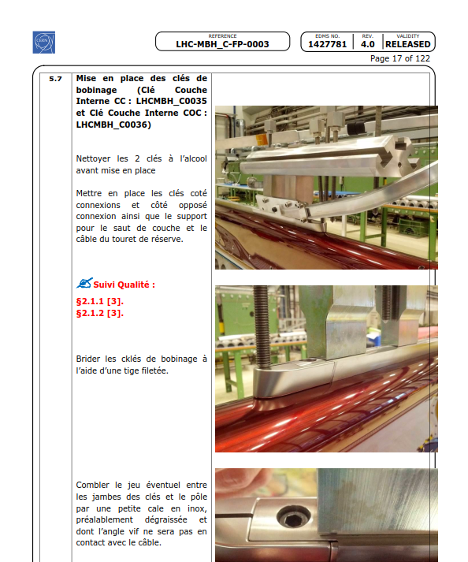
Procedures and work instructions

Slide 11
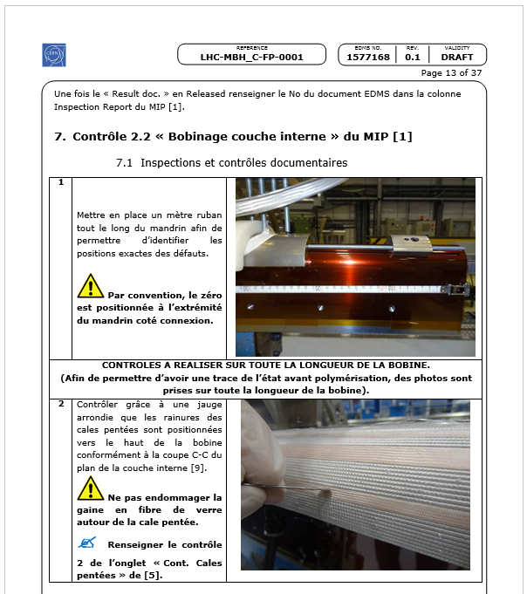
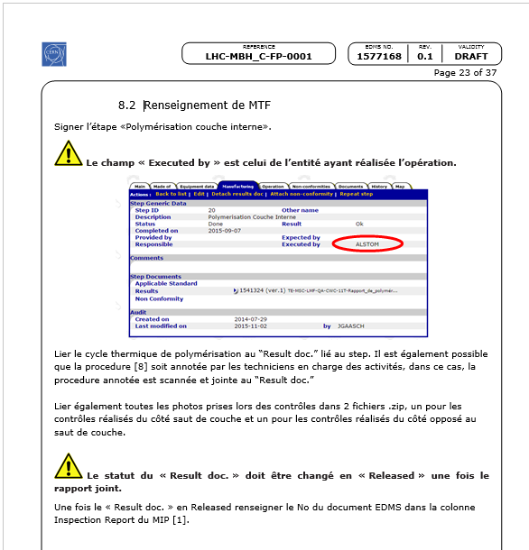
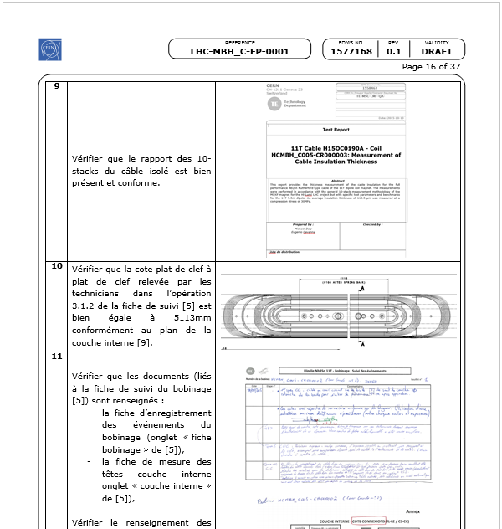
Control procedures

Slide 12
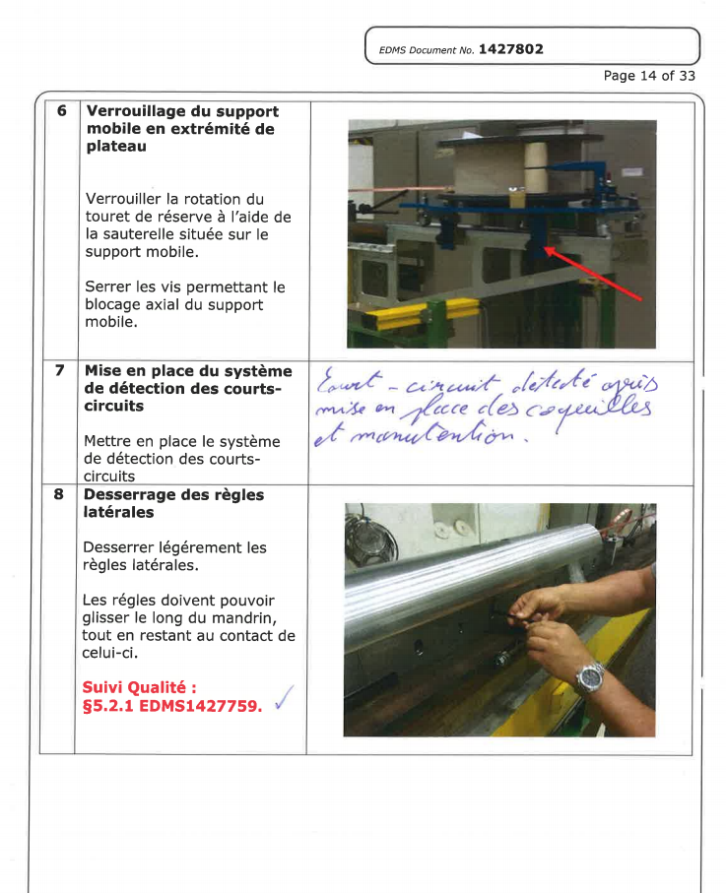
Annotated Procedures
Continuous upgrade
  Inform the modification on the paper version
  Register as a production report (avaliable in EDMS and MTF)
  Solid base for the new version

Slide 13
Status of the WP11 documents
Coil winding and curing
Also available in annex I to this presentation:
  Bus bar documentation
  Cold mass assembly
  Electric tests
WP11QA provides a « Fichier de suivi maîtrise documentaire des documents d'assemblage d'une masse froide » @ EDMS1995160

Slide 14
Coil Winding and Curing 1/3
Title | Doc type | EDMS | Status
Flowchart de bobinage et de polymérisation | Flowchart | LHC-MBH_C-FP-0009 | Released
Bobinage et de polymérisation | MIP | LHC-MBH_C-FP-0007 | Released
BOM bobine et bobine collarée | BOM | LHC-MBH_C-FP-0042 | In Work
10 Stack | Procédure | LHC-MBH_C-FP-0005 | In Work
Mise en cassette | Procédure | LHC-MBH_C-FP-0001 | Released
 | Spec d'approvisionnement des tourets | LHC-MBH_C-FRM-0007 | Released
Bobinage | Procédure | LHC-MBH_C-FP-0003 | Released
 | Fiche de suivi | LHC-MBH_C-FP-0014 | Released
Fabrication Inter-Layer | Procédure | LHC-MBH_C-FP-0002 | Released
Contrôle de fabrication d'une bobine | Procédure | LHC-MBH_C-FP-0006 | Engineering check
Polymérisation | Procédure | LHC-MBH_C-FP-0004 | Released

Slide 15
Coil Winding and Curing 2/3
Title | Doc type | EDMS | Status
Flowchart fabrication bobine impregnation | Flowchart | LHC-MBH_C-FP-0023 | Released
Réaction bobine | Flowchart | LHC-MBH_C-FP-0013 | Released
Réaction et imprégnation | MIP | LHC-MBH_C-FP-0012 | Released
Assemblage du carcan de réaction | Procédure | LHC-MBH_C-FP-0011 | Released
 | Fiche de suivi | LHC-MBH_C-FP-0016 | Released
Four de réaction | Guide d'utilisation | LHC-MBH_C-MAN-0004 | Released
Splicing | Procédure | LHC-MBH_C-FP-0022 | Released
 | Fiche de suivi | LHC-MBH_C-FP-0019 | Released
Impregnation fixture assembly | Fiche de suivi | LHC-MBH_C-FP-0024 | Released
 | Procédure | LHC-MBH_C-FP-0017 | Released
Protocole d'Imprégnation | Procédure | LHC-MBH_C-FP-0025 | Released
Impregnation and cleaning sub process | Procédure | LHC-MBH_C-FP-0040 | Released
Préparation des connexions éléctriques d’une bobine | Procédure | LHC-MBH_C-FP-0043 | Engineering check
 | Fiche de suivi | LHC-MBH_C-FP-0044 | Engineering check

Slide 16
Coil Winding and Curing 3/3
Title | Doc type | EDMS | Status
Collared coil | Flowchart | LHC-MBH_C-FP-0027 | Engineering check
Collared coil | MIP | LHC-MBH_C-FP-0026 | Released
Procédure d'assemblage des colliers de collaring | Procédure | LHC-MBH_C-FP-0015 | Engineering check
Fabrication insulation for collared coil | Procédure | LHC-MBH_C-FP-0028 | Engineering check
Collaring | Fiche de suivi | LHC-MBH_C-FP-0034 | In Work
 | Procédure | LHC-MBH_C-FP-0031 | In Work
Contrôle métrologique de la bobine imprégnée | Procédure | LHC-MBH_C-FP-0010 | Released
Contrôle dimensionnel bobine collarée | Procédure | LHC-MBH_C-FP-0045 | In Work
Manutention dipôles | Procédure | LHC-MBH-FP-0006 | Under Approval

Slide 17
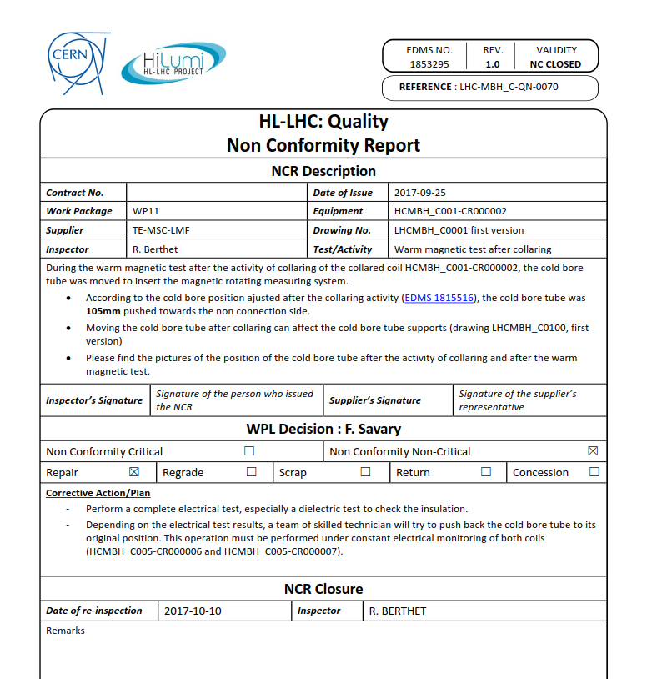
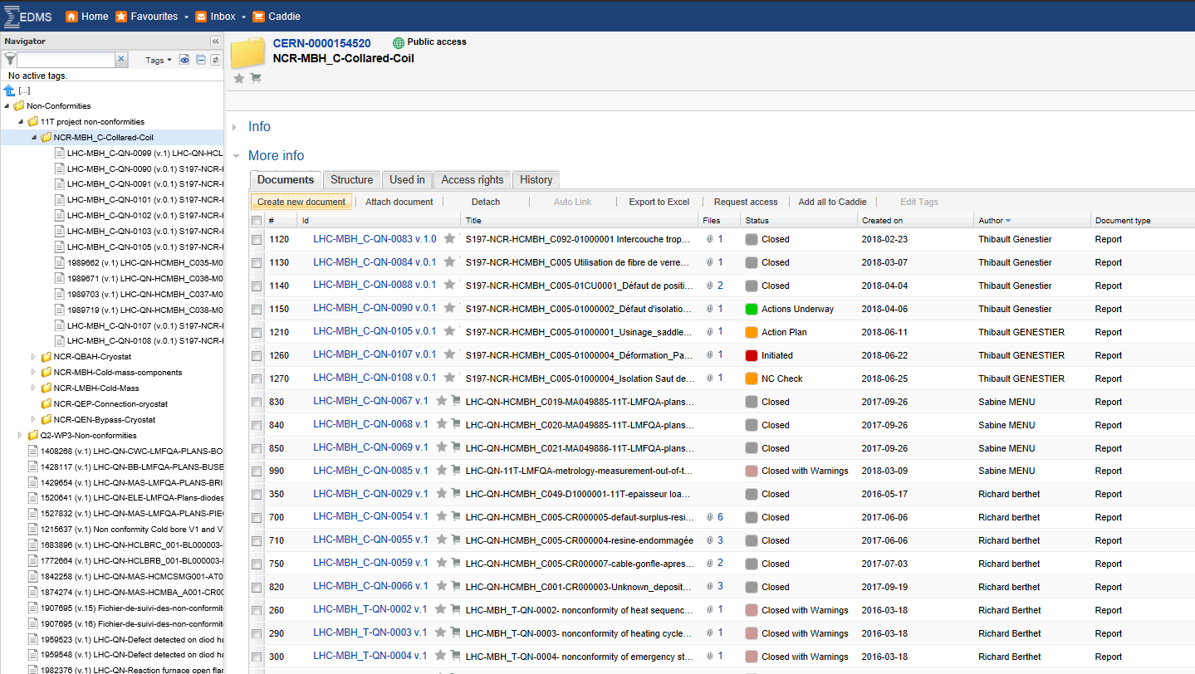
Non conformities
MBH_C-Collared-Coil
123 NCR initiated
13 ongoing (10%)

Slide 18
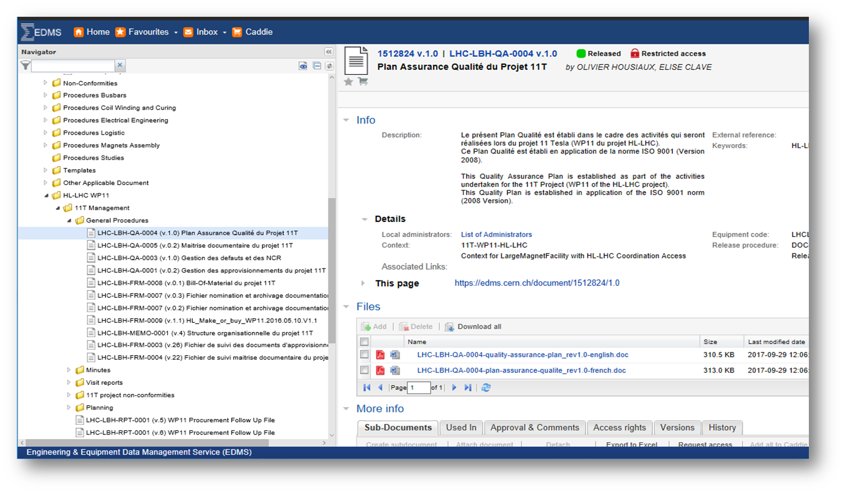
Equipment Data and Management System (EDMS)

Slide 19
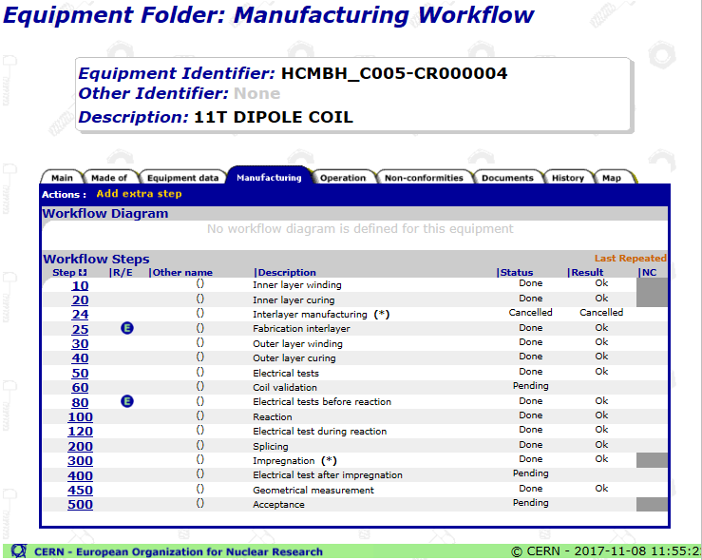
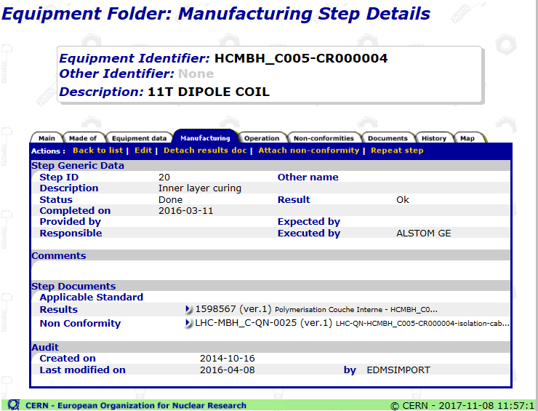
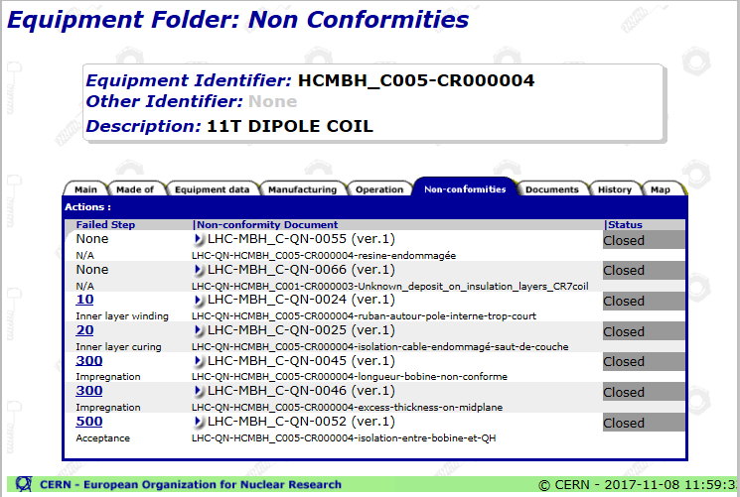
Manufacturing and Test Folder (MTF)

Slide 20
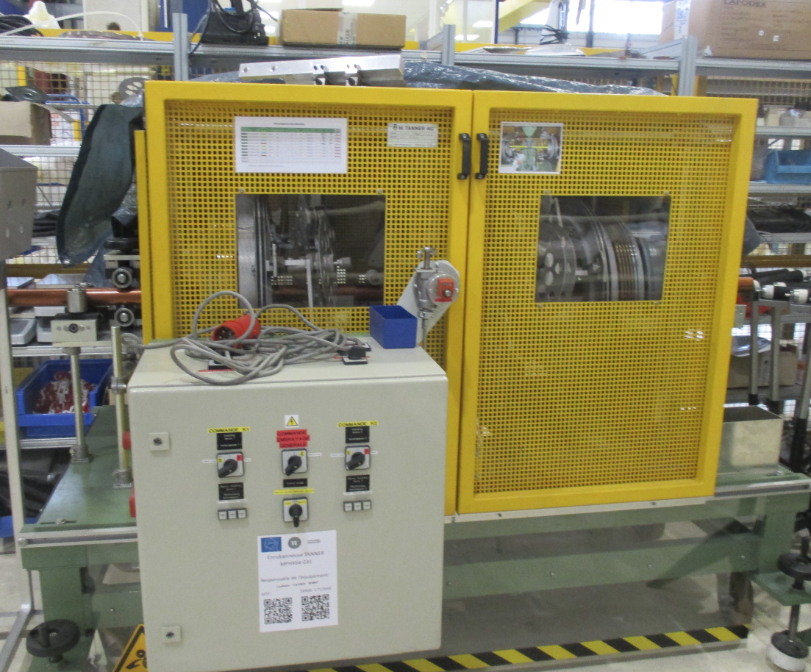
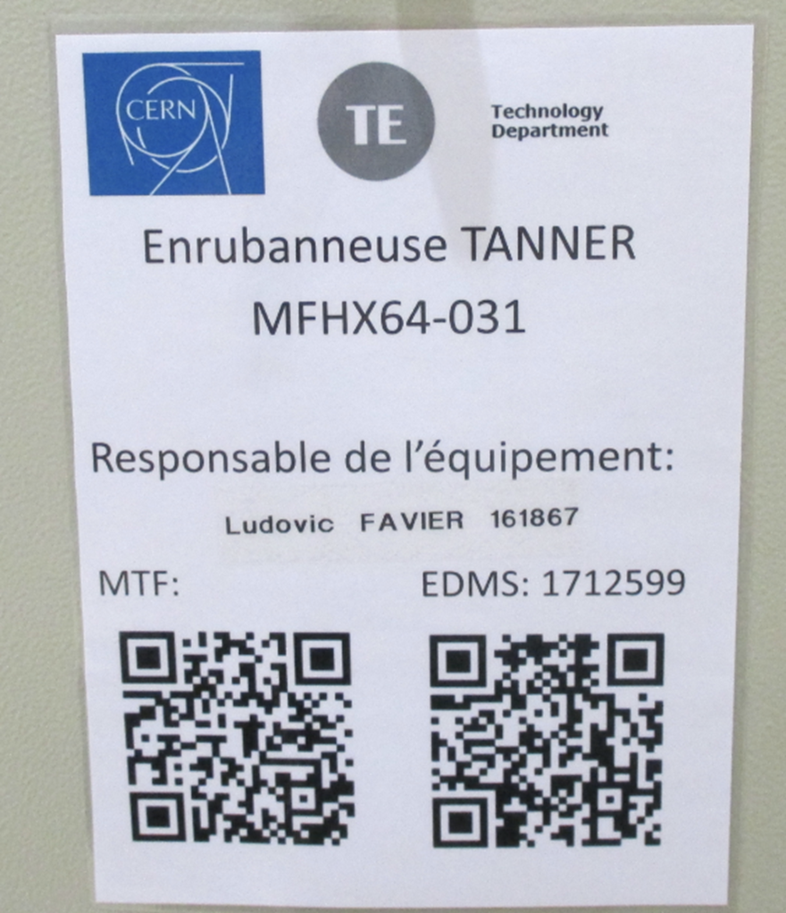
Tooling conformity and documentation

Slide 21
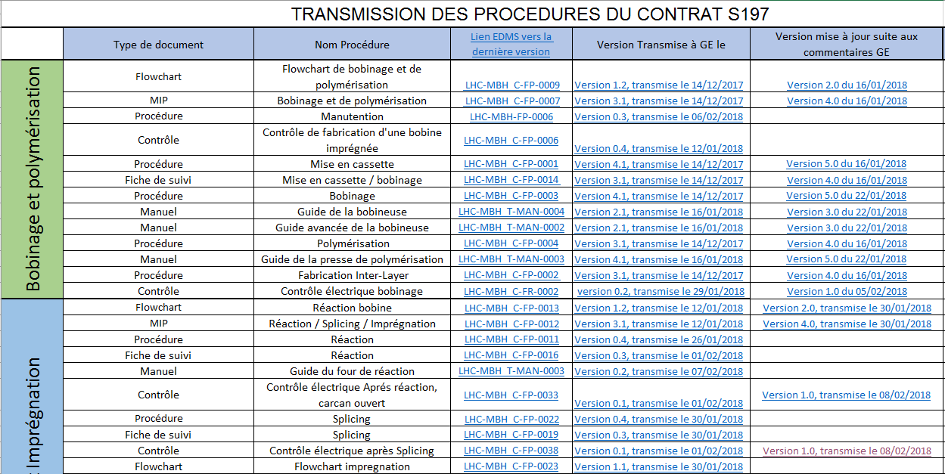
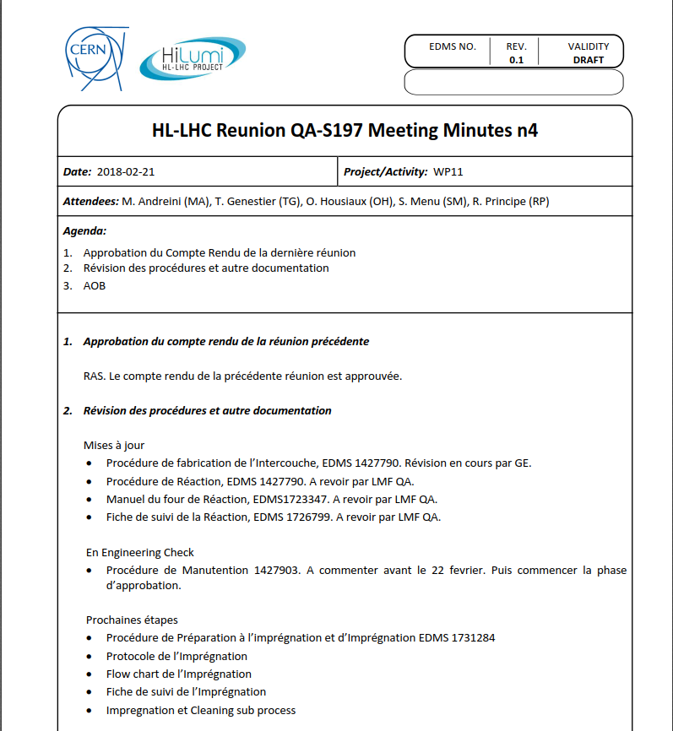
Contract S-197 WP11
Make the contract autonomous incl. QA/QC so far
Provide the fabrication procedures, flow charts, MIPs, follow up files, control procedure, et.
Provide the QC when needed (QA or WPL)
EDMS and MTF training and support
Today 0.4 FTA attributed to this task (weekly meeting on NCR and procedures to be discussed with WPL, WPE, et).

Slide 22
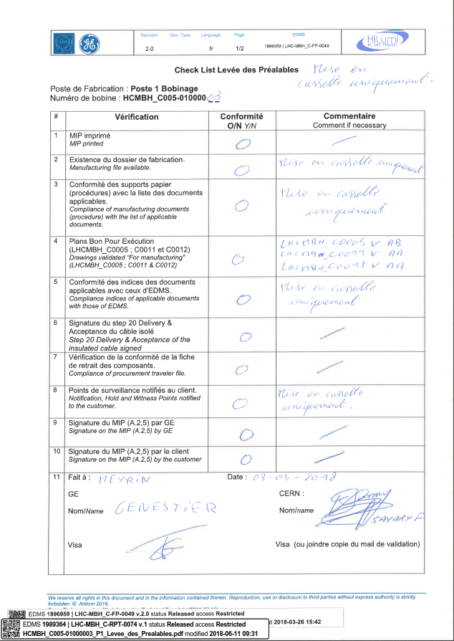
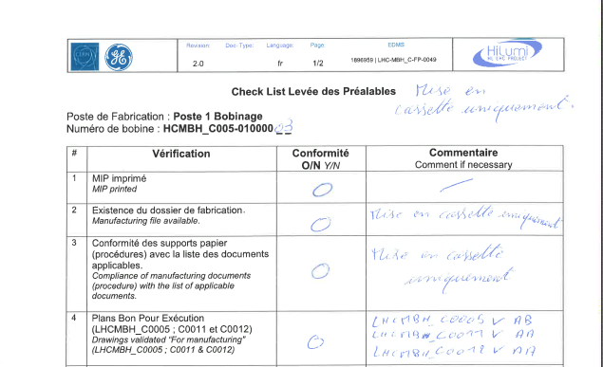
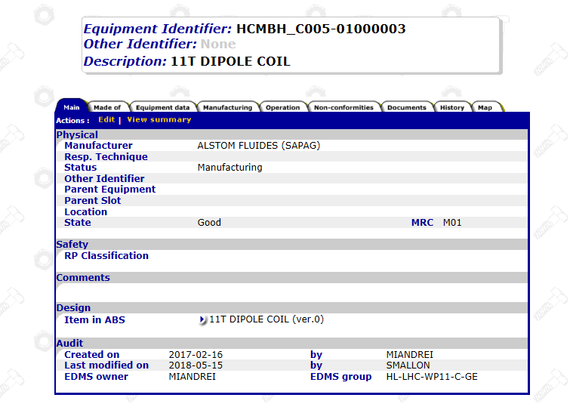
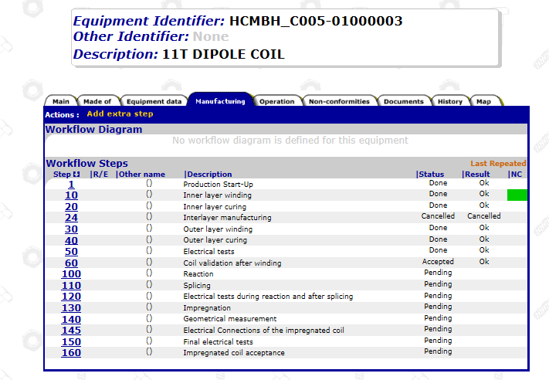
S197 Levée des Préalables

Slide 23
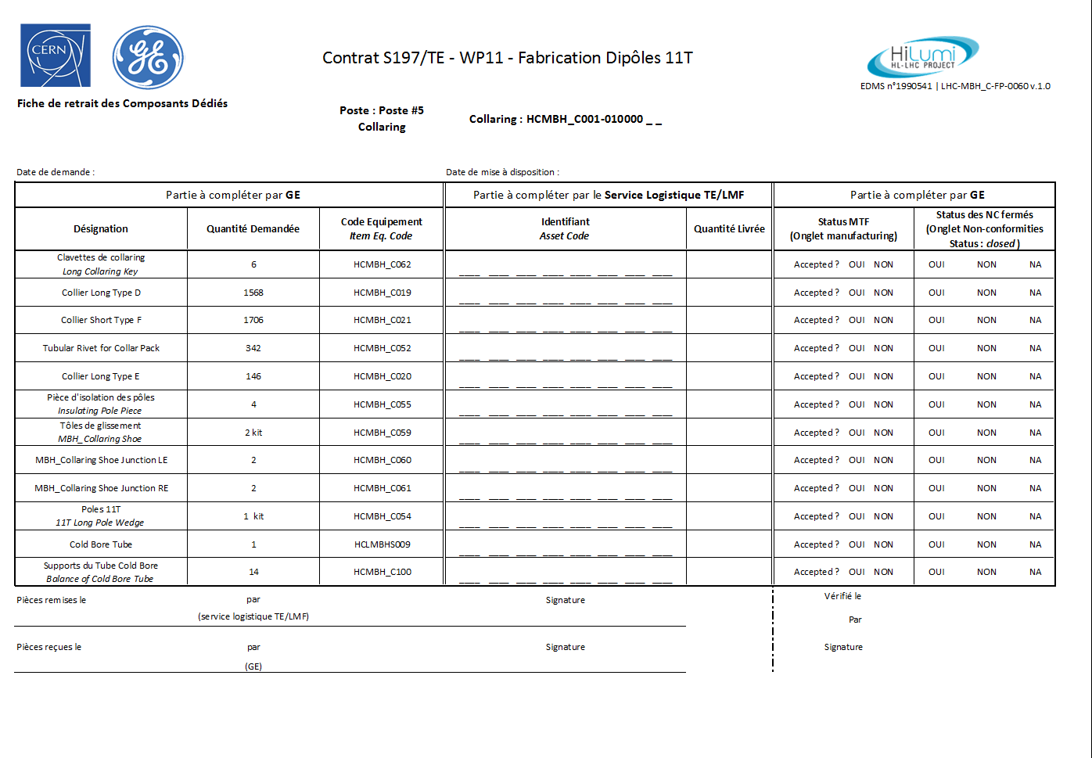
S197 Fiche de Retrait des Composants

Slide 24
Conclusion

Slide 25


Slide 26
Annex I – Busbars documentation
Title | Doc type | EDMS | Status
Flowchart fabrication busbar isolé | Flowchart | LHC-LMBHE-FP-0002 | Released
BOM fabrication busbar + Goulotte | BOM | LHC-LMBHE-FP-0008 | Engineering check
Fabrication busbar isolé-11T-Type B | MIP | LHC-LMBHE-FP-0003 | Released
Fabrication busbar isolé-11T-Type A | MIP | LHC-LMBHE-FP-0013 | In Work
Fabrication busbars | Procédure | LHC-LMBHE-FP-0001 | In Work
 | Fiche de suivi-Type B | LHC-LMBHE-FP-0004 | Engineering check
Contrôle de fabrication busbar isolé | Procédure | LHC-LMBHE-FP-0005 | In Work
Fabrication goulotte | MIP type B | LHC-LMBHE-FP-0011 | In Work
 | MIP type A | LHC-LMBHE-FP-0015 | In Work
 | Fiche de suivi | LHC-LMBHE-FP-0009 | Engineering check
 | Procédure
Contrôle de fabrication de la mise en goulotte | Procédure | LHC-LMBHE-FP-0012 | In Work

Slide 27
Annex I - Cold Mass Assembly
Title | Doc type | EDMS | Status
Assemblage d'une masse froide | Flowchart | LHC-LMBH-FP-0001 | Released
Manufacturing and Inspection Plan d'assemblage d'une masse froide | MIP | LHC-LMBH-FP-0002 | In Work
Assemblage culasse | Procédure | LHC-MBH-FP-0014 | Released
 | Fiche de suivi | LHC-MBH-FP-0013 | Released
Fiche de suivi d'assemblage d'une masse froide | Fiche de suivi | LHC-LMBH-FP-0018 | In Work
Active part assembly | Procédure | LHC-LMBH-FP-0008 | In Work
Longitudinal welding 11T coldmass | Procédure | LHC-LMBH-FP-0005 | In Work
Connexions D1, D2, C3 | Procédure | LHC-LMBH-FP-0019 | In Work
 | Fiche de suivi | LHC-LMBH-FP-0007 | In Work
Dipole 11T Nb3Sn Coldmass Extremities Set-Up | Procédure | LHC-LMBH-FP-0022 | In Work
Cintrage des busbars | Procédure | LHC-LMBH-FP-0023 | In Work
Soudure des extrémités des masses froides | Procédure | LHC-LMBH-FP-0009 | Draft for discussion
 | Fiche de suivi | LHC-LMBH-FP-0010 | Draft for discussion
Connection de l'IFS | Procédure | LHC-LMBH-FP-0024 | Draft for discussion
Préparation aux tests en pression | Procédure | LHC-LMBH-FP-0021 | In Work
Connexion au banc de test en pression | Procédure | 1566971 | Released
Contrôles de la masse froide | Procédure | LHC-LMBH-FP-0020 | In Work

Slide 28
Annex I - Electric tests
Title | Doc type | EDMS | Status
Procédure tests électriques bobines collarée et bobine | Procédure | LHC-MBH_C-FP-0063 | In Work
During-winding | Fiche de test | LHC-MBH_C-FR-0002 | Released
Before-reaction-Fixture-Closed | Fiche de test | LHC-MBH_C-FP-0020 | In Work
After-reaction-Fixture-Closed | Fiche de test | LHC-MBH_C-FP-0035 | Engineering check
After-reaction-Mould-Open | Fiche de test | LHC-MBH_C-FP-0033 | Released
After-Splicing | Fiche de test | LHC-MBH_C-FP-0038 | Released
Quench Heater check | Fiche de test | LHC-LMBHE-FP-0007 | In Work
Before-Impregnation-Fixture-Closed | Fiche de test | LHC-MBH_C-FP-0036 | Released
After-Impregnation-Fixture-Closed | Fiche de test | LHC-MBH_C-FP-0037 | Released
After-Impregnation-Outer-Mould | Fiche de test | LHC-MBH_C-FP-0021 | Released
Before-Collaring-Assembly | Fiche de test | LHC-MBH_C-FP-0018 | Released
After-Collaring-Assembly | Fiche de test | LHC-MBH_C-FP-0032 | Released
Monitoring-Collaring | Fiche de test | LHC-MBH_C-FP-0041 | Released
Test elec busbars LHCMBHA | Fiche de test | LHC-LMBHE-FP-0018 | Under approval
Test elec busbars LHCMBHB | Fiche de test | LHC-LMBHE-FP-0019 | Under approval
Test elec-goulotte-LHCLMBHE-M1, M2 & M3-Type-A | Fiche de test | LHC-LMBHE-FP-0016 | Under approval
Test elec-goulotte-LHCLMBHE-M1, M2 & M3-Type-B | Fiche de test | LHC-LMBHE-FP-0017 | Under approval
Fiche-tests-Before-Welding-Before-Pressing | Fiche de test | LHC-LMBH-FP-0012 | In Work
Fiche-tests-BeforeWelding-UnderLoad | Fiche de test | LHC-LMBH-FP-0013 | In Work
Fiche-tests-AfterWelding | Fiche de test | LHC-LMBH-FP-0014 | In Work
Fiche-tests-Before-End-Cup-Set-Up | Fiche de test | LHC-LMBH-FP-0015 | In Work
Fiche-tests-After-Capillary-Set-Up | Fiche de test | LHC-LMBH-FP-0016 | In Work
Fiche-tests-After-Capillary-Forming | Fiche de test | LHC-LMBH-FP-0017 | In Work

