Slide 1
WP11 – Production Readiness Review
Manufacturing and Inspection Plan
Olivier Housiaux
With contributions from: R. Berthet, S. Menu, R. Principe, S. Menu
11T PRR - 04/07/2018

Slide 2

Agenda
What is the MIP
How were they created,
List of the MIPs and Status,
What can be find in the MIPs,
MIP In Field (Procedure, Follow up file),
Controls procedures,
Hold point and traceability in MTF.

Slide 3
The Manufactured and Inspection Plan
The MIPs are the reference document that insure the manufacturing was properly done.
The MIPs are compliant with the HL-LHC template.
The MIP lists:
  The manufacturing steps,
  The inspection steps,
  The version of procedures and drawings used for the production.

Slide 4
The Manufactured and Inspection Plan
In the MIPs, there are different Inspection codes:
  Hold points: CERN, or its authorized representative, is informed that a specific step has been completed. The work-flow is stopped until CERN, or its authorized representative, provides a Hold Point Clearance.
  Witness points: CERN, or its authorized representative, intends to attend any specific step of the production.
  Review: The quality records will be reviewed.
  Notification points: CERN, or its authorized representative, is informed 5 working days in advance that a specific step.

Slide 5
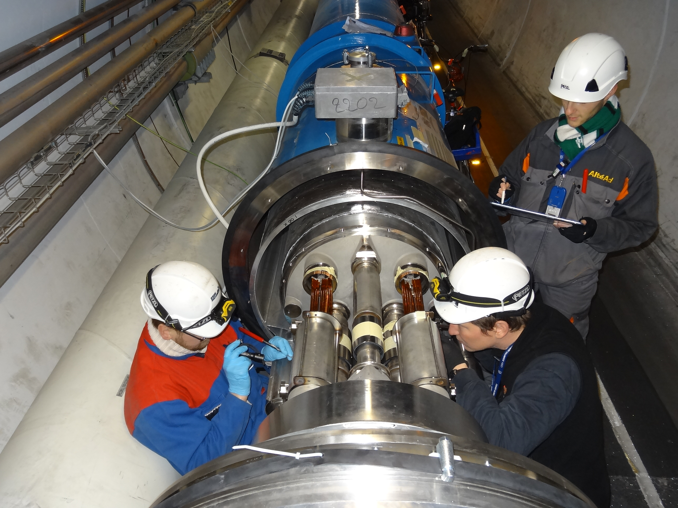
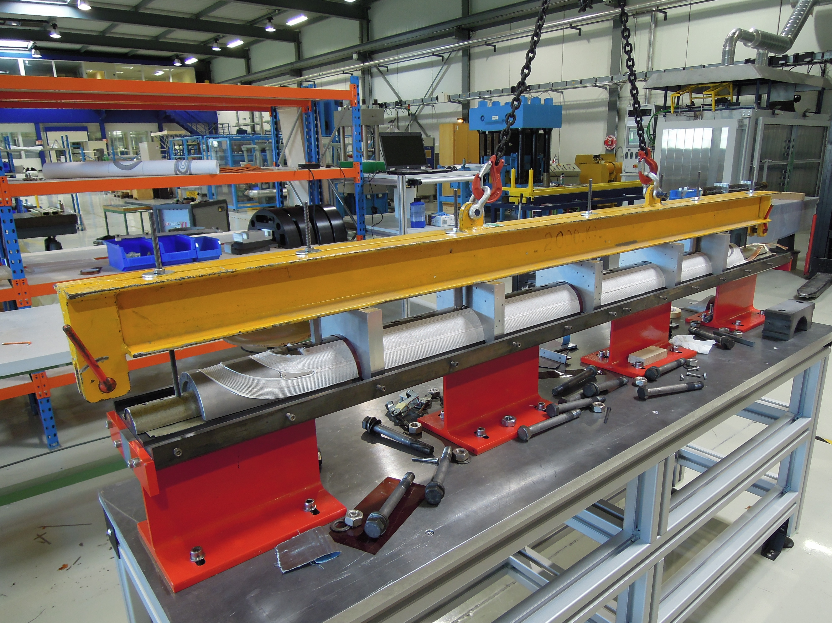
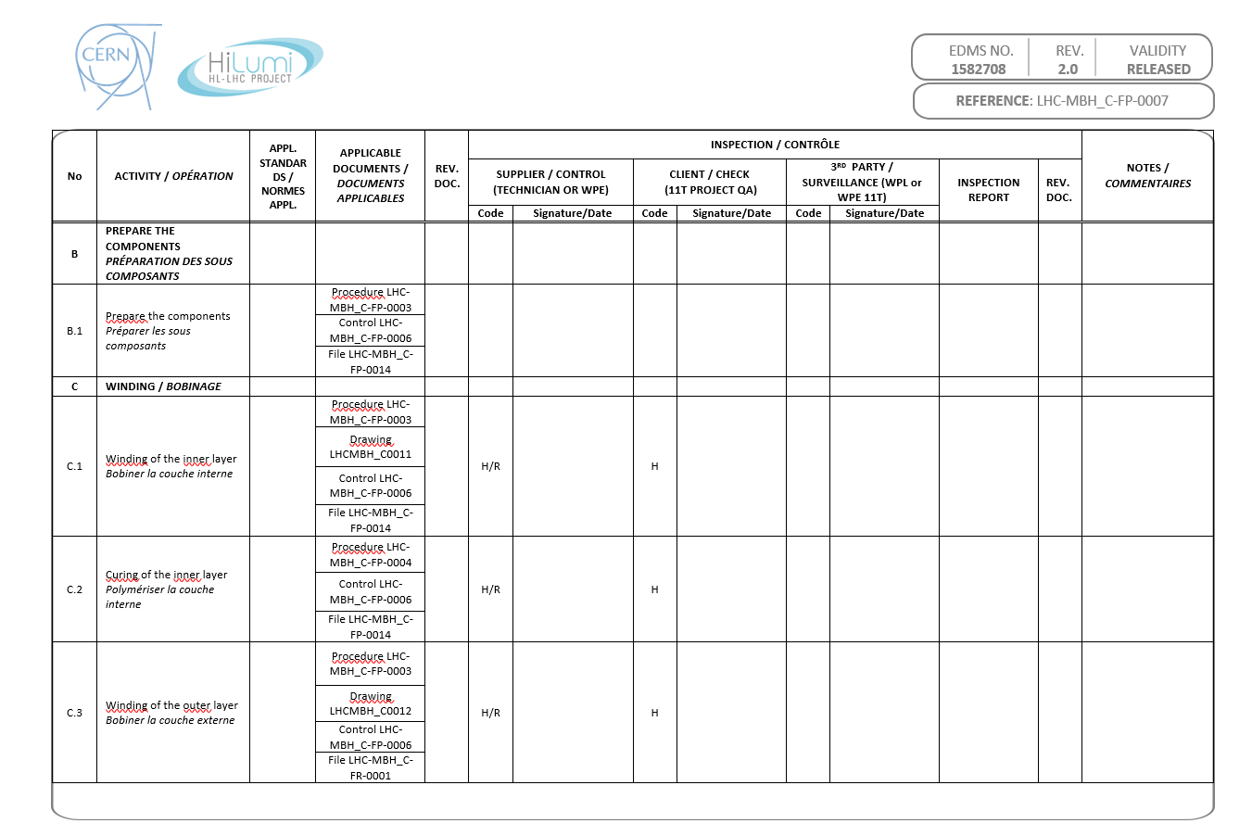
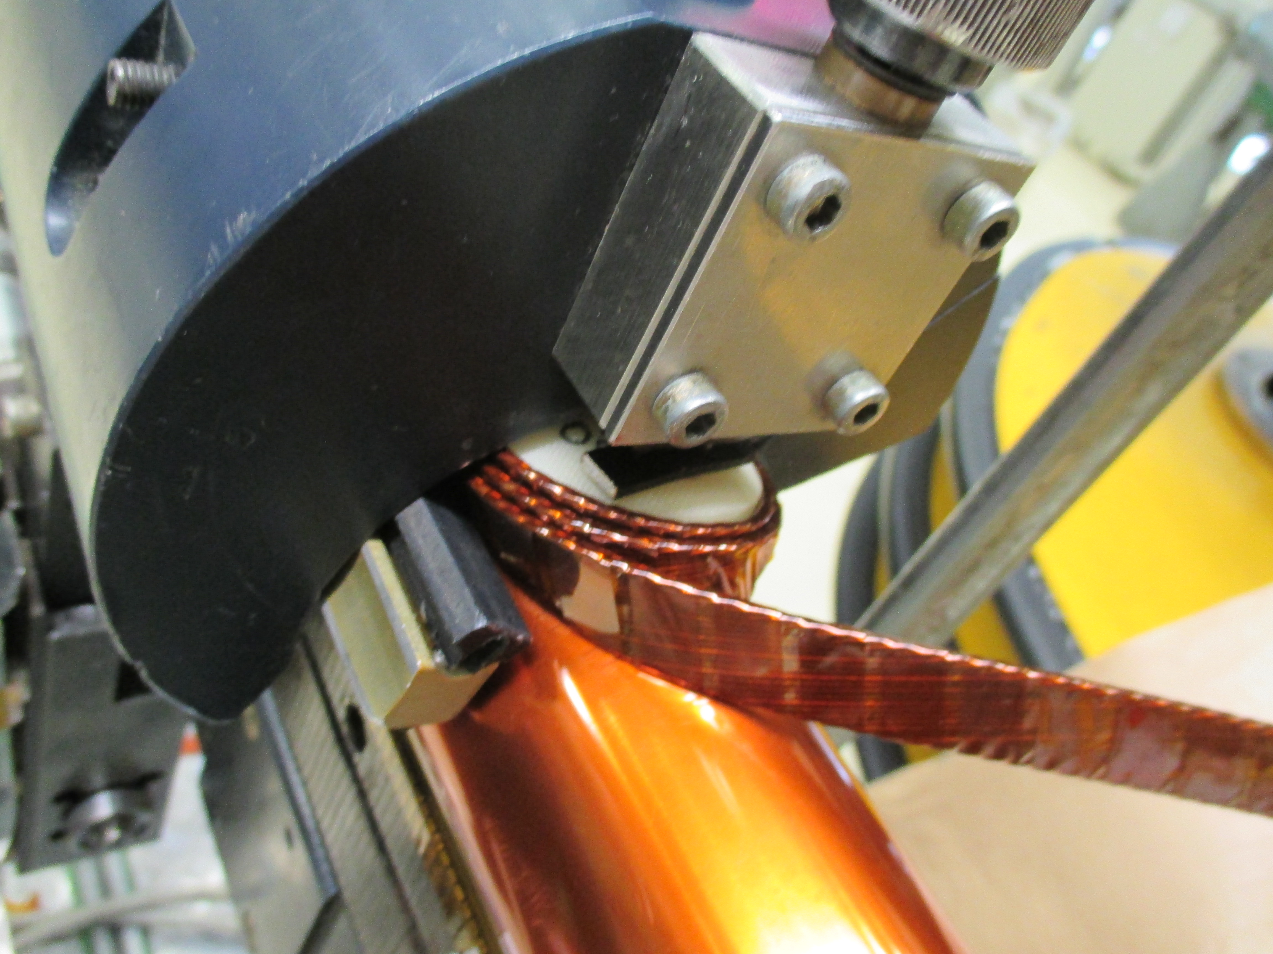
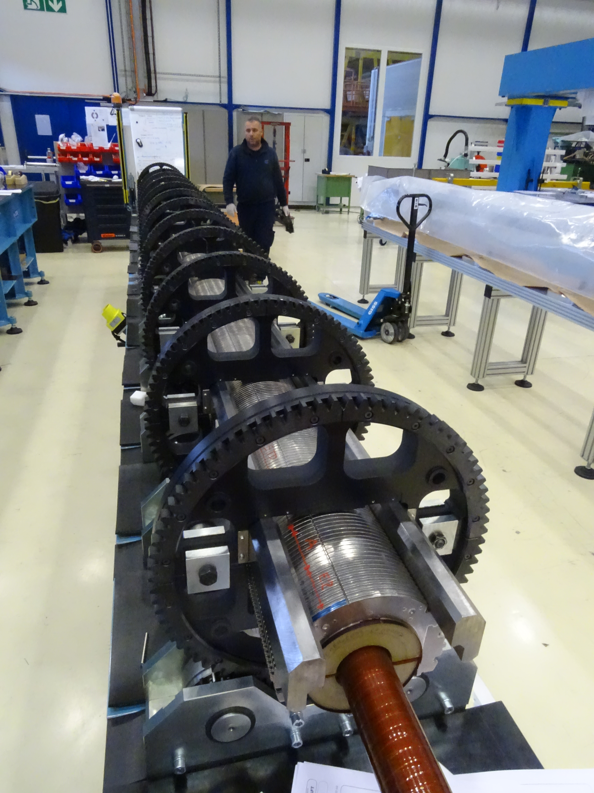
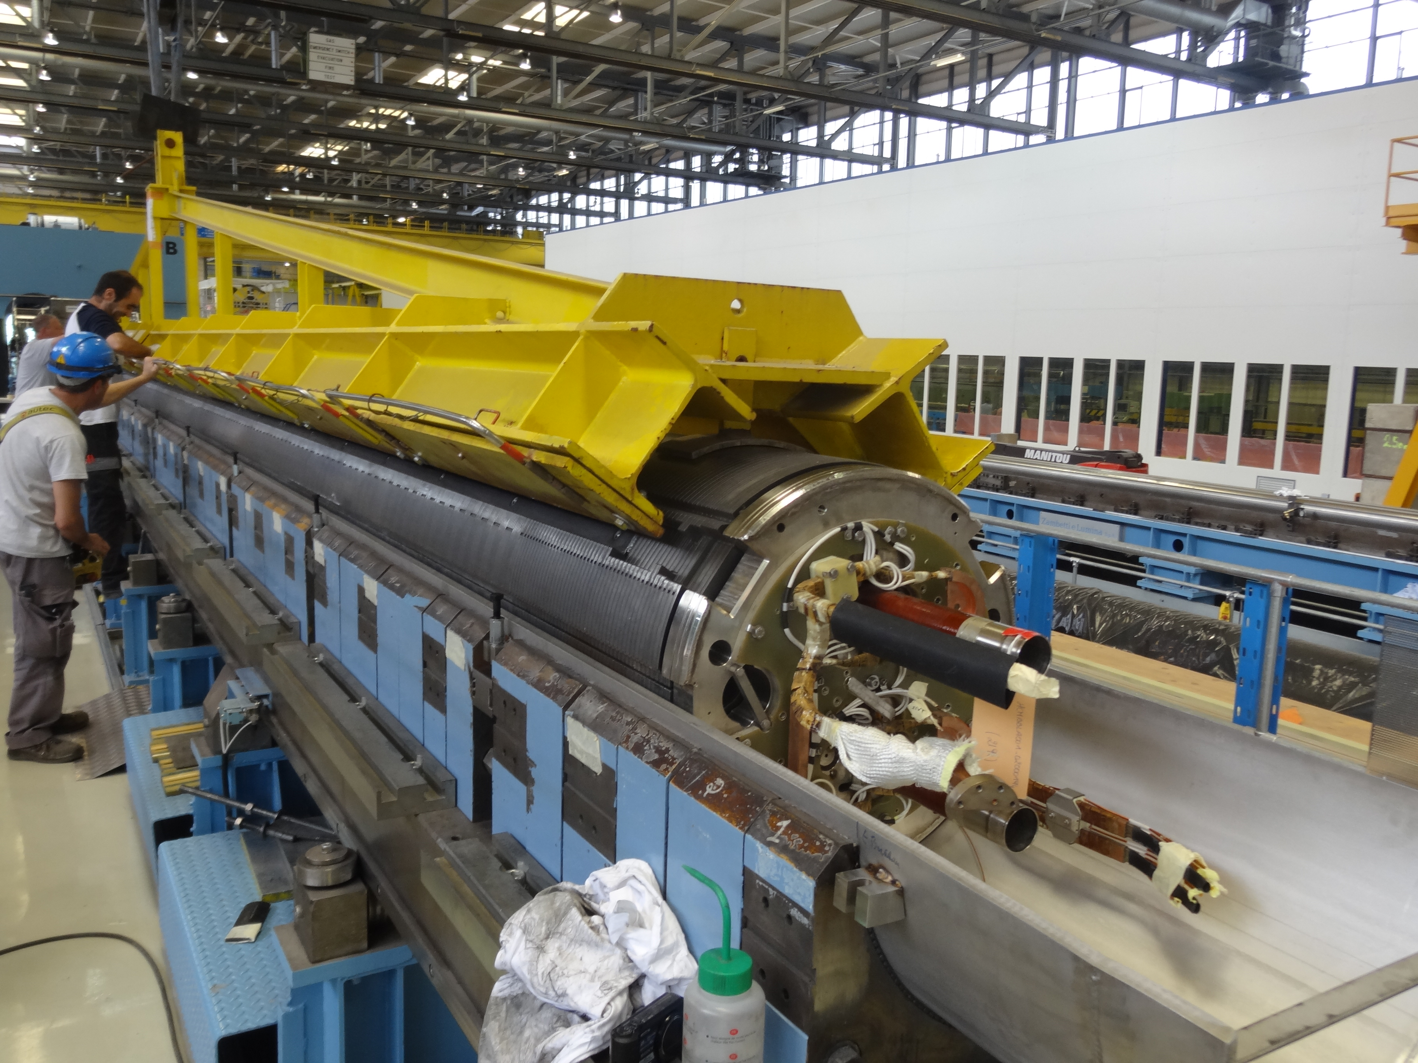
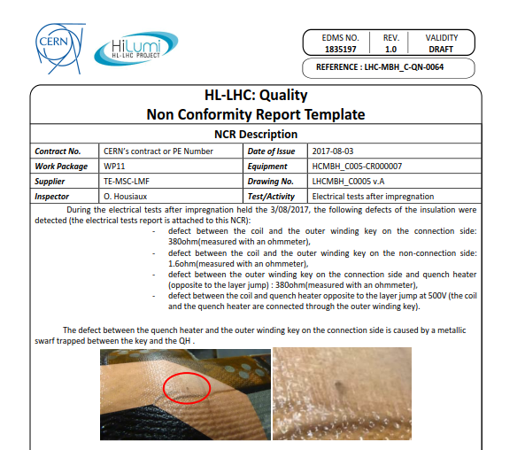
How were they created?
The MIPs were matured thanks to the on-field experience
LS1
Short Models (927)
Main LHC Dipoles
Corrective actions after NC
Long prototypes

Slide 6
Status of the MIPs
The manufacturing of the 11T dipole should covers many activities;
  Coil’s winding and curing (LHC-MBH_C-FP-0007):
    Approved,
    Adapted to insure the follow up of the contract S197,
  Coil’s Reaction and impregnation (LHC-MBH_C-FP-0012):
    Approved,
    Adapted to insure the follow up of the contract S197,

Slide 7
Status of the MIPs
  Coils’ collaring (LHC-MBH_C-FP-0026):
    Approved,
    Adapted to insure the follow up of the contract S197,
  Cold mass manufacturing (LHC-LMBH-FP-0002):
    Approved,
    Tested on the first prototype,
  Busbars manufacturing (LHC-LMBHE-FP-0003):
    Approved,
    Actually used on field.

Slide 8
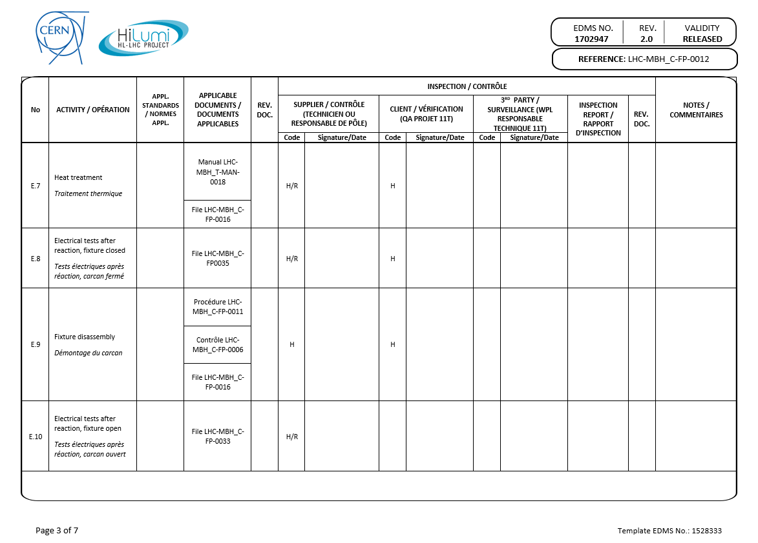
MIP’s Template
Description of the operation
Validation (operators or contractors)
3rd party (if any)
Documentation traceability
CERN Controls
Reports

Slide 9
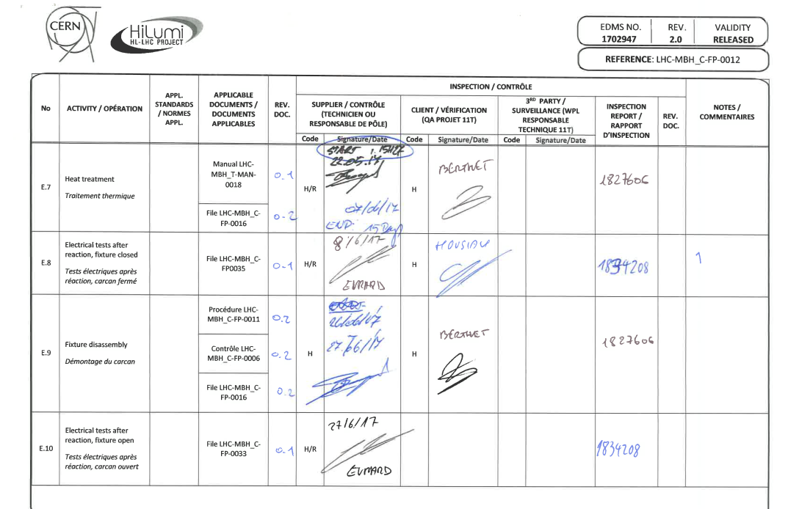
MIPs in reality
Description of the operation
Validation (operators or contractors)
3rd party (if any)
Documentation traceability
CERN Controls
Reports

Slide 10
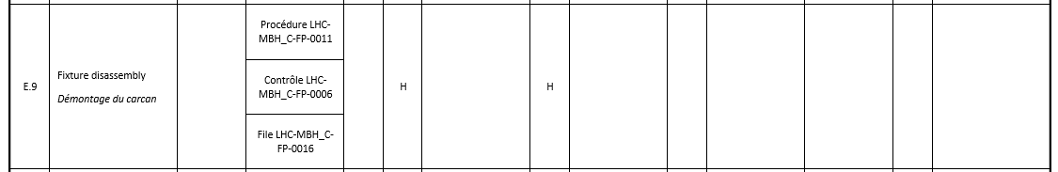
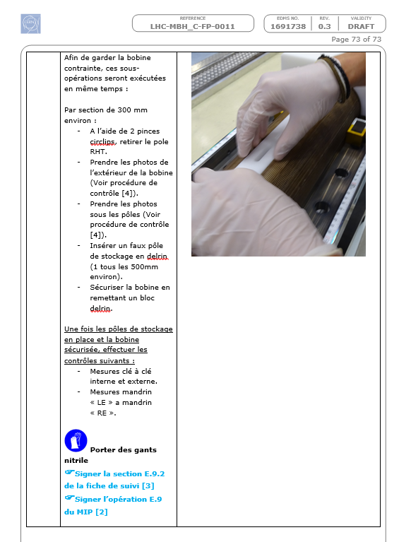
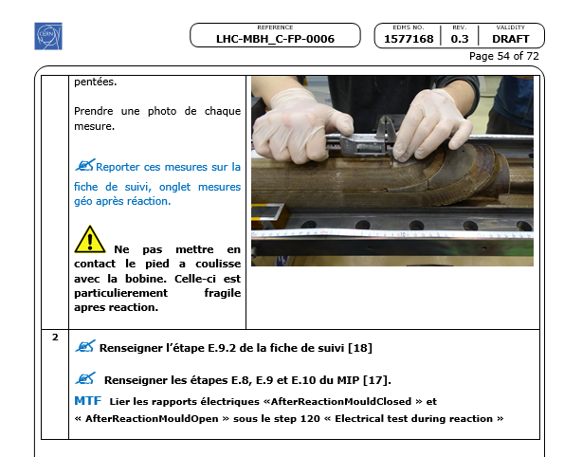
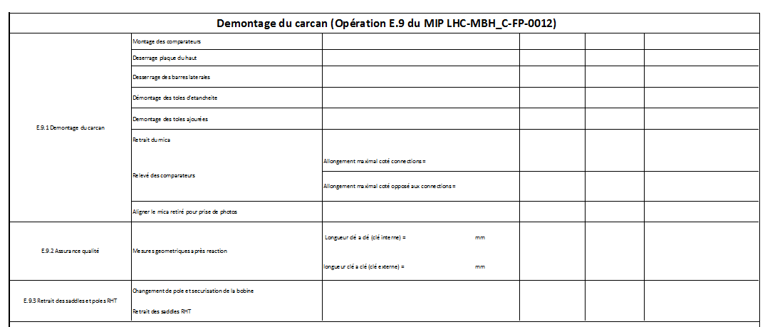
What can be found in the MIPs
The procedures
The Control procedure
The Follow up files

Slide 11
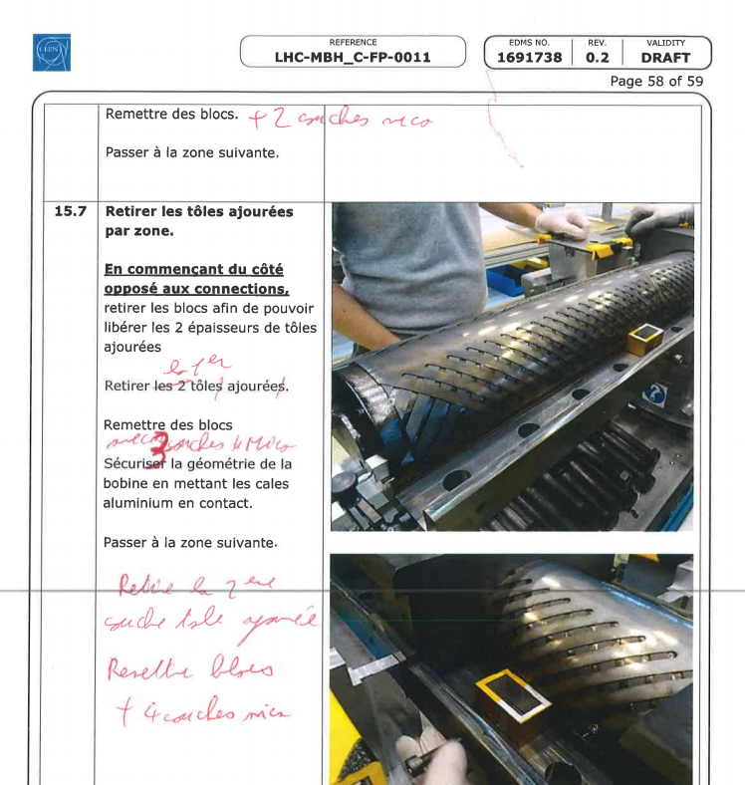
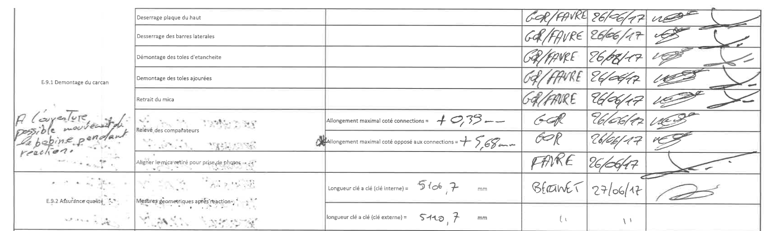
How the MIP is filled in
Procedures used (even annotated)
The Follow up file

Slide 12
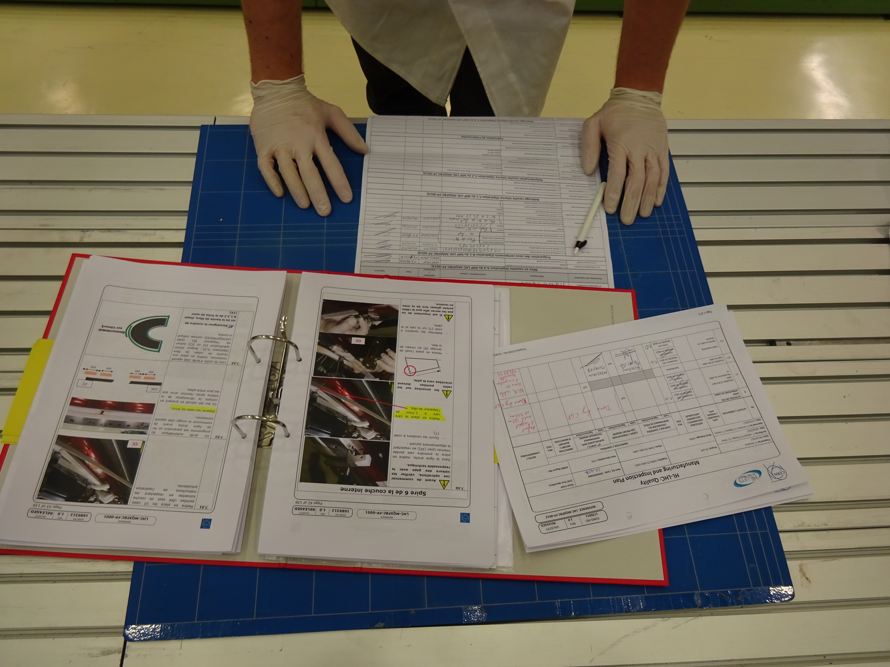
In field : MIPs, Procedure and Follow up files
    The technician / sub contractor have all documentation in field:
The Follow up file
The procedures
The MIP

Slide 13
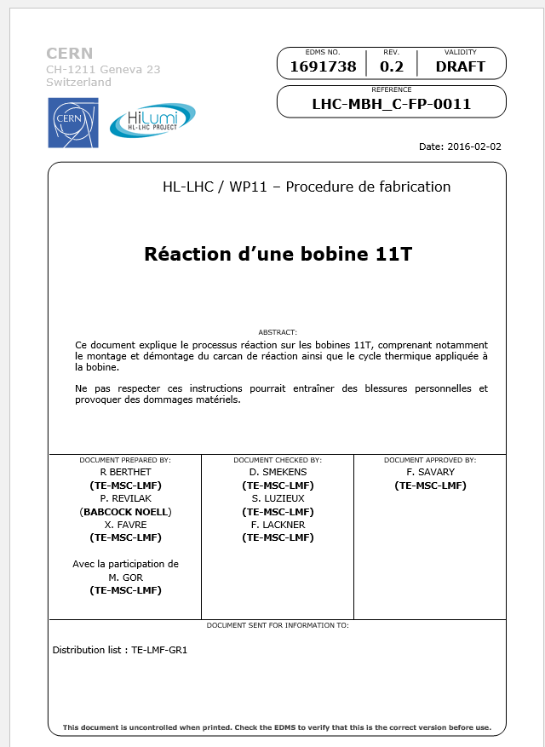
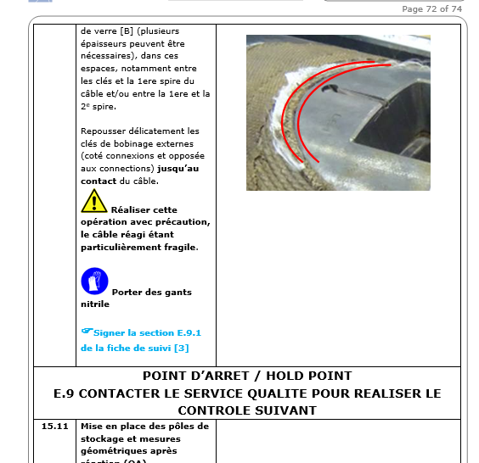
In field : MIPs, Procedure and Follow up files
  The procedure indicates :
    The information to be filled in the Follow up file by the technician:
    The Hold points.

Slide 14
Control procedures
Each Hold point /Review… can be found in the related Control Procedures
  In field Inspection,
  Documentation,
  Traceability in MTF.
Control procedure
Validation of the control
Documentation in EDMS / MTF

Slide 15
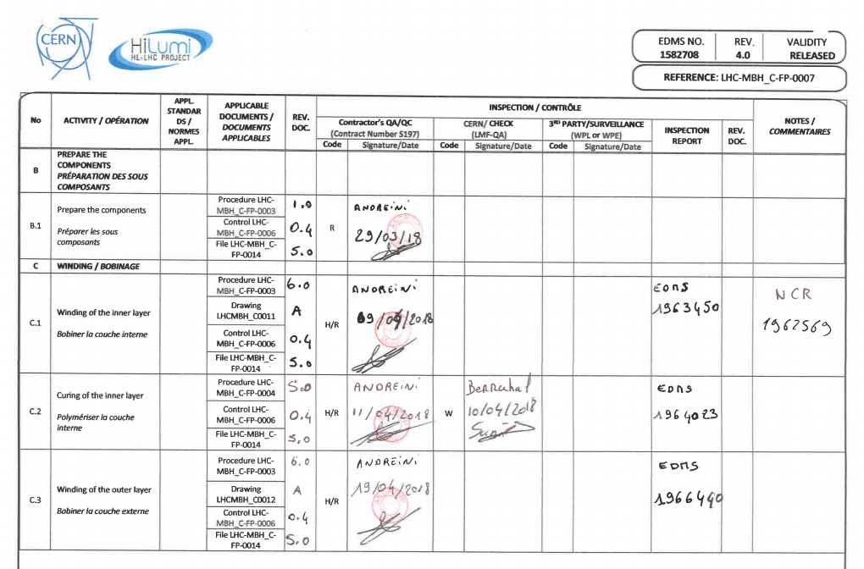
Tracability of the hold point in MTF
    The traceability in the MIP (Contract S197, Coils assembly)

Slide 16
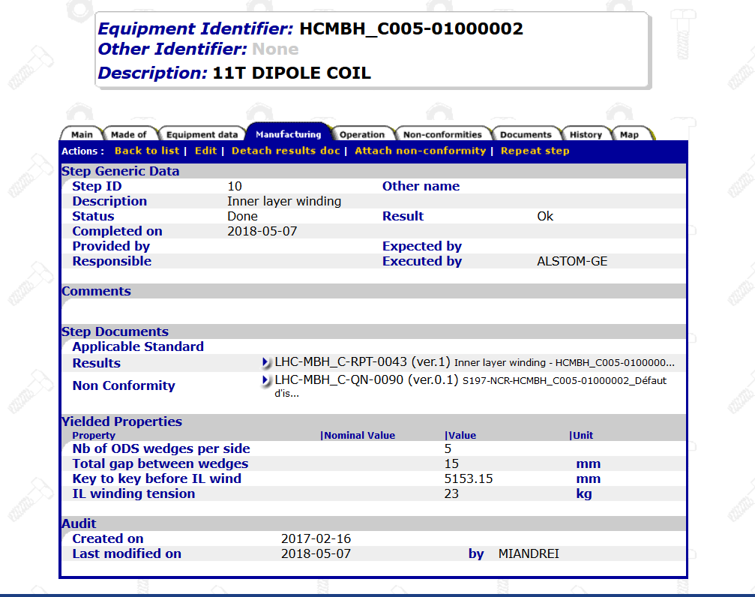
Tracability of the hold point in MTF

Slide 17
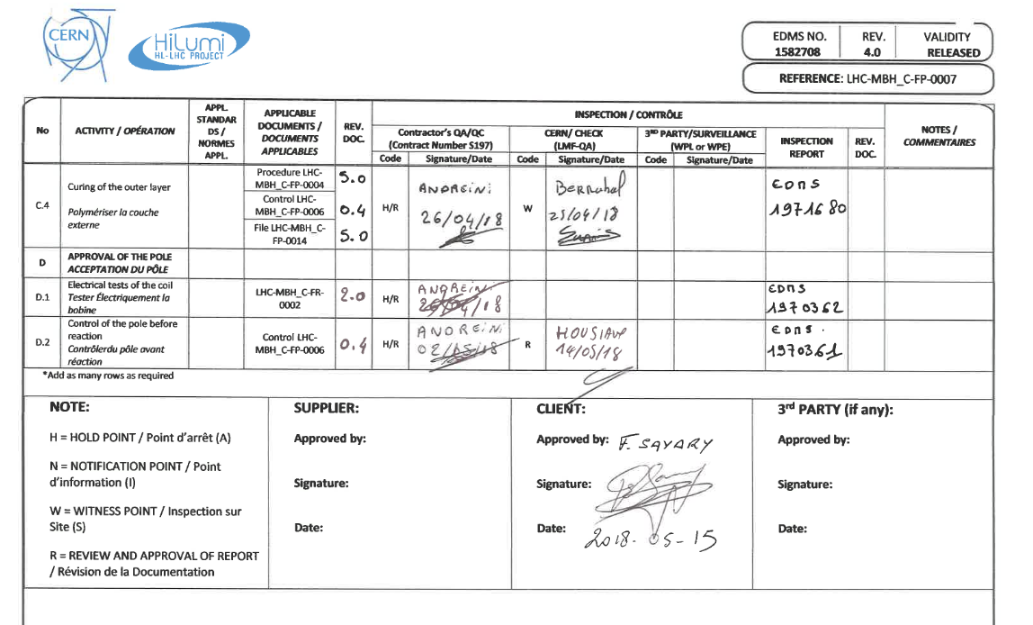
Tracability of the hold point in MTF
    The traceability of the acceptance by CERN (Contract S197, Coils assembly)
Review of the traceability in MTF
Formal acceptance before resuming the production

Slide 18
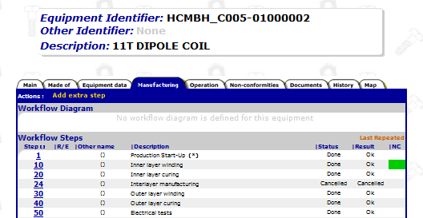
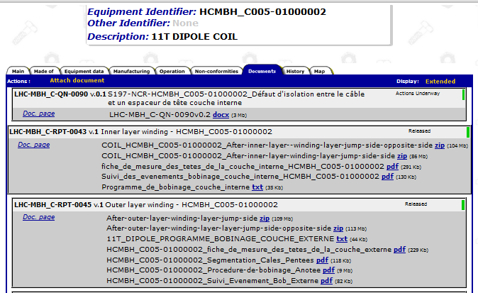
Tracability of the hold point in MTF
    Review of MTF(Contract S197, Coils assembly)
      Done in respect with the control procedure.
All documentation required linked
All steps filled in

Slide 19
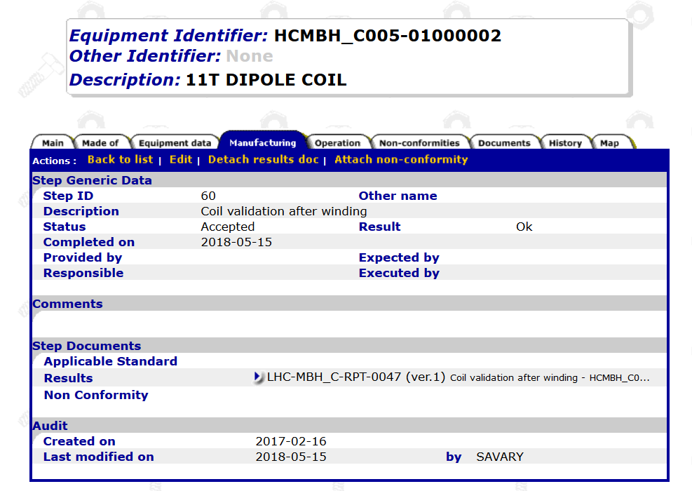
Tracability of the hold point in MTF
    Formal Acceptance in MTF(Contract S197, Coils assembly)

Slide 20
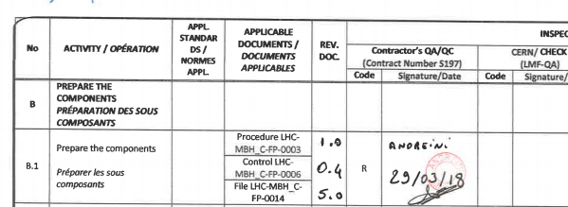
Control of the components before installation
    All MIPs contains, specific Hold points to ensure that the components to be installed are accepted by the Technical responsible:

Slide 21
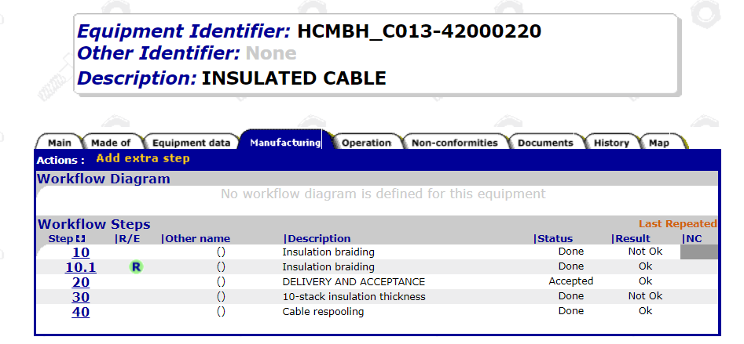
Control of the components before installation
    This control (describes in the control procedure) is done in MTF by the Technical Responsible:

Slide 22
Conclusion
For the production today:
  MIP in released
  Follow Up File in released,
All the Assets informed in MTF (Hold points..),
Component documentation
  Today available in EDMS
  in MTF as soon as the BOM approved

Slide 23
Thank you

