Slide 1
Production Readiness Review for 11T collared coils and cold mass
Draft: Procedures (fabrication and inspection)¶
F. Lackner, & input from QA-LMF (R. Principe and colleagues)
  Show one or a couple of examples of manufacturing procedures, e.g. one on cc, another one on cm
  Show one or a couple of examples of inspection procedures, e.g. one on cc, another one on cm
  Structure and content of the procedures
  Describe how they are used at the shop floor level

Slide 2
Coil fabrication
Bobinage
Mise en cassette | Procédure | LHC-MBH_C-FP-0001 | Released
 | Spec d'approvisionnement des tourets | LHC-MBH_C-FRM-0007 | Released
Bobinage | Procédure | LHC-MBH_C-FP-0003 | Released
 | Fiche de suivi | LHC-MBH_C-FP-0014 | Released
Fabrication Inter-Layer | Procédure | LHC-MBH_C-FP-0002 | Released
Contrôle de fabrication d'une bobine | Procédure | LHC-MBH_C-FP-0006 | Engineering check
Polymérisation
Polymérisation | Procédure | LHC-MBH_C-FP-0004 | Released
Réaction / imprégnation
Flowchart fabrication bobine impregnation | Flowchart | LHC-MBH_C-FP-0023 | Released
Réaction bobine | Flowchart | LHC-MBH_C-FP-0013 | Released
Assemblage du carcan de réaction Réaction bobine | Procédure | LHC-MBH_C-FP-0011 | Released
 | Fiche de suivi | LHC-MBH_C-FP-0016 | Released
 | Guide d'utilisation du four | LHC-MBH_C-MAN-0004 | Released
Splicing | Procédure | LHC-MBH_C-FP-0022 | Released
 | Fiche de suivi | LHC-MBH_C-FP-0019 | Released
Impregnation fixture assembly | Fiche de suivi | LHC-MBH_C-FP-0024 | Released
 | Procédure | LHC-MBH_C-FP-0017 | Released
Protocole d'Imprégnation | Procédure | LHC-MBH_C-FP-0025 | Released
Impregnation and cleaning sub process | Procédure | LHC-MBH_C-FP-0040 | Released
Préparation des connexions éléctriques dúne bobine | Procédure | LHC-MBH_C-FP-0043 | Engineering check
 | Fiche de suivi | LHC-MBH_C-FP-0044 | Engineering check

Slide 3
Collared coil fabrication
Collaring
Procédure d'assemblage des colliers de collaring | Procédure | LHC-MBH_C-FP-0015 | Engineering check
Fabrication insulation for collared coil | Procédure | LHC-MBH_C-FP-0028 | Engineering check
Collaring | Fiche de suivi | LHC-MBH_C-FP-0034 | In Work
 | Procédure | LHC-MBH_C-FP-0031 | In Work
Autres
Contrôle métrologique de la bobine imprégnée | Procédure | LHC-MBH_C-FP-0010 | Released
Contrôle dimensionnel bobine collarée | Procédure | LHC-MBH_C-FP-0045 | In Work
Manutention dipôles | Procédure | LHC-MBH-FP-0006 | Under Approval

Slide 4
Busbar
Nom Procédure | Fiches de suivi et tests | Lien EDMS | Statut dans EDMS
Fabrication busbars | Procédure | LHC-LMBHE-FP-0001 | In Work
 | Fiche de suivi-Type B | LHC-LMBHE-FP-0004 | Engineering check
Contrôle de fabrication busbar isolé | Procédure | LHC-LMBHE-FP-0005 | In Work
Fabrication goulotte | Fiche de suivi | LHC-LMBHE-FP-0009 | Engineering check
 | Procédure
Contrôle de fabrication de la mise en goulotte | Procédure | LHC-LMBHE-FP-0012 | In Work

Slide 5
Cold mass assembly
Nom Procédure | Fiches de suivi et tests | Lien EDMS | Statut dans EDMS
Assemblage culasse | Procédure | LHC-MBH-FP-0014 | Released
 | Fiche de suivi | LHC-MBH-FP-0013 | Released
Fiche de suivi d'assemblage d'une masse froide | Fiche de suivi | LHC-LMBH-FP-0018 | In Work
Active part assembly | Procédure | LHC-LMBH-FP-0008 | In Work
Longitudinal welding 11T coldmass | Procédure | LHC-LMBH-FP-0005 | In Work
Connexions D1, D2, C3 | Procédure | LHC-LMBH-FP-0019 | In Work
 | Fiche de suivi | LHC-LMBH-FP-0007 | In Work
Dipole 11T Nb3Sn Coldmass Extremities Set-Up | Procédure | LHC-LMBH-FP-0022 | In Work
Cintrage des busbars | Procédure | LHC-LMBH-FP-0023 | In Work
Soudure des extrémités des masses froides | Procédure | LHC-LMBH-FP-0009 | Draft for discussion
 | Fiche de suivi | LHC-LMBH-FP-0010 | Draft for discussion
Connection de l'IFS | Procédure | LHC-LMBH-FP-0024 | Draft for discussion
Préparation aux tests en pression | Procédure | LHC-LMBH-FP-0021 | In Work
Connexion au banc de test en pression | Procédure | 1566971 | Released
Contrôles de la masse froide | Procédure | LHC-LMBH-FP-0020 | In Work

Slide 6
Electrical tests
Nom Procédure | Fiches de suivi et tests | Lien EDMS | Statut dans EDMS
Coil winding and curing
Procédure tests électriques bobines collarée et bobine | Procédure | LHC-MBH_C-FP-0063 | In Work
Bobinage
During-winding | Fiche de test | LHC-MBH_C-FR-0002 | Released
Réaction
Before-reaction-Fixture-Closed | Fiche de test | LHC-MBH_C-FP-0020 | In Work
After-reaction-Fixture-Closed | Fiche de test | LHC-MBH_C-FP-0035 | Engineering check
After-reaction-Mould-Open | Fiche de test | LHC-MBH_C-FP-0033 | Released
After-Splicing | Fiche de test | LHC-MBH_C-FP-0038 | Released
Quench Heater
Quench Heater check | Fiche de test | LHC-LMBHE-FP-0007 | In Work
Imprégnation
Before-Impregnation-Fixture-Closed | Fiche de test | LHC-MBH_C-FP-0036 | Released
After-Impregnation-Fixture-Closed | Fiche de test | LHC-MBH_C-FP-0037 | Released
After-Impregnation-Outer-Mould | Fiche de test | LHC-MBH_C-FP-0021 | Released
Collaring
Before-Collaring-Assembly | Fiche de test | LHC-MBH_C-FP-0018 | Released
After-Collaring-Assembly | Fiche de test | LHC-MBH_C-FP-0032 | Released
Monitoring-Collaring | Fiche de test | LHC-MBH_C-FP-0041 | Released
Busbars
Test elec busbars LHCMBHA | Fiche de test | LHC-LMBHE-FP-0018 | Under approval
Test elec busbars LHCMBHB | Fiche de test | LHC-LMBHE-FP-0019 | Under approval
Test elec-goulotte-LHCLMBHE-M1, M2 & M3-Type-A | Fiche de test | LHC-LMBHE-FP-0016 | Under approval
Test elec-goulotte-LHCLMBHE-M1, M2 & M3-Type-B | Fiche de test | LHC-LMBHE-FP-0017 | Under approval
Magnet Assembly
Fiche-tests-Before-Welding-Before-Pressing | Fiche de test | LHC-LMBH-FP-0012 | In Work
Fiche-tests-BeforeWelding-UnderLoad | Fiche de test | LHC-LMBH-FP-0013 | In Work
Fiche-tests-AfterWelding | Fiche de test | LHC-LMBH-FP-0014 | In Work
Fiche-tests-Before-End-Cup-Set-Up | Fiche de test | LHC-LMBH-FP-0015 | In Work
Fiche-tests-After-Capillary-Set-Up | Fiche de test | LHC-LMBH-FP-0016 | In Work
Fiche-tests-After-Capillary-Forming | Fiche de test | LHC-LMBH-FP-0017 | In Work

Slide 7
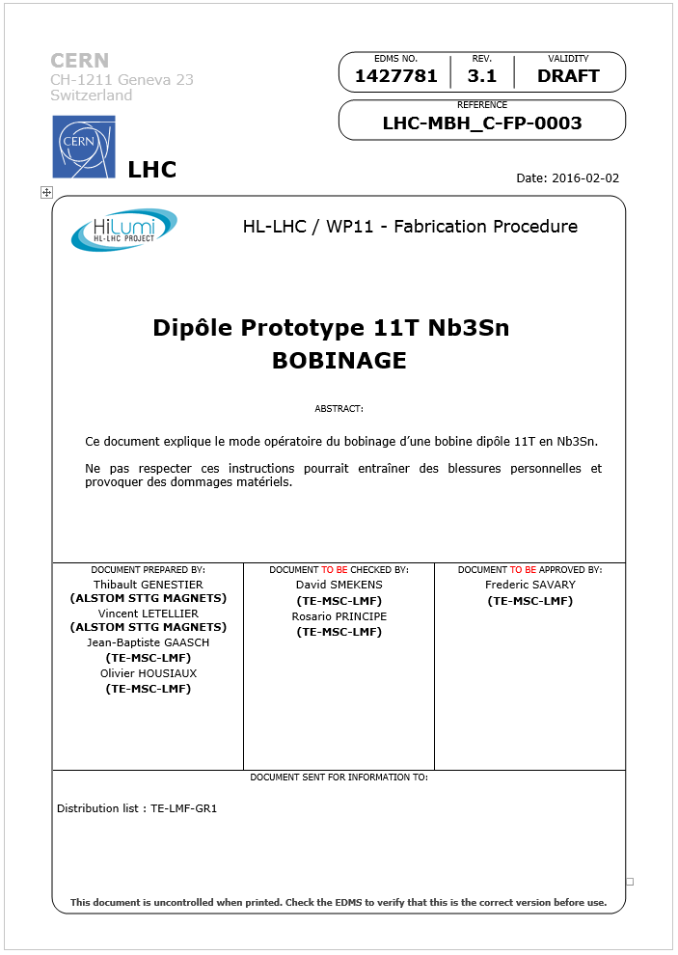
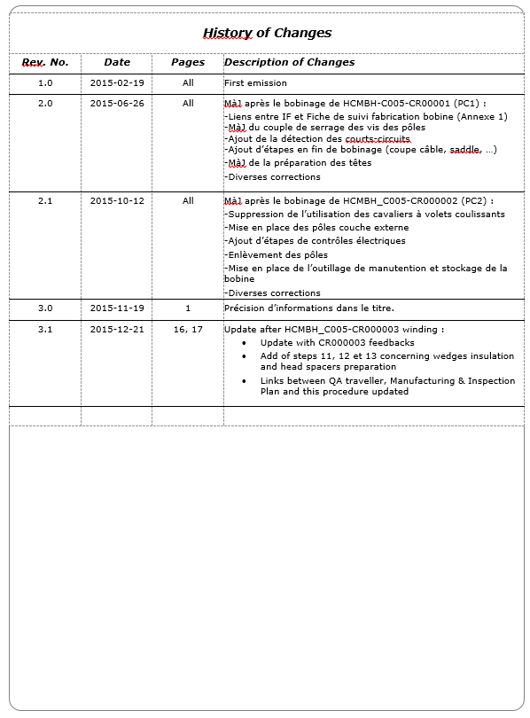
Fabrication Procedures
Naming and traceability
Traceability of modifications
Validation Process

Slide 8
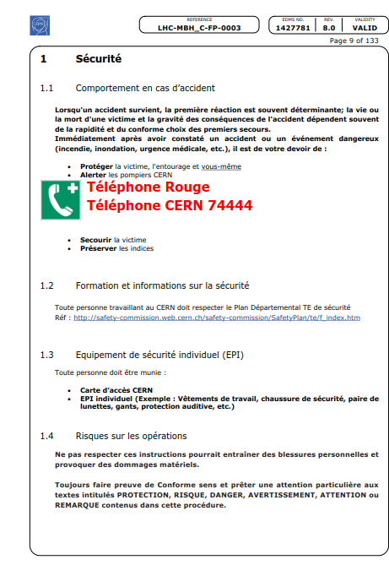
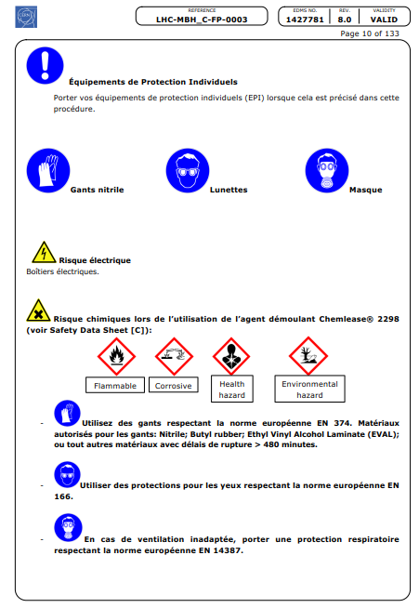
Safety first….

Slide 9
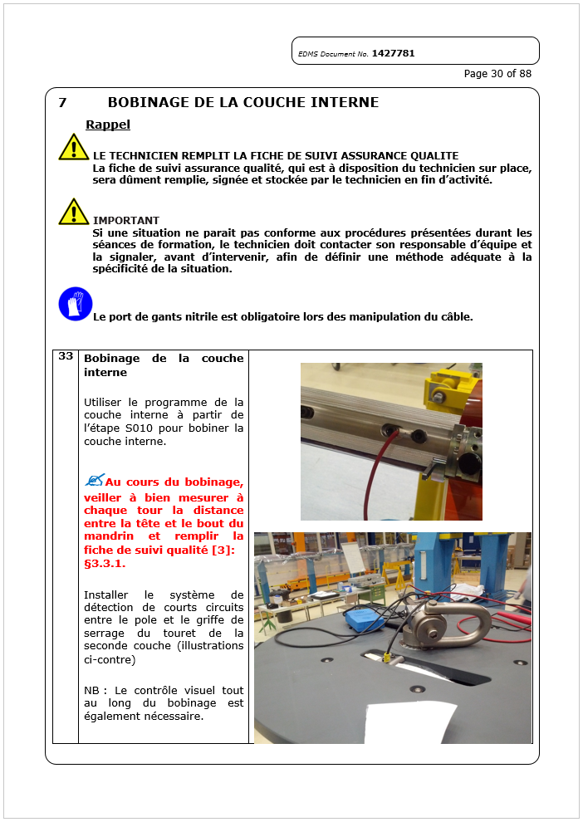
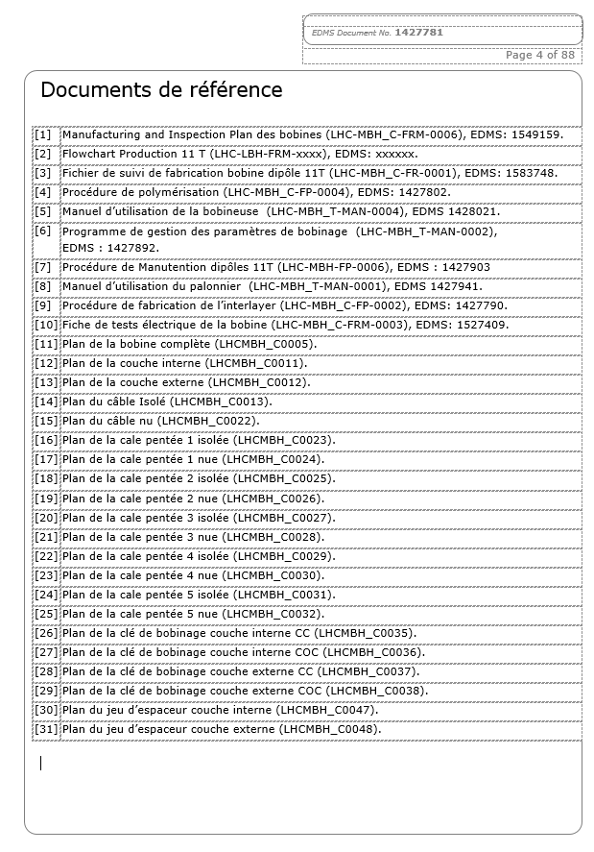
References (Follow up files, MIP, Flowchart…)
Specifications (E.g. fibre…)
Quality instructions.
Information/data logging.
Drawings
Manufacturing instructions

Slide 10
Follow-up
Follow-up in the Manufacturing and Test Folder (MTF)
CERN developped an interface which provides
    Traceability of the sub-equipments installed in a 11T magnet,
    Traceability of the operations,
    Retrieval of all documentation, reports, test results…
    Easy access to critical data (possibilities of reporting),
    Non conformity report management.

Slide 11
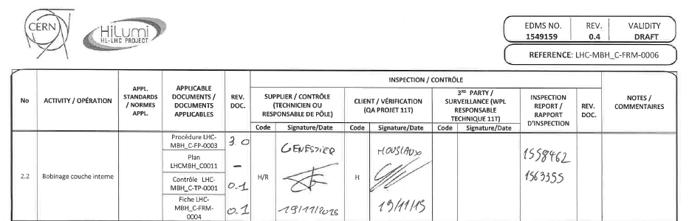
Control procedures
Each control step can be found in the related control procedure
  Inspection in field
  Documentation
  Traceability

Slide 12
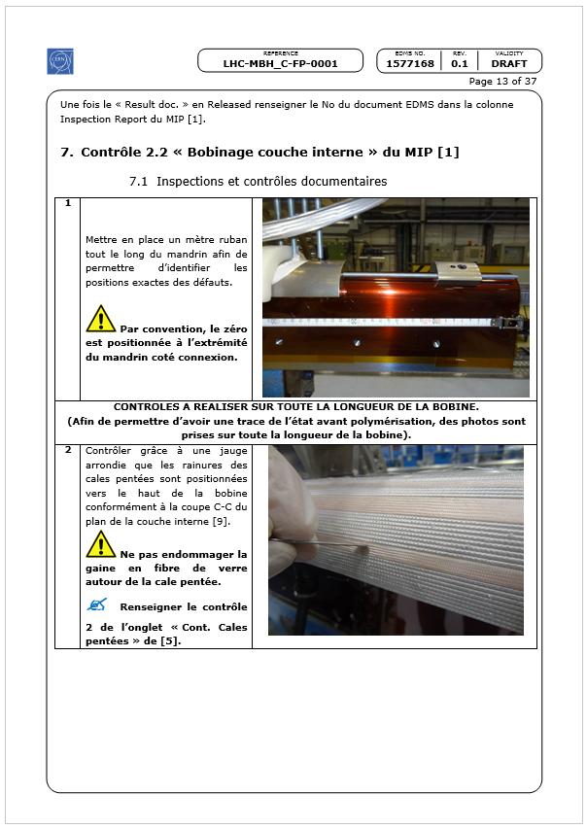
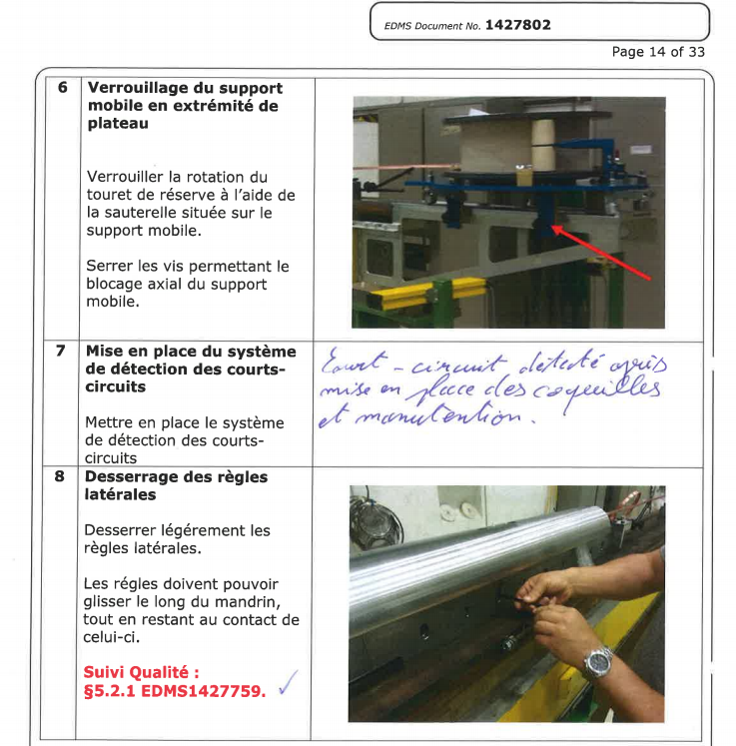

Slide 13
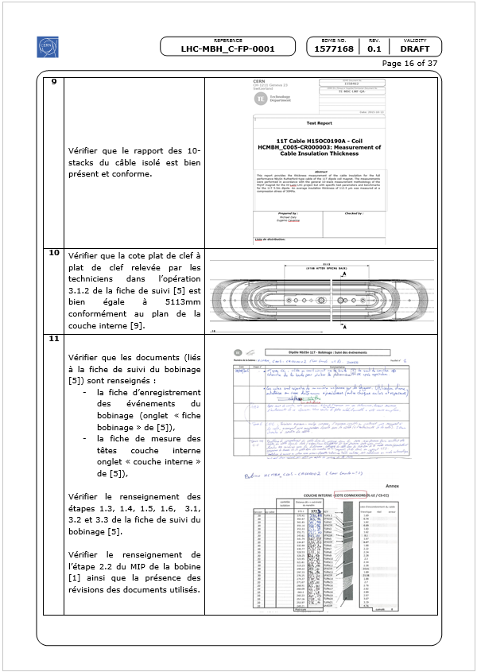
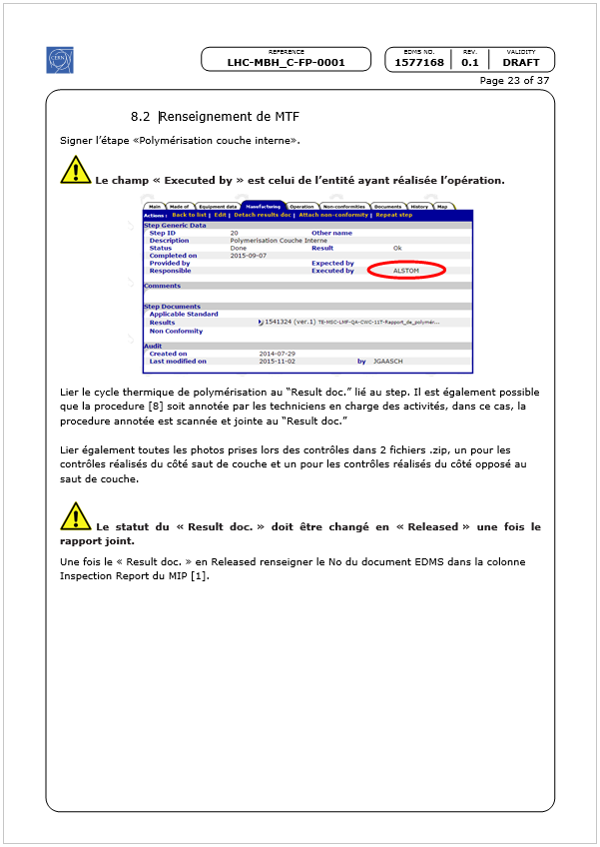
Documentation check

Slide 14
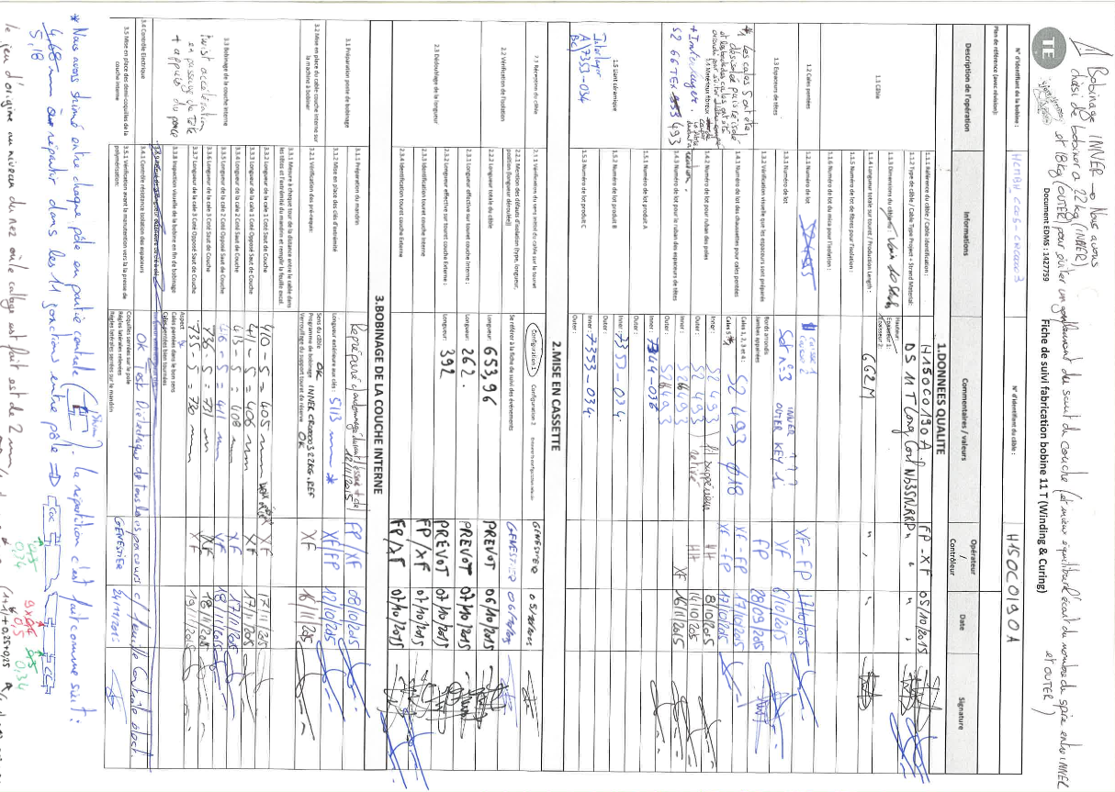
Follow-up files

Slide 15
Cold Mass

Slide 16
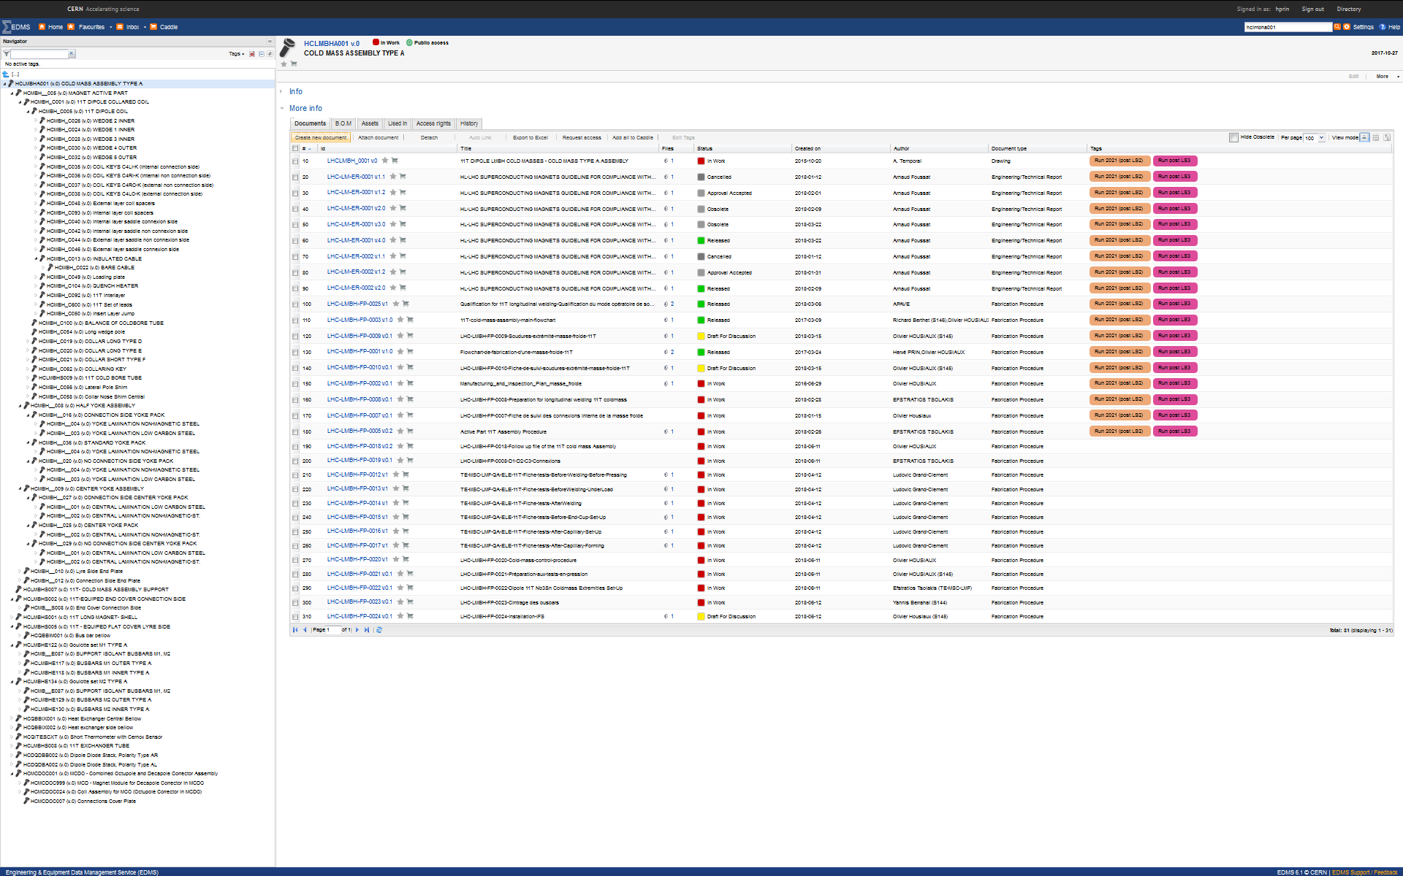
ABS Cold Mass 11T type A LMBHA
https://edms.cern.ch/ui/#!master/navigator/item?I:100014899:100038610:subDocs

Slide 17
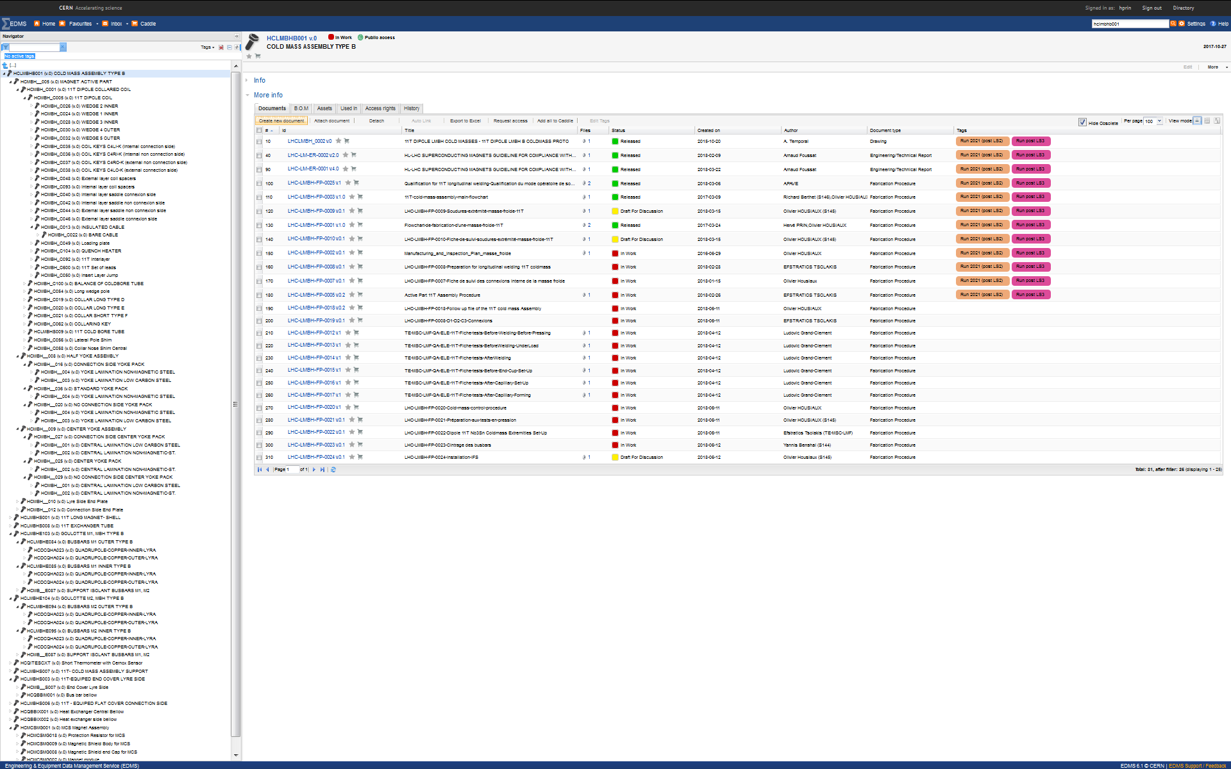
ABS Cold Mass 11T type B LMBHB
https://edms.cern.ch/ui/#!master/navigator/item?I:100014902:100014902:subDocs

Slide 18
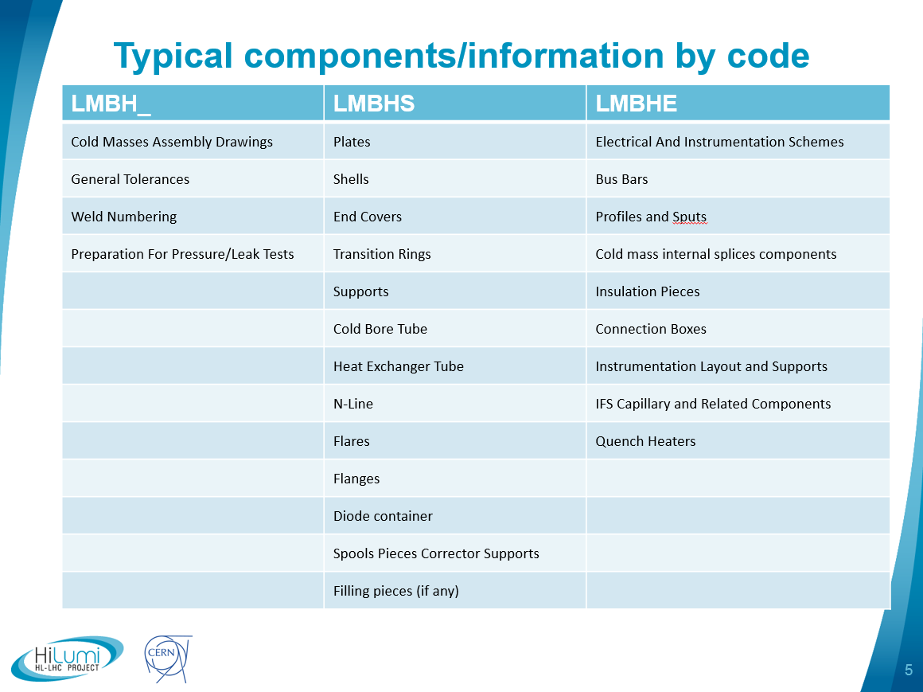
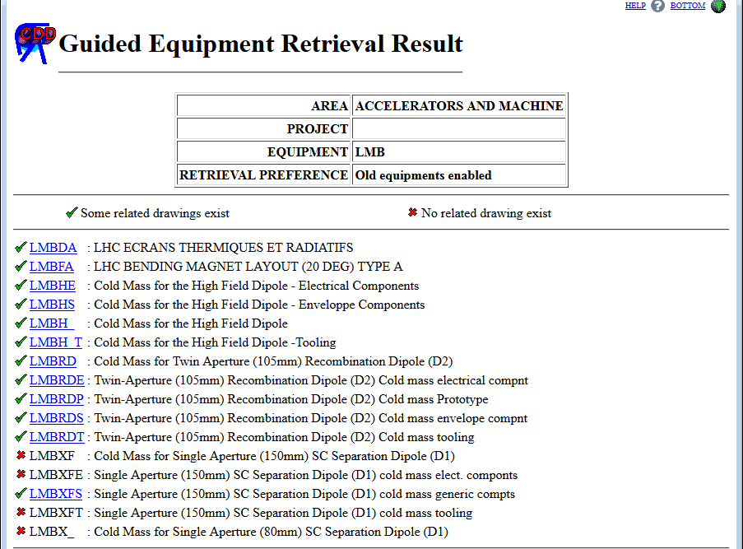
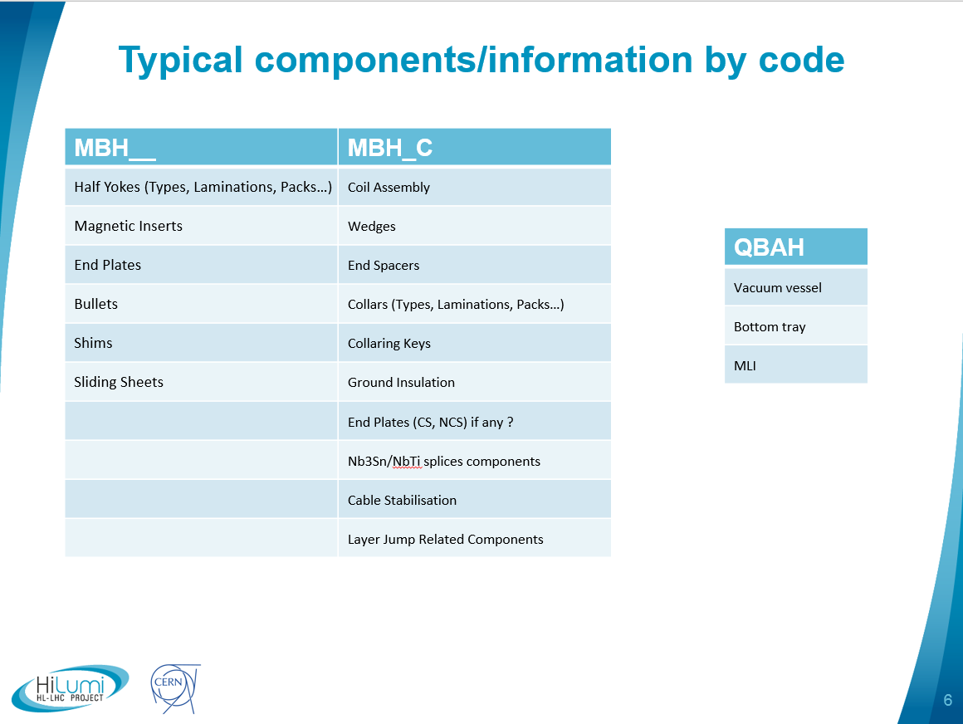
Drawing Structure and Eq. Codes in CDD
11T Cold Mass
https://edms.cern.ch/ui/#!master/navigator/document?D:100129697:100129697:subDocs

Slide 19
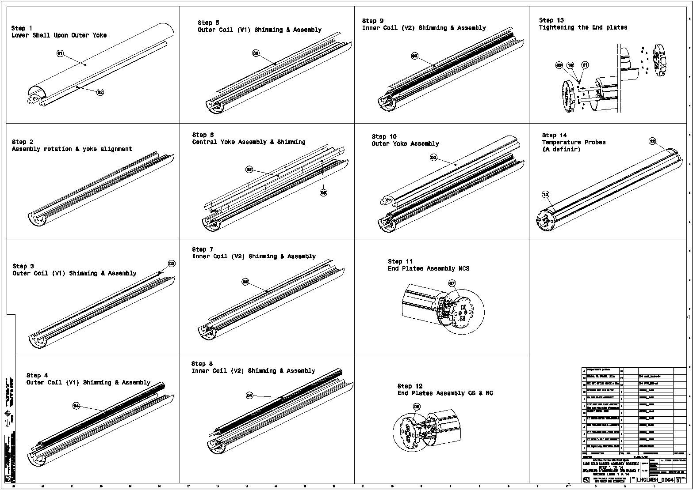
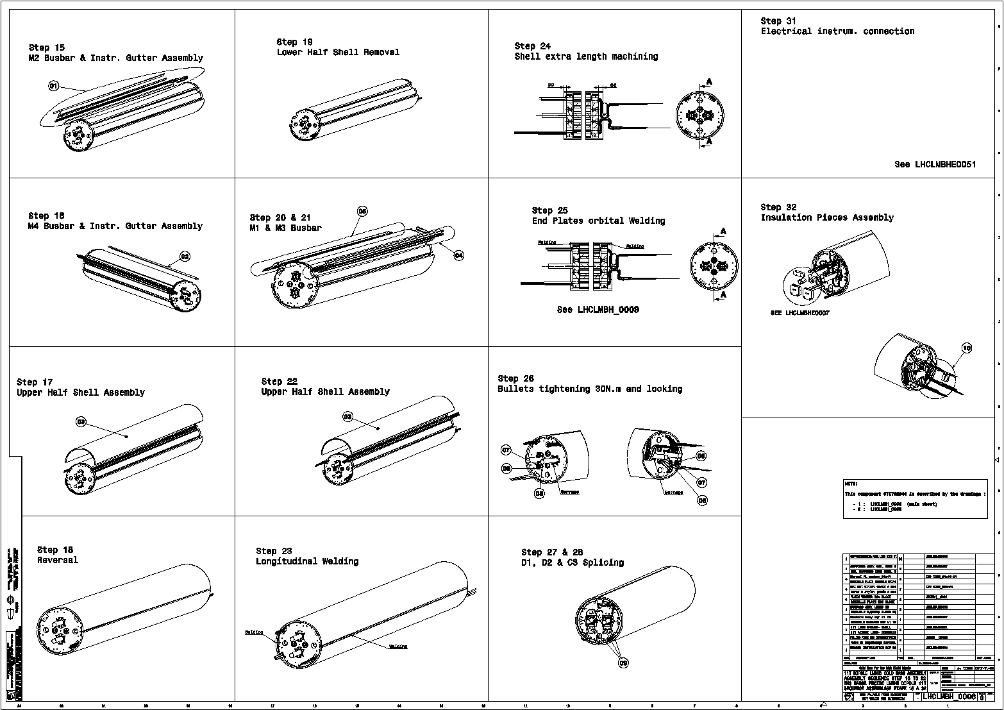
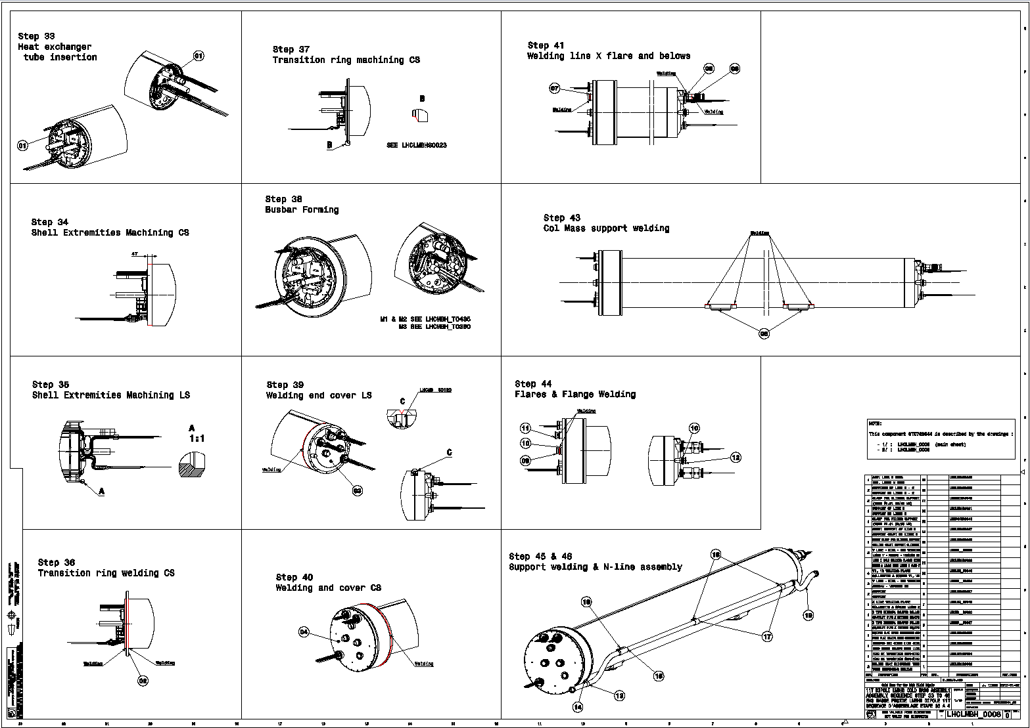
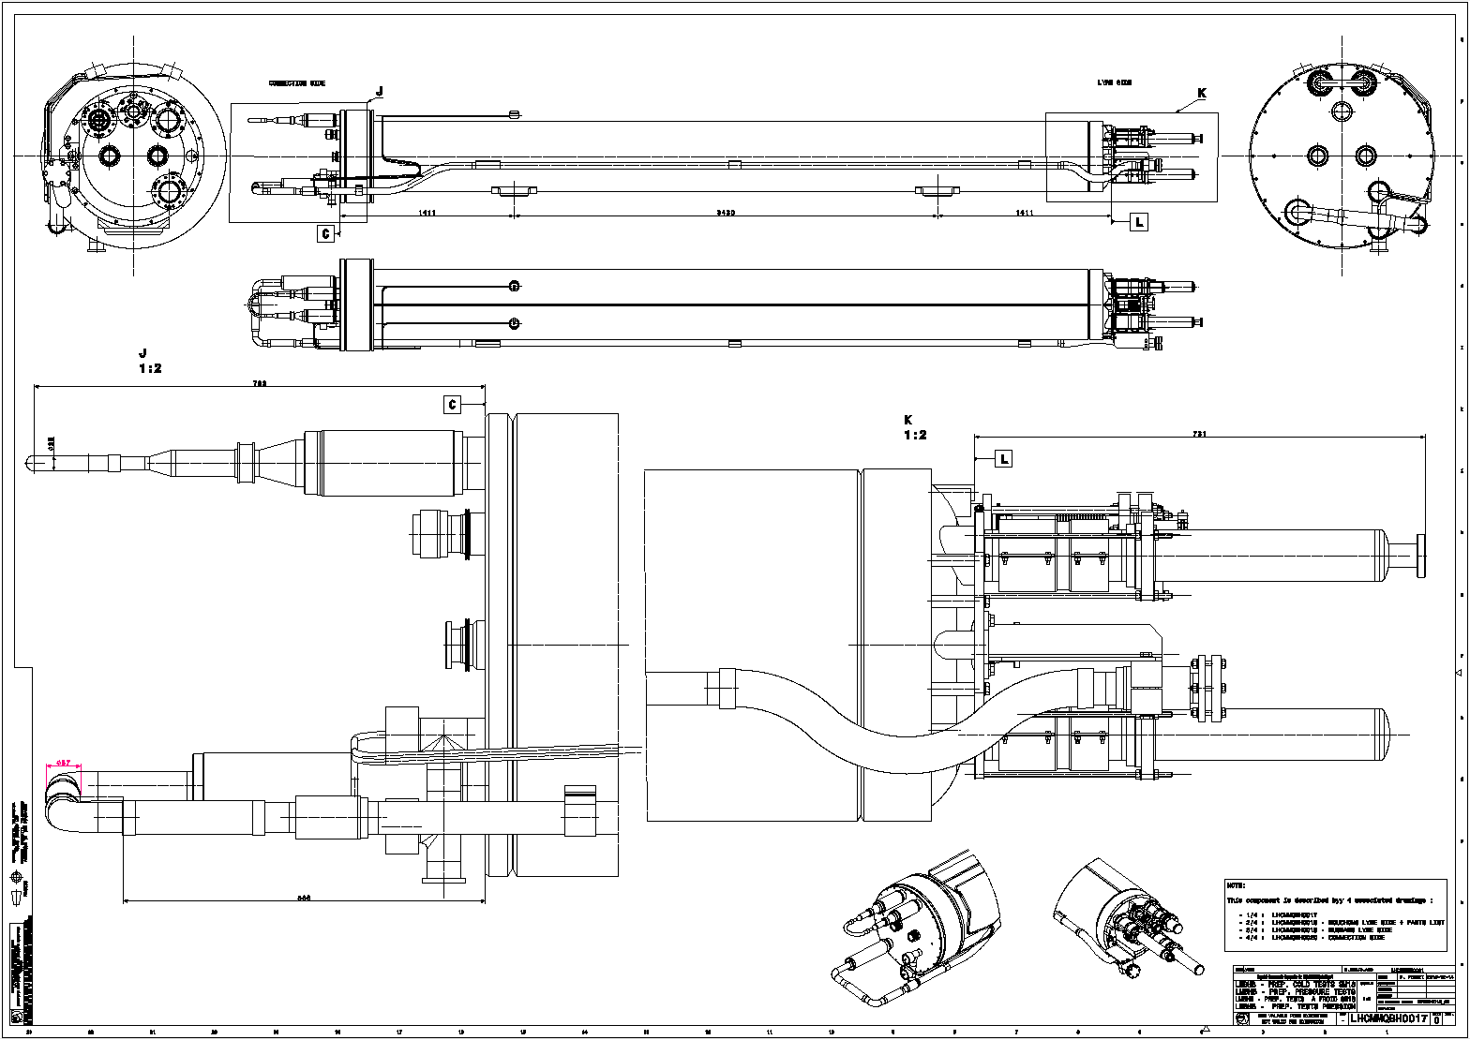
“Assembly Sequence Instruction” Drawings 1/2
Magnet active part assembly
LHCLMBH_0004
LHCLMBH_0005&6
Cold Mass Extremities Assembly
Cold Mass Preparation for Pressure Tests
LHCLMBH_0007&8
LHCMMQBH_0017,18,19

Slide 20
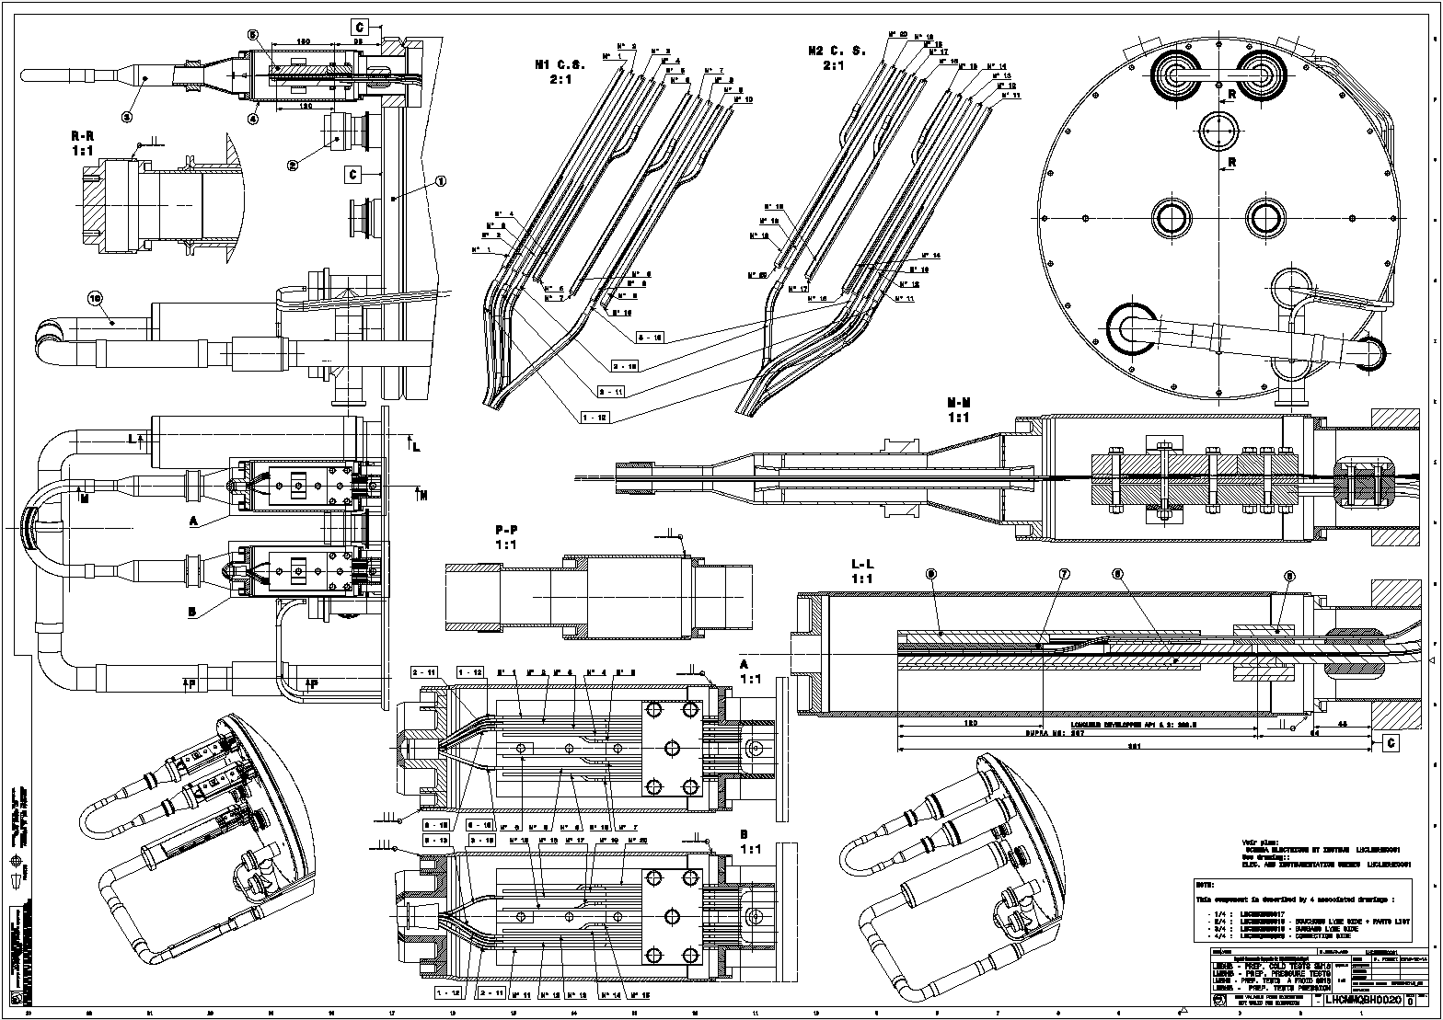
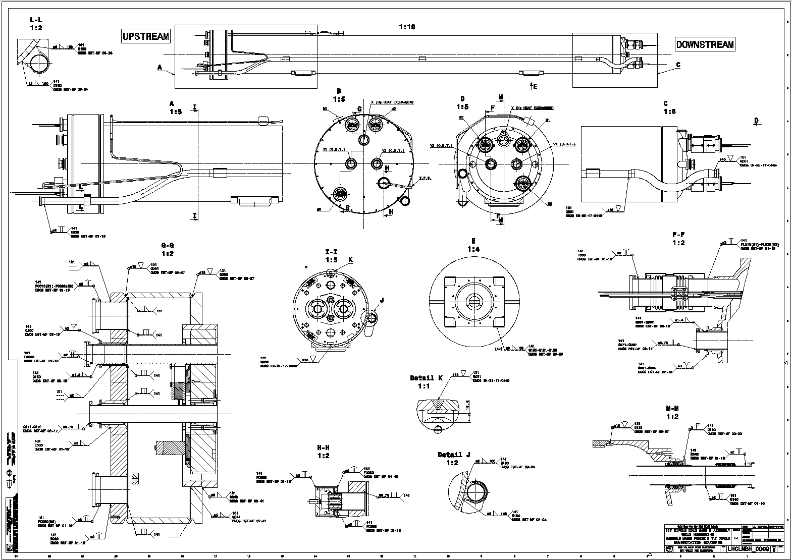
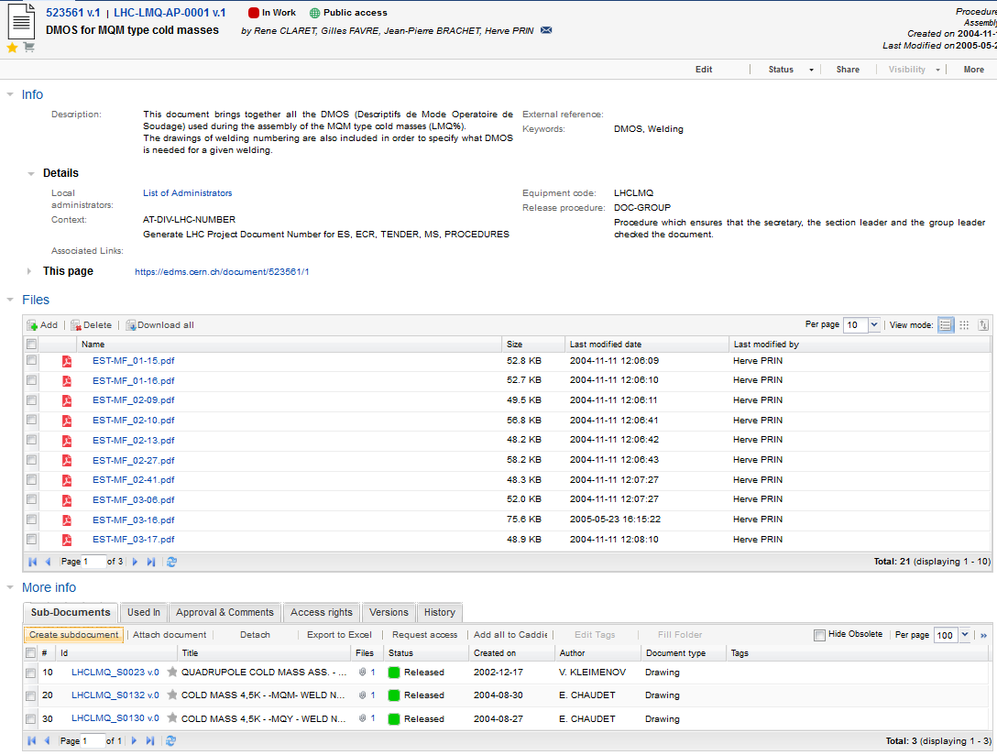
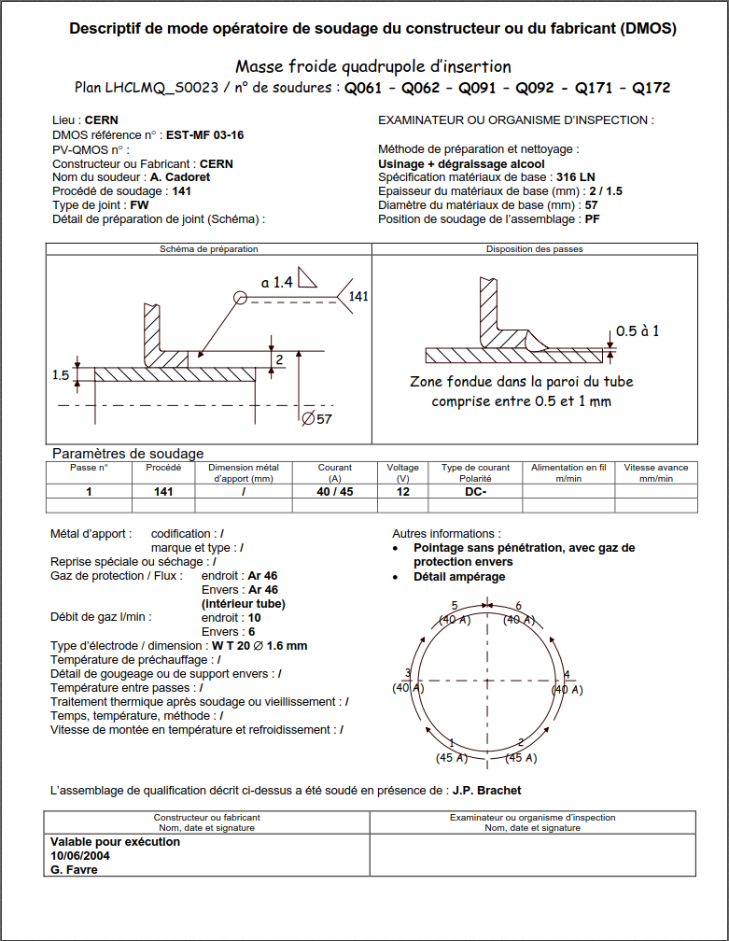
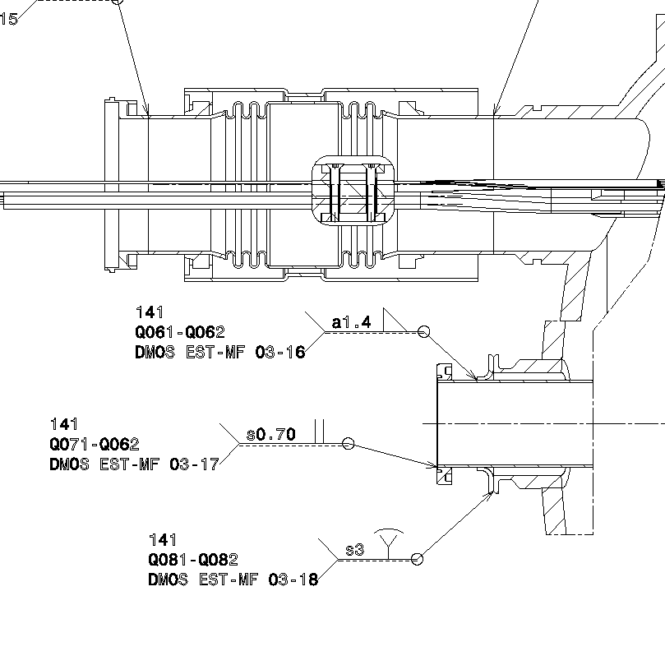
“Assembly Sequence Instruction” Drawings 2/2
Splicing preparation for cold test
Welding Specifications
LHCMMQBH_0020
LHCLMBH_0009 & 10
WPS
EDMS doc to collect all the WPS under preparation with EN-MME for 11T cold masses

Slide 21
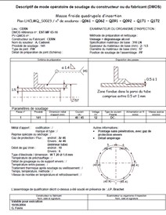
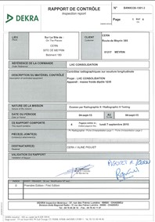
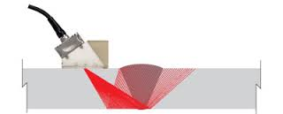
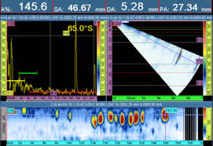
Cold mass welding
Available documents and Inspections
LHC-LMQ-AP-0001 (EDMS523561) brings together all the DMOS (Descriptifs de Mode Operatoire de Soudage) used during the assembly of the MQM type cold masses (LMQ%). Most of them are usable for the LMBH cold mass.
Operating Mode and Welders Qualification are prepared in collaboration with EN-MME and validated by external competent organism (APAVE in our case)
LHCLMBH_0009 and 10 drawings
Visual testing reports according to examination standard: EN ISO 17637 and acceptance criteria: EN 13480-5 category 1 (ex. Edms 1552072).
Radiographic inspection reports with specifications of reference NF EN 17636-2 Classe B + NF EN 5817 classe B (ex. Edms 1540439).
“Fiche de suivi de soudure” filled by the welders with parameters used, observations during welding, filler material certificates (composition, mechanical properties, impact test).
Non destructive inspection using Phased Array Ultra-Sonic technology ongoing development according to ISO 17640.
Structural analysis of LMBH 11T DS Dipole magnet cold mass (EDMS 1711518)

