Slide 1

Infrastructure and tooling availability
M.Daly, F. Lackner, H. Prin, M. Duret, F. Savary, D. Gerard, L. Favier, S. Triquet, S. Luzieux, R. Principe, C. Loeffler, O. Housiaux, T. Genestier,
& all other colleagues involved in the LMF 11T activities.
Review of the11T dipoles for the HL-LHC,
4 July 2018, CERN

Slide 2
Scope
Winding & Curing
Reaction & Impregnation
Metrology
Collaring
Shell Welding
Concluding remarks

Slide 3
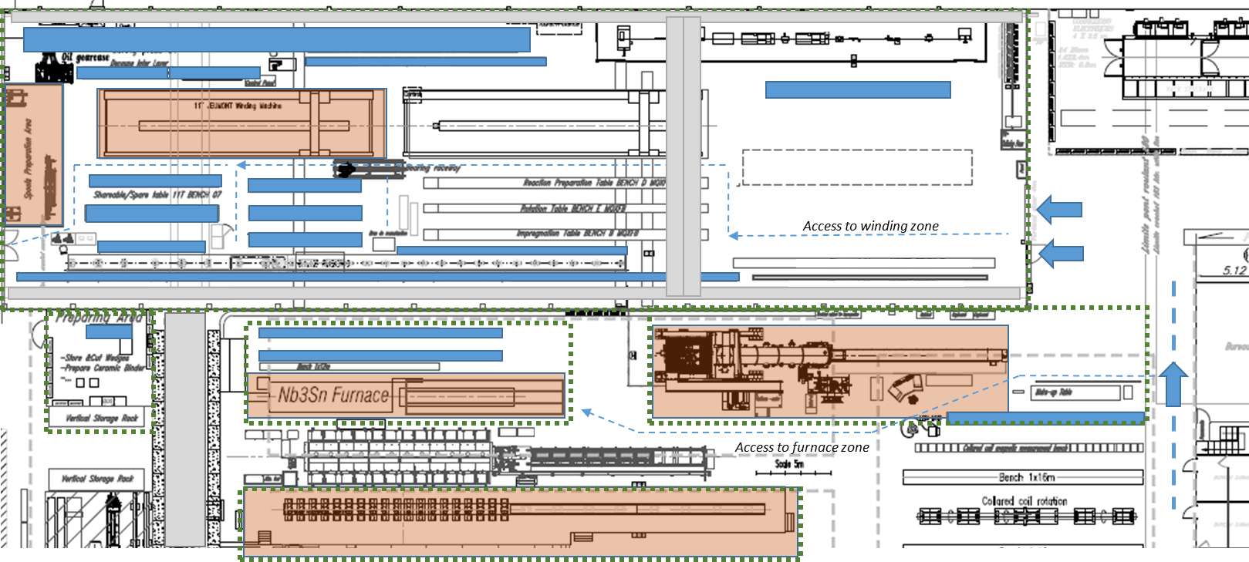

Slide 4
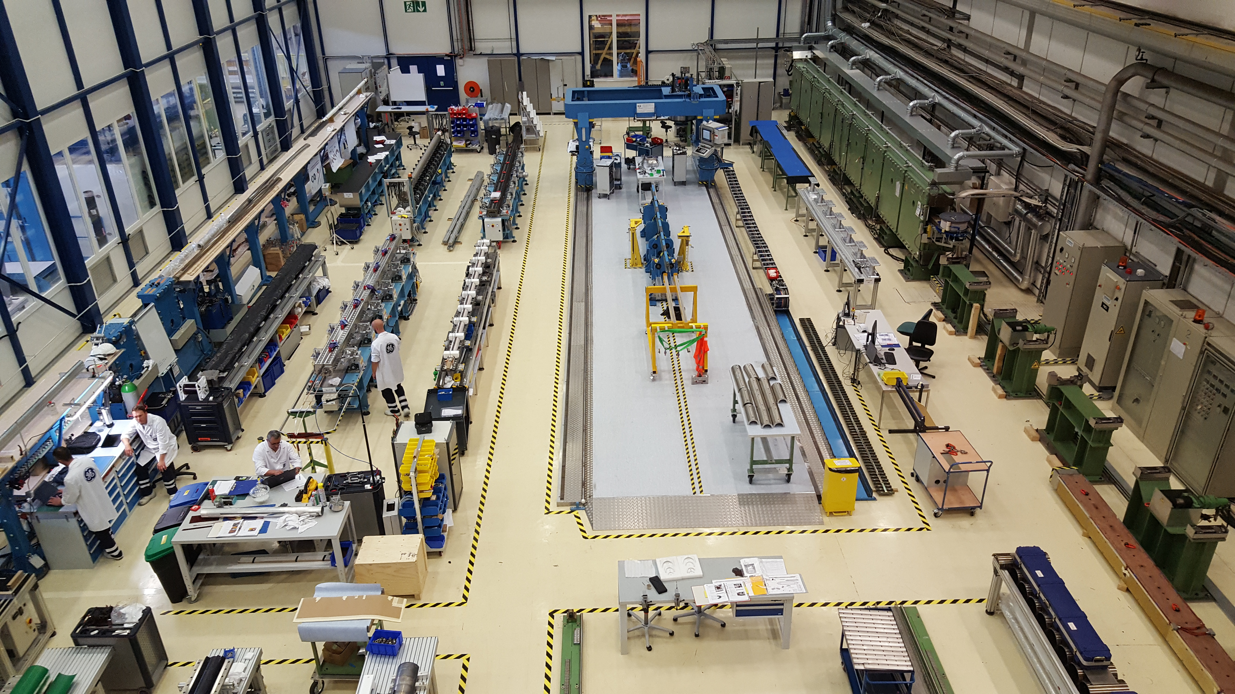
11T Dipole clean room zone
Spooling
Collaring
Curing
Winding
Reaction/
Impregnation

Slide 5
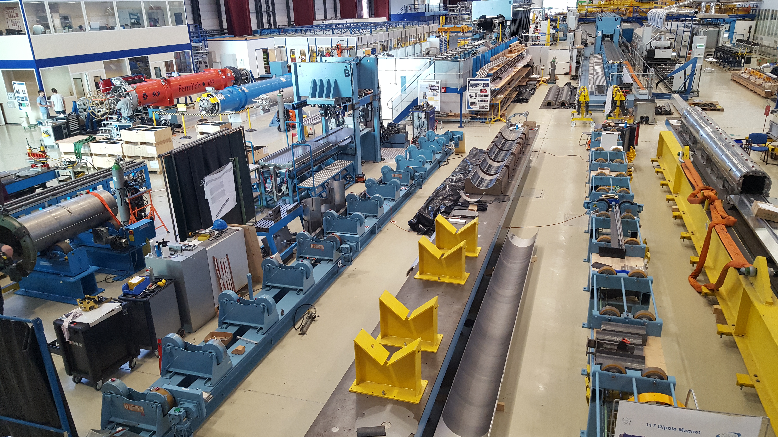
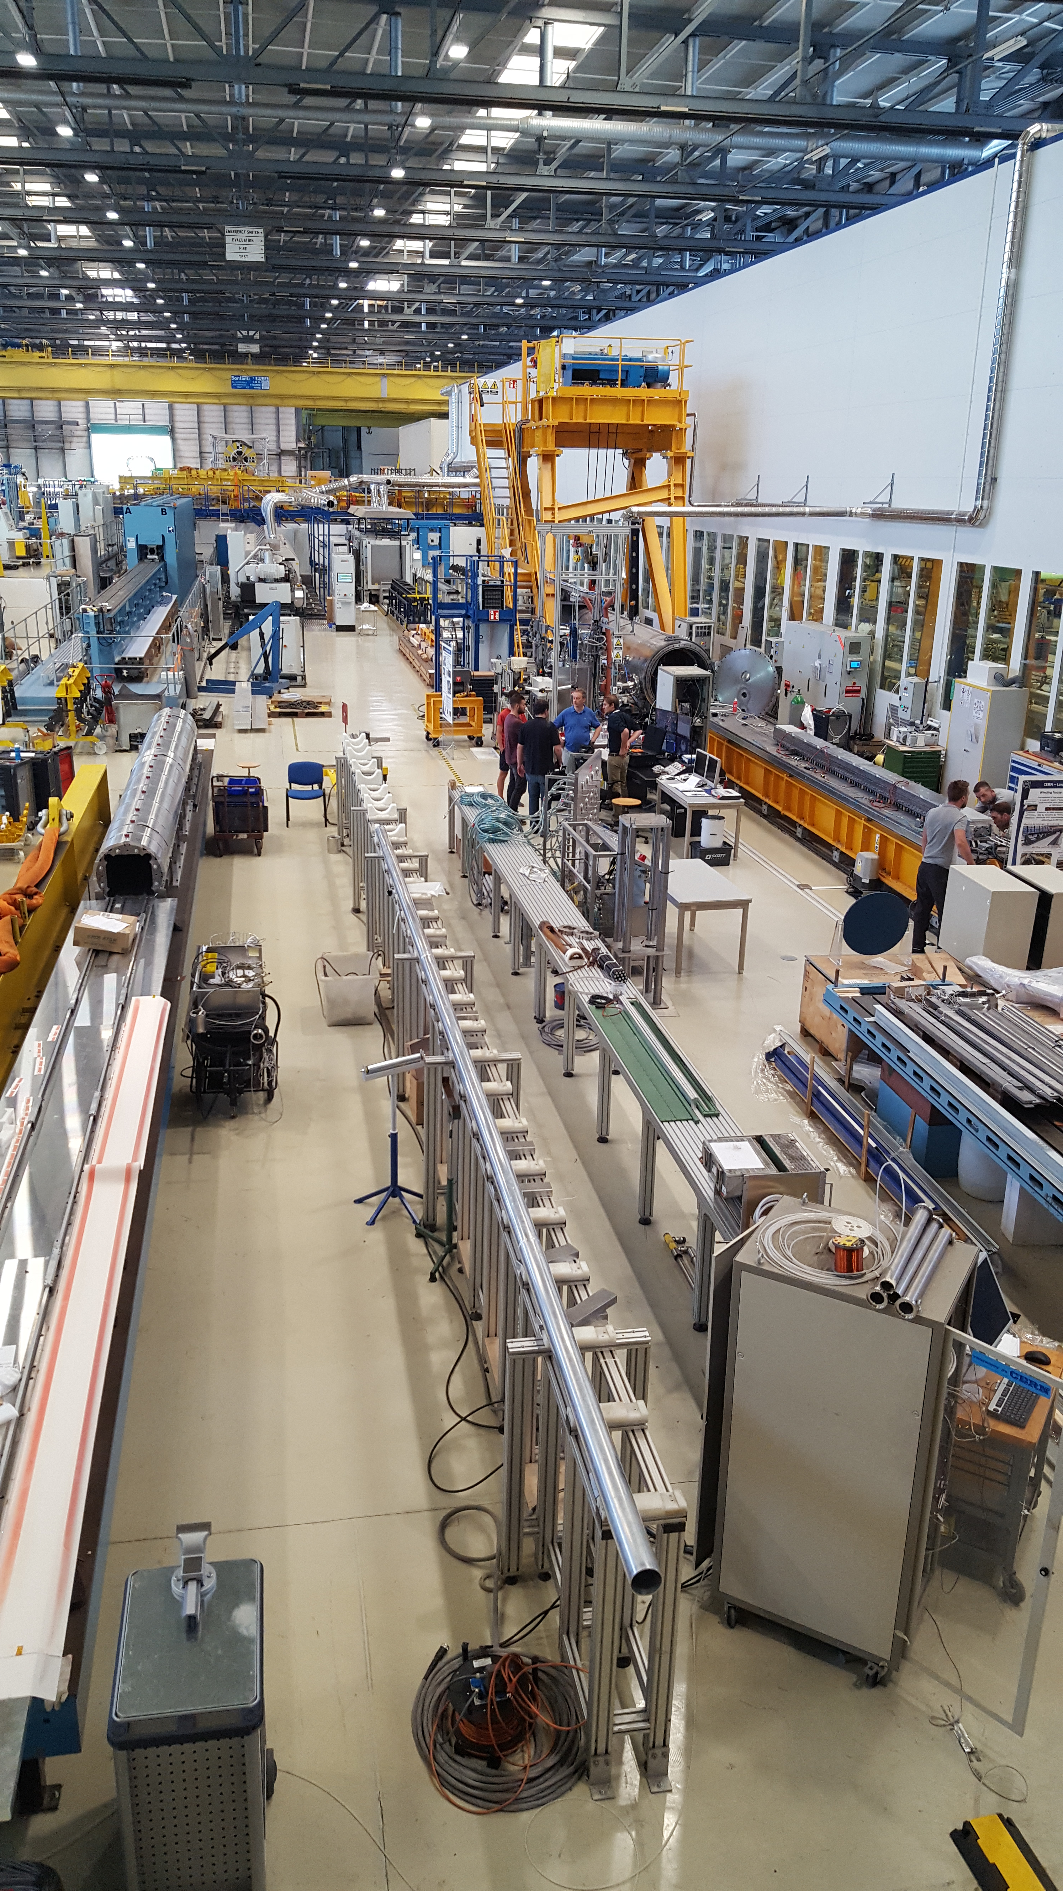
180 Hall Layout
Reaction
Oven
Cold Mass Final Assembly & Alignment
Shell Welding
Collaring
Reaction
Oven
Impregnation
Yoke Assembly
Yoke/Collared
Coil Assembly
Magnetic
Measurements

Slide 6
Winding & Curing
Asset | Tag | Information
Winding Machine P M | #1 | Winding machine available and functioning
Winding mandrels & winding poles | #1 | Mandrel available and functioning
 | #2 | Mandrel at CERN but requiring adjustments to mandrel and winding poles.
Curing Press M Done | #1 | Curing press available and functioning.
Curing tooling | #1 | Tooling available and in use.
 | #2 | Shells available, poles being measured

Slide 7
Reaction & Impregnation
Asset | Tag | Information
Reaction Mould | #1 | Both moulds (modified moulds: v2) are currently in use for the production.
 | #2
Impregnation Mould | #1 | Both moulds (modified moulds: v2) are currently in use for the production.
 | #2
Rotating Table (v2) | #1 | Available and functioning.
 | #2 | Recently commissioned and functioning.
Preparation Tables | #1 | Reaction/impregnation preparation table available.
 | #2 | Reaction/impregnation preparation table available.
 | #3 | Curing Mandrel Table requires some modifications
 | #4 | Cured coil to reaction preparation table available.
Reaction Oven M Done | #1 | Available and in use (with new thermo-couples).
Impregnation Vessel M Done | #1 | Available for use, most upgrades Completed.
Splicing tool | #1 | Available for use.
Miscellaneous tooling | multi | Suction cups | Lead supports
 |  | Coil lateral support | Saddle adjustment tool
Impregnated coil lifting beam | #1 | New modifications implemented and functioning.

Slide 8
Collaring
Asset | Tag | Information
Metrology Table (marble) | #1 | Available (incl mods to supports)
Electrical Measurement Table | #1 | Available and functioning.
Electrical Test Trolleys | #1 | Complete and ready.
 | #2
Preparation table | #1 | Available and functioning
Assembly Table | #1 | Available and functioning
Lifting equipment | #1 | Modifications completed and available.
Collar packs assembly | #1 | Available but some modifications required.
Collaring Press | #1 | Available and functioning.
Ground insulation templates | multi | Modification in progress for 40mm extra.

Slide 9
Shell Welding/Cold Mass Assembly
Asset | Tag | Information
Magnet Yoke Assembly | #1 | Available
Lower Shell Rotating Equip: - Lifting equipment - Rotating | #1 | Available and functioning. New lifting equipment in progress.
Collared coil lifting equipment | #1 | Available
Magnet yoke alignment | #1 | Available, additional mods in progress.
Welding Press | #1 | Some hydraulic issues remain.
Usinage Bague de Transition | #1 | Available, modifications are being implemented
Leica Metrology Lasers | #1 | 402 | 403 | AT 960
Cold Mass Supports (yellow) | #1 | Oil leak needs fixing, new modifications need to be concluded.
Pressure & Leak Test Station | #1 | Available

Slide 10
Concluding Remarks
We are ready!
Some final modifications/improvements need to be implemented but do not hold up production.
Some preventive maintenance has been performed on a number of critical equipment. A plan is being drawn up for future maintenance plans.

