Slide 1

Components procurement plan
José Luis Rudeiros Fernández
With contributions from F. Savary, H. Prin, O. Housiaux, S. Menu, R. Principe, A. Musso
Production Readiness Review for 11T Collared Coils and Cold Mass
04-07-2018
CERN

Slide 2

Contents
MSC3
Follow-up Spreadsheet with Status/Progress
E-BOM & Need Dates
Contract follow-up and inspection of incoming goods

Slide 3
1. MSC3
MSC3 - MSC Component Centre for HL-LHC
“The working group MSC3 is in charge of the follow-up of components for WP03, WP6A, WP11 and WP16 plus new spares for MQ and MQY.”
Synthetize the needs of the WPs;
Monitor the progress of the procurement plans and identify bottlenecks or issues;
Define delivery sequence in function of availability and project priorities. In case of impact on schedule, seek for arbitration at the appropriate level (MSC group, HighLumi project);
Help in solving critical issues (i.e. launch parallel procurement paths in case of [potential] bottlenecks);
Provide support to Technical Officer / Technical Responsible;
Ensures consistency of technical documents (i.e. Spec. Committee);
Provide QA support for incoming inspection;
Provide logistics support for storage and delivery according to WPs’ needs;
Centralise and make available information about procurement processes, needs of WPs and delivery plans.
Project Team
CC Manager | Andrea Musso
CC Manager Alternate | Jean-Philippe Tock
MME Link Person | Diego Perini
IPT Link Person | Jérôme Pierlot
HL-LHC Link Person | Benoît Delille
Logistics & QA Support | Rosario Principe
Administrative Support / Website | Macarena González Torres
Web: https://msc3.web.cern.ch/

Slide 4
1. MSC3
MSC3 - MSC Component Centre for HL-LHC
Components – Follow up Table
WP | Component | Class | Dept. Request | Tech. Desc. | Market Survey | Tech. Spec. | Invitation for Tender | Contract Signed | Remarks
WP03 | Austenitic Stainless Steel Strips for the HL-LHC Superconducting Magnets Collars | 3 | DR 6642612 | OK | MS 4294 | OK | IT 4294 | OK
WP11
WP03 | Circuits & cables for Quench Protection Heaters | 1 | DR 6674356 | OK | MS 4311 | OK | IT 4311 | OK
WP11
WP11 | Assembly works of collaring coils | 1 | DR 6531836 | OK | MS 4282 | OK | IT 4282 | OK
WP11 | Removable Poles | 1 | DR 6753384 | OK |  | OK |  | DO 30755
WP11 | Coil Keys | 1 | DR 6820894 | OK |  | OK |  | DO 30955
WP11 | 11T Spacers - Coating | 1 | DR 6753381 | OK |  | OK |  | DO 30786
*Example
Web: https://msc3.web.cern.ch/

Slide 5
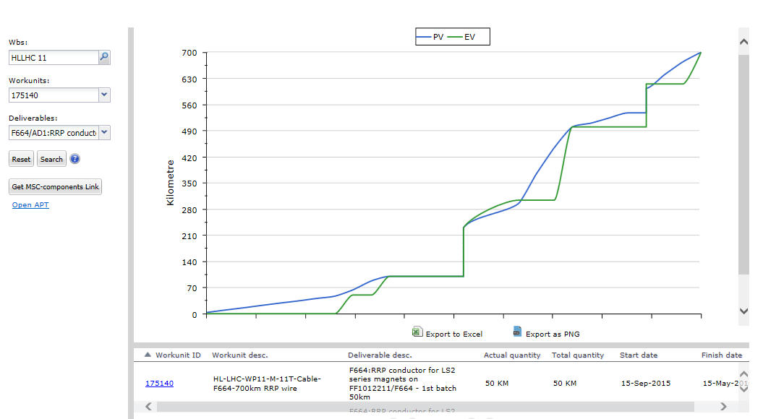
1. MSC3
MSC3 - MSC Component Centre for HL-LHC
Dashboard – Quick access to the progress of deliverables over time (EVM system)
*Example
Web: https://msc3.web.cern.ch/

Slide 6
2. Follow-up Spreadsheet with Status/Progress
The follow-up spreadsheet monitors the progress of the procurement of components for WP11 in greater detail than MSC3.
Integrates available information concerning the procurement of components for WP11 (e.g. status of the contract award procedure), including additional information (e.g. drawing number, expected delivery, etc.).
V14 of the document is monitoring approximately 200 items.
The document is maintained by S. Menu, R. Principe, O. Housiaux, R. Berthet and B. Arias.
Follow-up Spreadsheet
Collared coils
Cold mass
BusBars
Link: https://edms.cern.ch/document/1835979/

Slide 7
2. Follow-up Spreadsheet with Status/Progress
*Example
Designation | Drawing | Market Survey | Tech. Spec. | IT / DO | DAI | Expected delivery | Status | Availability | Contact Person | Remarks
Central Lamination Low Carbon 5.8 mm (Machining) | LHCMBH__0001 |  | 05/10/2015 | DO-29499/TE/HL-LHC | DAI 6746021 | 30/09/2017 | NON CRITICAL | OK | J.L. Rudeiros Fernandez/D. Gerard | material received
Central Lamination Non-Magnetic 3 mm (Machining) | LHCMBH__0002 |  | 05/10/2015 | DO-29499/TE/HL-LHC | DAI 6746021 | 30/09/2017 | NON CRITICAL | OK | J.L. Rudeiros Fernandez/D. Gerard | material received
Yoke Lamination Low Carbon 5.8 mm (Machining) | LHCMBH__0003 |  | 05/10/2015 | DO-29499/TE/HL-LHC | DAI 6746021 | 30/09/2017 | NON CRITICAL | OK | J.L. Rudeiros Fernandez/D. Gerard | material received
Yoke Lamination Non-Magnetic 3 mm (Machining) | LHCMBH__0004 |  | 05/10/2015 | DO-29499/TE/HL-LHC | DAI 6746021 | 30/09/2017 | NON CRITICAL | OK | J.L. Rudeiros Fernandez/D. Gerard | material received
Follow-up Spreadsheet
Collared coils
Cold mass
BusBars
Link: https://edms.cern.ch/document/1835979/

Slide 8
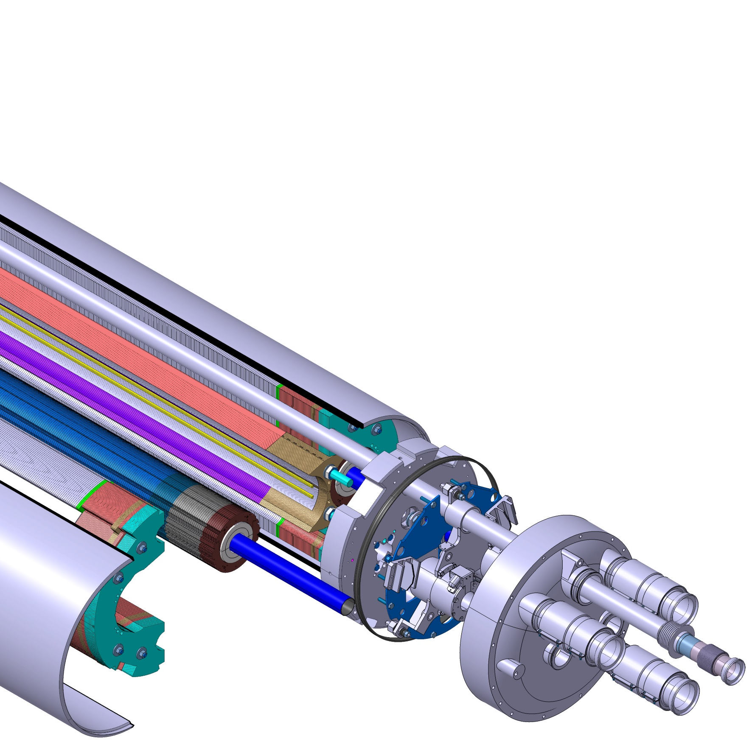
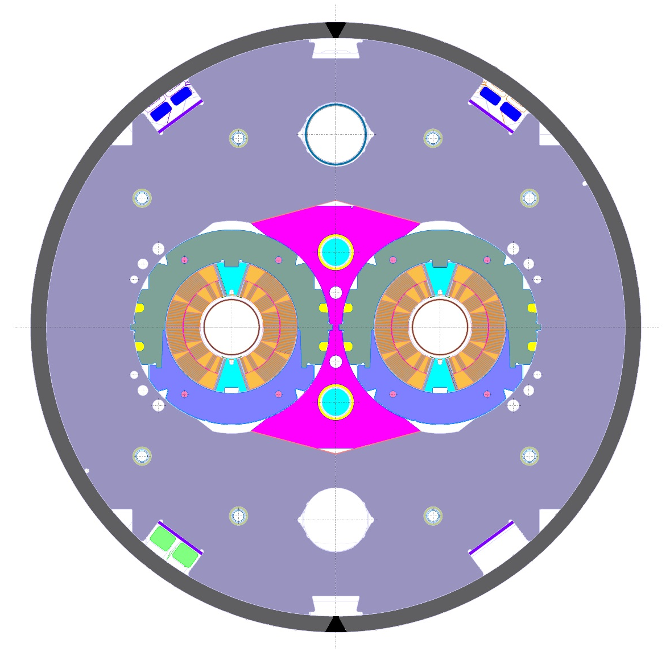
3. E-BOM & Need Dates
Engineering Bill of Materials:
Integrates all components from the engineering design.
Lists all components, assemblies and sub-assemblies contained in the overall product.
The filed is based on the CAD structure and is generated through CATIA and SmarTeam (Product Data Management solution).

Slide 9
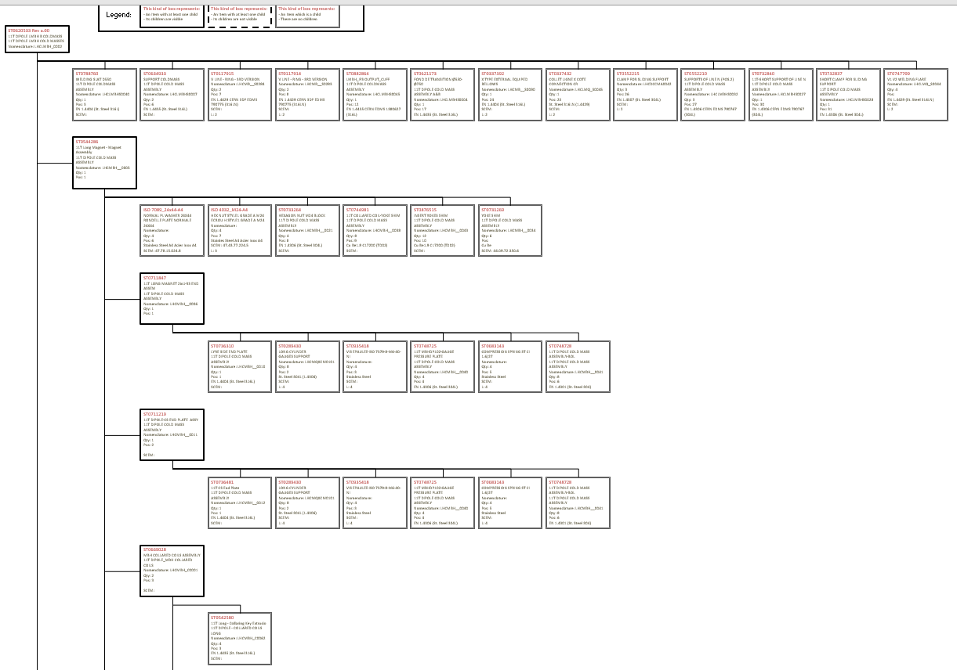
3. E-BOM & Need Dates
Engineering Bill of Materials:
The cold masses design contain more than 340 references, which can be displayed through three different layouts.
The generated item list is linked to respective files in EDMS.
E-BOM
E-BOM – Assembly Tree
ITEMS
Show in Graph | Show in Graph | Show in Graph | Show in Graph | Show in Graph | Don't show in Graph | Show in Graph | Don't show in Graph | Don't show in Graph | Show in Graph | Show in Graph
Level | ST number | Definition | Nomenclature | context qty | Make or Buy | Position | Supplier | Supplier Ref | Material | SCEM
1 | ST0620533 | 11T DIPOLE LMBH B COLDMASS 11T DIPOLE LMBH COLD MASSES | LHCLMBH_0002 | 1
2 | ST0544286 | 11T Long Magnet - Magnet Assembly 11T DIPOLE COLD MASS ASSEMBLY | LHCMBH__0005 | 1 | CERN Design | 1
3 | ST0711847 | 11T LONG MAGNET 2in1-RS END ASSEM 11T DIPOLE COLD MASS ASSEMBLY | LHCMBH__0006 | 1 | CERN Design | 1
4 | ST0736310 | LYRE SIDE END PLATE 11T DIPOLE COLD MASS ASSEMBLY | LHCMBH__0010 | 1 | CERN Design | 1 |  |  | EN 1.4404 (St. Steel 316L)
4 | ST0289430 | LONG CYLINDER GAUGES SUPPORT | LHCMQXCM0101 | 8 | CERN Design | 2 |  |  | St. Steel 304L (1.4306)
4 | ST0935418 | VIS EPAULEE-ISO 7379-8-M6-40-NI |  | 4 | CERN Design | 3 |  |  | Stainless Steel
4 | ST0748725 | 11T MBHDP102-GAUGE PRESSURE PLATE 11T DIPOLE COLD MASS ASSEMBLY | LHCMBH__0040 | 4 | CERN Design | 4 |  |  | EN 1.4306 (St. Steel 304L)
4 | ST0683143 | COMPRESSION SPRING ST CI 1.6/27 |  | 4 | Commercial Item | 5 | VANEL | C.116.160.0270.I | Stainless Steel

Slide 10
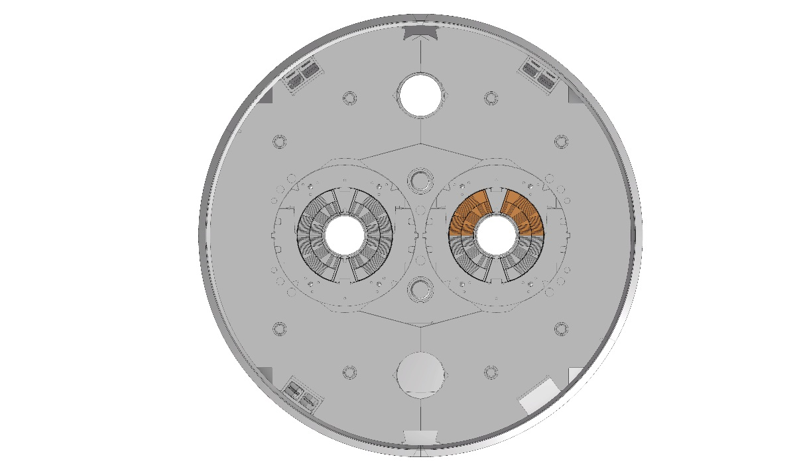
3. E-BOM & Need Dates
Coil Components*
Component | DR | TD | MS | TS | IT | Contract Signed | Remarks
Circuits & cables for Quench Protection Heaters | DR 6674356 | OK | MS 4311 | OK | IT 4311 | OK
Cu Coating Line for Quench Heaters | DR 6853309 | OK | OK | OK | OK | DO 30999 | DO 30999
ODS Wedges | DR 6821963 | OK |  | OK |  | DO 30754 | DO 30754
 |  |  |  |  |  |  | Order OK
SLS Printed Spacers | DR 6753383 |  |  | OK |  | DO 30955
Strand for 11T Spares | DR 6869424 | OK |  |  |  | OK | Amendment
11T Spacers - Coating | DR 6753381 | OK |  | OK |  | DO 30786
*Components included in MSC3 Follow up Table

Slide 11
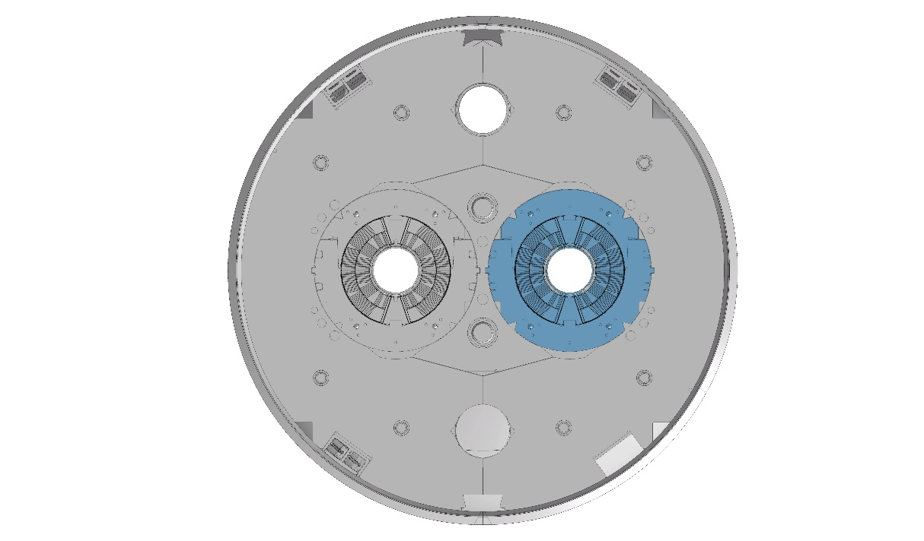
3. E-BOM & Need Dates
Collared Coil Components*
Component | DR | TD | MS | TS | IT | Contract Signed | Remarks
Loading Pole Ti | DR 6753384 |  |  | OK |  | DO 31011
Assembly works of collaring coils | DR 6531836 | OK | MS 4282 | OK | IT 4282 | OK
Saddles | DR 6573568 | OK | OK | OK | OK | DO 30955
Removable Poles | DR 6753384 | OK |  | OK |  | DO 30755
Coil Keys | DR 6820894 | OK |  | OK |  | DO 30955
*Components included in MSC3 Follow up Table

Slide 12
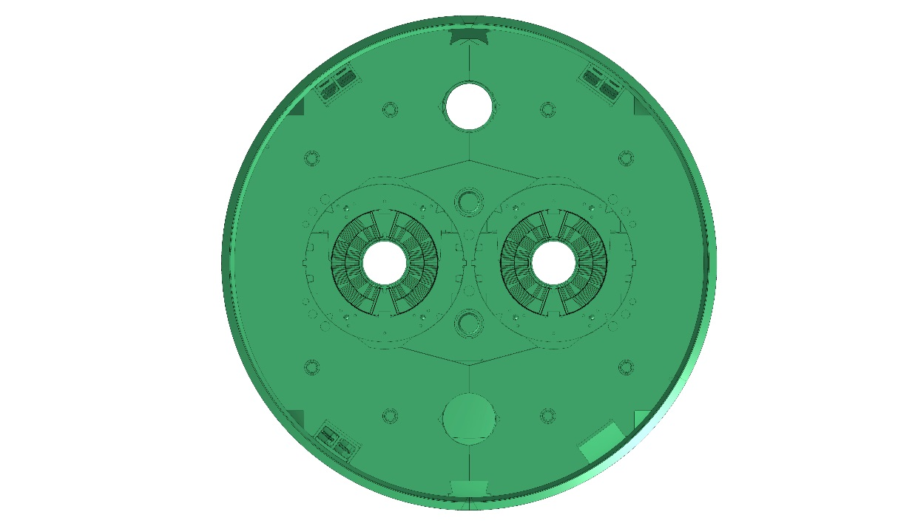
3. E-BOM & Need Dates
Cold Mass Components*
Component | DR | TD | MS | TS | IT | Contract Signed | Remarks
SS Shells for HL-LHC magnets (12m) | DR 6678323 | OK | MS 4313 | OK | IT 4313 |  | SC 13-March (along with D2-Shells (14mm) now -IT4358-)
Steel Laminations 11T (Yoke laminations) | DR 6673345 | OK | MS 4410 |  | IT 4410 |  | Only 11T. IT already sent to the firms.
Instrumentation cover flanges | DR 6907355 | OK | OK | OK | OK | DO 30924
End plates for 11T |  |  |  |  |  | DO 31136
*Components included in MSC3 Follow up Table

Slide 13
4. Contract follow-up and inspection of incoming goods
CSD
For each component, the technical and operational follow-up is the responsibility of the Technical Officer.
The progress of the procurement process is monitored by MSC3. If any change in schedule, the information is updated within the Follow-up Spreadsheet by LMF-QA.
With regards to commercial aspects (e.g. change of scope, amendments), the Procurement Officer in collaboration with the Technical Officer, are responsible.
Contract follow-up
Following Contract’s Specifications, the manufacturer shall:
  Update MTF steps and documentation;
  Notify the Technical Officer, requesting an agreement for shipment.
After the analysis of the documentation, and once the Technical Officer, LMF-QA and WP11 leader agree that the assets comply with the Contract’s Specification, the Technical Officer gives green light for shipment.
Once the assets are received at CERN, LMF-QA in collaboration with the Technical Officer:
  Check the ID and marking, quantity, and condition of the assets;
  Check that all related documentation (e.g. material certificate) has been received and stored;
  Organise and/or perform additional inspection (e.g. dimensional control, material tests);
  Check that all information is correctly stored in MTF, including correct DAI number and drawing version;
After the previous steps are completed and results are acceptable, the Technical Officer, in agreement with WP11 leader, signs the acceptance step in MTF.
The assets are stored by the LMF-Logistic team, awaiting for installation.
Reception & Inspection of incoming goods
Assets ready to be installed

Slide 14
Thanks!

