Slide 1
TDAQ for the Deep Underground Neutrino Experiment (DUNE)
Giovanna Lehmann Miotto (CERN)

Slide 2
Foreword
The DUNE TDAQ doesn’t exist…
... We are eagerly awaiting your ideas on how to design and implement it!

Slide 3
Outline
Deep Underground Neutrino Experiment (DUNE) parameters and challenges
Conceptual design of DUNE data flow
  Front end
  Module level trigger
  Event building
  Event filter
Predesign prototyping studies:
  ProtoDUNE-SP
DUNE DAQ control & monitoring
  Challenges and ideas

Slide 4
DUNE parameters and challenges
When designing a TDAQ system it’s essential to:
have a broad understanding of what the experiment wants to achieve;
understand the detection principles and front-end electronics;
understand the constraints in which the TDAQ will live.

Slide 5
DUNE - Physics
http://dunescience.org

Slide 6
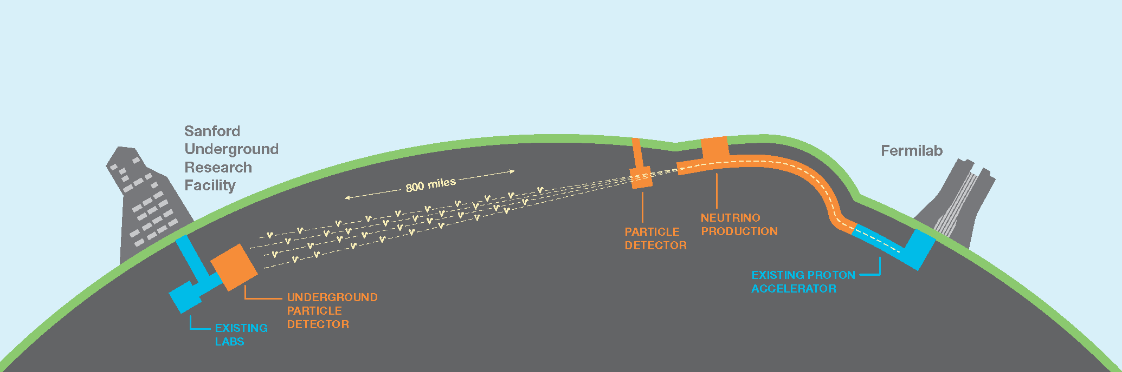
DUNE - Facility
Accelerator generating intense neutrino beam
Near detector measuring neutrinos close to source
Far detector 1300 km away from source and 1.48 km underground
TDAQ: no quick access and no large host lab in the vicinity!

Slide 7
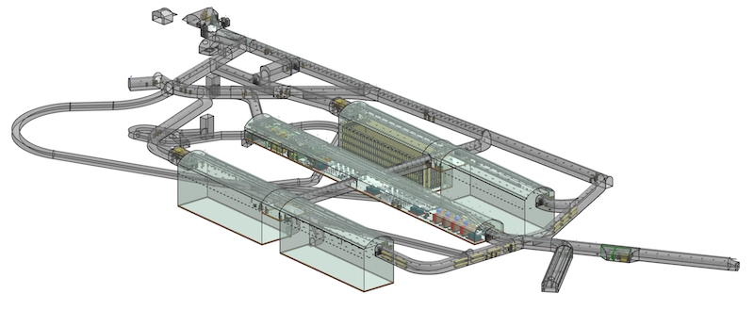
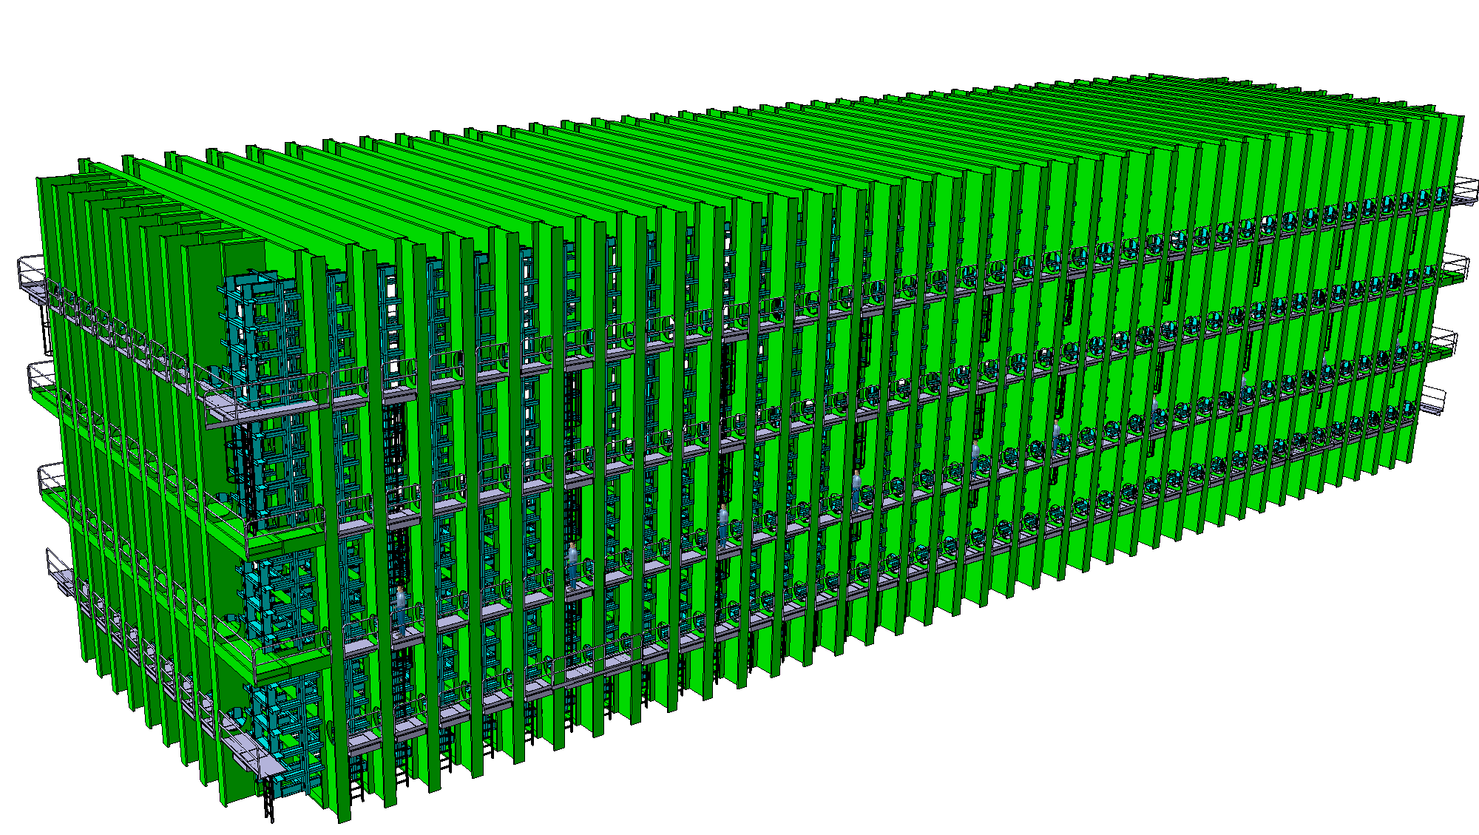
DUNE – The far detector
4 modules, each 18mx66mx17m (17 kton Lar)
Detector:
TPC (slow) + photon detectors (fast)
TDAQ:
4 independent instances, synchronized to a common clock, supporting potentially different detector technologies

Slide 8
DUNE - Signatures
Neutrino beam -> external trigger possible
Very local, rare signature
Very distributed, rare signature
TDAQ: active at “all” times!

Slide 9
A short digression on triggering…

Slide 10
Nomenclature
Globally triggered
  An “external device” decides that data are interesting
  There is a coherent event ID throughout the readout
  Front-end data are organized into fragments associated to the event ID
Locally triggered
  A local trigger element fires when data should be readout (e.g. signal above threshold)
  The trigger is relative to individual or groups of channels, not to the full front-end
  The readout can process incoming data to create fragments corresponding to the trigger
  There is no concept of a global event ID at the readout level
Continuous readout
  The front-end sends data to the readout at a fixed rate, irrespective of the data content
  Data rate and data size (if there is no zero suppression) are constant in input
  There is no indication for the readout on how to group front-end data into fragments corresponding to a physics event

Slide 11
Use cases for different readouts
Colliders
  Normally use global trigger: if something interesting has been seen somewhere, take all the data corresponding to that bunch crossing
Large distributed telescopes
  Often use local trigger: readout data for the portions of the detector that have seen something
Very slow detectors
  Sometimes use continuous readout: sample the analogue signals at a fixed rate and let the downstream DAQ decide whether there were any interesting signals

Slide 12
Globally triggered
N channels
N channels
N channels
TRIGGER
data digitization
data buffering
ADC
ADC
ADC
Front-End
ADC
ADC
ADC
ADC
ADC
ADC
data extraction
data formatting
data buffering
Processing
Processing
Processing
Readout
Data Collection
event assembly
event buffering
Event Building
Processing
event rejection
event buffering
Event Filtering
storage
Event Logging
file storage
file buffering

Slide 13
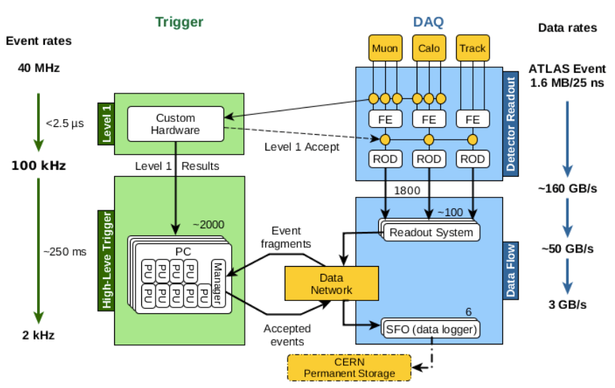
Globally triggered: ATLAS@LHC

Slide 14
An event

Slide 15
Locally triggered
N channels
N channels
N channels
TRG
TRG
TRG
data digitization
data buffering
ADC
ADC
ADC
Front-End
ADC
ADC
ADC
ADC
ADC
ADC
data extraction
data formatting
data buffering
Processing
Processing
Processing
Readout
Data Collection
event assembly
event buffering
???
Event Building
Processing
event rejection
event buffering
???
Event Filtering
storage
???
Event Logging
file storage
file buffering

Slide 16
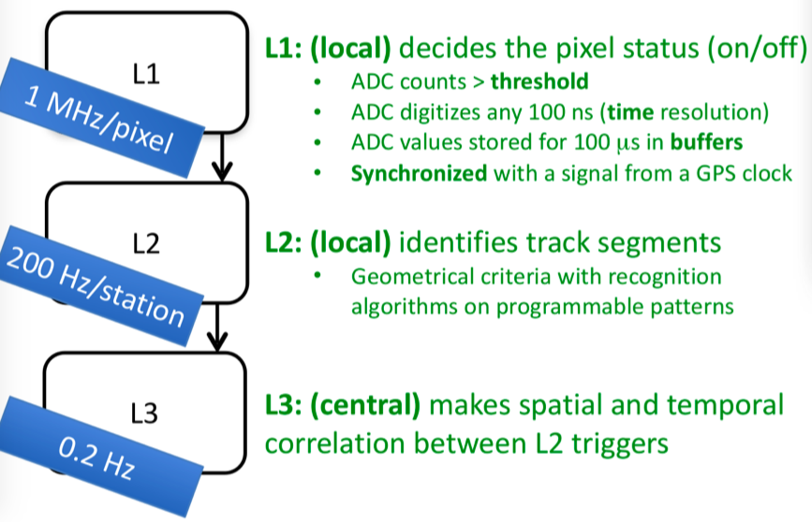
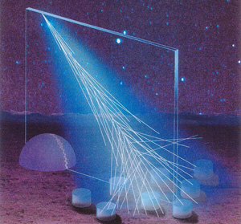
Locally triggered: Auger observatory

Slide 17
Continuous
N channels
N channels
N channels
CLOCK
data digitization
data buffering
ADC
ADC
ADC
Front-End
ADC
ADC
ADC
ADC
ADC
ADC
data extraction
data formatting
data buffering
Processing
Processing
Processing
???
Readout
Data Collection
event assembly
event buffering
???
Event Building
Processing
event rejection
event buffering
???
Event Filtering
storage
???
Event Logging
file storage
file buffering

Slide 18
Not events, but rather a movie
By Rick Harrison (license)

Slide 19
… end of digression, back to DUNE

Slide 20
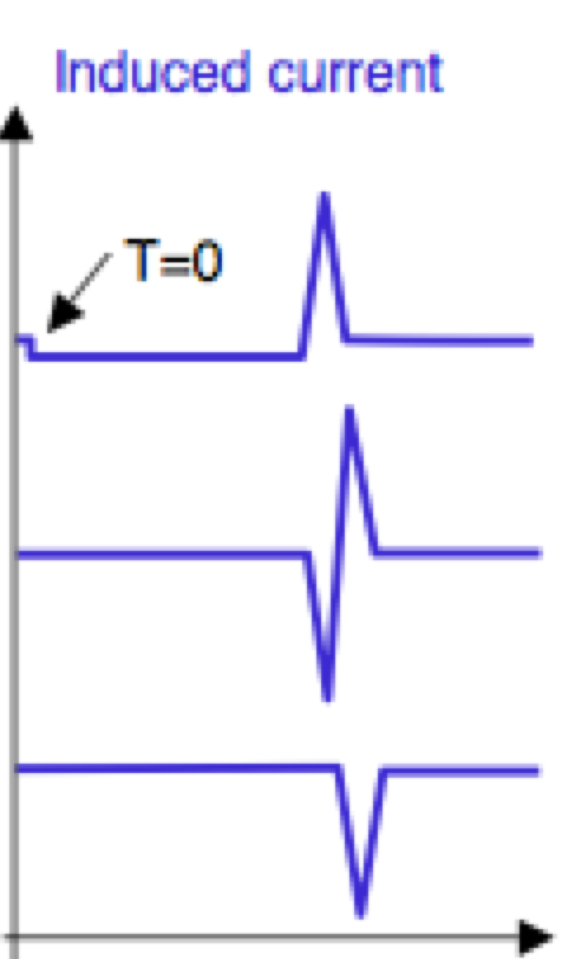
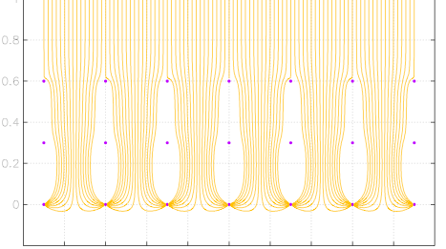
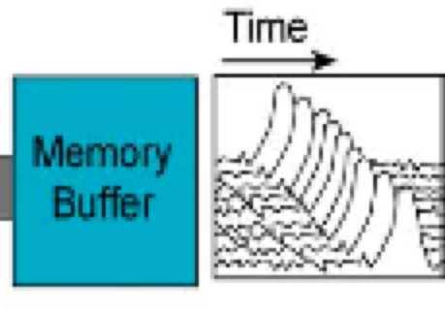
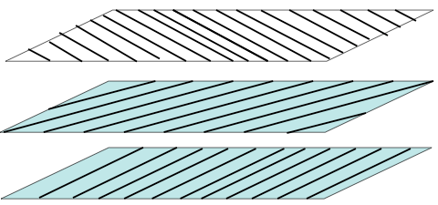
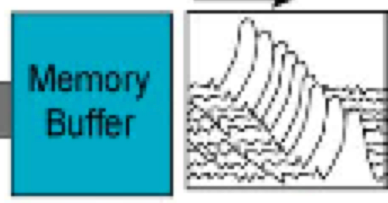
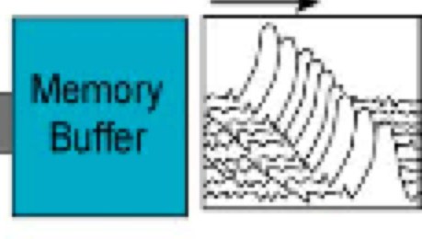
TPC schematic
charged particle ionizes argon
a = cross u
b = cross v
c = cross x
ionization electrons move
under E–field to wire-planes
E₀
electron drift lines from cathode to wires
(field lines from wires (fill white bits) not shown)
a b c
u
FADC
E₁
v
FADC
E₂
d
x
FADC
p
drift-time
drift-time
E₂>E₁>E₀
p~d~3-5 mm
Gatti, Padovini, Quartapelle, Greenlaw, Radeka
IEEE Trans. NS-26 (2) (1979) 2910]
Bunneman, Cranshaw, Harvey, Can. J. Res. 27 (1949) 191
Slide from S. Pordes

Slide 21
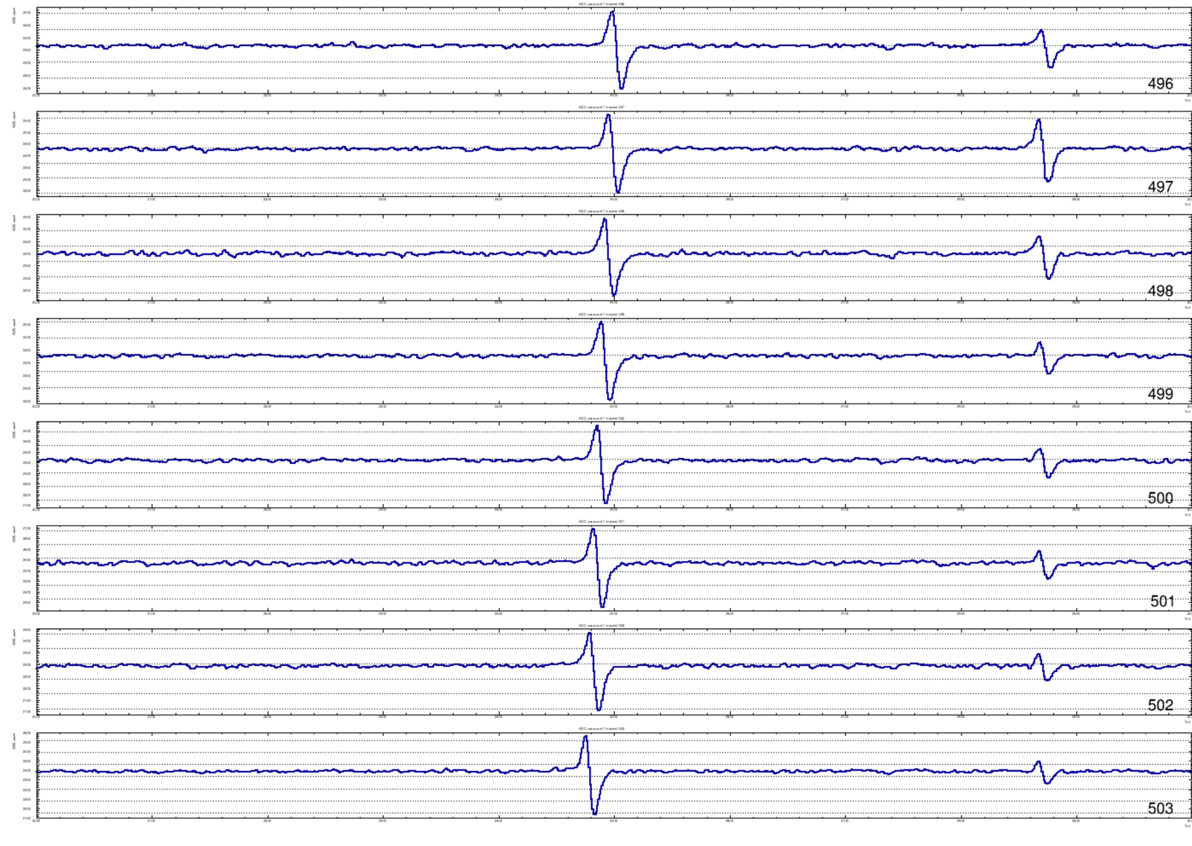
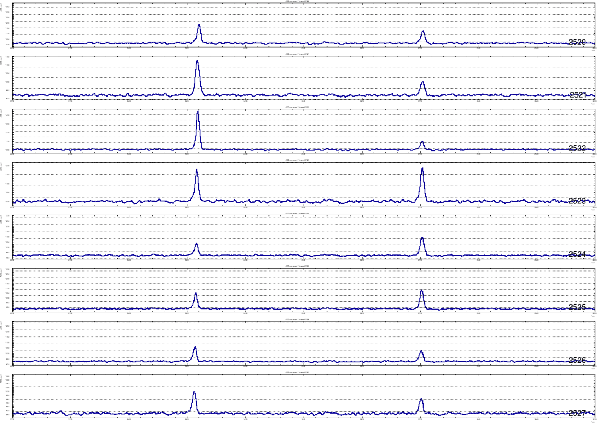
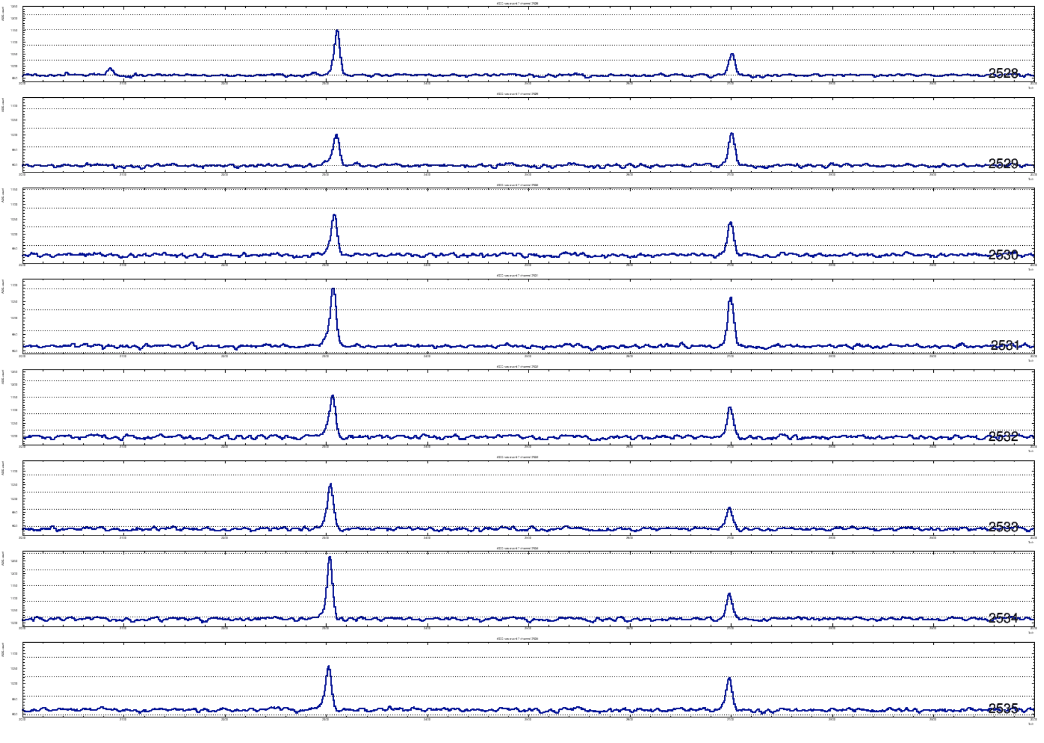
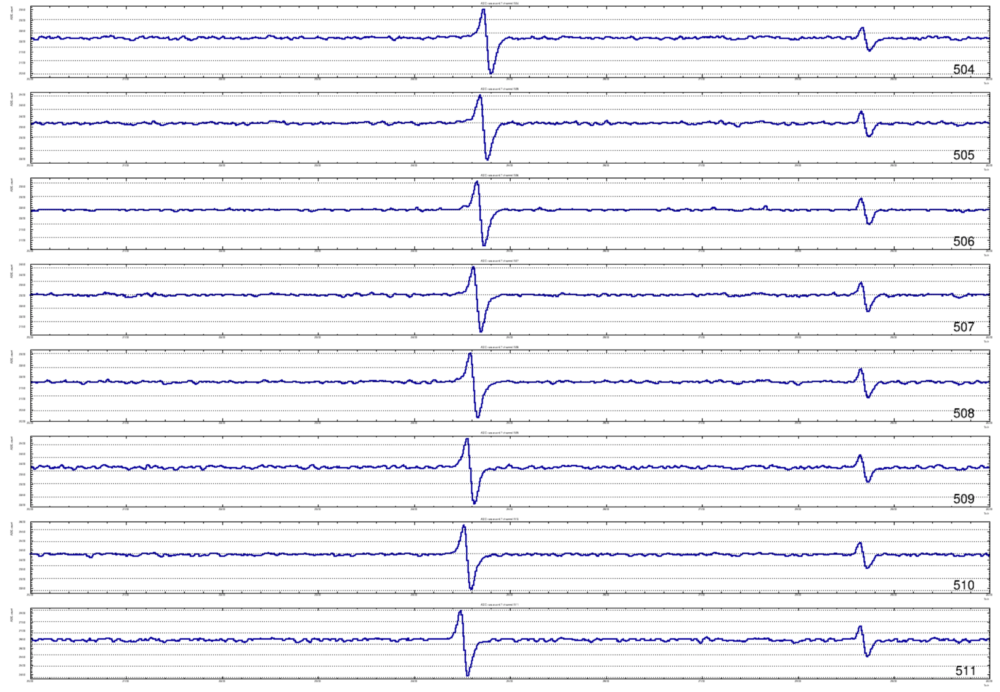
What the raw signals look like (16 sequential wires)
collection
plane
signals
induction
plane
Signals
Slide from S. Pordes

Slide 22
DUNE Front-End readout
DUNE mixes continuous readout (TPC) and locally triggered readout (Photon detectors)
  TPC sampling rate = 2 MHz
  Photon detectors sampling rate = 150 MHz (but data only when there is a signal)
  TPC wires (single phase technology) = 384000 per cryostat
  384 k channels (12 bit ADC) @ 2 MHz = 9.2 Tb/s (dominates data size)
  Adding all up the TDAQ has to sustain a readout of ~5 TB/s
    Sounds very much like HL-LHC…

Slide 23
DUNE post-readout data selection
It is responsibility of the post-readout system to combine data snippets into time windows of interesting detector regions
  In DUNE the ”window” can be anything from few ms to ~100s for the supernova core collapse
  The data corresponding to a trigger can have a size ranging from << 1 GB to ~100 TB!
The rate of events varies widely from few Hz to <<1/month
The data selection needs to accumulate a view on the activity of the detector over several seconds to identify some signatures (SNB)
  The readout needs to have very large buffers to accommodate for the decision latency

Slide 24
Conceptual design of the
DUNE data flow

Slide 25
DUNE data flow

Slide 26
Front end – data flow interfaces
Many similar modular elements (~100 / module)
Trigger
candidates
Module level trigger
Detector electronics
data
Frontend
data
Event builder
Trigger
primitives
Trigger primitives storage

Slide 27
Front end - functional blocks
Data reception
EB request
compress?
Noise filtering
Data buffer (~0.5 TB)
Data store
(2 TB)
Hit finding & archiving
Data EB output
Trigger candidates

Slide 28
DUNE data flow

Slide 29
Module Level Trigger– data flow interfaces
1 per module
Trigger
candidates
Front end
Calibration systems
timestamp
Module level trigger
Trigger decision / inhibit
Event builder
External Trigger
Trigger decision

Slide 30
Module Level Trigger - functional blocks
Candidates reception
Trigger
data buffer
Time-space correlation
EB I/O
Trigger
logics
Inhibit signals
Trigger decision
Calib signals
reception

Slide 31
DUNE data flow

Slide 32
Event builder – data flow interfaces
One orchestrator, few similar building elements (~10 / module)
Module level trigger
data
Module level trigger
Trigger decision
Inhibit
Event Builder
data
Front end
data
Data storage

Slide 33
Event builder - functional blocks
orchestrator
event builders
Trigger reception
EB request handling
Trigger/EB assignment
Trigger assignment
Data reception
Trigger inhibit
Event Building
EB book keeping
Files handling

Slide 34
DUNE data flow

Slide 35
Filter – data flow interfaces
Several similar elements (~10 / module)
External trigger
information
Data storage
Get data
Filter
Put data

Slide 36
Filter - functional blocks
Data retrieval
Data filtering
Ext trigger logics
Data compression
Data output

Slide 37
Predesign prototyping studies
The ProtoDUNE Single Phase project

Slide 38
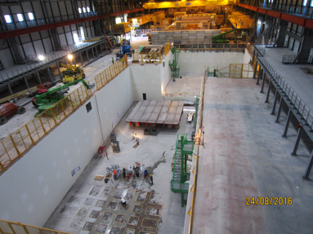
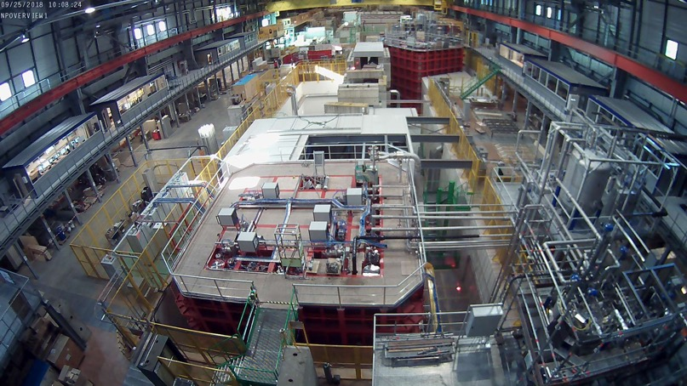
ProtoDUNE Single Phase
Largest monolithic single phase LArTPC detector and test beam built to date:
Goal is to validate detector design, construction and data acquisition solutions for DUNE’s Single Phase Far Detectors
  10x10x10 LArTPC
  800 tonnes of LAr
  Located on surface
  → external trigger needed
Extreme schedule:
  Project launch: Q1 2016
  Data taking with beam: Q4 2018
DAQ approach:
use ready-to-use solutions
  minimise development time

Slide 39
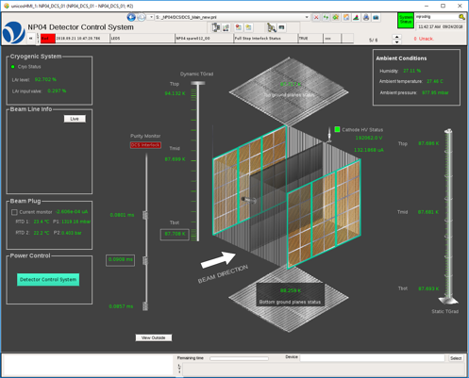
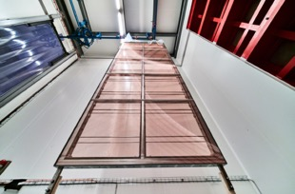
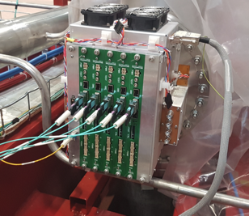
Data flow and volume
LArTPC → ionisation tracks are collected by the wires of the Anode Plane Assemblies (APAs)
Cold electronics in the detector digitise signals recorded by wires at 2 MHz
Warm interface boards (WIBs) then group the resulting channels into frames, each of which consists of a single 500 ns time slice of the grouped channels (128 or 256)
Output via optical links to DAQ:
  2x 9.6 Gb/s or 4x 4.8 Gb/s supported, depending on readout solution
  Continuous timestamped data frame streams
Each APA (2560 channels) is read out by 5x WIBs for a total payload of about 74 Gb/s
APA
WIBs

Slide 40
By M. Brice, CERN

Slide 41
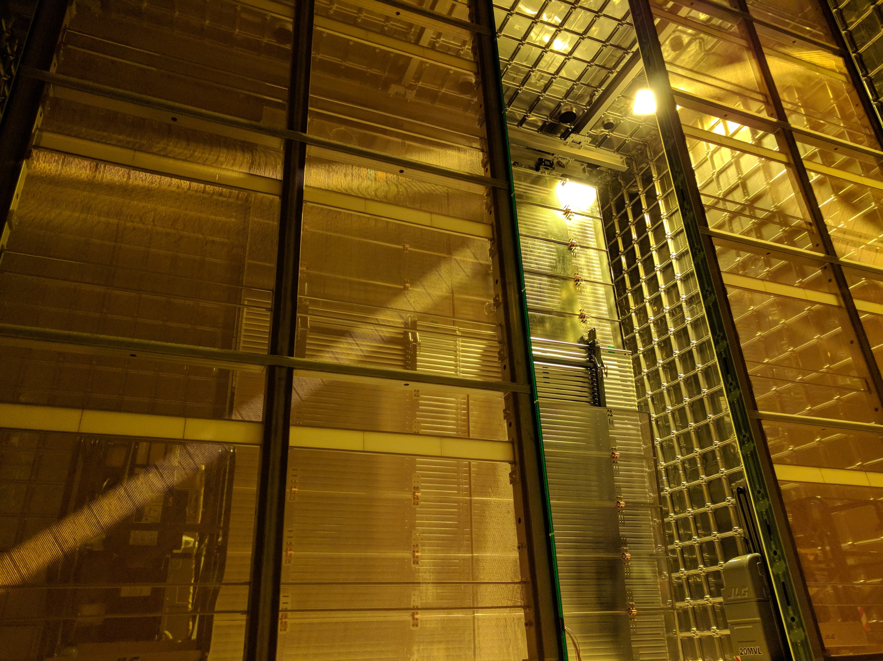

Slide 42
ProtoDUNE SP TDAQ
APAs
Photon Detectors
Loc Trigger
ADC
ADC
Readout with large buffers to allow exploiting the spill structure
Trigger logics implemented in a custom board
  Inputs from beam instrumentation, muon tagger, photon detectors
Data compression to reduce storage and network needs
An event is a 3 ms window of all data contained in the readout corresponding to the timestamp of a trigger
ADC
ADC
ADC
ADC
Trigger signals
~430 Gb/s
Readout
Readout
Readout
Readout
Trigger
Ext info
Event Builder
Event Builder
< 20 Gb/s
Storage

Slide 43
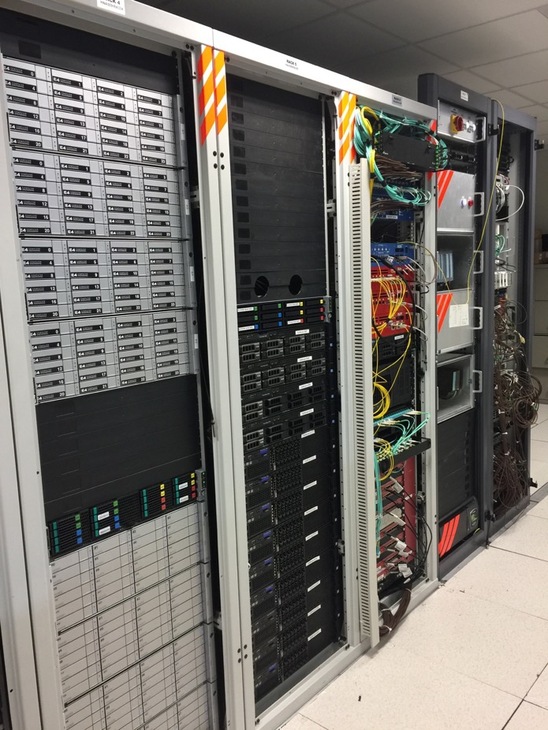
TDAQ Hardware setup
Network,
files servers, run control, monitoring, FELIX, board readers
Safety, power control, UPS
Trigger
Disk arrays
VST
Timing
Storage servers
BI interface
Disk arrays
RCE

Slide 44
ProtoDUNE SP TDAQ
Not a small DUNE TDAQ but an excellent test bench for TDAQ technologies for DUNE
  Timing system prototype
    Global time via White Rabbit
  Readout system prototypes
    Buffering in FPGA or server
  Compression scenarios
    On FPGA or SW
  Hit finding
    SW or FW
  Buffering
    RAM + SSD or
    new approaches such as
    Intel Optane Memory+QLC
    3D NAND storage

Slide 45
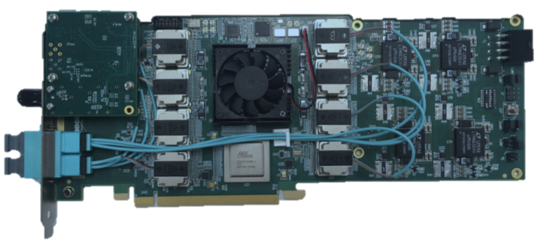
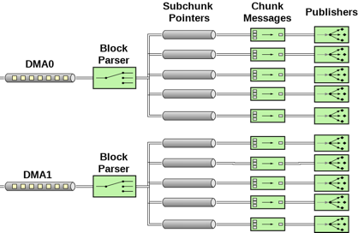
An example: FELIX based readout
P-to-p link throughput ✓
10 links -> host memory over
1 FELIX card ✓
  Need to switch to PCIe4 or greater to do 20 links
HW aided data compression using Intel QAT technology ✓
FLX-712 card
Mellanox
ConnectX-5
Full I/O over InfiniBand for ProtoDUNE ✓
  Need much less network I/O for DUNE
  Need longer and high throughput storage
  (but new technologies go in the right direction)
    Joint R&D with ATLAS, CMS, DUNE and Intel on DAQ DB

Slide 46
SW triggering from FELIX readout
Get the complete stream of raw data
Reformat WIB frames to
  Expand 12 bit ADCs into 16 bits
  Reorder wires in order to select only collection plane
Identify each time a wire has a “hit”
Combine information of hits in order to form track candidates
Implement a sw based trigger logics
This work is ongoing now! (next few slides from P. Rodrigues)

Slide 47
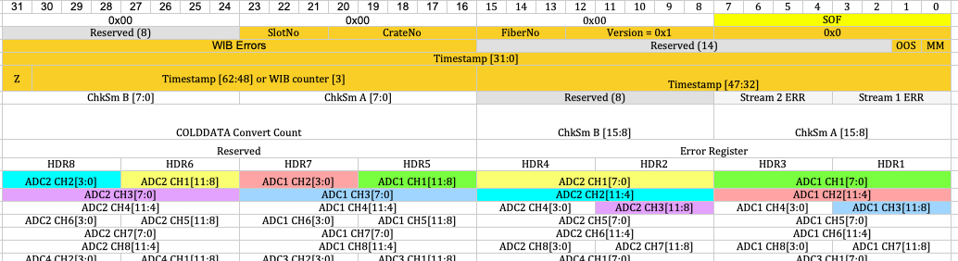
Data Reordering
1 WIB frame = 464 B => 256 ADCs + headers @ 2 MHz
Unpack collection channels with AVX2 code
Spoiler: this appears to be the biggest CPU consumer

Slide 48
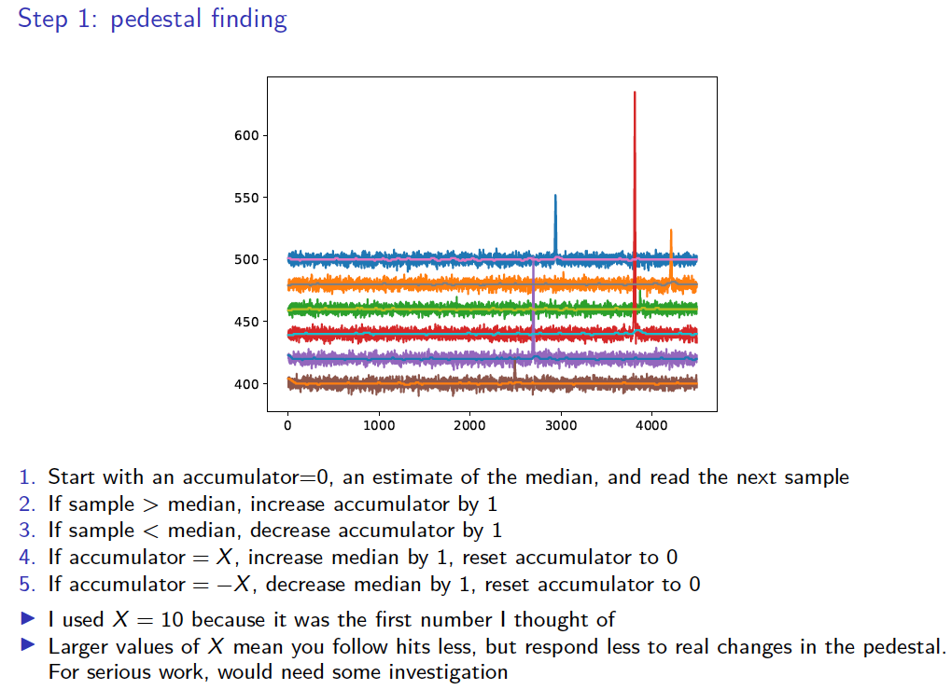

Slide 49
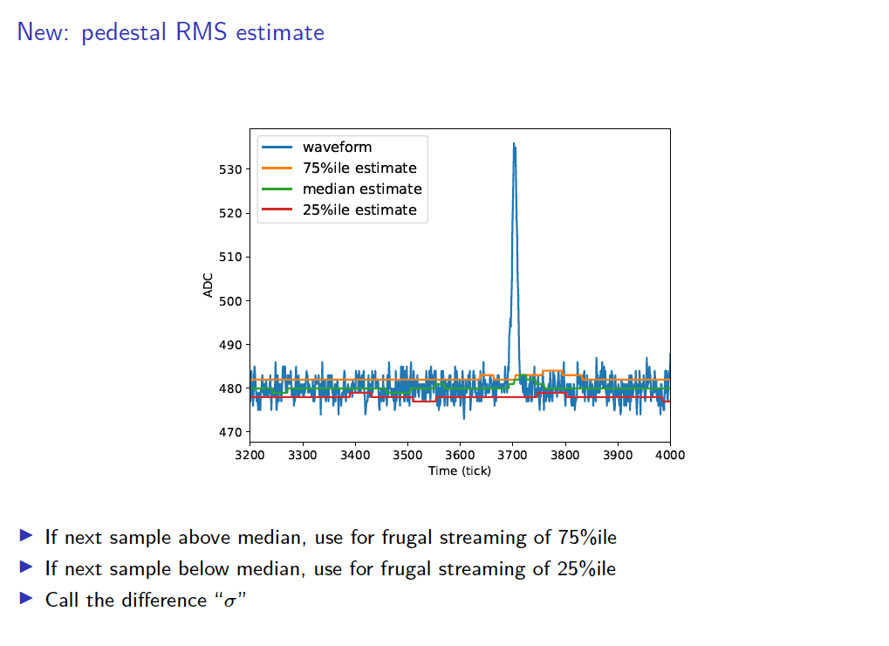

Slide 50
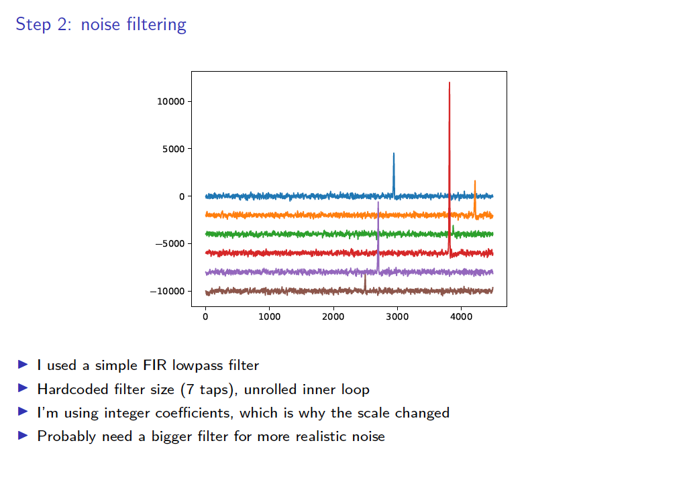

Slide 51
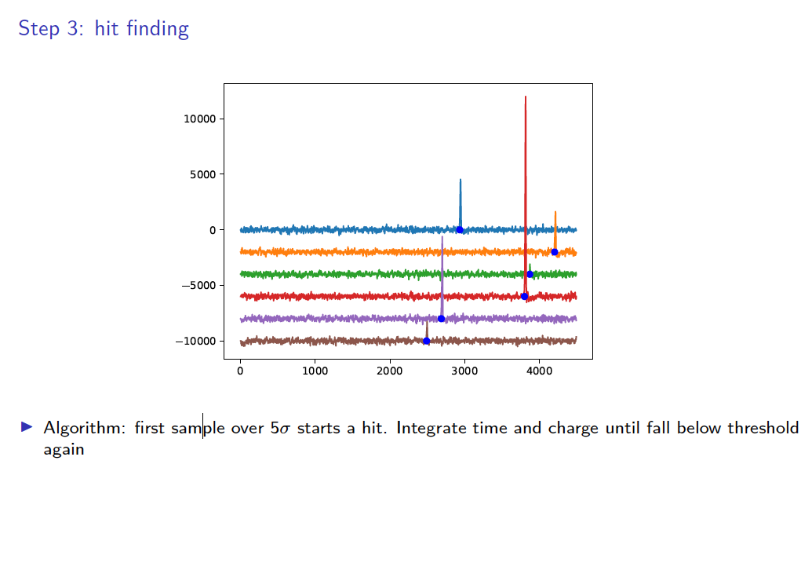

Slide 52
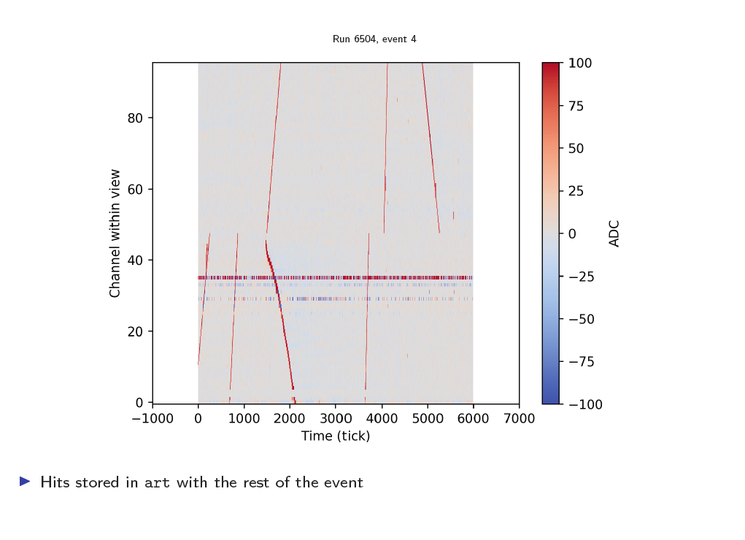

Slide 53
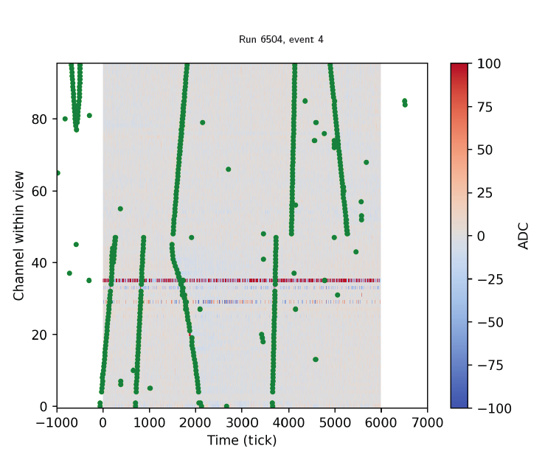

Slide 54
SW triggering next steps
Generate trigger candidates from hits
Form a module level trigger
Carry out data reformatting in FPGA
  Measure benefits
Move the complete hit finding into FPGA
  Measure benefits and assess any drawbacks

Slide 55
DUNE DAQ Control & Monitoring

Slide 56
What is special about DUNE?
Complexity and size of a large collider experiment
  Uptime <<30%
Uptime requirement of a “rare events” experiment (gravitational waves, supernovae detectors, double beta neutrino decays, etc
  Uptime “100%”
Accessibility of installation quite limited
The combination of those three doesn’t work well together…
The whole system must be conceived and setup in a different way
  Redundancy and fail over mechanisms
  Automated anomaly detection and recovery
  Remote monitoring and control
The control and monitoring system will have a predominant role for the success of the DUNE TDAQ (i.e. the experiment)

Slide 57
Few guidelines
Components must be as loosely coupled as possible
  Allow for tolerance to and recovery of local problems without affecting the data taking
Single points of failure (module level trigger, EB orchestrator) must have a running backup in standby mode
Running conditions must be as stable as possible
  Forget about stopping runs and regular full reconfigurations of the system
Assessment of data quality must be immediate and continuous
  Automated correction for bad data
System administration (computers, networks, storage) and repair must happen on an active system, i.e. be staggered and non intrusive
All tools need to be thought from the start for remote operators
  Heavily rely on web, but still ensure security and safety

Slide 58
Design of the Control and Monitoring for DUNE
Do we know how to do it?
  Not really…
  Ideas are mainly on paper and need to be tried out
  System and software engineering skills are essential to get this right
How would you go about designing and implementing such a system?

Slide 59
Summary and Outlook
DUNE is a new giant experiment scheduled to start taking data in 2025
The TDAQ system is being designed now
  Challenging readout performance
  Very challenging operational requirements
Predesign prototyping allows us to identify suitable technologies and validate ideas
  Advancing well on the main data flow path
  Still embryonic stage for the control and configuration
If ISOTDAQ awoke your desire of becoming a TDAQ expert
  DUNE is surely an experiment where you will be able to challenge your skills!

