Slide 1
Microcontrollers
Maurício Féo
m.feo@cern.ch
CERN/Nikhef

Slide 2
Objectives
Understand what are microcontrollers.
  What are they?
  What are they used for?
  How do they work?
  How can I use them?
  Are they suitable for my project?
Example of applications.
Have an overview of the lab 10.

Slide 3
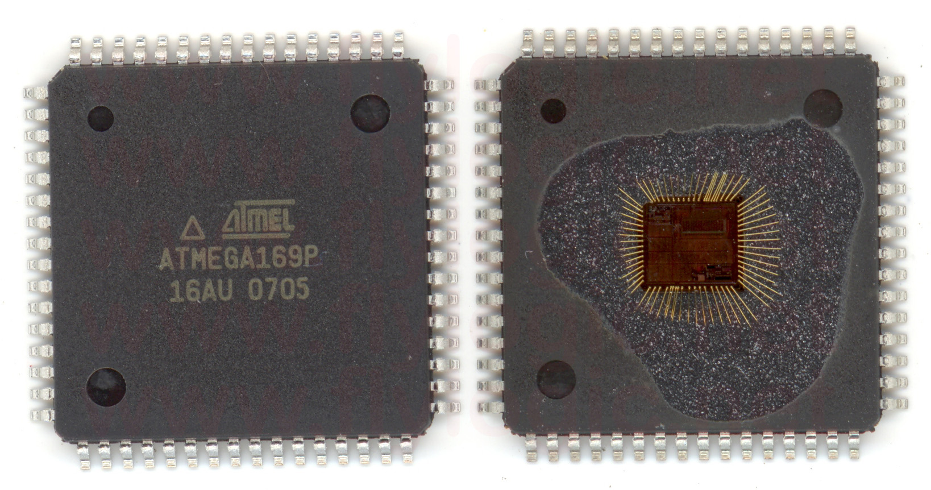
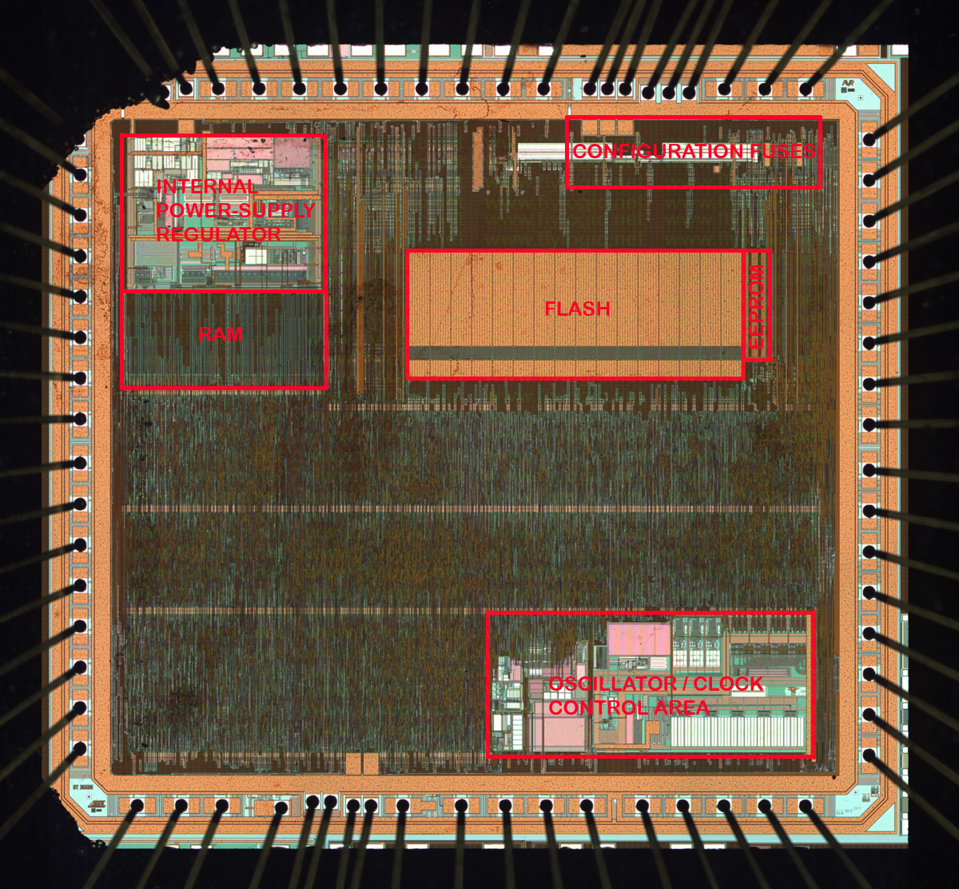
What is a microcontroller?
Tiny computer integrated in the same chip.
Microcontroller
CPU
Memories
I/O Interfaces
Etc.
CPU
Input
Output
Input
Output
Input
Output
Memory
Notes:
All the components of a normal computer, but integrated on the same chip.

Slide 4
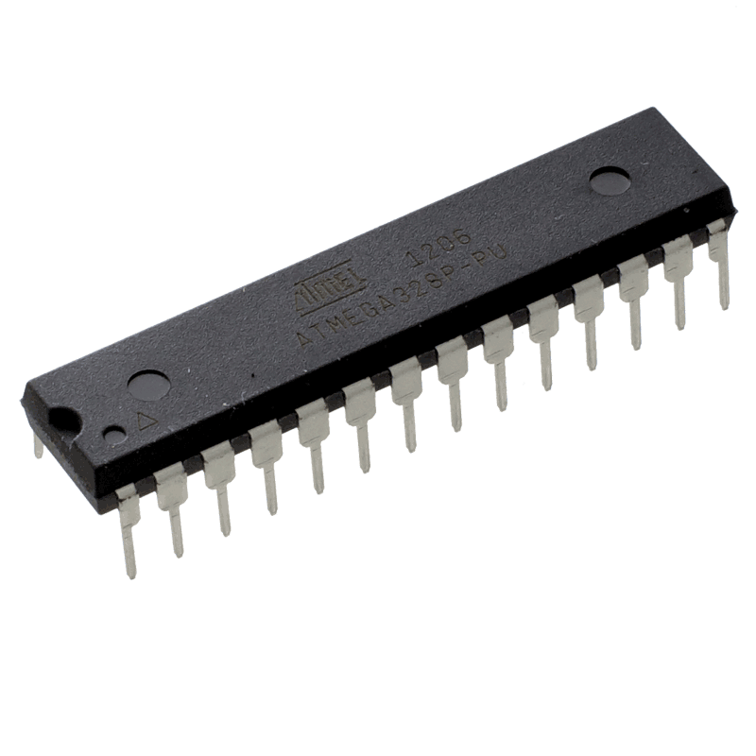
What is a microcontroller?
Tiny computers integrated in a single chip
  CPU, Memories and Peripherals in the same chip.
Main differences w.r.t. a computer:
Suitable for embedded applications.
Low cost (ATtiny: ~$0.27)
Low power consumption (ATtiny43U: 0.15uA in Sleep Mode)
Reduced clock frequency (~ dozens of MHz)
Stand-alone devices (Some require only power to work)
Low level control of your application.
Notes:
What makes it diferent from a normal PC?
(4.5u with watchdog)

Slide 5
What are they used for?
Monitoring
Data Acqusition
Control
Applications where:
  High performance is not required.
  Other devices are inadequate (overkill) due to:
      High power consumption
      need of external memories and peripherals
      cost
      etc.
Notes:
Basically for every application which needs processing but computers are overpower, or too big, or too power hungry.

Slide 6
Where are they used?
Everywhere!
Consumer electronics, home appliances, toys, vehicles, computers, hobbyist projects, etc.
According to wikipedia trusted sources, a typical mid-range automobile has as many as 30 or more microcontrollers.
According to me an even more trusted source, you have at least one in your pocket right now.
Notes:
Controlling the fuel injection
Reading sensors
Triggering your airbag
Calculating your velocity
Sensing the emission of your exhaust

Slide 7
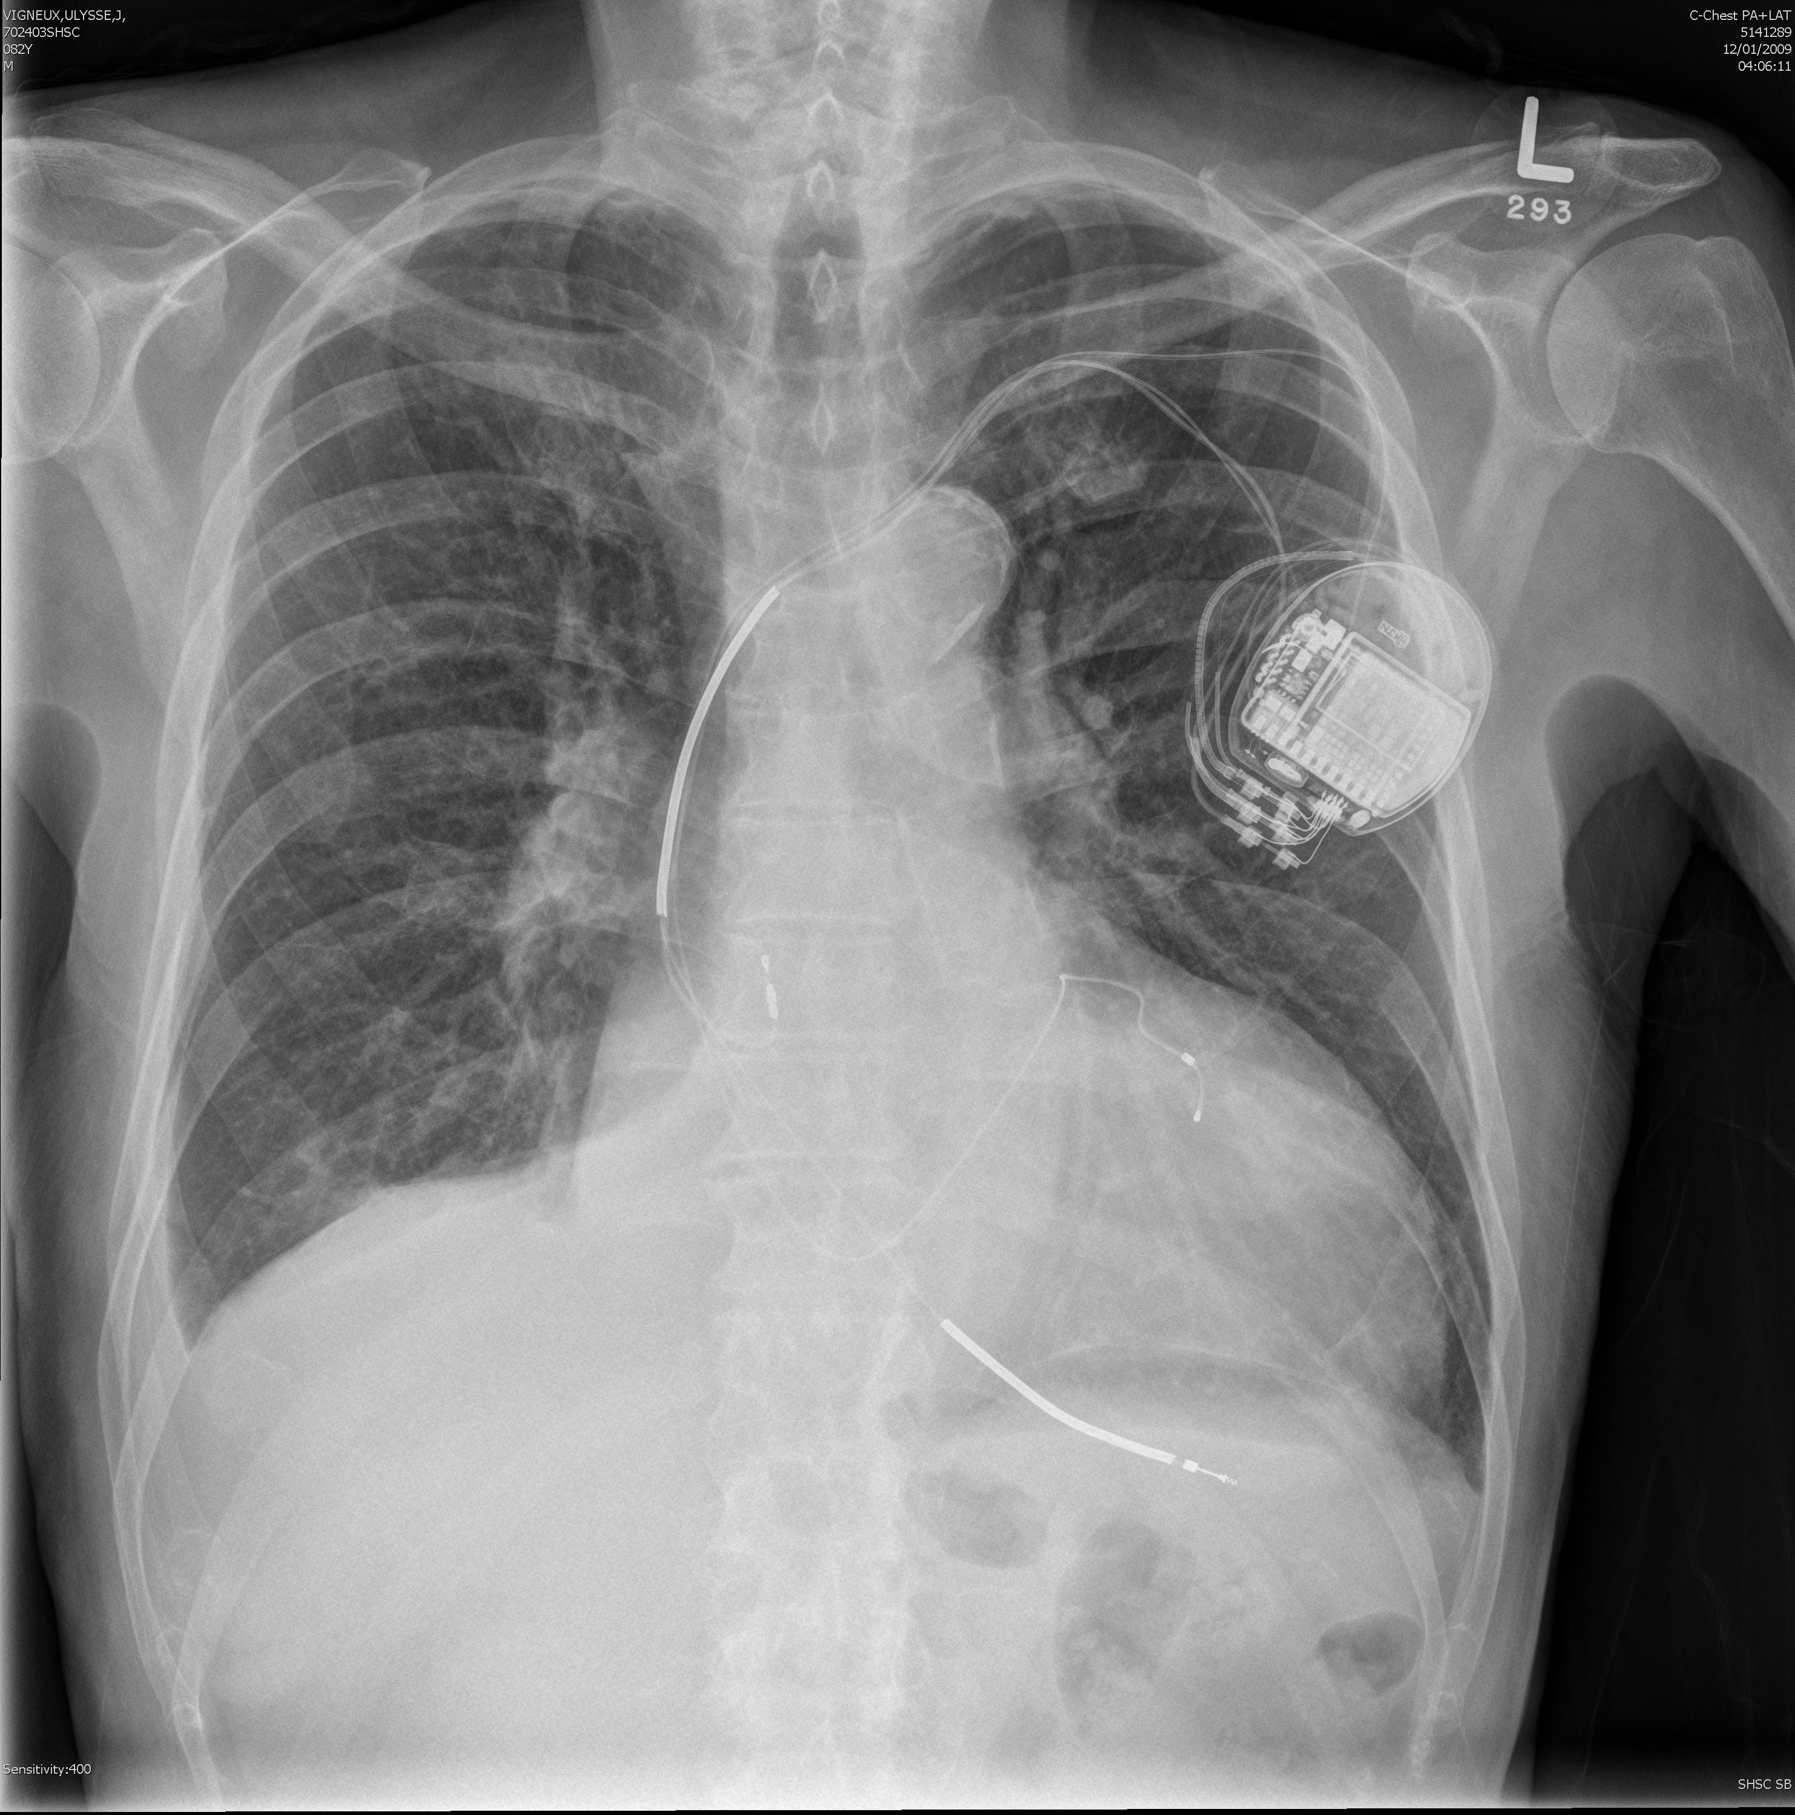
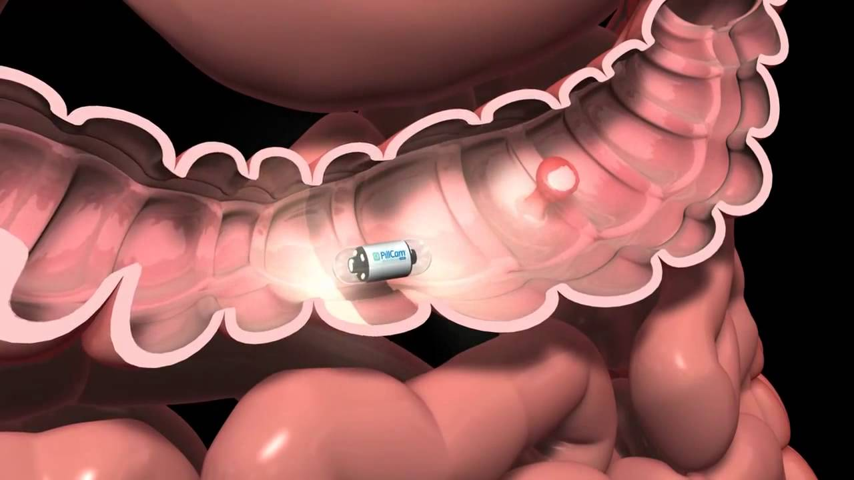
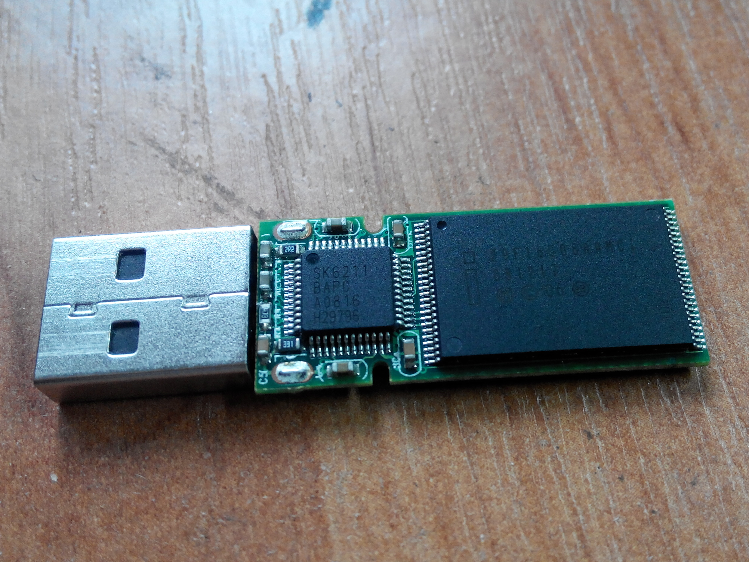
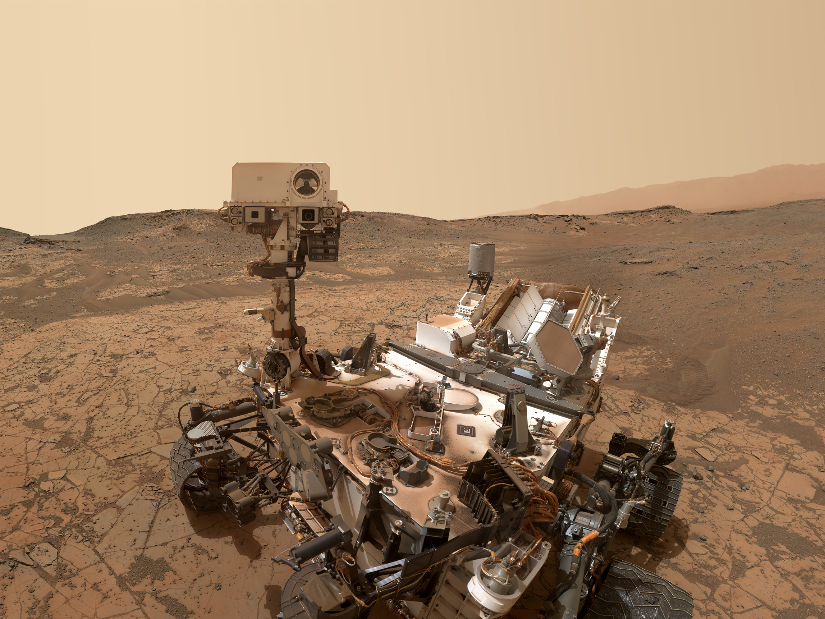
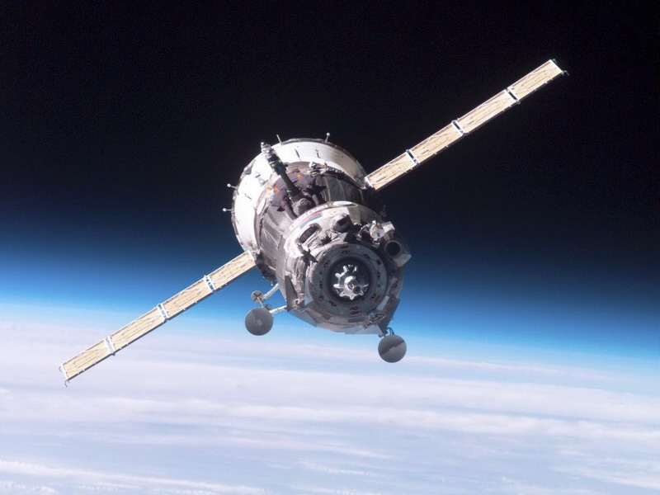
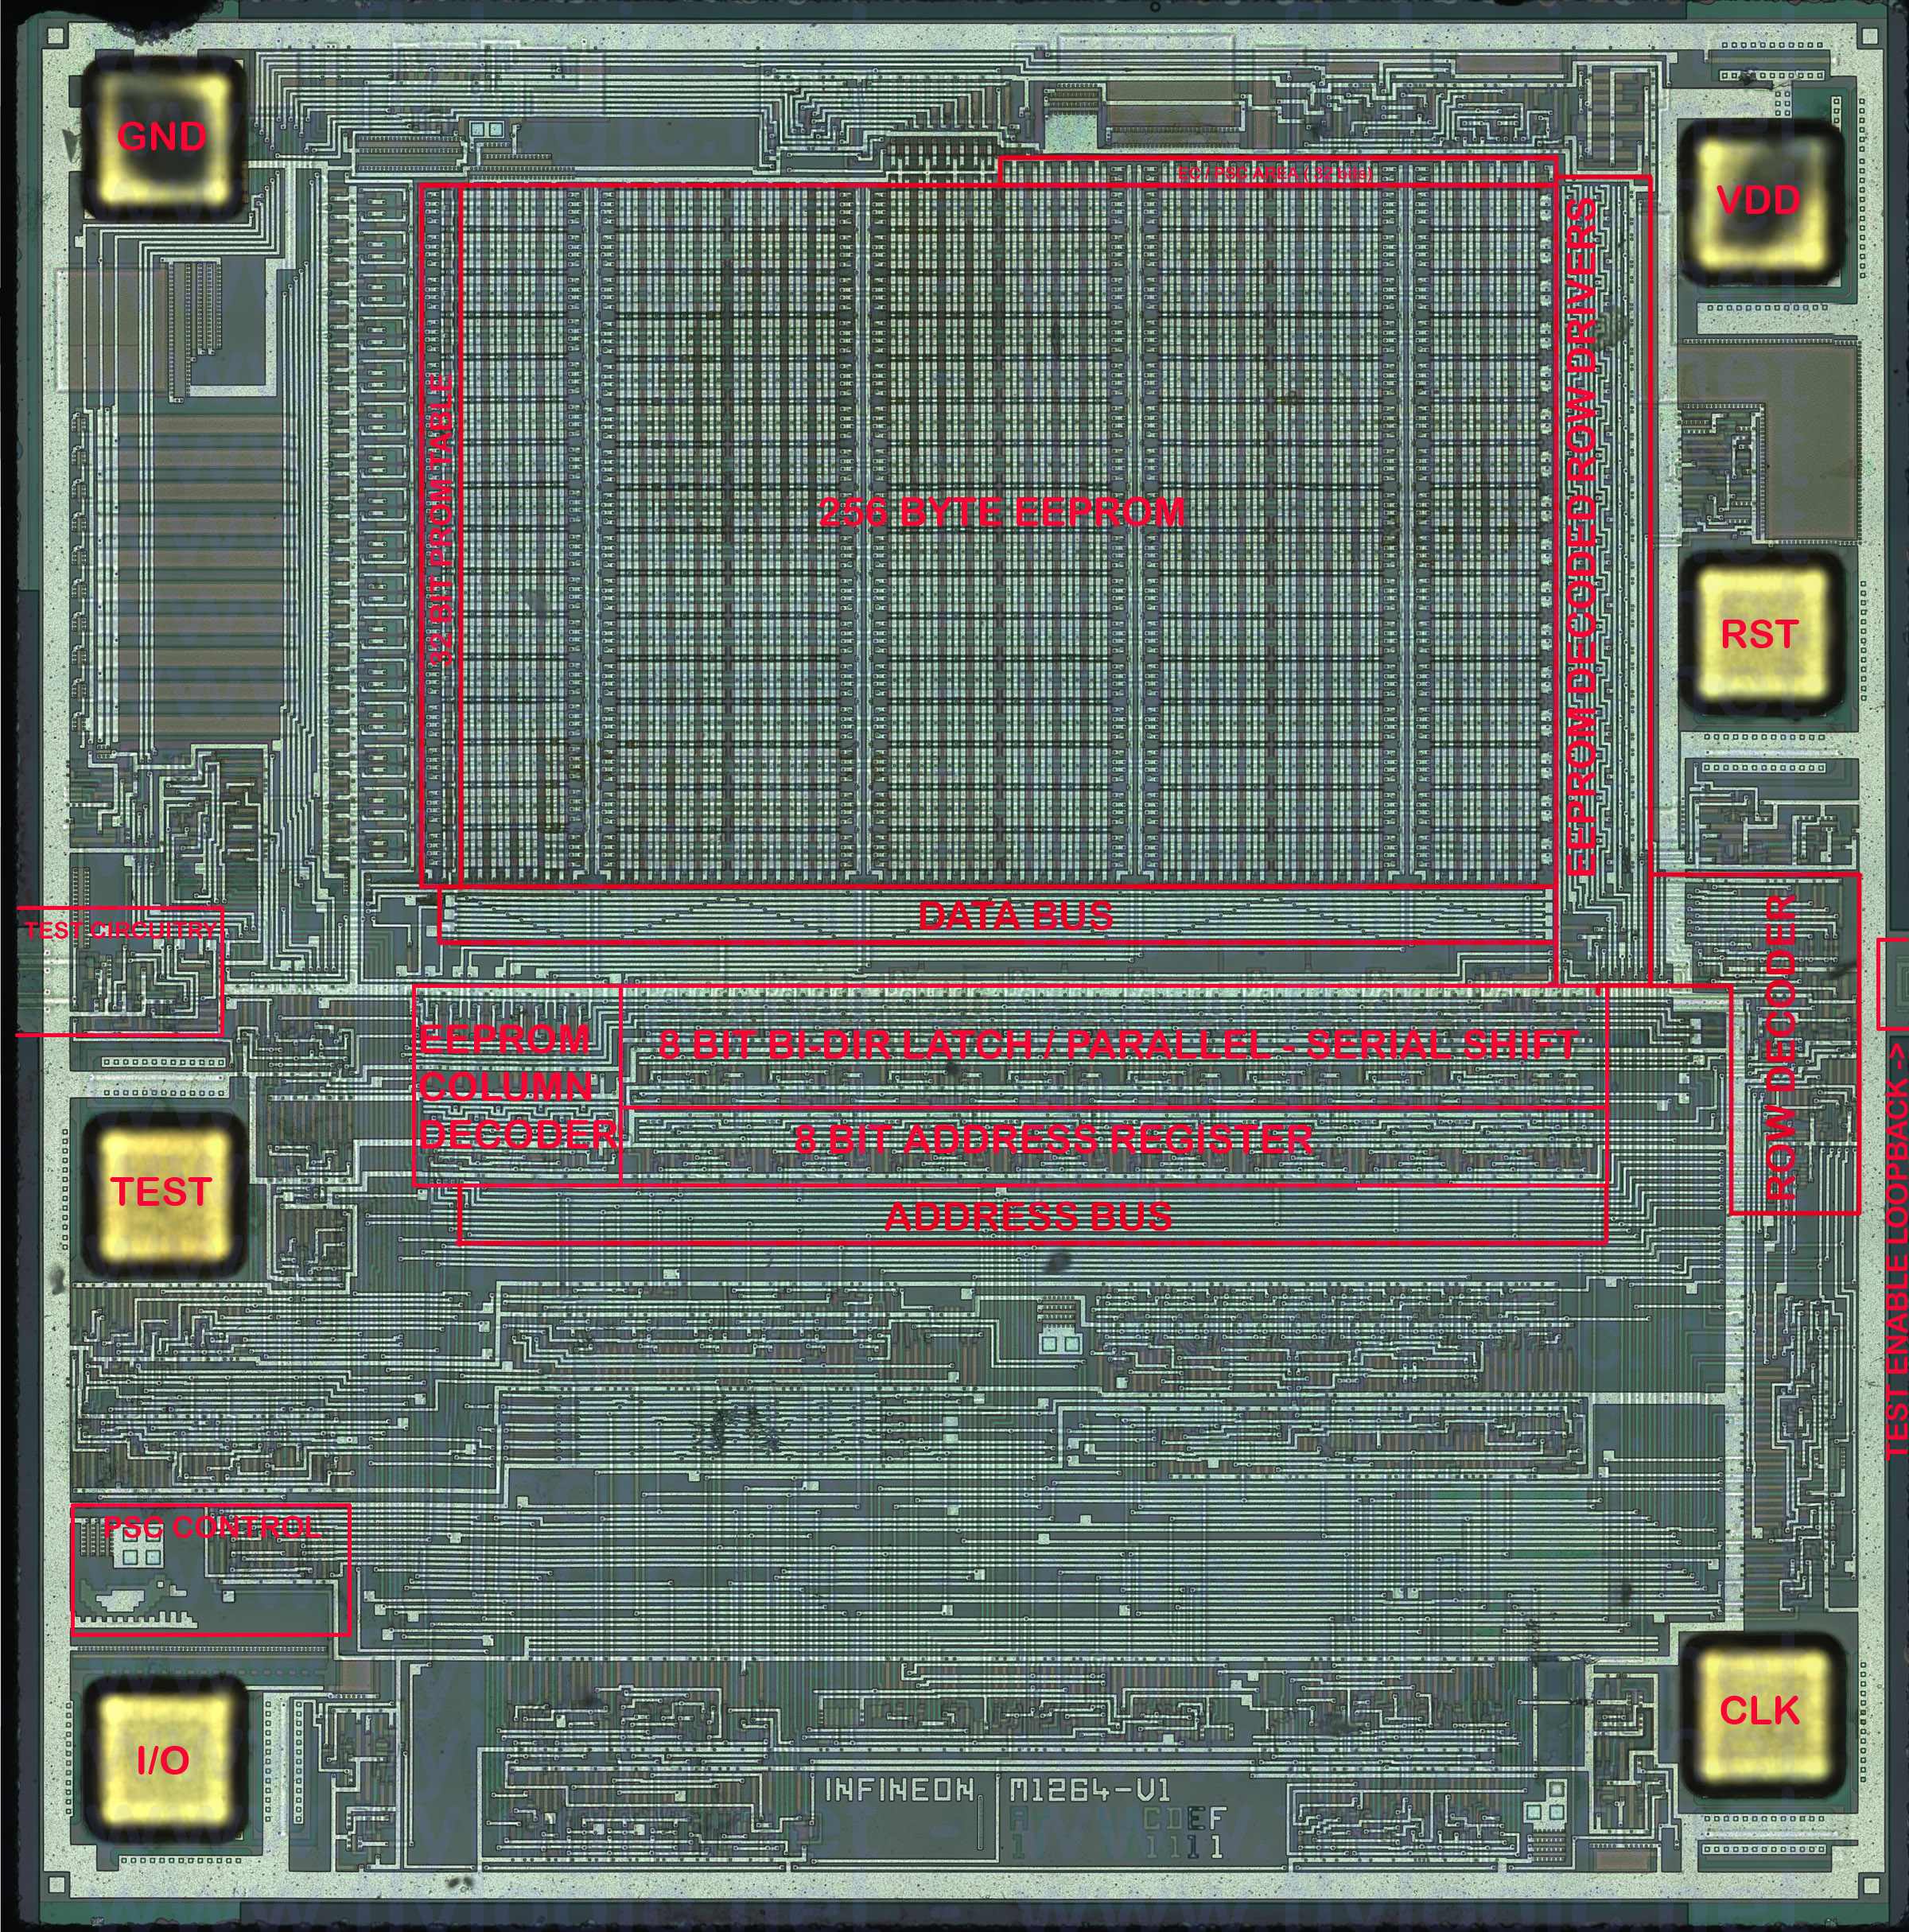

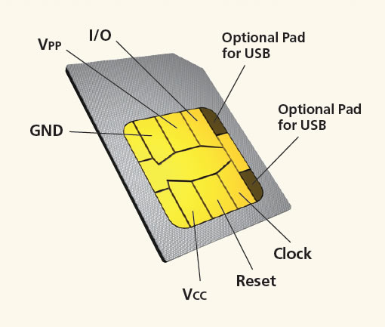
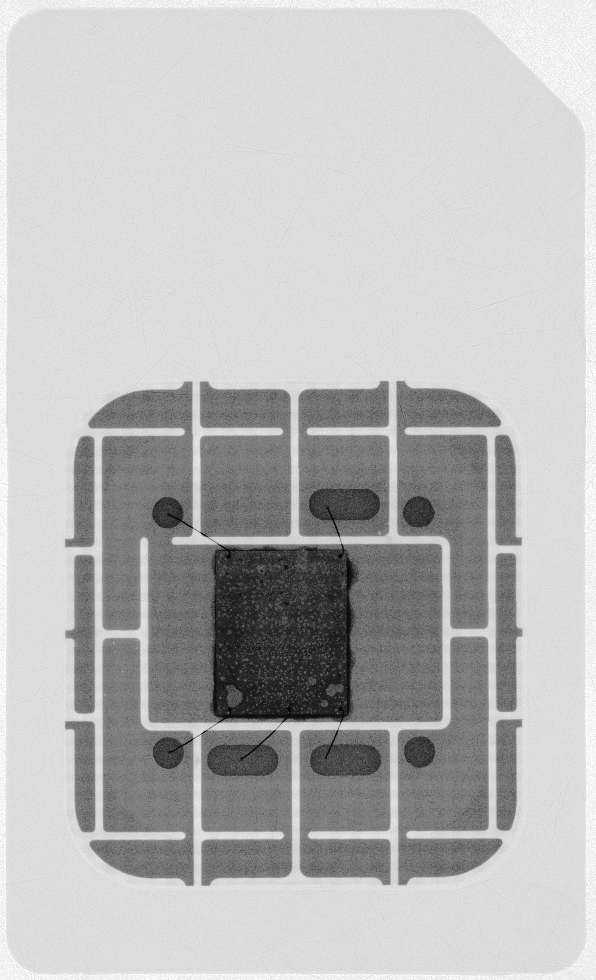
Where are they used?
Notes:
We really trust these things.

Slide 8
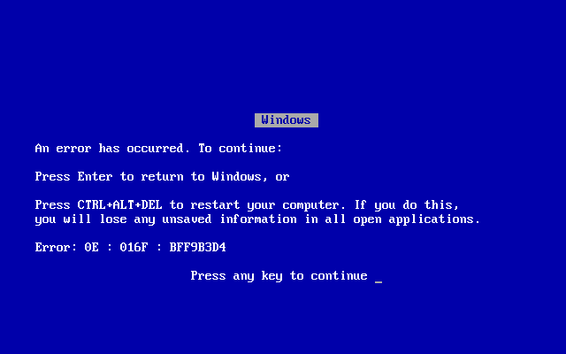

Slide 9
CERN CENTOS 7
rm –rf $ROOTSYS

Slide 10
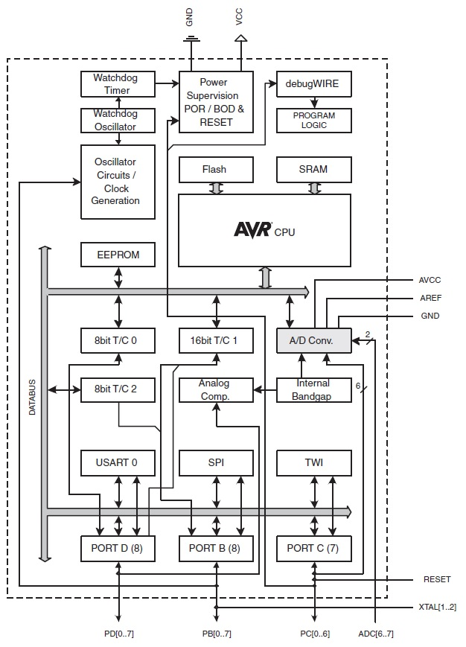
AVR
Architecture
(ATmega328P)
The one used on the lab.

Slide 11
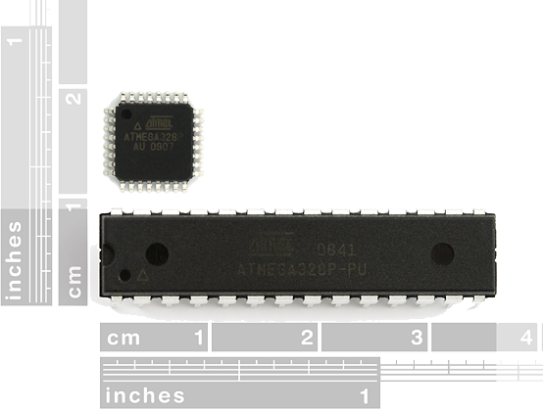
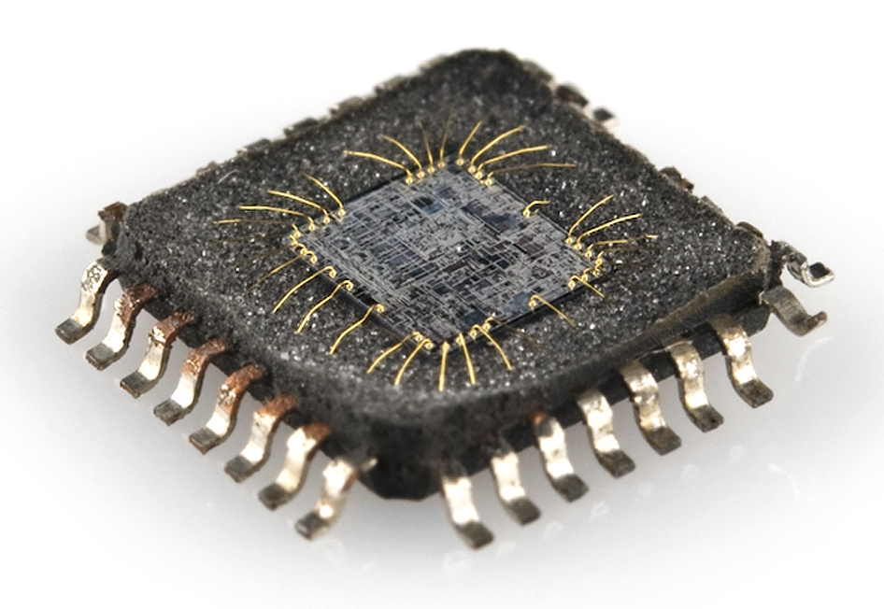
AVR
Architecture
(ATmega328P)
The one used on the lab.

Slide 12
AVR
Architecture
(ATmega328P)
8 bits architecture
32kB Flash program memory
2kB RAM
2kB EEPROM
Max 20MHz
6 x PWM
6 x ADC channels (10bits)
23 I/O pins
3 timers (2x8 bits 1x16 bits)
1x USART
1x SPI
1x TWI (I²C)
0.6mA/MHz
The one used on the lab.

Slide 13
AVR
Architecture
(ATmega328P)

Slide 14
AVR CPU
Different paths for data
and instructions
Data
Memory
CPU
Program
Memory
Harvard Architecture
8 bits architecture (with 16bits for instructions)
    Instructions executed 8 bits by 8 bits
Reduced Instruction Set Computing (RISC) (~130 instructions)
Up to 20 MIPS at 20 MHz (1 instruction / clock cycle)

Slide 15
AVR
Architecture
(ATmega328P)

Slide 16
General purpose Input/output (GPIO)
Pins programmable as Input and Output
Read / Write digital signals
‘0’ = 0V (Gnd), ‘1’ = 5V (Vcc)
Controlled by 3 registers:
DDR (Data Direction Register)
PORT (Where you write when it’s output)
PIN (Where you read when it’s input)
DATA
BUS
DDR reg
ON
OFF
PORT reg
Pin
PIN reg
Notes:
Controlled by 3 rÉgisters
One you use to read
One you use to write
Etc.

Slide 17
Interrupt
Interrupts break the program flow to handle some event.
It may be triggered by:
  Pin change (rise/fall/toggle)
  Timers / Counters
  Analog Comparator
  ADC reading done
  Serial interfaces (Rx/Tx done)
It allows the program to handle an event "right after" its occurrence, regardless of where the program is and without the need of polling constantly.
Main program
instruction 1
instruction 2
instruction 3
instruction 4
instruction 5
instruction 6
instruction 7
instruction 8
instruction 9
Interrupt
Service
Routine
ISR()
inst 1
inst 2
inst 3
inst 4
Interrupt
Notes:
Start with polling example from computer

Slide 18
AVR
Architecture
(ATmega328P)

Slide 19
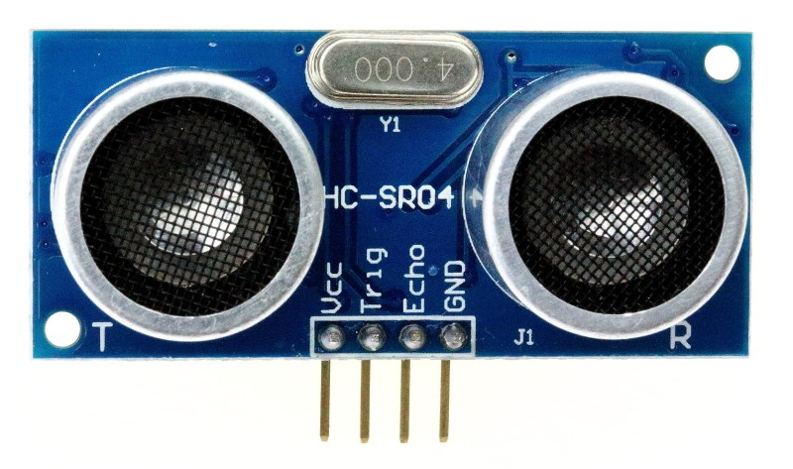
Timers / Counters
Internal registers that increment triggered by:
  A clock source: Timer
  An external event: Counter
May be used to:
  Measure time
  Raise interruption on:
    Overflow
    Reach a certain value (OCR)
  Create waveform
    PWM
Ultrasonic distance sensor
Measures distance based on the time to echo of an ultrasonic pulse.
Output
Compare
Register
Notes:
They reset when they overflow

Slide 20
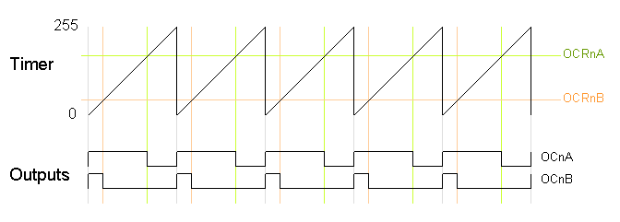
Pulse Width Modulation (PWM)
You can create an output signal which value depends on the status of the timer.
Outputs a train of periodic digital pulses with controlled width.
  (Can be used to "mimic" an analog signal)
191
(75%)
75%
25%
Notes:
Racing game example
Output Compare Register

Slide 21
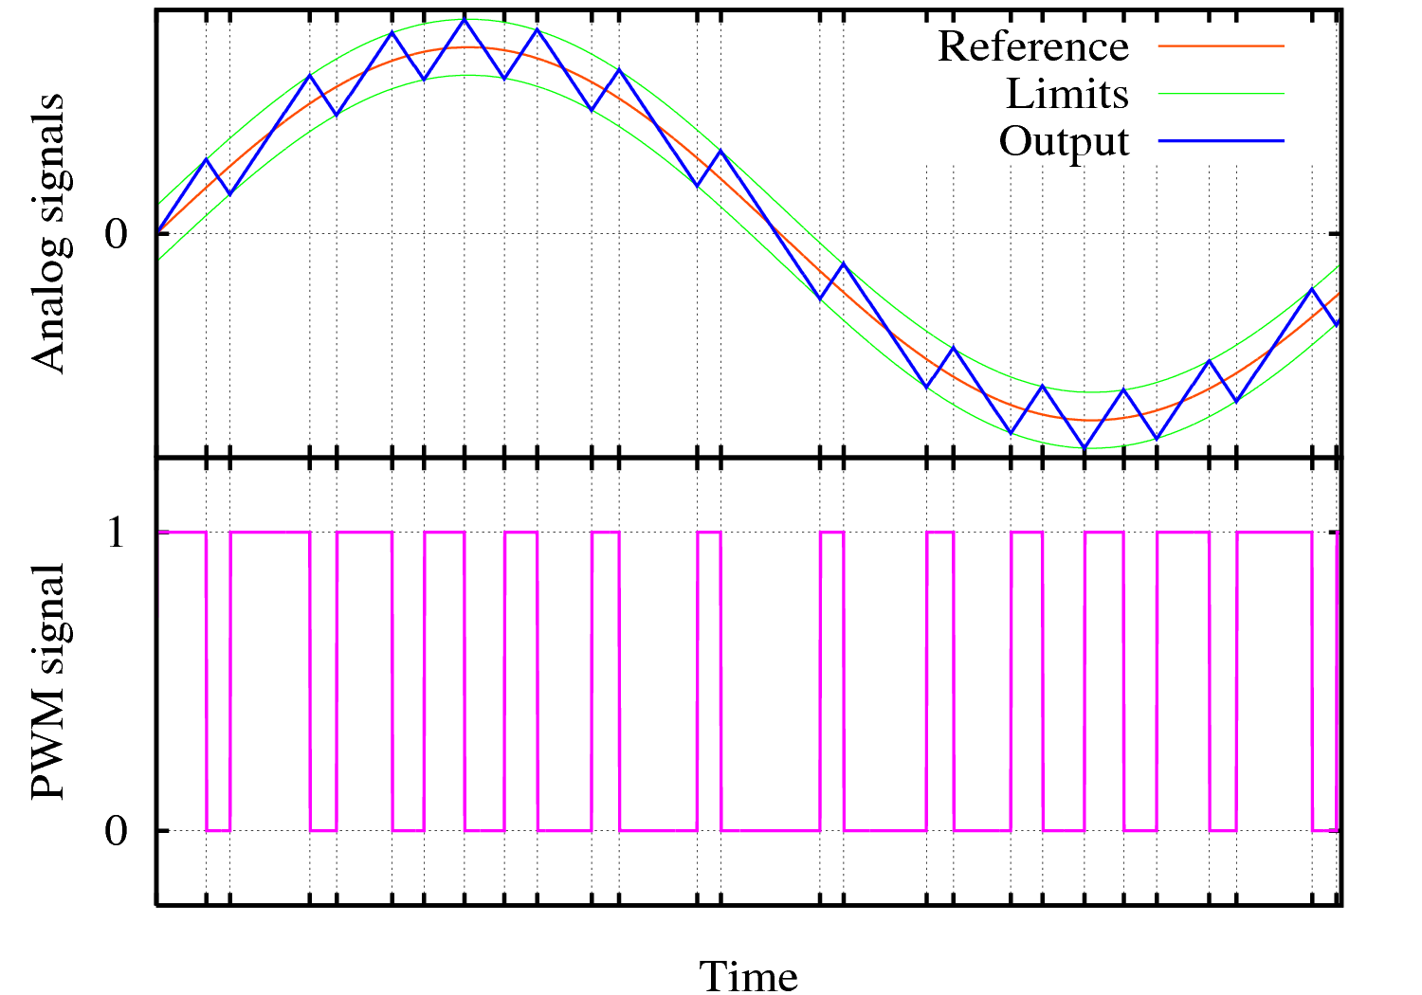
Pulse Width Modulation (PWM)
You can create an output signal which value depends on the status of the timer.
Outputs a train of periodic digital pulses with controlled width.
  (Can be used to "mimic" an analog signal)
Notes:
Racing game example
Output Compare Register

Slide 22
AVR
Architecture
(ATmega328P)

Slide 23
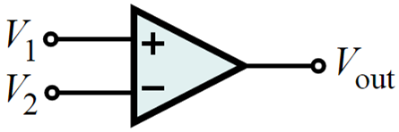
Analog Comparator
Tells whether positive pin AIN0 voltage is higher than negative pin AIN1.
Output is the internal bit ACO* of reg ACSR*.
Can be used to:
  Compare two analog signals
  Trigger a Timer/Counter
  Trigger an interrupt (rise, fall or toggle)
V₁ > V₂ V_{out} = 1
V₁ < V₂ V_{out} = 0
*
ACO = Analog Comparator Output
ACSR = Analog Comp. Control and Status Register

Slide 24
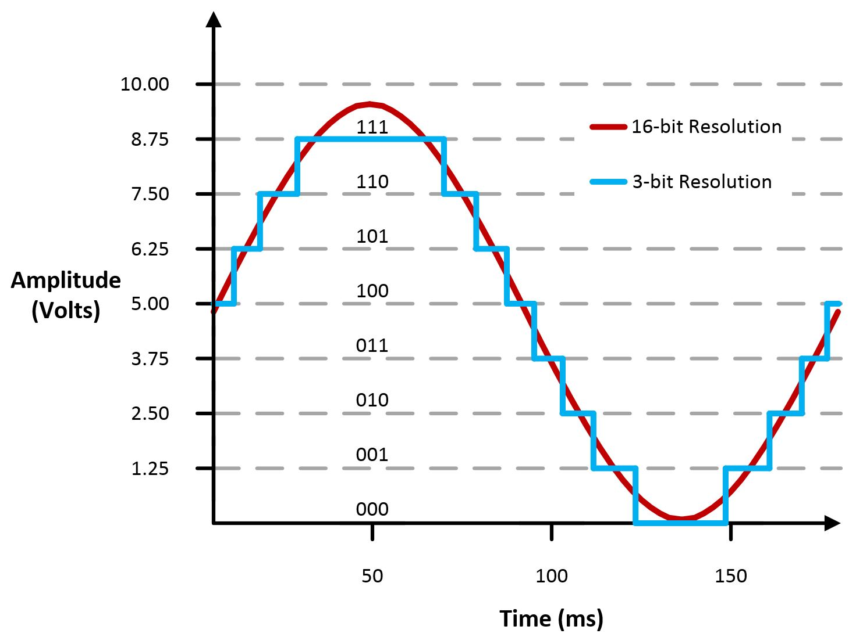
Analog to Digital Converter (ADC)
10-bit resolution
  0V-Vref → 0-1023
Vref can be:
  Vcc (Power source)
  1.1V internal ref.
  (from bandgap)
  External ref. on pin ‘AREF’
Successive approximation
  13-260 us Conversion time
Interrupt on complete
6 multiplexed channels on DIP package
  (internal Temp sensor on ch8)

Slide 25
AVR
Architecture
(ATmega328P)

Slide 26
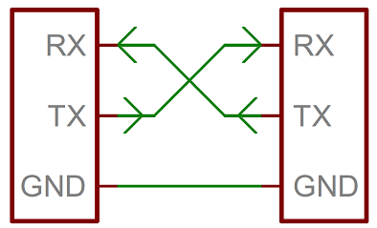
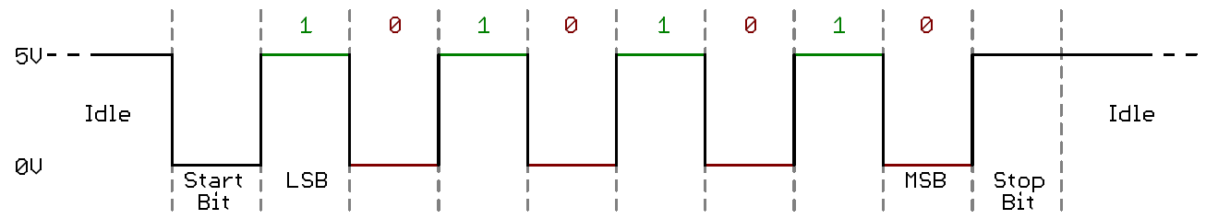
Serial Interfaces: USART
Universal Synchronous-Asynchronous Receiver Transmitter
A simple protocol
Widely used to communicate with PCs due to compability with RS232 protocol. (RS232 is not used anymore in most PCs but it’s still very easy to find USB-Serial converters)
Up to 250kbps
May trigger interrupts:
  Tx complete
  Rx complete
  Data reg empty
Notes:
The problem is: Up to 2 devices number

Slide 27
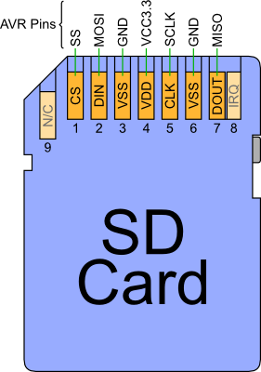
Serial Interfaces: SPI
Serial Peripheral Interface
Differently from the USART, SPI can talk to multiple devices on the same bus, but needs a Slave Select signal per Slave Device
Up to 10Mbps! (clk/2)
Slaves do not "talk" autonomously.
  Must be querried (and clocked) by master.
All SD cards
Uses the SPI serial interface
and can be easily accessed from a uC.
Maurício Féo – ISOTDAQ 2018

Slide 28
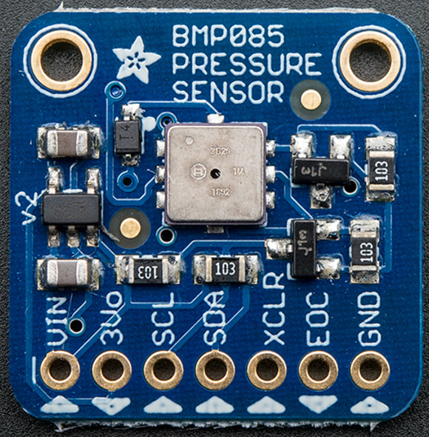
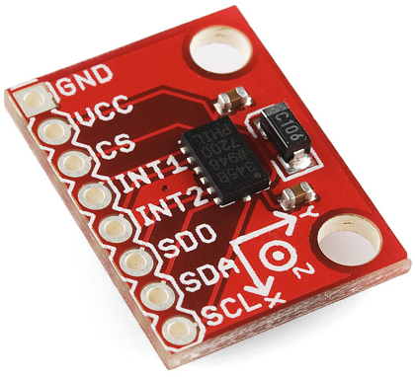
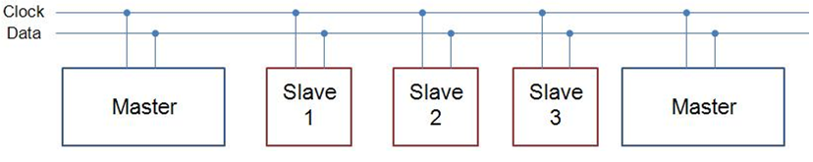
Serial Interfaces: TWI (I²C)
Two wire interface (Inter-integrated Circuit)
I2C allows multiple Masters and Slaves on the same bus. (up to 128)
Up to 400kbps (on the Atmega328)
Used in a variety of digital sensors.

Slide 29
AVR
Architecture
(ATmega328P)

Slide 30
Watchdog Timer (WDT)
A Watchdog Timer is a timer clocked by an on-chip oscillator
Once the counter reaches a certain value, the microcontroller may:
  Trigger an interrupt
  Reset the microcontroller
Used to prevent your program from getting stuck in any part of the code.
You use it by enabling the WDT and spreading WDT reset instructions on particular places of your code.
  If it gets stuck in an infinite loop, for ex., the counter won’t be reset and the microcontroller will be reset.

Slide 31
Clock circuit
Up to 20MHz from:
  External clock from a pin
  External crystal oscillator
  Internal RC oscillator
    7.3-8.1 MHz
  128kHz Internal oscillator
    128 kHz
System Clock Prescaler
  Divides the clock if needed
Keep in mind:
  Power consumption is proportional to clock frequency.

Slide 32
AVR
Architecture
(ATmega328P)

Slide 33
Sleep Modes
There are multiples Sleep Modes available. Each turns off certain parts of the microcontroller to save power and can only be waken up by certain sources.

Slide 34
Power and Debug
Brown-Out Detector (BOD)
  Resets the device whenever Vcc is below a certain threshold.
Power-on Reset (POR)
  Ensures the device is reset from Power On.
DebugWIRE
  On-chip debug tool from AVR.

Slide 35
Review

Slide 36
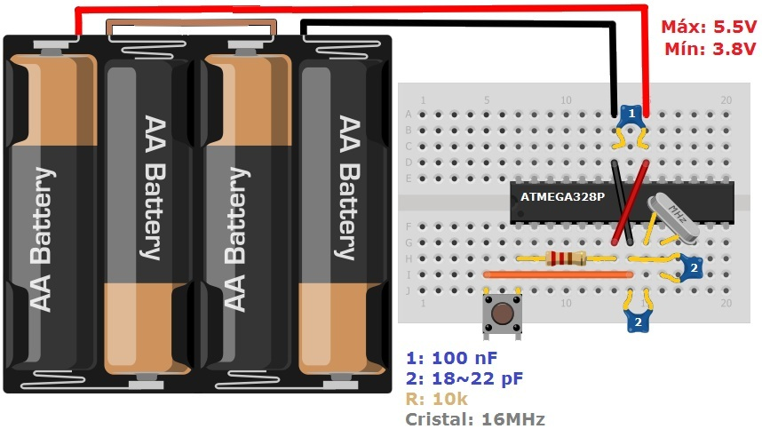
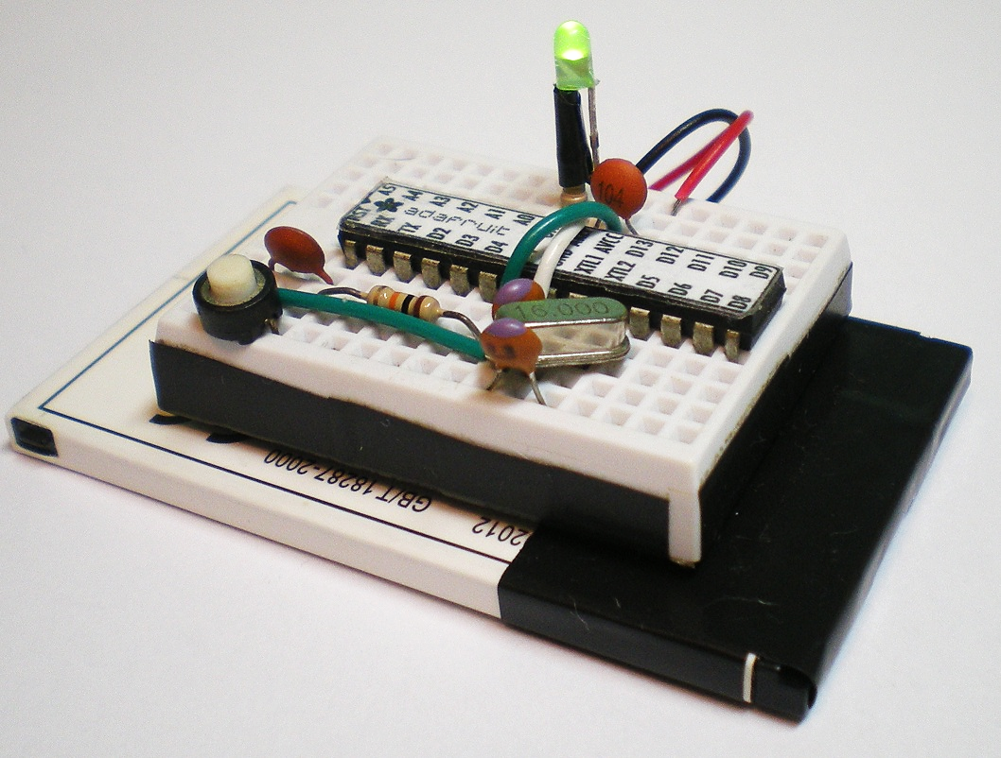
Atmega328 minimum required circuit
Needed Circuitry: using an external crystal
Notes:
Or simply buy it ready!

Slide 37
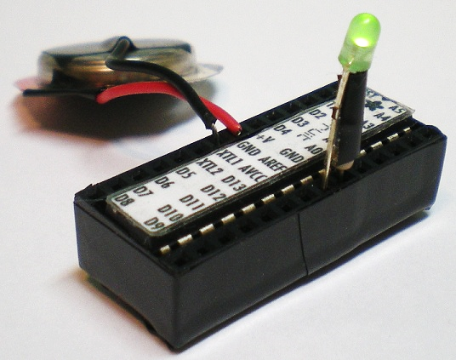
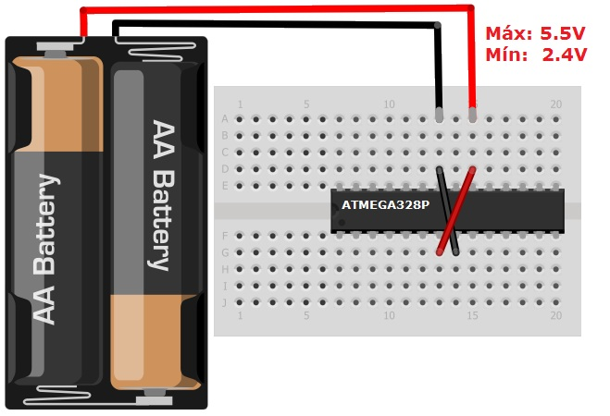
Atmega328 minimum required circuit
Needed Circuitry: Using the internal oscillator
Atmega328 comes with an internal 8MHz oscillator that can minimize the required circuit to a single battery.
Notes:
Or simply buy it ready!

Slide 38



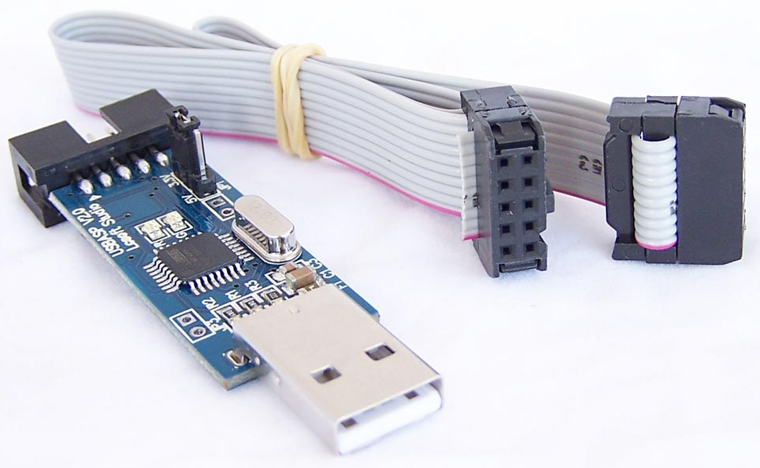
Usage of Microcontrollers
Development Cycle
Write your code. From Assembly to C. Or even higher level:
Compile it. (debug)
Upload to the uC memory (On Chip debug)
  Parallel programming
  Serial downloading (SPI)
  Self-programming (With bootloader)
(Burn the fuses)

Slide 39
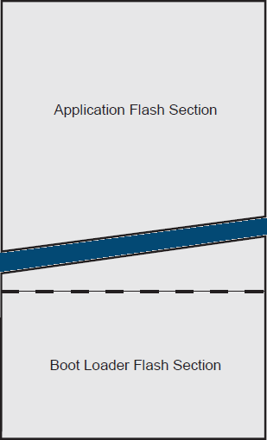

Self-Programming: Bootloader
The AVR core can write to it’s own program memory.
The Bootloader Section can be locked from rewritting.
This way developers can allow users to write their own programs without compromising the bootloader section.
This can also be used to ease the programming of the memory, eliminating the need for an external programmer.
USB-Serial

Slide 40
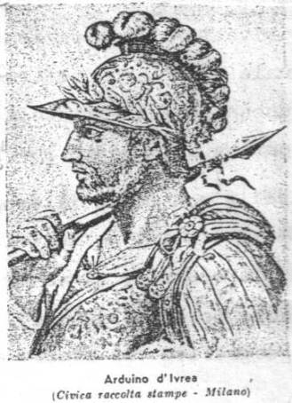

Arduino

Slide 41
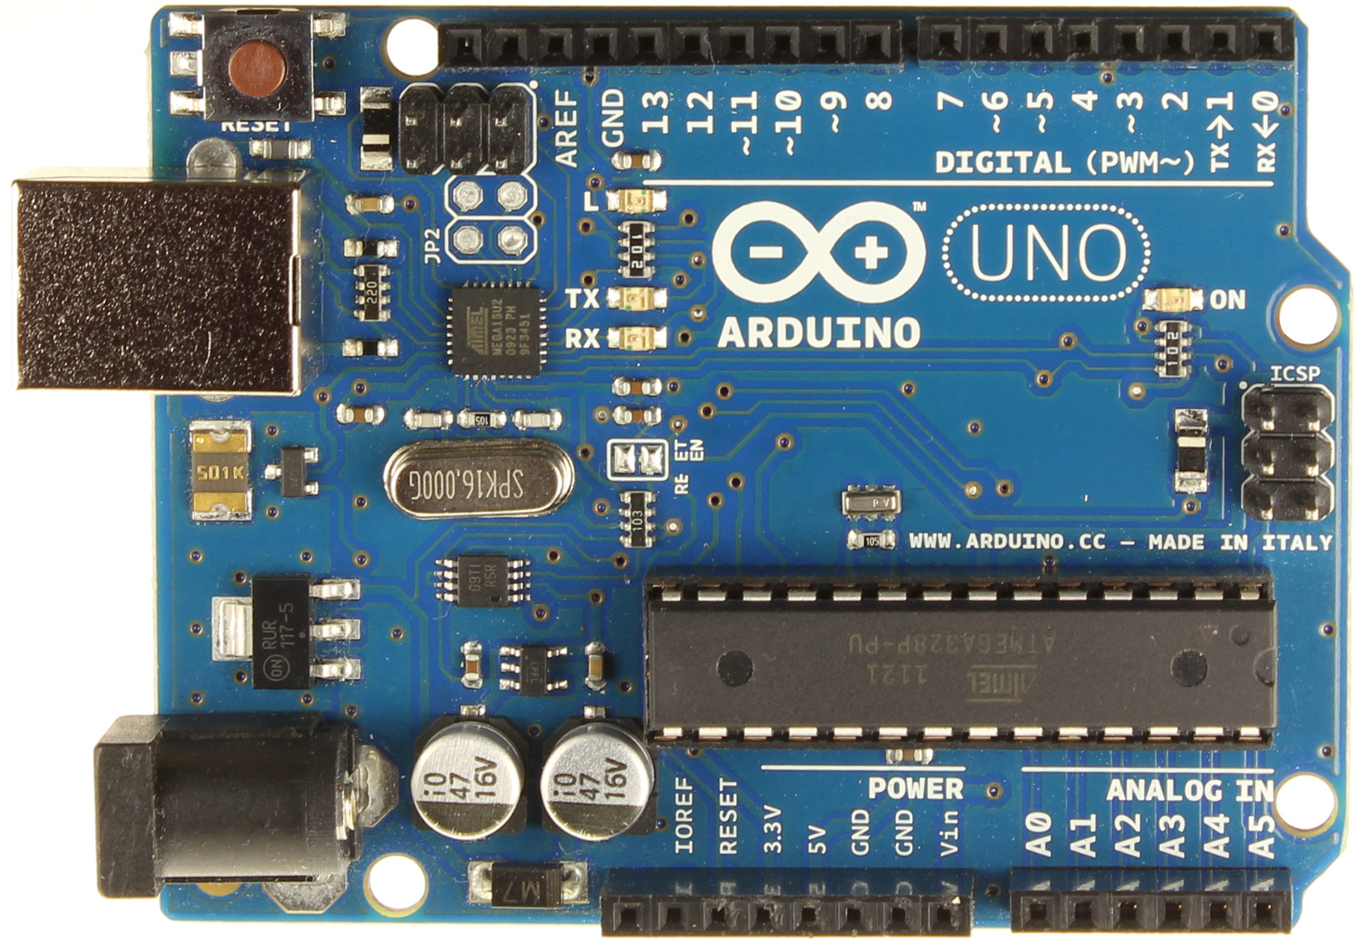
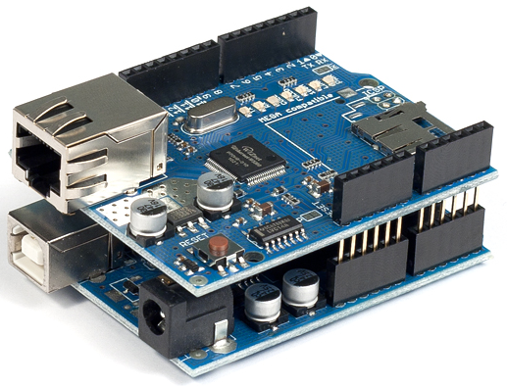
Arduino
Open-source platform created for "makers" who have no knowledge in electronics but still want their creations to interact with the environment.
Custom IDE + libraries
Inexpensive and really easy to use
  (Almost plug and play)
Huge community all over the world creating libraries, compatible hardware and sharing projects
Stackable addons called shields
Notes:
Saying about arduino
(engineer using arduino)
Microcontrollers are for everyone!

Slide 42
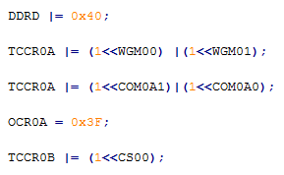
Setting PWM to 25% Duty Cycle
THE Medieval Original way
Registers:
25%
75%
DDR = Data Direction Register
TTCR0A = Timer/Counter Control Register A
TTCR0B = Timer/Counter Control Register B
OCR0A = Output Compare Register 0 A
Set direction of pin 6 from PORTD to output.
Set WGM to Fast PWM.
Set COM to «Clear On Compare».
Set OCR to 25% (0x3F of 0xFF)
Set the clock source to timer.
Bits:
WGM0[1..0] = Waveform Generator Mode 0
COM0A[1..0] = Compare Output Mode 0 A
CS0[2..0] = Clock Select 0

Slide 43


Setting PWM to 25% Duty Cycle
THE CHEATING Arduino way
25%
75%
Look at the board which pin you want to use.
$\frac{25}{100}=\frac{x}{255}$ Find x.

Slide 44
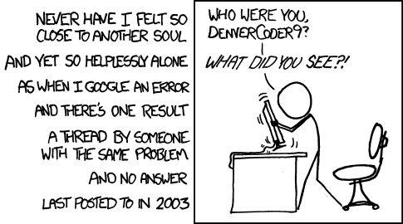
Advantages of Prototyping Platforms
http://xkcd.com/979/

Slide 45
Advantages of Prototyping Platforms
PRO | CON
Community / Support / StackOverflow | Performance is generally not good
Much easier to learn | No full control over the code
Fast development and Prototyping | Cost is higher
Portable code between supported devices | TRU ENGINEERS gon’ make fun of u cos ur not BRAVE ENOUGH to handle raw bits.

Slide 46
Usage of Microcontrollers
First of all
Is a microcontroller suitable for my application?
  Cost
  Development time
  Power consumption
  Processing power
  Timing requirements
  Etc.

Slide 47
Usage of Microcontrollers
Choosing a microcontroller
What kind of problem do I have?
  Processing intensive? Power limitation? Embedded?
Which kind of sensors/actuators will be used?
  Digital/Analog? Voltage levels?
What are the required peripherals?
  USB? I2C? ADCs? Timers?
What is the enviroment?
  Space? Right next to the LHC beam?
Alternatives?
Notes:
Consider the time spent in learning and development of different

Slide 48
Embedded Systems
Microcontroller
FPGA – Field Programmable Gate Array
DSP – Digital Signal Processor
SoC – System On a Chip
Single Board Computer
ASIC – Application Specific Integrated Circuit
Notes:
Board space is also related to power dissipation
FPGAs: Parallelism! But trully expensive.
Processors: Fast! But power hungry and requires other components to work!
DSPs: Can be fast, parallel, etc. But lacks flexibility.
ASIC: Application Specific Integrated Circuits

Slide 49
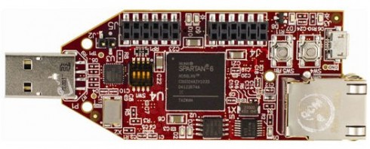
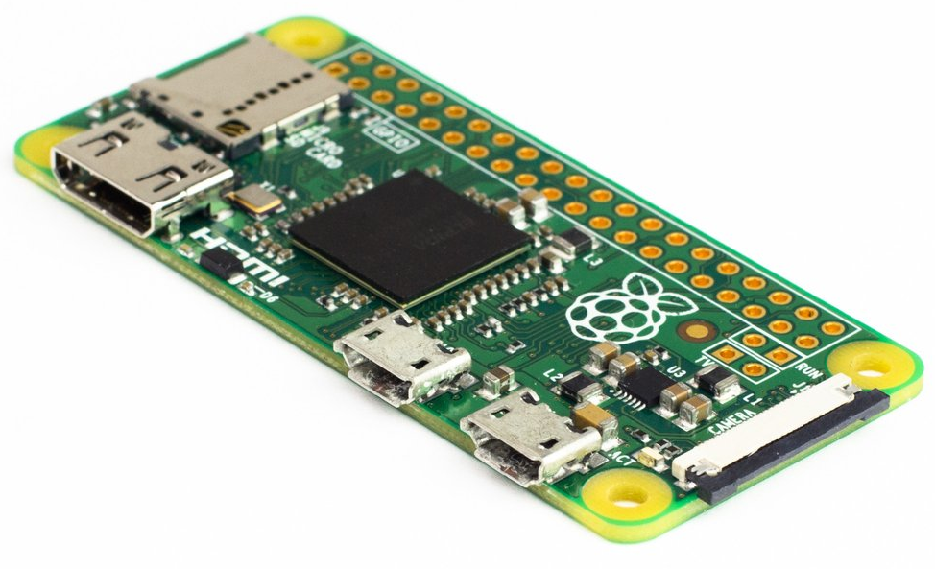
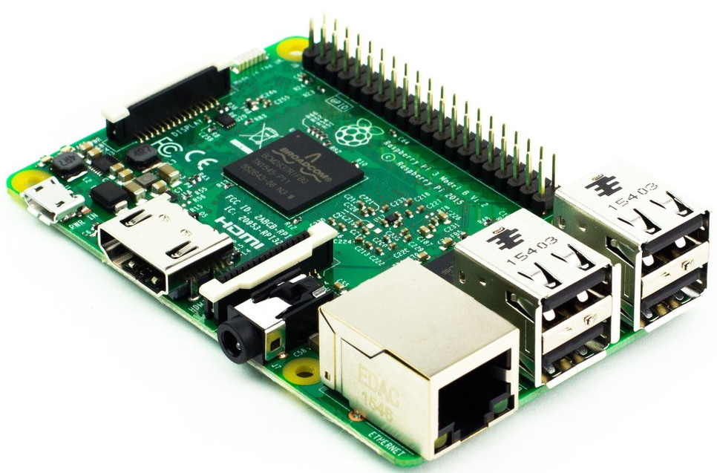
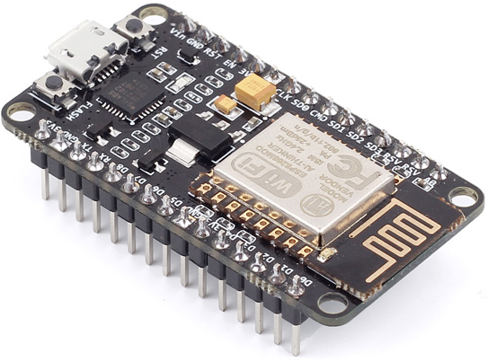
Embedded Systems
FPGA Xilinx Spartan 6
Ethernet Controller + USB
Raspberry Pi Zero
SoC (no FPGA)
$5 USD
1GHz
512MB RAM
Raspberry Pi 3
1.2GHz 64-bit quad-core
1GB RAM
Wifi + Bluetooth
NodeMCU
~$10 USD
Wifi Microcontroller

Slide 50
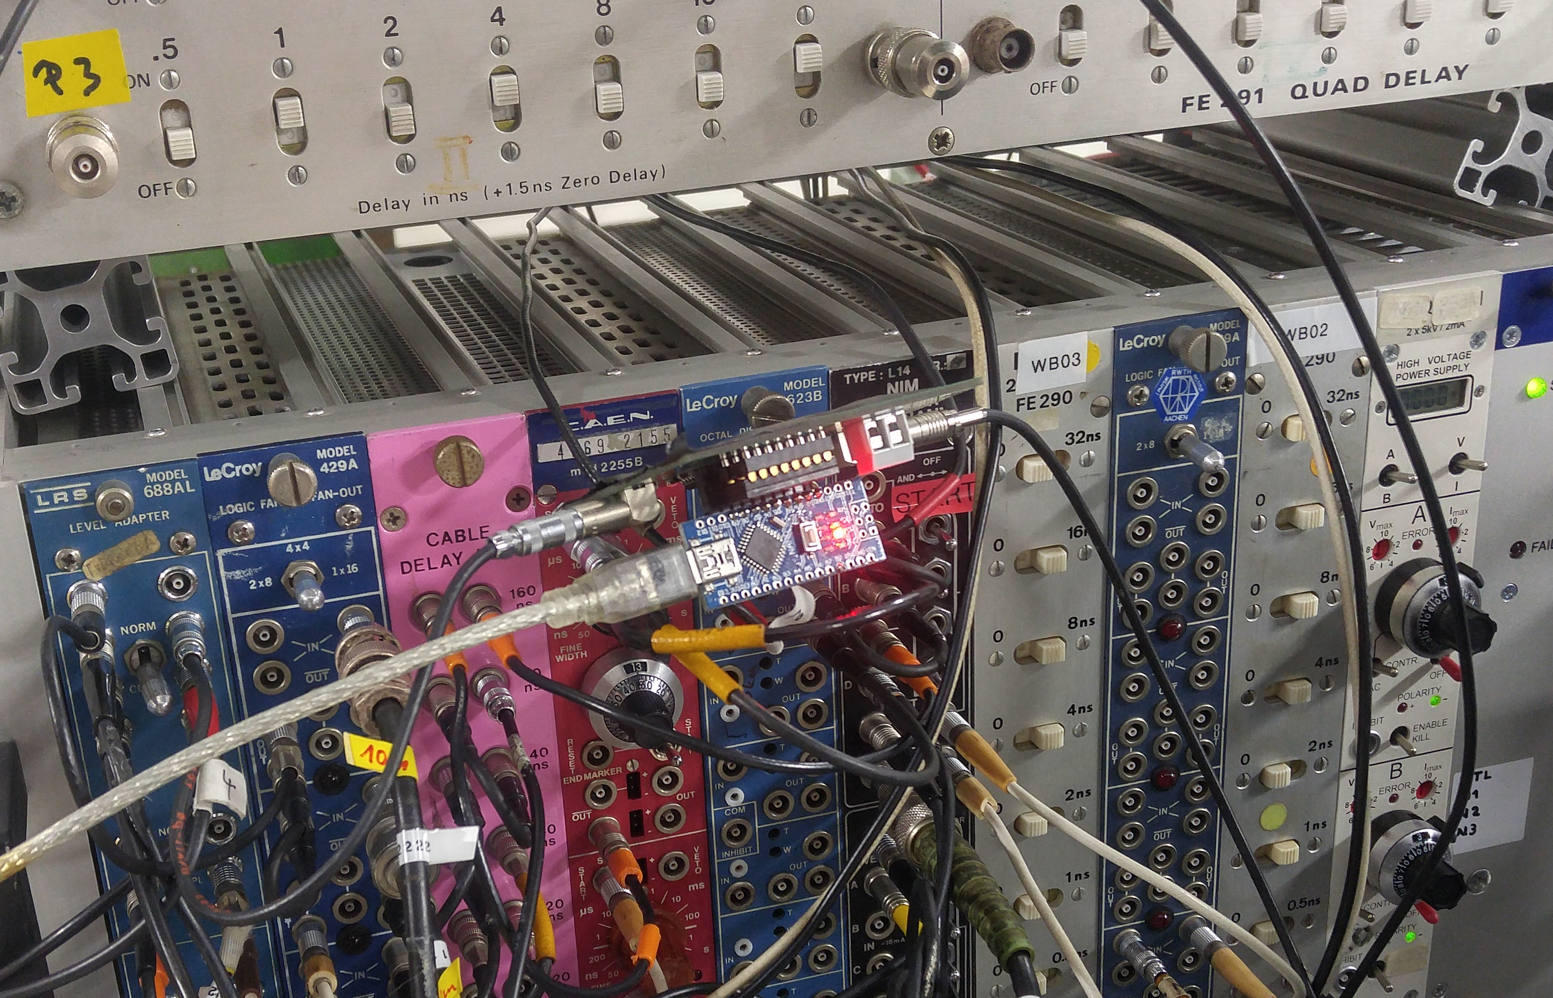
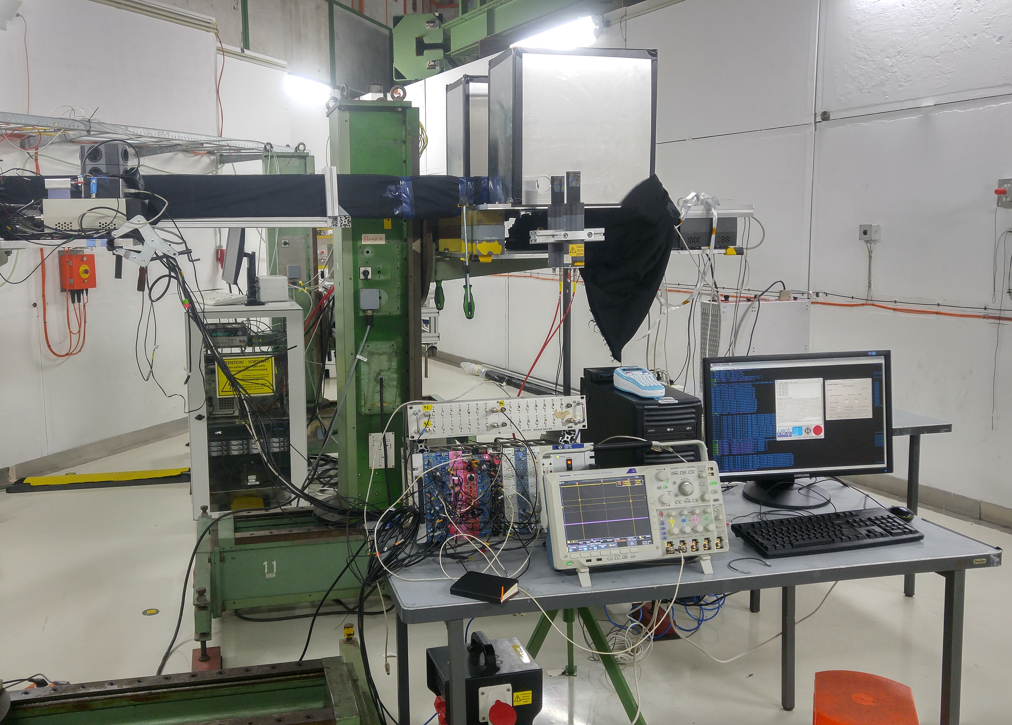
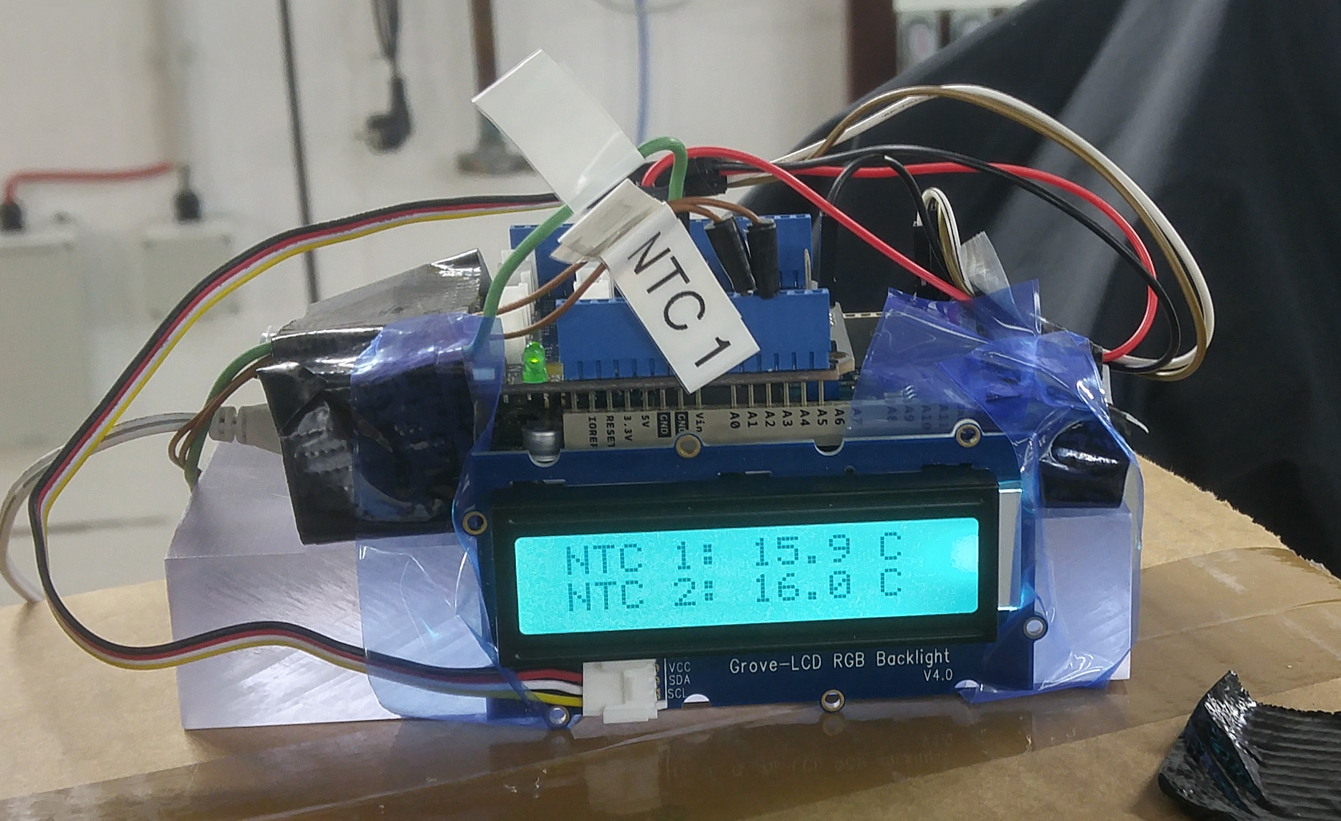
Applications in HEP Environments
Arduino as a delay control unit,
as a temperature monitor,

Slide 51
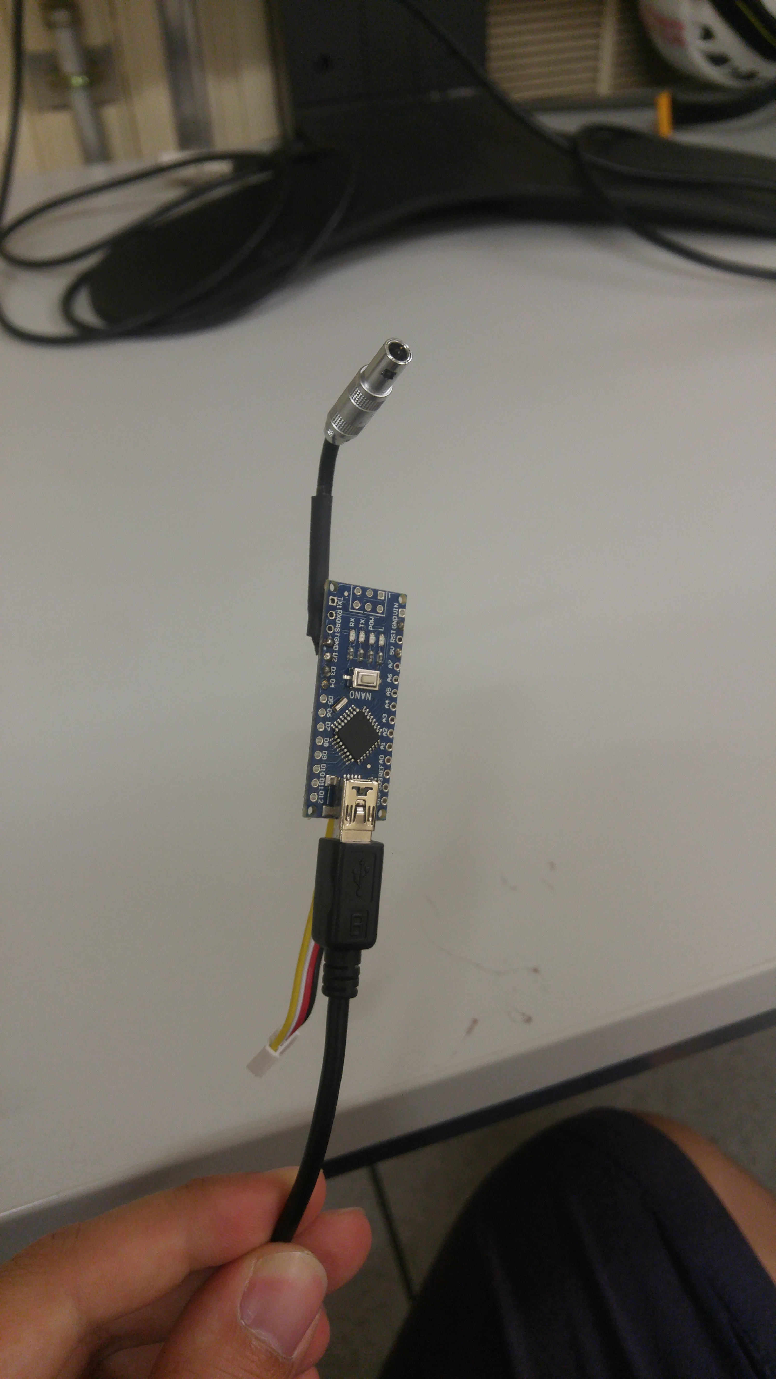
Applications in HEP Environments
Arduino as a delay control unit,
as a temperature monitor,
as an USB TTL/NIM generator.

Slide 52
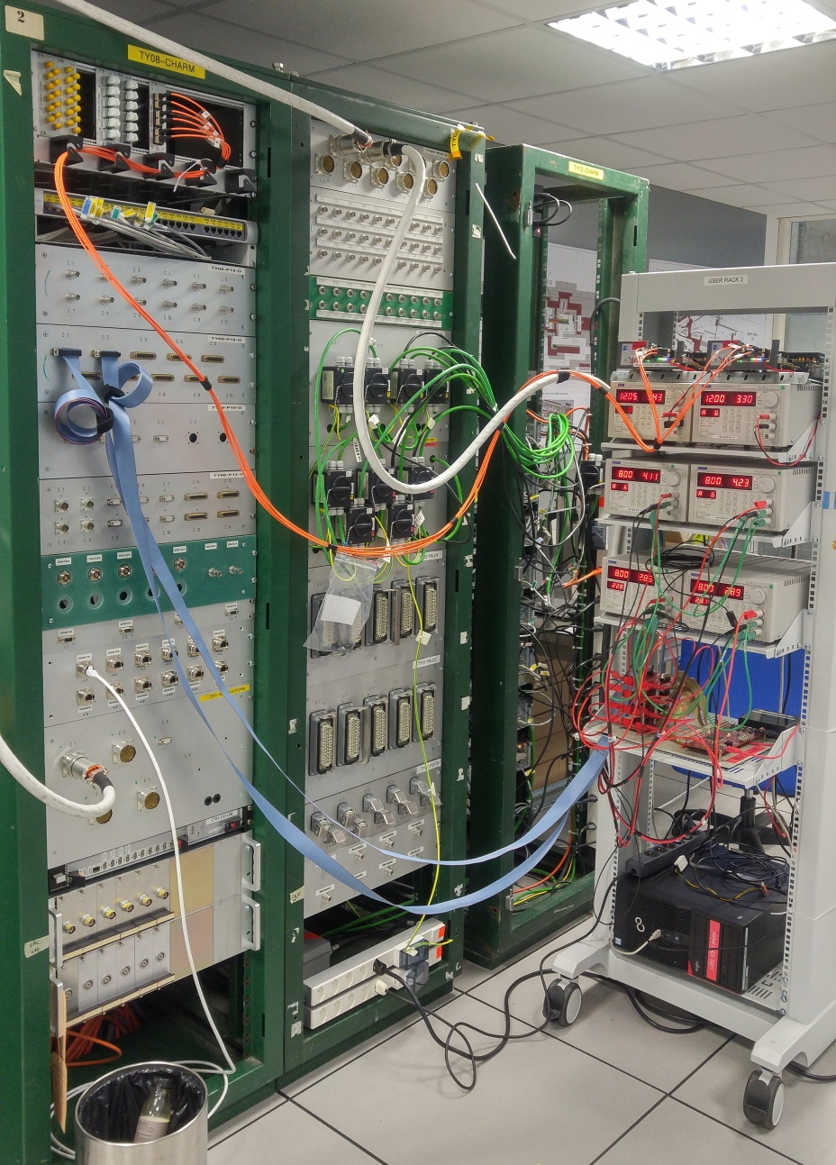
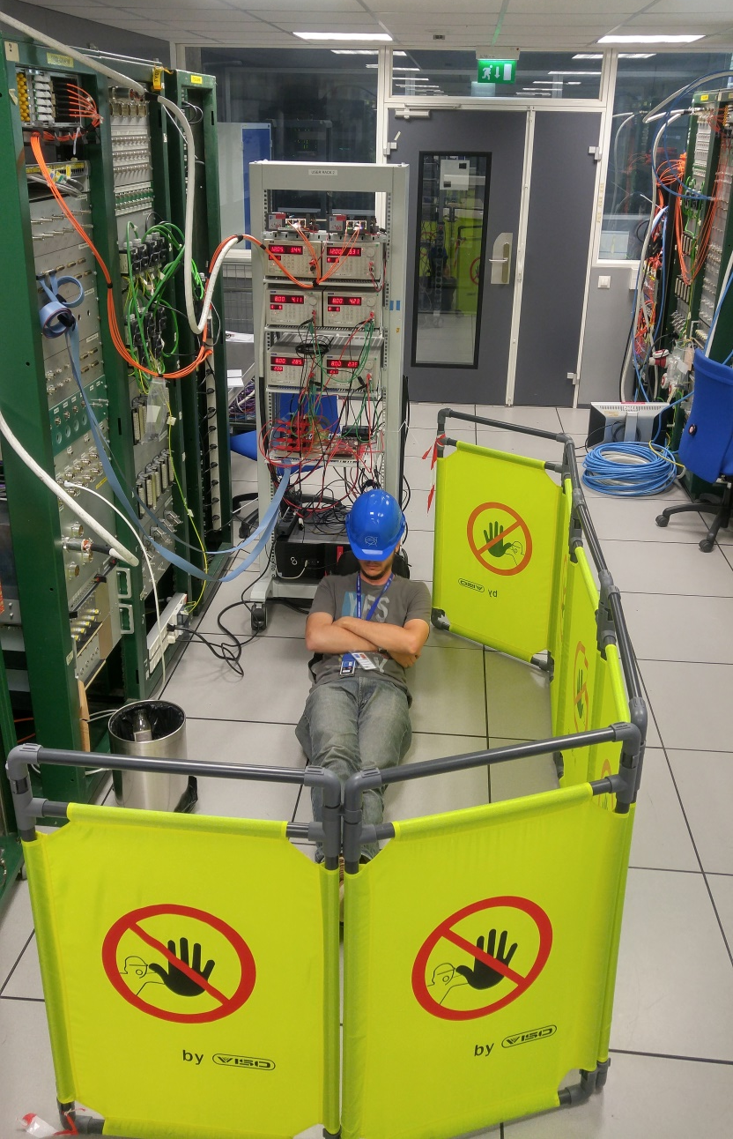
Applications in HEP Environments

Slide 53
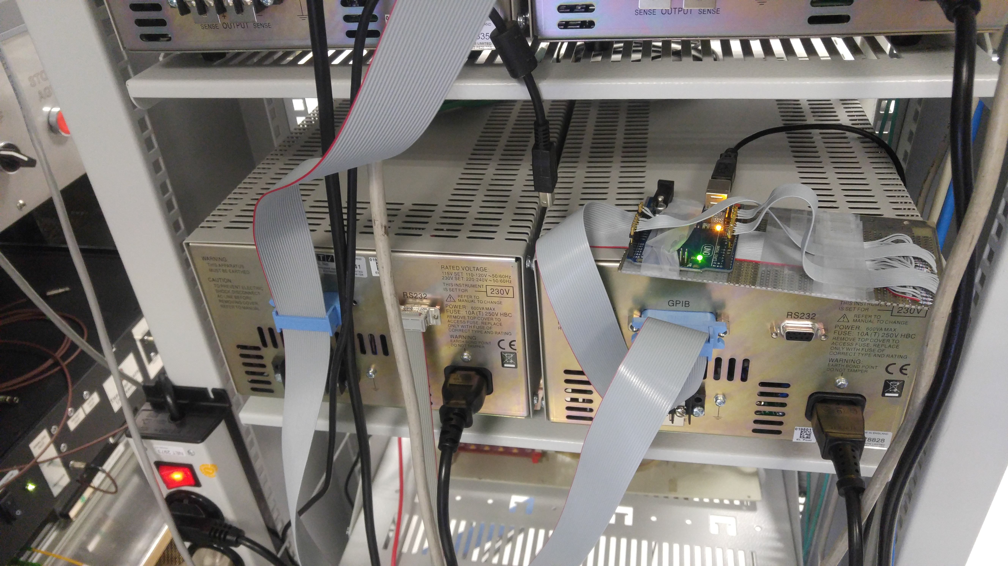
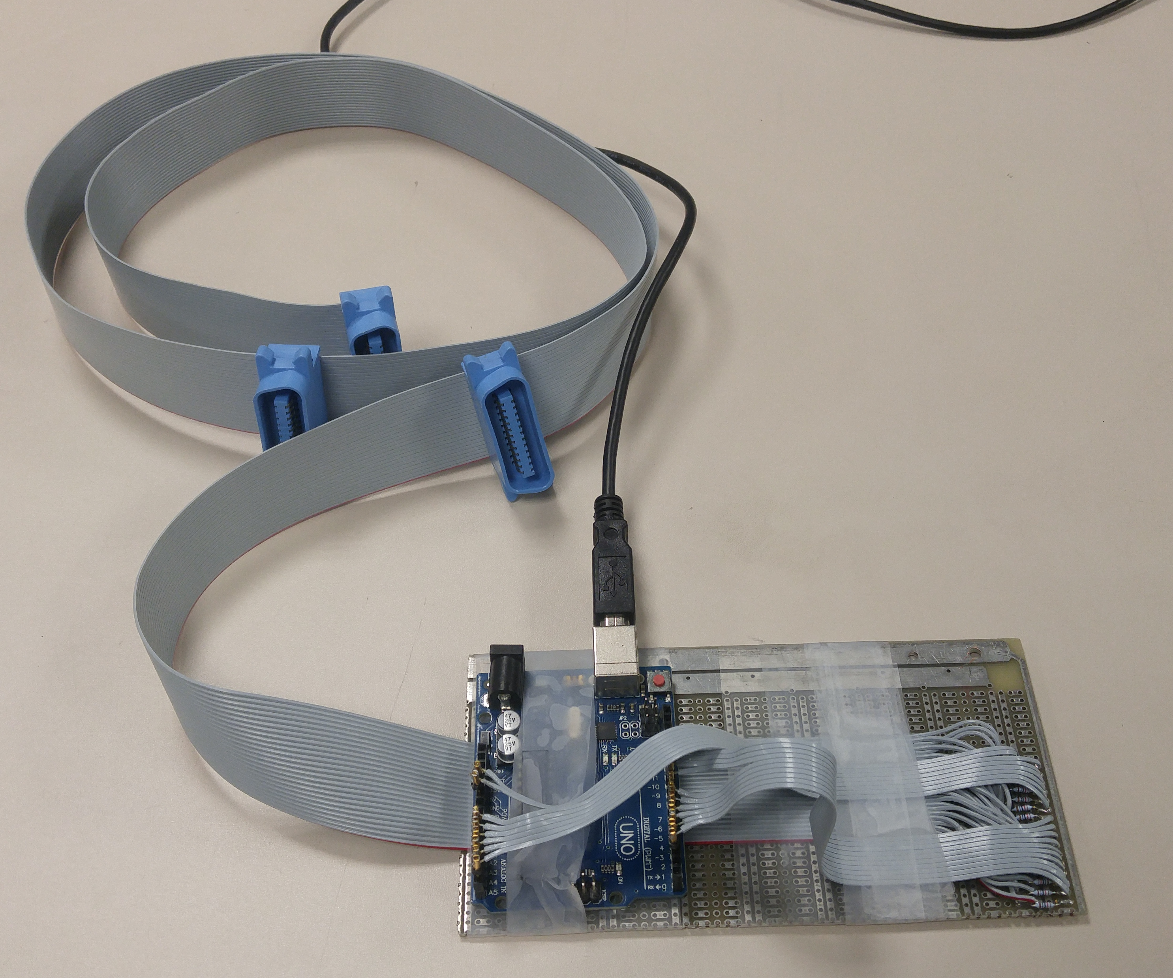
Applications in HEP Environments
Arduino as a remote GPIB controller.

Slide 54
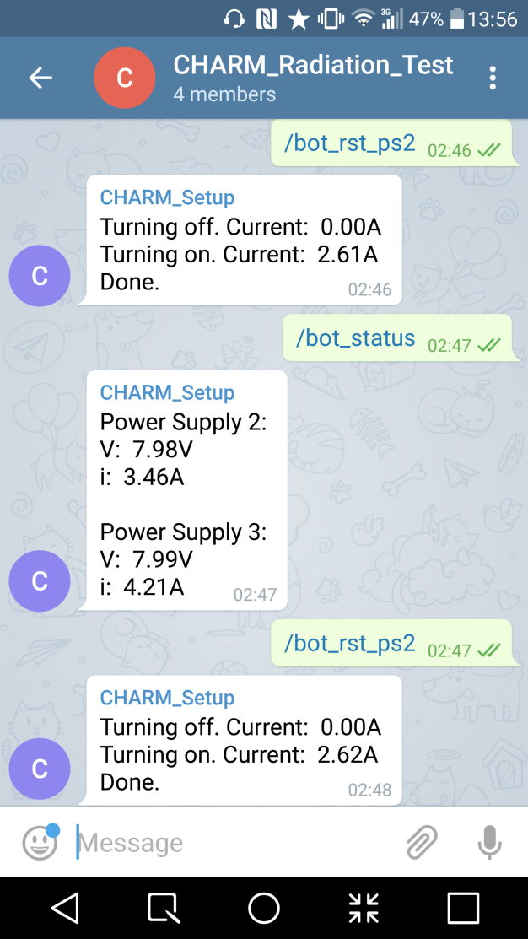


Applications in HEP Environments
Telegram BOT for Testbeam monitoring.
What’s your purpose?
-To report status and wake up Mauricio at 3am.

Slide 55

Applications in HEP Environments

Slide 56

Applications in HEP Environments

Slide 57

Applications in HEP Environments

Slide 58

LAB 10
9

Slide 59


Lab 10 - Microcontrollers

Slide 60
That’s it.
Obrigado!
Maurício Féo
m.feo@cern.ch

Slide 61
GPIO Diagram

Slide 62
CPU Diagram

Slide 63
ADC Diagram

Slide 64
Analog Comparator

Slide 65
USART

Slide 66
Where are they used?

