Slide 1




Design and Implementation of a Monitoring System
Serguei Kolos
(University of California, Irvine)

Slide 2

The Outline
Introduction: The Key Principals of Online Monitoring
Monitoring in a DAQ system
Scaling up to the size of the HEP experiments
Summary & Final Remarks

Slide 3
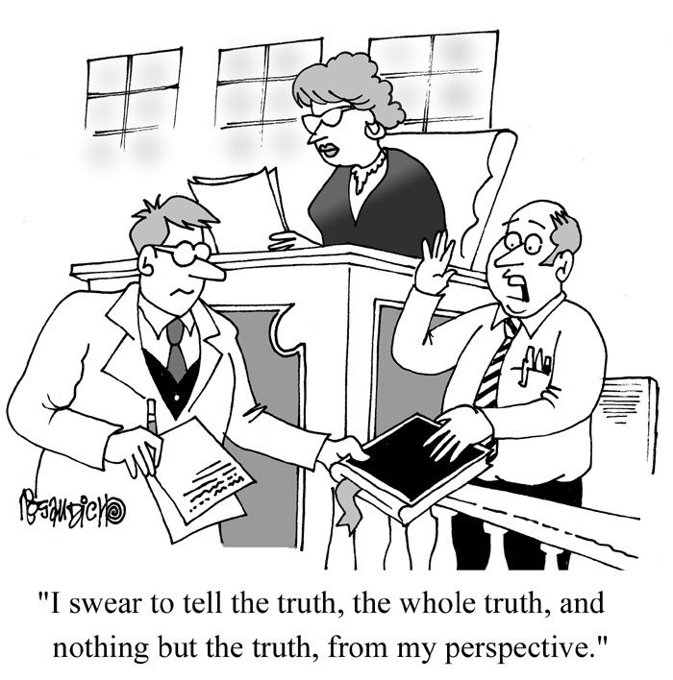
What Monitoring is used for?
A good Monitoring System should be capable to answer all possible questions about the system being monitored:
  What happened?
  Where that happened?
  When that happened?
There are some questions it is not competent to answer, e.g.:
  What to do next?
But it tries to provide all possible information to those who can answer such questions

Slide 4

How a Monitoring System does its job?
All of us are equipped with a perfect monitoring system:
  We have 5 types of sensors for detecting events in the outside space
  The information is transferred via nerve fibers to our brains which initiates an appropriate reaction
  Some information is memorized for the future reference
Monitoring for a complex HW+SW system acts in a similar way:
  The HW and SW elements play a role of sensors by publishing their status to the Monitoring System
  The Monitoring System transports this information to the system “brains”:
    A Human operator
    An Expert system
  It also records the monitoring information for a later in depth analysis

Slide 5
The Simplest Monitoring Code Sample
print(“Hello, World”)
This is a monitoring message
This is the monitoring API function

Slide 6
Is the Hello.py application well designed?
print(“Hello, World”)
The issue is that the “print(…)” function provides both the API and the implementation, which are tightly bound together
The destination for the messages passed to “print(…)” is fixed
Can we do better?

Slide 7
Logging Module to the rescue
Use the standard well-designed API
import logging
logging.info(“Hello, World”)
logging.basicConfig(format='%(asctime)s %(levelname)s [%(filename)s:%(lineno)s - %(funcName)s()] %(message)s', level=logging.INFO)
The output format can be easily changed
2017-02-02 16:21:13,583 INFO [hello.py:4 - <module>()] Hello, World
A lot of extra useful information is available for free
The message destination can be changed without
touching the application code

Slide 8
The Key Principal: Separate API from Implementation
Software Application
A Message Reporting API must not depend on a particular destination of messages
Multiple destinations can be supported by different implementations of the same API
Common properties will be automatically added to all messages by the API:
  Time, Process ID, User ID, etc.
Message Reporting API
File
Network
Database

Slide 9
Monitoring in a DAQ system

Slide 10
What shall be monitored in a DAQ System
System incidents:
  Expected and especially Unexpected incidents shall be immediately reported in a form of a message
System status:
  Health of individual HW & SW components:
    Resources consumption, IO rates, etc.
  Surrounding environment:
    Temperature, humidity, etc.
  Operational statistics:
    Number of triggers, number of recorded events, etc.
Data Quality Monitoring:
  Recorded physics data shall be constantly monitored for sensibility

Slide 11
DAQ Messaging Service
Logging API is a good candidate for the DAQ Messaging Service API
There are several important considerations to be taken into account about messages:
  Messages shall contain human readable (and understandable!) explanation of the corresponding incidents:
    A shifter calling you in the middle of a night can just read it
  Messages shall be ready for machine processing:
    Every message shall contain a unique ID which corresponds to the given incident
    Messages shall contain some common automatically generated parameters:
      Time stamp, application ID, computer name, etc.

Slide 12
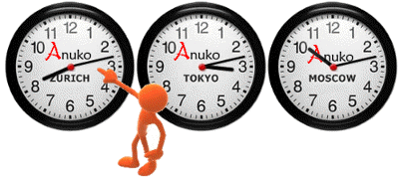
Some Remarks on Time Stamps
Time Stamp is a vital property of a message and of any monitoring information in general:
  Used for correlating messages from different sources
  Used for correlating monitoring information with real-life events
The time stamp guidelines:
  Use the best possible precision (nanoseconds)
  Use UTC time when reporting
  Conversion to the human readable local time shall be done by a message displaying applications with respect to its location

Slide 13
Message Types
CRITICAL – severe error has been detected. It can lead to system damage or affect Data Quality. Immediate attention is required
ERROR – recoverable error happened. Check the consequences
WARNING – nothing is bad so far, but system may be operating dangerously close to a certain limit
INFO – an expected incident occurred
DEBUG – shall be disabled in production system

Slide 14







CRITICAL Messages & Alarms
A DAQ system may produce a CRITICAL message when immediate shifter attention is required:
  Such a message can be used to trigger an Alarm:
    A dedicated message display application changes the color (and the shape – for color blind people) of an appropriate item
    It can also make a sound
Do not overuse alarms:
  ‘Cry-Wolf’ effect may result in a severe system damage or data corruption

Slide 15

Do not neglect WARNINGs
Reporting a CRITICAL event is straightforward
Deciding when to report a WARNING is much more cumbersome:
  Nothing wrong happened so far, but the system is dangerously close to a certain limit
  Requires some extra health-checking code to verify operational conditions
Warnings shall not be neglected as sooner or later they become errors:
  They can be effectively used for the future error prevention

Slide 16
When to issue a WARNING: A real life example
RUN X:
Everything goes well so far
RUN X+1:
CPU shortage causes dead-time
Extra CPU used periodically for histogram aggregation
CPU used for physics data processing
Adding new Trigger algorithm increased the average CPU usage

Slide 17
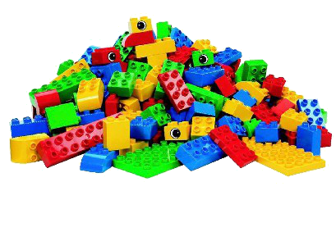
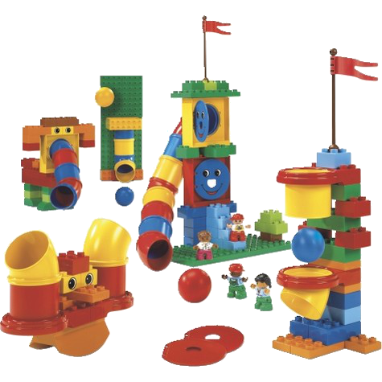
DAQ System Status Information
A DAQ system has many numeric parameters to be monitored:
  Logging API is not convenient for that
A simple status information item can be represented in a form of a <key:value> pair:
  “key” - a unique identity of a particular information
  “value” - information value for a given moment:
    This makes it obvious that every pair has to be time-stamped
A “value” can be a simple number as well as an object :
  The object represents a state of a DAQ SW or HW element with multiple properties
  The object has a number of attributes that contain the values of the corresponding properties for a given moment in time

Slide 18
Information Sharing: A Simple Provider API
interface InfoRepository {
void registerInfo(String id, InfoObject obj);
void unregisterInfo(String id);
}
A SW Application can register any information object with a unique ID:
  Afterwards it simply keeps updating the attributes of the objects in a usual way to reflect the status of the corresponding SW or HW component
The Interface intentionally does no expose any details of how information will be handled:
  This will be defined by an implementation

Slide 19
Information Sharing: A Simple Consumer API
interface InfoMonitor {
  Enumeration<String> getInfoList();
  InfoObject getInfo(String info);
}
A SW Application can use the InfoMonitor Interface:
  To get a list of available monitoring information
  To get a value of an information object
Implementation of this interface is bound to the one of the InfoRepository

Slide 20
Information Sharing: A Possible Implementation
REST – Representational State Transfer
  Client-server HTTP-based stateless communication
  Fits very well to the Status Monitoring communication model
The Web Service implements InfoRepository Interface
The HTTP Client implements InfoMonitor Interface
BONUS:
  A standard Web Browser can be used to display monitoring information
Software Application
InfoMonitor
HTTP Client
InfoRepository
RESTful Web Service

Slide 21
A DAQ specialty: Data Quality Monitoring

Slide 22

Data Quality Monitoring
Watching out the behavior of the DAQ system itself is not sufficient:
  The DAQ may be functioning perfectly well but at the same time is taking meaningless data, for example, due to wrong calibration constants
A dedicated service is required for checking that:
  Detector readout provides meaningful data
  Trigger does reasonable selection

Slide 23
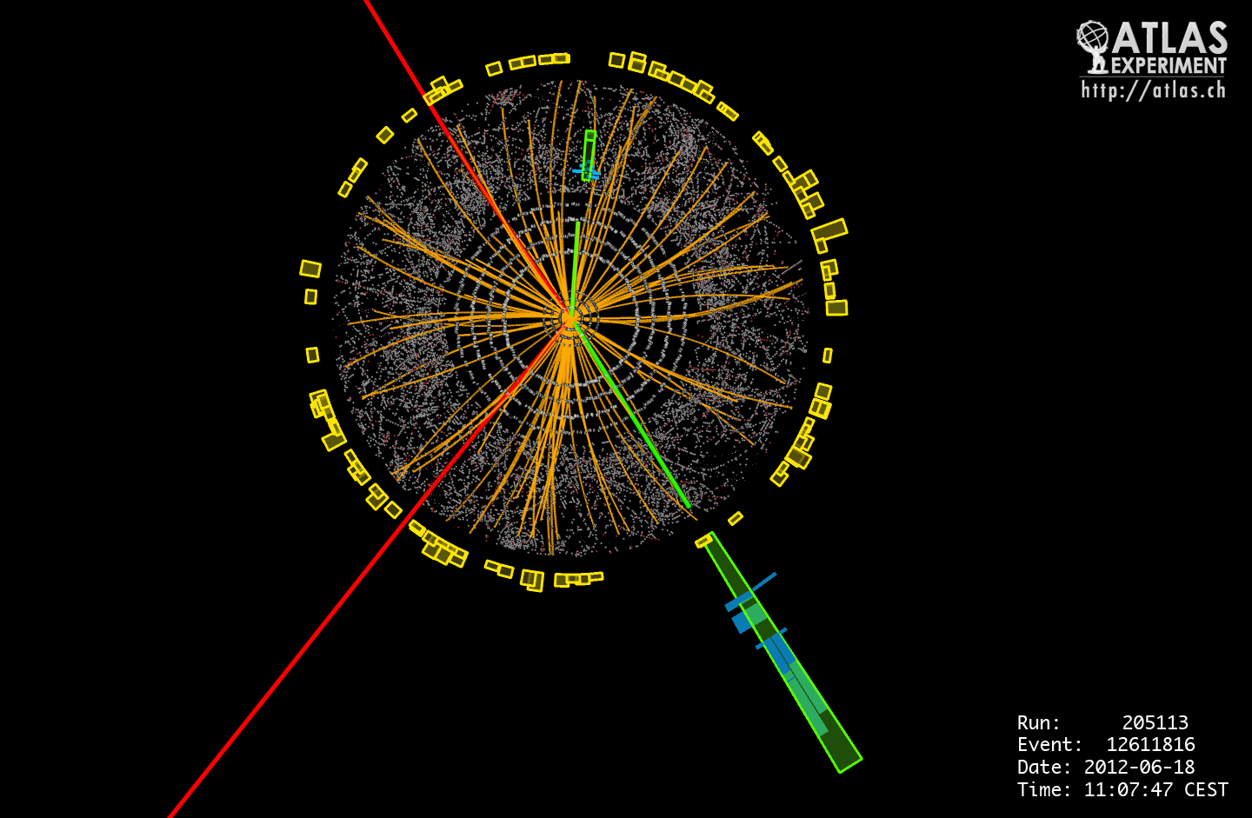
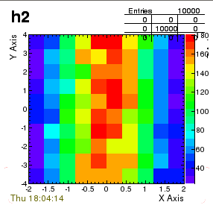

Data Quality Monitoring: Input Data
There are two main types of information that can be used for DQ Monitoring:
  A picture of a reconstructed physics event
  Histograms that accumulate data from a statistical sample of raw physics events
Only eyes of a true Experts can make sense of such data

Slide 24
Data Quality Monitoring Automated: Step 1
Histogram Analyzer
Event Analyzer
InfoRepository interface can be used to register histograms:
  Histogram is just an object with a number of specific attributes
Histogram Analyzer registers a DQ Status object per histogram:
  Periodically reads the corresponding histogram and executes DQ Algorithm that updates this DQ Status
DQ Algorithm
DQ Status
InfoRepository
InfoRepository
InfoMonitor

Slide 25
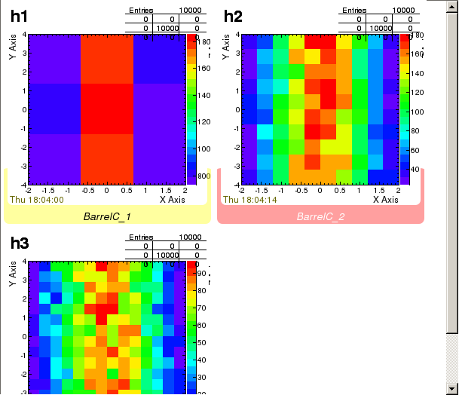
Data Quality Monitoring Automated: Step 2
A DQ Display application can read and display both the histograms and the DQ Statuses using the InfoMonitor Interface
Histogram Analyzer
Event Analyzer
DQ Algorithm
DQ Status
InfoRepository
InfoRepository
InfoMonitor

Slide 26

Scaling up the Monitoring System

Slide 27
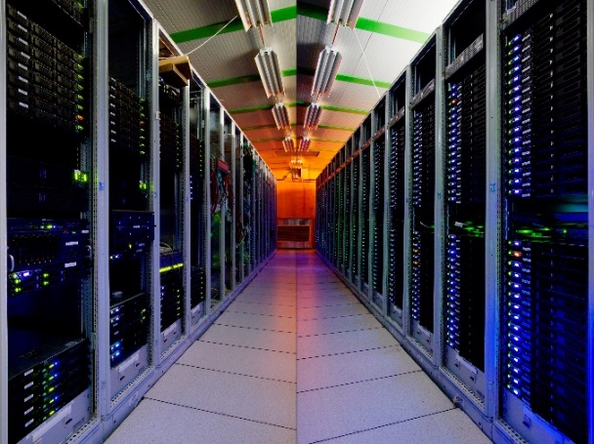
The HEP Experimental Realm
A DAQ system of a modern HEP experiment includes:
  O(1K) computers and network devices
  O(10K) SW applications
  O(100K) HW sensors
If Monitoring APIs were properly designed they will not be affected by the scalability requirements
However the implementations of the Monitoring APIs may need to be adjusted

Slide 28
Managing Monitoring Information in a distributed system
There are two main parameters which can be tuned for addressing scalability requirements:
  The information access model:
    Pull data vs Subscribe/Callback
  The communication model:
    Peer-to-Peer vs Client-Server
The choice of a particular model will limit a set of technologies which can be used for the implementations

Slide 29
Information Access Models
Pull Model (synchronous communication):
  An Information Consumer requests information whenever it is required
  RESTful Web Service is a good example of a technology which can be used to implement this access model
Subscribe/Callback model (asynchronous communication):
  An Information Consumer subscribes for the relevant subset of information to get notified when the information is updated
  RESTful architectur can not be used because a subscription changes the state of the Information Provider
  One can consider using one of the existing IPC systems:
    Low-level Libraries: ZeroMQ, Boost ASIO, etc.
    High-level communication brokers: Ice from ZeroC, CORBA: TAO, omniORB

Slide 30
Communication Models
Peer-to-Peer:
  Information Providers announce available information
  Information Consumers connect to the Providers to read information or subscribe for updates
Client-Server:
  Information Providers send their information to the server periodically or on demand
  Information Consumers connect to the server to read information or subscribe for updates

Slide 31
Which one is the best?
Peer-to-Peer
Client-Server
Has no single point of failure
Scales better
Uses more connections
Providers are exposed to Consumers due to the direct connections
More difficult to implement and maintain
Separates Providers from Consumers
Simplifies information access
Implementation and maintenance is simpler
Has a single point of failure
Scalability requires multiple servers and additional HW resources

Slide 32
A Client-Server Implementation Example
InfoRepository Interface implementations periodically save monitoring information to a database
A Web Browser can be used to query the database via the RESTful Web Service service and display the information
Software Application
Software Application
Software Application
InfoRepository
InfoRepository
InfoRepository
Web Browser
RESTful
Web Service
Database

Slide 33


Monitoring Information Aggregation
Monitoring information produced by individual DAQ Applications may need to be collected to provide high-level system status, e.g.:
  Aggregating counters produced by individual computers of the Trigger Computer Farm one can access a complete state of the Trigger system
  Aggregating histograms from all Trigger applications will give accumulated statistics for all processed events

Slide 34
Information Aggregation Implementation Options
The way of aggregating information may depend on the data access and communication models used for the Monitoring system implementation
Per-to-Peer communication model is used:
  Information Aggregator will retrieve data from all Providers
Client-Server communication model is used:
  Information Aggregator will retrieve data from the central server
Subscribe/Callback mechanism is available:
  Information Aggregator will subscribe for the information changes and do the aggregation only when information is updated

Slide 35
Archiving Monitoring Information
Ideally all monitoring information shall be archived to a permanent storage:
  Do post mortem analysis
    Special attention should be paid to WARNINGs
  Investigating problems
Conceptually Archiver is just a special type of the Information Consumer
In practice the task is non-trivial due to the huge amount of information
It might be feasible to have multiple Archivers for different information types:
  Histograms, errors, operational status

Slide 36
Bringing These All Together
A Monitoring system should consist of a number of independent services:
  More convenient for handling different types of monitoring information:
    E.g. messaging system vs status monitoring
  More simple to address scalability requirements
  Easier for development and maintenance
DAQ Messaging
Alarms Display
DAQ System
Information Sharing
Information
Archiving
Information
Aggregation
Data Quality
Assessment

Slide 37

Choosing Technologies for A Monitoring System Implementation

Slide 38
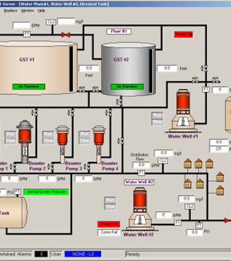
Commercial Solutions: SCADA systems
Supervisory Control and Data Acquisition
  It is primarily dedicated for control but does the monitoring as well
  Modern implementations scale well for small and mid-size systems
A SCADA system can be implemented using LabView:
  Graphical programming language for the system design
  Powerful and configurable graphical interface
Is used mostly for HW control and monitoring
  May not fit well to the DAQ specific monitoring, i.e. Data Quality

Slide 39
The spectrum of the IPC technologies
Performance overhead
Development and maintenance cost
Ice from ZeroC
CORBA: TAO, omniORB, …
Messaging systems: Qpid, ActiveMQ, RabbitMQ, ...
RESTful Web Services
Libraries: Boost ASIO, ZeroMQ, ACE, …
Socket API, TCP, RDMA, …
In realty situation is slightly more complicated:
  Maintenance cost and performance overhead very often depend on the implementation quality
A choice would depend on a particular system requirements:
  System size, Programming languages, available resources, implementation time scale, etc.

Slide 40
Data format for network transfer
For HTTP communication Json is the natural format:
  { “CPU”: 90, “Memory”: 4.3, … }
Advantages of Json:
  Simple, Human readable, self-contained
However performance is the weak point:
  Parsing Json is CPU-hungry
  Transferring attributes names adds noticeable overhead to the amount of data passed over network
Compact protocol buffer format can be considered as an alternative:
  E.g. google/protobuf, binary Json, etc.

Slide 41
Data Archiving Technologies
A choice strongly depends on the requirements of a particular experiment
Large HEP experiments generate O(1)TB of monitoring information per year
Traditional (SQL) databases are not good for storing and indexing such amount of data
Big Data approach is the new trend in this area
  Hadoop, Teradata, Cassandra and many others

Slide 42
Visualization Technologies
GUI Frameworks/Libraries
WEB Browsers
Normally is bound to some specific programming languages:
  Qt – C++, Python
  Swing – Java
Has to be installed in a binary form:
  Platforms compatibility
  3rd party libraries
Very good performance
Visualization is easily customizable (javascript, CSS, etc.)
A lot of out-of-the-box graphical visualization libraries are available
No additional software required on a client computer
Available all over the globe
Performance may not be adequate for real-time systems

Slide 43
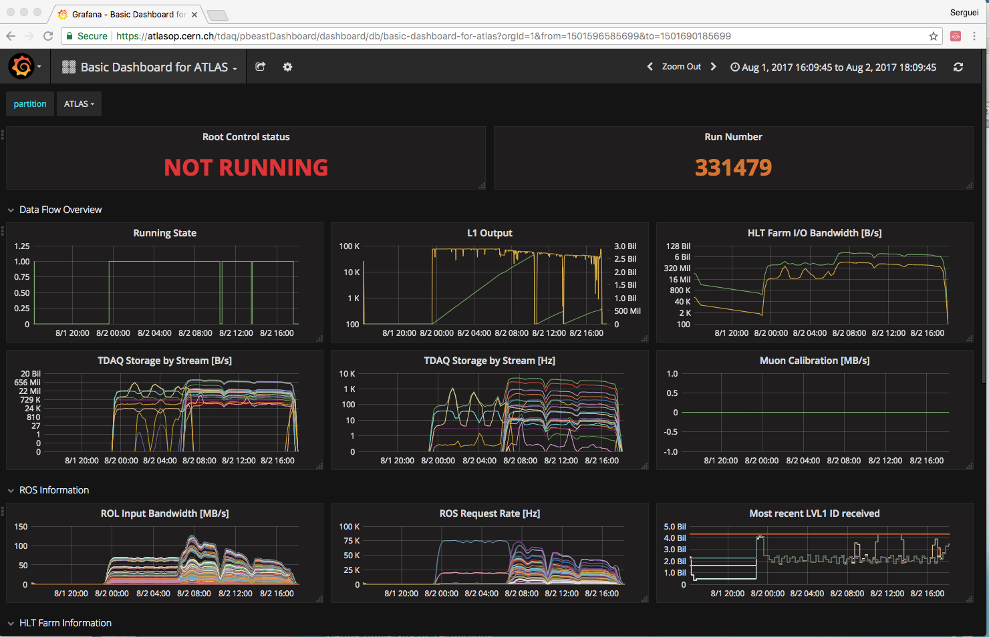
Web-based ATLAS Online Monitoring Customizable Dashboard implemented using Grafana

Slide 44
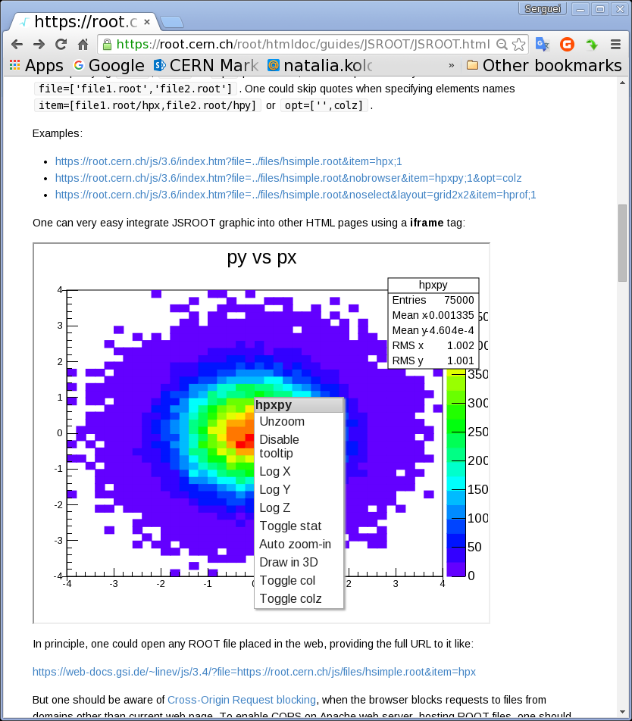
Web Browser Visualization Technologies: Physics Special
Physicist needs histograms, which limits a range of suitable visualization technologies
Starting from Version 6 ROOT contains JavaScript library for histograms visualization in Web browsers:
  JSROOT
  https://root.cern.ch/root/htmldoc/guides/JSROOT/JSROOT.html

Slide 45
Summary & Final Remarks

Slide 46

The Key Points to Keep in Mind
A well-designed and complete Online Monitoring API is a pre-requisite for implementing a DAQ system:
  Use standard Monitoring APIs as much as possible:
    e.g. Logging API
  Think carefully when designing a custom API:
    It shall not depend on a communication technology
    It shall not change when a data access or communication model would need to be changed
It is acceptable that final implementations of Monitoring APIs are not available at the very beginning:
  Any way they may need to be changed in the course of the DAQ system development

Slide 47
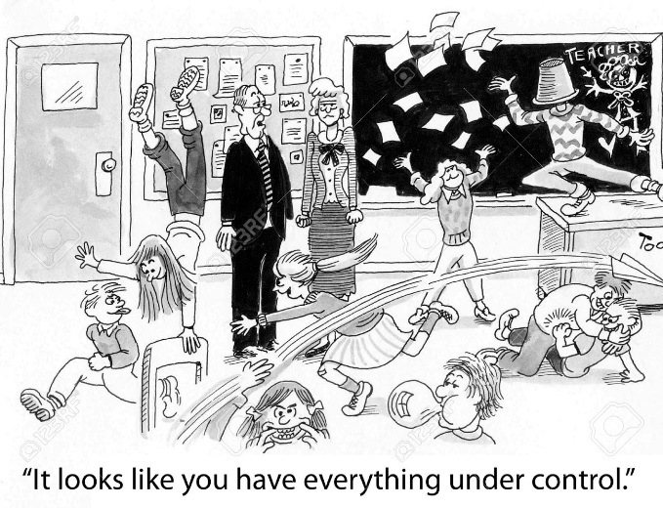
Monitoring vs DAQ
Monitoring is often considered as an ad hoc system, which can be developed at leisure when a system to be monitored (e.g. DAQ) is ready:
  Big mistake!
A properly designed monitoring system will help to keep things under control even during the DAQ system development:
  Reduces time for testing and debugging of the DAQ system
  Feedback will help fixing issues in the Monitoring system itself

