Slide 1


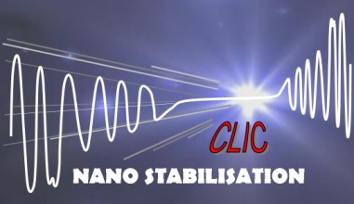


CLIC/LHC sub-micron ground motion and vibration measurements
K. Artoos, C. Collette, P. Fernandez Carmona, M. Guinchard, C. Hauviller, S. Janssens, A. Kuzmin, R. Leuxe, A. Slaathaug, M. Sylte
http://clic-stability.web.cern.ch/clic-stability/
http://en-dep.web.cern.ch/en-dep/Groups/MME/DEO/MECHANICAL-LAB/
Collaboration Stabilisation WG, participations from:
The research leading to these results has received funding from the European Commission under the FP7 Research Infrastructures project EuCARD

Slide 2
Outline
Measurement devices
Measured quantities
Coherence and propagation local vibrations sources
Some measurements around CMS
Conclusions

Slide 3
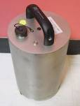
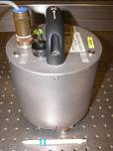
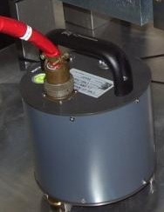

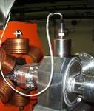
Measurement devices
How to measure nanometers and picometers ?
Catalogue products
Absolute velocity/acceleration measurements
Seismometers (geophones)
Accelerometers (seismic - piezo)
Streckeisen
STS2
Guralp
CMG 3T
Guralp
CMG 40T
Guralp
CMG 6T
Eentec
SP500
PCB
393B31
x,y,z
x,y,z
x,y,z
x,y,z
2*1000Vs/m
30s-80Hz
z
z
electrochemical
2*750Vs/m
2*750Vs/m
2*800Vs/m
2000Vs/m
1.02Vs²/m
120 s -50 Hz
360s -50 Hz
30 s -50 Hz
60 s -70 Hz
10 s -300 Hz
13 kg
13.5 kg
7.5 kg
0.750 kg
0.635 kg

Slide 4
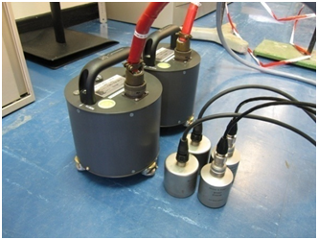
Equipment and settings
  Vibrations sensors
Type | Supplier | Type | Sensitivity | Freq. Range | Axes
Geophones | GURALP | CMG 6T | 2000 V/m/s | 30s to 100Hz | NS, EW, V
Seismic accelerometers | PCB | 393B31 | 10 V/g | 0.1 to 200Hz | V
 | ENDEVCO | 86 | 10 V/g | 0.1 to 200Hz | V
  Data acquisition system
  Spectrum analyser with 16 channels
  24 bits on 10mV for the lowest dynamic range
  Sampling frequency up to 200kHz
  Noise level DAC< 1 μV
  Software for signal treatment (FFT, PSD, Filtering, etc…)
Parameters:
Sampling rate | 1024Hz
Measurement Length | 1440s
Block length | 64s
Overlap | 66,7%
Window function | Hanning
Averaging | Linear
M. Guinchard, M. Sylte

Slide 5
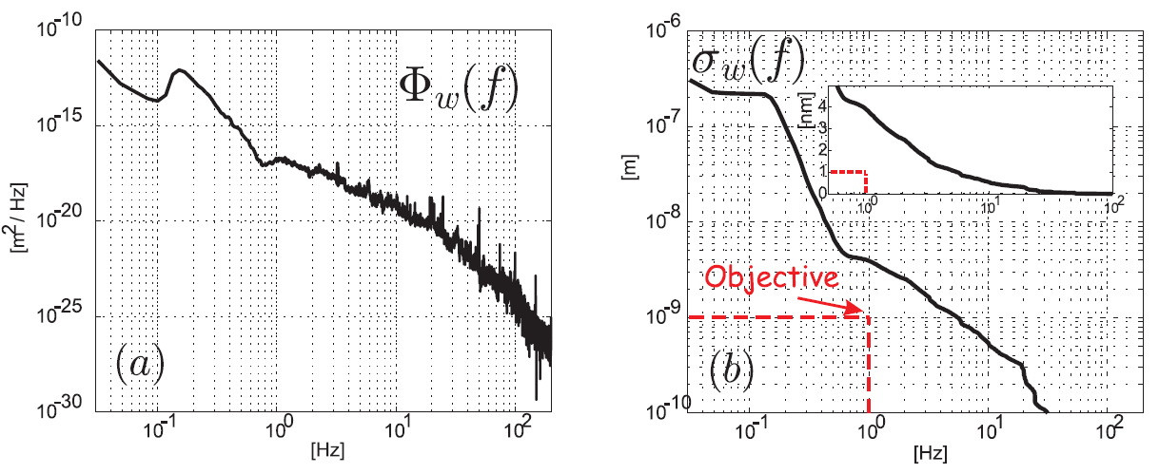
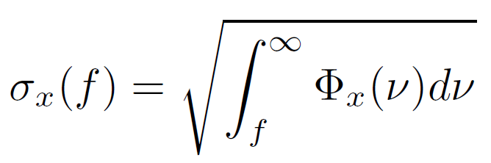
PSD, RMS objectives
 | FF | MBQ
Vert. | 0.2 nm > 4Hz | 1.5 nm > 1 Hz
Lat. | 5 nm > 4 Hz | 5 nm >1 Hz

Slide 6



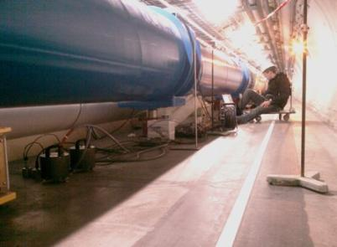
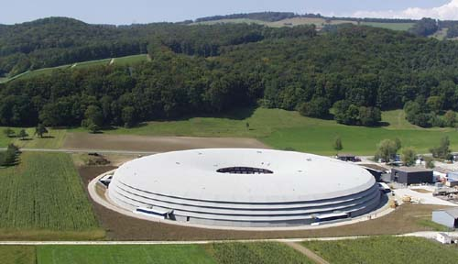
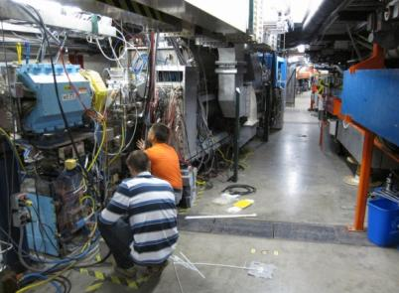
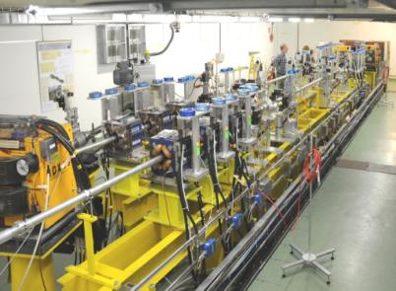
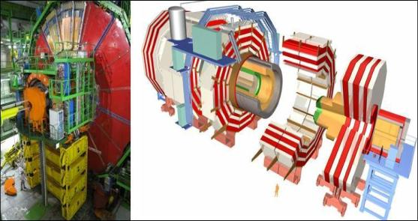
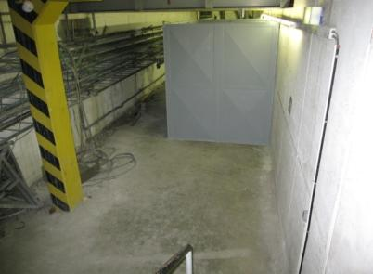
Characterisation vibration sources
Measurements LAPP, DESY, SLAC, ...
Broadband seismometers characterisation
> 50 references on http://clic-stability.web.cern.ch/clic-stability/
More measurements by CERN in accelerator environments
LHC
CesrTA
SLS
CMS
CLEX
ISR
M. Sylte, M. Guinchard, A. Kuzmin, A. Slaathaug

Slide 7
Very low frequency absolute measurements:
S. Takeda et al. 1994
STS-2

Slide 8
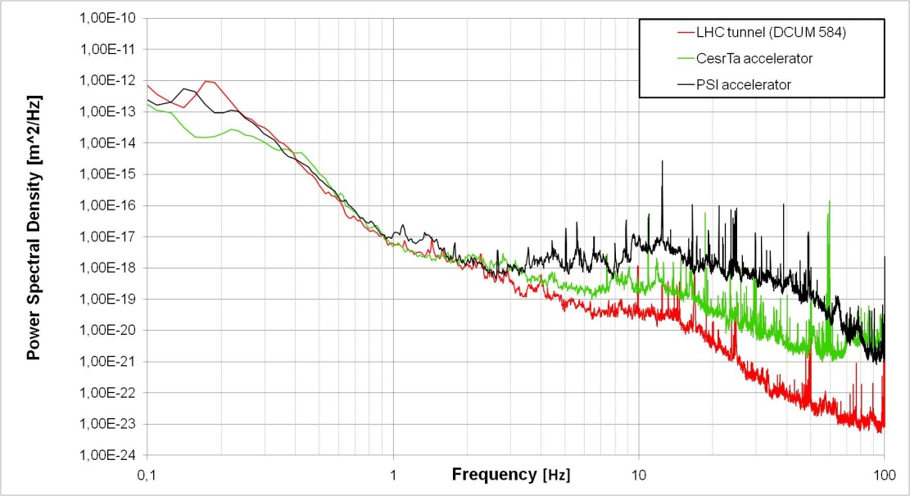
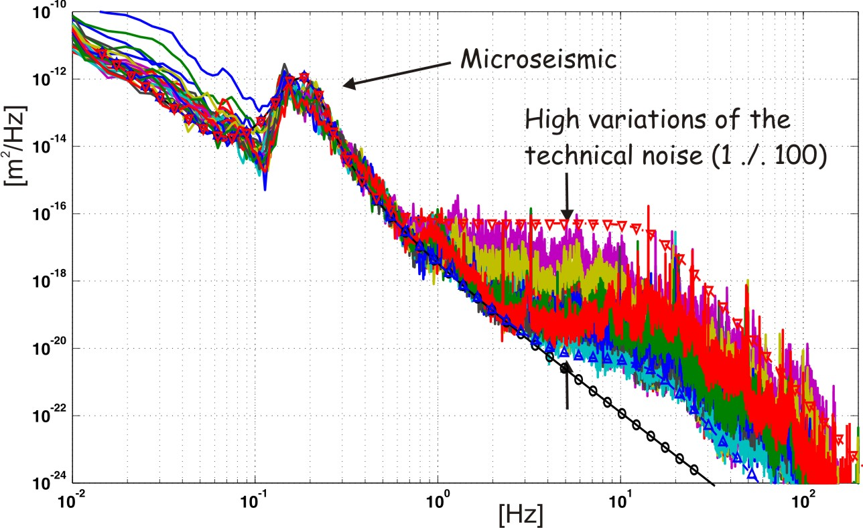
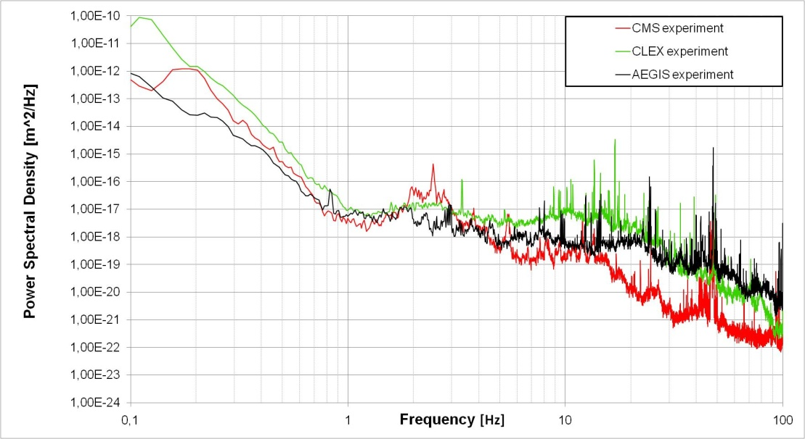
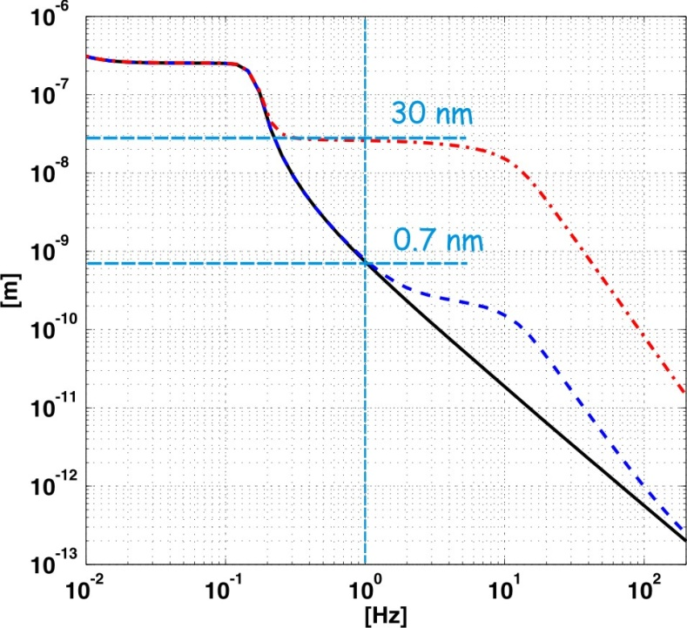
Power Spectral Density
LHC tunnel in operation

Slide 9
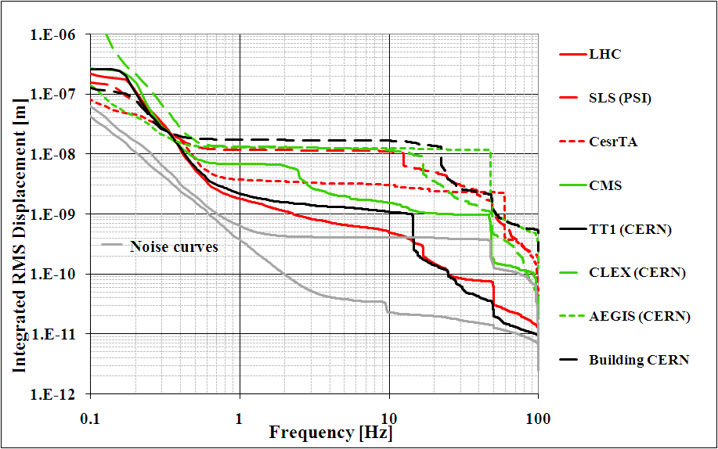
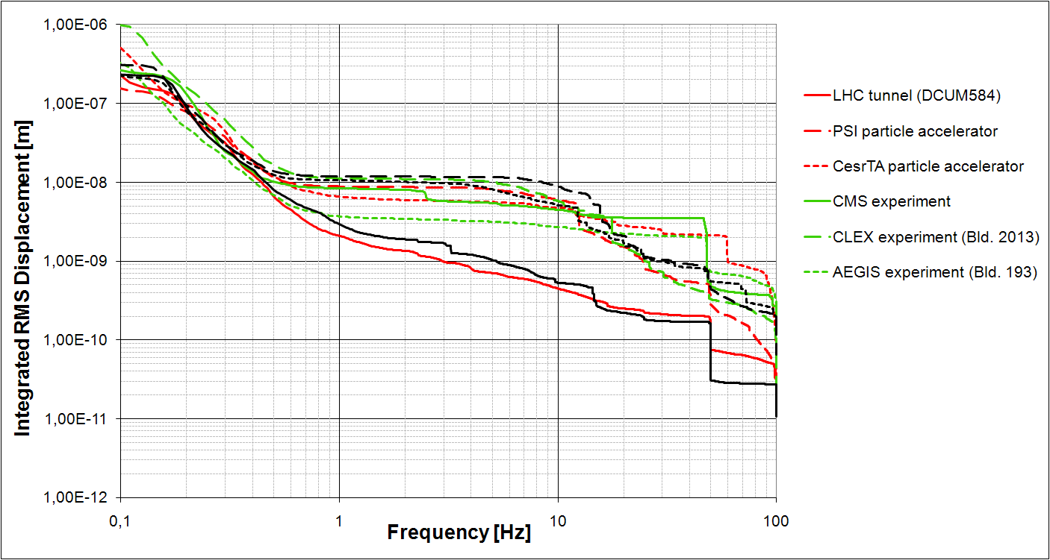
Integrated R.M.S. displacements
vertical
lateral

Slide 10
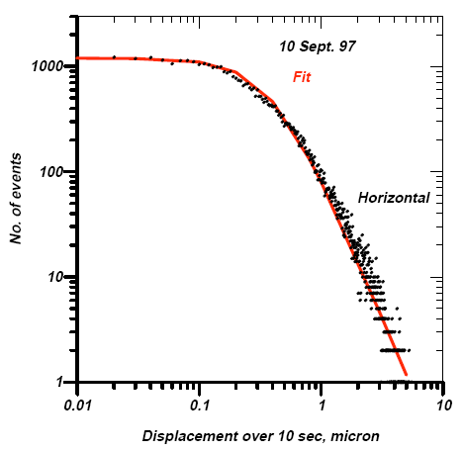
Averaging, window, histogram, color map
50 averages of 64 sec blocks with 66.7% overlap:
To have a good frequency resolution + definition of PSD
To “see” something within the noise
But: it’s an average view
Histogram
Baklakov, Shiltsev et al. Fermilab 1997
R.Amirikas, A. Bertolini DESY 2005

Slide 11
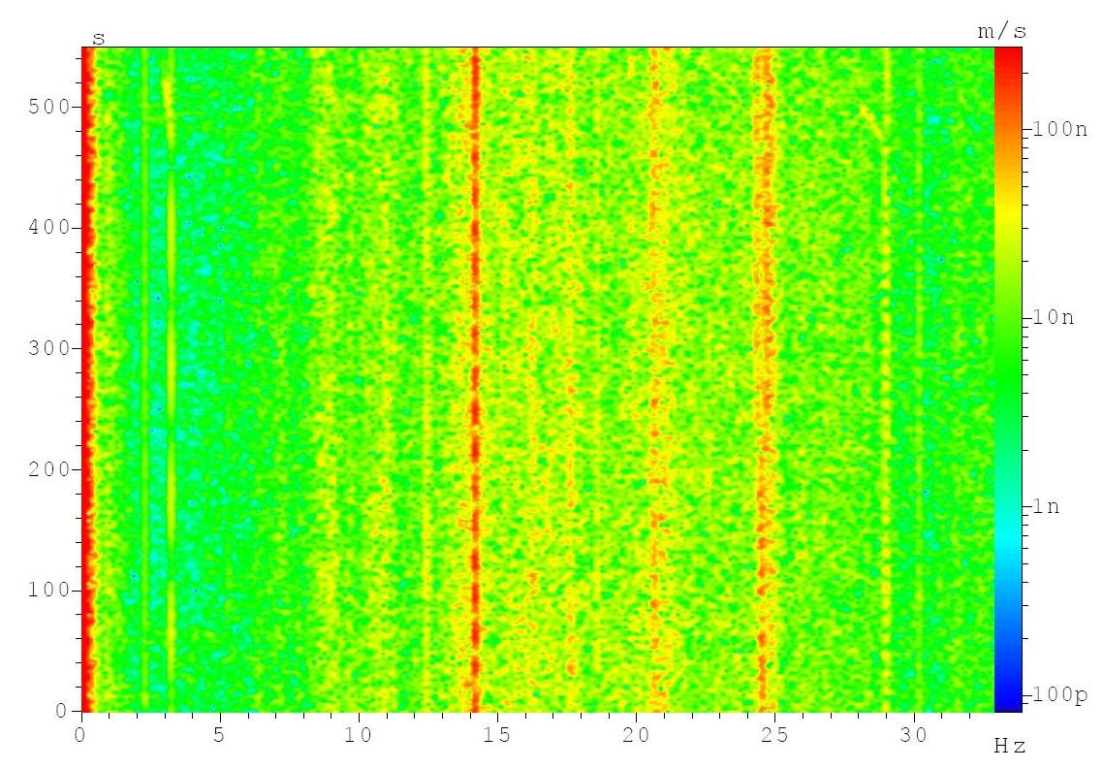
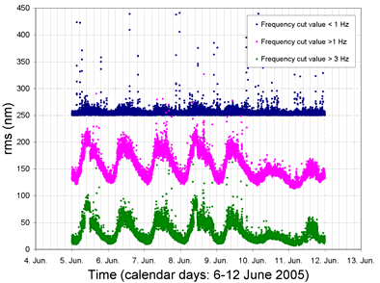
Variation in time of integrated R.M.S.
W. Bialowons et al.

Slide 12
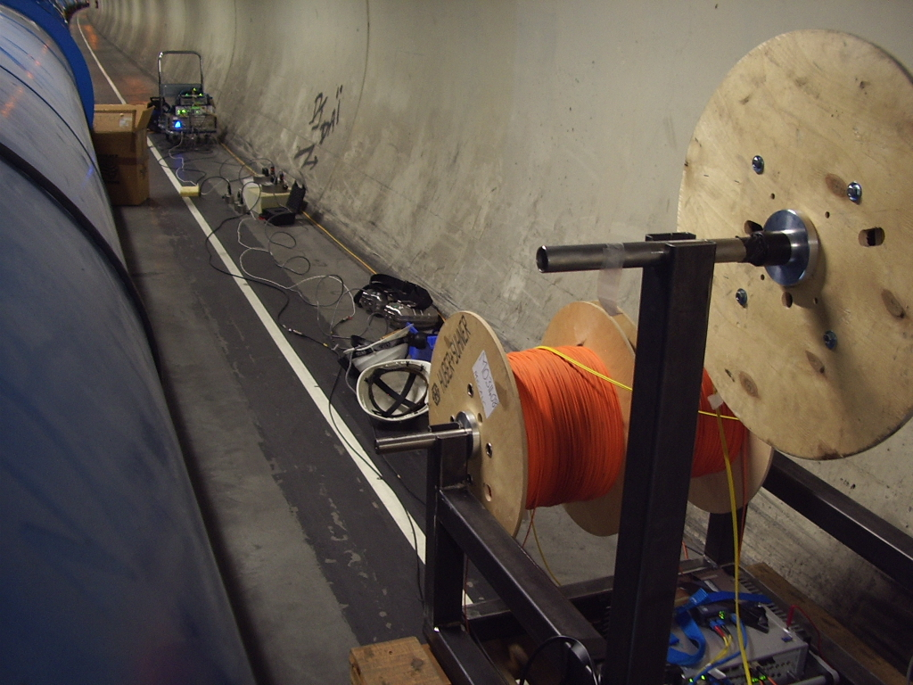
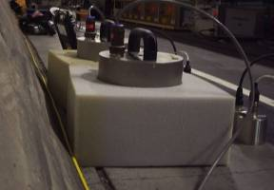
Coherence Measurements
1 km of optical fibre for synchronisation + timing
and Data Transfer
Parameters
Sampling rate
256 Hz
Block duration
64 s
Average
Lin – 50
Overlap
66.7 %
2 Muller-BBM
MKII Analyzers
24 bit on 100 mV
Low ADC noise
Guralp
CMG 40T
x,y,z
2*800Vs/m
30 s -50 Hz
ENDEVCO 86
PCB 393B31

Slide 13
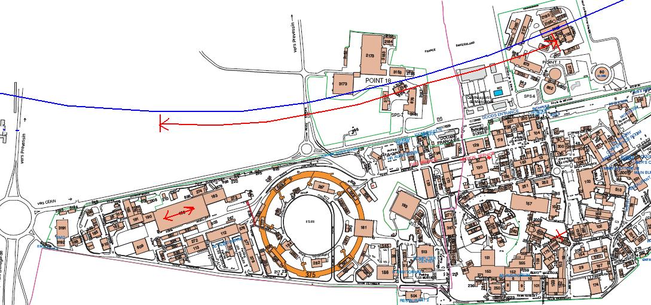
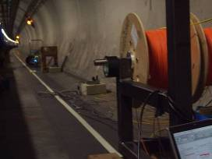
LHC Measurements
LHC DCUM 1000
~ 80 m under ground
Measurements: 0 1 2 3 4 5 6 7 8 9 10 12 20 30 38 54 108 198 306 412 509 604 706 960 (m)
Specific features :
- Synchronous measurements
LHC systems in operation, night time
Multi-directional

Slide 14
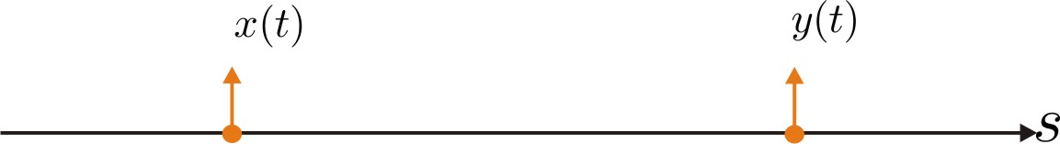
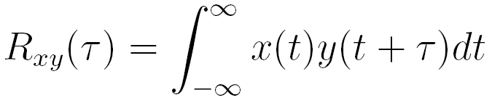
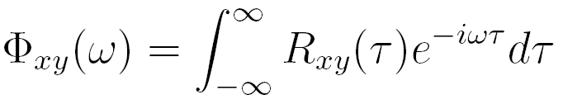
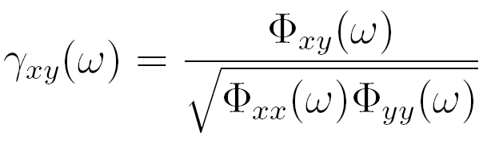

Characteristics
- Correlation function:
- Cross spectral density:
- Normalized spectral density between
two measurements x(t) and y(t):
Power spectral density of the
relative motion d(t)=x₁(t)-x₂(t):

Slide 15
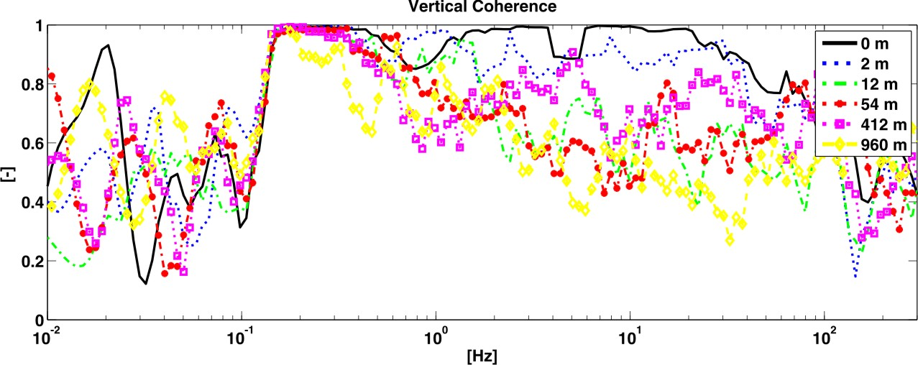
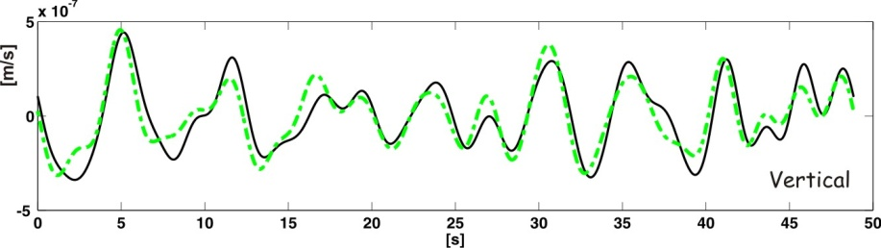
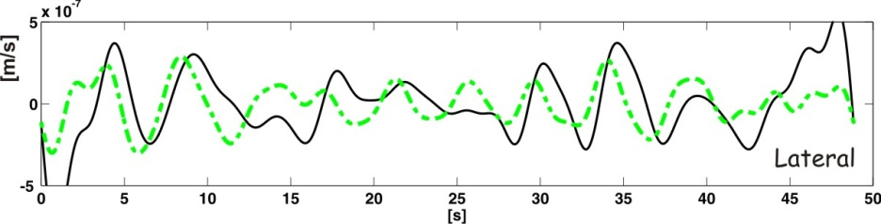
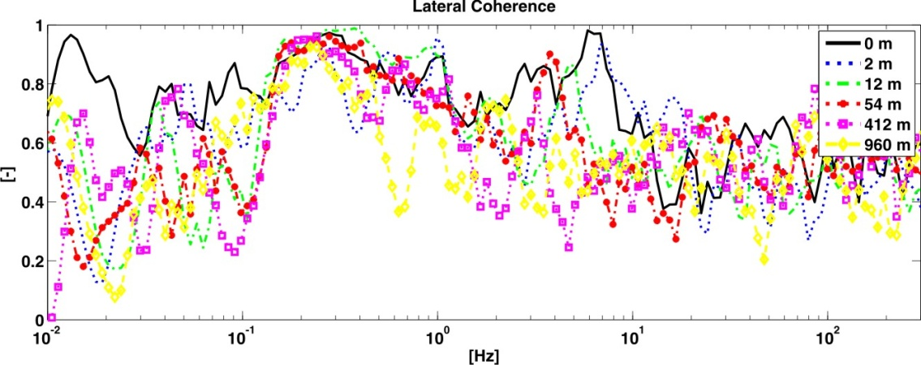
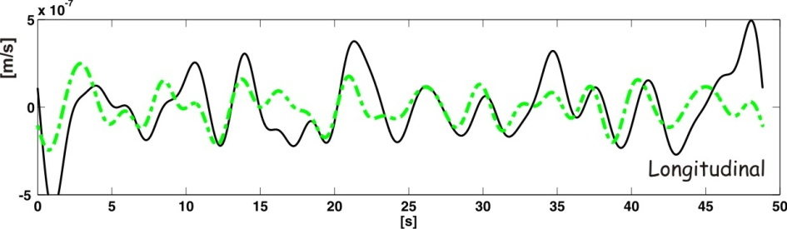
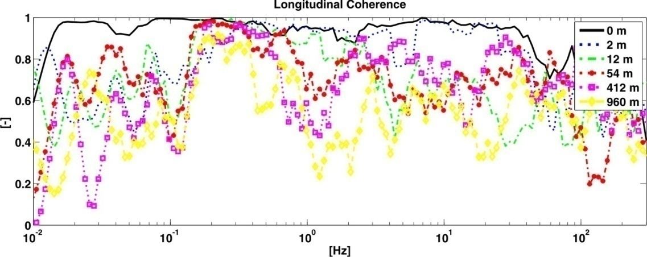
3D coherences
d=960 m; filtered between
0.08 Hz and 0.5 Hz
Correlation in the low frequency range
Similar amplitudes in all directions
Higher frequencies are dominated by local vibration sources

Slide 16
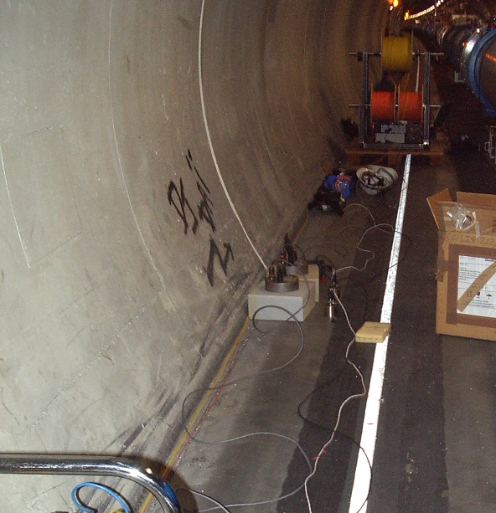
Joints between tunnel segments
S. Takeda et al. 1996

Slide 17
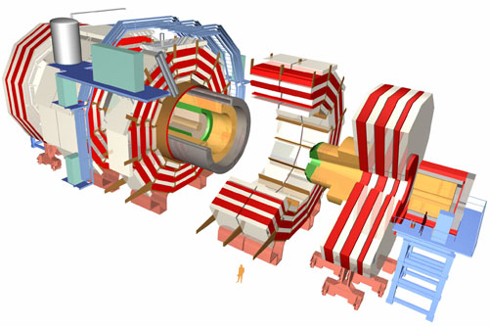
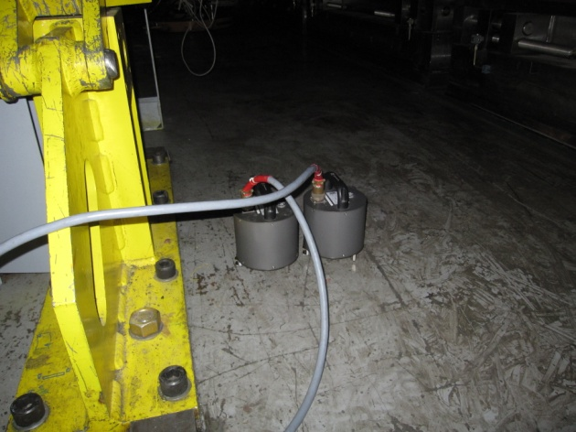
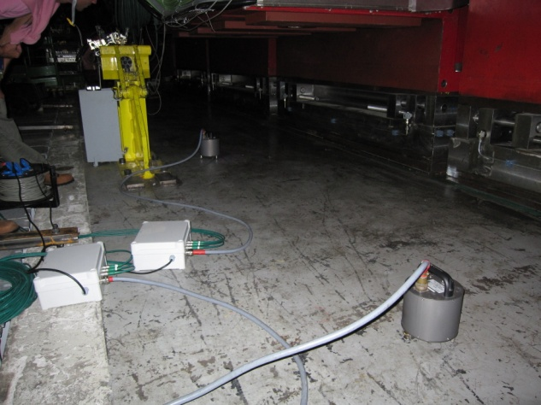
Coherence Length Measurements
Coherence
Reference
Geophone
Measuring
Geophone
Three measurements were provided:
Geophones side by side
Geophones 2.5 m away from each other
Geophones 4.8 m away from each other

Slide 18
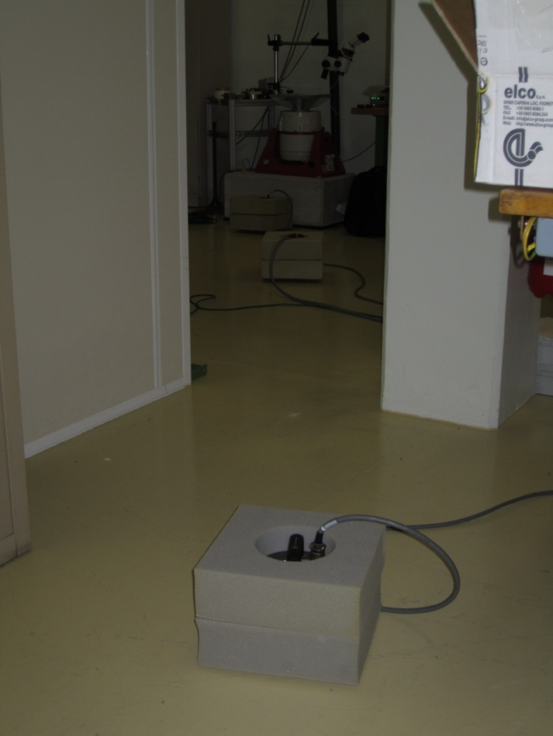
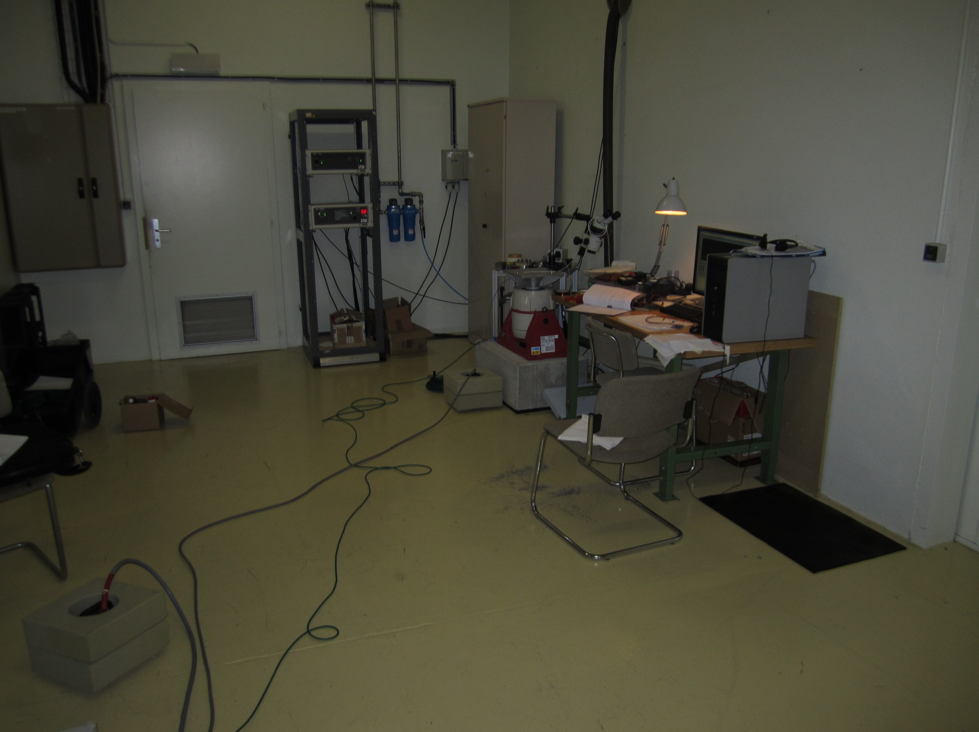
Propagation of local technical noise in concrete floor: some initial tests
Michael Guinchard & Ansten Slaathaug
Reference geophone
V
E/W
N/S
10 nm @ 1 Hz
Mechanical Measurement Lab
Ansten.Slaathaug@cern.ch
2010.03.31
18

Slide 19
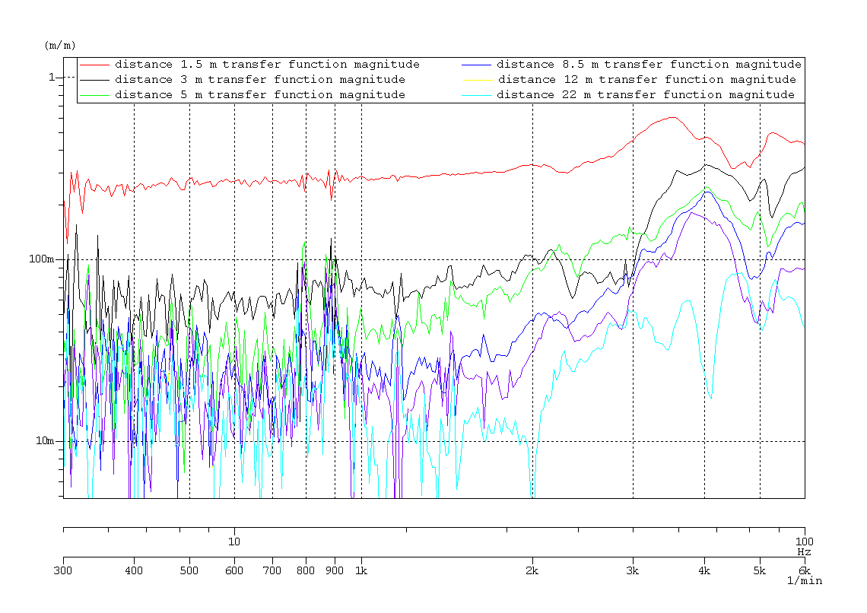
Transfer function magnitude along sweep sine.
Increasing distance
  Transfer function magnitude between reference geophone and geophone at measured points
Mechanical Measurement Lab
Ansten.Slaathaug@cern.ch
2010.03.31
19

Slide 20
Results
Experiment2 :
Sine with fixed frequency with the shaker
Vibration level change with distance
(general = no excitation)
Goal: Test different concrete floors with an exact reproducible vibration source
Mechanical Measurement Lab
Ansten.Slaathaug@cern.ch
2010.03.31
20

Slide 21
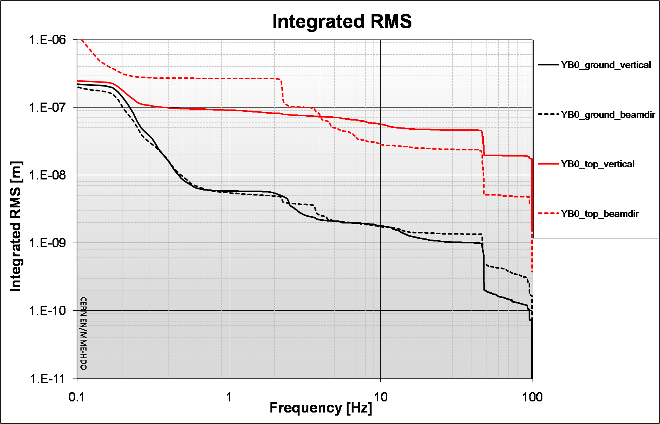
CMS YB0 motion measurement
PSD of the signals Vertical direction
Geophones
Cooling system OFF
PSD of the signals Beam direction

Slide 22
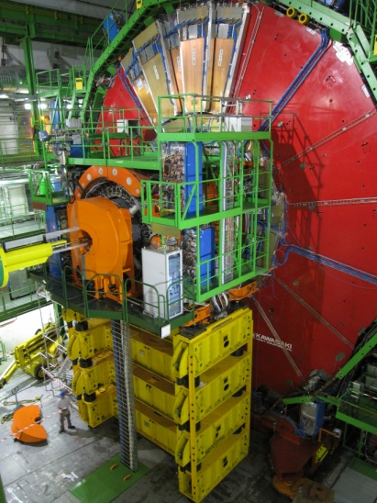
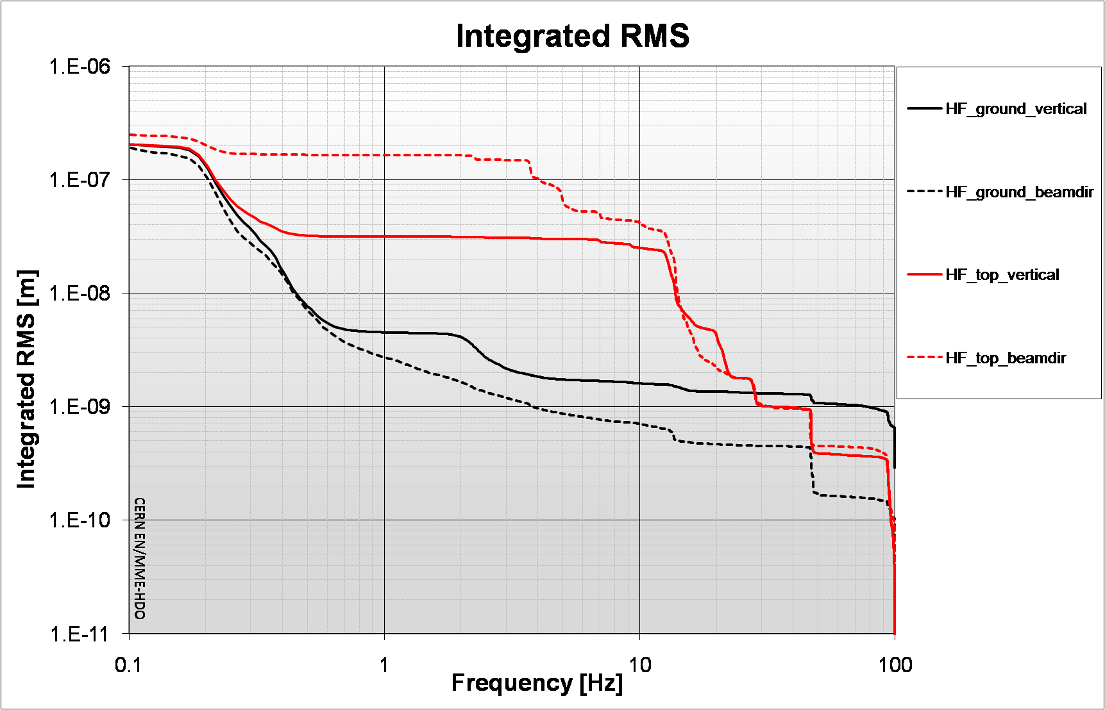
CMS HF structure motion measurement
PSD of the signals Vertical direction
Cooling system OFF
Geophones
PSD of the signals Beam direction

Slide 23
Interpretation
Technical noise is higher on top of experience at all frequencies.
Modal analysis is not easy: not enough sensors, not measured at same time, no good phase measurements because low signal to noise ratio, not known excitation,...
Refer to work of Hiroshi Yamaoka KEK, BELLE

Slide 24
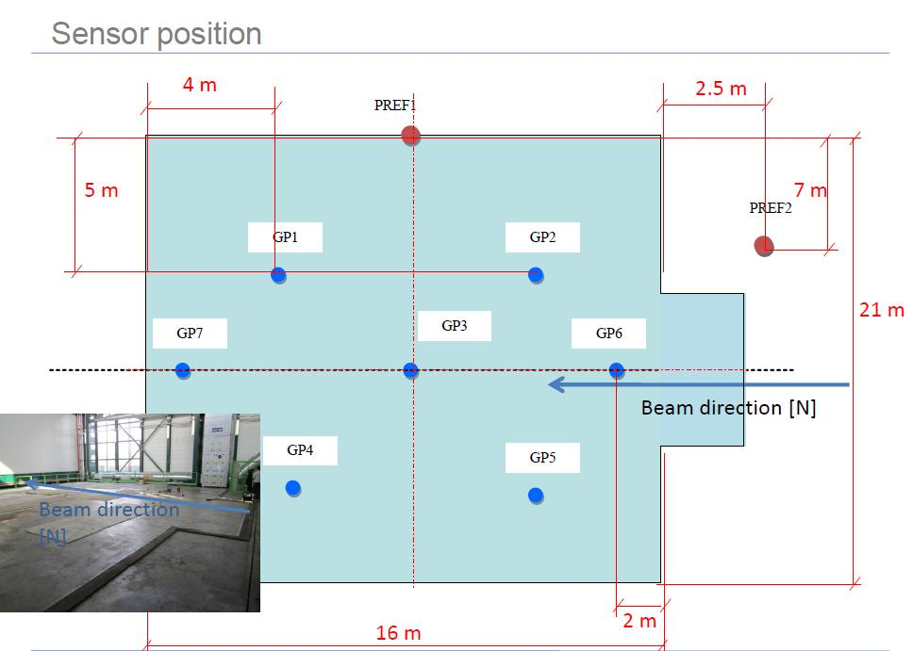
CMS slab measurements

Slide 25
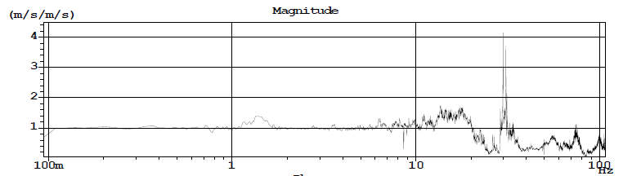
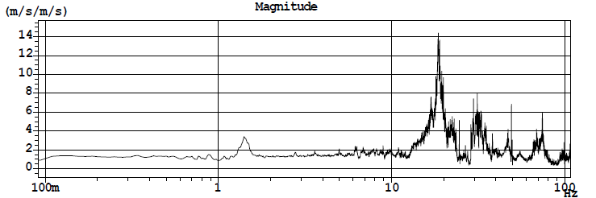
First measurements on CMS slab
Vertical Transfer function (reference seismometer above rail)
Vertical Transfer function (reference seismometer on floor)

Slide 26


Slide 27

Second measurements

Slide 28


Slide 29
Conclusions
Micro seismic wave (0.1 to 0.25 Hz, 0.1 to 3 micron integrated R.M.S.) Depends on weather conditions + geology (ref. G.E. Fischer)
Micro seismic wave does not depend on tunnel depth
Technical noise from surface decreases with depth of tunnel
Technical noise varies in time. Day night variations of factor 5 on surface and factor 2 for deep tunnels. (ref. measurements DESY)
Only low frequency ground motion is coherent over long distances. At and above one Hz the ground motion is coherent to maximum 40 m on a continuous concrete floor.
Local vibration sources are attenuated by the concrete floor over some distance. It would be good to characterize different concretes.
A particle detector is “noisy”, even during “quiet” conditions.
The CMS slab amplifies ground motion, mechanism not entirely clear

