Slide 2

Michal Simon
XRootD workshop report
10/07/2019
Michal Simon

Slide 3
Outline
XRootD status and plans
Xcache
Delegation & TPC
Experiments
HTTP ecosystem
10/07/2019
Michal Simon

Slide 4
XRootD workshop overview
France, Lyon, IN2P3 (11-12/06/2019)
~20 registered participants (~5 remote)
1.5 days presentations from users and the XRootD team
10/07/2019
Michal Simon

Slide 5
XRootD status and plans
Current adoption 4.9.x (4.9.1 recommended)
  Though many still run 4.8.x (or even older)
The upcoming feature release is 4.10.0
  RC5 cut last Friday
  To be released tomorrow
On the horizon R5 (Q3 2019)
10/07/2019
Michal Simon

Slide 6
XRootD status: 4.9.x highlights
Client: redirections on stateful operations, redirect trace-back, force disconnect, ZIP support bug fixes, declarative API
Server: enhancements for containerization, XCache ingest via HTTP, Macaroon support, SAN support
Client/Server: TPC-lite with delegation, vector writes
10/07/2019
Michal Simon

Slide 7
XRootD status: 4.10.x highlights
Client: retry/redirect policy changes for better metamanager/metalink utilization, chunked response (dirls)
Server: multiple XCache write back streams, direct XCache access, additional clustering options for XCache
Client/Server: new prepare plug-in and interface
10/07/2019
Michal Simon

Slide 8
XRootD status: R5 highlights
Client: channel level plug-ins, review ABI and public headers
Server: sec entity refactoring, monitoring g-stream (periodic medium level information, JSON/XML), trivialize OFS plug-in wrapping
Client/Server: extended attributes, encryption, extended stat
10/07/2019
Michal Simon

Slide 9
XRootD status: post R5 highlights
Client: RDMA support, dynamic data source selection
Server: recursive delete, uid/gid tracking
Client/Server: bundled requests, verified close, streaming read
10/07/2019
Michal Simon

Slide 10
XRootD status and plans
Server: https://indico.cern.ch/event/727208/contributions/3444600/attachments/1859800/3056084/IN2P3-190611-XRootD_Server_Status_and_Plans.pdf
Client: https://indico.cern.ch/event/727208/contributions/3444599/attachments/1859886/3056268/xrdwrkshp_status.pdf
10/07/2019
Michal Simon

Slide 11
XCache status and plans
Serve data to local clients (origin: remote data source – usually federation)
  Data are read in blocks, prefetching is optional
  Store data on disk via write queue
  Purge old files as disk gets full
Standard XRootD client used to access remote server (behaves as xrdcp, also in terms of authentication)
10/07/2019
Michal Simon

Slide 12
XCache status
Minimal Xcache setup / configuration
List of features and configuration options:
  pfc.blocksize (large buffer for whole file streaming vs small for vector reads),
  pfc.origin vs authenticaction
  pfc.prefetch, pfc.ram, pfc.writequeue, pfc.diskusage, pfc.spaces, pfc.decision, pfc.trace
10/07/2019
Michal Simon

Slide 13
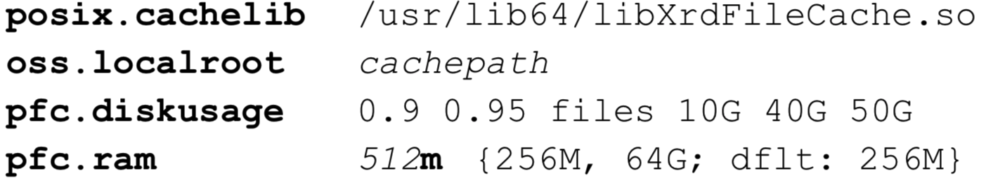
XCache status
Serveless / client-side caching
  Available only through the POSIX interface
  Single process only
Minimal config / setup
10/07/2019
Michal Simon

Slide 14
XCache plans
Monitoring, quota based purging
Optimizations (RAM management, block selection for prefetching, etc.)
Efficient running with smaller block sizes
XCache clusters (balancing disk usage and staging frequency)
Dealing with corrupted files
10/07/2019
Michal Simon

Slide 15
XCache status and plans
https://indico.cern.ch/event/727208/contributions/3444604/attachments/1859894/3056280/XCache-FeaturesEtc-Lyon-2019.pdf
10/07/2019
Michal Simon

Slide 16
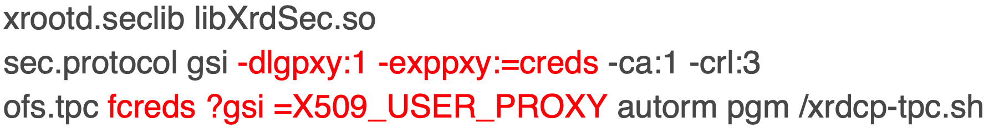
Delegation and TPC
GSI authentication (verify server cert using known CAs, RFC 2818, SAN, verify client DN using known CAs)
X509 proxy delegation (server: generate RSA pair, client: sign public key using its X509 proxy + voms attributes)
Server side configuration:
10/07/2019
Michal Simon

Slide 17
Delegation and TPC
Extend vanilla TPC to WLCG storage ecosystem (X509 proxy delegation)
All storage use redirections to data servers
  EOS, DPM & dCache add additional AA info in CGI so TPC script must start from head-node
Destination maybe XRootD proxy
  May choose to write directly to backend storage
10/07/2019
Michal Simon

Slide 18
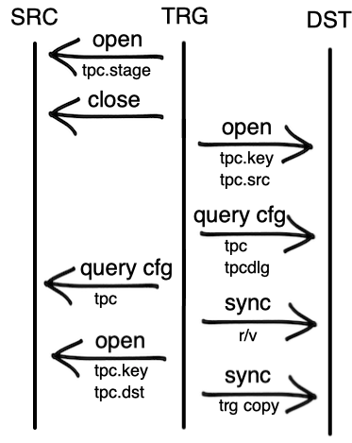
Delegation and TPC
10/07/2019
Michal Simon

Slide 19



Delegation and TPC
10/07/2019
Michal Simon

Slide 20
Delegation and TPC: status
Two implementations: native (XRootD, ECHO, DPM, Storm) and Java for dCache
EOS is bit different as it has it’s own TPC plug-in (working solution exists)
10/07/2019
Michal Simon

Slide 21
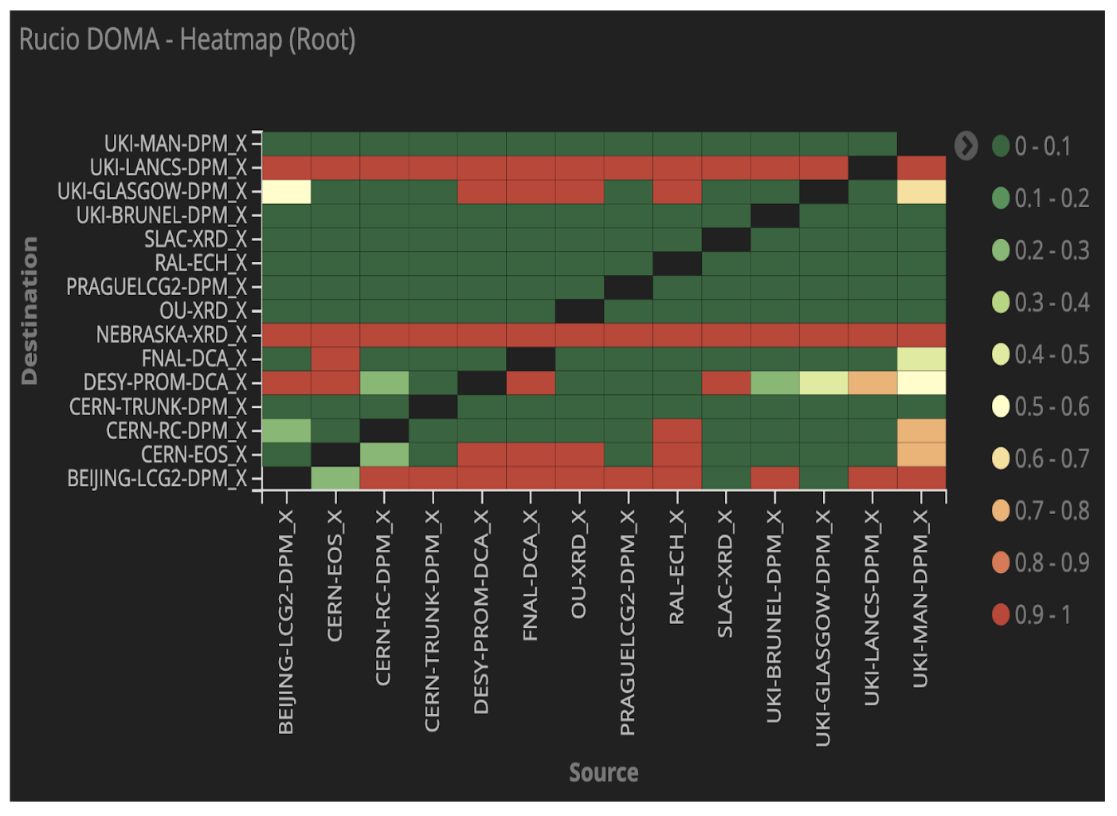
Delegation and TPC: status
The coverage phase is completed,
Entering the phase of early deployment
FTS works with XRootD TPC & delegation
10/07/2019
Michal Simon

Slide 22
Delegation and TPC
Delegation: https://docs.google.com/presentation/d/1fZrFP9U23p9RalIqdA7ivTgiRuKyEQA3kqvIkSS_nmw/edit#slide=id.p
TPC: https://docs.google.com/presentation/d/1Wt1l5XhUqFN5k27Gc5PmN-2OBEnnveGEu1ky1OzrjC4/edit#slide=id.p
10/07/2019
Michal Simon

Slide 23
Experiments
Atlas: centrally managed caches with kubernetes, SLATE and k8s
  https://docs.google.com/presentation/d/1dijMTIyKULNtuDnEYboEwc-V6ct8SIsc0NxzxKoMppQ/edit#slide=id.p
CMS: remote file access latency has big impact on CMS analytics jobs, XCache helps with latency hiding
  https://indico.cern.ch/event/727208/contributions/3444609/attachments/1860136/3056787/XRootD-Workshop-201906.pdf
10/07/2019
Michal Simon

Slide 24
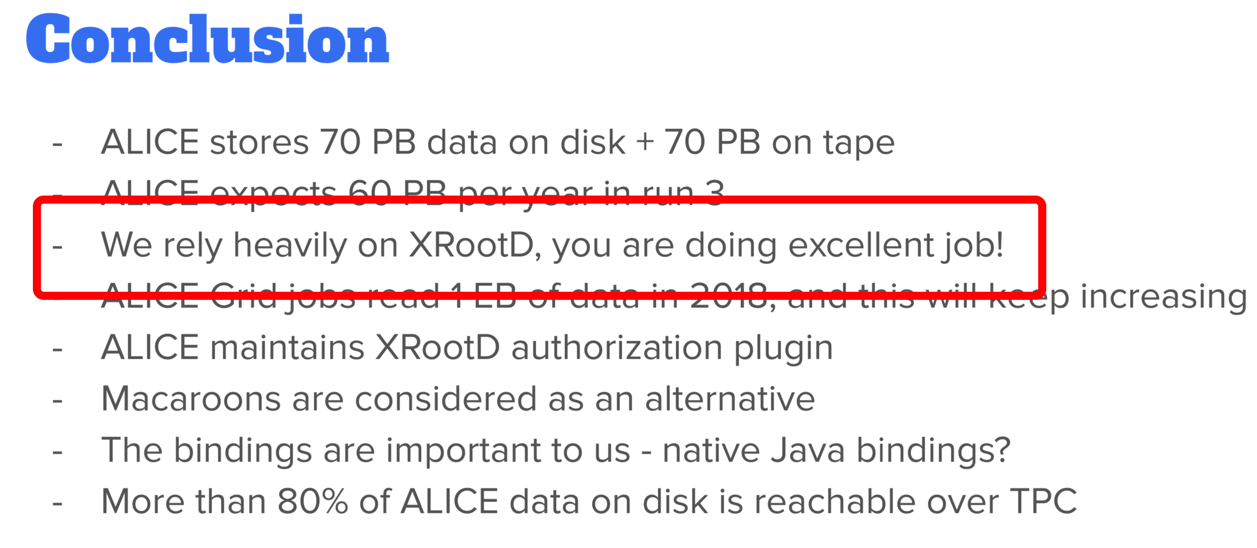
Experiments
Alice:
11/06/2019
Michal Simon

Slide 25
HTTP ecosystem
XrdHttp: simplicity (compared to Apache), TPC plug-in, Macaroons authorization support, SciTokens authorization support
  Port sharing with XRootD or vanilla HTTP port (80) through systemd socket inheritance
  Security extractor plug-ins – recognize VOMS
  HTTPS -> HTTP + security token (used e.g. in DPM)
HTTP ingestion to XCache
10/07/2019
Michal Simon

Slide 26
HTTP ecosystem
XrdHTTP: https://indico.cern.ch/event/727208/contributions/3444621/attachments/1860746/3058009/XrdHTTP.pdf
HTTP ingestion to Xcache: https://indico.cern.ch/event/727208/contributions/3444622/attachments/1860256/3057010/Adding_HTTP_Ingestion_Support_to_XCache.pdf
10/07/2019
Michal Simon

Slide 27
Summary
Overall positive feedback from users on the XRootD framework
XRootD TPC with delegation is production ready
Increasing roll of XCache
Encryption will be the enabling factor for access token in root/xroot protocol
Thanks a lot for participation and feedback ☺
10/07/2019
Michal Simon

Slide 28
Question?
10/07/2019
Michal Simon

