Slide 1



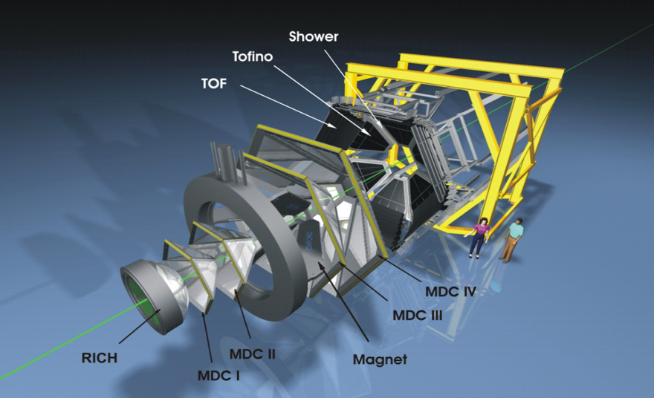
Studying time-like electromagnetic baryonic transitions with HADES in pion induced reactions
B. Ramstein (IPN Orsay) for the HADES collaboration
NSTAR conference, Bonn, June 12, 2019
N
R
e⁺
γ∗
e⁻

Slide 2
Outline
Introduction
General motivations of the HADES experiment
Access to time-like electromagnetic baryon transitions
P. Salabura, plenary talk, Thursday 13 , 11:15 am
Exploring time like transitions in pp(n),πp and AA reactions with HADES
I. Ciepal, parallell A, Partial Wave Analysis of HADES Data for Two-Pion Production in Pion-Nucleon Reactions
A. Belounnas , parallel B, Study of baryonic resonances and the ρ meson production
in the reaction pp -> pp π⁺ π⁻ at 3.5 GeV with HADES
Results from the experiment with the GSI pion beam in the second resonance region
Prospects for future : higher energies, hyperon transitions
Conclusions
N
R
e⁺
γ∗
e⁻
Notes:
43’

Slide 3
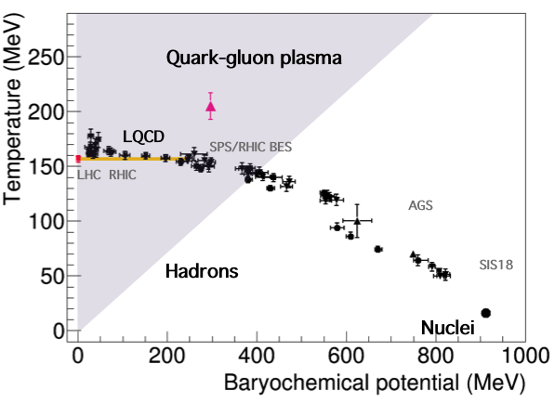
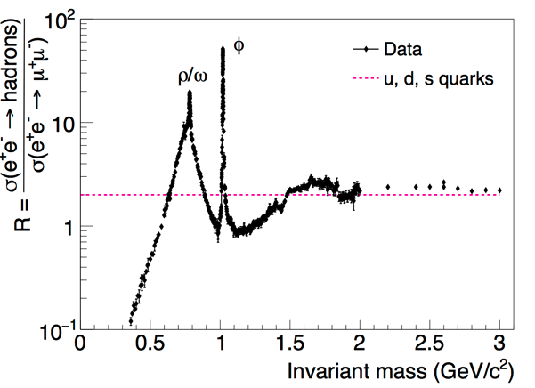
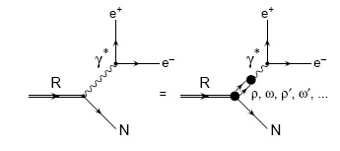
QCD properties and role of e⁺e⁻ production
Studies of QCD matter and hadron electromagnetic structure
e⁺
HADES
γ*
e⁻
Vector mesons
ρ, ω, φ→e⁺e⁻ J^{P}=1⁻
T. Galatyuk, NPA-D-18-00411 (2018) QM18
J. Beringer et al. (PDG), Phys. Rev. D (2012) 010001
Are vector meson spectral functions modified in medium ?
What is the role of vector mesons in
hadron electromagnetic couplings ?
QCD fundamental properties
Chiral symmetry restoration
Hadron structure, QCD dynamics
Notes:
e+e- production is an ideal probe both for QCD matter and hadron electromagnetic structure. At low energies, this interest comes from the existence of vector mesons, which have the same quantum numbers as photons and have a very strong electromagnetic coupling, as can be measured in e+e- annihilation at low energies. The study of vector meson allow to address fondamental quastions of QCD. In HI reactions, one can investigate whether vector meson spectral functions are modified in the medium, which is a question related to the restoration of the chiral symetry at high baryonic density and temperature. And with elementary reactions the role of vector mesons in hadron electromagnetic couplings can be studied, which is related to hadron structure and the dynamical properties of QCD.

Slide 4
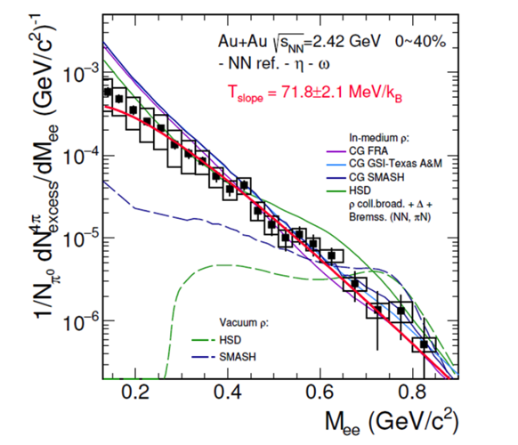

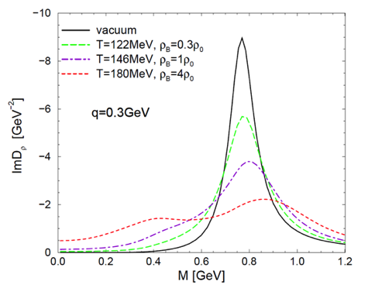
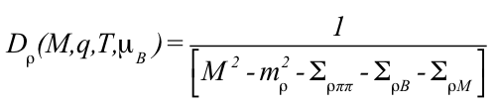
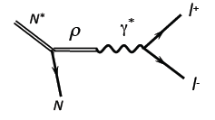
In medium vector meson spectral functions
inclusive e⁺e⁻ production
Au+Au @1.25A GeV
HADES, accept. for pub. in Nature Phys. 2019
Strong broadening of in medium ρ spectral function due to its coupling
with baryonic resonances.
Σ_{π}
Δ, N(1520), …
ρ
Σ_{π}
ρ
>
Σ_{ρπ} =
+
Σ_{ρB} =
Σ_{π}
>
h = N
R. Rapp and J. Wambach EPJA 6 (1999) 415
Baryonic loop
sensitive to ρNN* couplings
related to baryon Dalitz decay
  R. Rapp, G. Chanfray and J. Wambach,
Nucl. Phys. A617 (1997) 472

Slide 5
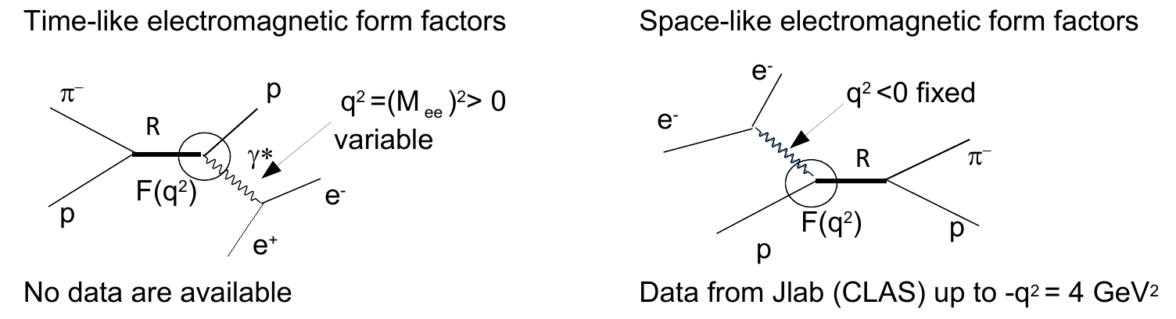
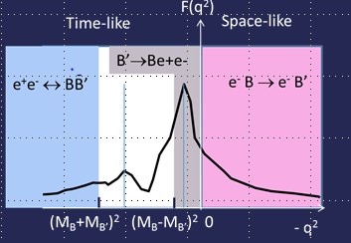
Electromagnetic form factors
and soon higher q² with CLAS12

Slide 6
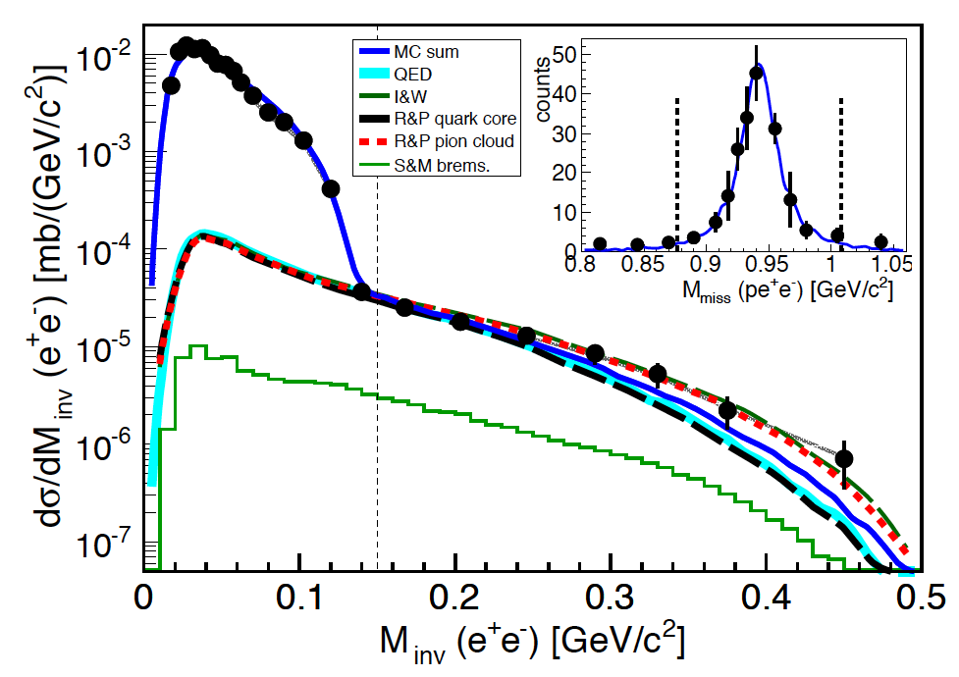
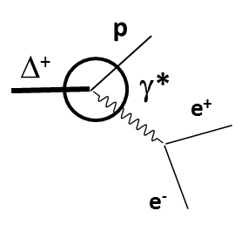
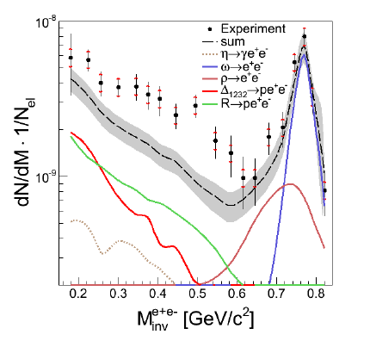
Baryon Dalitz decay studies with HADES
E=1.25 GeV pp → ppe⁺e⁻
HADES PRC95, 065205 (2017)
First measurement of Δ (1232) Dalitz decay branching ratio ( Δ⁺ →pe⁺e⁻)
BR= 4.19 ± 0.42^{model} ± 0.46^{syst.} ± 0.34^{stat.} × 10⁻⁵ →PDG 2018 entry
Sensitivity to the electromagnetic structure (form factor) of the N-Δ transition
Wan and Iachello, Int. J Mod. Phys. A20 (2005) 1846
T. Pena and G. Ramalho, Phys.Rev. D85 (2012) 113014
π°→γe⁺e⁻
Δ⁺→pe⁺e⁻
E=3.5 GeV pp → ppe⁺e⁻
HADES Eur.Phys.J. A50 (2014) 8
Higher lying resonances
Evidence for form factors of the Vector Dominance type (ρN coupling)
Calculation with point-like Dalitz decay vertex
underestimates the e⁺e⁻ yield below vector meson poles

Slide 7
Pion beam experimental program
Investigation of N(1520) (second) resonance region
Goal:
π⁻ p → π⁺ π⁻ n, π⁻ p → π⁰ π⁻ p : 4 measurements √s = 1.46-1.55 GeV/c²
  Improve very poor database used for extracting baryon resonance properties.
π⁻ p → ne⁺e⁻ : √s = 1.49 GeV/c²
  Access to time-like electromagnetic form factors of baryons
  No data are available

Slide 8
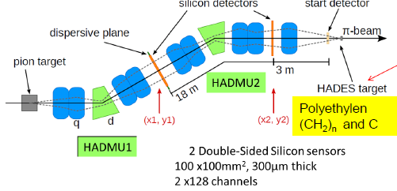
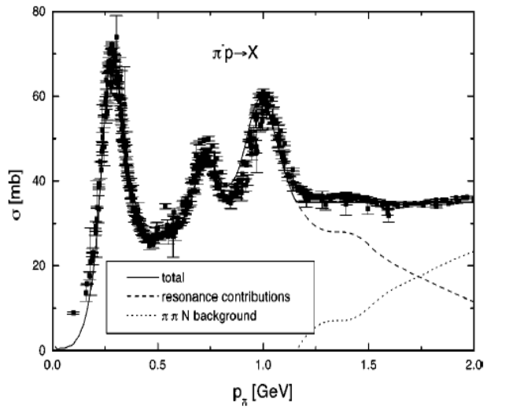
Pion beam at GSI
Primary beam: 8 × 10¹⁰ N₂ ions/spill
Kinetic beam energy E = 2A GeV
Secondary pion beam: 3-4 × 10⁵ π/s
Momentum acceptance = 2 %
Momentum range p_{π} = 0.65 – 2.5 GeV/c
August 2014 commissioning experiment
Total ~15 days of measurements
Main run: momentum p_{π} = 0.690 GeV/c (√s=1.49 GeV)
Energy scan: √s=1.46,1.52,1.55
Polyethylene (CH₂) and carbon targets

Slide 9
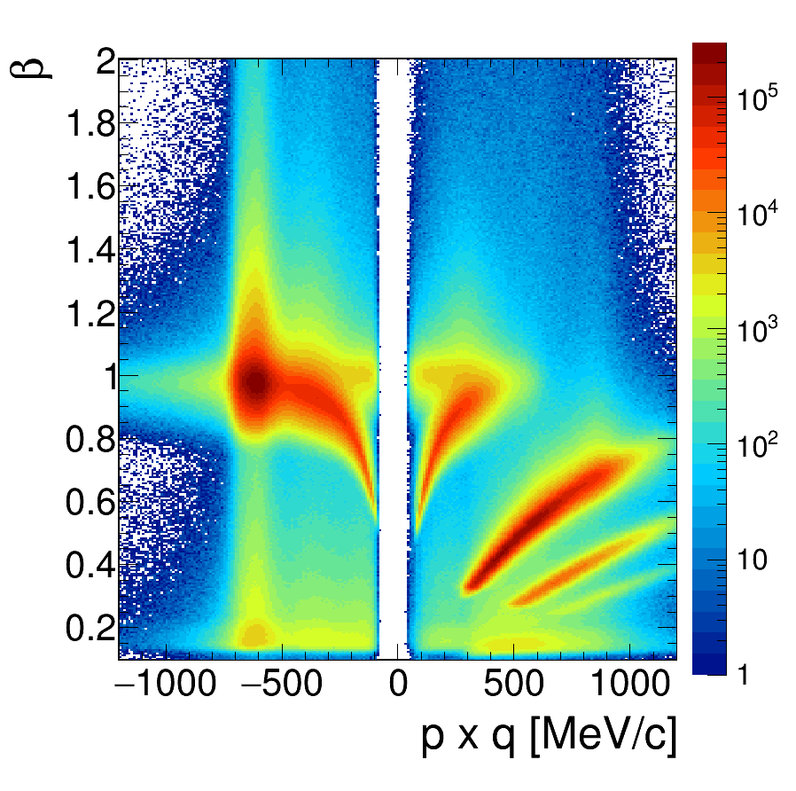
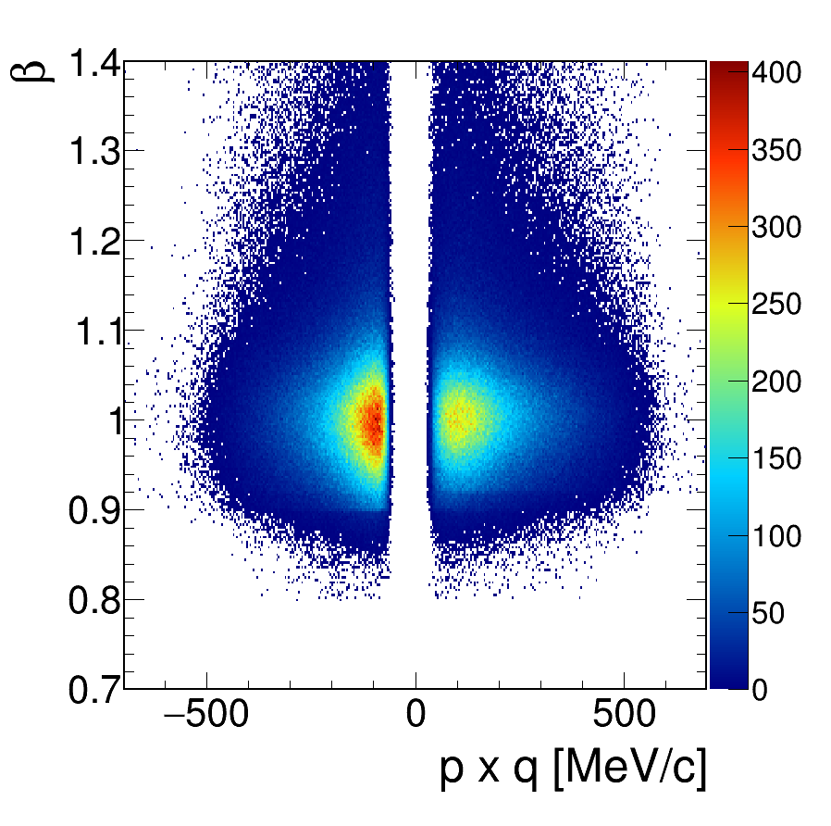
The HADES detector
Acceptance: Full azimuth, polar angles 18º - 85º
Particle identification: e⁺/e⁻, π⁺/π⁻ , K⁺/K⁻, p
RICH, Time Of Flight, Pre-Shower (pad chambers & lead converter) (also MDC (K⁻))
Trigger: ~ 50 kHz
Momentum measurement
  Magnet: ∫Bdl = 0.1- 0.34 Tm
  MDC: 24 Mini Drift Chambers
  Leptons: Δx~ 140 μ per cell, Δp/p ~ 1-2 %
before lepton selection
after lepton selection
On-going upgrade
(to be discussed later)
  ΔM/M ~ 2% at ω peak

Slide 10
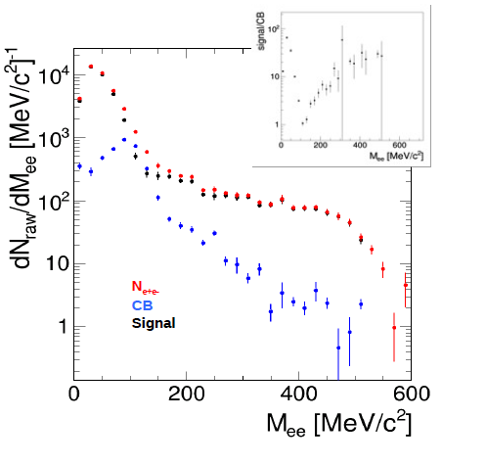
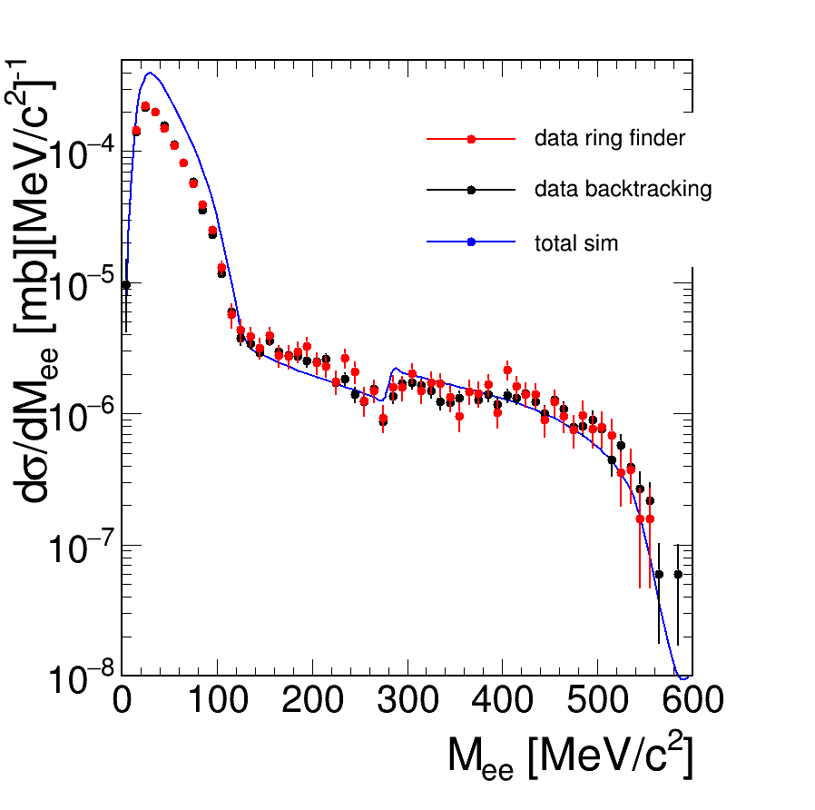
Data Analysis: Signal extraction
Combinatorial Background: same-event like-sign pairs
Signal = N_{e+e-} -CB
CB rejection cuts:
Reject tracks with other track segment within 4°
e⁺e⁻ opening angle > 9°
Consistent
Consistent efficiency corrections
Signal (M<140 MeV/c²) = 13138
Signal (M>140 MeV/c²) = 3300
Syst. errors : point-to-point 10-20% included
global 20% not included
Normalization via known π⁻ + p elastic cross section
6/12/2019

Slide 11
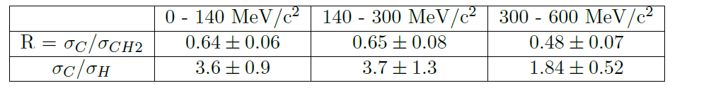
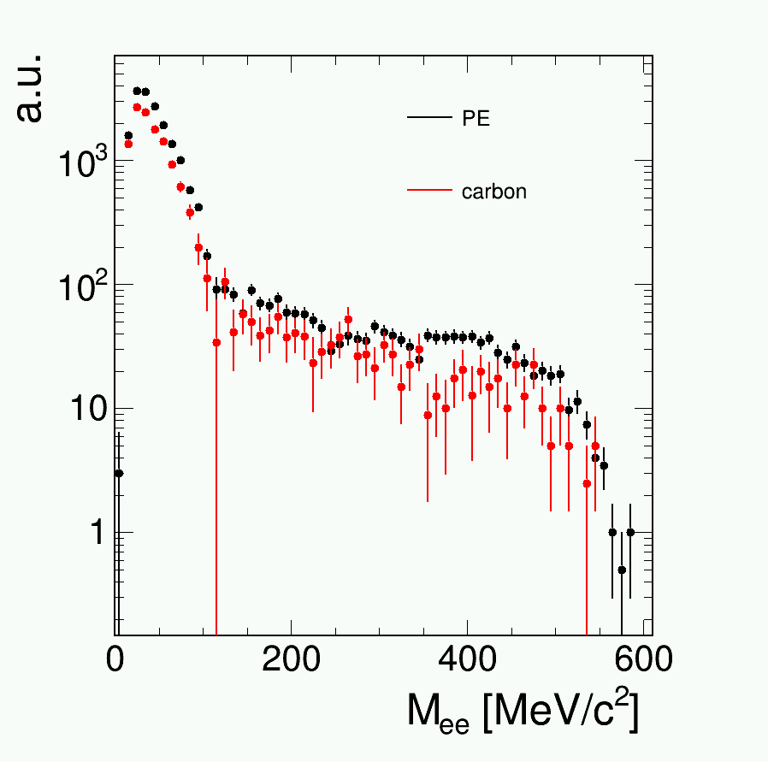
Carbon contribution
Normalisation carbon/polyethylene using π⁻p elastic scattering
CH2 target
C target
Description of interactions with ¹²C nuclei
in CH₂ target:
Quasi-free participant-spectator model i.e. ¹²C = participant off-shell proton + spectator ¹¹B
π⁻ interacts with an off-shell proton moving with Fermi momentum in the target rest frame
N.B. Measurement on CH2 target provides (dσ/dM)_{H}+0.5 (dσ/dM)_{C}

Slide 12
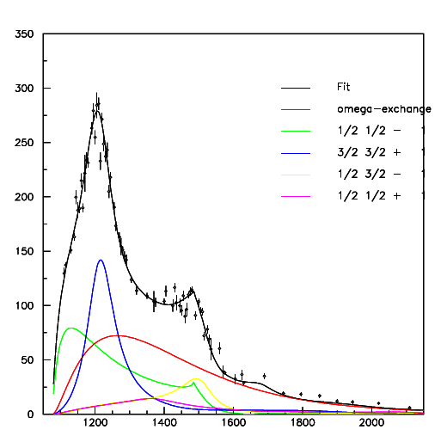
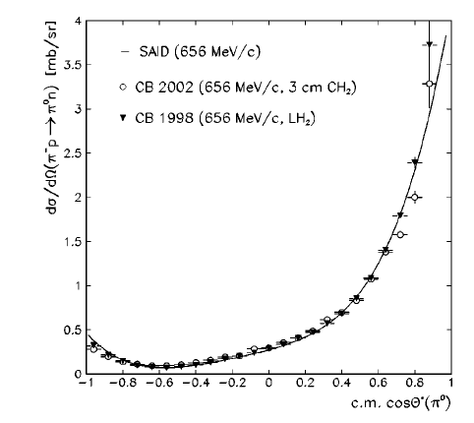
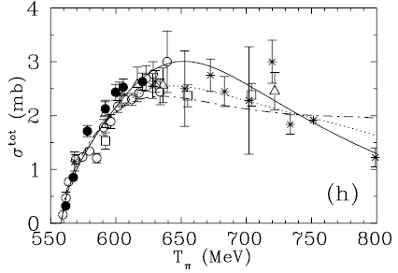
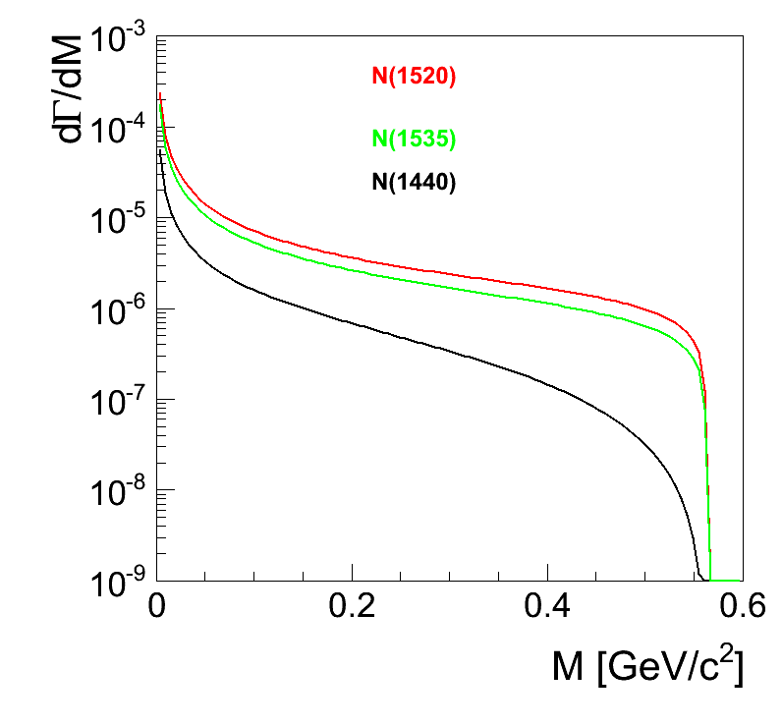
Inputs for π⁻p→Xe⁺e⁻
√s(MeV)
π⁰→γe⁺e⁻
η→γe⁺e⁻
N*⁰→ne⁺e⁻
Meson exchange
σ(μb)
γn→π⁻p
π⁻p→n π⁰ π⁰
π⁻p→n η π⁰
Arndt et al Phys.Rev. C72 (2005) 045202
√s(MeV)
π⁻p→n π⁰ (SAID)
π⁻p→n π⁰ π⁰ (Δ⁰π⁰ )
π⁻p→p π⁻ π⁰ (Δ⁰π⁰ )
input for π⁻p →γ*(e⁺e⁻)n
“point-like Dalitz decay contribution”
N*⁰→ne⁺e⁻
M_{ee}(GeV/c²)

Slide 13
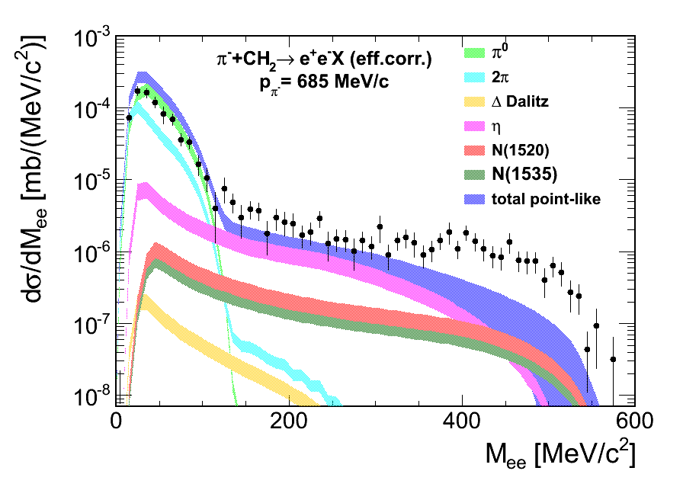
Deviation from point-like (inclusive production)
simulated events in HADES acceptance
Resolution smearing
pion beam momentum dispersion
Fermi momentum for interaction with
carbon nuclei
Error bands due to uncertainties in proton
and carbon cross sections
preliminary
Yield above 300 MeV/c² can not be reproduced
with point-like baryon Dalitz decay
Effect of time-like form factors ?
(equivalent to an off-shell ρ contribution in the Vector Dominance Model)

Slide 14
Off-shell ρ contribution
π⁻p→π⁺π⁻n
p_{π}=690 MeV/c
ρN
PWA
preliminary
ρN via N(1520)
Bonn-Gatchina PWA results (I. Ciepal’s talk)
New π⁻p→ππN HADES data are crucial to
extract the ρ contribution
Total π⁻p→ρn cross section σ = 1.3 mb
Dominated by N(1520)D₁₃
Δπ
N(1520)
σN
From ρ→π⁺π⁻ to ρ→e⁺e⁻
(dσ/dM_{ee})= (dσ/dM_{ππ} )* BR(M_{ee}=M_{ρ}) * (M_{ρ}/M_{ee})³

Slide 15
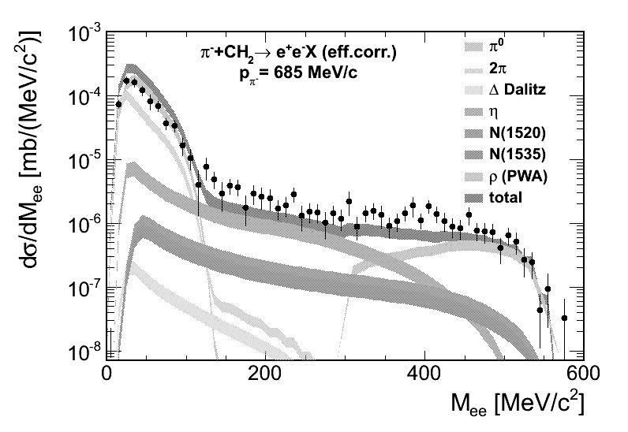
Full description of inclusive spectrum
Vector dominance
p_{π}=690 MeV/c
ρ
e⁺
ρ
preliminary
γ∗
e⁻
Off-shell ρ contribution
Simulation bands take into account uncertainties
on proton and carbon cross sections
Results of inclusive analysis:
Good description of the whole spectrum with the cocktail of dilepton sources
High invariant mass contribution consistent with VDM

Slide 16
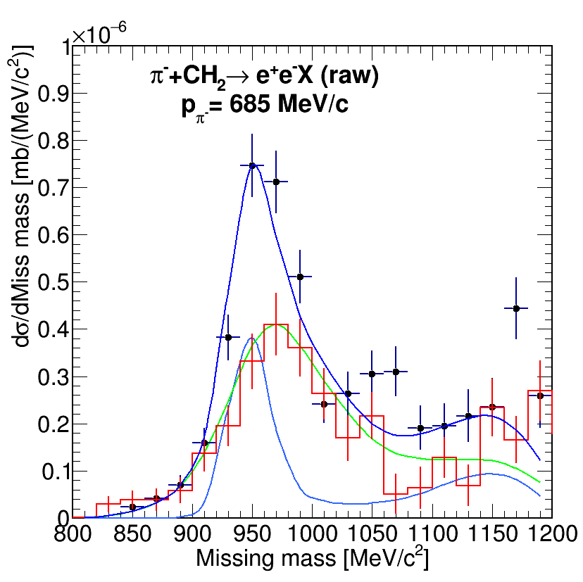
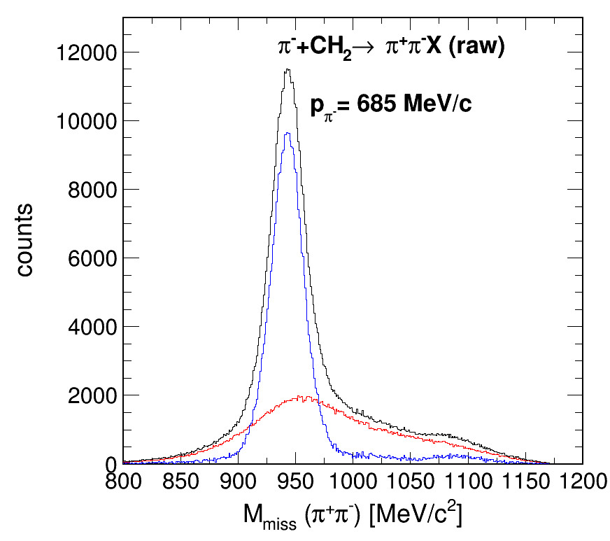
Evidence for quasi-free process
Data compared to simulation including
resolution effects
pion beam momentum
carbon Fermi momentum distribution
CH2 target
C target
H contribution
preliminary
p_{π}=690 MeV/c
preliminary
p_{π}=690 MeV/c
M_{ee}>120 MeV/c²
π⁻p→ n e⁺e⁻
π⁻ p → n π⁺ π⁻
π^{-’}p’→ n π⁺ π⁻
Quasi-free π^{-’}p’→ n e⁺e⁻
Carbon contribution consistent with a quasi-free process
π⁺π⁻ production off carbon much reduced with respect to e⁺e⁻ (absorption)

Slide 17
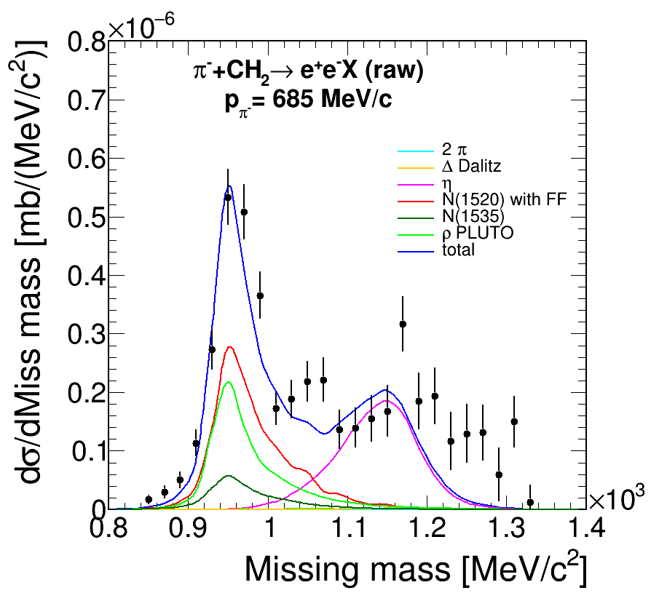
Selection of exclusive e⁺e⁻ production
Data compared to simulation including
resolution effects
pion beam momentum
carbon Fermi momentum
preliminary
p_{π}=690 MeV/c
Quasi-free exclusive process
π^{-’}p’→ n e⁺e⁻ (1500 events)
Dominated by η→γe⁺e⁻
Good description of missing mass spectrum by the simulation
Rejection of η contribution
→ selection of quasi-free exclusive process π^{-’}p’→ n e⁺e⁻ using missing mass

Slide 18
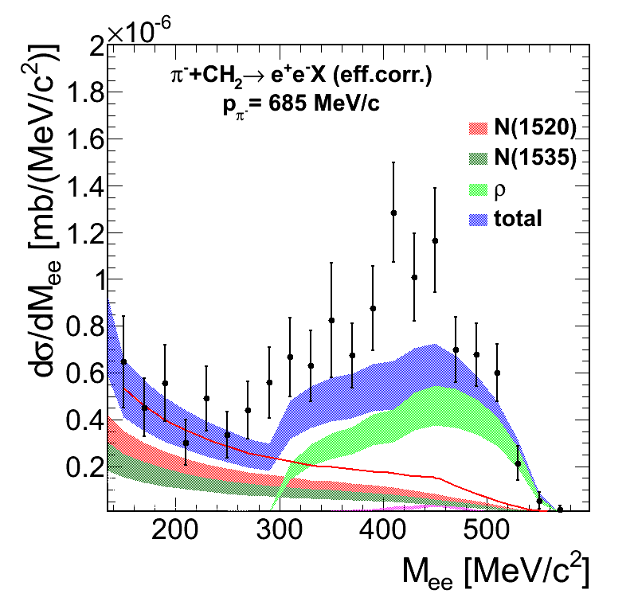
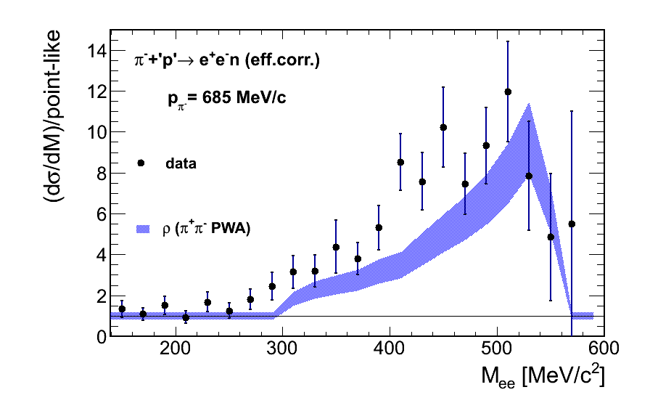
Deviation from point-like (exclusive production)
0.9 < M^{miss} < 1.03 GeV/c²
Ratio to point-like reference
p_{π}=690 MeV/c
p_{π}=690 MeV/c
preliminary
preliminary
« point-like » reference
Deviation from point-like behavior strongly enhanced for the exclusive channel
Direct evidence for off-shell ρ contribution
Consistent with PWA (ρ →ππ)
ρ
e⁺
ρ
γ∗
e⁻

Slide 19
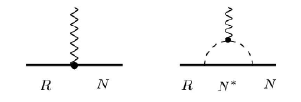
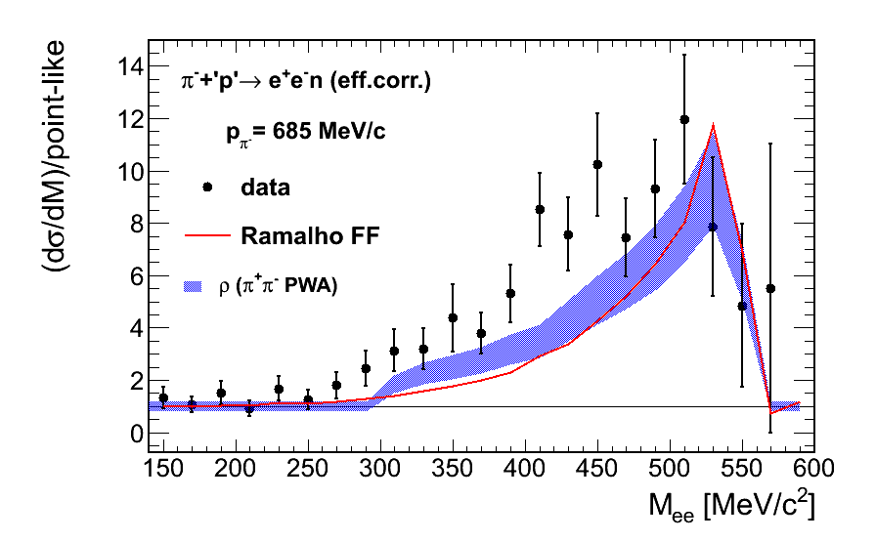
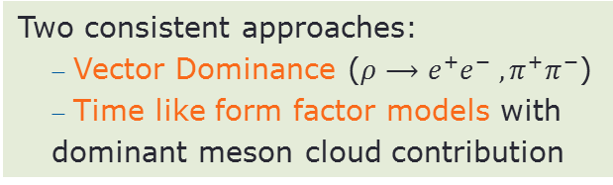
Implementing form factor models
G. Ramalho and M. T. Pena, Phys. Rev. D95, 014003 (2017)
Model for p-N(1520)⁺ time-like form factor updated for n-N(1520)⁰
Quark core contribution :
Quark form factors inspired by VDM
Meson cloud contribution:
Based on pion electromagnetic form factor
Dominant contribution in the time like region
Excess to point-like (dσ/dM)/(point-like)
Parameters of the model fitted to
space-like data (see G. Ramalho’s talk))
preliminary
p_{π}=690 MeV/c
Two consistent approaches:
  Vector Dominance ($ρ⟶e^{+}e^{−} , π^{+}π^{−}$)
  Time like form factor models with
  dominant meson cloud contribution

Slide 20

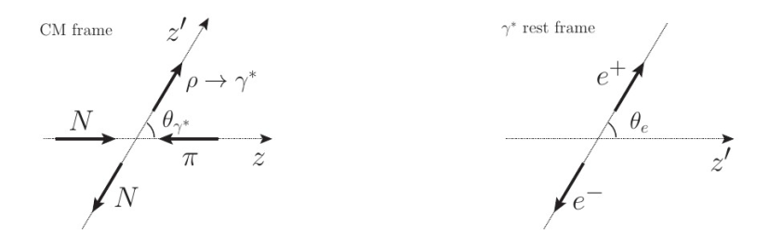

Electron angular distributions: spin density matrix
$\frac{d3σ}{dMeedΩγ∗dΩe}$ ∼ |A|² =
Spin density matrix formalism:
E.Speranza et al. Phys.Lett. B764 (2017) 282-288
A. Sarantsev (ECT* meeting, May2017)
3 independent density matrix elements: ρ_{11 ,} ρ_{10,} ρ₁₋₁ depending on M_{ee} and θ_{γ}
Depend on the spin and parity of the transition
contain information on electromagnetic structure
e.g. pure transverse (E/M): ρ₁₁ =1/2, ρ₁₀ =0
Related to helicity amplitudes or electromagntic form factors

Slide 21
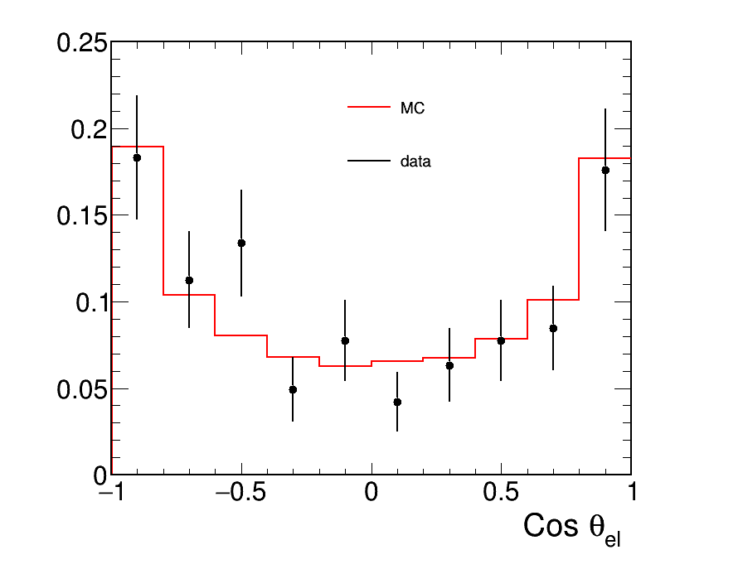
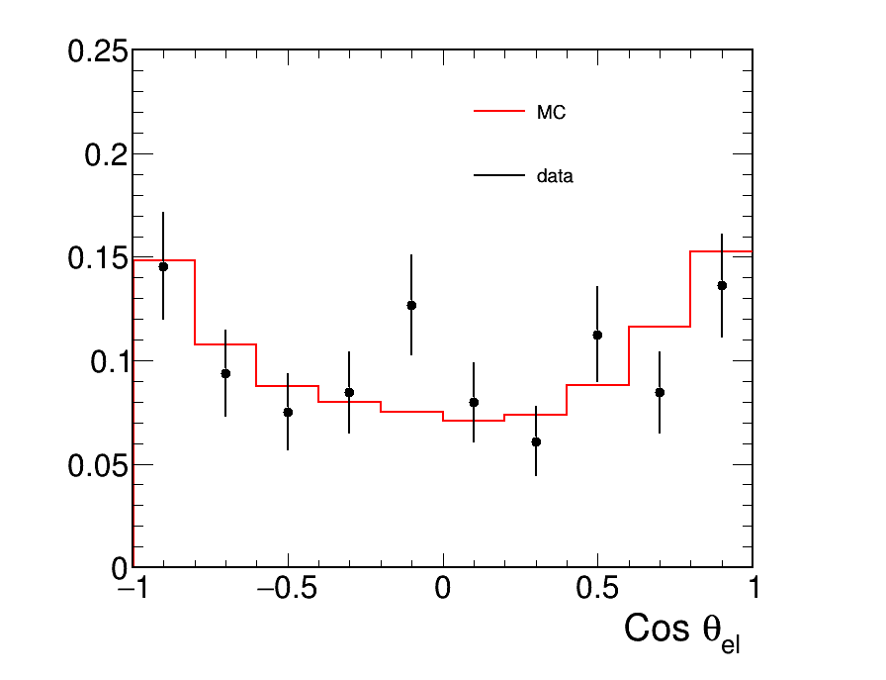
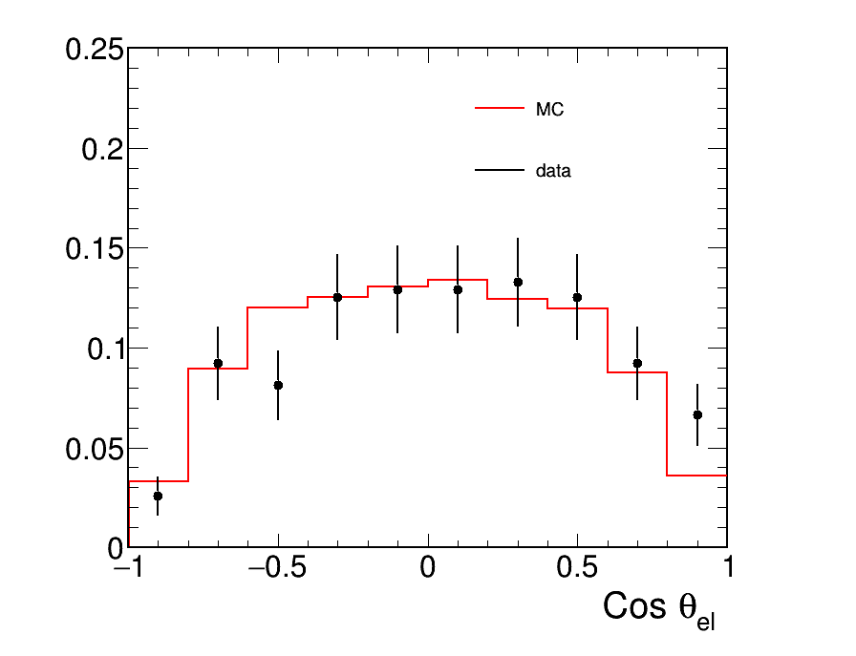

electron angular distributions: fit results in HADES acceptance
Similar procedure as Bonn-Gatchina PWA (collaboration with A. Sarantsev)
Monte Carlo includes acceptance and efficiency of the detector
The estimation of the coefficients is performed via a log-likelihood event-by-event approach
3 bins in cos θ_{γ}
e⁺
Quasi-free exclusive process
π^{-’}p’→ n e⁺e⁻ √s=1.49 GeV/c²
M_{ee} > 300 MeV/c²
ρ
γ∗
e⁻
weighted Monte Carlo events compared to the data
cos θ_{γ} <0.
0.< cos θ_{γ}<0.5
0.5 < cos θ_{γ} < 1.
Data
Monte Carlo
Data
Monte Carlo
Data
Monte Carlo

Slide 22
electron angular distributions:
spin density coefficients
HADES data points:
ρ_{11 ,} ρ_{10,} ρ₁₋₁ extracted for quasi-free π⁻’p’→ne⁺e⁻
in 3 bins in cos θγ
Compared to spin density coefficients
corresponding to VDM form factors
for N(1520) →ne⁺e⁻
E.Speranza et al. Phys.Lett. B764 (2017) 282
D. Nitt’s talk (Wednesday 12, 18:00)
Compared to spin density coefficients
ρ→ππ (Bonn-Gatchina PWA)
preliminary
T
preliminary
T
Dominant e⁺e⁻ production from N(1520) Dalitz decay via an off-shell ρ

Slide 23
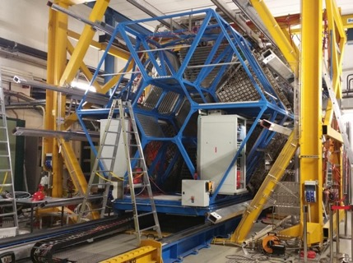
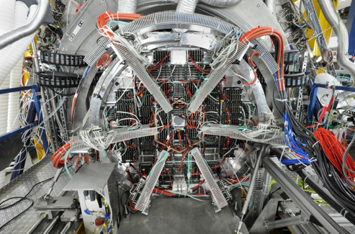
HADES upgrade
New ECAL (lead glass)
ΔE/E ~5%
γ and e⁺/e⁻ detection
used in Au+Au exp. March 2019
New RICH photon detector
& read-out
(coll. with CBM@FAIR)
Gain in e⁺e⁻ efficiency x5
used in Au+Au exp. March 2019
Forward detector (0.5-6.5°)
Straws + RPC TOF
(coll. with PANDA@FAIR))
σ(x)~150 μm σ(TOF)~70 ps
To be installed before end 2019
6/12/2019

Slide 24
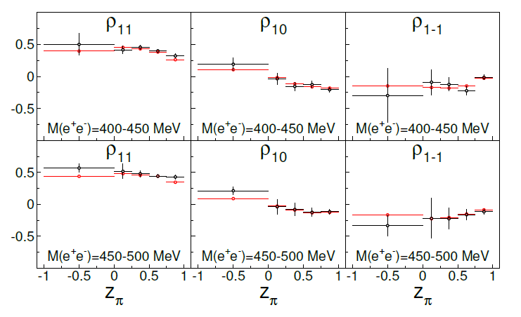
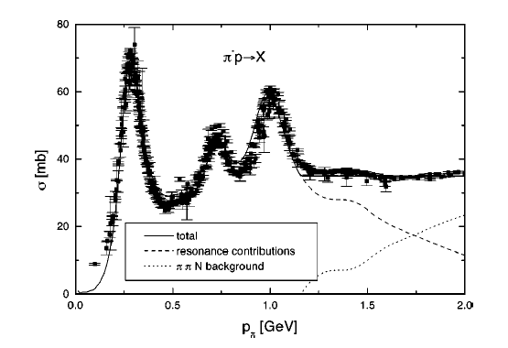
Future plans: third resonance region
Exp. proposal at GSI/SIS18 : explore the third resonance region (√s~1.7 GeV/c²)
channels: π⁻p→ ne⁺e⁻ , π⁻p→ ππN, ωn, ηn , K⁰Λ, KΣ,….+photons
(new electromagnetic calorimeter)
Expected sensitivity with 10⁴ events
η
ω
Cos θ_{γ*} ^{CM}
Possibly after 2019: √s~2 GeV/c² (Λ(1405),…)

Slide 25
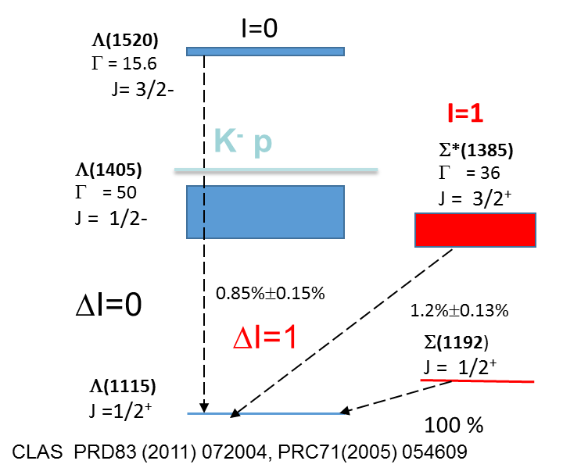
Future plans : hyperon Dalitz decays
Hyperons are narrow (Γ=15-40 MeV) : can be studied in pp, pA with HADES
(and later pp with PANDA at FAIR see K. Schönning’s talk).
Radiative decays of hyperons Y →Λγ
Badly known
High sensitivity to internal structure (quark correlations )
Dalitz decays of hyperons Y →Λ e⁺e⁻ (BR~10⁻⁵)
No measurement.
Relevance of Vector Dominance in the hyperon sector?
-
e.g. Σ*(1385)→Λγ* is anologue of Δ(1232)→Nγ* transition (measured by HADES)
calculations C. Granados et al. Eur. Phys. J.A54(2018)1.
E=4.5 GeV pp→ pp Y Y=Λ(1520), Σ(1385), Λ(1405)
Y→Λe⁺e⁻
Expected count rate 34 hyperon Dalitz decays/day

Slide 26
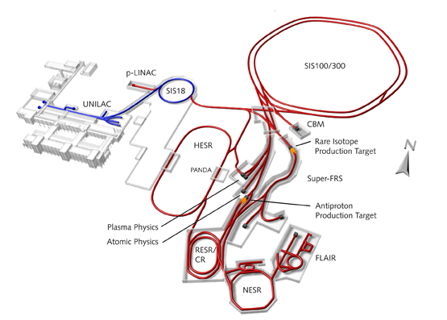
Conclusion and outlook
Pioneering studies for Time-Like electromagnetic baryon transitions in the second resonance region with HADES and GSI pion beam)
e⁺e⁻ invariant mass and e+/e- angular distributions are consistent with
  dominant N(1520) contribution
  Vector Dominance Model
For mid-term future, in parallel to the HADES program on medium effects:
Investigate heavier resonances Δ(1620), N(1720),…in e⁺e⁻ channels and many hadronic channels, e.g. π⁻p→ηn , K⁰Λ, KΣ,….
Electromagnetic decays of hyperons in pp reactions : Y→Λγ, Y→Λe⁺e⁻
Higher acceptance (Forward Detector + Electromagnetic Calorimeter
After 2025: HADES experiments att FAIR
(p and ion beams, possibly pions in future….)

Slide 27
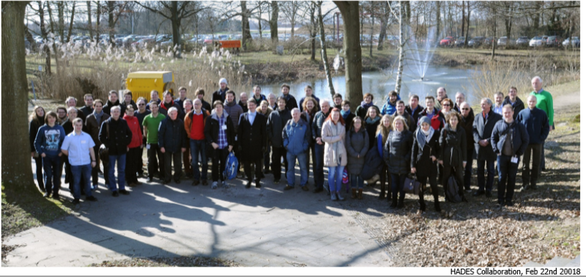
Thank you

Slide 28
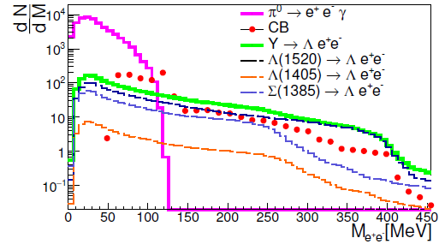
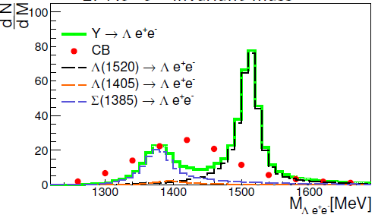
Simulations for hyperon Dalitz decays
E=4.5 GeV pp→ pp Y
Y→Λe⁺e⁻
p+p →K⁺+Λ(1520)+p
|
→ Λ(1115)+γ (0.85%)
Λ(1115)+e⁺e⁻ (8 10⁻⁵)
Beam= 10⁸ p/s
Luminosity= 2 10³¹ cm⁻²s⁻¹
ε=0.5%
Expected count rate 34 hyperon Dalitz decays/day
e⁺e⁻ invariant mass
Λe⁺e⁻ invariant mass

Slide 29
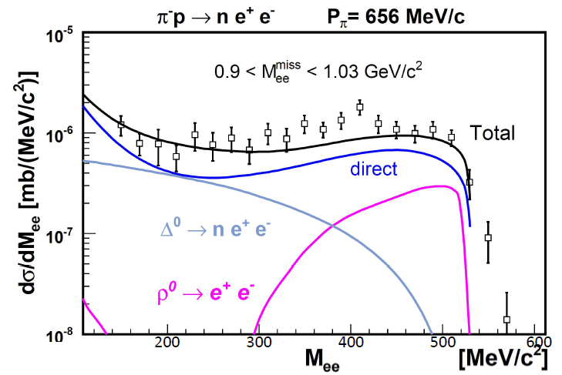
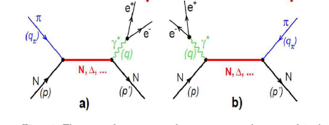


More models
G. Lykasov, A. Malakhov, A. Ierusalimov , JINR Dubna
direct
with monople FFs
ρ

Slide 30





Model predictions for π⁻p→ne⁺e⁻ reaction
Lagrangian model : real γ + VDM coupling
Resonant contributions
Large Born term
Zetenyi and Wolf
Phys. Rev. C 86 (2012) 065209
s channel model based on ρ/ωNN* couplings
B. Kaempfer , A Titov , R.Reznik NPA 721(2003)583
M. Lutz , B. Friman, M. Soyeur NPA 713 (2003) 97–118
Large destructive interference between ρ and ω contributions
$\frac{dσ}{dMee}$ = 0.06 μb/GeV for M_{ee}=0.5 GeV
about 60 times smaller than our measurement

Slide 31

Comparison with GiBUU transport model
strict VDM approach:
R→Nρ→Ne+e- (no 2π mass cut)
Vector Dominance Model
(dσ/dM_{ee})= (dσ/dM_{ππ} )* BR(M_{ee}=M_{ρ}) * (M_{ρ}/M_{ee})³
Too large yield from baryonic contribution at low M_{ee}
Related to known overestimate of radiative decays by the strict VDM model

Slide 32


Time-like form factor models
e-VDM model (ρ,ρ’,ρ’’,…) M. Krivoruchenko, Ann. Phys. 296 (2002) 299
Currently being updated (work in progress) to recent data
- SL transition FF (CLAS)
- ρ/ωNN* couplings (PWA)
Two-component model (real photon +vector meson couplings)
Zetenyi and Wolf, Phys. Rev. C 86 (2012) 065209
constituent quark model
existing for N-Δ(1232)
Wan and Iachello, Int. J. Mod. Physics A20 (2005) 1846,
I. Fröhlich et al., Eur.Phys.J. A45 (2010) 401-411
N-Δ(1232)
Space Like
core
constituent quark-core+ meson cloud
existing for N-Δ(1232) and N-N(1520)
G. Ramalho, T. Pena Phys.Rev. D85 (2012), 113014
G. Ramalho et al., Phys. Rev. D93, 033004 (2016)
G. Ramalho, T. Pena Phys. Rev. D95 (2017), 014003
Time Like
core

