Slide 1
Requirements for Bi-Volt & Tri-Volt project
S. Uznanski, B. Todd

Slide 2



Current installation
EPC Item / type | Location | TID [Gy] | SEE XS [cm²] | DD [/cm2] | Cost [/unit] | Design/ Production
Tri-Volt HCRFBUB | RR/UA-UJ 740x* | 200 | <5E-13 | >1E12 | 800CHF** | 2019-2020 LS2+
Bi-Volt HCRFBVB | RR/UA-UJ 490x* | 200 | <5E-12 | >1E12 | 833CHF** | 2019-2020 LS2+
Fan-Tray | RR/UA-UJ 200x* | 200 | <5E-12 | >1E12 | ? | 2019-2020 LS2+
* Numbers not accounting for units for HL-LHC120A and HL-LHC60A
** Price estimation based on 25 unit cost

Slide 3
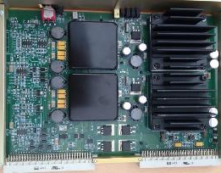
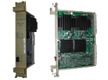
Current design
Approaching end of life, developed in 2003
Tri-, Bi-Volt and Fan-Tray used in RR locations as well as UA/UJ
Radiation tests have showed a certain rad-tolerance but insufficient for HL-LHC (25-50Gy)

Slide 4
Rad-test campaigns
DC-DC module tested at CNGS in 2009: EDMS 1053817
Bi-Volt/Tri-Volt PSUs tested at CHATM in 2017: EDMS 1933100

Slide 5
Requirements for the new design
Input 48V, Output 5V, ±15V, ~100W
Plug-in compatible with the current designs: 6U, same form factor.
Rad-Tol design with TID lifetime of 200Gy and SEL-free
Possible to manufacture for the next 8 years (LS3)
Pre-series produced & tested by Q4’2020

Slide 6
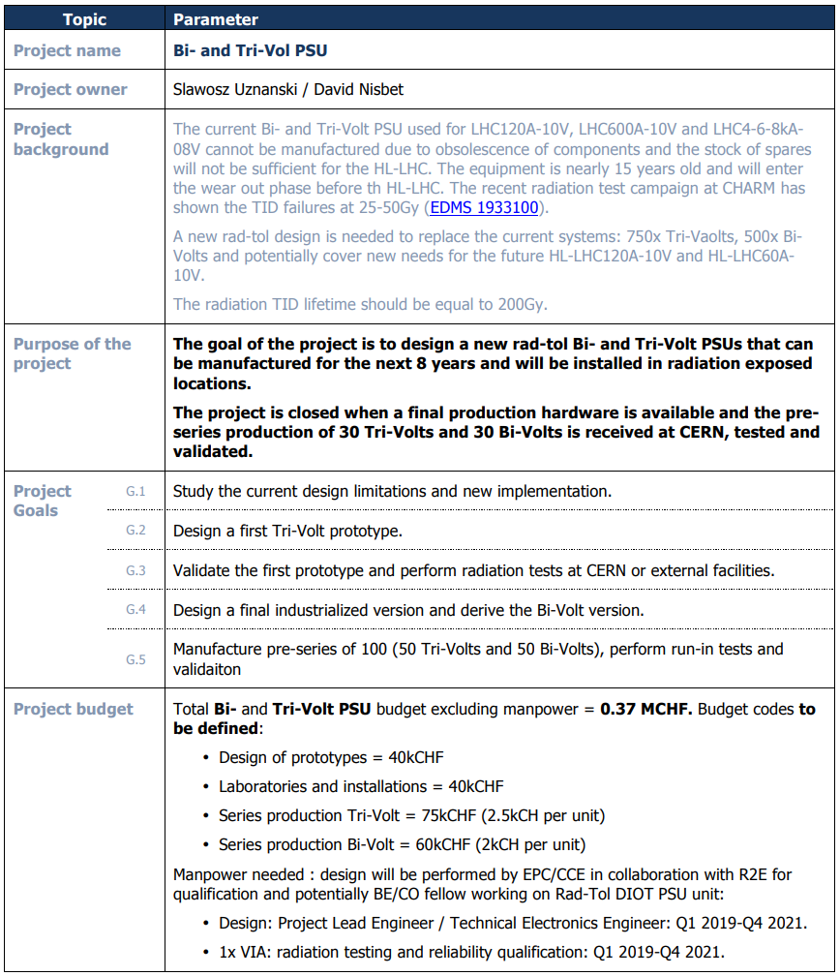
Project mandate: EDMS 1850550

Slide 7
Project mandate: EDMS 1850550

Slide 8
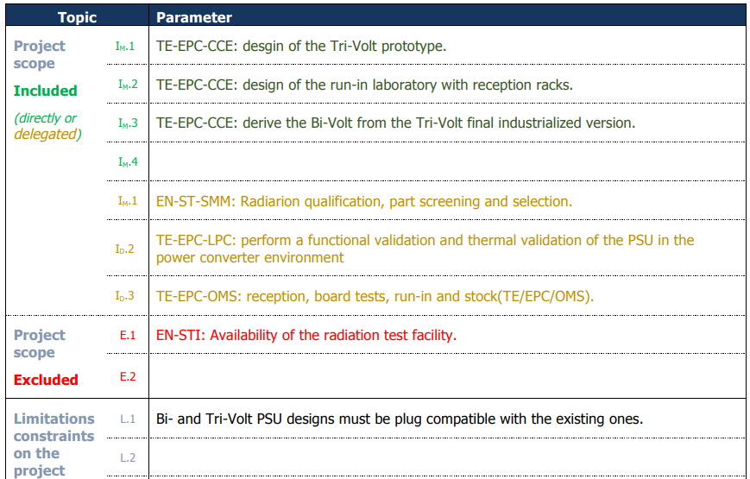
Project mandate: EDMS 1850550

