Slide 1
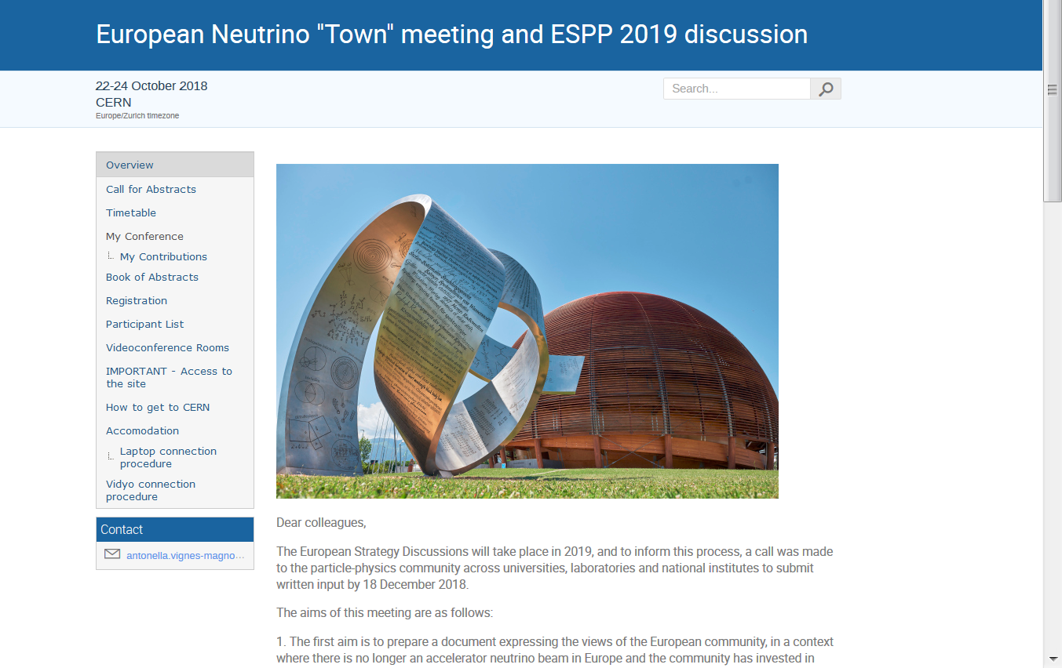
Welcome to the
131 participants
at 10:00 on monday
https://indico.cern.ch/event/740296/

Slide 2
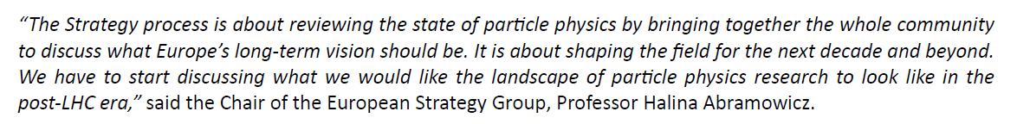
The European Strategy Discussions will take place in 2019,
(see next pages for more info, links etc…)
-- deadline for written contributions (10 pages) 18 December 2018
-- open Scientific Open Symposium in Granada, Spain, 13 to 16 May 2019,
-- final writing (by strategy group) : Bad Honnef, Germany, 20 to 24 January 2020.
to inform this process, a call was made to the particle-physics community across universities, laboratories and national institutes to submit written input by 18 December 2018.
We propose to organize a contribution by the European Neutrino community,
“town” meeting 22-24 October 2018 at CERN
-- open to the European neutrino community
-- and others, especially if they carry out experiments at CERN.

Slide 3
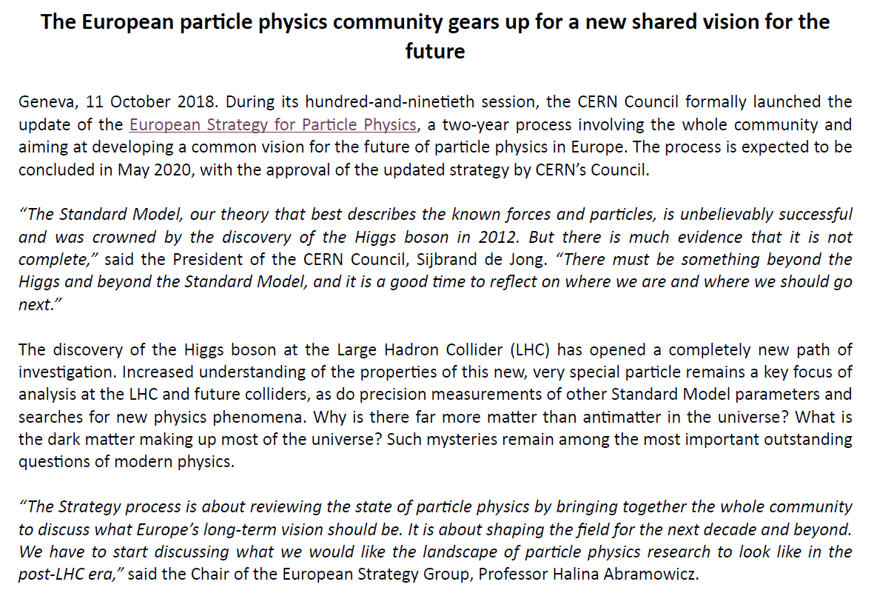

Slide 4
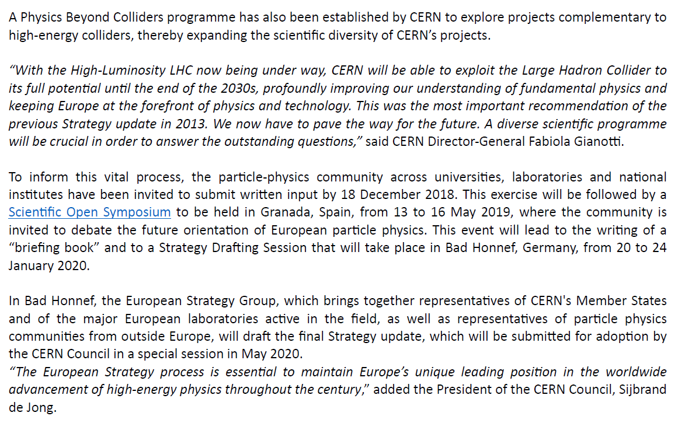

Slide 5
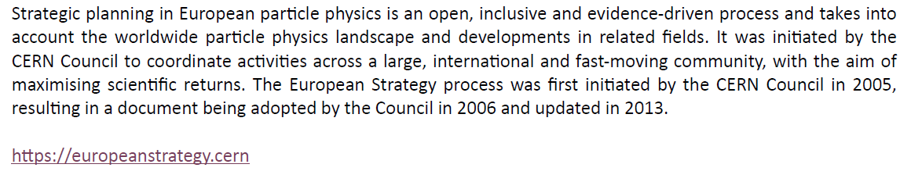

Slide 6
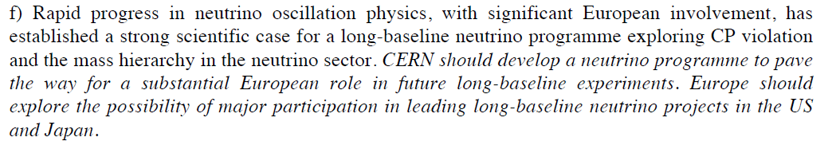
Goals of the meeting
The aims are as follows:
1. The first aim is to prepare a document expressing the views of the European community, in a context where there is no longer an accelerator neutrino beam in Europe and the community has invested in projects in China, Japan and the USA.
2013 Strategy:
2. The document should take stock of the properties of the "present" LBL program
(T2K+SK+NOvA, JUNO, T2K upgrade, HyperK and DUNE) in physics terms,
identifying and quantifying who measures what and how well, and what is the complementarity in quantitative and qualitative terms and under which time scale.

Slide 7
3. It should also address the status and possible future of the short baseline neutrino experiments in search for ‘sterile neutrinos’ and ‘anomalies’.
4. Address possible contributions or support of CERN to this program and discuss the best possible investment based the above physics considerations.
5. address the question of the future of the field
-- with neutrinos beams to complete the present LBL program
-- includes HP-TPC, nustorm, moment, P2O and R&D on supplementary detector methods
-- searches for ‘sterile/Right-handed neutrinos’ with the existing or foreseen neutrino near detectors as well as with beam dump experiments such as SHIP, and at high energy (LHC, Future Colliders)
-- neutrinoless double beta decay experiments
to this effect
1. we have invited a number of speakers to cover the issues
2. we have created preparatory panels:

Slide 8
‘Hot’ events:
-- 10 minute ‘hot news’ Monday 17:50
on activities of CERN’s neutrino platform
(we must walk to CERN main building before 19:00)
-- 10 minute ‘hot news’ on Tuesday 12:30
Hiroaki Aihara: 2020 start of construction of HyperK
ideally one would want many others, but this small number is requested
by Freddy for good discussion

Slide 9
Round table discussion
participants:
Masayuki Nakahata
(Nigel Lockyer, remote),
Marzio Nessi,
Peter Shanahan,
Dave Wark,
Christian Weinheimer
Tuesday 17:15-18:45
Main purpose of this round table is to provoke questions from the participants and
ask them questions in view of the final discussion, that takes place the next day.

Slide 10
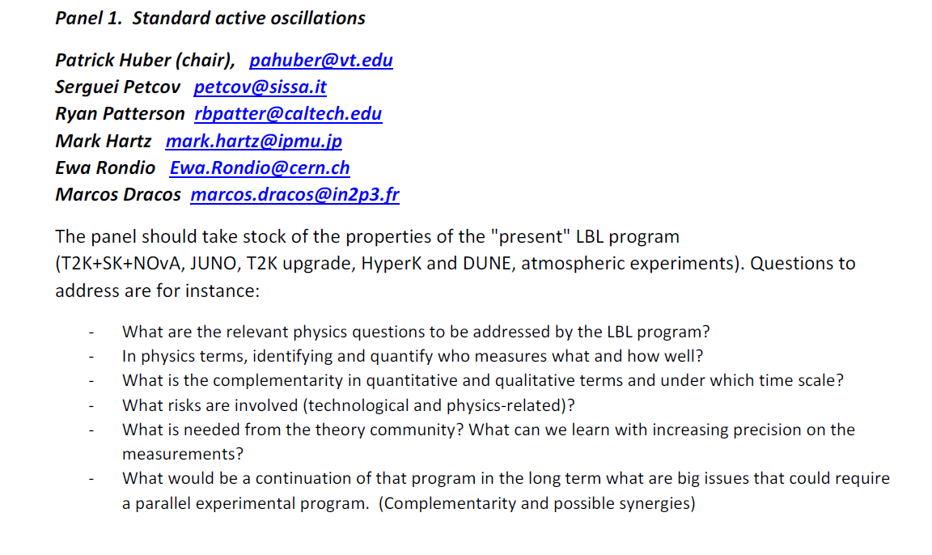
First draft was delivered – many comments and questions

Slide 11
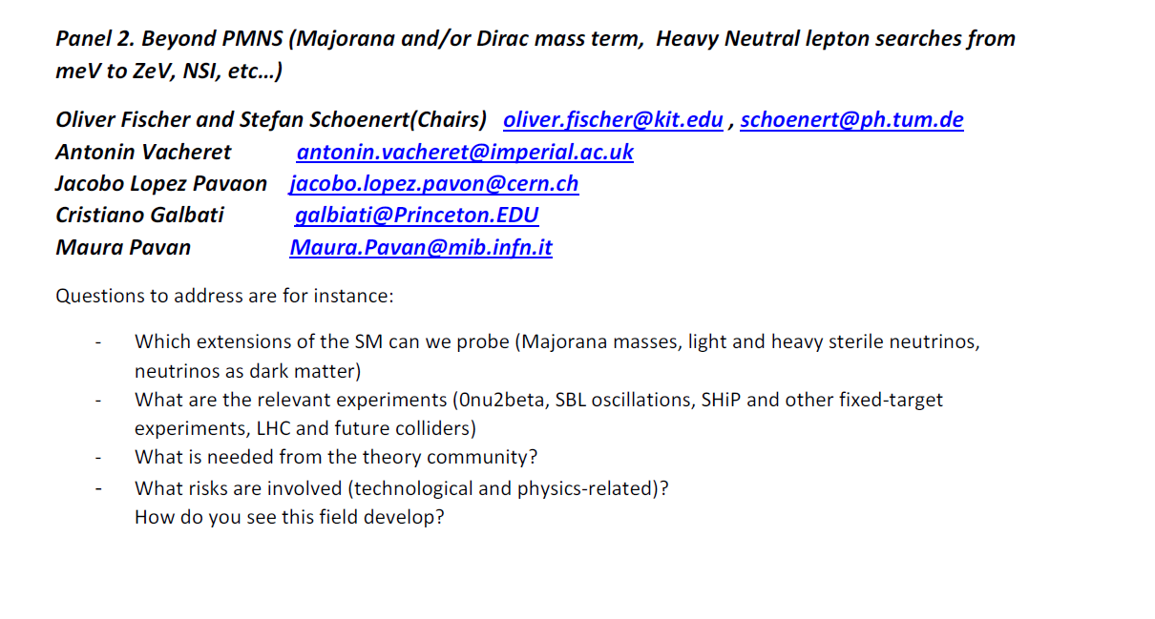
First draft was delivered – a few comments and questions

Slide 12
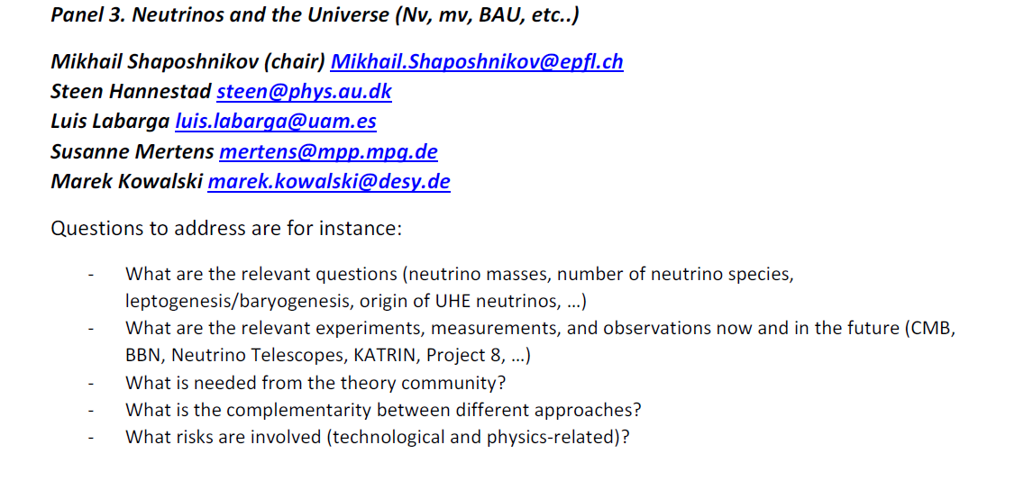
First draft was delivered – minor comments and suggestions

Slide 13
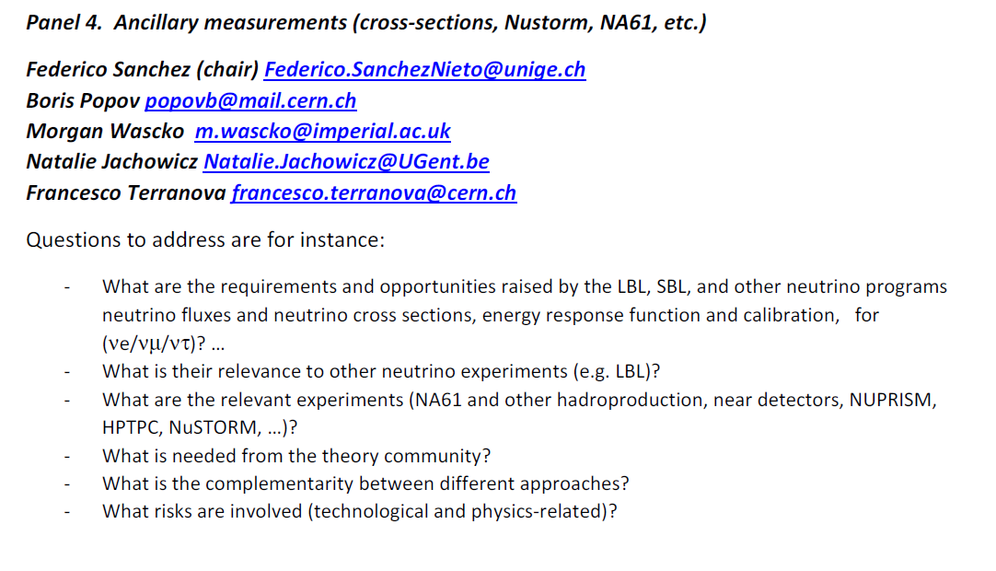
Panel report being completed

Slide 14
Presentation of panel reports
Wednesday 24 October afternoon + discusssion
preparation of ESPP contribution:
Albert de Roeck, Joachim Kopp and AB
+ 1 member of each panel
will edit the final 10 pages document and distribute soon after meeting.
(goal is first week of November) to all meeting participants
(who can distribute draft more widely)
for comments two weeks later.

Slide 15
Practical informations
welcome drink + poster session : tonight Monday at 19:00 in CERN pas perdus (same place as registration this morning)
Group photo tomorrow after lunch (make yourselves beautiful ☺)
Meeting Dinner Tomorrow night starting at 19:00
for those that have purchased a ticket. They need to bring the ticket with them
WARNING: Easy access gates to CERN close at 19:00
➔ everybody should move over to CERN before that time (session chairs be aware!)
otherwise only entrance B wil be open for those that do not have an electronic access card (➔ more difficult, lines etc…)

Slide 16
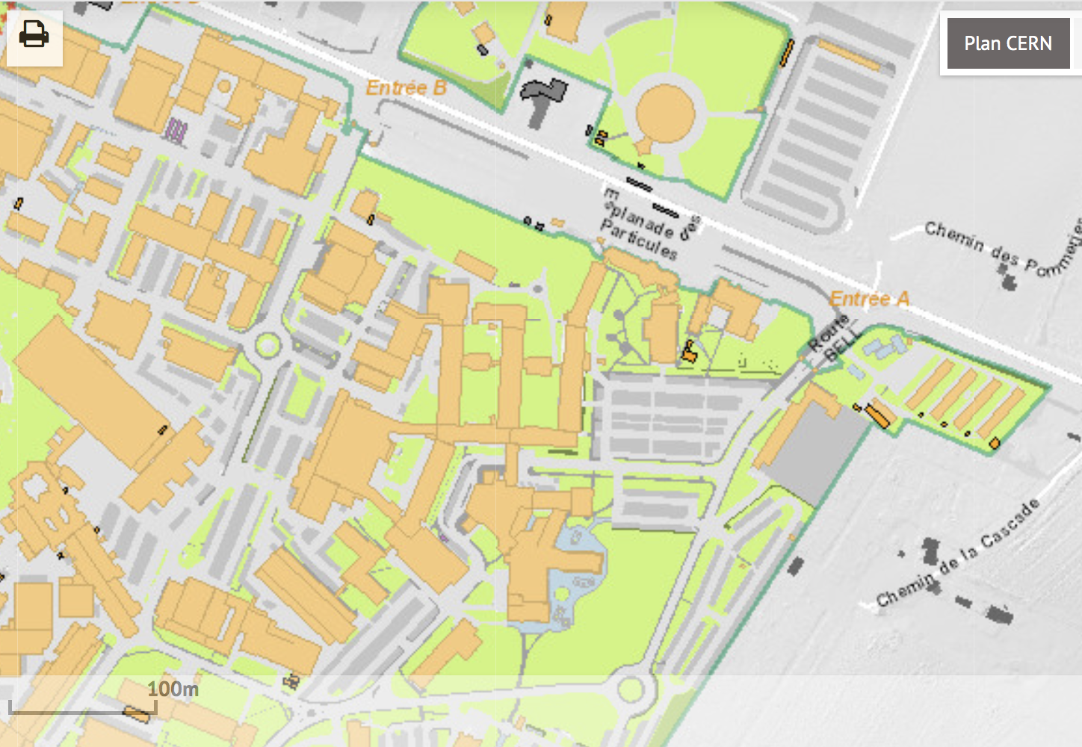
France, Jura
Entry to CERN
24:00 hrs
Meeting Venue
Entry to CERN
till 19:00
Entry to CERN
till 17:45
Entry to CERN
till 19:00
Switzerland
Alps
Registration Monday Morning
Welcome drink & posters
Meeting dinner

