Slide 1
UNDERSTANDING OUTGASSING TEST EQUIPMENT
Presentation 2
Lexxi Reddington
Lexxi Reddington

Slide 2
GEM LAB
PURPOSE
Quality control of GEM detectors
Importance of work
Performance sustainability
MY project
Operate outgassing tests to validate materials used in GEM detectors

Slide 3
Determine the particle count from a radiation source as a function of varying voltage
Training and Preparation

Slide 4
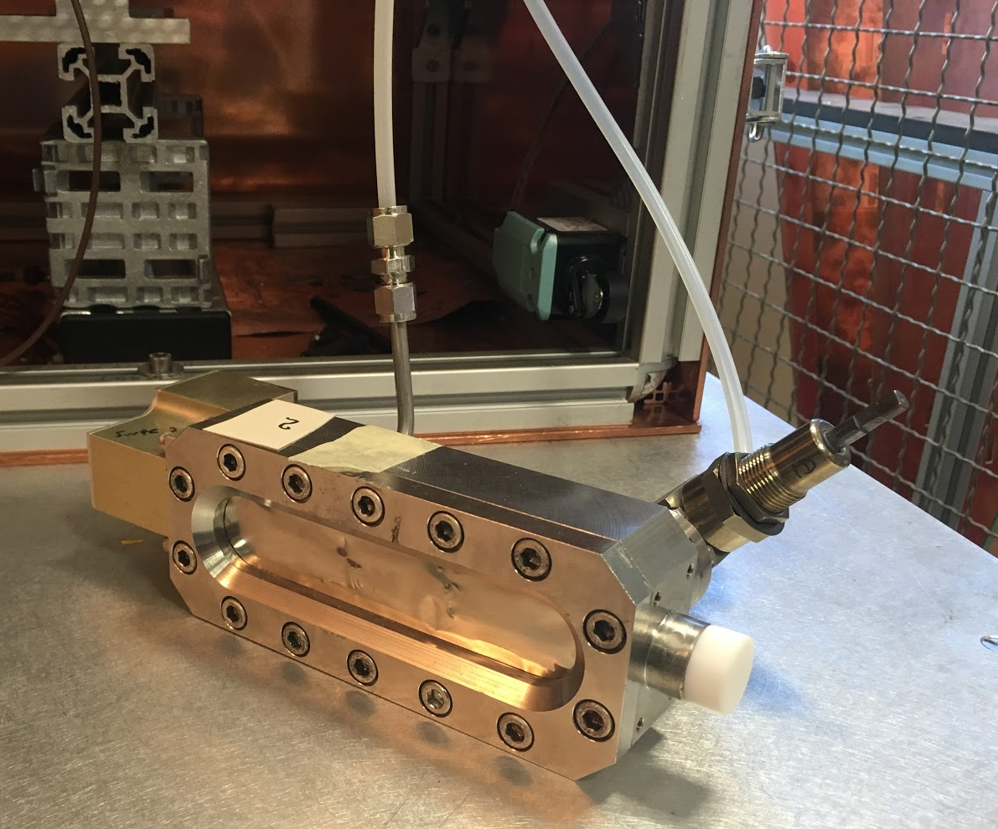
Single Wire Chamber

Slide 5


Slide 6
Threshold

Slide 7
Variations
Changing the radiation source
(X-ray, cadmium, iron, americium)
Increasing the attenuation of the signal
Changing the threshold value
(30 mV, 60 mV, 90 mV)

Slide 8
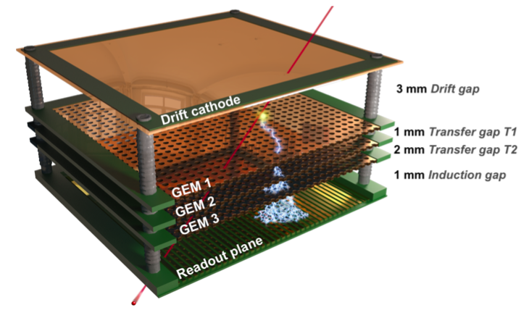

Slide 9
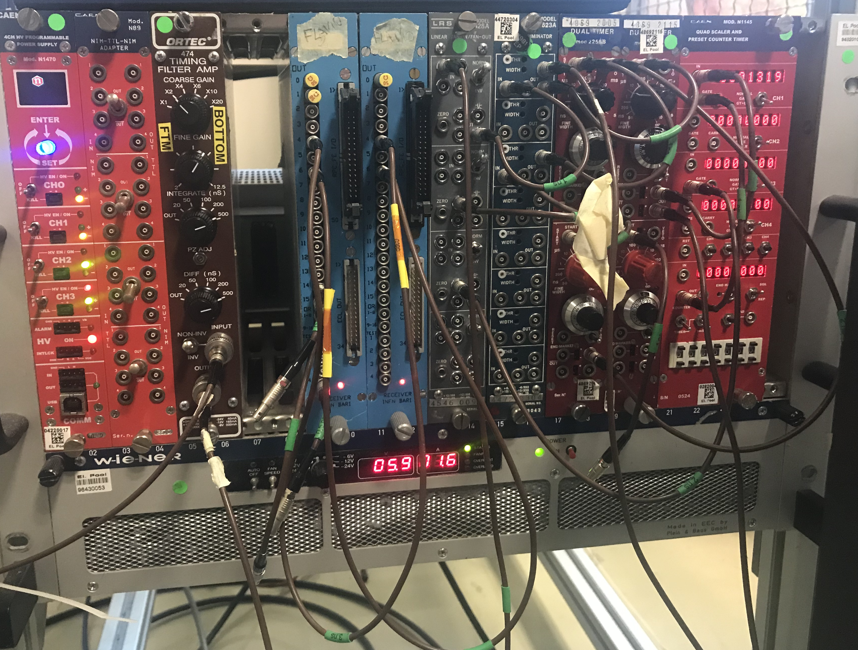
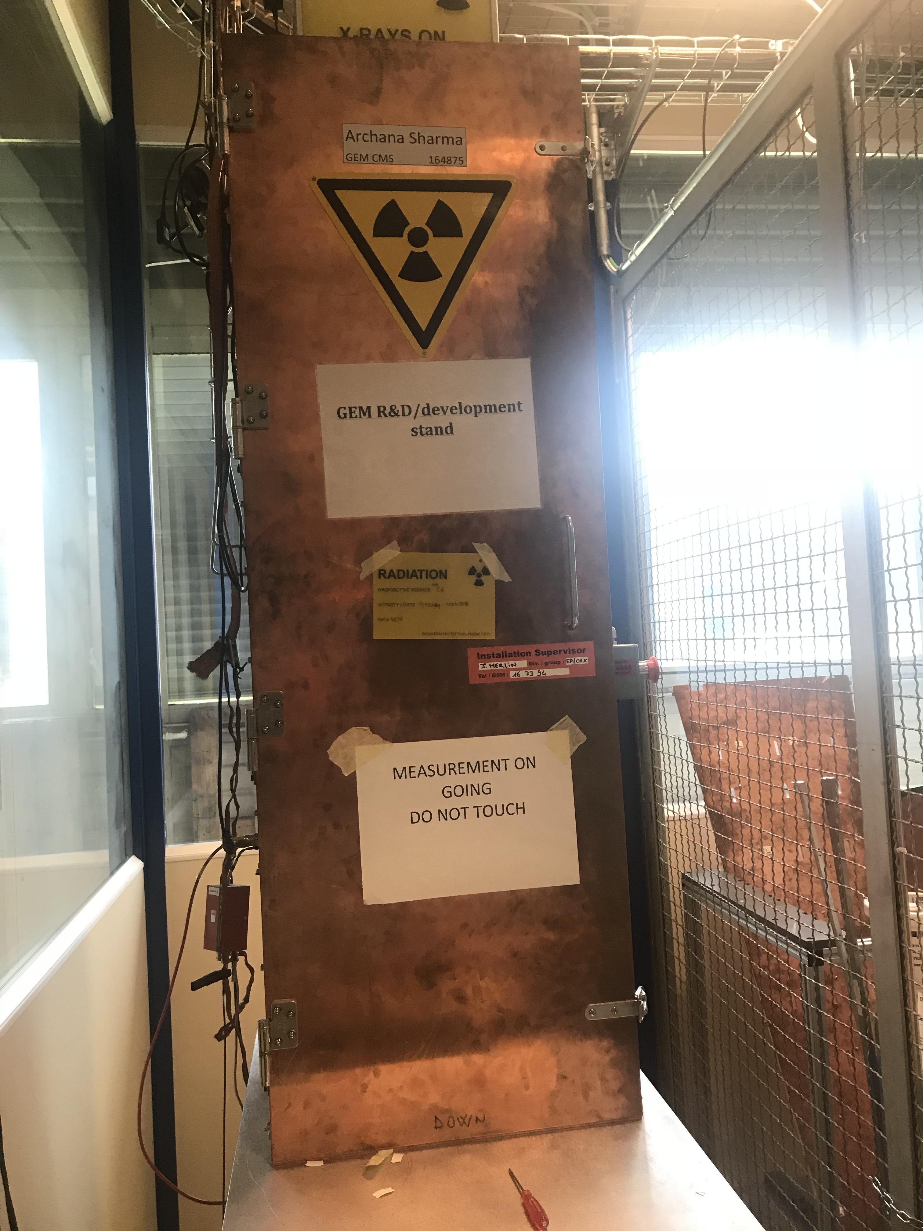

Slide 10
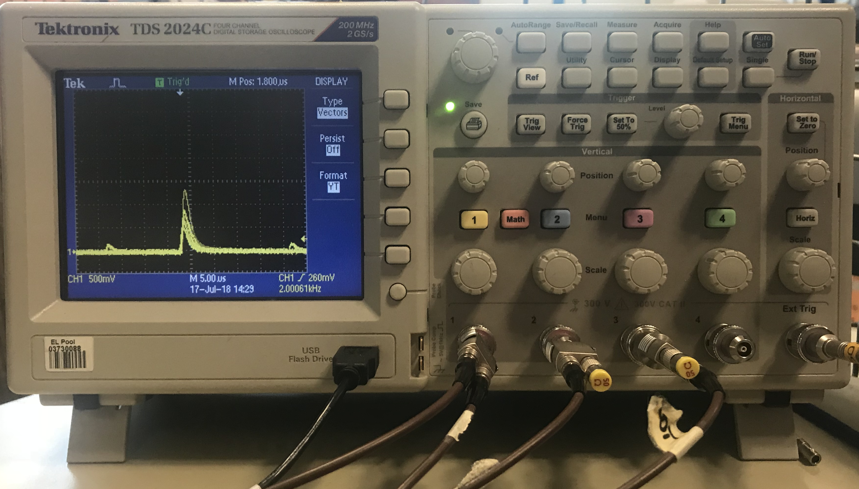
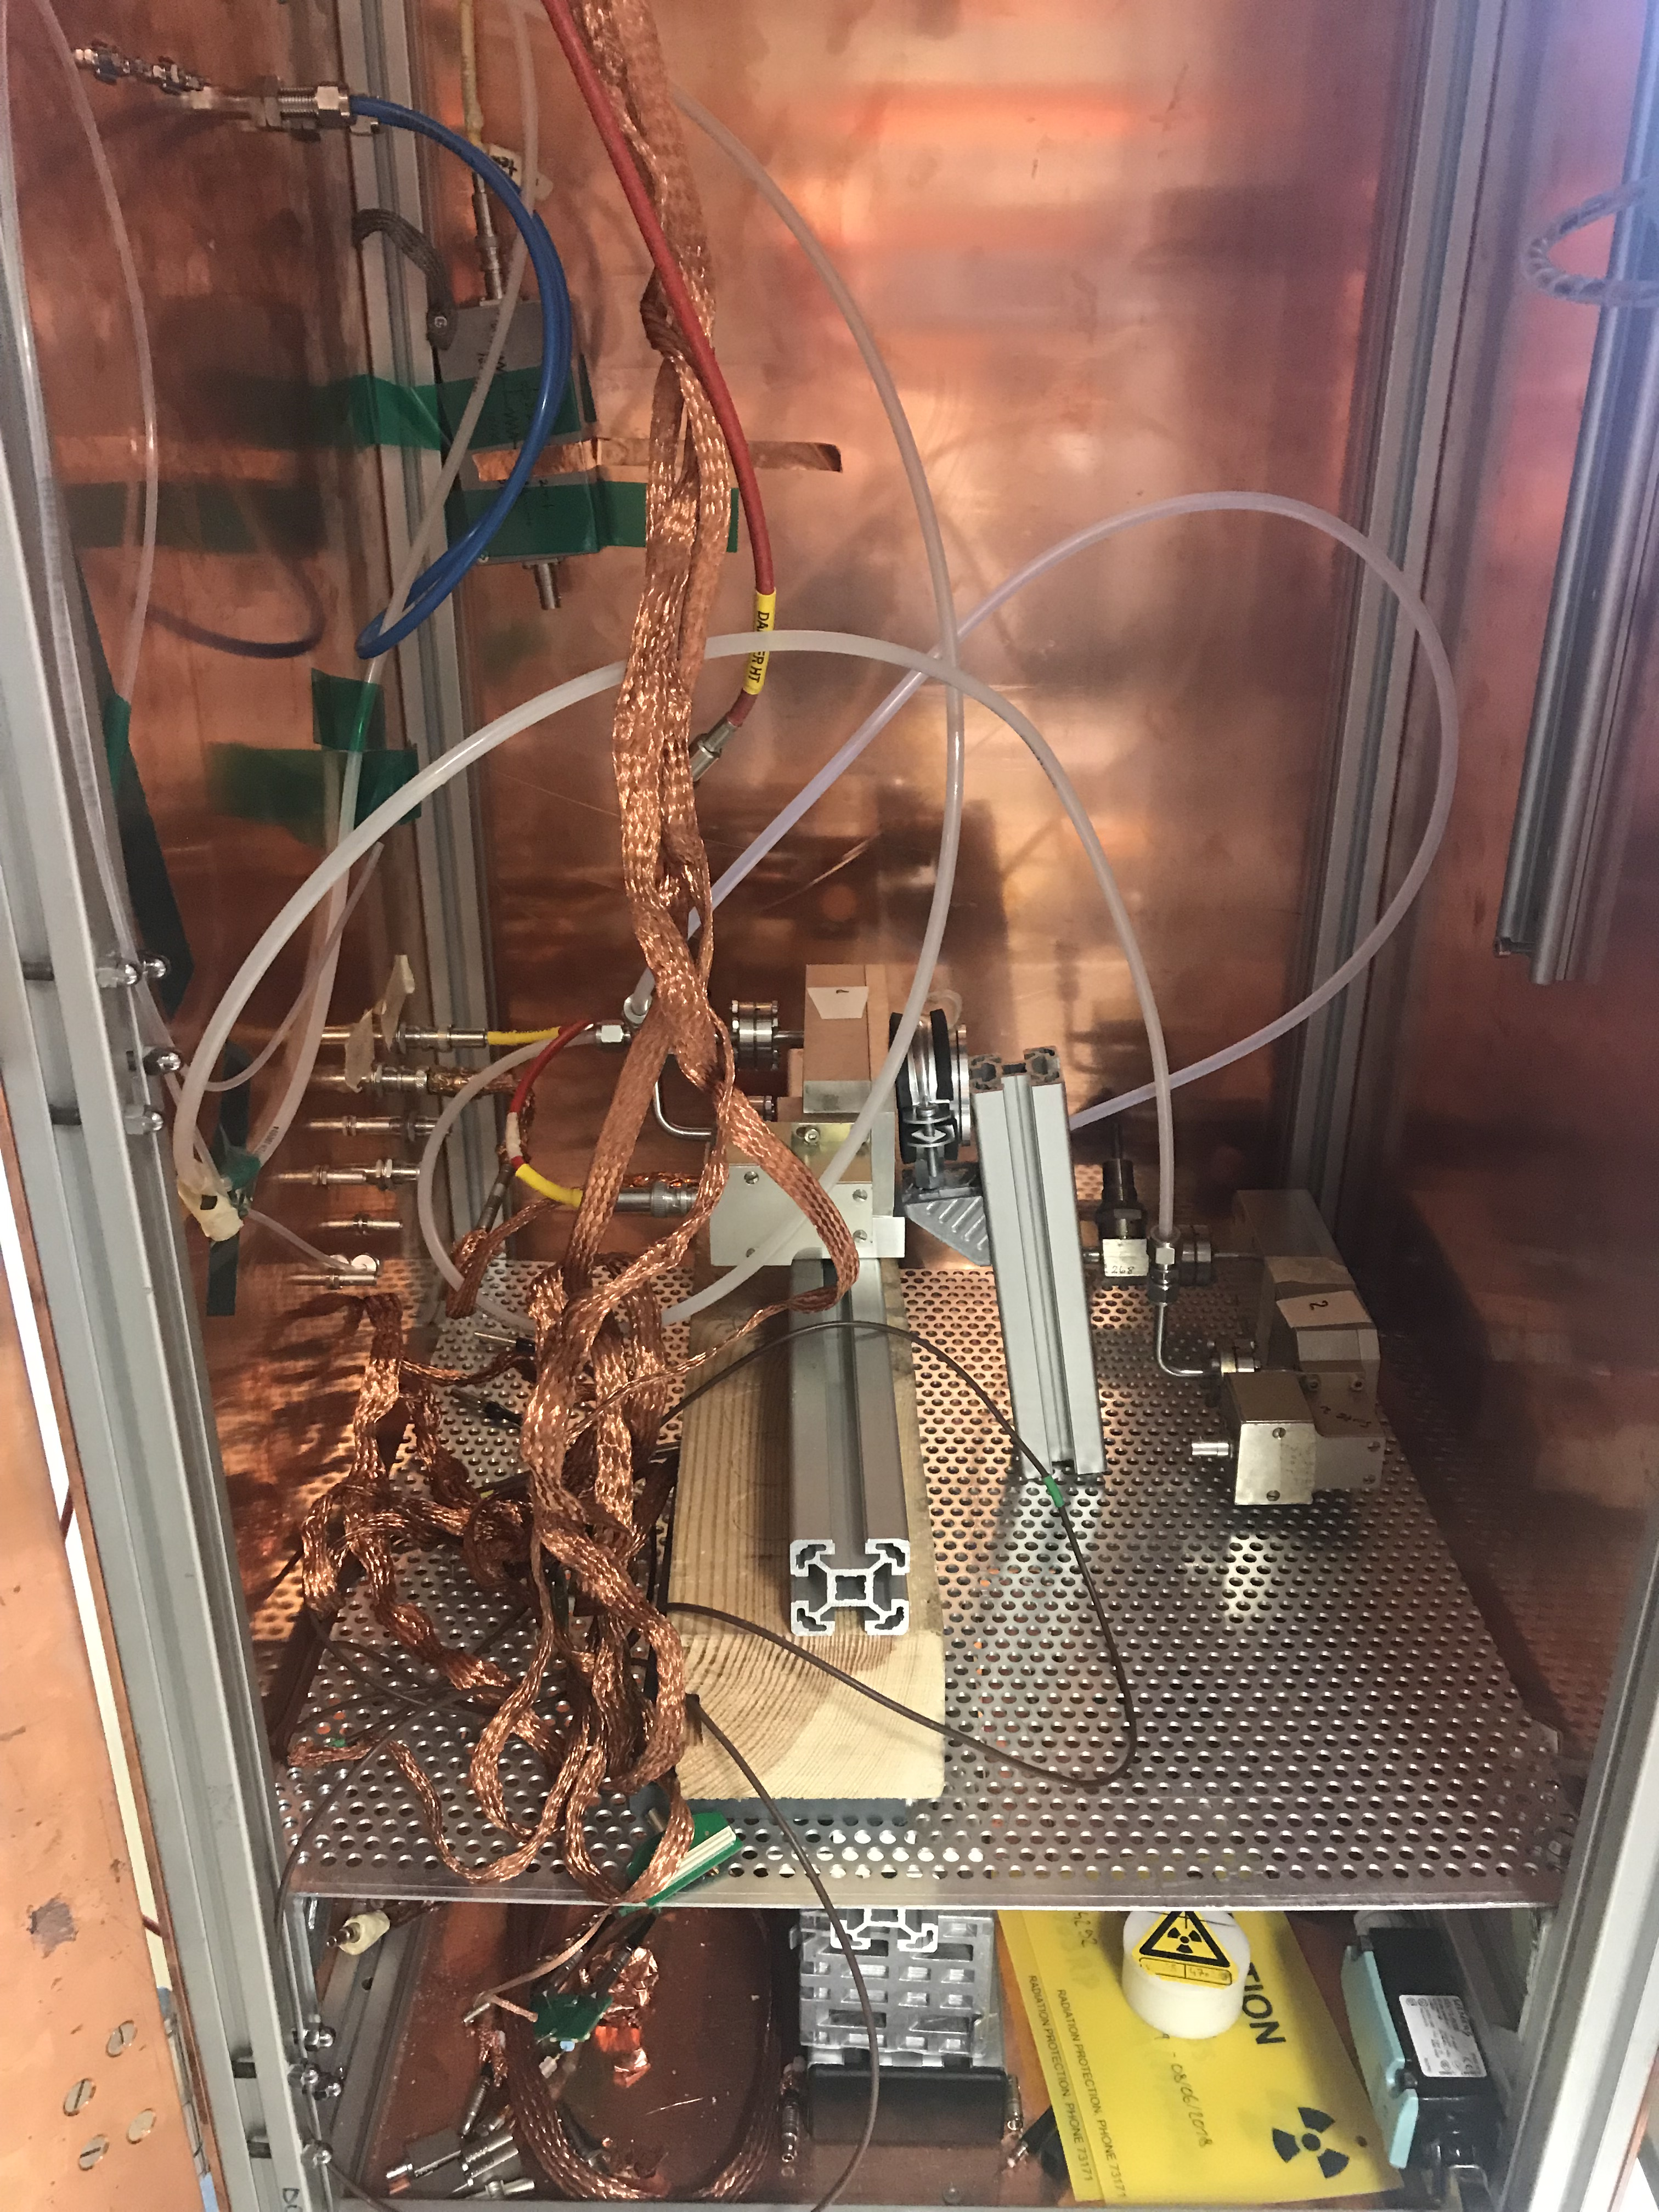
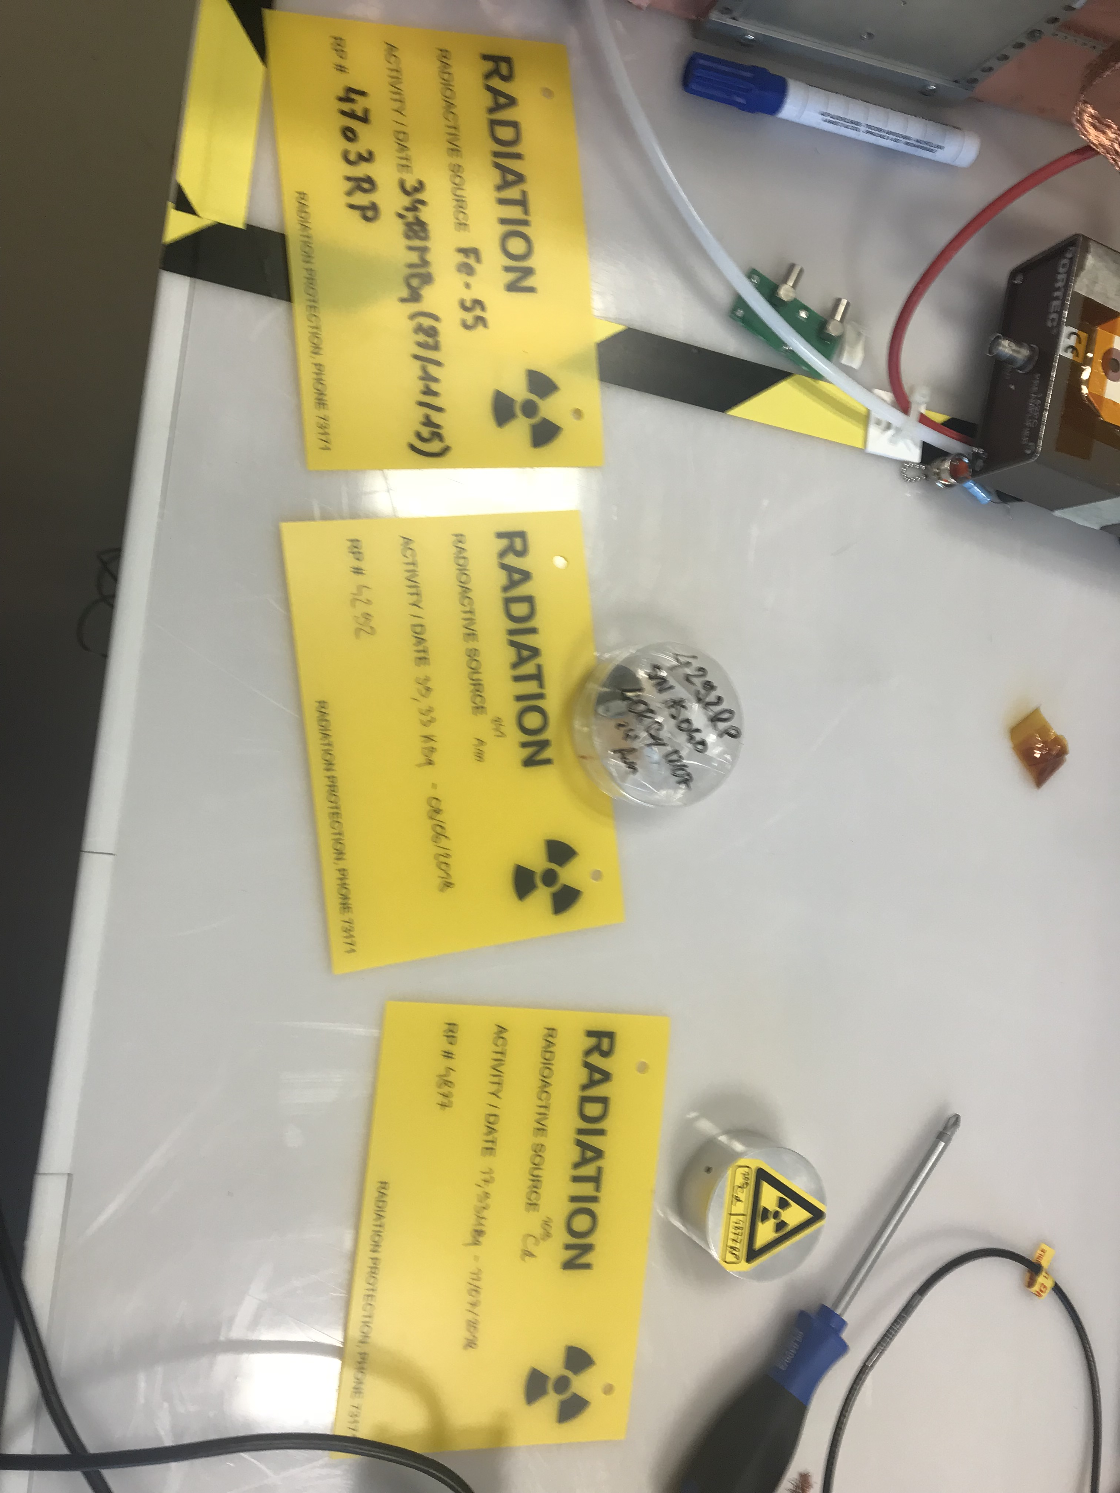

Slide 11
Thank you!

