Slide 1

Knowledge & Technology
Transfer at CERN
Nick.Ziogas@cern.ch
Knowledge Transfer Group
2017

Slide 2
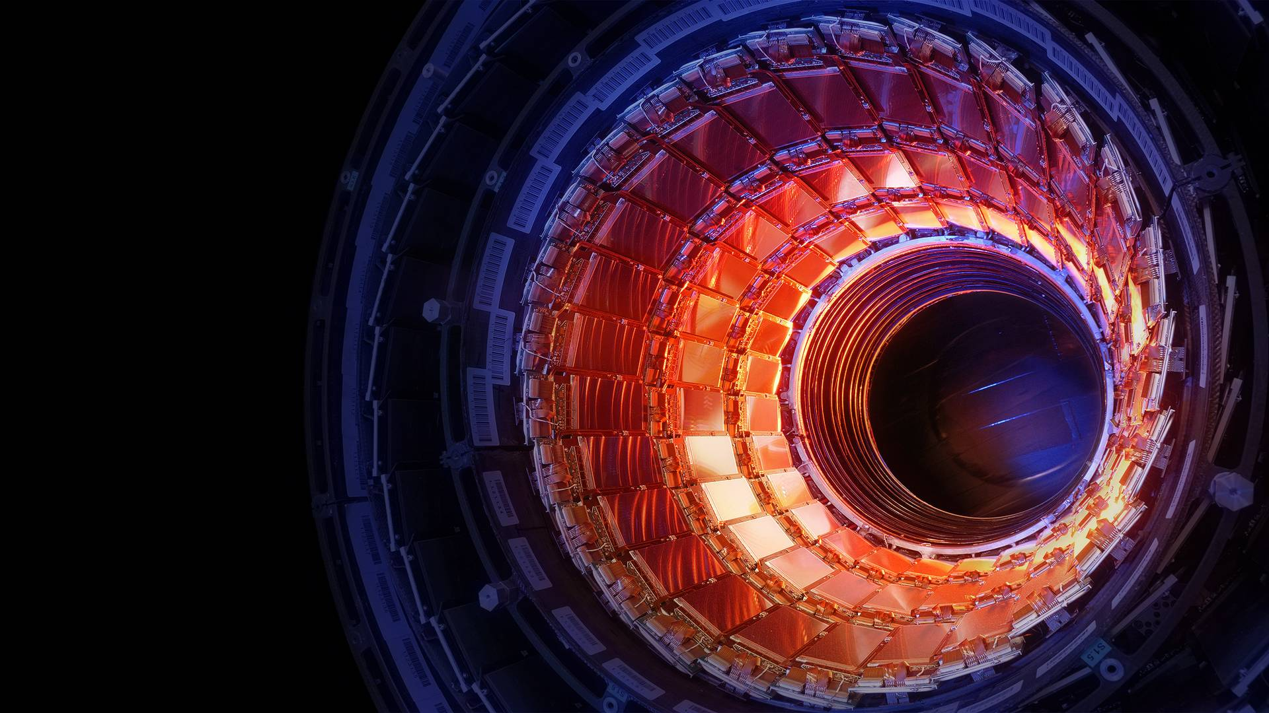
SCIENCE
TECHNOLOGY
TRAINING
COOPERATION

Slide 3
Knowledge Transfer: Mission
Maximize the technological and knowledge return to society, in particular through Member States industry;
Promote CERN’s image as a centre of excellence for technology and innovation;
Demonstrate the importance and impact of fundamental research investments;
Key words: dissemination and impact

Slide 4
KT Strategy
Engage with the outside world (in particular Member States industry, institutes and KT representatives) to disseminate and maximize the impact of CERN’s knowledge on society;
Promote to CERN’s researchers the benefits of KT for the Organisation, identify new opportunities and provide a high quality timely service;
Communicate on CERN’s KT activities to key stakeholders (in particular to decision makers in CERN’s Member States).

Slide 5
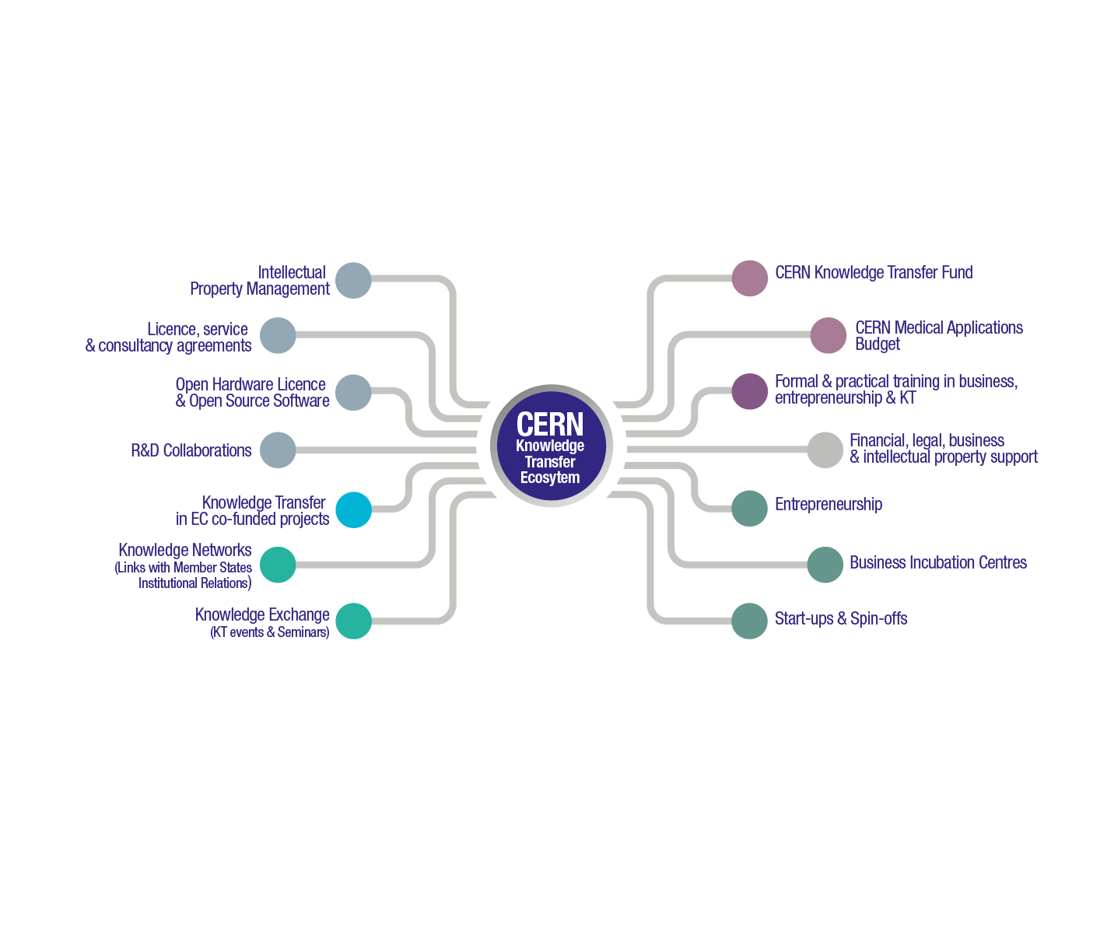
Building an Ecosystem

Slide 6
Medical Applications
Strategy and Framework Applicable to Knowledge Transfer by CERN for the Benefit of Medical Applications
Approved by the CERN Council in June 2017
https://cds.cern.ch/record/2271003
First KT Forum dedicated to Medical Applications held on 30 November 2017

Slide 7
Strategy
Focus on R&D projects, using technologies and infrastructures that are uniquely available at CERN
- minimise duplication of R&D efforts taking place in CERN’s MS
- avoid overlap with the activities of external service providers
Identify the most promising CERN technologies and infrastructures – accelerators, detectors, and computing.
Match with the requirements of the medical research communities, in particular in CERN’s Member States

Slide 8
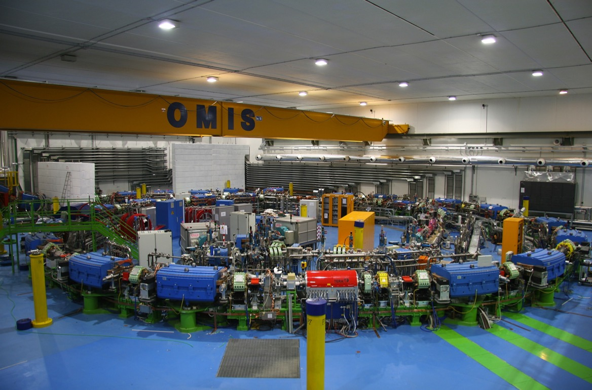
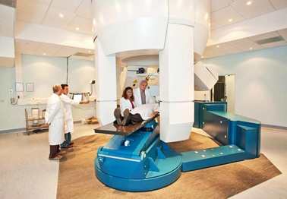

Slide 9
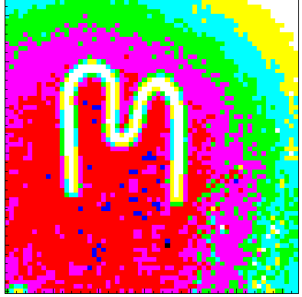
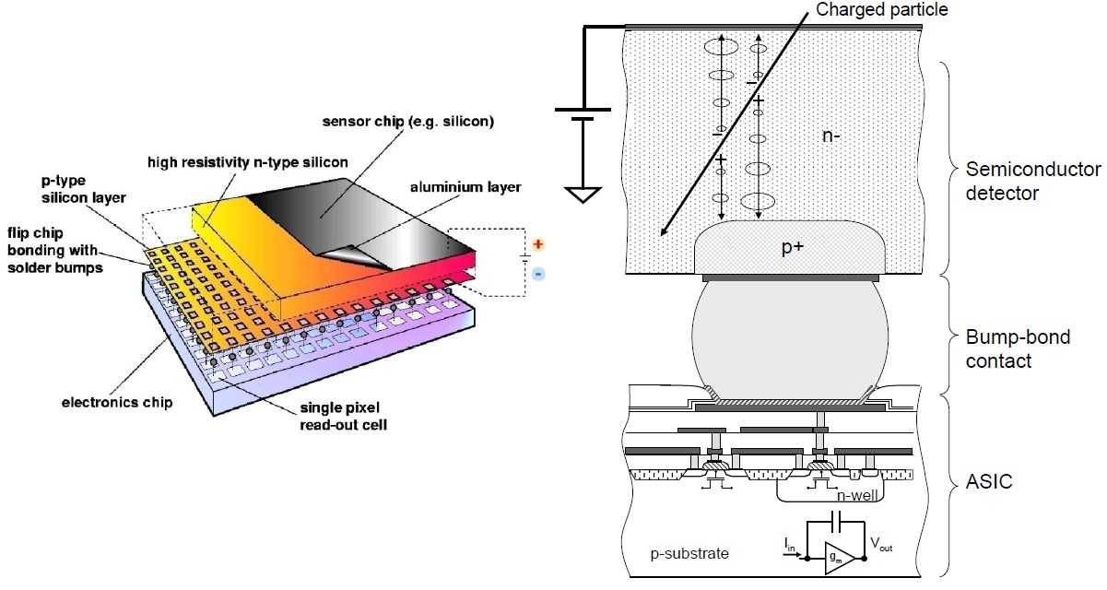
Medipix

Slide 10
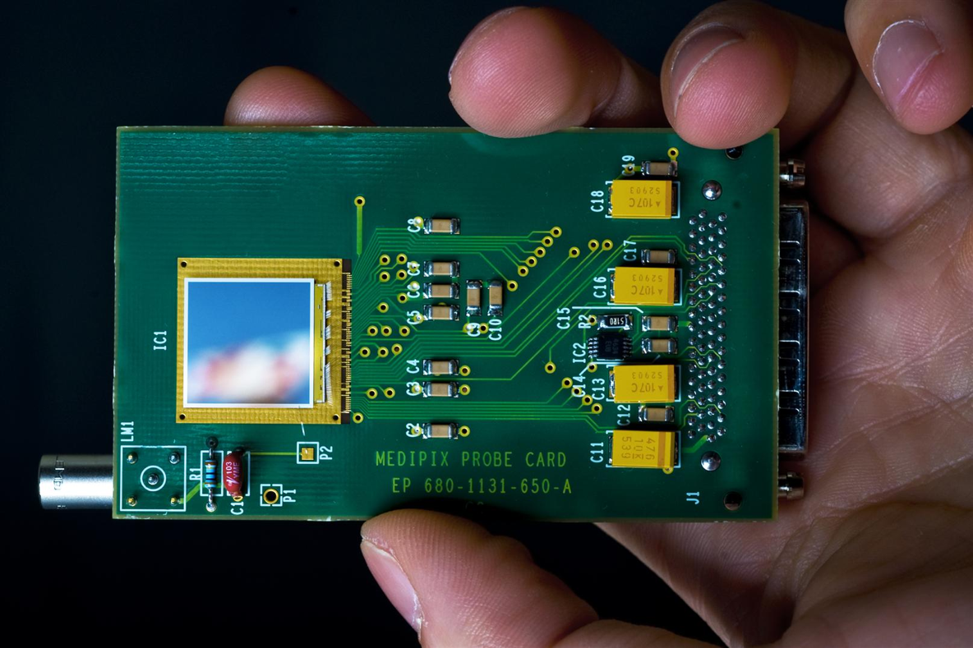

Slide 11
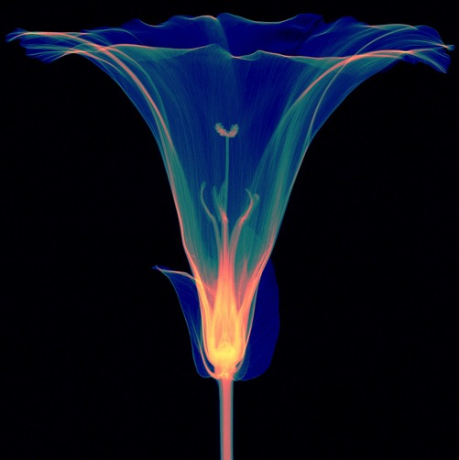
Credit: Simon Procz

Slide 12
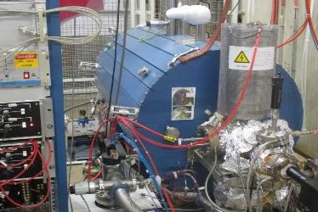
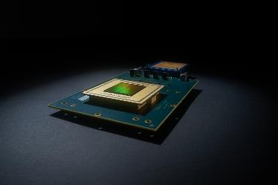
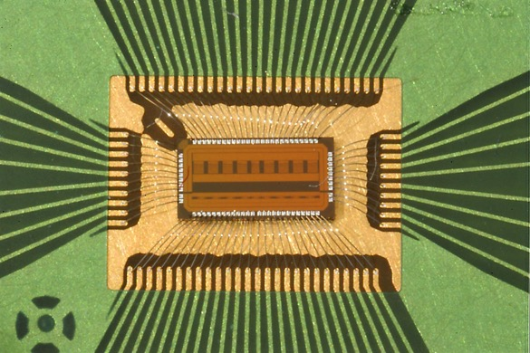
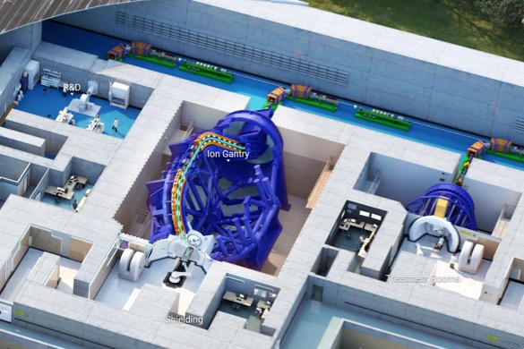
Medical & Biomedical Applications
GEMPix: Large area project approved
MEDeGUN: Project finished
NINO: 2 Licences granted for TOF-PET
“New NINO” project kicked off
Toroidal Gantry: Project approved

Slide 13
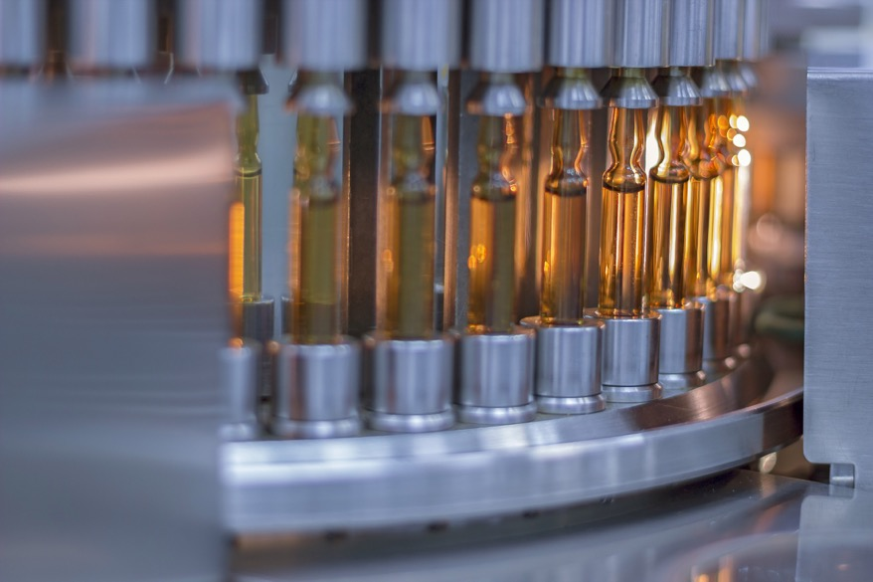
Medical & Biomedical Applications
CERN & Sanofi:
"How can machine learning improve vaccine production?"

Slide 14
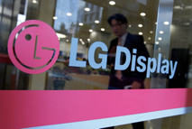
CERN’s controls middleware software for worldwide factory automation.

Slide 15
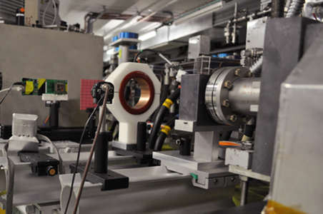
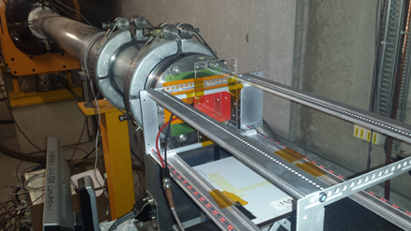
Aerospace Applications – testing facilities
2017 Tests in CERN facilities:
High energy electrons in VESPER for ESA JUICE mission
Mixed-field in CHARM for CNES EyeSat nanosatellite
Heavy ions in SPS North Area for high penetration tests on components for telecommunication and exploration space missions (tests performed in collaboration with TRAD and IROC companies)

Slide 16
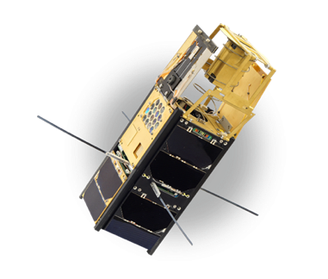
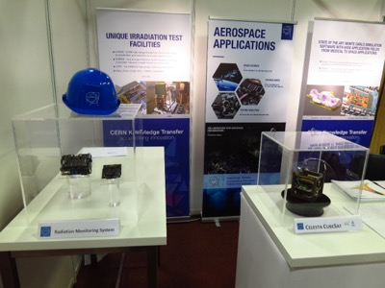
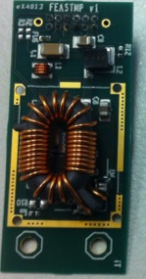
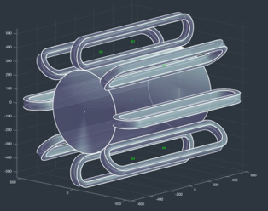
Aerospace Applications – technologies
HDMS project:
CERN KT Fund project
Demonstrator of REBCO HTS technology for astroparticle spectrometry in space and radiation shielding
VZLUSAT-1:
Czech nanosatellite launched on 23/06/17
One of the payloads is a miniaturized X-ray telescope based on Timepix (CTU-RITE)
RADECS-17 Conference:
CERN stand showcasing radiation monitoring technologies
KT in charge of Industrial Exhibition (50 booths) and Welcome event
Commercial discussions with ISISpace (NL) and Syderal (CH)
DCDC Converter:
1 licence agreement with MAGICS Instruments (Belgium)
Integration of DC-DC converter into digital rad-hard sensor networks for nuclear (ITER) and space environments.

Slide 17
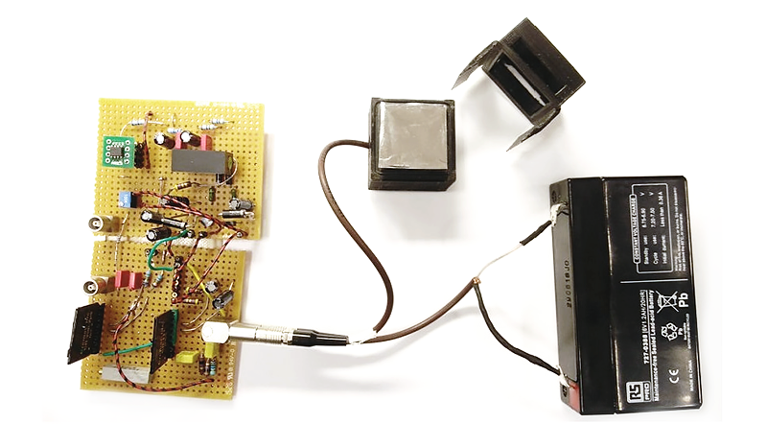
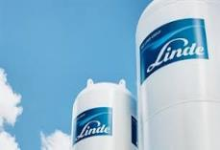
Safety
RaDoM project selected in MassChallenge 2017 Start-up Accelerator Programme in CH.
Funding from AIDA-2020 PoC and Medical Applications Fund.
World largest industrial gas company uses Kryolize software to size safety valves. A KT Fund project.

Slide 18
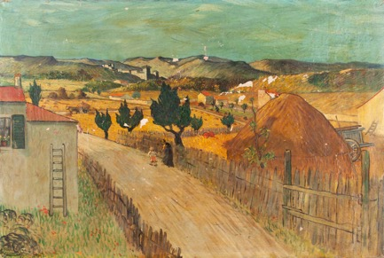
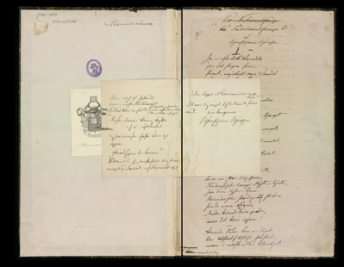
Cultural Heritage
InsightART: start-up with Medipix
X-ray eyes for cultural heritage
Machina: new transportable accelerator for cultural heritage using PIXE-RFQ
TIND: digital preservation
2018 is the European Year for Cultural Heritage
#EuropeForCulture

Slide 19
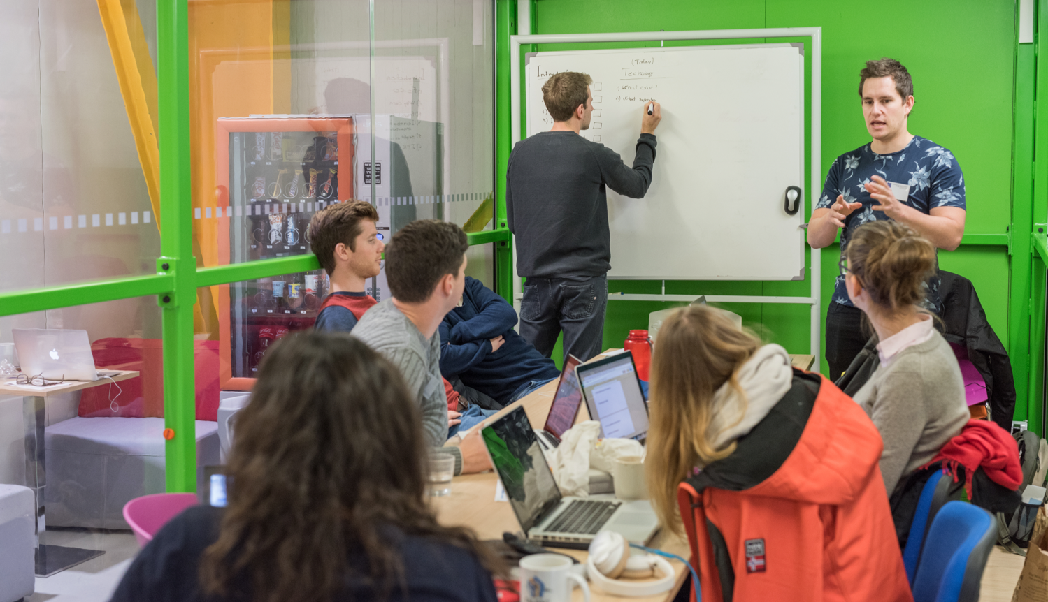
Building a culture of entrepreneurship

Slide 20
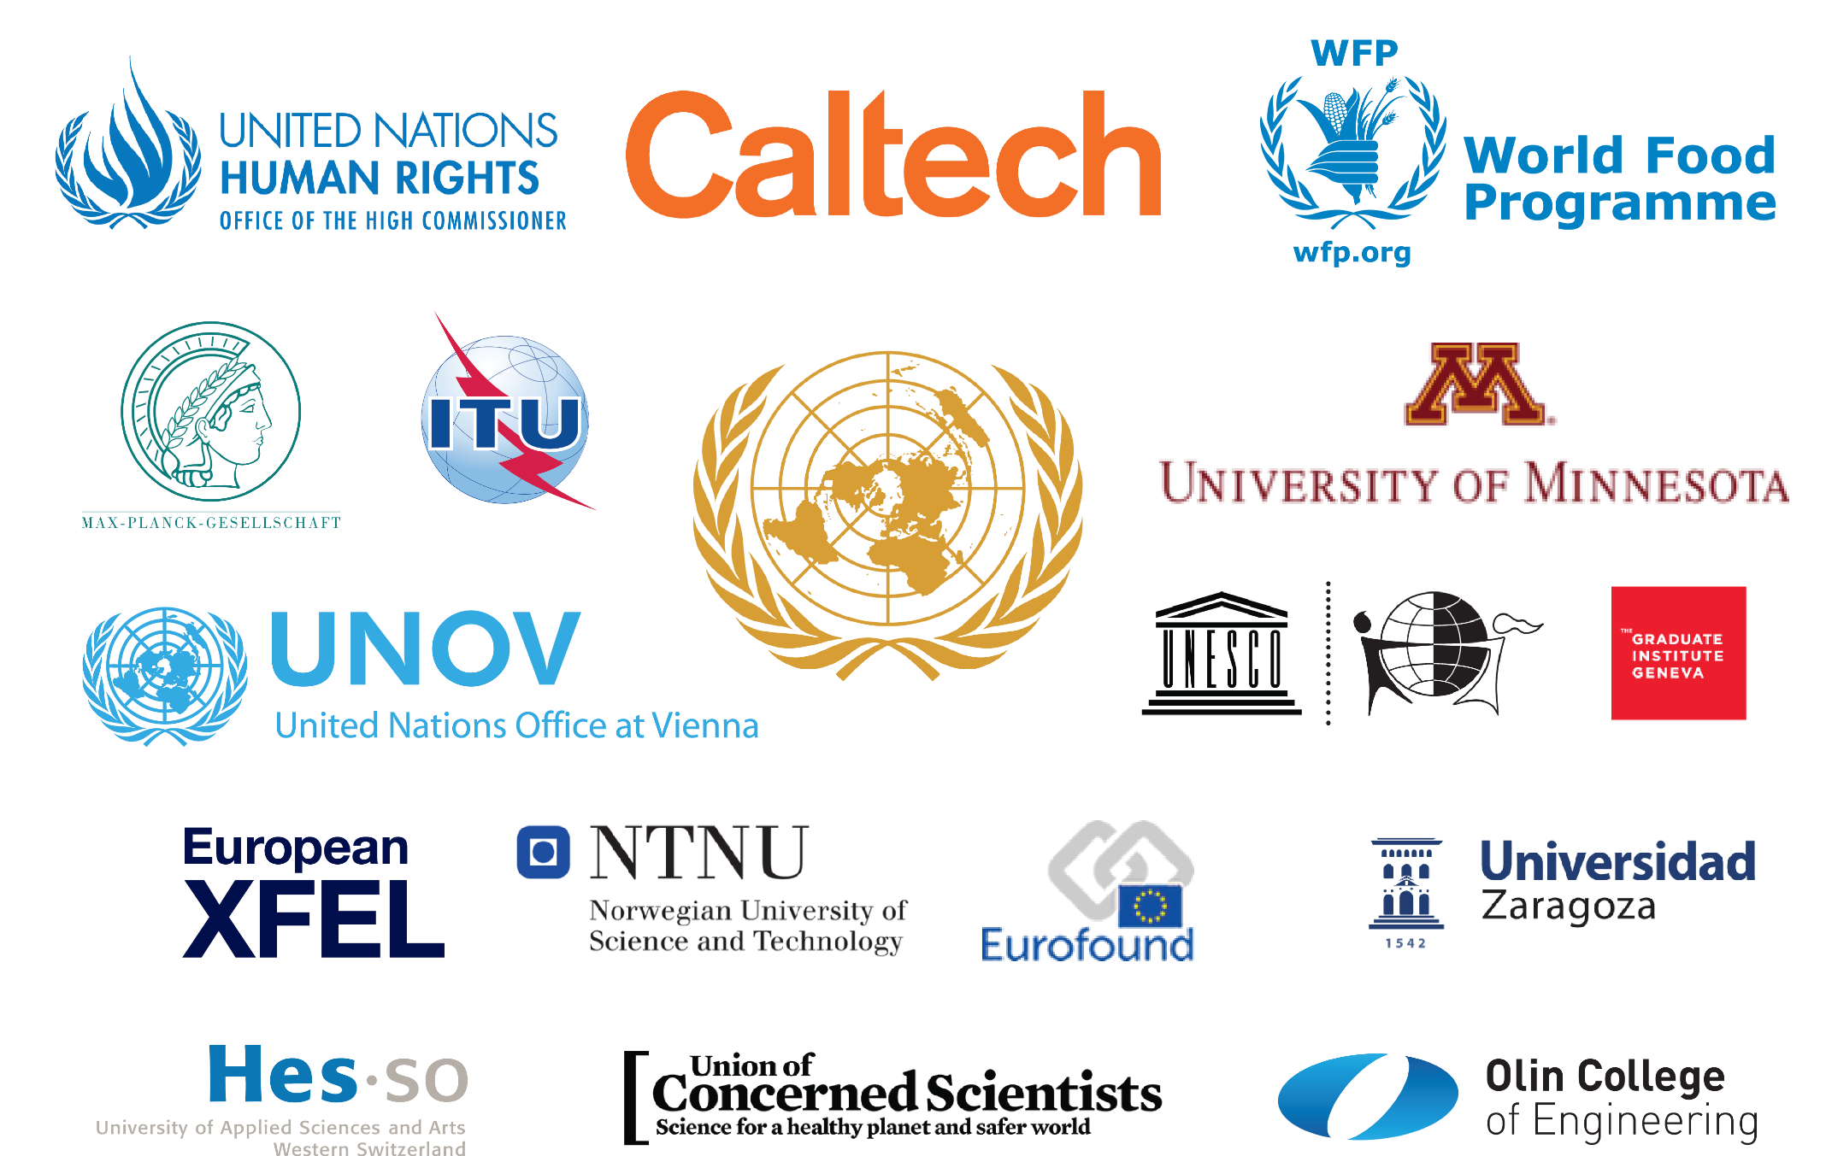
Notes:
TIND Solution customers. Start up using CERN Invenio Software

Slide 21
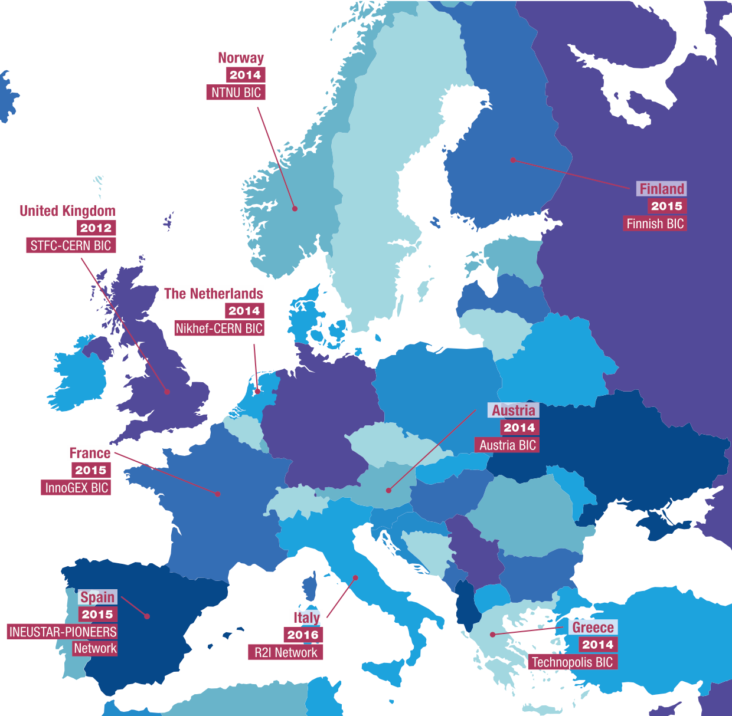
Nine Established Business Incubation Centres
Notes:
BIC principle. Association with a local incubator. Use of CERN tech or expertise at preferential terms.

Slide 22
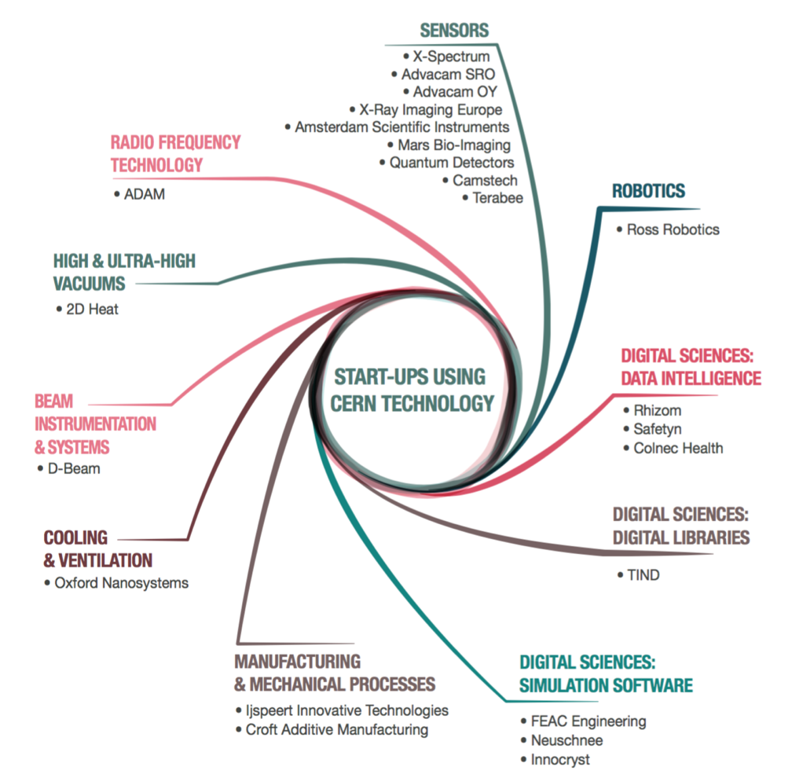
Notes:
23 Start up using CERN tech or expertise, some CERN Spin Offs

