Slide 1
Microscopic Investigation of Flux Expulsion at FNAL
M. Martinello, Z. Sung, S. Posen
TTC/ARIES topical workshop on flux trapping and magnetic shielding
CERN, Nov 2018

Slide 2
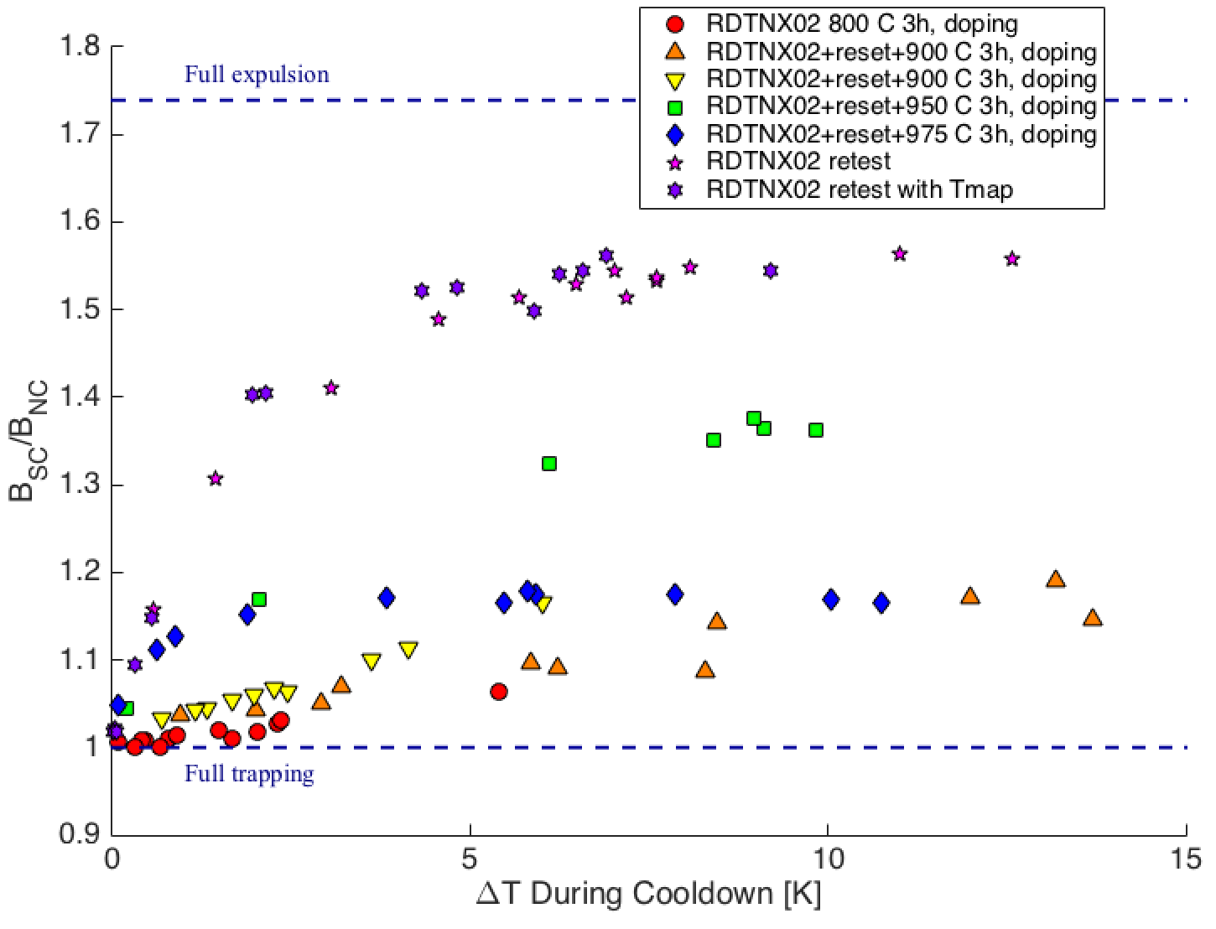
T-map on Ningxia Cavity After Annealing at 975C
Ningxia cavity (RTDNX02):
  Very poor flux expulsion after 3h at 800C
  Little improvement after subsequent annealing at 900C for 3h
  Some improvement after subsequent annealing at 950C for 3h
  Medium flux expulsion properties after annealing at 975C for 3h
T-map acquired after annealing at 975C after fast and medium cool-down
S. Posen, TTC 2018, Milan

Slide 3
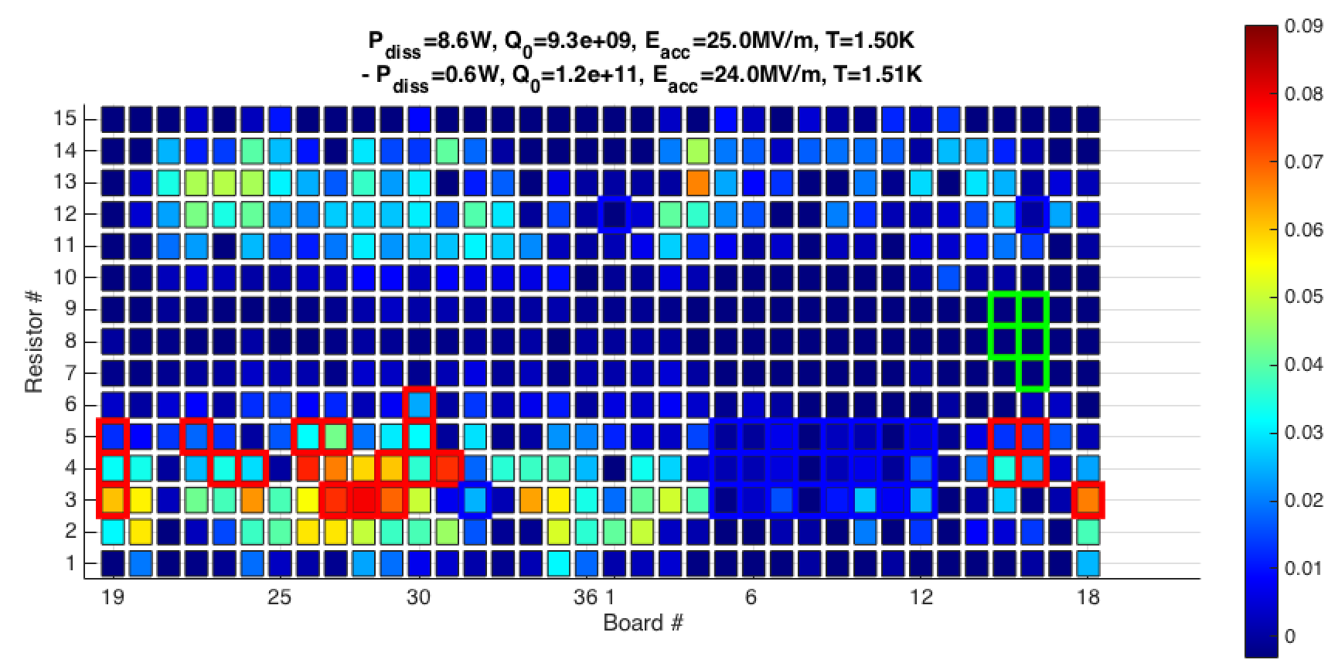
T-map on Ningxia Cavity After Annealing at 975C
Ningxia cavity (RTDNX02):
  Very poor flux expulsion after 3h at 800C
  Little improvement after subsequent annealing at 900C for 3h
  Some improvement after subsequent annealing at 950C for 3h
  Medium flux expulsion properties after annealing at 975C for 3h
T-map acquired after annealing at 975C after fast and medium cool-down
S. Posen, TTC 2018, Milan

Slide 4
Cold vs Hot cut-outs (TE1NX002)
Hot region: bad flux expulsion
Cold region: good flux expulsion
ToF-SIMS analysis to check if cold and hot spots show different level of impurities
    Higher level of impurities may oppose to dislocations movement and stress release
    Impurities may act as pinning center
SEM/EBSD/ECCI analysis to check if there are differences in terms of crystallographic properties between cold and hot spots

Slide 5
Cold vs Hot cut-outs (TE1NX002)
Hot region: bad flux expulsion
Cold region: good flux expulsion
ToF-SIMS analysis to check if cold and hot spots show different level of impurities
    Higher level of impurities may oppose to dislocations movement and stress release
    Impurities may act as pinning center
SEM/EBSD analysis to check if there are differences in terms of crystallographic properties between cold and hot spots

Slide 6
Hot vs Cold spots - Profile
Hot Spot
Cold Spot
Positive ions
Positive ions
Negative ions
Negative ions

Slide 7
Cold vs Hot cut-outs (TE1NX002)
Hot region: bad flux expulsion
Cold region: good flux expulsion
ToF-SIMS analysis to check if cold and hot spots show different level of impurities
    Higher level of impurities may oppose to dislocations movement and stress release
    Impurities may act as pinning center
SEM/EBSD/ECCI analysis to check if there are differences in terms of crystallographic properties between cold and hot spots

Slide 8
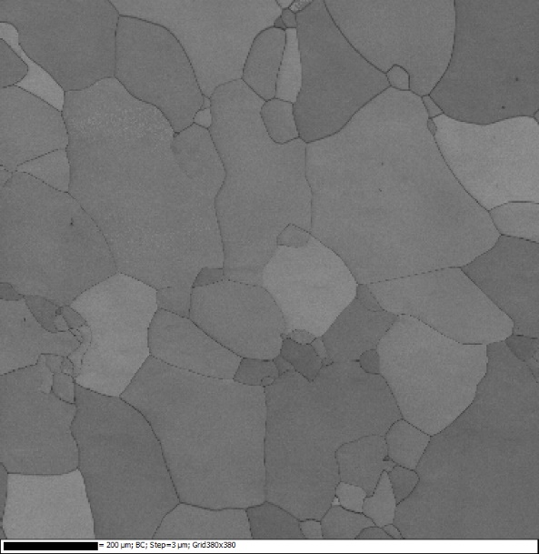
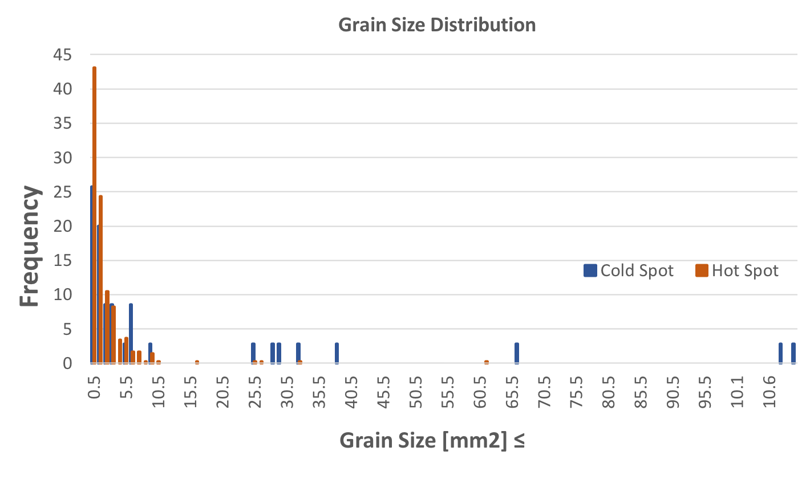
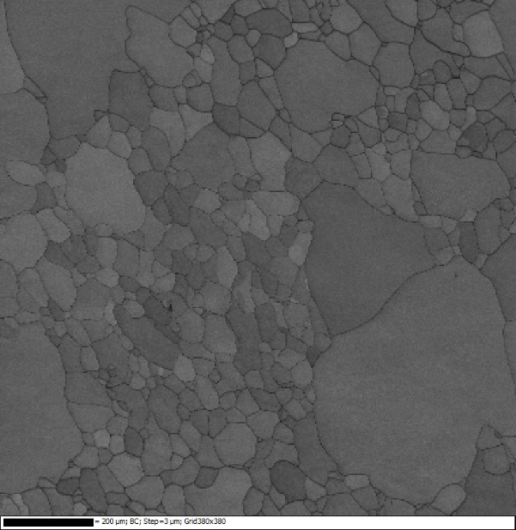
Band Contrast (BC) Cold vs Hot Spots
Cold spot
Number of Grains in Cold Spot: 52/mm²
Number of Grains in Hot Spot: 353/mm²
Hot spot
Hot spot shows significantly smaller grains than cold spot, which translate in a much larger number of grains per unit of area

Slide 9
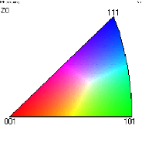
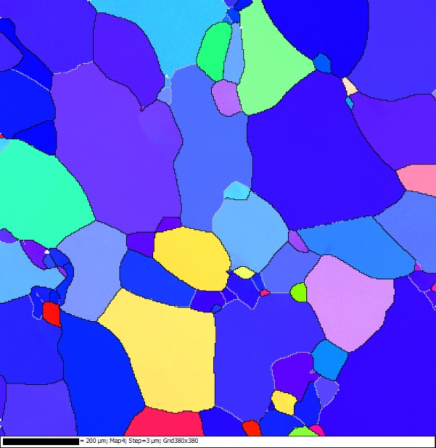
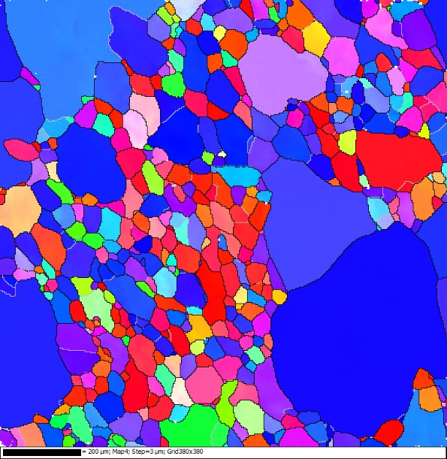
Inverse Pole Figure (IPF) Cold vs Hot Spots
Cold spot
Cold spot: preferential grain orientation is 111
Hot spot: crystal orientation of the majority of small grains is 001
Hot spot

Slide 10

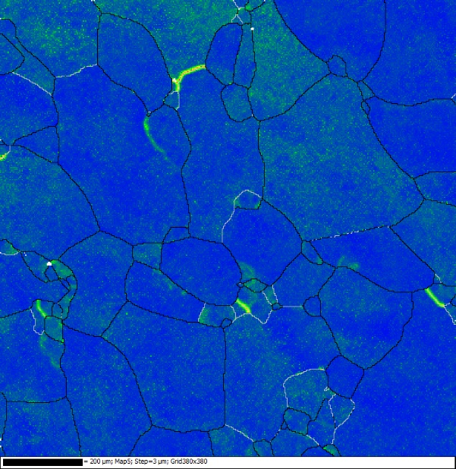
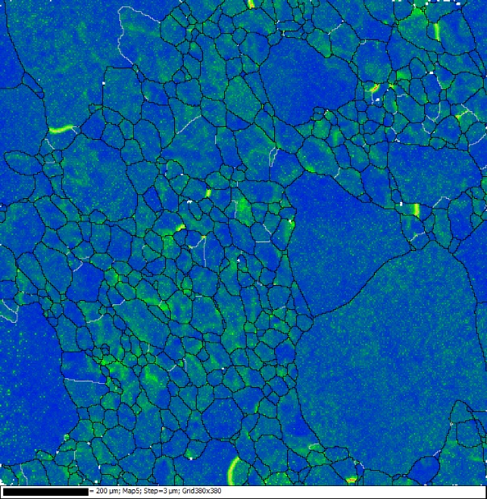
Local Misorientation (LM) Cold vs Hot Spots
Cold spot
Hot spot
Average value of local misorientation is larger in hot spots

Slide 11
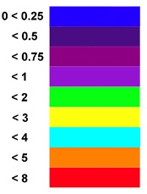
Grain Orientation Spread (GOS) Cold vs Hot Spots
Cold spot
Hot spot
Larger grain orientation spread observed in hot spots

Slide 12
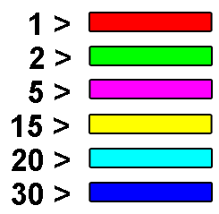
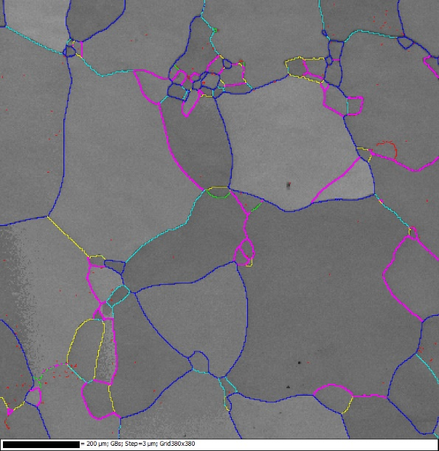
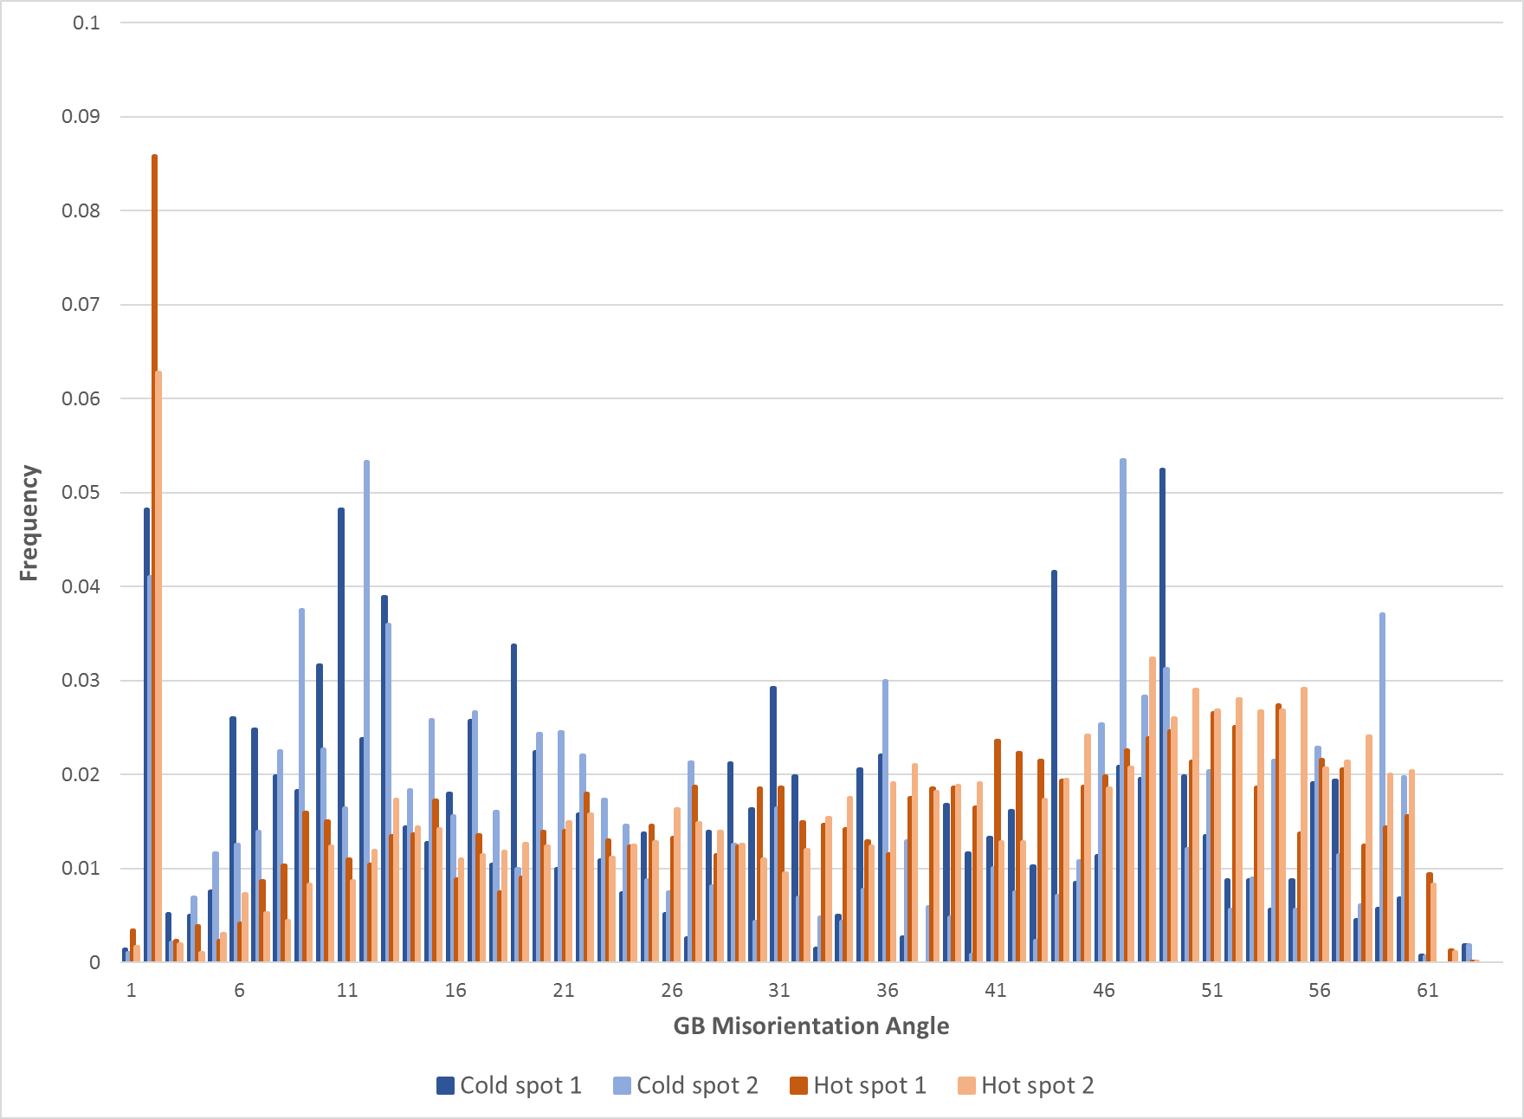
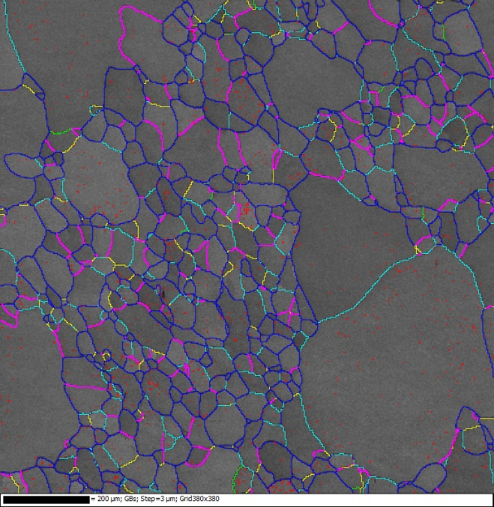
Grain Boundary Misorientation Cold vs Hot Spots
Cold spot
Low angle GBs
High angle GBs
Hot spot
Hot spots show large number of very low angle GBs and slightly larger amount of high angle GBs
Notes:
Dislocations tangles/dislocation cells, dimension is tens of nm -> stronger pinning center

Slide 13
Grain Boundary Misorientation Cold vs Hot Spots
Cold spot
Low angle GBs
High angle GBs
Hot spot
Hot spots show large number of very low angle GBs and slightly larger amount of high angle GBs
Notes:
Dislocations tangles/dislocation cells, dimension is tens of nm -> stronger pinning center

Slide 14
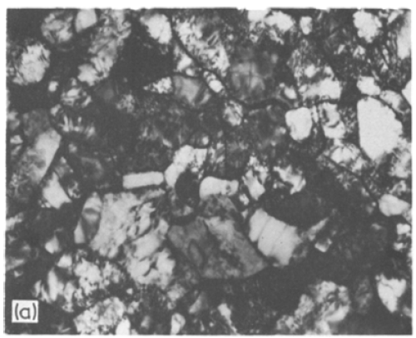
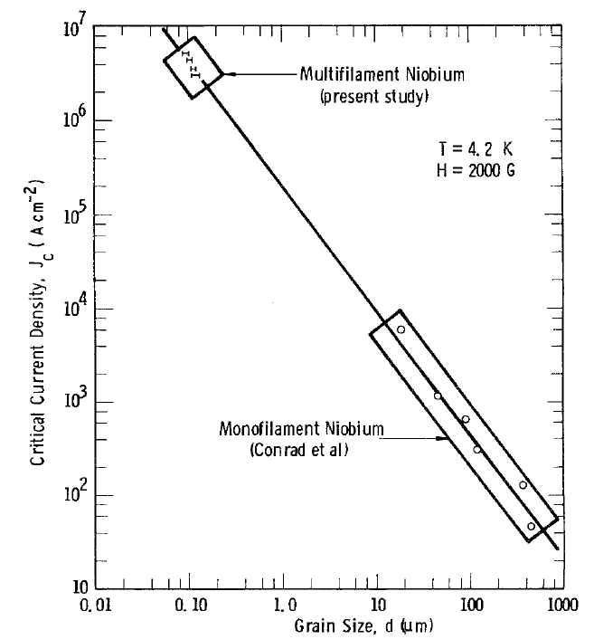
Grain Boundary Misorientation Cold vs Hot Spots
Low angle GBs
High angle GBs
A. T. Santhanam, Journal of Material Science 11(1976)
These very low angle GBs may be given by dislocation tangles (dimension of ~10-100 nm)
The pinning force of these dislocation cells is order of magnitude larger than normal grain boundaries
Notes:
Dislocations tangles/dislocation cells, dimension is tens of nm -> stronger pinning center

Slide 15
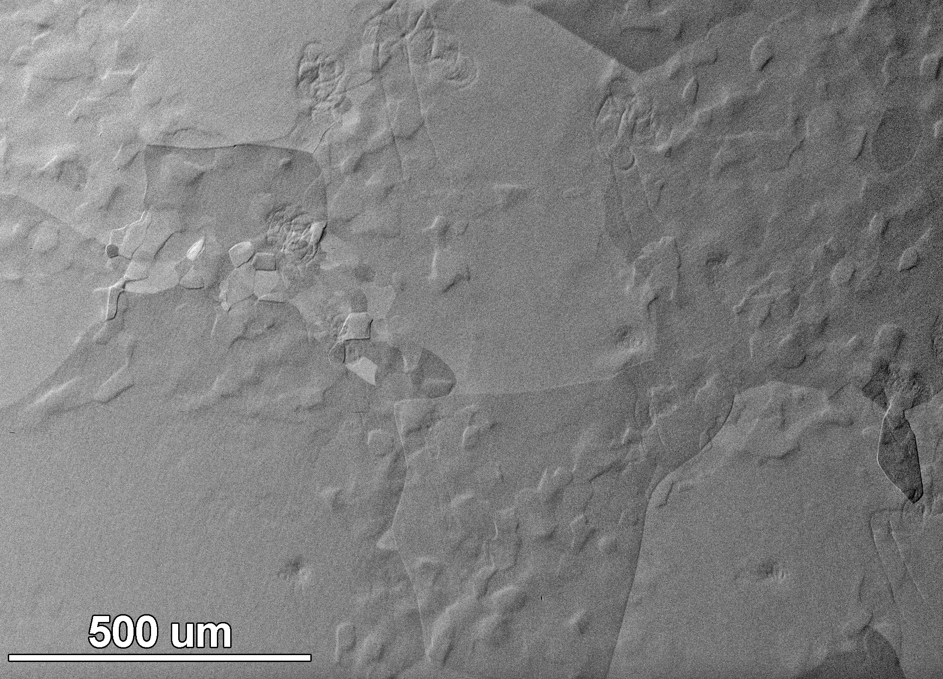
ECCI analysis Cold vs Hot Spots
Cold spot
Electron Channeling Contrast Image
Band Contrast Image w EBSD
grain boundaries
dislocations
Both EBSD and ECCI shows the grain boundaries in the material
Only the ECC image shows dislocations

Slide 16
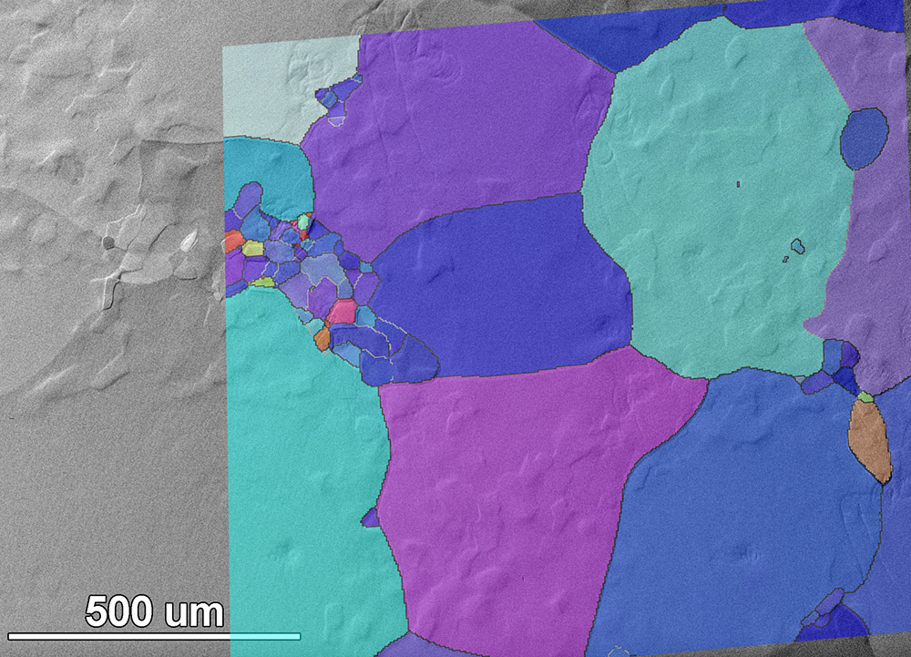
ECCI analysis Cold vs Hot Spots
Cold spot
Electron Channeling Contrast Image + Inverse Pole Figure
Band Contrast Image w EBSD
grain boundaries
dislocations
Both EBSD and ECCI shows the grain boundaries in the material
Only the ECC image shows dislocations

Slide 17
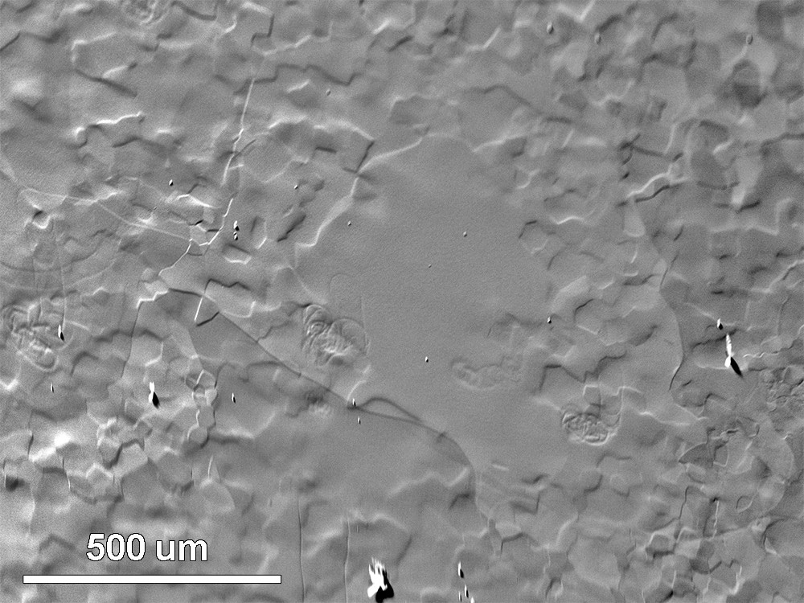
ECCI analysis Cold vs Hot Spots
Hot spot
Electron Channeling Contrast Image
Band Contrast Image w EBSD
Both EBSD and ECCI shows the grain boundaries in the material
Only the ECC image shows dislocations

Slide 18
ECCI analysis Cold vs Hot Spots
Hot spot
Electron Channeling Contrast Image
Band Contrast Image w EBSD
dislocations
grain boundaries
Both EBSD and ECCI shows the grain boundaries in the material
Only the ECC image shows dislocations

Slide 19
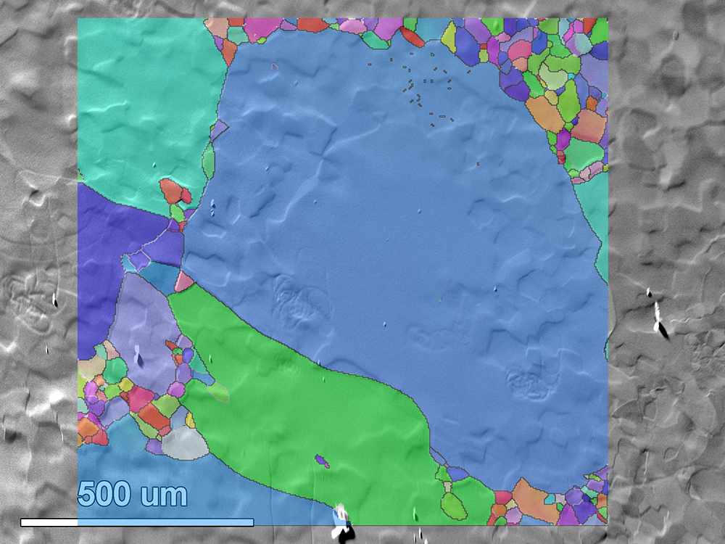
ECCI analysis Cold vs Hot Spots
Hot spot
Electron Channeling Contrast Image + Inverse Pole Figure
Band Contrast Image w EBSD
dislocations
grain boundaries
Both EBSD and ECCI shows the grain boundaries in the material
Only the ECC image shows dislocations

Slide 20
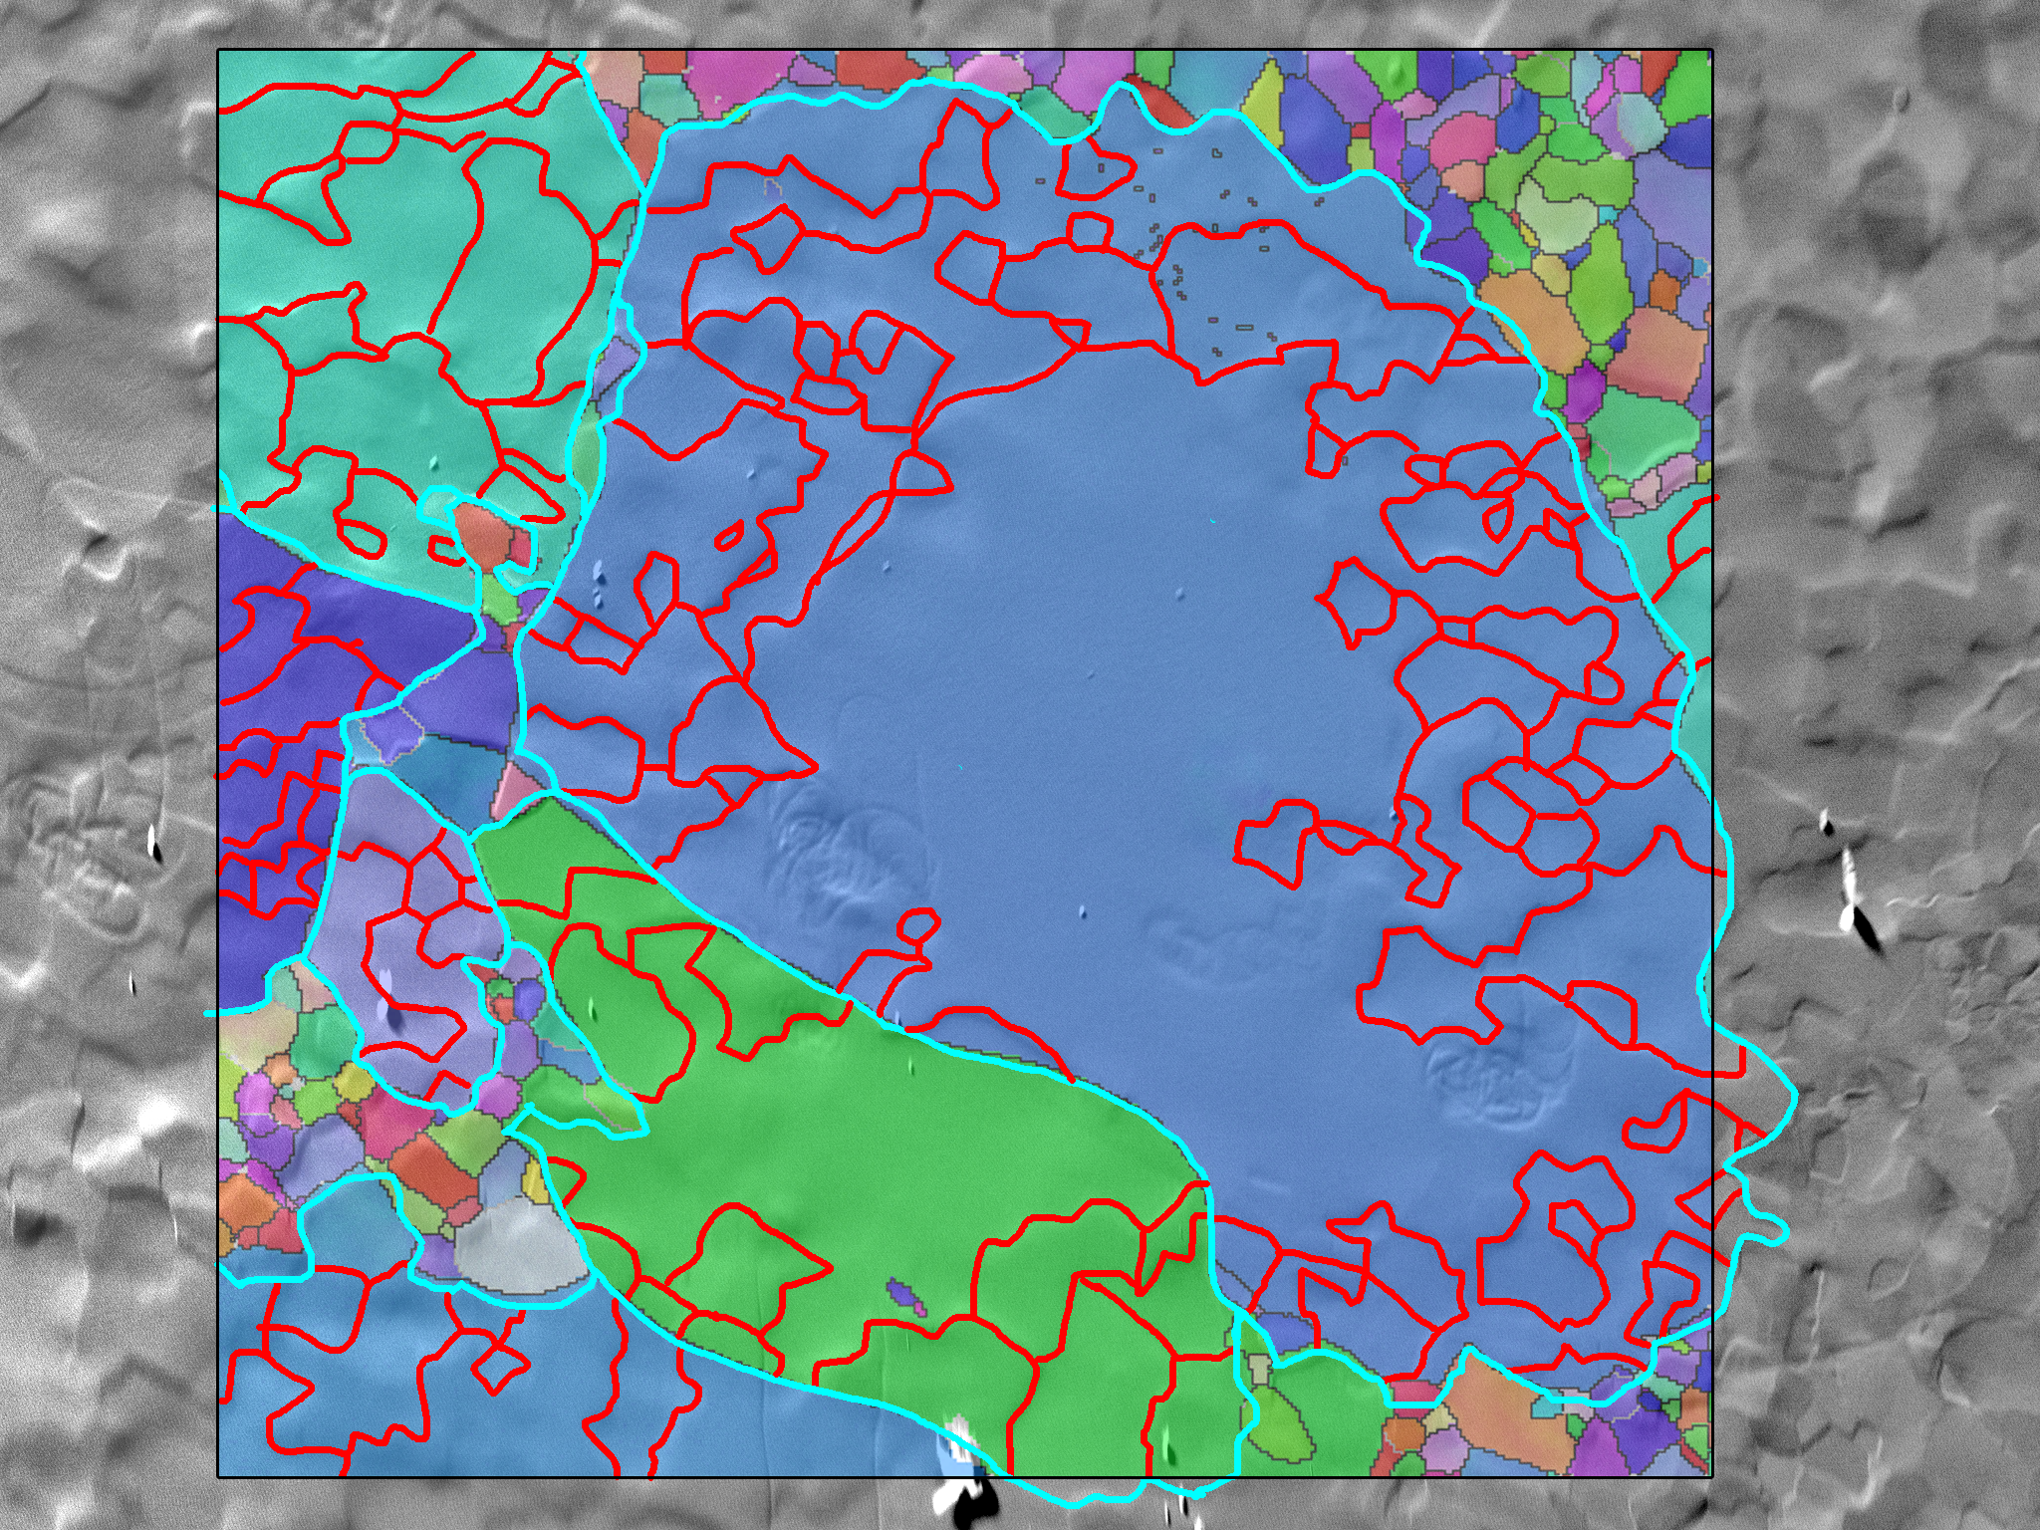
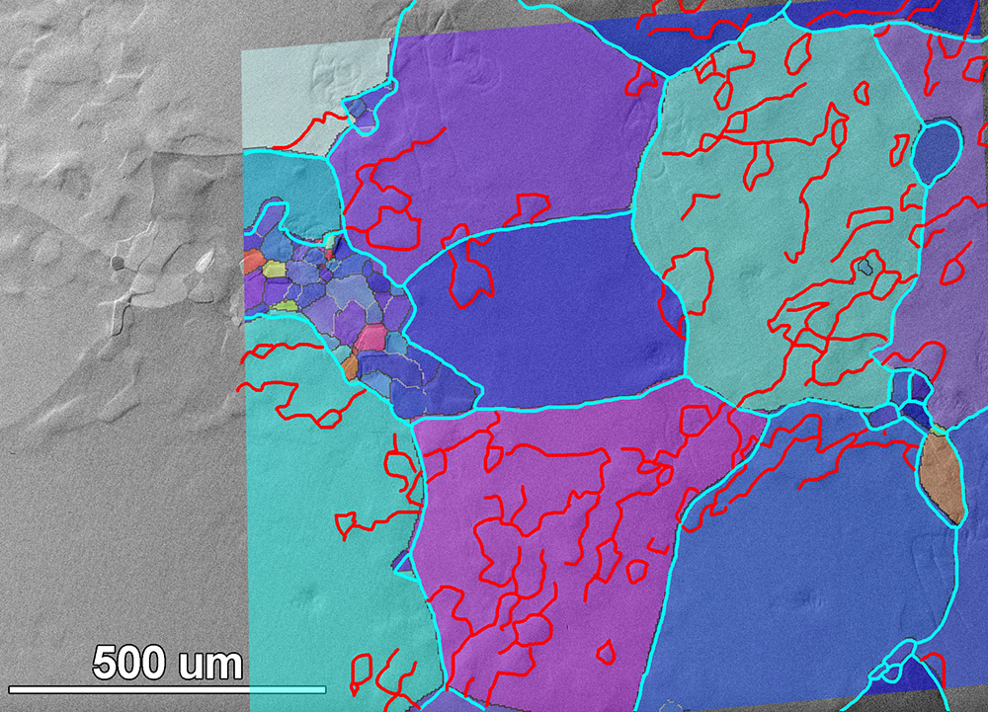
ECCI analysis Cold vs Hot Spots
Electron Channeling Contrast Images + Inverse Pole Figure
Cold spot
Hot spot
Light blue: grain boundaries
Red: dislocations
1.15 x1.15 um² scan area
Total length of low angle GBs is 26598 um
1.15 by 1.15 um² scan area
Total length of low angle GBs is 31465 um

Slide 21
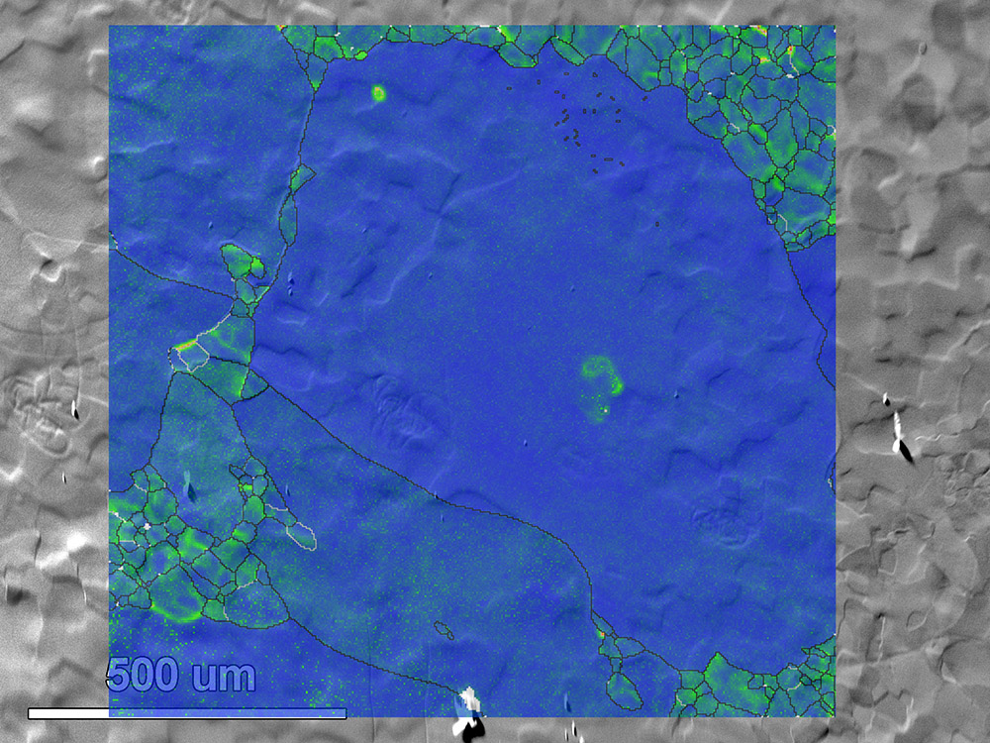
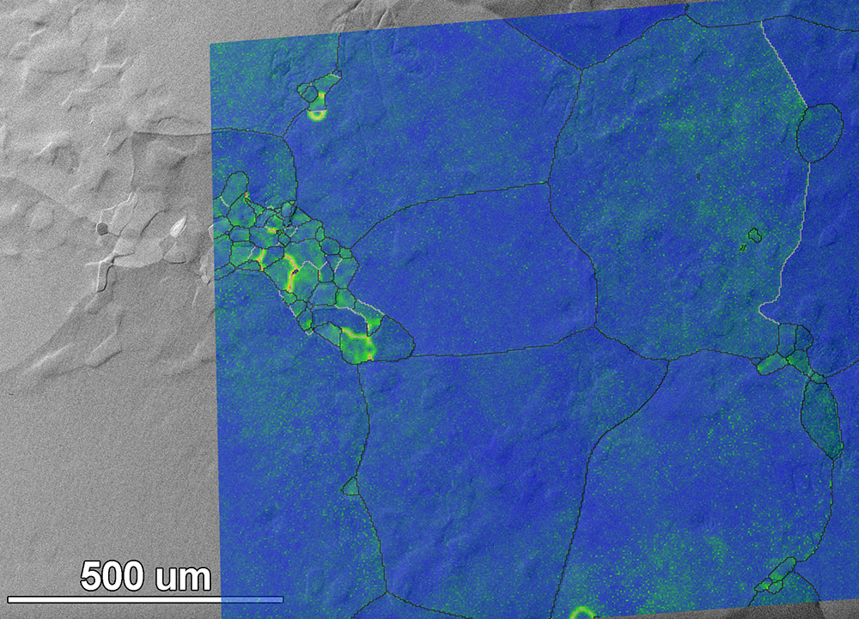
ECCI analysis Cold vs Hot Spots
Electron Channeling Contrast Images + Local Misorientation
Cold spot
Hot spot

Slide 22
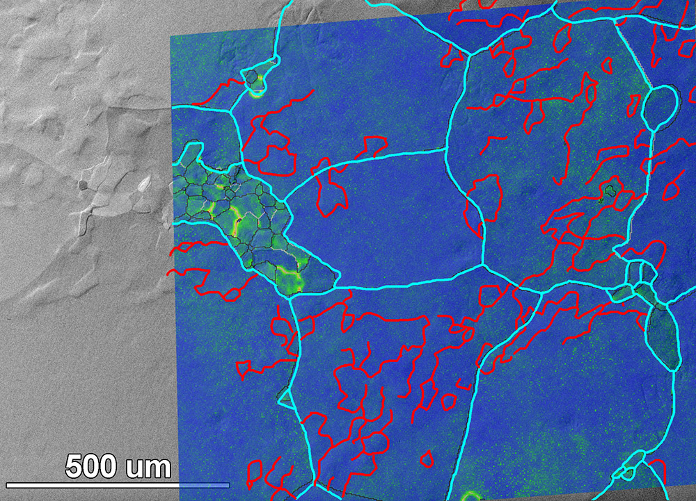
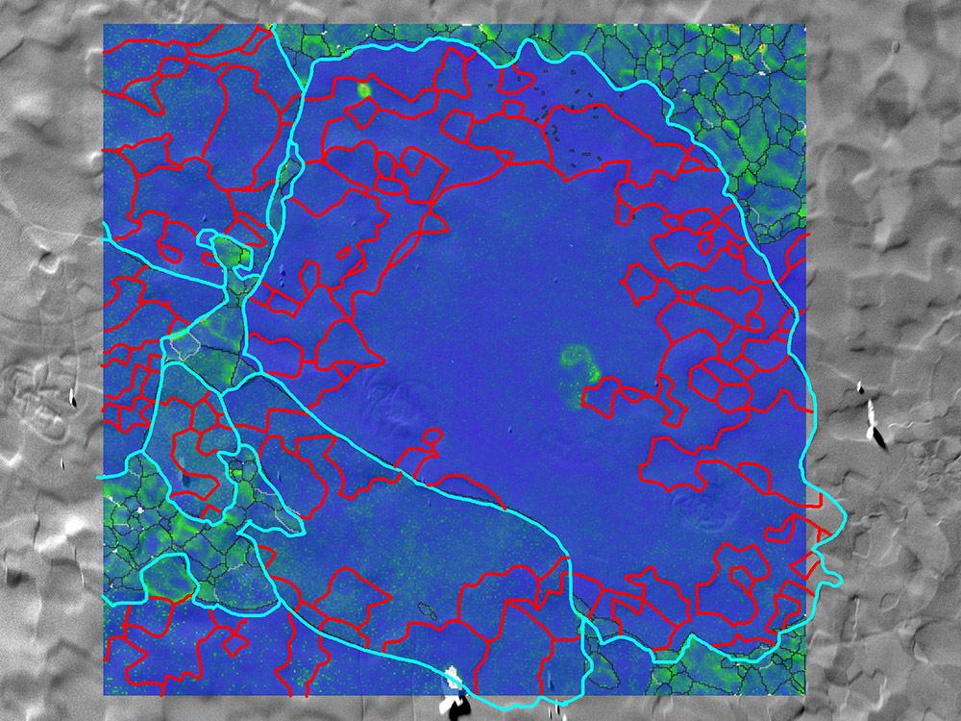
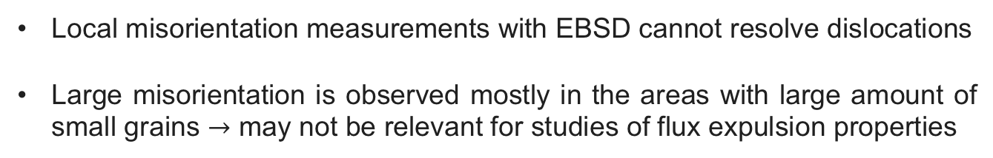
ECCI analysis Cold vs Hot Spots
Electron Channeling Contrast Images + Local Misorientation
Cold spot
Hot spot
Local misorientation measurements with EBSD cannot resolve dislocations
Large misorientation is observed mostly in the areas with large amount of small grains $→$ may not be relevant for studies of flux expulsion properties

Slide 23
Conclusions
SIMS analysis shows no significant differences in terms of impurity profiles between hot and cold spots
Cold spot shows larger grain, lower grain orientation spread (GOS) and lower local misorientation (LM) than hot spot
Hot spot showed higher amount of dislocation tangles (with both EBSD and ECCI studies) that can act as strong pinning center preventing flux from being expelled
Future studies should understand the nature of such dislocation tangles to better correlate with flux expulsion properties of Nb cavities

Slide 24
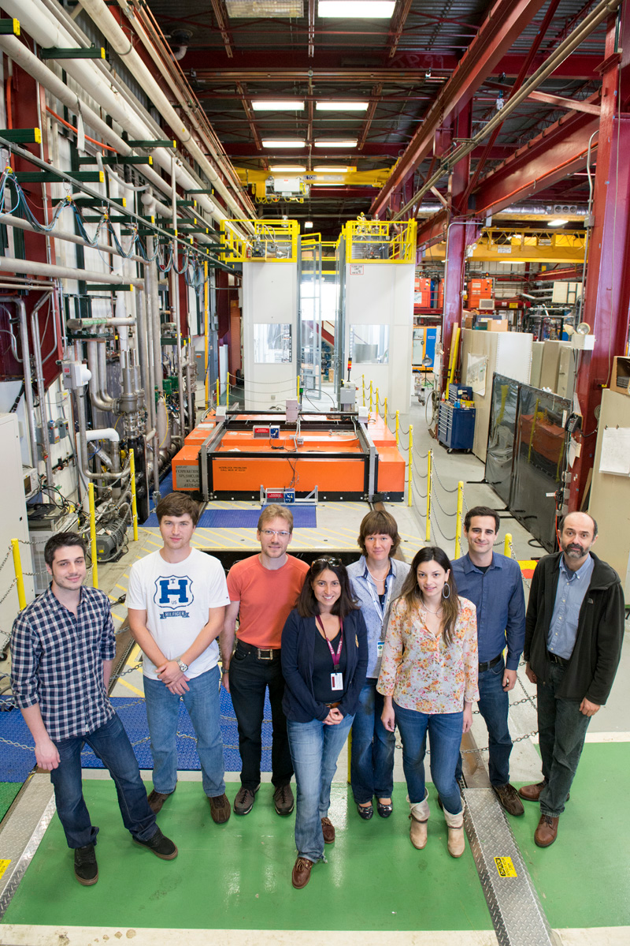
Acknowledgments
Fermilab SRF team, in particular:
ZuHawn Sung (EBSD/ECCI measurements)
Sam Posen
Mattia Checchin
Anna Grassellino
Alex Romanenko
Founding agencies:
DOE-HEP
LCLS-II / DOE-BES

Slide 25
Thank you for your attention!

