Slide 1
Experimental Study of Flux Expulsion and Cold Work
Sam Posen, Fermilab SRF Team
TTC Topical Workshop on Flux
9 November 2018
CERN

Slide 2
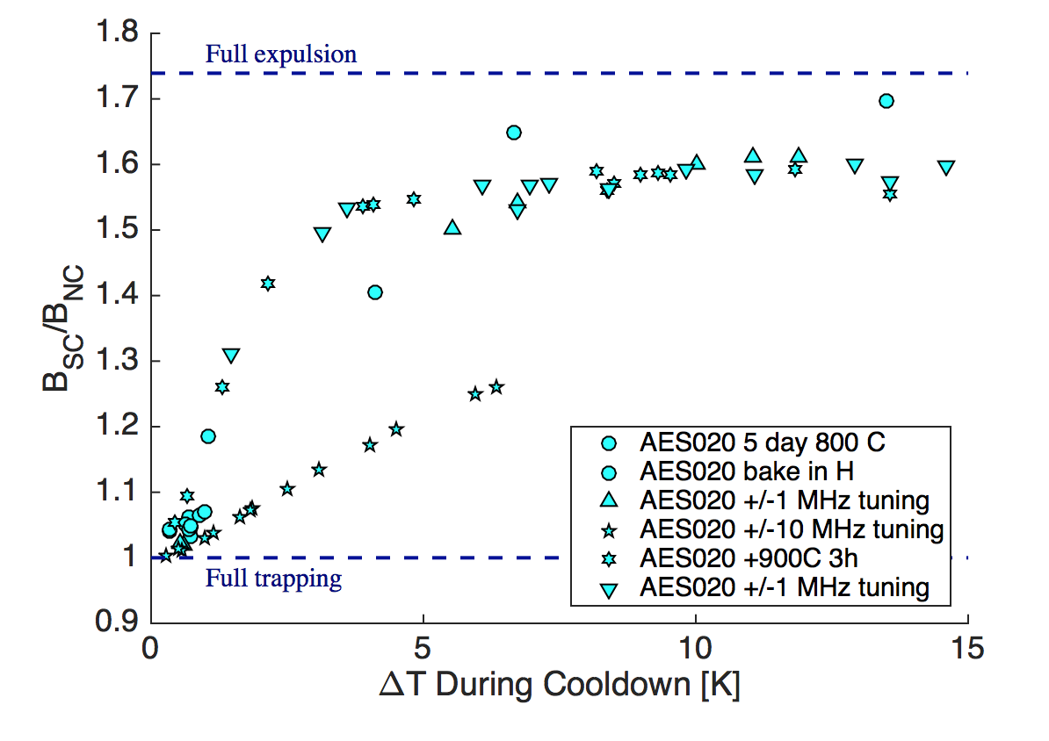
Heavy deformation degrades expulsion behavior
From SRF 2017
Heavy tuning
Influence of stress/dislocations?
Tantalizing hint that cold work plays a major role in flux expulsion
This presentation presents new results from an experiment to follow up on influence of cold work

Slide 3
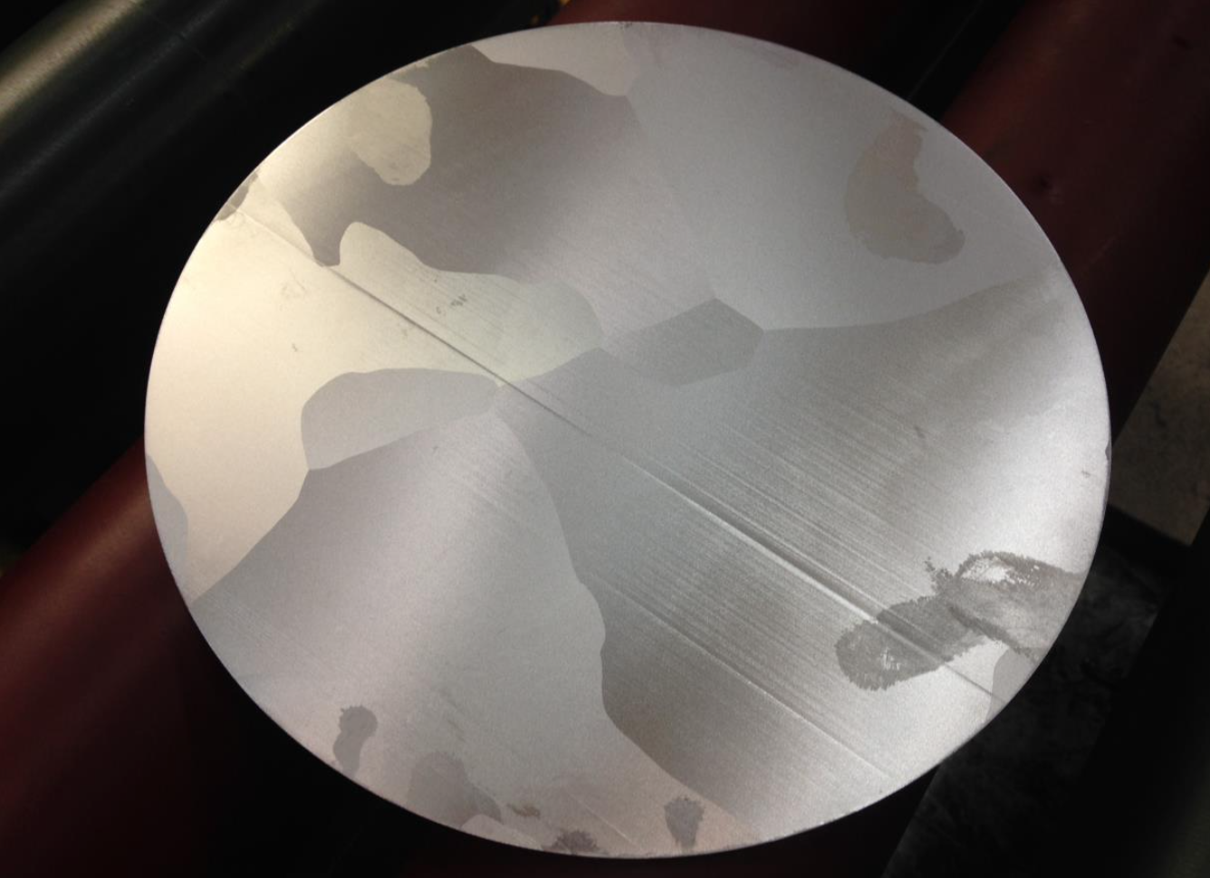
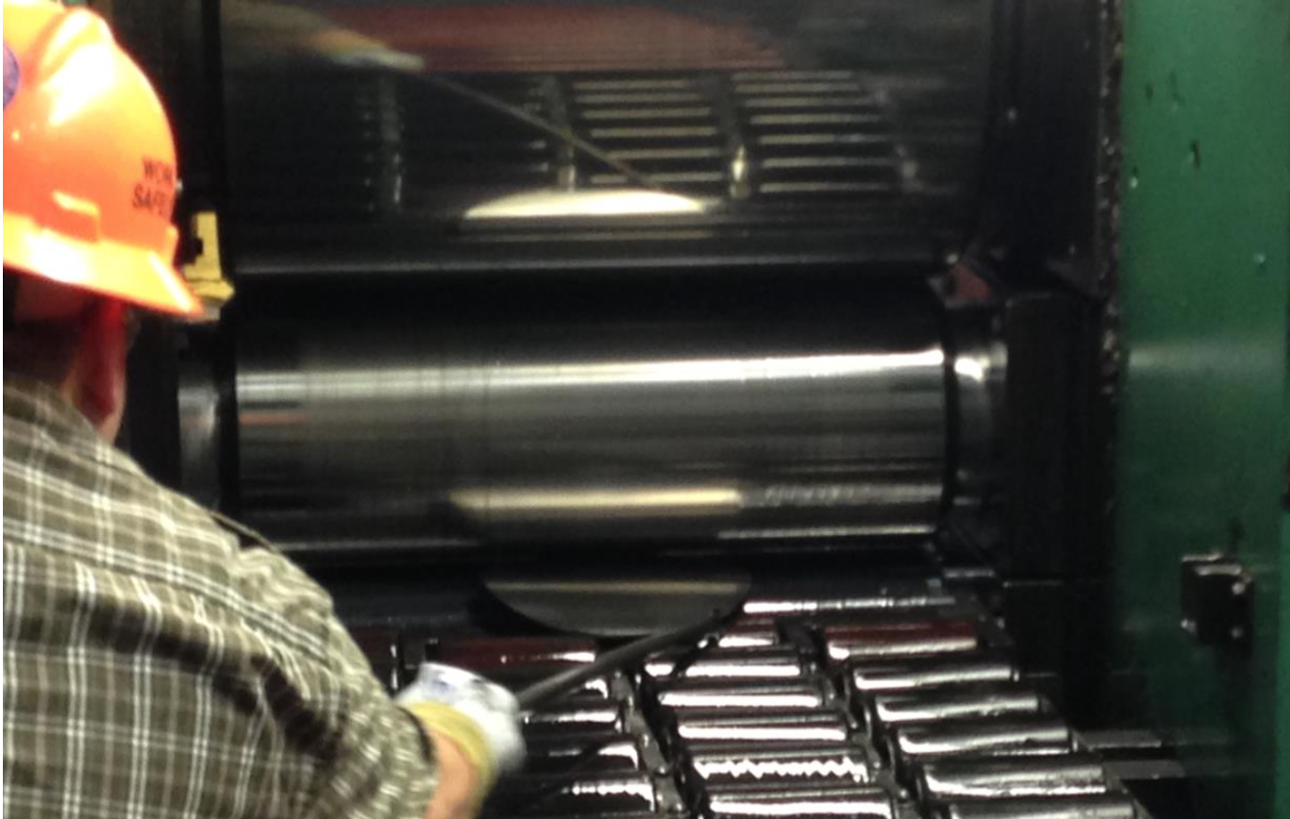
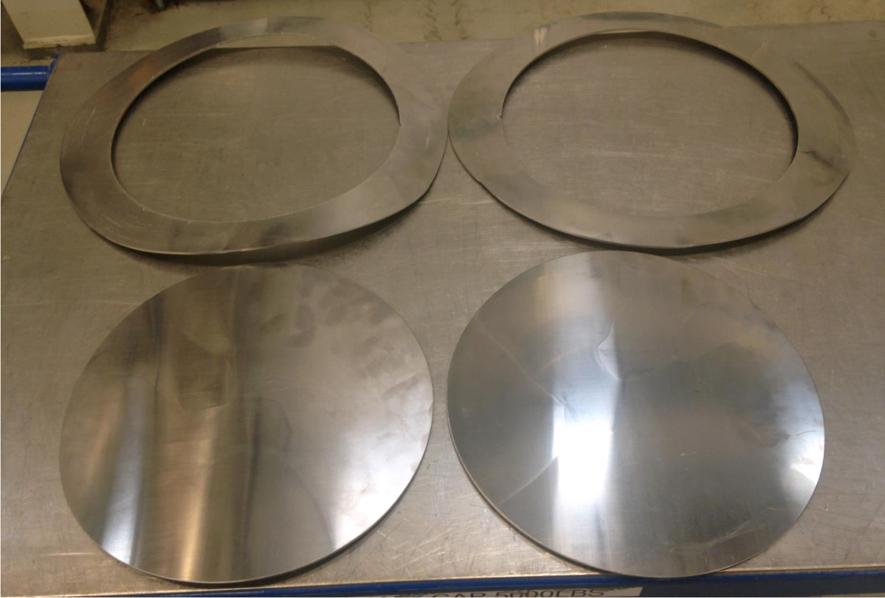
Large Grain Experiment
Experiment designed to distinguish effects of dislocations independent of grain size: does LG material inherently expel strongly?
Large Grain Ingot
Cut 2 slices, 3 mm thick
1-cell 1.3 GHz cavity fabrication (now)
Large grains, low dislocation content
Large grains, high dislocation content
Cut 2 slices, 5 mm thick
Roll to 3 mm thickness
Cut down to disc size
1-cell 1.3 GHz cavity fabrication (now)

Slide 4
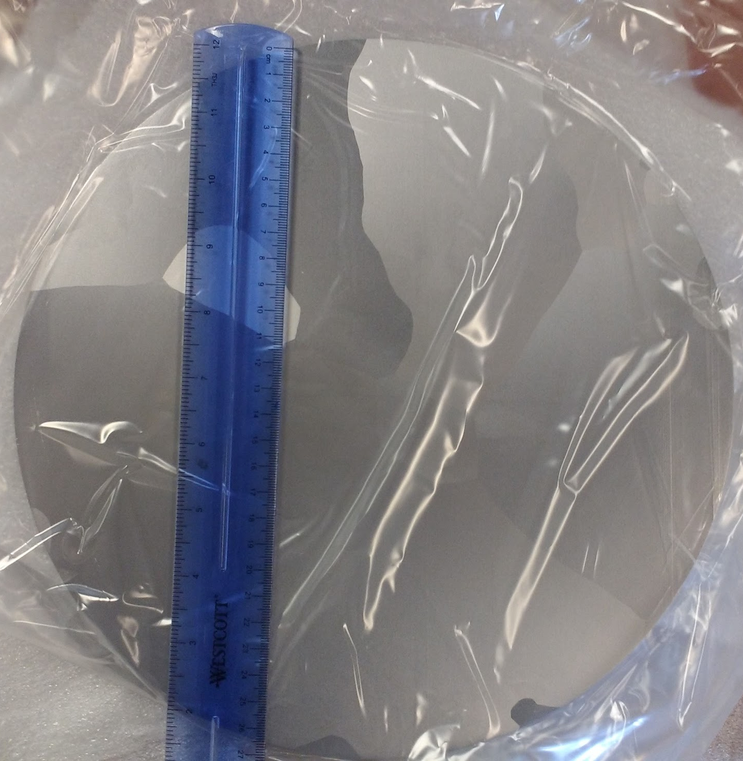
Wire EDM from Ingot
2 sheets 3 mm thick -> BCP + send direct to cavity vendor
2 sheets 5 mm thick -> BCP + send for rolling

Slide 5

Sheets Rolled by ATI
Thickness reduction from 5 mm to 3 mm (area increase)
Cold worked so that no longer flat even after roller levelling
Material sent to cavity vendor
Photo courtesy ATI

Slide 6
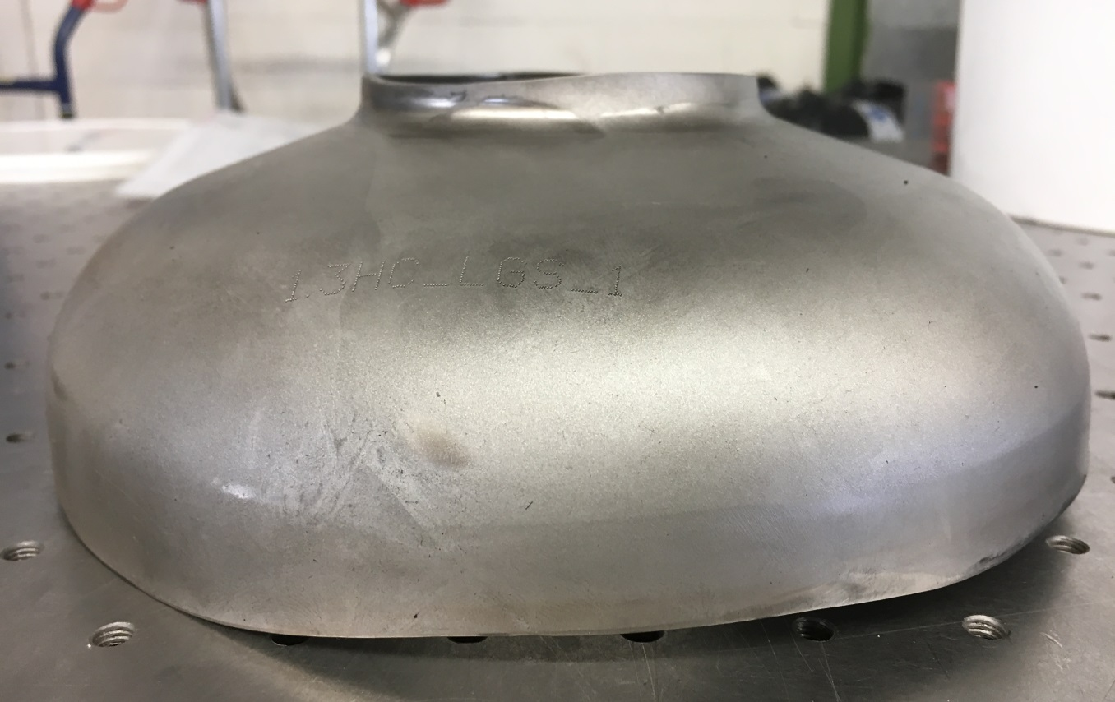
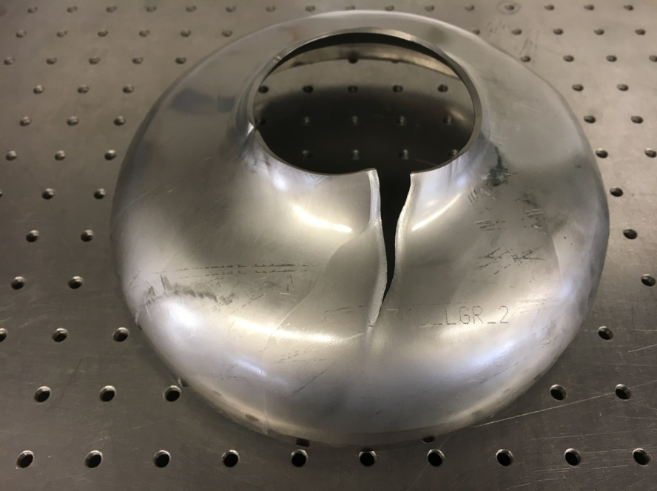
Half Cell Forming
RI received the sheet material and began deep drawing
The non-rolled material formed half cells well
The rolled material tore during the forming process
This is not entirely unexpected as the material was not annealed at any point during the manufacturing process
Photos courtesy RI

Slide 7
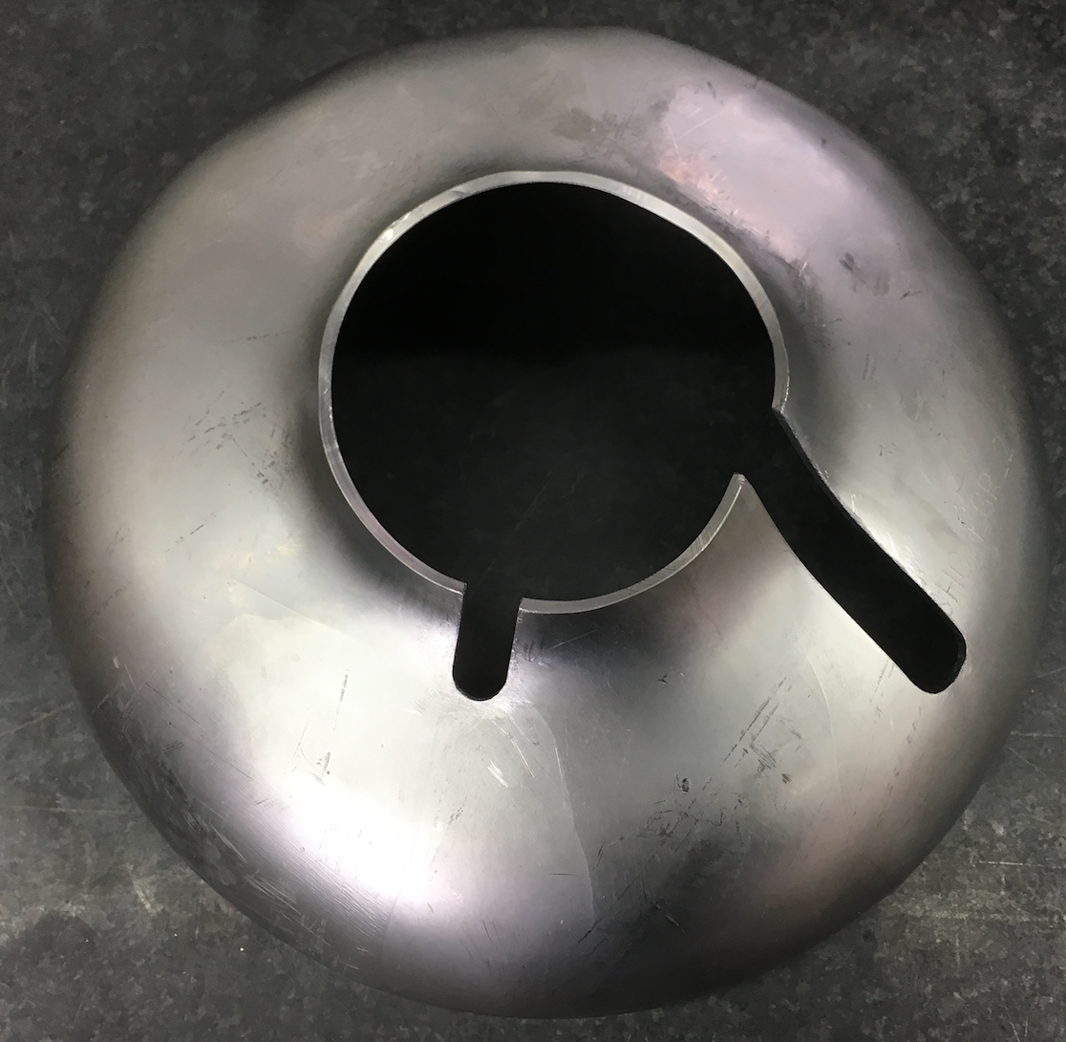
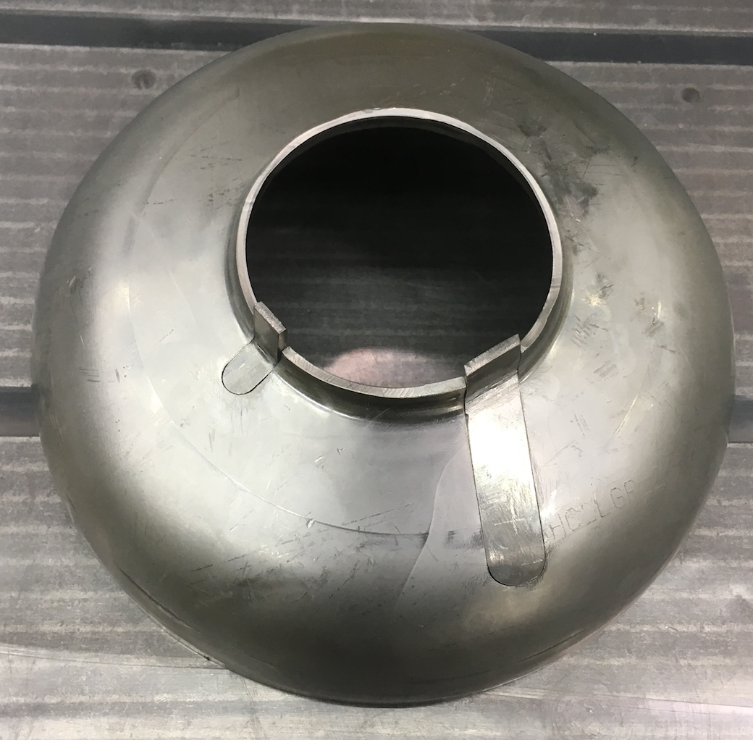
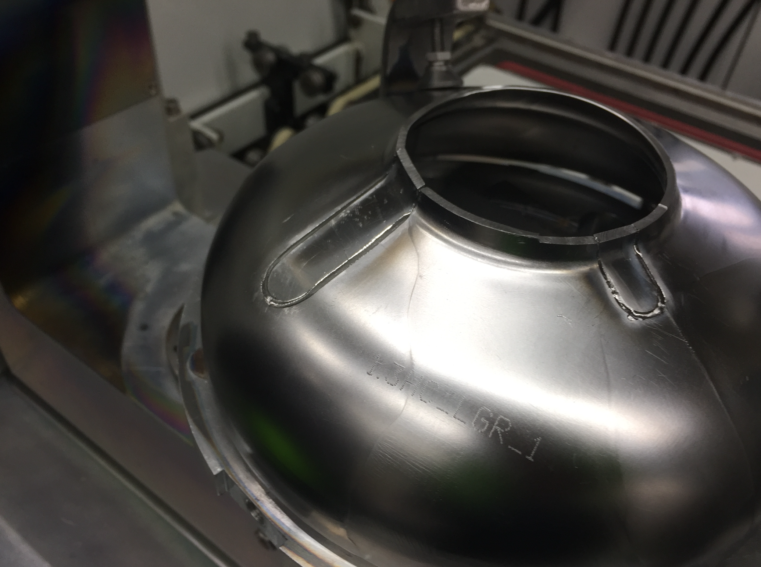
Repair Developed by RI
Photos courtesy RI
RI used the extra rolled material to plug the holes in the half cells
Some extra beam welds, but should still be representative!
ATI
Extra material

Slide 8
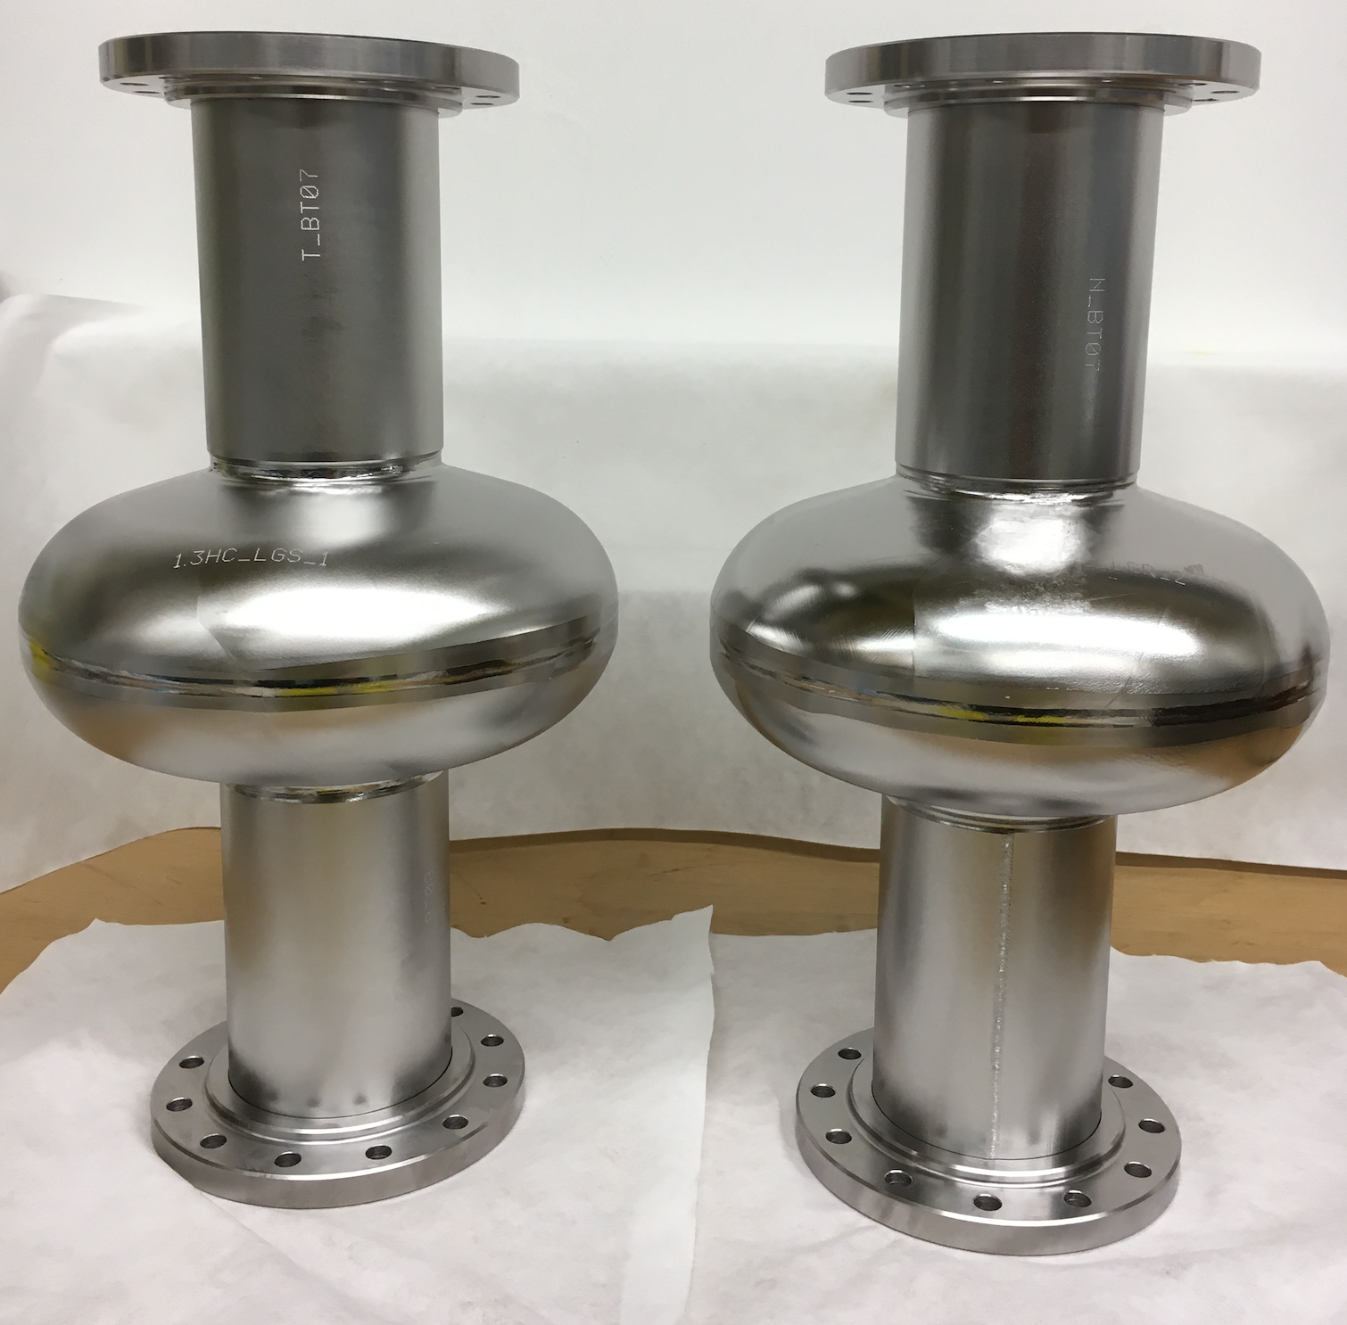
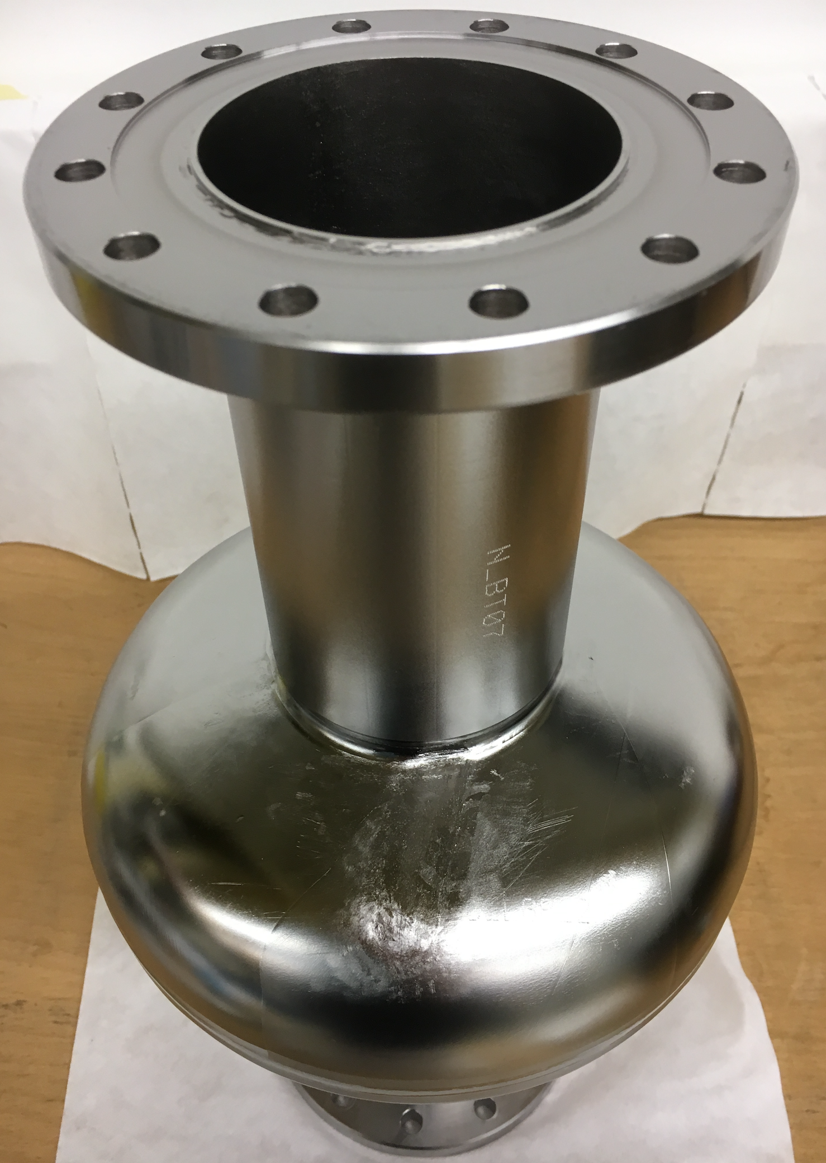
Completed Cavities
Photos courtesy RI

Slide 9
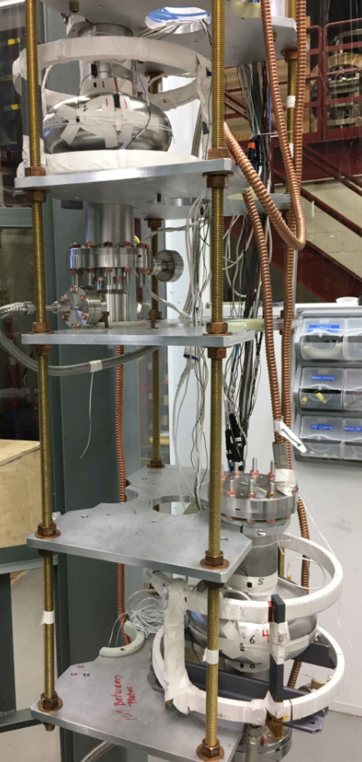
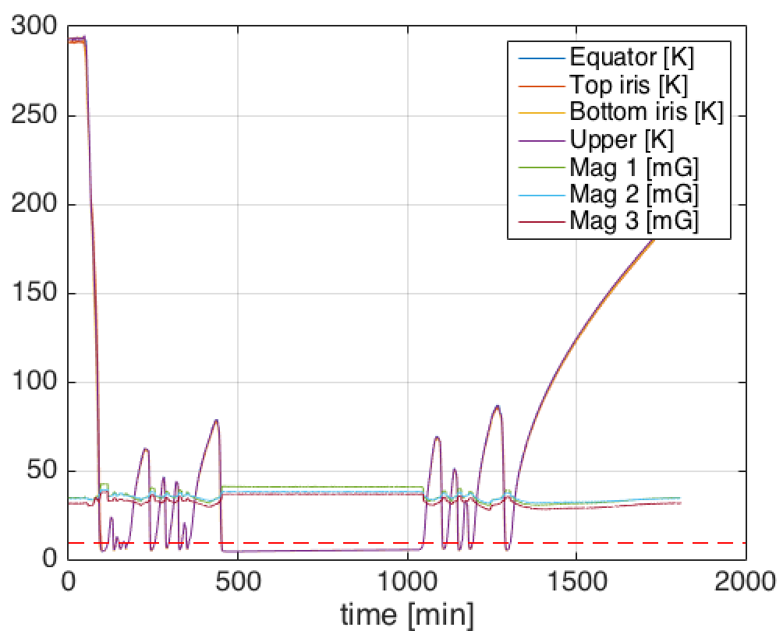
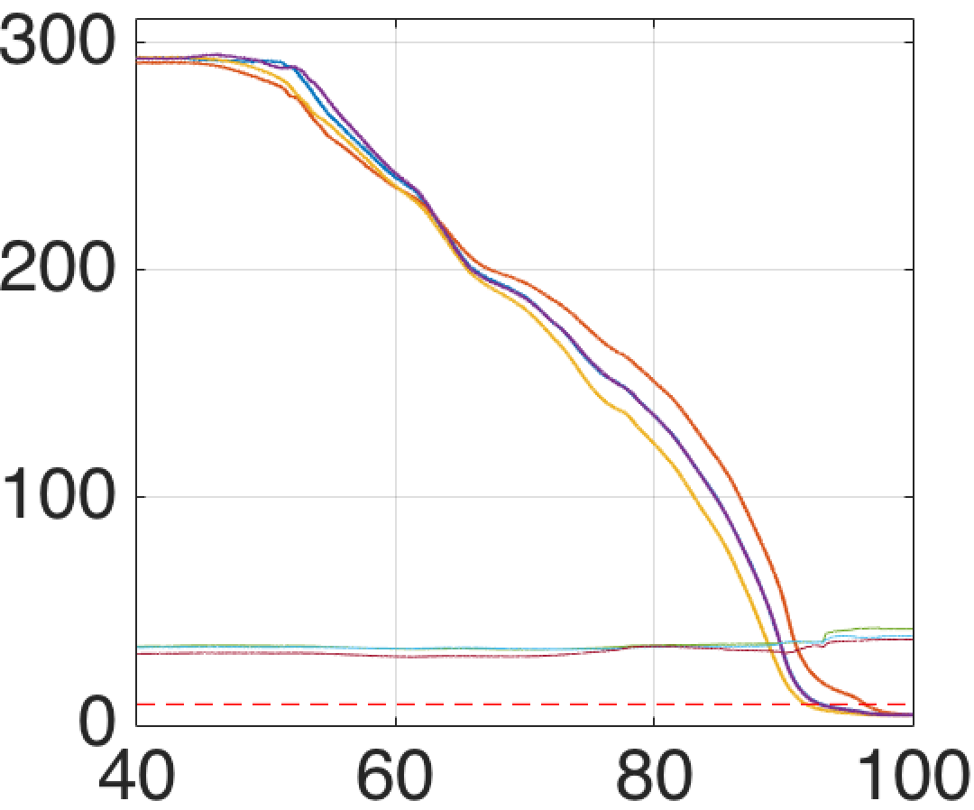
Expulsion Measurement
Assembled as-received cavities with only vacuum connections (no RF)
Cavities cooled quickly through range 150-100 K to avoid formation of hydrides
Thermal cycles to measure expulsion

Slide 10
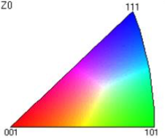
Material
Orientation Map
Local Misorientation Angle
Cavities are made:
  From the same ingot
  By the same vendor
  And both have large grains
Key difference:
  Cold work
Non-rolled
Rolled
Cold work shows in both maps

Slide 11
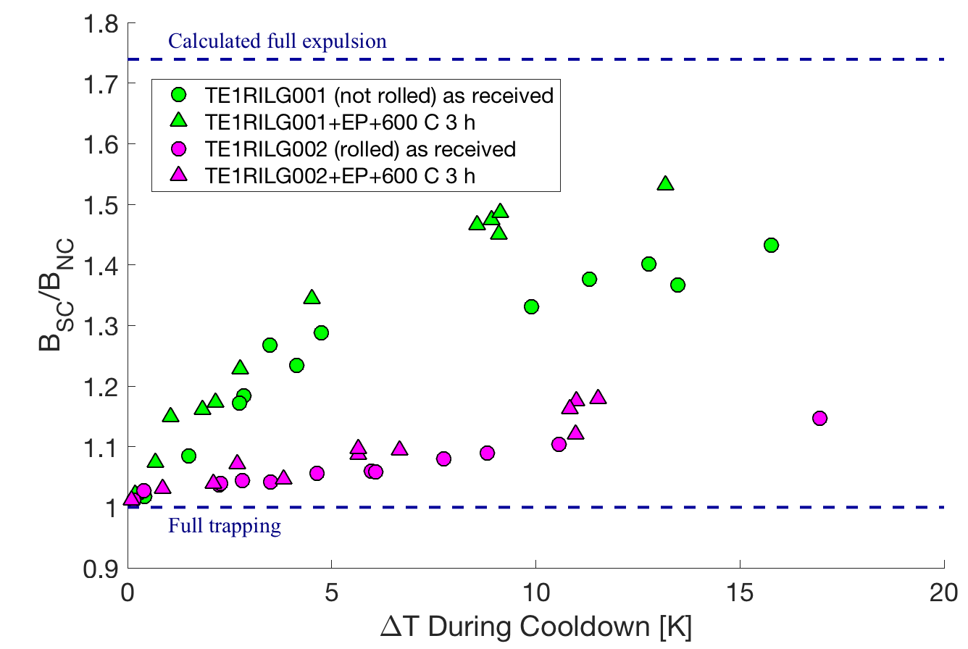
Expulsion Measurement
Non-rolled
Rolled sheets

Slide 12
Expulsion Measurement
Cold worked material very strong trapping
Incomplete expulsion for both LG cavities
Non-rolled
Rolled sheets

Slide 13
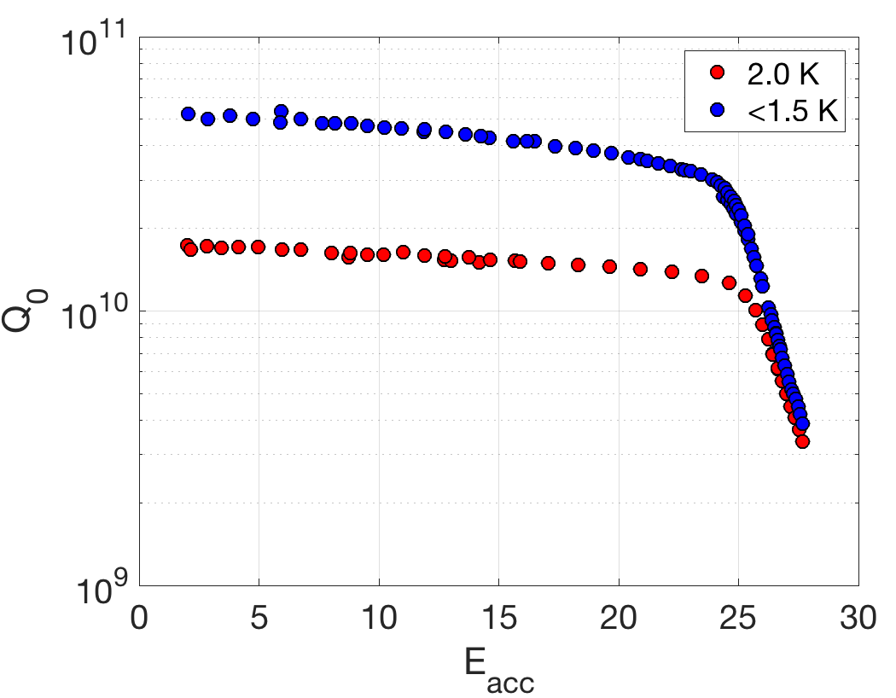
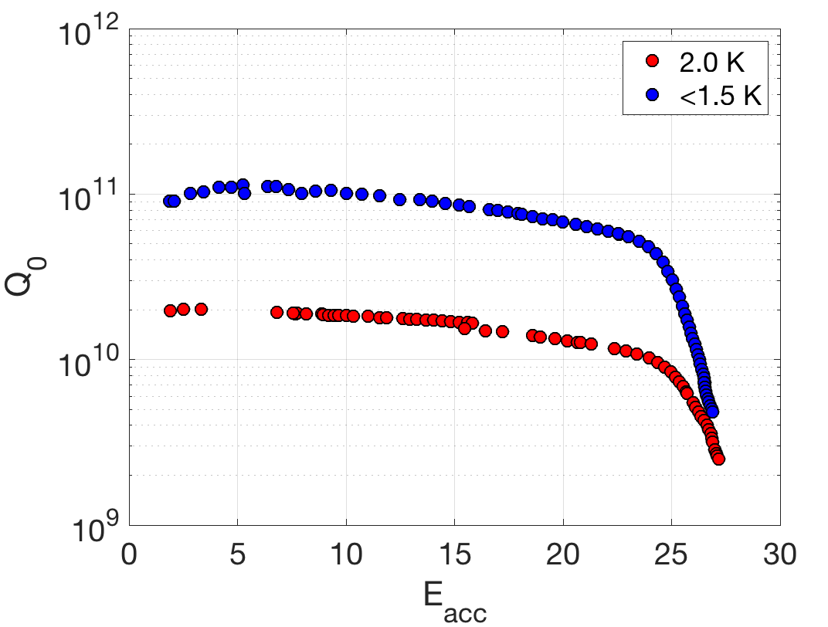
Q vs E Curves after Bulk EP + 600 C 3 hr + Light EP
Note: processing quenches at 2 K led to some Q₀ degradation
TE1RILG001
(non rolled)
TE1RILG002
(rolled)

Slide 14
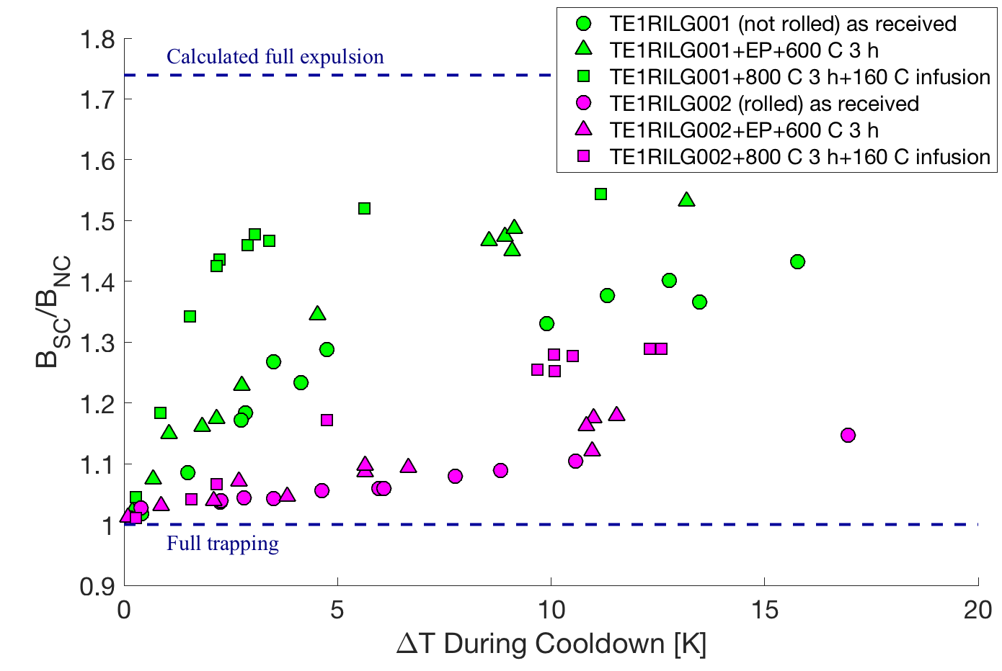
Expulsion Measurement
Non-rolled
Low expulsion even after 800 C 3 hour heat treatment
Rolled sheets

Slide 15
Conclusions
See also P. Dhakal (JLab), TTC Topical 2017
Strong trapping behavior is possible with large grain material even after 800 C 3 hour heat treatment, especially for rolled material
These results contribute to a body of evidence that cold work in SRF-grade niobium is crucially important to determining the flux trapping behavior
Implicates rolling steps in producing material that requires very high temperature heat treatment to have acceptable flux expulsion
Further motivate studies of dislocations in strongly trapping material

