Slide 1






Future Circular Collider Study
Overview and Design Status
M. Benedikt
gratefully acknowledging input from FCC coordination group,
global FCC design study team and all other contributors
LHC
HE-LHC
PS
SPS
FCC
http://cern.ch/fcc
Work supported by the European Commission under the HORIZON 2020 projects EuroCirCol, grant agreement 654305; EASITrain, grant agreement no. 764879; ARIES, grant agreement 730871; and E-JADE, contract no. 645479
photo: J. Wenninger
photo: J. Wenninger

Slide 2

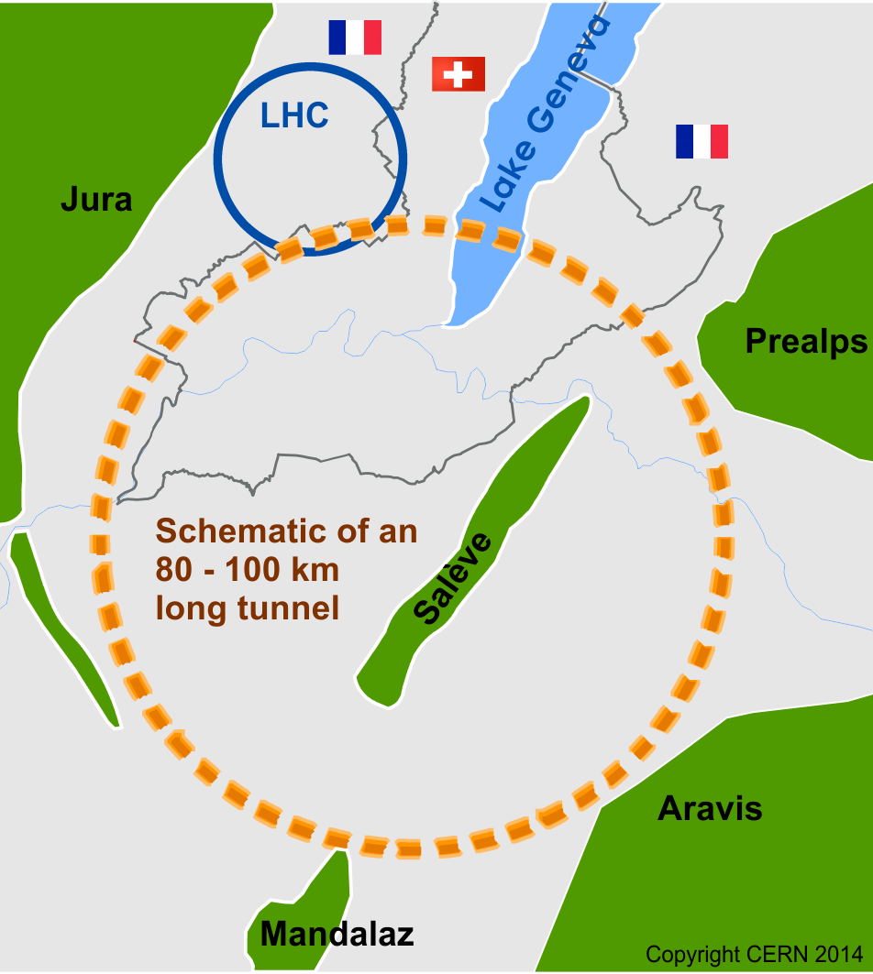

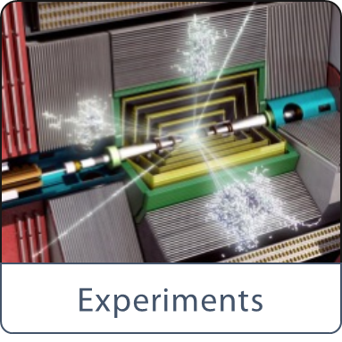
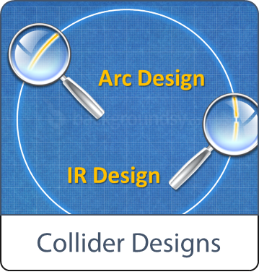
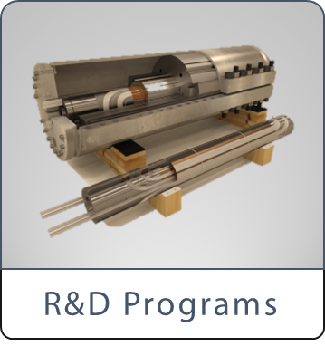


Future Circular Collider Study - Scope:
International FCC collaboration (CERN as host lab) to study:
pp-collider (FCC-hh) → long-term goal, defining infrastructure requirements
~100 km tunnel infrastructure in Geneva area, site specific
e⁺e⁻ collider (FCC-ee), as potential first step
HE-LHC with FCC-hh technology
p-e (FCC-he) option, IP integration, e⁻ from ERL
HE-LHC
~16 T ⇒ 100 TeV pp in 100 km

Slide 3
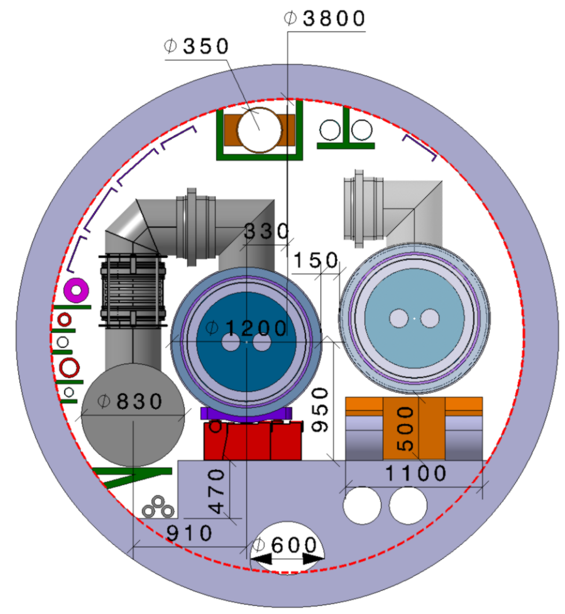
HE-LHC integration aspects
  Working hypothesis for HE LHC design:
  No major CE modifications on tunnel and caverns
  Similar geometry and layout as LHC machine & experiments
  Maximum magnet cryostat diameter ~1200 mm
  Maximum QRL diameter ~830 mm
  LHC tunnel diameter 3.8 m
Integration and design strategy:
Development of optimized 16 T magnet, compatible with HE LHC requirements
New cryogenic layout to limit QRL dimension

Slide 4

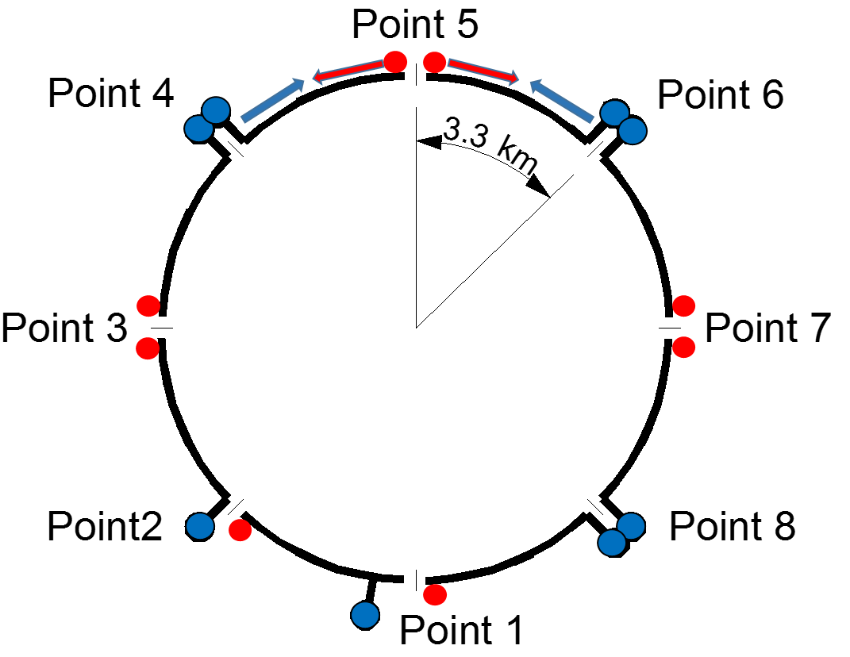
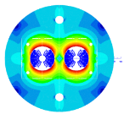
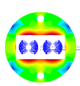
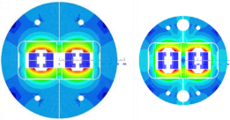
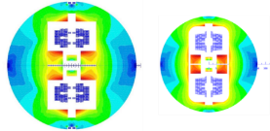
16 T dipole design evolution
Coil optimization and margin 18 → 14%
Inter-beam distance 250 → 204 mm
Stray-field < 0.1 T at cryostat
Half-sector cooling instead of full sector (as for LHC)
to limit cross section of cryogenic distribution line
800 mm 600 mm
Cosine-theta (baseline)
Block-type coils
Common-coils
higher heat load and integration limitations:
8 additional 1.8 K refrigeration units wrt. LHC
8 new higher-power 4.5 K cryoplants
2015 2017

Slide 5
Worldwide FCC Nb₃Sn program
5400 mm²
3150 mm²
Main development goal is wire performance increase:
J_{c} (16T, 4.2K) > 1500 A/mm² →50% increase wrt HL-LHC wire
Reduction of coil & magnet cross-section
~1.7 times less SC
~10% margin
HL-LHC
~10% margin
FCC ultimate
After only one year development, prototype Nb₃Sn wires from several new industrial FCC partners already achieve HL-LHC performance
Conductor activities for FCC started in 2017:
Bochvar Institute (production at TVEL), Russia
KEK (Jastec and Furukawa), Japan
KAT, Korea
Columbus, Italy
University of Geneva, Switzerland
Technical University of Vienna, Austria
SPIN, Italy
University of Freiberg, Germany
  In addition, agreements under preparation:
  Bruker, Germany
  Luvata Pori, Finland
Notes:
New slide from Davide.
Showing that conductor development is launched at international level, Russia, Japan, (Korea and Europe in preparation)
Underline importance of that development as main cost driver for the hadron collider machine.

Slide 6

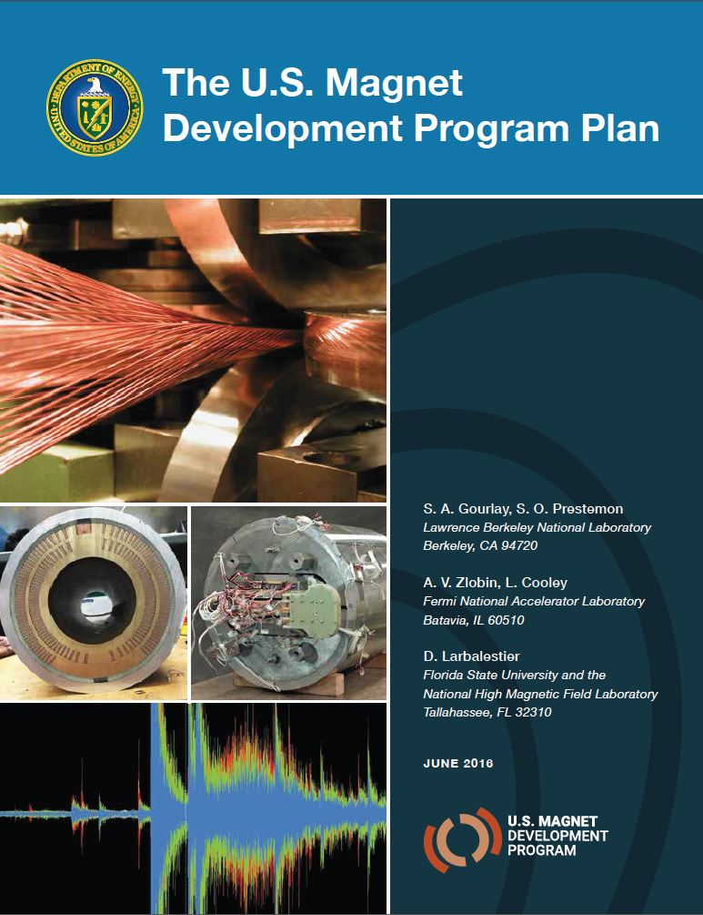
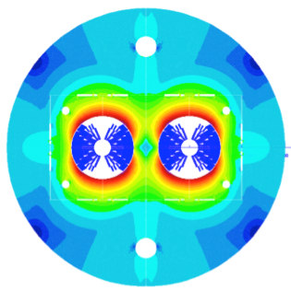
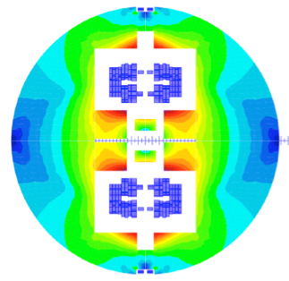

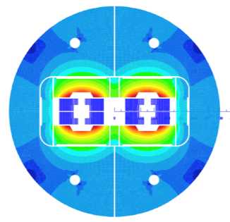
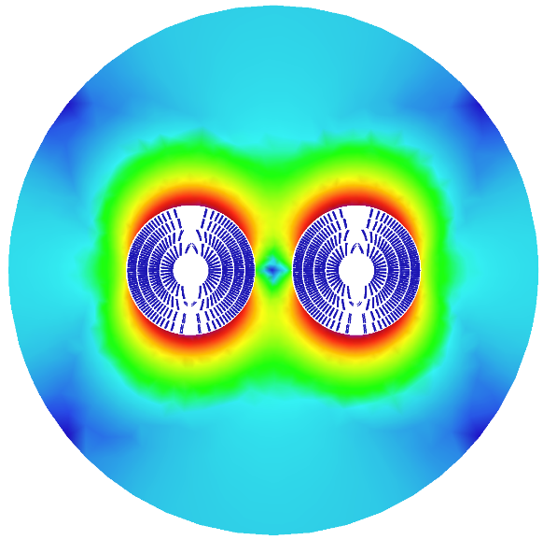
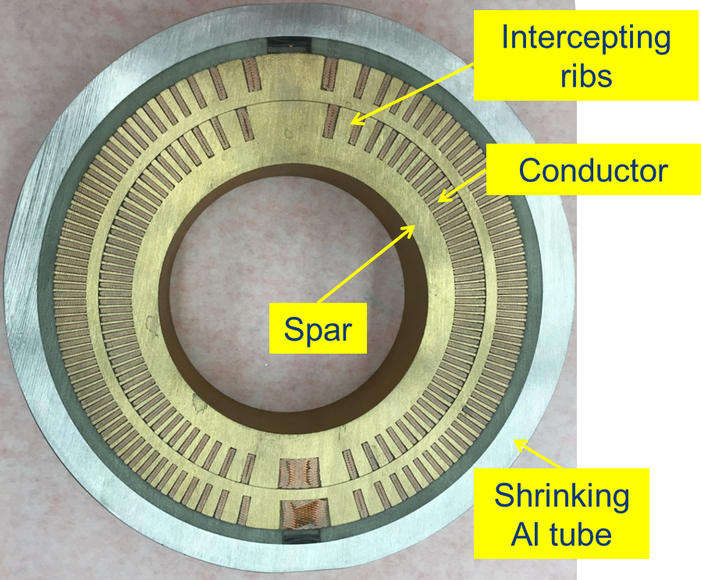
16 T dipole design activities and options
H2020
Swiss contribution
CHART
Cos-theta
Common coils
Canted
Cos-theta
Blocks
INFN
CIEMAT
LBNL
CEA
PSI
FNAL
Short model magnets (1.5 m lengths) will be built from 2018 – 2022
Russian 16 T magnet program launched by BINP recently.

Slide 7

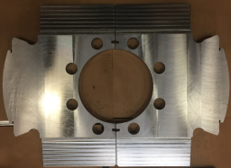
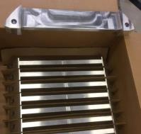
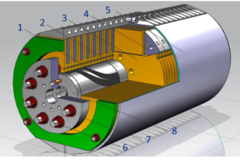
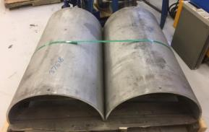
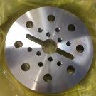
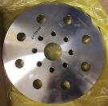
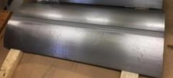
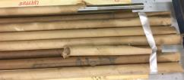
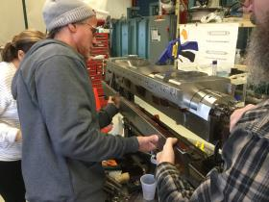
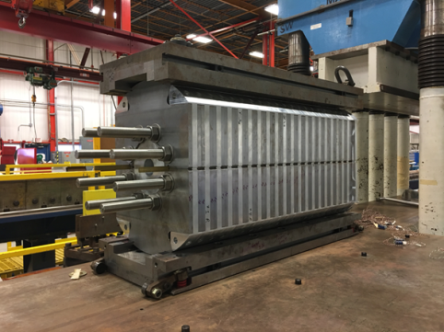
15 T dipole demonstrator (US-MDP)
Iron Laminations
AL I-Clamps
StSt Skin
End Plates
Fillers
Axial Rods
All coil parts, structural components and tooling are available at FNAL
Coil fabrication and the work with mechanical structure are in progress
First magnet test in September 2018

Slide 8
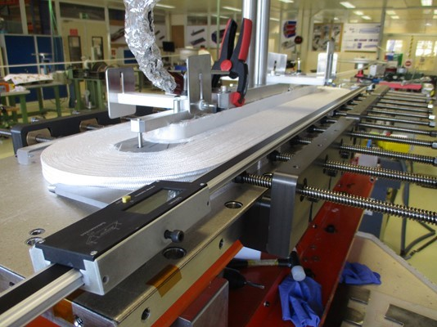
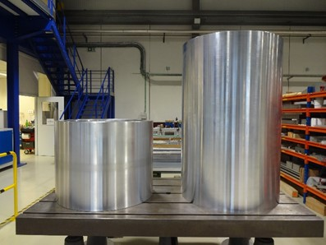
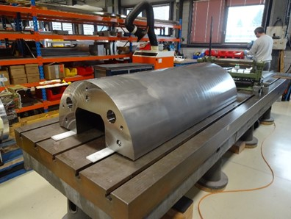
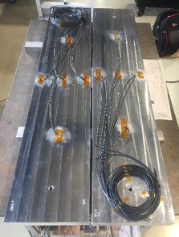
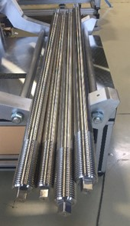
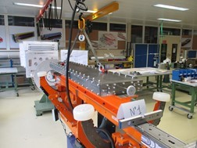
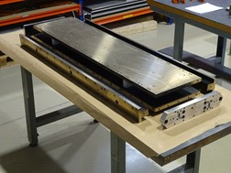
16 T ERMC construction at CERN
Aluminum shell
Coil fabrication
  Winding of the first coil has been completed
  Preparation for reaction on-going
  All tooling for coil production ready
Magnet yoke
First ERMC coil winding
Magnet assembly
  components and tooling ready
  Dummy assembly to characterize the structure behavior on-going.
Coil Reaction Tool
Coil Impregnation Tool
Dummy coils
Axial rods

Slide 9
Technical Schedule for each of the 3 options
20
22
24
26
28
30
32
34
36
38
40
42
Technical Design Phase
Strategy Update 2026 – assumed project decision
Dipole short models
Dipole long models
16 T magnets
SC Magnets
16 T dipole indust. prototypes
16 T dipoles preseries
16 T series production
Civil Engineering FCC-hh ring
FCC-hh
FCC-hh
CE TL to LHC
LHC Modification
Installation + test FCC-hh
CE FCC-ee ring + injector
FCC-ee
FCC-ee
Injector
Installation + test FCC-ee
LHC Removal
HE-LHC
HE-LHC
schedule constrained by 16 T magnets & CE
→ earliest possible beam operation dates
FCC-ee: 2039
FCC-hh: 2043
HE-LHC: 2040 (with HL-LHC stop LS5 / 2034)
Installation HE-LHC

Slide 10
Further Planning – CDR production
Compact summary CDRs 1, 2, 4, 6 ready by November 2018
CDR long technical volumes 3, 5, 7:
  Collection of input (from status June 2018) during July – October 2018.
  Overall volume editing November 2018 – January 2019
  Proof reading and approval February – March 2019

