Slide 1



EuroCirCol Cosθ 16 T dipole
Presented @ FCC week
9-13 April 2018
Amsterdam
BARBARA CAIFFI
G. Bellomo, P. Fabbricatore, S. Farinon, s. MARIOTTO, A.Pampaloni A. M. RICCI, M. Sorbi, M. STatera

Slide 2
Outlook
Magnetic design
  2D and 3D magnetic model
  Field qualty & peak field
Mechanical design
  VM stress
  Contact pressure to the pole
  Preliminary 3D mechanical design
Conclusions and Future Work

Slide 3
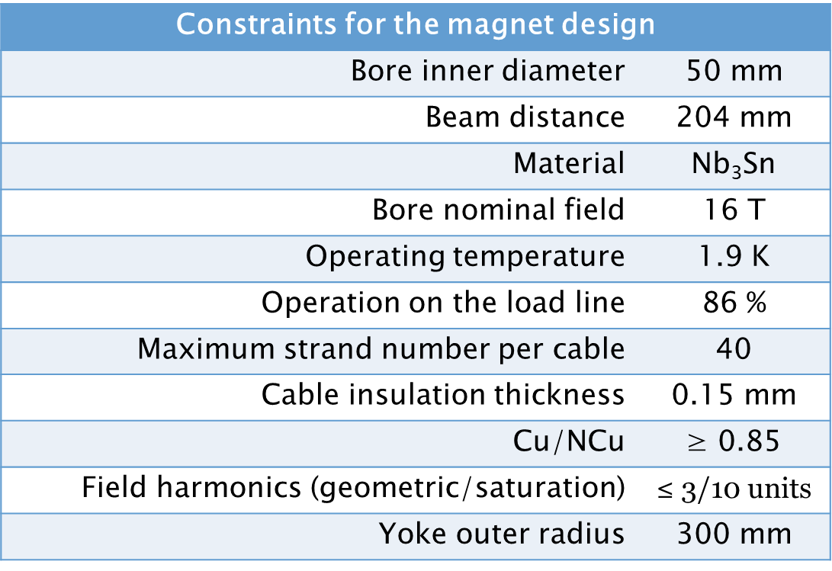
Design parameters

Slide 4

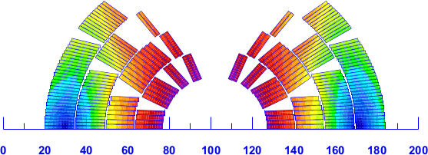
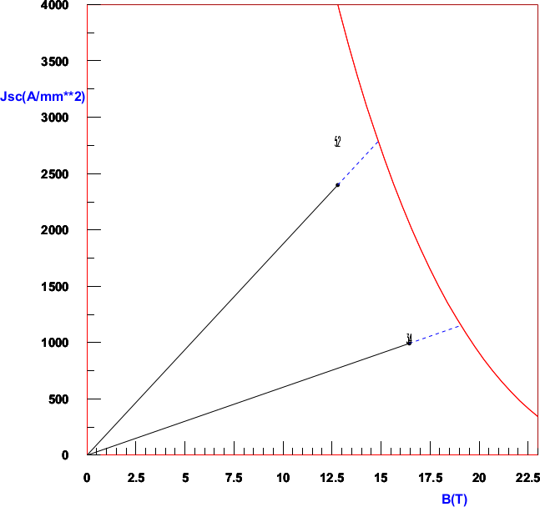
Magnetic model
B_{peak} (HF cable)= 16.44 T
Wedge = 0.86 mm
B_{peak} (LF cable) = 12.8 T
Number of turns:
Layer 1: 13
Layer 2: 19
Layer 3: 29
Layer 4: 39
Tot: 200/ap.
Load Line
1.9 K
LF cable
J_{c}[A/mm²]
 | HF Cable (inner) | LF Cable (outer)
Strand number | 22 | 38
Strand diameter | 1.1 mm | 0.7 mm
Bare width | 13.2 mm | 14 mm
Bare inner thickness | 1.892 mm | 1.204 mm
Bare outer thickness | 2.007 mm | 1.3261 mm
Insulation | 0.15 mm | 0.15 mm
Keystone angle | 0.5° | 0.5°
Cu/Ncu | 0.82 | 2.1
Operating current | 11390 A | 11390 A
Operating point on LL (1.9 K) | 86 % | 86 %
HF cable
B[T]

Slide 5
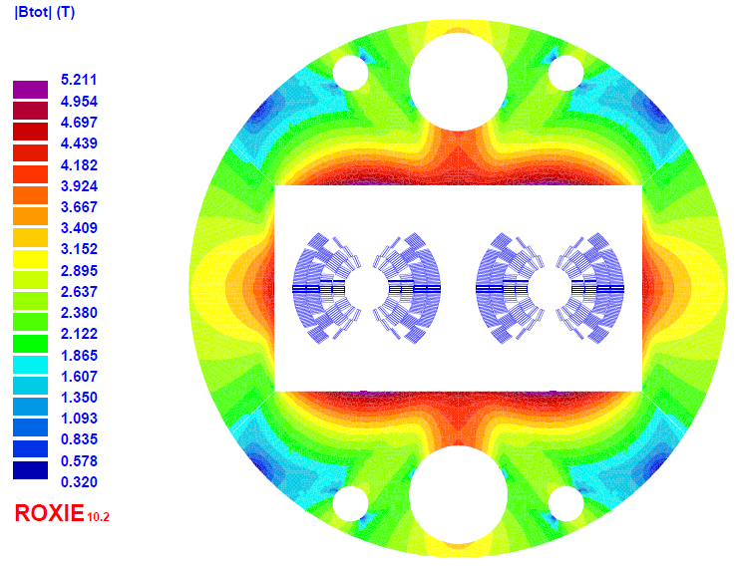
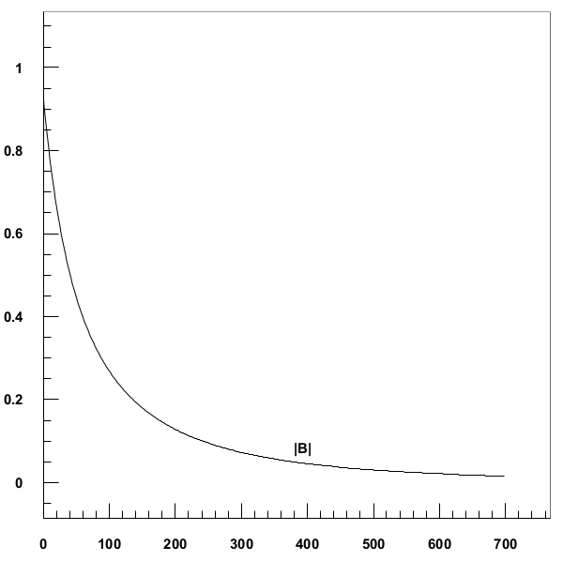
Magnetic model
Fringe field along r
Fringe field
B[T]
Distance from yoke [mm]
Outer yoke radius: 300 mm
B=0.1 T @ 245 mm from the yoke
(545 mm from the center)

Slide 6
Field Quality (geometrical + iron saturation)
B | b2 | b3 | b4 | b5 | b6 | b7 | b8 | b9
16T | -56.6 | 1.5 | 1.2 | -1.0 | -0.01 | 1.8 | -0.001 | 1.4

Slide 7
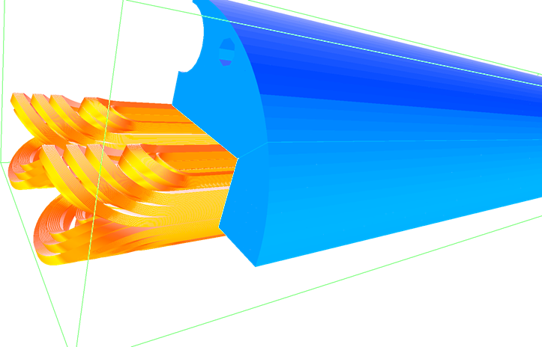
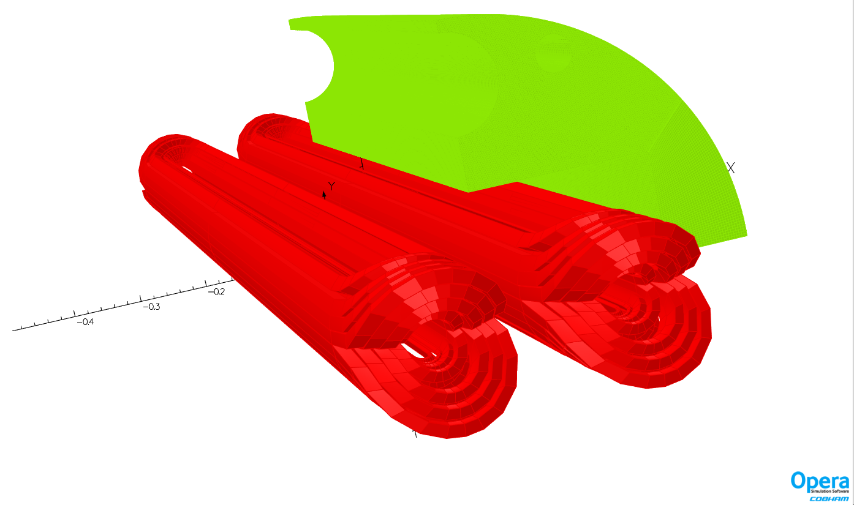
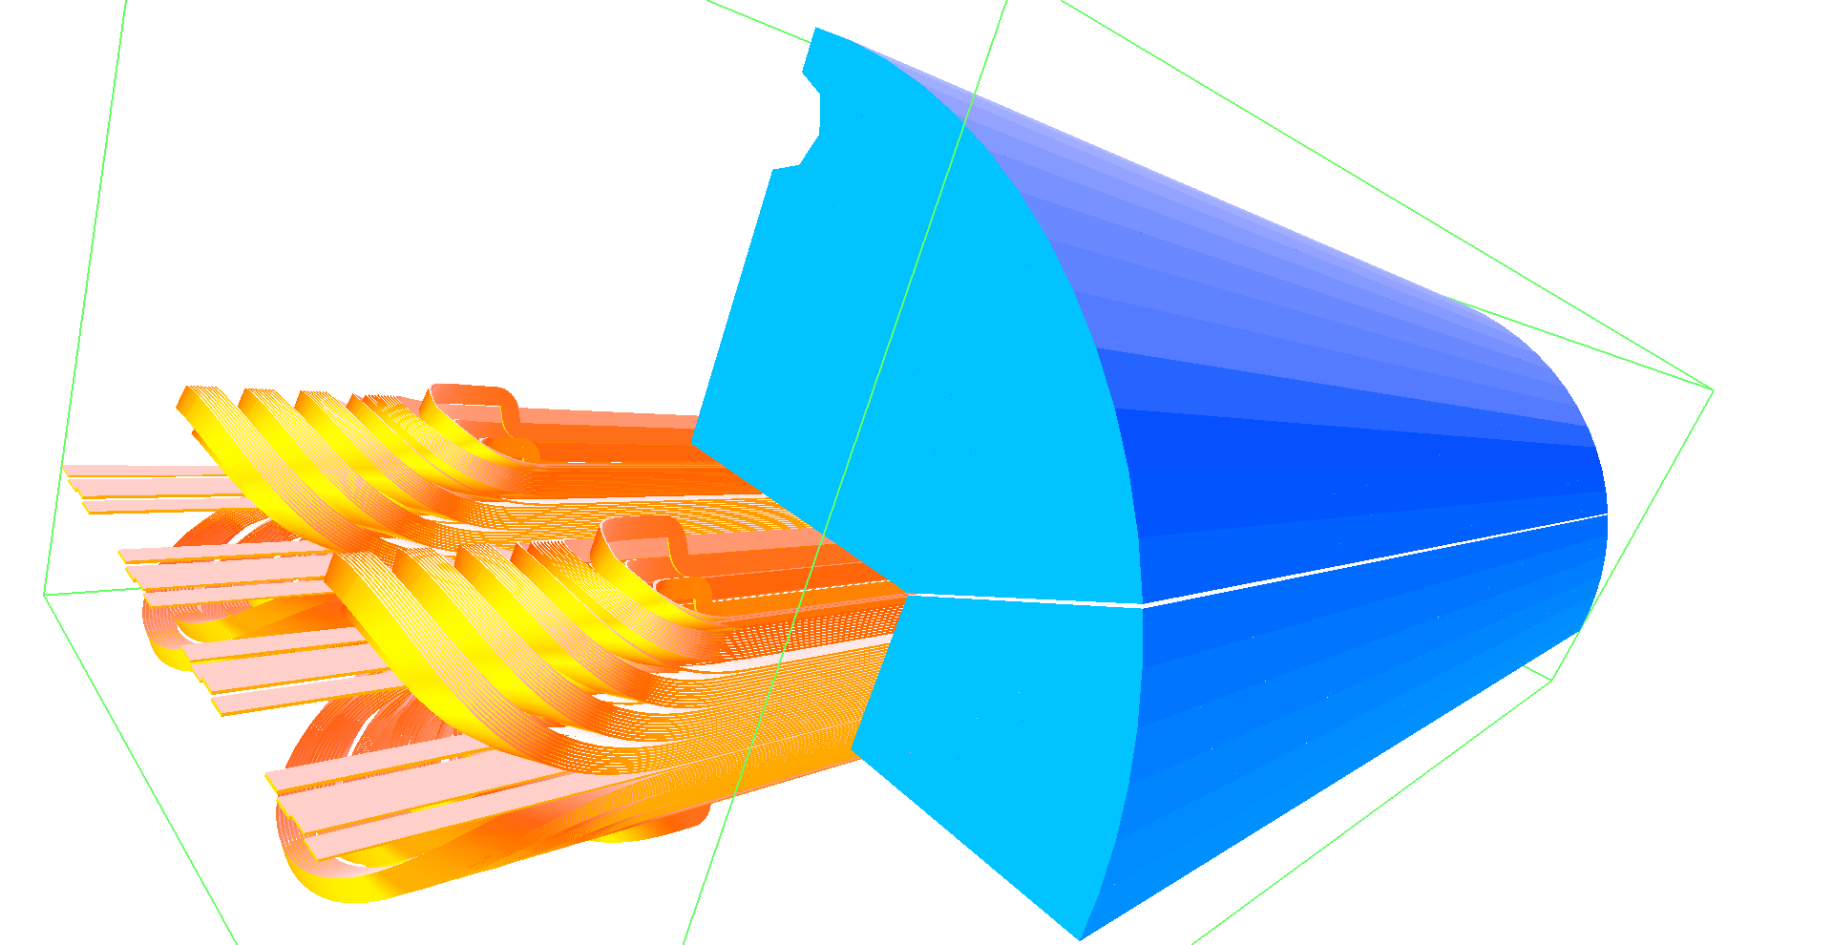
3D magnetic end design
Roxie
Connection side
Opera
Side opposite to connection

Slide 8
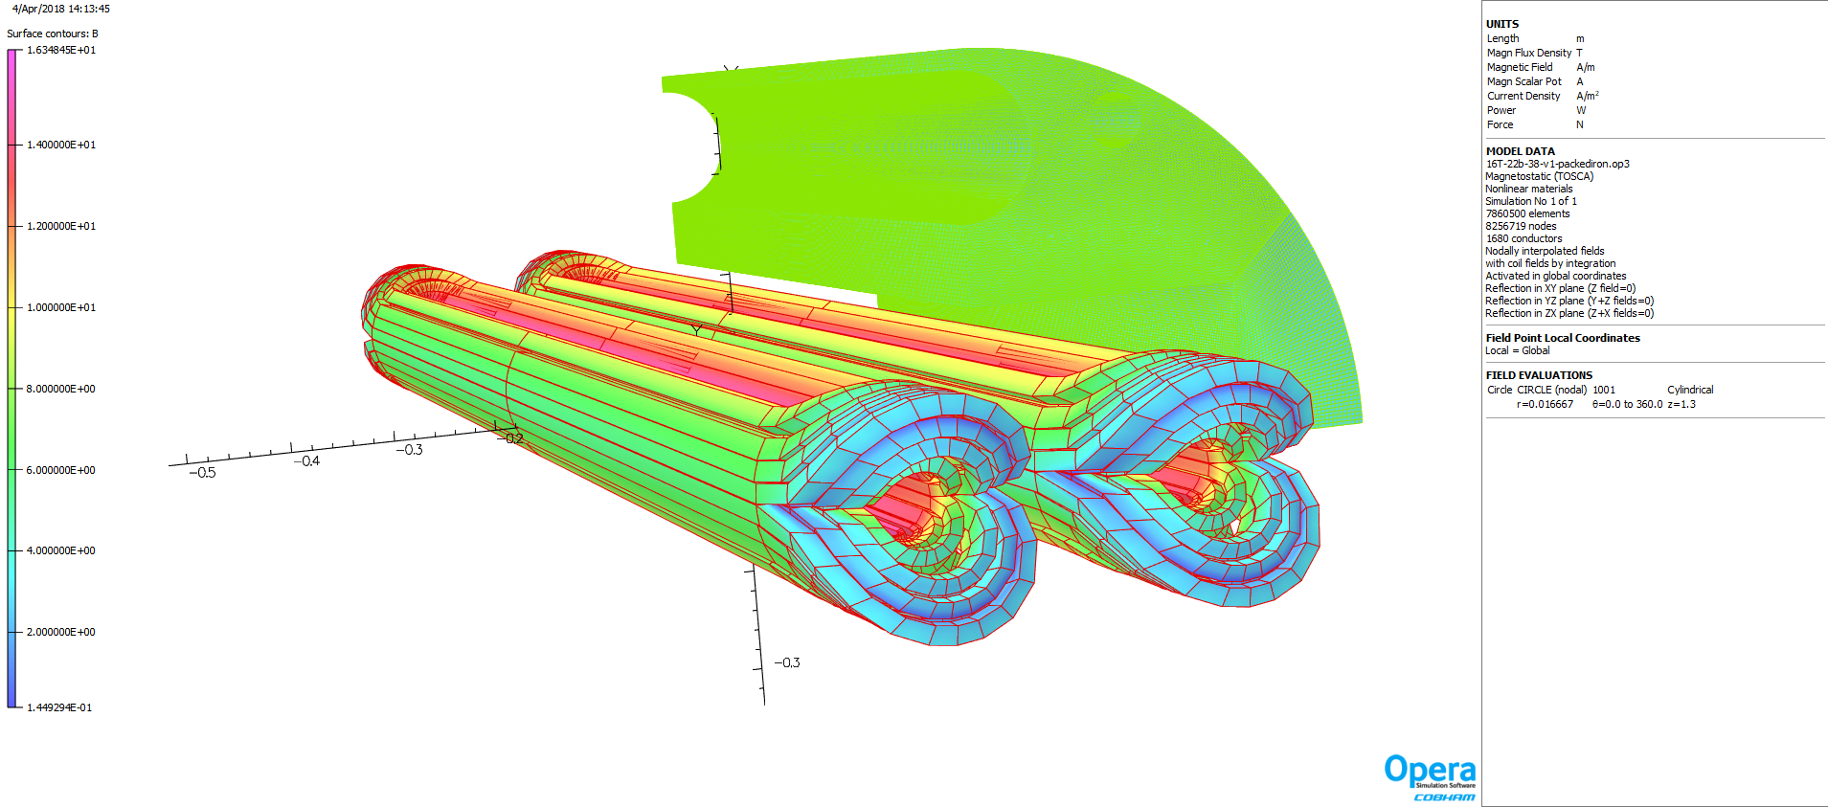
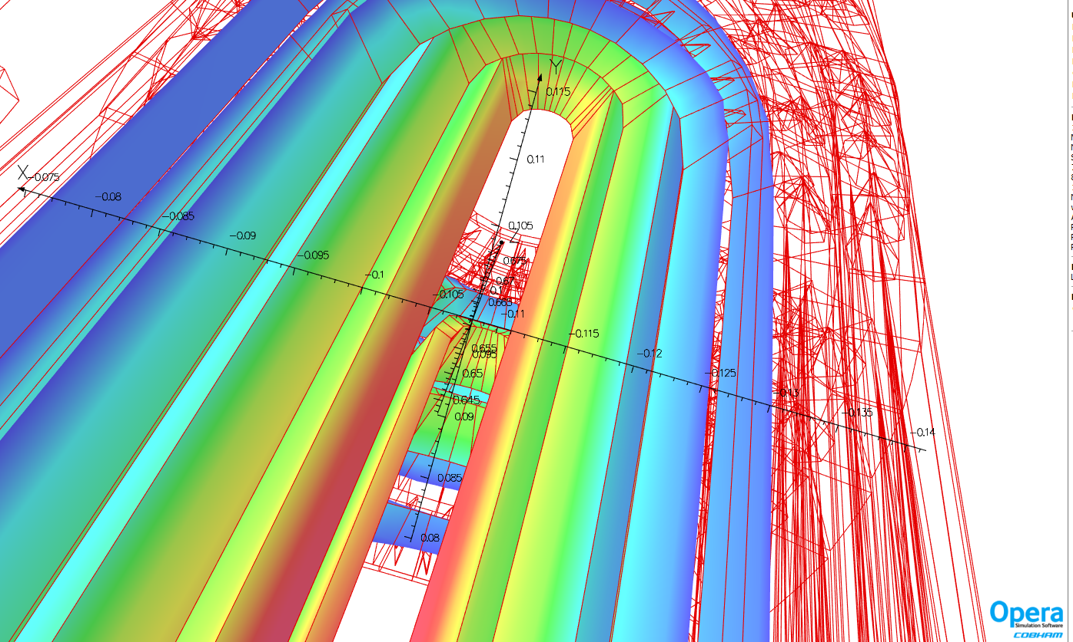
3D magnetic end design
B_{peak} = 16.39 T (Opera)
16.44 T (Roxie 3D)
16.44 T (Roxie 2D)
Good agreements between
2D and 3D models
Peak field in straight section

Slide 9
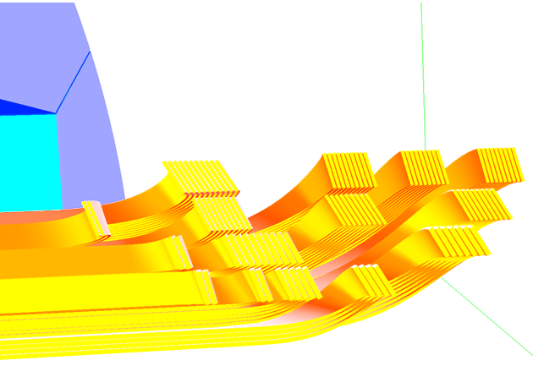
3D magnetic end design
NORMAL 3D INTEGRAL RELATIVE MULTIPOLES
B | b2 | b3 | b4 | b5 | b6 | b7 | b8 | B9
16T | -65.3 | 2.1 | -1.2 | -0.6 | -0.01 | 1.7 | -0.0002 | 1.4
End of yoke
Iron Length: 890 mm
Magnetic length:1032 mm
Physical length: 1100 mm

Slide 10
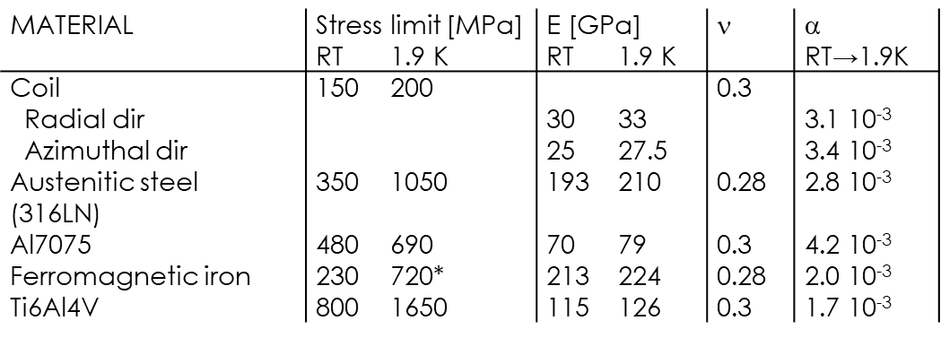
Mechanical constrains
Stress in the conductor < 150 MPa @ RT, < 200 MPa @ 1.9 K
Stress on mechanical structure < yield strength
No detachment between coil and pole

Slide 11
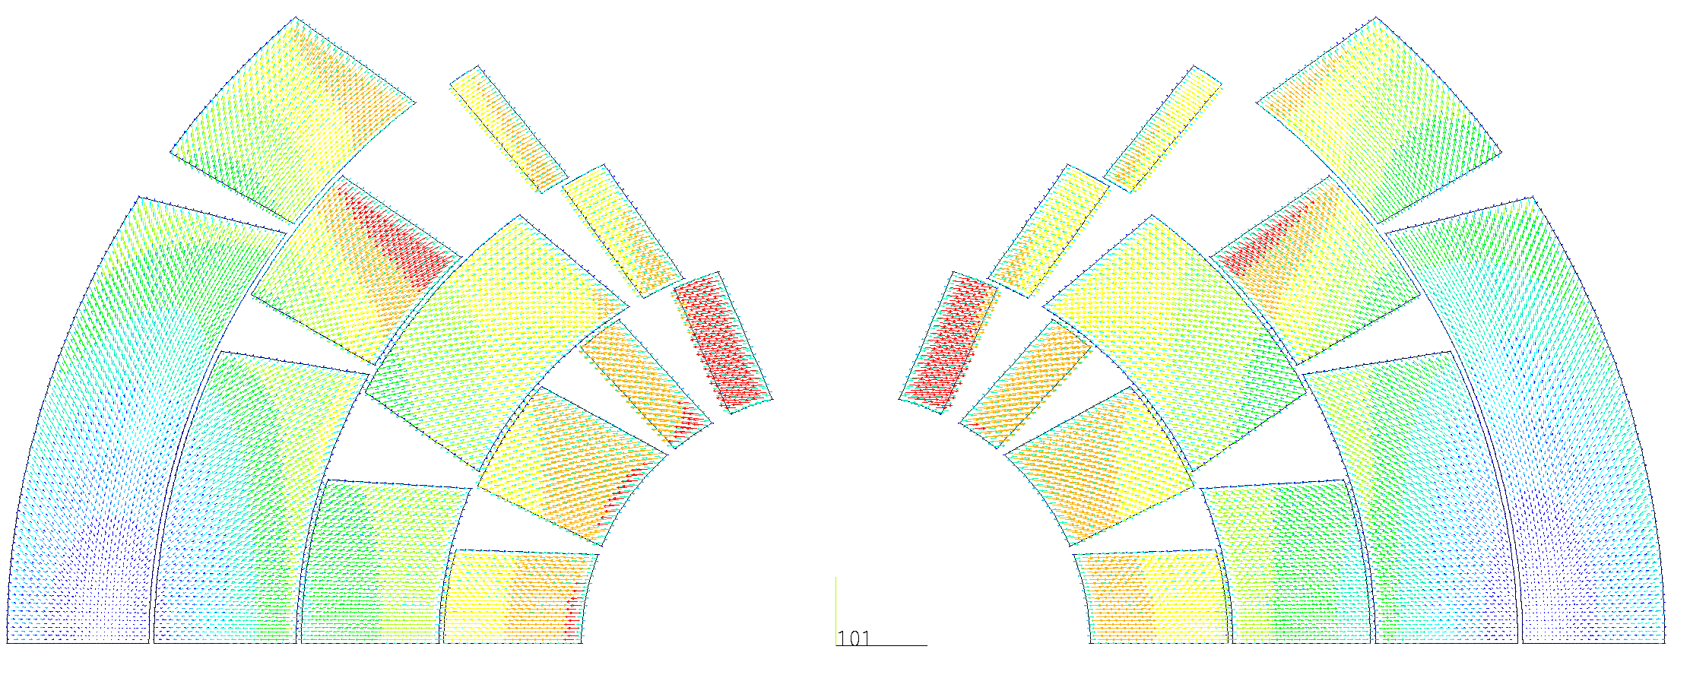
Lorentz Forces
RH | FX sum (MN) | FY sum (MN) | Fθ sum (MN) | σθ sum (MPa)
1 | 2,1 | -0,1 | -1,2 | -90,5
2 | 2,3 | -0,5 | -1,6 | -120,4
3 | 2,0 | -1,1 | -1,8 | -125,9
4 | 0,3 | -2,0 | -2,1 | -145,8
Total RH | 6,8 | -3,7 | -6,7 | -118,0
LH | FX sum (MN) | FY sum (MN) | Fθ sum (MN) | σθ sum (MPa)
1 | -2,1 | -0,2 | 1,3 | -92,9
2 | -2,4 | -0,6 | 1,7 | -125,9
3 | -2,2 | -1,2 | 2,0 | -136,9
4 | -0,7 | -2,3 | 2,4 | -166,9
Total LH | -7,4 | -4,2 | 7,3 | -127,9
total winding | -0,6 | -7,9 | 0,6 | /
In cosθ configuration, Lorentz forces push the coil:
Outward in the radial direction
Toward the midplane in the azimuthal direction

Slide 12
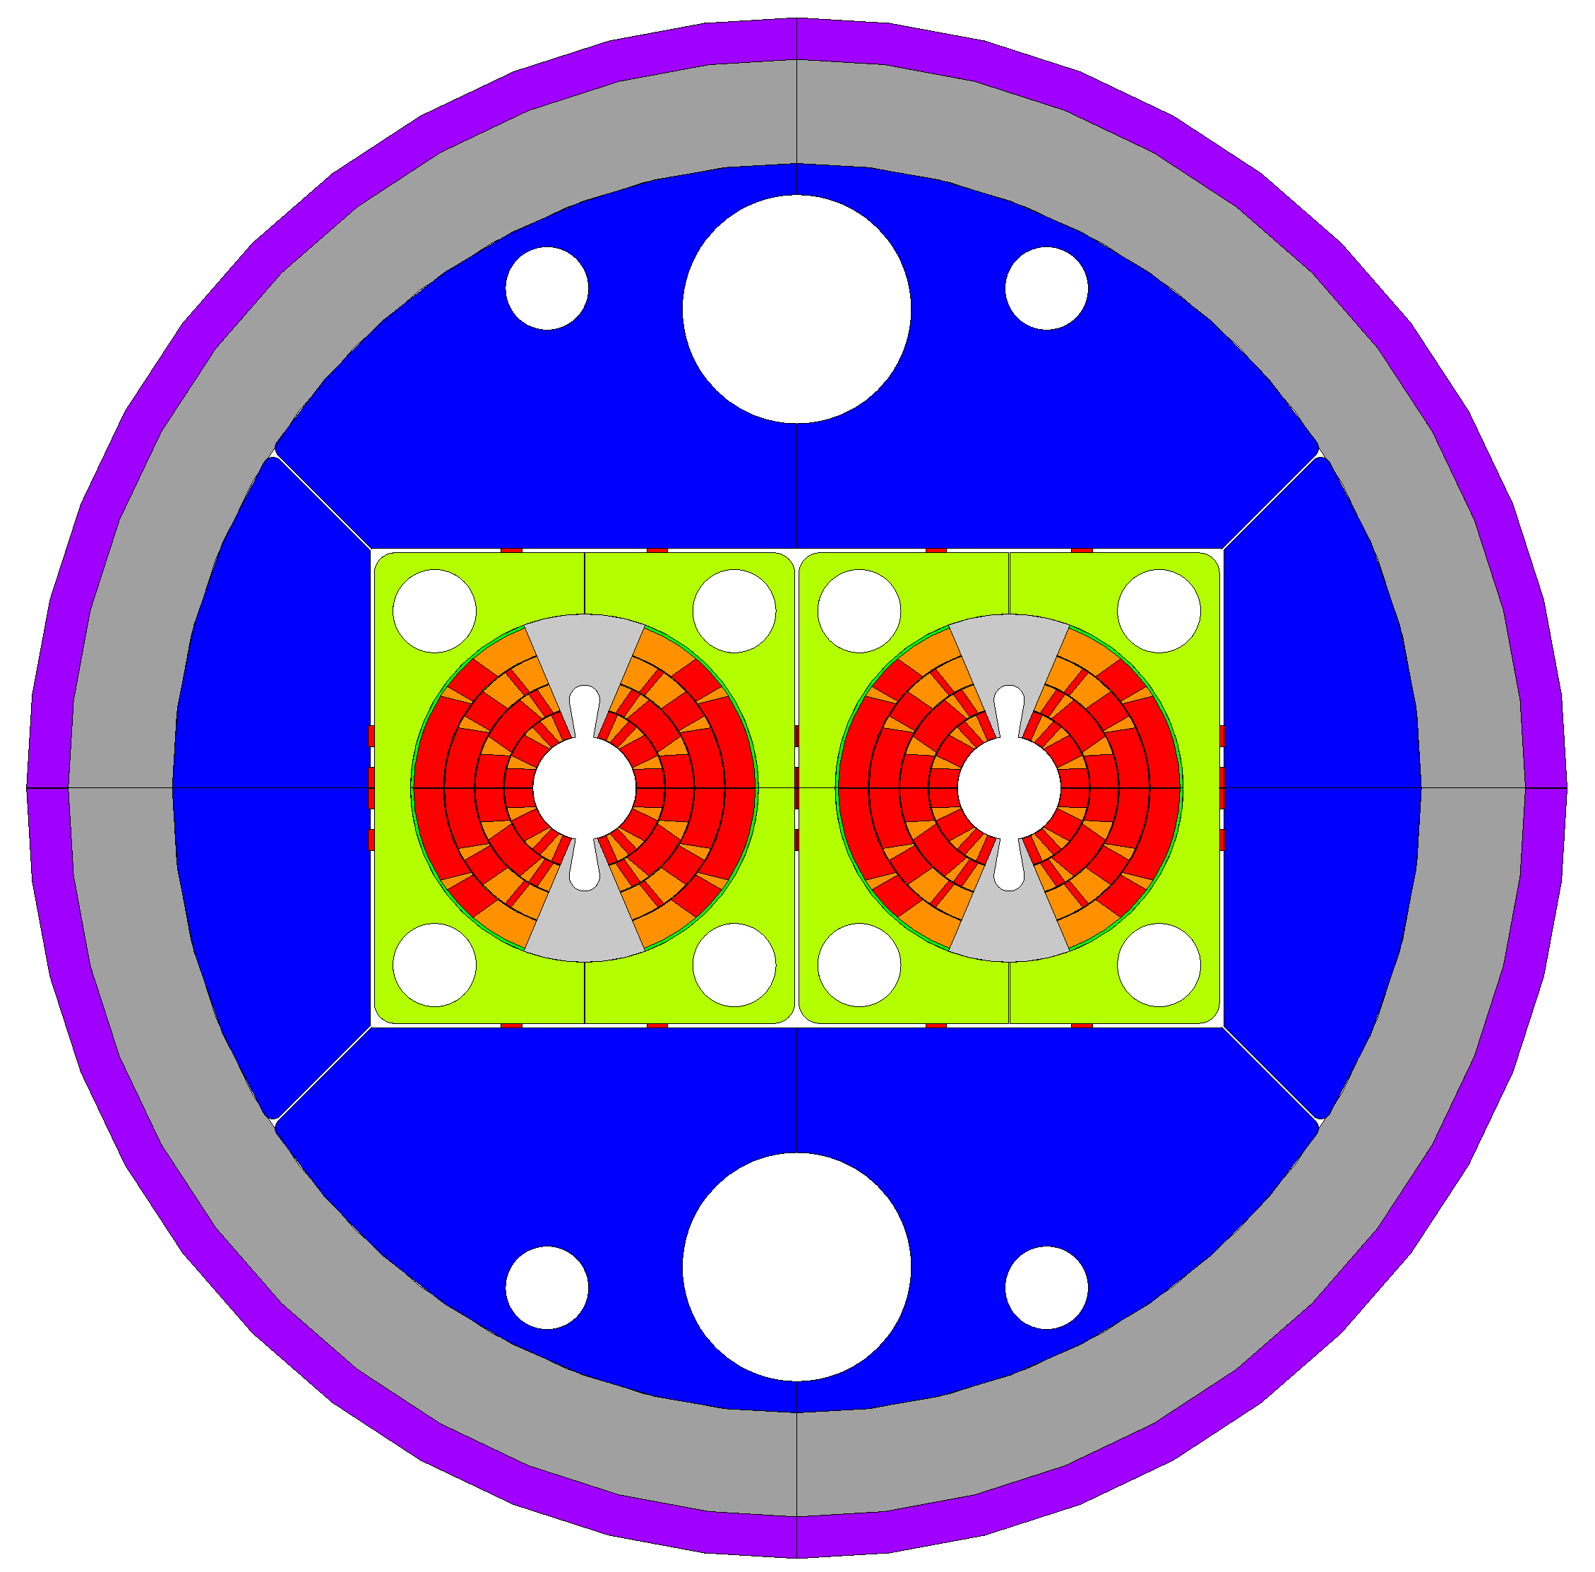
Cosθ mechanical layout
40 mm
R_{iron} = 300 mm
50 mm
Yoke outer diameter: 600 mm
Al alloy shell thickness: 50 mm
SS shell thickness: 20 mm
Outer magnet diameter: 740 mm
Inter-beam distance: 204 mm
Inter-beam = 204 mm
20 mm
110 mm

Slide 13
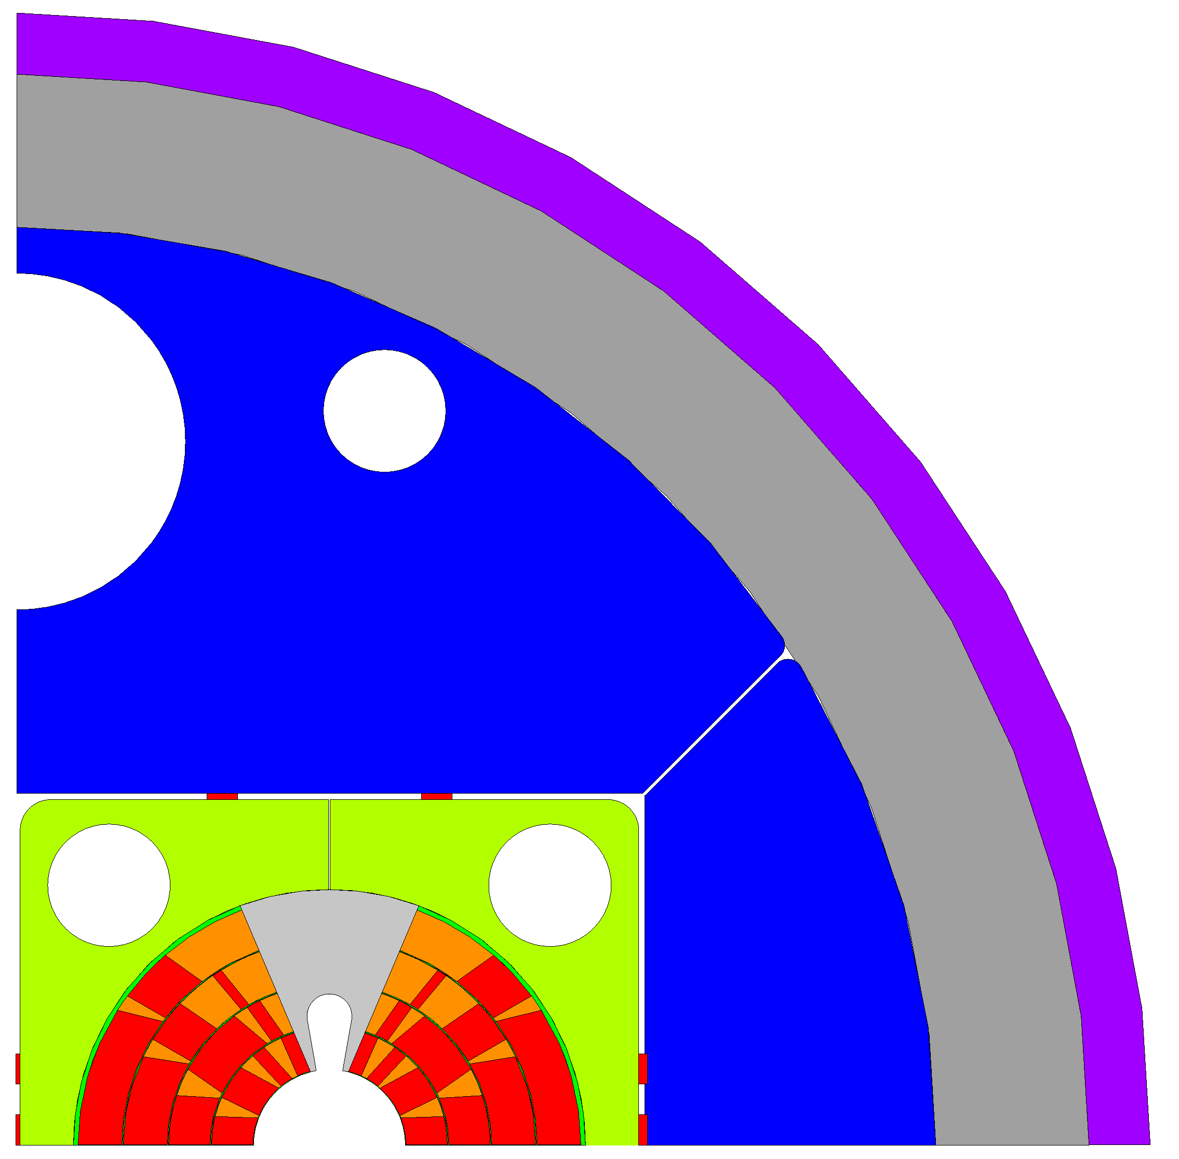
ANSYS mechanical models
Outer steel shell
Aluminum shell
Iron yoke
Titanium pole
Steel pad
Copper wedges
Conductor

Slide 14
Mechanical analysis
Glued contact elements
Outer steel shell
Aluminum shell
Iron yoke
Titanium pole
Steel pad
Copper wedges
Conductor

Slide 15
Mechanical analysis
Sliding permitted contact elements
Outer steel shell
Aluminum shell
Iron yoke
Titanium pole
Steel pad
Copper wedges
Conductor

Slide 16
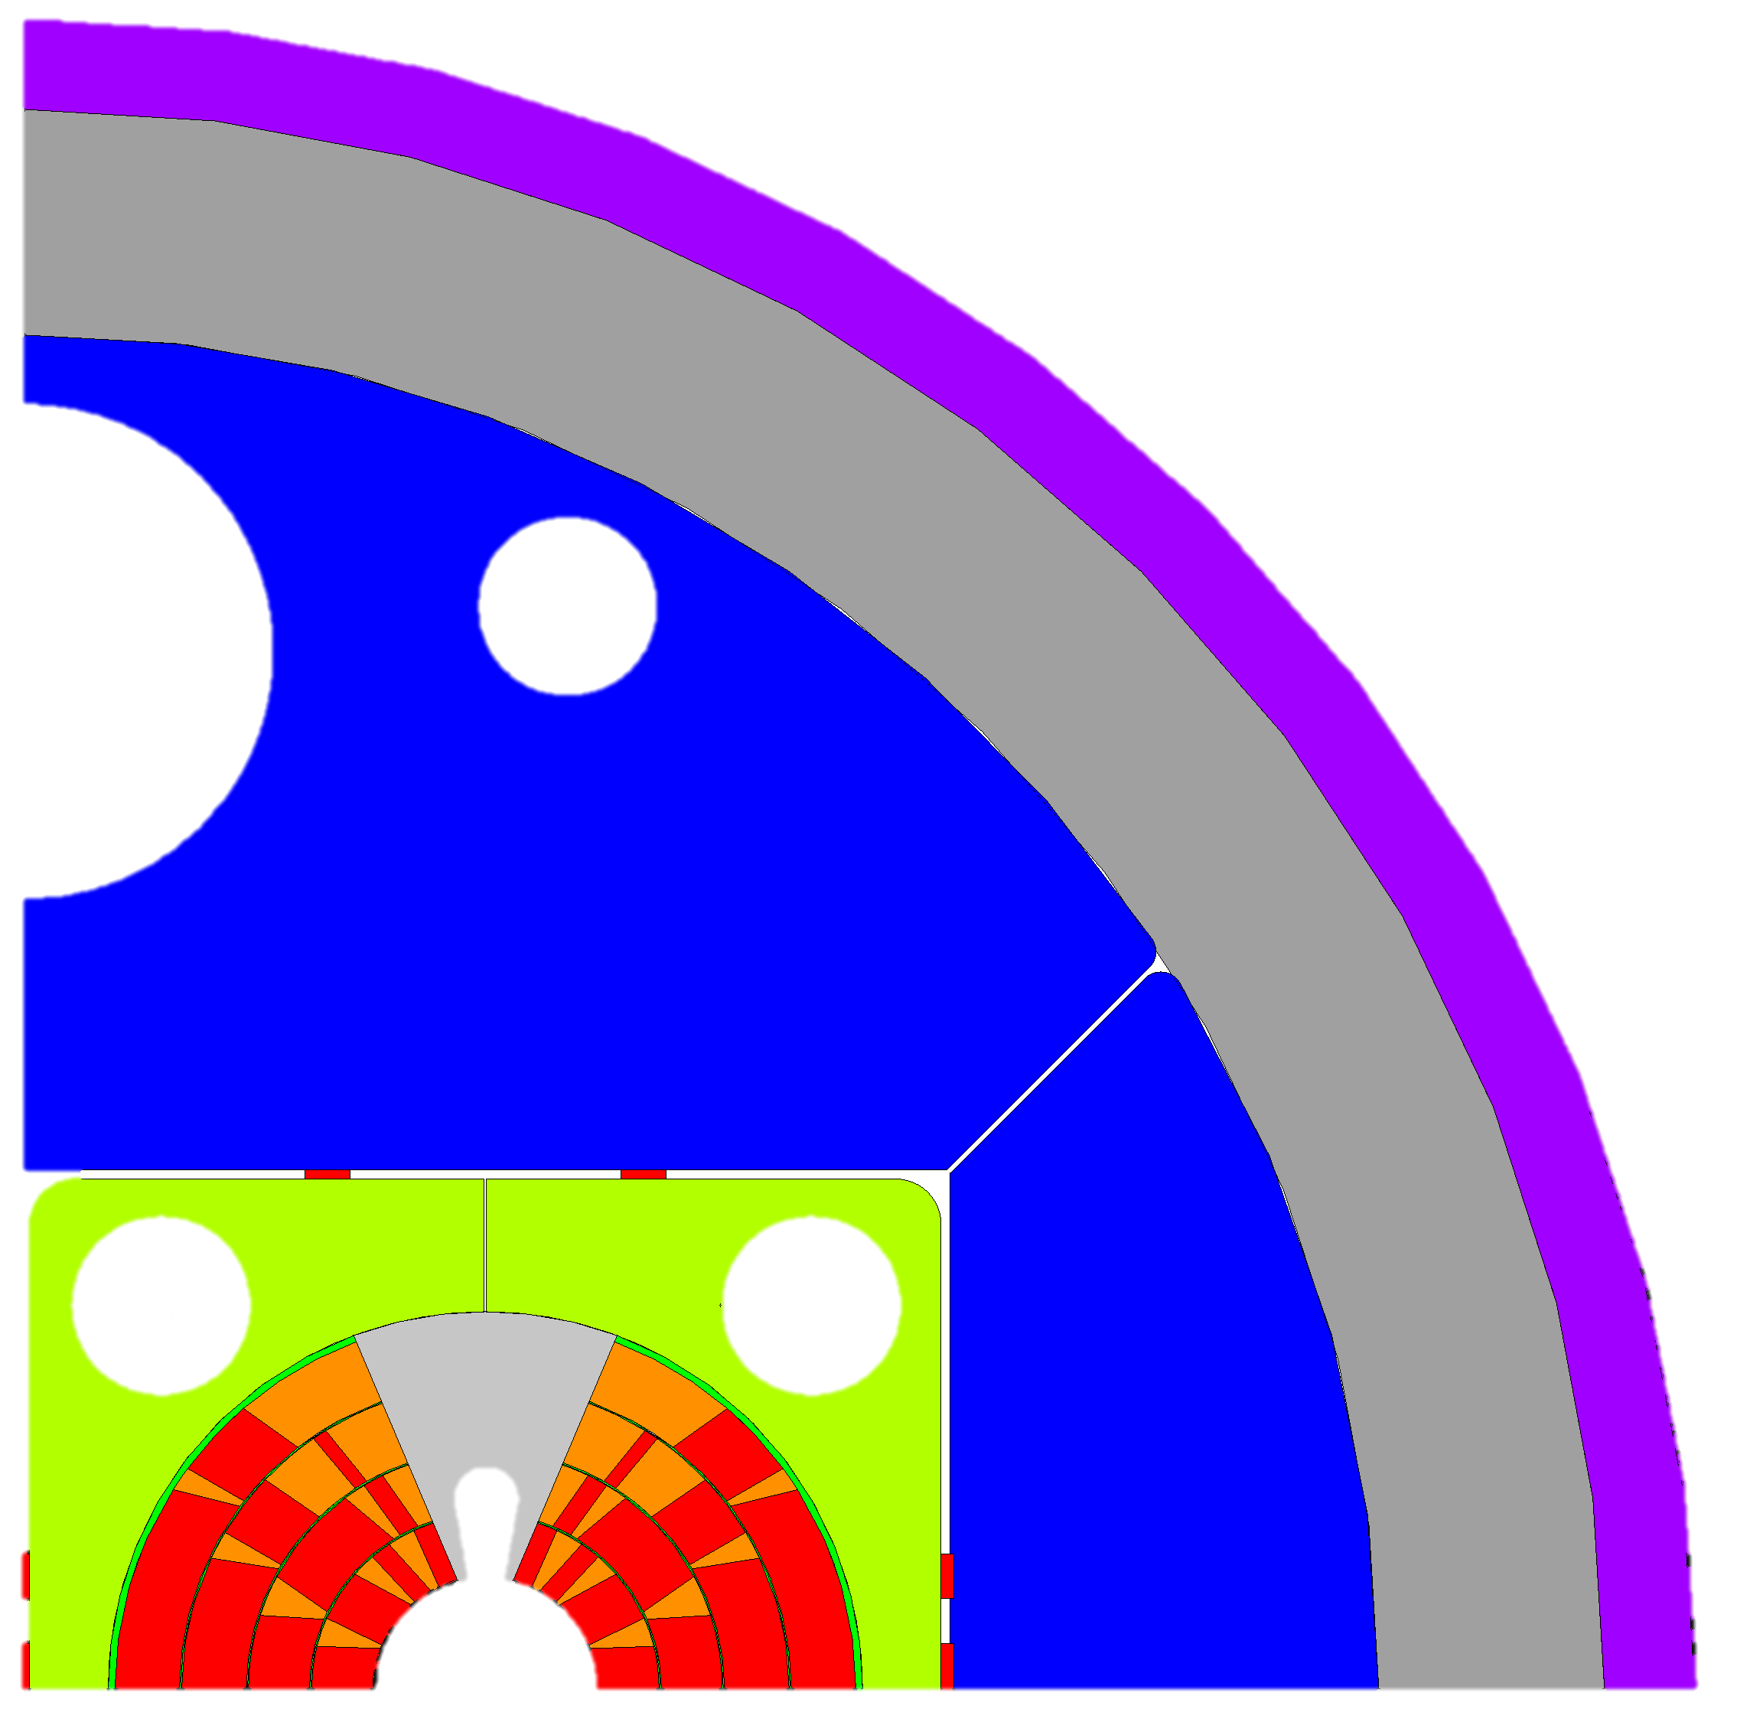
Mechanical analysis
Sliding and detachment permitted contact elements
Outer steel shell
Aluminum shell
Iron yoke
Titanium pole
Steel pad
Copper wedges
Conductor

Slide 17
Mechanical analysis
Step 1: assembly (key insertion)
Step 2: assembly under compression of SS shell 0.2 mm per side cut on midplane
Step 3: cooling down
Step 4: energization to 16 T (application of Lorentz forces to the conductor elements)
Outer steel shell
Aluminum shell
Iron yoke
Titanium pole
Steel pad
Copper wedges
Conductor

Slide 18
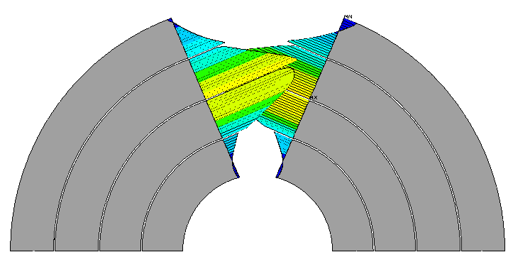
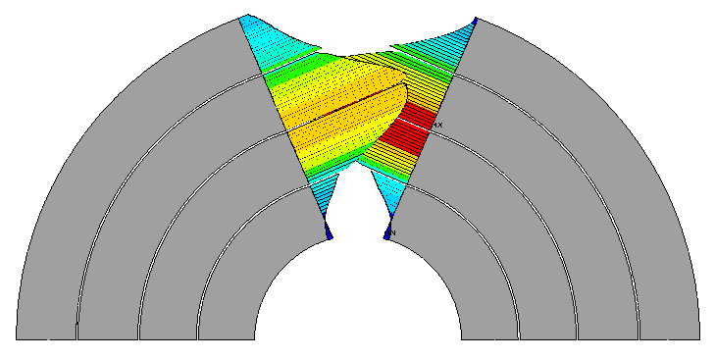
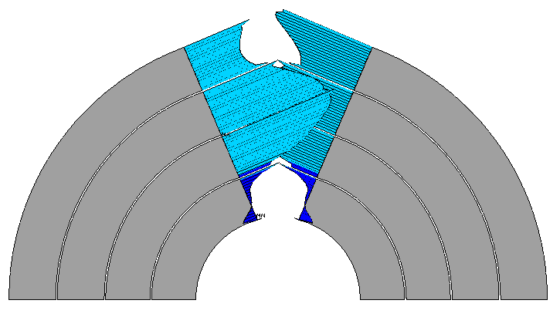
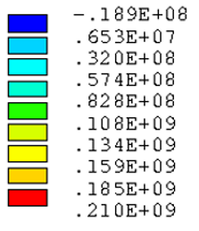
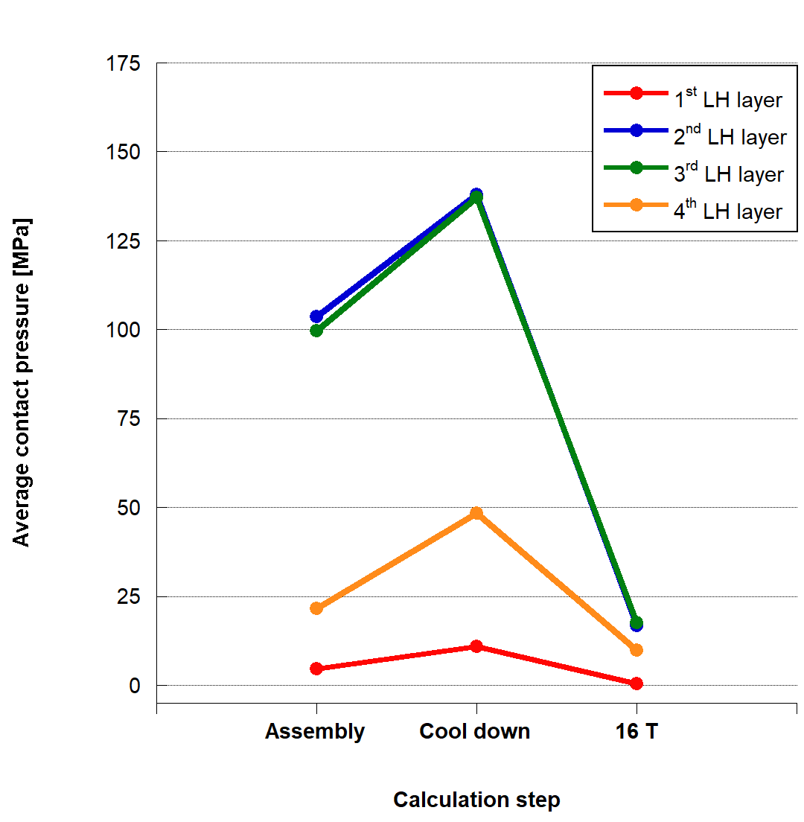
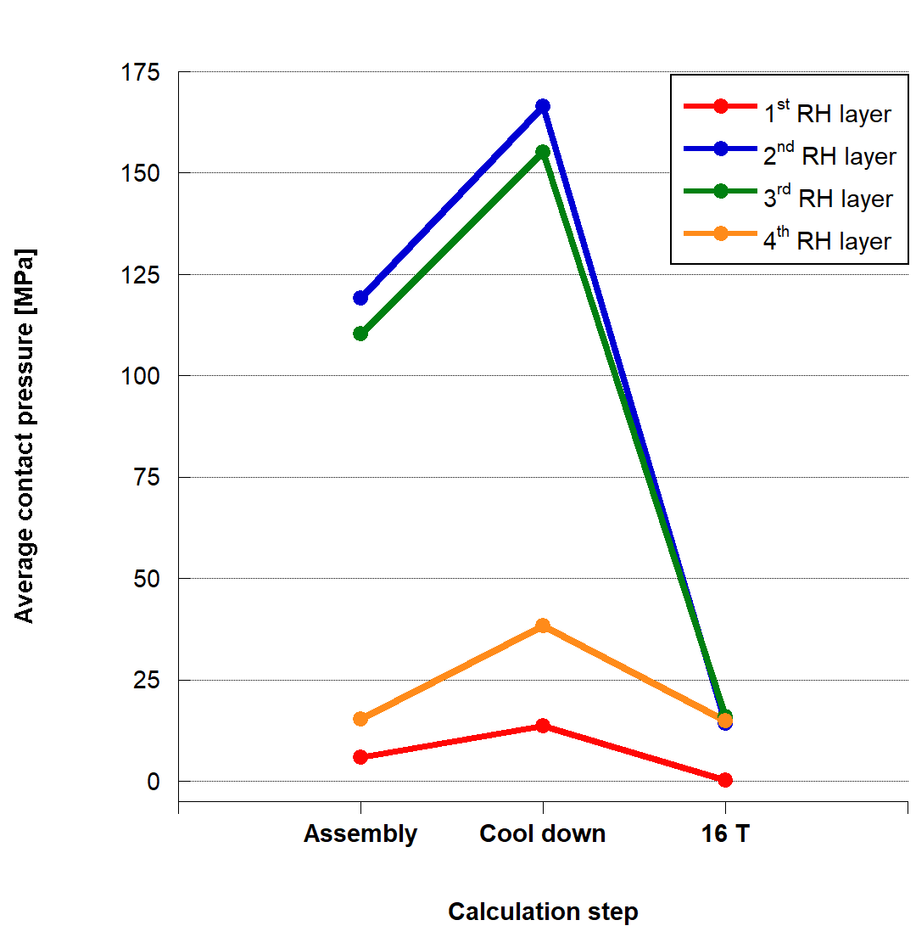
Contact Pressure at Pole
ASSEMBLY
COOL DOWN
16 T
Contact pressure [Pa]
LEFT
RIGHT
<P_{cont,1°layer} (16 T)> = 2 MPa
P_{cont,1°layer} (16 T)|_{mid-point} = 1 MPa
<P_{cont,1°layer} (16 T)> = 2 MPa
P_{cont,1°layer} (16 T)|_{mid-point} < 1 MPa
Contact pressure increases after cool down (Al + SS shell shrinking)
P_{cont,med} > 0 for 1° layer after energization at 16T

Slide 19
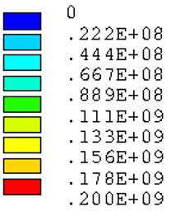
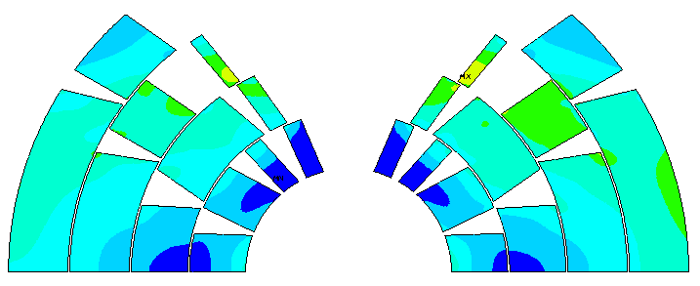
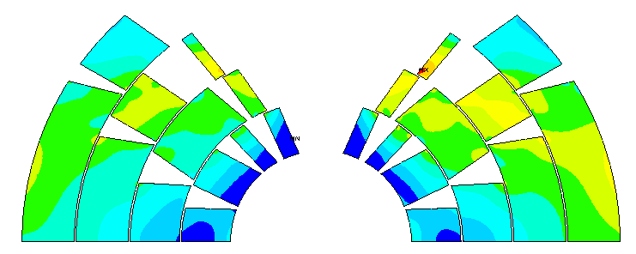
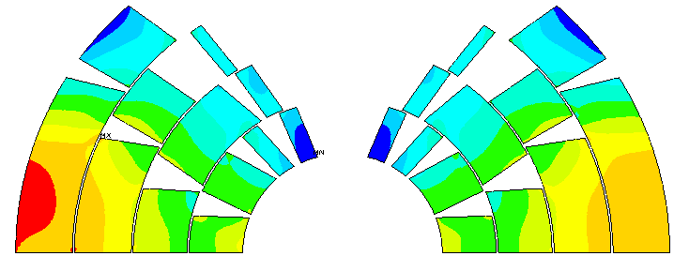
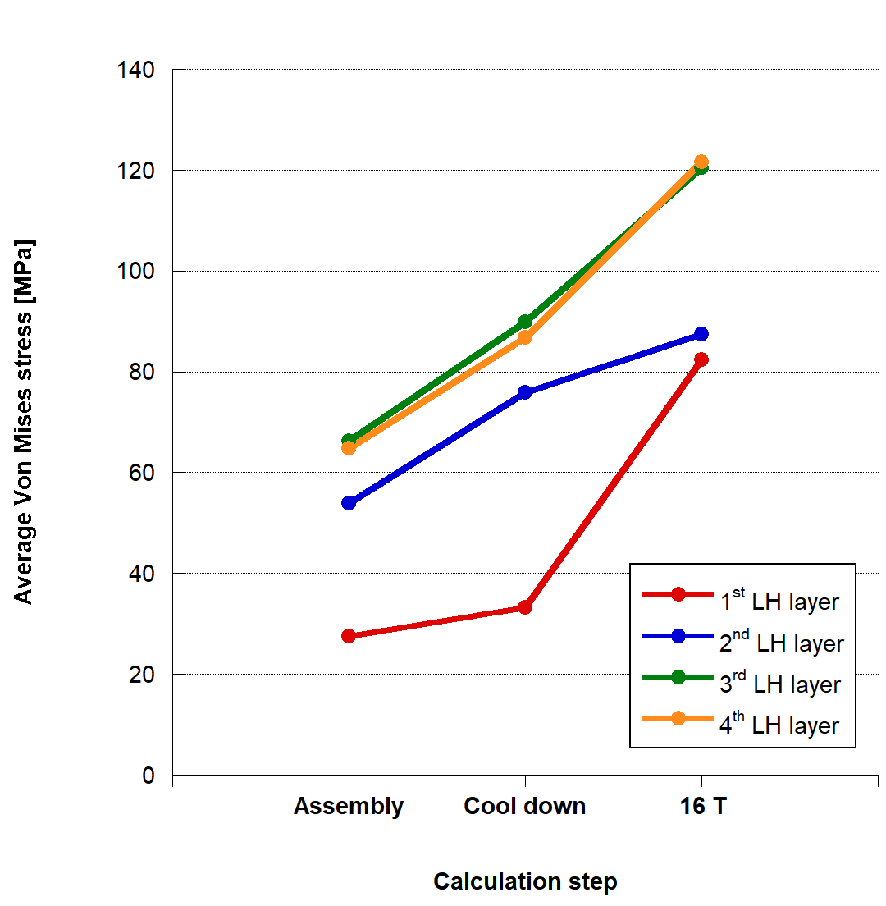
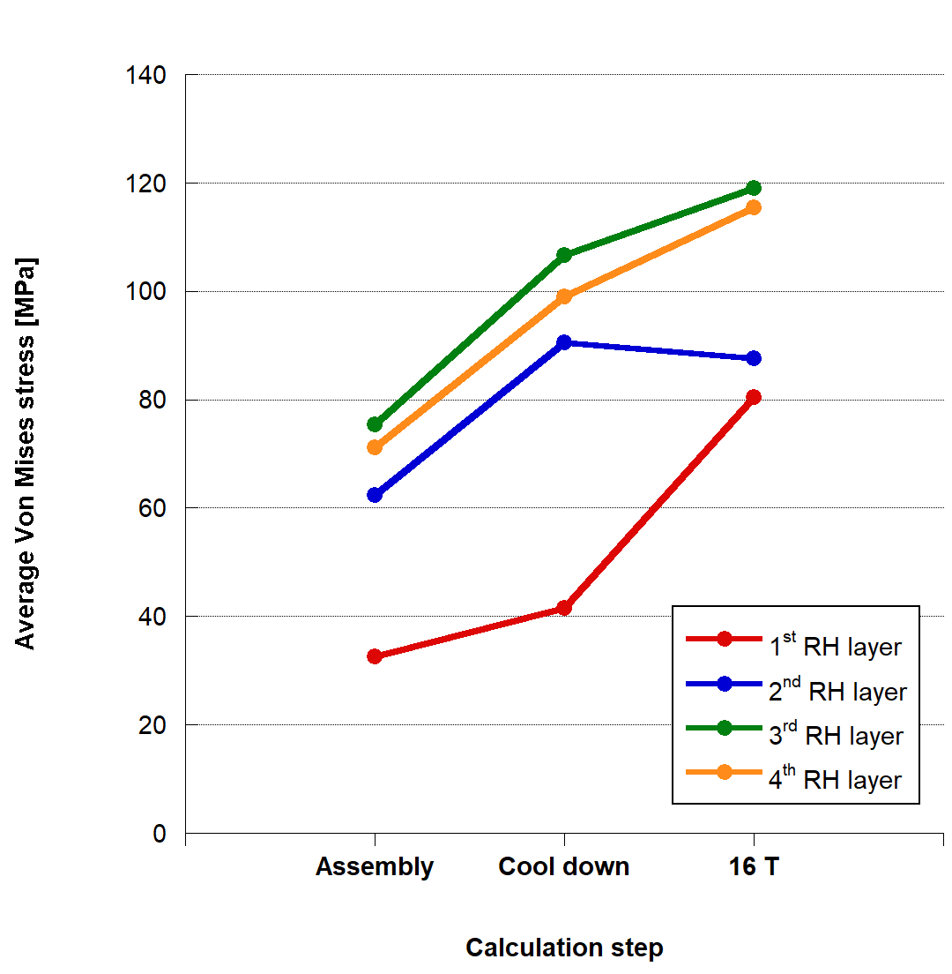
VM stress in the conductors
ASSEMBLY
COOL DOWN
16 T
VM stress [Pa]
σ_{VM,max} = 145 MPa
σ_{VM,max} = 192 MPa
σ_{VM,max} = 199 MPa
LEFT
RIGHT
VM stress far below current degradation limit (150 MPa @ RT -200 MPa @ 1.9K)
Localized hot spot due to wedge edges after cooling down
After energization, the high stress region is located in the fourth layer (low field region), VM(peak field region)< 50 MPa

Slide 20
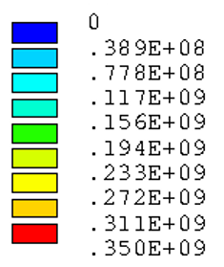
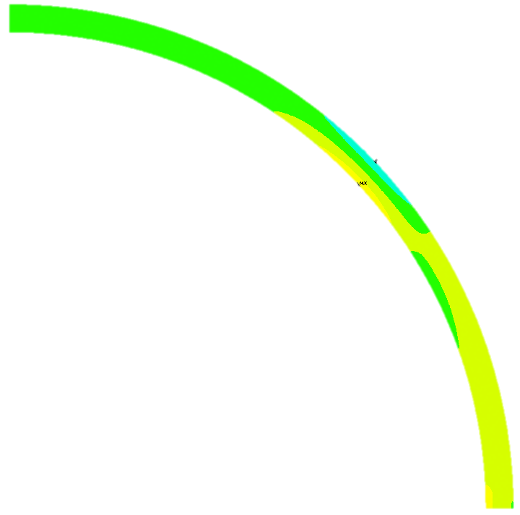
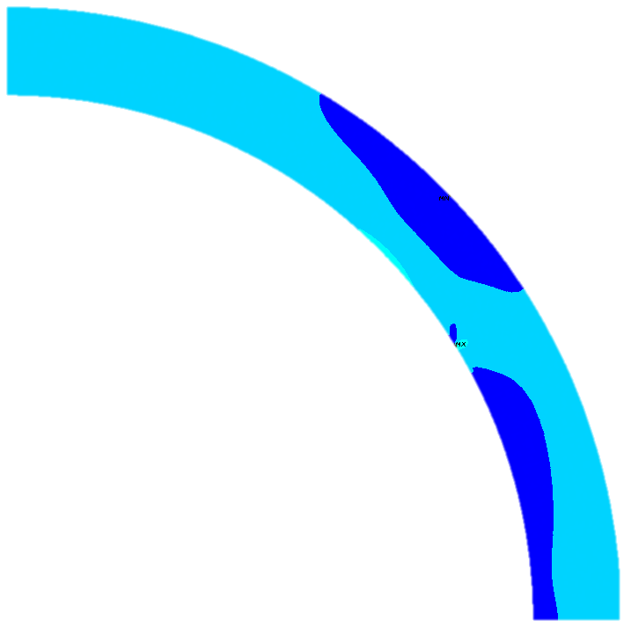
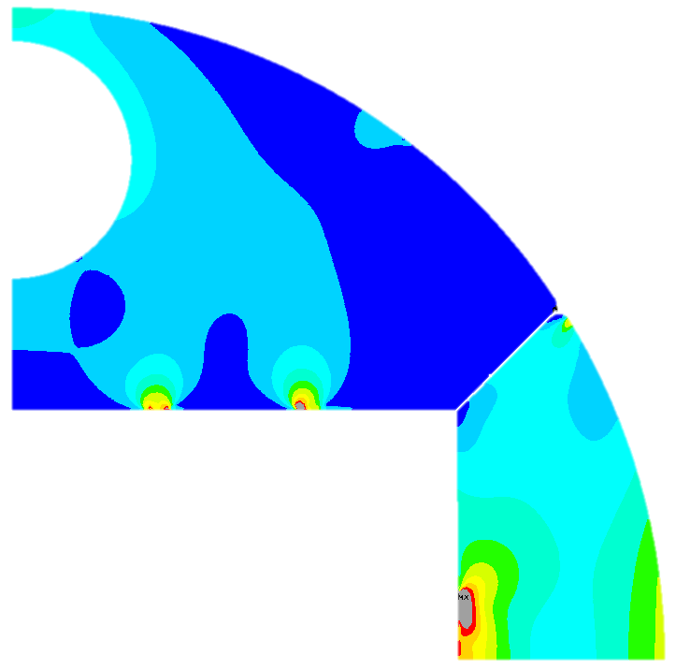
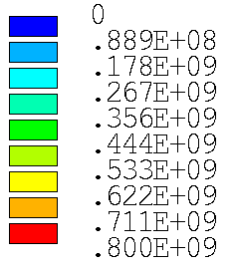
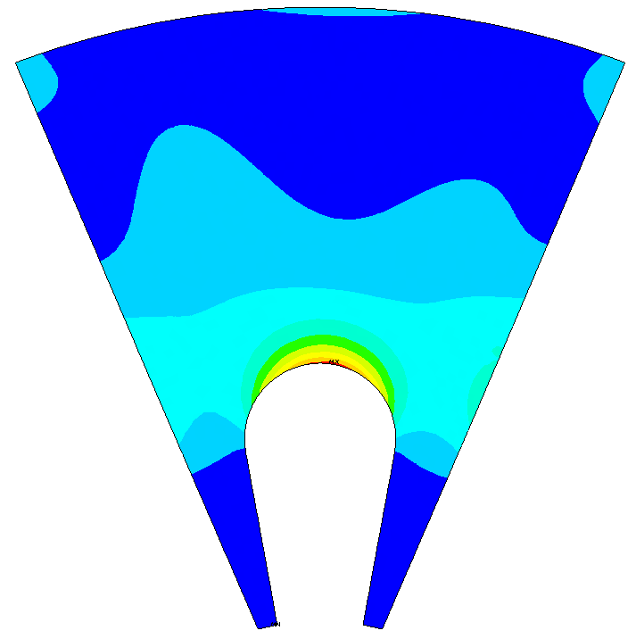
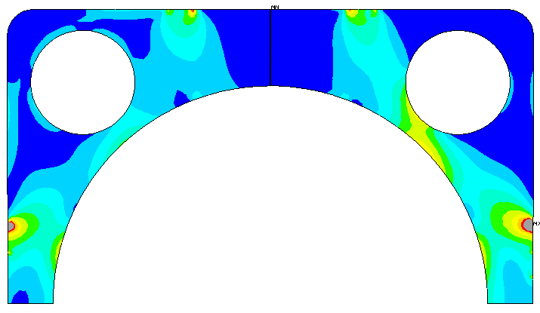
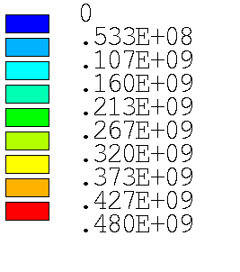
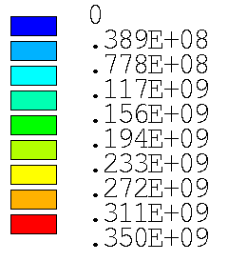
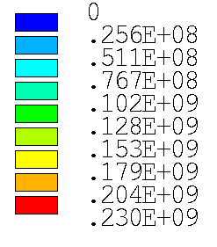
VM stress in the mechanical structures
ASSEMBLY
MATERIAL | Stress limit [MPa]
 | RT
Austenitic steel (316LN) | 350
Al7075 | 480
Ferromagnetic iron | 230
Ti6Al4V | 800
σ_{VM,max} = 749 MPa

Slide 21
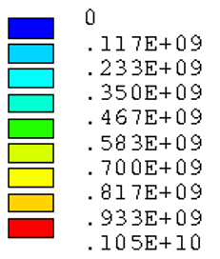
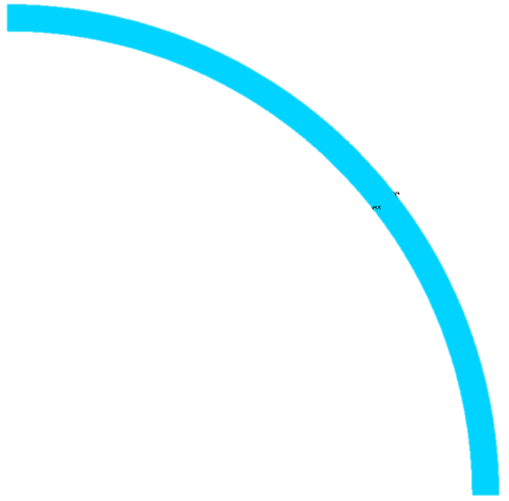
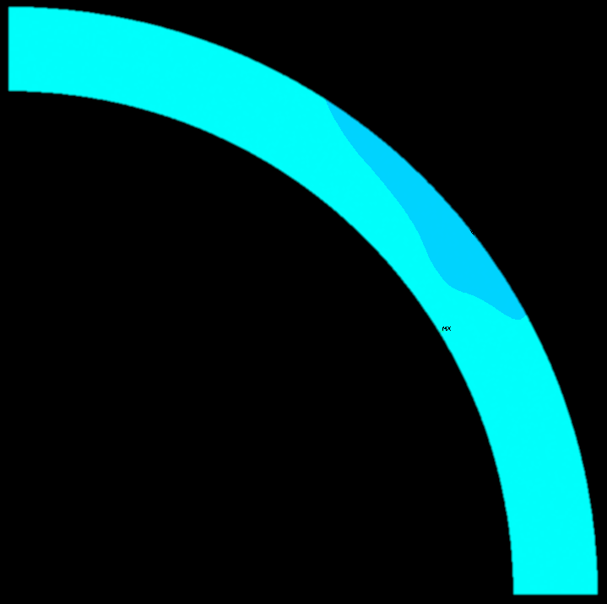
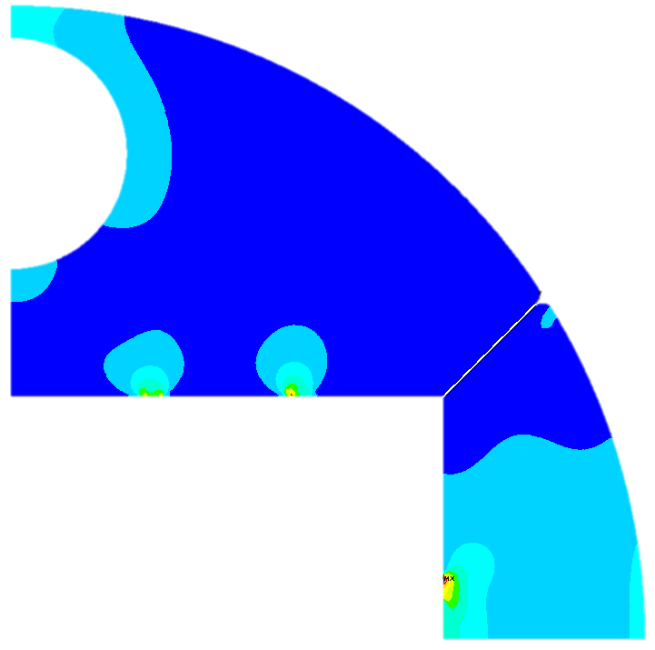
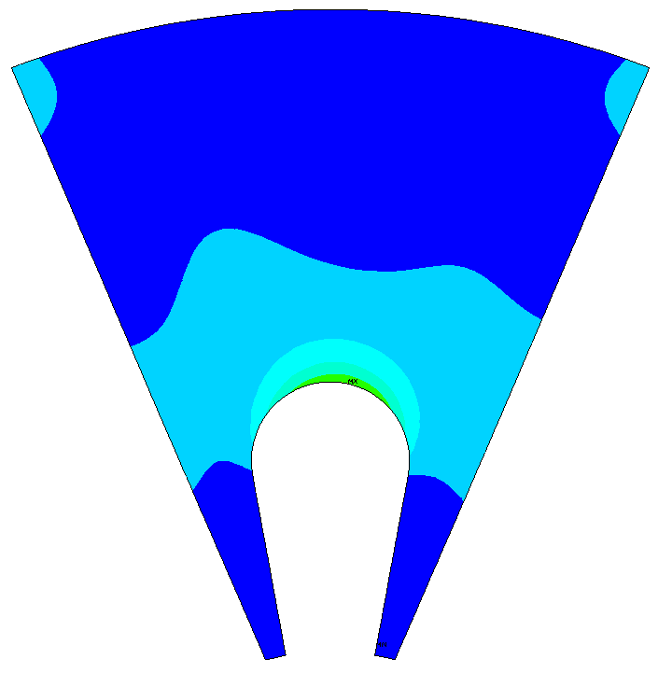
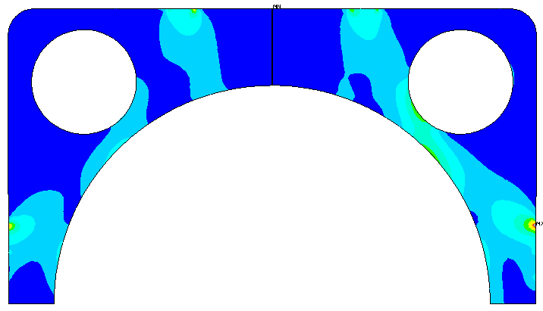
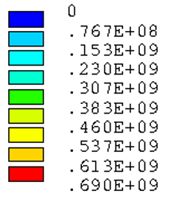
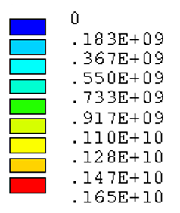
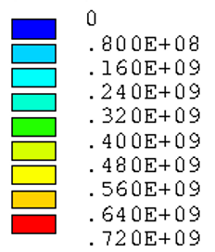
VM stress in the mechanical structures
COOL DOWN
MATERIAL | Stress limit [MPa]
 | 1.9 K
Austenitic steel (316LN) | 1050
Al7075 | 690
Ferromagnetic iron | 720
Ti6Al4V | 1650

Slide 22
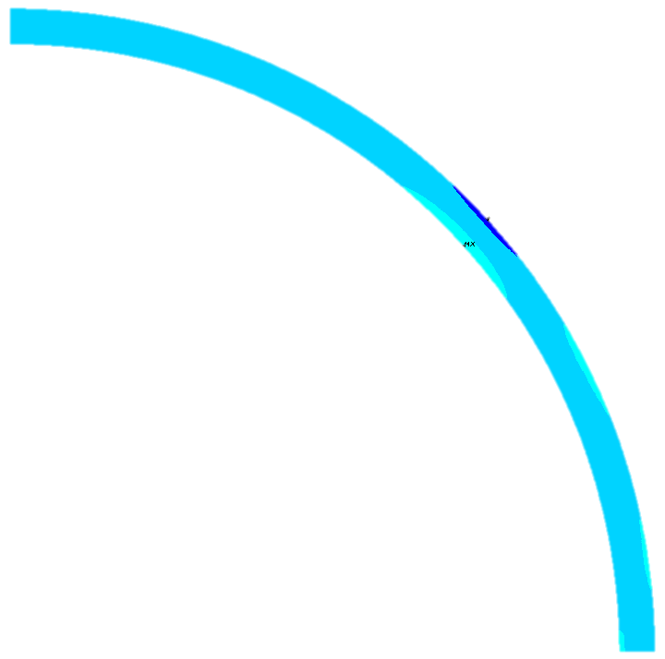
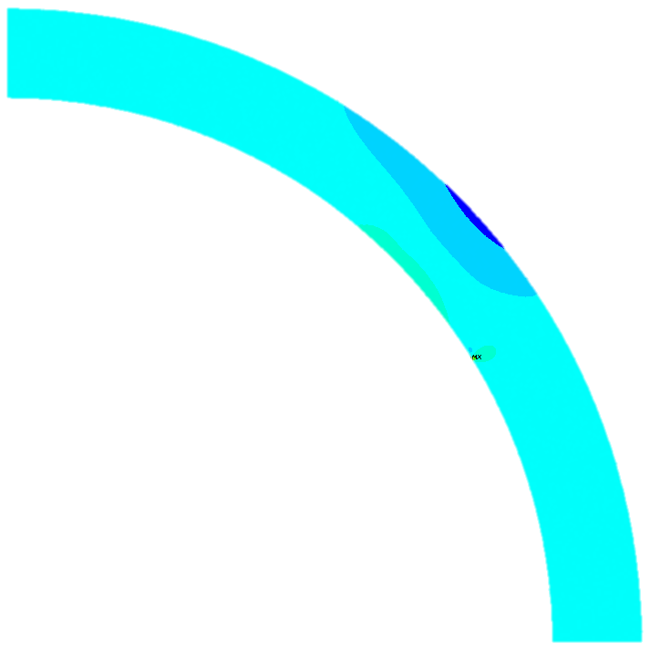
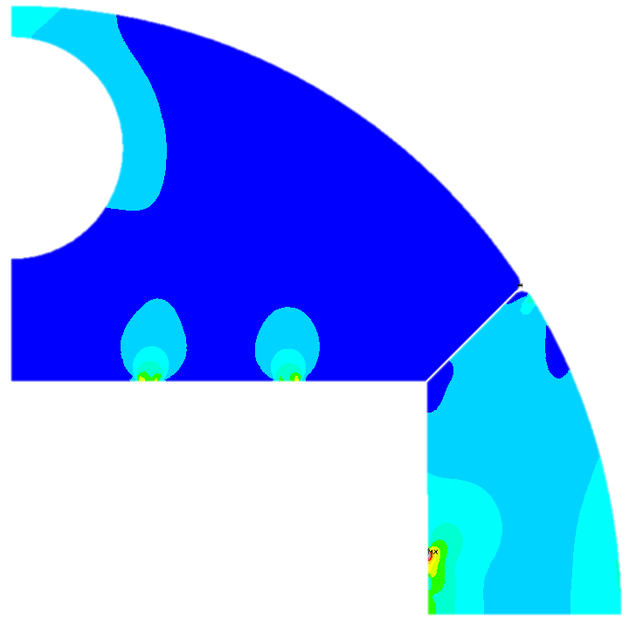


VM stress in the mechanical structures
ENERGIZATION
MATERIAL | Stress limit [MPa]
 | 1.9 K
Austenitic steel (316LN) | 1050
Al7075 | 690
Ferromagnetic iron | 720
Ti6Al4V | 1650

Slide 23

3D mechanical design
3D mechanical ANSYS model, very preliminary

Slide 24




3D mechanical design
3D mechanical ANSYS model, very preliminary
End spacers ( from Roxie)
Wedges
Straight section
Conductor ends
Conductors

Slide 25

3D mechanical design
25
3D mechanical ANSYS model, very preliminary
VM stress after cool down
Average VM stress in reasonable agreement with 2D results
Work still on going
Still open issues ( e.g. how to treat proprieties of conductor ends? Isotopically?)
FCC Week 2018 Costheta 16T dipole
06/07/18

Slide 26



3D mechanical design
26
After assembly and cool down...
VM stress in straight section of conductor in agreement with 2D
End design still not optimized from mechanical point of view
FCC Week 2018 Costheta 16T dipole
06/07/18

Slide 27
Conclusions
We have designed a 4 layer cosine-theta bending dipole for the FCC, according to the EuroCirCol constraints:
  Able to produce 16 T bore field
  Operation point on the load-line is 86% at 1.9 K
  Good field quality (2D and 3D)
  B&K mechanical structure able to keep azimuthal pre-stress, within stress limits
The magnet is mature enough to go in a more advanced design phase:
  3D mechanical analysis for longitudinal pre-stress
  Finalization of the harmonic optimization (b2 and iron saturation)
  Starting the development of a prototype

Slide 28
Thank you

Slide 30




Displacements Undeformed - Assembly
Notch in the pole
Full pole
X displacement [m]
MAX X DISP: 392 μm
MIN X DISP: -167 μm
MAX X DISP: 389 μm
MIN X DISP: -10 μm

Slide 31



Displacements Assembly - Cool Down
Notch in the pole
Full pole
X displacement [m]
MAX X DISP: 61 μm
MIN X DISP: -635 μm
MAX X DISP: 61 μm
MIN X DISP: -640 μm

Slide 32



Displacements Cool Down- Energization 16T
Notch in the pole
Full pole
Displacement [m]
MIN X DISP: -134 μm
MAX X DISP: 401μm
MIN X DISP: - 85 μm
MAX X DISP: 249 μm

Slide 33


Cosθ mechanical layout
Alluminum shell
Alluminum + SS shell
Yoke outer diameter: 600 mm
Al alloy ring thickness: 75 mm and 50 mm
SS shell thickness: 20 mm
Outer magnet diameter: 750 mm and 740 mm
New pole design
Inter-beam distance: 204 mm

Slide 34


Persistent Currents
50 µm filament diameter
-50 units on b3 at injection
+8 units on b5 at injection
No effect on b2
Negligible effect at operation current

Slide 35


Persistent Currents
Possible solution: iron on the beam pipe?
Field quality to be optimized

