Slide 1
16 T cosθ dipole short model
Kickoff meeting collaboration CERN-PATRAS for the FCC

Slide 2
EuroCirCol short models

Slide 3
EuroCirCol short models
within the EuroCirCol collaboration we agreed that the 16 T dipole short models should:
  be a single aperture
  have the same cross section of the double aperture baseline (no field quality optimization)
  have an outer iron yoke radius compatible with the one of the double aperture =330-250/2=205 m
  (total outer diameter=2·(205+70)=560 m agreed with CEA)
  have no outer stainless steel shell (to be tested at CERN)
we will start design activities as soon as the double aperture cross-section is frozen again

Slide 4
16 T cos-theta short model
The INFN/CERN agreement includes the construction of:
  1 dummy coil (Cu conductor)
  2 practice poles (low performance Nb3Sn conductor)
  3 final poles (target Nb3n conductor)
  2 assemblies (1 practice+1 final with the best 2 poles out of the 3)

Slide 5
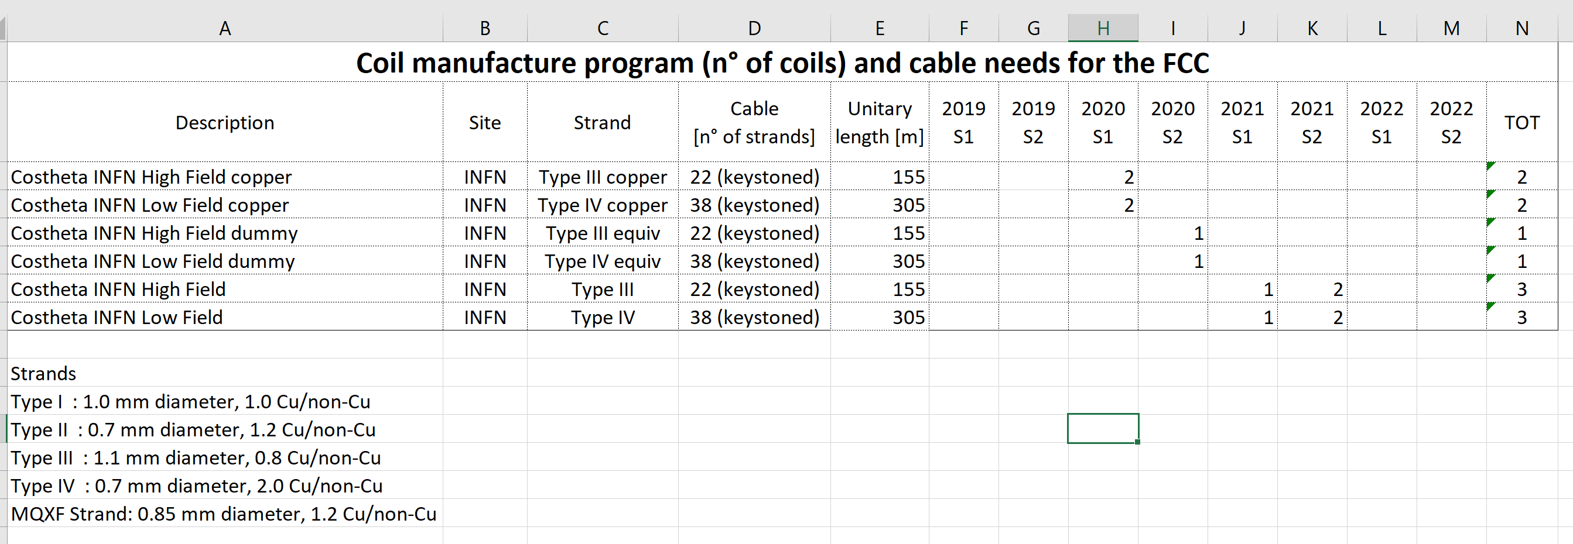
Conductor production

Slide 6


Falcon Dipole
Future Accelerator post-LHC Costheta Optimised Nb3Sn Dipole

Slide 7
Double aperture design finalization
Kickoff meeting collaboration CERN-PATRAS for the FCC

Slide 8
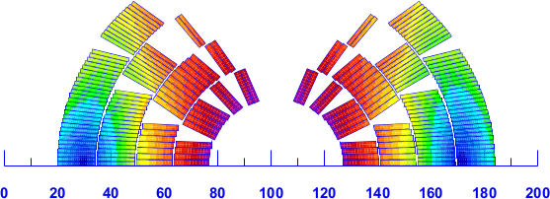

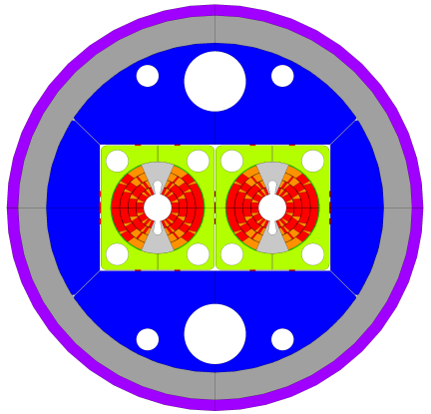
work to do on the double aperture
design the baseline cross-section
  as shown by Massimo, presently we do not have a cross-section fulfilling all the electromagnetic requirements
  as soon as we reach a «stable» elmg. solution we could start in parallel working on the mechanical cross-section
  In particular:
    mandatory activity: the design optimization with the same characteristics of the previous baseline
    optional activities: explore other solutions, involving other materials (INVAR?), other techniques (collaring?), other ideas

Slide 9
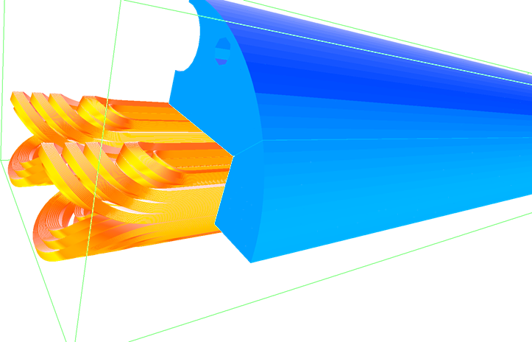
work to do on the double aperture
3D magnetic design
  we have all the Roxie toolings ready for the optimization
  we start this activity as soon as a new cross-section is defined

Slide 10
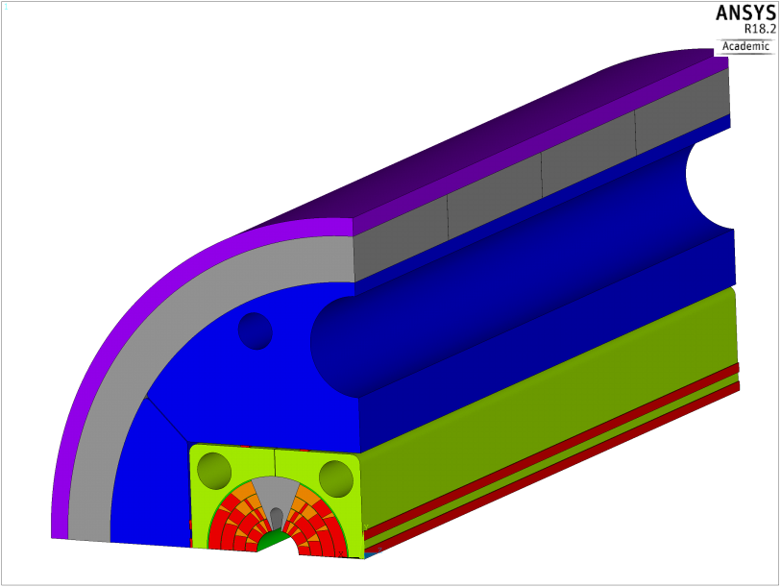
work to do on the double aperture
3D mechanical design
  minimal activities: set main
  parameters of the pre-loading
  system on the basis of simple
  analytical analysis
  desired activities:
    perform 3D mechanical analysis
    of the system in “FCC configuration”,
    i.e. with thick Al shell, no SS shell
    and longitudinal preload given using longitudinal tie-rods
    perform 3D mechanical analysis of the system in “HE LHC configuration”, i.e. with thinner Al shell, SS shell and longitudinal preload given using the SS shell through end flange

