Slide 1

Measuring beam size with the BGV results from the demonstrator in Run2
Benedikt Würkner on behalf of the BGV Team
8th HL-LHC Collaboration Meeting – 2018-10-18

Slide 2
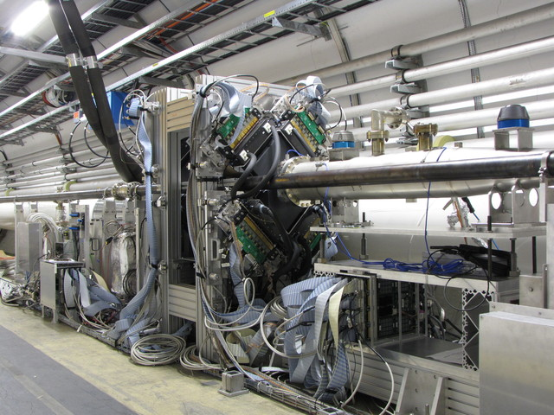
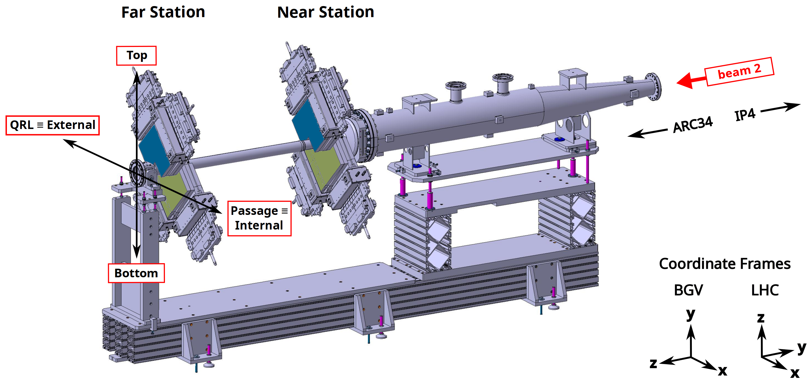
Beam Gas Vertex Detector
Non destructive beam size measurement for HL-LHC not limited by accelerator luminosity
Tracks from beam-gas interactions to reconstruct beam spot
Ne @ 10⁻⁷ mbar injected at interaction volume
Goals:
Measurement error: 2% in less than 1 min for beam of 2556 x 10^11 p/bunch
Should allow ε measurements with similar precision
Demonstrator built around Beam 2, in Pt4
Demonstrator fully commissioned
Data acquisition working as expected
Analysis ongoing

Slide 3
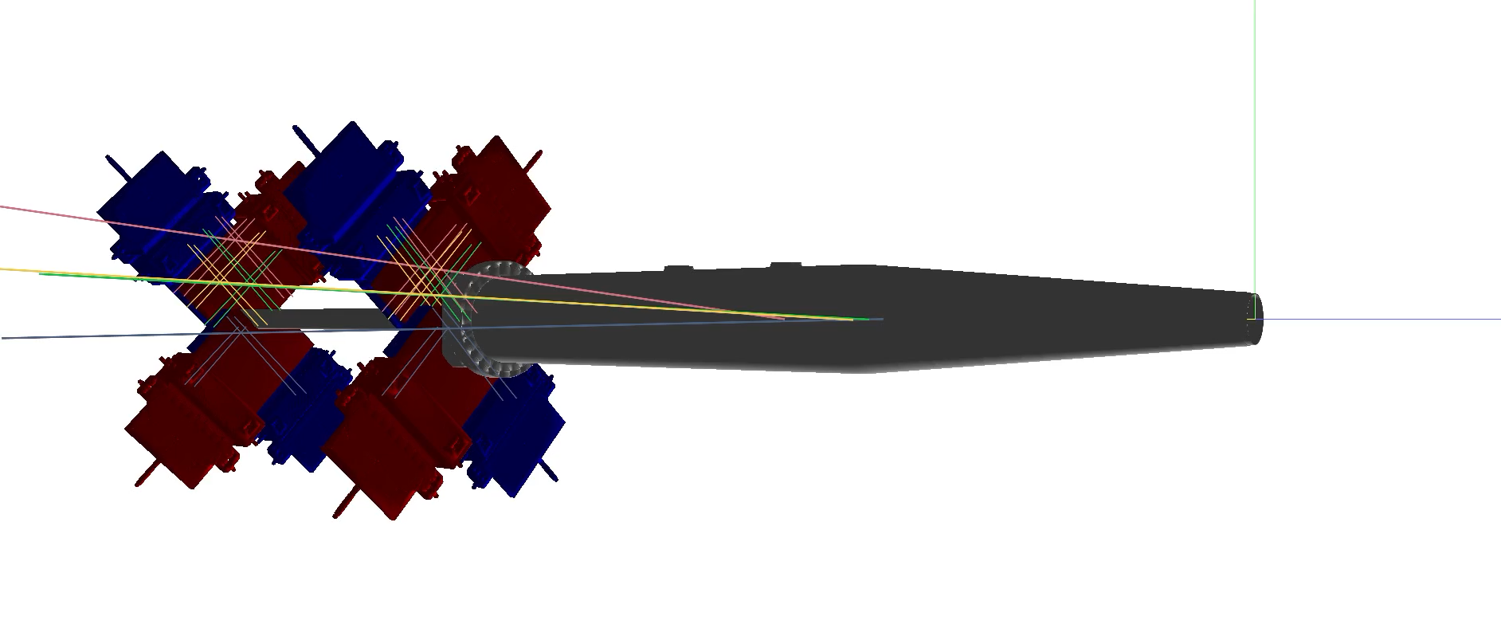
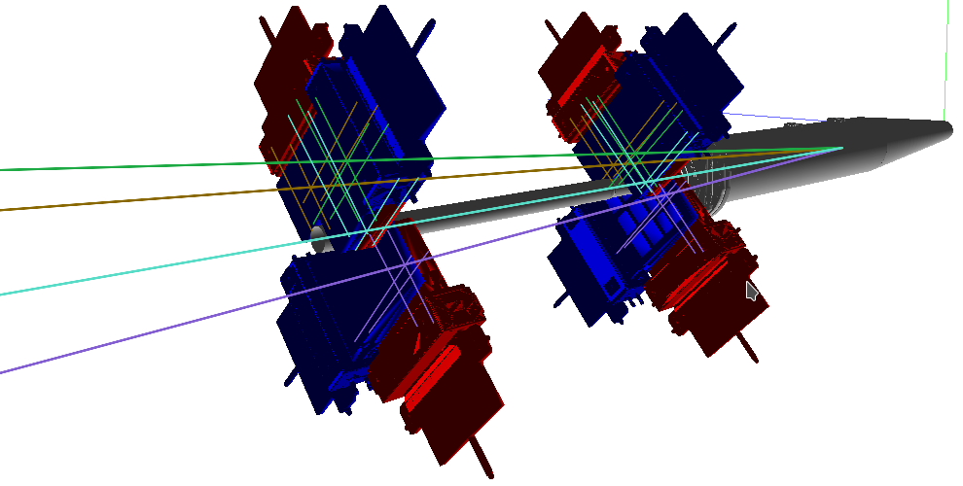
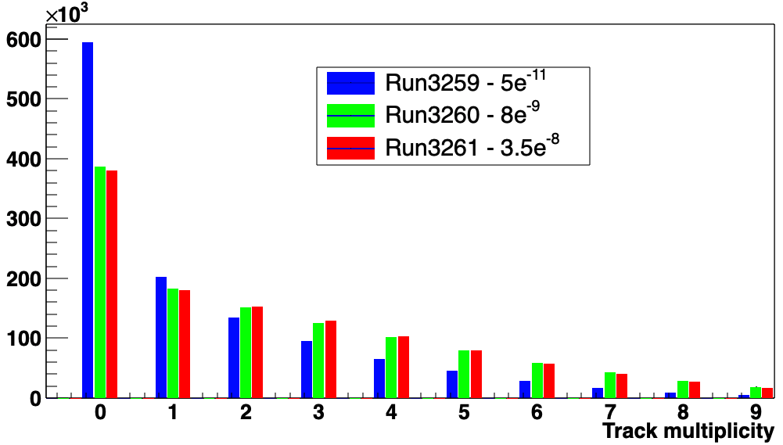
Gas interaction volume
Almost 2m long gas tank with a thin aluminum exit window
Gas injection system allows to inject Neon to increase the local pressure up to 1e-7 mbar
Increases interaction rate by ~16x
No influence on the beam quality
The quality of recorded events increases significantly (50% vs 66%) when injecting gas due to the higher percentage of interactions with Neon
For samples of 1.2M events

Slide 4
Trigger system
Hardware trigger system based on scintillating fiber panels
Requires coincidence between “Trigger” and “Confirm” planes and no “Veto”
The coincidence signal is handed to the Readout supervisor “ODIN”
ODIN synchronizes the signal with the Filling
scheme and triggers acquisition of an event
Higher level Trigger system selects events online
based on number of clusters and tracks for storage

Slide 5
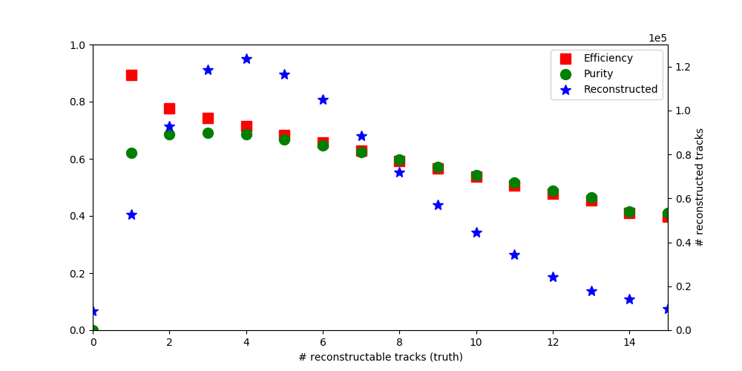
Data analysis and treatment
Dedicated pattern recognition algorithm
  Written to take advantage of all geometric properties
  Very efficient with regards to processing time
  Requires a very precisely aligned detector to keep the search windows small
Overall pattern recognition efficiency of the algorithm >60% for the relevant range of 2 to 7 Tracks/Event
About 30-40% of tracks
with wrong clusters in them
This influences the results and
therefore needs a very robust
vertexing algorithm

Slide 6



Beam width measurement
IP and ɸ (1,2) of particles from the same primary vertex are correlated:
$$\left\langle {IP}_{1}{ IP}_{2}\right\rangle =σ_{sum}^{2}\cos\left(φ_{1}−φ_{2}\right)+σ_{diff}^{2}cos (φ_{1}+φ_{2} )$$
$σ_{sum}^{2}$ = $\frac{σ_{x}^{2}+σ_{y}^{2}}{2}$ , $σ_{diff}^{2}$ = $\frac{σ_{y}^{2}−σ_{x}^{2}}{2}$
$σ_{x}^{2}$ ($σ_{y}^{2})$being the beam spot width along x (y)
Correlation independent of measurement resolution $σ_{IP}$
Increased statistics diminish influence of random errors
Track 1
Track 2
$$φ_{1}$$
y
$$φ_{2}$$
d₁
y_{v}
x_{v}
x
d₂

Slide 7
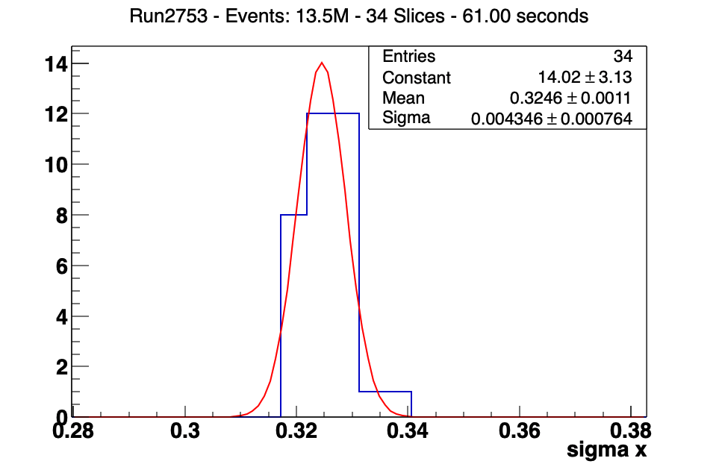
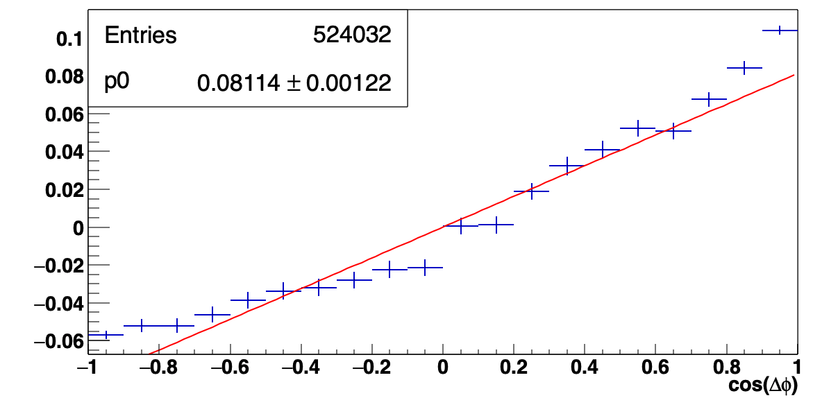
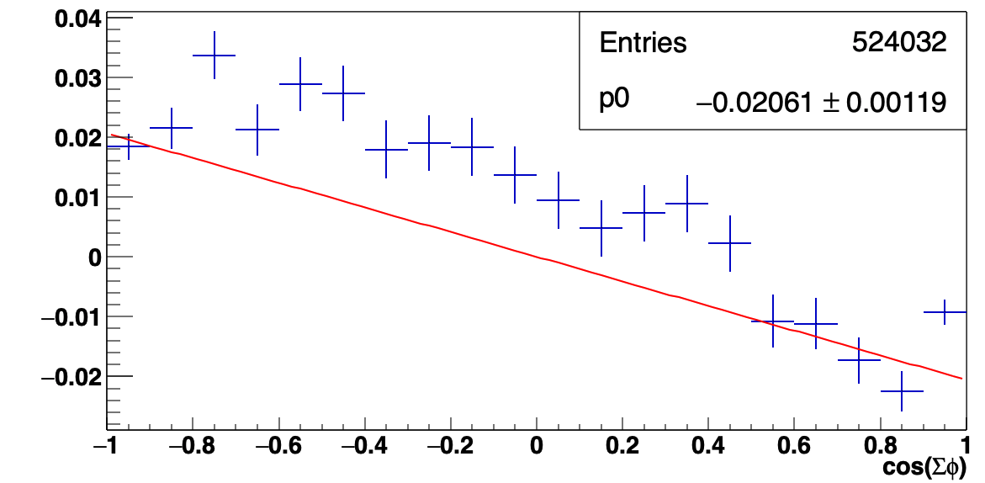
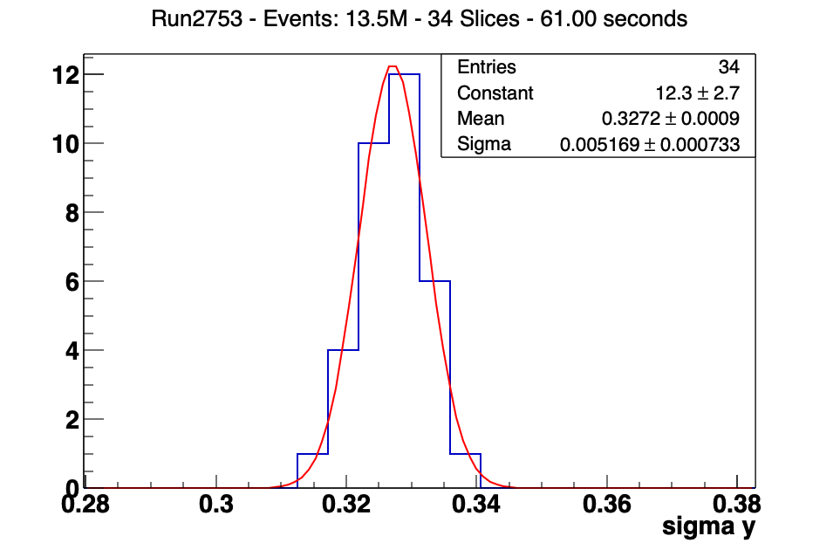





IP correlation $→$ $σ_{beam}$
Assuming uncorrelated $φ_{1}−φ_{2}$ and $φ_{1}+φ_{2}$ the parameters $σ_{sum}^{2}$ and $σ_{diff}^{2}$ can be fit independently
$σ_{sum}^{2}$
$$σ_{x}^{2}=σ_{sum}^{2}−σ_{diff}^{2}$$
$$σ_{y}^{2}=σ_{sum}^{2}+σ_{diff}^{2}$$
$σ_{diff}^{2}$
A more detailed explanation can be found at 2018-05-07_-_WP13_-_BGV_update

Slide 8
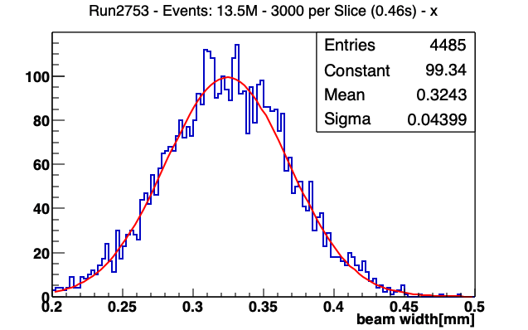
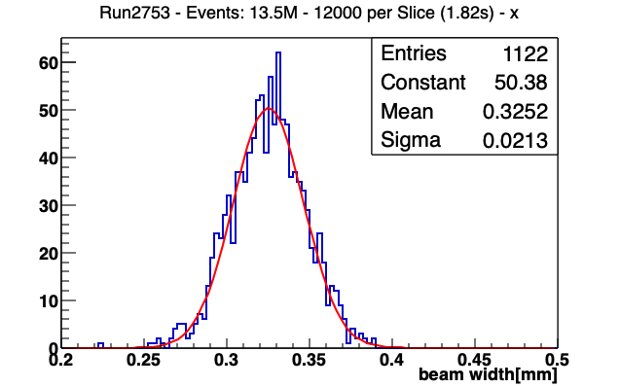
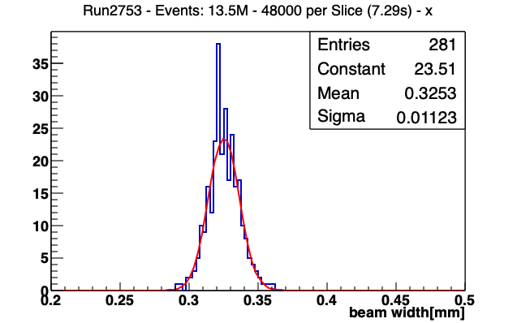
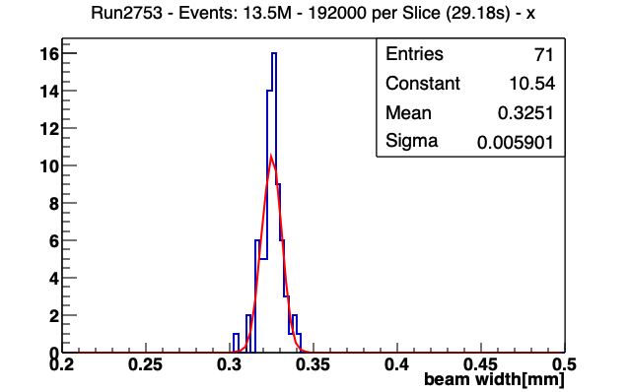
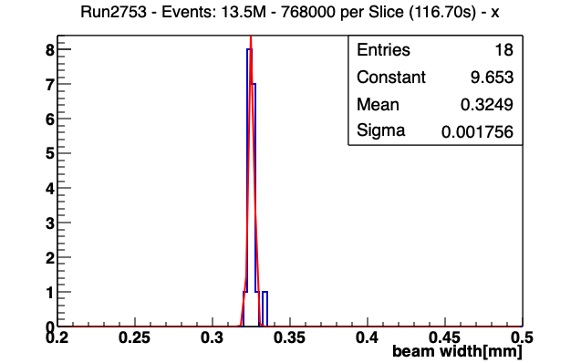
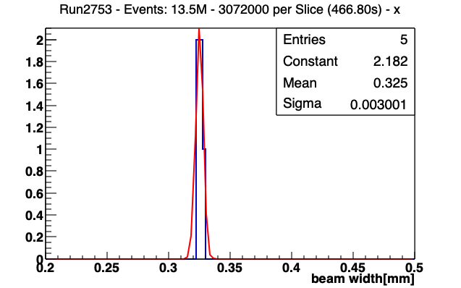
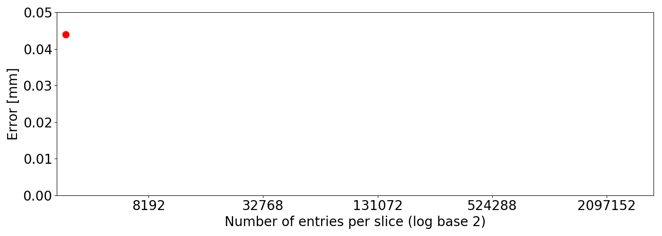
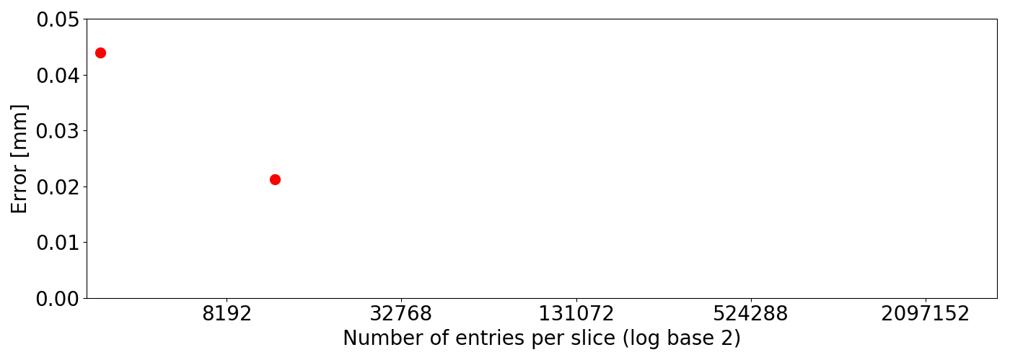
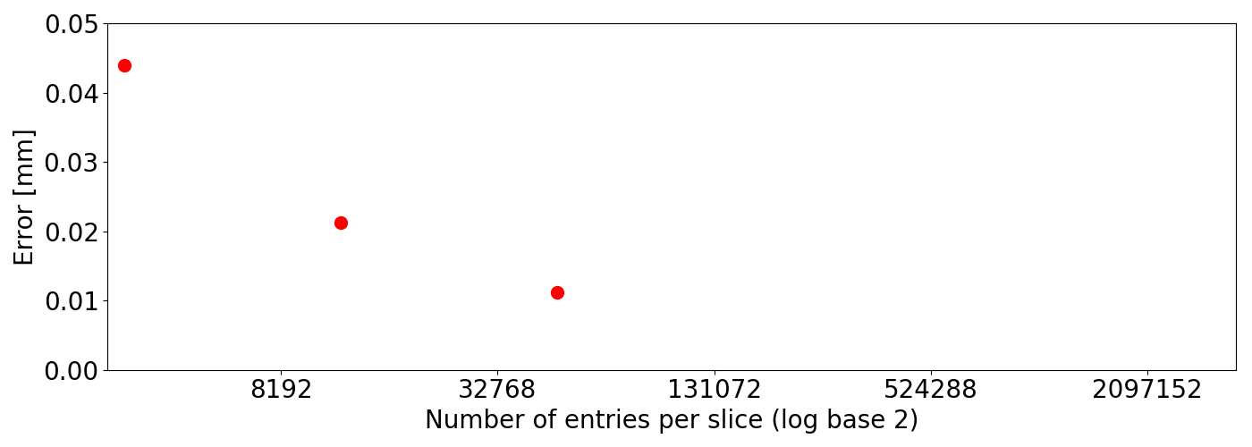
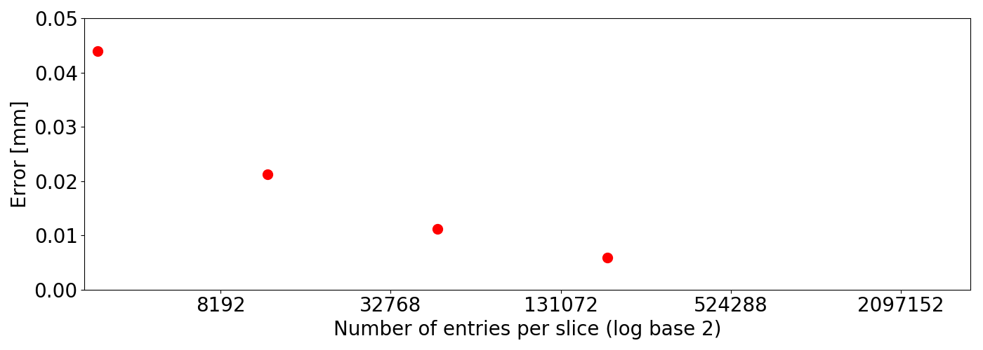
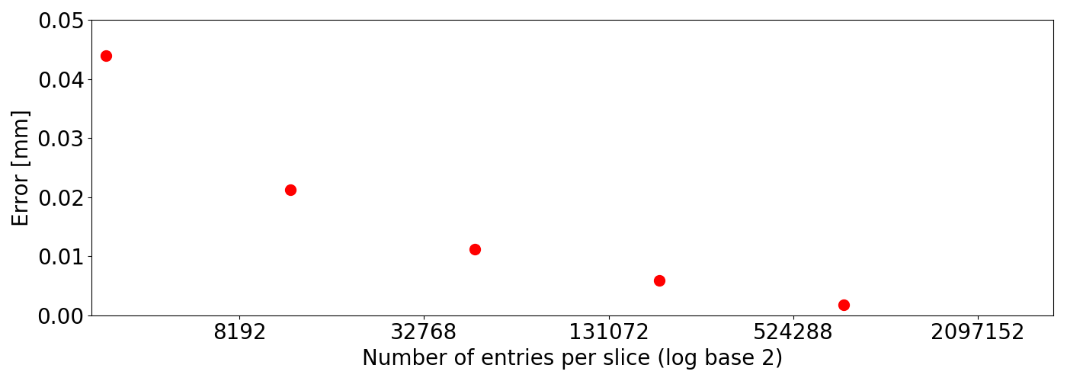
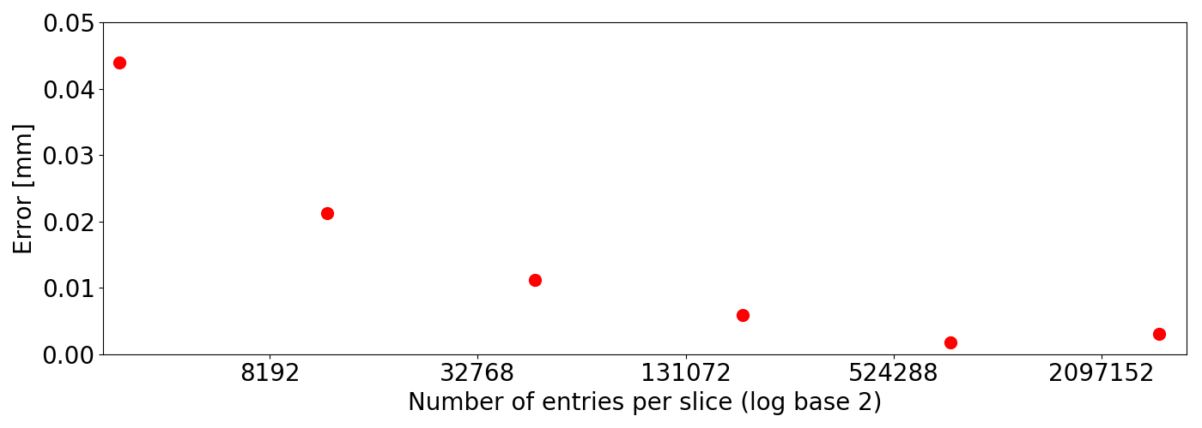
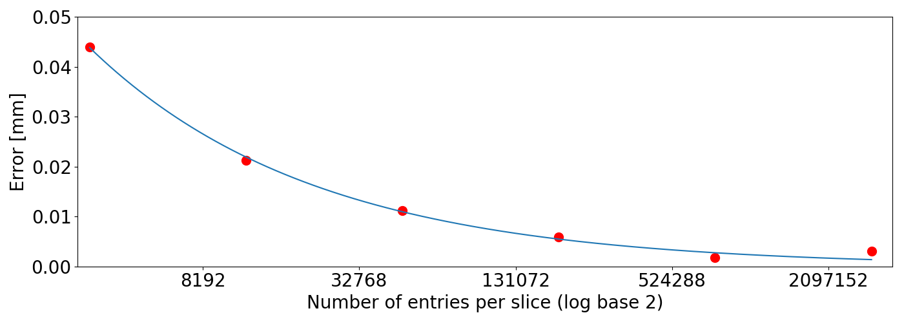

Resolution vs integration time
The longer the integration time the higher the precision (until ~5µm)
Error vs number of entries (log₂ plot)
$σ\left(N\right)=σ_{s}\frac{1}{\sqrt{N}}$

Slide 9

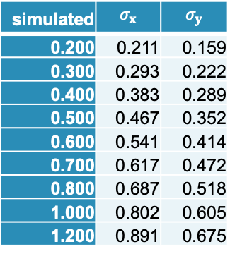



Comparison to Simulation
simulated | $$σ_{x}$$ | $$σ_{y}$$
0.200 | 0.211 | 0.159
0.300 | 0.293 | 0.222
0.400 | 0.383 | 0.289
0.500 | 0.467 | 0.352
0.600 | 0.541 | 0.414
0.700 | 0.617 | 0.472
0.800 | 0.687 | 0.518
1.000 | 0.802 | 0.605
1.200 | 0.891 | 0.675
Simulating round beam with defined sigma using Hijing
Reconstructed size is not equal to simulated size due to
  Detector geometry
  clusters from secondary tracks and noise
Fitting polynomial of second order to these results gives correction factors for both axis independently
$$σ_{x}$$
$$σ_{y}$$
$$σ_{x}^{(corr)}=0.81σ_{x}^{2}+0.53σ_{x}^{}+0.07$$
$$σ_{y}^{(corr)}=1.39σ_{y}^{2}+0.72σ_{y}^{}+0.06$$
Notes:
Comparison and therefore correction factor
X: [0.80811406 0.5268704 0.07322875]
Y: [1.39280182 0.72141125 0.063215 ]

Slide 10
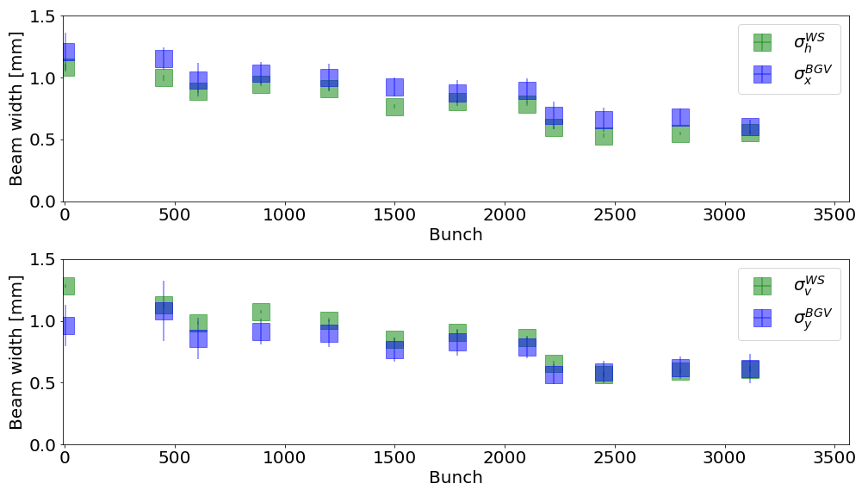
BGV vs Wirescanner (450GeV)
Fill 7220, BSRT calibration fill on 2018-09-25

Slide 11
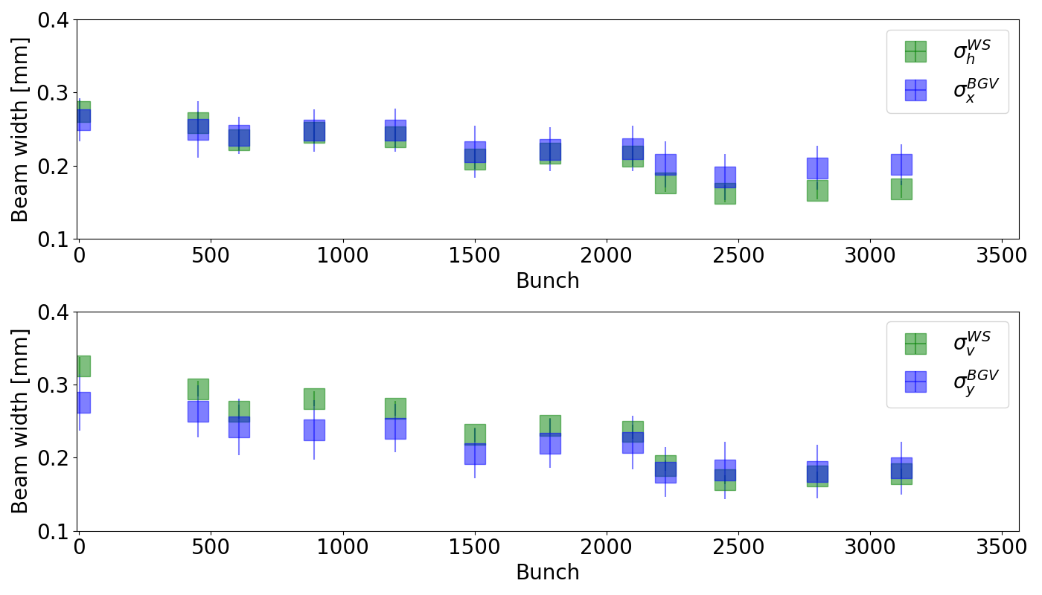
BGV vs Wirescanner (6.5TeV)
Fill 7220, BSRT calibration fill on 2018-09-25

Slide 12
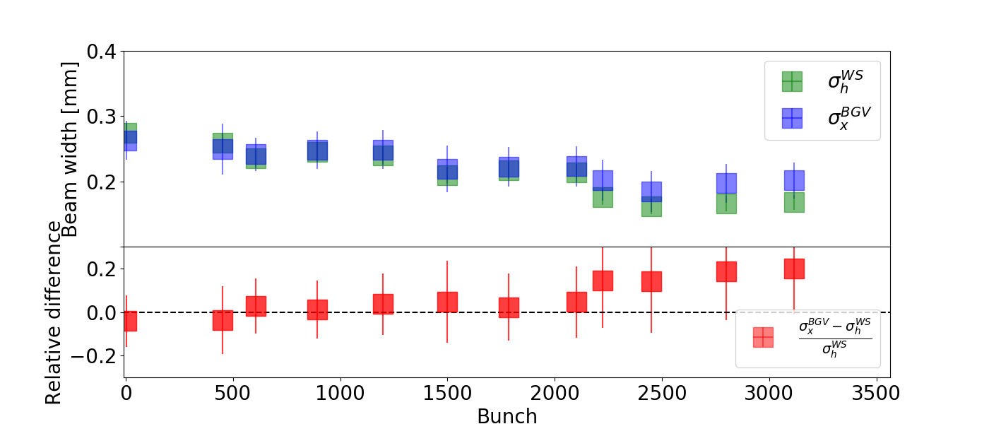
BGV vs WS relative error – horizontal (6.5TeV)
Fill 7220, BSRT calibration fill on 2018-09-25

Slide 13
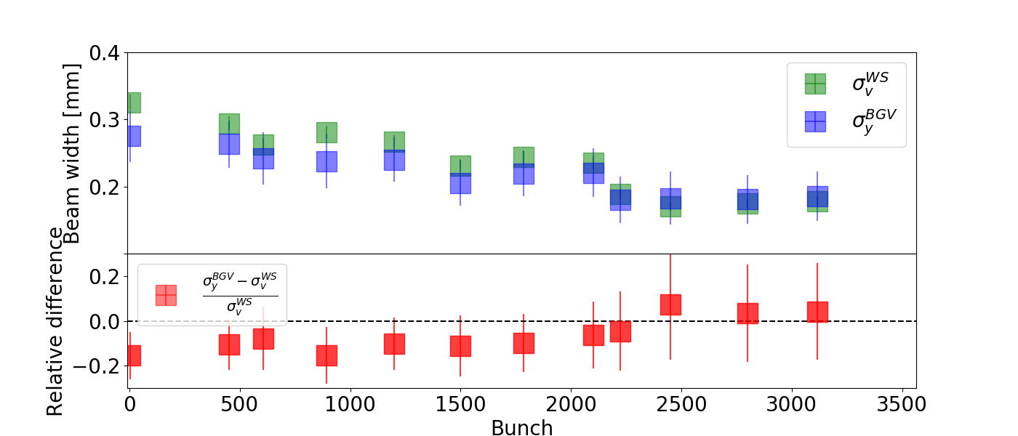
BGV vs WS relative error - vertical (6.5TeV)
Fill 7220, BSRT calibration fill on 2018-09-25

Slide 14
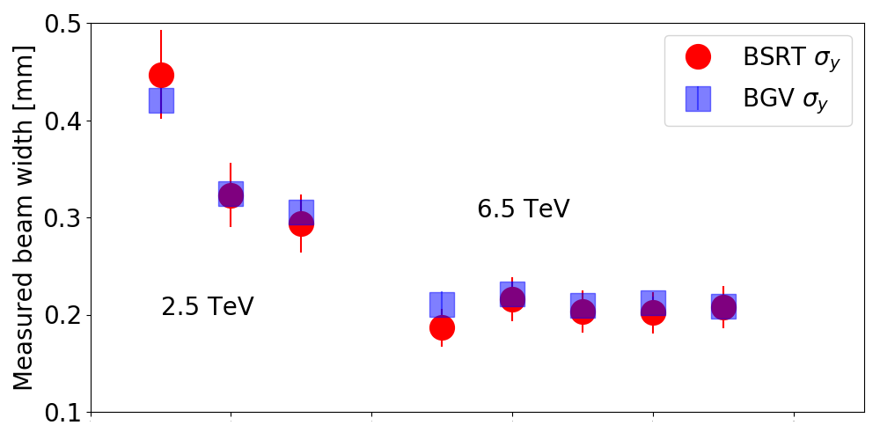
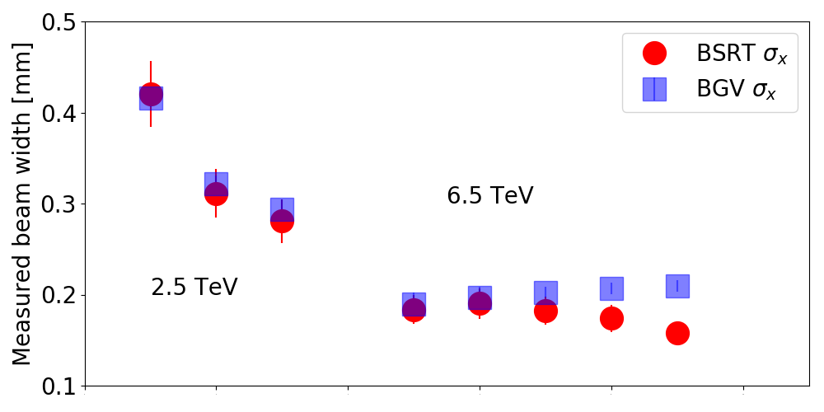
Average beam profile measurement
fill numbers - 6.5TeV
6358 | November 2017
6371 | November 2017
7127 | September 2018
7145 | September 2018
7232 | September 2018

Slide 15
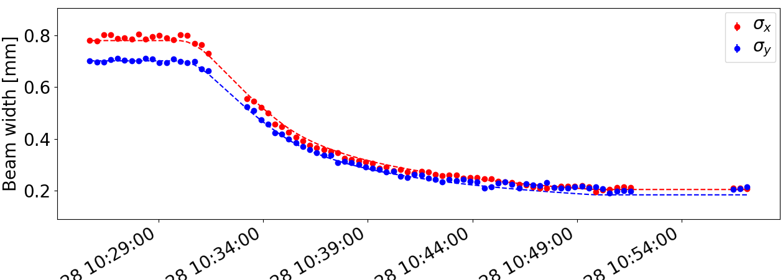
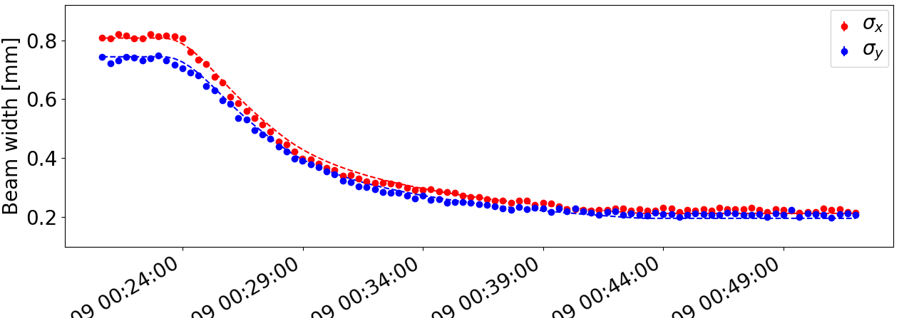
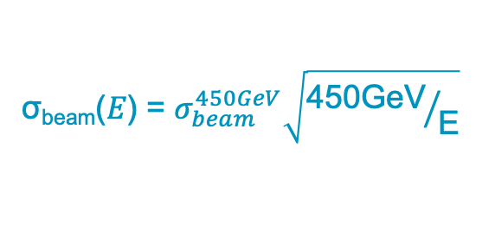
Beam size measurement during ramp
σ_{beam}(𝛦) = $σ_{beam}^{450GeV}\sqrt{{\text{450}\text{GeV}}/{\text{E}}}$
Integration time per data point: 20s
Fill 7232,
2556 nominal bunches
on 2018-09-28
Fill 7270,
2556 nominal bunches
on 2018-10-09

Slide 16
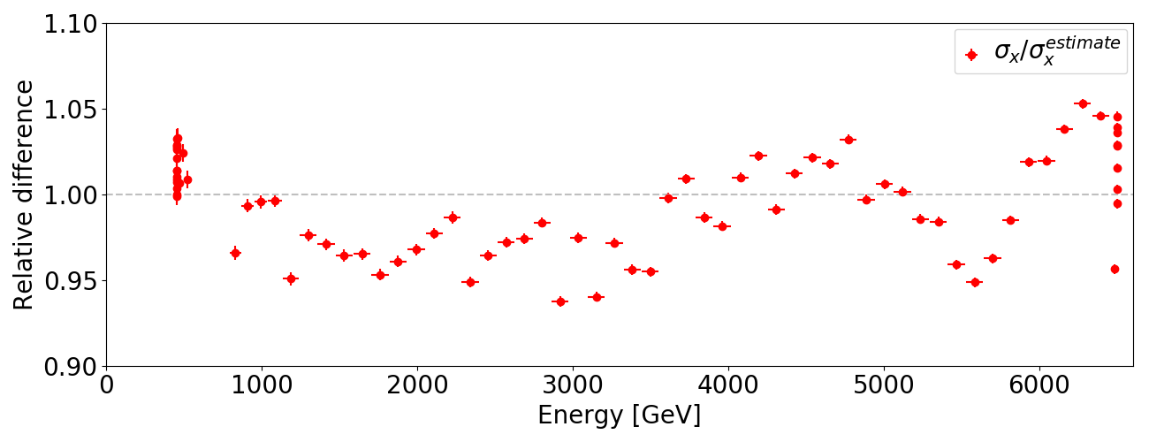
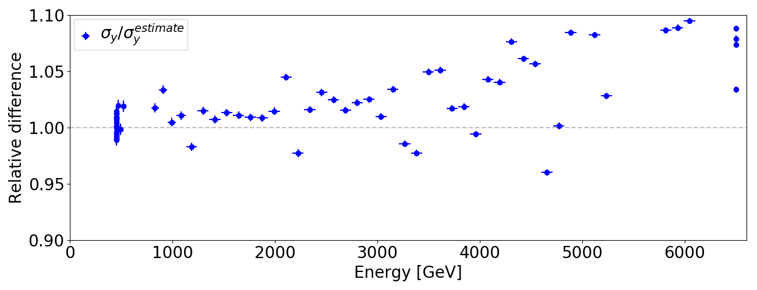
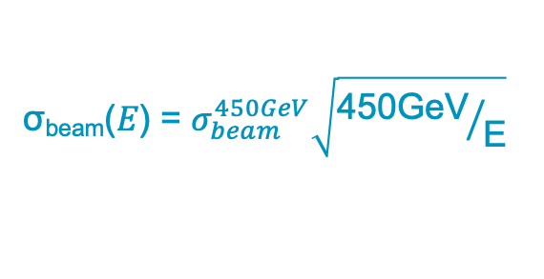
Beam size measurement during ramp
σ_{beam}(𝛦) = $σ_{beam}^{450GeV}\sqrt{{\text{450}\text{GeV}}/{\text{E}}}$
Integration time per data point: 20s
Fill 7232, 2556 nominal bunches on 2018-09-28

Slide 17
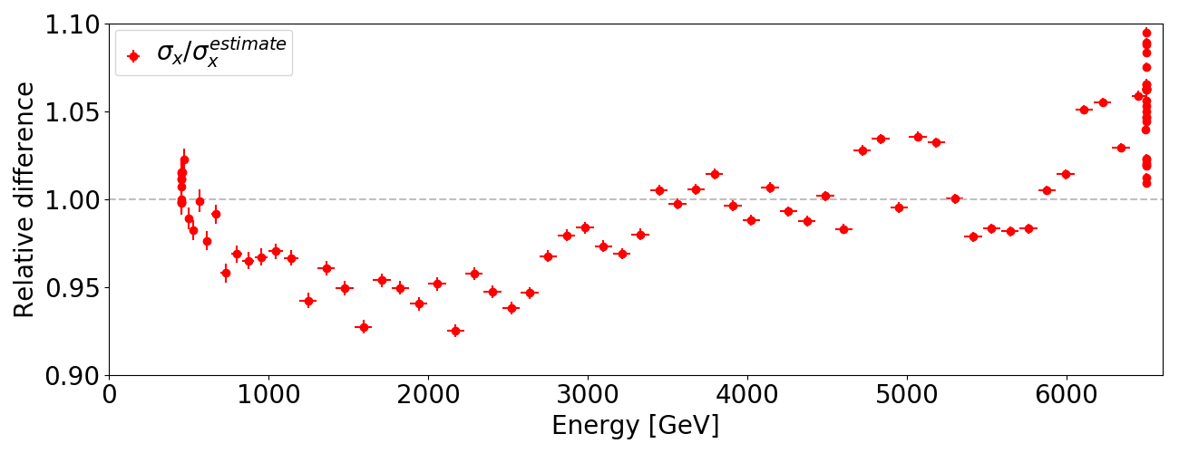
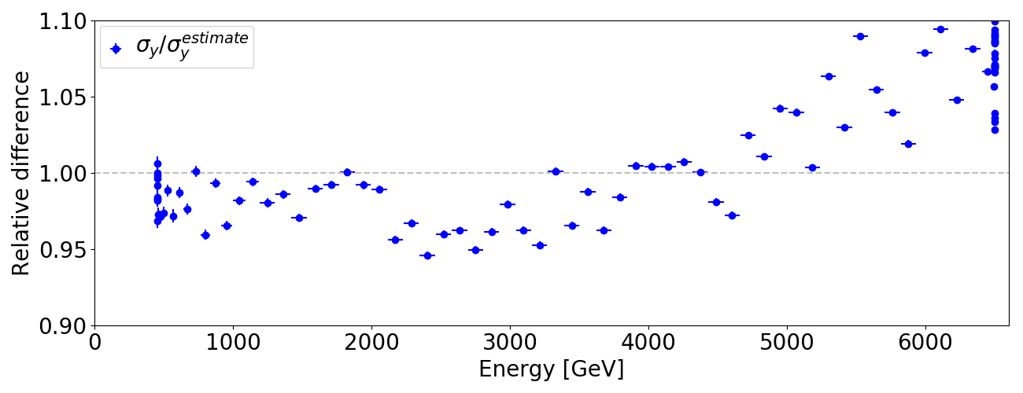
Beam size measurement during ramp
σ_{beam}(𝛦) = $σ_{beam}^{450GeV}\sqrt{{\text{450}\text{GeV}}/{\text{E}}}$
Integration time per data point: 20s
Fill 7270, 2556 nominal bunches on 2018-10-09

Slide 18
Summary
The BGV has demonstrated that it can non-invasively measure beam size including measurements during ramp
The BGV Demonstrator already fulfills the design specifications for the final system
  Average beam size measurement with a precision of better than 5µm in 30s for 6.5TeV
  Bunch by bunch measurement with a precision of better than 20µm in 60s for 6.5TeV
Multiple measurements were taken during
  BSRT calibration
  Energy ramp
  Stable beams
Relative average difference to Wirescanner of ~8%
Plans for the Analysis
  Quantification of systematic errors
  Online publishing of results
BGV in Run 3?
  Not yet clear if the system can be maintained post LS2
Considerations for future developments are already ongoing and were presented on Tuesday by Robert Kieffer
Error of measurements:
beam average: 2.2% within 30s
for one bunch: ~10% within 60s
Performance adequate for
HL-LHC operation!

Slide 19
Thank you for your attention

Slide 20
Backup

Slide 21
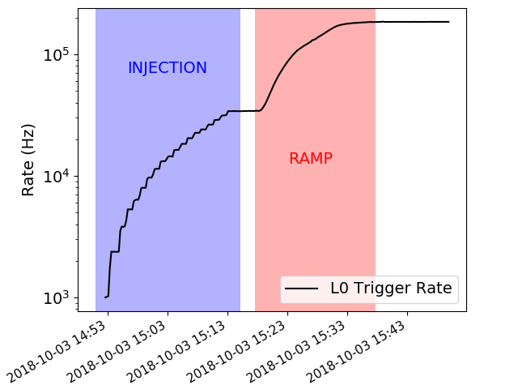
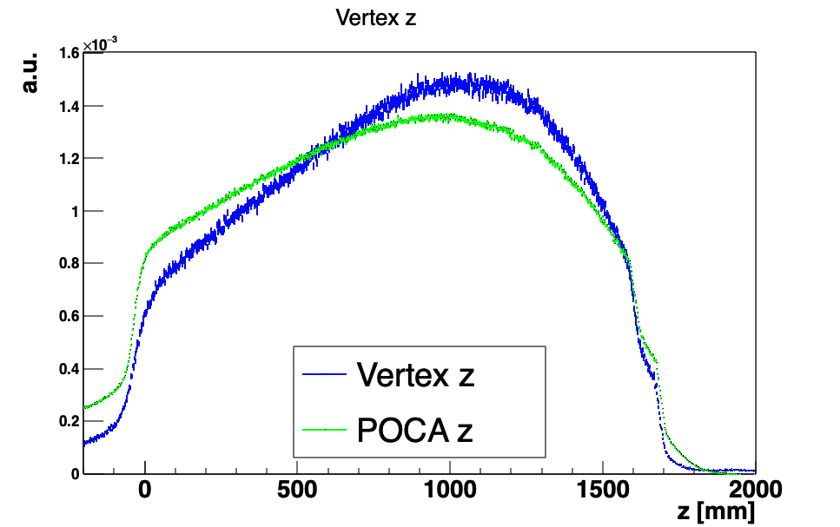
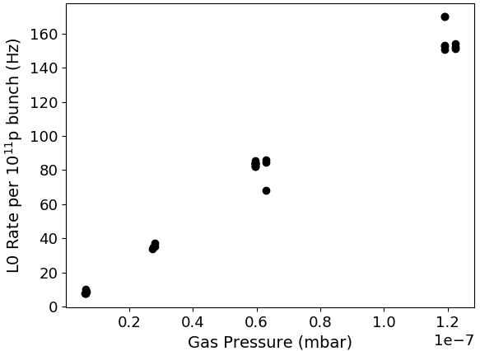
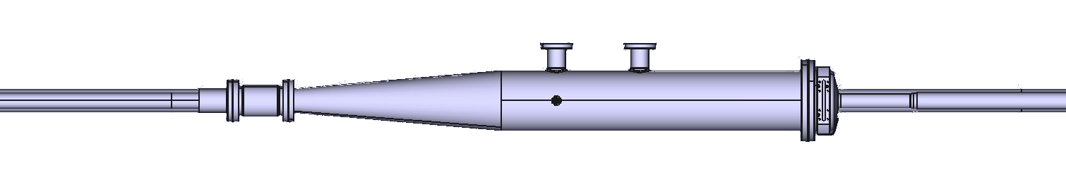
Gas interaction volume
Almost 2m long gas tank with an exit window made from thin aluminum
Gas injection system allows to inject Neon to increase the local pressure up to 1e-7 mbar
Increases interaction rate by ~16x
Doesn’t influence the beam quality
The pressure distribution can be approximated with the distribution of the
z-coordinate of the POCA (green line)
This in mimicked by the vertex
z-distribution (blue line)

Slide 22
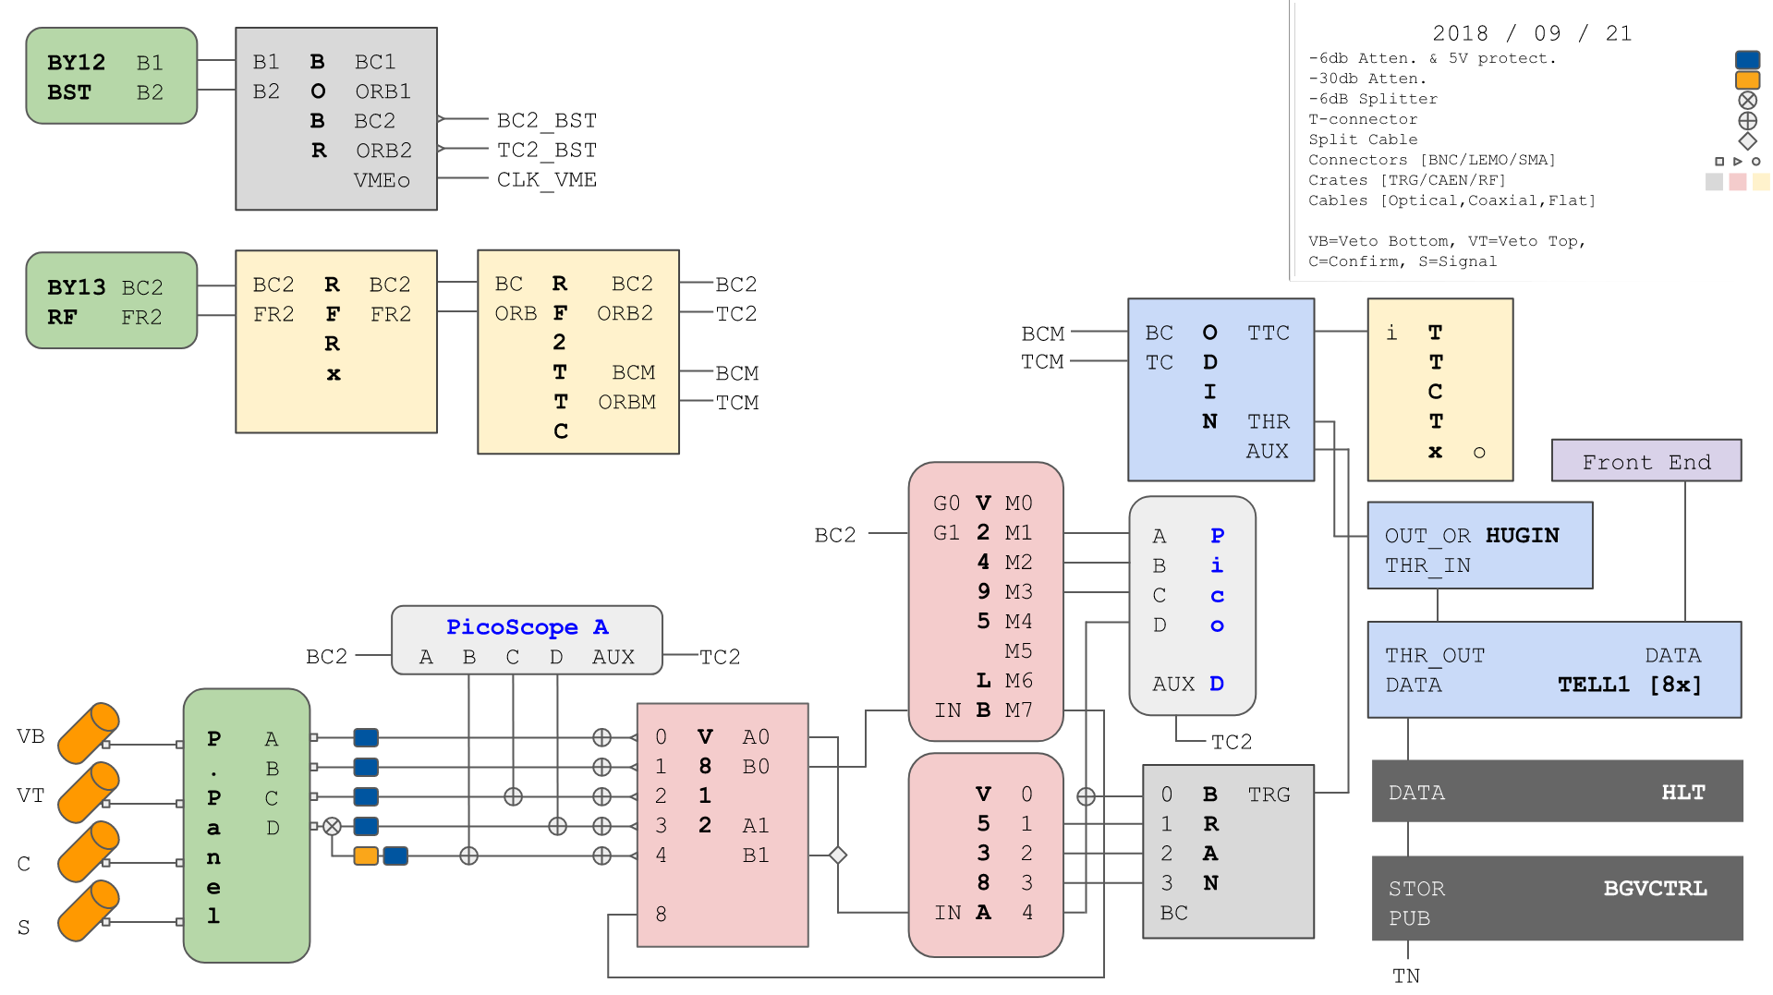
Full BGV Trigger layout

Slide 23
Trigger logic and data flow
Analog pulse
Trigger signal
Detector data
Signal
Detector
Confirm
AND
Veto
Not
TELL1
Digitization
ODIN
Clustering
HLT
Match Bunch
Capacity available
Cluster Filter
Discard Event
Pattern recognition
Track Filter
UDP Package
HDD Storage

Slide 24
Data acquisition and processing
Analog readout by Tell1 Digitization board
Zero suppression in Tell1 -> Clusters
Transmission of Clusters to HLT node
Filtering of event based on cluster cut
Filtering of event based on clusters/module
Track reconstruction is performed for remaining events
Discarding Events with less than 2 tracks
Storage of remaining events (~6kHz)

Slide 25
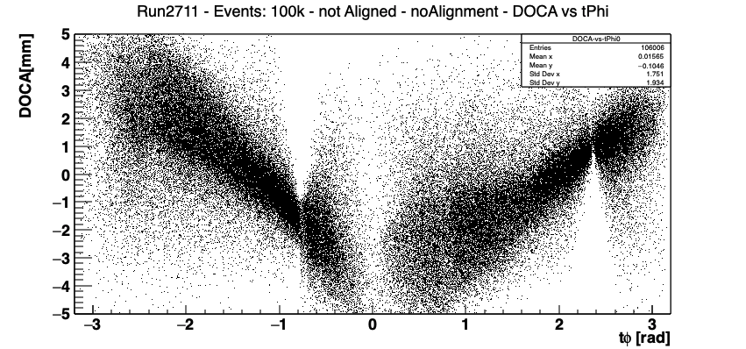
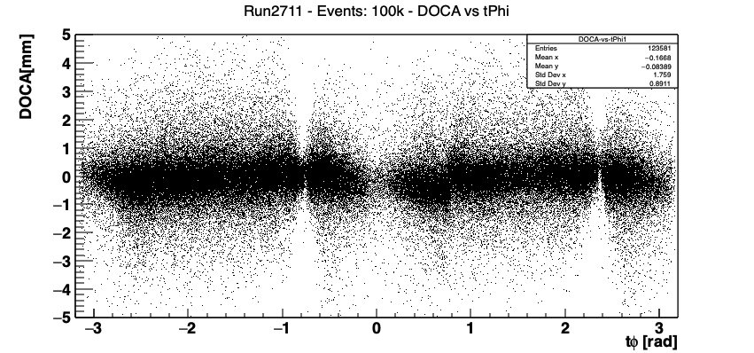
Alignment
A detailed survey of the setup was performed during installation
The detector was not perfectly aligned around the center hence a precise (order of micrometers) alignment procedure had to be developed

