Slide 1
Circuit Disconnector Boxes for HL-LHC
Samer Yammine on behalf of WP6b
53rd TCC
2018-07-12

Slide 2
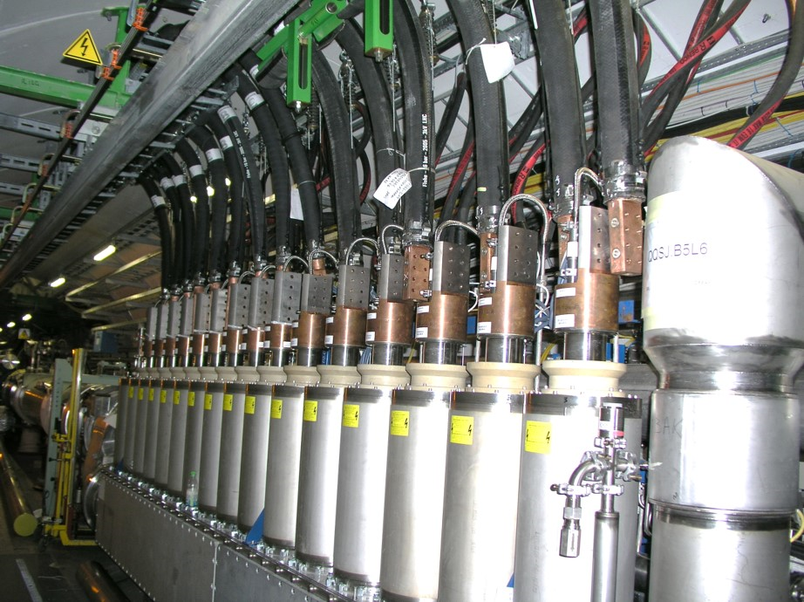
Introduction: LHC Warm/Cold Transition - DFBA.L6
6 kA
1000 mm2
13 kA
2000 mm²
Courtesy of JC. Guillaume, L. Sburlino

Slide 3
Motivation for Circuit Disconnector Boxes
Main motivation for Circuit Disconnector Boxes is ElQA interventions
Disconnection & Re-connection of water cooled cables in the LHC is:
  Required every year for ElQA tests (leakage current in demi-water is high for ElQA)
  Time consuming & caution required during manipulation
  Risky for current leads (fragile vs. heavy cables – above 800N damages the current leads)
  Contact quality must be ensured
  Presents additional risks on personnel
    Ladder required in case of most DFBs

Slide 4
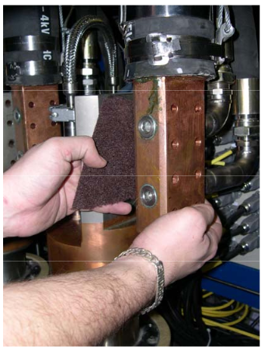
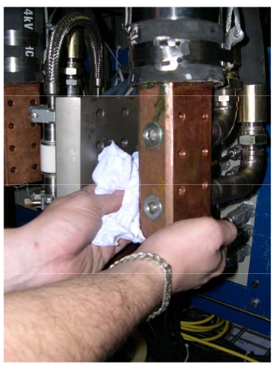
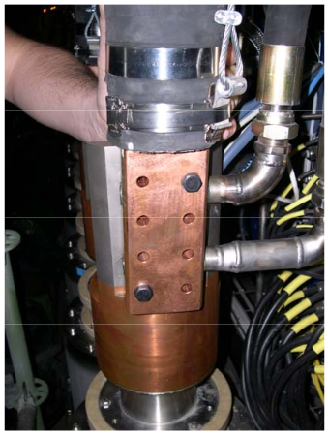
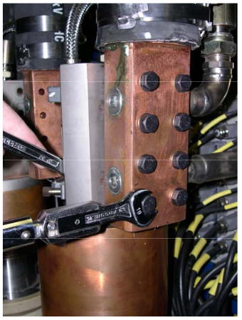
Motivation for Circuit Disconnector Boxes
Example: Connection of water cooled cables in the LHC
Surface Cleaning
Heavy cables positioning
Bolt torque tightening
Courtesy of P. Denis (13 kA DC cables installation procedure EDMS 822785)

Slide 5
Motivation for Circuit Disconnector Boxes
Duration of on site interventions:
Extrapolation of total time required for disconnection and re-connection of HL-LHC cables:
  500 min (more than 8 hrs) of continuous work per IP side
  Inner triplet circuits is 30% of that time (estimation: to be done at least once per year)
  Duration does not include personnel mobility time & preparation time
Circuit type | Disconnection | Connection
13 kA | 8 min / cable | 15 min / cable
6 - 8 kA | 5 min / cable | 10 min / cable
600 A | 5 min / cable | 5 min / cable
120 A | 5 min / cable | 5 min / cable
Courtesy of G. D’Angelo: estimation of time for LHC cables

Slide 6
Requirements to WP6b
Provide solution to simplify the disconnection of warm & cold powering
  Improve safety of people during intervention
  Ensure galvanic insulation
    3 kV withstand level between poles and to ground with <1 µA leakage current
  Reduce risks of damaging current leads
    Due to mechanical strain (incorrect manipulation)
    Due to hydraulic shocks (water hammer effect) when water is turned on/off
  Maintain current leads contact quality without additional intervention
  Reduce intervention time
  Short circuit and grounding connections possibility (to maximize safety during intervention)
First pre-study and first proposal done by Knud Dahlerup-Petersen and Giorgio D’Angelo in MCF no. 6 (link)

Slide 7
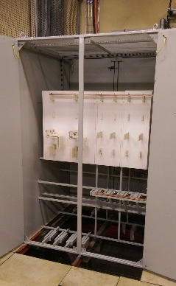
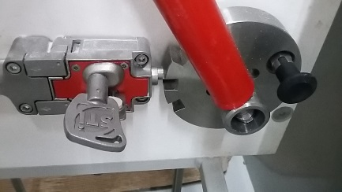
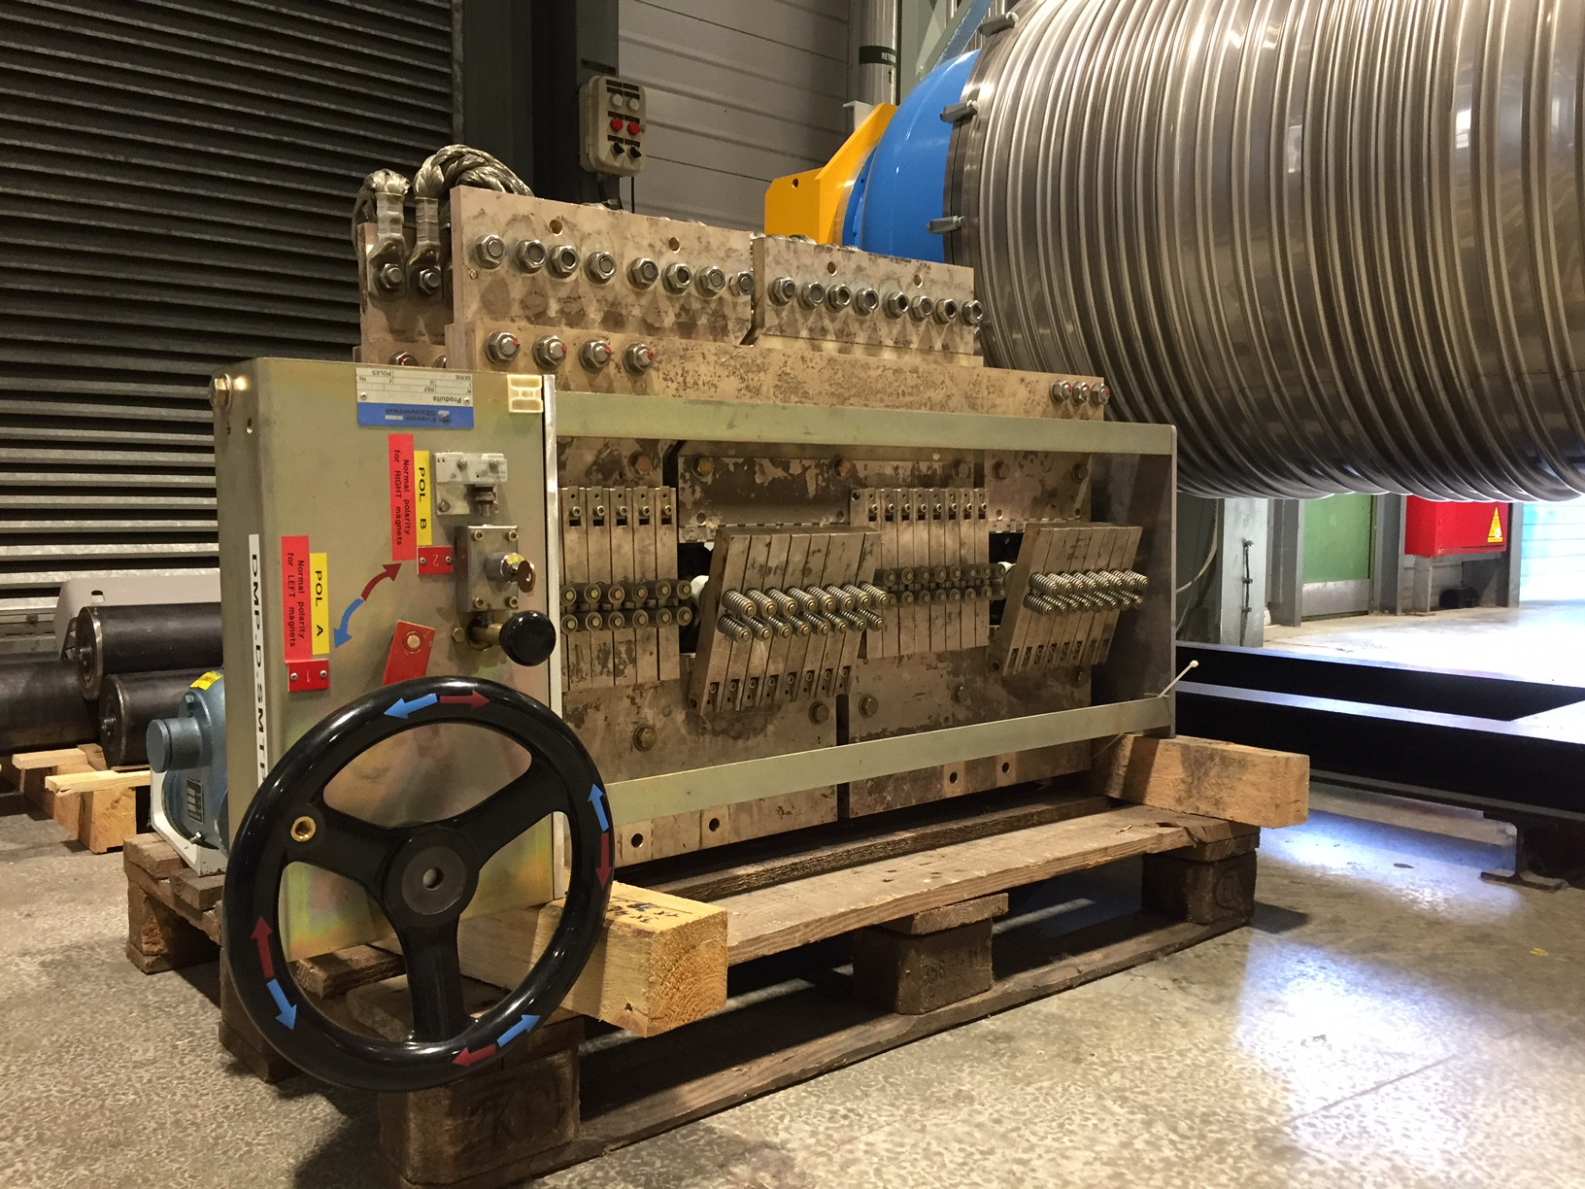
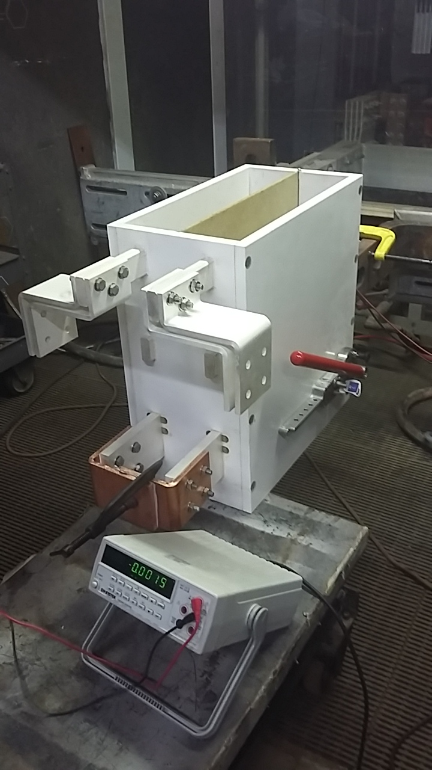
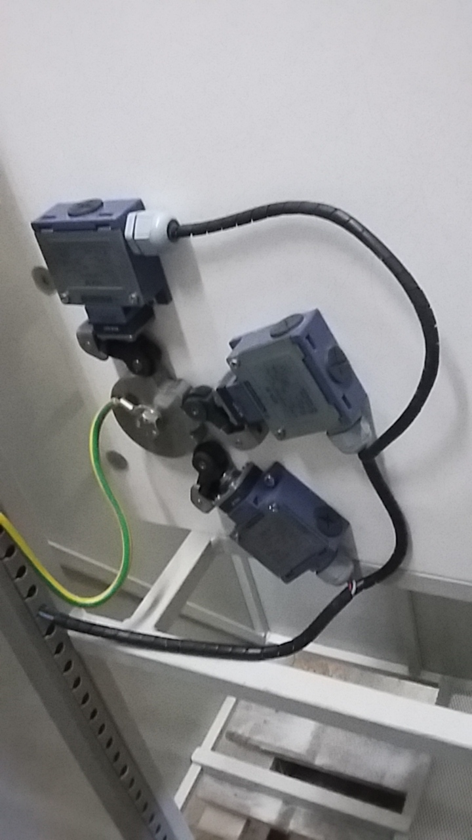
Circuit Disconnector Boxes already at CERN
TE-EPC already have a wide experience with this type of disconnectors
  SM18 (16 kA)
  POPS-B (3 kA/7.2 kV)
  Several more examples (LHCb, SPS Mains, 163 for Fresca 2, etc.)
SM18
POPS-B

Slide 8
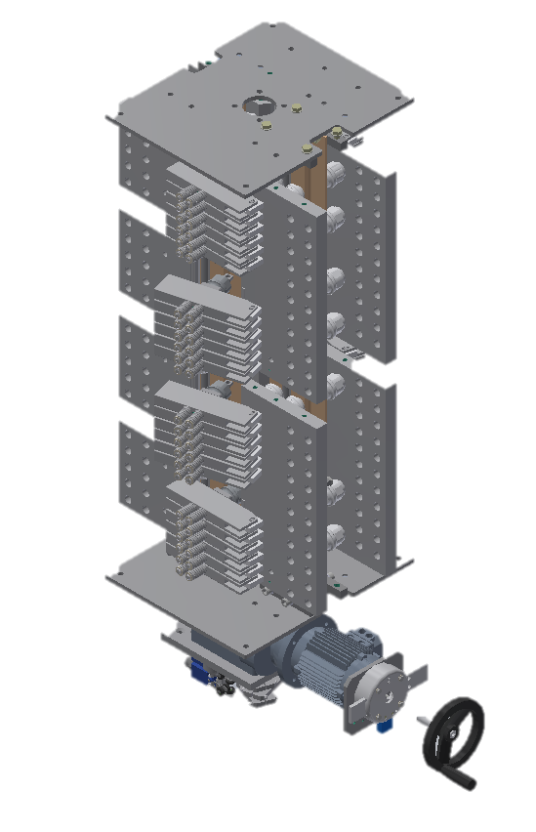
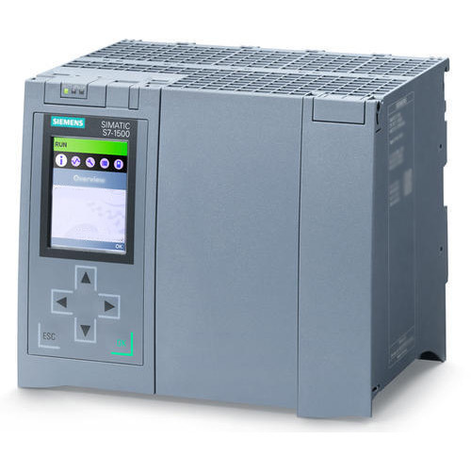
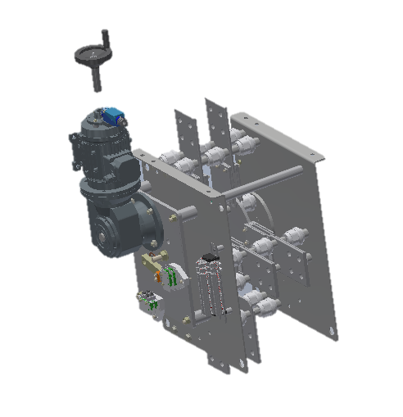
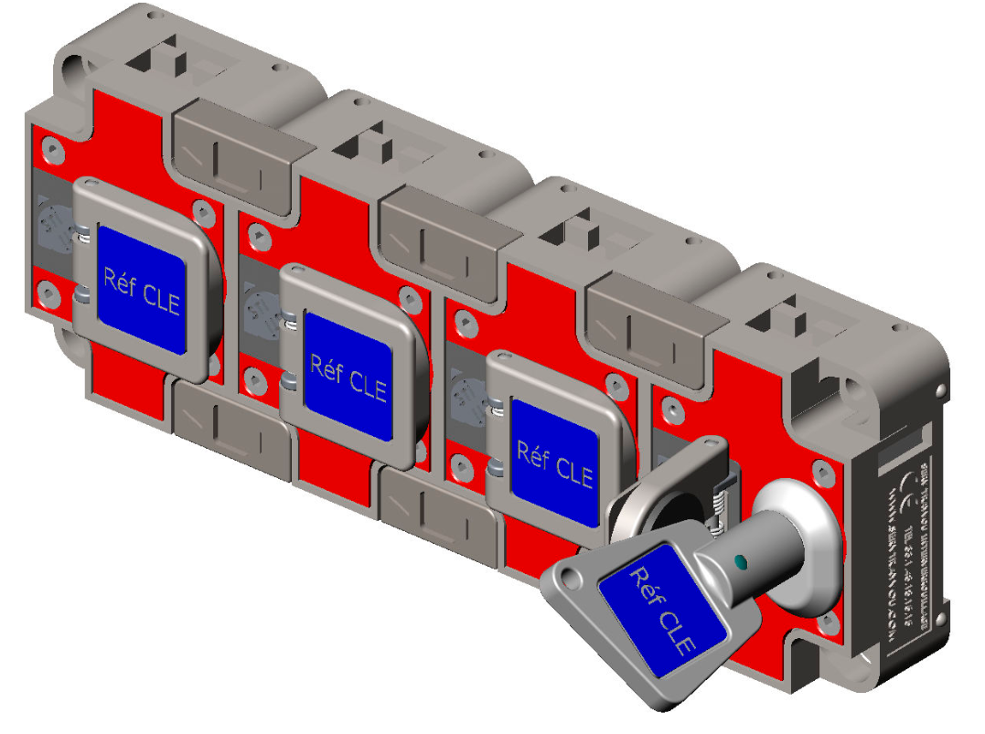
Proposed Technical Solution
Present TE-EPC disconnector concept relies on:
  Switchable fingers type for 18 & 13 kA circuits
  Rotative position type for ≤ 2 kA circuits
  PLC to communicate state of the disconnectors and ensure correct manipulation
  Panel key controller to control access and to ensure correct manipulation
Considered solutions introduces a negligible resistance
  Less than 2 µΩ per polarity for 18 kA circuit
18 kA System Example
2 kA System Example
PLC System
Panel Key Controller

Slide 9
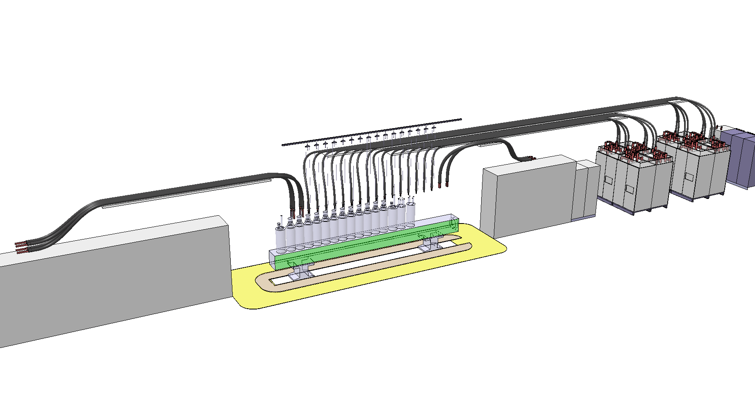
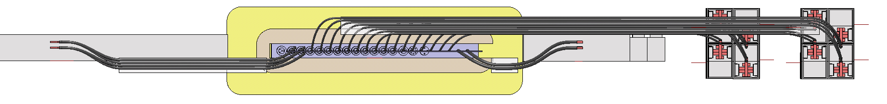
Recall: Today’s Baseline
Water cooled cables
2 kA
2 kA
13 kA
DFBA-like concept
Courtesy of JC. Guillaume, L. Sburlino
18 kA
Top view

Slide 10
Proposed Circuits with Disconnector Boxes (CDBs)
CDBs for circuits in the URs
  1x18 kA Circuit
  2x13 kA Circuits
  8x2 kA Circuits
  4x0.6 kA Circuits
  1x0.035 kA Circuit
CDBs are not considered (so far) for:
  1x0.2 kA Circuit (as could be moved to ULs)
  8x0.12 kA Circuit (as could be moved to ULs)

Slide 11
Proposed Circuits with Disconnector Boxes
Recap of the Baseline:
Circuit | Circuit Rating | Number of Circuits per IP side | Baseline DC Cables Cooling | Baseline Cable Section per polarity
IT Main | 18 kA | 1 | Water-cooled | 2 x 1300 mm²
D1 and D2 | 13 kA | 2 | Water-cooled | 2000 mm²
2 kA Correctors and Trims | 2 kA | 8 | Water-cooled | 500 mm²
0.6 kA D2 Correctors | 0.6 kA | 4 | Air-cooled | 400 mm²
K-modulation Circuit | 0.035 kA | 1 | Air-cooled | 25 mm²

Slide 12
Integration Concept in the UR with CDBs
Proposed integration concept with CDBs and distributed current leads
  Several iterations between WP6a and WP6b
  In the envelope and no consequences on the defined civil engineering
  Current leads are adjacent to 18 kA power converter to reduce resistance and optimize magnet energy recuperation
  Access and handling space of the different equipment is respected
  Minimum resistance is ensured for 13 kA circuits (1 quadrant power converter) to discharge in the shadow of the RB circuits
  Standardized connections between the different 2 kA circuits

Slide 13
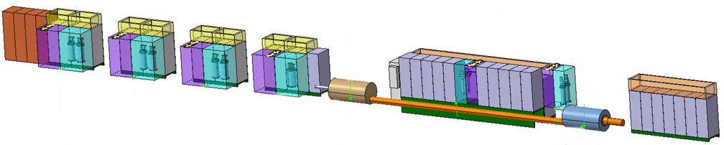
Integration Concept in the UR (Q1→ D1) with CDBs
Proposed integration concept with CDBs and distributed current leads (ongoing work with WP15)
DFHX no. 2
DFHX no. 1
2 kA – Orbit Correctors
2 kA + 35 A Trims
18 kA - RQX
13 kA – RD1
Disconnector racks (in purple)
Courtesy of R. Betemps
Current leads racks (in light blue)

Slide 14
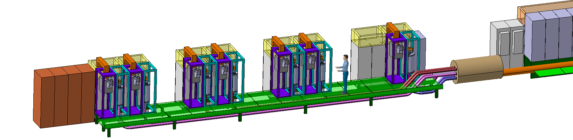
CDBs: Integration Concept for 2 kA Circuits
More advanced conceptual integration from WP15 (ongoing work)
Courtesy of S. Maridor
2 kA Trim Circuits
MCBXFB Circuits
MCBXFA Circuits with EES

Slide 15
Conceptual Solution for the IT Main Circuit

Slide 16
Solutions Scope vs. Budget and Financing
Recap of proposed solution impact:
  No water cooled cables (direct bus-bars connections under the responsibility of WP6b)
  All cooling and ventilation services are optimized and in the shadow of baseline
Estimated cost table
Impact on WP17 cost
  Reduces WP17 planned spending on water-cooled cables by the order of 2.9 MCHF
Circuits | Number of CDBs per IP side | Cost per IP side | Cost for 4 IP sides + IT String (HL-LHC Spare)
IT Main Circuit | 1 x 18 kA + 2 x 2kA + 1 x 35 A + 1 x Warm Diodes | 100 kCHF | 500 kCHF
D1 and D2 | 2 x 13 kA | 120 kCHF | 600 kCHF
2 kA Orbit Correctors | 6 x 2 kA | 140 kCHF | 700 kCHF
0.6 kA Orbit Correctors | 4 x 0.6 kA | 40 kCHF | 200 kCHF
Complete System |  |  | 2 MCHF (comprehensive budget)

Slide 17
Conclusion
Disconnector significantly facilitates ElQA activities
Disconnectors improve conditions for intervention on the equipment
Required budget could come from water cooled DC cables savings
Decision should be taken before end of 2018 to fit with the project schedule

Slide 18
Thank you for your attention

