Slide 1
QuarkNet Data Portfolio and Activities
Spencer Pasero (with much assistance from
Deborah Roudebush and Ken Cecire)
IPPOG Fall 2018 Meeting
4 October 2018

Slide 2
Data Portfolio Goals
Make current physics accessible to high school teachers and students
Establish a resource on the Web of tested lessons vetted against best practices in instructional design
Develop pedagogical pathways to guide teachers in selecting modern physics lessons for the classroom

Slide 3
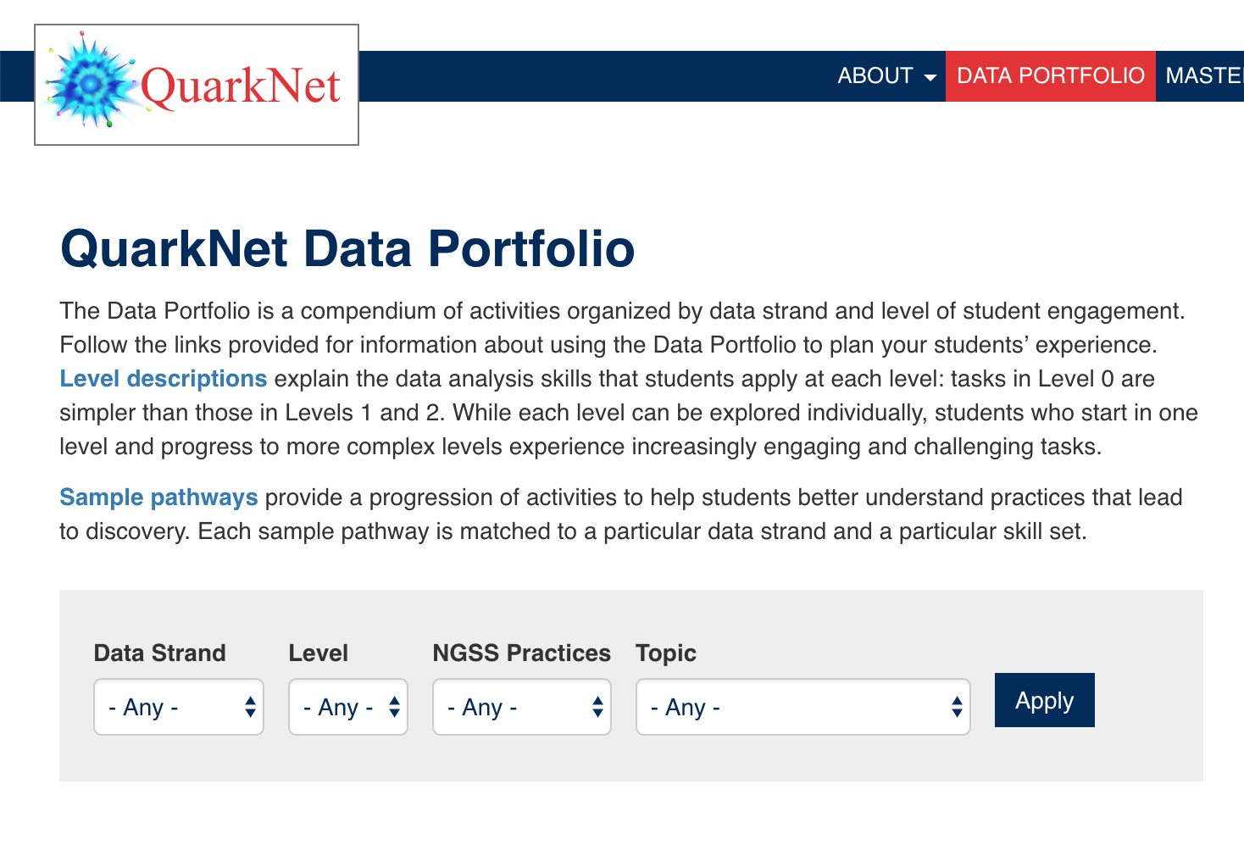
Data Portfolio
The Data Portfolio is available at:
https://quarknet.org/data-portfolio

Slide 4
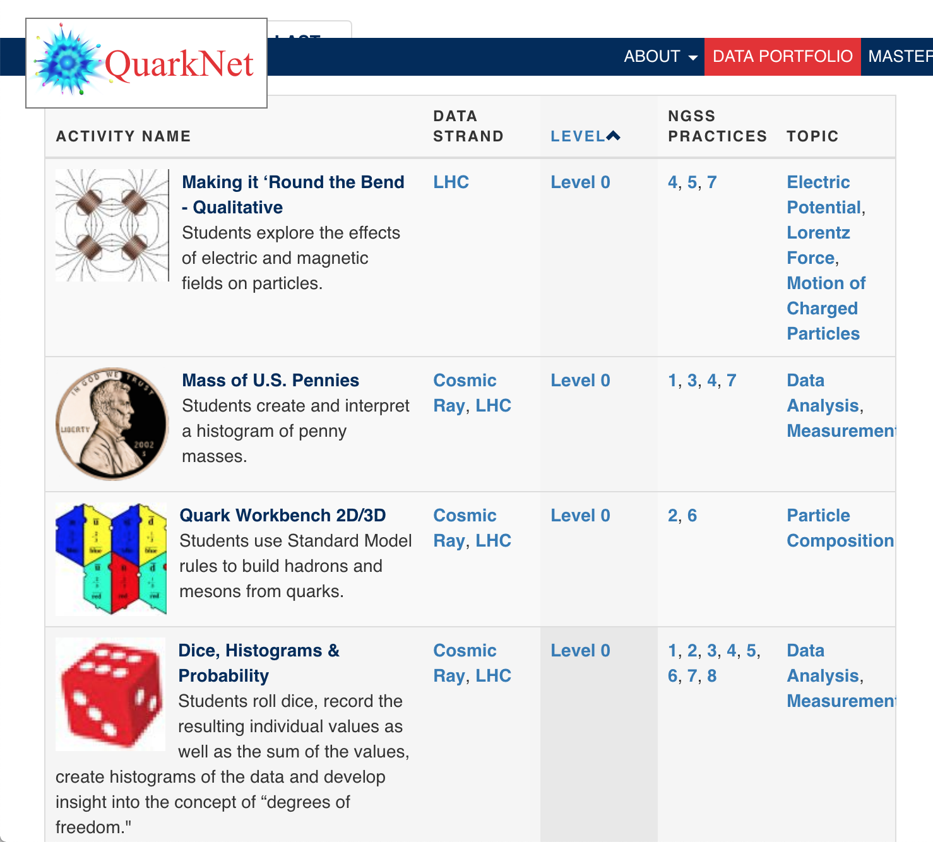
Accessing Activities
Activities are all free and available for download. Each is keyed to one or more Data Strands, a Level of complexity, Science and Engineering Practices, and one or more Topics

Slide 5
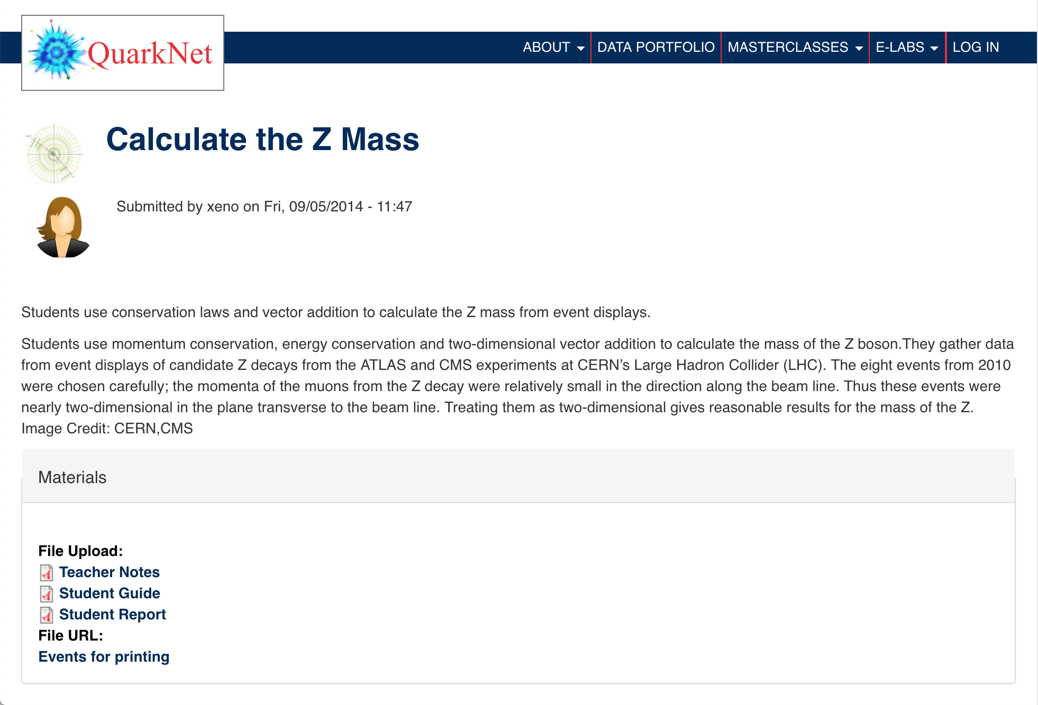
Inside a Lesson
When you go to a lesson page, you will see links for a student page, a teacher page, and any data files or supplemental materials you need.

Slide 6
Path Structure
Level 0 lessons help build knowledge and skill base.
Complexity builds through Level 3; hoping to implement Level 4 lessons in this grant cycle.
We are also planning to expand neutrino content, which brings us to our activity for the day:

Slide 7
Neutrinos in the Classroom (MINERνA activity)
This is an activity where students can use events from the MINERνA detector to estimate the muon lifetime.
Students look for events in which a muon stops in the detector, measure how long it takes the muon to decay, and then plot that data collectively to make the measurement.
http://neutrino-classroom.org/particle_decay.html

Slide 8

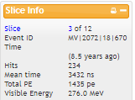
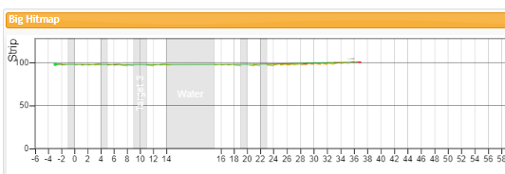
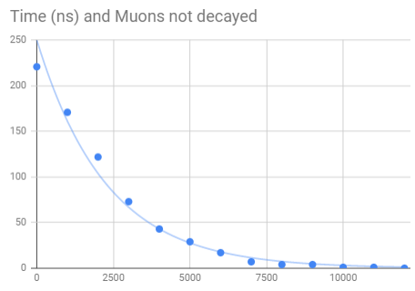
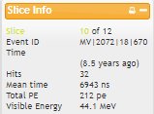
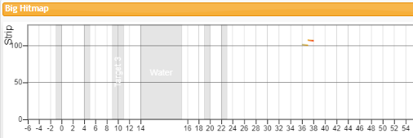
Measurement

Slide 9
Questions for you:
What are the enduring understandings that you think students should take away from this activity?
What do you think students should be able to do as a result of completing this activity?

Slide 10
Content Slide [28pt Bold]
Bullet points are optional. If preferred, only first level bullets can be used or bullets can be set to “NONE.” [24pt Regular]
First level bullet [24pt Regular]
  Second level bullet [22pt Regular]
    Third level bullet [20pt Regular]
      Fourth level bullet [18pt Regular]
        Fifth level bullet [18pt Regular]

Slide 11
Content Slide [28pt Bold]
Bullet points are optional. If preferred, only first level bullets can be used or bullets can be set to “NONE.” [24pt Regular]
First level bullet [24pt Regular]
  Second level bullet [22pt Regular]
    Third level bullet [20pt Regular]
      Fourth level bullet [18pt Regular]
        Fifth level bullet [18pt Regular]

Slide 12
Content Slide [28pt Bold]
Bullet points are optional. If preferred, only first level bullets can be used or bullets can be set to “NONE.” [24pt Regular]
First level bullet [24pt Regular]
  Second level bullet [22pt Regular]
    Third level bullet [20pt Regular]
      Fourth level bullet [18pt Regular]
        Fifth level bullet [18pt Regular]

Slide 13
Content Slide [28pt Bold]
Bullet points are optional. If preferred, only first level bullets can be used or bullets can be set to “NONE.” [24pt Regular]
First level bullet [24pt Regular]
  Second level bullet [22pt Regular]
    Third level bullet [20pt Regular]
      Fourth level bullet [18pt Regular]
        Fifth level bullet [18pt Regular]

Slide 14
Content Slide [28pt Bold]
Bullet points are optional. If preferred, only first level bullets can be used or bullets can be set to “NONE.” [24pt Regular]
First level bullet [24pt Regular]
  Second level bullet [22pt Regular]
    Third level bullet [20pt Regular]
      Fourth level bullet [18pt Regular]
        Fifth level bullet [18pt Regular]

Slide 15
Comparison Slide [28pt Bold]
First level bullet [24pt Reg]
  Second level bullet [22p]t
    Third level bullet [20pt]
      Fourth level bullet [18pt]
        Fifth level bullet [18pt]
First level bullet [24pt Reg]
  Second level bullet [22pt]
    Third level bullet [20pt]
      Fourth level bullet [18pt]
        Fifth level bullet [18pt]
Click to add caption text [16pt Bold]
Click to add caption text [16pt Bold]

Slide 16
Content and Caption Slide [28pt Bold]
Click to add caption text
[16pt Bold]
First level bullet [24pt Reg]
  Second level bullet [22pt]
    Third level bullet [20pt]
      Fourth level bullet [18pt]
        Fifth level bullet [18pt]

Slide 17
Picture and Caption Slide [28pt Bold]
Click to add caption text [16pt Bold]

Slide 19














Collaborations / Partnerships / Members 28pt Bold

