Slide 1
BE
Strategic
or
Be Gone
Interactive Strategizing for Project Managers

Slide 2
Results of the Survey
%
Question Nbr
Q 1 : Is there a clear definition and understanding of the strategy of your project ?
Q 2 : Does you project team understand the difference between goals objectives strategy and tactics ?
Q 4 : Does you project team have clear strategies in written form for each of the project goals ?
Q 12 : Do you have a one page strategic plan to drive your daily project activities ?
Q 13 : Is the allocation of project resources evaluated at least monthly ?

Slide 3
PURPOSE
Goals
Objectives
Strategy
Tactics
What
What
How
How
Global
Detail
Global
Detail

Slide 4
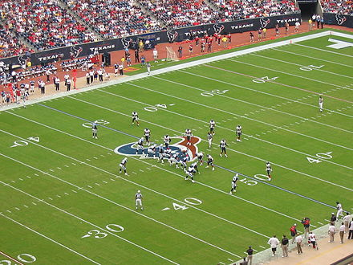

Slide 5
Assessment
Define Future State
Implementing
Monitoring
See below
See behind
See beside
See beyond
Seeing it through
Seeing it happen
Vision
PPP
Internally
KPIs and CSFs
Describe the future state
Portfolio
Programs
Projects
Resources
Culture
Skills
Beliefs
Expectations
Command
Without targets !
Are we realizing our strategic goals ?
Mission
Describe why your department, group, team exists ?
Operations
PIs
Activities
Processes
Low level procedures
High level procedures
Process system
With targets !
Is the process system effective ?
Review frequently
Goals & Objectives
Externally
What do you want to achieve ?
Political
Social
Economical
Allocate resources
Monitor resources
Strategy formulation
e.g. Cash flows, Space, ..
Morale of the troops
How are going to achieve this ?
Operations vs PPP

Slide 6
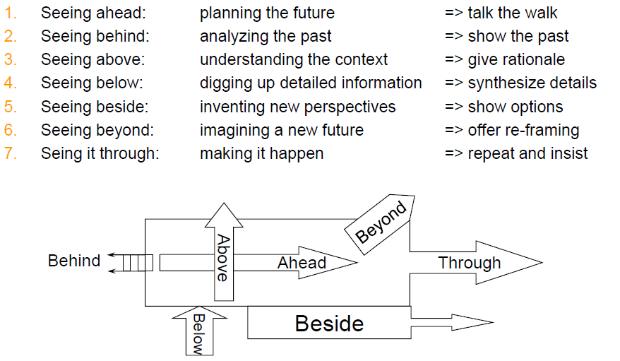
Strategy as ‘Seeing’
Slide from Prof. Dr. Martin J. Eppler

Slide 7
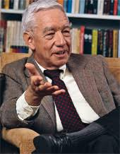
“Strategizing consists of the determination of the basic
long-term goals and objectives of an enterprise, the
adoption of courses of action and the allocation of
resources necessary for carrying out these goals.”
Alfred D. Chandler, Harvard Business School

Slide 8
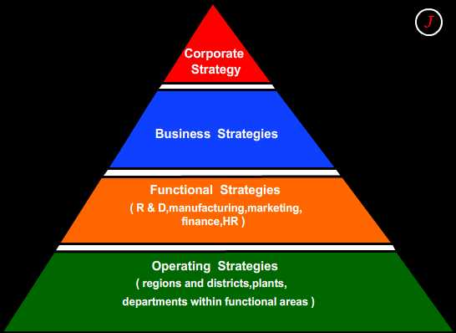

Slide 9
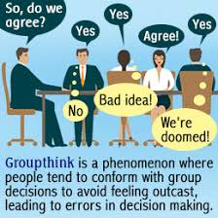
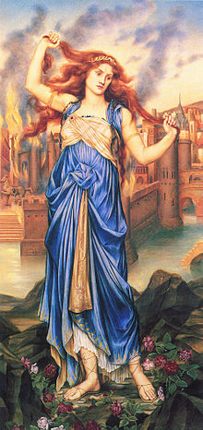
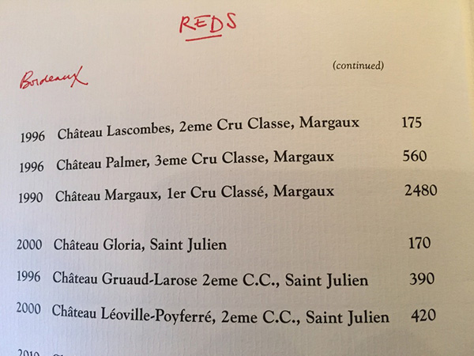
Biases
Cognitive Bias
  Framing and Anchoring
  Sunk cost and loss aversion
  Overconfidence
Communication Bias
  Cassandra Syndrome
  ASK problem
  Groupthink
  Audience Tuning
Decision Making Bias
  Premature closure
  Knowing Doing Gap
  Tool fixation
  Principal Agent

Slide 10
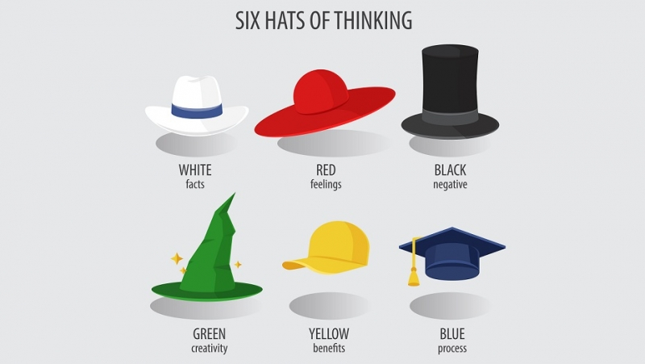
What can you do ?
Roles (devils advocate, challenge and defend)
Principles (80/20, hailing failing still sailing, 2nd opinions, more than 2 options)
Use of tools (lets-focus, toulmin, IBIS etc)
Methods (ladder of interference, thinking hats, debriefings)
Rules (write down initial opinion, next best idea etc)

Slide 11
Leading Strategic Conversations
8 Mai
From G. Ross, Beyond Strategic Planning, 1996 Ed.

Slide 12
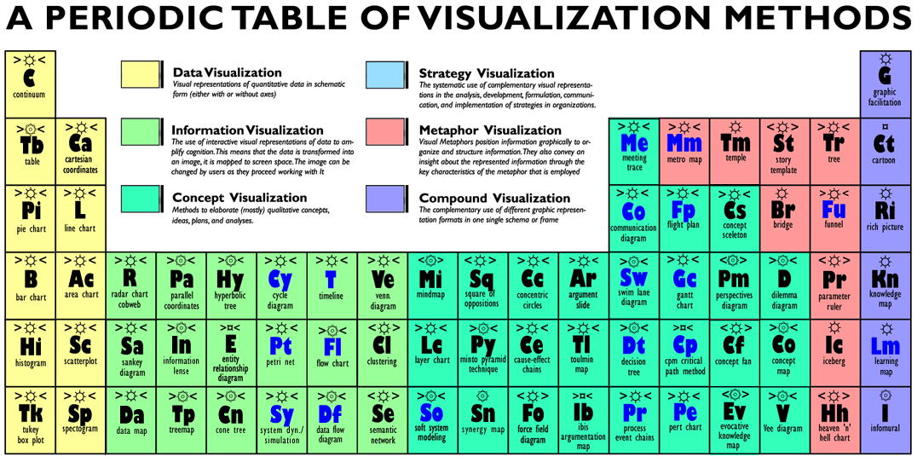
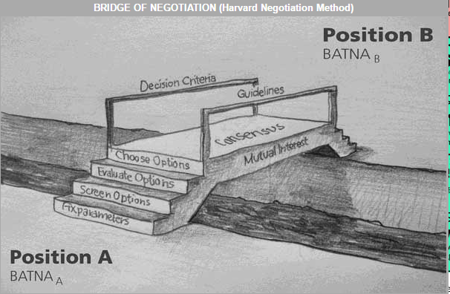
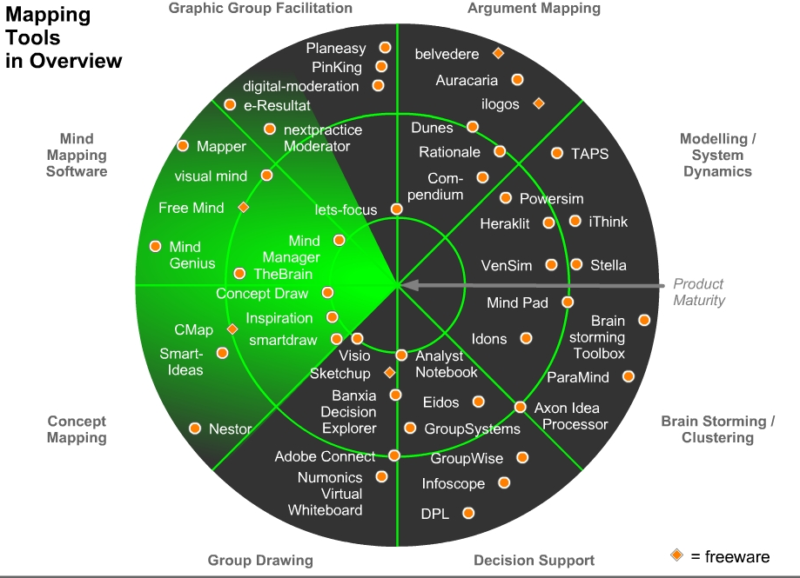
www.visual-literacy.org

Slide 13
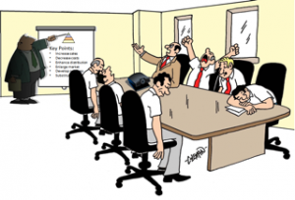
By Frederic (http://www.conseilsmarketing.com)

Slide 14
Strategy communication

Slide 15
