Slide 1
The LHCb experiment: looking for New Physics in B decays
b
s
b
s
s
b
Frederic Teubert
(CERN, PH Department)

Slide 2
Outline
Introduction:
  B Physics as an indirect probe for New Physics
  How LHCb will contribute in the search for New Physics?
LHCb experimental conditions:
  LHC as a B factory
  Detector requirements
Examples of (early) Physics Results:
  First physics calibrations and J/ψ measurements
  B_{s} → μ⁺μ⁻
  B_{s} mixing phase: φ_{s}
  γ at tree level
Outlook and Conclusions.

Slide 3
0. Preamble

Slide 4

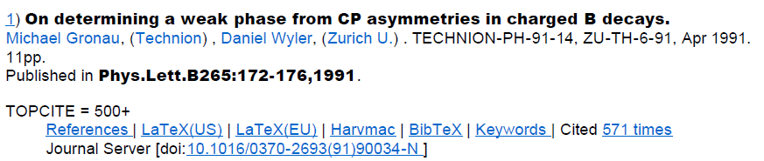
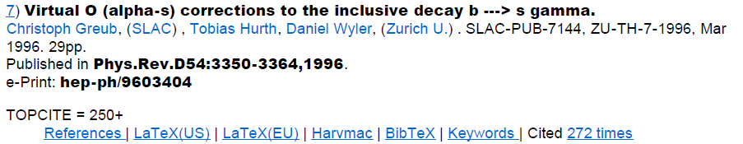
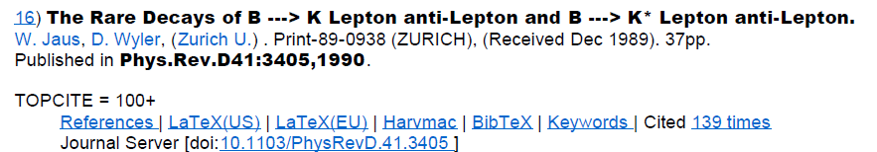
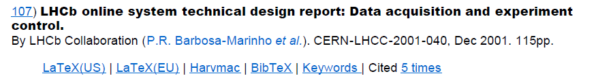
Wyler and the LHCb physics program
A fast search for Daniel Wyler in SPIRES, according to the number of citations, gives a clear picture of the influence of his work on the LHCb physics program, spanning from CP asymmetries to rare decays, to include even the LHCb online system!!!

Slide 5
Introduction

Slide 6

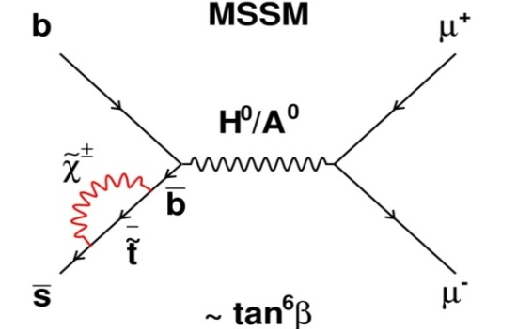
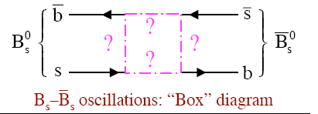
B Physics as an indirect probe for New Physics
SM cannot be the ultimate theory
  must be a low-energy effective theory of a more fundamental theory (able to describe dark matter and matter-antimatter asymmetry in the Universe) at a higher energy scale. It may very well be in the TeV region if it has to deal with the “hierarchy problem” (accessible at LHC !)
How can New Physics (NP) be discovered and studied ?
  NP models introduce new particles, dynamics and/or symmetries at a higher energy scale. These new particles could
    be produced and observed as real particles at energy frontier machines (e.g LHC)
    appear as virtual particles (in loop processes), leading to observable deviations from the pure SM expectations in flavour physics and CP violation.
?
B_{s} → μ⁺μ⁻ Higgs “Penguin”

Slide 7
CKM picture of CP violation
Using the Wolfenstein parameterisation (λ, A, ρ, η)
1-λ²/2- λ⁴/8 λ Aλ³(ρ-iη)
-λ 1-λ²/2 -λ⁴/8(1+4A²) Aλ²
Aλ³(1-ρ-iη) -Aλ²+Aλ⁴/2(1-2(ρ+iη)) 1+A²λ⁴/2
V =
+ O(λ⁵)
arg V_{td} = -β
arg V_{ub} = -γ
arg V_{ts} = -φ_{s}/2+π

Slide 8
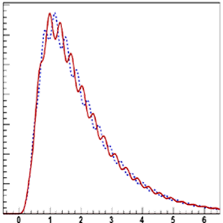
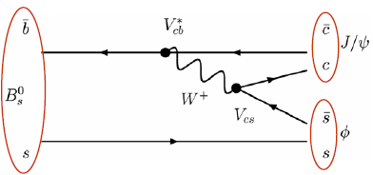
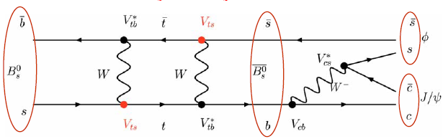


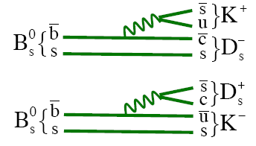
How do we measure these phases?
Tagged B_{s}
Tagged B_{s}
B_{s}⁰
B_{s}⁰
B_{s}⁰
Proper time (ps)
Lifetime distributions of events with a B_{s} (B_{s}) at production show oscillation pattern due to mixing.
The frequency of these oscillations is Δm_{s} while the amplitude of the oscillation is proportional to sinφ_{s} due to the phase in the mixing box diagram.
If we take the asymmetry of the two distributions (A_{CP}) many factors cancel out
and we are left with:
If we consider the final state B_{s}→D_{s}⁺K⁻ then
the amplitude is proportional to sin(φ_{s}-γ).
V_{ub}

Slide 9
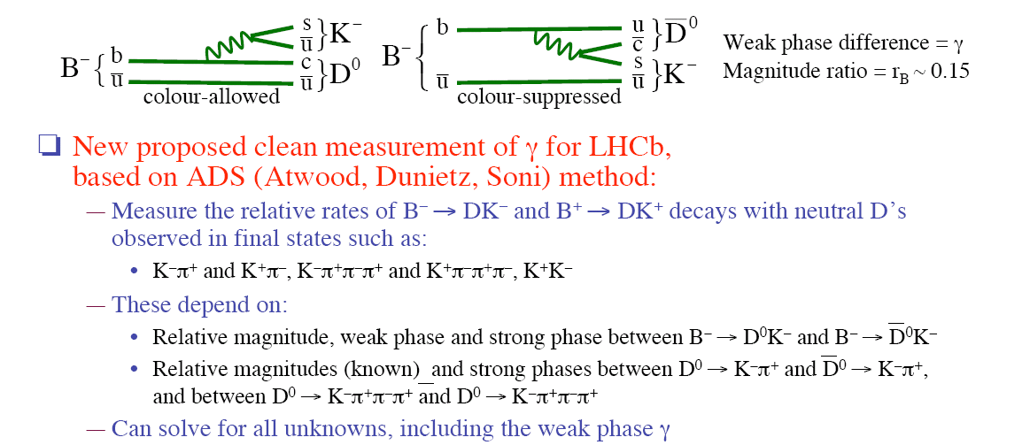
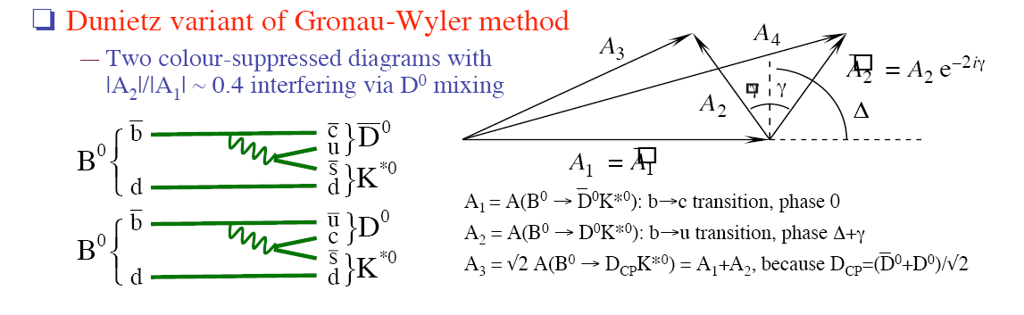
Time-independent methods to measure γ
γ from B± → D K± :
V_{ub}
First proposal by Gronau, London and Wyler (GLW, 1991) using D decays to CP eigenstates.
Later expanded by Atwood, Dunietz and Sony, (ADS, 1997) to include flavour specific final
states and Giri, Grossman, Soffer, Zupan and Bondar (2003) to include Dalitz analysis:
Measure the relative rates of B⁺→DK⁺ and B⁻→DK⁻ with neutrals D’s observed in finals
states such as: K±π , K±π π⁺π⁻, K⁺K⁻.
±
±
γ from B⁰ → D K* :
Dunietz variant (1998) of Gronau-Wyler method:
Two colour suppressed diagrams with⏐A₂⏐/⏐A₁⏐≅0.4 interfering via D⁰ mixing
V_{ub}

Slide 10
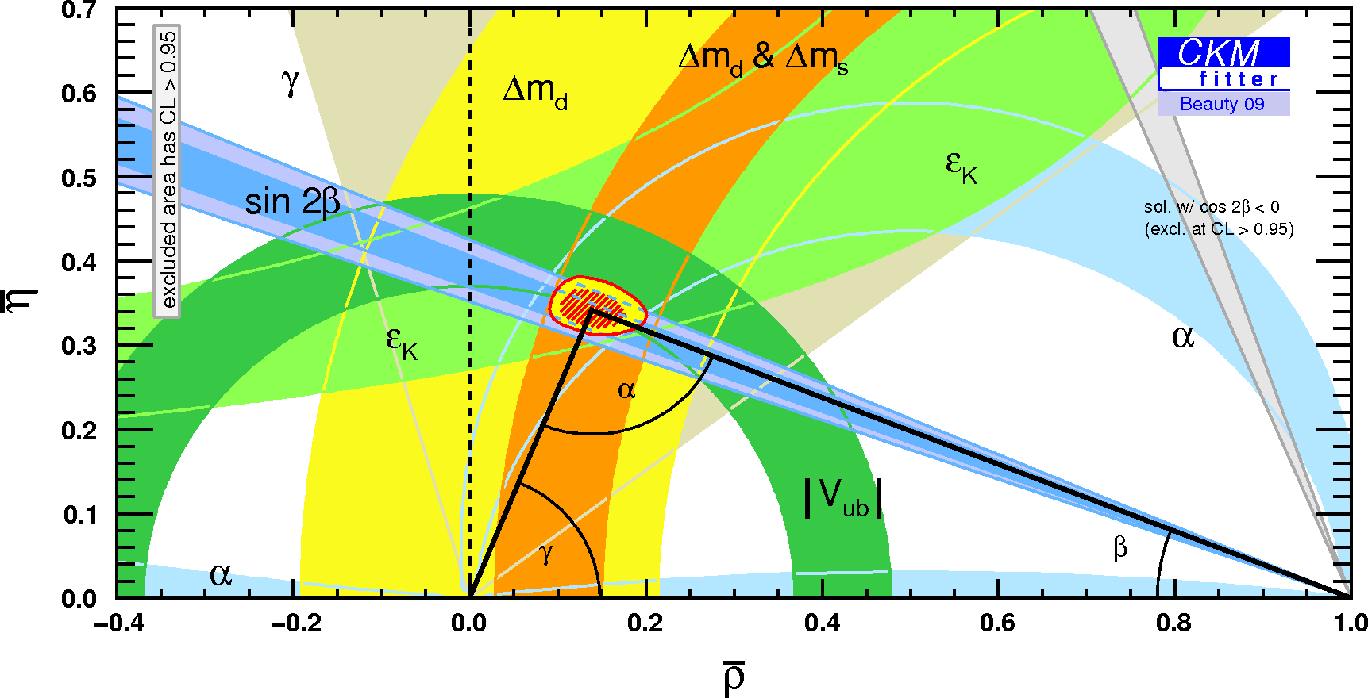
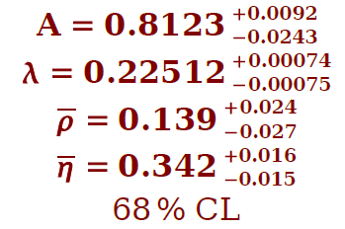
What’s the status of the CKM parameters now?
http://ckmfitter.in2p3.fr/
Beauty 09
Certainly, the CKM mechanism is the dominant source of the CP violation observed so far.
However...

Slide 11
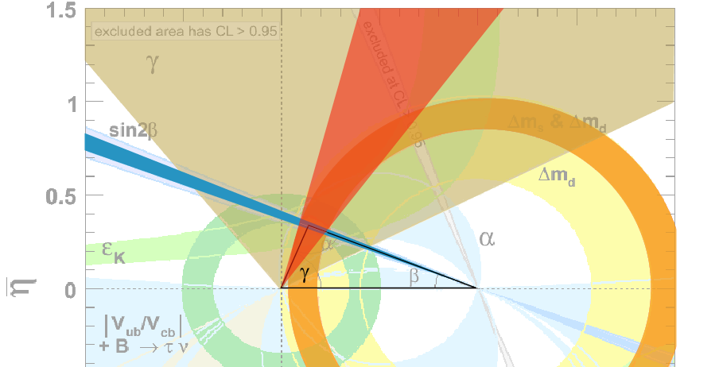
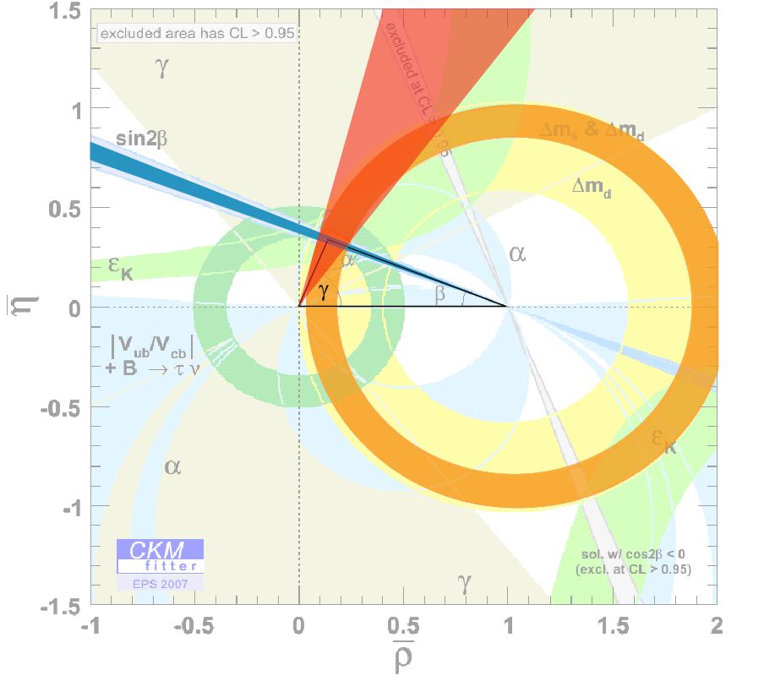
γ measurement
Direct
measurement
Indirect
All measurements together determine (indirectly) the CKM angle γ = (68 ± 4)º
However, as processes involve loops, may be affected by new physics
→ should be compared with measurement of γ from tree process:
B → DK, unaffected by new physics
Currently only poorly constrained: γ = (75 ± 21)º (direct measurement)

Slide 12
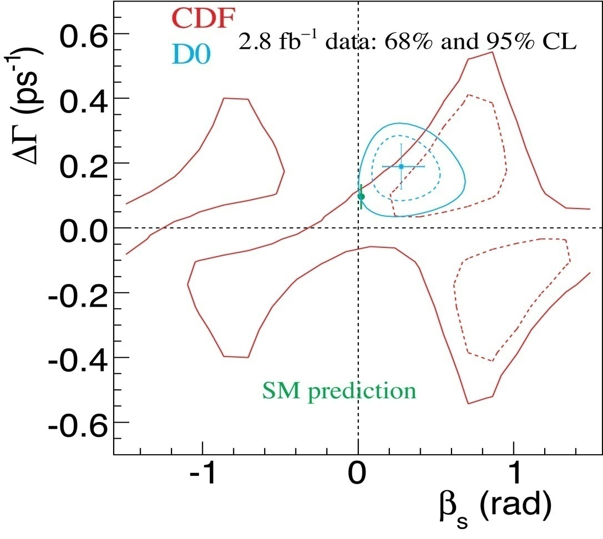
φ_{s} measurement
First measurement from CDF/D0 of the phase in the mixing of the Bs system using the time dependent analysis of the decay B_{s}→J/ψφ shows tantalizing hints… with only ~3k signal candidates there is ~2σ difference w.r.t. the very precise SM prediction.

Slide 13
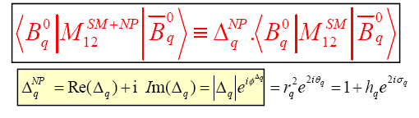
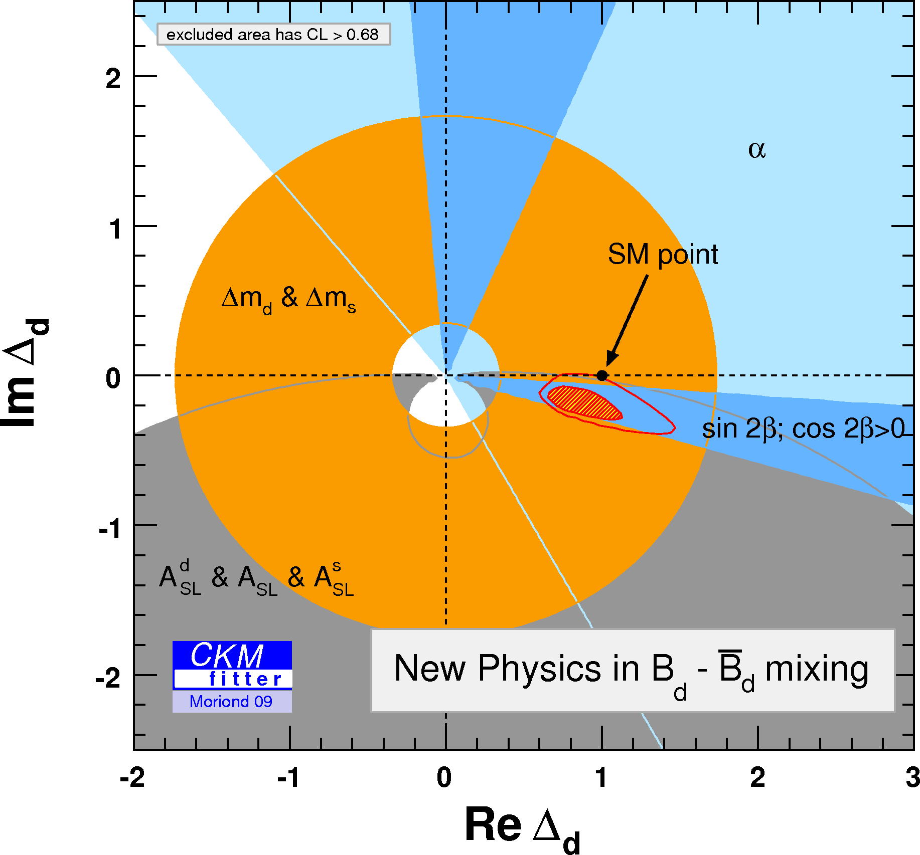
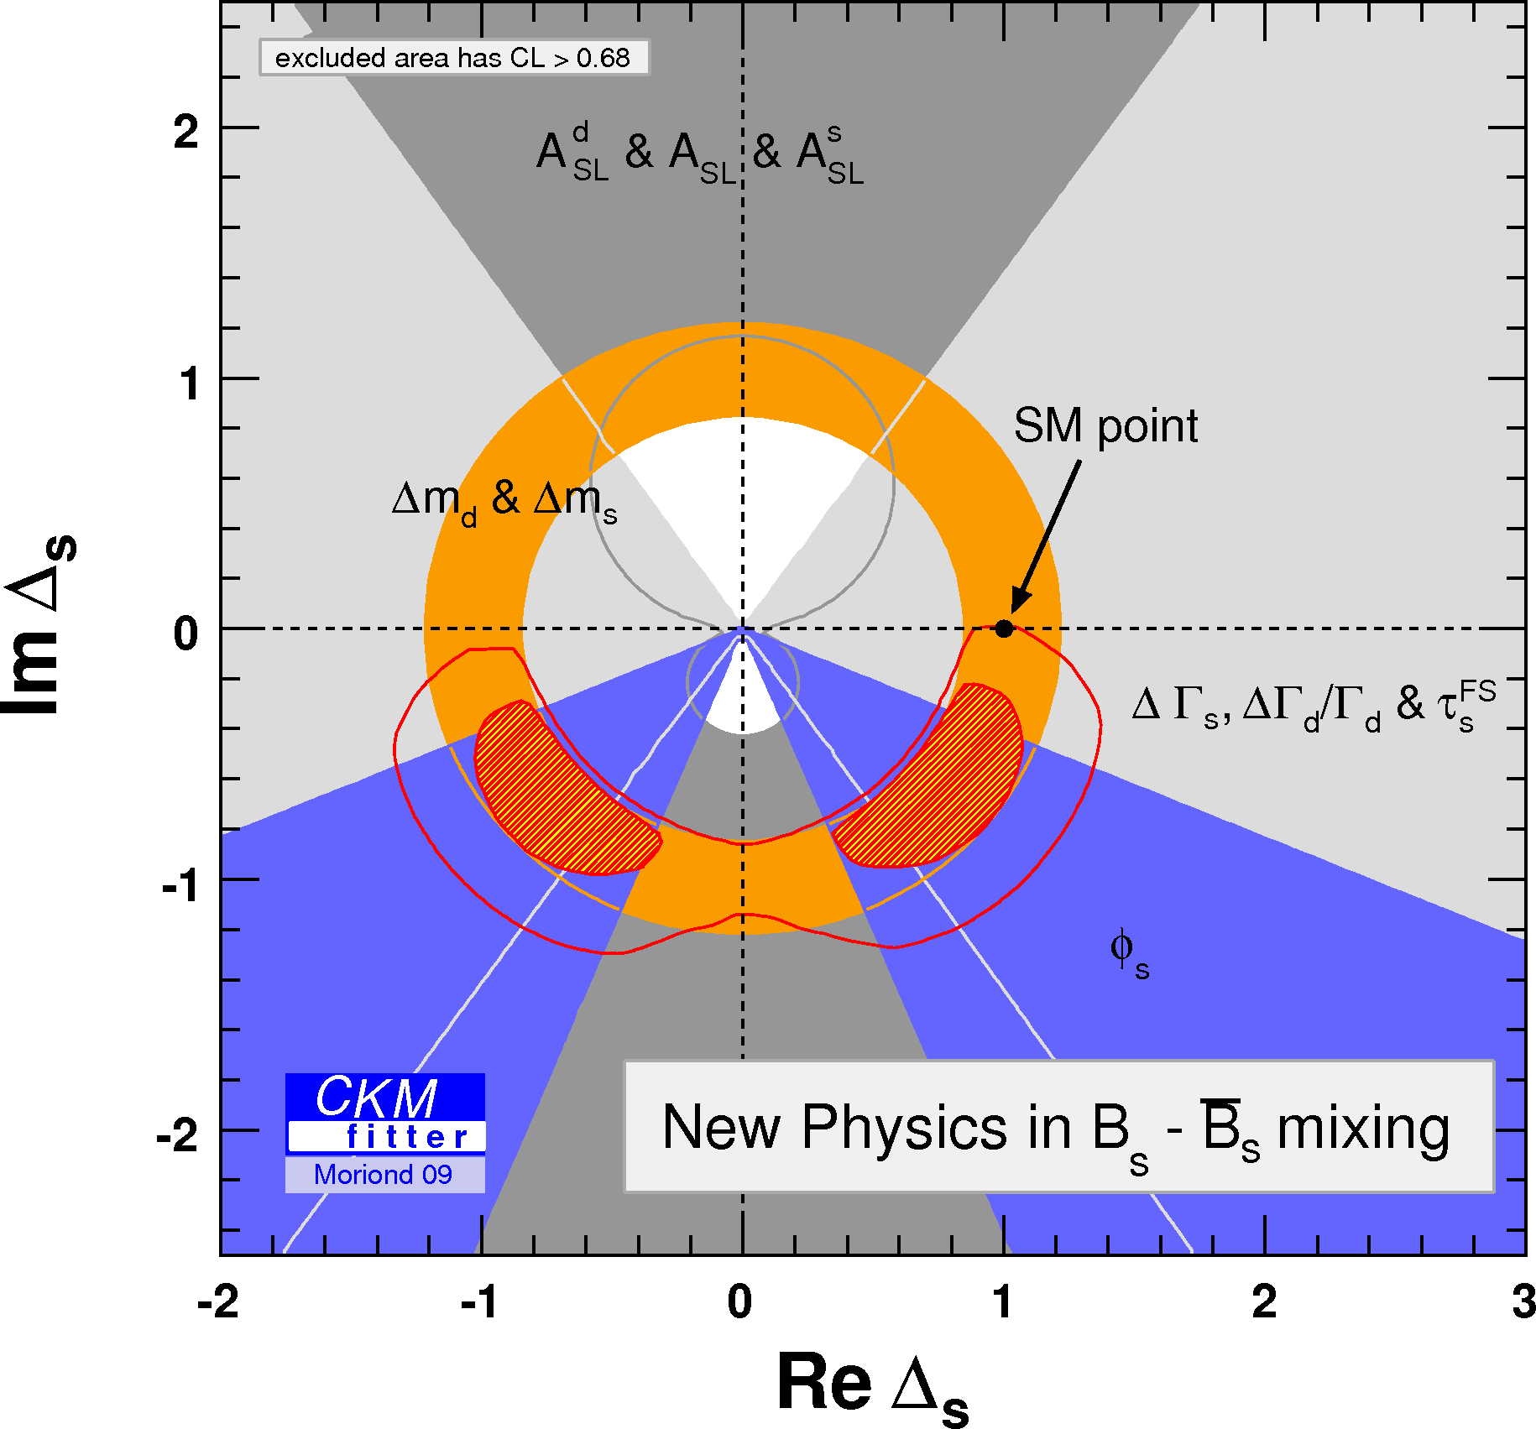
Parameterization of New Physics in mixing
The effects of New Physics in the oscillation can be parameterized as:

Slide 14
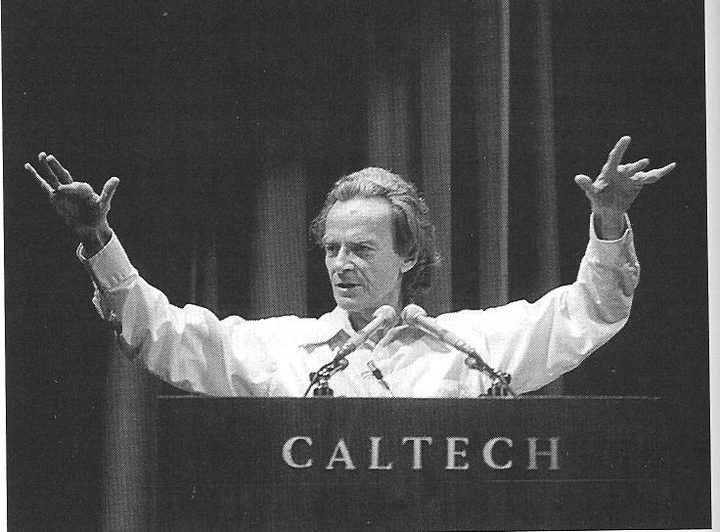
Rare decays
The penguin diagram prefers heavy virtual fields in the loop; penguin-to-tree ratio:
a controversy…
why (the hell) do you call these
Penguin diagrams?
They don’t look like penguins!
I’ve never seen a
Feynman diagram
that looks like you ☺
mirror image of Richard Feynman

Slide 15
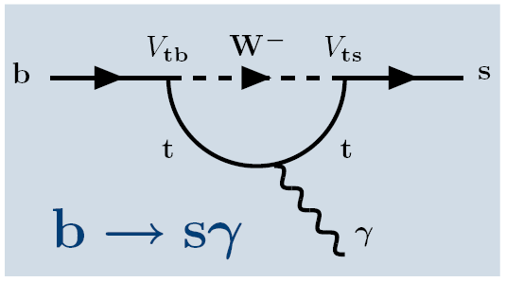
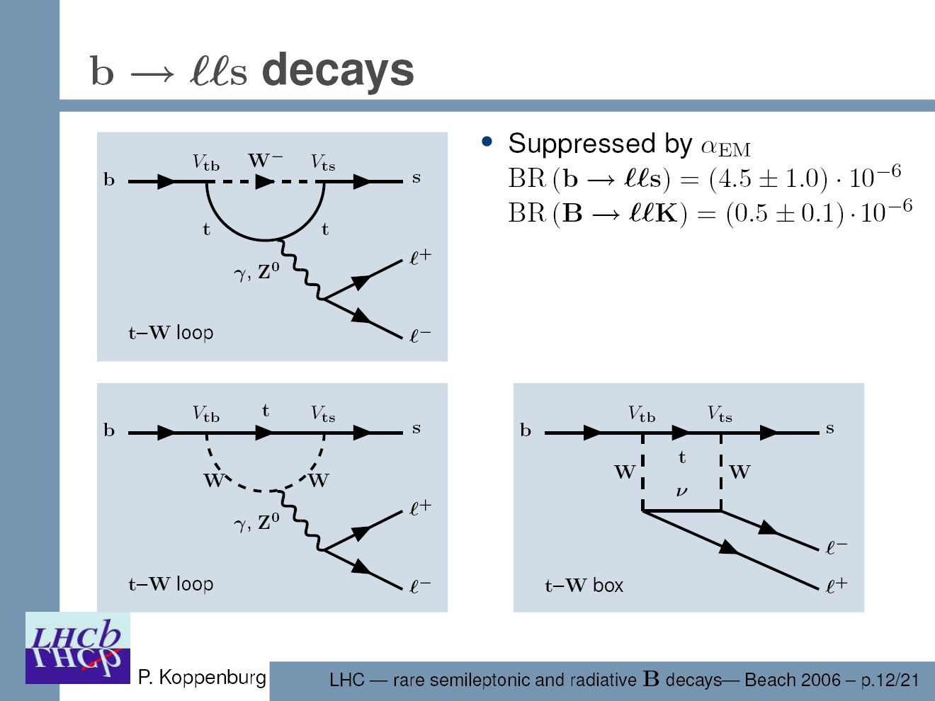
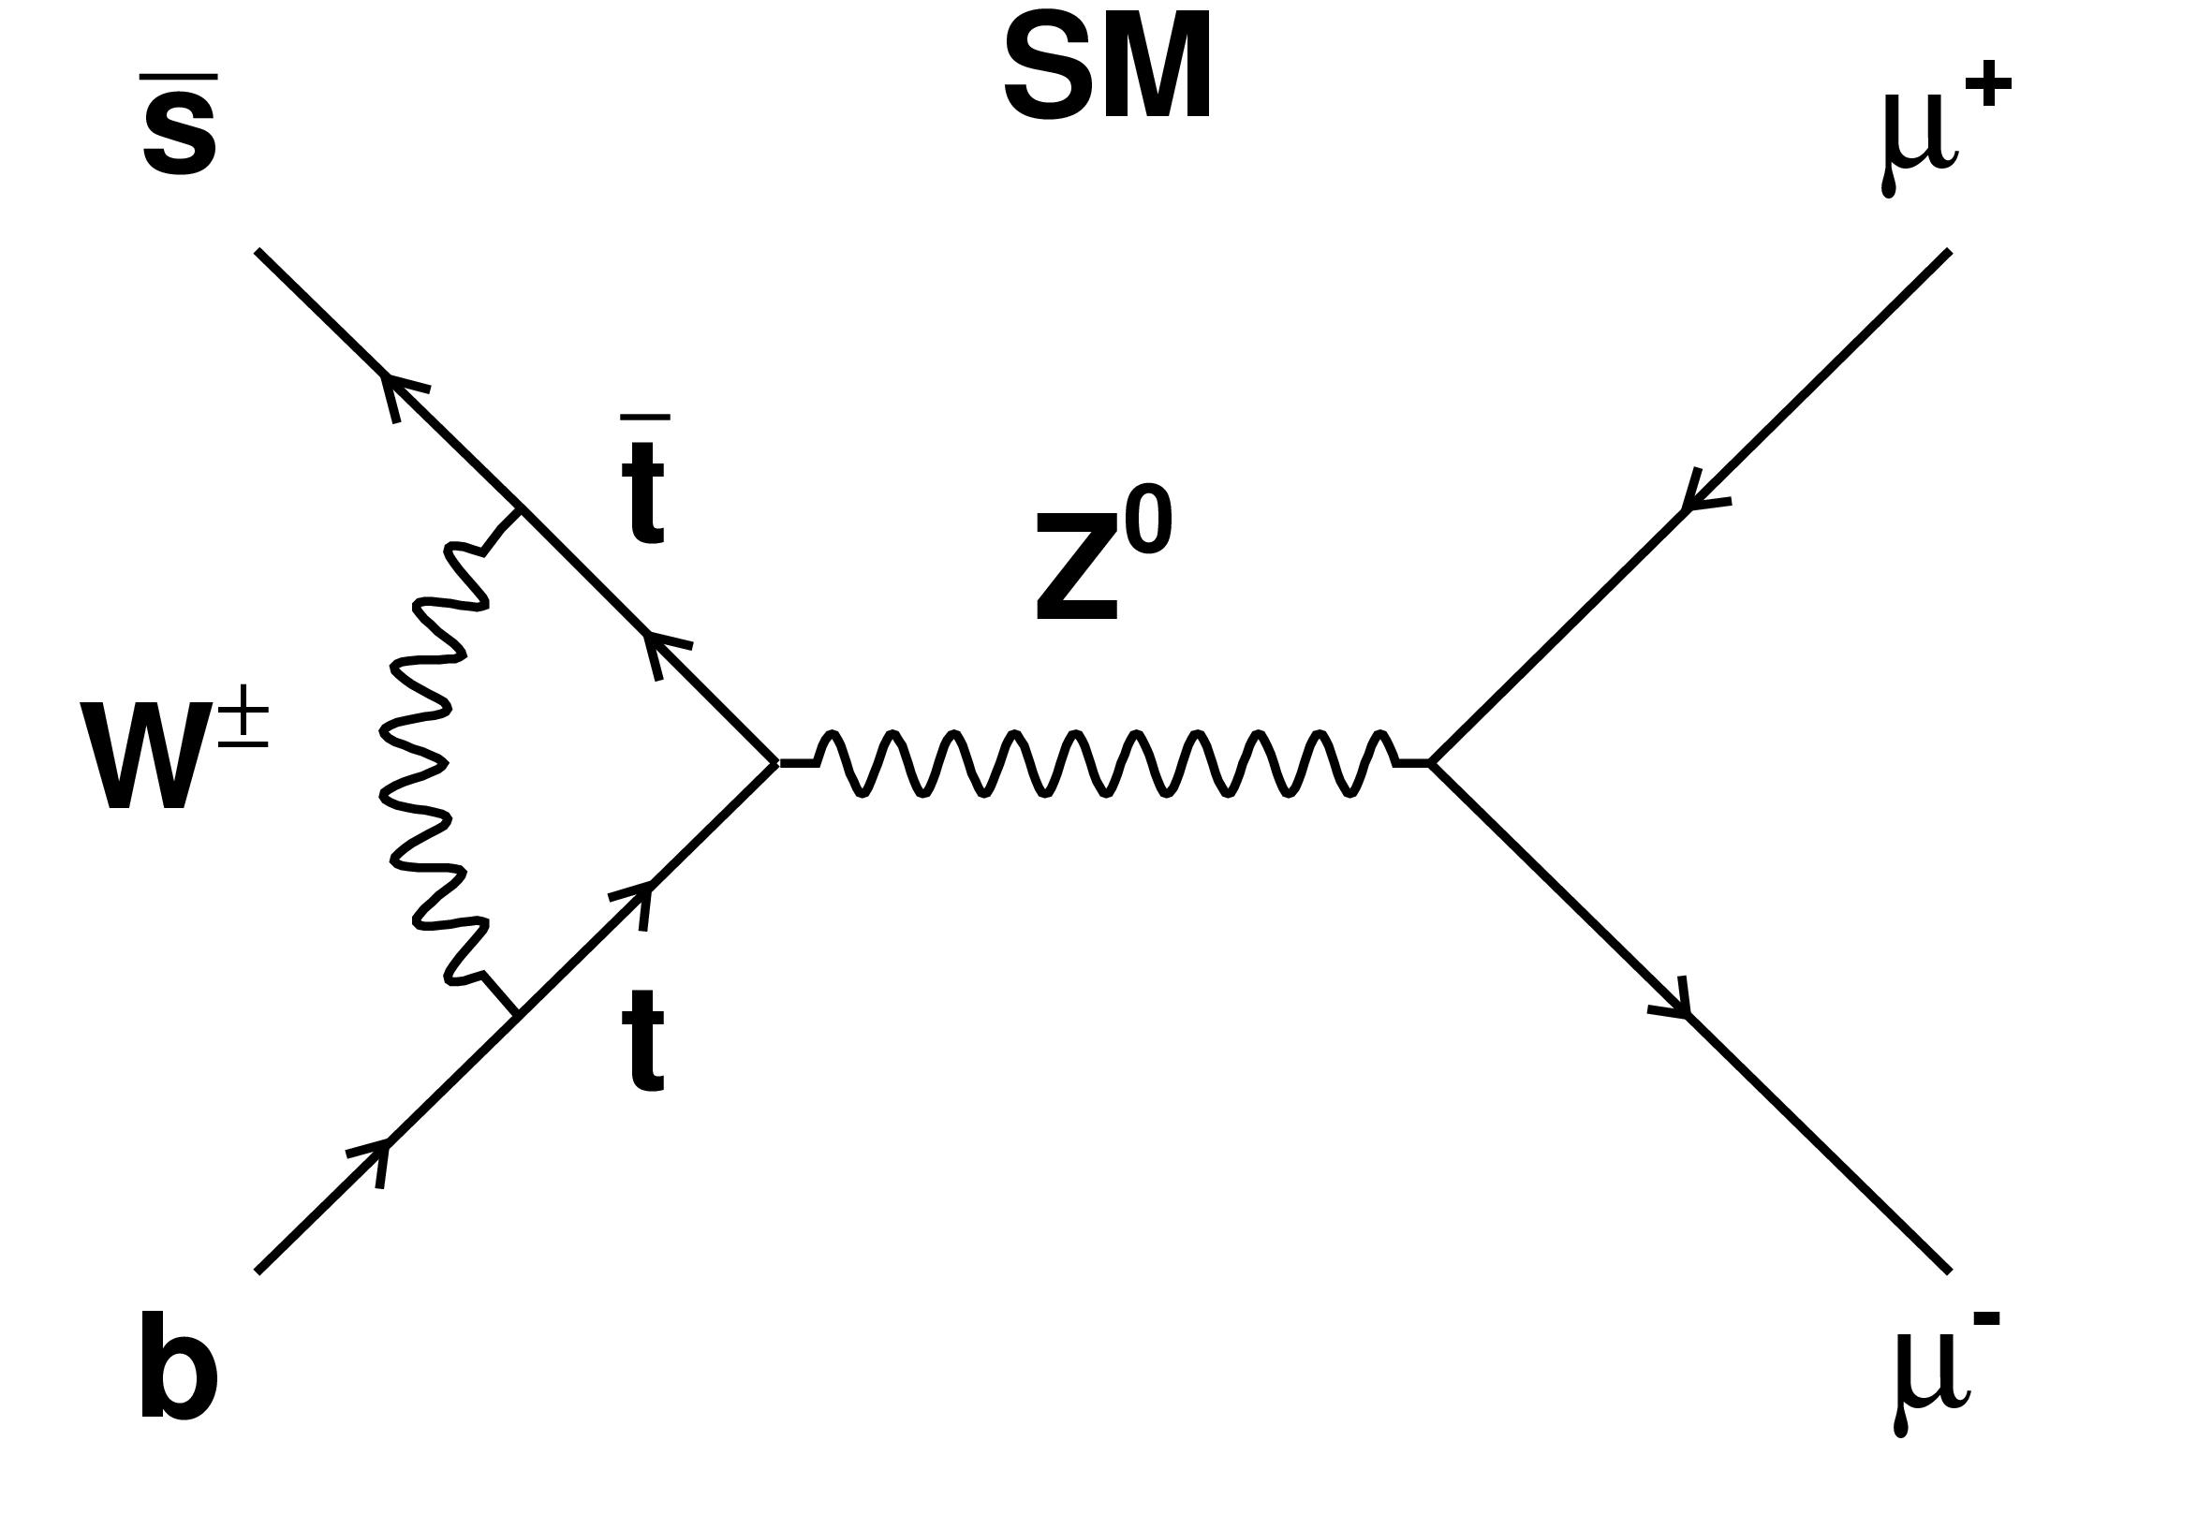
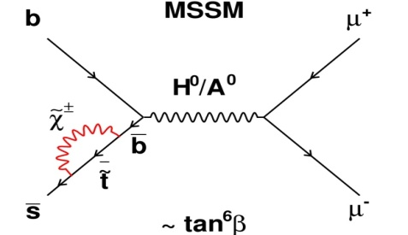
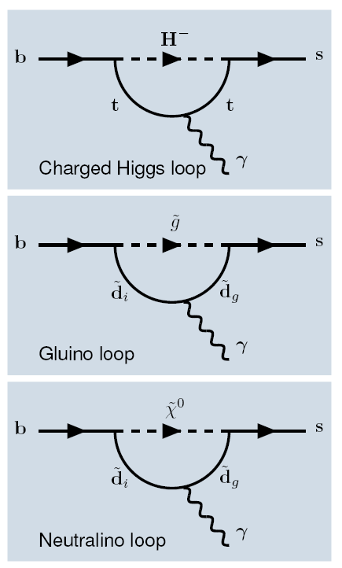
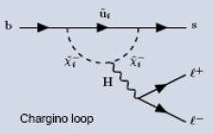



Three interesting examples of rare decays
BR(SM)
BR exp
@ LHCb
Relevant Operators
B_{s}→φγ
Large theory errors on exclusive BRs
  (57⁺¹⁸₋₁₂⁺¹²₋₁₁) 10⁻⁶ Belle’08
γ polarization
(9.8±2.1)·10⁻⁷ BaBar/Belle
angular distributions
B⁰→K*μ⁺μ⁻
(3.6±0.4)·10⁻⁹
helicity suppressed
TeVatron @ 90% CL (4 fb⁻¹) < 36×10⁻⁹
B_{s}→μ⁺μ⁻
BR

Slide 16
Search strategies for NP at LHCb
Measure FCNC transitions where NP may show up as a relatively large contribution, especially in b→s transitions which are poorly constrained by existing data:
  B_{s} mixing phase (φ_{s})
  b → sγ, b → sl⁺l– , B_{(s)} → μμ
  Also: rare K and D decays, D⁰ mixing
Improve measurement precision of CKM elements
  Compare two measurements of the same quantity,
  one which is insensitive and another one which is sensitive to NP (tree vs loop):
    sin(2β) from B⁰ → J/ψK_{S} and sin(2β) from B⁰ → φK_{S}
    γ from B_{(s)} → D_{(s)}K and γ from B⁰→π⁺π–and B_{s}→K⁺K–
  Measure all angles and sides in many different ways
    any inconsistency will be a sign of new physics
Single measurements with NP discovery potential
Precision CKMology,
including
NP-free determinations of angle γ
Notes:
φ_{s} (= –arg(V_{ts}²)= –2λ²η in SM)

Slide 17
So... what do we need to fulfil this program?
High statistics of B_{d} and B_{s}.
Trigger sensitive to final states with leptons and only hadrons.
Excellent proper time resolution to measure the CP violating oscillation amplitudes of the Bs system.
Good π/K/μ/e separation to reduce the combinatorial background and other B meson decays. K-id is also very useful for flavour tagging.
Good momentum and vertex resolution to reduce background

Slide 18
LHC experimental
conditions

Slide 19
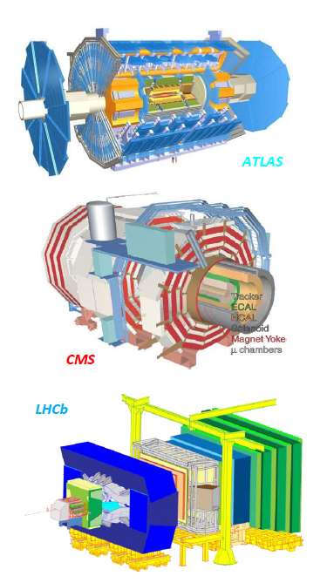
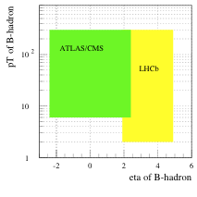
LHC experiments: B acceptance
ATLAS/CMS:
  central detectors, |η|<2.5
  B physics using high-p_{T} muon triggers, mostly with modes involving dimuon.
  Expect L<2×10³³ cm⁻² s⁻¹ for first 3 years, i.e. 10 fb⁻¹ per nominal year.
LHC bb cross-section ~ 5x TeVatron
LHCb:
  designed to maximize B acceptance(within cost and space constraints)
  forward spectrometer, 1.9 < η < 4.9
    more b hadrons produced at low angles
    single arm OK since bb pairs produced correlated in space
  rely on much softer, lower p_{T} triggers
  efficient also for purely hadronic B decays.
  Choose to run at L<5 ×10³² cm⁻² s⁻¹
  Clean environment and less radiation damage.
  Expect 2 fb⁻¹ per nominal year.
–
bb production cross section at √s=14 TeV
100 μb
230 μb
2010 data taking:
  lower √s, low L ⇒ similar L_{int} to each experiment
0.2 fb^{–1} at √s = 7 TeV in 2010 (?)

Slide 20
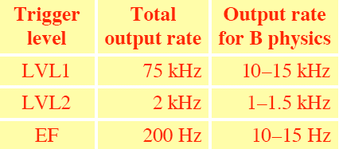
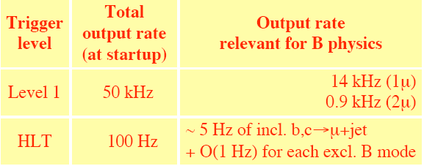
LHC Experiments: Trigger Strategy
ATLAS Trigger
CMSTrigger
ATLAS (CMS) Strategy for B-Physics Trigger:
L1: dimuon with Pt>6(3) GeV/c each and single muon
with Pt>6 GeV/c .
HLT :Limited time budget. Restrict B reconstruction to RoI around the muon
LHCb Strategy for B-Physics Trigger:
L0: dimuon with ΣPt>1.3 GeV/c and single muon
with Pt>1.1 GeV/c.
Hadron with Et>3.6 GeV … also ECAL triggers.
HLT : Inclusive single μ, μ+track and dimuon triggers.
Inclusive topologic and electromagnetic triggers.
Exclusive triggers
LHCbTrigger
30 MHz
L0
e, γ
L0
had
L0
μ
Level -0
1 MHz
ECAL
Alley
Had.
Alley
Muon
Alley
HLT1
High-Level Trigger
30 kHz
Global reconstruction
Inclusive selections
μ, μ+track, μμ, topological, charm, ϕ
HLT2
Trigger efficiency | ε(L0) | ε(HLT1) | ε(HLT2)
Electromagnetic | 70 % | > ~80 % | > ~90 %
Hadronic | 50 %
Muon | 90 %
& Exclusive selections
2 kHz
Storage: Event size ~35kB

Slide 21
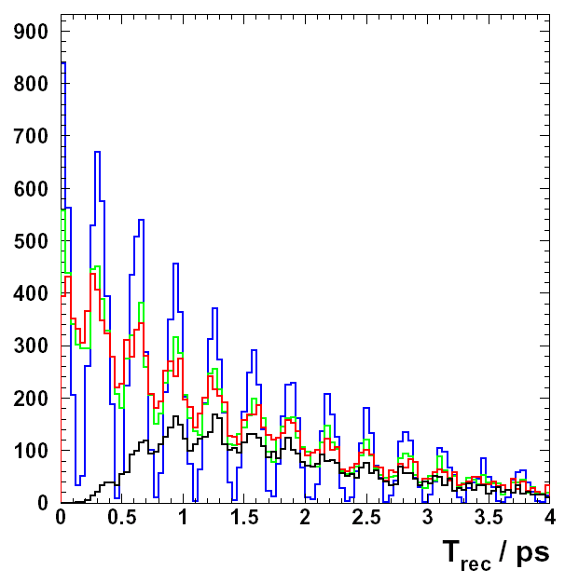
Detector requirements
pp interaction
b-hadron
l⁻
K⁻
Flavour Tag
π⁺
❒
B_{s}⁰_{t = 0}
→ D_{s}⁺Κ⁻
π⁺
π⁺
Κ⁻
Κ⁻
Hadron Trigger!
primary
vertex
Κ⁺
B decay distance
B momentum
proper time: t
--- ideal resolution and tag
--- realist. tag
--- realist. tag+resolution
--- realist. tag+res+BG+sel
CP violating oscillation amplitudes are damped by
proper time resolution
good decay vertex resolution
B_{s}→D_{s}K
wrong flavour tag
good momentum resolution
background
good particle identification

Slide 22
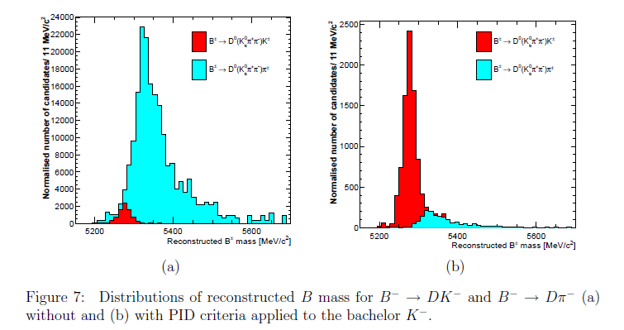
Detector requirements II
Even for CP measurements not using proper time distribution, hadron trigger, mass resolution and hadron PID are crucial!

Slide 23
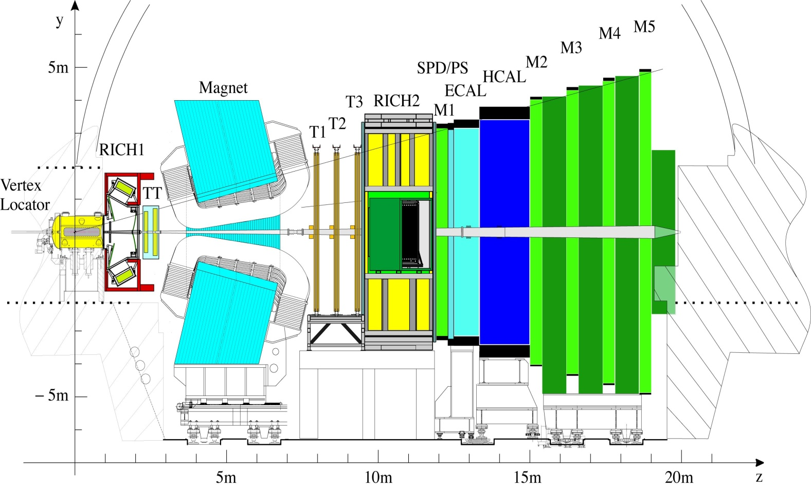
The LHCb detector
RICHES:
PID: K,π separation
Muon System
VELO:
primary vertex
impact parameter
displaced vertex
Interaction region
Calorimeters:
PID: h,e,γ, π⁰
Trigger Tracker: p for trigger and K_{s} reconstruction
Tracking Stations:
p of charged particles

Slide 24
LHCb (early)
Physics Results

Slide 25
Extracting physics from (very) first data
Exploit minimum bias data (almost no trigger)
σ∙ε
Number of selected signal events:
S=
σ_{mb}
∙N_{mb}
10⁶ minimum bias in 2009!

Slide 26
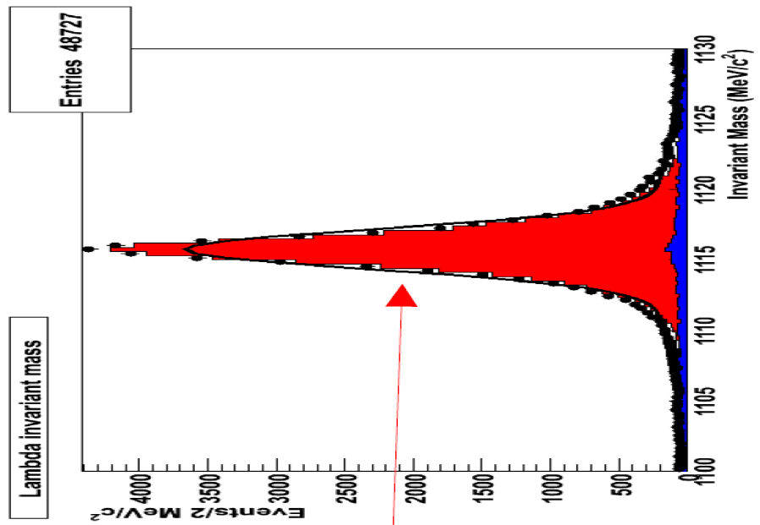
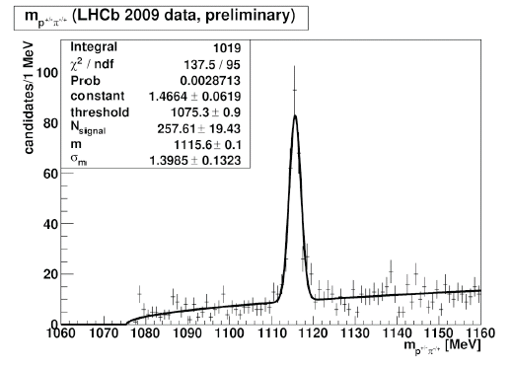
Exploiting minimum bias data
in 10⁸ minimum bias events
~ 40 mins @ 10³¹ cm⁻² s⁻¹
→ ~50k Λ→pπ events
      plenty of K_{s}→ππ and Λ→pπ
      95% purity with kinematical and vertex cuts only
      → clean & unbiased sample for PID studies
      study hadron identification performance and lepton misidentification probability.
      search for D→Kπ, Kπππ, K⁰_{S}ππ, Kππ⁰
      → assess background levels, resolutions & relative efficiencies
      demonstrate capability to reconstruct first final states
      collect ~1.4k prompt J/ψ→μμ
      → second muon unbiased for PID studies
      study muon identification performance
LHCb MC Λ→pπ

Slide 27
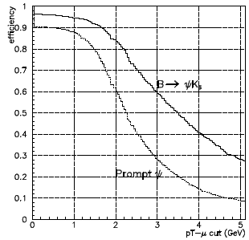

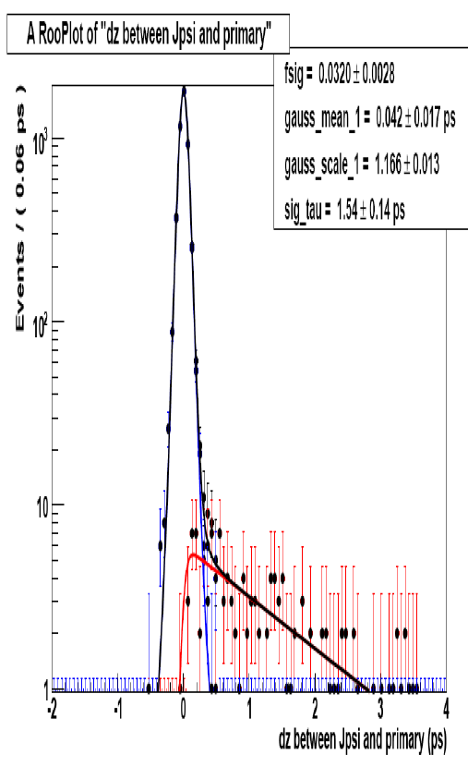
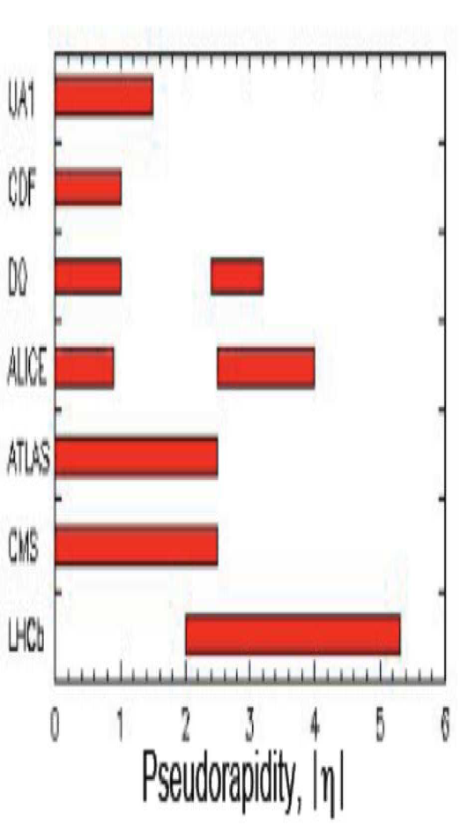
Exploiting first muon trigger data
      applying J/ψ trigger with p_{t}-cut on single muon
      expect ~10⁶ J/ψ→μμ with 1 pb⁻¹
Reconstruct J/ψ→μμ and disentangle fraction of prompt and detached J/ψ’s
μ⁺
μ⁻
discriminating variable:
PV
dz
Measure prompt J/ψ and bb cross section in a region not accessible to other collider experiments
study proper time resolution with prompt component

Slide 28
Exploiting ~0.5 fb⁻¹ of data with full trigger
Search for very rare decay B_{s} → μ⁺μ–
See arXiv:0912.4179 for more details
Within the SM the dominant contribution stems from the “Z-penguin”
diagram. The “box” diagram is suppressed by a factor (M_{W}/m_{t})²
  Small BR in SM: (3.6 ± 0.4) x 10⁻⁹
It is very sensitive to New Physics with new scalar or pseudoscalar
interactions. Highly interesting to probe models with extended Higgs sector!
For instance, in the MSSM the branching ratio
scales as
Limit from TeVatron at 90% CL:
  Current (~3.7 fb⁻¹): < 36×10⁻⁹
    ~ 10 times higher than SM!

Slide 29
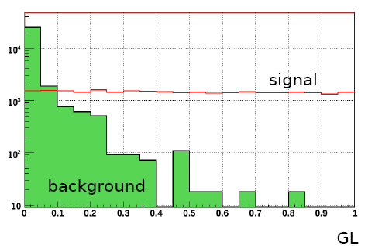
Search for the very rare decay B_{s}→ μ⁺μ⁻
Selection of B_{s}→ μ⁺μ⁻ , as common as possible with the control channels: B⁺→J/ψ (μ⁺μ⁻) K⁺, B→ J/ψ (μ⁺μ⁻) K* (K⁺π⁻), B_{(s)}→h⁺h⁻
Each selected and triggered event is given a likelihood to be signal or background like in a 3D space:
  Geometry Likelihood (GL) : lowest muon IPS, B lifetime, isolation, B IP, DOCA
  Invariant mass Likelihood
  Particle ID Likelihood
(arbitrary
normalization)
Get the background Geometry & Mass likelihood
using sidebands
Use of control channels to get the probability,
for a signal event, to fall in each bin:
  Geometry & Mass: Use of B_{(s)}→h⁺h⁻
  PID: Calibration muons (J/Ψ→μ+μ-)
  and misidentification (Λ→ pπ, B_{(s)}→h⁺h⁻…)
  Translate number of observed candidates to a measurement of the Branching Ratio using a known control channel

Slide 30


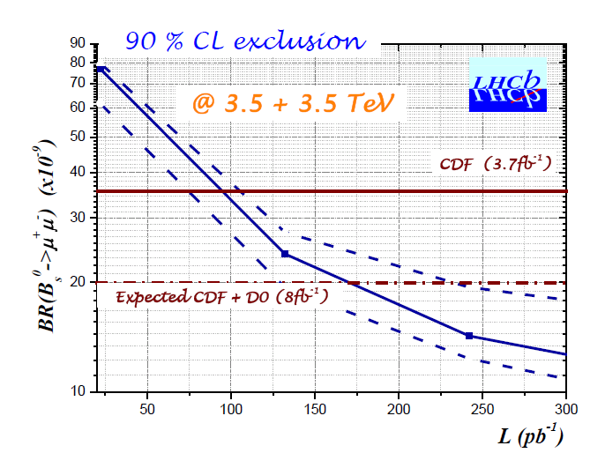
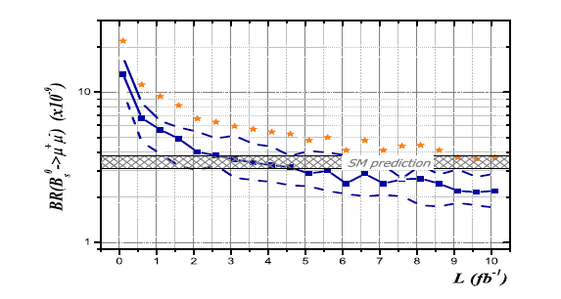
Search for the very rare decay B_{s}→ μ⁺μ⁻
Main systematic uncertainty ~13%
α(J/ψ (μ⁺μ⁻) K⁺) ≅ 0.6 → Evaluate ratio of tracking efficiency from data
α(K⁺π⁻) ≅ 0.4 → Evaluate ratio of trigger efficiency from data
α
@ 7+7 TeV
5σ observation
3σ observation
The best limit expected from TeVatron in 2010 (~2x10⁻⁸) is reached with less than 0.2 fb⁻¹at 7 TeV CoM. If there is a signal, we expect to observe with it 5σ significance down to the SM BR with less than 10 fb⁻¹ at 14 TeV CoM.

Slide 31
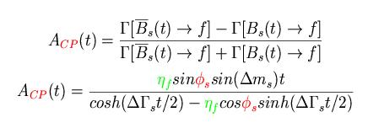
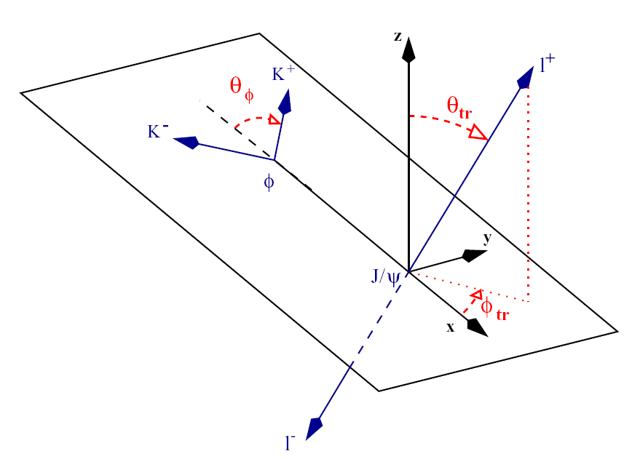

Exploiting ~0.5 fb⁻¹ of data with full trigger
measure B_{s}-B_{s} mixing phase φ_{s} in B_{s}→J/ψ(µµ)φ
See arXiv:0912.4179 for more details
Sensitive to New Physics effects in mixing
    φ_{s} = φ_{s}(SM) + φ_{s}(NP)
+NP?
η_{f} = +, - 1 CP eigenstates
Θ_{tr}= angle between l⁺ and normal to φ decay plane
  in SM: φ_{s} = – 2β_{s} = –arg(V_{ts}²) ~ –0.0360^{+0.0020}_{-0.0016}
J/ψφ is not a pure CP eigenstate (2 CP even, 1 CP odd amplitude)
  need to fit angular distributions of decay final states as function of proper time

Slide 32

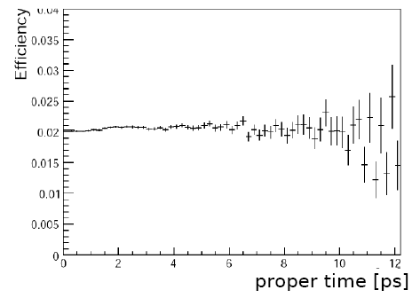

Measurement of B_{s} mixing phase (φ_{s})
Selection of B_{s}→ J/ψ (μ⁺μ⁻) φ(K⁺K⁻) , as common as possible with the control channels: B→ J/ψ (μ⁺μ⁻) K* (K⁺π⁻), B⁺→J/ψ (μ⁺μ⁻) K⁺, B_{s}→D_{s}⁺π⁻
Measure proper time, transversity angles and tag the initial B_{s} flavour;
≅ 6%
Unbinned Likelihood fit to determine:
Use of the MC simulation minimized using
control channels:
- Acceptance: B→ J/ψ (μ⁺μ⁻) K* (K⁺π⁻)
- Tagging: B→ J/ψ (μ⁺μ⁻) K* (K⁺π⁻),
B⁺→J/ψ (μ⁺μ⁻) K⁺, B_{s}→D_{s}⁺π⁻
- Background: Sidebands
Acceptance after trigger and selection almost flat
with 3k reconstructed B_{s}→J/ψ(µµ)φ signal events (before tagging)
→ σ_{stat}(φ_{s})~0.2 with 0.3 fb⁻¹ at 7 TeV CoM
σ_{TeVatron}(φ_{s})~0.2 expected in 2010

Slide 33
Exploiting ~0.5 fb⁻¹ of data with full trigger
Study of the rare decay B → K*μ⁺μ–
See arXiv:0912.4179 for more details
In SM, the decay is a b → s penguin diagram
But NP diagrams could also contribute at the same level
d
d
B_{d}
b
s
K*
μ
γ,Z⁰
μ
Br:(9.8±2.1) ×10⁻⁷
The measured Br agrees within 20% with the SM prediction.
However, New Physics could modify the angular distributions by much more than this!
With 2 fb⁻¹ at 14 TeV CoM, LHCb expects (6.2±1.6)k signal events with B/S ~ 0.3 (uncertainty mostly due to BR)

Slide 34
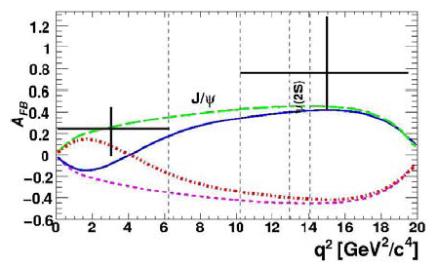

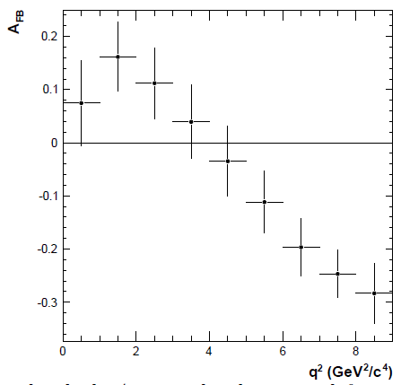
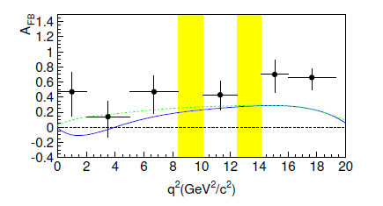

Study of the rare decay B→K*μ⁺μ⁻
Measure
the angular distribution of the μ⁺ in the μμ rest frame
relative to the B direction.
Measure the Forward – Backward Asymmetry (FBA)
of this distribution as a function of the μμ invariant mass (M_{μμ}²)
Determine, s₀, the M_{μμ}² for which FBA = 0.
    SM: s₀=4.36^{+0.33}_{-0.31} GeV²/c⁴
Example 2 fb⁻¹
LHCb experiment
σ(s0)=0.5 GeV²/c⁴)
(LHCb @ 0.5 fb⁻¹ at 7 TeV similar to BELLE/BABAR today

Slide 35
Exploiting ~0.5 fb⁻¹ of data with full trigger
measure phase γ of V_{ub} using tree decays
See arXiv:0912.4179 for more details
γ from B → D K* : crucial hadron trigger and K/π separation
Both colour suppressed
→ Same magnitude
Good for large interference.
D₁=(D₀ + D₀)/√2
Observe B⁰→D⁰K^{*o}, B⁰→D⁰K^{*0}, B⁰→D₁K^{*0} and the 3 charge conjugate reactions.
The D⁰ and the K* are observed in their K⁺⁻π⁻⁺ decay modes. The D₁ in π⁺π⁻ or K⁺K⁻
The flavour of the B is identified by the charge of the K in K* decay.
The flavour of the D by the charge of the K in D decay → Self tagging.
3200
0.2±0.5
With r_{B}=0.3,
290
10±5
370
20±10

Slide 36
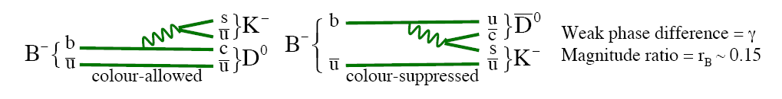
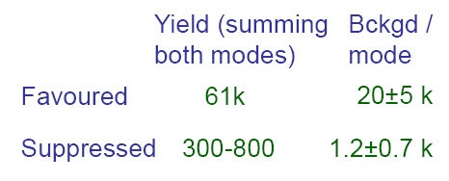

γ at tree level from B→DK
measure phase γ of V_{ub} using tree decays
γ from B± → D K±: crucial hadron trigger and K/π separation
Challenge is to find the suppressed Kπ modes (Br ~ 10⁻⁷)
Kπ modes
With r_{B}=0.1
K_{s}ππ modes
84k
50±3k
6.8k
2.3±0.3k
1.6k
1.0±0.5k
Caveat in the K_{s}ππ modes the
treatment of intermediate resonances
needs to be understood and no HLT trigger has been applied

Slide 37
γ at tree level from B→DK
measure phase γ of V_{ub} using tree decays
γ from B_{s} → Ds K : crucial hadron trigger and K/π separation
Two tree decays (b→c) and (b→u) that interfere via B_{s} mixing. Can determine φ_{s}+γ in the same way than 2β+γ using B→D*π done at the B-factories. However in this case, both amplitudes are similar (~λ³) and their ratio can be extracted easier from data!
Fit D_{s}K time distributions, simultaneously with
10 x more abundant D_{s}π, and the untagged sample.
This allows simultaneous extraction of :
Δm_{s}, ΔΓ_{s}
ω the wrong tag rate
strong phase difference δΔ,
φ_{s} + γ
Using φ_{s} obtained from B_{s} to J/ψφ,
and 14k B_{s}→D_{s}K with B/S = 0.3±0.2
σ(γ) ~ 10º with 2 fb⁻¹

Slide 38





γ at tree level from B→DK
LHCb overall precision from tree processes: σ(γ) ~ 5º with 2 fb⁻¹
σ(γ) ~ 20º with 0.3 fb⁻¹ at 7 TeV CoM → similar than BABAR/BELLE today
  B-factories measurements (tree decays only): γ = (75± 21)º
  From global fit (2009) (incl. loop processes!): (68 ± 4)º
γ
γ
In few years we should know if γ as measured with tree processes is compatible with loop measurements !
loops (2009)
|Vub/Vcb|

Slide 39
Conclusions

Slide 40

Conclusions
LHC is a superb B-factory (~100 kHz), of all types including Bs, and is back online since Nov09!
LHCb is completely installed and taking data!. Hardware and software is being commissioned right now and so far everything looks very promising!
The B-physics program will certainly contribute significantly to the overall LHC effort to find and study Physics beyond the SM.
A few highly-sensitive b→s observables are accessible from the very first data:
?
Z⁰,H⁰
b
s
B_{s} → μ⁺μ⁻ Higgs “Penguin”
LHCb will pursue the program and improve precision of CKM angles. Several γ measurements from tree decays only may reveal inconsistencies in the CKM picture.

