Slide 1

From Physics to Data Science
Sebastiana Rita Gianì
Data Scientist at BTData – BTO Group

Slide 2




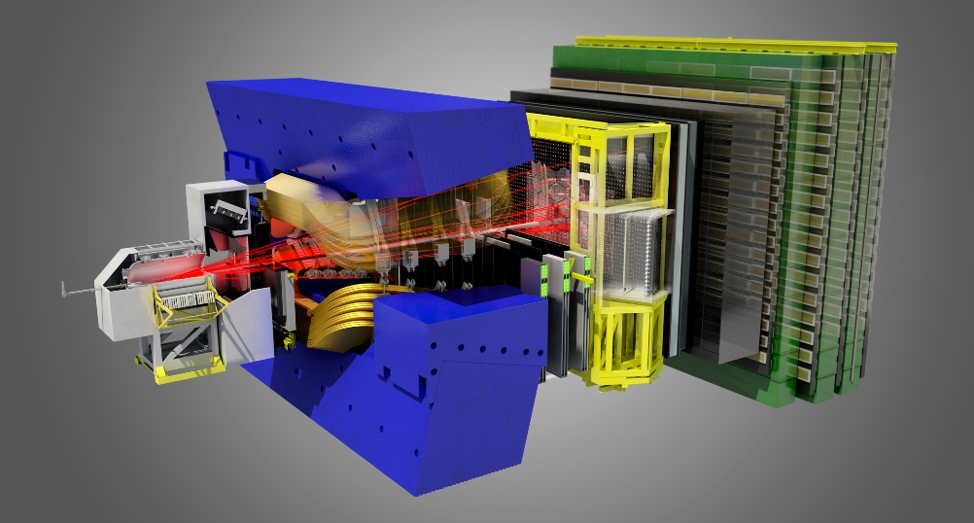
Career in Physics
2012 : Master Degree in Physics , University of Catania
2012 – 2013: University of Catania – INFN
2013 – 2017: CERN – EPFL , PhD student
2017: PhD in Physics , EPFL, Lausanne
My work at CERN:
I mainly worked in DATA ANALYSIS (Charmless B – Bs decays) but also:
- DETECTOR R&D
TRIGGER
OUTREACH ACTVITIES

Slide 3


Move-out process
The idea came up during the last period of my PhD…
Attending courses/seminars on career change
Attending dedicated job fairs and networking events
Talking with former colleagues
After some research and reflection, Data science field appeared the most attractive to me for a career change.
But not an already taken decision…
Still I applied for PostDoc position
So when I ended up with offers for a very interesting position as a PostDoc and
an interesting and challenging job in a new field, it was an hard decision to make…

Slide 4
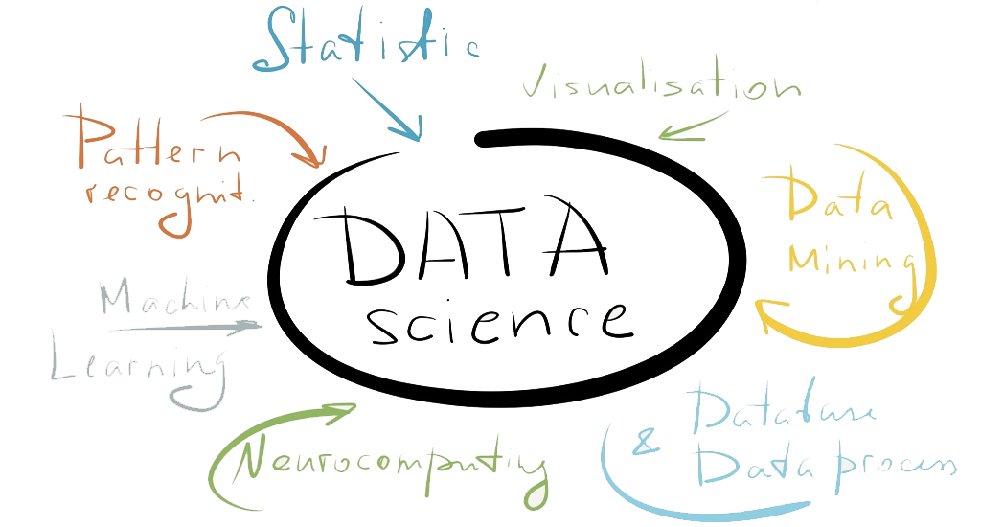
What now ?
December 2017 – current : Data Scientist at BTData – BTO group
Working on several projects (for customers, internal)
PROJECTS I HAVE WORKED SO FAR…
Sentiment analysis on social media and dedicated blog
on specific topics/brand
Design and development of computer vision pipeline
for recognition system
Predictive Manteinance analysis
Predictive modeling for detecting Out-of-Stock
(retailing industry)
Data science is many things and I learned most of them during my period at CERN. Of course this is not enough!
On the other hand, the main skills you get doing research are the ability to learn new things and challenge yourself, aren’t they?

