Slide 1
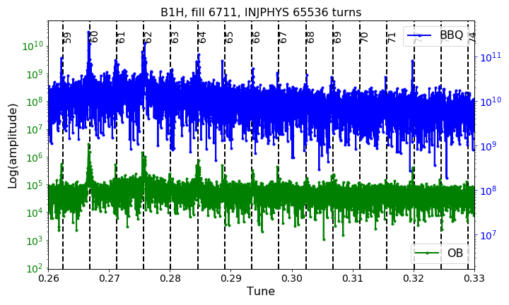
Switch ON/OFF the active filters of the 8 arc dipoles converters
3 kHz
3.5 kHz
MOTIVATION:
In preparation for the MD#3 proposal to detect the source of the “50 Hz harmonic” observed on the beam spectra (action of the 220th LMC). See also https://hackmd.web.cern.ch/s/Sy4F9l2zm.
QUESTIONS to rMPP:
1. Can we switch ON/OFF the filters with PILOT at injection (possibly during a PHYSICS FILL)? BUT with PILOT not enough signal the 50 Hz harmonics NOT visible…
2. After this test, could we aim for an EoF test? What are the different steps/tests suggested?
BBQ
ObsBox
Δf=50 Hz
ΔQ=4.4e-3
Courtesy of S. Kostoglou

Slide 2
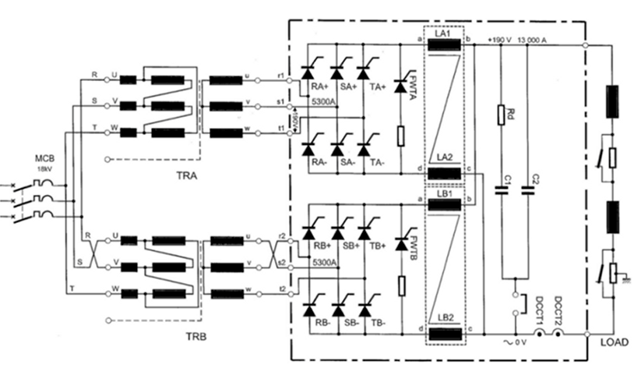
http://te-epc-lpc.web.cern.ch/te-epc-lpc/converters/lhc13ka-190v/general.stm

