Slide 1
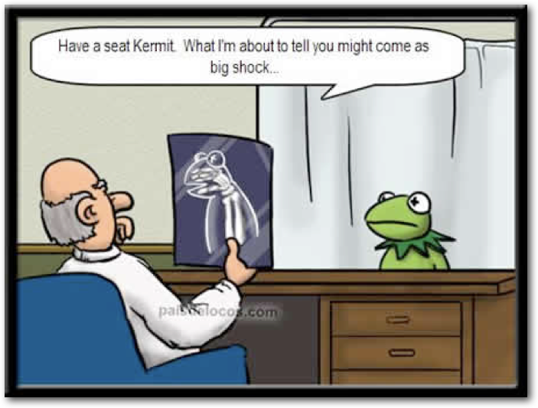
Medical Applications
of Particle Physics

Slide 2
Curriculum and classroom connection
Notes:
common areas in our curriculum:
Swedish curriculum: Models of physics to describe and explain the occurrence of particle radiation and electromagnetic radiation, and also the impact of radiation on living organisms. How different types of radiation can be used in modern technology, such as in healthcare and information technology.
PL - in Australia, we have a topic called Universe to the atom and one of the outcomes examines the validation of theories based on particles detectors. The application of PET and Xrays relies on the theories involved with the standard model, so the fatc we are successfully diagnosing and treating people validates the theories on which the technology is based
Jason - in Texas the regular physics course covers applications of radiation therapy and diagnostic imaging, and I use these as examples of application of EM fields
Kelly-in Germany we have the medical applications in our curriculum in the 9th grade and in the 12th grade but it doesn´t says how deep you have to dug into it.

Slide 3
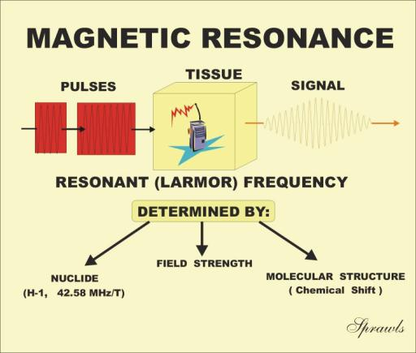
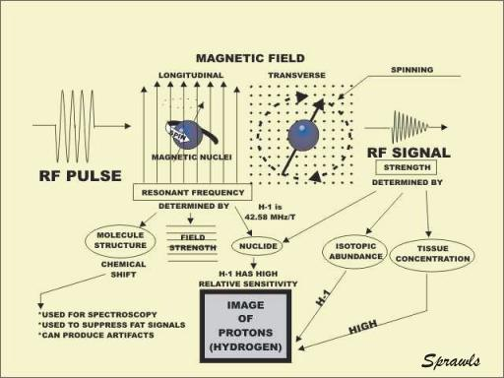
Applications of EM Fields
Images courtesy of http://www.sprawls.org/mripmt/MRI03/index.html

Slide 4
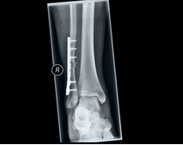
Radiation in Medicine
http://www.bfs.de/SharedDocs/Bilder/BfS/DE/ion/medizin/roentgen-aufnahme.jpg?__blob=poster&v=3

Slide 5
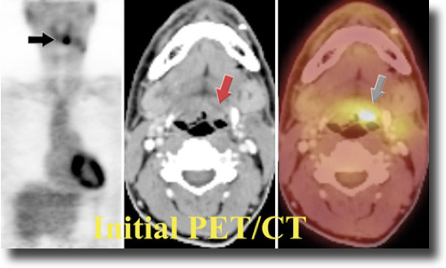
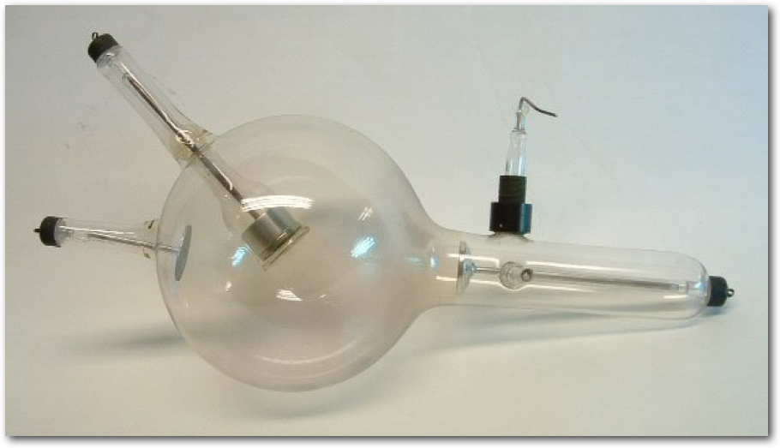
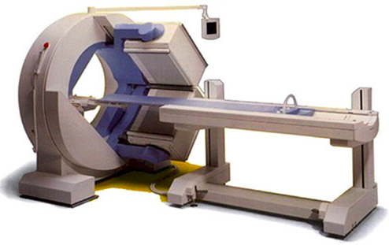
Validation

Slide 6
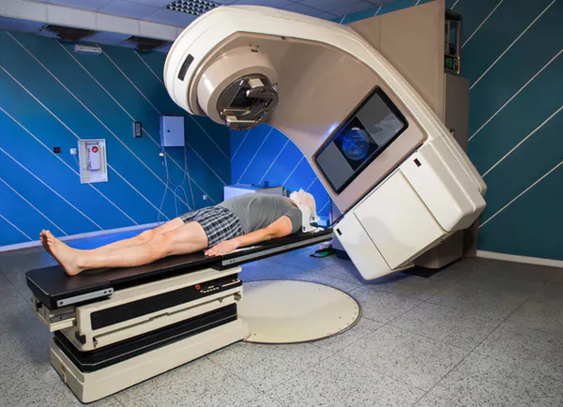
Notes:
Swedish curriculum: Models of physics to describe and explain the occurrence of particle radiation and electromagnetic radiation, and also the impact of radiation on living organisms. How different types of radiation can be used in modern technology, such as in healthcare and information technology.

Slide 7
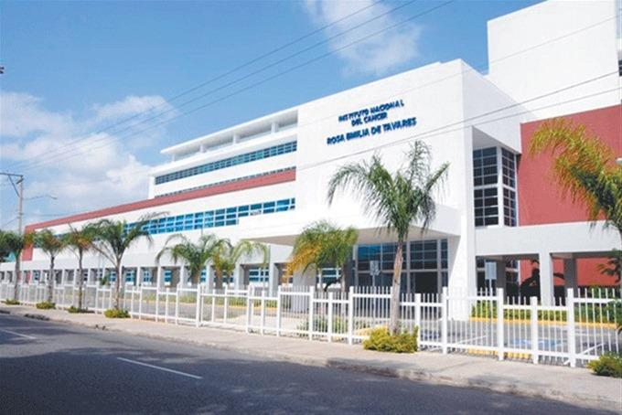
A trip to the oncology Institute Rosa Emilia Tavarez

Slide 8
Key Ideas
Behind
Medical Applications

Slide 9
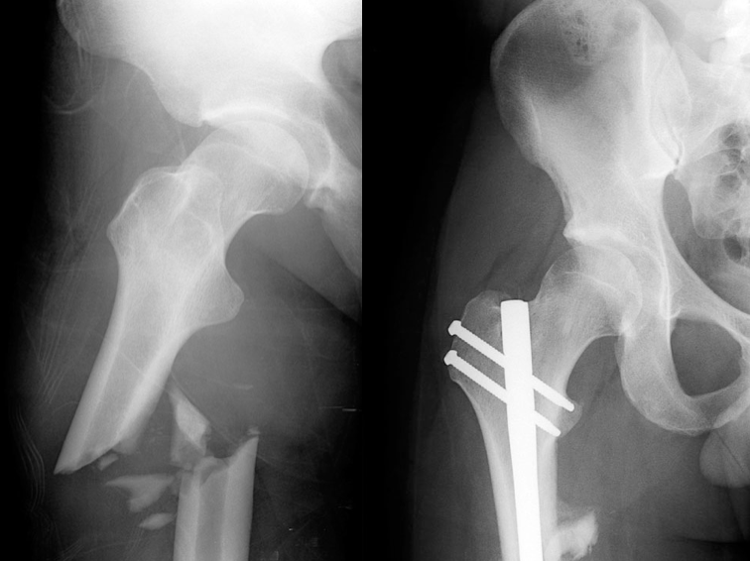
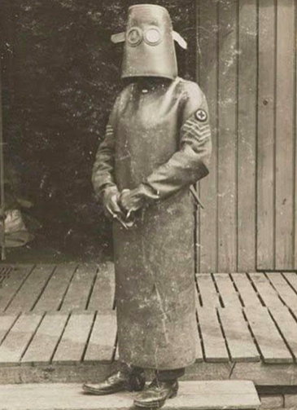
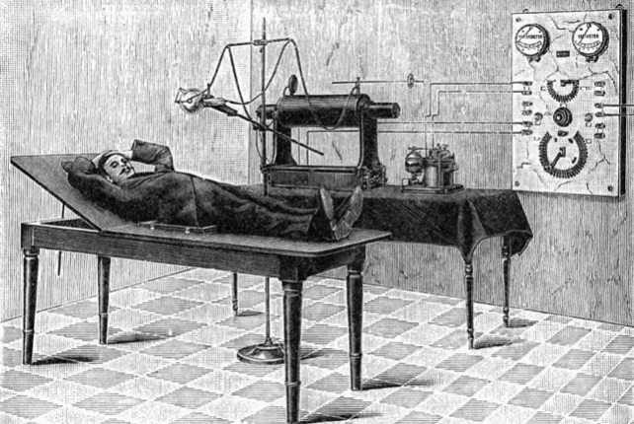
OLD

Slide 10
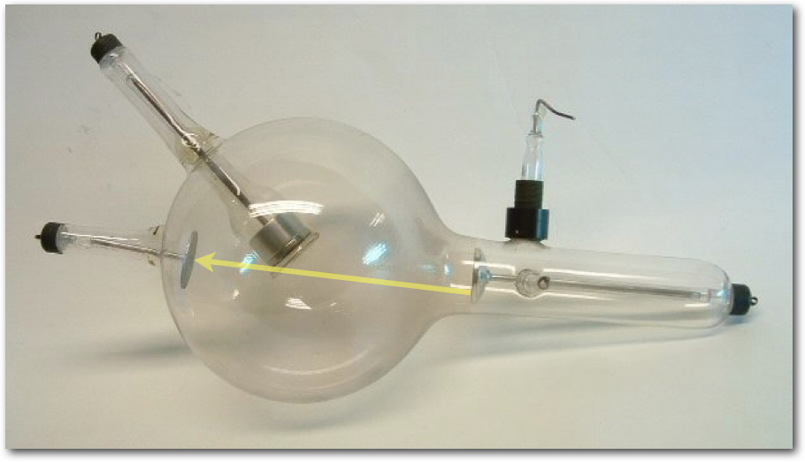
OLD

Slide 11
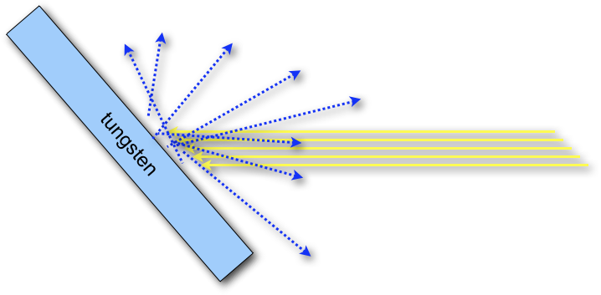
OLD
particle accelerator
particle interactions

Slide 12
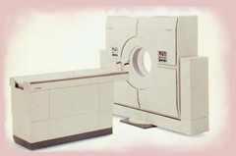
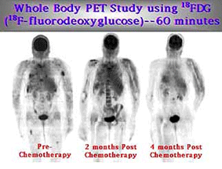
NOW
Notes:
Positron emission Tomography (uses radioactive tracers e.g FDG (metabolic activities of tissues, gallium (infections) Thallium (heart blood flow), ¹⁸F-fluoride (for imaging of new bone formation etc)

Slide 13
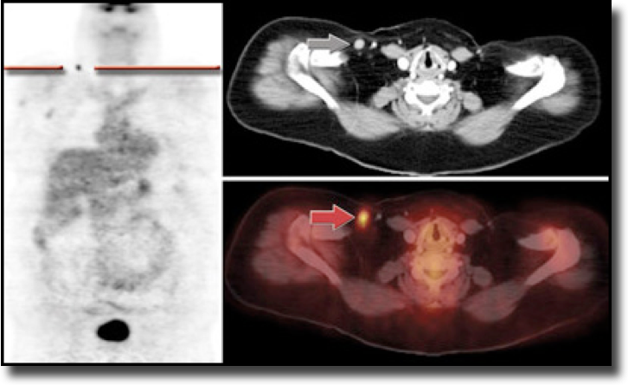
NOW
Notes:
History
42 year-old woman recently diagnosed with recurrent non-Hodgkin's lymphoma from an excisional biopsy of her right elbow. Referred for a PET/CT for re-staging.
PET/CT Findings
2 focal areas of FDG uptake corresponding to normal sized lymph nodes. Findings suspicious for malignant nodes. History
42 year-old woman recently diagnosed with recurrent non-Hodgkin's lymphoma from an excisional biopsy of her right elbow. Referred for a PET/CT for re-staging.
PET/CT Findings
2 focal areas of FDG uptake corresponding to normal sized lymph nodes. Findings suspicious for malignant nodes.
Discussion
This is another good case demonstrating the benefit of PET/CT over CT alone by identifying 2 abnormal lymph nodes that appear normal in size and have no necrosis.

Slide 14
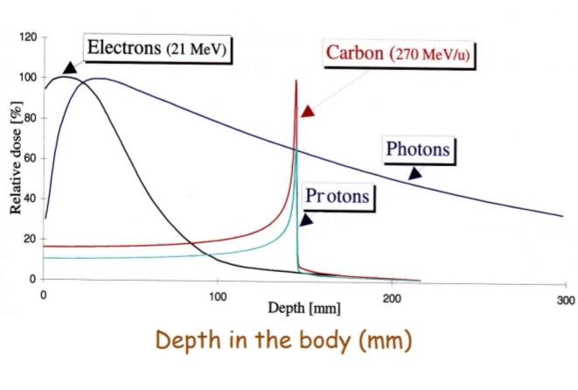
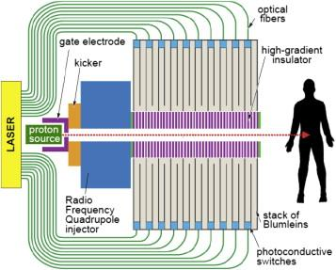
NEW
hadron therapy
A scheme of a compact Dialectic wall accelerator For proton therapy.

Slide 15
Potential Student Conceptions and Challenges

Slide 16
NAMES!
CT
X-Ray
MRI
PET
PET-CT
MRI-LINAC
Hadron
CONCEPTS!
Accelerator
Mag. Fields
Radiation
Proton
Antiproton
The WHY!
❓❓❓
❓❓❓
❓❓❓

Slide 17

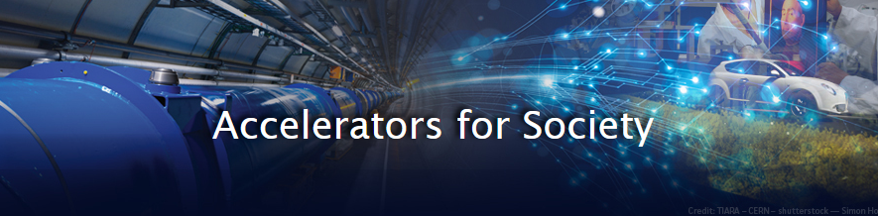

Helpful Material and Resources
PET Scan as explained by Paul Looyen
CERN medical appications
https://home.cern/tags/medical-applications
http://www.accelerators-for-society.org/health/index.php?id=7
information about tumortherapy
https://www.weltderphysik.de/gebiet/leben/tumortherapie/
Notes:
new information on the website of cern medical application to all new inventions from CERN starting in year 2012
Accelerators for Health and Medicine - rechts nach
The most direct way that particle accelerators impact most of our lives will be through their applications in medicine. With the advancement of accelerator science, new techniques for the treatment of cancer and diagnosis of various diseases have contributed significantly to major steps forward in the last decades.
information in german (but can be translated with eg google)
https://www.leifiphysik.de/kern-teilchenphysik/anwendungen-der-kernphysik/grundwissen/ionisierende-strahlung-der-medizin

Slide 18
Best Practice

Slide 19
Notes:
PL - A sheet of paper covers an object

Slide 20
Notes:
PL - two strips of paper represents shadows that form when light is passed underneath

Slide 21
Notes:
PL - the following shadows form. Can you guess the image and density?

Slide 22
Notes:
Preeti - you can see its shape as well as its position

Slide 23
Notes:
Preeti - if its less dense the shadows will be different

Slide 24
Notes:
Kelly - what about a circle, will it form these shadows?

Slide 25
Notes:
Kelly - they will have gradation

Slide 26
Notes:
Ismari - we can add a third strip, to better understand its shape and location

Slide 27
Notes:
Jason - but we can design this backward, and ask the students to determine the “scans” needed to identify this shape

Slide 28
Notes:
Jason - but we can design this backward, and ask the students to determine the “scans” needed to identify this shape

Slide 29
Notes:
Jason - but we can design this backward, and ask the students to determine the “scans” needed to identify this shape

