Slide 1

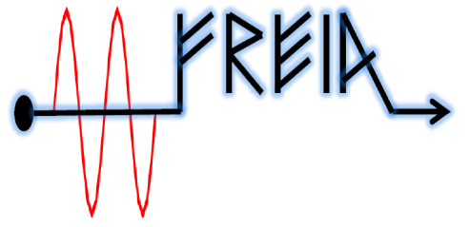
Notes from Science@Fels and Attosecond FEL Conferences
Vitaliy Goryashko
2018, Uppsala

Slide 2
Contents
Key requirements from users
Potential killer apps
Peak brightness of FELs and a quasi-gap in the lasing spectrum
Average brightness of FELs
State-of-the-art of short pulse generation
Science drivers for LCLS-II
Longstanding dream of single molecule imaging
LCLS template for beam time application
Proposed user committee for CompactLight
Some thoughts on Strength and Weakness of CompactLight
Regarding the comment on short bunches from an X-band gun

Slide 3
Key requirements from users*
Stability
Coherence
Polarization control
Sub-fs and fs pulses
Microfocus
Multiple colors independently tunable
Synchronization with pump sources
Phase control between FEL harmonics
High rep. rate
Comment: science applications are very diverse and it is not possible
to fulfill all the requirements simultaneously. We need to identify
killer apps (not single molecule imaging!) and proceed with them.
*Collecting quantitative requirements will take time.

Slide 4
Potential killer apps
Materials far from equilibrium such as
light-induced superconductivity
Nonlinear X-ray optics
Multidimensional attosecond spectroscopy
Surface chemistry and pathways for catalysis
Matter under extreme conditions

Slide 5
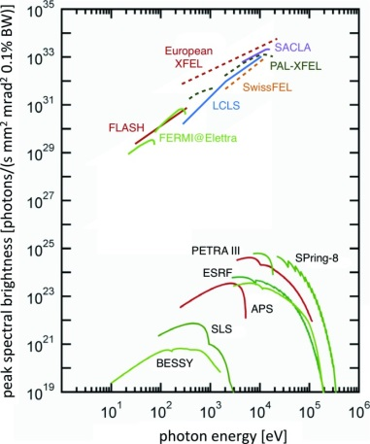
Peak Brightness of FELs
The region ~ 2-10 keV is quite well covered:
LCLS
SACLA
PAL-XFEL
EXFEL
SwissFEL
The region ~ 0.2-2 keV has a window of opportunities at the moment but around 2022
SwissFEL
FLASH-2 (?)
LCLS-II
E. Weckert. "The potential of future light sources." IUCrJ 2.2 (2015).

Slide 6
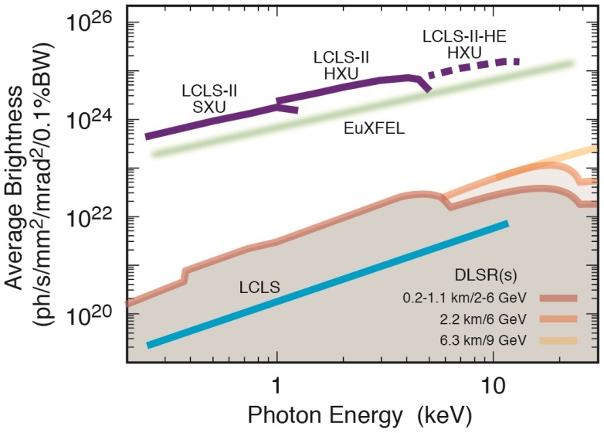
Average Brightness of FELs
LCLC-II is an excellent source for spectroscopy and imaging which usually require a high photon flux.

Slide 7
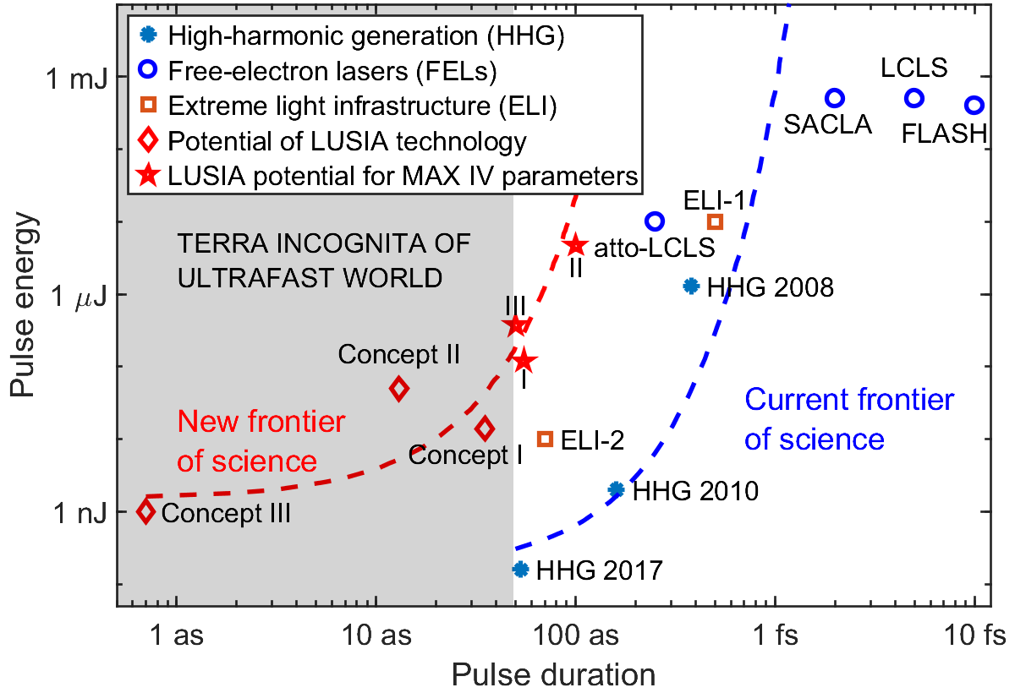
State-of-the-art of short pulse generation
LUSIA = Attosecond Single-cycle Undulator Light.

Slide 8
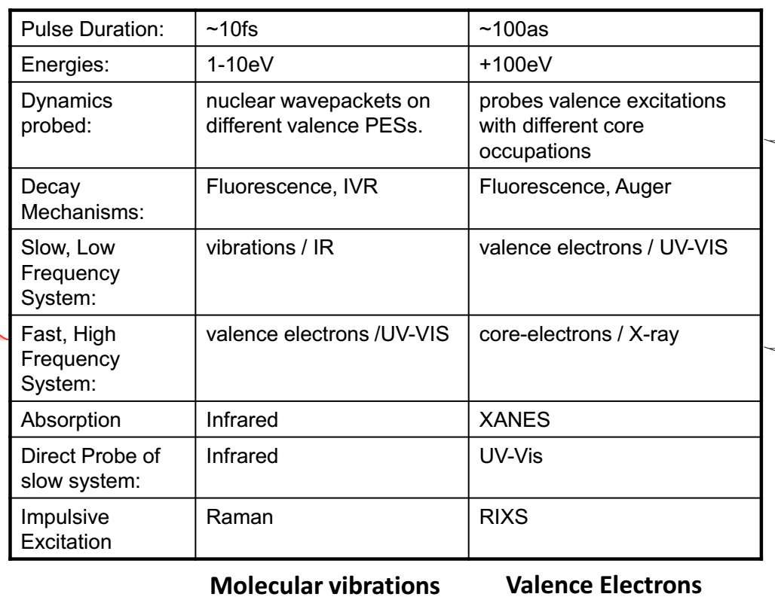
Ultrafast physics of VUV vs X-rays

Slide 9
Science drivers for LCLS-II

Slide 10
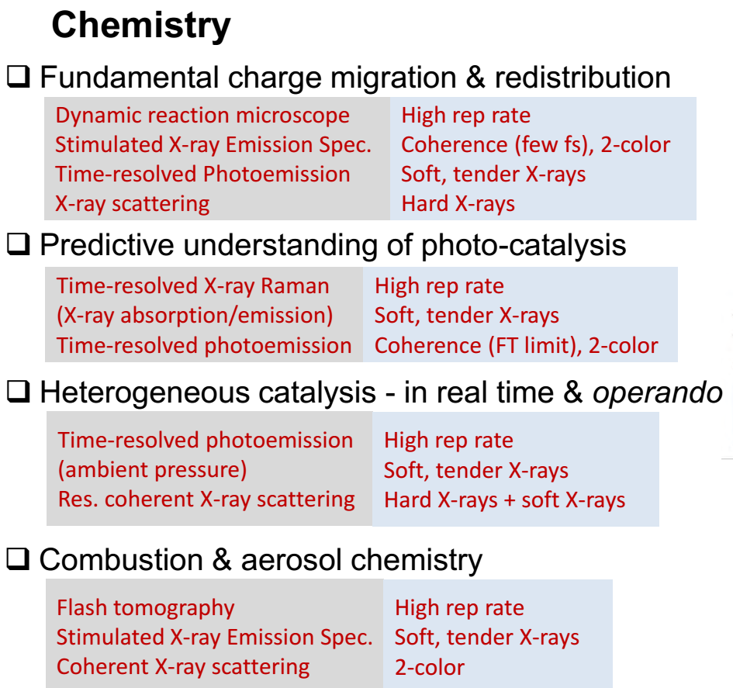
Chemistry (courtesy of R. Schoenlein, SLAC)

Slide 11
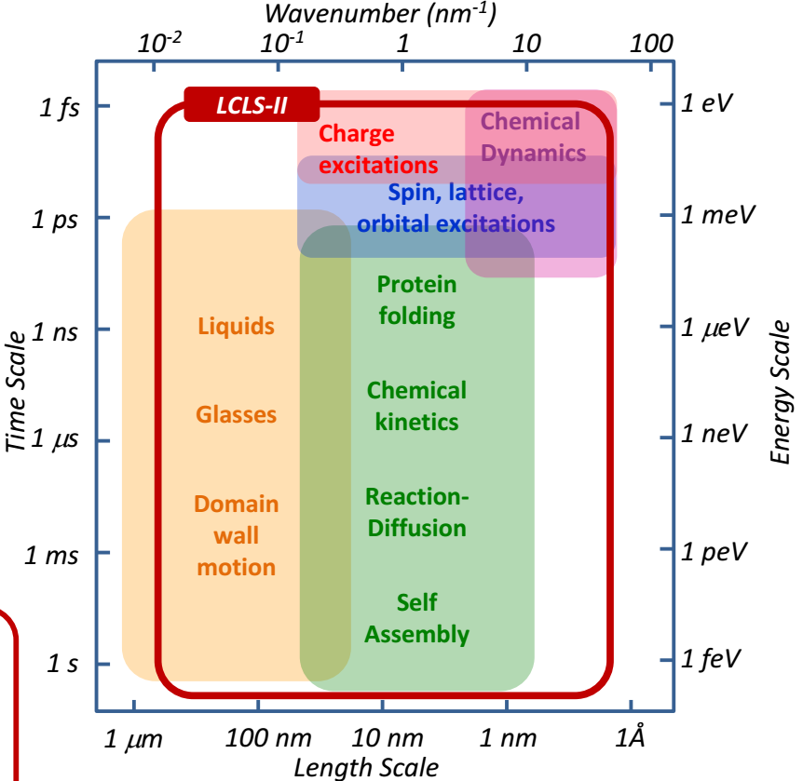
Complex materials (courtesy of R. Schoenlein, SLAC)

Slide 12
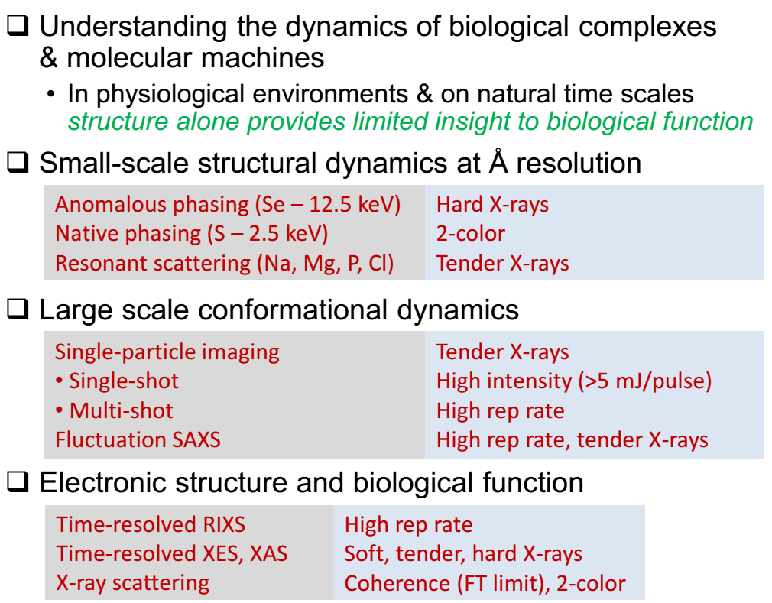
Life Sciences (courtesy of R. Schoenlein, SLAC)

Slide 13
Single molecule coherent imaging was of the main killer application motivating LCLS and European XFEL.
Neither LCLS nor European XFEL managed to realized this longstanding dream in structural biology.
Single-shot imaging does not look the direction to go for us.

Slide 14
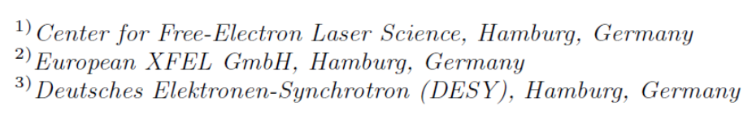
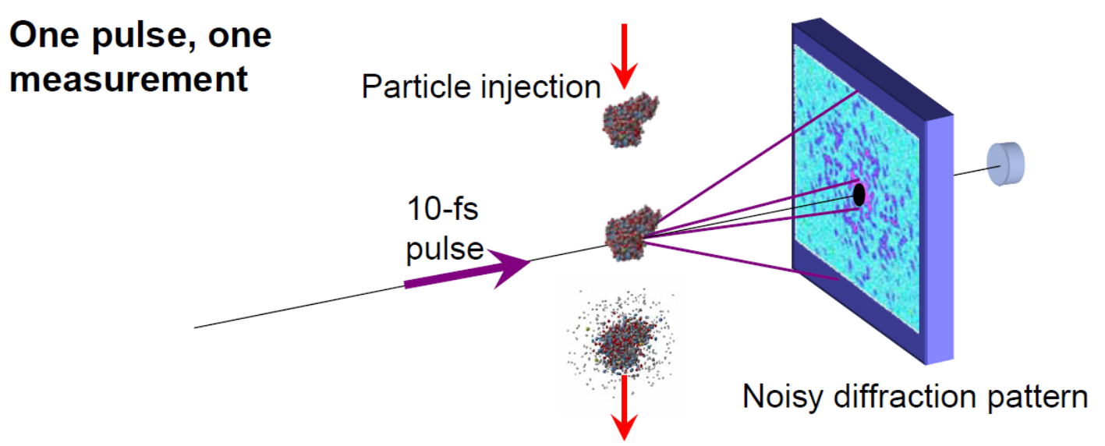
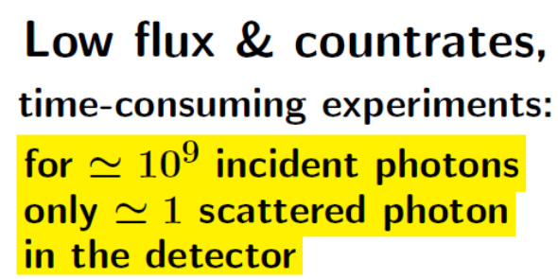
Towards single-molecule imaging
Courtesy of Saldin, Nobel Symposium 2015
Longstanding dream of biologists! Still not feasible even with the European XFEL.

Slide 15
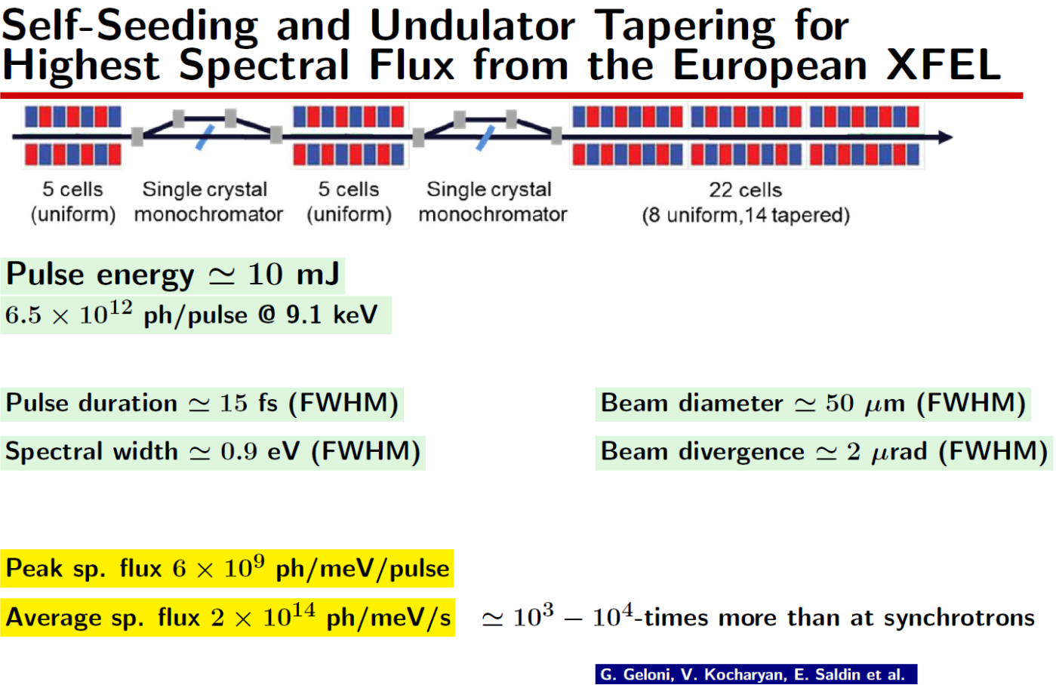
Towards single-molecule imaging: cont’d
Courtesy of Saldin, Nobel Symposium 2015
Courtesy of Saldin, Nobel Symposium 2015

Slide 16
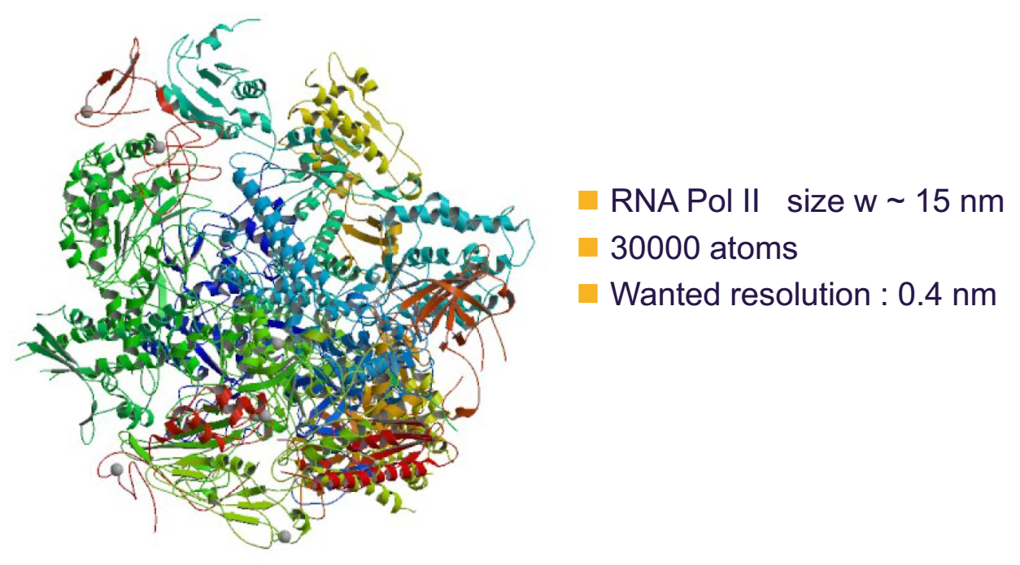
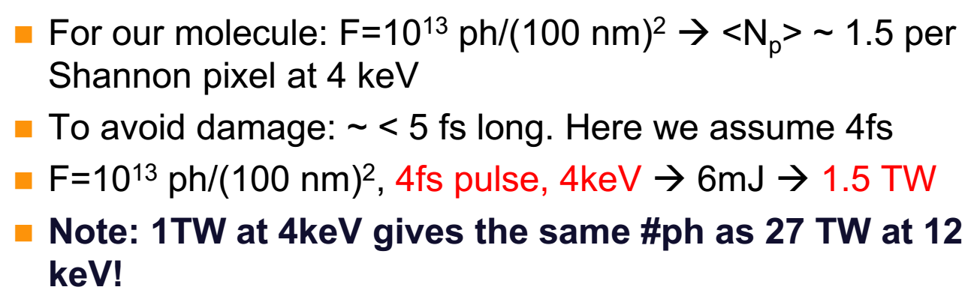
Requirements for molecule imaging
Courtesy of Saldin, Nobel Symposium 2015

Slide 17
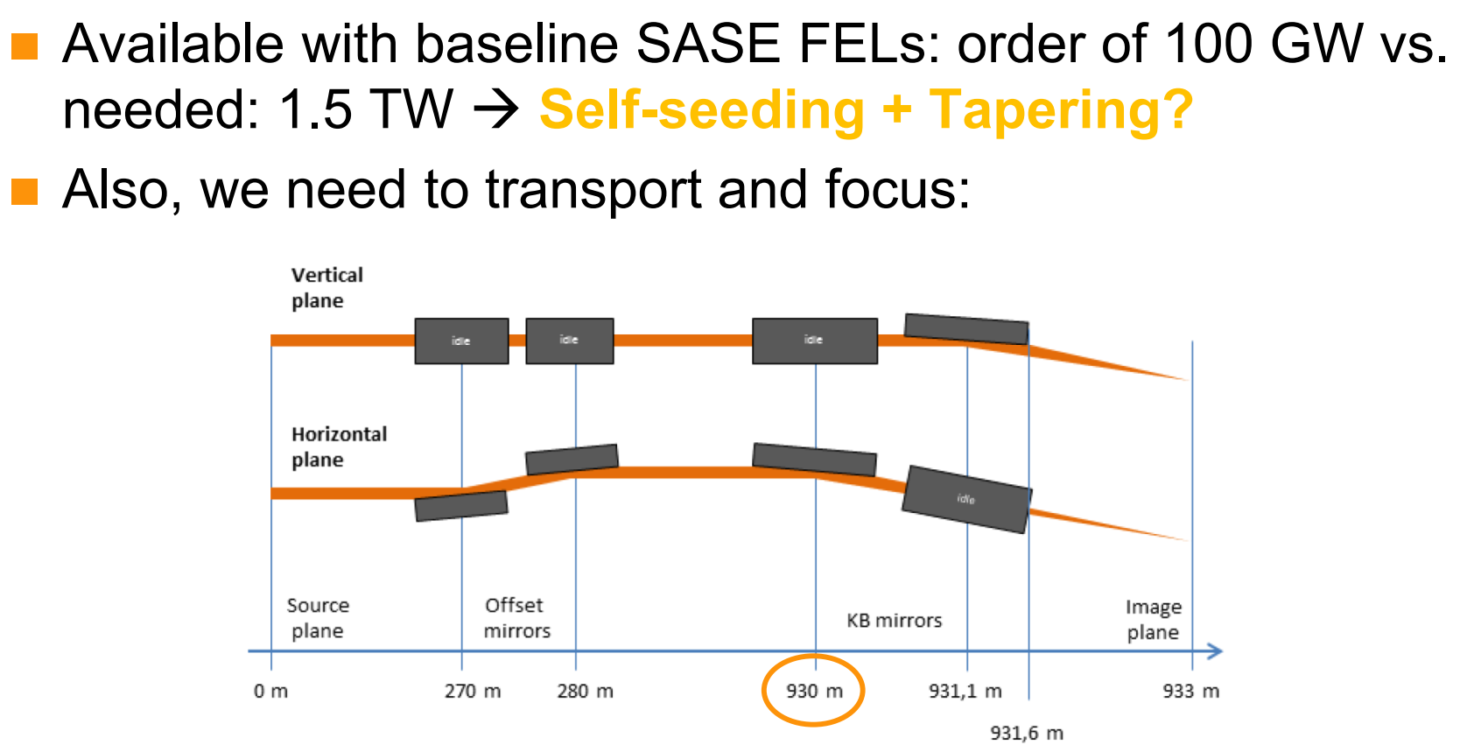
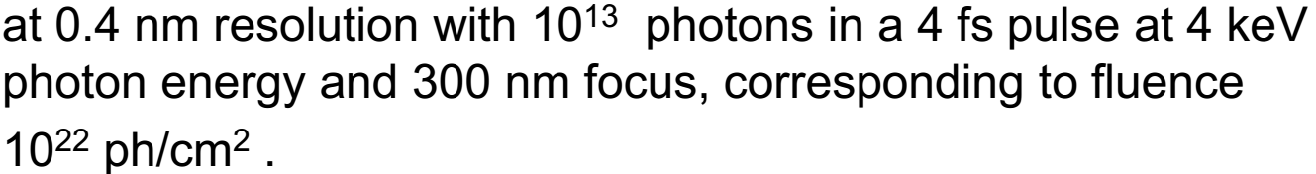
Single-shot imaging of molecules remains a dream
Optical transport takes around 1 km!
Courtesy of Saldin, Nobel Symposium 2015
30 000 shots are needed for pattern reconstruction.
Single-shot imaging does not look the direction to go for us.

Slide 18
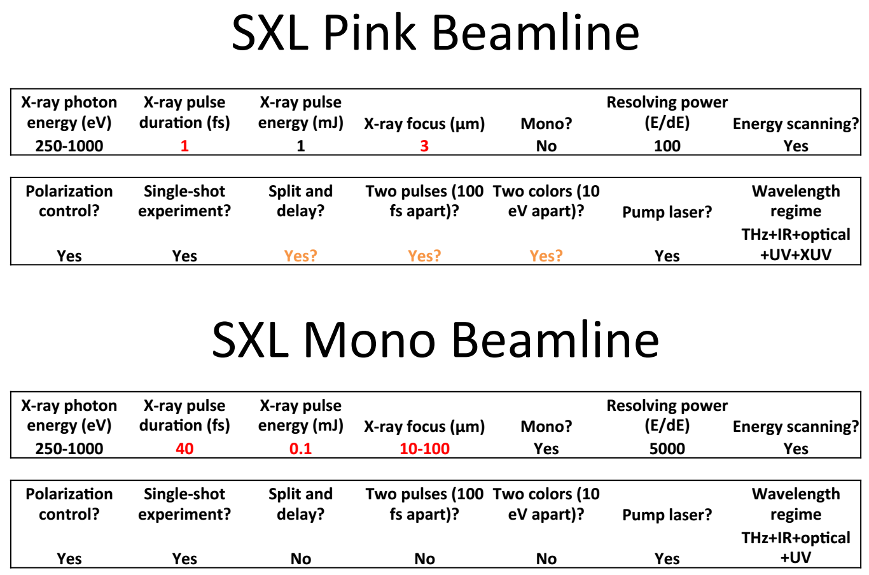
LCLS template for beam time application

Slide 19
Proposed user committee for CompactLight
 | Name | Organization | Discipline | Field
1 | Anders Nilsson | Stockholm University, Sweden | Chemistry | Catalysis
2 | Stefano Bonetti | Stockholm University, Sweden | Condensed matter physics | Magnetism
3 | Andrea Cavalleri | Max Plank Institute, Germany | Condensed matter physics | Non-equilibrium and strongly correlated materials
4 | Jan-Erik Rubensson | Uppsala University, Sweden | Atomic, molecular and optical physics | Attosecond and nonlinear dynamics
5 | Linda Young | Argonne Lab, USA | Atomic, molecular and optical physics | Pump-probe experiments, attosecond dynamics
6 | Justin Wark | University of Oxford, UK | Plasma and material physics | Solid Density Plasmas
7 | Sam Vinko | University of Oxford, UK | Plasma and material physics | Matter in extreme conditions
8 | Jerry Hastings | Stanford, USA | Condense mater physics | Inelastic X-ray scattering by phonons, plasmons, liquids
9 | Robin Santra (theory) | DESY, Germany | Atomic, molecular and optical physics | Multiphoton ionization and high-intensity phenomena
10 | Thomas Moller | University of Berlin, Germany | Material physics | Nanopartickles and nanoclusters
11 | Nina Rohringer | DESY, Germany | Atomic, molecular and optical physics | Nonlinear X-Ray spectroscopy
12 | Steve Johnson | ETH Zurich, Switzerland | Condense mater physics | Non-equilibrium and strongly correlated materials

Slide 20
Some thoughts on Strength and Weakness of Comp.L
Characteristic | +1/0/-1 | Notes
Peak Brightness | 0 | Hard to make a transformational leap in brightness requires seeding and long tapered undulator needs a high bunch charge but then wake fields are of concern in CLIC structures needs a tight photon focus leading to a long X-ray line
Average brightness | -1 | Cannot compete with superconducting (SC) linacs
Compactness | +1 | Need to work out a compact X-ray collimation line
Ultra high photon energy | +1 | Science case for gamma-rays is not convincing.
Stability | 0 | Poor compared to SC linacs
Short pulses ( < 1 fs) | +1 | High gradient X-band gun will allow shorter bunches X-band gun is advantageous for ultra-low emittance
Polarization control | ?
Coherence | +1 | new FEL schemes with improved coherence

Slide 21
Regarding the comment on short bunches from an X-band gun

Slide 22
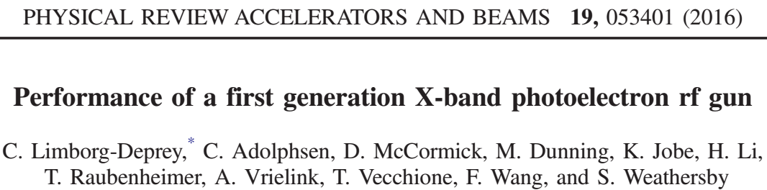
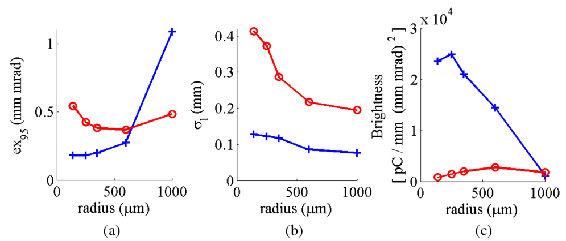
The maximum peak brightness is 10 times larger at X-band than at S-band.

Slide 23
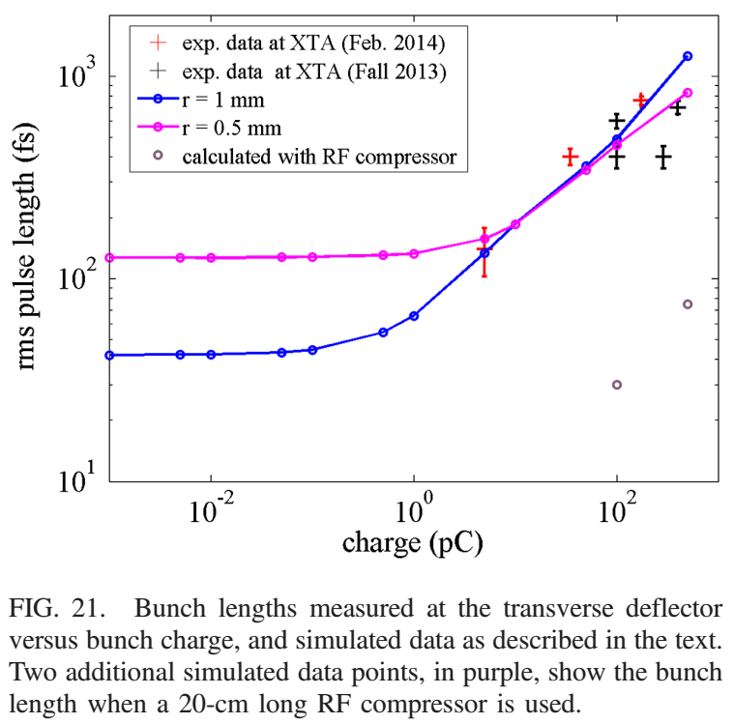
Measurements of SLAC X-band gun
measured
400 fs, 100 pC bunches
Having short bunches right from the gun might reduce the number of required bunch compressors.

