Slide 1
Simulations of longitudinal coupled bunch instabilities
s
LIU-PS Beam Dynamics Working Group
12/07/2018
A. Lasheen
Acknowledgements: H: Damerau, G. Favia, M. Migliorati,
B. Popovic, BLonD dev team, all contributors to the PS impedance model

Slide 2
Outline
Benchmark with previous simulations
  At 15 GeV with only 10 MHz cavities impedance
Present status of the PS impedance model
  RF cavities
  Kickers
  Vacuum equipment
  Beam dumps
  Space charge & resistive wall
  Ongoing (remaining kickers and beam instrumentation)
Simulations with the present impedance model
  Along the ramp, in single and double rf

Slide 3
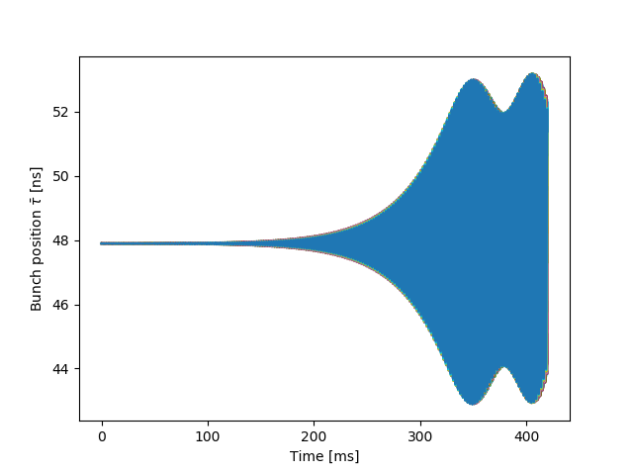
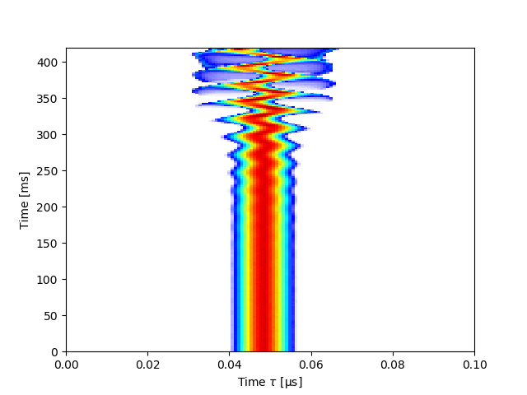
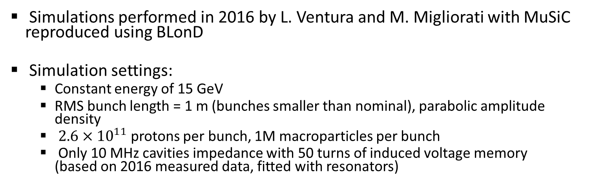
Simulations at 15 GeV (1)
Simulations performed in 2016 by L. Ventura and M. Migliorati with MuSiC reproduced using BLonD
Simulation settings:
  Constant energy of 15 GeV
  RMS bunch length = 1 m (bunches smaller than nominal), parabolic amplitude density
  $2.6×{10}^{11}$ protons per bunch, 1M macroparticles per bunch
  Only 10 MHz cavities impedance with 50 turns of induced voltage memory
  (based on 2016 measured data, fitted with resonators)

Slide 4
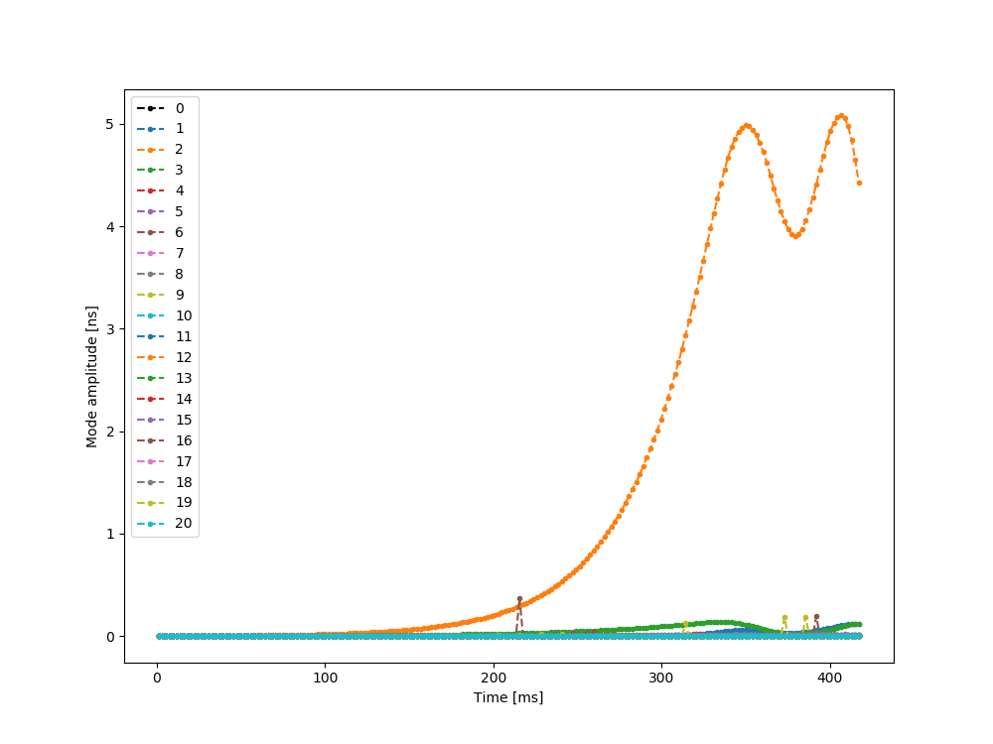
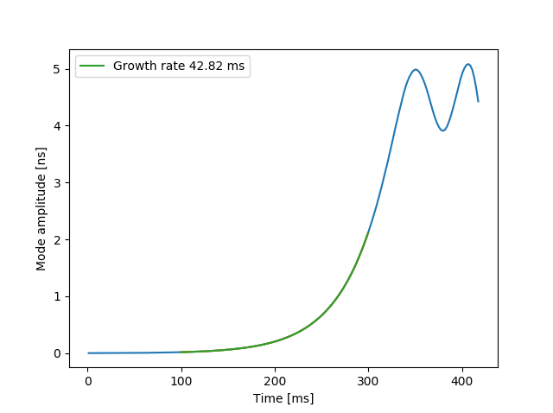
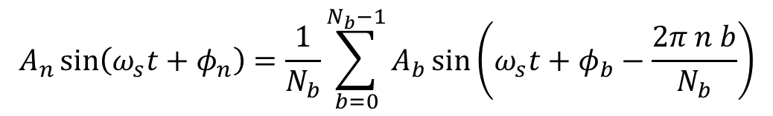
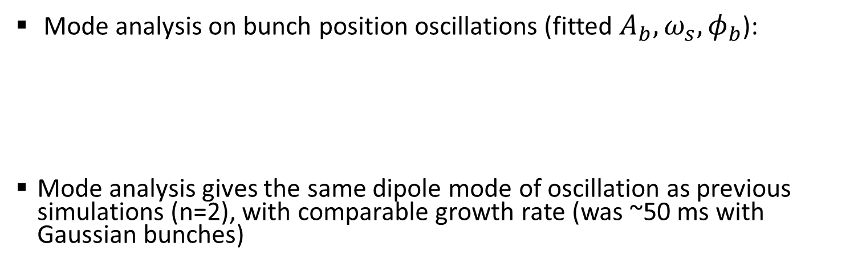
Simulations at 15 GeV (2)
Mode n=2
Mode analysis on bunch position oscillations (fitted $A_{b}, ω_{s},φ_{b}$):
Mode analysis gives the same dipole mode of oscillation as previous simulations (n=2), with comparable growth rate (was ~50 ms with Gaussian bunches)
$$A_{n}\sin\left(ω_{s}t+φ_{n}\right)=\frac{1}{N_{b}}\sum_{b=0}^{N_{b}−1}{A_{b}\sin\left(ω_{s}t+φ_{b}−\frac{2π n b}{N_{b}}\right)}$$

Slide 5
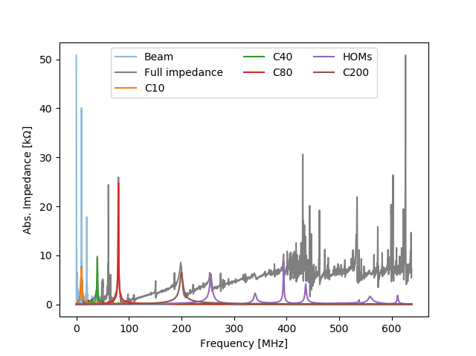
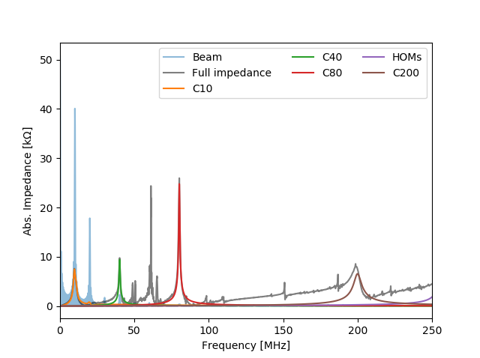
Present impedance model – RF cavities (1)
Included in the model:
  RF cavities:
    10 MHz, from 2016 measurements (h21 for these simulations)
    20 MHz, from 2003 measurements (gap closed for these simulations)
    40 MHz, from 2017 measurements, HOMs from end 1990’s
    80 MHz, from 2017 measurements, HOMs from end 1990’s
    200 MHz, from 2014 CST simulations
https://gitlab.cern.ch/longitudinal-impedance/PS/tree/master/impedance/rf_cavities

Slide 6
Present impedance model – RF cavities (2)
To be soon included in the model:
  RF cavities
    10 MHz, impedance with gaps closed,
    change of impedance along the cycle
    20 MHz, opening the gap before splittings
    Finemet cavity
https://gitlab.cern.ch/longitudinal-impedance/PS/tree/master/impedance/rf_cavities

Slide 7
Present impedance model – RF cavities (3)
Not included:
  RF cavities
    10 MHz -> one-turn delay feedback
    40 MHz & 80 MHz -> multi-harmonic feedback
https://gitlab.cern.ch/longitudinal-impedance/PS/tree/master/impedance/rf_cavities

Slide 8
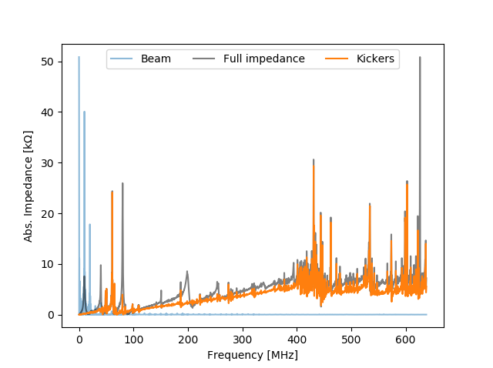
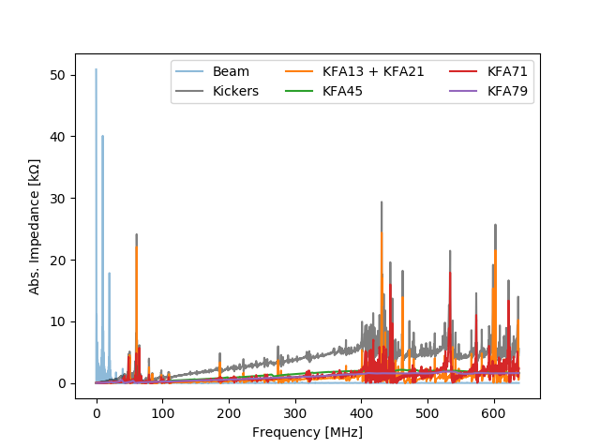
Present impedance model – Kickers (1)
Preoccupying mode(s)
Included in the model:
  Kickers:
    KFA13 and KFA 21 (identical), from 2017 CST simulations
    simulations KFA45, from 2017 CST simulations
    KFA71, from 2017 CST simulations
    KFA79, from 2017 CST simulations
https://gitlab.cern.ch/longitudinal-impedance/PS/tree/master/impedance/kickers

Slide 9
Present impedance model – Kickers (2)
Not included:
  Kickers (migrating from Tsutsui models to upgraded CST models)
    KFA04
    KFA28
    All BFAs (BFA09S, BFA09P, BFA21S, BFA21P)
  Septa
https://gitlab.cern.ch/longitudinal-impedance/PS/tree/master/impedance/kickers

Slide 10
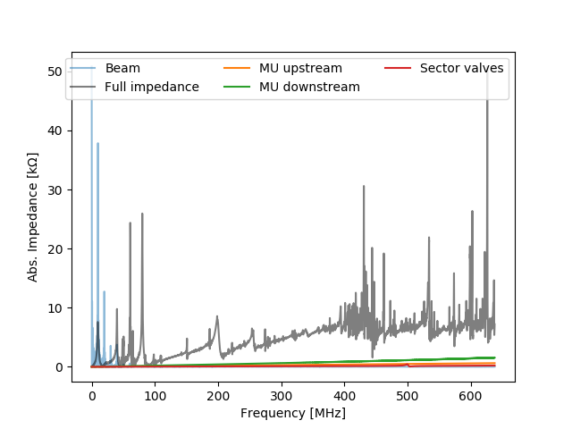
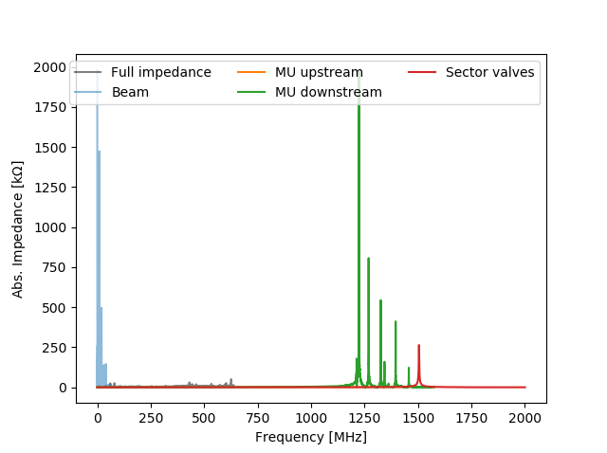
Present impedance model – Vacuum
Height of
Mt-Blanc
Included in the model:
  Vacuum equipment:
    Magnet Unit downstream assembly (x36 unshielded pumping manifold), from 2017 CST simulations
    Magnet Unit upstream assembly (x99 bellows), from 2017 CST simulations
    Sector valves (x10), from 2017 CST simulations
https://gitlab.cern.ch/longitudinal-impedance/PS/tree/master/impedance/vacuum

Slide 11
Present impedance model – Vacuum
Height of
Mt-Blanc
To be included:
  Vacuum equipment:
    Other variations of Magnet Unit upstream and downstream assemblies
    Details here
https://gitlab.cern.ch/longitudinal-impedance/PS/tree/master/impedance/vacuum

Slide 12
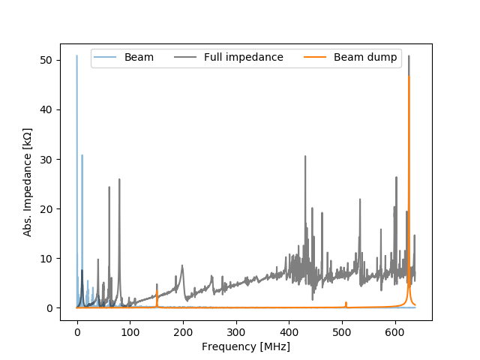
Present impedance model – Beam dump
https://gitlab.cern.ch/longitudinal-impedance/PS/tree/master/impedance/miscellaneous
Included in the model:
  Miscellaneous:
    Beam dumps (x2), from 2018 CST simulations

Slide 13
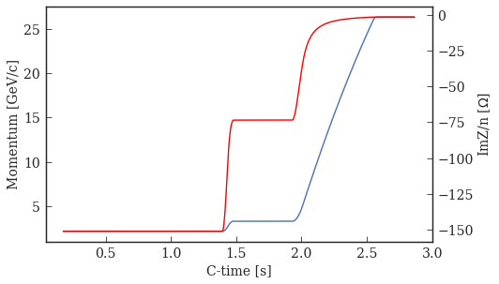
Present impedance model – SC & RW
To be included in the model:
  Space charge:
    based on 2013 aperture information (G. Sterbini’s toolbox), integrating over the length of the ring accounting for variation in beam size with the optics settings from 2017 (injector-optics PS gitlab), assuming rectangular aperture
  Resistive wall:
    taking into account 20% of the beam pipe in Inconel X750 alloy and 70% in stainless steel 316 LN, to be upgraded to account for variation of aperture
https://gitlab.cern.ch/longitudinal-impedance/PS/tree/master/impedance/space_charge

Slide 14
Present impedance model (ongoing)
Kickers (migrating from Tsutsui models to upgraded CST models)
  KFA04
  KFA28
  All BFA
Septa
Beam instrumentation (no BI equipment included yet in the model)
  Closed orbit acquisition system (CODD), in the downstream assembly of the Magnet units (x39 positions)
  Various equipment:
    SEM grids in the downstream assembly of the Magnet units
    Wall Current Monitors
    Wire scanners
    Beam Current Transformers
    Beam Gas Ionization Monitor
    Wideband pickups
    …

Slide 15
Future impedance model
Included
  New beam dumps, from 2018 CST simulations
To be included
  Impedance of 10 MHz cavities with new amplifiers
  (based on C10-11 measurements in 2015)
Not included
  CT extraction equipment to be removed
    Kickers BFA21S, BFA21P, BFA9S
    Septa SES31, SEH31
    Orbit bumpers: magnet type D205 in SS27 and D210 in SS35

Slide 16
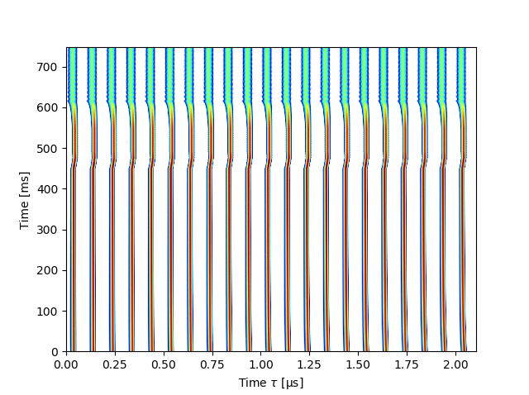
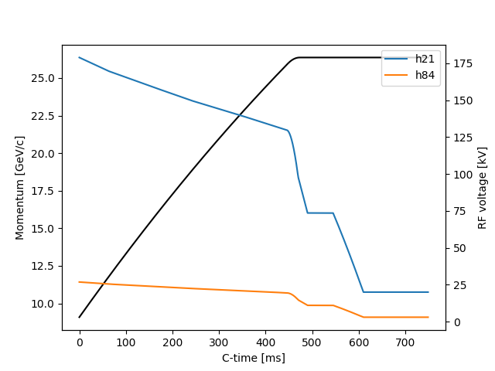
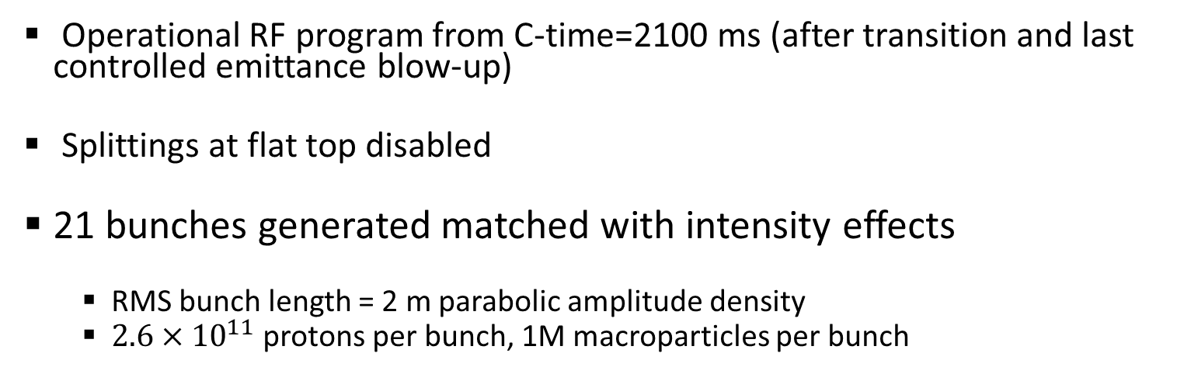
Simulation set-up
Operational RF program from C-time=2100 ms (after transition and last controlled emittance blow-up)
Splittings at flat top disabled
21 bunches generated matched with intensity effects
  RMS bunch length = 2 m parabolic amplitude density
  $2.6×{10}^{11}$ protons per bunch, 1M macroparticles per bunch

Slide 17
Simulation set-up
Sample size for induced voltage calculation set to ~600 MHz
  Accounting for broadband component of impedance at low frequency from very high frequency impedance sources, but discarding their very high shunt impedance that could lead to microwave instability
Induced voltage memory of 50 turns

Slide 18
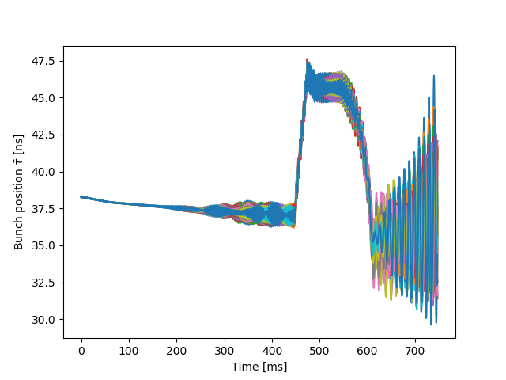
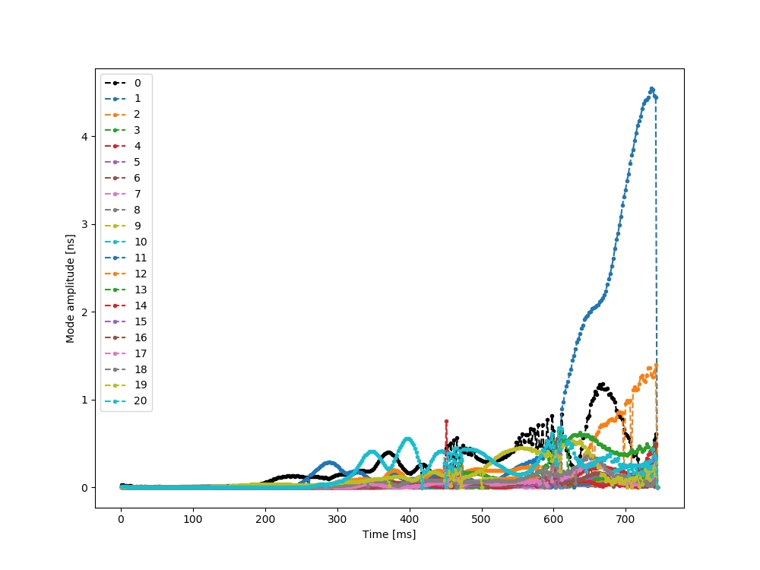
Simulations along the ramp (single RF)
Beam is unstable, with as main mode of coupled bunch oscillations n=1
Space charge along the ramp and closure of gap relays for 10 MHz cavities not included
  Space charge may change the start of the oscillations around 300 ms
  The closure of 10 MHz cavities will reduce the growth rate around 600 ms

Slide 19
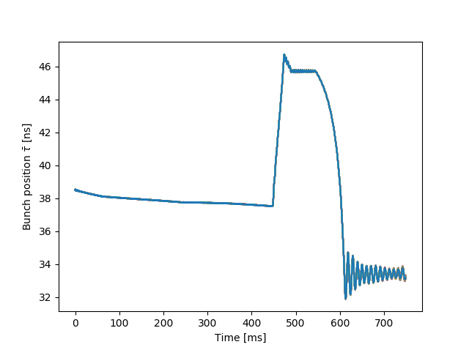
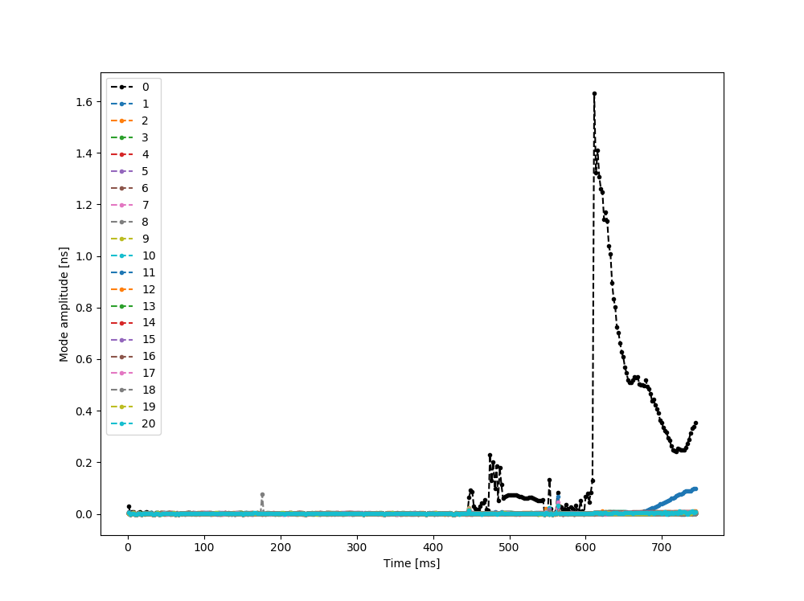
Double RF, harmonic ratio 4 (1)
Using a Landau cavity in bunch shortening mode with harmonic ratio of 4 and voltage ratio of 15% stabilizes the beam
Arrival to the flat top and at 20 kV (normally before splittings) is not very friendly for the beam
  Start of phase oscillations with mode n=0 which is normally handled by the phase loop (not included in simulations)

Slide 20
Double RF, harmonic ratio 4 (2)
Start of coupled bunch oscillations with mode n=1 around 700 ms
The amplitude of oscillations is small, starts at a time after the splittings should take place and in presence of 10x10 MHz cavities (only one gap remains opened at that moment in the operational cycle)

Slide 21
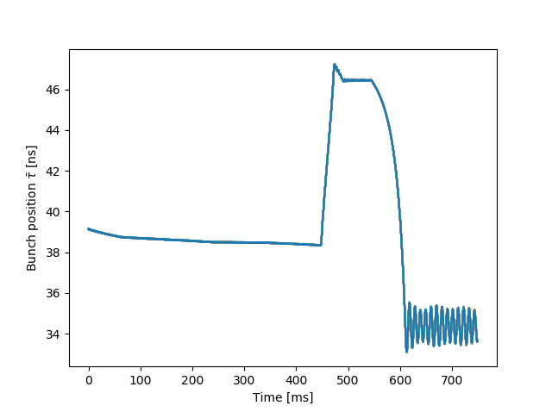
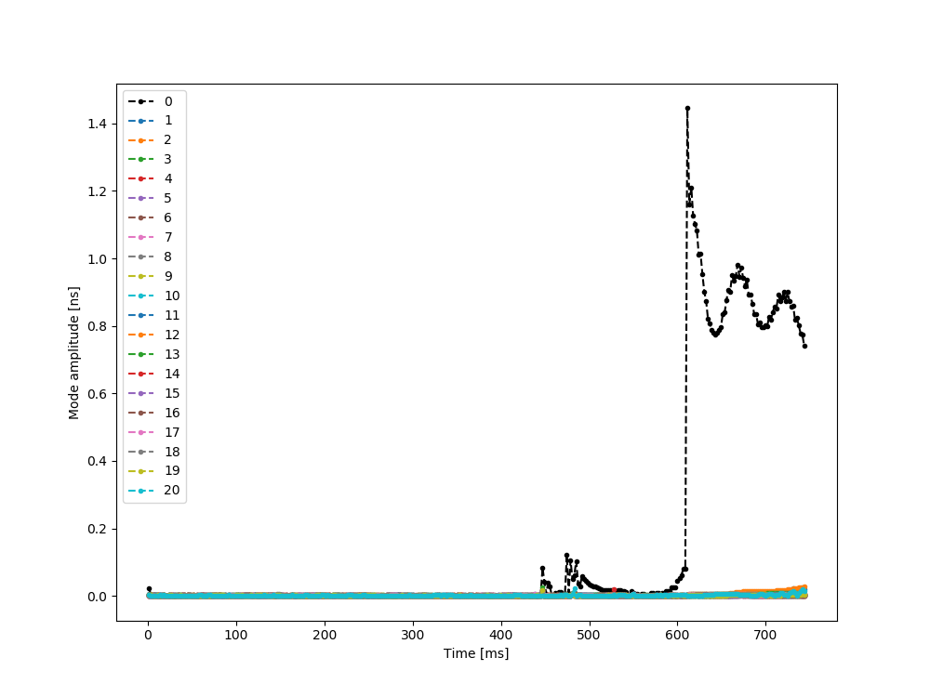
Double RF, harmonic ratio 3
The beam is also stabilized with a Landau cavity with harmonic ratio 3 and voltage ratio of 25%
The oscillations after 600 ms are not damping
  No active instability but remaining loss of Landau damping ?
  Parameters of the Landau cavity need to be scanned systematically

Slide 22
Conclusions
The simulation code was benchmarked with respect to previous results obtained in 2015
Preliminary results show that a Landau cavity in bunch shortening mode with harmonic ratio of 3 or 4, and respectively a voltage ratio of 25% and 15% is able to stabilize the beam

Slide 23
Next steps
Setup batch simulations to widely scan parameters (beam intensity, longitudinal emittance, landau cavity parameters)
Continue updating the impedance model and check impact on beam stability
Including the present assumptions for the Landau cavity impedance
Include a model of the coupled bunch feedback to observe quadrupolar instability in simulations
Simulations through the splittings, up to bunch rotation and extraction to check for uncontrolled emittance blow-up
Evaluation of the influence of very high frequency impedance sources in terms of microwave instability (and tail generation)

