Slide 1
CCT5 Impregnation Process
10/08/2018
US Magnet Development Program
Lawrence Berkeley National Laboratory

Slide 2
Epoxy Impregnation of Individual CCT Layers has been Implemented for CCT5
CCT4 magnet reached 86% of short sample critical current but required significant training
Changes to CCT5 are focused on reducing training due to epoxy failure at the layer-to-layer interfaces
  Tougher epoxy has been introduced (FSU mix-61 instead of CTD-101K)
  New method for pre-loading and mechanically coupling the layers (bend-and-shim)
Epoxy impregnation of individual layers has several advantages
  Individual layer impregnation enables bend-and-shim assembly method
  Methods for individual layer impregnation are scalable to long lengths and require minimal tooling
  Most materials required for impregnation are inexpensive consumables
  May be possible to disassemble magnet after test and replace layers for accelerated R&D

Slide 3
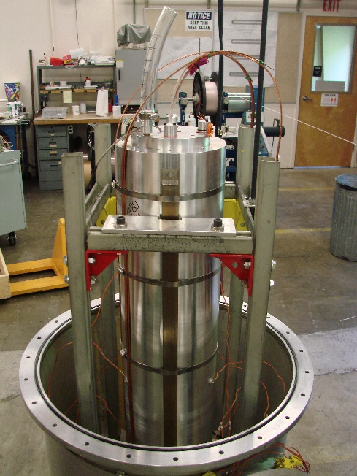
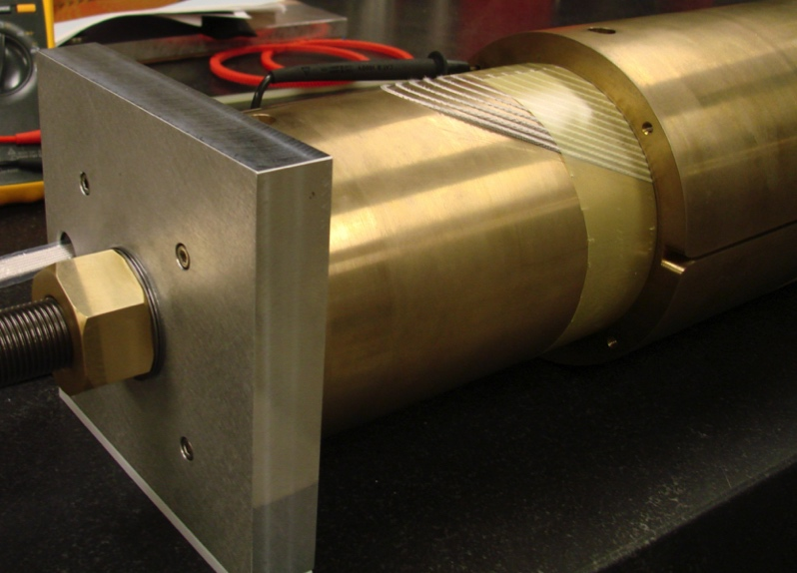
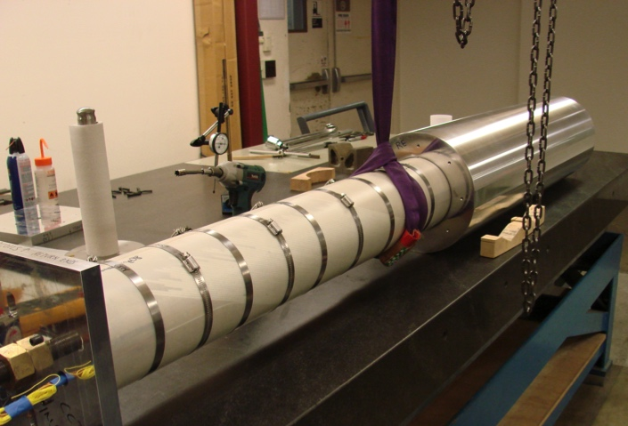
CCT3/CCT4 Assembly and Impregnation Process
Reacted coils are assembled together with G10 shim between layers
Coils are inserted into the Aluminum shell and the entire assembly is vacuum impregnated with epoxy
Areas of unfilled epoxy remain between the layers
  G10 shim has to be substantially thinner than gap between layers due to distortion of the mandrels during heat treatment
Step 3. all impregnated together
with the shell used as tooling
Step 1. Assemble Layers
Layer 2
Step 2. Layers 1+2 into shell
Layer 1
Linear driver
G10 slip plane
3

Slide 4
CCT5 Assembly Process
Layer 1 / 2 Assembly
  Layer 1 is inserted into layer 2 and centered with end shims
  Shims and glass filled Kapton bags are inserted on both sides of the midplane
  Kapton bags are filled with epoxy
Coils / Shell Assembly
  Coil / Shell assembly is inserted in press
  Shell is deformed vertically (horizontal gap opens by 0.1 mm)
  Shims and glass filled bags are inserted on the midplane
  Kapton bags are filled with epoxy and allowed to cure
  Force is released from the press
Applied Force
Force Release After Cure
epoxy filled Kapton bag
shell
layer 1
Directional
Pre-Load on Coils
layer 2
Notes:
Angular coverage of Kapton bag is chosen so that all areas with outward radial Lorentz force are covered

Slide 5
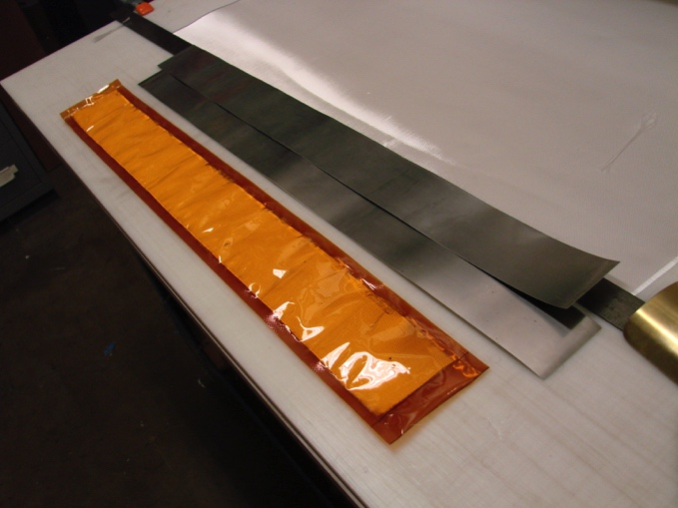
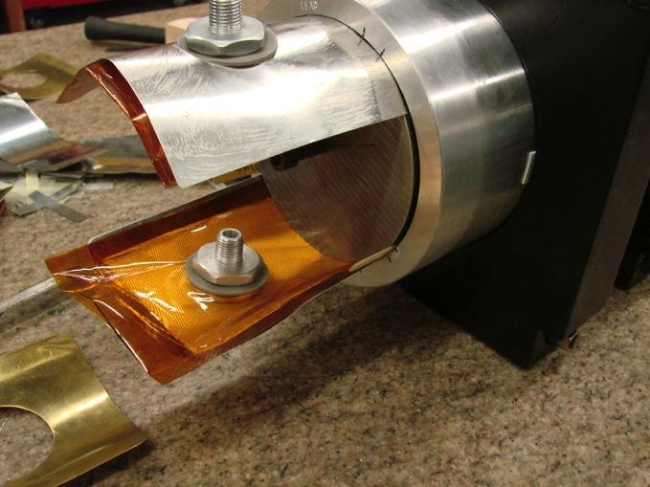
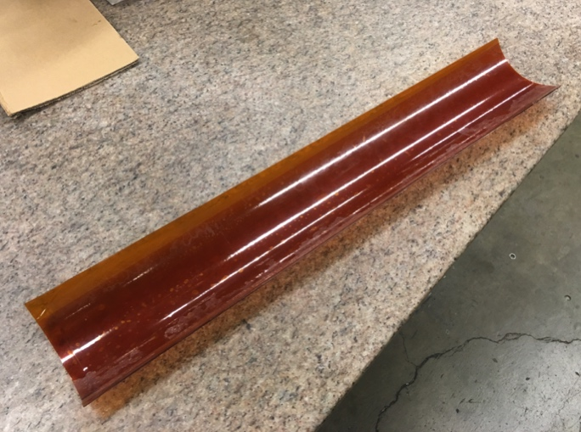
New Method for Coupling of Individually Potted Layers (Bend-and-Shim)
Contact location between layers is controlled by using shims and Kapton bags that are filled with glass and epoxy
  Allows for control of contact location
  Fracture in interface epoxy can not propagate to the coil
  Improved cooling at the pole regions from direct contact with LHe
Directional preload to reduce energized stress can be applied by bending layers or shell, filling and curing epoxy in bent state, releasing bending pressure
Shims and Bag Inserted Between Layers
Kapton Bag Filled with Cured Epoxy was Extracted
Kapton Bag and Shims

Slide 6
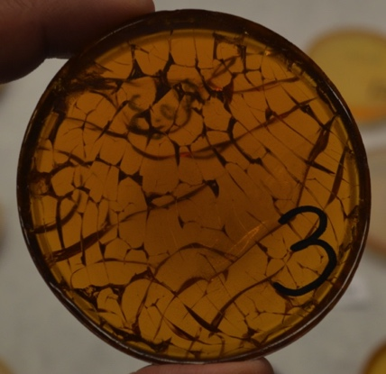
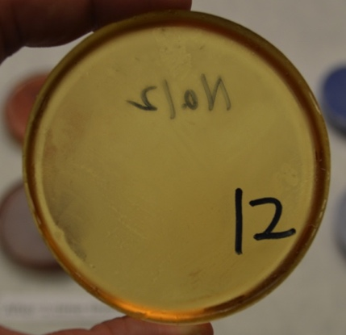

CCT5 Is Impregnated With FSU Mix-61 Due to its Higher Toughness
Mix 61 has excellent performance in thermal shock tests when compared to CTD-101K
Stress-Strain curve of Mix-61 has been measured at room temperature
F
Room Temperature, test standard - ASTM-D638
CTD-101K after one thermal cycle to 77 K
Mix-61 epoxy after one thermal cycle to 77 K
Extensive cracks
No crack
F
Courtesy of T. Shen and S. Yin
NHMFL
61 mix
Notes:
Mix 61 is cured at 100 degrees C for 24 hours

Slide 7
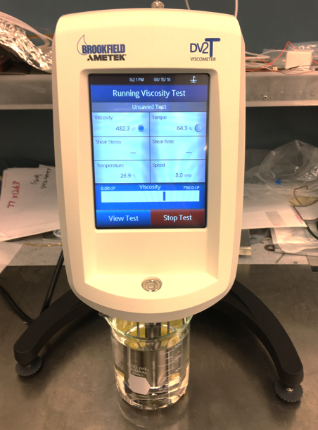
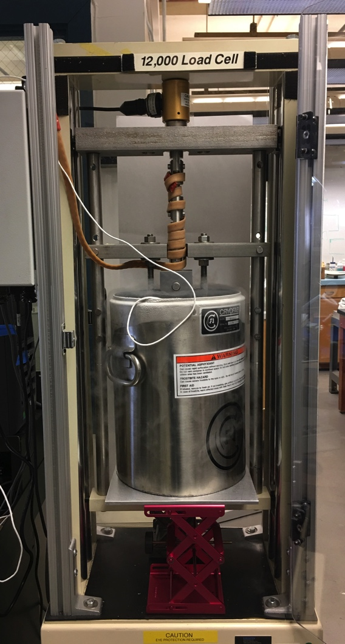
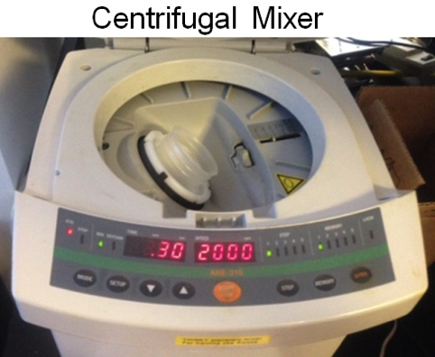
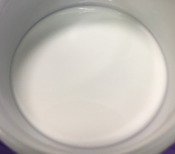
Further Studies And Development of High Performance Epoxies Are Ongoing at LBNL
Mechanical testing at 77K
Viscosity test
High specific heat epoxies by adding fillers

Slide 8
Impregnation Process for CCT5
Coils are impregnated with mix 61 epoxy
Did not deviate too far from usual LBNL potting procedures to avoid delaying CCT5 test
  Use vacuum vessel for impregnation
  Seal coil ends with Aluminum end plugs as with CCT3/4
  Sealing of external coil surface is done with inexpensive consumable materials
Use common techniques and materials from vacuum bag process
  Peel ply to minimize epoxy on surface of mandrel
  Flow media for epoxy flow
  Use Nylon vacuum bag
  Use shrink tape to compress the compress the bag and flow media layer tightly onto the mandrel

Slide 9
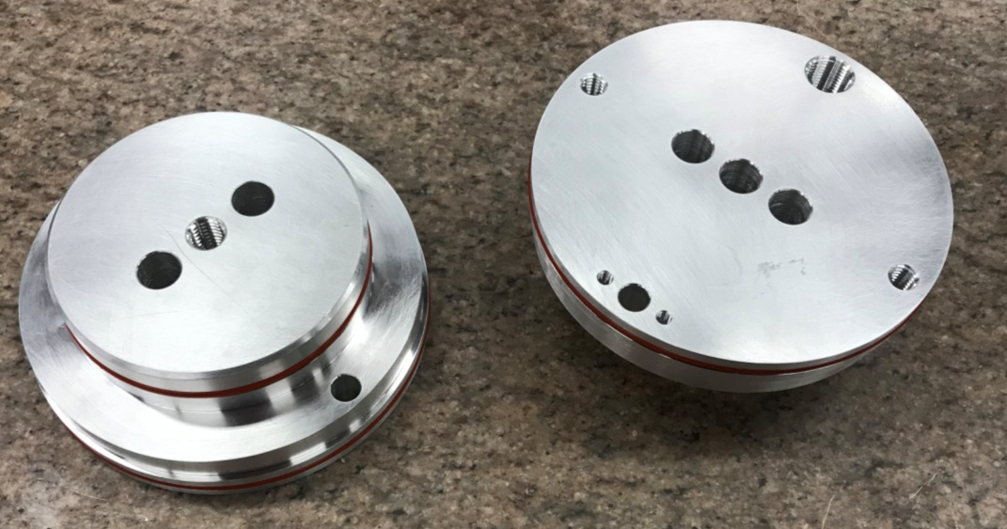
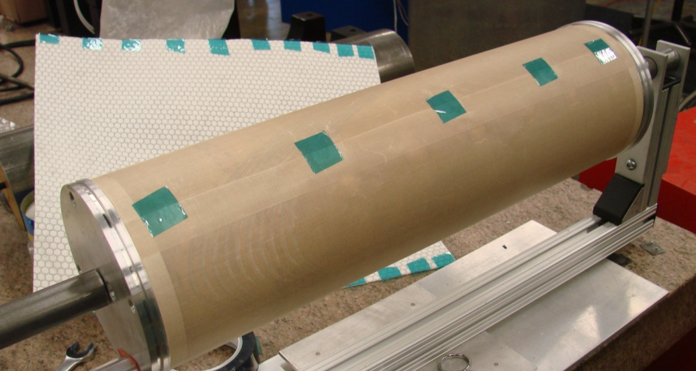
Potting Tooling and Release Film
O-ring Seals
Holes for heaters
Holes for Leads
Heater Slug is inside of coil bore
Peel-Ply
(Teflon Coated Fiberglass)

Slide 10
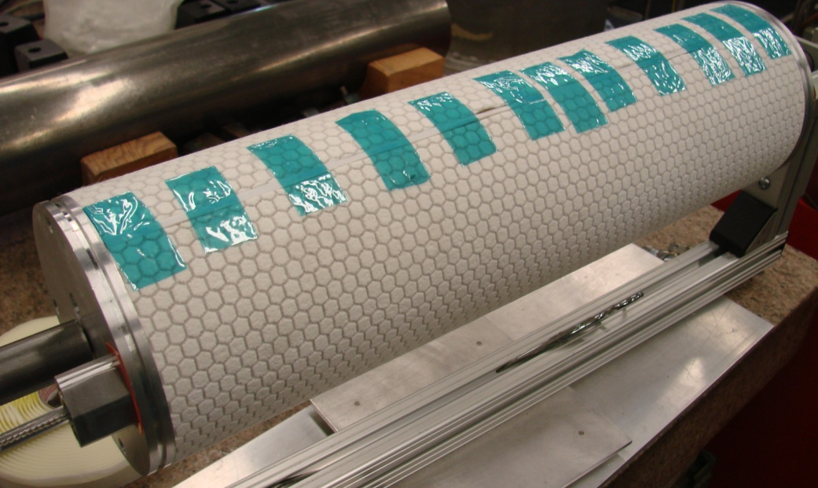
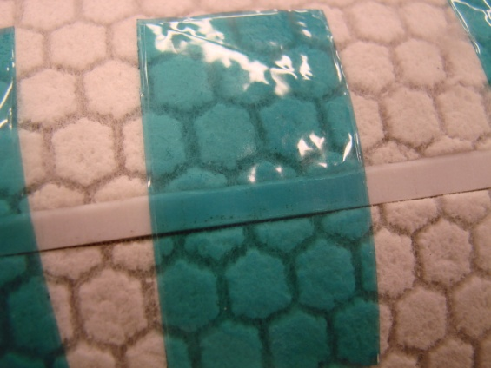
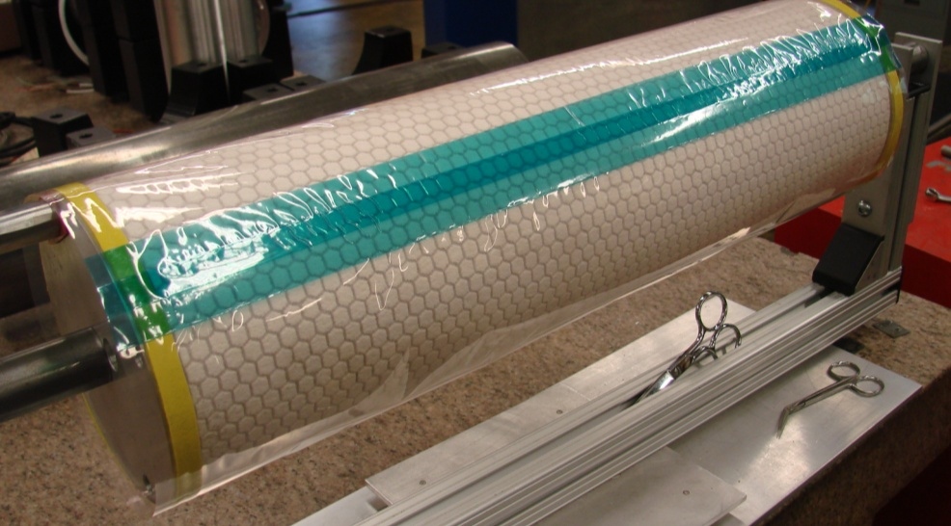
Flow Media and Vacuum Bag
Teflon strip to separate seam after potting
Flow Media
Vacuum Bag
(Seam Sealed with Tape)
Sealing tape for seal to end plug

Slide 11
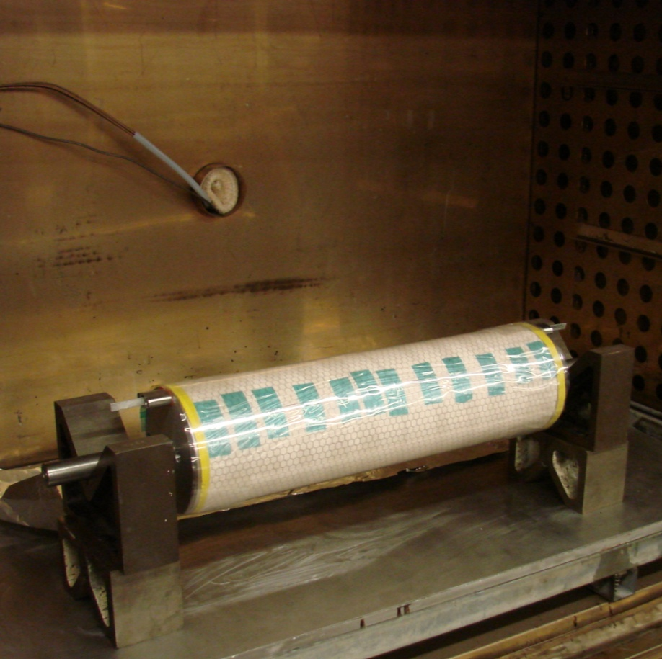
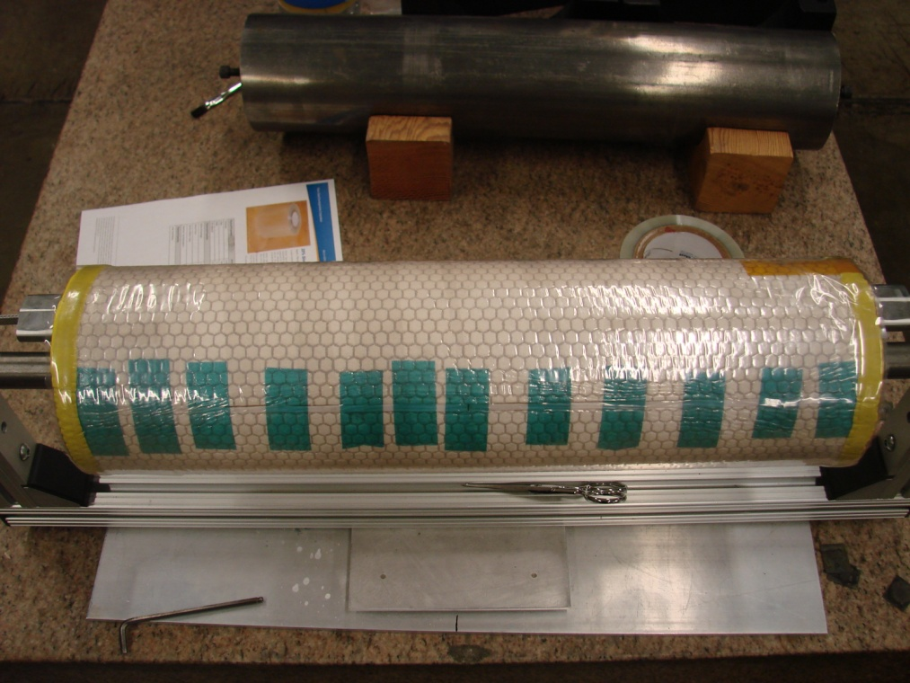
Shrink Tape Applies Pressure
Coil is wrapped with shrink tape and heated in oven
Coil after removing from oven

Slide 12
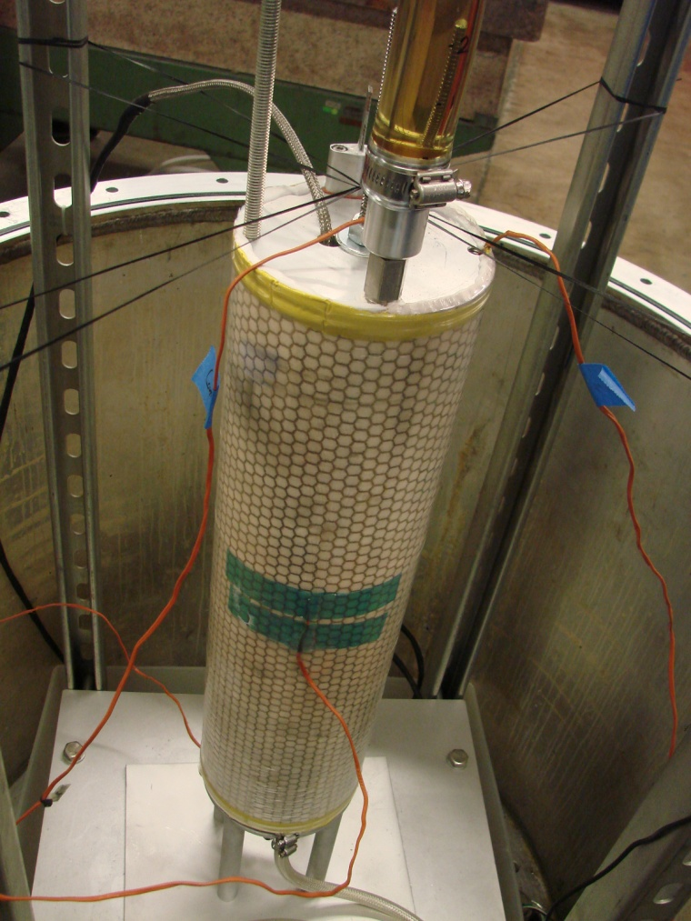
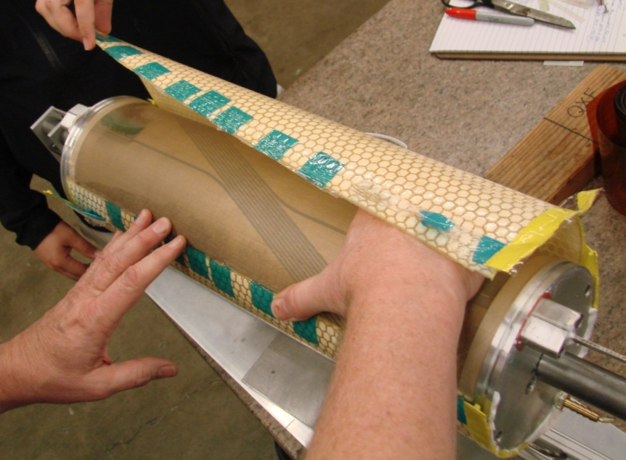
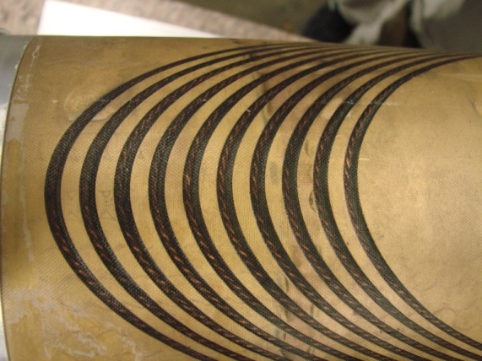
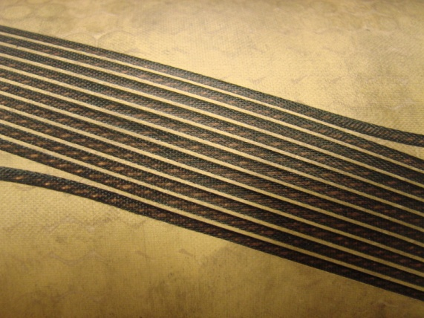
Coil Impregnation in Vacuum Vessel
Coil Inside of Vacuum Vessel
Coil after removing flow media and Peel Ply
Epoxy Inlet

Slide 13
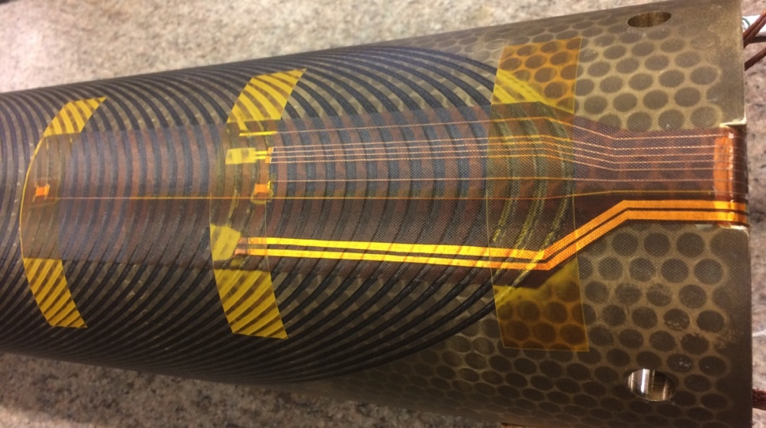
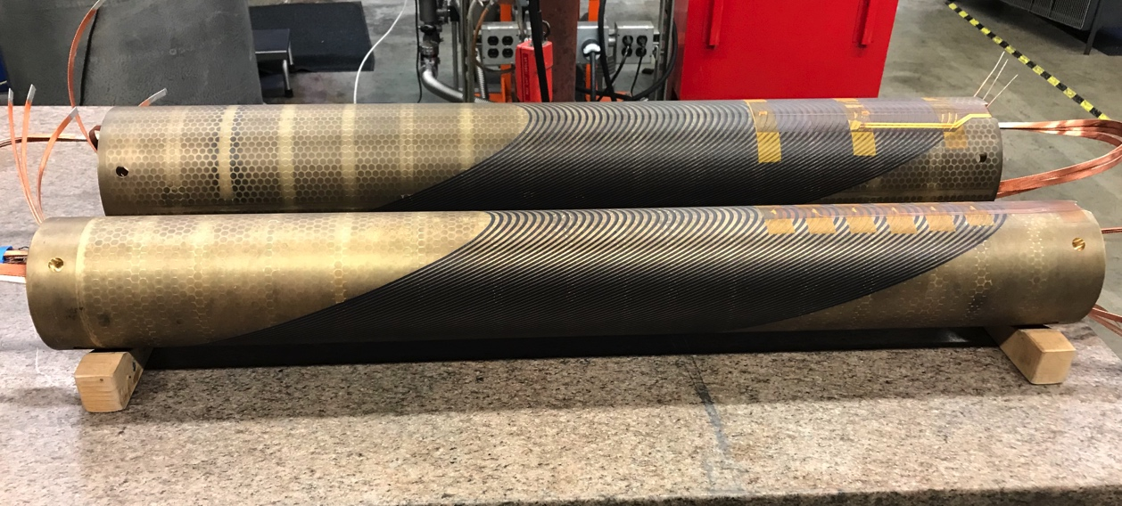
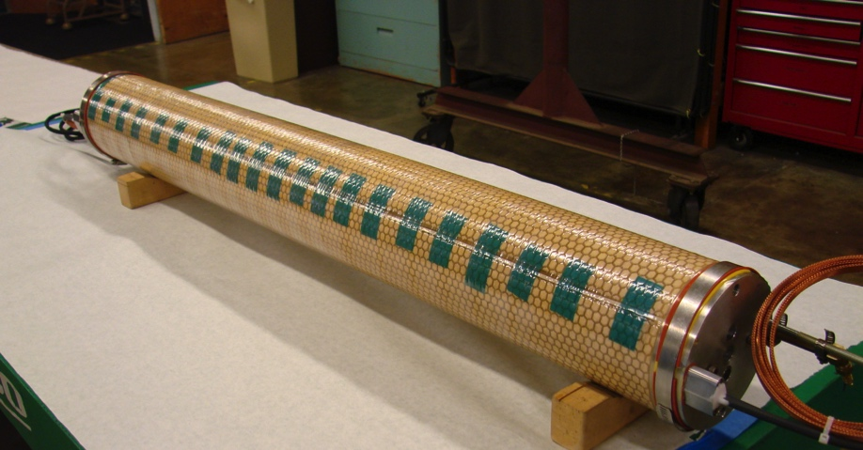
Impregnation of CCT5 1 Meter Long Coils
Instrumentation Trace After Potting
CCT5 coils were successfully impregnated with new process
Instrumentation traces were included in the impregnation
V taps
Thermometer
Heater
Wrapped Coil After Impregnation

Slide 14
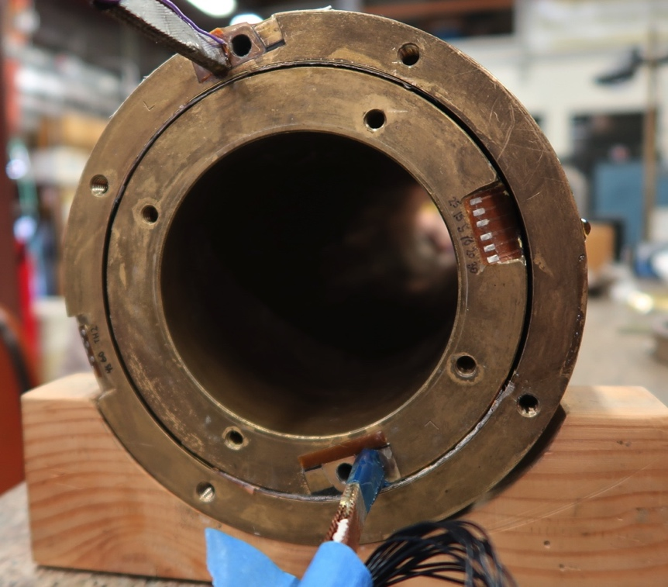
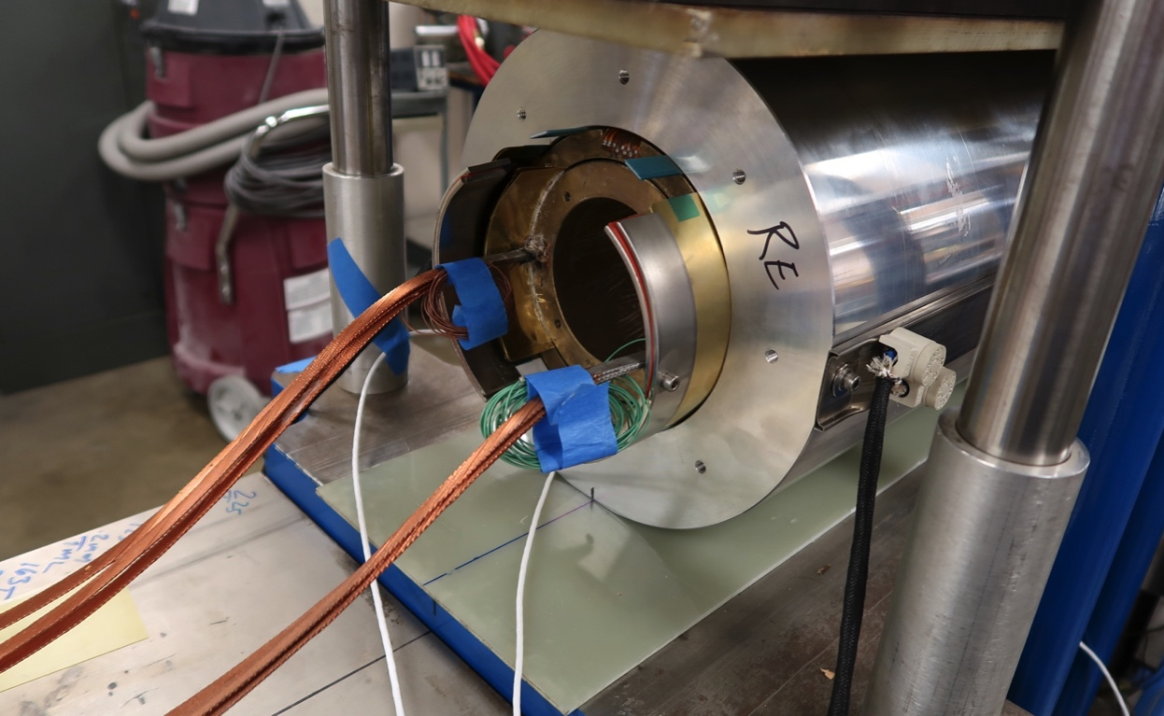
Bend and Shim Assembly Process
Bend and shim assembly process was performed after coil impregnation
CTD 528 epoxy was used due to cryogenic toughness, sufficiently long working life, and near room temperature cure
CCT Layers after Filling and Curing of Epoxy Filled Kapton Bag
Shell and Coils in Press After Epoxy Cure
Notes:
CTD 528 was cured at 45 degrees C for 24 hours

Slide 15
Conclusions
New assembly process for CCT magnets has been developed with goal to reduce training due to layer-to-layer interfaces
Method for epoxy impregnation of individual CCT layers has been developed
  Minimal tooling
  Scalable to longer lengths
Methods have been applied for CCT5, the next magnet in CCT 2-layer series at LBNL

