Slide 1


Dimensional measurements Nb₃Sn coils after impregnation
Salvador Ferradas Troitino (CIEMAT & CERN / TE-MSC-MDT)
Michela Semeraro (CERN / TE-MSC-LMF)
Alejandro Carlon Zurita (CERN / TE-MSC-SCD)
Jose Ferradas Troitino (UNIGE & CERN / TE-MSC-MDT)
Paris-11 October 2018

Slide 2
Dimensional measurements review
Outline
Equipment
Methodology
Results
Annex: Backup slides

Slide 3
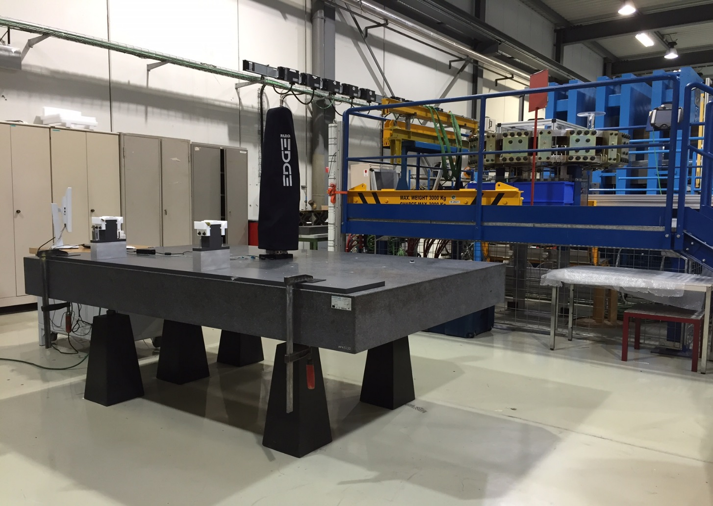
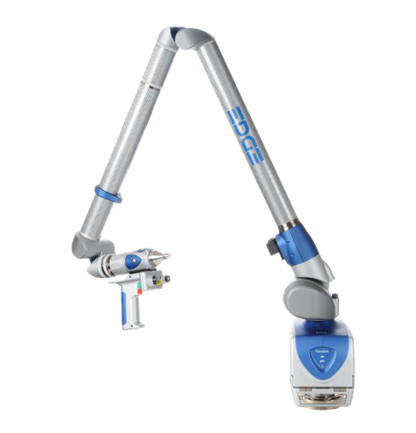
Equipment: CMM and Software
CMM Portable device: Faro Arm Edge 2.7
  Faro Arm Edge 2.7 volumetric accuracy: ± 41μm
  Faro Arm Edge 2.7 repeatability: 29 μm
Polyworks Inspection Software 2016 IR21.1 & 2017 IR6.1 & 2018 IR3.1
The CMM is sent to maintenance and is calibrated once a year
Technical datasheet: http://www.b3-d.com/files/96731539.pdf

Slide 4
Equipment: Marble & Tooling
Coils clamped using a specially designed support
Dedicated area for metrology inside the workshop
  Marble @ short coils (2.5 m x 1.5 m) Class 0
  Marble @ long coils (10 m x 1.2 m)
Arm fixed to the table.
Parts of the support are aligned and screwed to the marble before operations

Slide 5
General Procedure
Coil clamping
Data acquisition
Analysis

Slide 6
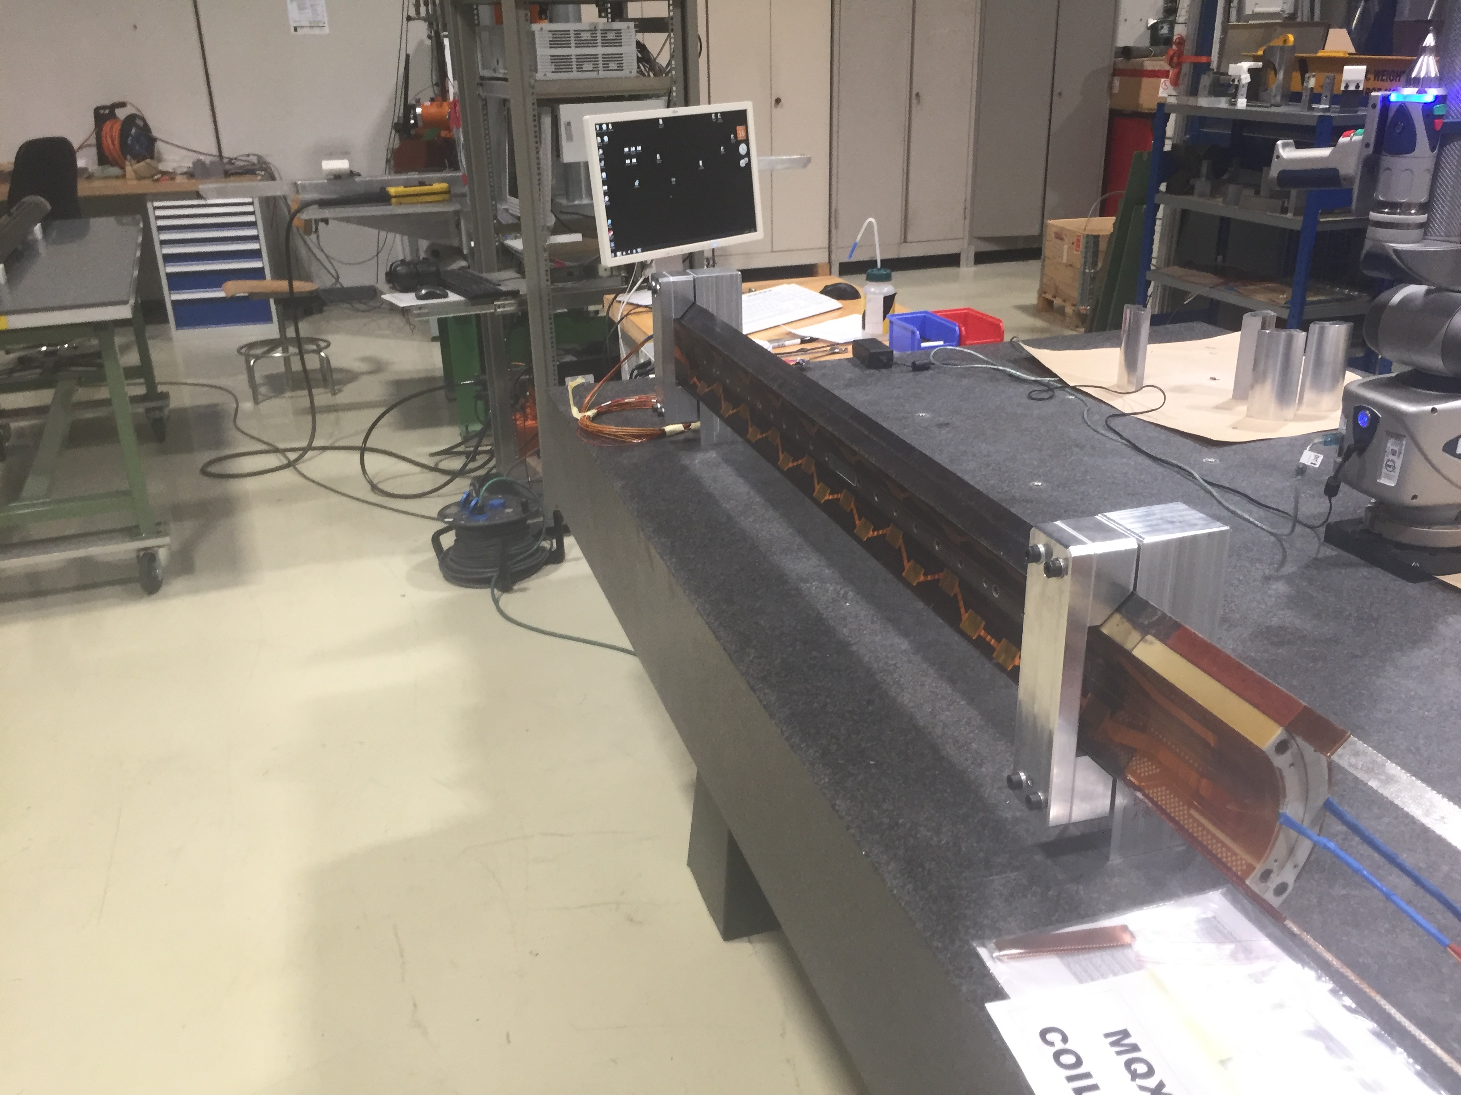
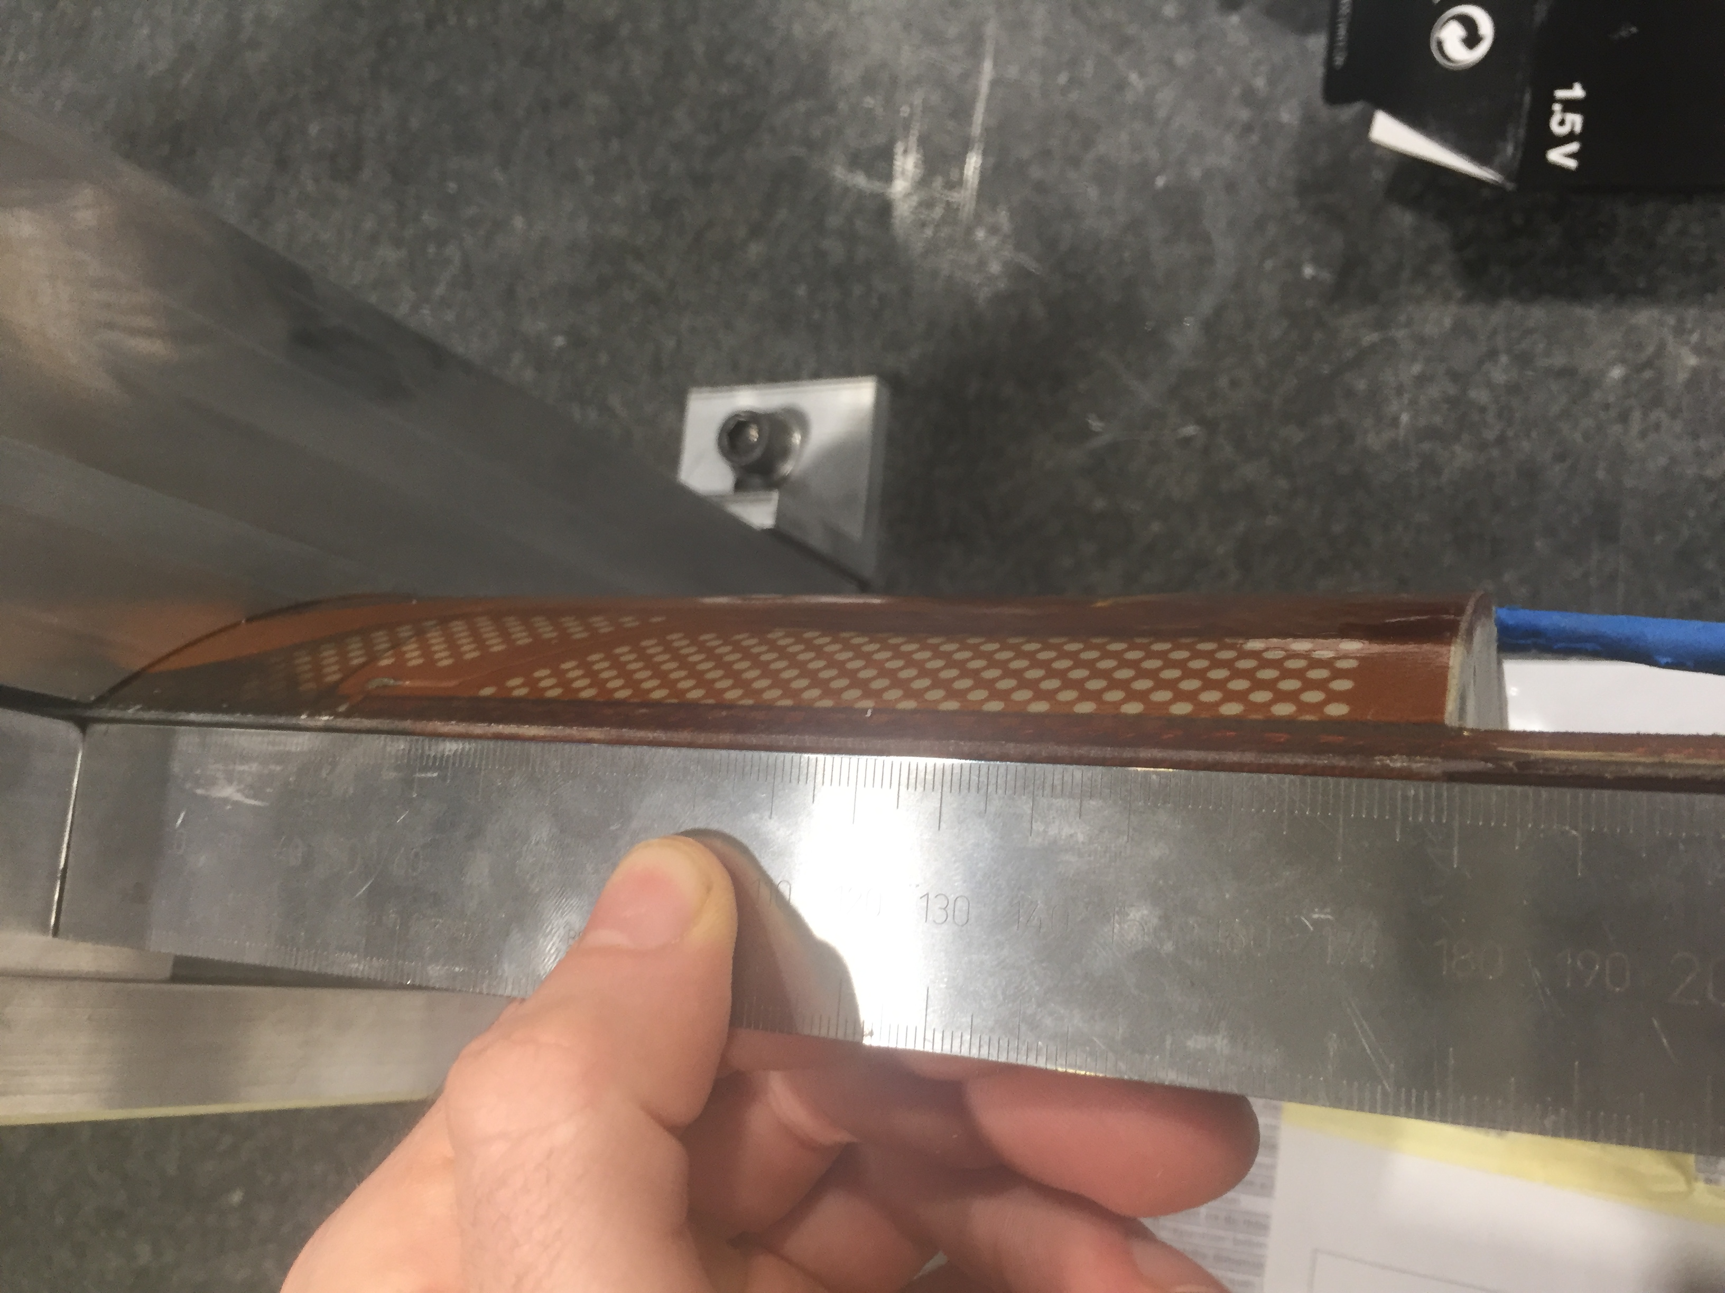
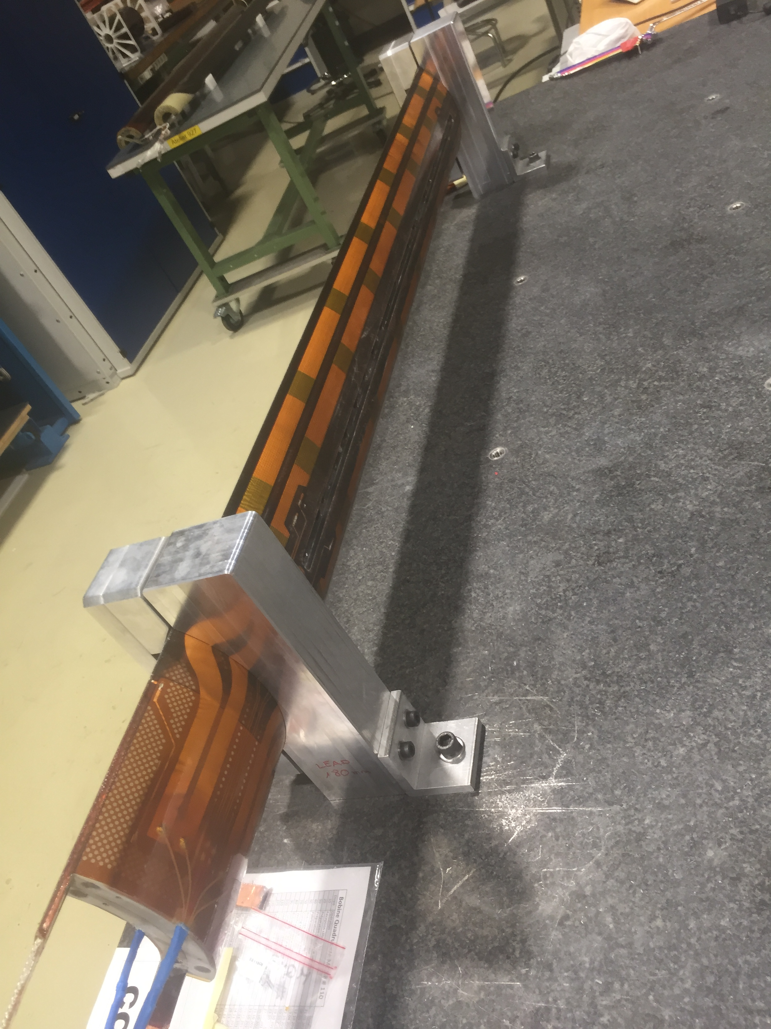
Procedure
Coil clamping (I/IV): MQXFS
Rubber pads
Distance between supports : 1200 mm
Distance between lead end and support : 180 mm

Slide 7
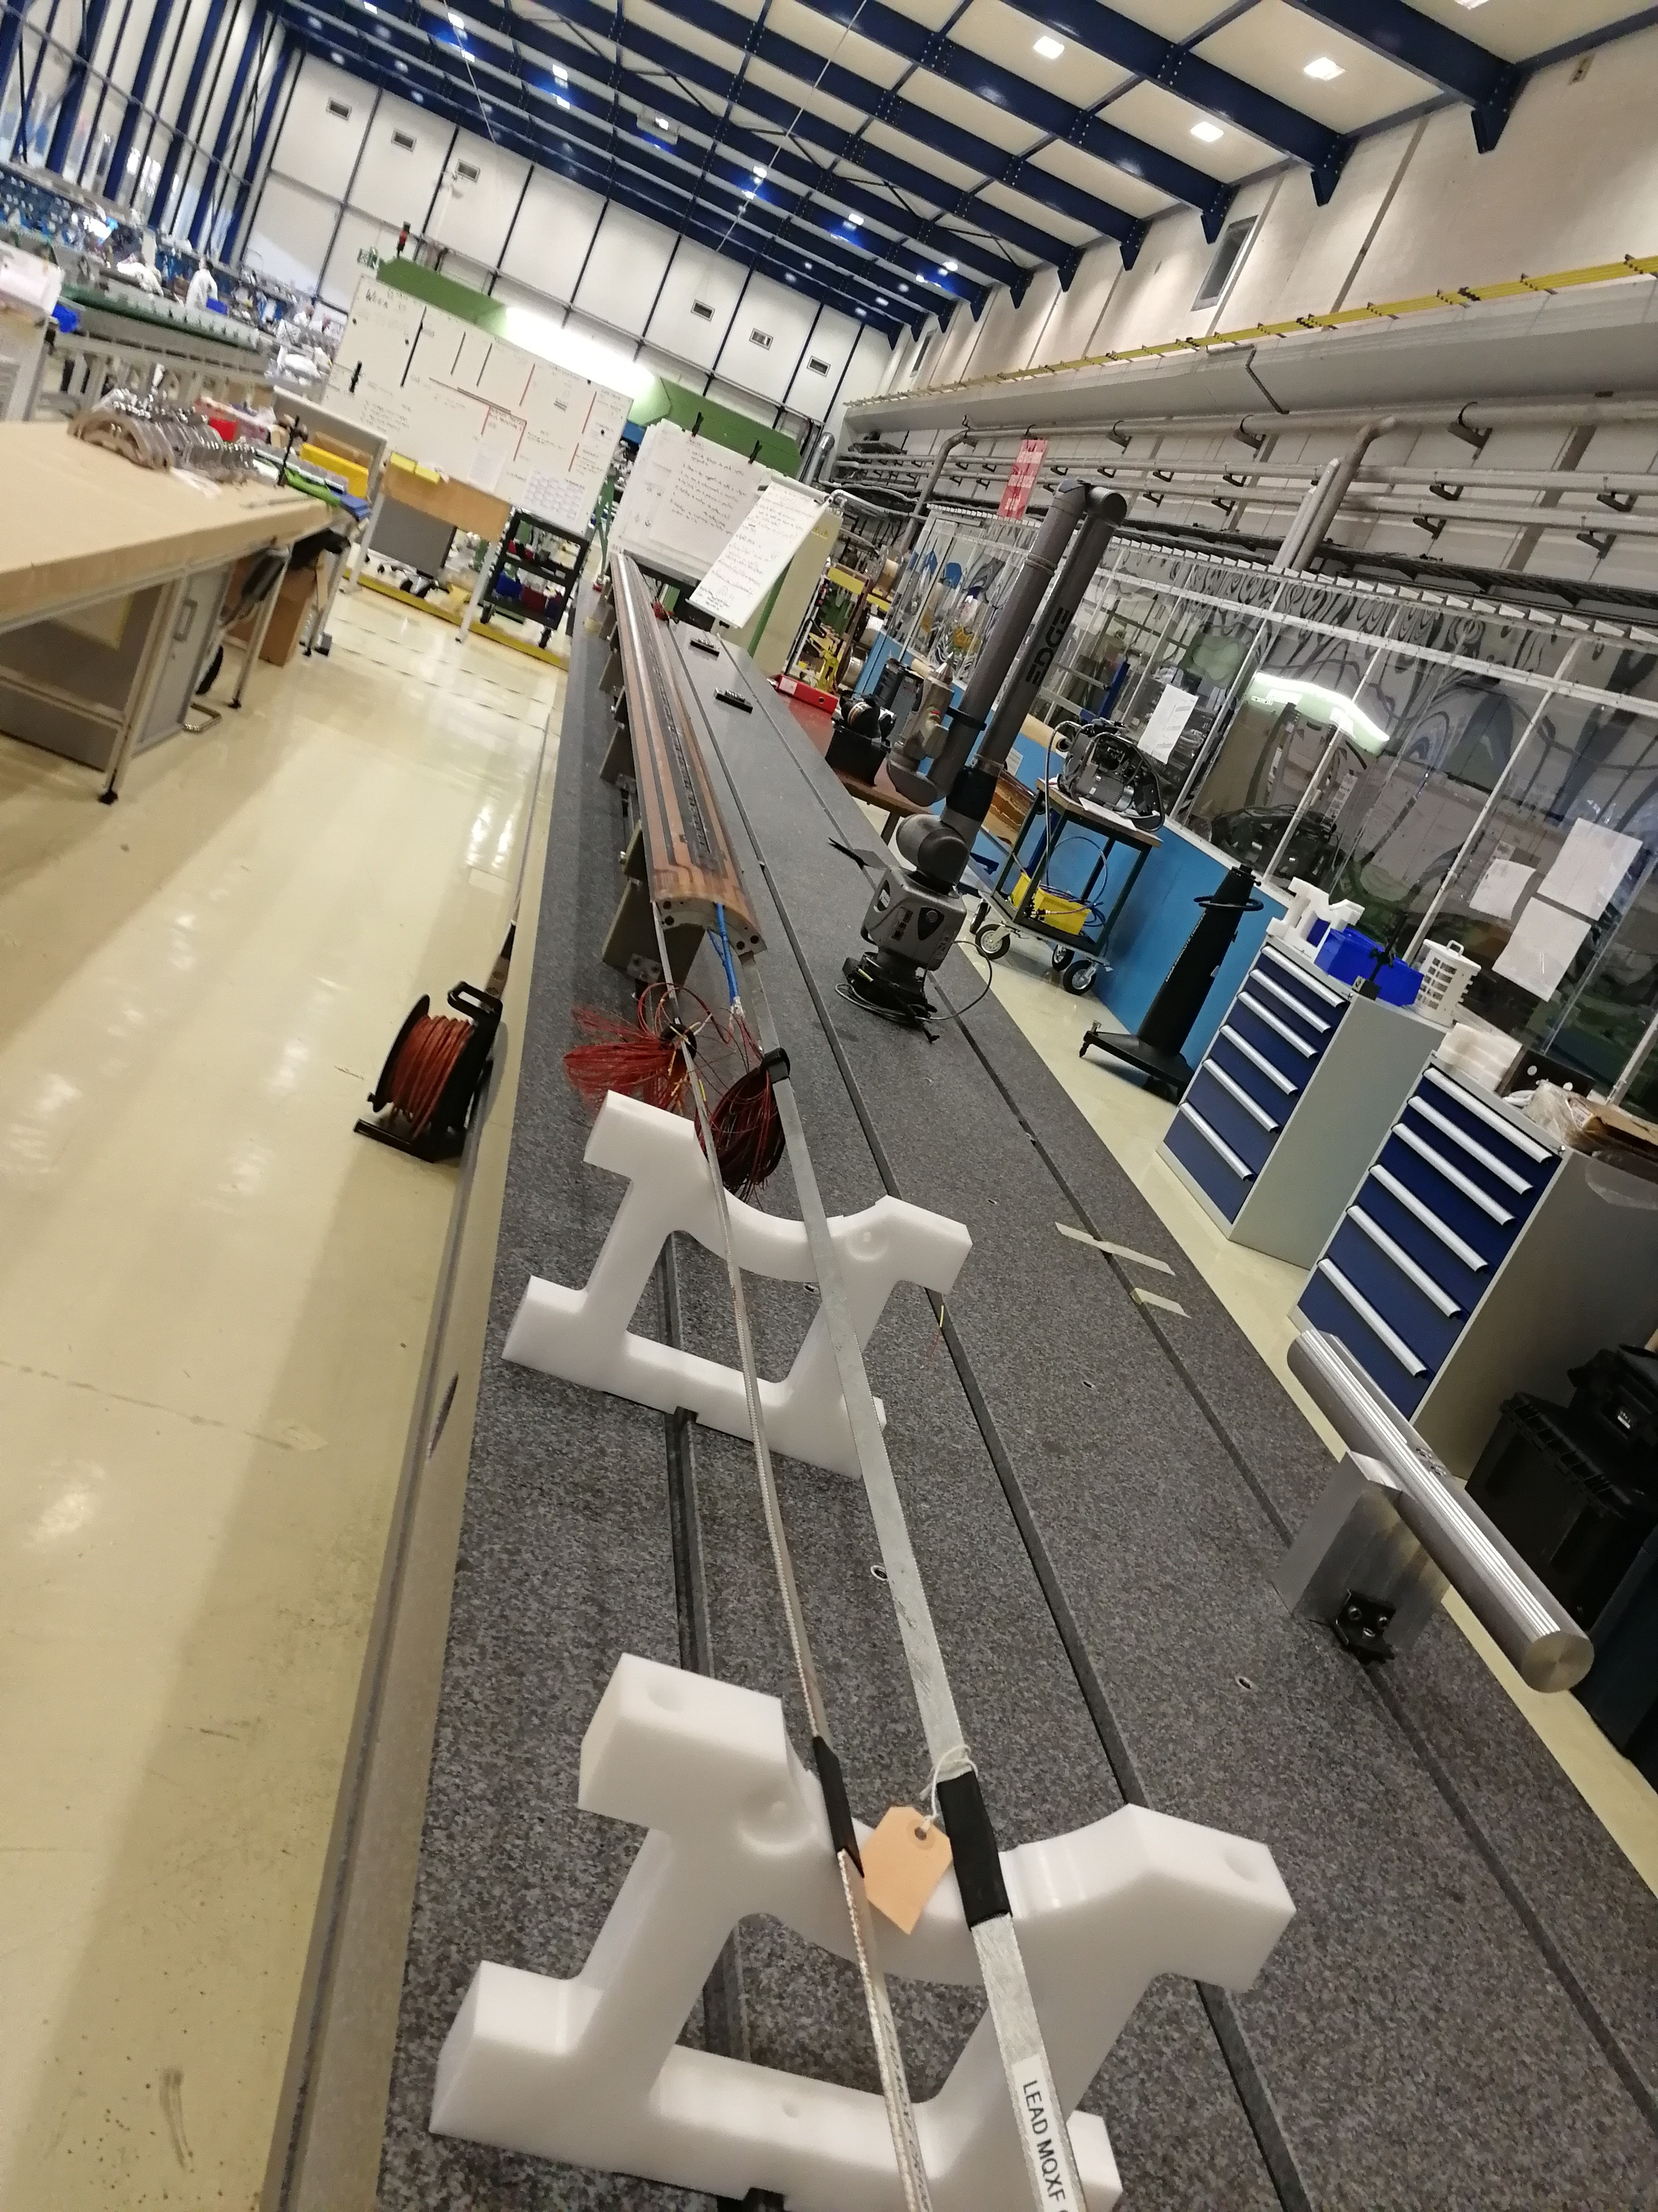
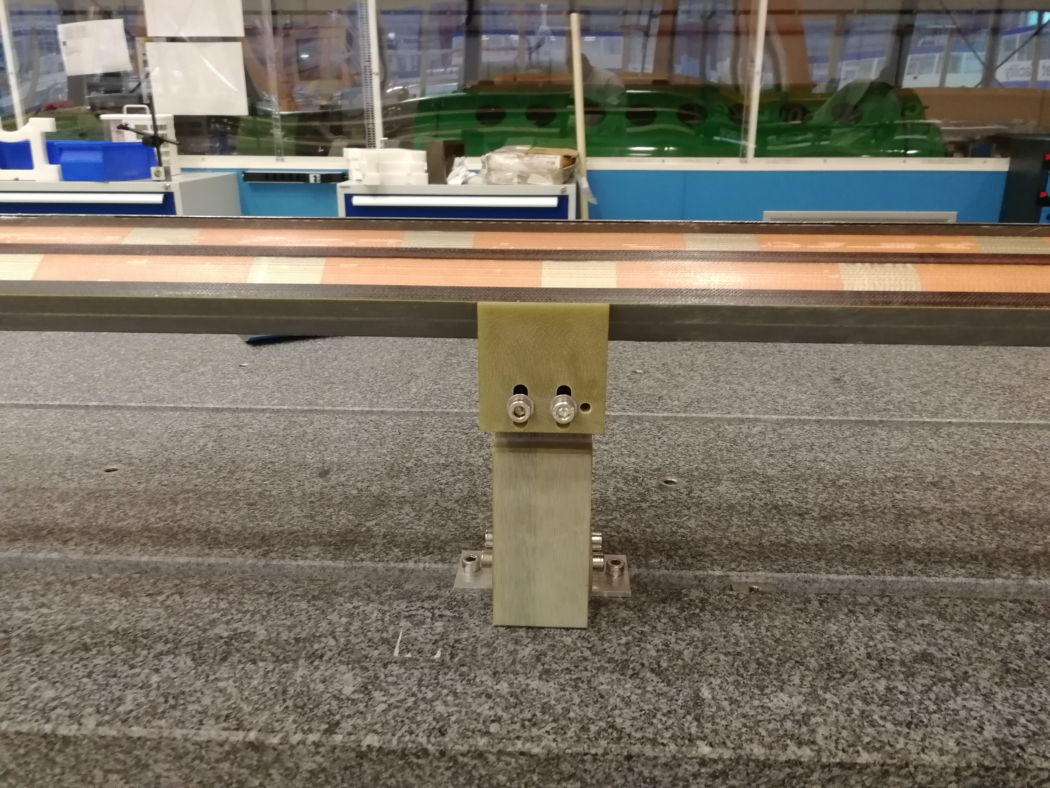
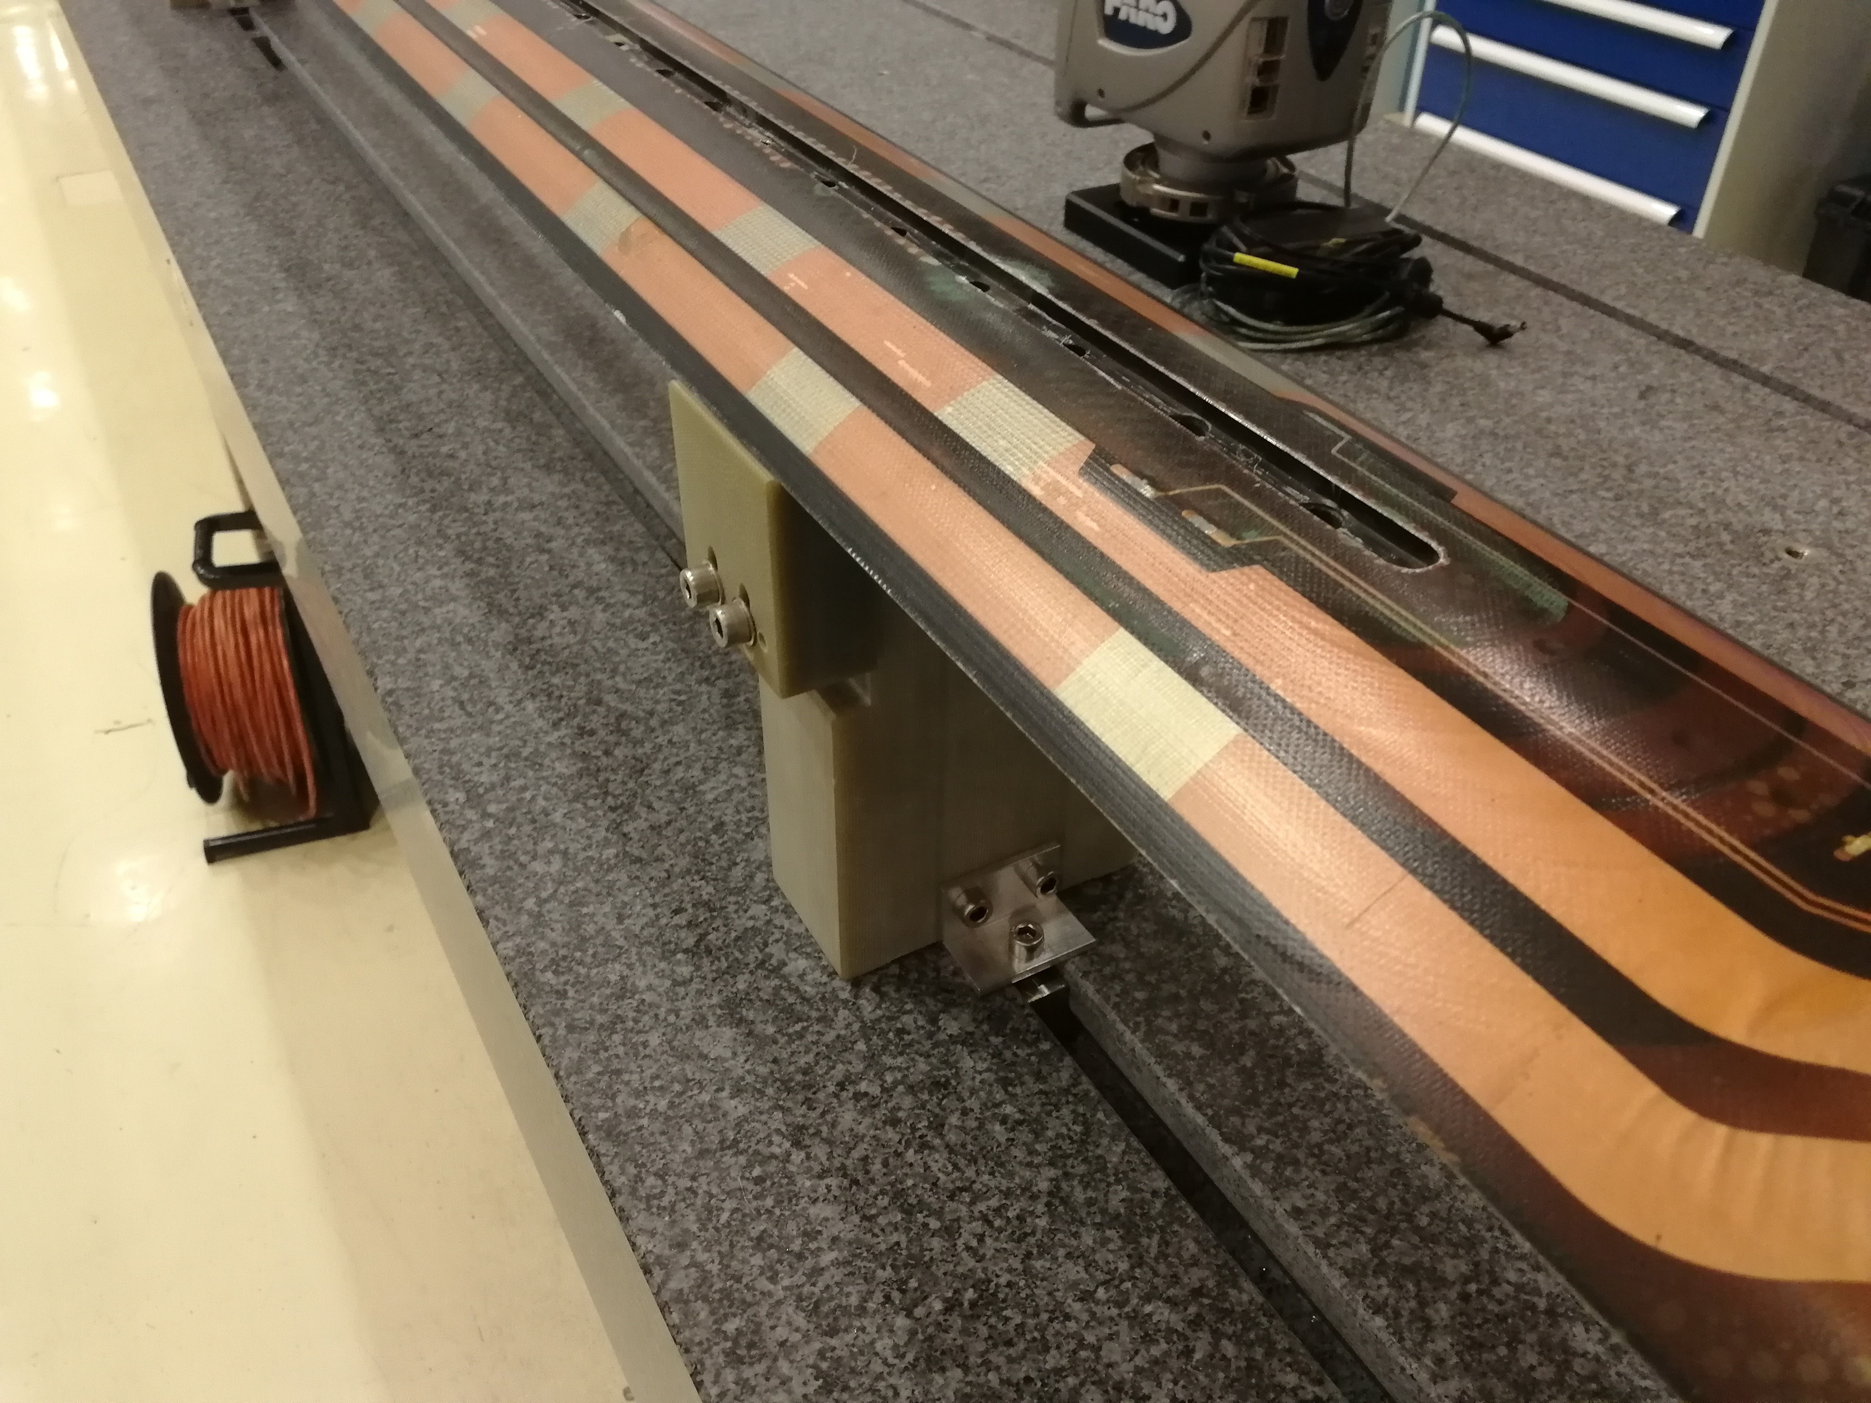
Procedure
Coil clamping (II/IV): MQXFB
Distance between supports : ~1400 mm
Distance between lead end and support : 250 mm

Slide 8
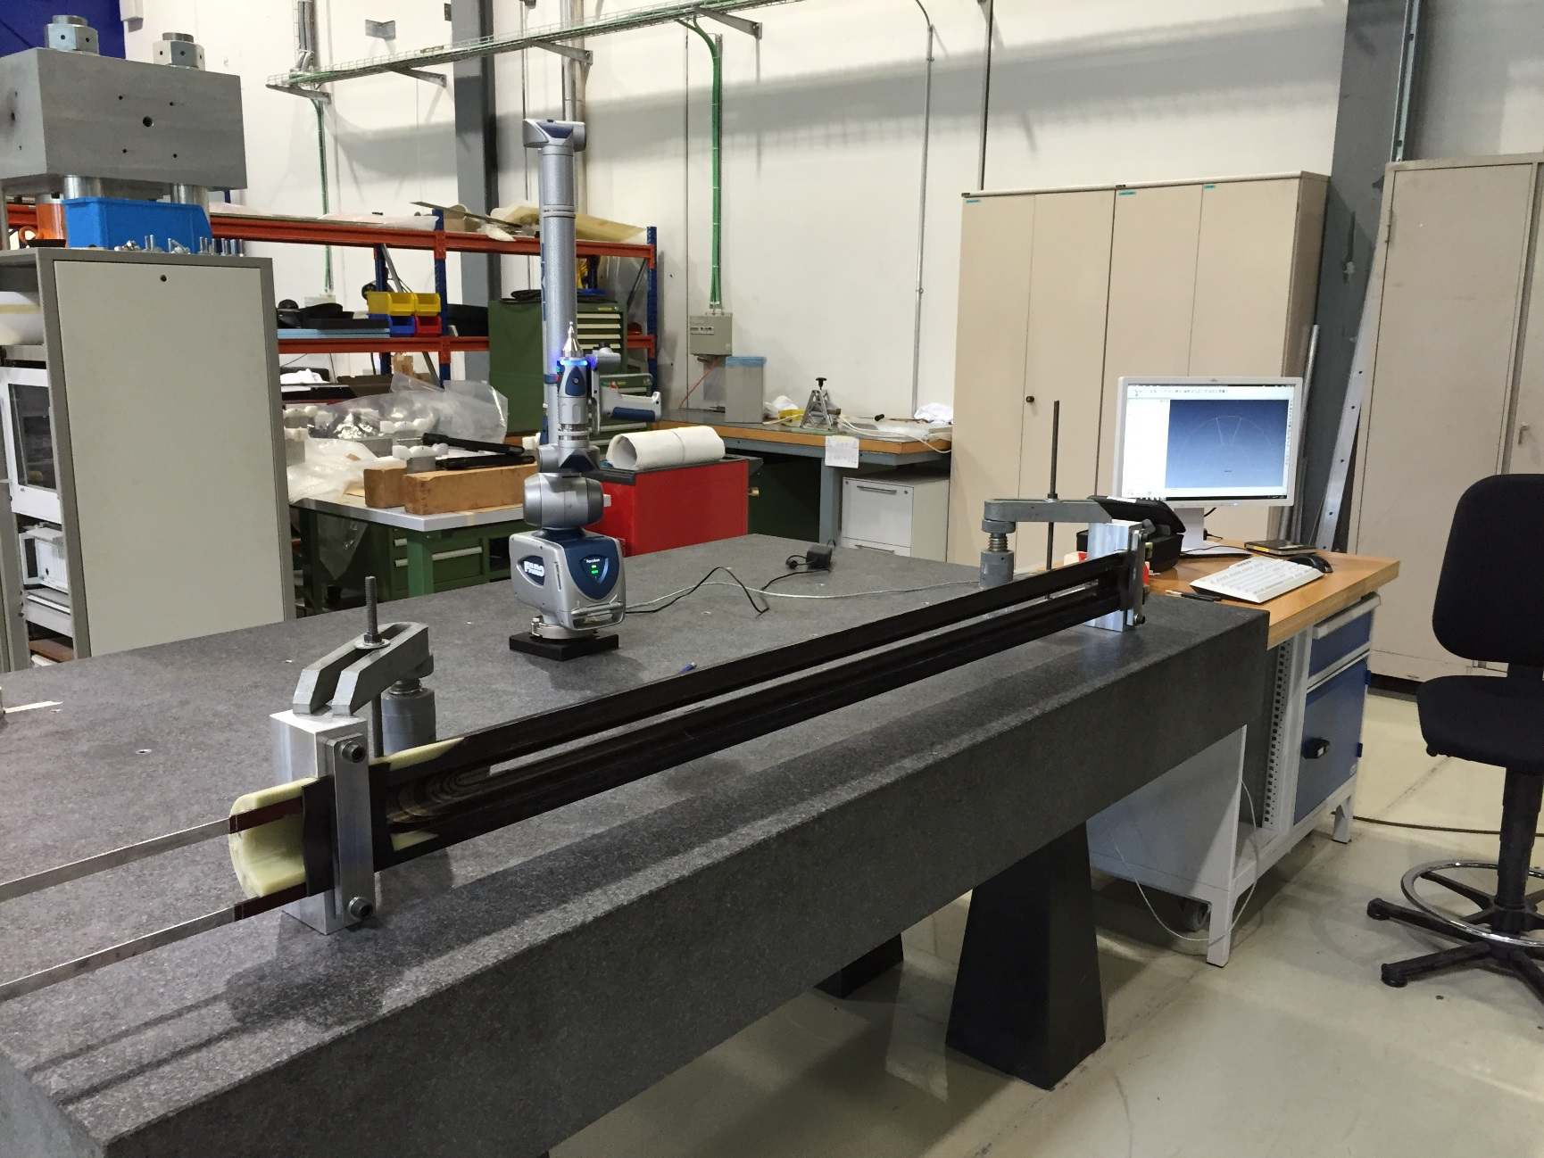
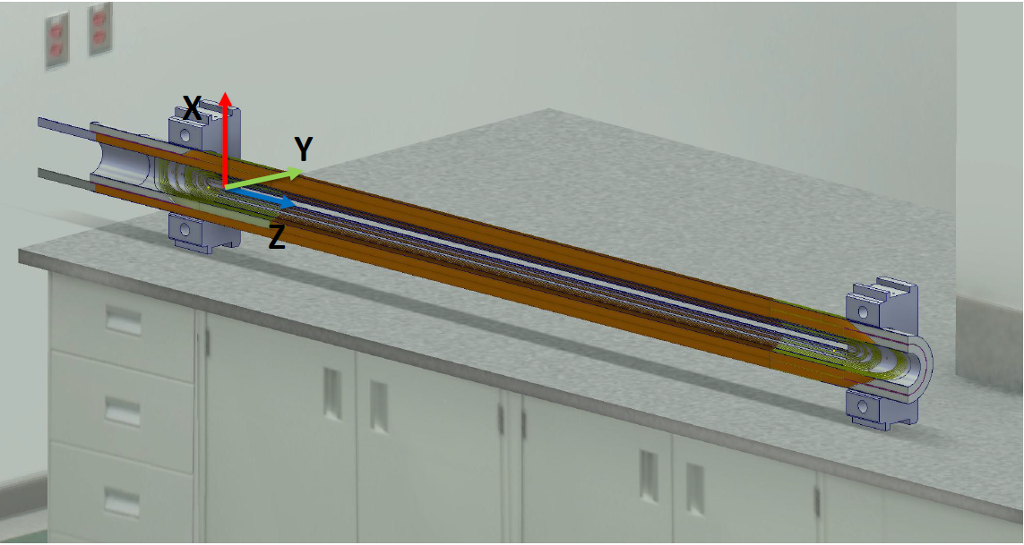
Procedure
Coil clamping (III/IV): DS 11T
Rubber pads
Distance between supports : 1500 mm
Distance between lead end and support : 120 mm
Notes:
The 11T dipole has to branches that we consider separately.

Slide 9
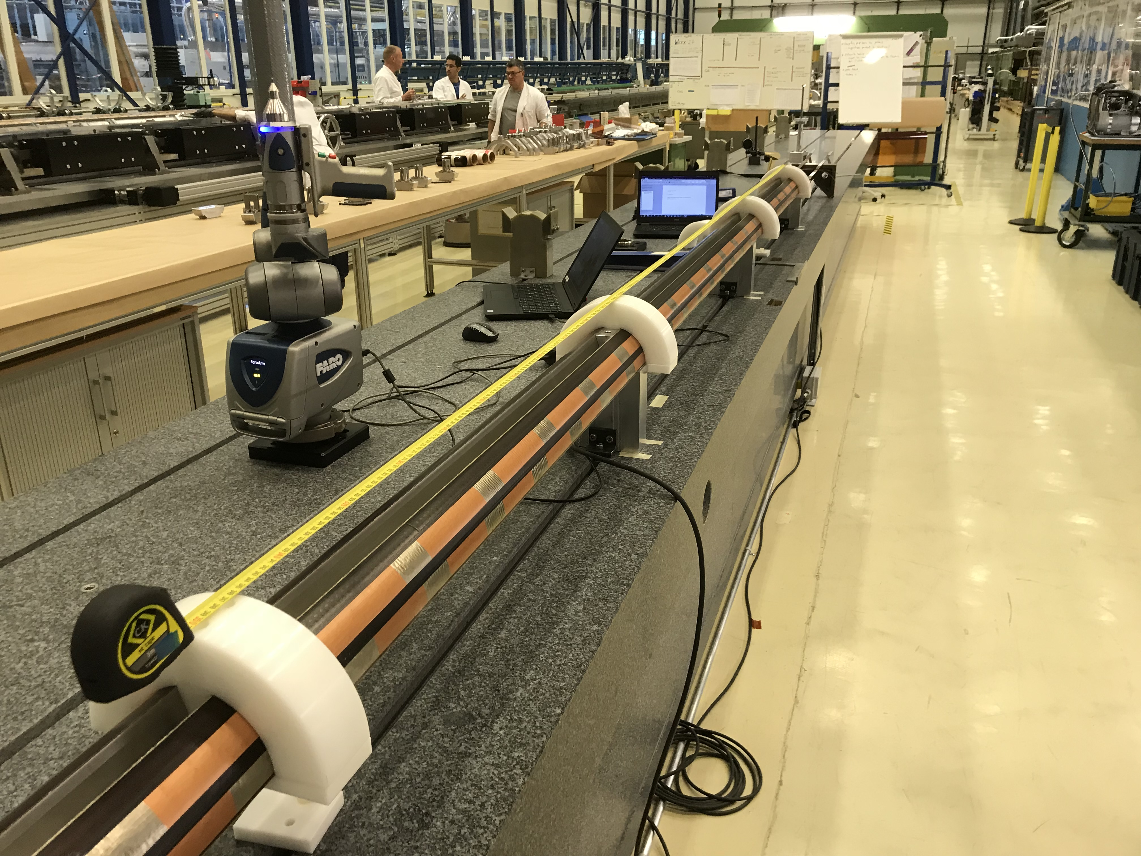
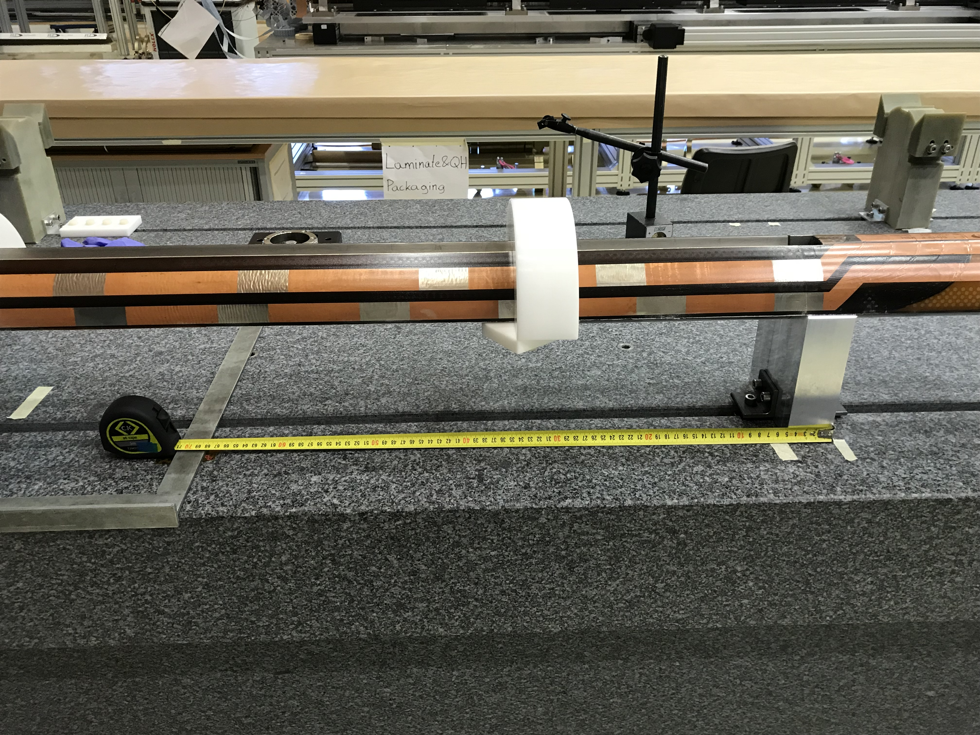
Procedure
Coil clamping (IV/IV): D 11T
Distance between supports : ~1000 mm

Slide 10
Procedure
Data acquisition (I/II)
Device compensation (already warmed-up)
Device validation
Pre-alignment
General geometry probing
Best fit alignment to precisely determine the position of the cross sections
Usual results:
Hole compensation 2-sigma: Below 10μm
Calibrated pieces:
Deviation below 8μm
Cross section probing
¹Compensation
The process by which a measurement device is optimized to perform accurate measurements. This may be done through mechanical adjustments, as well as software corrections. Although the FaroArm is factory compensated, you have the ability to change probes and individually compensate each probe after mounting to the FaroArm. This process determines the centre of the probe tip relative to the arm coordinate system.
The value reported by 2 sigma is twice the standard deviation of all the points taken while performing the compensation. 2 Sigma is used to determine whether the arm passes or fails.
¹Calibration
The process by which one proves that a device is performing within factory specification. After calibration, a certificate is issued to authenticate the process, thus the use of the term certification.
¹https://knowledge.faro.com/Hardware/FaroArm_and_ScanArm/Gage/Compensation_and_Calibration_Standards_for_the_FaroArm_and_Gage
Notes:
Specialists at the FARO production facility perform the factory compensation. Using patented proprietary hardware and software, the true dimensions and kinematics of the FaroArm are determined. The results of this factory process are stored in the arm. The FaroArm is permanently compensated, such that it does not require periodic mechanical adjustments or software corrections during normal operation in the field, unless mechanical or electrical damage occurs.
Although the FaroArm is factory compensated, you have the ability to change probes and individually compensate each probe after mounting to the FaroArm. This process determines the center of the probe tip relative to the arm coordinate system.

Slide 11
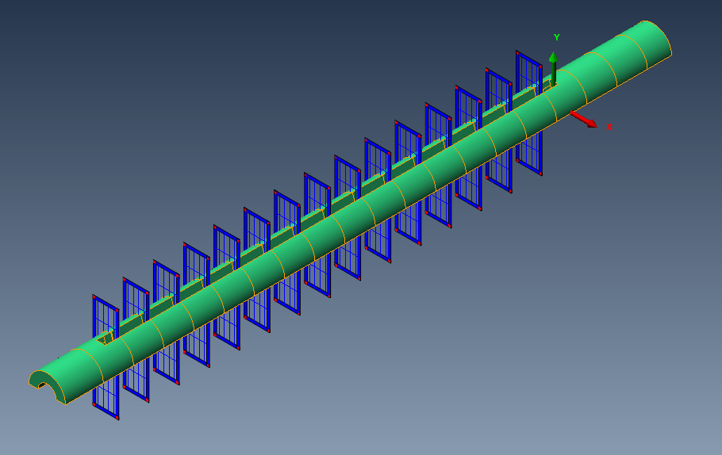
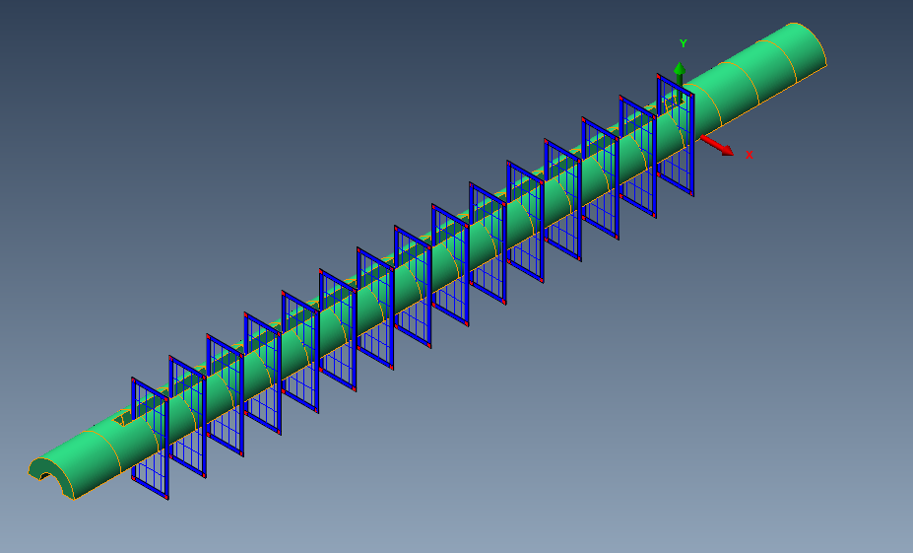
Procedure
Data acquisition (II/II)
MQXFS
11 Cross sections. The straight section is probed each 6 inches.
MQXFB
33 Cross sections. The straight section is probed each 200mm
11T 2m
15 Cross sections. Probed each 100mm. The two branches are independent.
11T 5.5m
33 cross sections. Probed each 150mm. The two branches are independent.

Slide 12
Procedure
Post-processing (Polyworks) (I/IV)
Normal vectors extraction
Each CS is aligned individually
Aligned point cloud is exported as .TXT
.TXT point cloud is imported as separate data
Results
Point cloud clean-up

Slide 13
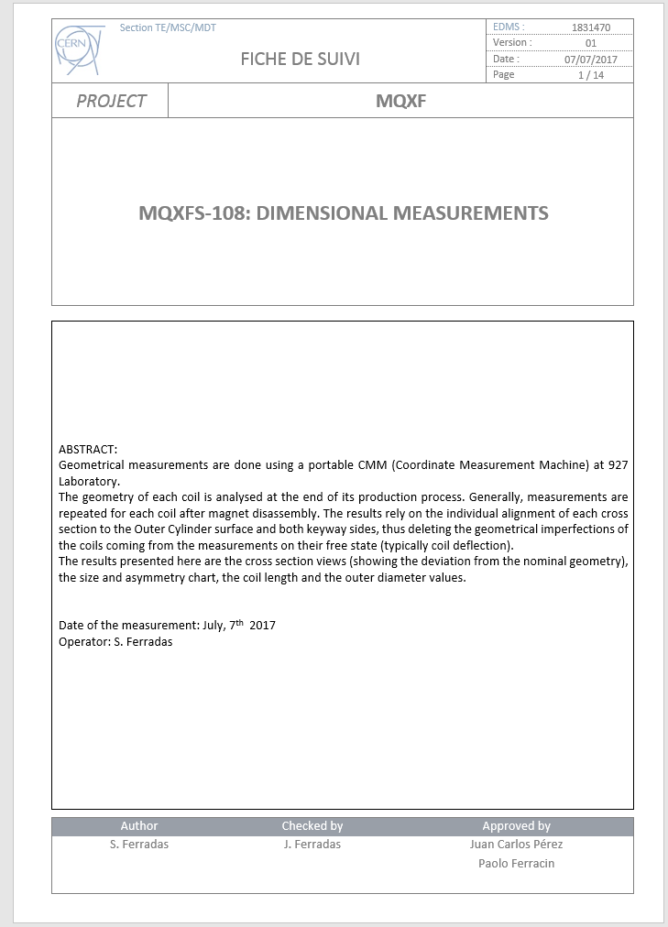
Procedure
Post-processing (II/IV)
Coil azimuthal size and asymmetry
Coil length
Coil width
Outer diameter of each cross section
Inner diameter of each cross section
Results

Slide 14
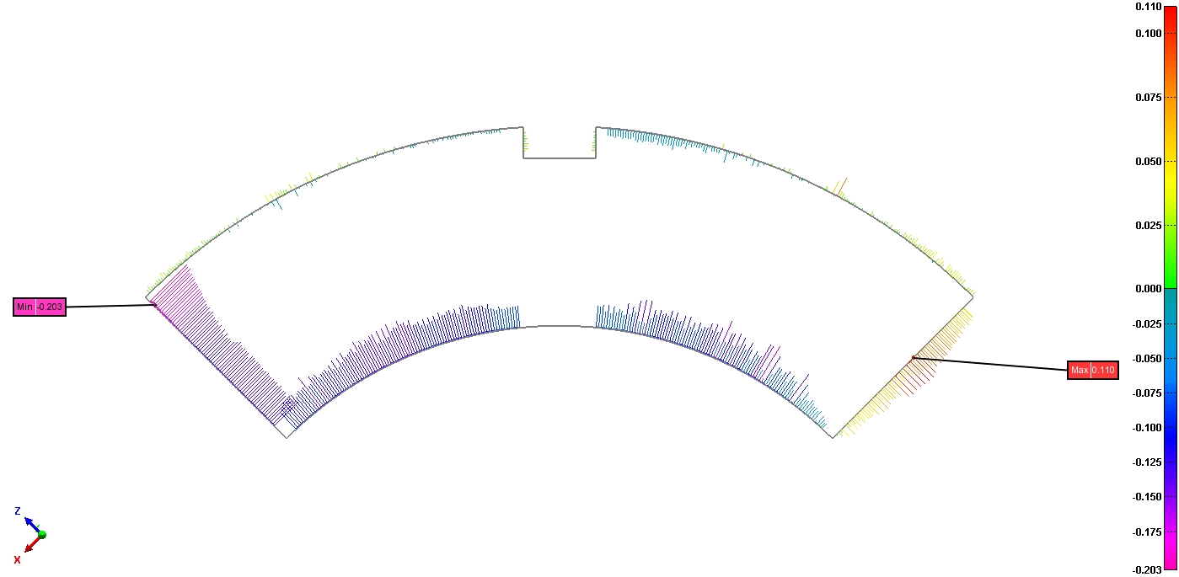

Procedure
Post-processing (III/IV)
MQXF Coil azimuthal size and asymmetry
$$dev right=avg\left(signed_abs(deviation left wo outliers)\right)$$
$dev left=avg(signed_abs(deviation right wo outliers))$
$coil azimuthal size=dev left+dev right$
$coil asymmetry=dev left−dev right$
Only results from cross sections along the keyway are used because these values depend on the alignment
Sample results:
Deviation vectors left
Deviation vectors right

Slide 15
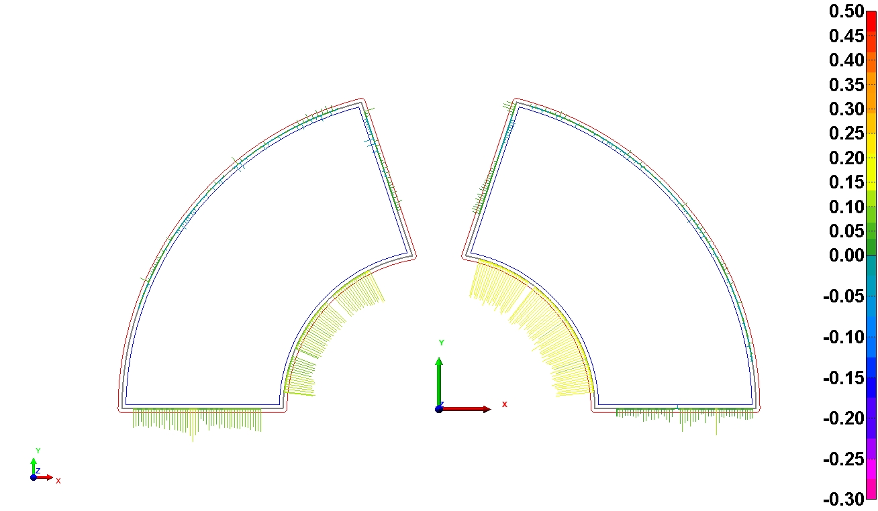
Procedure
Post-processing (IV/IV)
11T Coil azimuthal size and asymmetry
$$dev right=avg\left(signed_abs(deviation left wo outliers)\right)$$
$dev left=avg(signed_abs(deviation right wo outliers))$
$coil azimuthal size=dev left+dev right$
$coil asymmetry=dev left−dev right$
Only results from cross sections along the loading plate are used
Sample results:
Deviation vectors left
Deviation vectors right

Slide 16
Results:
Production plots

Slide 17
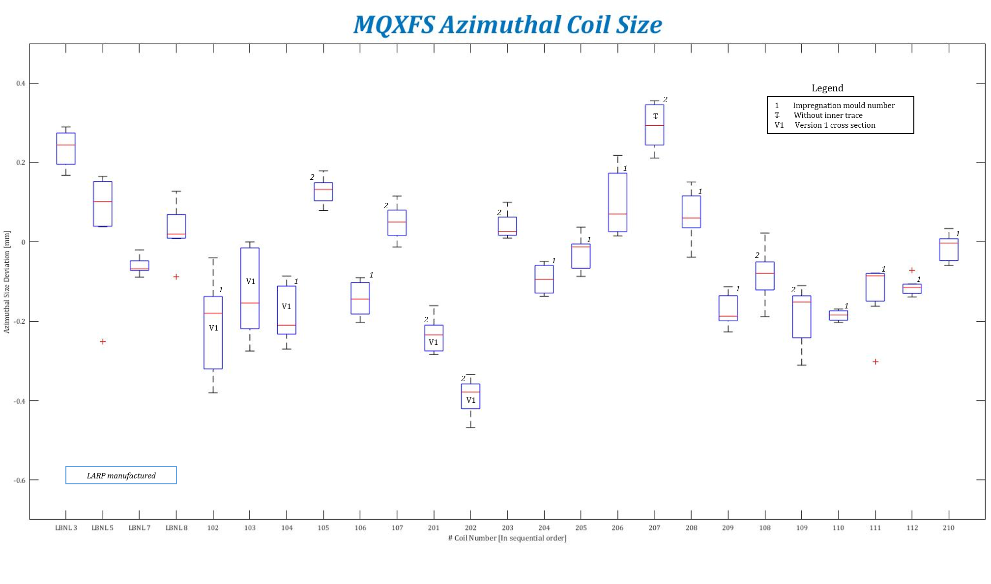

Slide 18
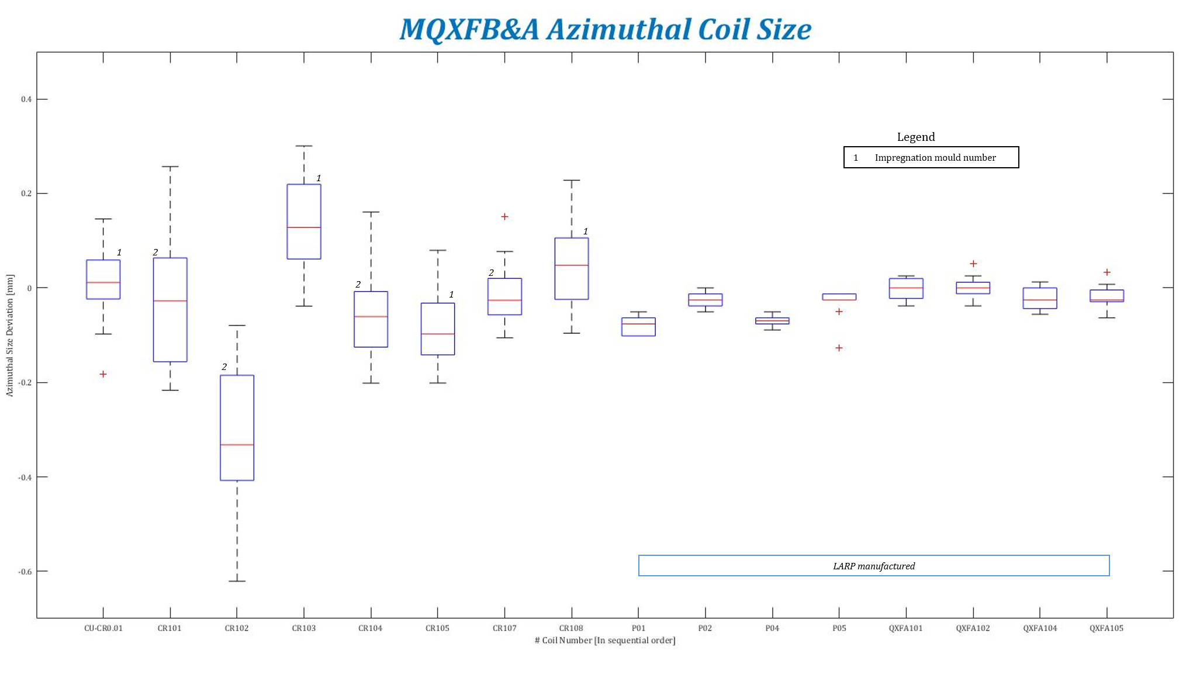

Slide 19
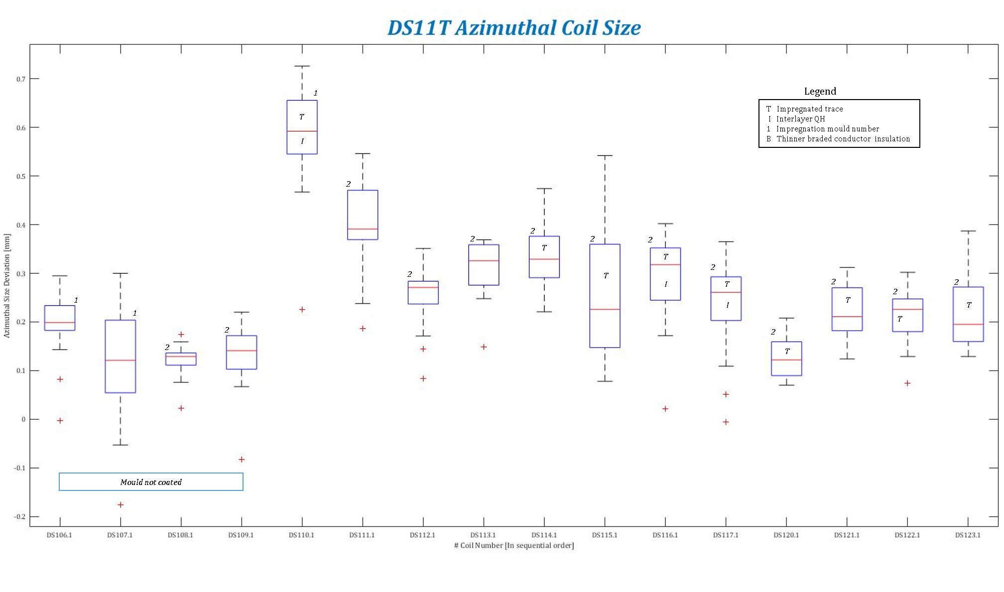

Slide 20
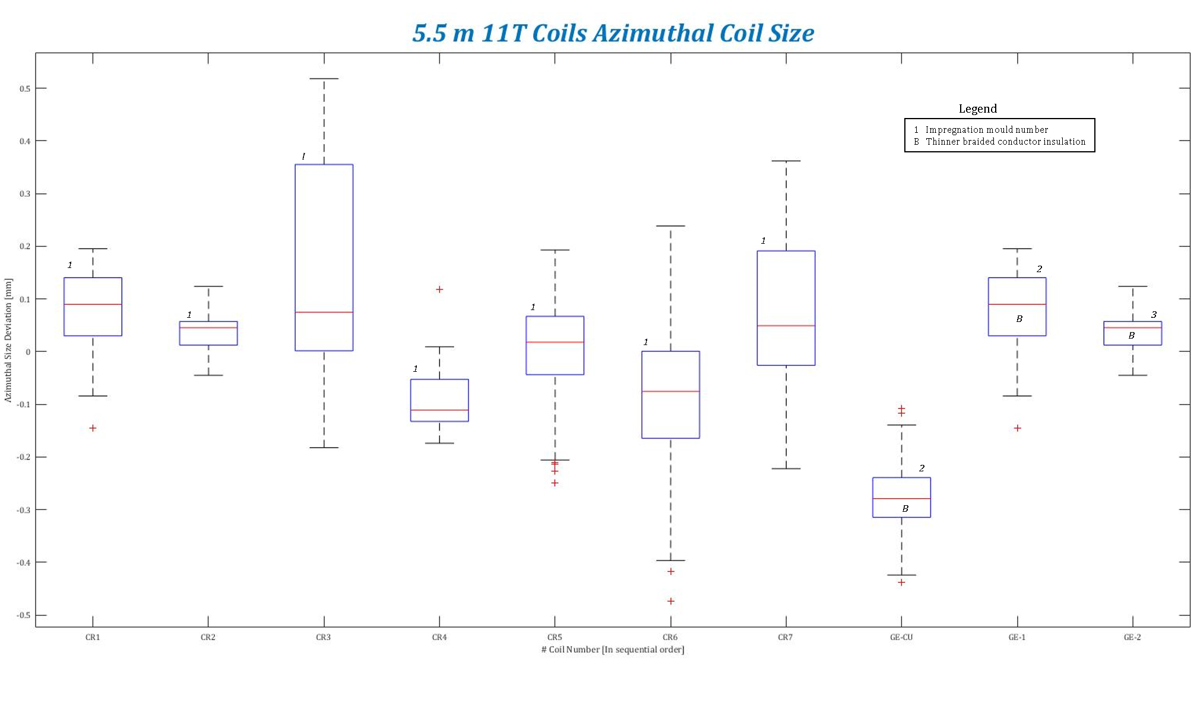

Slide 21
MEASUREMENTS REVIEW
Annex:
Backup slides

Slide 22
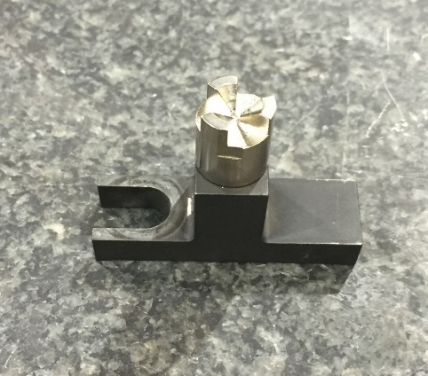
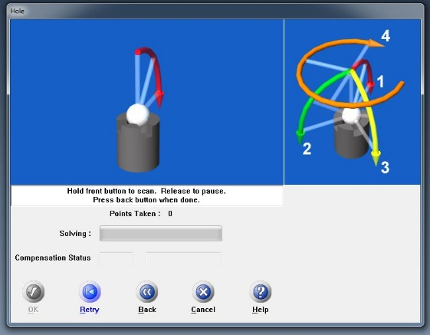
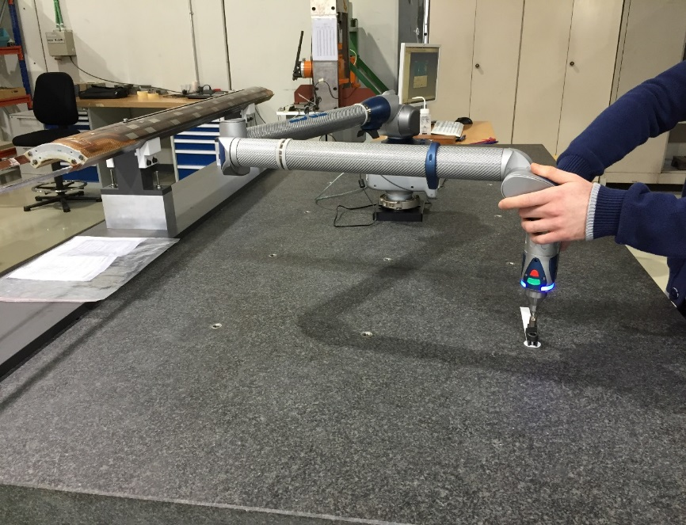
Procedure: Measurements
Device compensation
Performed following FARO hardware calibration procedures:
  Hole compensation method (600 points)

Slide 23
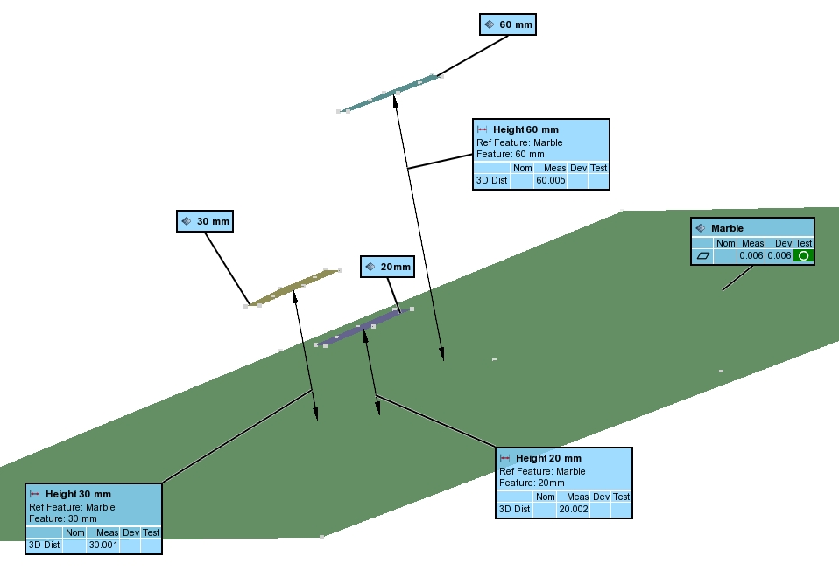
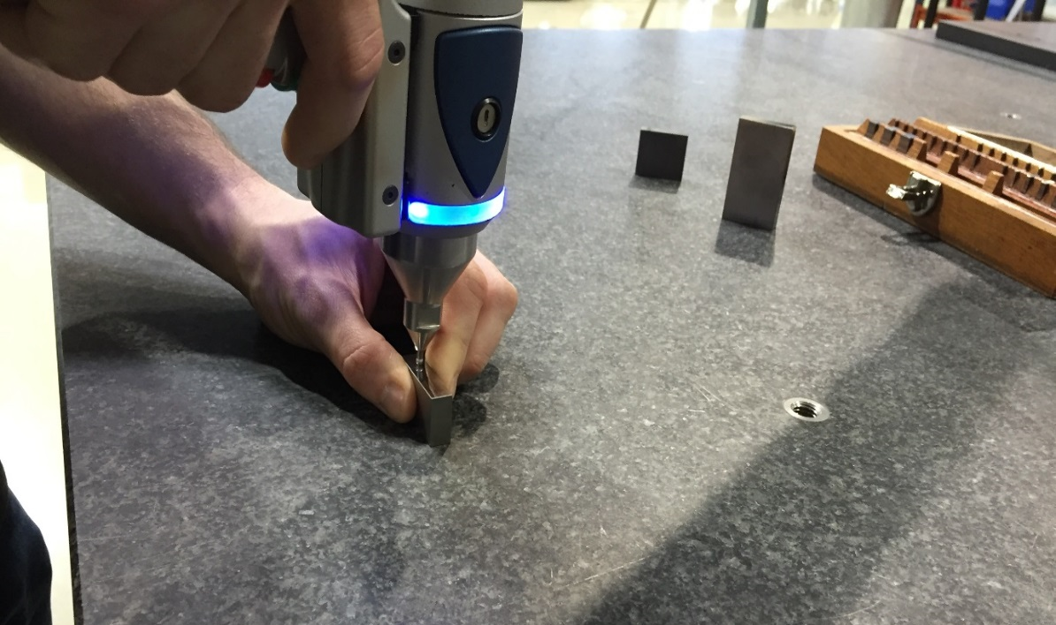
Procedure: Measurements
Device validation

Slide 24
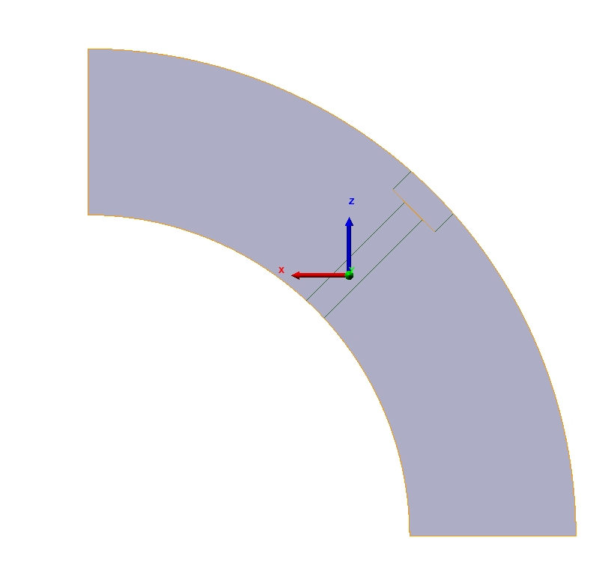
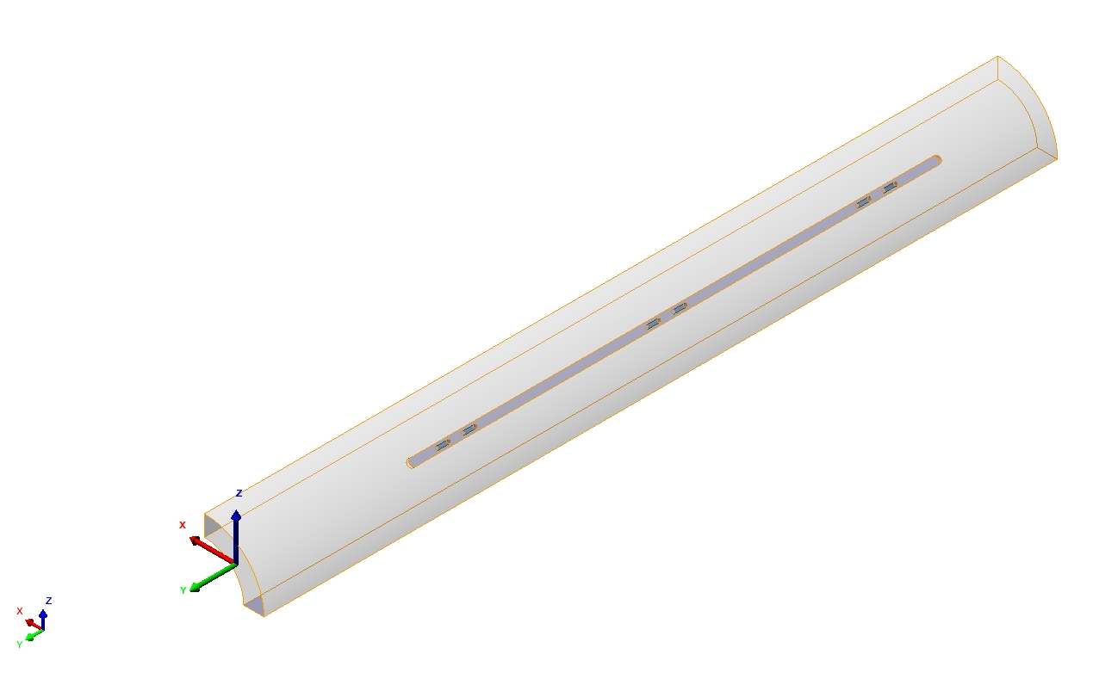
Procedure: Measurements
Reference system (MQXF Quadrupole)

Slide 25
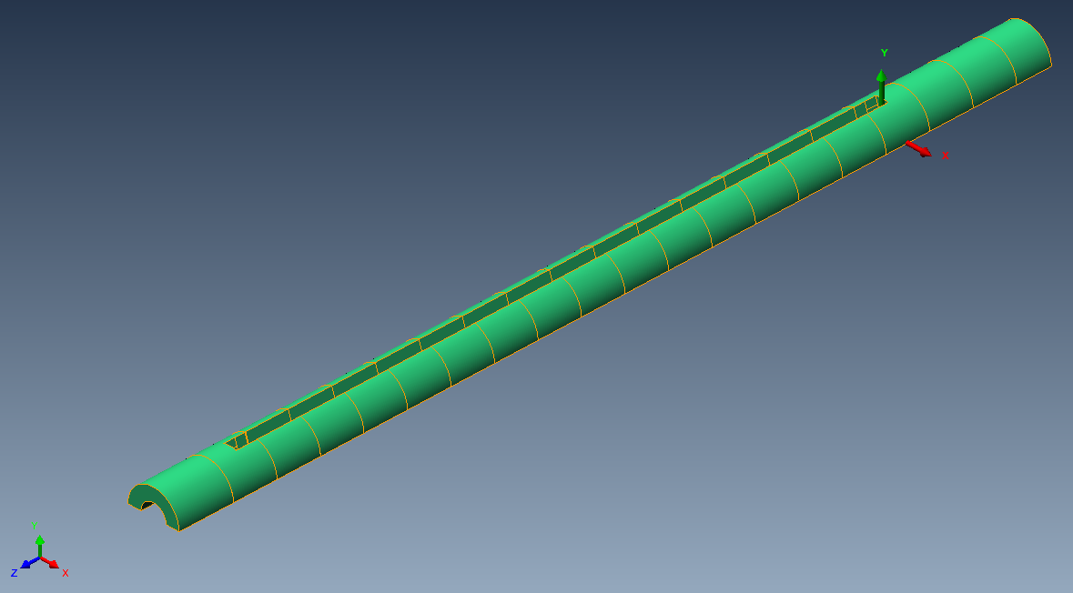
Procedure: Measurements
Reference system (11T dipole)

Slide 26
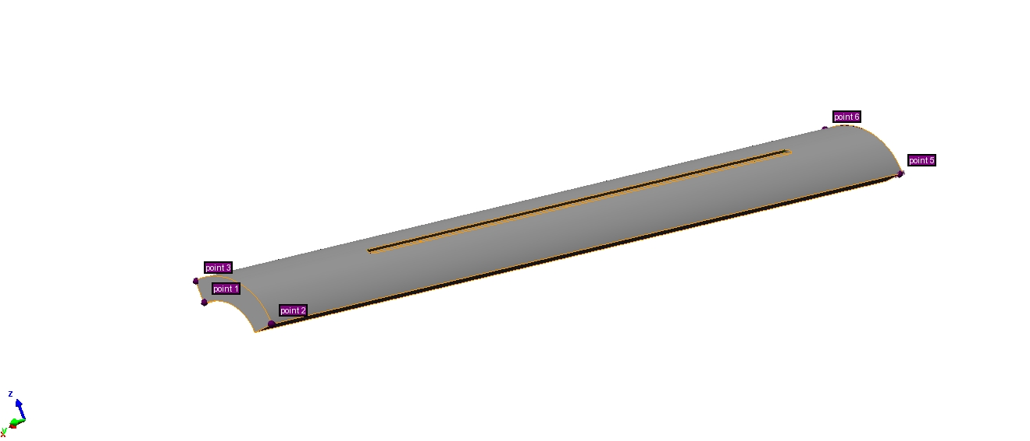
Procedure: Measurements
Pre-alignment
Starting point: Pre-alignment of real coil to CAD model
  Using 6 “Surface point alignment”
  6 points are defined in the CAD model, operator must probe the same 6 points in real coil
  For improving reproducibility, singular points are chosen (Corners, edges…)

Slide 27
Procedure: Measurements
Best fit alignment (MQXF) (1/3)
After the general geometry is probed, we perform a better alignment to precisely locate the cross sections
Best-fit alignment of real point cloud to CAD model is performed using:
  Lead end plane
  Outer cylinder
  Left key plane
  Right key plane
All degrees of freedom are fixed
Coil is aligned to Lead end in order to define the cross section distances

Slide 28
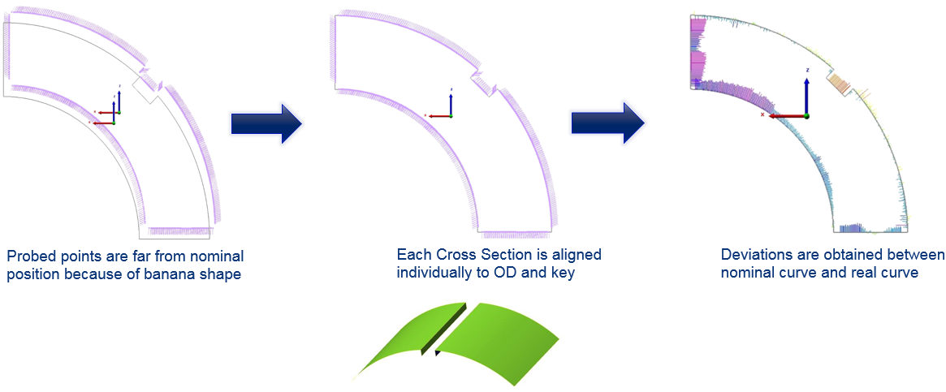
Procedure: Measurements
Best fit alignment (MQXF) Cross section alignment (2/3)
Example of cross section alignment

Slide 29
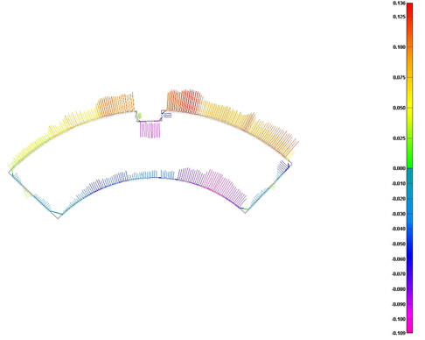
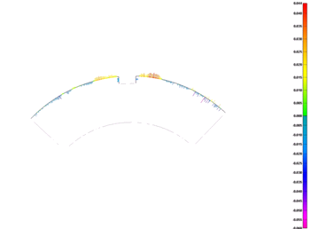
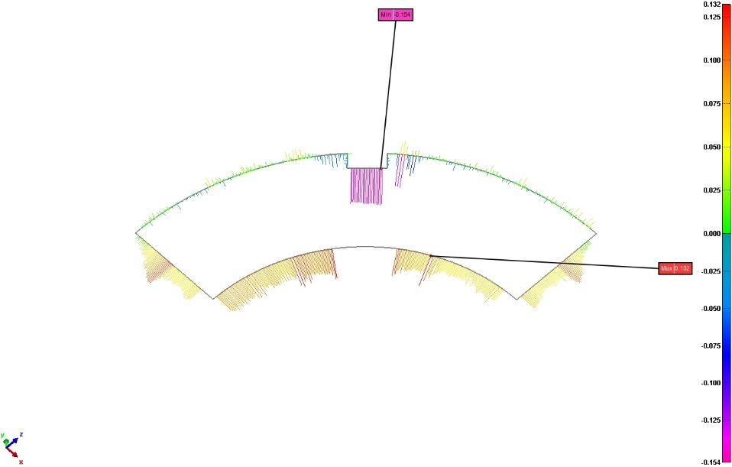
Procedure: Measurements
Best fit alignment (MQXF) Cross section alignment (3/3)
Example of cross section alignment
Resulting CS
Aligned points compared with full CAD
Original CS
Banana shape present
CS aligned using special CAD

Slide 30
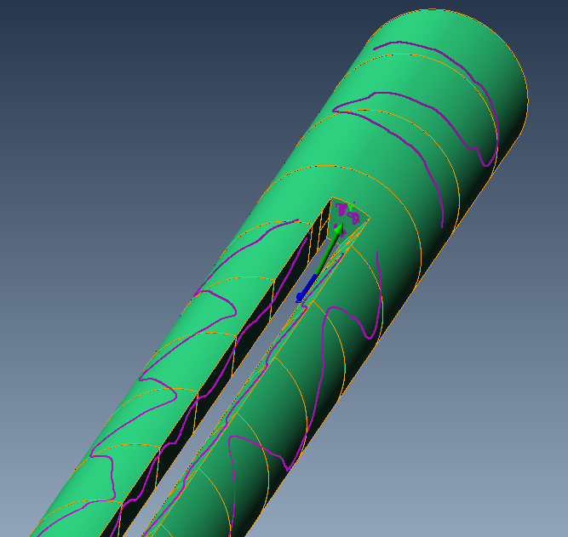
Procedure: Measurements
Best fit alignment (11T Dipole) (1/3)
After the general geometry is probed, we perform a better alignment to precisely locate the cross sections
Best-fit alignment of real point cloud to CAD model is performed using:
  Pole end Lead end
  Outer cylinder
  Left loading plate plane
  Right loading plate plane
Outer Diameter
Loading plate Right
Pole end lead end (where the reference system is)
Outer Diameter
Loading plate Left

Slide 31
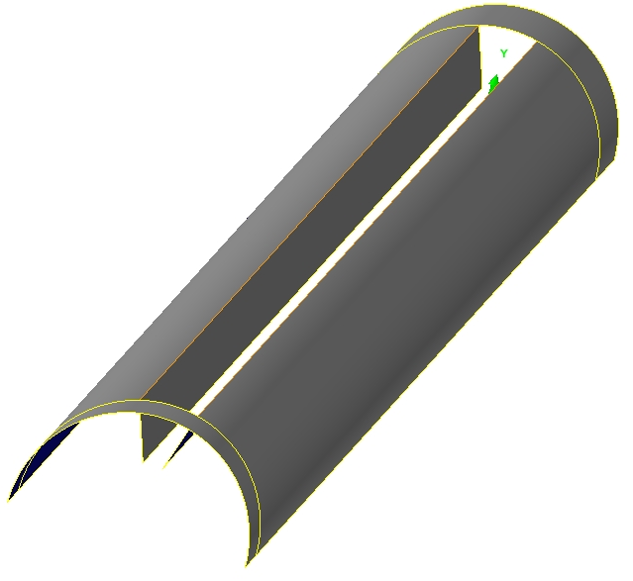
Procedure: Measurements
Best fit alignment (11T Dipole) (2/3)
After first part of the probing process, information is enough to perform a better alignment
Best-fit alignment of real point cloud to CAD model is performed using:
  Pole end Lead end
  Outer cylinder
  Left loading plate plane
  Right loading plate plane
Coil is aligned to Lead end in order to define the cross section distances

Slide 32
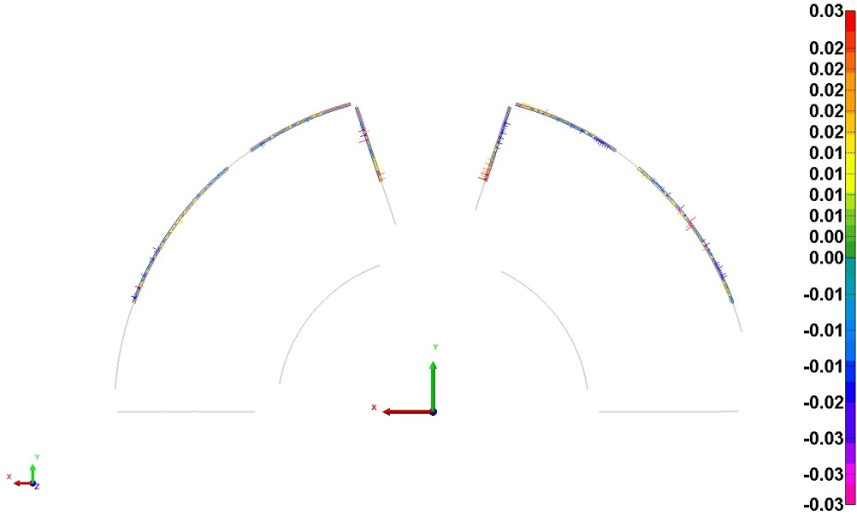
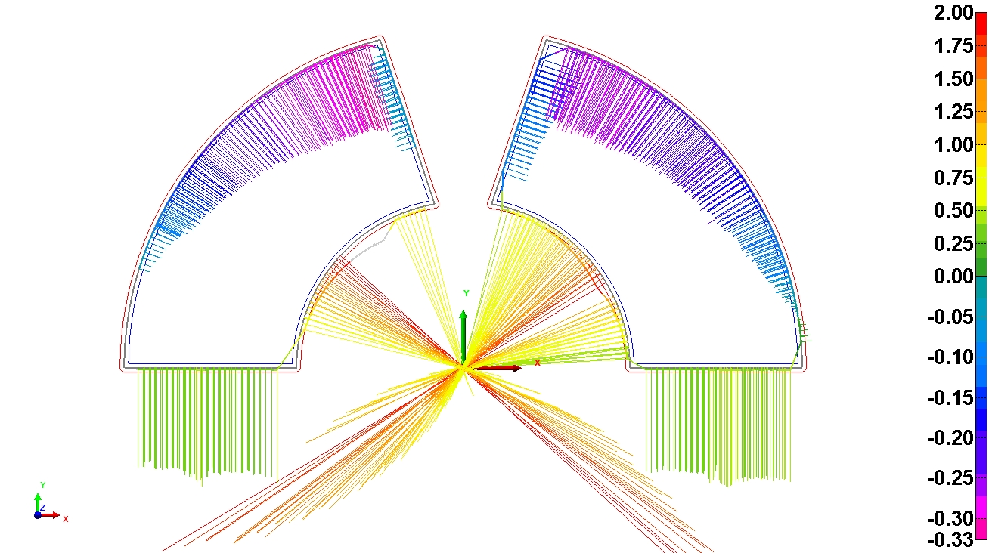
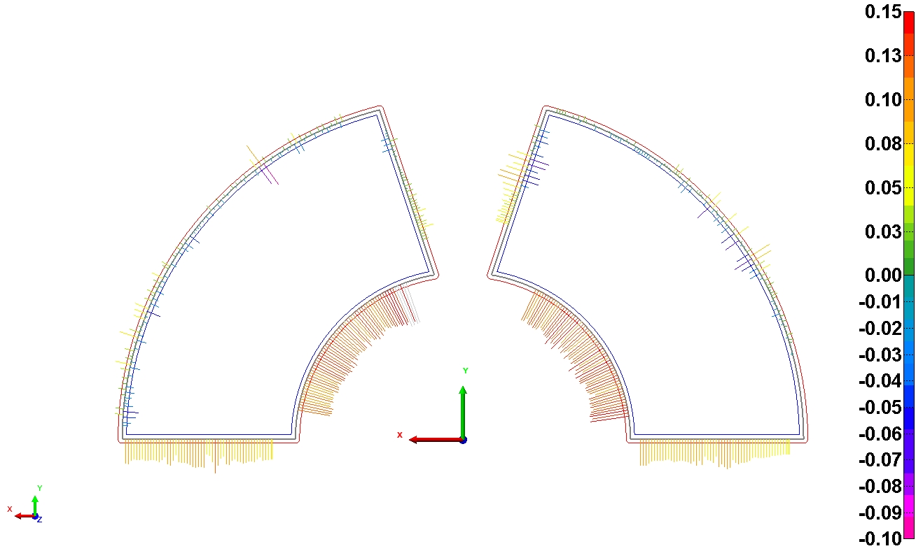
Procedure: Measurements
Best fit alignment (D11T Cross section alignment (1/3)
Example of cross section alignment
Final “CS
Aligned” points and deviation vectors to nominal
Original CS
Banana shape present
CS aligned using special CAD

Slide 33
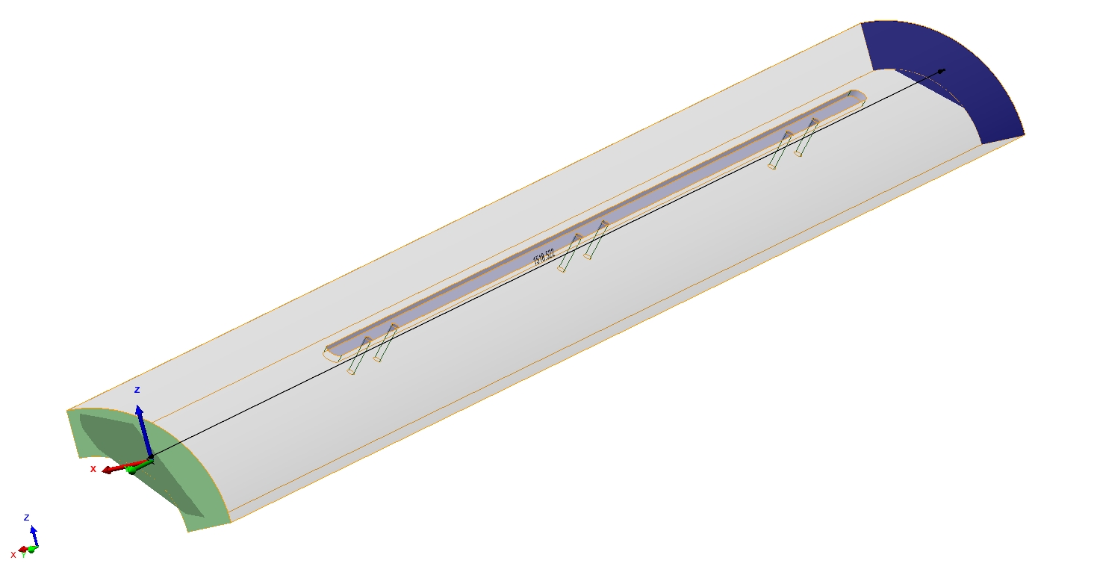
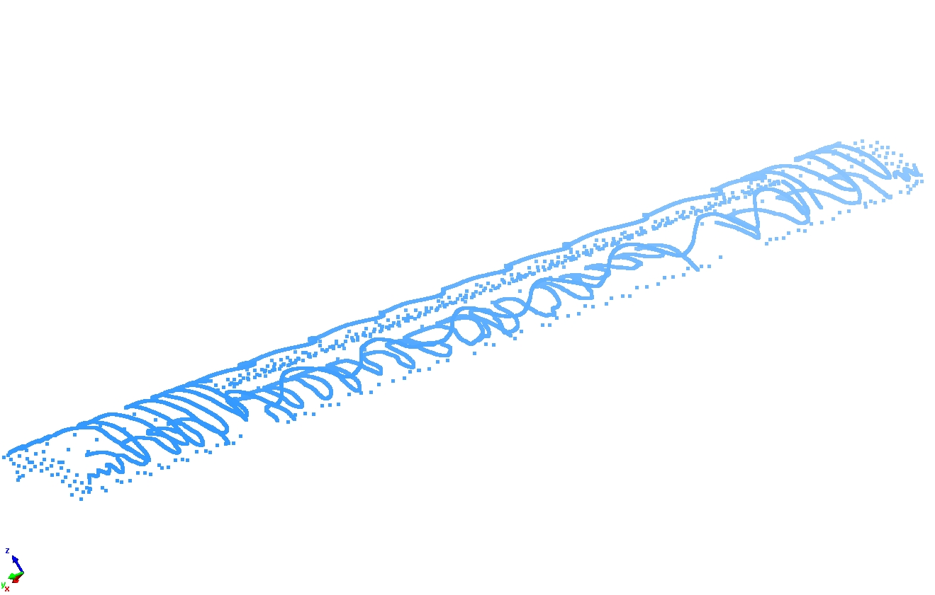
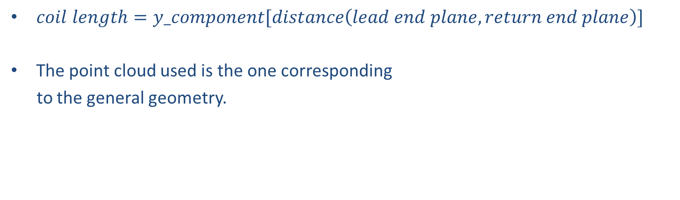
Procedure: Measurements
Extra: Post-processing (V/IV)
Coil length
Ref.
$coil length=y_component[distance\left(lead end plane, return end plane\right)]$
The point cloud used is the one corresponding
to the general geometry.

Slide 34
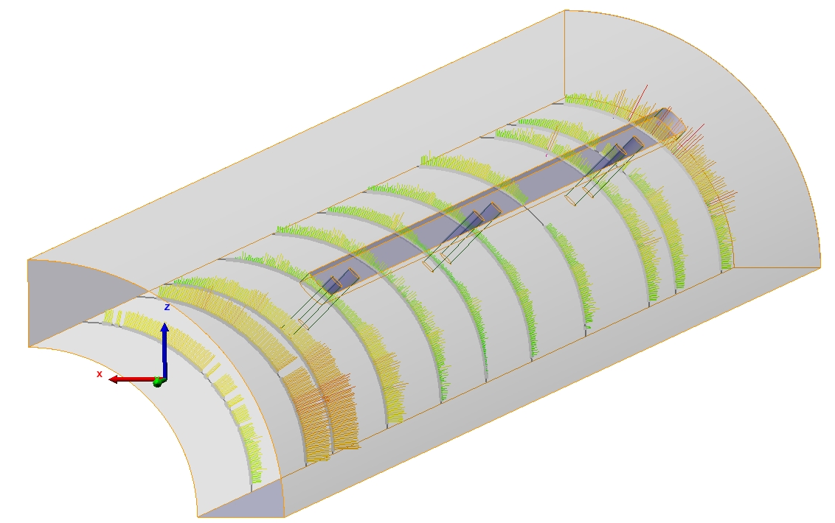
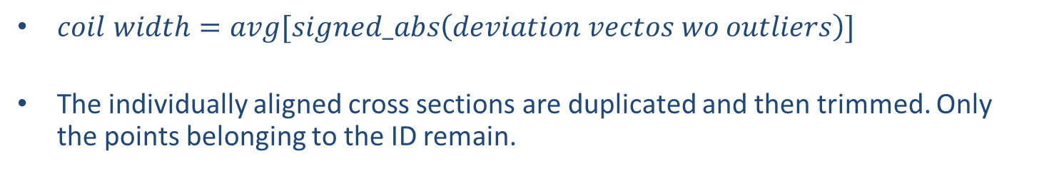
Procedure: Measurements
Extra: Post-processing (VI/IV)
Coil width
$coil width=avg[signed_abs\left(deviation vectos wo outliers\right)]$
The individually aligned cross sections are duplicated and then trimmed. Only the points belonging to the ID remain.
Sample results:
Name | Dev
Δ T3 | -0.177
Δ T4 | -0.100
Δ T5 | -0.120
Δ T6 | -0.058
Δ T7 | -0.097
Δ T8 | -0.101
Δ T9 | -0.135
Only results from cross sections along the keyway//loading plate are used because the result depends on the alignment

Slide 35
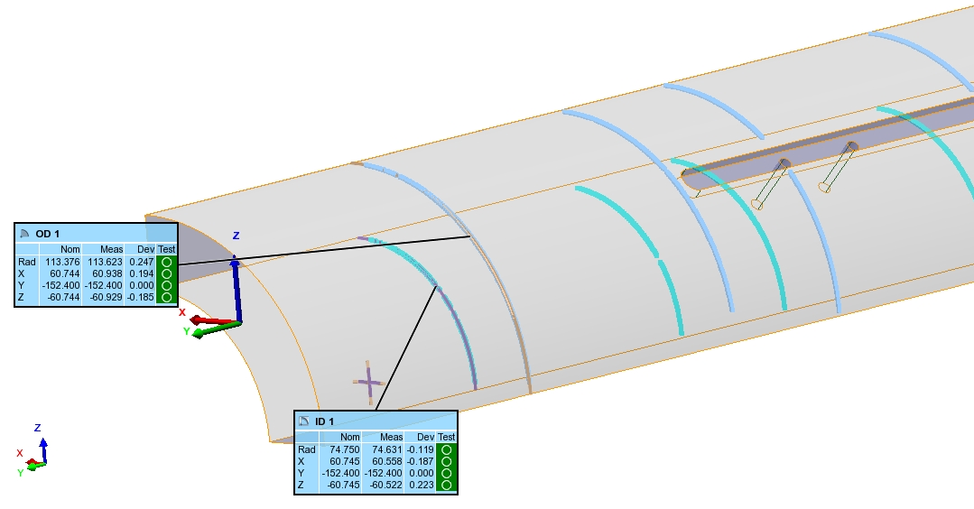
Procedure: Measurements
Extra: Post-processing (VII/IV)
Outer diameter and Inner diameter
Circumferences are best-fitted to the points belonging to the inner and outer diameter (wo outliers). The algorithm makes minimum the square of the deviation of the points belonging to the arc. Then the center and the radius are computed.
The radius does not depend on the alignment. The center does.
Sample results:
Name | Nominal | Measured | Dev
ID 1 | 74.750 | 74.664 | -0.086
ID 2 | 74.750 | 74.737 | -0.013
ID 3 | 74.750 | 74.811 | 0.061
ID 4 | 74.750 | 74.884 | 0.134
ID 5 | 74.750 | 74.755 | 0.005
ID 6 | 74.750 | 74.863 | 0.113
ID 7 | 74.750 | 74.759 | 0.009
ID 8 | 74.750 | 74.780 | 0.030
ID 9 | 74.750 | 74.725 | -0.025
ID 10 | 74.750 | 74.683 | -0.067
ID 11 | 74.750 | 74.525 | -0.225
RADIUS

Slide 36
Thanks for your attention,

