Slide 1
The History of Transverse Pressure Tests of Nb₃Sn Rutherford Cables
Workshop on Nb₃Sn Technology for Accelerator Magnets Paris, October 12, 2018
Arno Godeke
Varian Medical Systems Particle Therapy GmbH

Slide 2
Agenda
A learning curve for “low J_{c}“ conductors
Converging to stable results
A learning curve for “high J_{c}” conductors
Keeping up with magnet performance…
In reflection

Slide 3
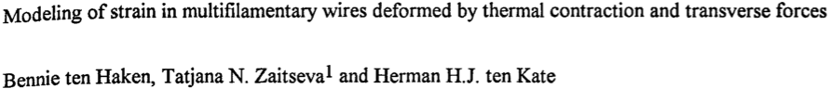
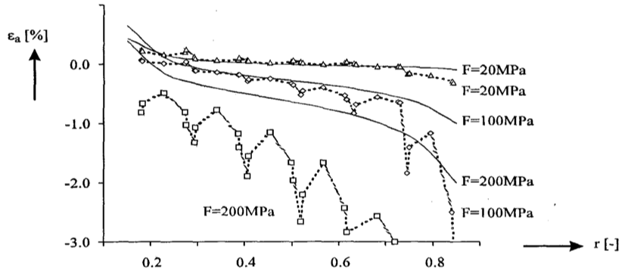
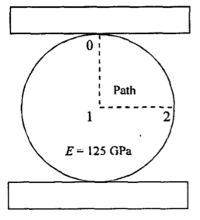
Many Transverse Pressure Experiments on Wires
Relatively simple, but not representative for cables in magnets
Lines: Elastic deformed cylinder (analytical)
Points: Wire with plastically deformed matrix

Slide 4

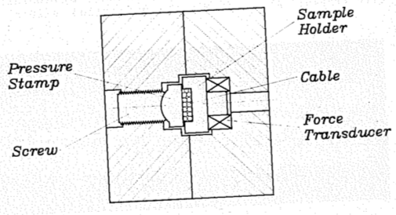
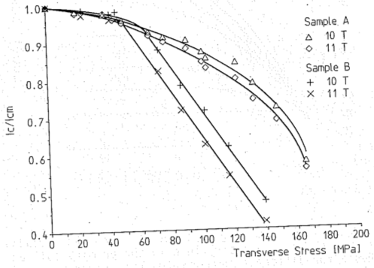
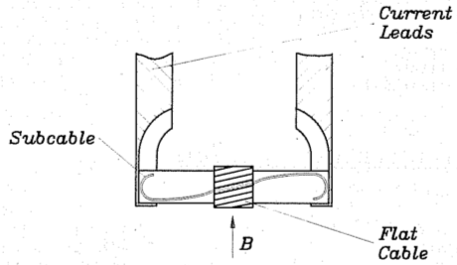
An Early (first?) Nb₃Sn Rutherford “Cable” Experiment
“Three-stage flat” cable for SULTAN: Measurement on one sub-cable
Pressure adjusted at
room temperature

Slide 5
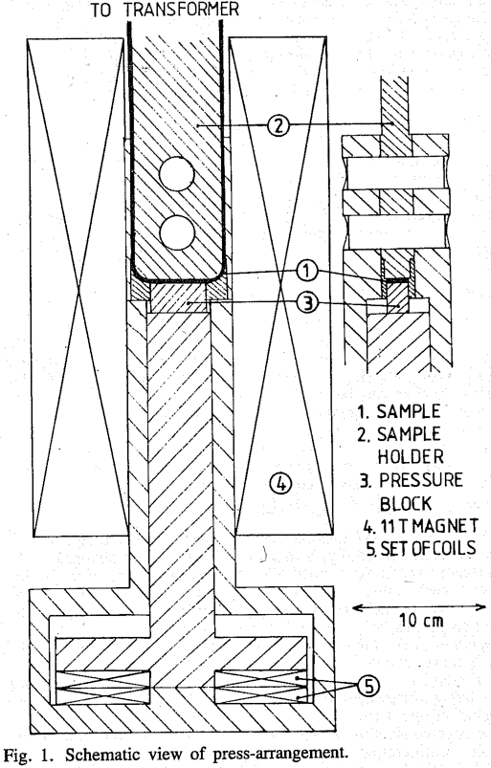
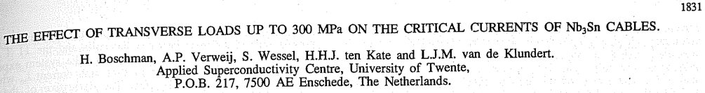
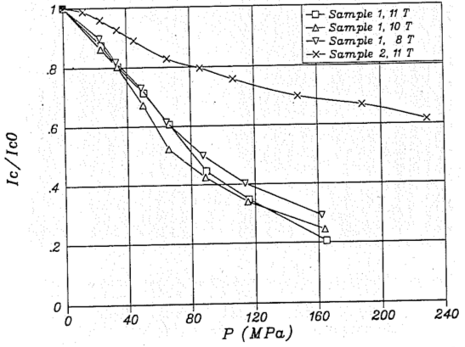
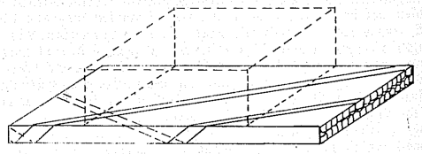
First (?) Measurements on Full-Size Rutherford Cables
192 filament PIT wire in ECN LHC-B and ECN-SULTAN cables
Trans. Magn. V27 n2 1991
Voltage taps per
strand and globally
Stycast filled
Not filled
Field and current within 1%
Pressure within 2%
Voltage within 50 nV

Slide 6
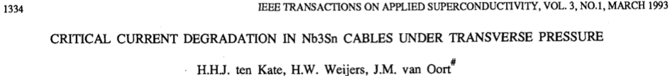
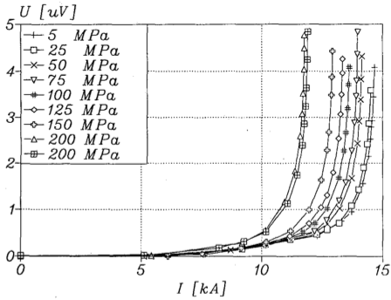
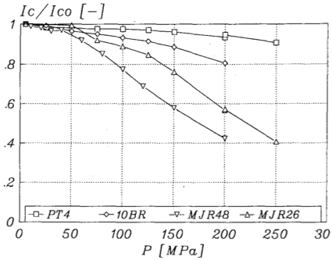
Better Statistics and Experience (& smaller filaments), Better Results
About 15 cables measured in Twente in the early 1990’s
Twente 11 T MSUT & LBNL 13 T D20
  Basic studies on 2D samples and wires
  Full size cable measurements
Pressure
“Filament”
count
192
50,000
36
6

Slide 7
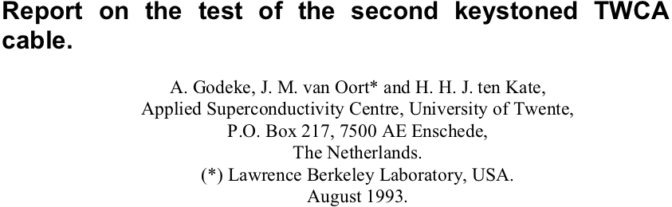
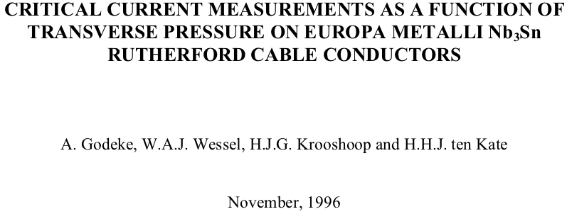
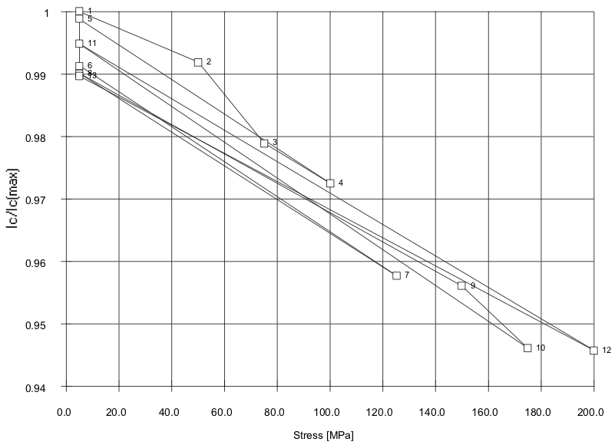
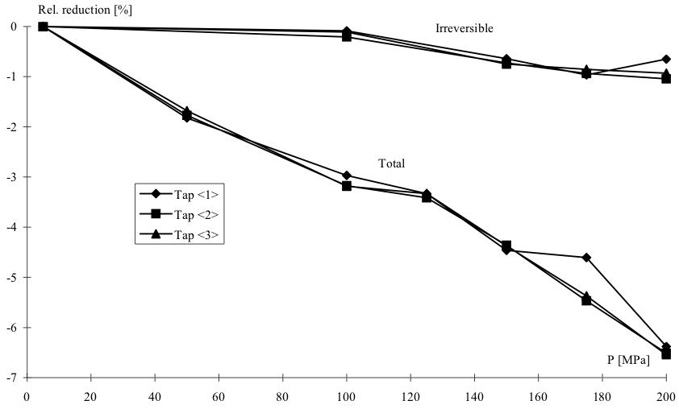
Stable Cable Characterizations
1
MJR with 120 or 378
sub-elements (…):
D20 will work!
0%
Irreversible
Total
0.95
-7%
0
200 MPa
0
200 MPa

Slide 8
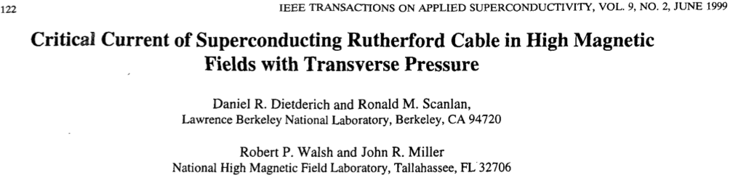
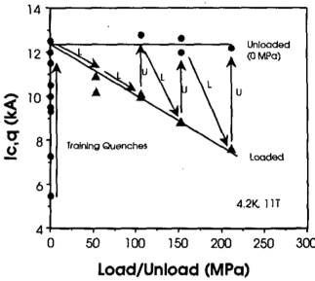
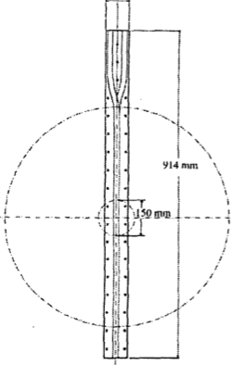
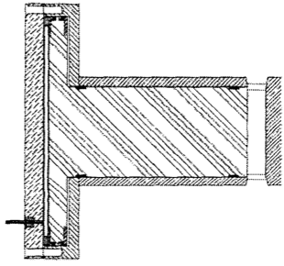
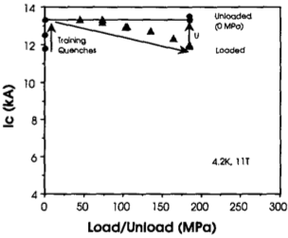
Independent Confirmation by LBNL
Long straight cable sections with 122 mm pressure in NHMFL 12 T split pair
IGC 19 sub-elem.
- 40% at 200 MPa
Cables
Magnet
Helium bellows
for pressure
Bore
MJR 122 sub-elem.
- 11% at 200 MPa

Slide 9
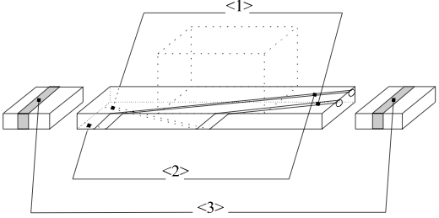
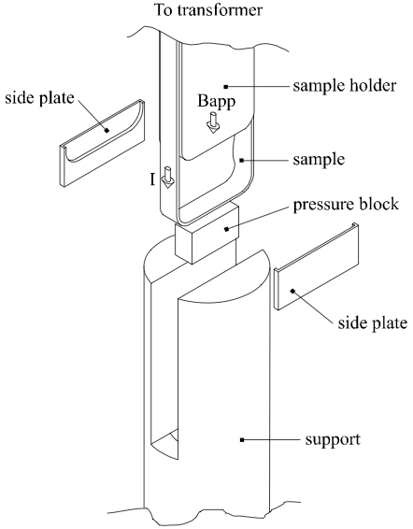
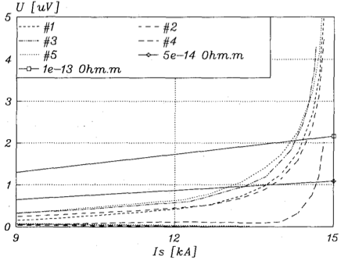
Lessons learned
Kink
Impregnate cable
G10 above and below (UT)
  Or dummy cables (LBNL)
Solid side support
No correlation to V-tap location
  Current distribution not known
  Global is not equipotential
U(I) is not proportional to I^{n}
Small filaments survive > 150 MPa
  If the experiment is done properly
(And a couple of anecdotes…)
Straight
Global
n = 40
Global = about average
n = 4
Kink thin edge

Slide 10
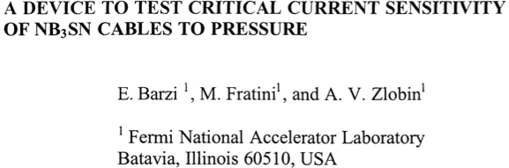
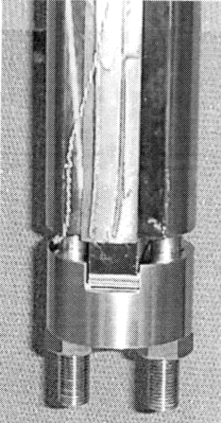
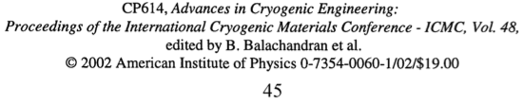
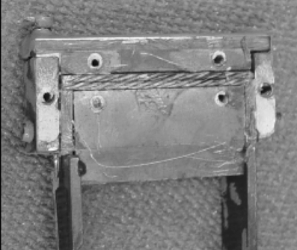
High J_{c} Strands in Copper Dummy Cables
A possible cheap and fast way to characterize “cables”?
Impregnated ✅
Dummy cable below ✅
G10 side plates ?
SC strand in Cu cable ?
Kink under pressure block
with “soft” surroundings ?
Copper cable
Copper cable with
“kink” SC strand
Reaction holder

Slide 11
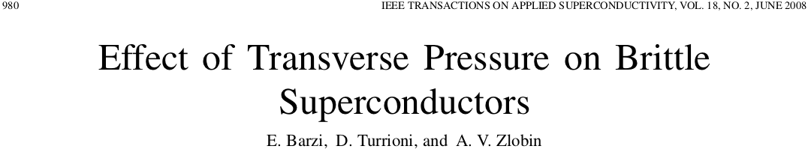
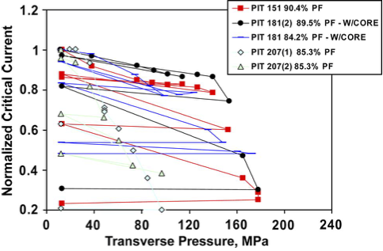
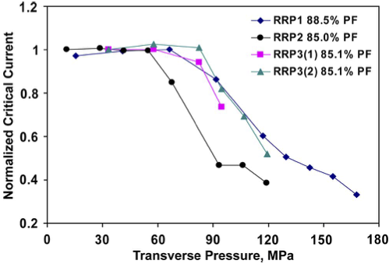
High J_{c} Strands in Copper Dummy Cables
Some selected results
Are high J_{c} cables more sensitive to transverse pressure?

Slide 12

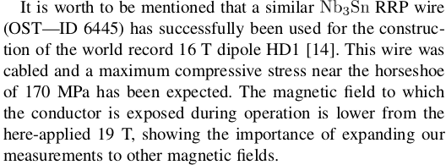
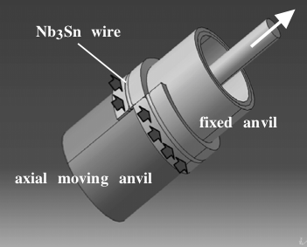
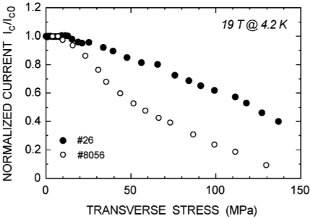
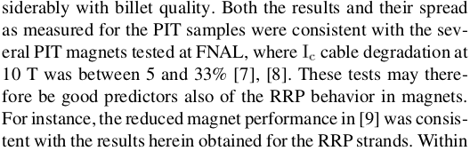
Transverse Pressure on High J_{c} Wires
Seeber, et al. 2007:
Bronze
RRP
Barzi, et al. 2008:
Initially on bare wires
Later on impregnated wires
…so, is there, or is there not, a problem with the stress sensitivity of high J_{c} cables?
(LBNL attempted to test high J_{c} cables at the NHMFL but the experiment failed)

Slide 13

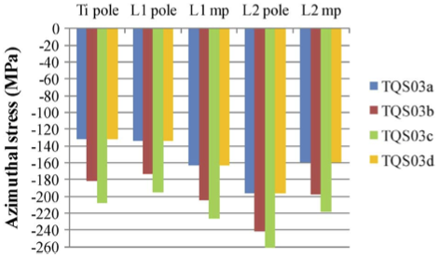
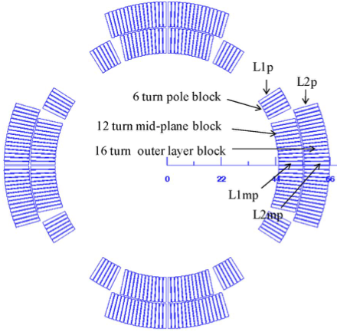
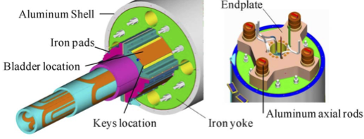
What do Magnets Tell Us?
US LARP Technology Quadrupole TQS03 tested at CERN under high stress

Slide 14
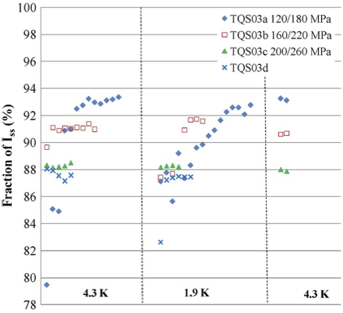
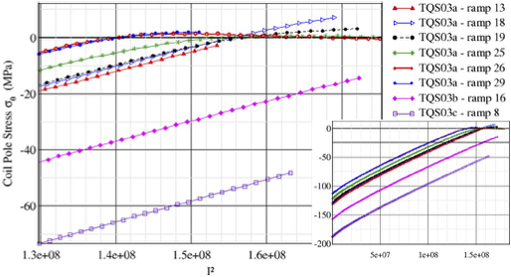
TQS03 Performance Under Intentionally High Stress
Unloading during magnet excitation and corresponding training
Insufficient pre-load and training
but closest to short sample
Higher pre-load
has reduced I_{c}
Higher pre-load
has again
reduced I_{c}
All reductions seem
irreversible since
the limit is measured
at minimal load!
Discussion points:
We observe that above 180 MPa permanent damage does occur (?)
We still not seem to know if reaching 93% of short sample is caused by damage at 180 MPa (?)

Slide 15
Summary
Proper cable
measurements
are tough!
A learning curve for “low J_{c}“ conductors
Converging to stable results
A learning curve for “high J_{c}” conductors
Keeping up with magnet performance
In reflection…some provocative thoughts!
Data showing less stress sensitivity is the better measurement…
(…similar to a critical current measurement where the highest value is correct!)
Discussion:
Are cable measurements indeed necessary as long as filaments are small?
Was the TQS03 test indeed undecisive, even for 180 MPa?

Slide 16

Less than 3% of cancer patients that would benefit from proton therapy has access
Thank You
EVERY DAY COUNTS!
Notes:
Demand is high and growing
But currently, only 1% of cancer patients receive proton therapy
(when 20% of them would benefit)
In fact, a patient in this city would have to travel XX miles for proton therapy

