Slide 1
An Introduction to Axial Strain Characterization of Nb₃Sn Wires
Workshop on Nb₃Sn Technology for Accelerator Magnets Paris, October 12, 2018
Arno Godeke
Varian Medical Systems Particle Therapy GmbH

Slide 2
Agenda
High strain sensitivity of Nb₃Sn explained
Evolution of axial strain experiments

Slide 3
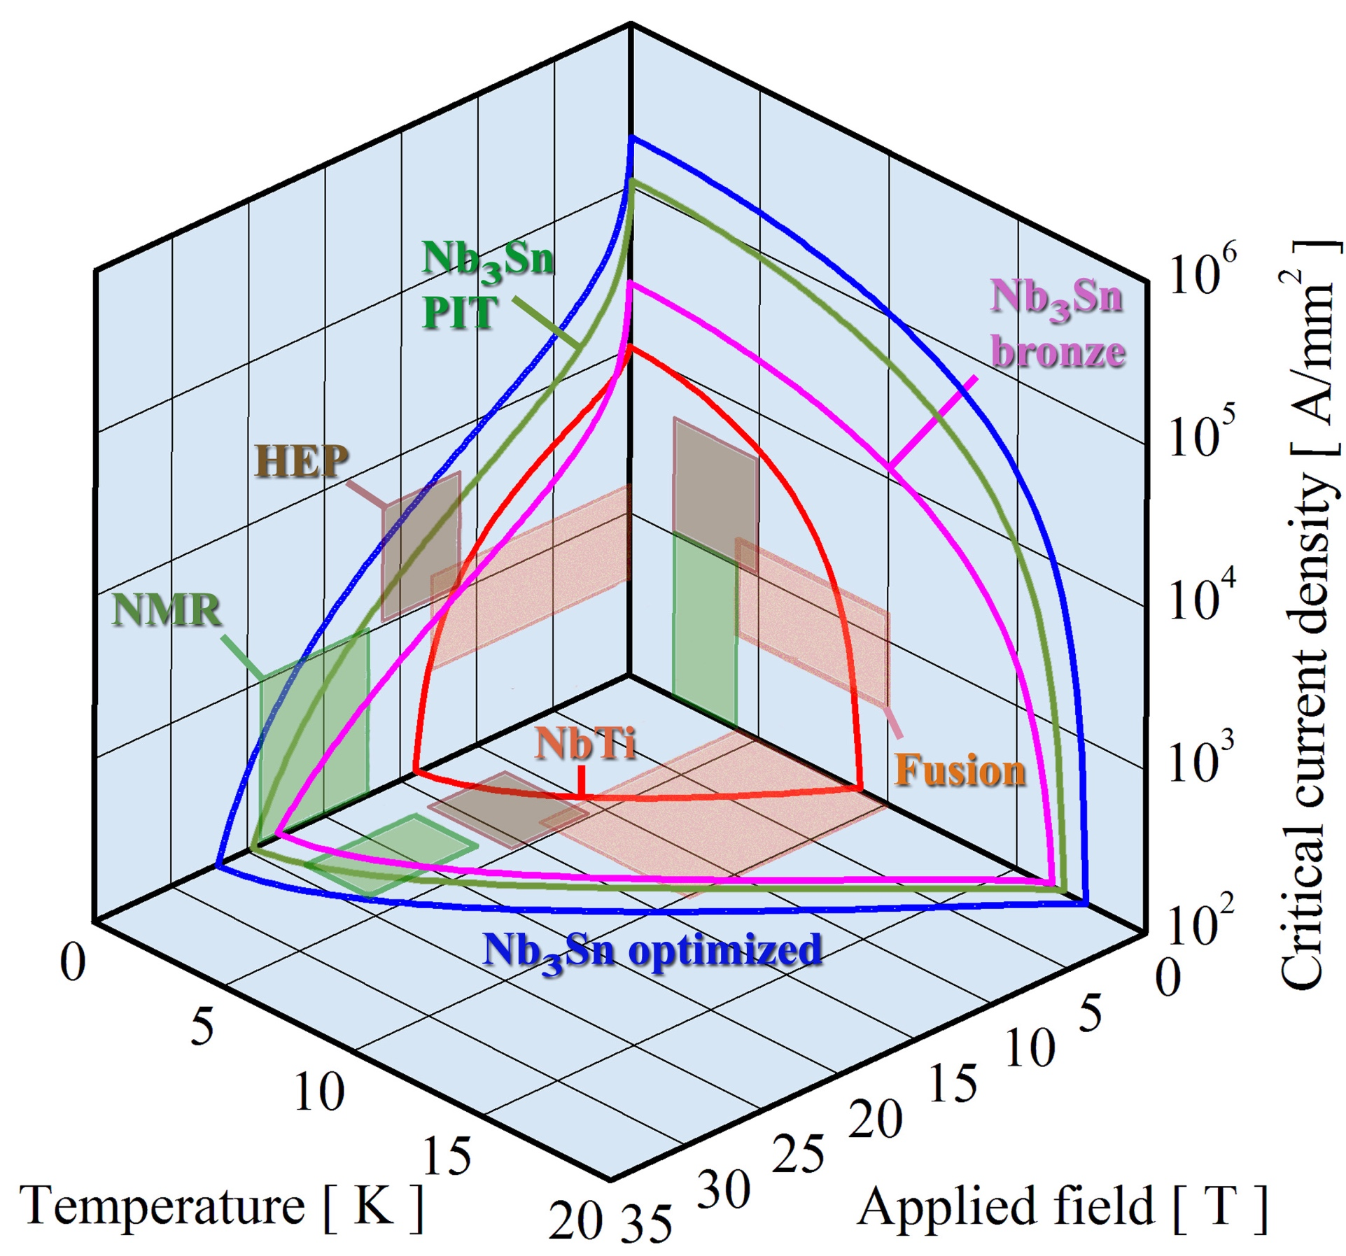
Nb₃Sn: Limits on T, H, and J
Limits on T and H are affected by strain, leading to a change in the maximum J
Maximum J
  Critical current density J_{c}
Maximum H
  Critical magnetic field H_{c2}
Maximum T
  Critical temperature T_{c}
Critical surface
  J_{c} ➔ J_{c}(H,T,ε)
  Determines performance
  envelope for applications

Slide 4
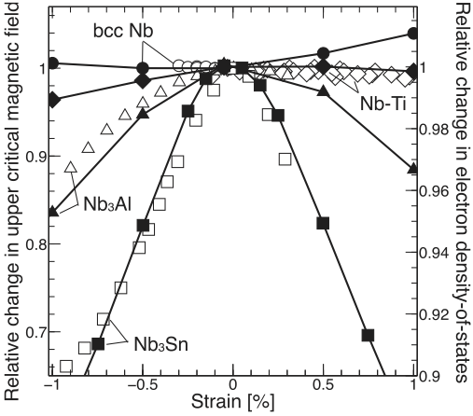
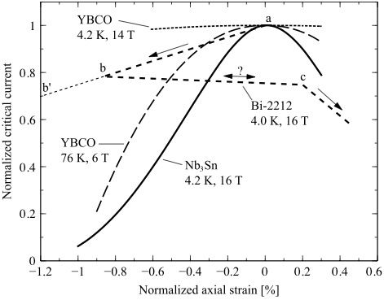
Probing H_{c2}(ε) or I_{c}(ε)
Nb₃Sn has due to sub-lattice instability a relatively high sensitivity to strain
Godeke, Hellman, ten Kate, Mentink
Supercond. Sci. Techn. 31 105011 (2018)
Bottura, Godeke
Rev. Acc. Sci. Techn. 5 25 (2012)
Compared to other LTS
Compared to HTS

Slide 5
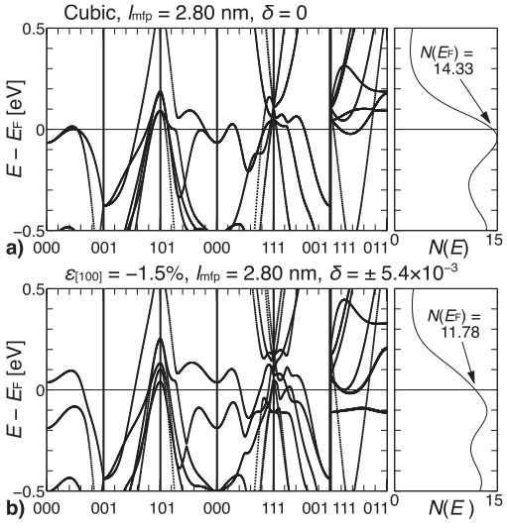
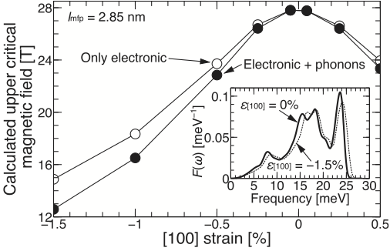
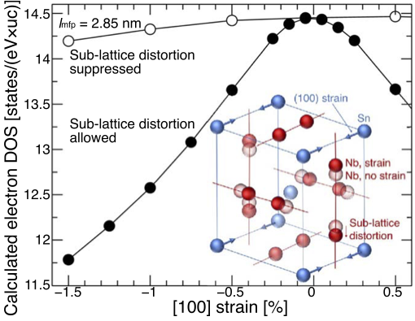
Fundamental origin of high strain sensitivity of Nb₃Sn
Ab-initio calculations + GLAG microscopic theory + experiments (Mentink PhD)
Godeke, Hellman, ten Kate, Mentink
Supercond. Sci. Techn. 31 105011 (2018)
Strain sensitivity is for 80%
caused by electronic properties
20% is cause by phonons
Electron DOS as proxy for sensitivity:
Sub-lattice distortion causes
large strain sensitivity
Electron DOS collapses
causing reduced SC properties

Slide 6
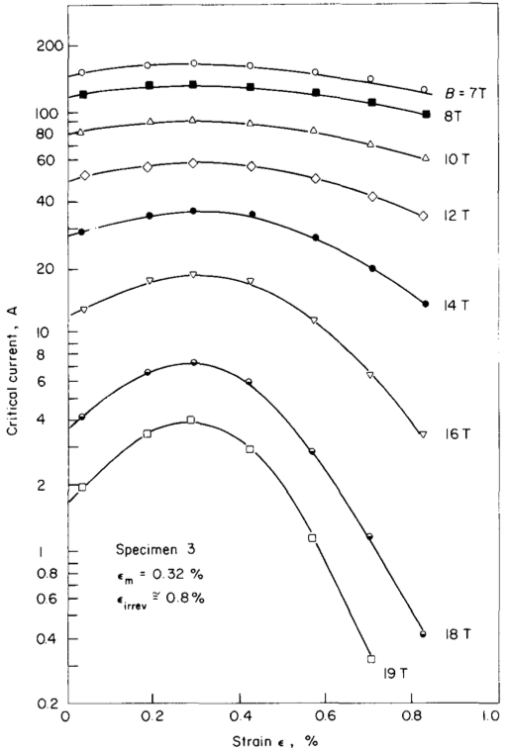
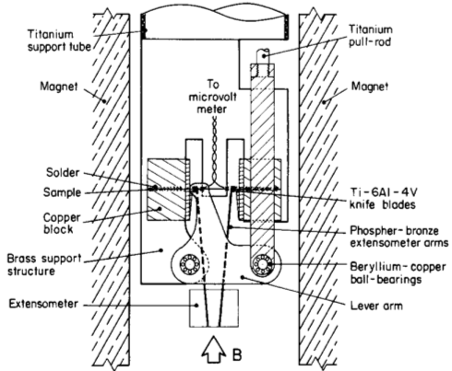
Early I_{c}(ε) results
Tensile tests on short wire sections
OK for fine-filament
bronze, but modern
high-J_{c} wires break
in this region
Ekin
Cryogenics 20 611 (1980)

Slide 7
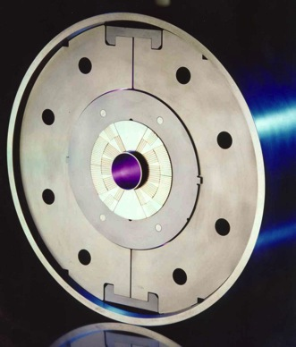
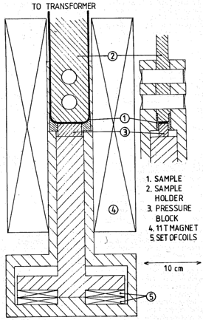
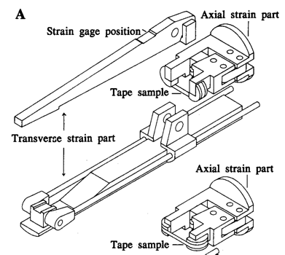
University of Twente, early 1990’s
Supporting R&D: I_{c}(strain, stress)
  Nb₃Sn cables under load: I_{c}(H,F⊥)
MSUT: An 11 T Nb₃Sn dipole magnet
den Ouden, et al.,
IEEE Trans. Appl. Supercond. 7 733 (1997)
Boschman, et al.
IEEE Trans. Magn. 27 1829 (1991)
Dietderich and Godeke, Cryogenics 48 331 (2008)
  Nb₃Sn tapes under load: I_{c}(H,F⊥,ε_{axial})
ten Haken, Godeke, ten Kate,
IEEE Trans Appl. Supercond. 3 1273 (1993)

Slide 8
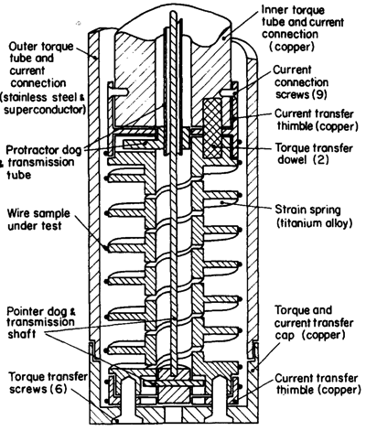
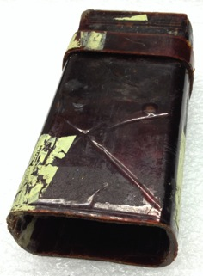
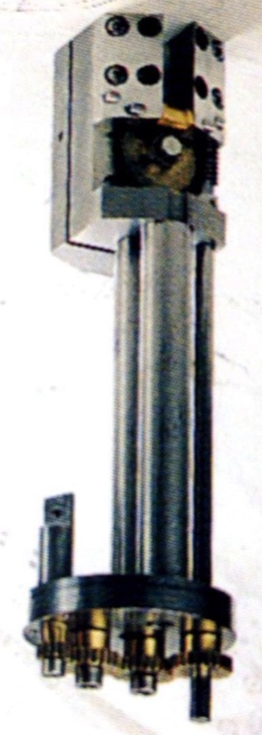
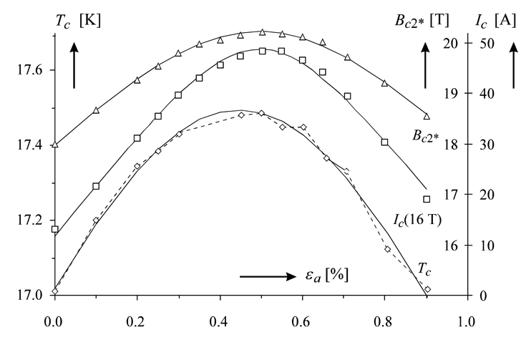
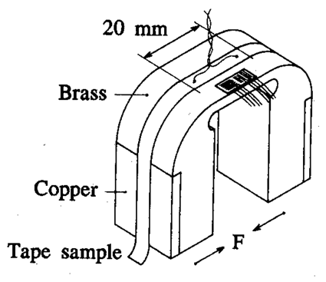
1992: U-shaped bending springs
Novel variable temperature
  Flow cryostats have large time constants
  Helium gas bubble under Kapton cup
CTE Nb₃Sn is low: Wires in compression
  Look at compressive axial strain
Godeke, Graduation Report (1992)
Walters, Davidson, Tuck,
Cryogenics 26 406 (1986)
Soldering a sample
on a substrate enables
compression and
homogenizes strain
First I_{c}(H,ε)
with variable T !
ten Haken, Godeke, ten Kate,
IEEE Trans Appl. Supercond. 3 1273 (1993)
ten Haken, Godeke, ten Kate, IEEE Trans Appl. Supercond. 5 1909 (1995)

Slide 9
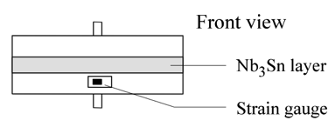
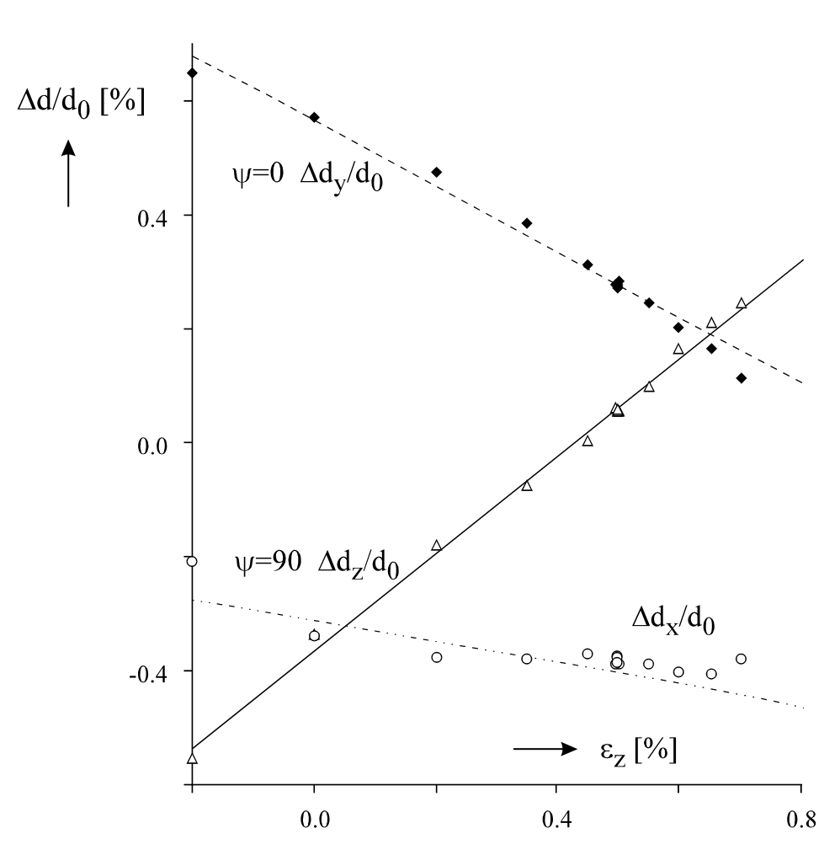
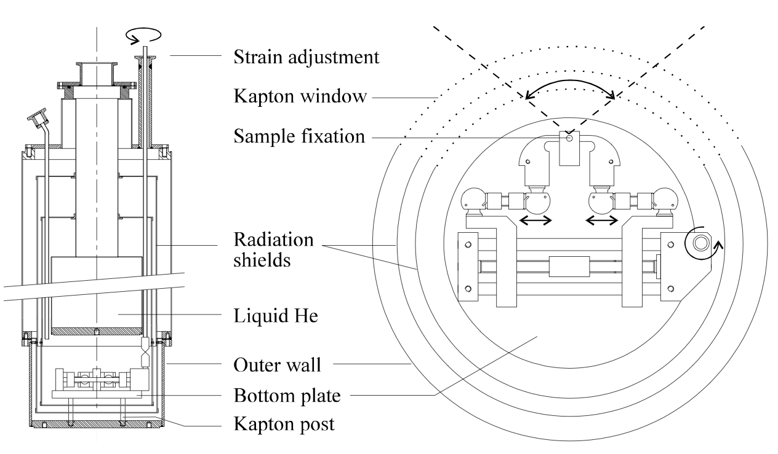
1996: Does the lattice strain follow externally applied strain?
Is solder strong enough to transfer close to 1% longitudinal strain?
  Low temperature X-ray diffraction experiment on tape with exposed Nb₃Sn
Measured with x-rays
Measured with strain gauge
ten Haken, Godeke, ten Kate,
Adv. Cryo. Eng. 42B 1463 (1997)
Lattice strain follows externally applied strain

Slide 10
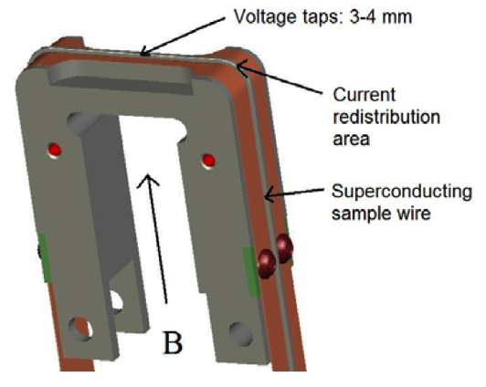
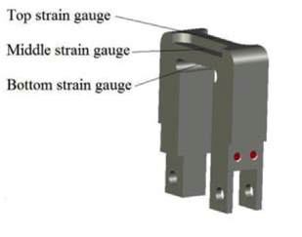
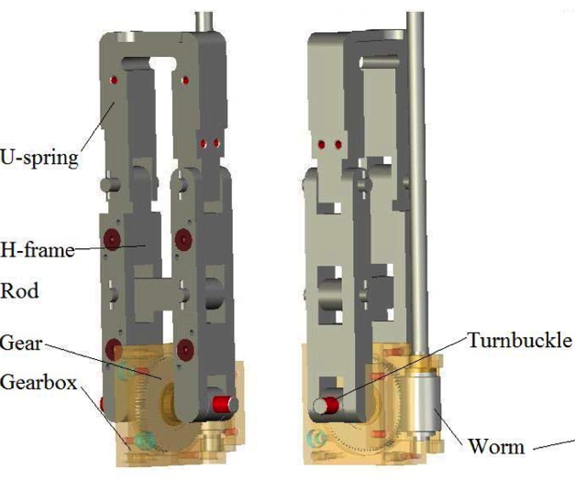
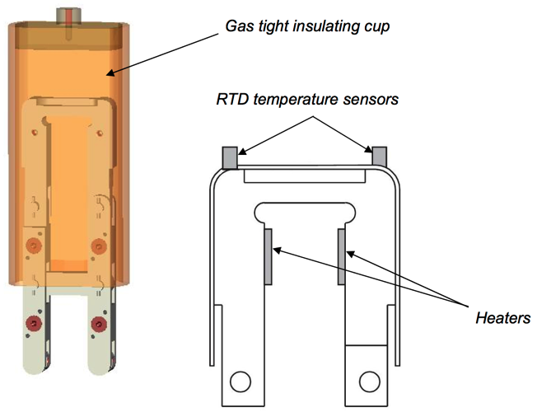
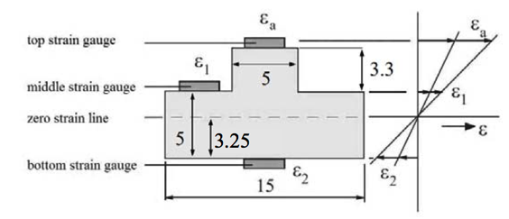
1997: Variable temperature, Ti-6Al-4V U-spring for wires
  Ti-6Al-4V elastic limit is 1.3% (Brass = 0.3%, Cu2w.%Be = 1%)
  Ti-6Al-4V CTE matches barrels
  Brazed Cu buffer layer to enable “regular” soldering
  Highest current in non-strained regions
Godeke, et al., EFDA Report (1998)
Godeke, ten Haken, ten Kate, IEEE Trans. Appl. Supercond. 9 161 (1999)
ten Haken, Godeke, ten Kate, J. Appl. Phys. 85 3247 (1999)

Slide 11
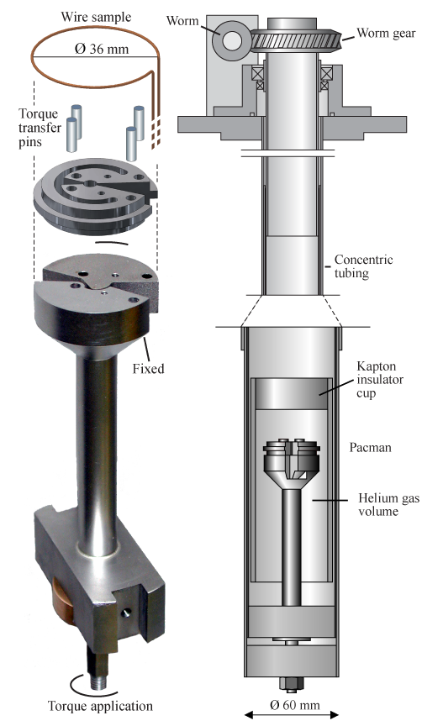
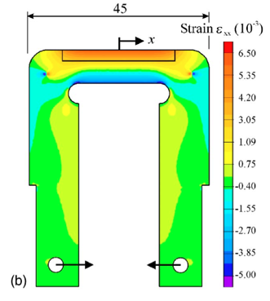
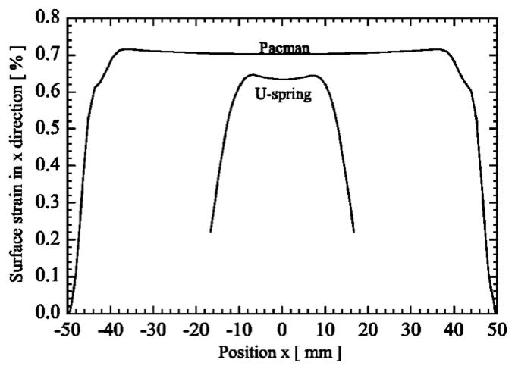
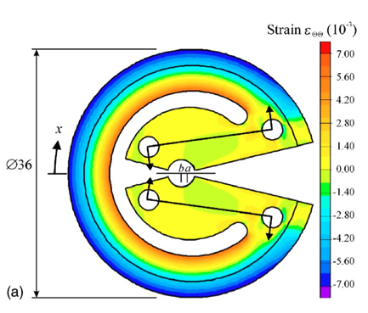
2002: Longer length strain experiments: “Pacman”
From U-spring to Pacman
  10 x sample length (> 50 mm vs. < 5 mm)
  10 x voltage resolution (0.1 μV/cm vs. 1 μV/cm)
  Thermodynamically optimized
Godeke, et al., Rev. Sci. Instr. 75 5112 (2004)

Slide 12

2011: 0.1 μV/cm resolution possible on U-shaped springs
Going from I // B to I ⊥ B causes current redistributions that can be done earlier
Entrance voltages
Redistribution voltages
Godeke, et al.,
Adv. Cryo. Eng. 58 209 (2012)

Slide 13
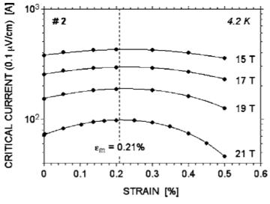
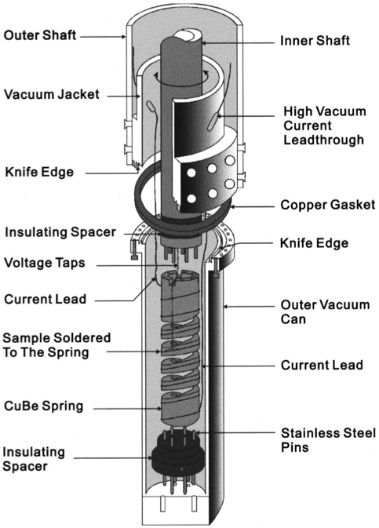
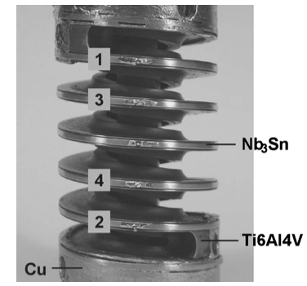
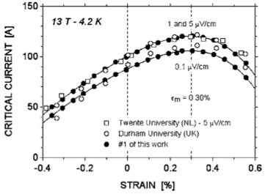
Selected Axial Strain Devices
Twente setups already mostly shown
Cheggour, Hampshire
Rev. Sci. Instr. 71 4521 (200)
Seeber, et al.
Rev. Sci. Instr. 76 093901 (2005)
Geneva Walters spring
Extended to transverse pressure
Durham Walters spring
Reproduced at NIST,
now at NHMFL
“Bending” springs at:
NIMS Tsukuba, Kyoto Univ., …

