Slide 1
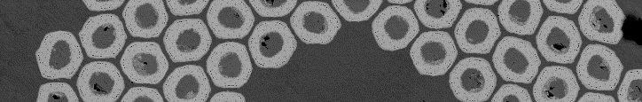


Workshop ^{#2} on
Nb₃Sn
technology
for accelerator magnets
Pierre MANIL
on behalf of the scientific committee
Paris, 11-12 October 2018

Slide 2
Welcome to Paris

Slide 3
Outline
Why this workshop series?
Introduction to workshop ^{#2}

Slide 4
Outline
Why this workshop series?
Introduction to workshop ^{#2}

Slide 5
Nb₃Sn raises a large variety of questions
Possible showstoppers:
  Heat treatment optimization
  Brittleness (irreversible degradation…)
  Series production of strand (unit lengths, procurement strategies)
  J_{c} optimization (production methods, Cu/nCu ratio, flux pinning…)
  Effect of transverse/longitudinal stress/strain
  Electromagnetic stability (self-field instabilities…)
  Stress management at the magnet level (design criteria?)
  Predictivity: need for ab initio approach
  …
+ « Side problems »
  Terminology/concepts not standardized (unhomogeneous literature)
  Numerical model parameters
  Difficult in-situ observation of the reaction process
  Heat-treatment-proof tooling
  Test facilities (need for high field/high pressure)
Cf. workshop^{#1}

Slide 6
Intention of the workshop series
This workshop series aims at sharing experience gained worldwide in the field of Nb₃Sn technology for accelerator magnets.
At the end of the series, the idea is to set-up a best practice manual resulting from the discussions having taken place all along the workshops.
From today, we can evaluate that 3 to 5 workshops could be necessary.
Workshop^{#1}, held in Madrid last year, has covered:
  Mechanical characterization of impregnated conductor
  Dimensional changes during heat treatment
Proceedings now available!

Slide 7
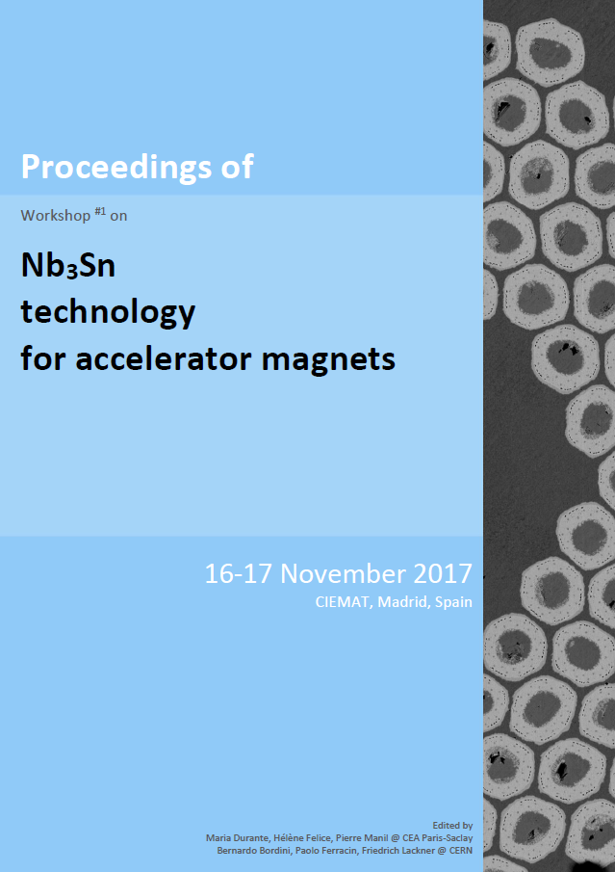
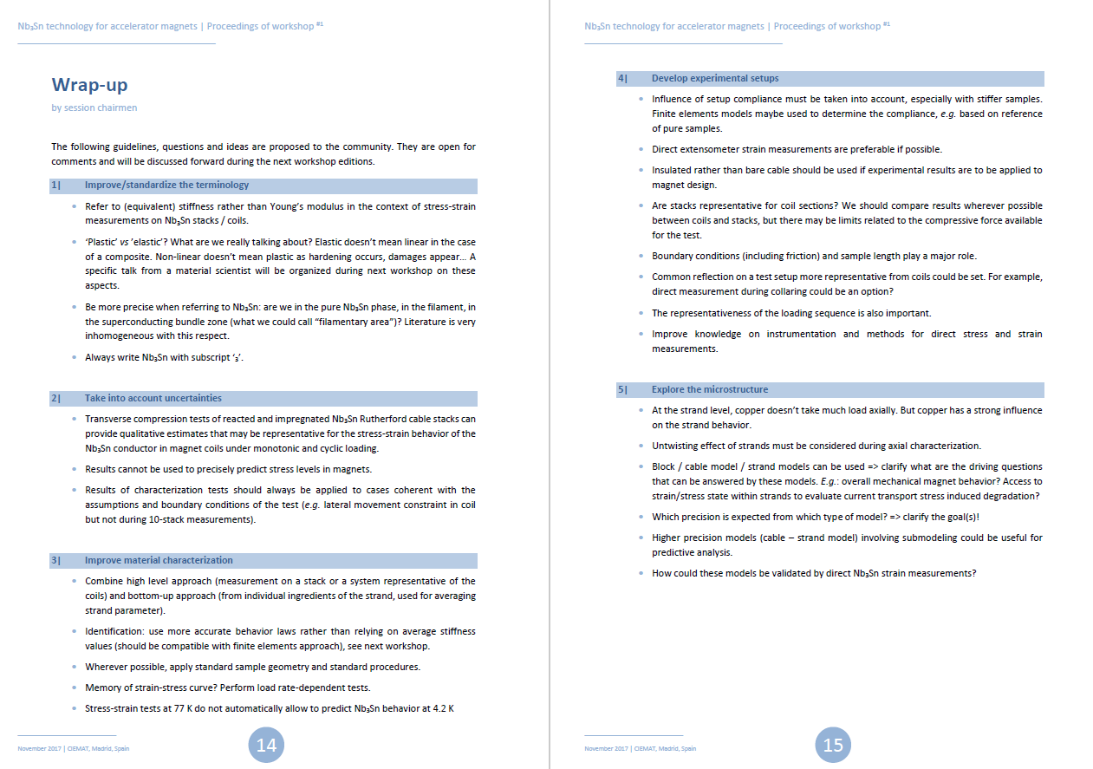
Proceedings of workshop^{#1} now available
Short summary of each session, revised by the presenters
Guidelines from the wrap-up session (open for comments)
Selected references (by the presenters)
Professional background of participants

Slide 8
Outline
Why this workshop series?
Introduction to workshop ^{#2}

Slide 9
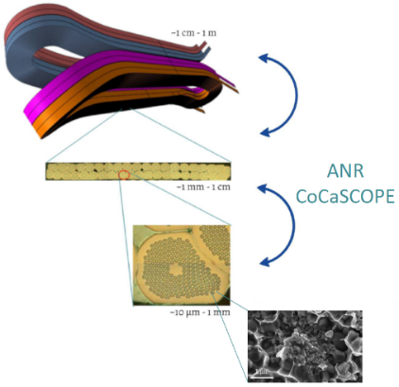
Nb₃Sn raises multiscale questions
Macroscopic behaviour of the magnet is controlled at the microstructure level
Workshop^{#2}
Magnet scale
Cable scale
Strand scale
Filament scale
- Impregnation process
Workshop^{#1}
- Impregnated conductor characterization
- Dimensional changes
during heat treatment
- J_{c} dependence
to stress/strain state
- Material aspects / Characterization

Slide 10
Agenda
Today 11 October
Session #1 | Coil technology – Impregnation process /
Influence of process on coil dimensions
Session #2 | Mechanical aspects / characterization
Tomorrow 12 October
Session #3 | Critical current dependence to stress/strain state
Wrap-up session every day

Slide 11
New! External points of view
We identified during last workshop that it would be interesting to confront our vision with other views
3 speakers ‘out of the accelerator magnets box’ have been invited
  Véronique AUBIN (material scientist @ CentraleSupélec, France) will dicuss the possible contribution of a multi-scale approach to model and characterize our superconductors
  Michel GREDIAC (material scientist @University of Clermont, France) present the grid method for in situ in-plane displacement measurement and its application on a detector magnet conductor
  Luigi MUZZI (researcher @ENEA Italy) will discuss strain effects on Nb₃Sn cable-in-conduit conductors for fusion magnets
  External contribution planned about impregnation has unfortunately been cancelled

Slide 12

64 participants (53 on-site)
CERN CEA INFN CIEMAT ENEA IFJ PSI Twente
16 15 4 1 2 1 1 1
+ academic newcomers:
CentraleSupélec
University of Clermont
Udine university
+ 2 companies
Bruker
Varian
54
4
3
FNAL
1
1
1
IHEP KEK
LBNL
NHMFL

Slide 13
Practical | Organizing committee
Organization
  Martine Baldini, Séverine Candau, Sophie Durand, Armelle Le Noa, Natacha Lomet, Florian Paget @ CEA Paris-Saclay
  On-site support available
Financial support
  CEA Paris-Saclay / IRFU (Nicolas ALAMANOS + DACM + DIS)
  HL-LHC and FCC projects (Lucio ROSSI, Michael BENEDIKT)
Scientific committee
  Bernardo Bordini, Paolo Ferracin, Friedrich Lackner @ CERN
  Maria Durante, Hélène Felice, Pierre Manil @ CEA Paris-Saclay

Slide 14
Practical | Wifi connection
Espace St Martin is equipped with Wifi network
Login: ESM-PUBLIC
Password: wifi.esm

Slide 15
Practical | Catering
Two coffee breaks per day are planned
in the middle of the morning and afternoon sessions.
Lunches are not provided. Many restaurants are located around Espace St Martin.
A selection of recommended addresses is available in your participant folder.
The organizers are delighted to invite you to a workshop dinner tonight at 8pm at the restaurant Le Train Bleu.
Registration is mandatory.
Directions will be provided at the end of the afternoon session.

Slide 16
In your workshop folder, you will find…
Agenda of the workshop
List of participants
(including professional backgroung, domain of expertise, interest in the workshop topic)
Proceedings of workshop^{#1}
Wifi connection details
Selection of restaurants for lunch (with map)
Directions to the workshop dinner

Slide 17
Guidelines to the presenters
Each talk slot is 30’ long, firm (+10’ for external points of view)
Besides the scientific results that you wish to present, please keep significant time to present the experimental setups and procedures.
Do not hesitate to present negative or partial results if you think they can bring constructive input.
Please take some time at the end of your talk to conclude on the problems and success encountered and try to draw conclusions (even negative) that could serve the whole community.

Slide 18

Guidelines to the attendees
Ask questions, share your own experience
Wrap-up sessions (one per day) are an additional opportunity to discuss. Please stay with us for this important session!
For remote participants:
  Vidyo room is accessible on the Indico page of the workshop
  One connection point per Institute is preferable!
  Please switch off your microphone when not needed
  Chairmen will open the session for distant questions at the end of each talk
  Backup option only: questions can be sent by email to the chairmen during the session
After the workshop: share your comments about the proceedings

Slide 19
Thank you

