Slide 1

Transverse Mode Coupling Instability in LHC and HL-LHC
D.Amorim, S.Antipov, N.Biancacci, X.Buffat, L.Carver, E.Métral
Many thanks to:
T.Levens, A.Mereghetti, B.Salvant, M.Soderen,
D.Valuch, LHC and Injectors Operations
Work Package 2 meeting
24/07/2018

Slide 2
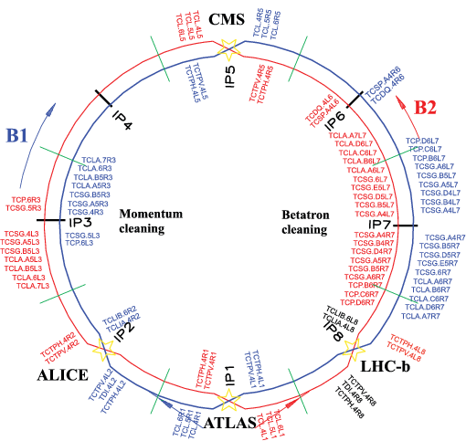
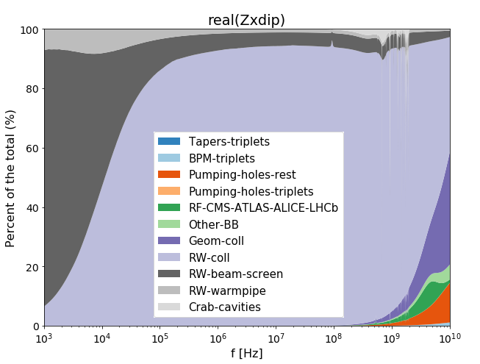
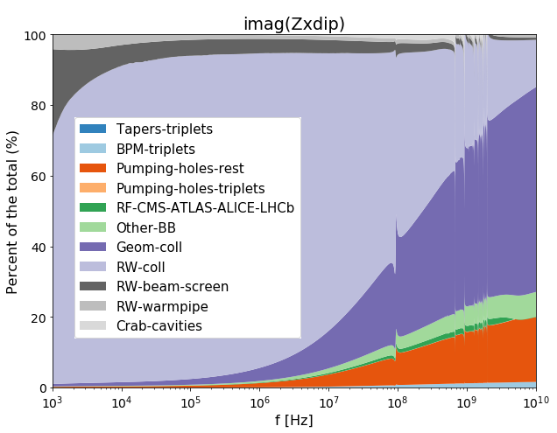
Stability in the HL-LHC era
At top energy, the collimators are the main contributors to the impedance
  54 per beam, 11 in IR7 betatron cleaning region
  In IR7: made of resistive materials (Carbon Fiber Composite), tightest gaps (<2mm)
Low resistivity collimators will start to be implemented during LS2
HL-LHC impedance budget at top energy
LHC collimation system

Slide 3
TMCI threshold in LHC / HL-LHC
Investigate the single bunch stability limits
  Transverse Mode Coupling Instability happens when two bunch
  oscillation modes couple at high intensity
  It could be a single bunch intensity limitation as HL-LHC will use brighter beams
Goal: measure the tune-shift as a function of intensity to assess it
  Simulations using the LHC and HL-LHC impedance models
  Measurement in the machine: need to work with LHC operational constraints
  Try to reproduce an equivalent HL-LHC impedance in the LHC
Showcase the benefits of the impedance reduction for HL-LHC

Slide 4

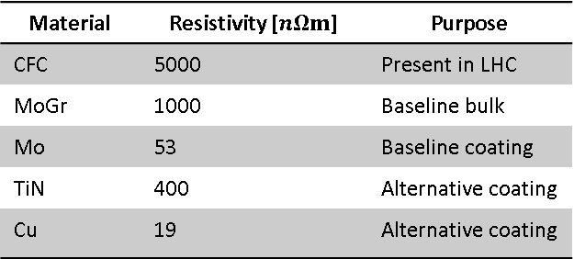
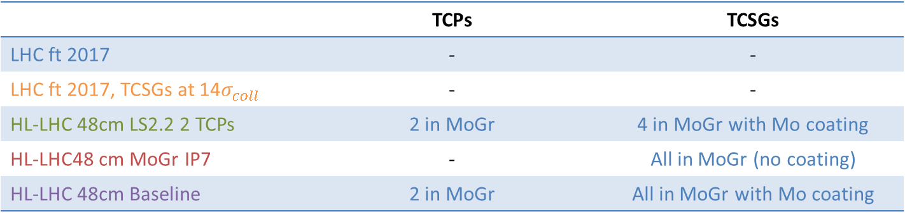
Five impedance scenarios studied
‘LHC ft 2017’: 2017 LHC flat top nominal configuration
‘LHC ft 2017, TCSGs at 14$σ_{coll}$’: 2017 LHC flat top with open TCSGs gaps
  Reproduce an equivalent HL-LHC impedance
‘HL-LHC 48cm LS2.2 2 TCPs’: LS2 collimators upgrade
  Mo coating of 4 TCSGs + MoGr upgrade of 2 TCPs
‘HL-LHC 48 cm MoGr IP7’: TCSGs in MoGr (without coating)
  TCPs stay in CFC
‘HL-LHC 48cm Baseline’: HL-LHC baseline scenario
  Mo coating of all IR7 TCSGs + MoGr upgrade of 2 TCPs
Material and coatings resistivity
From N.Biancacci, IPAC18, WEYGBE4
Material | Resistivity [$nΩm$] | Purpose
CFC | 5000 | Present in LHC
MoGr | 1000 | Baseline bulk
Mo | 53 | Baseline coating
TiN | 400 | Alternative coating
Cu | 19 | Alternative coating
 | TCPs | TCSGs
LHC ft 2017 | - | -
LHC ft 2017, TCSGs at 14$σ_{coll}$ | - | -
HL-LHC 48cm LS2.2 2 TCPs | 2 in MoGr | 4 in MoGr with Mo coating
HL-LHC48 cm MoGr IP7 | - | All in MoGr (no coating)
HL-LHC 48cm Baseline | 2 in MoGr | All in MoGr with Mo coating
Simulated + Measured
Simulated
Notes:
HL-LHC48 cm MoC IP7 ???

Slide 5
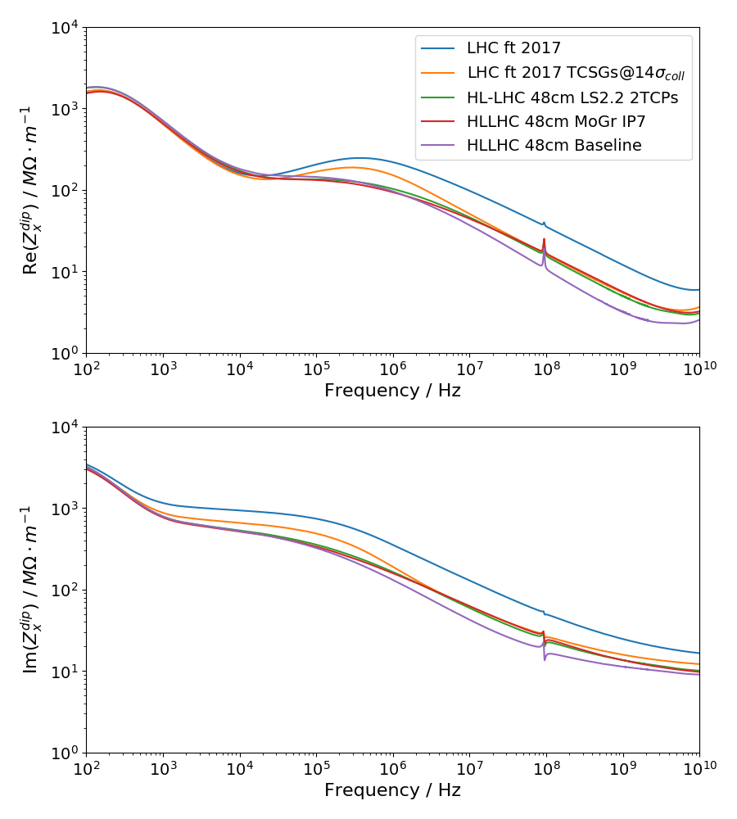
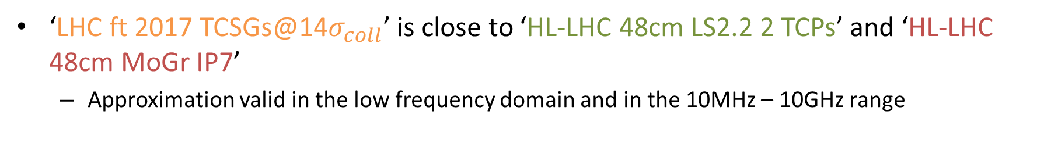
Impedance models for the five cases
‘LHC ft 2017 TCSGs@14$σ_{coll}$’ is close to ‘HL-LHC 48cm LS2.2 2 TCPs’ and ‘HL-LHC 48cm MoGr IP7’
  Approximation valid in the low frequency domain and in the 10MHz – 10GHz range
Notes:
Change plot to simplified one

Slide 6
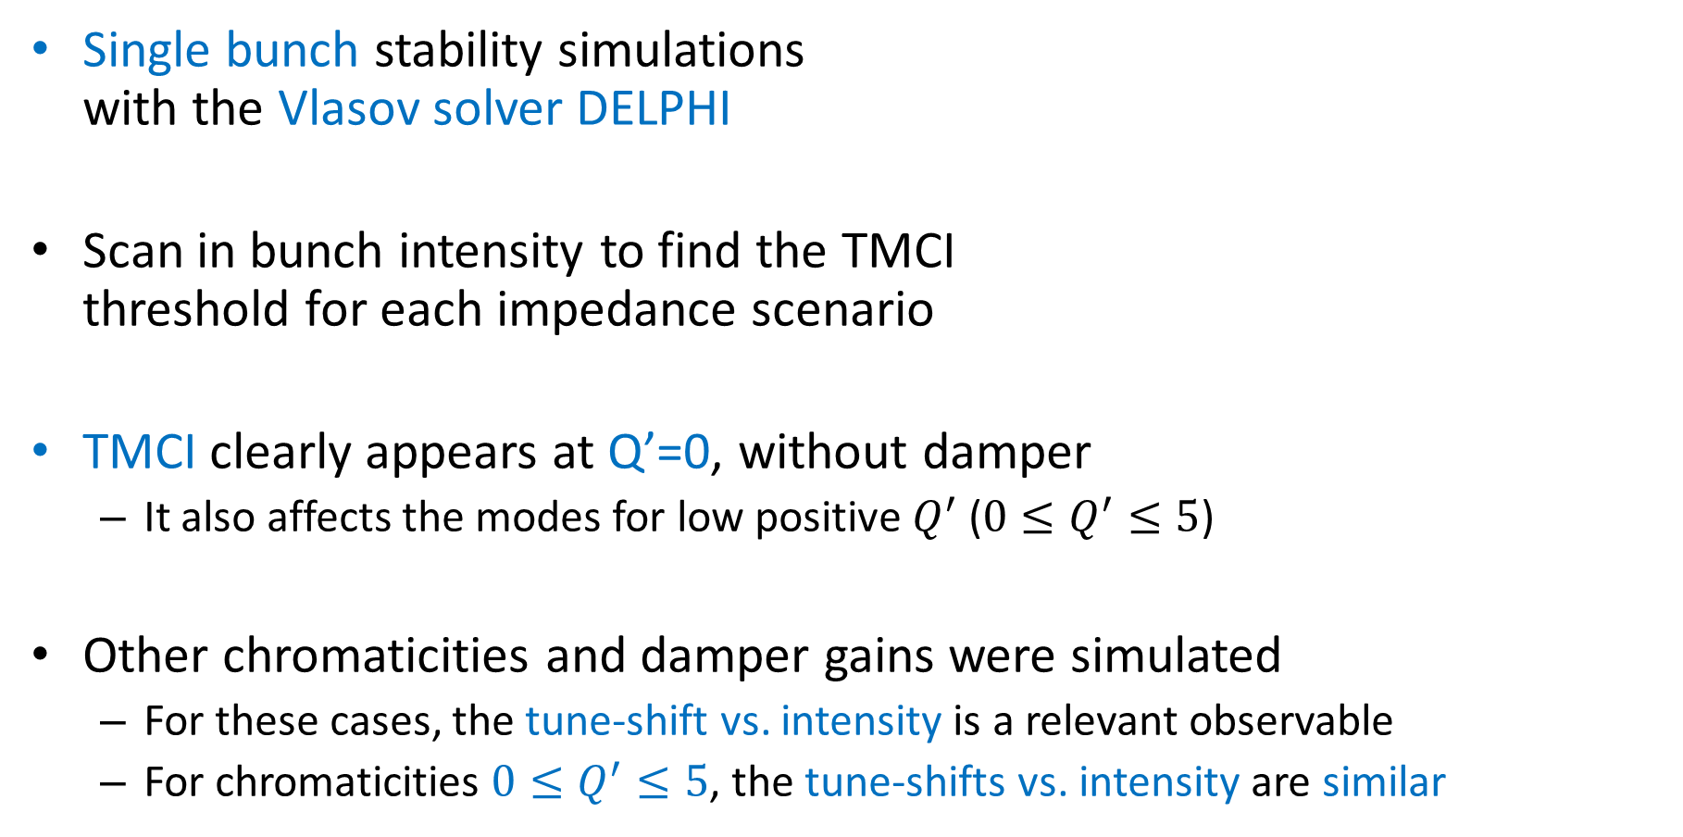
DELPHI simulations for TMCI
DELPHI simulations parameters
Single bunch stability simulations
with the Vlasov solver DELPHI
Scan in bunch intensity to find the TMCI
threshold for each impedance scenario
TMCI clearly appears at Q’=0, without damper
  It also affects the modes for low positive $Q^{′}$ ($0≤Q^{′}≤5$)
Other chromaticities and damper gains were simulated
  For these cases, the tune-shift vs. intensity is a relevant observable
  For chromaticities $0≤Q^{′}≤5$, the tune-shifts vs. intensity are similar
Parameter | Value (LHC) | Value (HL-LHC)
Bunch intensity scan / p.p.b | 0…0.7e12 | 0…1e12
Qs | 2.1e-3 | 2.0e-3
Energy / TeV | 6.5 | 7
Q’ scan | -5…5 | 0…20
Damper gain scan | 0 / 0.01 | 0 / 0.01

Slide 7
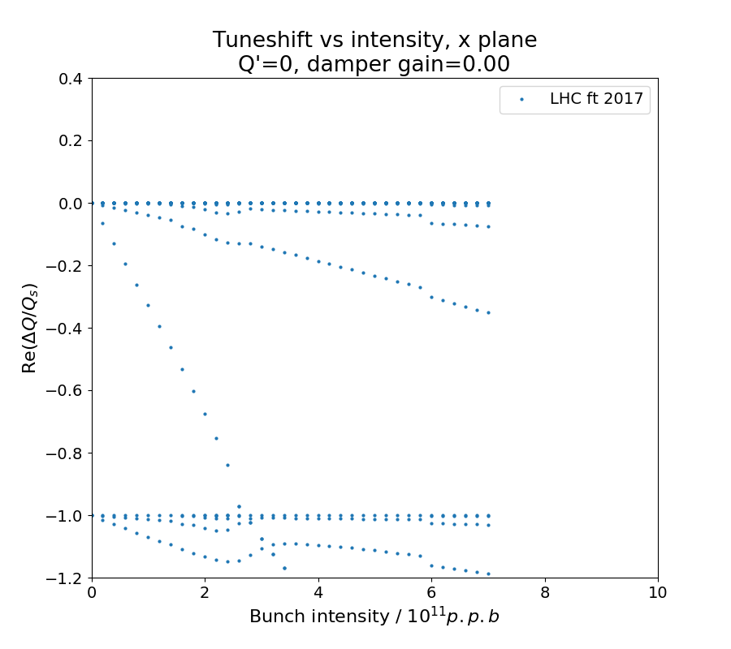

Scenario: LHC ft 2017
LHC flat top 2017 nominal settings
  TCPs at $5σ_{coll}$
  TCSGs at $6.5σ_{coll}$
TMCI threshold at $2.6⋅{10}^{11} p.p.b$
DELPHI Simulations
Mode 0
Mode -1
2.6
Notes:
Show a first plot without HLLHC results

Slide 8
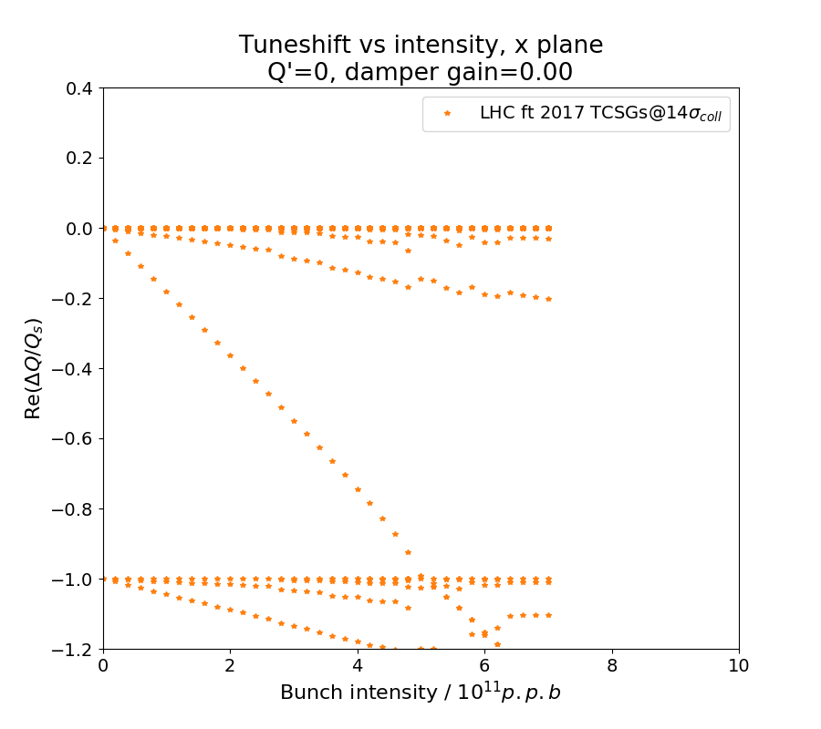
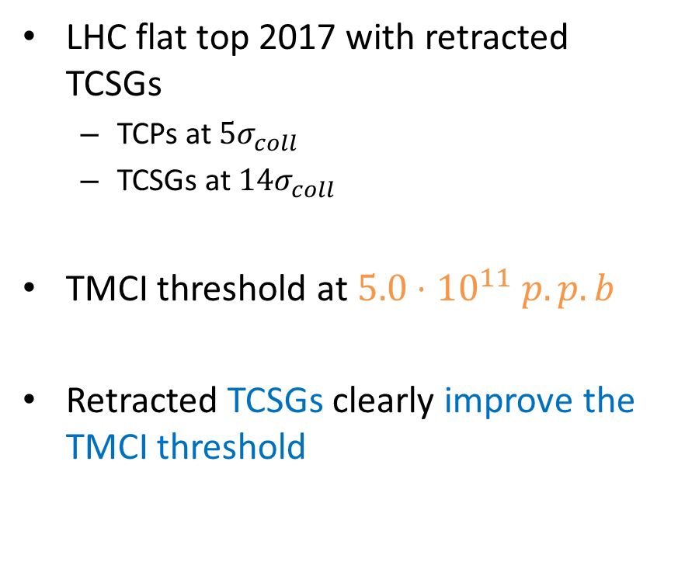
Scenario: LHC ft 2017, TCSGs at 14$σ_{coll}$
LHC flat top 2017 with retracted TCSGs
  TCPs at $5σ_{coll}$
  TCSGs at $14σ_{coll}$
TMCI threshold at $5.0⋅{10}^{11} p.p.b$
Retracted TCSGs clearly improve the TMCI threshold
DELPHI Simulations
Mode 0
Mode -1
5.0
Notes:
Show a first plot without HLLHC results

Slide 9
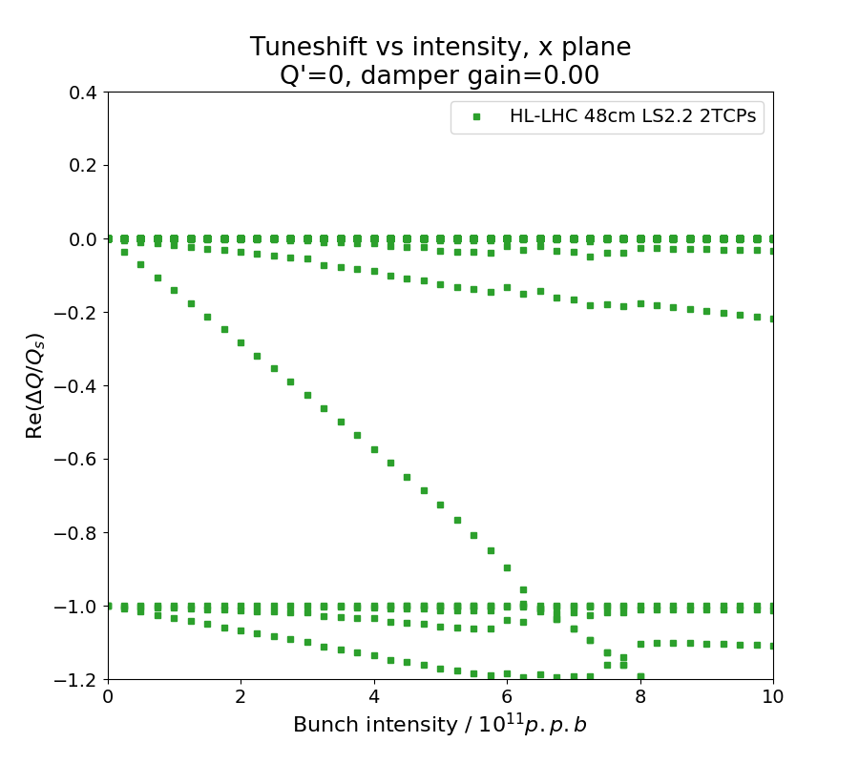
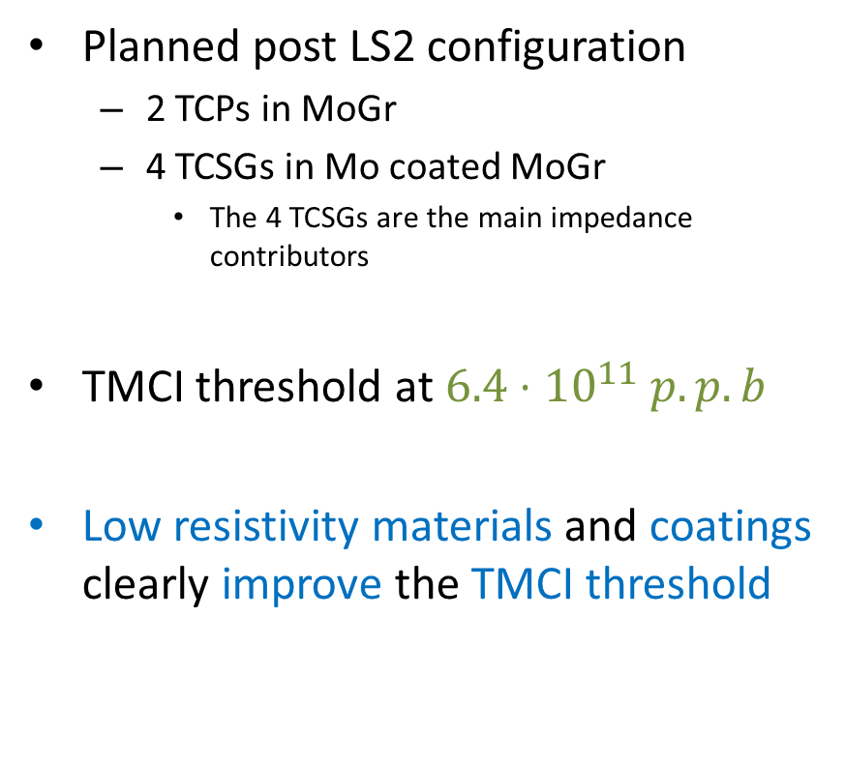
Scenario: HL-LHC 48cm LS2.2 2 TCPs
Planned post LS2 configuration
  2 TCPs in MoGr
  4 TCSGs in Mo coated MoGr
    The 4 TCSGs are the main impedance contributors
TMCI threshold at $6.4⋅{10}^{11} p.p.b$
Low resistivity materials and coatings clearly improve the TMCI threshold
DELPHI Simulations
6.4
Notes:
TCPs and TCSGs sigmas ?

Slide 10
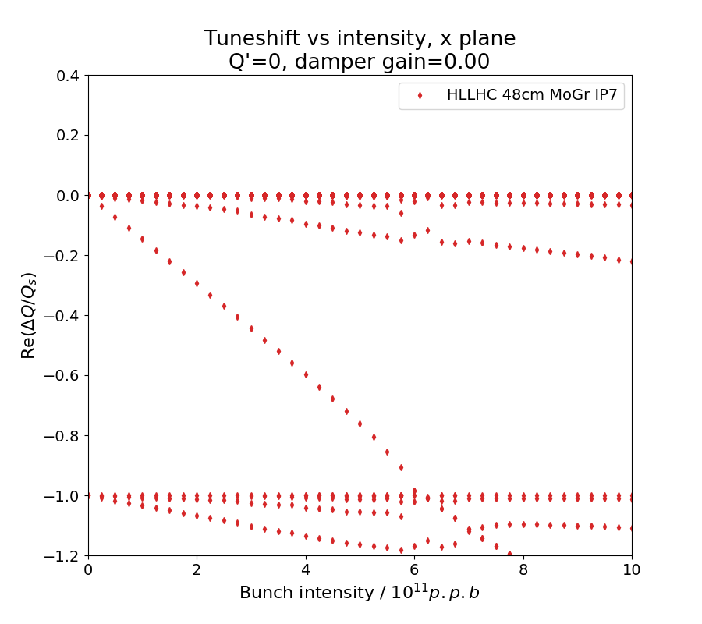
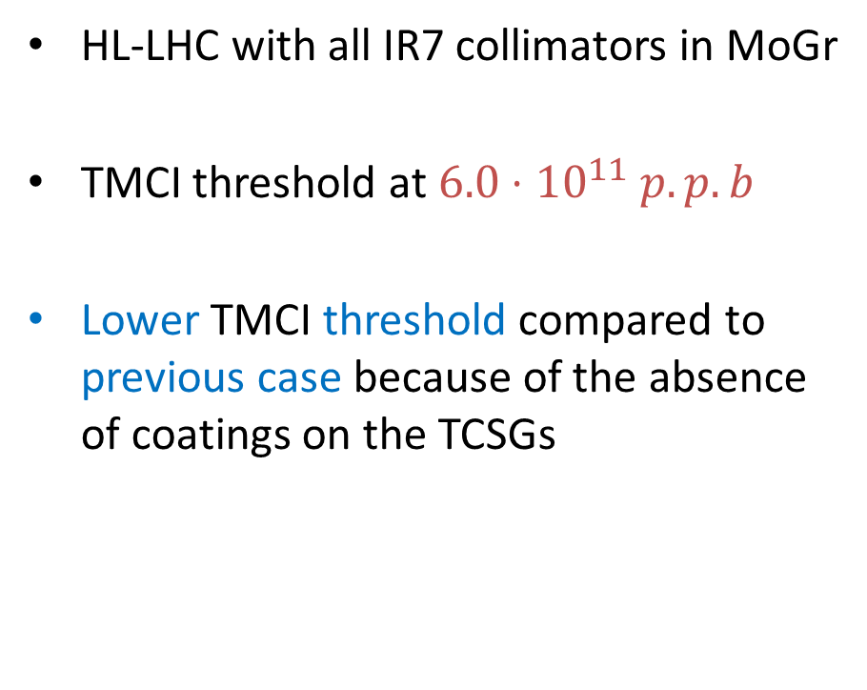
Scenario: HL-LHC48 cm MoGr IP7
HL-LHC with all IR7 collimators in MoGr
TMCI threshold at $6.0⋅{10}^{11} p.p.b$
Lower TMCI threshold compared to previous case because of the absence of coatings on the TCSGs
DELPHI Simulations
6.0
Notes:
TCPs and TCSGs sigmas ?

Slide 11
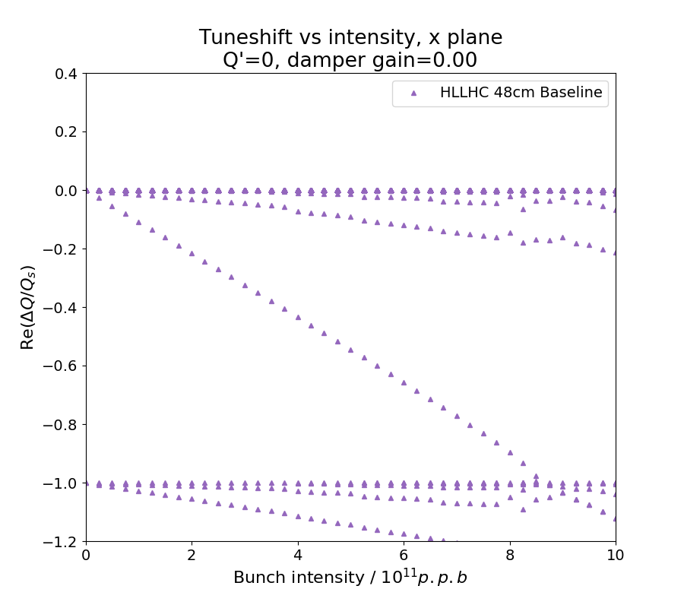
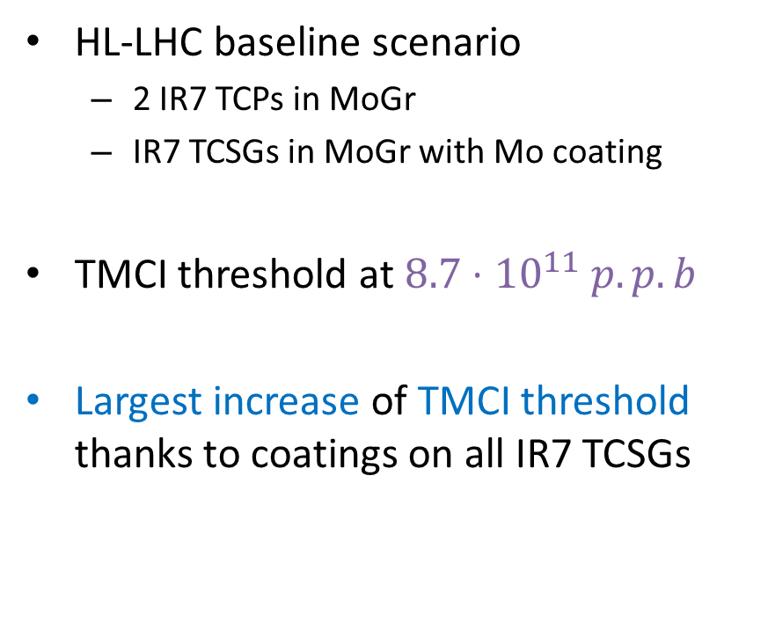
Scenario: HL-LHC 48cm Baseline
HL-LHC baseline scenario
  2 IR7 TCPs in MoGr
  IR7 TCSGs in MoGr with Mo coating
TMCI threshold at $8.7⋅{10}^{11} p.p.b$
Largest increase of TMCI threshold thanks to coatings on all IR7 TCSGs
DELPHI Simulations
8.7
Notes:
TCPs and TCSGs sigmas ?

Slide 12
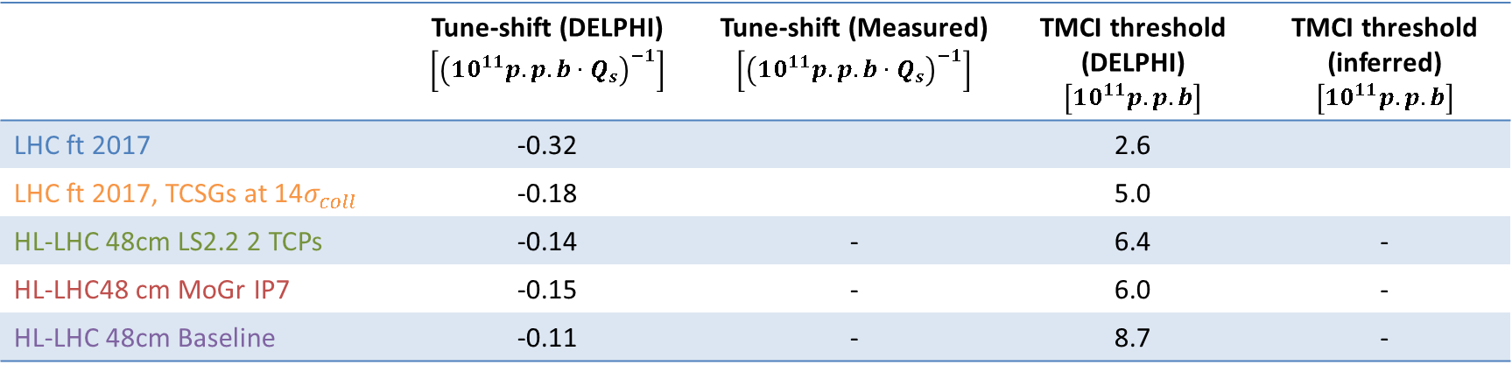
Summary of simulations results
Tune-shift vs. intensity also computed for the different scenarios
Clear TMCI threshold increase when moving the TCSGs out (LHC simulations) or coating them (HL-LHC simulations)
 | Tune-shift (DELPHI) $$\left[{\left(10^{11}p.p.b⋅Q_{s}\right)}^{−1}\right]$$ | Tune-shift (Measured) $$\left[{\left(10^{11}p.p.b⋅Q_{s}\right)}^{−1}\right]$$ | TMCI threshold (DELPHI)$\left[10^{11}p.p.b\right]$ | TMCI threshold (inferred) $$\left[10^{11}p.p.b\right]$$
LHC ft 2017 | -0.32 |  | 2.6
LHC ft 2017, TCSGs at 14$σ_{coll}$ | -0.18 |  | 5.0
HL-LHC 48cm LS2.2 2 TCPs | -0.14 | - | 6.4 | -
HL-LHC48 cm MoGr IP7 | -0.15 | - | 6.0 | -
HL-LHC 48cm Baseline | -0.11 | - | 8.7 | -

Slide 13
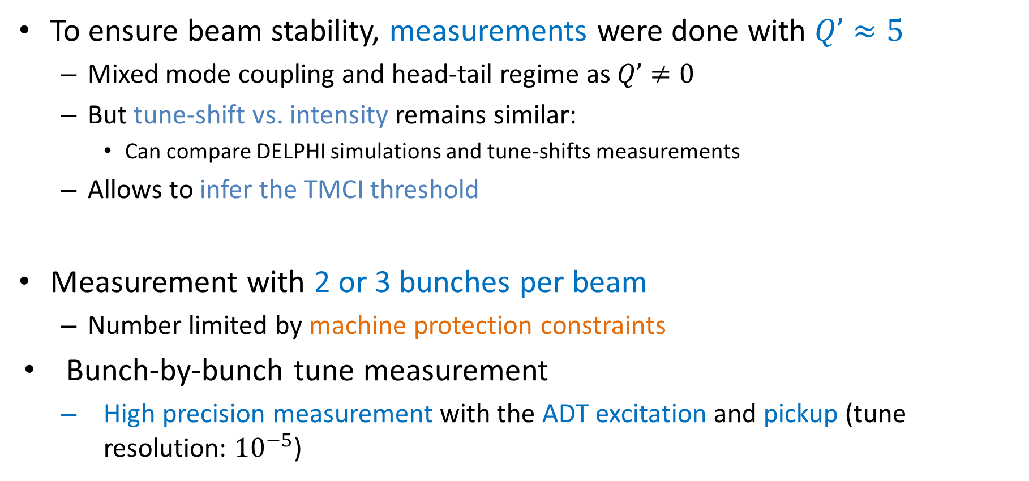
Measurement of the TMCI threshold
To ensure beam stability, measurements were done with $Q’≈5$
  Mixed mode coupling and head-tail regime as $Q’≠0$
  But tune-shift vs. intensity remains similar:
    Can compare DELPHI simulations and tune-shifts measurements
  Allows to infer the TMCI threshold
Measurement with 2 or 3 bunches per beam
  Number limited by machine protection constraints
Bunch-by-bunch tune measurement
  High precision measurement with the ADT excitation and pickup (tune resolution: ${10}^{−5}$)
Notes:
Show a first plot without HLLHC results

Slide 14
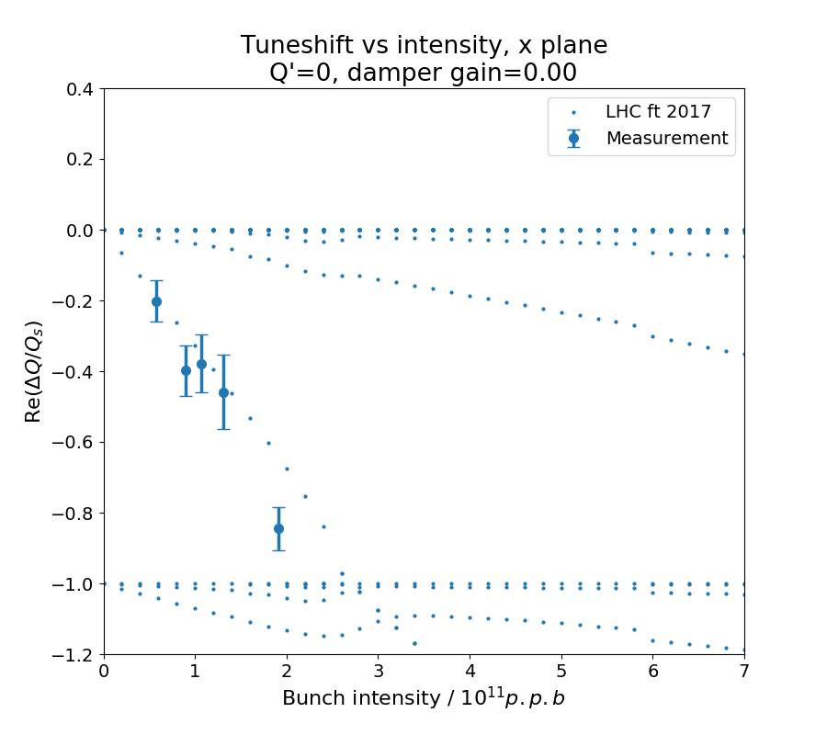
Measurement of the TMCI threshold, B2H
Simulations
Mode 0
Mode -1
Notes:
Show a first plot without HLLHC results

Slide 15
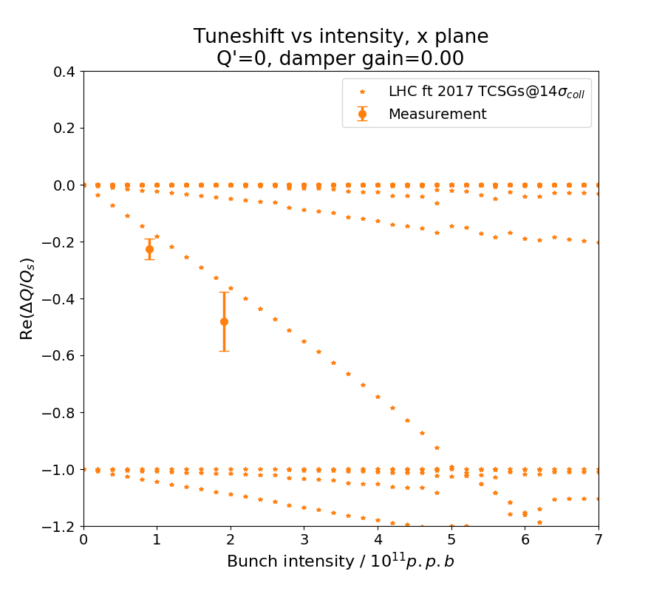
Measurement of the TMCI threshold, B2H
Mode 0
Mode -1
Notes:
Show a first plot without HLLHC results

Slide 16
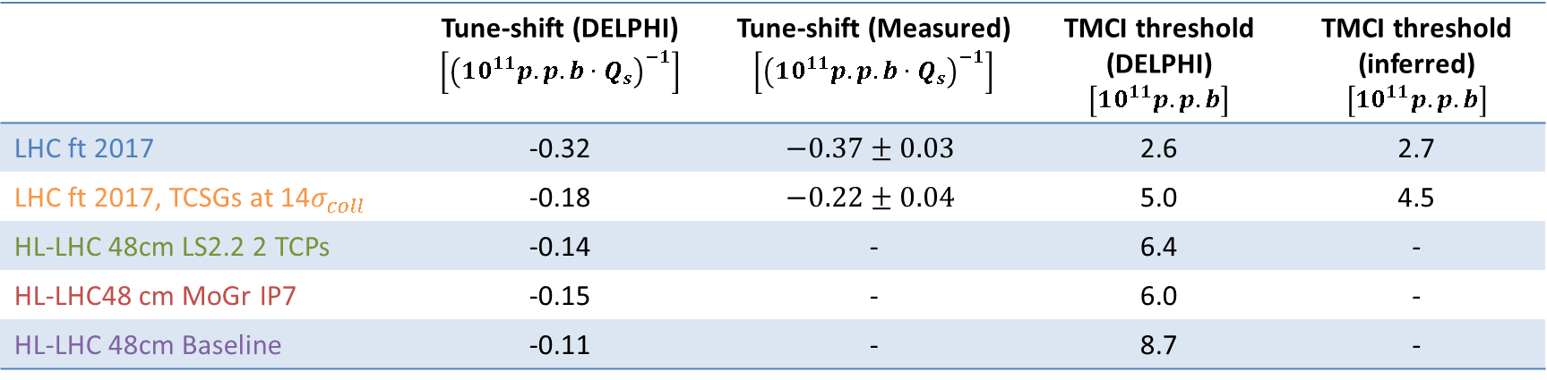
Summary of simulations results
Measured tune-shift higher than simulated
But a clear reduction is observed when opening the TCSGs
  Confirms the critical role played by IR7 TCSGs on impedance
Inferred TMCI threshold is also increased
 | Tune-shift (DELPHI) $$\left[{\left(10^{11}p.p.b⋅Q_{s}\right)}^{−1}\right]$$ | Tune-shift (Measured) $$\left[{\left(10^{11}p.p.b⋅Q_{s}\right)}^{−1}\right]$$ | TMCI threshold (DELPHI)$\left[10^{11}p.p.b\right]$ | TMCI threshold (inferred) $$\left[10^{11}p.p.b\right]$$
LHC ft 2017 | -0.32 | $$−0.37±0.03$$ | 2.6 | 2.7
LHC ft 2017, TCSGs at 14$σ_{coll}$ | -0.18 | $$−0.22±0.04$$ | 5.0 | 4.5
HL-LHC 48cm LS2.2 2 TCPs | -0.14 | - | 6.4 | -
HL-LHC48 cm MoGr IP7 | -0.15 | - | 6.0 | -
HL-LHC 48cm Baseline | -0.11 | - | 8.7 | -

Slide 17
Conclusions
The LHC and HL-LHC TMCI thresholds were investigated with simulations and measurements
  Measurement useful to assess the LHC impedance and stability model at low chromaticities
  Probe the possible stability limitations for HL-LHC
Direct measurement in the machine is challenging because of operational and safety constraints
  The TMCI threshold can be inferred by measuring the tune-shift versus bunch intensity
  Higher than simulated tune-shifts vs. intensity were found
Highlighted the beneficial effect of low resistivity collimators for HL-LHC
  Reproduced a low impedance scenario by changing the IR7 TCSGs gaps
  Clear tune-shift reduction and inferred a TMCI threshold 70% higher than for LHC

Slide 18
Backup
Notes:
Add quadrupolar effect
Add V plane:
- V plane is less critical for LHC and HL
Add B1: difference between B1 and B2 for LHC case

Slide 19
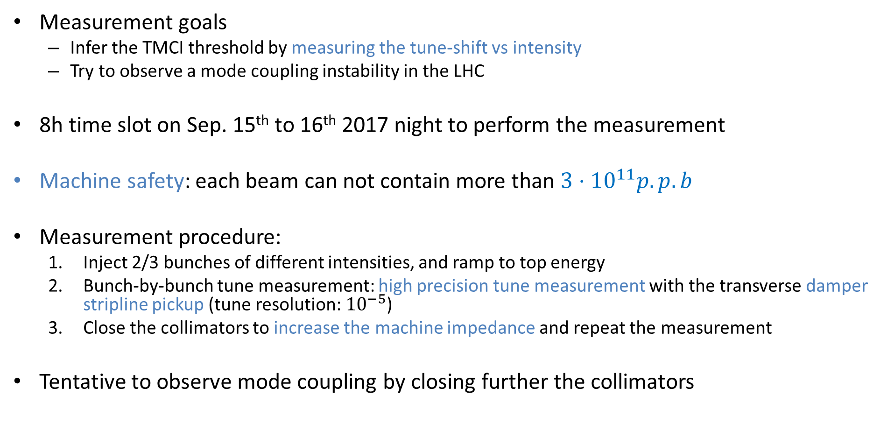
TMCI in the LHC: measurement procedure
Measurement goals
  Infer the TMCI threshold by measuring the tune-shift vs intensity
  Try to observe a mode coupling instability in the LHC
8h time slot on Sep. 15th to 16th 2017 night to perform the measurement
Machine safety: each beam can not contain more than $3⋅{10}^{11}p.p.b$
Measurement procedure:
  Inject 2/3 bunches of different intensities, and ramp to top energy
  Bunch-by-bunch tune measurement: high precision tune measurement with the transverse damper stripline pickup (tune resolution: ${10}^{−5}$)
  Close the collimators to increase the machine impedance and repeat the measurement
Tentative to observe mode coupling by closing further the collimators
Notes:
State of the art measurement
10-5 precision
ADT stripline BPM
LHC BPMs not precise to reach this precision

Slide 20
Comparison of B2H simulations without and with damper
Notes:
Add quadrupolar effect
Add V plane:
- V plane is less critical for LHC and HL
Add B1: difference between B1 and B2 for LHC case

Slide 21
Measurement of the TMCI threshold, B2H
Notes:
Show a first plot without HLLHC results

Slide 22
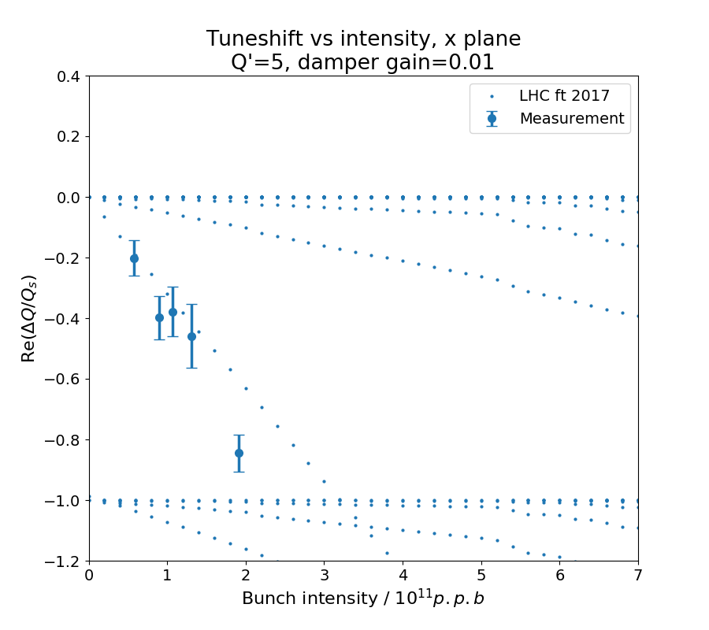
Measurement of the TMCI threshold, B2H
Notes:
Show a first plot without HLLHC results

Slide 23
Measurement of the TMCI threshold, B2H
Notes:
Show a first plot without HLLHC results

Slide 24
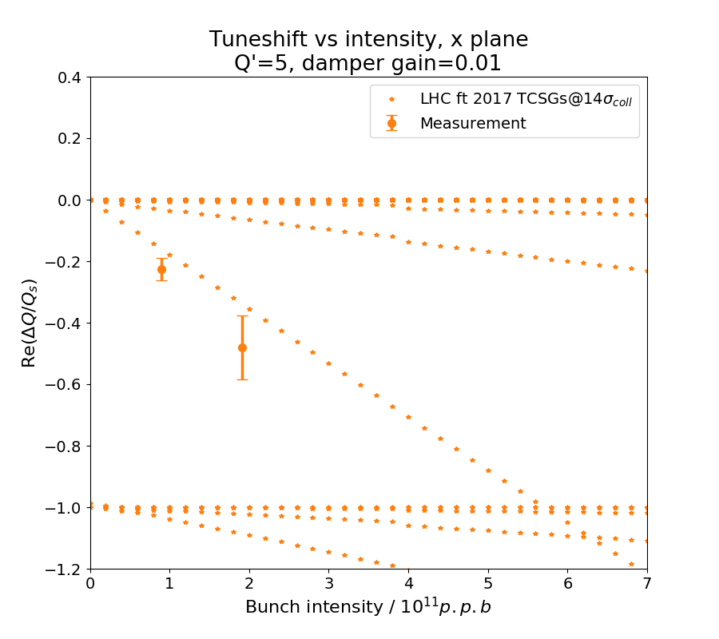
Measurement of the TMCI threshold, B2H
Notes:
Show a first plot without HLLHC results

Slide 25
Results for B2V
Notes:
Add quadrupolar effect
Add V plane:
- V plane is less critical for LHC and HL
Add B1: difference between B1 and B2 for LHC case

Slide 26
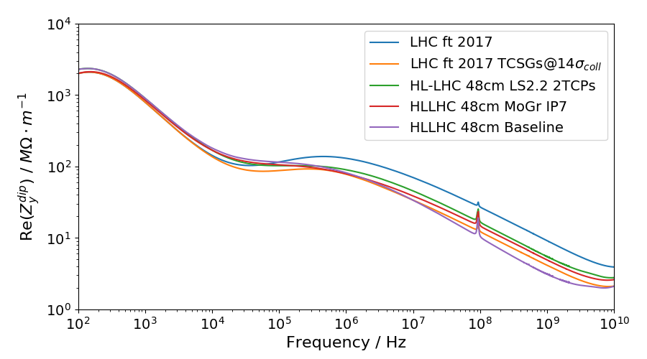
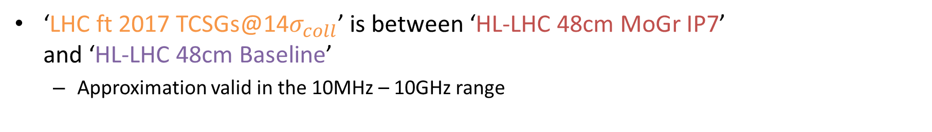
Impedance models for the five cases, B2V
‘LHC ft 2017 TCSGs@14$σ_{coll}$’ is between ‘HL-LHC 48cm MoGr IP7’
and ‘HL-LHC 48cm Baseline’
  Approximation valid in the 10MHz – 10GHz range
Notes:
Change plot to simplified one

Slide 27
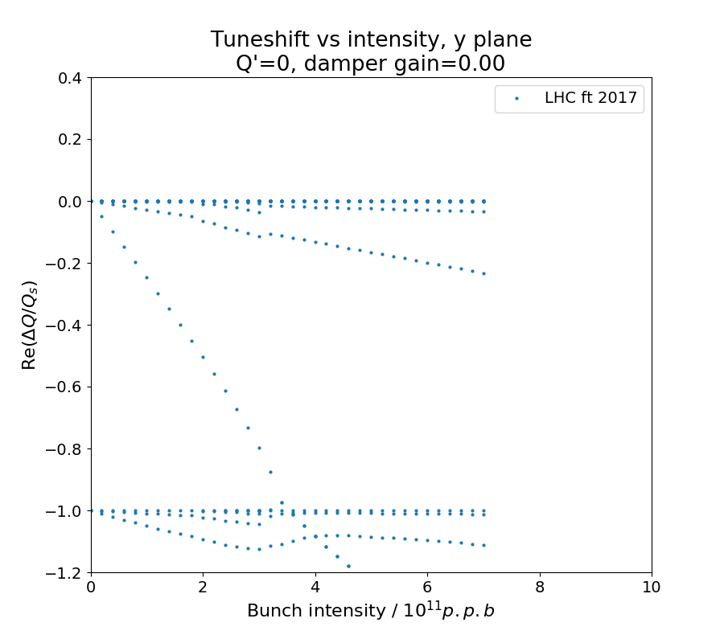
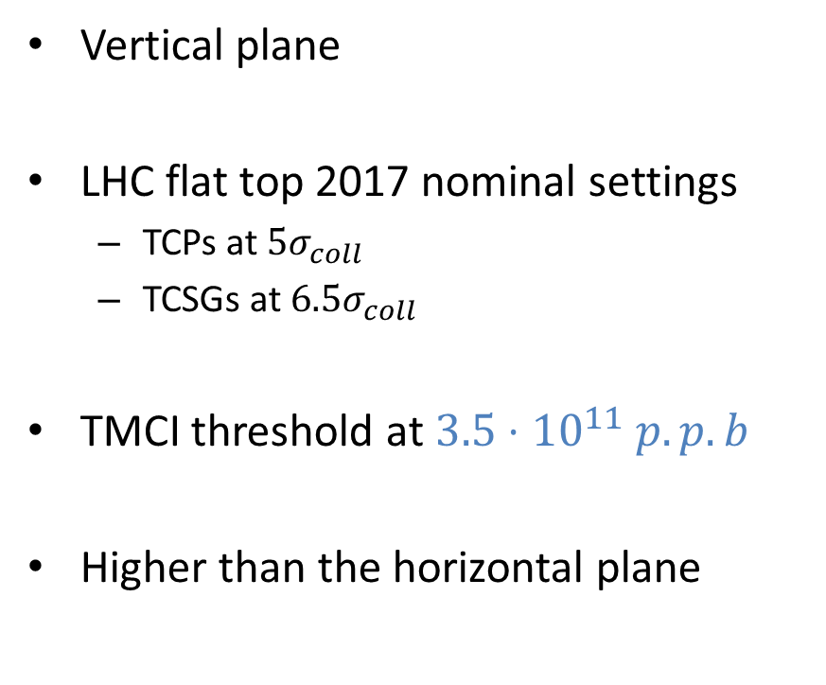
Scenario: LHC ft 2017
Vertical plane
LHC flat top 2017 nominal settings
  TCPs at $5σ_{coll}$
  TCSGs at $6.5σ_{coll}$
TMCI threshold at $3.5⋅{10}^{11} p.p.b$
Higher than the horizontal plane
DELPHI Simulations
3.5
Notes:
Show a first plot without HLLHC results

Slide 28
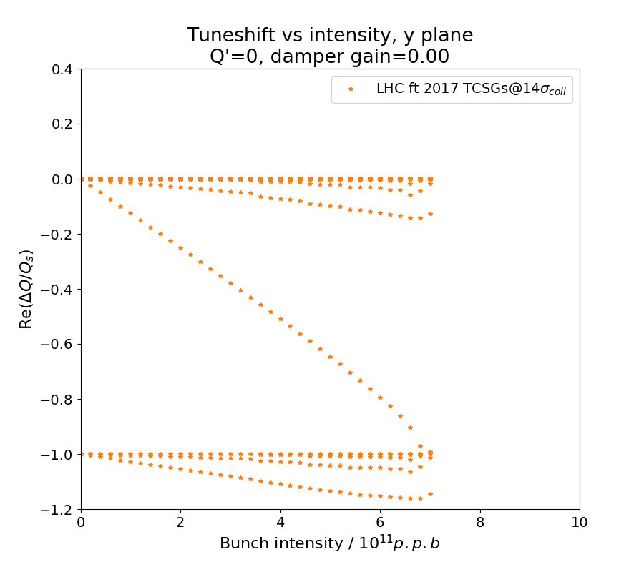
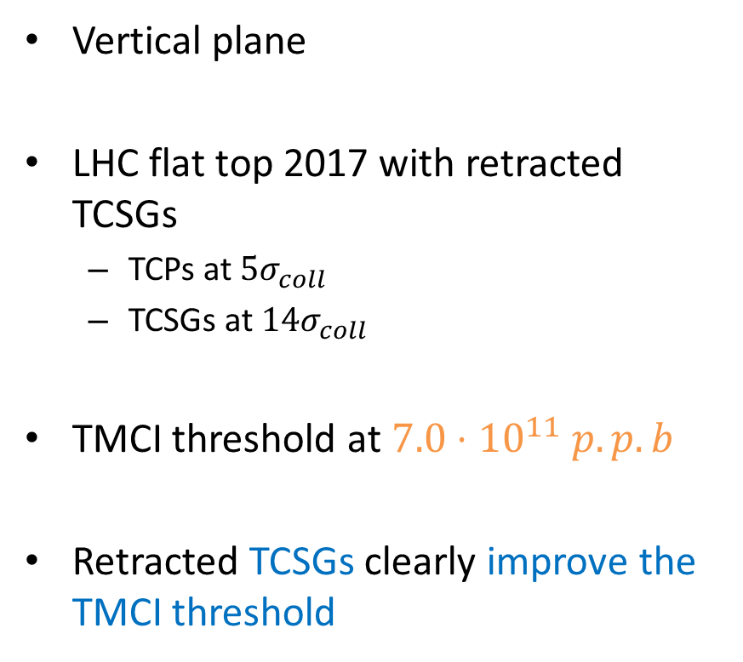
Scenario: LHC ft 2017, TCSGs at 14$σ_{coll}$
Vertical plane
LHC flat top 2017 with retracted TCSGs
  TCPs at $5σ_{coll}$
  TCSGs at $14σ_{coll}$
TMCI threshold at $7.0⋅{10}^{11} p.p.b$
Retracted TCSGs clearly improve the TMCI threshold
DELPHI Simulations
7.0
Notes:
Show a first plot without HLLHC results

Slide 29
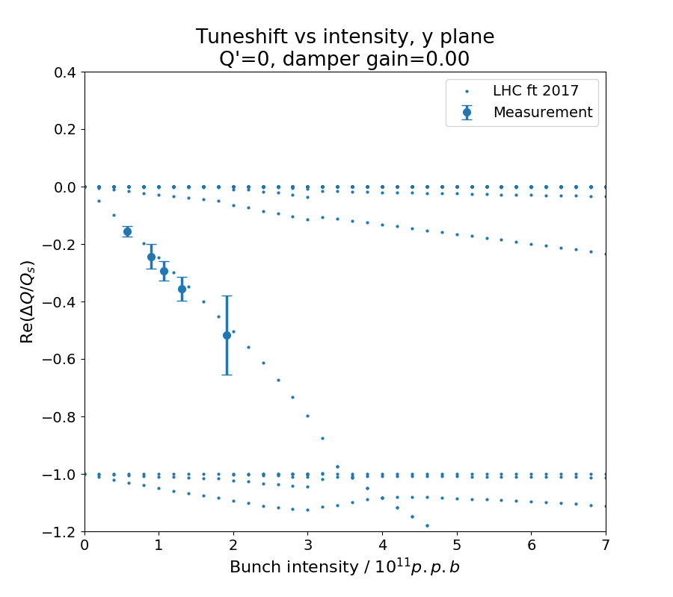
Measurement of the TMCI threshold, B2V
Notes:
Show a first plot without HLLHC results

Slide 30
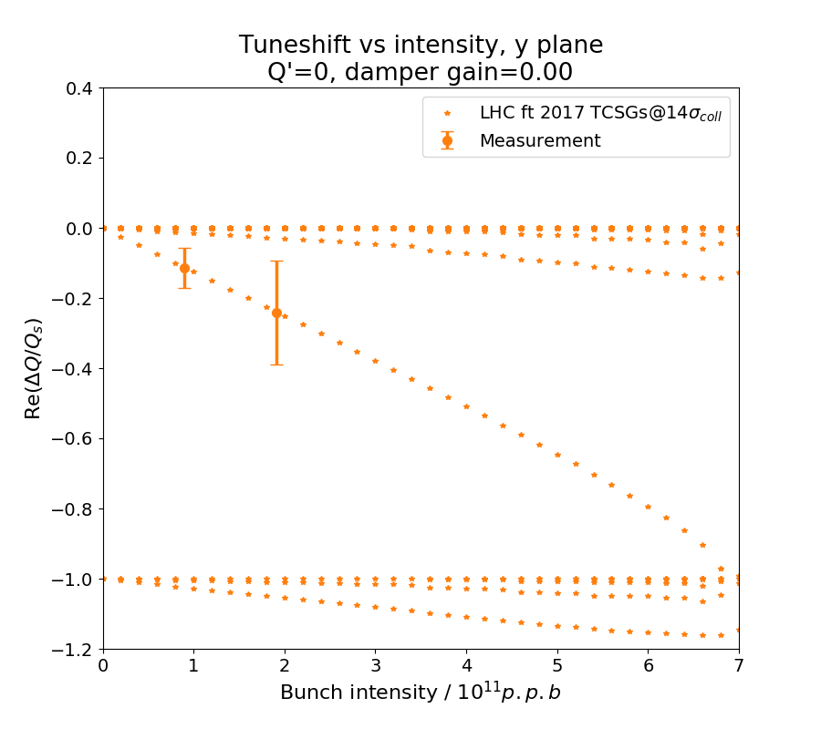
Measurement of the TMCI threshold, B2V
Notes:
Show a first plot without HLLHC results

Slide 31
Results for B1H and B1V
Notes:
Add quadrupolar effect
Add V plane:
- V plane is less critical for LHC and HL
Add B1: difference between B1 and B2 for LHC case

Slide 32
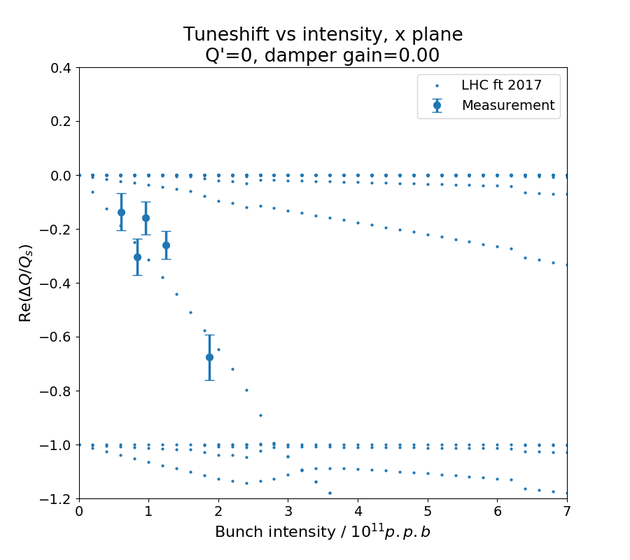
Measurement of the TMCI threshold, B1H
Notes:
Show a first plot without HLLHC results

Slide 33
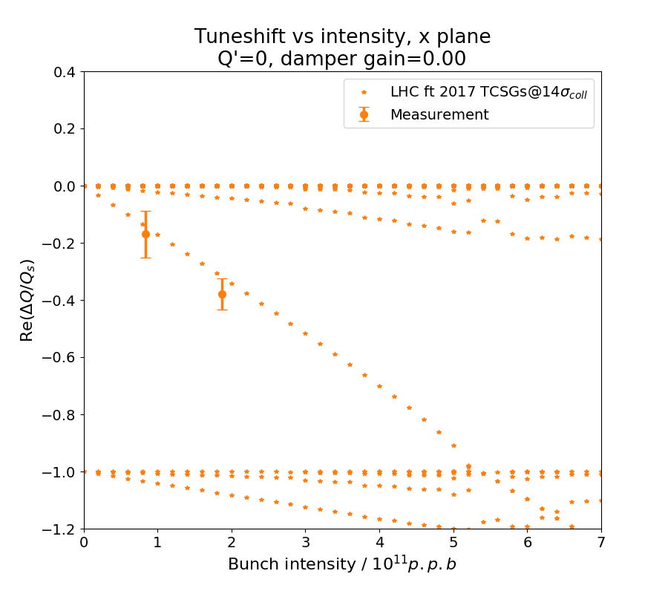
Measurement of the TMCI threshold, B1H
Notes:
Show a first plot without HLLHC results

Slide 34

Measurement of the TMCI threshold, B1V
Notes:
Show a first plot without HLLHC results

Slide 35
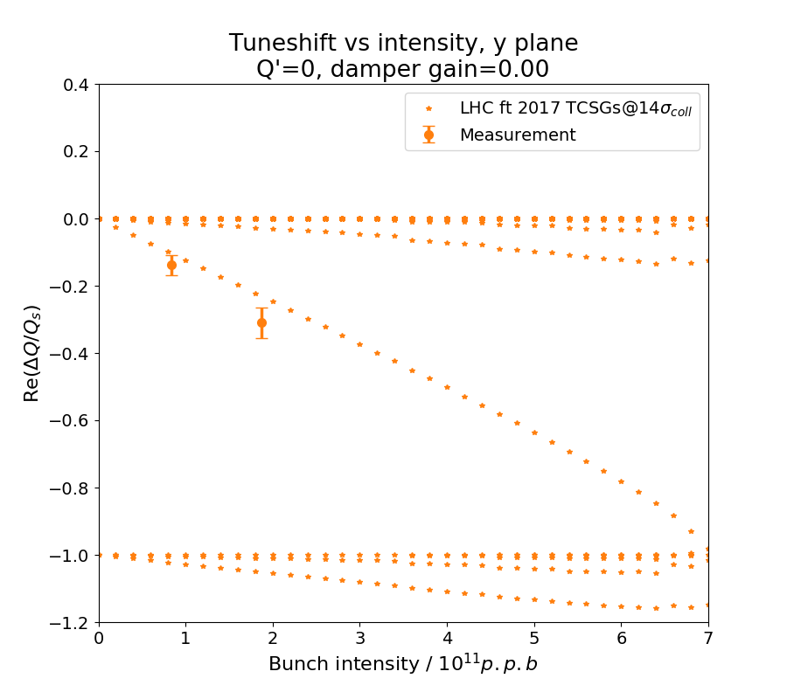
Measurement of the TMCI threshold, B1V
Notes:
Show a first plot without HLLHC results

