Slide 2
Instagram lessons learnt
Cristina Agrigoroae, Kate Kahle

Slide 3
Defining a strategy
What is the goal of your Instagram channel?
What are the key messages?
Who is your audience?
How much time and resources do you want to commit to the channel?
What will be the frequency of posts?

Slide 4
Building an audience
Look at relevant hashtags already on Instagram and like the posts so people see that you exist
CERN uses #CERNalumni for our throwback Thursday posts

Slide 5
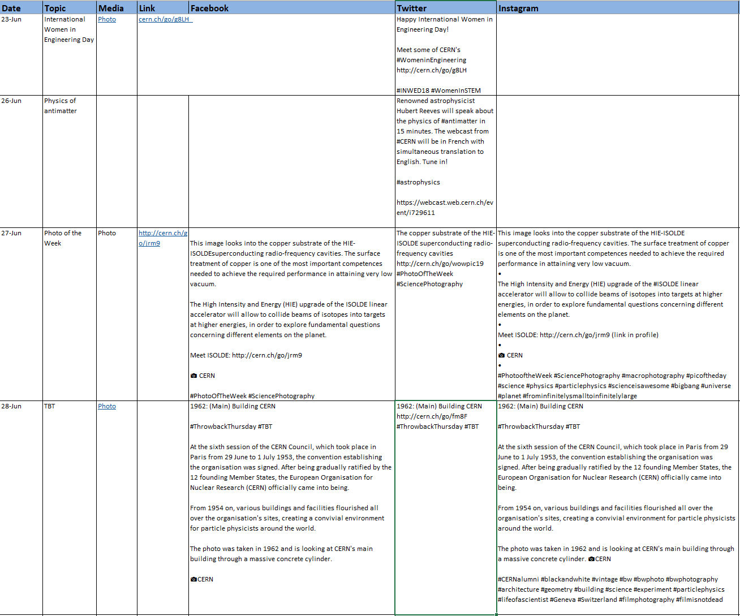
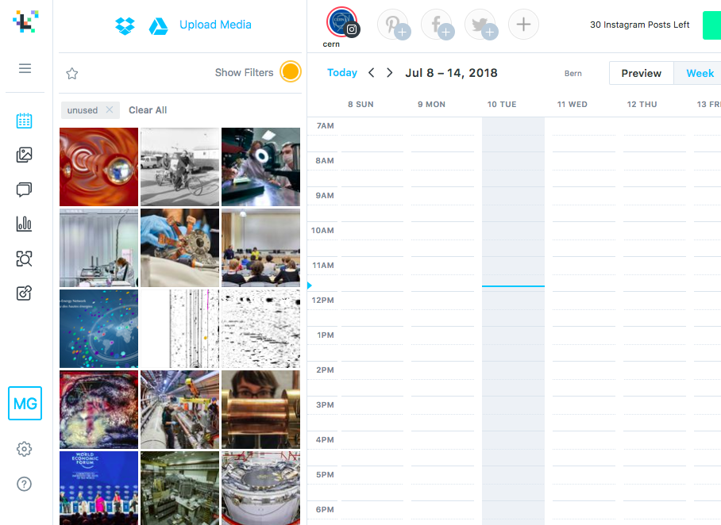
Calendar and frequency of posts
Excel calendar
Later.com

Slide 6
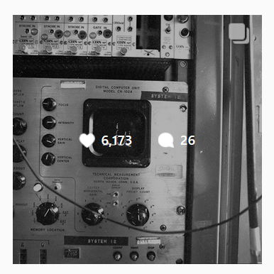
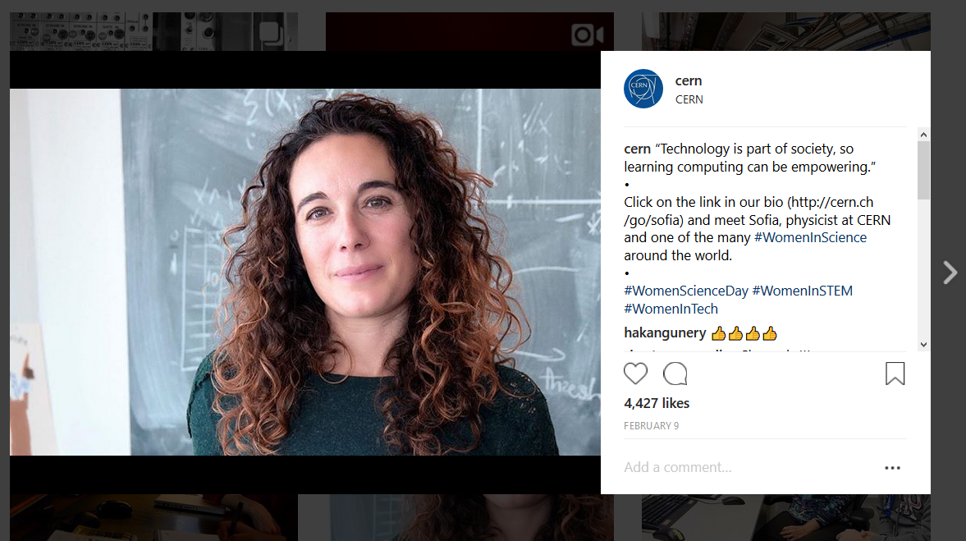
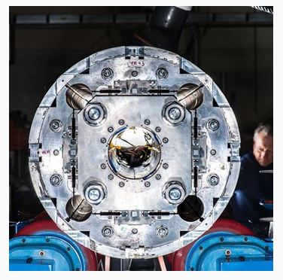

Choosing images
Albums
Retro images
Portraits
Artistic techy images

Slide 7
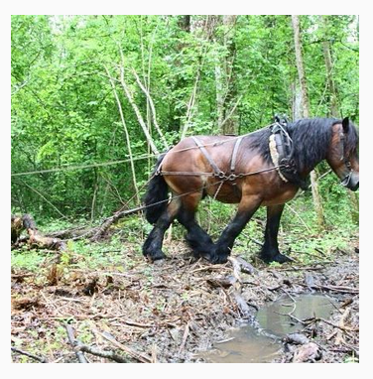
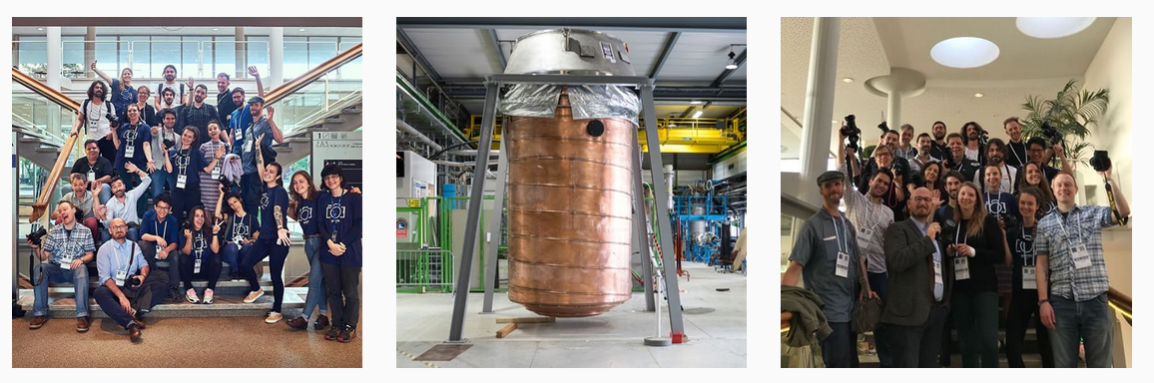
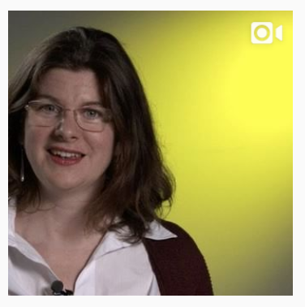
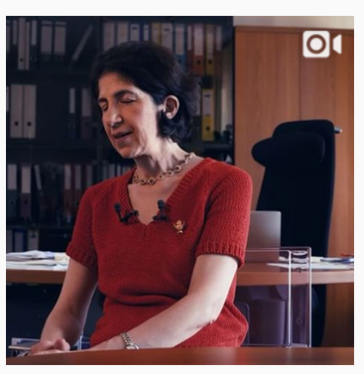
Choosing images: our mistakes
Photos taken with a phone, badly lit
Videos in the feed (better to use stories)
“normal photos”, low res, strangely cropped

Slide 8
Accompanying text
Bio
Link in bio
Use of hashtags
Using short links https://webservices.web.cern.ch/webservices/Services/ShortenUrl/

Slide 9
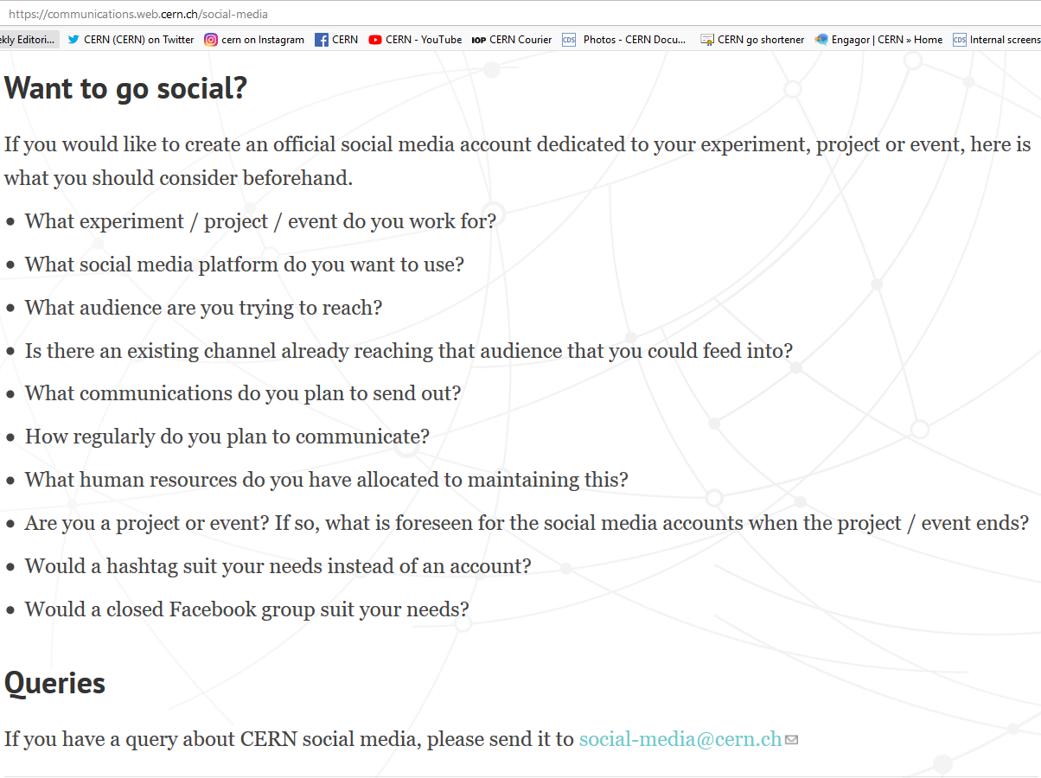
Conclusions
Running a social media account takes time and resources, here’s the advice we generally give:

Slide 10
home.cern

