Slide 1
SNS Ring BPM
Old and New
Richard Dickson
Nov 12, 2018

Slide 2
Topics:
Facility overview
Old system and requirements
New system topology and functional diagrams
Data compression
Jitter reduction
New capabilities

Slide 3
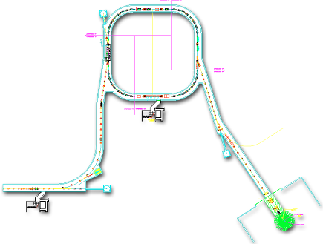


Spallation Neutron Source (SNS) Accelerator Complex
Accumulator Ring: compress 1-msec long pulse to ~700 nsec
Collimators
Front-End:
Produce a 1-msec long, chopped, H- beam
Injection
Extraction
1 GeV LINAC
RF
<1 μsec
2.5 MeV
186 MeV
1000 MeV
RTBT
HEBT
Front-End
Warm LINAC
Cold LINAC
Liquid Hg Target
Chopper system makes gaps
38A
945 ns
mini-pulse
Current
Current
38mA
1 ms macropulse
1ms
1 ms macropulse
1 ms
Courtesy of A. Aleksandrov
The SNS is located in Oak Ridge, Tennessee (U.S.)

Slide 4
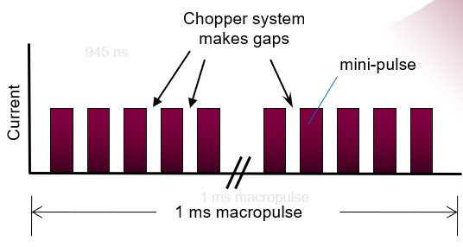
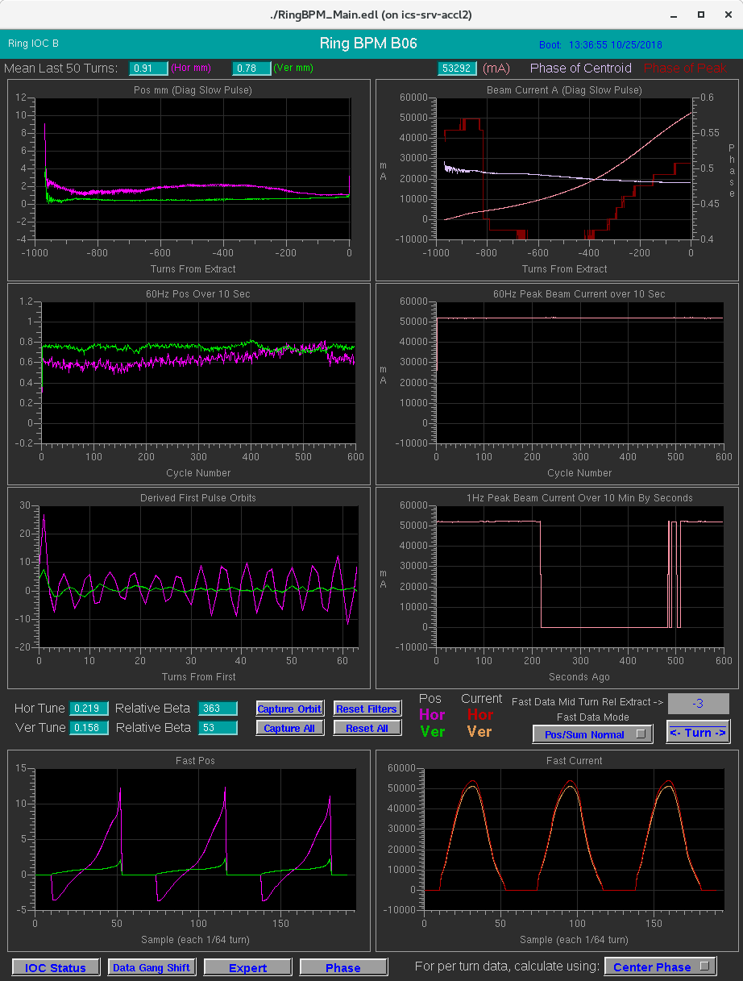
Ring Beam Structure
Nice square pulses: Not!
Beam varies within and between each turn in:
Intensity
Position
Energy
Beam in 4/5 of beam turn.
(~800nS of ~1000nS)

Slide 5
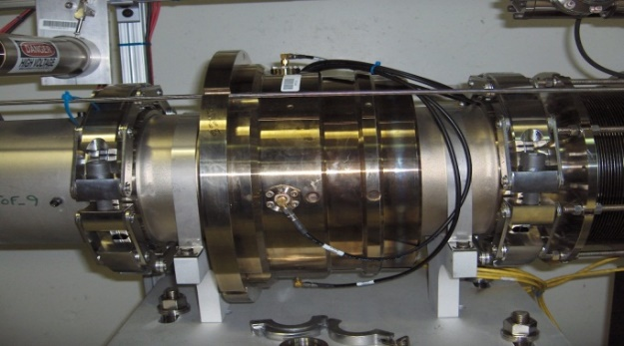
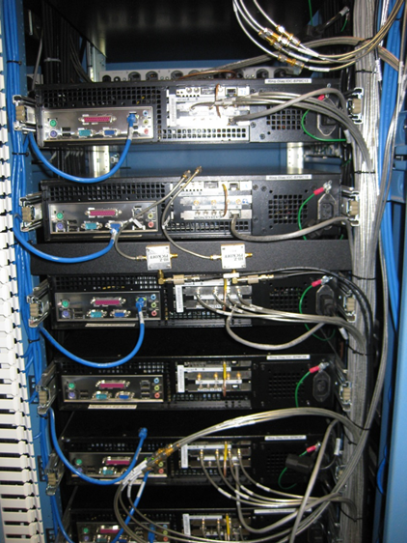
SNS Ring Beam Position Monitors (BPMs)
44 floated strip-line BPMs of aperture: (28) 21cm, (8) 26cm, (8) 30 cm
Position Resolution and Accuracy of +/- 1% half aperture
Original requirement of ~5E10 to 2E14 protons per pulse (~8mA to 35A).
  Now ~6E9 to 6E14 ppp (~1mA to 100A)
  Dynamic range is of major importance
Custom made PCI AFE and digital cards (no in-house expertise)
LV 2001 SW with Embedded Windows XP on individual PCs (one per BPM)
Meets accuracy specs but reliability is poor

Slide 6
New System Motivation
Hardware obsolescence is major problem
  Parts, cards, PC motherboards
Software obsolescence is major problem
  Impossible to upgrade OS, security concerns
Lost ability to repair boards with personnel attrition
Original system limited to 1Hz. Would like to include 60Hz acquisition.
Long term solution: New System

Slide 7
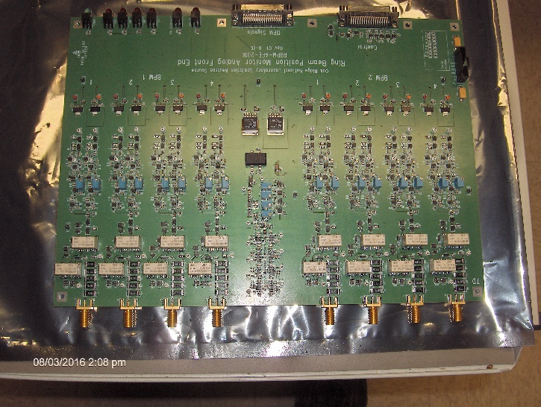
New Analog Front End

Slide 8
Analog Front End System Diagram
(Each AFE hosts 2 BPMs)
To Digitizer
To Digitizer
AFE
5 MHz
Filter
5 MHz
Filter
Low Gain
Amp
High Gain
Amp
X8
Relay Switch
Each wire
Cal Oscillator
(1 MHz)
CPU Control & Status
X8
2 BPMs
(2 X 4 Wires)

Slide 9
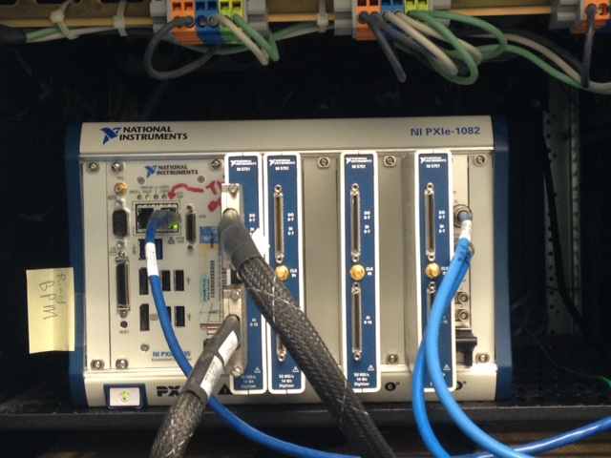
PXIe system with four FPGA/Digitizer(center blue), processor running LabVIEW RealTime (left) and SNS timing card (right).
1/4 space, 1/5 power consumption of previous system.

Slide 10
System Diagram
PXI System
Real Time CPU
EPICS
Network
Beam Envelope Calculation
Data Formatting
RTDL
Envelope
PXI Bus
FPGA (X4)
Gate
Gain Mixing
Timing Decode
Logic
Digitizer
(50 MHz)
Triggers
Data
PXI Bus
SNS Timing Interface
Event Link/
Real Time Data Link
Analog Front End
(2 X 8 Ch High/Low Gain)
NI PXIe-8880 CPU
NI PXIe-7971 FPGA (x4)
NI 5751B ADC (x4)
2 BPM Pickups
(8 Wires)

Slide 11
Data Compression
ADC resolution of 14 bits delivered in 16 bits.
Each BPM wire has high and low gain analog channels (2 ADC channels)
Data is compressed by FPGA for transfer to RT CPU as follows:
Low Gain
1
S
7 Bits (X128)
High Gain (X128)
0
S
Re-Combined
S
21 Bits Range (not resolution)
Data Rates (per BPM, after compression):
1 Hz rate 50 MHz full accumulation: 1.31 mS (512 kB/s)
60 Hz rate single turn position (22.5 kB/s)
60 Hz rate orbit data (30 kB/s)
Each FPGA supports two BPMs (16 ADC channels)
Each system supports four FPGAs (64 ADC channels)

Slide 12
Jitter Reduction

Slide 13
Ring turns as seen by BPM
Stacked
Turns

Slide 14
Jitter Type 1: Sampling Mismatch Jitter
47.75 Samples
47 Samples
48 Samples
50 MHz ADC
With (for example):
1.047115 MHz Ring
50/1.047115 = 47.75 samples/turn

Slide 15
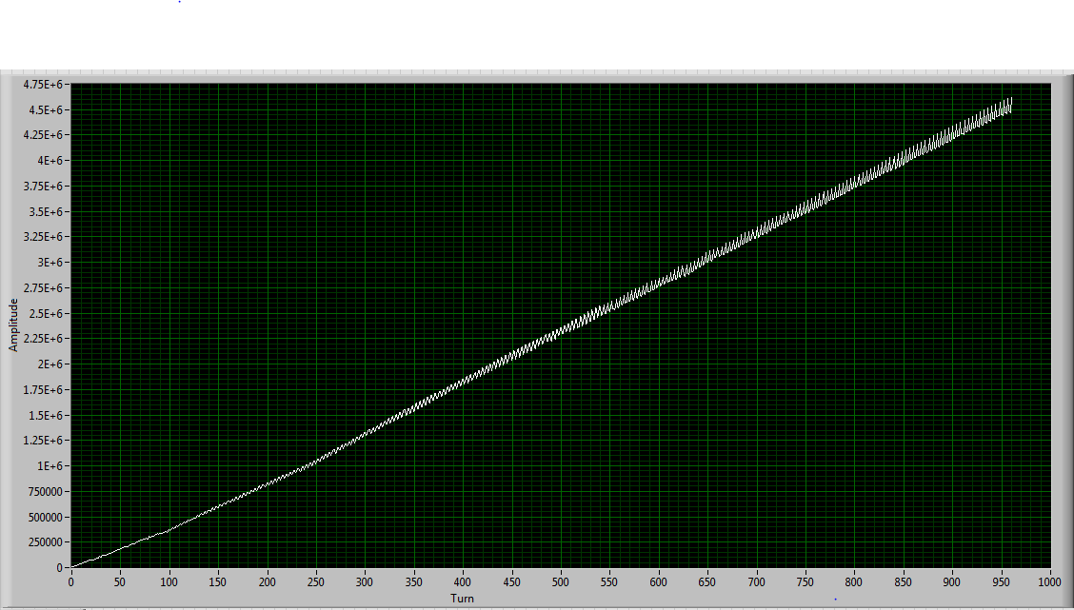
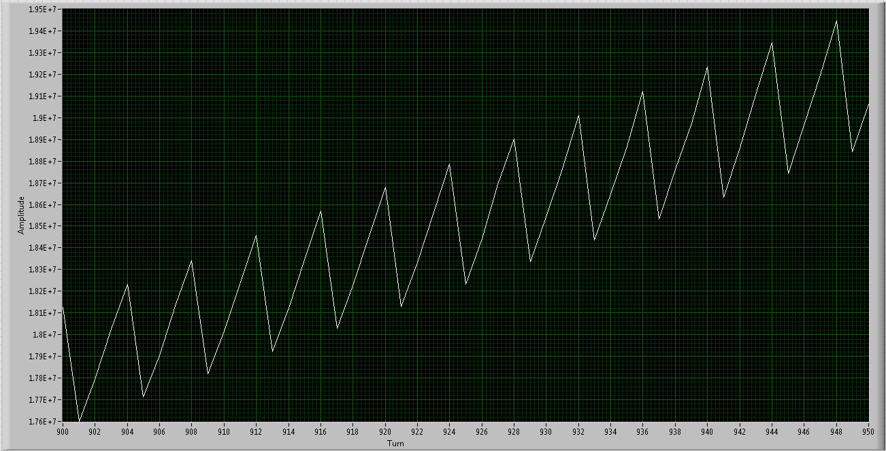

Slide 16
Turn 65/64
ADC n
ADC data is interpolated to force
it to 64 samples per ring turn.
Turn 64/64
ADC n-1
Turn 63/64
ADC n-2
N is ring turn number
n is closest integer number of samples
%
%
% = %
Turn 0, ADC 0

Slide 17
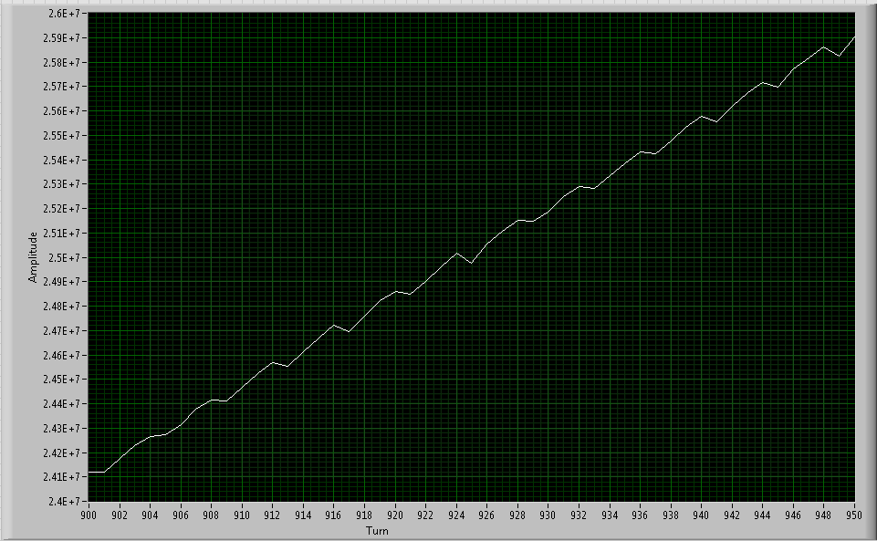
Before:
After:

Slide 18
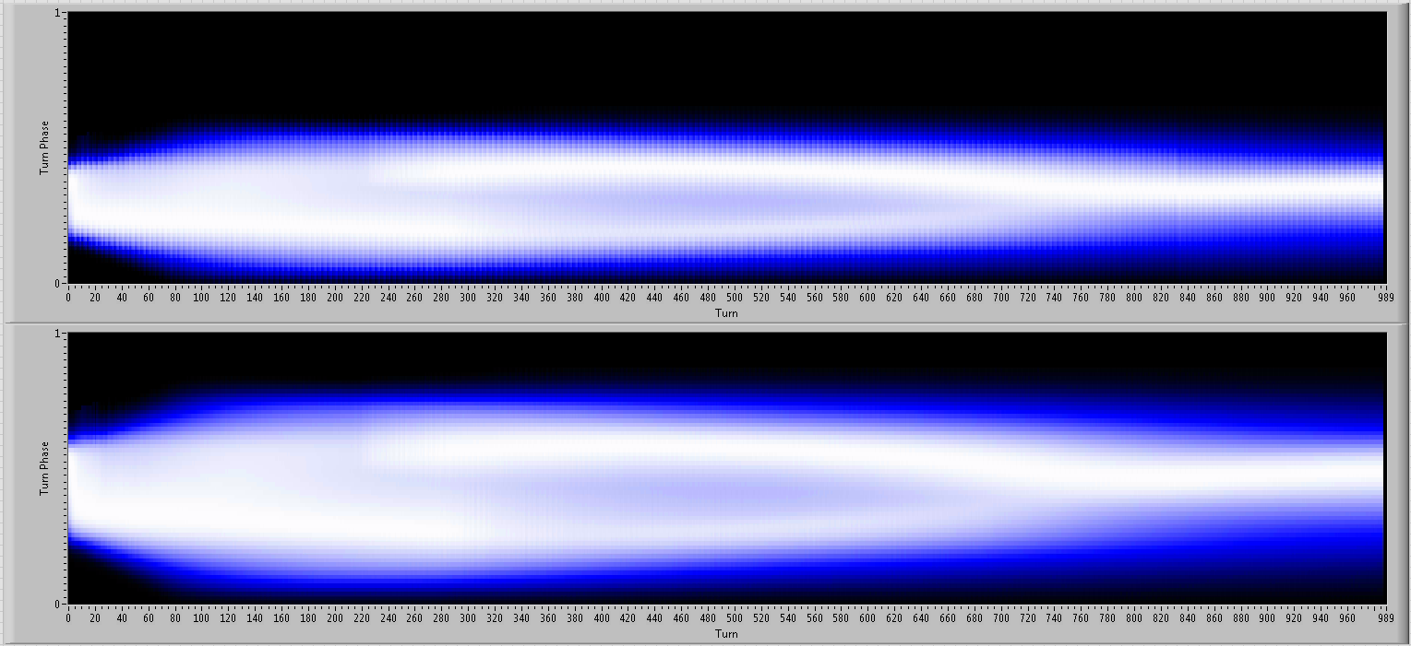

Slide 19
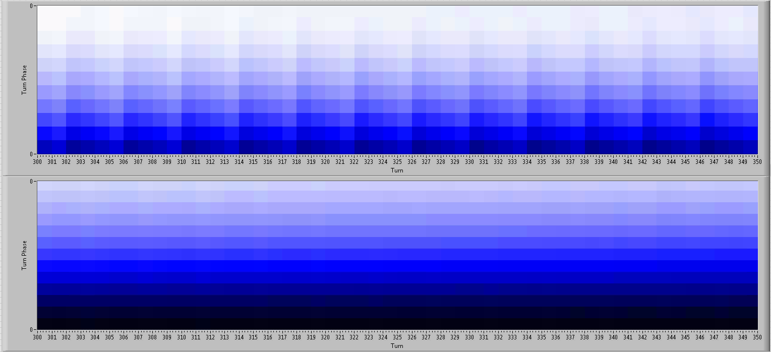

Slide 20
Jitter Type 2: Trigger Jitter
Sample N-1
50 MHz ADC Clock
(20 nS)
Sample N
4
3
Jitter
50 MHz ADC
2
1
Trigger Window
Start
200 MHz Timing
3
0
1
2
3
0
200 MHz Trigger Clock
(5 nS)
SNS Beam Trigger

Slide 21
Sample N-1
50 MHz ADC Clock
Sample N
3
2
1
0
Actual Trigger
3
0
1
2
3
0
200 MHz Timing Clock

Slide 22
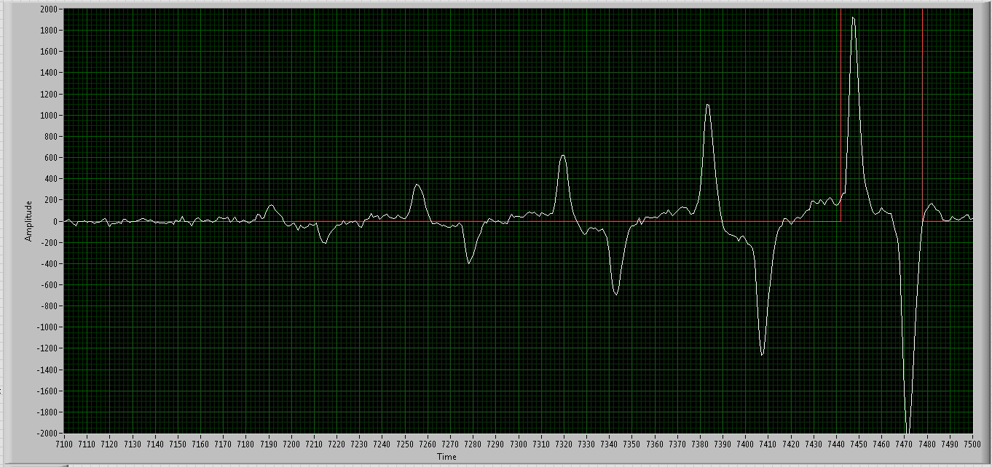
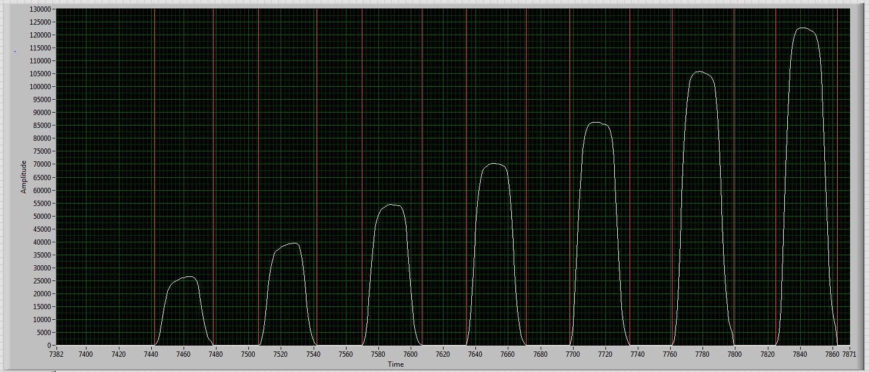
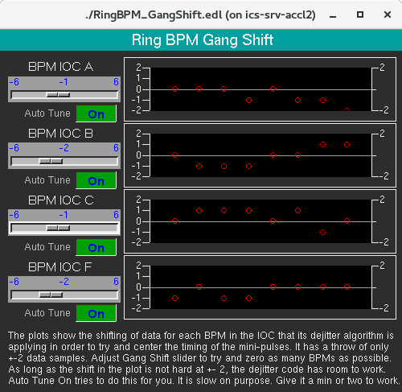

Slide 23
New Features
Orbit synthesis
Centroid/Peak phase display
Single turn motion
Combined screen

Slide 24
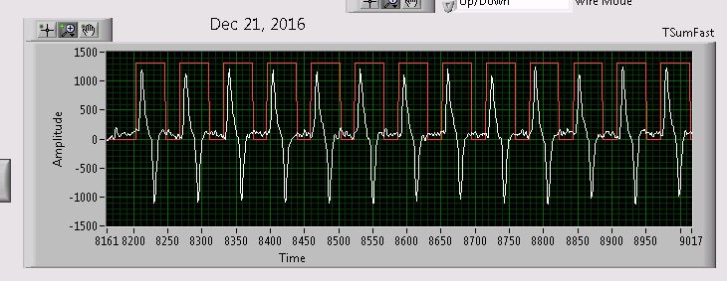
Orbit Synthesis
Multi Pulse Beam
Single Pulse Beam (many Stored Turns)
(Used during tuning to compute “Orbit” of particles in ring)

Slide 25
Pulse
Measured
Single Pulse Orbit De-Convolution
 | 1 | 2 | 3 | 4 | 5 | M
1 | 0 |  |  |  |  | 0
2 | 10 | 0 |  |  |  | 5
3 | -4 | 10 | 0 |  |  | 2
4 | -10 | -4 | 10 | 0 |  | -1
5 | -6 | -10 | -4 | 10 | 0 | -2
On1 = Om1 |  | M1 = O11 |  |  |  |  |  |  | O11 = M1
On2 = Om2 |  | M2 = (O12+O21)/2 |  |  | 2*M2 = O12+O21 |  | O12 = 2*M2 - O21 |  | O12 = 2*M2 - M1
… |  | M3 = (O13+O22+O31)/3 |  |  | 3*M3 = O13+O22+O31 |  | O13 = 3*M3-(O22+O31) |  | O13 = 3*M3 - 2*M2
Ont = Omt |  | M4 = (O14+O23+O32+O41)/4 |  |  | 4*M4 = O14+O23+O32+O41 |  | O14 = 4*M4-(O23+O32+O41) |  | O14 = 4*M4 - 3*M3
* Ont is the orbit (position) of the n'th injected pulse on its t'th turn around the ring. |  |  |  |  |  |  |  |  | O1t = t*M(t) - (t-1)*M(t-1)
Mt is the measured agragate position of all mini-pulses on turn t.
Turn
Pos

Slide 26
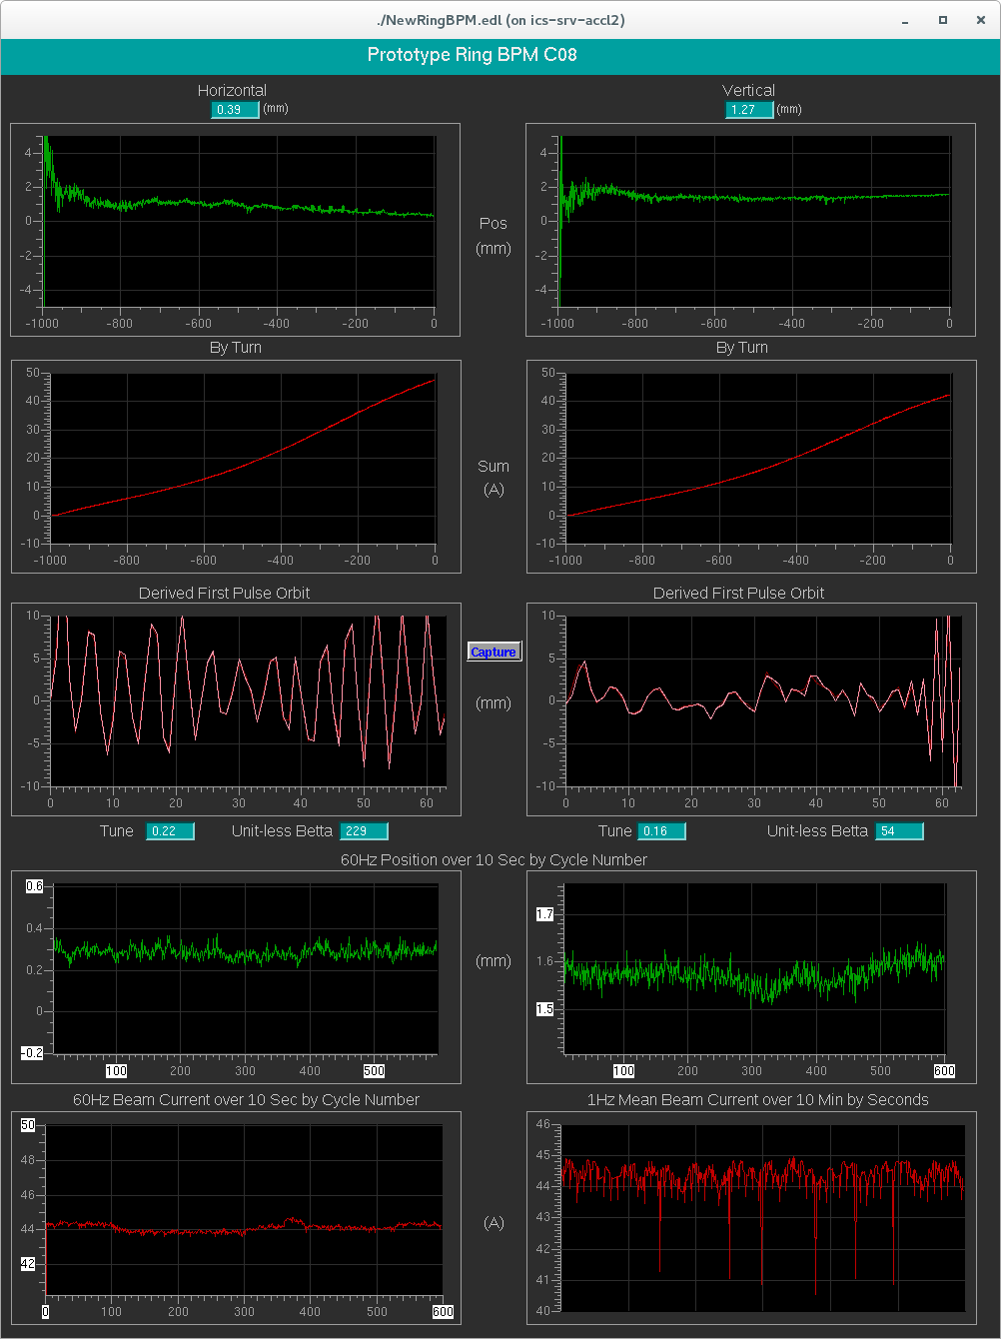

Slide 27
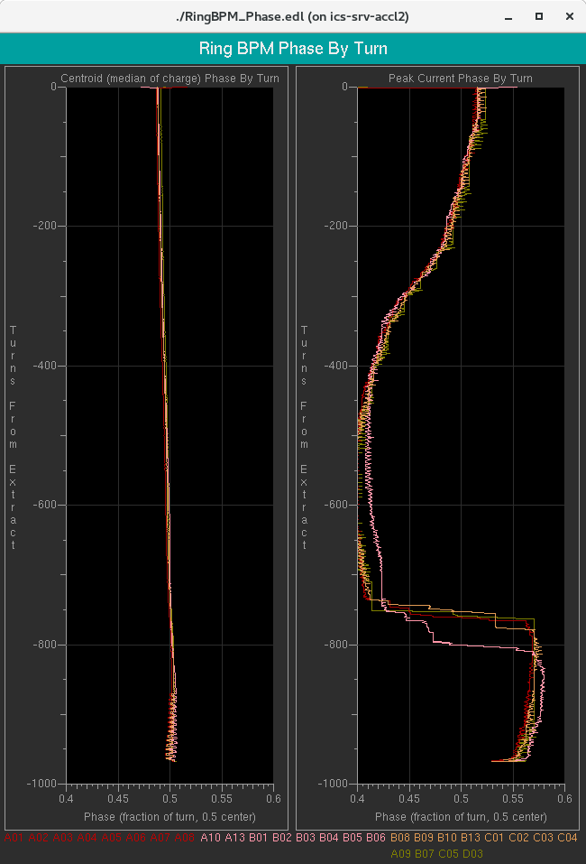
Centroid Phase

Slide 28
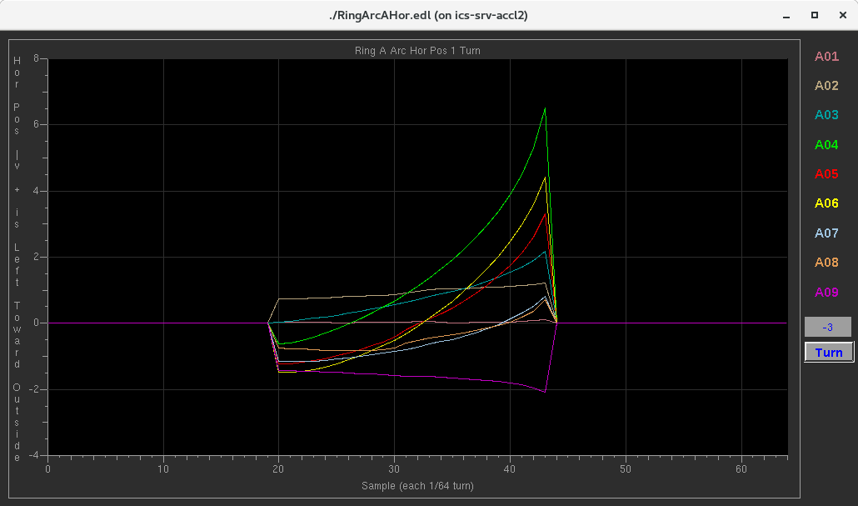
Single Turn Position

Slide 29
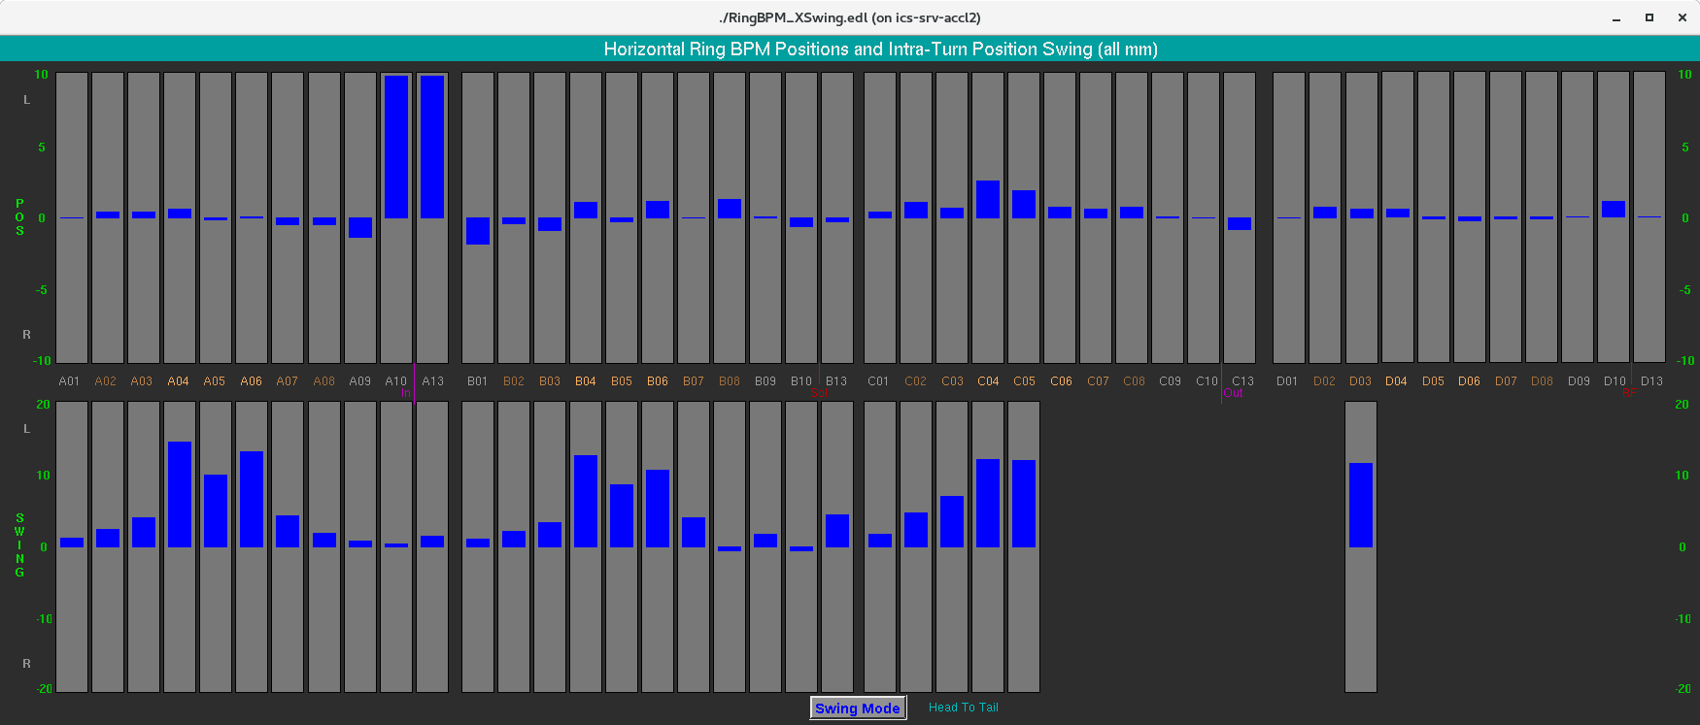
Position and Swing Bars

Slide 30
Combined Screen

Slide 31
SNS Ring BPM
Old and New
Questions?
System development thank you to:
Alexander Aleksandrov
Taylor Davidson
Alysse Dawson
Anthony Webster

Slide 32
The following slides are not part of this presentation.
They are included only in anticipation of being needed to answer questions.

Slide 33
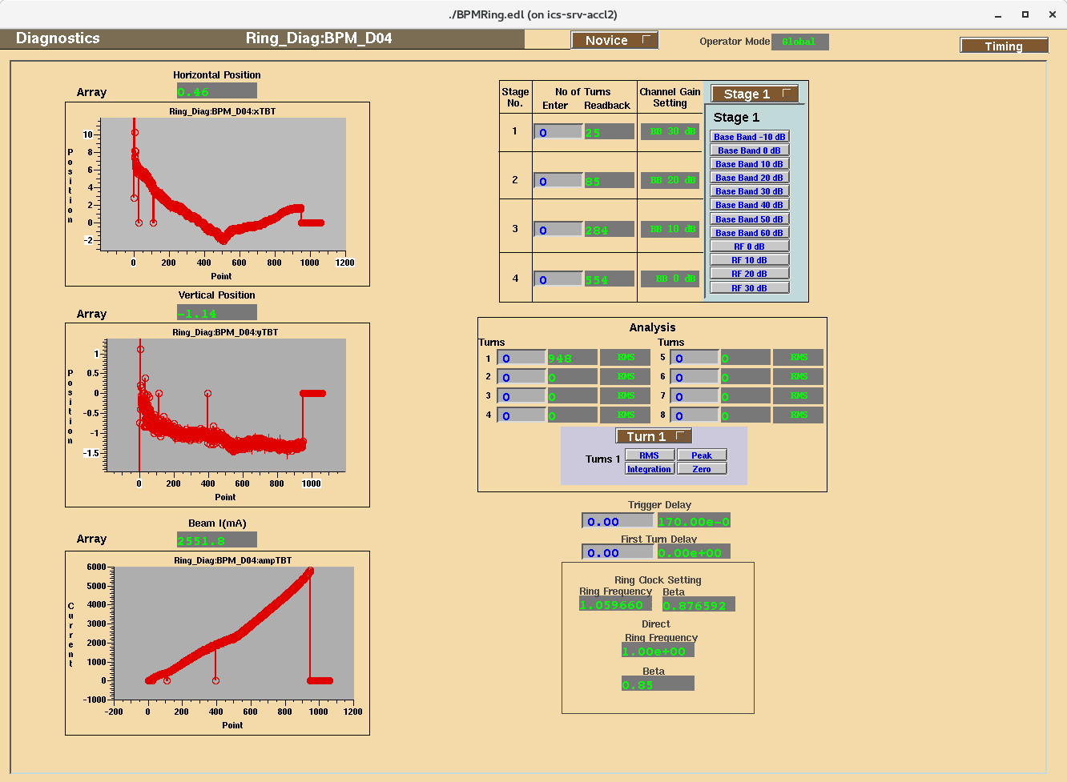

Slide 34
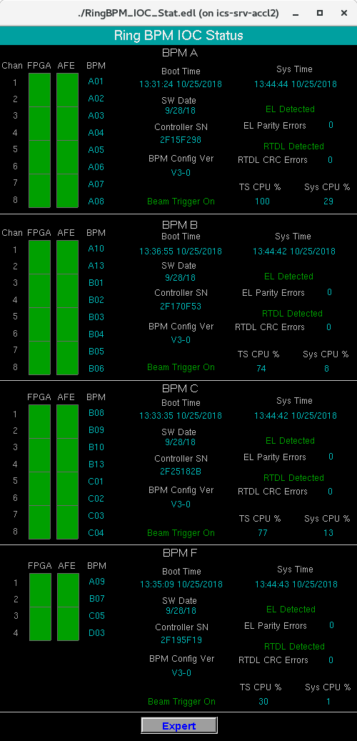

Slide 35
