Slide 1
BPM Signal Processing using Time-Multiplexed
Electrode Signals
M. Wendt
CERN

Slide 2
Outline
Introduction to the Beam Position Measurement
  Symmetry in beam position monitoring
  Calibration methods to ensure a high measurement stability
  Single channel heterodyne receiver
BPM electronics utilizing time-multiplexed electrode signals
  DESY: BPM electronics at HERA-e and FLASH
    Design principle introduced by R. Neumann
  CERN: LHC interlock BPM R&D
    Based on the thesis activities of Oskar Bjorkquist,
    and with help of Irene Degl’Innocenti and Jan Posipil

Slide 3
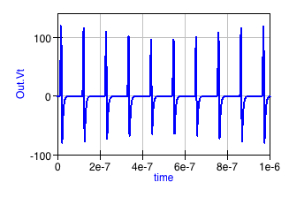
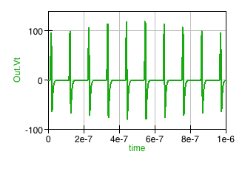


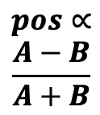


Introduction: A typical BPM setup
small difference mode
signal contents
$$∝beam pos. \\ \frac{A−B}{2}$$
large common mode
signal contents
$$∝beam int. \\ \frac{A+B}{2}$$
analog
digital
A_{elec} signal conditioning
ADC
DAQ
A_{elec} signal
A
beam
position
symmetry
plane
$$pos∝$$
$$\frac{A−B}{A+B}$$
B_{elec} signal
B
B_{elec} signal conditioning
ADC
large common mode
signal contents
$$∝beam int. \\ \frac{A+B}{2}$$
small difference mode
signal contents
$$∝beam pos. \\ \frac{A−B}{2}$$

Slide 4
Beam Position Measurement
BPMs are based on a symmetric measurement setup
  Detect the beam asymmetry, i.e. the beam position,
    by a perfect symmetric arrangement of 2 identical read-out channels
    to suppress the common mode
    to simplify the normalization to the beam intensity
    Beam position signals: An AM signal with the bunch response as carrier
Asymmetries in the BPM read-out system channels
  Will result in an (electronic) offset of the reported beam position
    can be tolerated and calibrated if the asymmetric effect does not change over time
    Is often linked to tolerances of RF / analog electronic components, RF cables and connectors, etc.
      Can also be design choices, e.g. different BPM electrodes or asymmetric arrangement, different gains to electronically center a permanent large beam offset
Time varying asymmetries result in uncontrollable position offsets, and are a major limitation of the BPM performance!
  Caused by a variety of effects in the analog and RF signal processing, e.g. ambient temperature, humidity, aging and radiation effects of components
  Also external EM-fields (pulsed RF, kicker signals), or uncontrolled grounding can break the symmetry

Slide 5
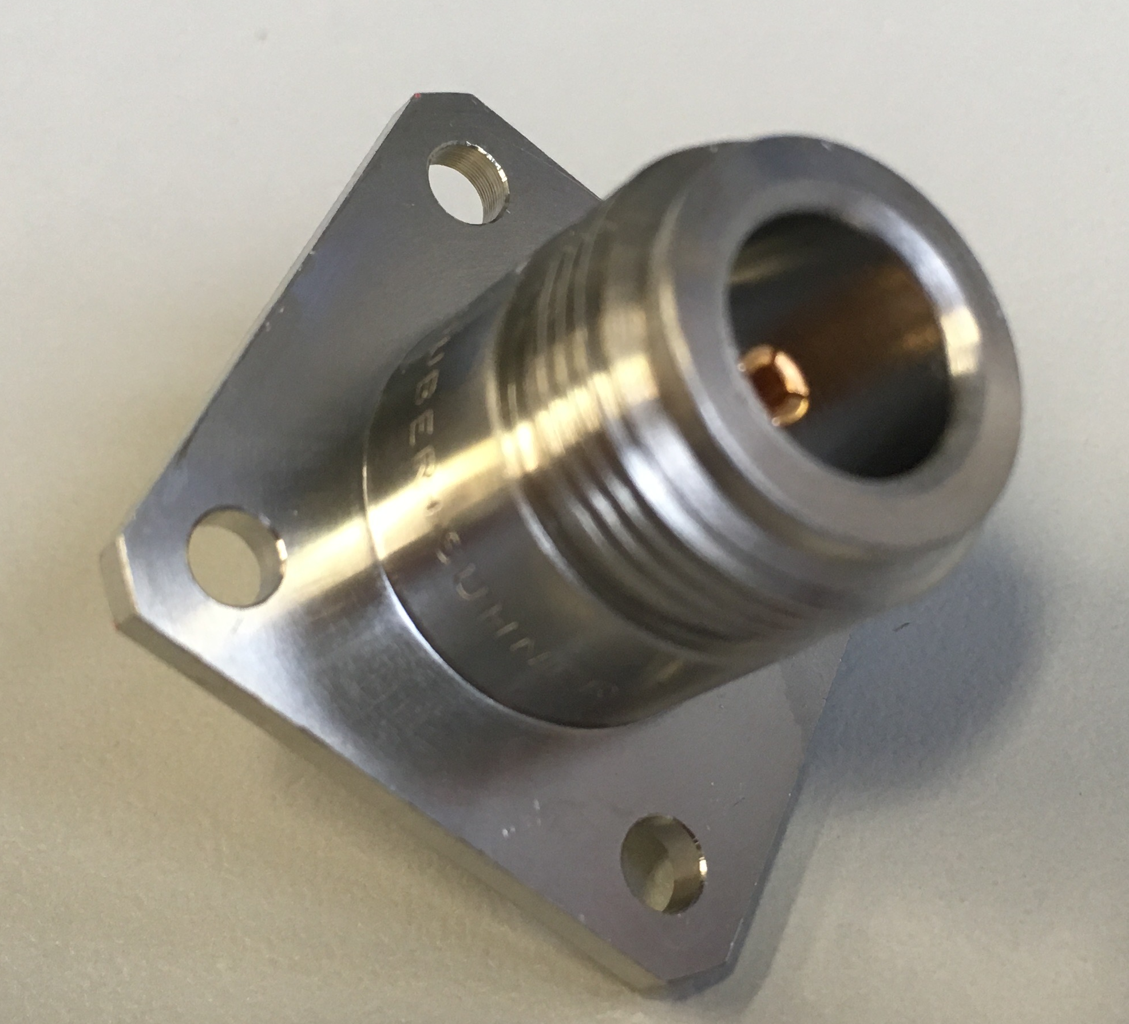
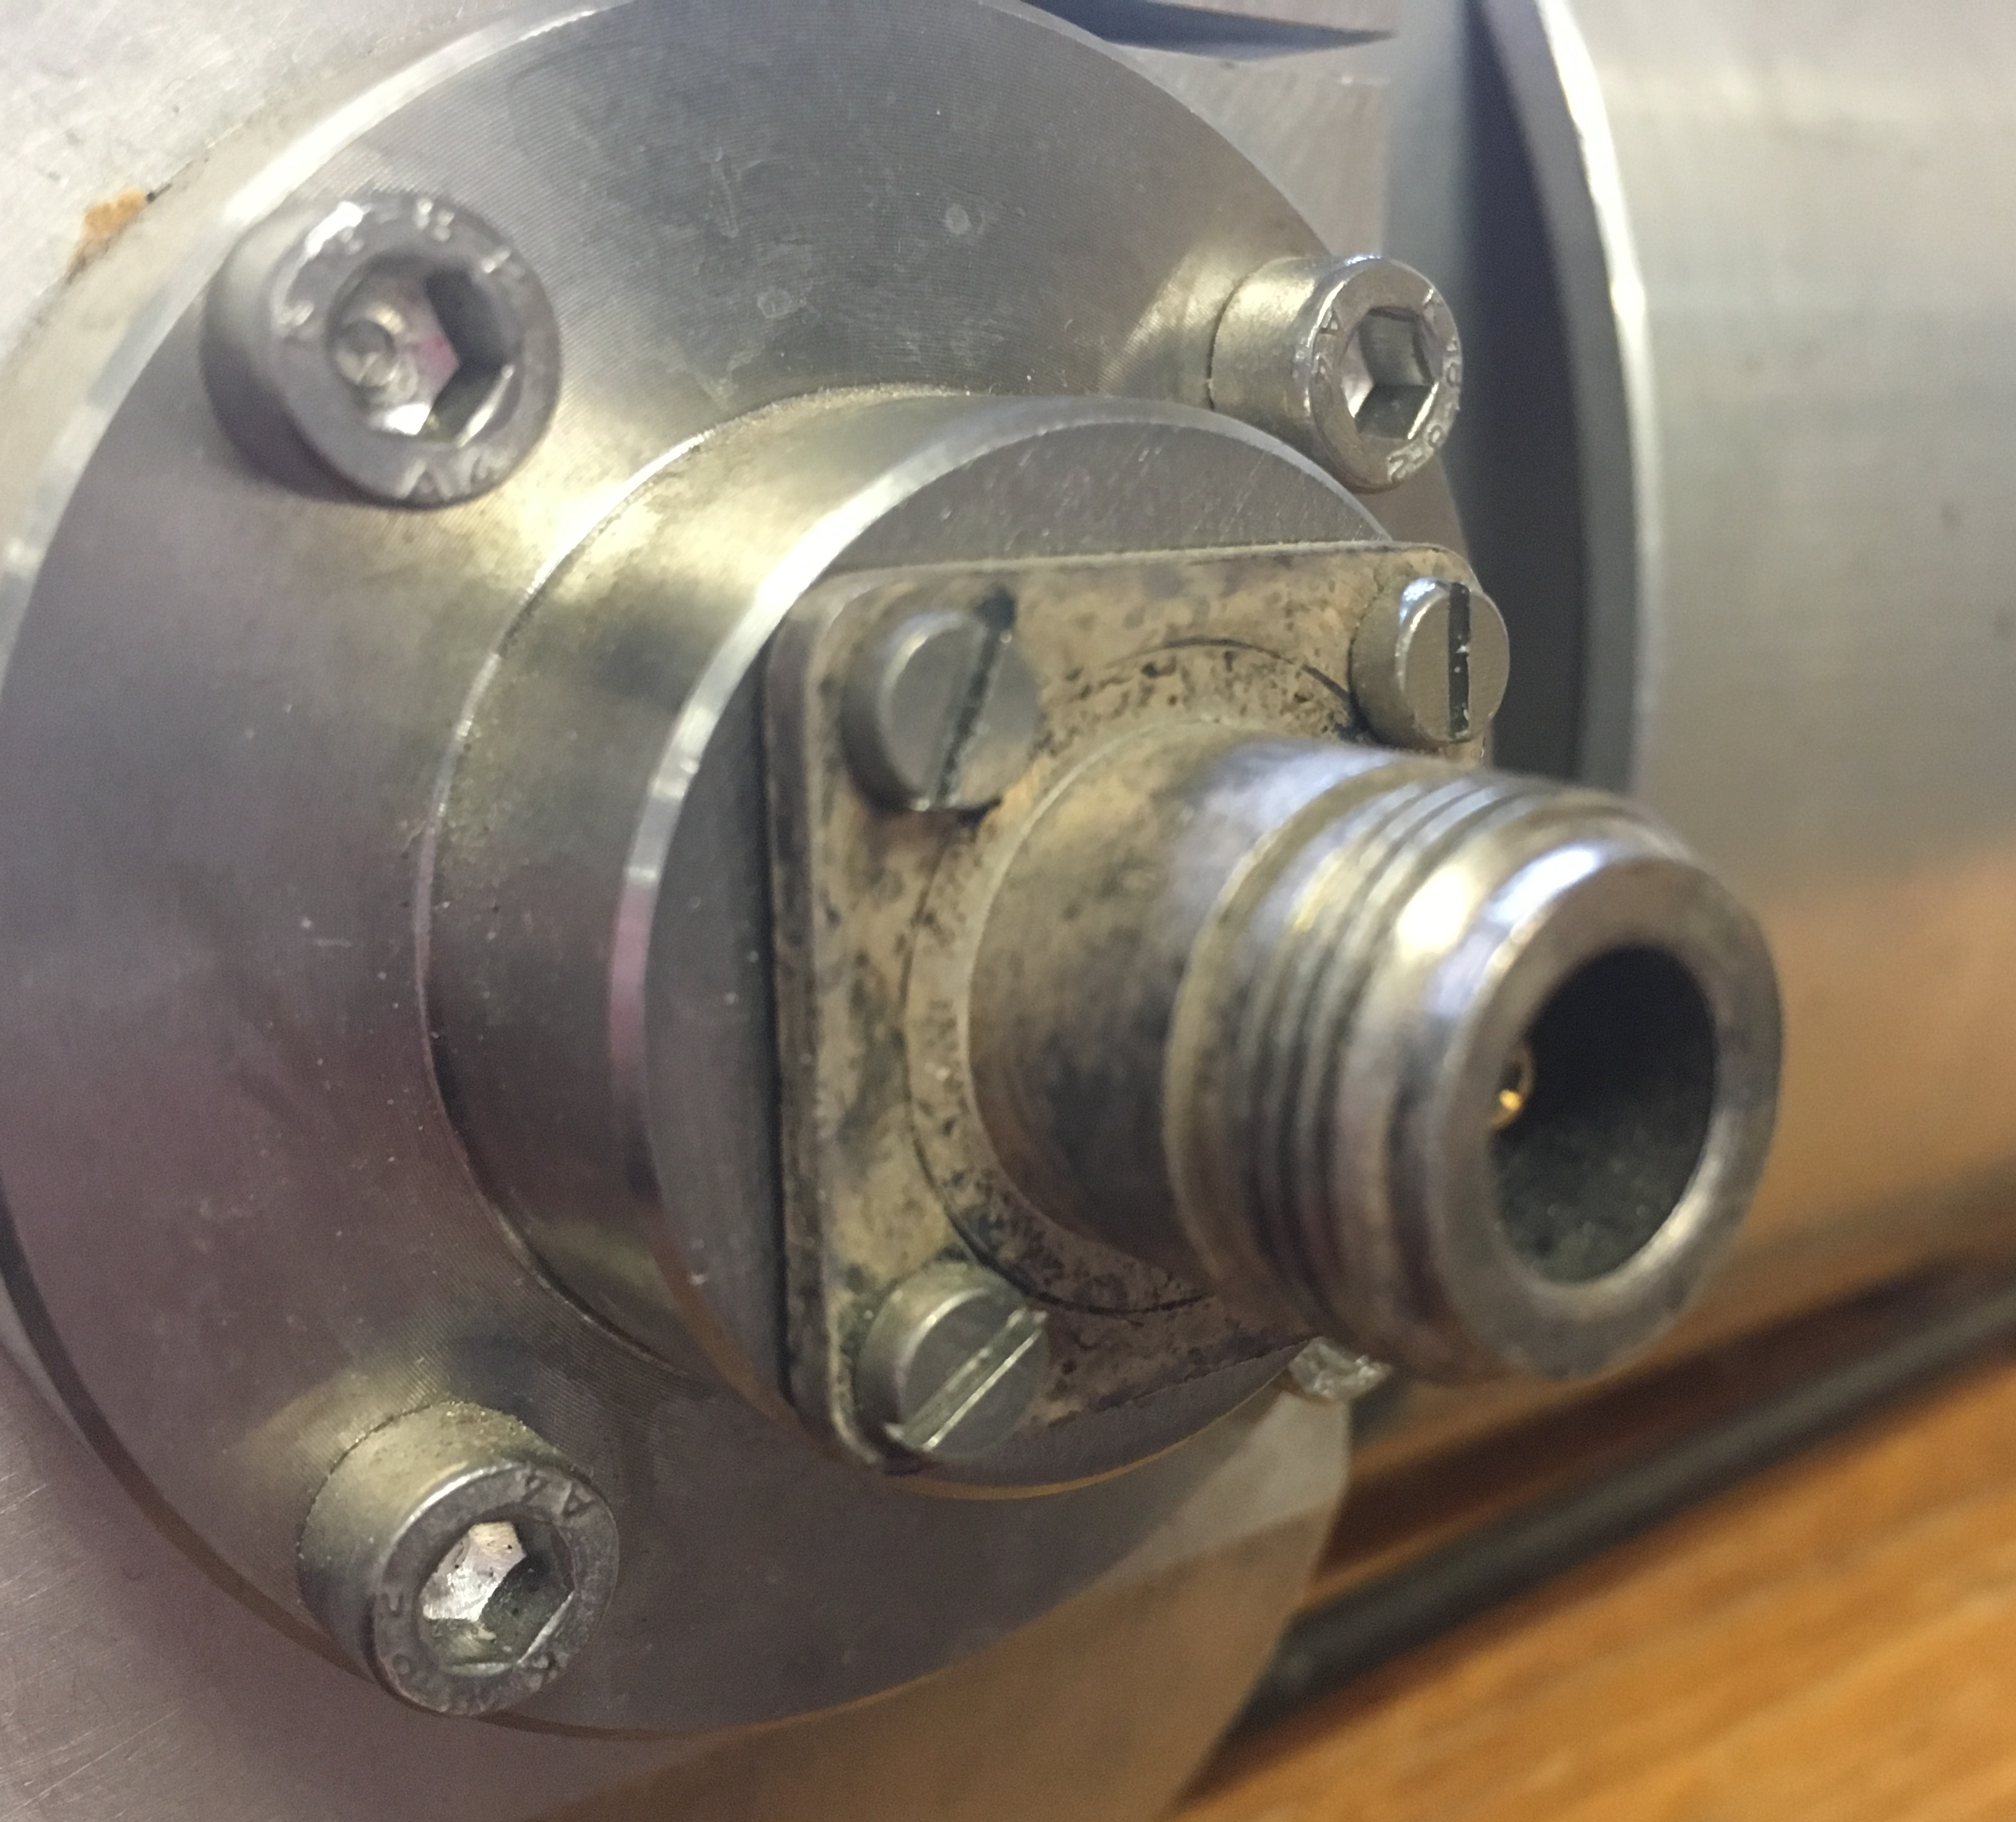
Example: Aging of RF components
RF connectors and coaxial cables also undergo aging effects!

Slide 6
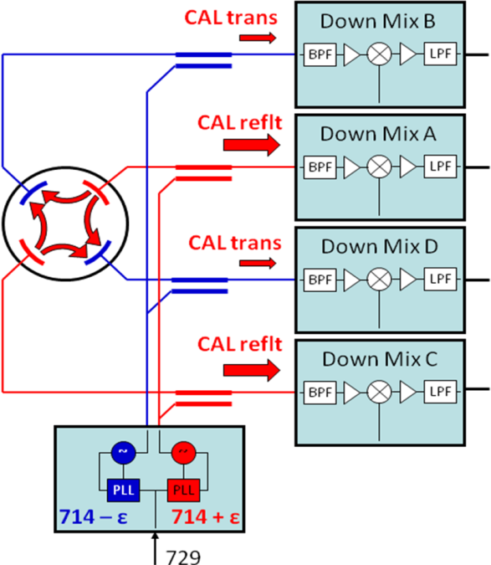
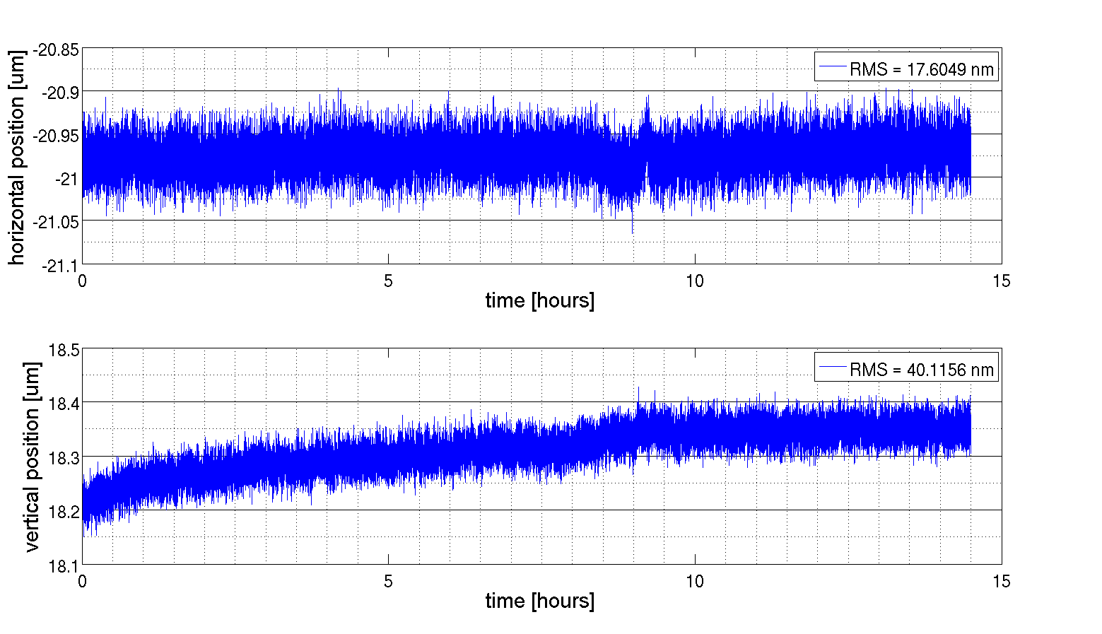
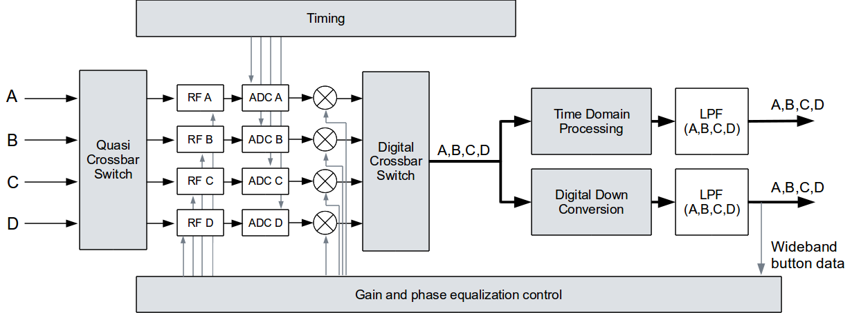
Online Calibration Methods
Crossbar switching technique
  e.g. used for the Libera BPMs from Instrumentation Technology
  <100 nm stability over 14 hours
  No position measurement during switching transition
Online calibration methods
  require a few stable, high performance “reference” components, like
    analog switches
    RF couplers & connectors
    transmission-lines
  Adds complexity to the BPM system
courtesy
N. Eddy
courtesy P. Leban
Calibration tone technique
  only applicable in narrowband
  operation
  Requires a separate detector channel

Slide 7
Single channel BPM: MPX Receiver
Limiter
Freq.
Synth.
PLL
VCO
A
VLSI
A
B
X
BP
Filter
BP
Filter
BP
Filter
Active
Matrix
B
Pre-
Amp
IF
Amp
Y
MPX
Mixer
MPX
C
Mixer
C
D
D
AGC
courtesy J. Hinckson,
K. Unser, J. Bergoz
S
Narrowband RF heterodyne receiver with multiplexed inputs:
  Downmix, demodulate and normalize the BPM signals
    Classical RF radio-receiver technology applied to process BPM signals
    Supplies the individual BPM electrode signals and the hor./ vert. position signals
  Single channel signal processing with T&H at the analog outputs
    Improves the stability due to drift of electronics components

Slide 8
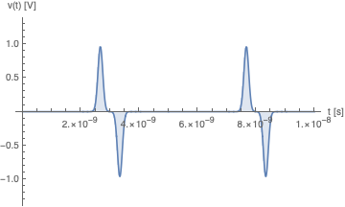
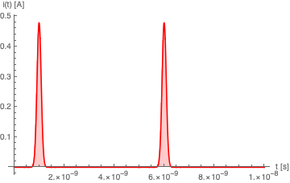
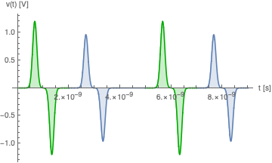
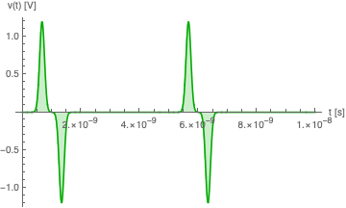
Time-multiplexed BPM signals
A_{elec} signal,
delayed
signal delay,
e.g. coaxial cable
requires every 2nd or more RF buckets empty!
Electrode A
+
signal conditioning
ADC
DAQ
Electrode B
B
A
B
A
bunched beam current
B_{elec} signal,
direct
combined A & B signal

Slide 9
DESYs early MPX BPM System
Developed and operated at the DESY HERA electron ring
  Every 48th 2 ns bucket filled (96 ns bunch-to-bunch distance)
“Exported” to the Fermilab A0-Photoinjector test facility linac

Slide 10
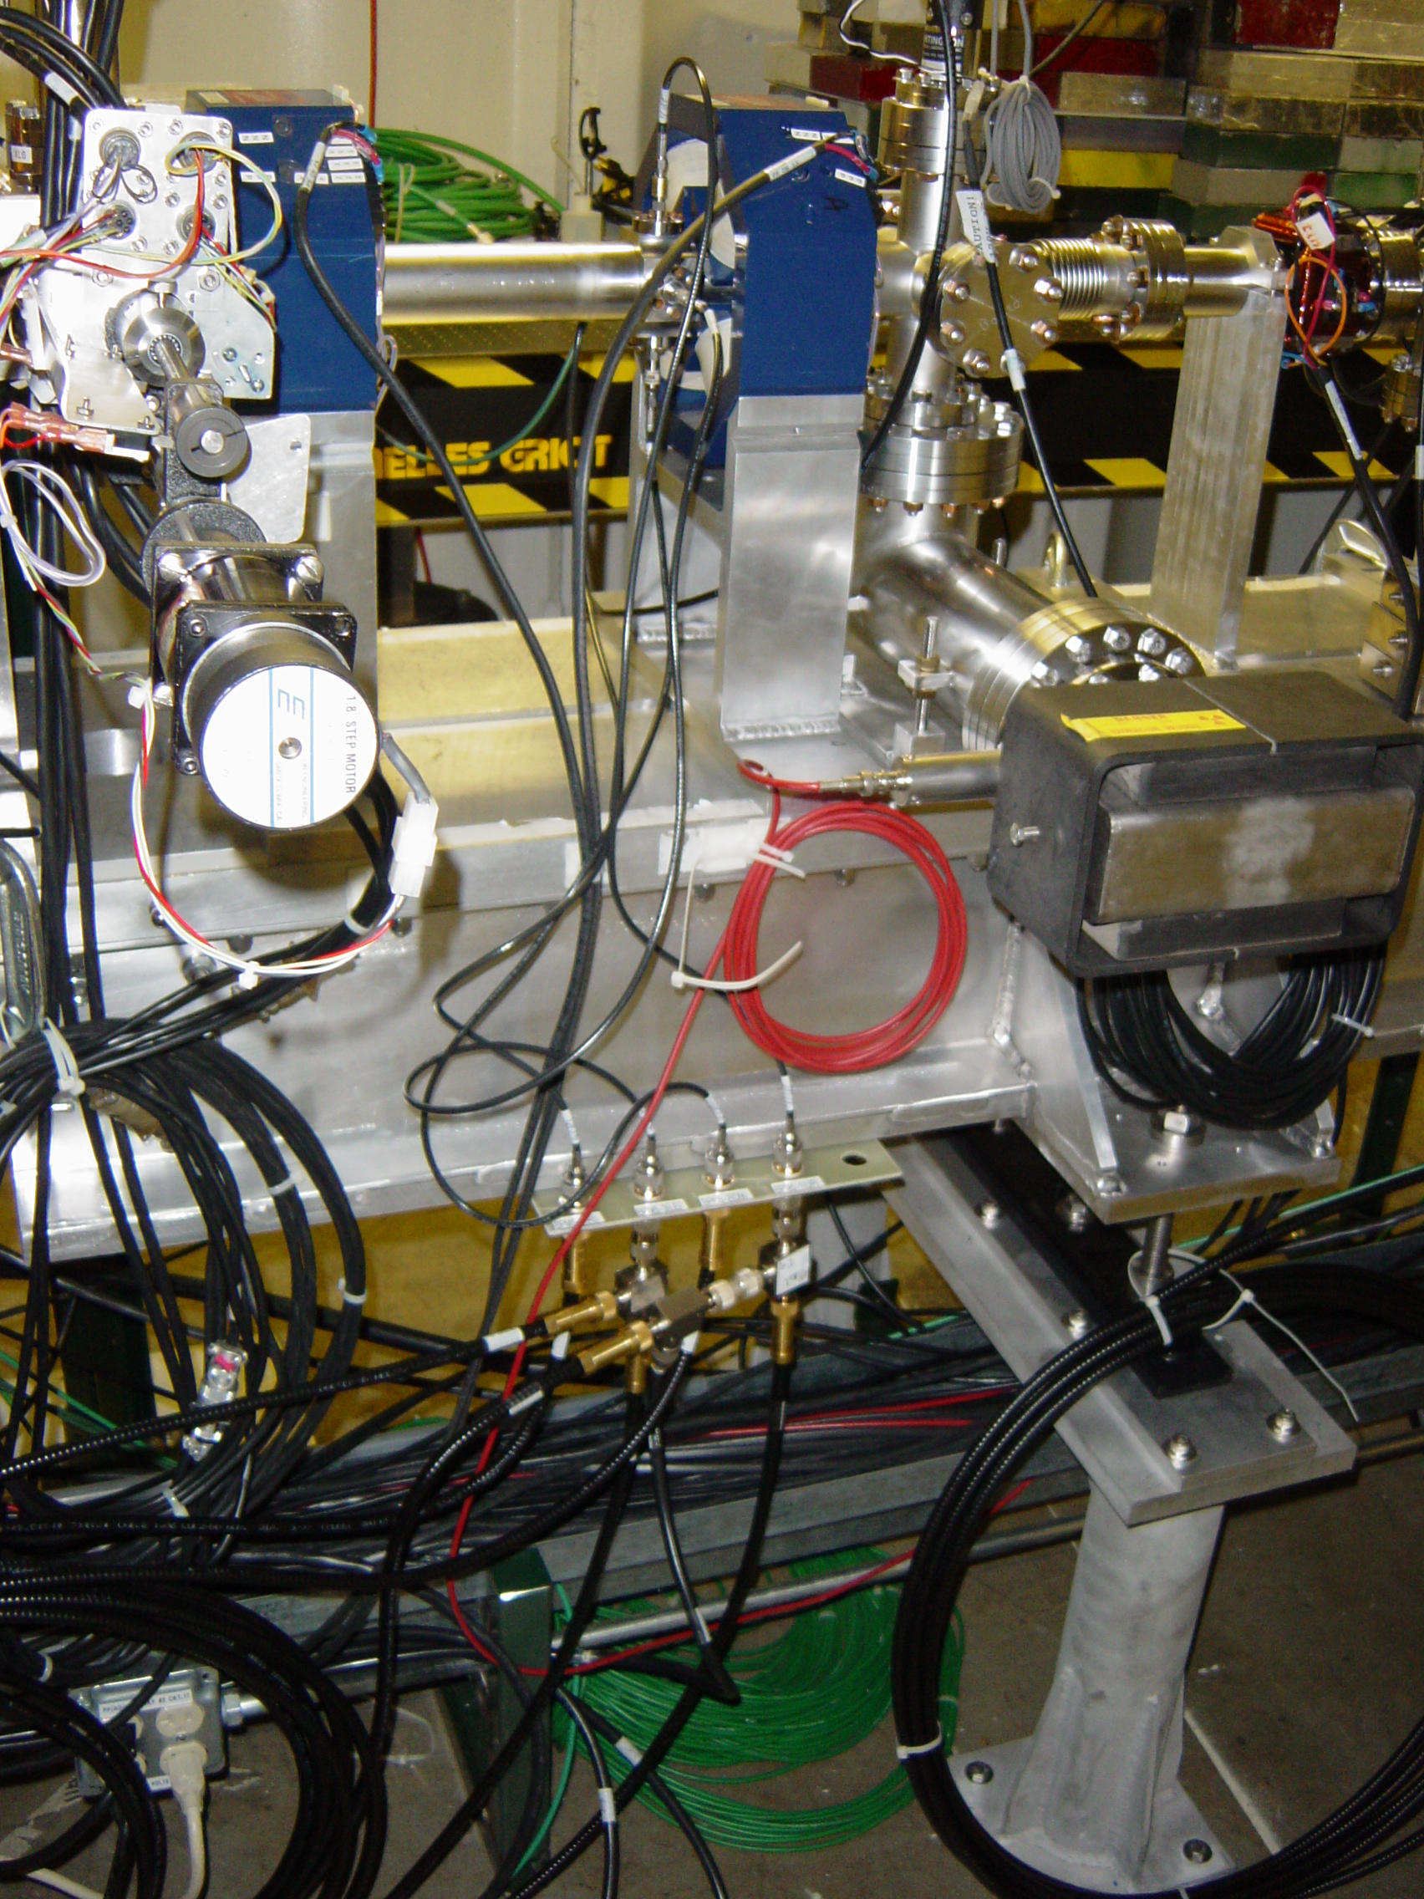
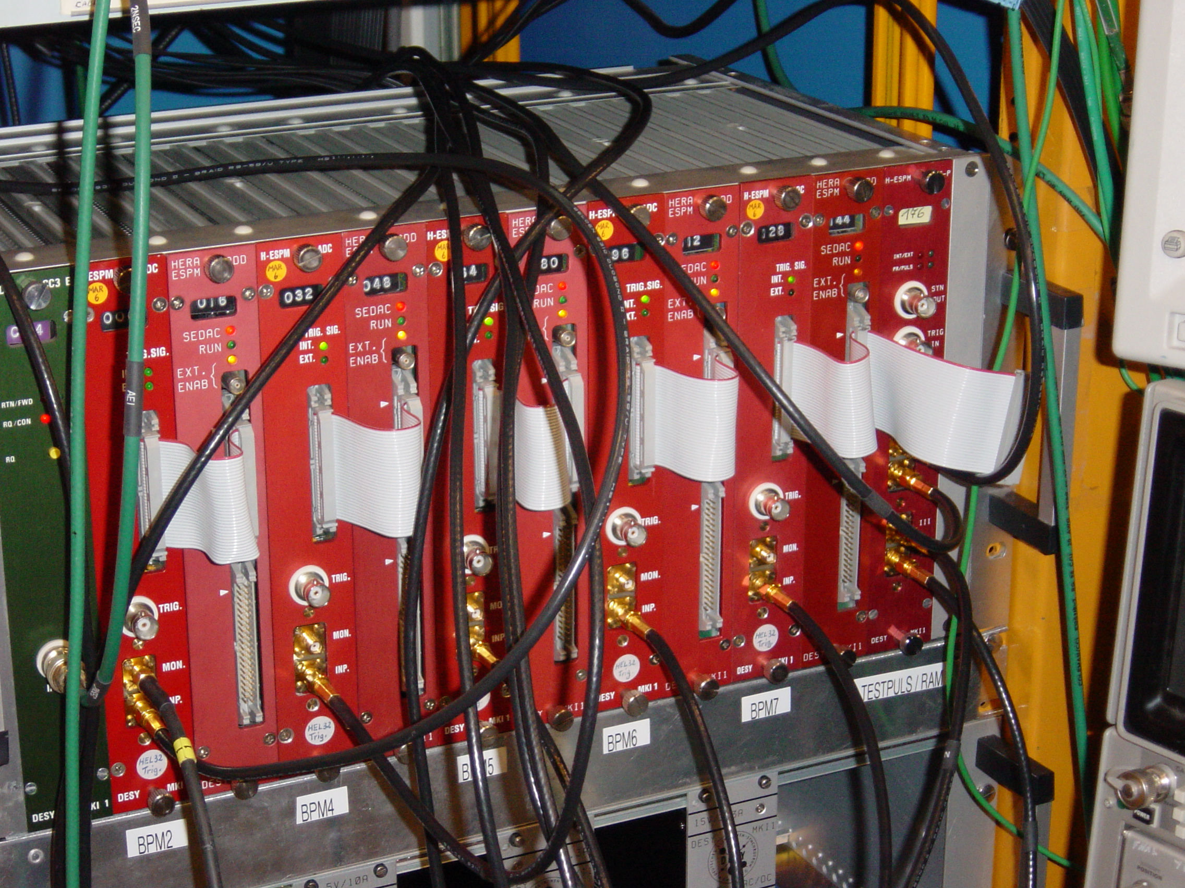
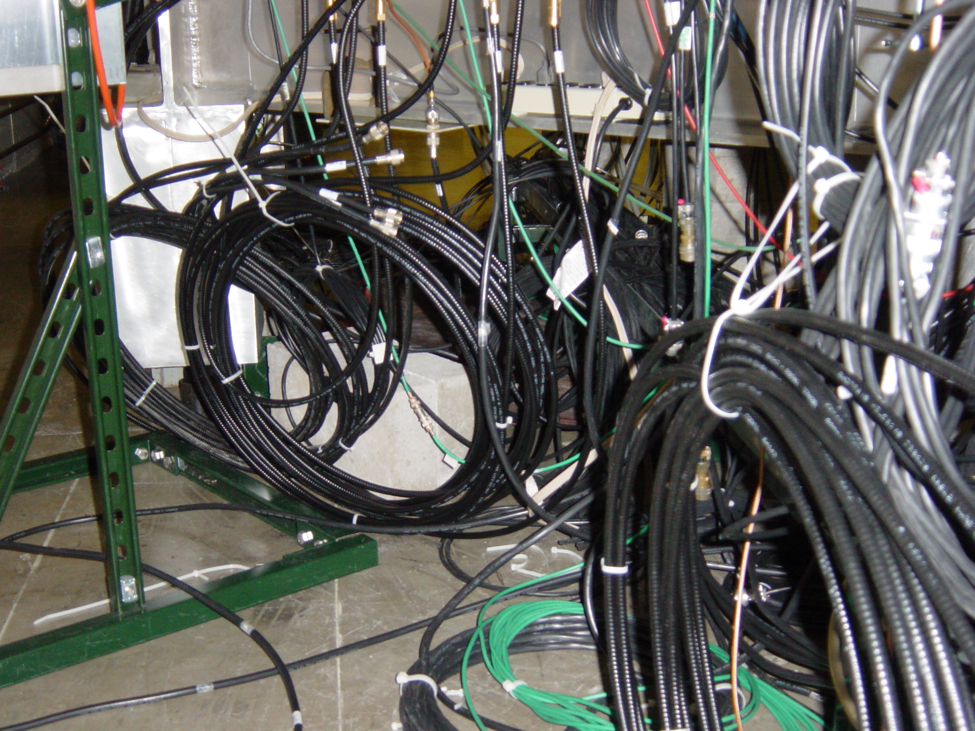
DESY MPX BPM Electronics @ FNAL

Slide 11
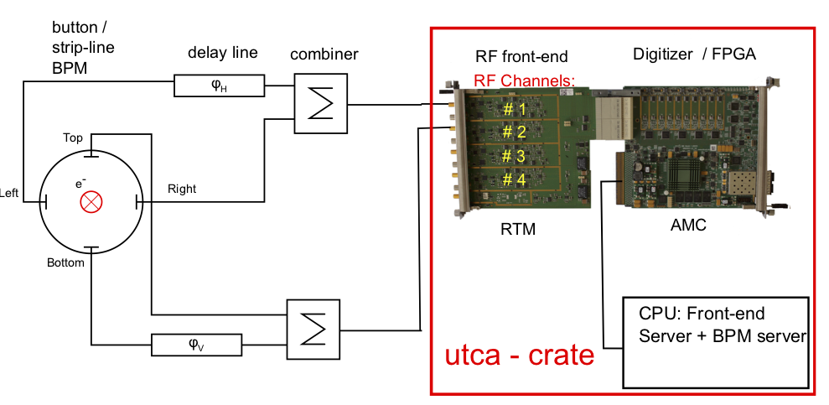
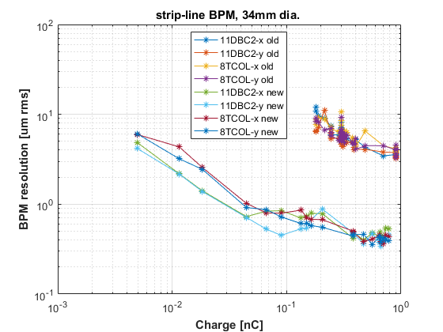
DESY FLASH MPX BPM System
courtesy B. Lorbeer

Slide 12
DESY MPX BPM Electronics
100 ns delay-line signal combination (2 electrodes)
  80 m long 3/8” high quality coaxial cables
40 dB RF pre-amplifier to cover 15 pC single-bunch operation
  NF = 3.3 dB, 600 MHz BW
  Resolution <10 μm for single bunch operation >10 pC
Analog electronics based on μTCA RTM
  600 MHz BW (-3 dB) & double-peak detector
    V_{RF} peak min = 5 mV
  Gain switching (RF step attenuator)
  4 input channels and test pulse generators
Commercial μTCA digitizer Struck SIS8300
  10-ch, 125MS/s, 16-bit
  External RF synchronous 108 MHz clock
Unfortunately: No long-term drift analysis data available, …yet.
  However, this BPM technology is routinely and successfully used for beam energy calibration, which is cross calibrated to the photon energy of the FLASH FEL.

Slide 13
CERN LHC Interlock BPM R&D
25 ns
Delay 12.5 ns
Beam
25 ns
Delay 2 ns
comb
BPF
anti-aliasing LPF
Stripline pick-up
~50 m coaxial cable
Filter output
Tunnel
Electronics rack

Slide 14
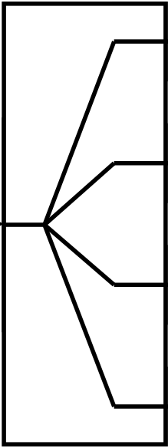
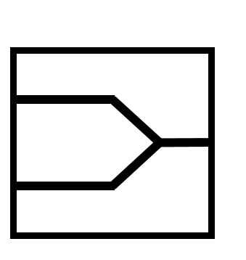
LHC Interlock BPM: Key Elements
Delay line filter
Stripline BPM
Amplitude balanced
combiner
∆2 ns
Digitizer
&
FPGA
∆4 ns
∆6 ns
12.5 ns
Stripline BPM
  2 vertical and 2 horizontal, 120 mm long electrodes
High isolation, balanced high-power signal combiner
4-stage delay-line based, comb (FIR) band-pass filter
ADC digitizer and digital signal processing

Slide 15
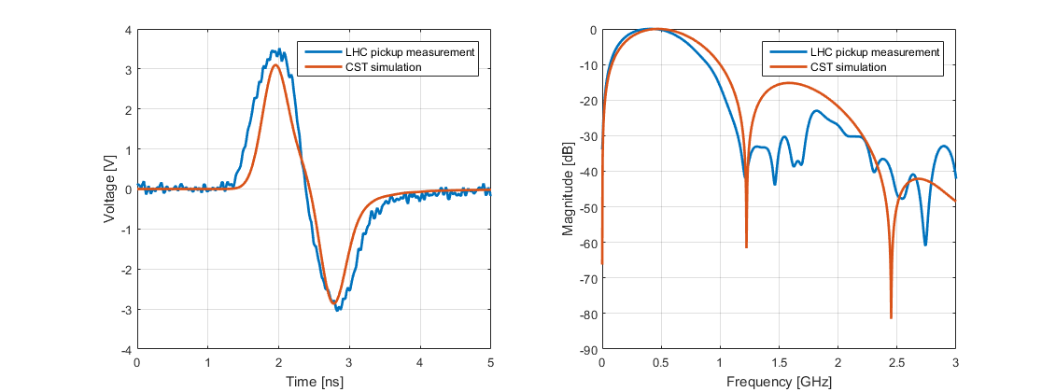
Stripline BPM Bunch Signals
Amplitude difference: 10 %
~500 MHz
2 ns
Time domain comparison: Simulation and measurement
Frequency domain comparison: Simulation and measurement
CST wakefield simulation and oscilloscope measurement
  1.35e11 protons per bunch
  Measurement captured after ~70 m ½” Heliax cable
    Oscilloscope LeCroy Waverunner SDA 18000 (60 GS/s, 18 GHz BW)

Slide 16
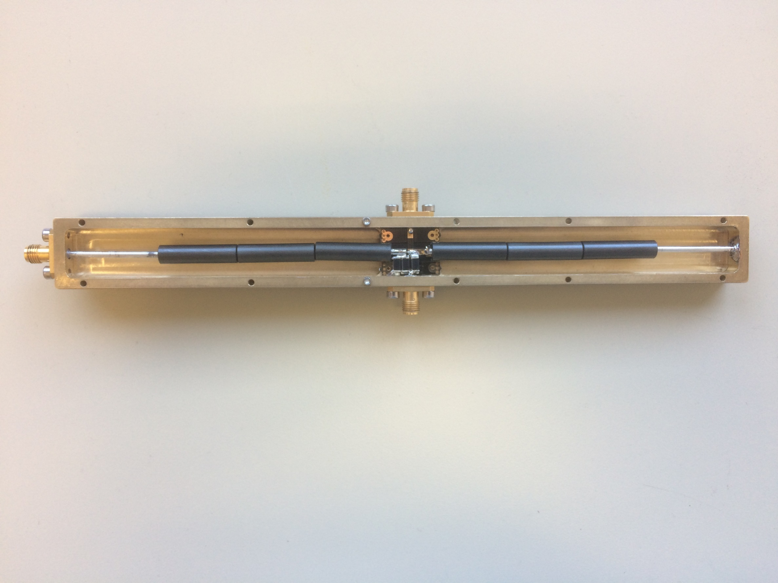
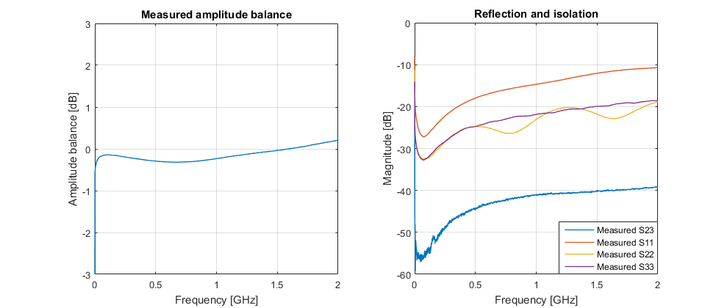
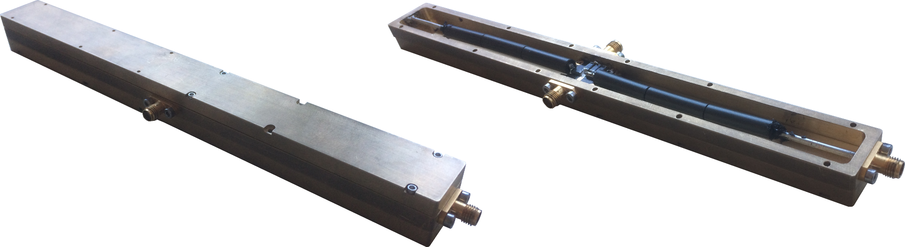
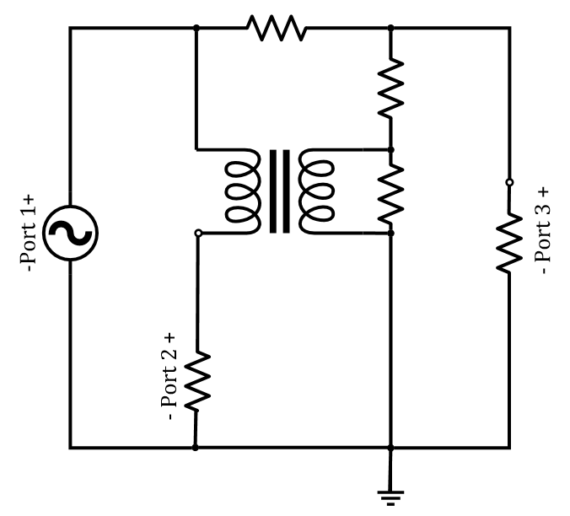
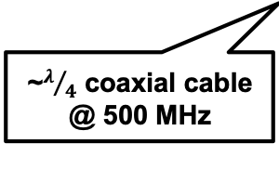
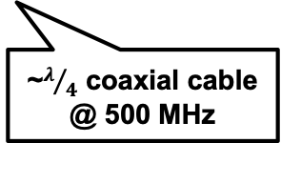
Amplitude-balanced Power Combiner
~6 dB insertion loss
10 W CW power handling
40 dB isolation @ 2 GHz
±0.4 dB amplitude, ±4⁰ phase balance
  in the range 10-5000 MHz
port 3
Ferrite beads
Ferrite beads
port 2
Σ-port 1
~$λ/4$ coaxial cable @ 500 MHz
~$λ/4$ coaxial cable @ 500 MHz

Slide 17
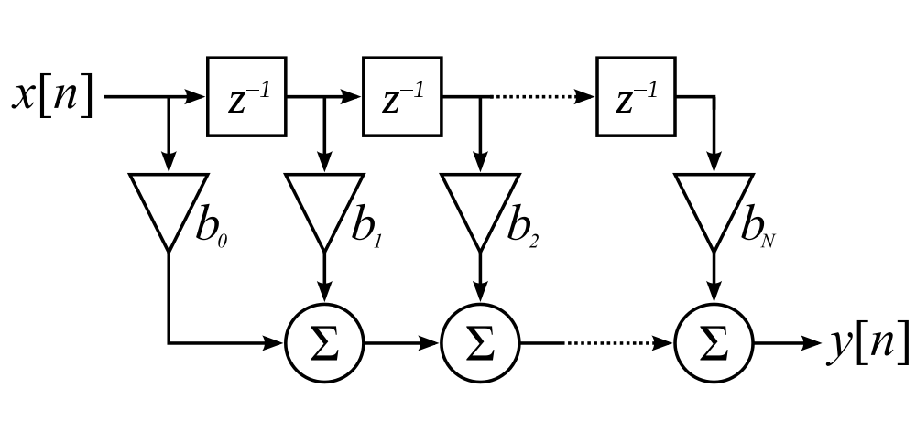
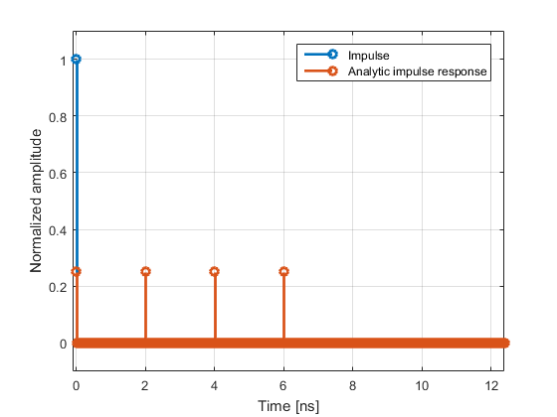
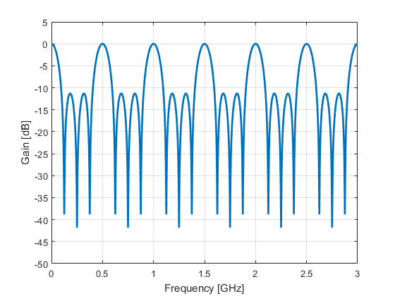
RF FIR Filter Theory
4x 2 ns delays:
  maxima at: n x 500 MHz
Ideal filter impulse response
Ideal filter transfer function

Slide 18
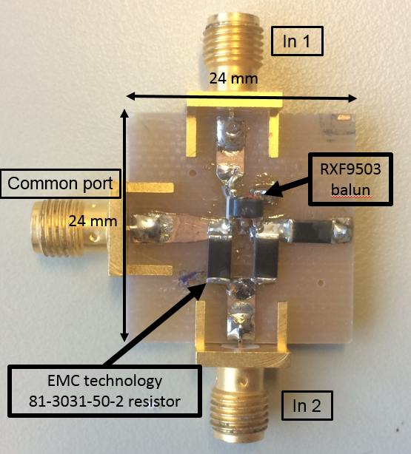
High Isolation Power Combiner
Prototype design
Port 2
Port 1
Port 3

Slide 19
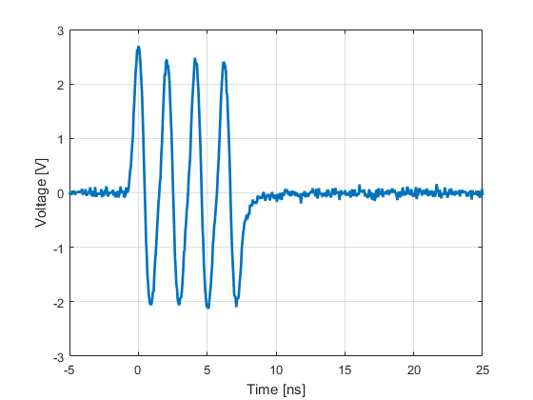
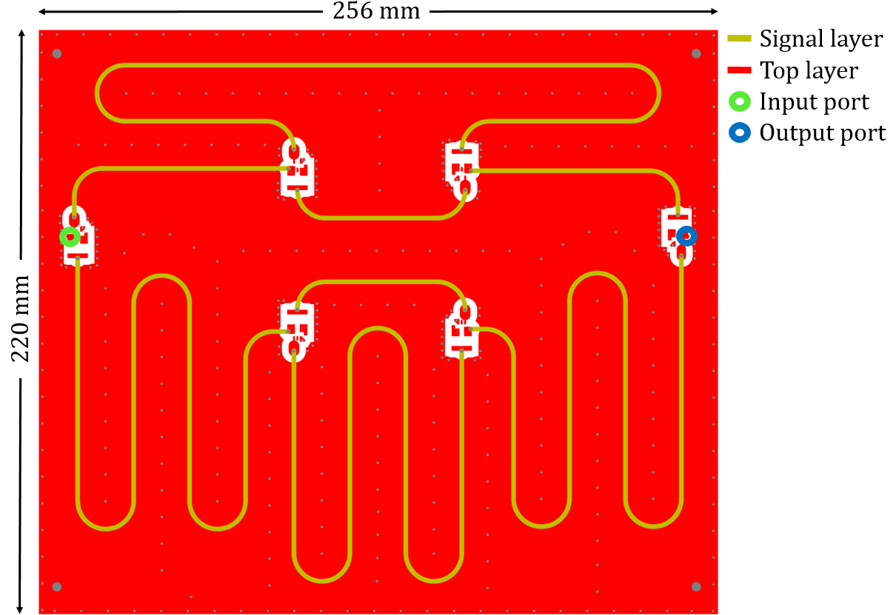
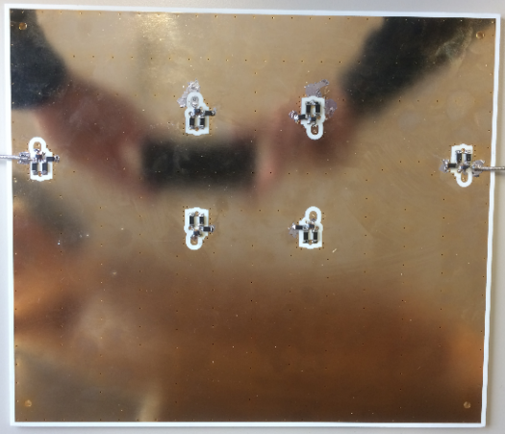
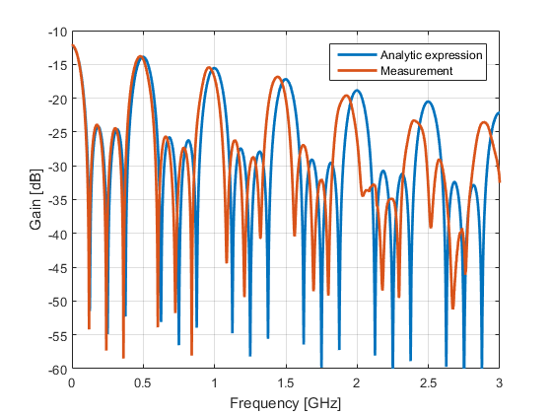
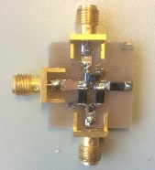

Stripline PCB Comb BPF
1.35e11 proton bunch via ~70 m long coaxial cable
  Acquired at 60 GS/s with 18 GHz BW
Stripline PCB prototype
  Center frequency off by ~5 %
  Substrate: Rogers RO4360G2 (ε_{r} = 6.15)
LHC beam measurement of PCB filter at 1.35e11 bunch intensity.
PCB layout and initial power divider design.
First manufactured prototype.
Frequency response of PCB filter.

Slide 20
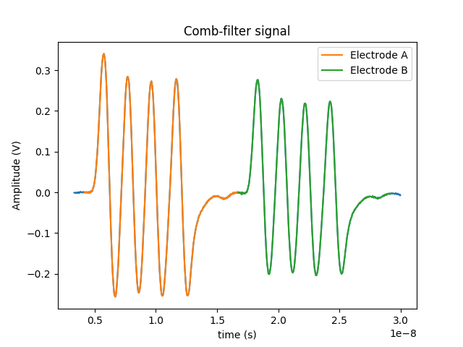
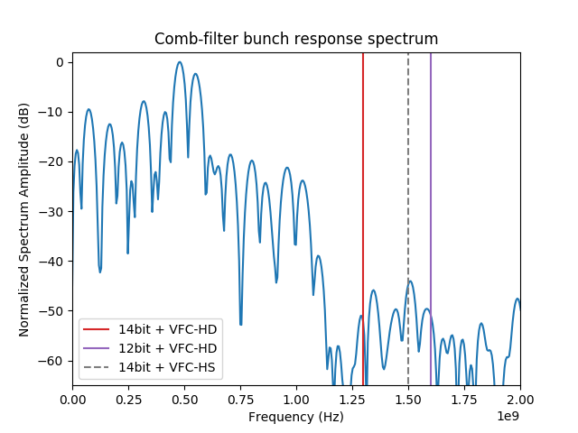
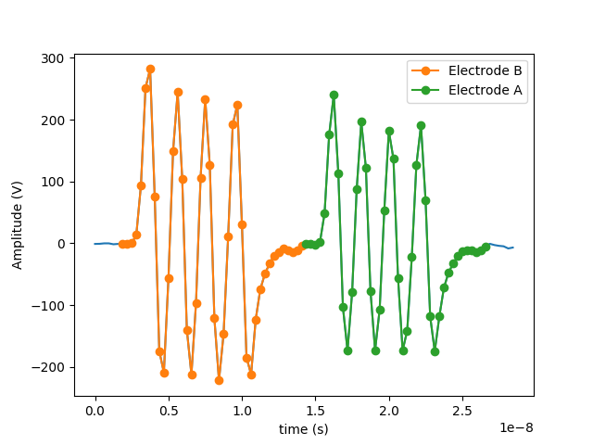
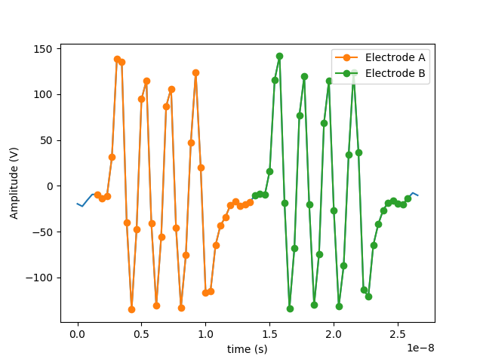
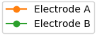
Beam Measurements
60 GS/s, 8-bit
3.2 GS/s, 12-bit
2.6 GS/s, 14-bit

Slide 21
LHC Doublet Bunches (Simulation)
25 ns
25 ns
A₂+
A₂-
A+
A-
A₁+
A₁-
Single bunch (measured)
Doublet bunch (simulated)

Slide 22
Estimated Performance
Meets the LHC interlock BPM resolution requirement
  <500 μm RMS bunch-by-bunch for a range of 5e9…2e11 ppb w/o gain switching!
  including a beam displacement range of ±7.5 mm
Keeps the reported mean value beam position over the entire bunch intensity range
Operates also with 5+20 ns doublet bunches
  at a reduced performance

Slide 23
Summary
Single channel, time-multiplexed BPM electronics can be an alternative to a multi-channel BPM read-out technique
  Requires empty RF buckets
Time MPX BPM technologies are based on
  Precise, stable time delays utilizing high quality coaxial cables and power combiners
  Low-pass integration or comb-style FIR band-pass filters in connection with track&hold circuits, peak detectors, or fast digitizers
Time MPX BPMs performance is successfully demonstrated in ring and linear accelerators
  DESY HERA-e, Fermilab A0-Photoinjector, DESY FLASH
  In future: CERN LHC interlock BPMs
Long term drift stability could not yet be quantified: TBD!
  However, the concept omits the needs of online calibration or channel switching schemas, thus appears to be more simple and straightforward.

Slide 24
Backup Slides…
Thank you!

Slide 25
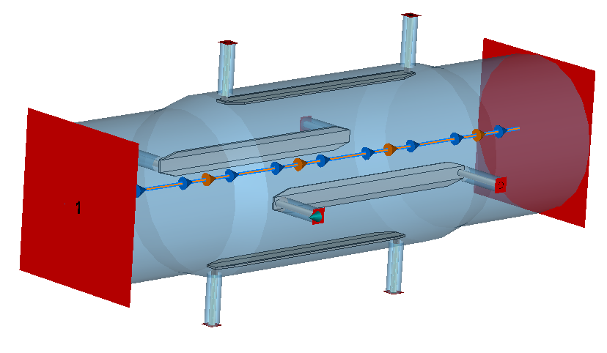
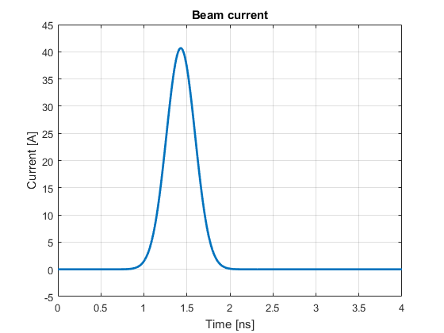
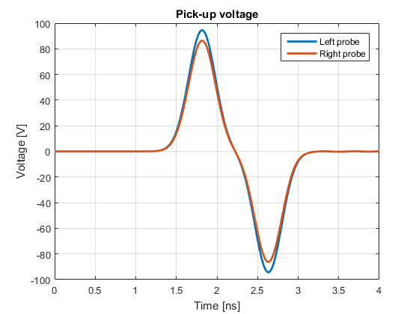

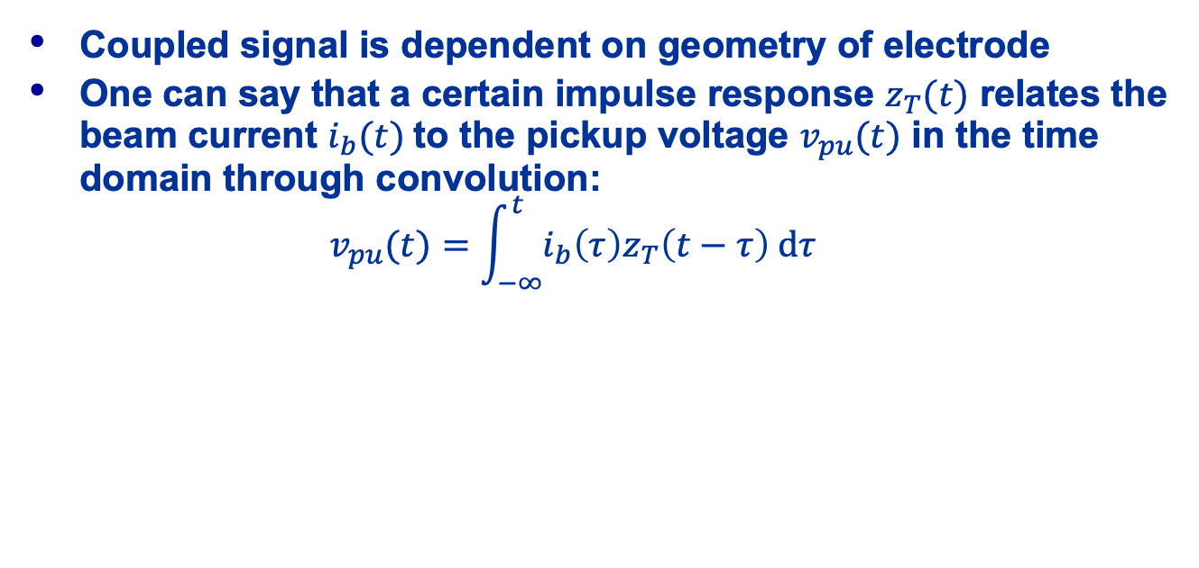
Stripline electrodes: Characteristics
Coupled signal is dependent on geometry of electrode
One can say that a certain impulse response $z_{T}(t)$ relates the beam current $i_{b}(t)$to the pickup voltage $v_{pu}(t)$ in the time domain through convolution:
$v_{pu}(t)=\int_{−∞}^{t}{i_{b}\left(τ\right)z_{T}\left(t−τ\right) dτ}$
Beam current
Electrode voltage
$$z_{T}$$

Slide 26
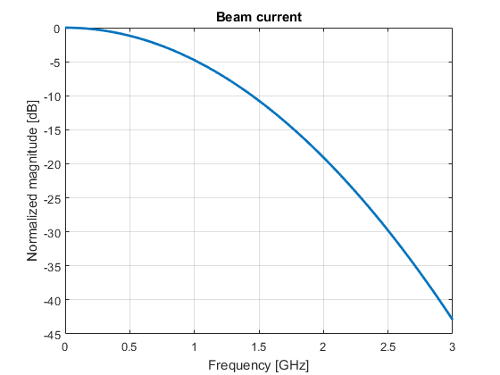
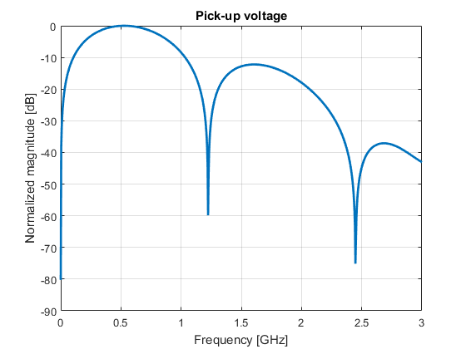


Stripline electrodes: Characteristics
… And in the frequency domain, a certain transfer
impedance $Z_{T}(ω)$ relates the beam current and the
pickup voltage through multiplication (ohms law):
$V_{pu}(ω)=Z_{T}(ω)I_{b}(ω)$
Beam current
Electrode voltage
$$Z_{T}$$

Slide 27




Stripline electrodes: Characteristics
Given the beam current and the electrode voltage signal, the transfer impedance can be calculated:
$$z_{T}(t)$$
$$Z_{T}(ω)$$
FFT

Slide 28



Wilkinson power divider
‘Typical’ choice of high isolation power divider
+ Cheap and simple to manufacture
- Poor bandwidth
Transmission
Reflection
Isolation

Slide 29

High isolation power combiner:
How does the isolation work?
A Balun is a 1:1 transformer
  Signal amplitudes on primary and secondary are equal
Primary and secondary signals are 180⁰ out of phase
  Bal-Un: Balanced-Unbalanced transformer

Slide 30








High isolation power combiner:
How does the isolation work?
Example: Assume the input signal at port 2
  All resistors are 50 Ohm
The 180⁰ phase shift of the balun forces the node at port 3 to receive zero voltage
  port 2-3 isolation
$$+v_{1}$$
$$50 Ω$$
$$v=0$$
$$50 Ω$$
$$−v_{1}$$
$$50 Ω$$

Slide 31

Amplitude balanced power combiner:
Coaxial balun design
Notes:
I want to talk a bit about the balun design:
The balun transformer that I am going to show you has the exact same function as the balun that I was talking about previously. It should produce equal amplitudes on the balanced outputs and also should produce a perfect 180 degree phase shift. This balun however works a very differently and is instead made using a set of coaxial cables.
It is actually possible to create a balun using a single piece of coaxial cable as is suggested in the top picture. However, due to the skin effect, electrons are concentrated to inner side of the coaxial jacket which leads to the outer side acting as a separate signal path, effectively acting as a short circuit stub that is connected in parallel with the 180 degree output. This means that the two outputs will see different loads and thus there will be an imbalance in amplitudes. This problem is solved by connecting a second coaxial sleeve to the zero degree output, which makes each of the two outputs see the same load.

Slide 32


Amplitude balanced power combiner:
Balun design
Second coax balances amplitudes, but balanced outputs are still frequency dependent
Amplitude: Balanced output 1
Amplitude: Balanced output 2
Amplitude: Balanced output 2
Amplitude: Balanced output 1
Notes:
I made measurements that show this effect: In the graph to the left I have measured a balun using only a single coaxial cable, and on the right I have added the second, balancing cable. The graphs show the amplitudes on the two differential outputs and should in the ideal case be completely equal. As expected we can see very big imbalances in the left graph as the two outputs are effectively loaded with different impedances. On the right, the two outputs have approximately the same loads and the amplitudes are thus much more even. However, there are still these notches for certain frequencies at which no signal at all is transmitted through the balun. This is still an unwanted effect, and we can counteract this by introducing a ferrite material onto the coaxial sleeve. This will make the currents flowing on the outer jacket see a very high inductance that instead makes this signal path look more like an open circuit.

Slide 33

Amplitude balanced power combiner:
Balun design
Ferrite beads nearly remove frequency dependency
Amplitude: Balanced output 1
Amplitude: Balanced output 2

Slide 34


Amplitude balanced power combiner:
Balun design
Max amplitude difference:
< 0.8 dB
Max phase deviation:
$±$4 degrees

Slide 35
Amplitude balanced power combiner:
Balun design
Coaxial cable based balun
Cables covered in ferrites to prevent currents from flowing on the outside of coaxial jacket
Produces a very well performing amplitude balance over a large frequency range
Balun amplitude: Balanced output 1
Balun amplitude: Balanced output 2

Slide 36




Delay line filter: Theory
An ideal filter (no losses) can be modelled very easily using basic signal theory

Slide 37



Filter theory
What is the frequency domain behavior?
Impulse response:
Standard transform pairs:
Transfer function:

Slide 38
Surface mount power
dividers/combiners: Why high isolation?
Why can we not split and combine the signals directly on the transmission line?
- No isolation causes filter to ring!

Slide 39

Amplitude balanced power combiner
The surface mount combiner is not well balanced for some frequencies
This performance is effectively limited by performance
of the balun transformer
The other circuit is in principle the same as the surface mount version
  uses a different type of a balun,
  based on distributed transmission-line elements
Surface mount combiner transmission: Input 2
Surface mount combiner transmission: Input 2

Slide 40


Power combiners: Dissipation
Software developed specifically to estimate the power dissipation in a S-parameter network that is fed with a real stripline pickup signal

