Slide 1

Diode orbit electronics
Marek Gasior
CERN Beam Instrumentation Group
Next Generation Beam Position Acquisition and Feedback Systems
Joint ARIES Workshop on Electron and Hadron Synchrotrons
ALBA Synchrotron, 12 – 14 November 2018

Slide 2
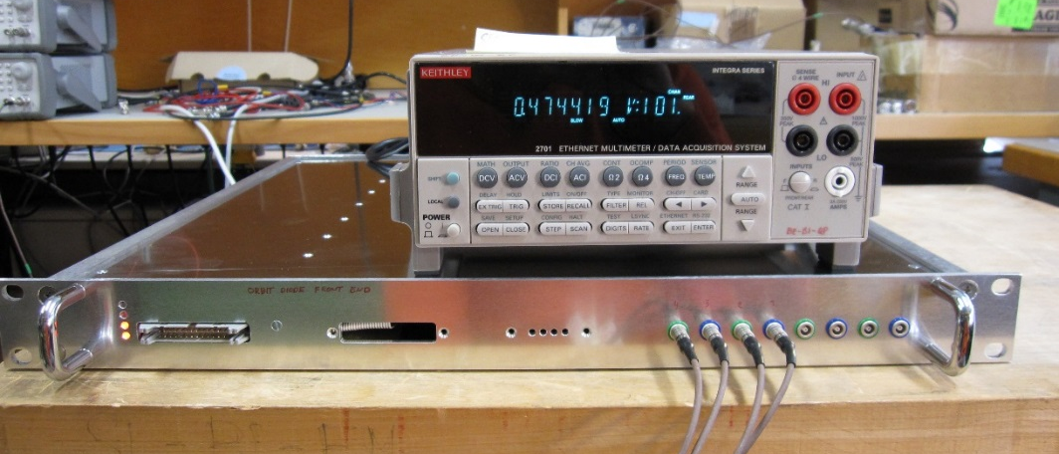
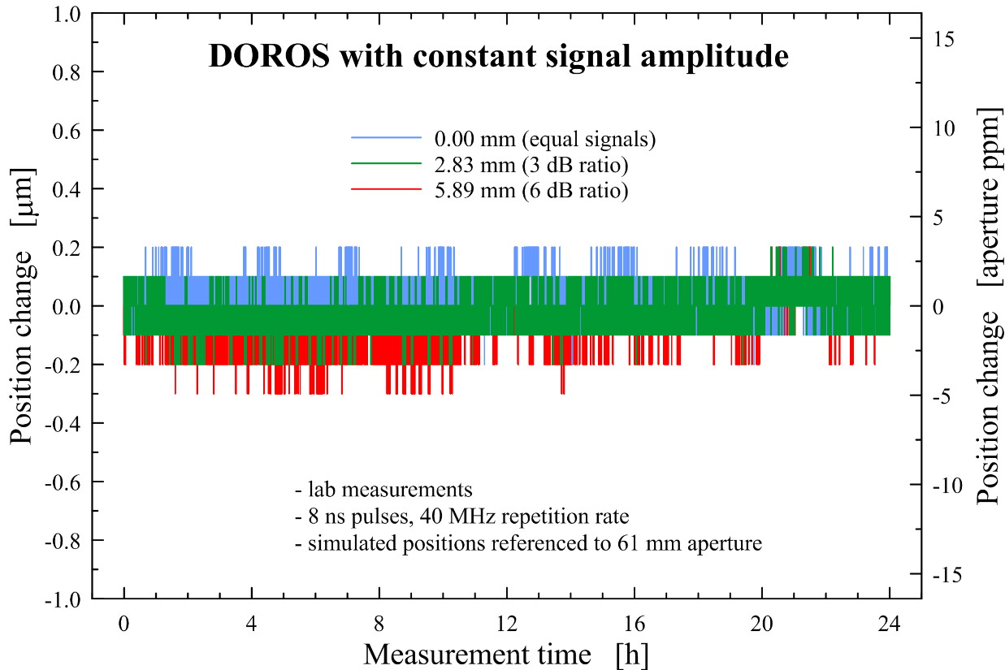
Why diodes for orbit measurements ?
With diode detectors short beam pulses are converted to slowly varying DC voltages
DC voltages can be measured with high resolution ADCs, resulting in large resolution of orbit measurements
Very good long term stability
With large detector time constants the output signal changes little with the number of circulating bunches
(LHC: 1 .. 2600)
Simplicity and robustness
The most important limitation:
slow

Slide 3
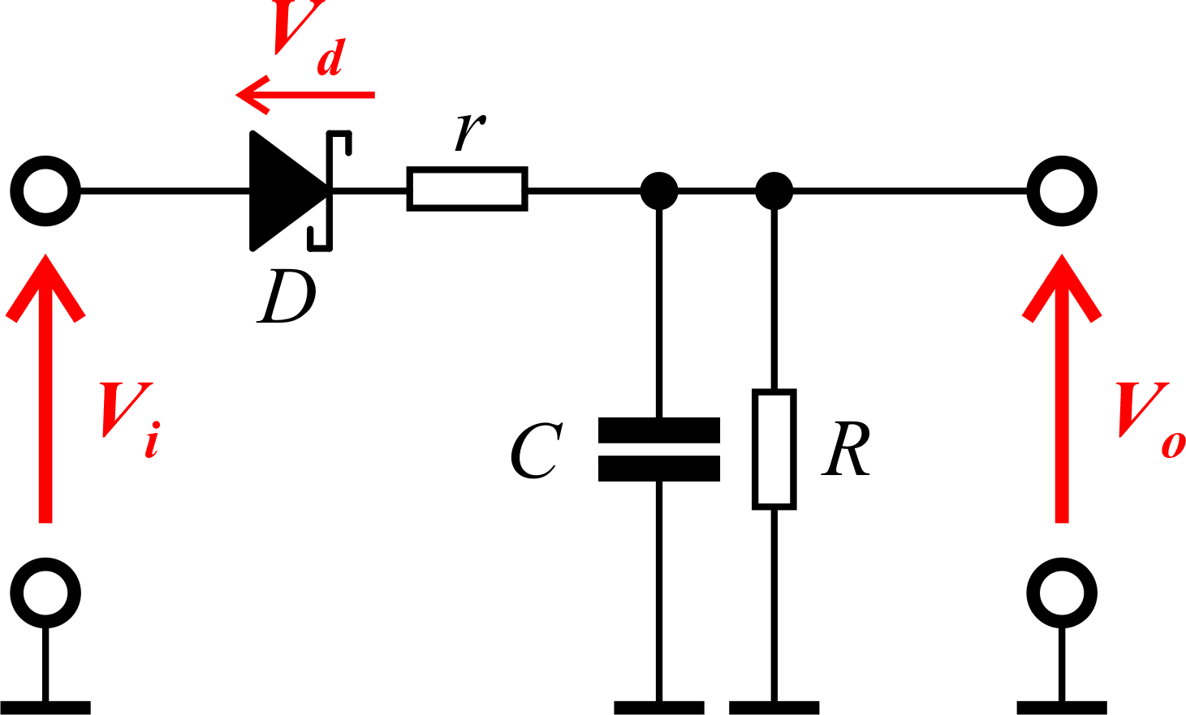
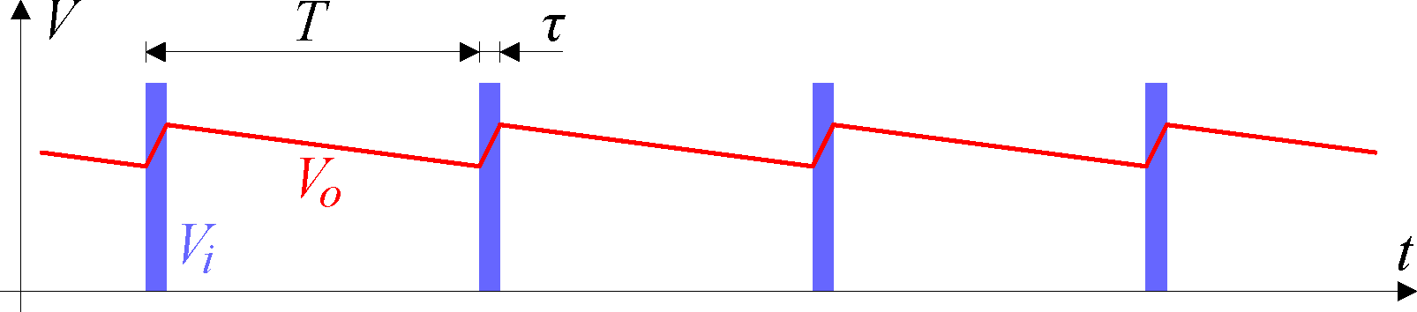
Diode detectors for short pulses
Charge balance equation for the following assumptions:
  a simple diode model with a constant forward voltage V_{d} and a constant series resistance r
  constant charging and discharging current, i.e. output voltage changes are small w.r.t. the input voltage
For large T to τ rations (small signal duty cycle) peak detectors require large R values and a high input impedance amplifier, typically a JFET-input op-amp
For LHC with one bunch the duty cycle is very small:
τ ≈ 1 ns and T ≈ 89 μs, so τ /T ≈ 10 ppm.
In practice 10 MΩ resistors in use.
The slowest capacitor discharge is limited by the reverse leakage current of the diode (in the order of 10 nA for RF Schottky diodes)
V_{i} >>V_{d}
n bunches

Slide 4
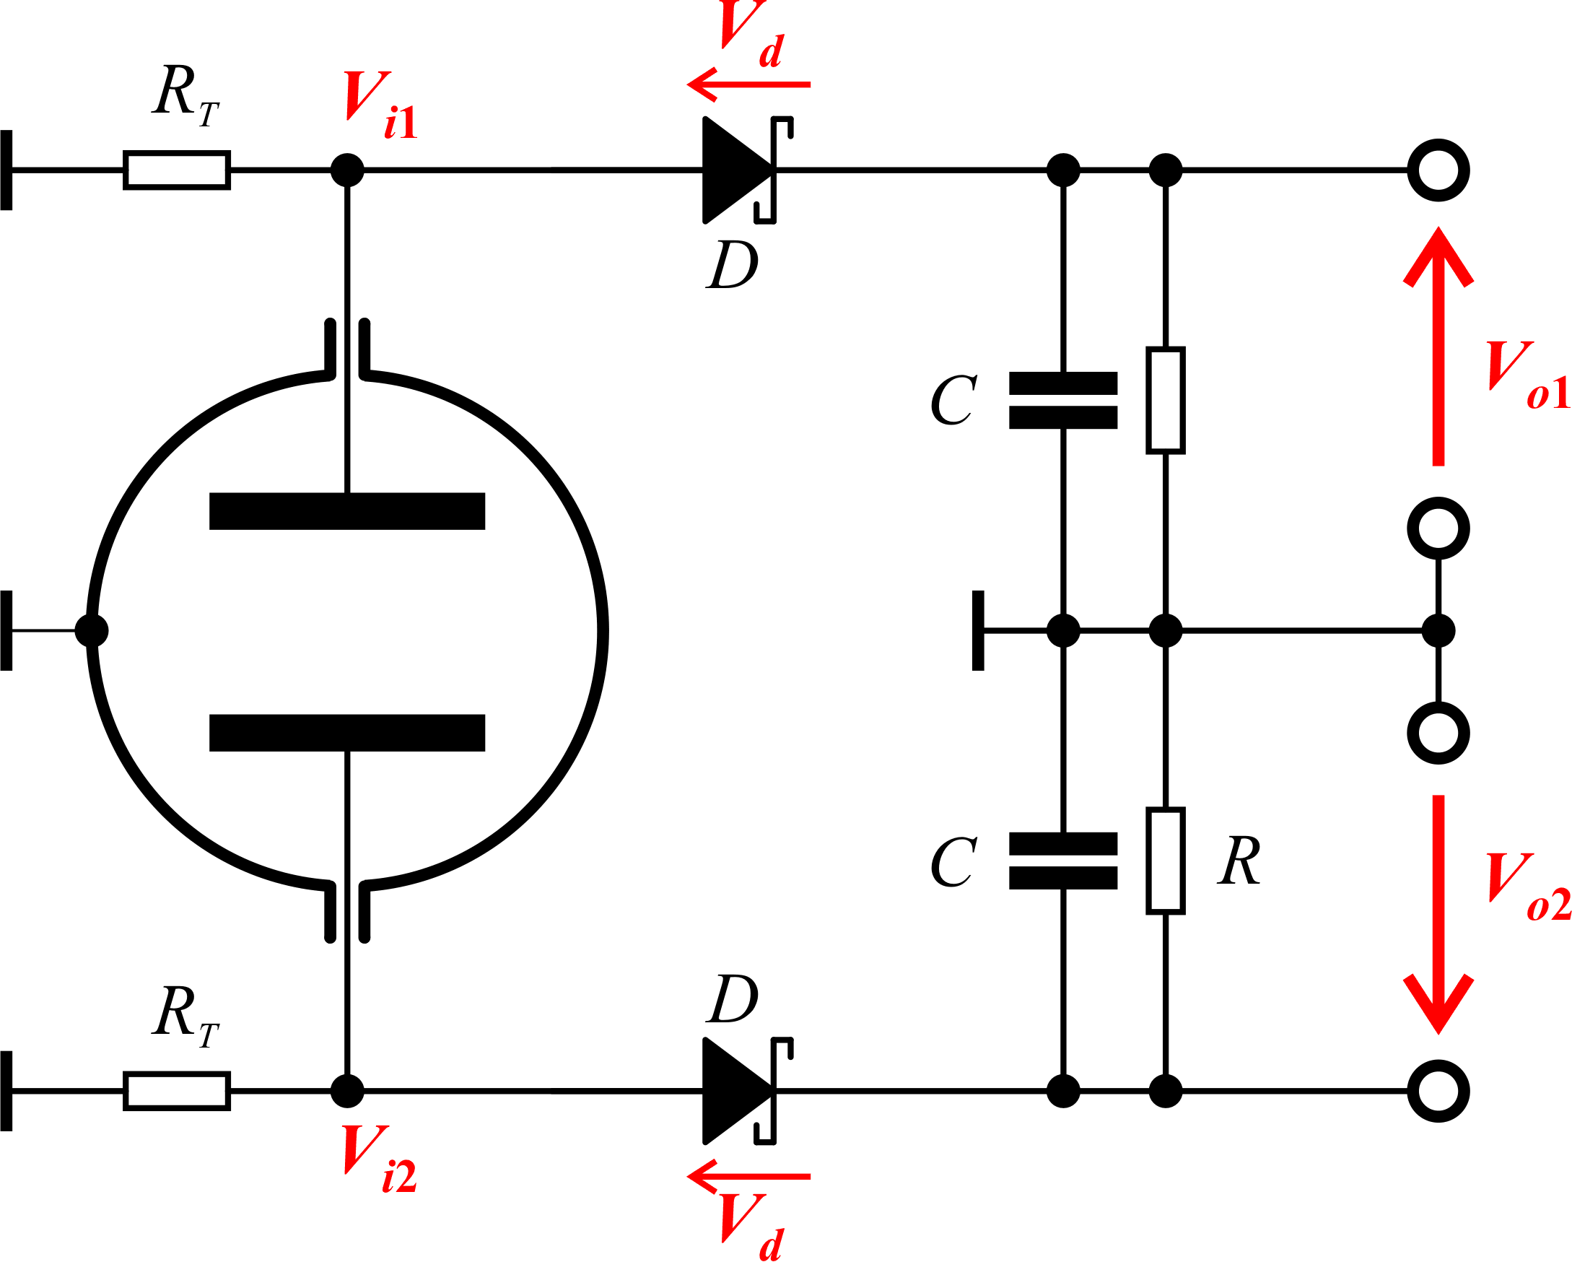
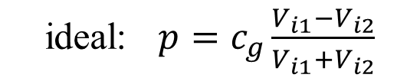
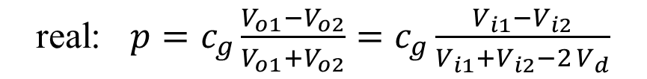
Simple diode detectors for BPM signals
ideal: $p=c_{g}\frac{V_{i1}−V_{i2}}{V_{i1}{+V}_{i2}}$
real: $p=c_{g}\frac{V_{o1}−V_{o2}}{V_{o1}{+V}_{o2}}=c_{g}\frac{V_{i1}−V_{i2}}{V_{i1}{+V}_{i2}−2{ V}_{d}}$
One diode detector for each BPM electrode
Subtracting signals before the detectors (e.g. by a 180° hybrid) does not help, as the resulting signal
would be:
  smaller, resulting in larger position errors
  changing the sign when crossing the BPM centre
The diode forward voltage V_{d} introduces a significant position error
V_{d} depends on the diode current (and by consequence on V_{i}) and temperature
Simple diode detectors can be used for applications when beam position errors are not important, e.g.
  tune measurement systems
  “intensity” beam presence detection systems (LHC Beam Presence Flag System)

Slide 5
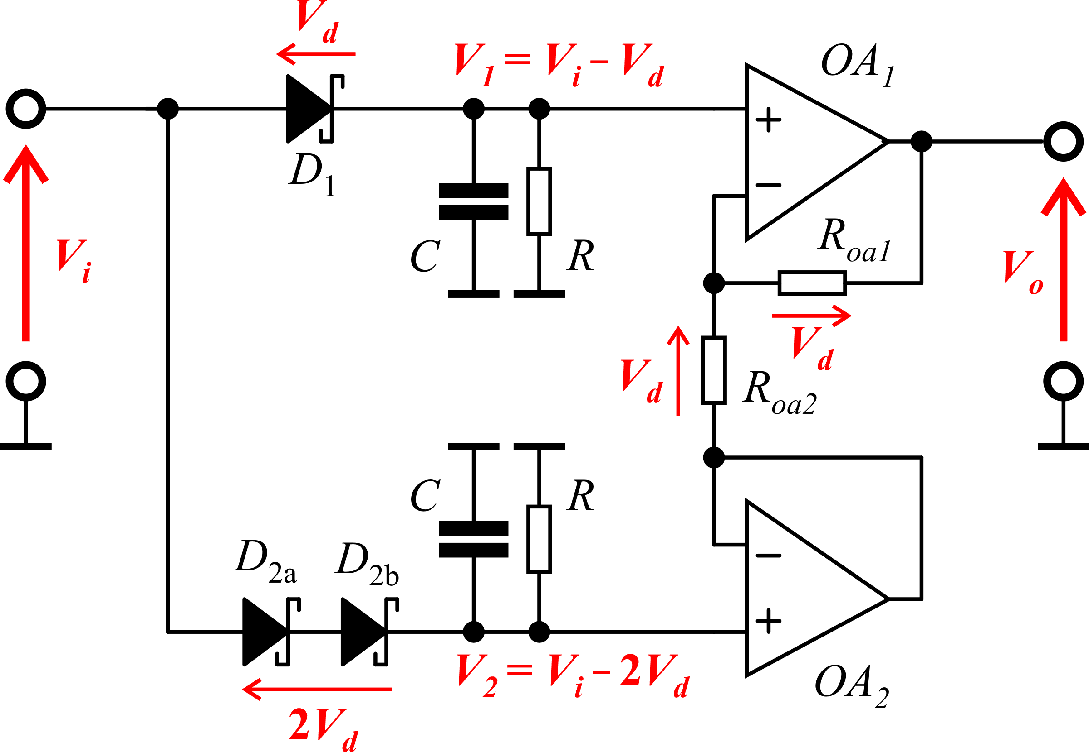
Compensated diode detector
Compensated diode detector consists of two diode peak detectors, one with single, second – with two diodes.
All three diodes are in one package, for good thermal coupling and symmetry of the forward voltages V_{d}.
Two operational amplifiers are used to derive 2 V_{d} voltage and to add it to the output of the two-diode detector. This way the resulting output voltage is equal to the input peak voltage.
To get an “ultimate peak mode operation”, the discharge resistors are in practice omitted.
In this case the discharge is done by the reverse leakage current of the diodes.
The asymmetry in the charging conditions for each individual detector becomes less important for larger input voltages. Therefore, the compensation improves with increasing signal levels
In practice the largest signal level is limited by the linear operation levels of the driving amplifier

Slide 6
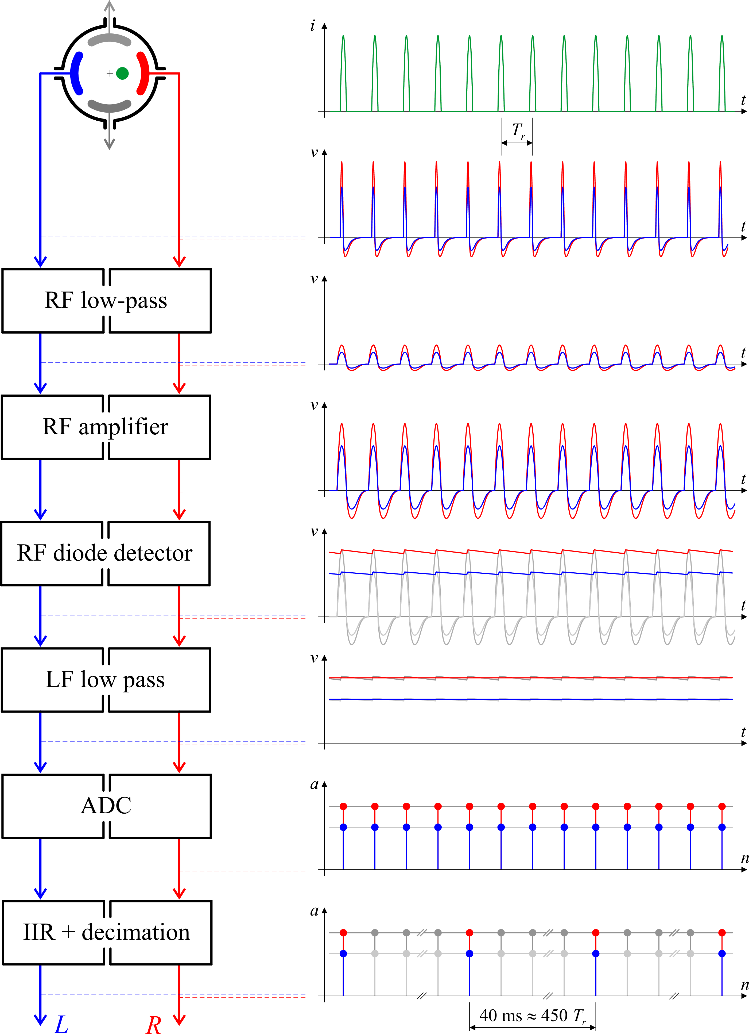
Diode orbit processing overview
Short pick-up pulses go through input low-pass filters to limit their slew rate and reduce peak amplitudes
RF amplifiers provide optimal amplitude of the pulses on the compensated diode detectors
Diode detectors convert pulses into slowly varying signals
Low frequency low-pass filters remove bunch pattern ripple and act as anti-aliasing filters
24-bit ADC digitises detector signals at the f_{rev} rate (for LHC 11.2 kHz)
IIR acts as an averaging filter to decrease signal noise and as an mailbox between two clock domains (f_{rev} of the machine and ms of the control system)
The filtered signals are decimated to 25 Hz
for compatibility with the LHC orbit feed-back system

Slide 7
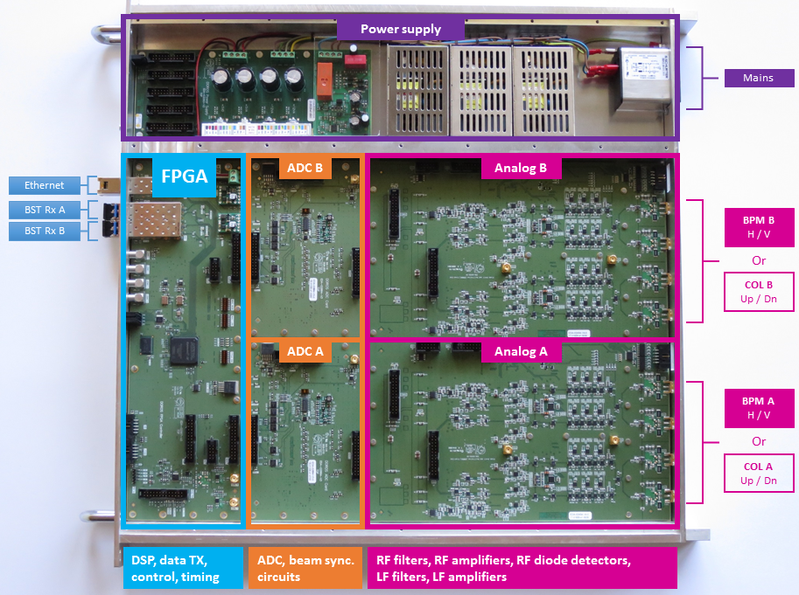
Is it really so simple ?
DOROS = Diode
ORbit and
OScillation system

Slide 8
Linearity of orbit diode detectors
The left upper plot shows a laboratory measurement of the detector linearity together with its linear fit.
The right upper plot shows the deviation of the detector characteristic from the linear fit for three detector time constants. Which time constant is used depends on the number of circulating bunches.
Systematic position errors show up when there is at the same time a larger position offset and important signal amplitude change

Slide 9
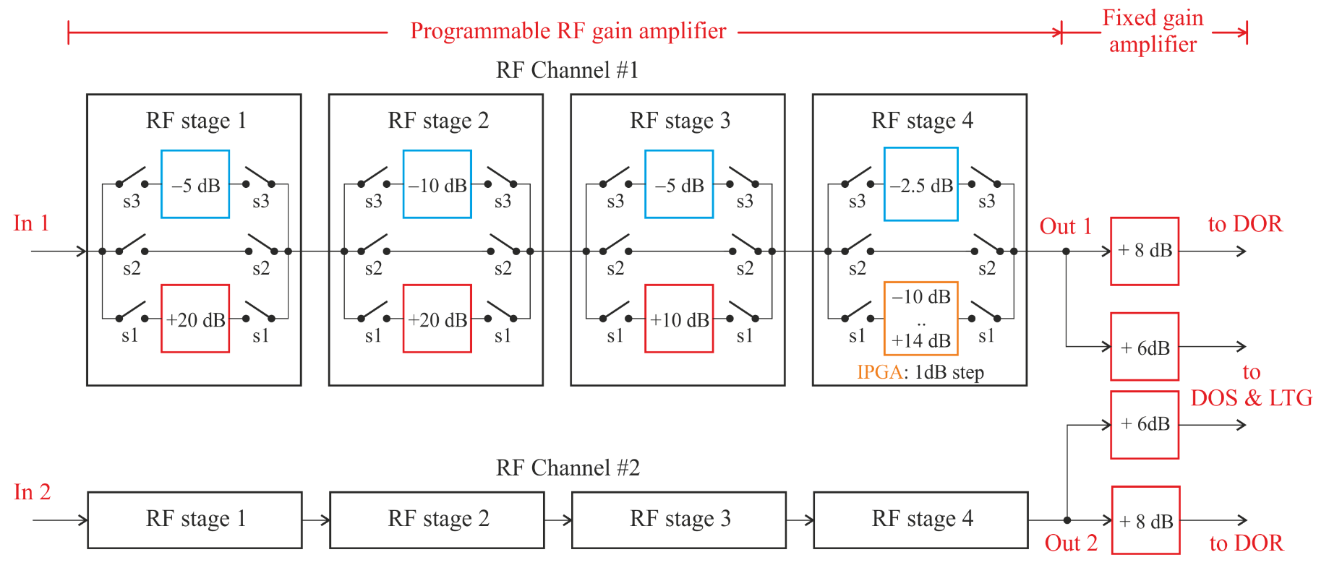
RF amplifier
Shown one RF amplifier pair for one BPM plane (out of 4 of one DOROS front-end)
Each RF amplifier is identical
The RF amplifier block is the most complex analogue part of the DOROS front-end and required the longest development
Each channel consists of 4 attenuators, 5 fixed gain amplifiers and one programmable gain amplifier with 1 dB gain step
Each RF amplifier has at least 200 MHz bandwidth
The gain of the RF amplifier can be changed from -14 dB to 72 dB in 1 dB steps, covering an 86 dB dynamic range

Slide 10
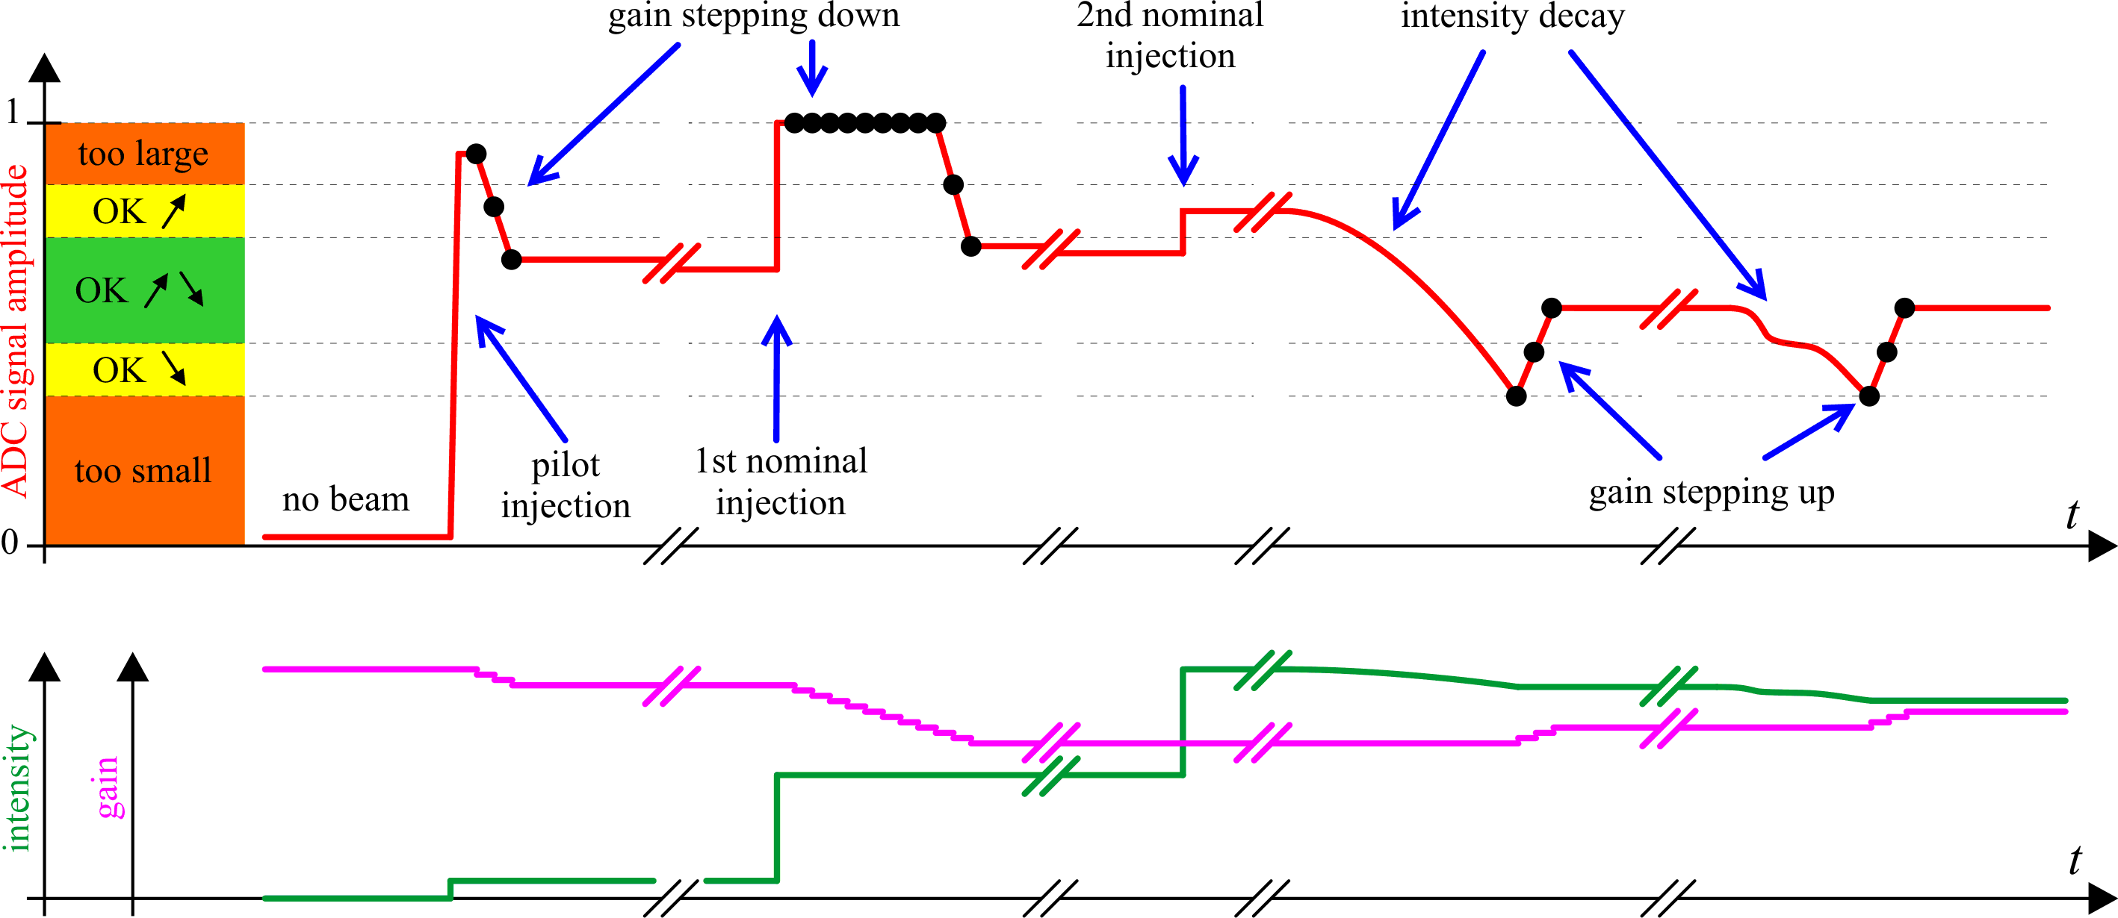
Automatic gain control of the RF amplifier
Four channels of one pick-up have the same gain
Gain control is based on the largest signal of all four electrodes
The gain is adjusted to cause the largest signal to have the amplitude in the green zone
The gain control levels are programmable and can be changed according to actual beam conditions
One gain step is 1 dB i.e. about 12 %

Slide 11
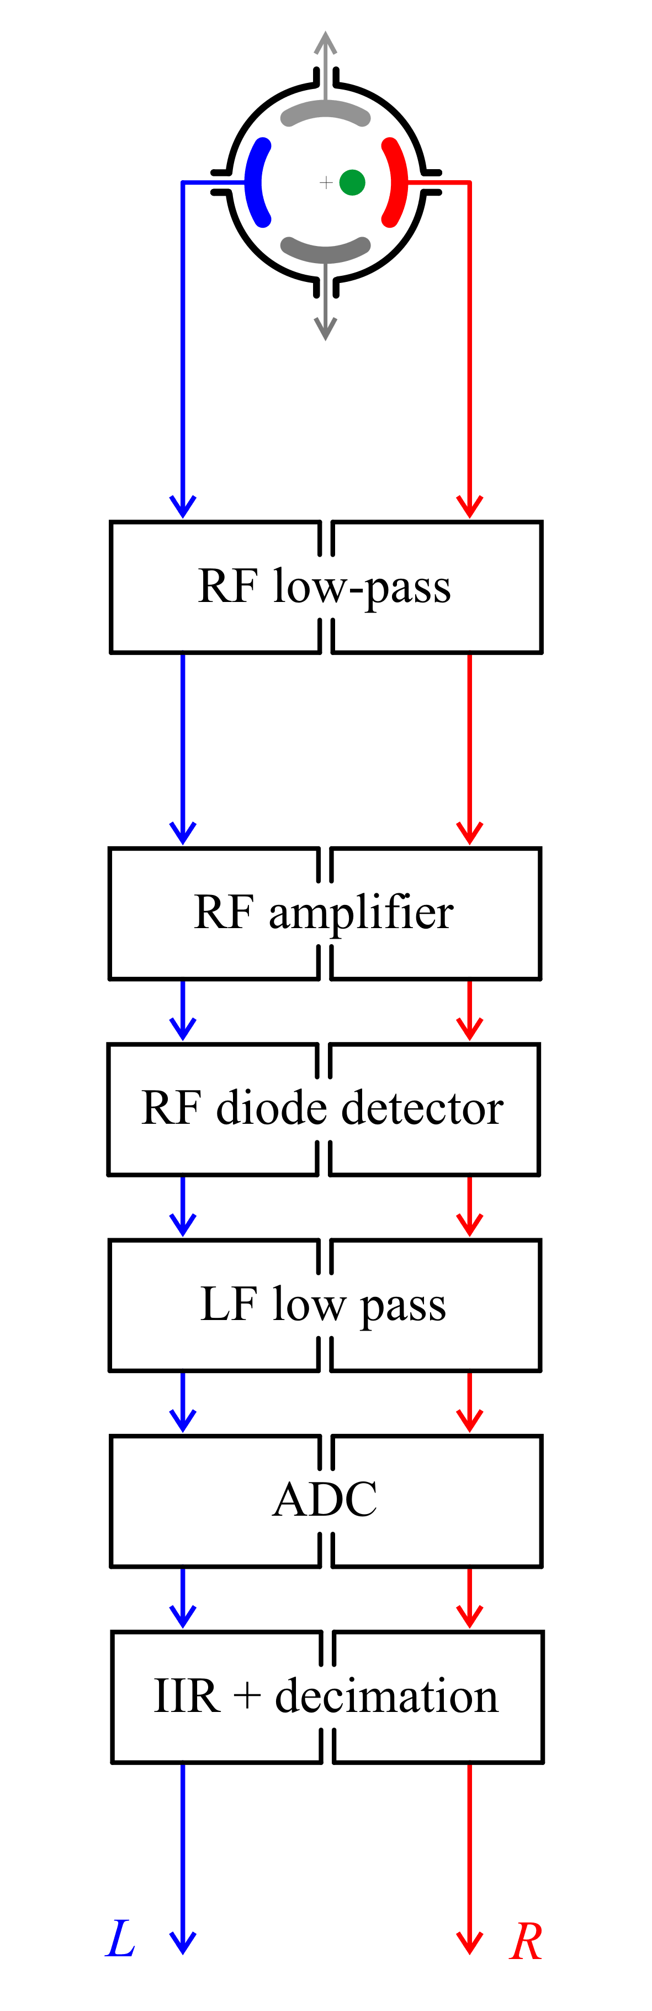
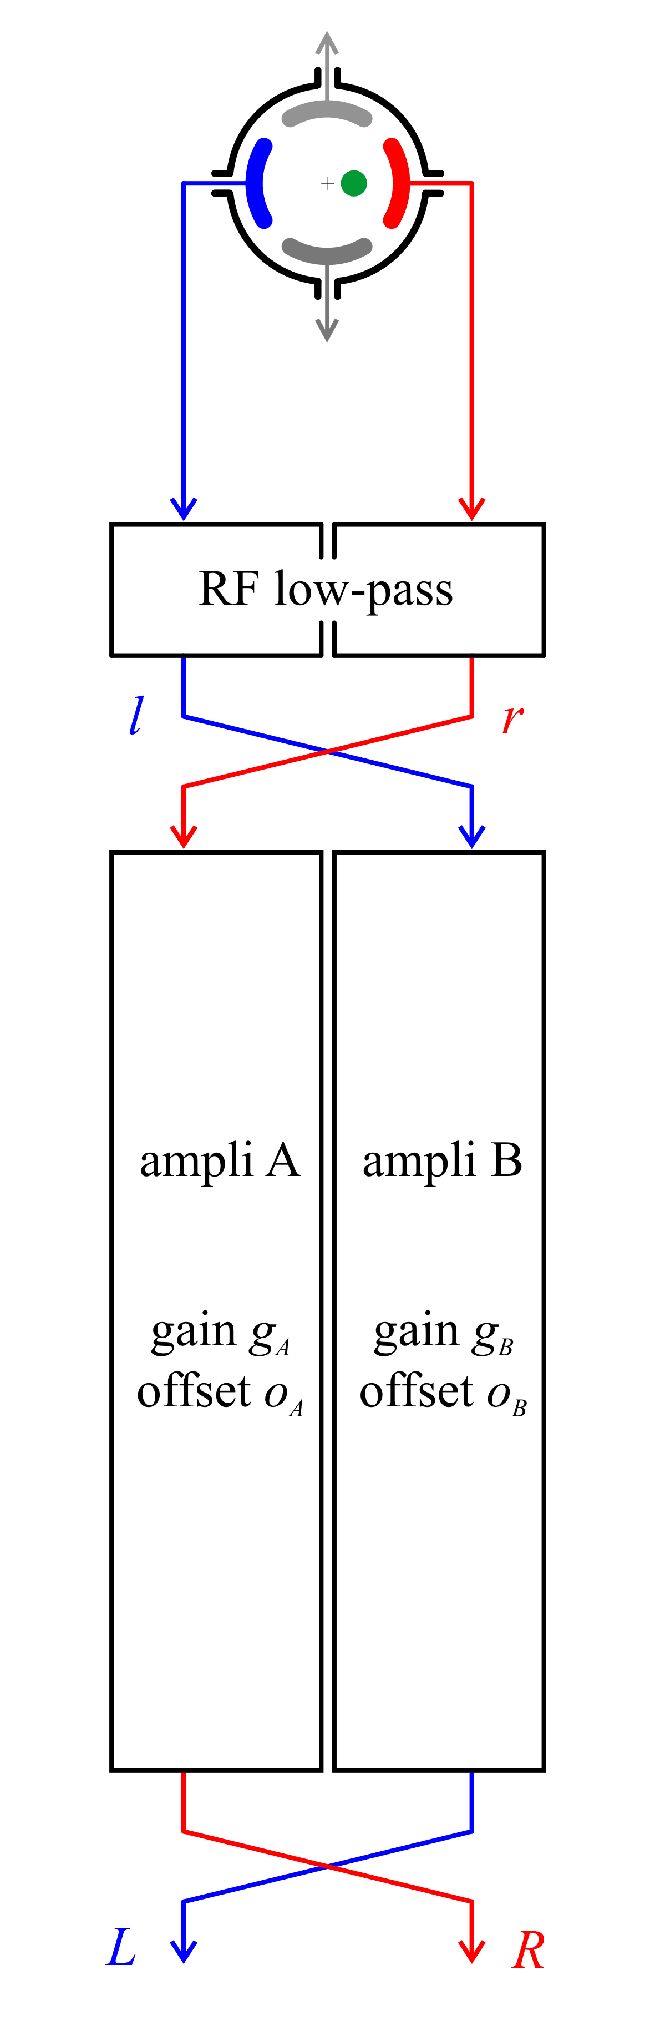
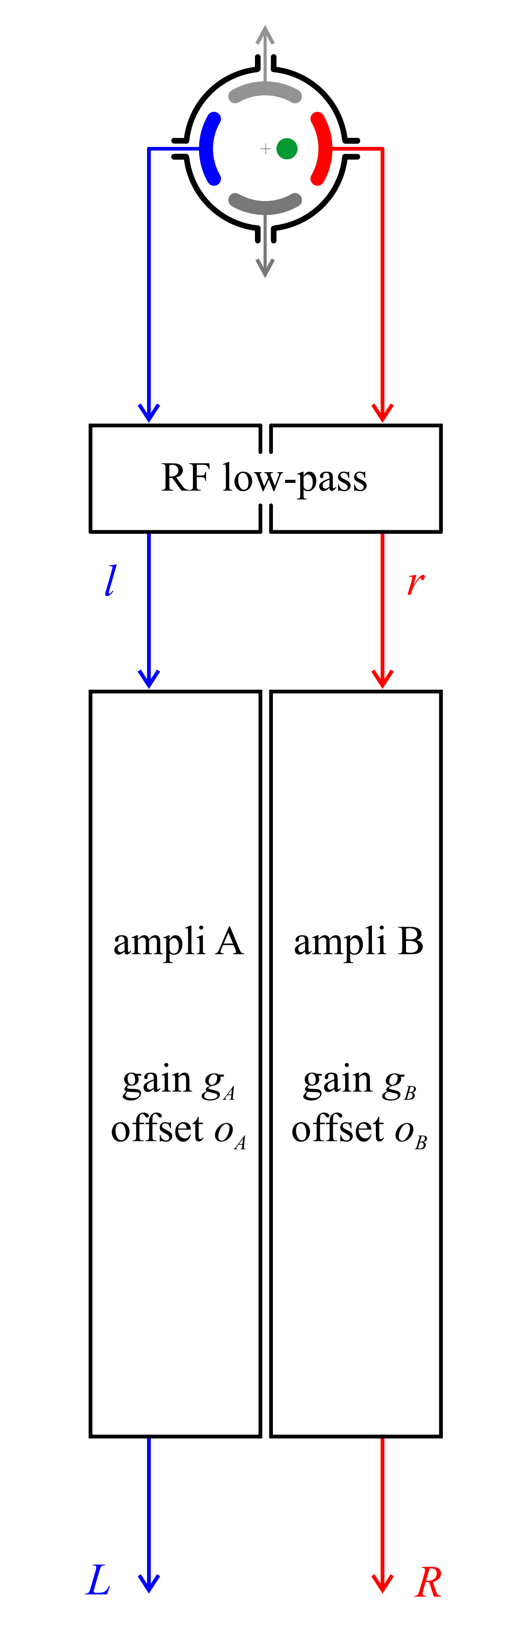
Channel asymmetry compensation (“auto-calibration”)
measurement 1
measurement 2
Channel switching is done typically every 1 s.
The fastest can be 12.5 Hz.
One calibrated measurement comes from two simple ones using moving average = one calibrated measurement every 1 s with 1 s delay
Typically g_{A}, g_{B} ∈ [0.95, 1.05], o_{A}, o_{B} ∈ [-0.001, 0.001]
A numerical example (assuming simple linear characteristic of the pick-up):
Perfect amplifiers (g_{A} = g_{B} = 1 and o_{A} = o_{B} = 0):
for l = 0.5, r = 1, p_{H} = 0.3333 and P_{H} = 5.083 mm for
Q1 BPM with d = 61 mm.
Assume amplifiers with g_{A} = g_{B} = 1.05 and o_{A} = o_{B} = 0.001:
p_{H} = 0.3329 and P_{H} = 4.927 mm, resulting in an error of 6 μm

Slide 12
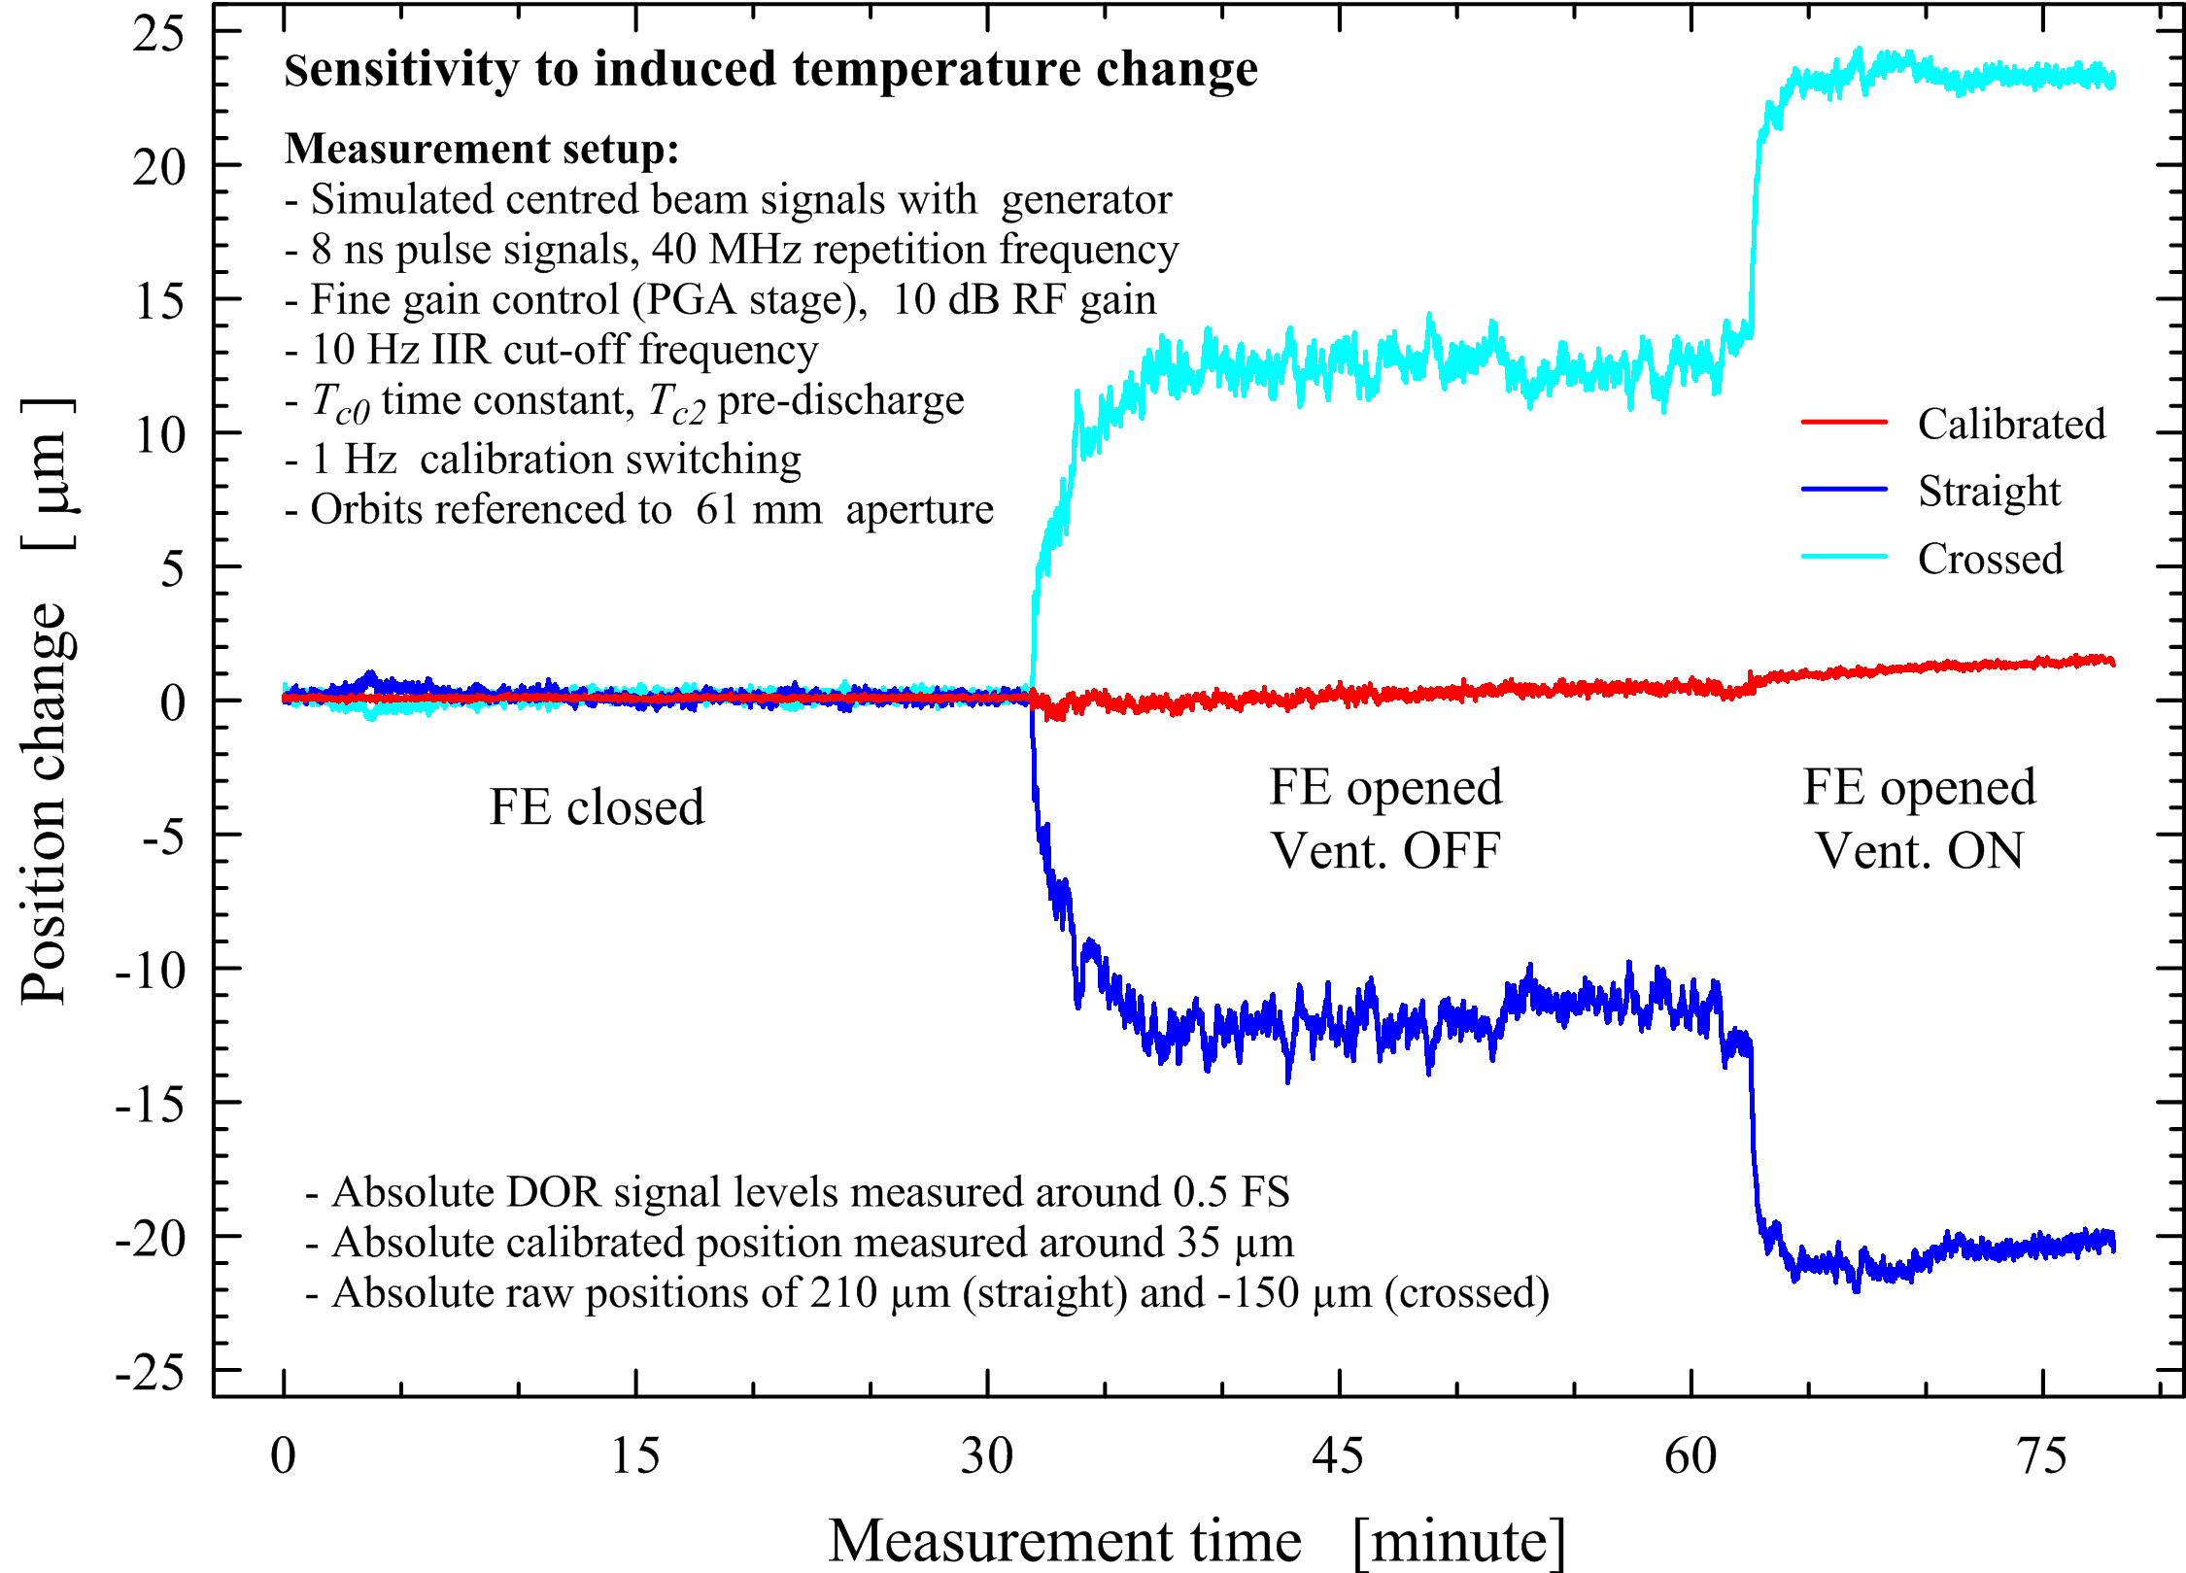
Orbit auto-calibration dealing with drifts

Slide 13
Orbit auto-calibration dealing with noise

Slide 14
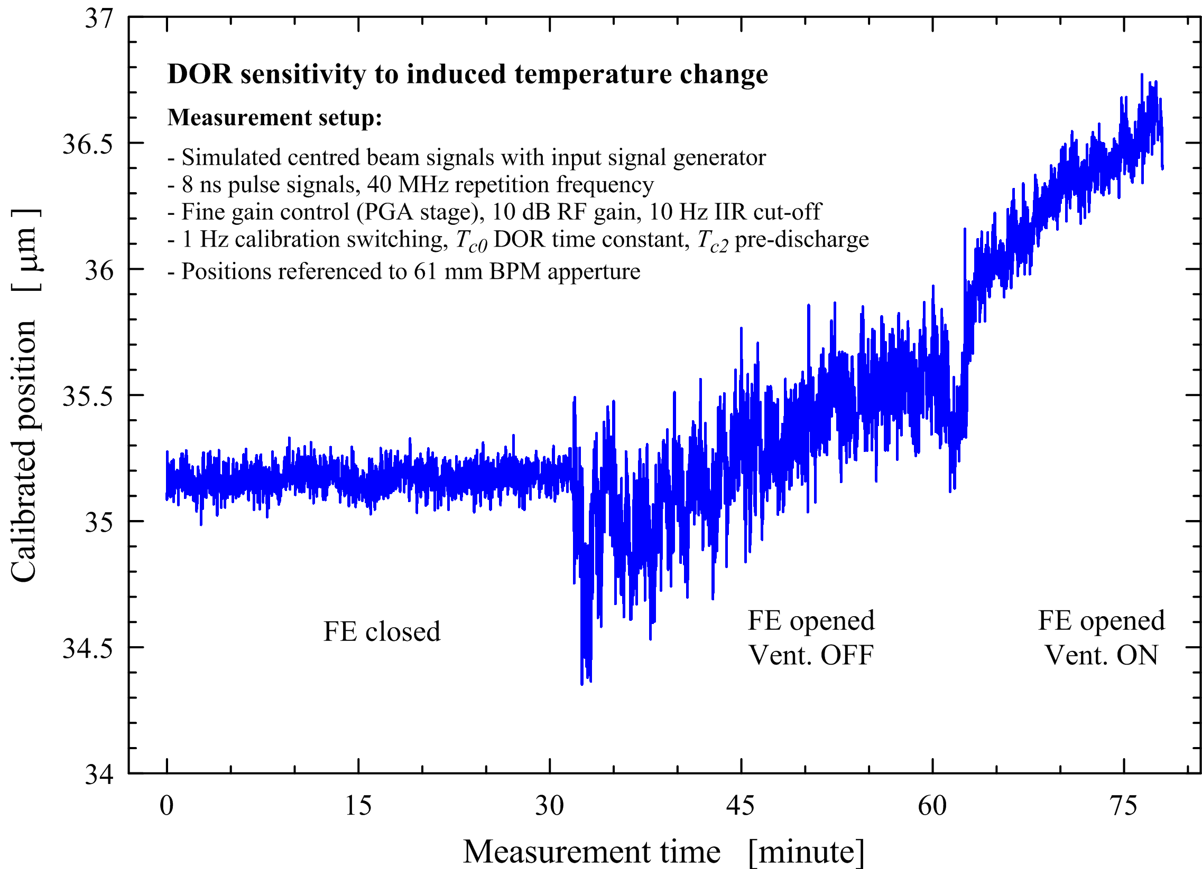
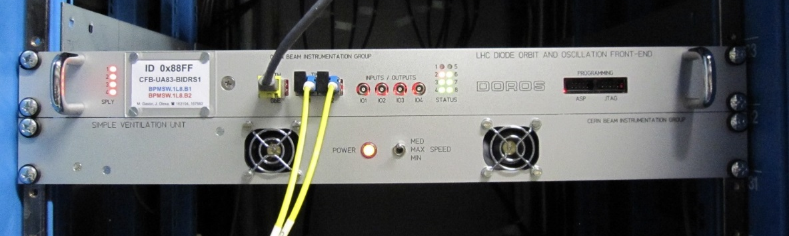
Thermal sensitivity

Slide 15
Stability with LHC beam and collimator BPMs

Slide 16
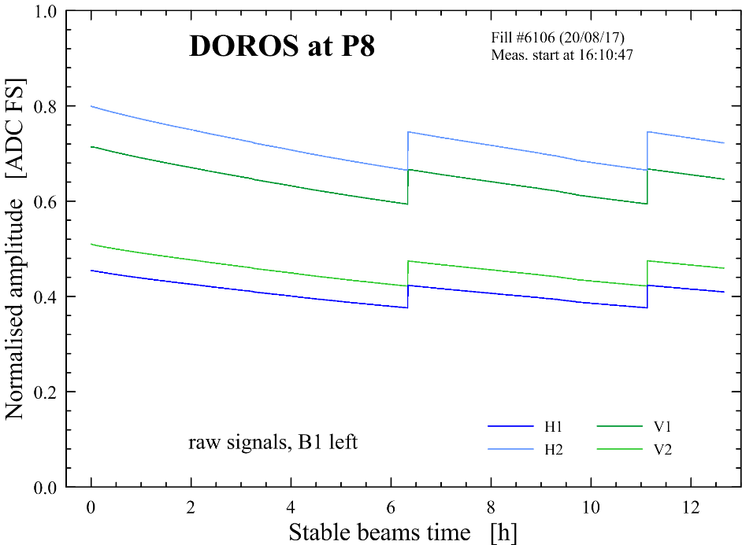
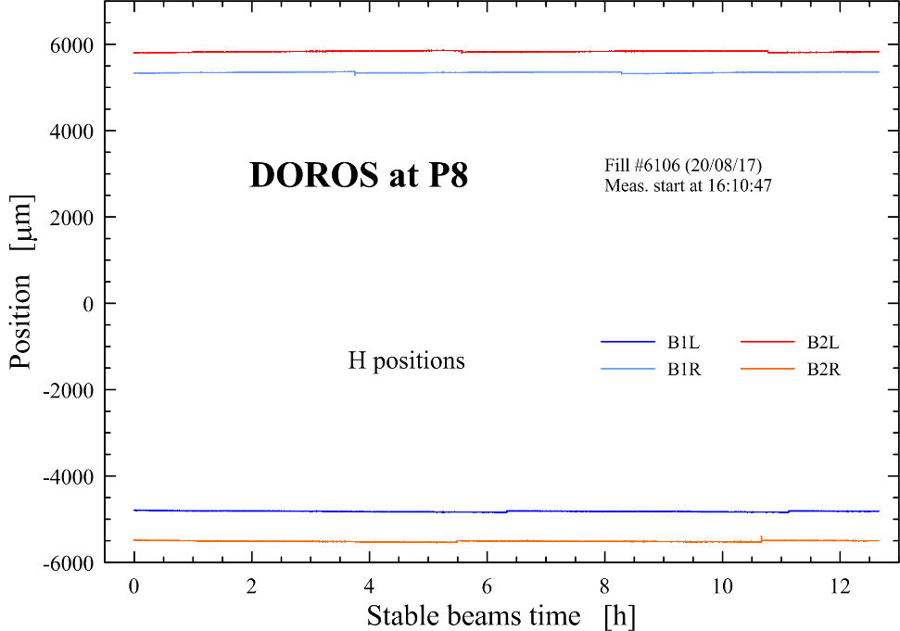
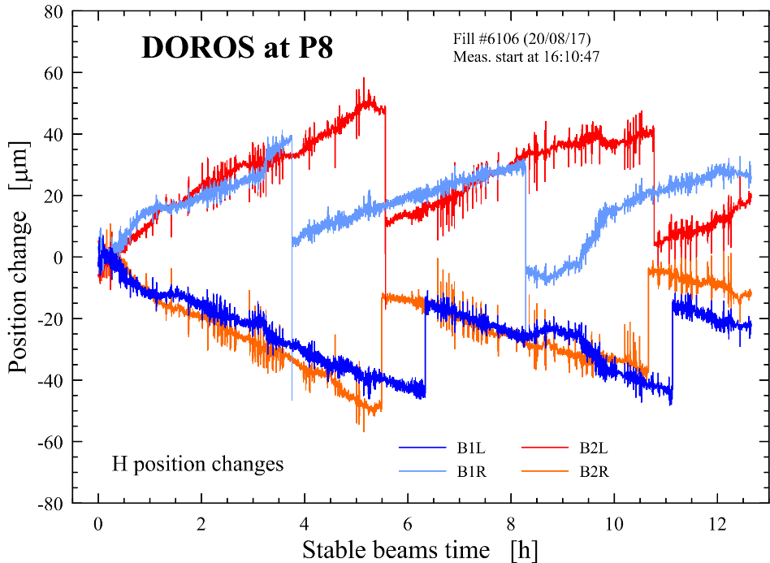
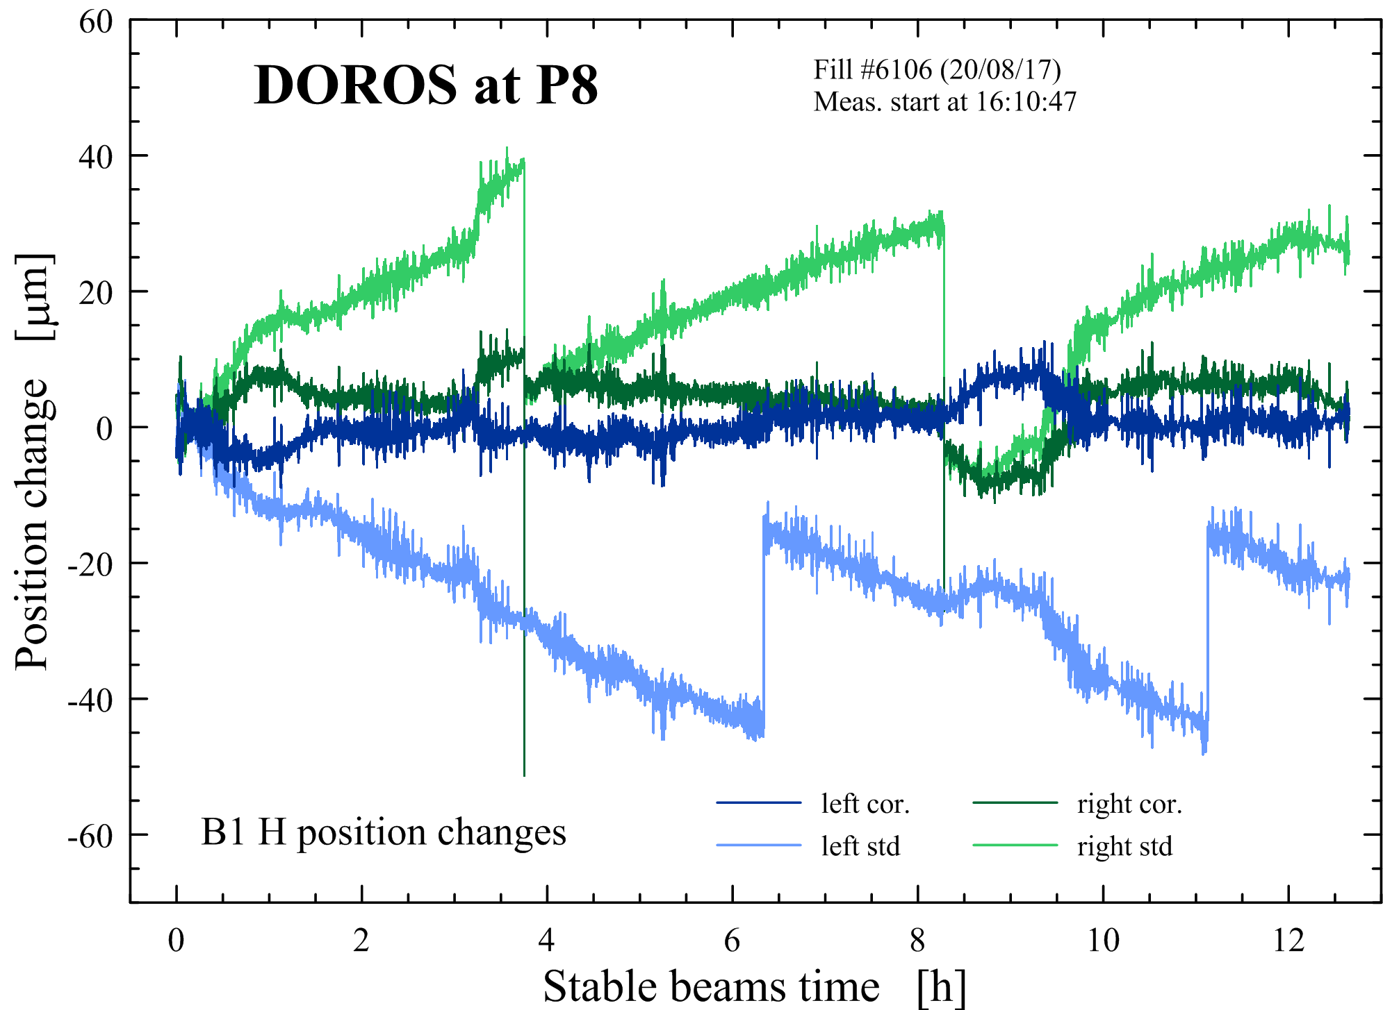
Stability at LHC P8 and the detector linearity correction

Slide 17
Stability with (almost) constant intensity

Slide 18
Beam orbit stability and noise

Slide 19
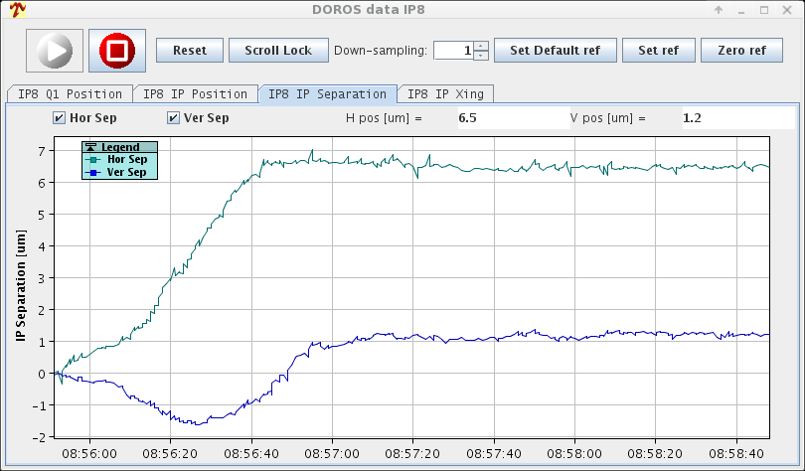
An example from the LHC logbook: beams separation in IP8
Time stamp: 8:58:48 25/04/18
Beam 1 to beam 2 separation in the interaction point (IP) is calculated using beam positions from the left and right BPMs closest to the experiment, interpolated to the IP
Please note that each separation on the plot is calculated upon readings from 4 BPMs.

Slide 20
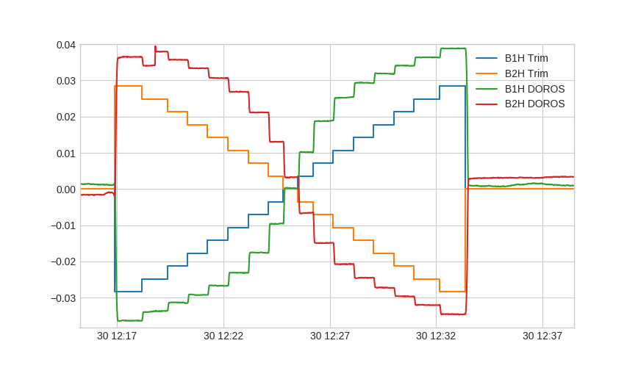
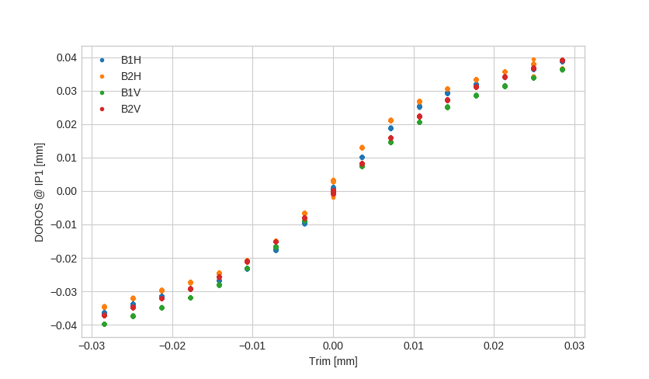
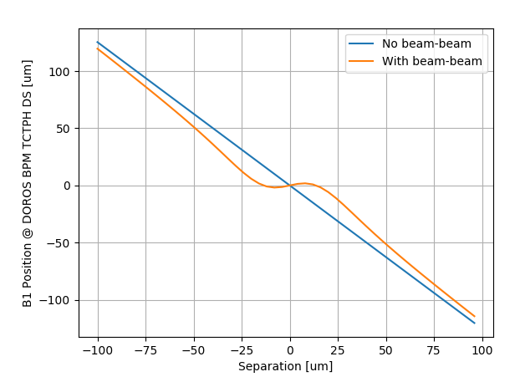
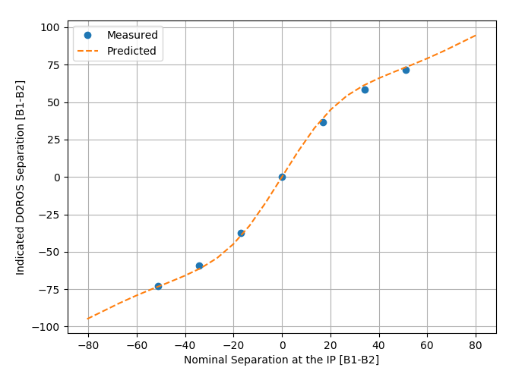
Beam-beam orbit effects observed with DOROS
[micrometres]
Measurements first reported as a DOROS non-linearity, later explained by beam-beam forces. Plots curtesy of M. Hostettler et al.

Slide 21
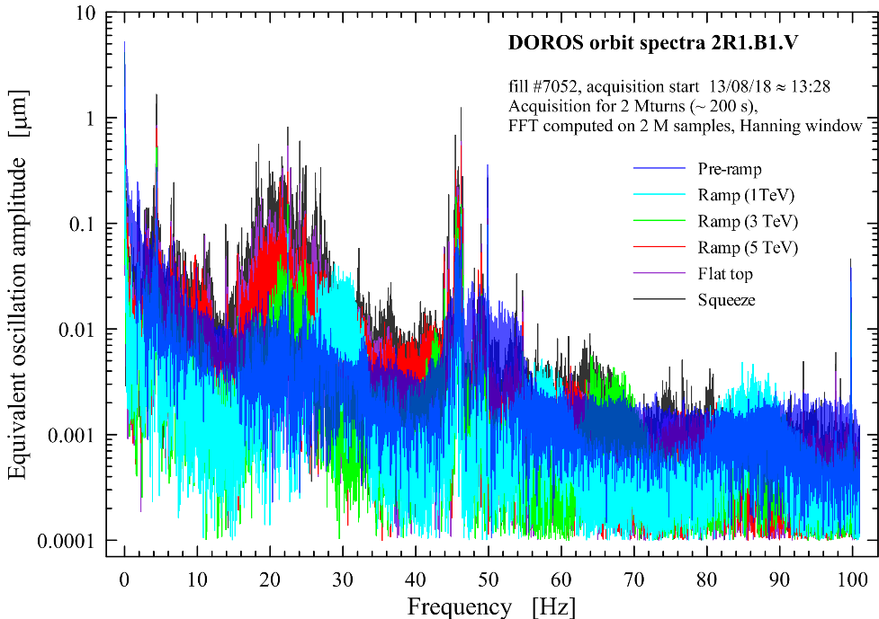
2 Mturn LHC orbit spectra at P1
fill #7052, 13/08/18
2 Mturn spectra, Hanning window

Slide 22
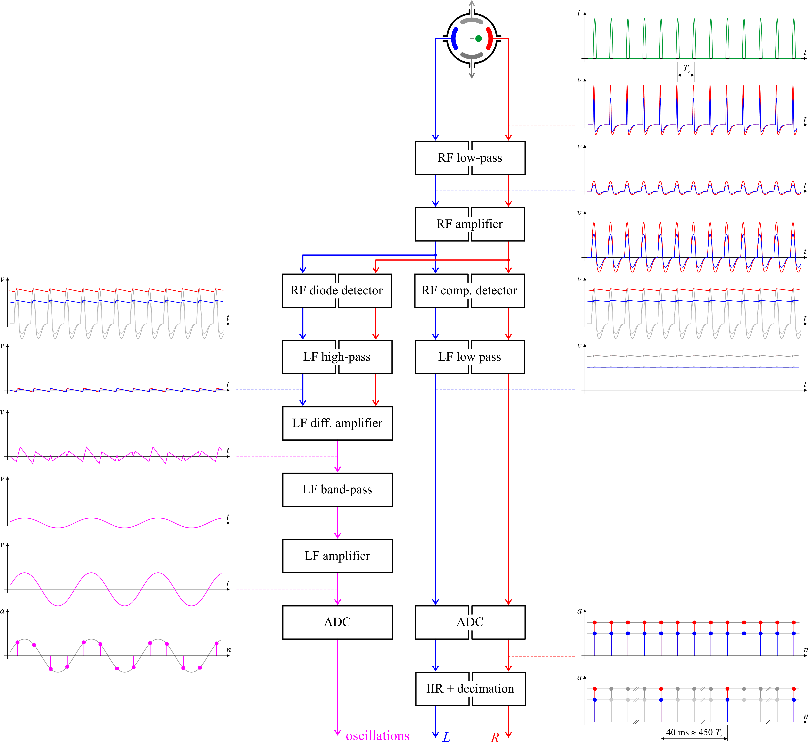
DOROS – oscillation part
Separate analogue processing optimised for beam oscillation signals
Designed for betatron coupling and phase advance measurements
Shares with the orbit a lot of the front-end resources
Processing bandwidth is from about 0.05 to 0.5 f_{rev}
Signals are digitised synchronously to the f_{rev}

Slide 23
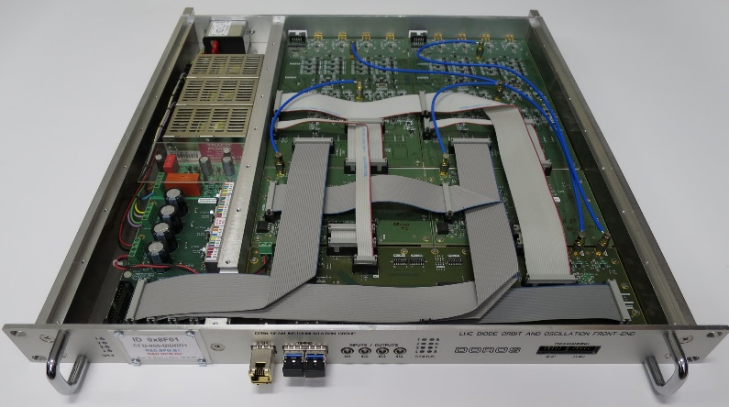
Summary
Diode orbit strengths:
Excellent resolution
Very good long term stability
Limited dependence of the output voltages on
the number of circulating bunches
Simple and robust
Very low rates of the digital data
“Perfect beam sampling” even for very short bunches without any precise timing
Slowly varying signals at the detector output, easy for precise signal processing and high resolution digitization
“Natural noise gating” due to very low “diode detector gain” for noise between beam pulses
No limit for beam offsets, as signals from each electrode are processed separately
Diode orbit weaknesses:
Limited dynamic range of the detector linear operation, variable gain amplifiers required to compensate important bunch intensity variations
Only turn by turn, bunch by bunch not easy
(some ”reset techniques” required)
Large bunches favoured
(good for masking undesirable reflections)
Important dependence of the measured position on the signal amplitude change for large beam offsets. Related errors some two orders of magnitude larger than the system resolution…
LHC DOROS system:
Currently some 50 FEs in use on some 100 BPMs;
about 50/50 on collimator and standard BPMs
Very good performance on BPMs with small beam offsets
Ongoing development to improve systematics with large beam offsets and changing intensity. The most promising strategy: smaller gain step. Currently studied PIN diode attenuators.

Slide 24
Spare slides

Slide 25
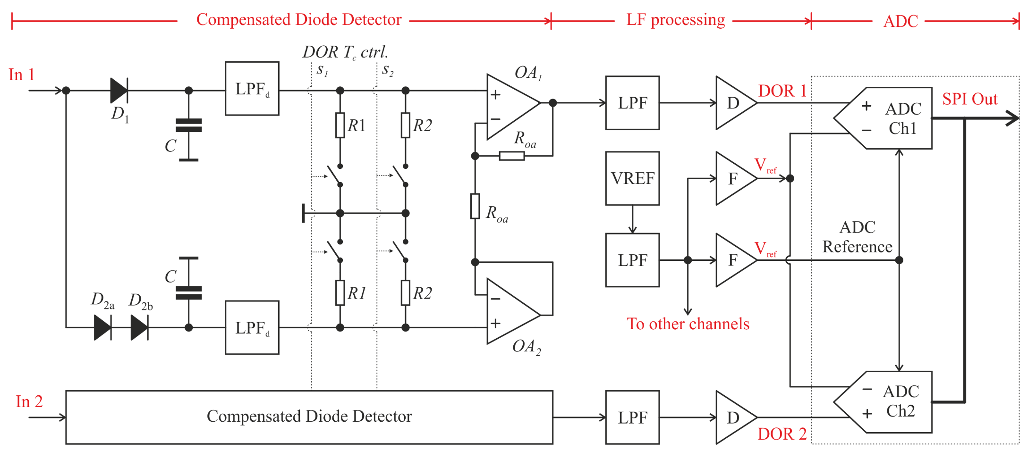
Analogue orbit processing

Slide 26
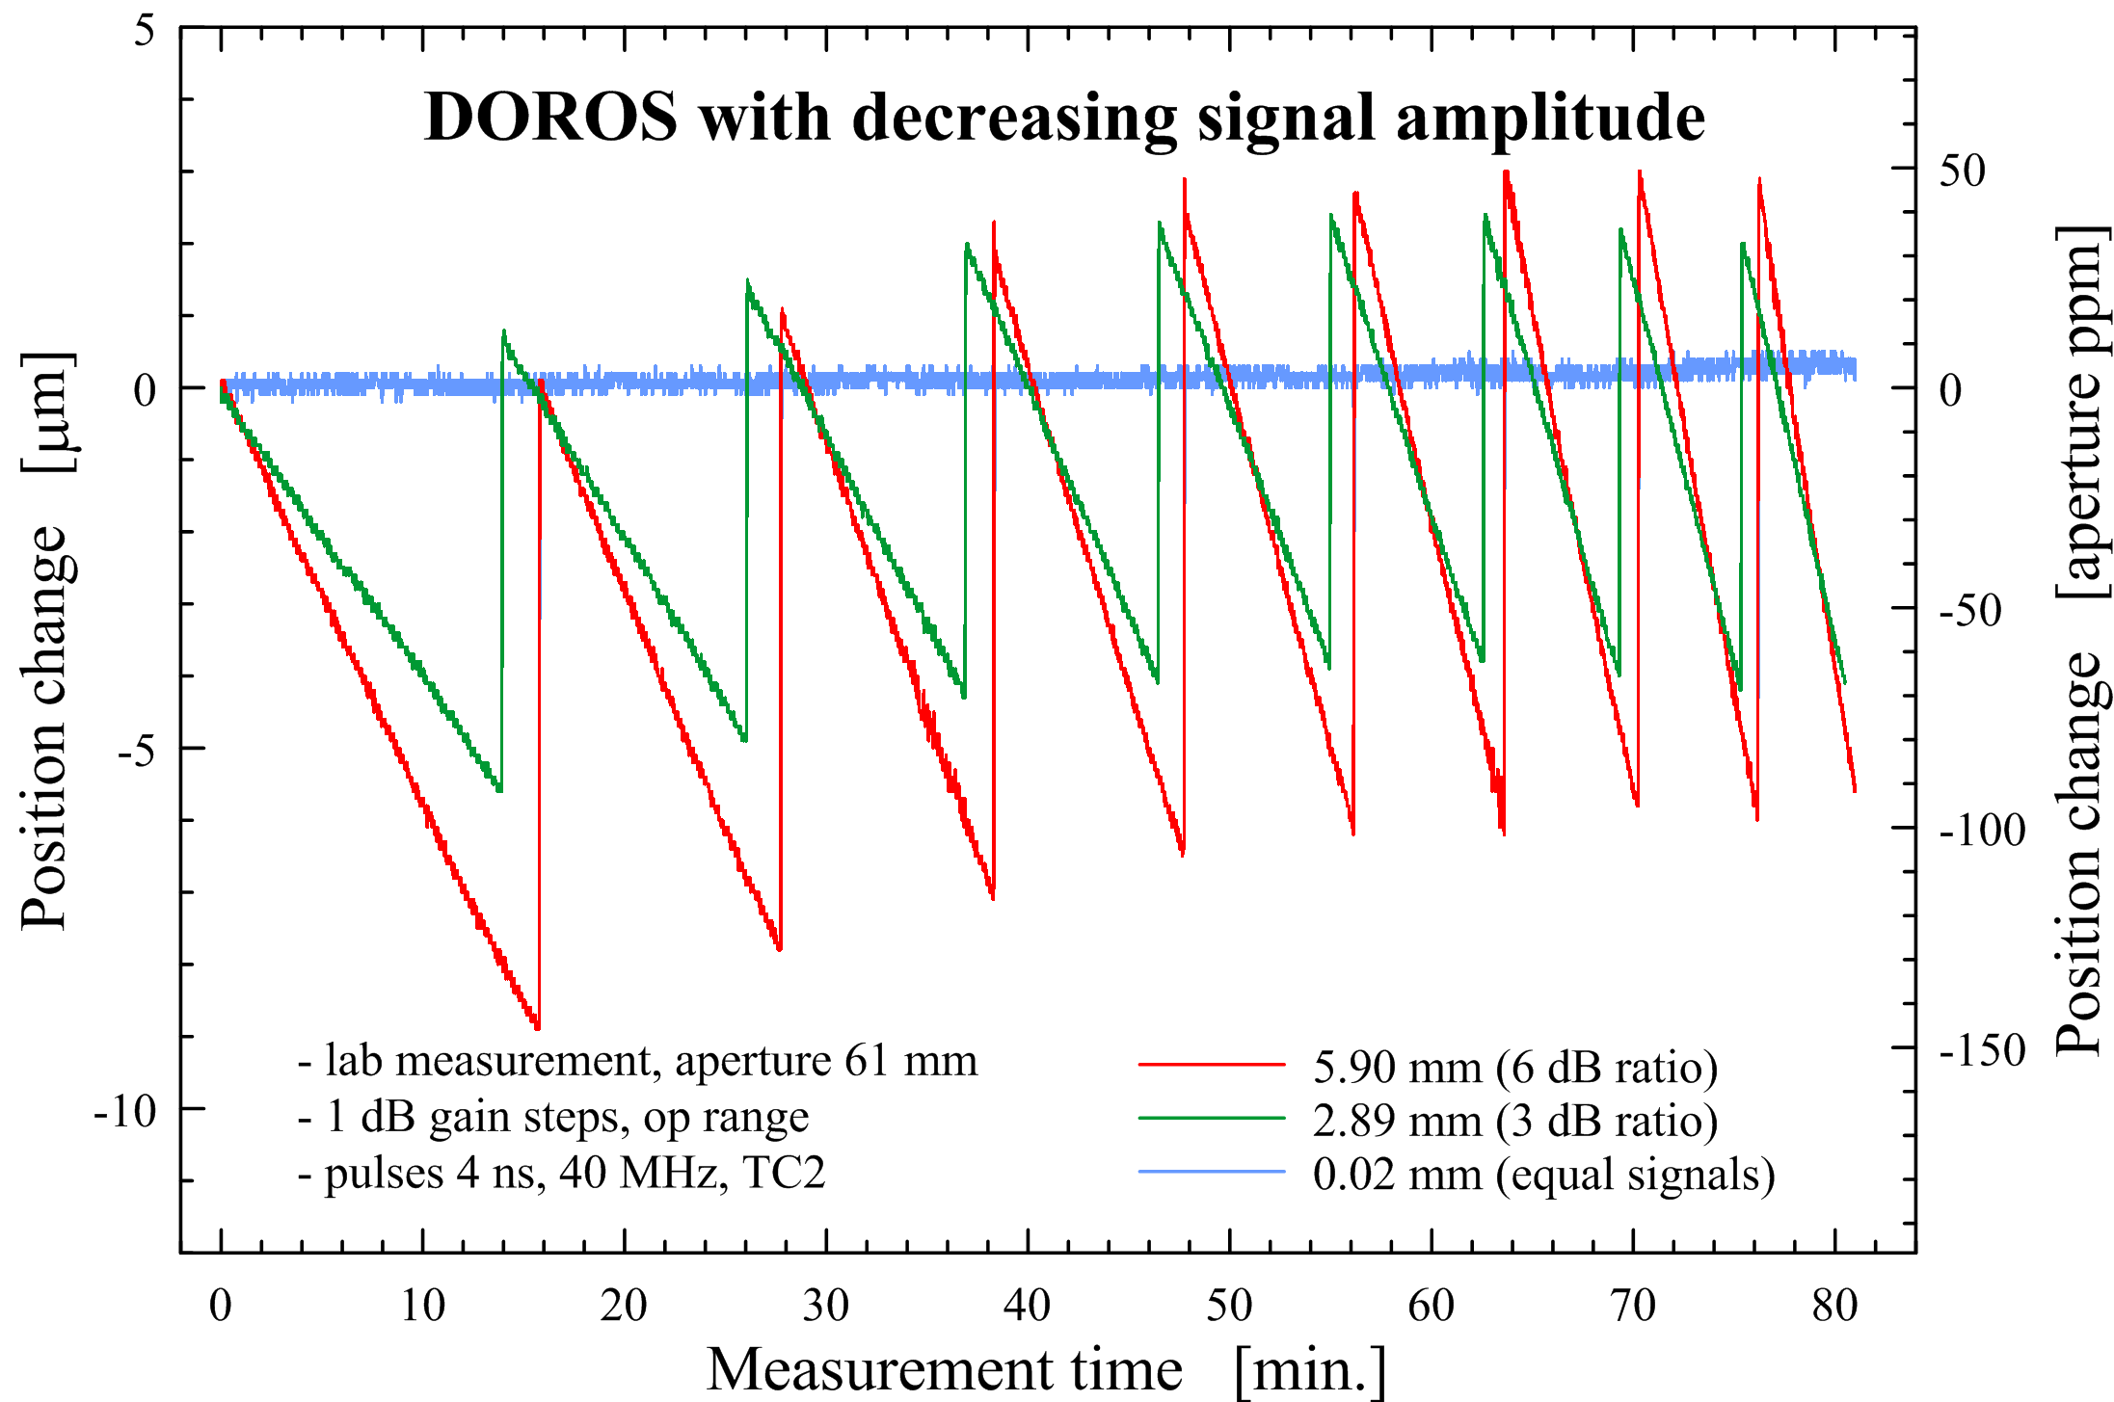
Systematic errors due to signal amplitude changes

Slide 27
DOROS vs. standard BPMs for orbits

Slide 28
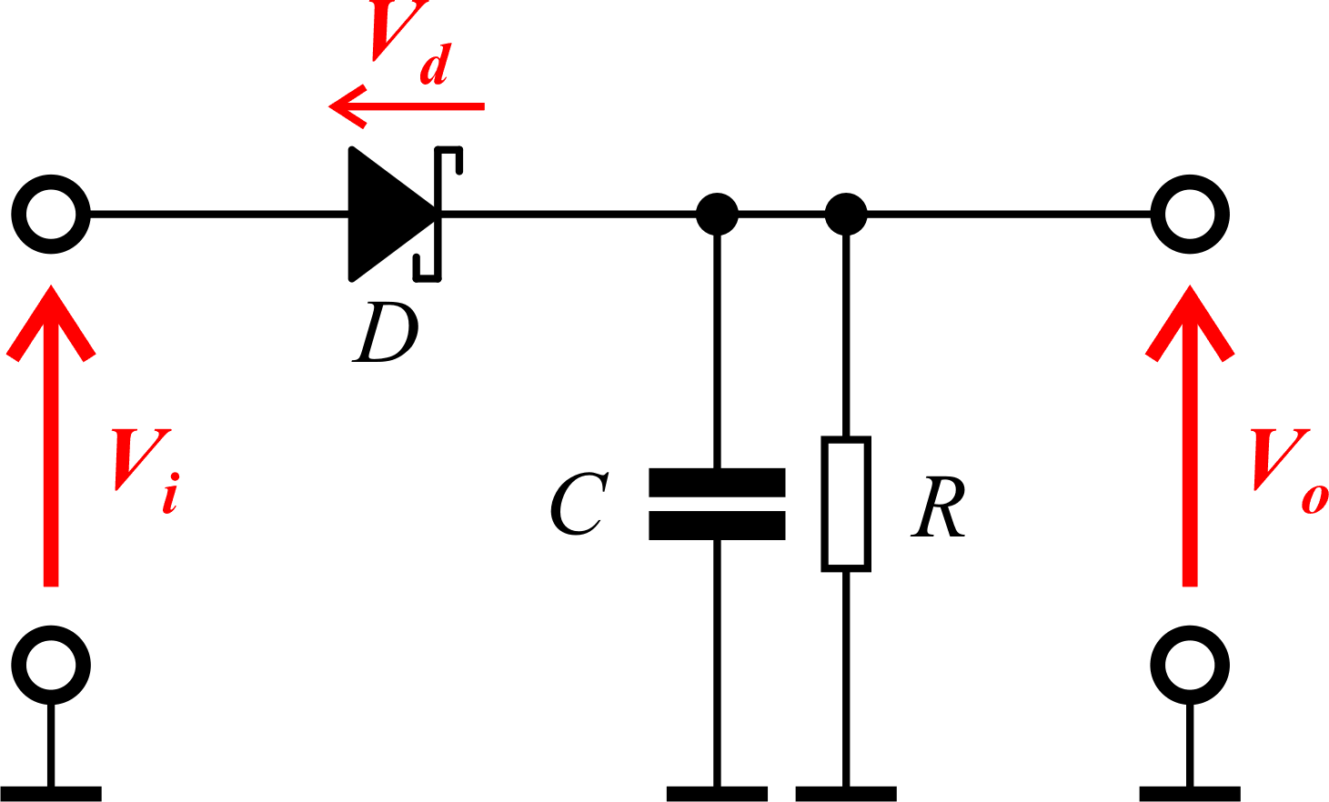
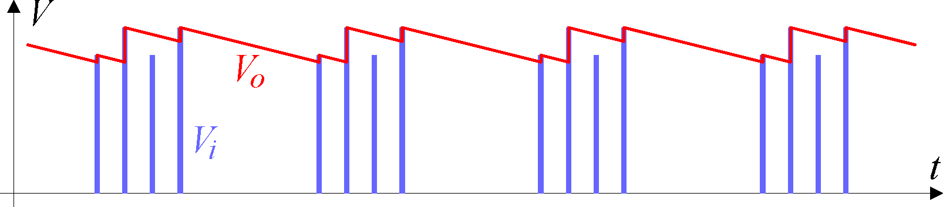
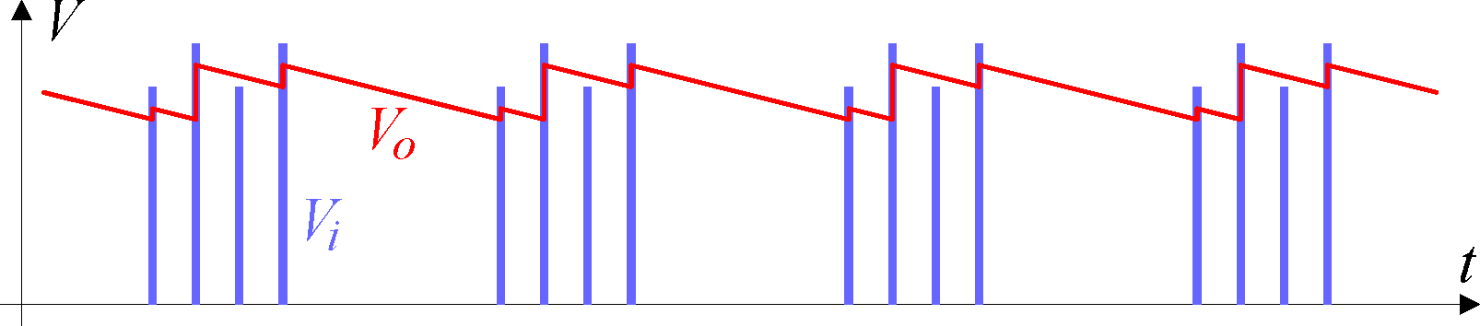
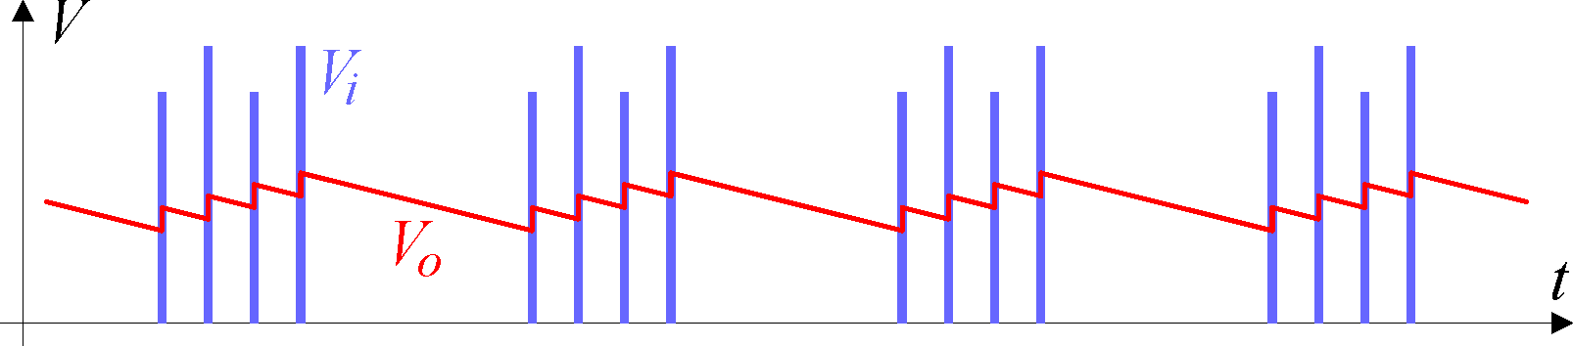
A simple detector and short pulse signals
Input (V_{i}) and output (V_{o}) voltages
peak detector, ideal diode
peak detector, real diode
“average” detector, real diode

Slide 29
Diode ORbit and OScillation system (DOROS)
DOROS is a beam position measurement system based on diode detectors
The system has been developed to be used with the LHC collimators equipped with embedded BPMs.
It is also installed on selected LHC standard BPMs.
DOROS front-ends contain two parallel subsystems which share the same RF processing:
  DOR – diode orbit processing
    optimised for sub-micrometre resolution and micrometre precision
    does not require beam synchronous timing
    cost 1: bandwidth limited to some 100 Hz
    cost 2: not bunch-by-bunch, it measures an “average” of all bunches
  DOS – diode oscillation processing
    optimised for processing of small beam oscillations in the bandwidth 0.05 – 0.5 frev
    cost 1: orbit information removed from the processing
    cost 2: signals not in mm and changing with the beam intensity
LPF – low-pass filter,
TSG – test signal generator,
PGA – programmable gain amplifier,
FGA – fixed gain amplifier,
CDD – compensated diode detector,
ODD – oscillation diode detector,
OSP – oscillation signal processing.

Slide 30
Features of the DOROS orbit part
Measuring orbits in the frequency range 0 – 100 Hz limited by analogue low-pass filters
Each BPM electrode signal processed by a dedicated diode detector
Cancellation of the residual asymmetry in the analogue processing of the signals from opposing BPM electrodes with periodic signal multiplexing (1 Hz rate)
Processed electrode signals sampled simultaneously with 24-bit ADCs at the LHC f_{rev} (11.2 kHz )
Real-time UDP streaming of the processed ADC data from the diode orbit channels
  Raw electrode data IIR filtered, decimated and sent to a system server at a 25 Hz rate
  Cut-off of the IIR filter can be programmed in the range 0.01 Hz – 2 kHz.
  System server computes orbit data and absolute beam orbits in mm;
  they are published at 1 Hz rate with 1 s latency.
  Beam data and front-end parameters are logged
  12.5 Hz asymmetry calibration switching available to reach data rates and latency compatible with the current orbit feedback operation
On-demand “Capture/Freeze” mode:
  Electrode ADC samples stored at f_{rev} rate in the front-end memory.
  Rolling turn-by-turn buffer depth of about 1.8 million turns (up to 3.5 minutes @ f_{rev})
  If enabled in the front-end the capture can be triggered with dedicated Beam Synchronous Timing (BST) event
  Optional capture/freeze triggers upon server commands
  Optional data decimation during front-end readout
  Acquired data can be used to compute orbit spectra in the bandwidth 0 – 100 Hz.
  (limited by the available signal bandwidth form the analogue processing)
Post-mortem rolling buffers:
  UDP datagrams stored in the front-end memory
  The UDPs contain information on the electrode signals + statuses, temperatures, flags, settings…
  Rolling UDP buffer depth of about 4600 UDPs (up to 3 minutes @ 25 Hz rate)
  Buffer start/stop control and readout from the system server

