Slide 1
The new ASTRID2 Fast Orbit Feedback system
Jørgen S. Nielsen
Center for Storage Ring Facilities (ISA)
Department of Physics and Astronomy
Aarhus University
Denmark

Slide 2
ASTRID2
ASTRID2 is since 2013 the new synchrotron light source in Aarhus, Denmark
ASTRID2 main parameters
  Electron energy: 580 MeV
  Emittance: 12 nm
  Beam Current: 200 mA
  Circumference: 45.7 m
  6-fold symmetry
    lattice: DBA with 12 combined function dipole magnets
      Integrated quadrupole gradient
  4 straight sections for insertion devices
  Using ASTRID as booster (full energy injection)
      Allows top-up operation

Slide 3
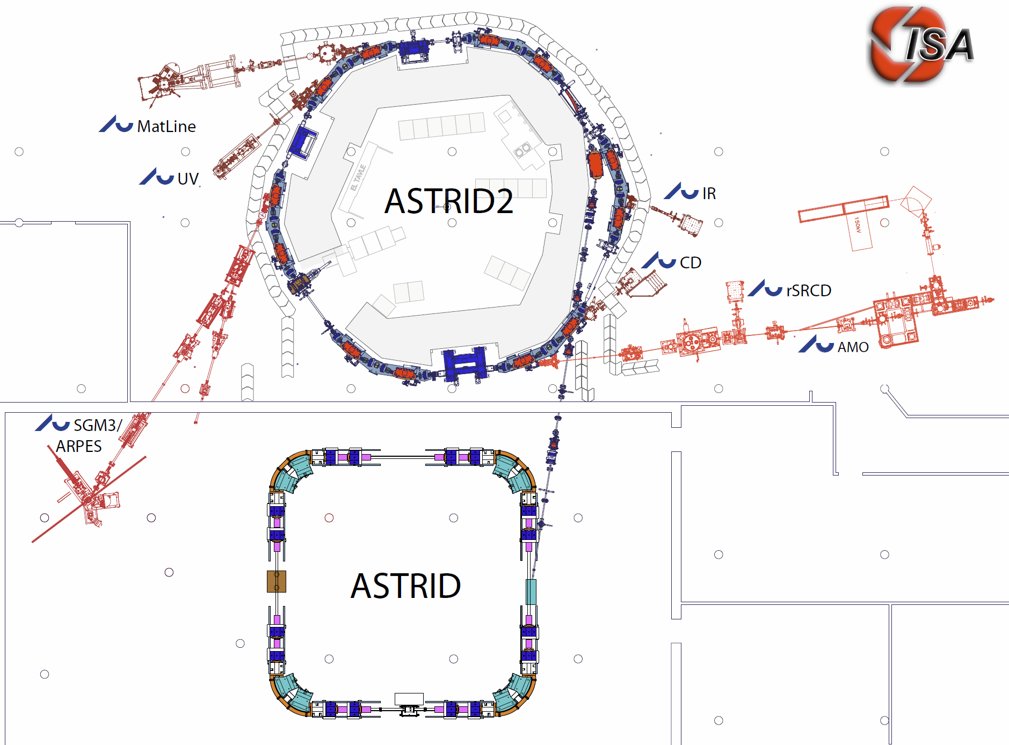
The ASTRID 2 facility
ASTRID2 main parameters
Circumference 45.71m
Energy 580MeV
Current 200mA
Characteristic energy 257eV
RF frequency 105MHz
Harmonic 16
Horiz. emittance 12nmrad
#Straight sections 6
Length of straight sections 2.82m
#ID’s 3
10m
Microtron (100MeV)
Notes:
Microtron, Booster, Inj. Bl., A2 ring, 6 beamlines, 7 experiments

Slide 4
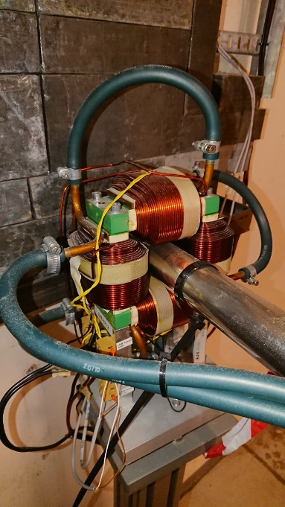
ASTRID2 Orbit Control
Design/Construction (2010-2012)
  12 HV window frame correctors + 12 H correctors
    Home-made ±15 A power supplies
  24 Button BPM’s (4 in each arc)
  24 Libera Electron BPM processors
  Slow Orbit FeedBack
    LabVIEW
    Only using the 12 HV correctors
  No Fast Orbit Feedback
    To keep cost and complexity down
HV window
frame corrector

Slide 5
Orbit problems (disturbances)
Disturbance from ASTRID during injections
  Up to ~20 µm (with feedforward)
Cars on parking lot above ASTRID2
  Up to ~5 µm
Fairly strong 50 Hz noise peaks
    50 Hz: ~3 µm
    150 Hz: ~0.4 µm
    250 Hz: ~0.2 µm
    350 Hz: ~0.3 µm
    550 Hz: ~0.2 µm
Insufficient resolution in PS (16 bit)
  ~1 µm

Slide 6
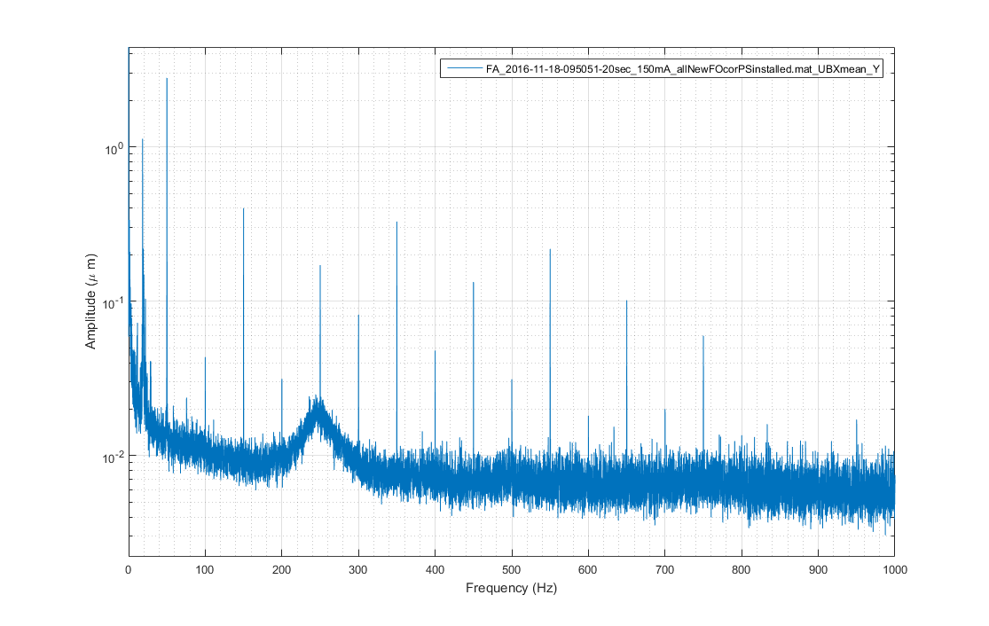
Orbit disturbances
Average of FFT of beam positions from all 24 vertical pickups
Notes:
Beam position FF plot from \\isa\data\Astrid2\AccPhys\Orbit\FAdata\FOFB\161118-AllNewFOcorrectorsInstalled (FA_2016-11-18-095051-20sec_150mA_allNewFOcorPSinstalled_UBXmean_Y.png),

Slide 7
Ideas for Fast Orbit FeedBack
Beam positions from the 10 kHz Libera Electron FA output
Tested the original window frame correctors
  Verified bandwidth >~1 kHz
Possible to upgrade the existing power supplies with a fast (1 kHz) analog input
  Summing existing 10 Hz control with fast input
  Bandwidth of supply and magnet >~1 kHz
    But latency (Liberas) is limiting feedback bandwidth
  Only 1% range => (much) improved resolution
Slow DAC
+
New fast DAC
-

Slide 8
Fast Orbit FeedBack control
Cheap and simple
    k€ (and not 10’s of k€)
Tested various solutions
    CompactRIO (NI-9066): too slow
    Ethercat (from LabVIEW realtime): too slow
Final solution
  Standard PC running LabVIEW real-time
    Receive Libera FA data through dedicated network card
    Does the orbit calculations (at 10 kCalc/s)
    Output: Using a FPGA enabled DAQ-card digital values are feed to 4 DAC chips (TI DAC8568 (8 ch, 16 bit)) via SPI-like lines at a rate of 24*10 kS/s
  Price: ~3 k€ (plus some work)

Slide 9
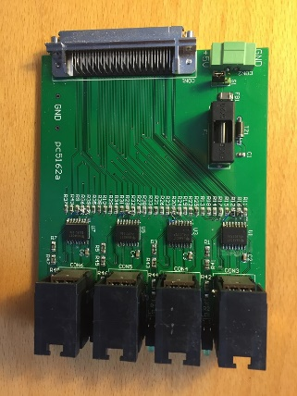
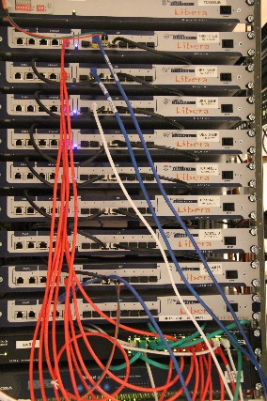
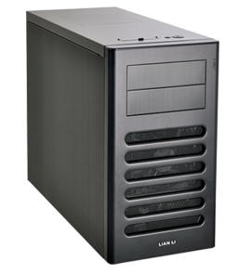
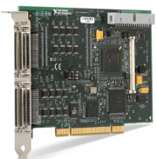
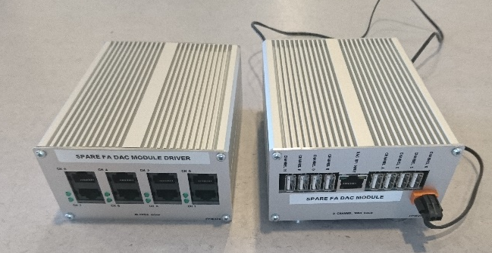
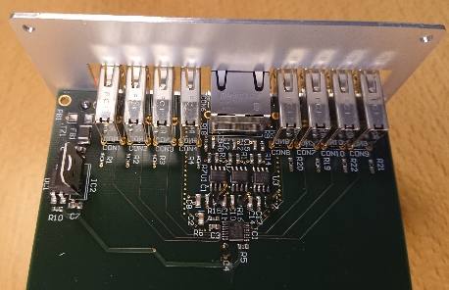
FOFB overview
Cable driver
24 Libera Electron with Grouping
One 10 kHz FA output
Ethernet
Standard PC (i7-6700)
with NI PCI-7811R (FPGA enabled DAQ)
Running LabVIEW real-time
SPI-like connections
4 wire each
DAC 8568
cable
driver
DAC
8568
DAC
8568
DAC
8568
DAC
8568
DAC
8568
6 Power
supplies
6 Power
supplies
6 Power
supplies
6 Power
supplies

Slide 10
Software loops
Timed loops for
    High priority (10 kHz):
      Receive network data (FA data) and unpack these
        ~45% CPU load
      Orbit correction calculation, summing (PID), and transfer of new dac values to FPGA card (for transmission)
        ~20% CPU load
    Low priority (1-10 Hz)
      Analyses
        Averaging, rms, min/max
        Optional FFT
    Data are transferred between the loops via Realtime FIFO’s

Slide 11
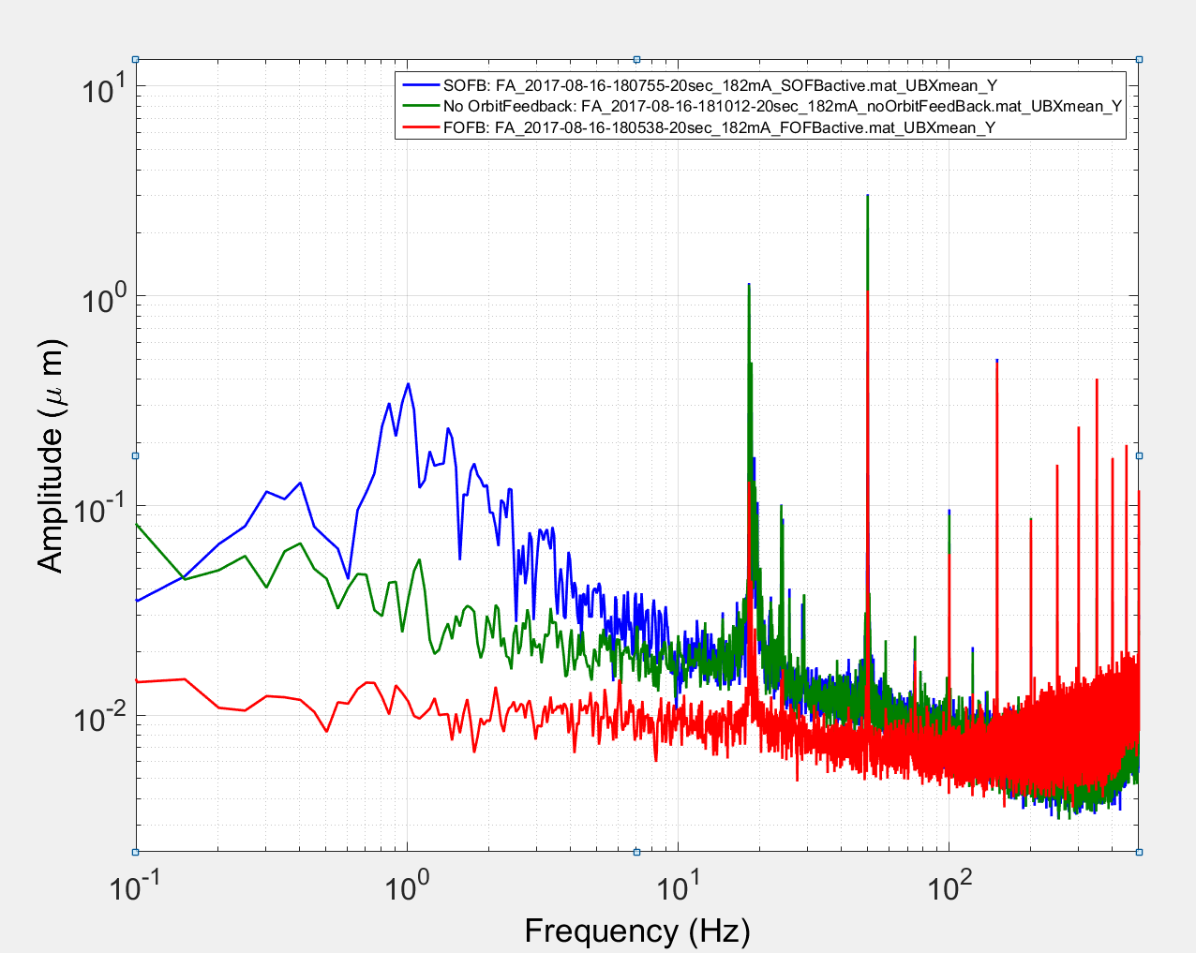
FOFB results
Clear improvement below ~100 Hz
Much improvement 0.1~10 Hz range
  Where SOFB made noise (partly due to insufficient resolution)
Disturbance from ASTRID during injections
  Hor: From ~20 µm (after feedforward) to a few µm
  Vert: From ~10 µm to not really noticeable
Cars on parking lot above ASTRID2
  From ~5 µm to almost not noticeable
50 Hz noise peaks
    50 Hz: ~3 µm -> ~1 µm
    150 Hz: ~0.5 µm -> same
Very pleased
Average of FFT of FA beam positions from all 24 vertical pickups
SOFB
noFB
FOFB

Slide 12
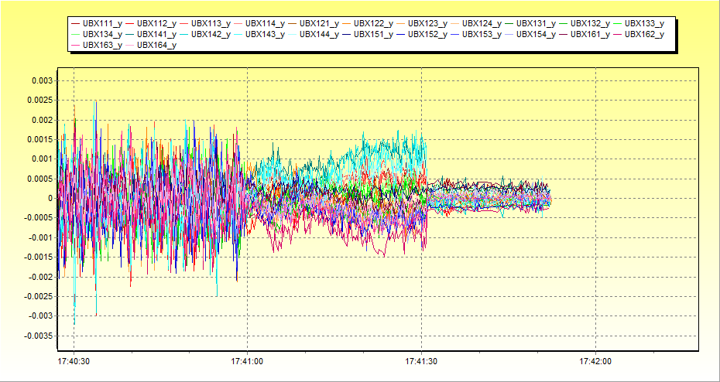
FOFB results
SOFB
No OrbitFB
FOFB
Vertical orbit (SA data from 24 Libera Electrons)
Notes:
Beam position plot from \\isa\data\Astrid2\AccPhys\Orbit\FAdata\FOFB\170811-CommisioningFOFBforUserOp\170816a-Testing (170816_174231-A2UBX_all_Y_SOFB_noFB_FOFB_annotated.png),

Slide 13
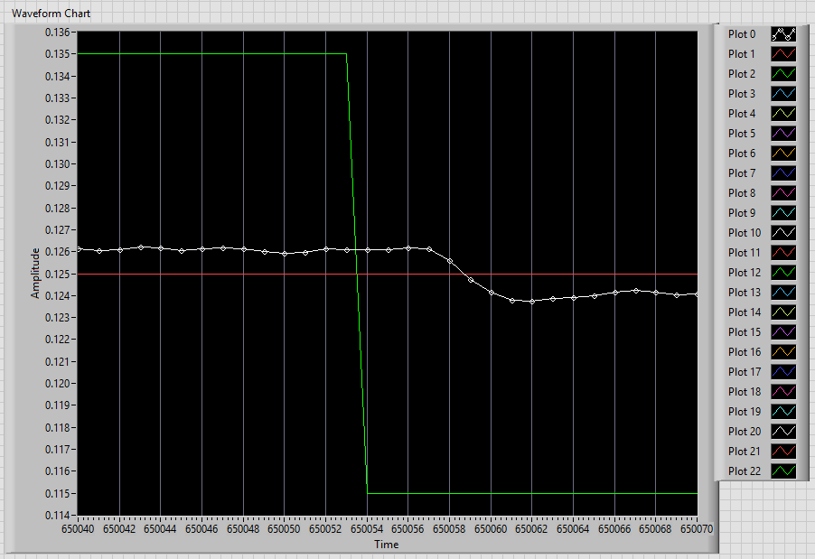
FOFB improvements
Still much 50 Hz and harmonics
Bandwidth is limited (only up to ~150 Hz)
  Latency is 600-800 µs (delay of 400 µs + change takes 400 µs)
      Libera: ~250 µs, RT program: 100-200 µs
Ideas:
  Improve feedback algorithm
    Tried with proper PID, but no improvement
    Tried with in-loop filter
    but no success
    50 Hz is predictable
    (on short term)
      Should allow some
      feed-forward
  Inputs from you

Slide 14
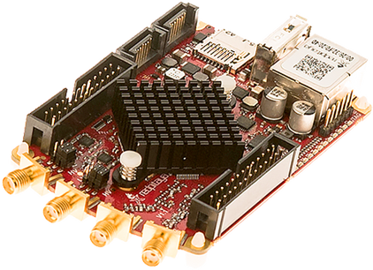
Ideas for LBbB feedback system
Following a suggestion from Gunther Rehm we are contemplating using a Red Pitaya for a LBbB feedback processor
Red Pitaya:
  Xilinx ZYNQ XC7Z010 SoC
  125 MS/s ADC and DAC (x2)
    ASTRID2 RF frequency is 105 MHz
  Price: ~300 €
Status:
  We have made our first
  FPGA code modifications
  for the Red Pitaya

Slide 15
Conclusions
Have shown you a FOFB system, which is simple and cheap, but still does a quite good job
Good value for money
Thanks to
Martin Stougaard and Per Christensen from Department of Physics and Astronomy for power supply modifications, DAC modules and DAC data transmit system (incl. LabVIEW FPGA code)
Thank you for your attention

Slide 16
Extra slides

Slide 17
FOFB results
Average of FFT of FA beam positions from all 24 vertical pickups
SOFB
noFB
FOFB
Notes:
Beam position FOFB plot from \\isa\data\Astrid2\AccPhys\Orbit\FAdata\FOFB\170811-CommisioningFOFBforUserOp\170816b-FAdata\forESLS_2017,

Slide 18
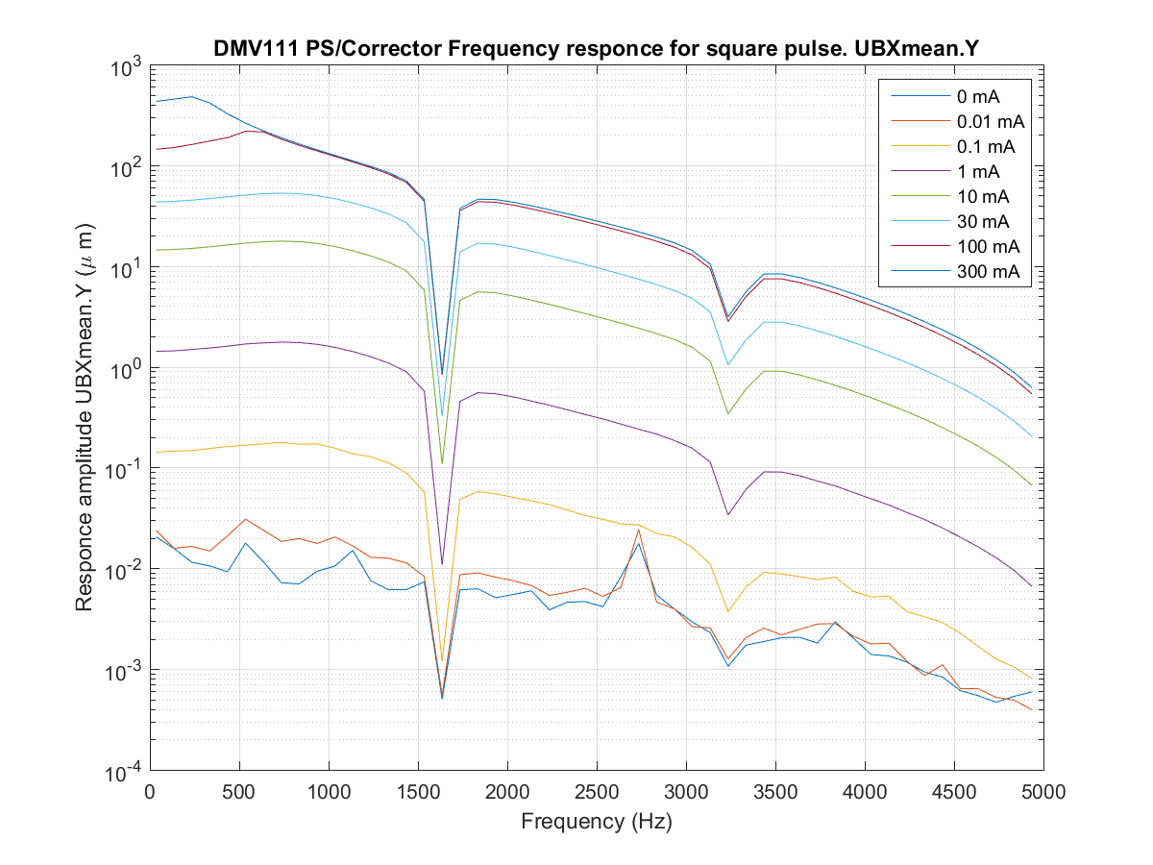
Corrector Responce
Measured frequency response
Notes:
Corrector responce plot from \\isa\data\Astrid2\AccPhys\PowerSupplies\CorrectorSupplies\160329-TestingFastCorrectorUpgrade\analyse (FastCorrector_Overall_1f.png),
See ELOG http://isaelog:5717/Ast2Facility/801

Slide 19
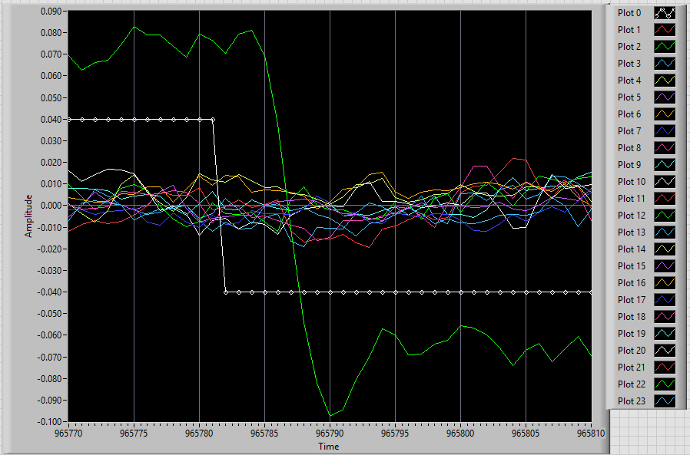
FOFB Open Loop Responce
Notes:
Beam position FOFB plot from \\isa\data\Astrid2\AccPhys\Orbit\FAdata\FOFB\170811-CommisioningFOFBforUserOp\170816b-FAdata\forESLS_2017,

