Slide 1
Robustness considerations for a fast
orbit feedback at hadron synchrotrons
Sajjad Hussain Mirza^{1,2}
Dr. Rahul Singh¹
Dr. Peter Forck¹
¹Beam Instrumentation Group,
GSI Helmholtz Centre for Heavy Ion Research
GSI, Darmstadt
²TEMF, TU, Darmstadt
Germany

Slide 2
Outline
GSI and FAIR project
Upgrade of SIS18
  Robustness requirements of SIS18 Closed orbit feedback (COFB) system
Global orbit correction methods
  Harmonic analysis of the perturbed orbit
  Singular value decomposition (SVD) of response matrix
  Missing connection between two methods
Exploitation of Circulant symmetry in response matrix
  Simple symmetry
  Nearest-Circulant approximation
    Application of symmetry exploitation for subtracting the dispersion-induced orbit shift
  Block-Circulant symmetry in response matrix
Characterizing the effect of model mismatch on orbit correction
  Demonstration in COSY synchrotron Julich
Summary

Slide 3
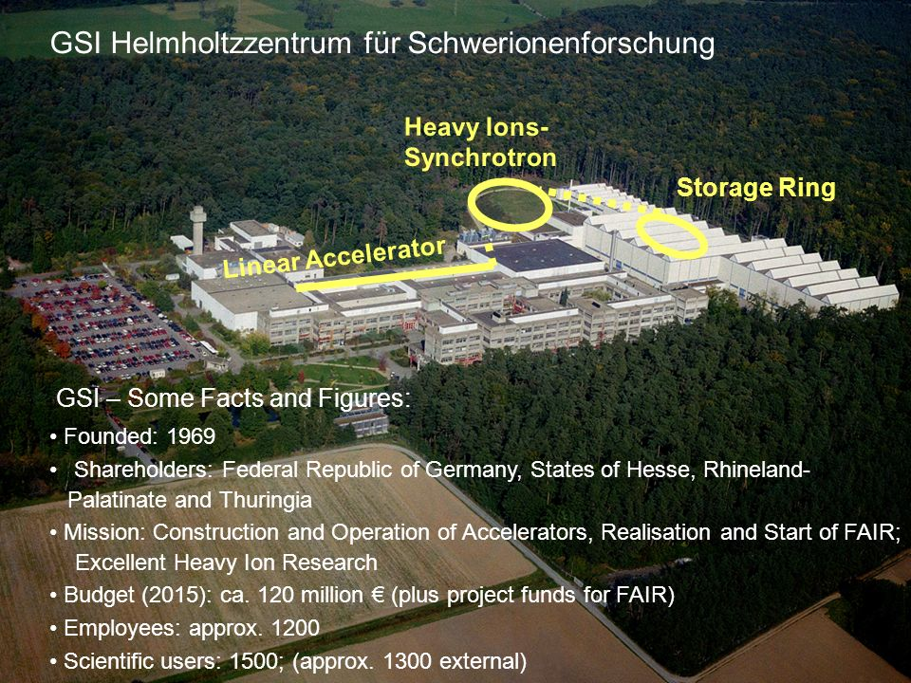
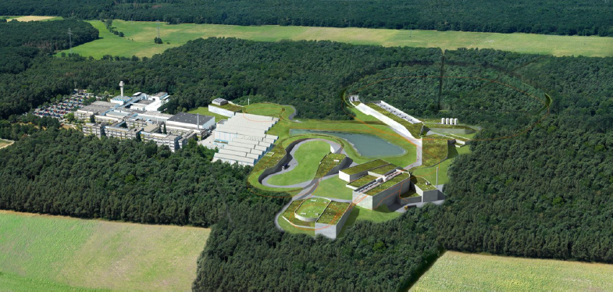
GSI and FAIR: brief introduction
GSI
UNILAC(2-11.4 MeV/u)
SIS18(0.010-2 GeV/u)
Experimental storage ring (ESR)
Fragment separator FRS
FAIR
GSI and SIS100
SIS100 (0.2- 2.7 GeV/u)
Facility for Antiproton and Ion Research
Specialties
Large range of ions (p to U)
Variable charge states
Ramp rates more than 10 T/s
Variable ramps (0.1 to 1s)
Magnet power supplies start at 3% of full power at injection
Beam size few cm
SIS100
SIS18

Slide 4
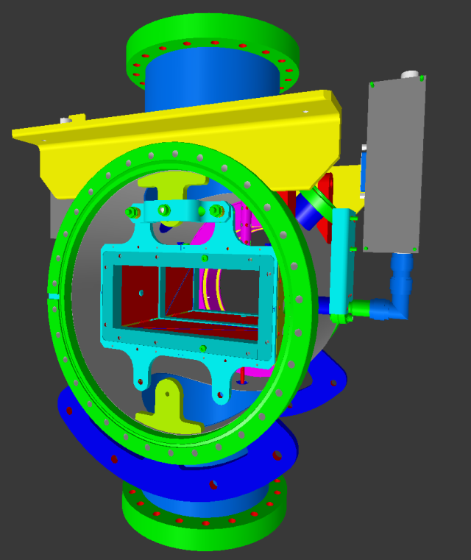
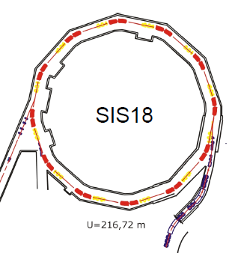
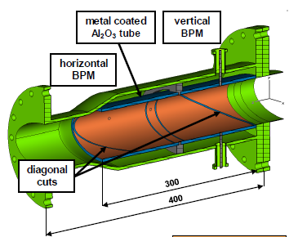
SIS18 upgrade (as booster ring for SIS100)
Parameter/Time | Today | FAIR Booster
Reference Ion | U⁷³⁺ | U²⁸⁺
Maximum Energy GeV/u | 1 | 0.2
Maximum Intensity (Ions per pulse) | 4×10⁹ | 4×10¹¹
Repetition Rate (Hz) | 0.3 – 1 | 2.7
SIS18
BPM
Linear Ampl.
70 mm
180 mm
SIS100
BPM
Higher to lower charge state to avoid space charge effects at high intensities
Vacuum improvements to avoid beam losses due to residual gas pressures
More control on beam quality to deliver more intensity to SIS100 (Closed orbit care)
135 × 65 mm

Slide 5
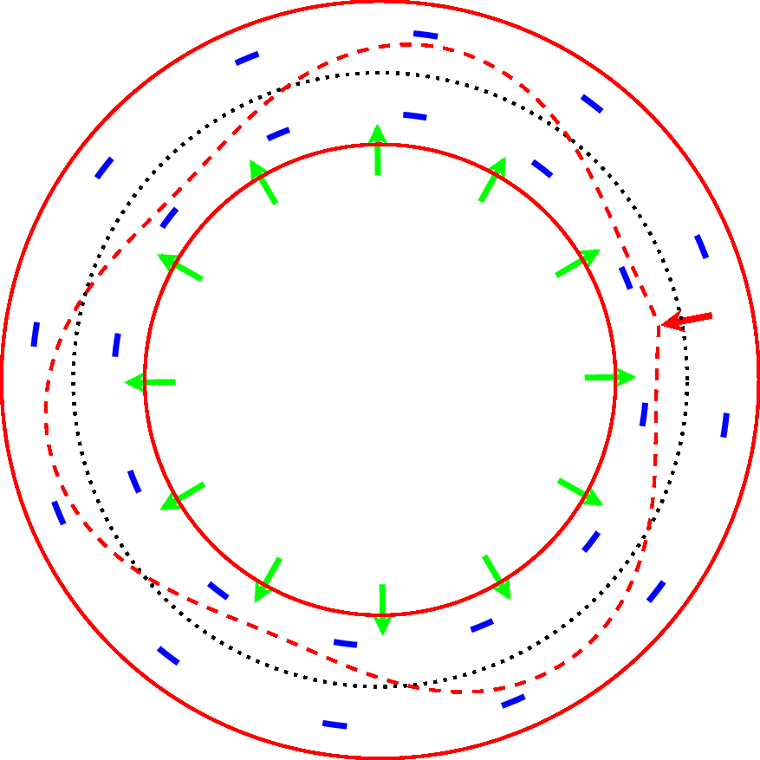
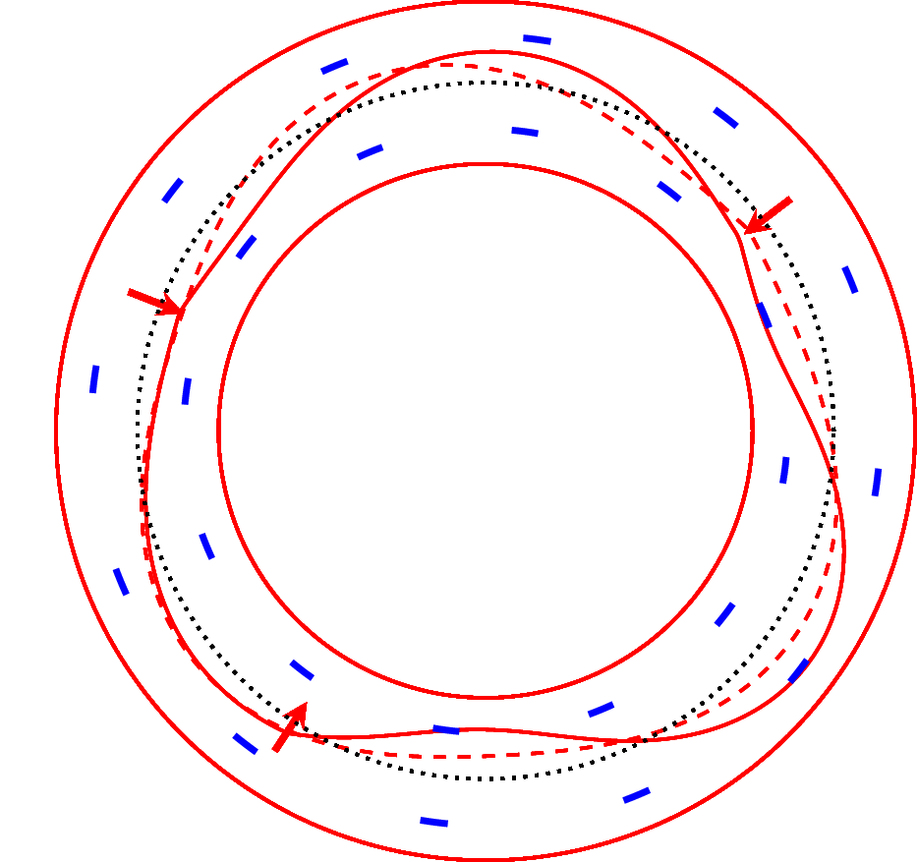
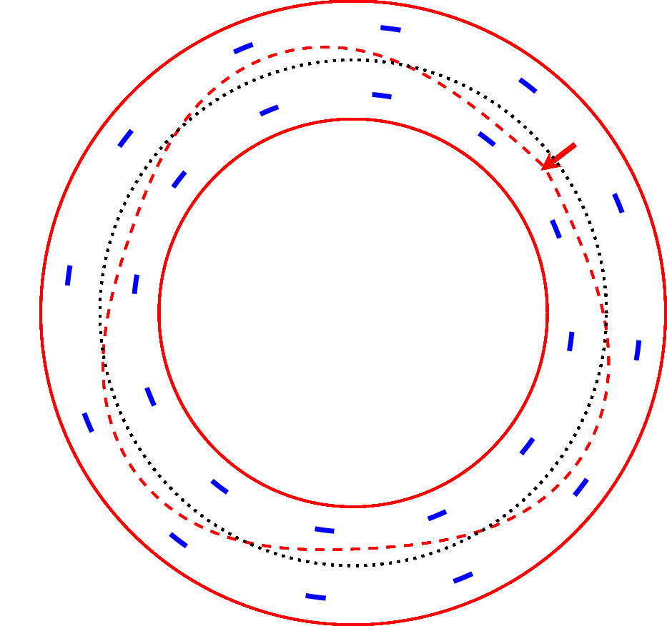
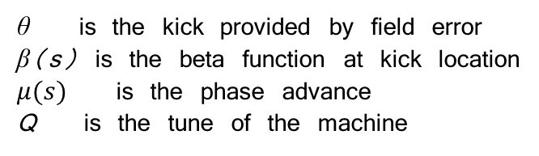
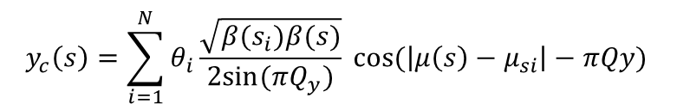
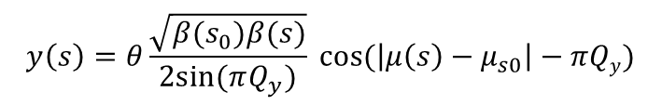

Closed orbit perturbation (distortion)
Perturbed orbit due to single error
$$y\left(s\right)=θ\frac{\sqrt{β(s_{0})β(s)}}{2sin⁡(πQ_{y})} cos⁡(\left|μ\left(s\right)−μ_{s0}\right|−πQy)$$
‘m’ BPMs
‘n’ correctors
θ is the kick provided by field error
β(s) is the beta function at kick location
$μ(s)$ is the phase advance
Q is the tune of the machine
$$y_{c}\left(s\right)=\sum_{i=1}^{N}{θ_{i}\frac{\sqrt{β(s_{i})β(s)}}{2sin⁡(πQ_{y})}} cos⁡(\left|μ\left(s\right)−μ_{si}\right|−πQy)$$
$${[Y]}_{m×1}={[R]}_{m×n}{[Ѳ]}_{n×1}$$
R is called the orbit response matrix
Notes:
Enough of 3D plots, lets come back to 2D, visualization easier

Slide 6
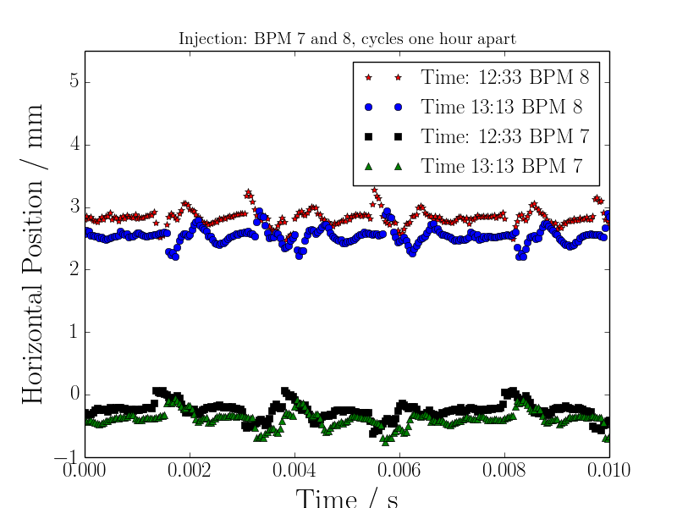
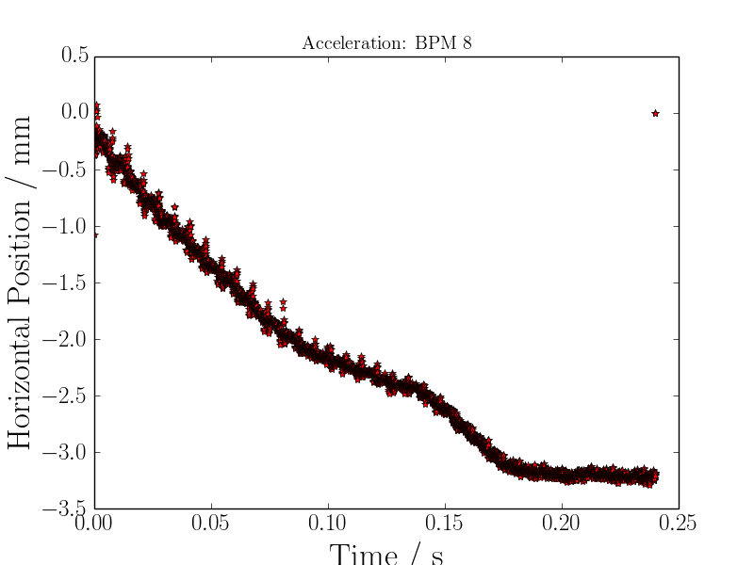
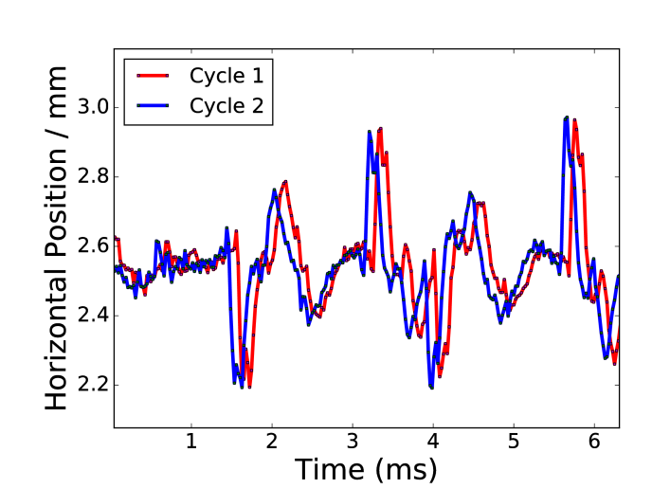
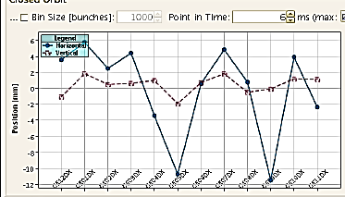
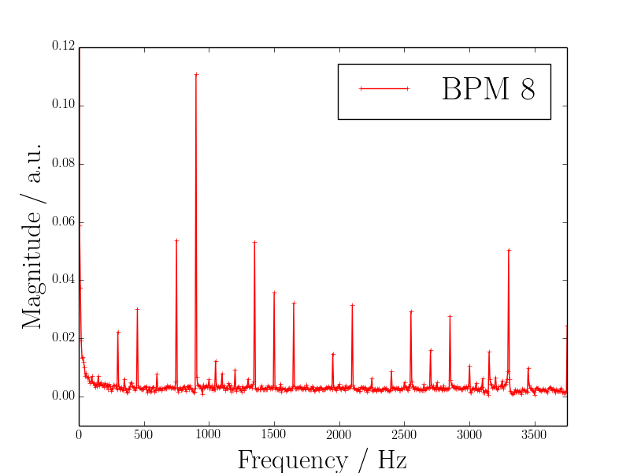
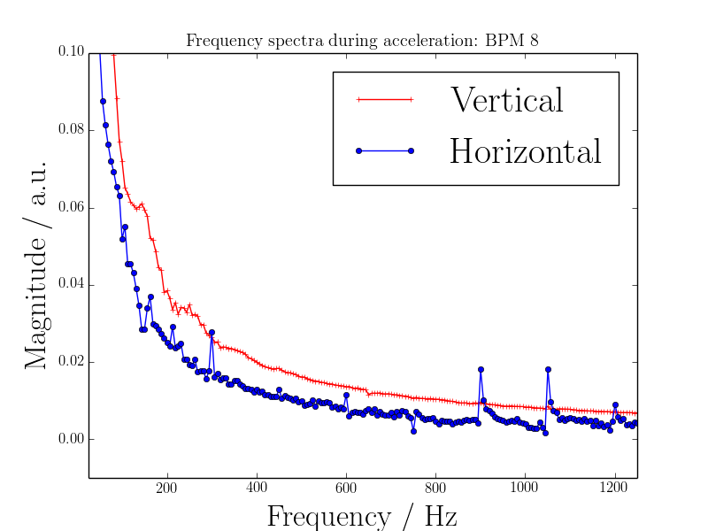
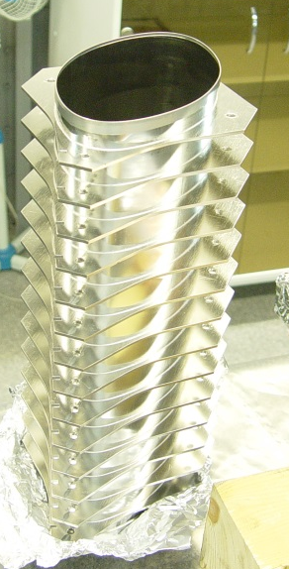
Closed orbit perturbations in SIS18
At injection
During ramp
Ramps of two cycles
Static perturbation
6
horizontal
0
position [mm]
vertical
-6
along synchrotron
-12
0 2 4 6 8 10
Time (ms)
0 50 100 150 200 250
Time (ms)
Fourier Transform
Fourier Transform
116 mm
200mm
0 0.5 1 1.5 2 2.5 3 3.5
Frequency (kHz)
0 0.2 0.4 0.6 0.8 1 1.2
Frequency (kHz)
Wall thickness = 300 μm

Slide 7
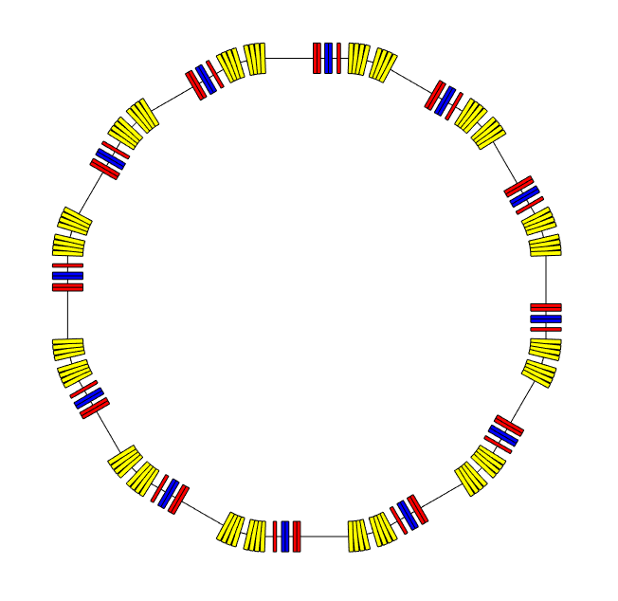
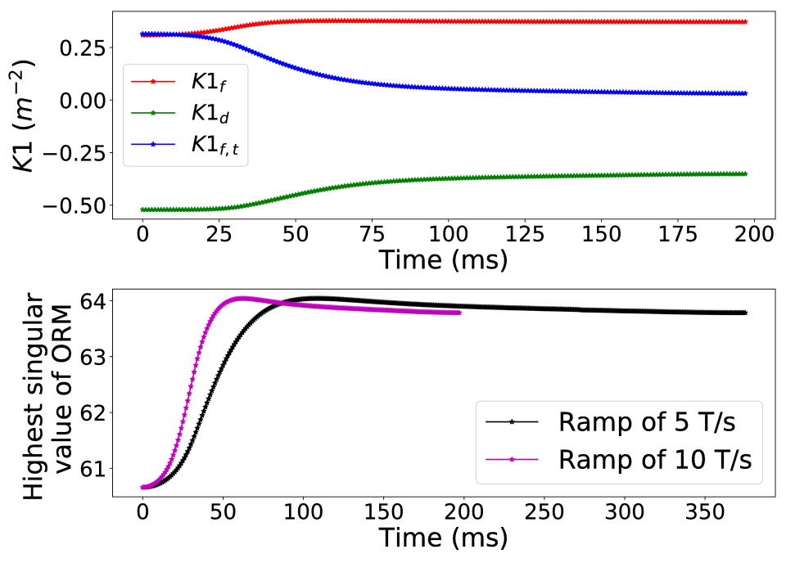
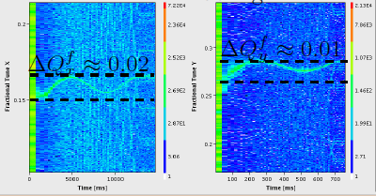
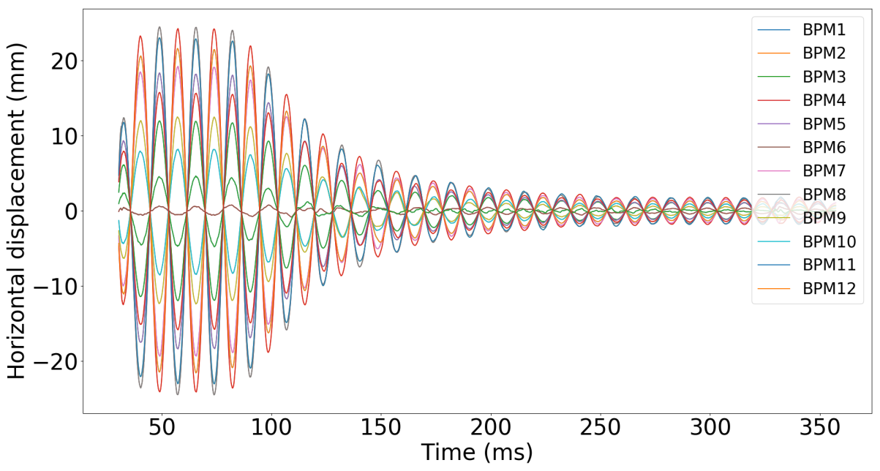
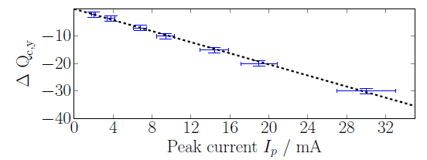
Features of planned SIS18 COFB system
On-ramp orbit correction is planned
Ions have no synchrotron damping to restore beam quality at high energy
triplet
doublet
Focusing magnets
defocusing magnets
SIS18 cell
triplet focusing magnet
Bending magnets
model-variation over ramp
sinusoidal excitation on one corrector
R. Singh, PhD Thesis, TU Darmstadt 2014.

Slide 8
Features of planned SIS18 COFB system
Online updating of the machine model?
How many models required for a given ramp?
Do we really need to update the ORM?
What if we use wrong ORM for the orbit correction and what are boundaries?
Uncertainty modeling
Orbit correction methods
model-variation over ramp
200 116
sinusoidal excitation on one corrector
R. Singh, PhD Thesis, TU Darmstadt 2014.

Slide 9
Outline
GSI and FAIR project
Upgrade of SIS18
  Robustness requirements of SIS18 Closed orbit feedback (COFB) system
Global orbit correction methods
  Harmonic analysis of the perturbed orbit
  Singular value decomposition (SVD) of response matrix
  Missing connection between two methods
Exploitation of Circulant symmetry in response matrix
  Simple symmetry
  Nearest-Circulant approximation
    Application of symmetry exploitation for subtracting the dispersion-induced orbit shift
  Block-Circulant symmetry in response matrix
Characterizing the effect of model mismatch on orbit correction
  Demonstration in COSY synchrotron Julich
Summary

Slide 10
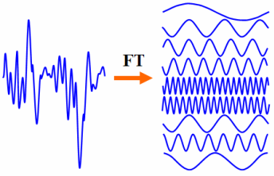
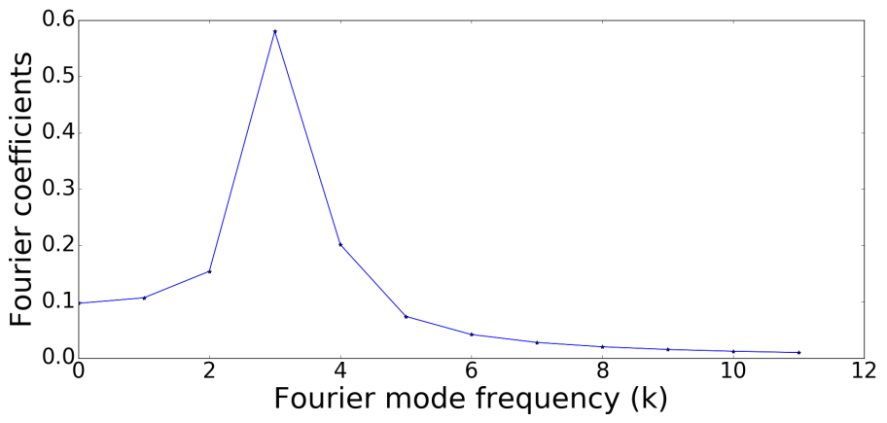



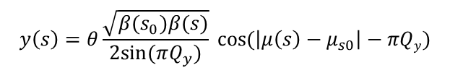
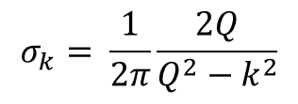
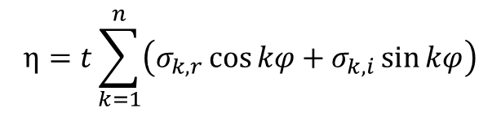

Harmonic analysis (global correction)
$$y\left(s\right)=θ\frac{\sqrt{β(s_{0})β(s)}}{2sin⁡(πQ_{y})} cos⁡(\left|μ\left(s\right)−μ_{s0}\right|−πQy)$$
$$t=\frac{\sqrt{β_{0}}θ}{2\sin{(πQ)}}$$
$$η=\frac{y}{\sqrt{β}}$$
$$φ=\frac{μ}{Q}$$
$$η=t cos Q(\left|φ\left(s\right)−φ_{s0}\right|−π)$$
$$η=t\sum_{k=1}^{n}{\left(σ_{k,r}\cos{kφ+σ_{k,i}\sin{kφ}}\right)}$$
$$σ_{k}= \frac{1}{2π}\frac{2Q}{Q^{2}−k^{2}}$$
Modes to be removed (corrected) are selected before-hand
measured orbit is fitted over corresponding mode e.g. modes around tune frequency
Corrector strengths are proportional to the Fourier coefficients
Mathematically complicated procedure
L.H.Yu et al.“Real time harmonic closed orbit correction”, Nucl. Instr. Meth. A, vol. 284, pp. 268–285, 1989

Slide 11
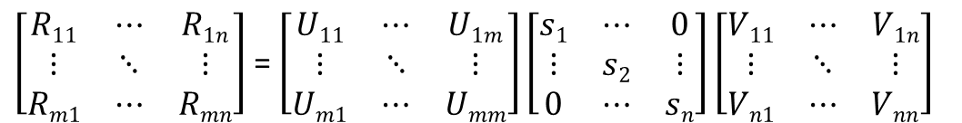
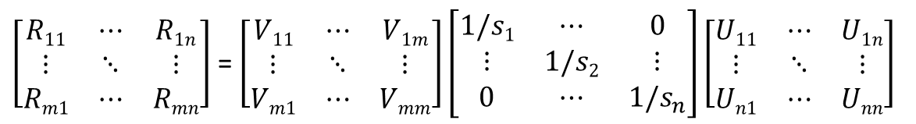



Singular Value Decomposition (SVD)
$${[Y]}_{m×1}={[R]}_{m×n}{[Ѳ]}_{n×1}$$
$$R=USV^{T}$$
T
$\left[\begin{matrix}R11 & ⋯ & R1n \\ ⋮ & ⋱ & ⋮ \\ Rm1 & ⋯ & Rmn\end{matrix}\right]$ = $\left[\begin{matrix}U11 & ⋯ & U1m \\ ⋮ & ⋱ & ⋮ \\ Um1 & ⋯ & Umm\end{matrix}\right]\left[\begin{matrix}s1 & ⋯ & 0 \\ ⋮ & s2 & ⋮ \\ 0 & ⋯ & sn\end{matrix}\right]\left[\begin{matrix}V11 & ⋯ & V1n \\ ⋮ & ⋱ & ⋮ \\ Vn1 & ⋯ & Vnn\end{matrix}\right]$
$$si are called singular values arranged as s_{1}>s_{2}>s_{3}….s_{n}$$
U and V are orthogonal matrices such that
$U^{−1}\text{ = }U^{T}$ and $V^{−1}\text{ = }V^{T}$
where the columns of U and V are the eigenvectors of RR^{T} and R^{T}R
Which helps to find inverse R⁻¹ (if R is invertible) as
Pseudo-inverse
-1
T
$\left[\begin{matrix}R11 & ⋯ & R1n \\ ⋮ & ⋱ & ⋮ \\ Rm1 & ⋯ & Rmn\end{matrix}\right]$ = $\left[\begin{matrix}V11 & ⋯ & V1m \\ ⋮ & ⋱ & ⋮ \\ Vm1 & ⋯ & Vmm\end{matrix}\right]\left[\begin{matrix}1/s1 & ⋯ & 0 \\ ⋮ & 1/s2 & ⋮ \\ 0 & ⋯ & 1/s_{n}\end{matrix}\right]\left[\begin{matrix}U11 & ⋯ & U1n \\ ⋮ & ⋱ & ⋮ \\ Un1 & ⋯ & Unn\end{matrix}\right]$
William H. Press, Numerical recipes; The art of scientific computing (2007) Cambridge university press
Notes:
First characteristic of SVD to decompose any matrix
singular values are positive scalars
orthoganal matirx measn all the coloumns are othogonal to each other i.e.their dot product equals zero (necessary conditions)

Slide 12
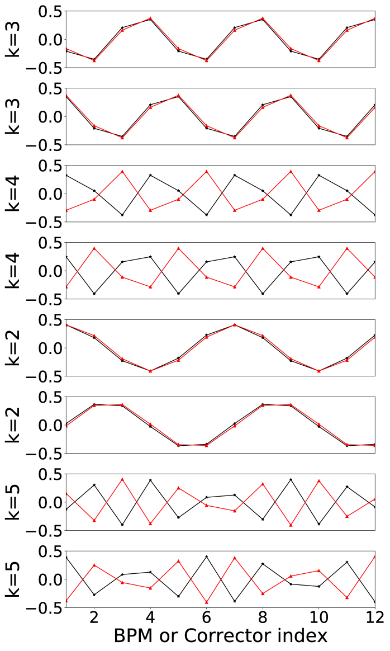

Singular Value Decomposition (SVD)
$$R=USV^{T}$$
Features of SVD
U and V matrices form the BPM and corrector spaces.
SVD can decompose and invert (or pseudo-invert) “any” matrix
A robust algorithm for global orbit correction
Benefits of SVD over harmonic analysis
One needs not to select the modes to be corrected before correction: decompose in all possible modes
“simple” matrix inversion
Mode-by-mode correction is still possible through selecting certain eigenvalues
Columns of U:Black
Columns of V: Red

Slide 13

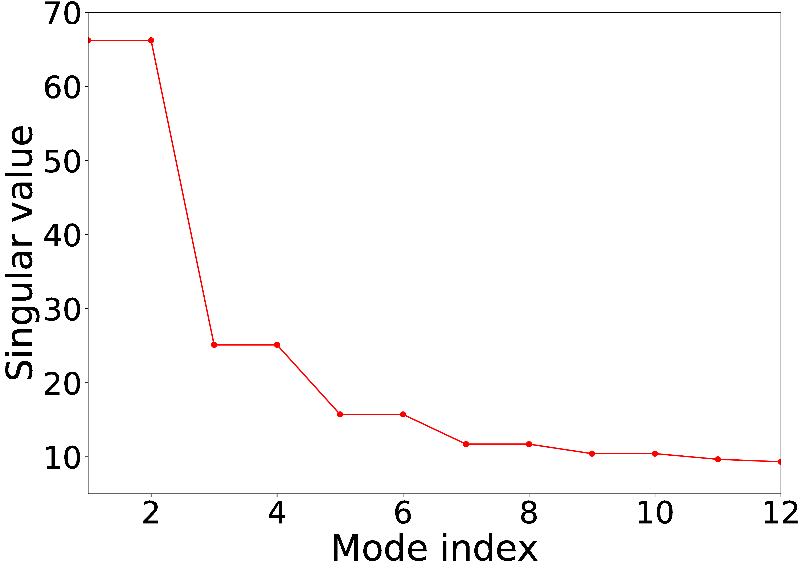
Weaknesses of SVD
$$R=USV^{T}$$
U and V are interconnected through a phase relation
Over the ramp, updating of all three matrices required
Uncertainty modeling is required in all three matrices
Time complexity of the order of n³ , n being dimension of matrix
Loss of physical meaning of modes (interpolation)
Fourier coefficients of harmonic analysis have been proposed for uncertainty modeling
k=3
Q_{y} = 3.28
k=4
k=5
Columns of U:Black
Columns of V: Red
S. Gayadeen, “Synchrotron Electron Beam Control”, Ph.D. thesis, St. Hugh’s College, University of Oxford, UK, 2014.

Slide 14
Outline
GSI and FAIR project
Upgrade of SIS18
  Robustness requirements of SIS18 Closed orbit feedback (COFB) system
Global orbit correction methods
  Harmonic analysis of the perturbed orbit
  Singular value decomposition (SVD) of response matrix
  Missing connection between two methods
Exploitation of Circulant symmetry in response matrix
  Simple symmetry
  Nearest-Circulant approximation
    Application of symmetry exploitation for subtracting the dispersion-induced orbit shift
  Block-Circulant symmetry in response matrix
Characterizing the effect of model mismatch on orbit correction
  Demonstration in COSY synchrotron Julich
Summary

Slide 15




Symmetry exploitation in SIS 18 vertical ORM
$$β_{bpm1}=β_{bpm2}=β_{bpm3}……=β_{bpm12}$$
$$β_{corr1}=β_{corr2}=β_{corr3}……=β_{corr12}$$
$${∆μ}_{bpm}=constant$$
SIS18 lattice
(out of scale schematics)
$${∆μ}_{corr}=constant$$
$$R=\left[\begin{matrix}R_{1} & R_{2} & R_{3} & R_{4} & ⋯ & R_{n} \\ R_{n} & R_{1} & R_{2} & R_{3} & ⋯ & R_{n−1} \\ R_{n−1} & R_{n} & R_{1} & R_{2} & ⋯ & R_{n−2} \\ R_{n−2} & R_{n−1} & R_{n} & R_{1} & ⋯ & R_{n−3} \\ ⋮ & ⋮ & ⋮ & ⋮ & ⋱ & ⋮ \\ R_{2} & R_{3} & R_{4} & R_{5} & ⋯ & R_{1}\end{matrix}\right]$$
Each row is cyclic shift of previous row
All diagonal elements are identical
Such a square matrix is called
Circulant Matrix
Reference: Philips J.Davis, Circulant matrices, (1994), Chelsea

Slide 16
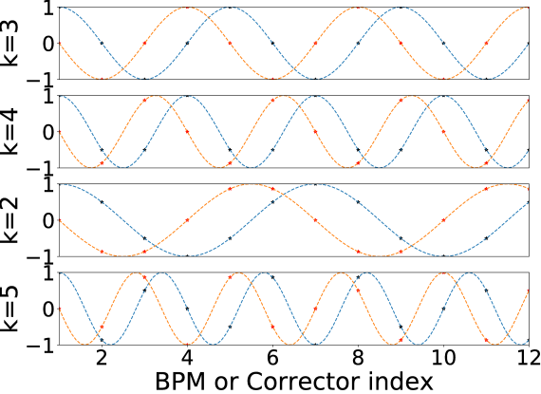

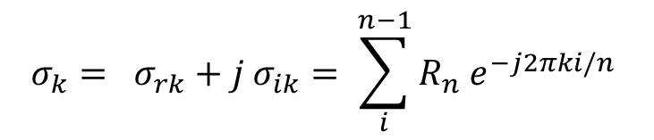

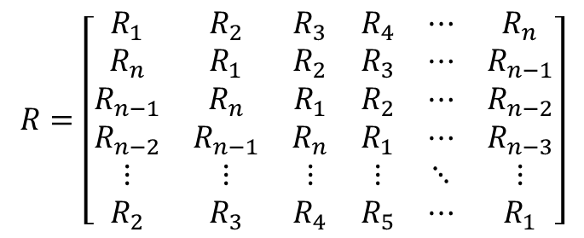
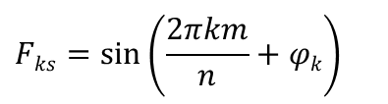

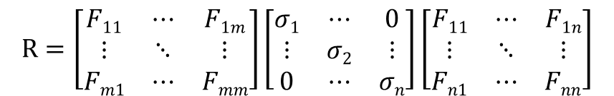
Diagonalization of a Circulant matrix
$$R=\left[\begin{matrix}R_{1} & R_{2} & R_{3} & R_{4} & ⋯ & R_{n} \\ R_{n} & R_{1} & R_{2} & R_{3} & ⋯ & R_{n−1} \\ R_{n−1} & R_{n} & R_{1} & R_{2} & ⋯ & R_{n−2} \\ R_{n−2} & R_{n−1} & R_{n} & R_{1} & ⋯ & R_{n−3} \\ ⋮ & ⋮ & ⋮ & ⋮ & ⋱ & ⋮ \\ R_{2} & R_{3} & R_{4} & R_{5} & ⋯ & R_{1}\end{matrix}\right]$$
Inverse is straightforward
$$R^{−1}=F^{∗}H^{−1}F$$
$H^{−1}$ =diag($\frac{1}{σ_{k}}$) ,k=1...n
$$σ_{k}= σ_{rk}+j σ_{ik}= \sum_{i}^{n−1}{R_{n} e^{−j2πki/n}}$$
Standard Fourier matrix
$$R=\left[\begin{matrix}F11 & ⋯ & F1m \\ ⋮ & ⋱ & ⋮ \\ Fm1 & ⋯ & Fmm\end{matrix}\right]\left[\begin{matrix}σ1 & ⋯ & 0 \\ ⋮ & σ2 & ⋮ \\ 0 & ⋯ & σn\end{matrix}\right]\left[\begin{matrix}F11 & ⋯ & F1n \\ ⋮ & ⋱ & ⋮ \\ Fn1 & ⋯ & Fnn\end{matrix}\right]$$
$$F_{k}= F_{kc}+jF_{ks}$$
$$Fks=\sin\left(\frac{2πkm}{n}+φk\right)$$

Slide 17


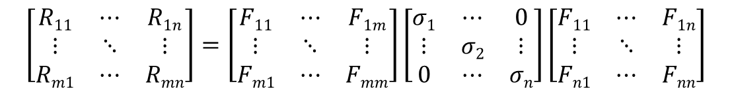
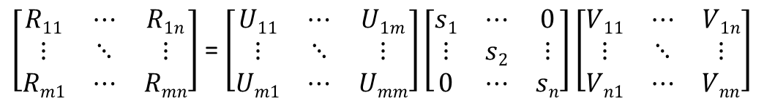
Equivalence of DFT and SVD
$$\left[\begin{matrix}R11 & ⋯ & R1n \\ ⋮ & ⋱ & ⋮ \\ Rm1 & ⋯ & Rmn\end{matrix}\right]=\left[\begin{matrix}F11 & ⋯ & F1m \\ ⋮ & ⋱ & ⋮ \\ Fm1 & ⋯ & Fmm\end{matrix}\right]\left[\begin{matrix}σ1 & ⋯ & 0 \\ ⋮ & σ2 & ⋮ \\ 0 & ⋯ & σn\end{matrix}\right]\left[\begin{matrix}F11 & ⋯ & F1n \\ ⋮ & ⋱ & ⋮ \\ Fn1 & ⋯ & Fnn\end{matrix}\right]$$
DFT:
$$s_{k}=\left|σ_{k}\right|= \sqrt{{{{σ_{rk}^{}}^{2}+σ}_{ik}^{}}^{2}}$$
$φdk$ = phase$\left(σ_{k}\right)$
$\left[\begin{matrix}R11 & ⋯ & R1n \\ ⋮ & ⋱ & ⋮ \\ Rm1 & ⋯ & Rmn\end{matrix}\right]$ = $\left[\begin{matrix}U11 & ⋯ & U1m \\ ⋮ & ⋱ & ⋮ \\ Um1 & ⋯ & Umm\end{matrix}\right]\left[\begin{matrix}s1 & ⋯ & 0 \\ ⋮ & s2 & ⋮ \\ 0 & ⋯ & sn\end{matrix}\right]\left[\begin{matrix}V11 & ⋯ & V1n \\ ⋮ & ⋱ & ⋮ \\ Vn1 & ⋯ & Vnn\end{matrix}\right]$
SVD:
Why to do SVD when Circulant symmetry exits?
Herbert Karner et al. Spectral decomposition of real Circulant matrices, Linear Algebra and its Applications,
Volume 367, 2003
Notes:
whole information is the magnitude and phase of Fourier coefficinets differnetly distributed in case of SVD.
phase and magnitude of weighting factors is only in the middl matrix in case of DFT
in case of SVD the information is distributed which means finding U and V for each new values of R
DFT gives possibility of online calculation

Slide 18
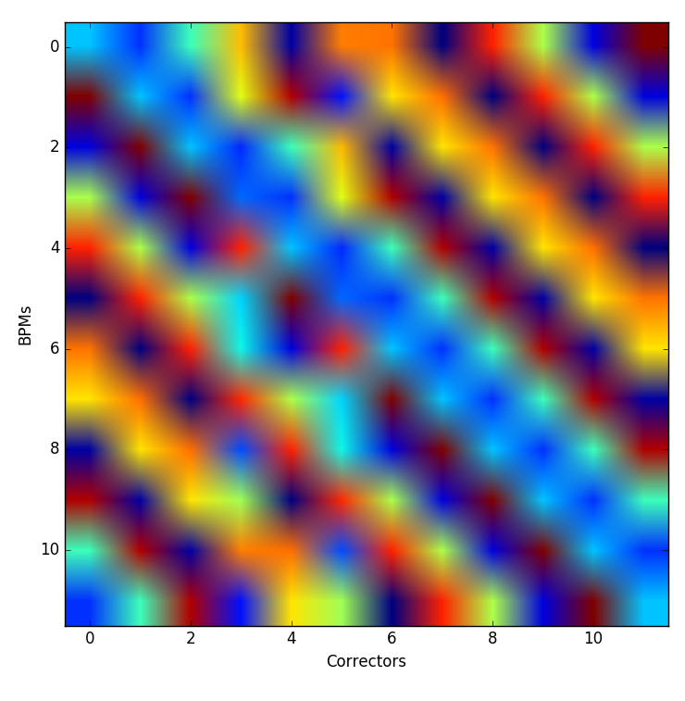
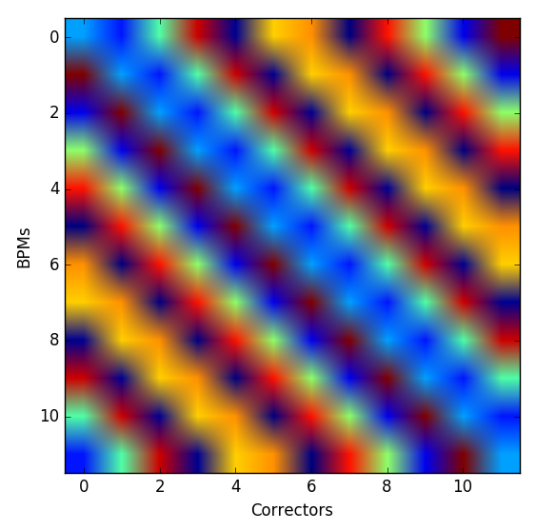
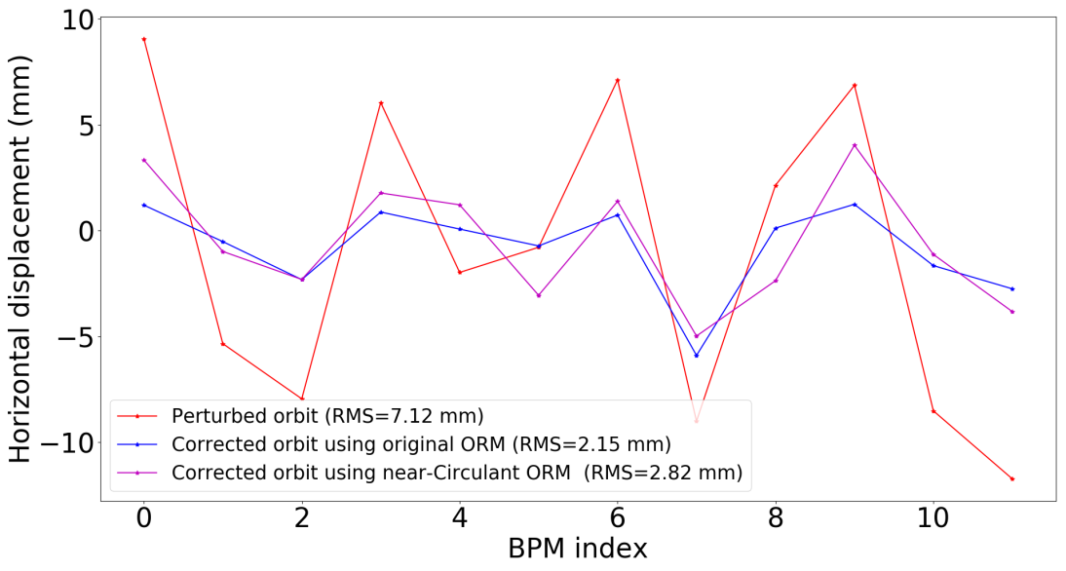
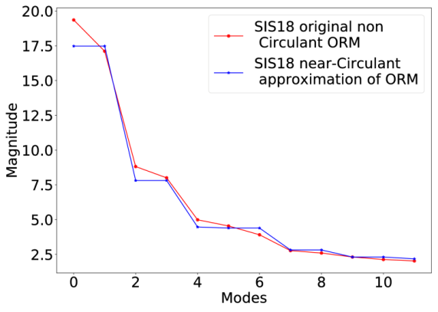

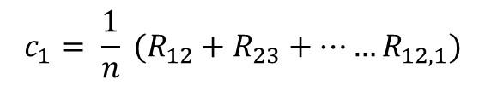
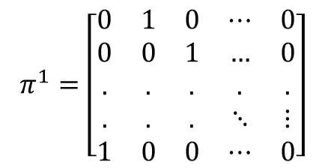
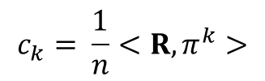
Nearest-Circulant symmetry
SIS18 horizontal plane
$$c_{k}= \frac{1}{n}<R,π^{k}>$$
Frobenius product
$$π^{1}=\left[\begin{matrix}0 & 1 & 0 & ⋯ & 0 \\ 0 & 0 & 1 & … & 0 \\ . & . & . & . & . \\ . & . & . & ⋱ & ⋮ \\ 1 & 0 & 0 & ⋯ & 0\end{matrix}\right]$$
Condition number =12
Condition number =9
$$c_{1}= \frac{1}{n} (R_{12}+R_{23}+……R_{12,1})$$
Orbit correction in SIS18 (9 July 2018)
$$R_{nc}=circ\left(c_{0},c_{1},c_{2},..,c_{11}\right)$$

Slide 19
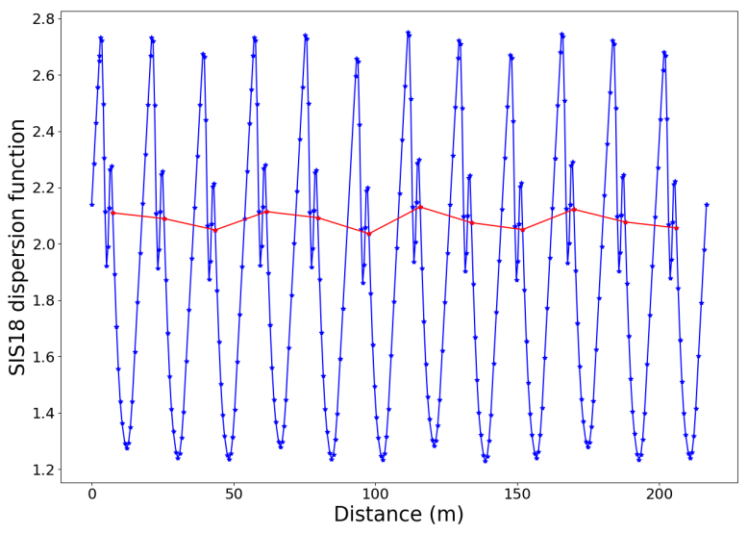
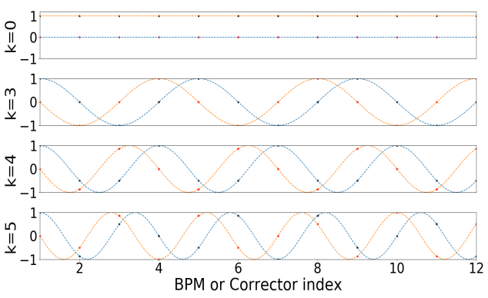
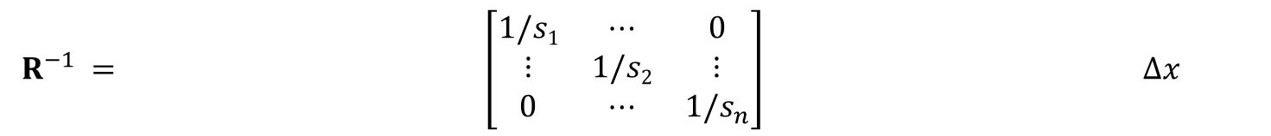






Dispersion effect in closed orbit
Mismatch between RF frequency and the dipole field
$${∆x}_{D}\left(s\right)=D\left(s\right)\frac{∆p}{p}$$
$${Δx={∆x}_{co}+∆x}_{D}\left(s\right)$$
an attempt to correct it can saturate the corrector magnets.
A DC shift in
closed orbit
$${∆x}_{D}\left(s\right)=D\left(s\right)\frac{∆p}{p}$$
$${Δx={∆x}_{co}+∆x}_{D}\left(s\right)$$
$$\left[\begin{matrix} & ⋯ & \\ ⋮ & ⋱ & ⋮ \\ & ⋯ & \end{matrix}\right]$$
$$\left[\begin{matrix} & ⋯ & \\ ⋮ & ⋱ & ⋮ \\ & ⋯ & \end{matrix}\right]$$
$R^{−1} = \left[\begin{matrix}1/s1 & ⋯ & 0 \\ ⋮ & 1/s2 & ⋮ \\ 0 & ⋯ & 1/s_{n}\end{matrix}\right] ∆x$

Slide 20











Induced dispersion and closed orbit in SIS18
x-plane
$$0.02$$
$$\frac{∆p}{p}=$$
$$0.015$$
$$0.010$$
$$0.005$$
$$0.0$$
$$−0.005$$
$$−0.010$$
$$−0.015$$
$$−0.02$$

Slide 21




Induced dispersion and closed orbit in x-plane
Experiment at SIS18
$$θ=VS^{−1}U∗Δx$$

Slide 22







Block Circulant symmetry
SIS100
$$R_{BC}=circ(A_{1},A_{2},A_{3},…..A_{n})$$
$$R_{BC}=\sum_{k=0}^{n−1}{({π_{m}}^{k}⊗A_{k+1})}$$
$R_{BC}=\left(F_{m}⊗F_{n}\right)diag(M_{1},M_{2},M_{3},…M_{n})$ $\left(F_{m}⊗F_{n}\right)$
$$D=\left[\begin{matrix}M_{1} & 0 & 0 & . & . & 0 \\ 0 & M_{2} & 0 & . & . & 0 \\ . & . & . & . & . & 0 \\ . & . & . & . & . & 0 \\ 0 & 0 & 0 & . & . & M_{n}\end{matrix}\right]$$
$${R^{+}}_{BC}=\left(F_{m}⊗F_{n}\right)(D^{+})\left(F_{m}⊗F_{n}\right)$$
Circulant Matrices by P. J. Davis

Slide 23








Extension of Circulant symmetry exploitation
SIS100
Circulant Matrices by P. J. Davis

Slide 24
Outline
GSI and FAIR project
Upgrade of SIS18
  Robustness requirements of SIS18 Closed orbit feedback (COFB) system
Global orbit correction methods
  Harmonic analysis of the perturbed orbit
  Singular value decomposition (SVD) of response matrix
  Missing connection between two methods
Exploitation of Circulant symmetry in response matrix
  Simple symmetry
  Nearest-Circulant approximation
    Application of symmetry exploitation for subtracting the dispersion-induced orbit shift
  Block-Circulant symmetry in response matrix
Characterizing the effect of model mismatch on orbit correction
  Demonstration in COSY synchrotron Julich
Summary

Slide 25













Characterizing the effect of spatial model mismatch
concept of spatial bandwidth
SIS18 is a unique synchrotron in terms of flexibility of operational scenarios.
Variable optics
Orbit response matrix variations
How much ORM variation we can live with?
How to quantify the effect of “wrong” model on orbit correction?
Measured
orbit
Source of orbit perturbation
Corrector
settings
Reference
orbit
$$Δz0$$
residual
$$C(s)$$
$$θ$$
$$G(s)$$
$$+$$
$$+$$
$$0$$
$$r$$
$$+$$
$$−$$
C$ontroller ∗R^{−1}$
$$G\left(s\right)=g\left(s\right) R$$

Slide 26


Characterizing the effect of spatial model mismatch
concept of spatial bandwidth
SIS18 is a unique synchrotron in terms of flexibility of operational scenarios.
Variable optics
Orbit response matrix variations
How much ORM variation we can live with?
How to quantify the effect of “wrong” model on orbit correction?
Source of orbit perturbation
Measured orbit
Corrector
settings
$$Δz0$$
Reference
orbit
$${R′}^{−1}$$
$$θ$$
$$R$$
$$+$$
$$+$$
residual
$$0$$
$$r$$
$$+$$
$$−$$

Slide 27




Characterizing the effect of spatial model mismatch
Mathematical treatment
Let $θ$[k] is the controller output at k^{th} iteration
$$θ\left[k\right]=θ\left[k−1\right]+ae\left[k\right]+be\left[k−1\right]+ce[k−2]$$
where,
$$a=(k_{p}+k_{i}\frac{T_{s}}{2}+\frac{k_{d}}{T_{s}})$$
$$b=({−k}_{p}+k_{i}\frac{T_{s}}{2}−\frac{2k_{d}}{T_{s}})$$
$$c=\frac{k_{d}}{T_{s}}$$
Source of orbit perturbation
Measured orbit
Corrector
settings
$$Δz0$$
Reference
orbit
$${R′}^{−1}$$
$$θ$$
$$R$$
$$+$$
$$+$$
residual
$$0$$
$$r$$
$$+$$
$$−$$

Slide 28





Characterizing the effect of spatial model mismatch
Mathematical treatment
$$Ѳ= R^{′−1}∆z_{0}$$
Corrector settings
$$r_{1}=∆z_{0}−RѲ$$
First iteration residual
$$r_{1}=∆z_{0}−RR^{′−1}∆z_{0}$$
$$r_{1}=(I−RR^{′−1})∆z_{0}$$
$$r_{n}={(I−RR^{′−1})}^{n}∆z_{0}$$
n^{th} iteration residual (n costs the bandwidth)
Source of orbit perturbation
Measured orbit
Corrector
settings
$$Δz0$$
Reference
orbit
$${R′}^{−1}$$
$$θ$$
$$R$$
$$+$$
$$+$$
residual
$$0$$
$$r$$
$$+$$
$$−$$

Slide 29










Characterizing the effect of spatial model mismatch
Mathematical treatment
$$Ѳ= R^{′−1}∆z_{0}$$
Corrector settings
$$r_{1}=∆z_{0}−RѲ$$
First iteration residual
$$r_{1}=∆z_{0}−RR^{′−1}∆z_{0}$$
$$r_{1}=(I−RR^{′−1})∆z_{0}$$
$$r_{n}={(I−RR^{′−1})}^{n}∆z_{0}$$
n^{th} iteration residual (n costs the bandwidth)
$$S=(I−RR^{′−1})$$
Spatial sensitivity function
$$S=PΛ_{S}P^{−1}$$
$$r_{n}={(PΛ_{S}P^{−1})}^{n}∆z_{0}$$
$$λ_{k}<1$$
Correctability
$$r_{n}={P(Λ_{S})}^{n}P^{−1}∆z_{0}$$
$$λ_{k}=1$$
No correction
$$λ_{k}≈(1−λ_{R,k}{λ^{−1}}_{R^{′},k})$$
$$λ_{k}>1$$
Instability

Slide 30








On-ramp model variation in SIS18
Simulations: Orbit correction using injection ORM
$$S=(I−RR^{′−1})$$
$$R$$
$$S=PΛ_{S}P^{−1}$$
$$λ_{k}≈(1−λ_{R,k}{λ^{−1}}_{R^{′},k})$$
$$R^{′−1}$$
First iteration residual

Slide 31





Effect of wrong model on the orbit correction
Experiment: y-plane of COSY synchrotron Julich (31 Oct 2018)
ORM was varied as a function of betatron tune (3.52 – 4.18)
Machine tune was 3.62
Ratio of the RMS of first iteration to that of the perturbed orbit is plotted below
Thanks to Lorentz Bernd and Christian Weidemann for helping in the experiment.

Slide 32
Summary
On-ramp orbit correction is planned for SIS18 synchrotron of GSI
  Symmetry exploitation in the ORM can result into faster matrix inversion than SVD
  DFT based diagonalization also gives physical meaning to SVD modes
  DFT based diagonalization provides the missing connection between SVD and harmonic analysis
Nearest-Circulant approximation can be made for slightly broken symmetries
Block-wise Circulant symmetry can also be applied for larger lattices (more than one BPMs per cell)
Spatial sensitivity function is defined as tool for the quantification of the effect of model mismatch on the orbit correction
2 to 3 ORM will be required over the ramp orbit correction for SIS18
Application of spatial sensitivity function has been demonstrated in COSY synchrotron Julich
I would like to acknowledge Dr. Guenther Rehm for nice discussions during my visit to Diamond Light Source

